Slide 1


PICMIC* concept
I.Laktineh
* PICosecond subMICron detection concept

Slide 2
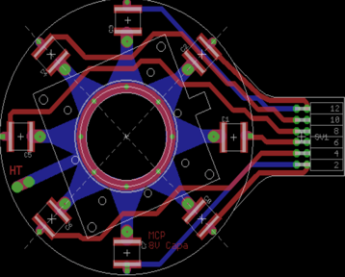
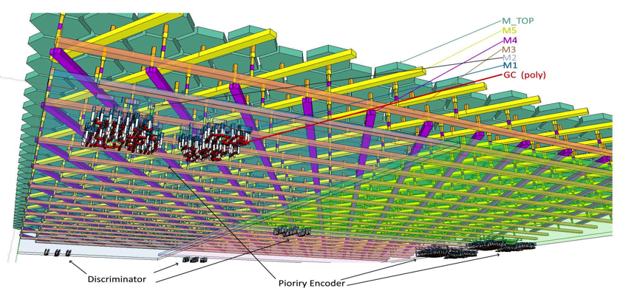
PICMIC
A new concept to reach simultaneously 1 ps and submicron measurement resolutions
Patented concept:
PCT/EP2020/050058
MCP
T₃
T₂
T₄
T₁
Time + position
Grid
Delay plane concept
T₅
T₆
Pixels
Position+ time
X,Y
Woven strips concept

Slide 3
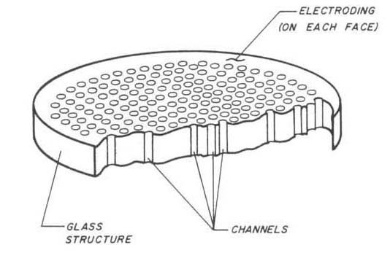
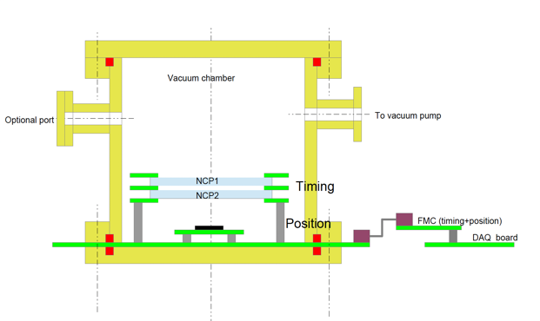
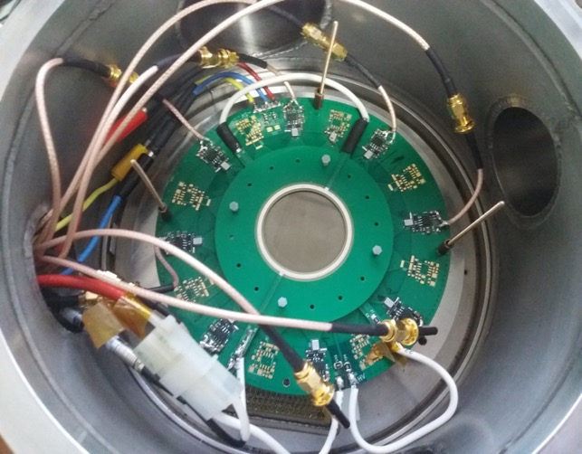
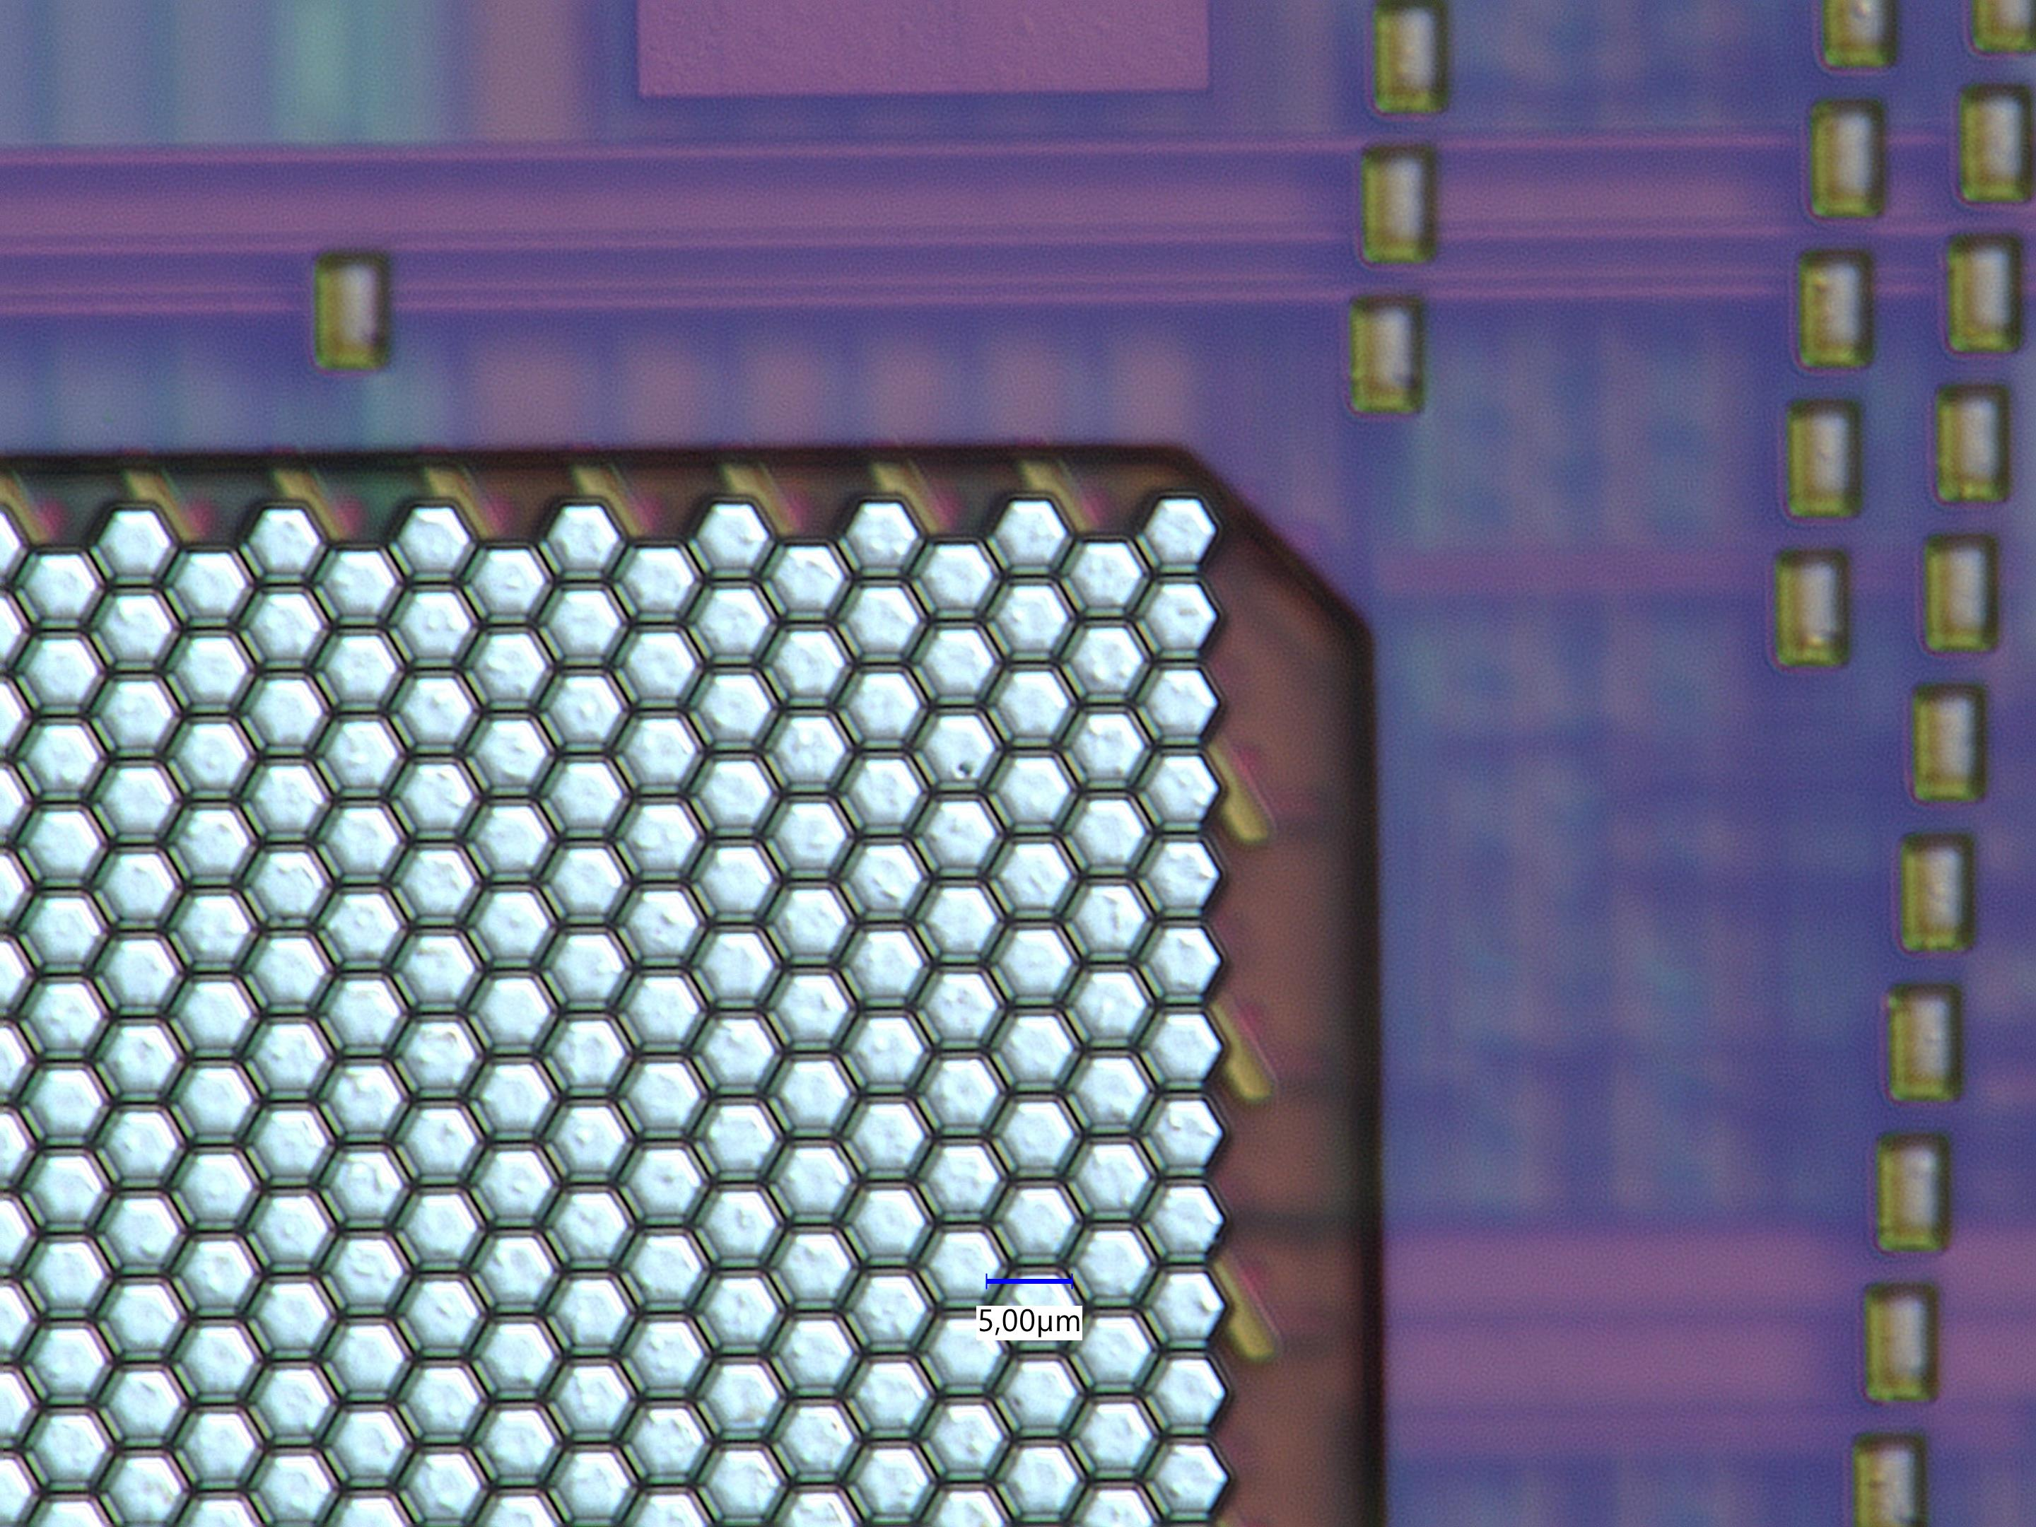
First demonstrator:
Doublet of MicroChannel Plate
Time measurement using waveform techniques
Position measurement with a new sensors using
interconnected pixels of 5 µm
5 µm pixel
6.5 mm x 7.5 mm
A collaboration between French groups ( IP2I, IJCLAB, IPHC ) and Chinese groups ( SDU, Nankai)

Slide 4
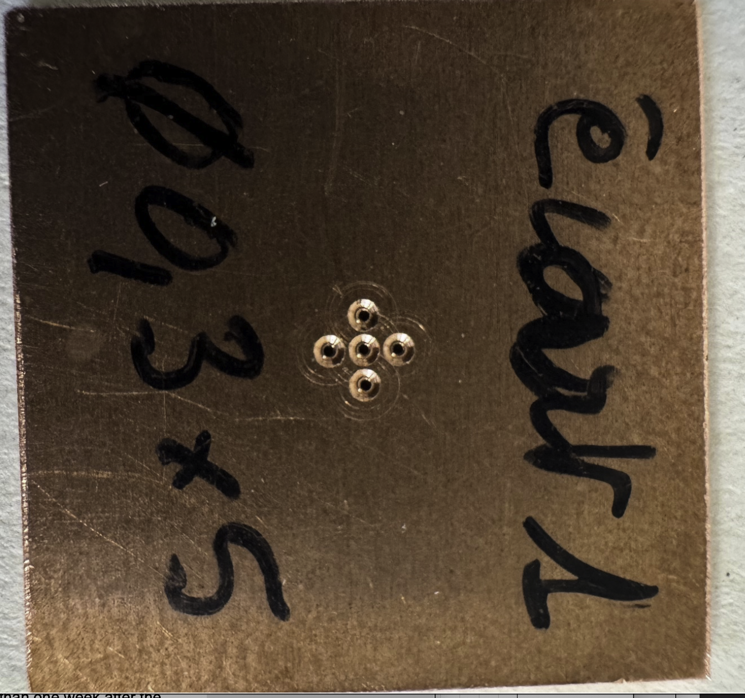
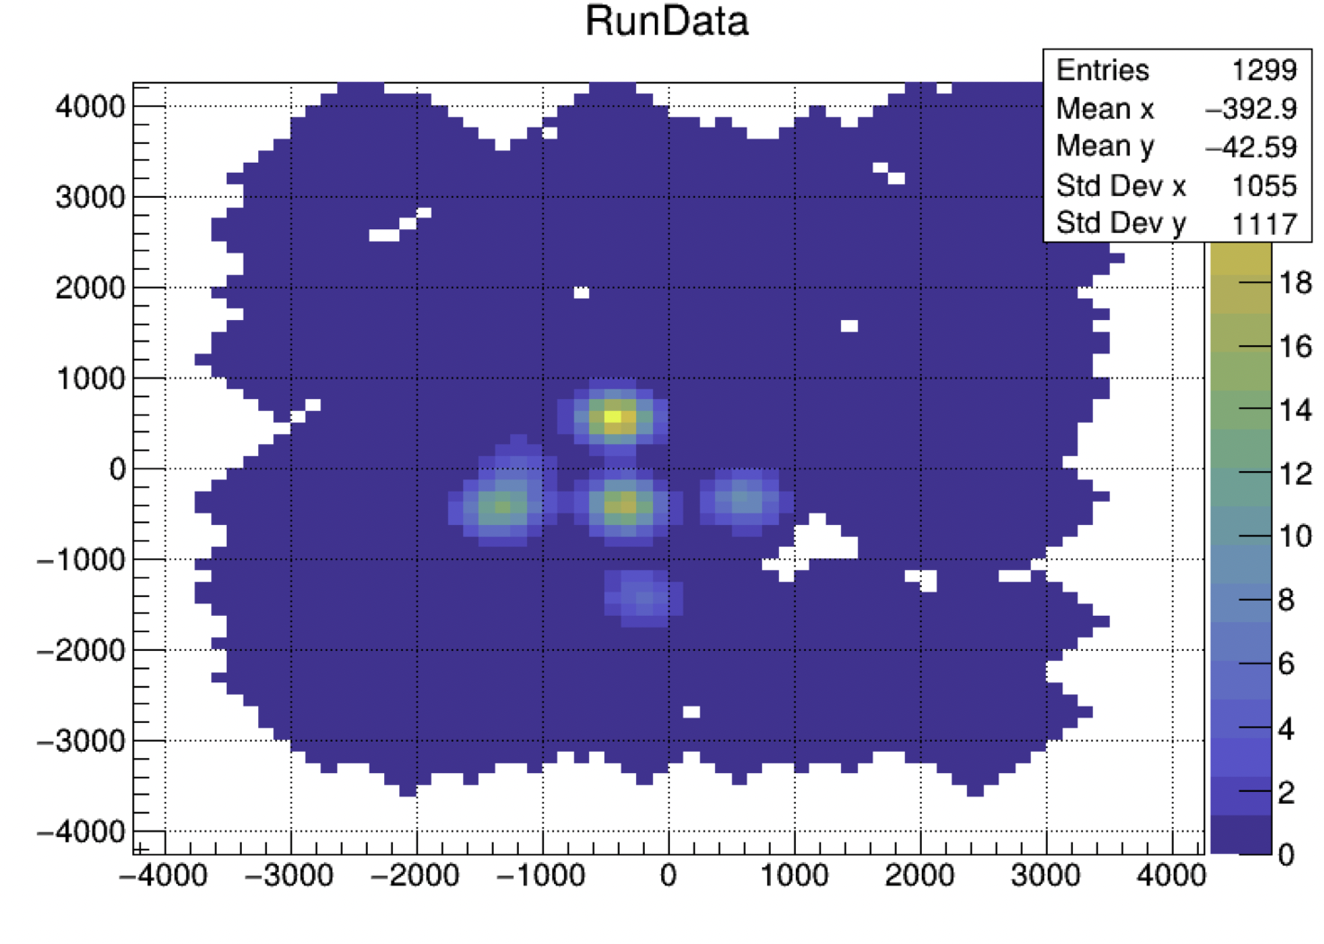
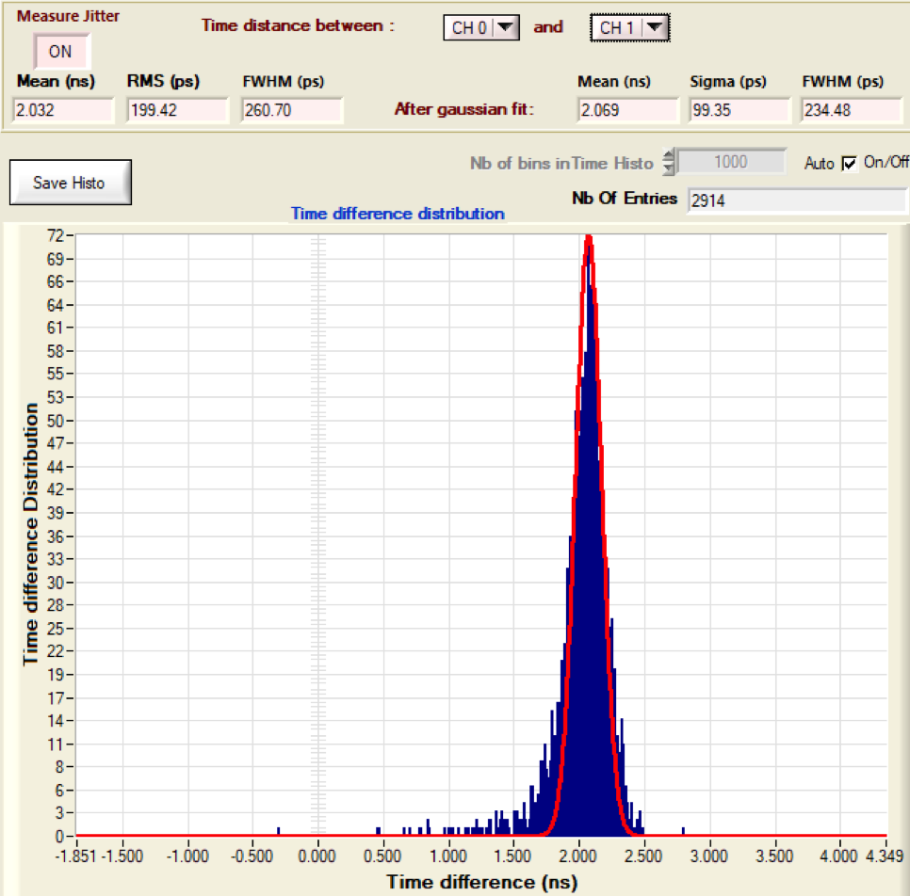
First demonstrator:
Doublet of MicroChannel Plate
Time measurement using waveform techniques
Position measurement with a new sensors using
interconnected pixels of 5 µm
Spatial dispersion < 70 µm
Next version of pixels sensor has been submitted and we expect to reach 10 µm
σ (T_{i} -T_{j}) is better than 100 ps
σ_{abs} is around 25-30 ps
Even with our first version we have better results than Timepix4

Slide 5
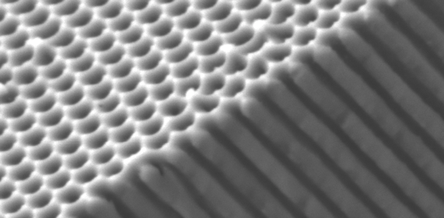

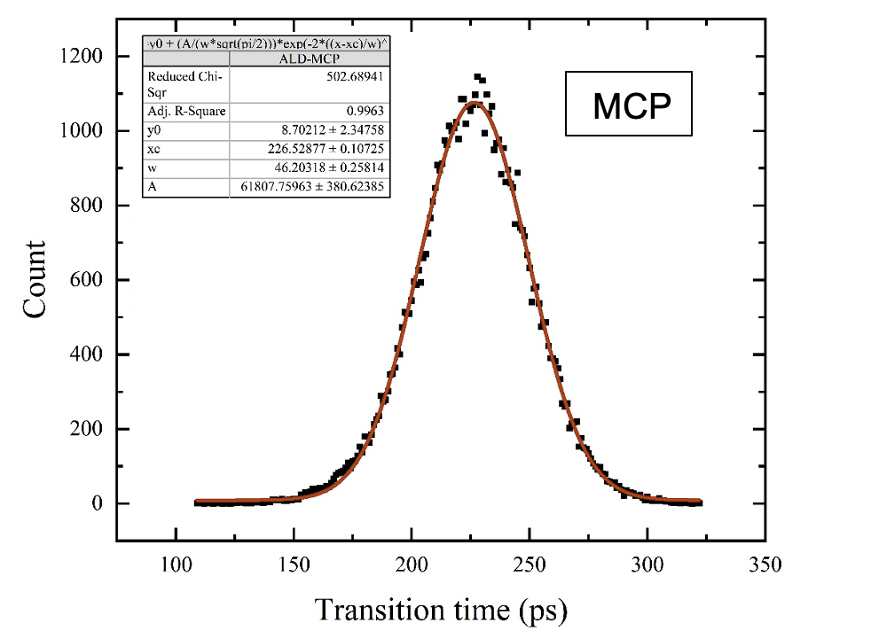
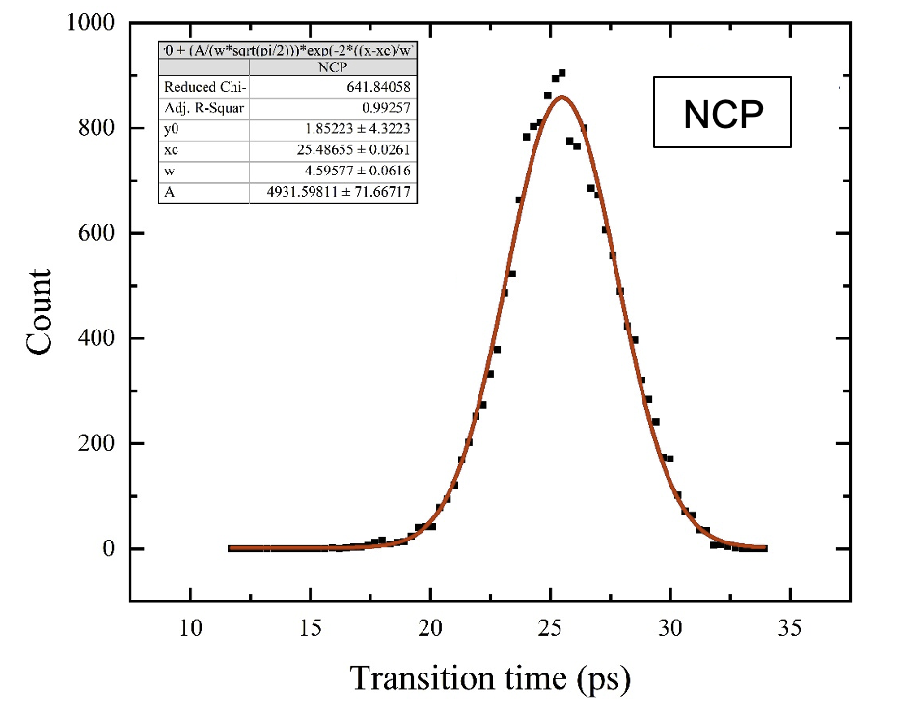
NCP
A new kind of MCP that we call NanoChannel Plate (NCP) is being developed.
It aims at producing structures with nanoholes that could be coated with
emissive and resistive materials to achieve unprecedented performances
Three technologies are followed:
Anodized Aluminium Oxide AAO (IP2I-IMP)
Silicon electrochemical etching. (IP2I-INL)
Femto-laser digging (IP2I-LabHC)
Time and spatial resolutions are expected to be 10 times better.

Slide 6
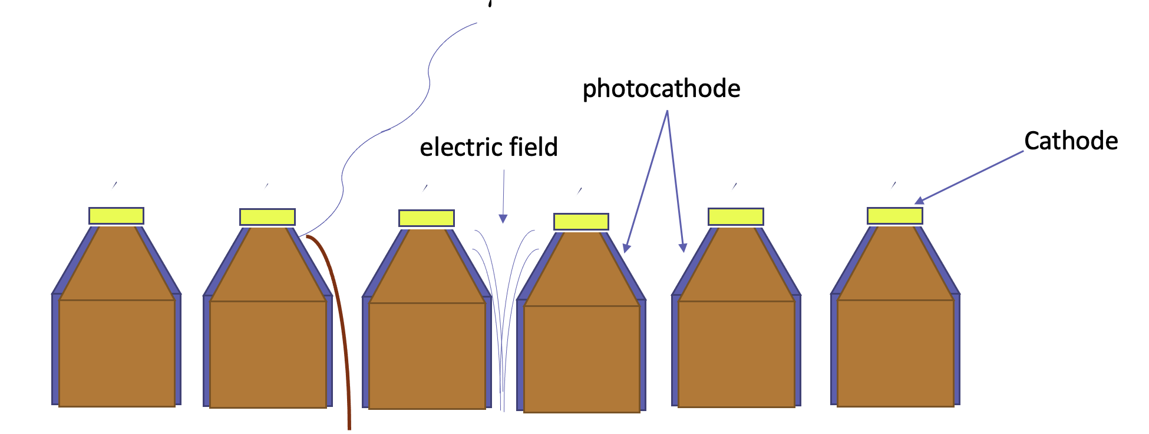
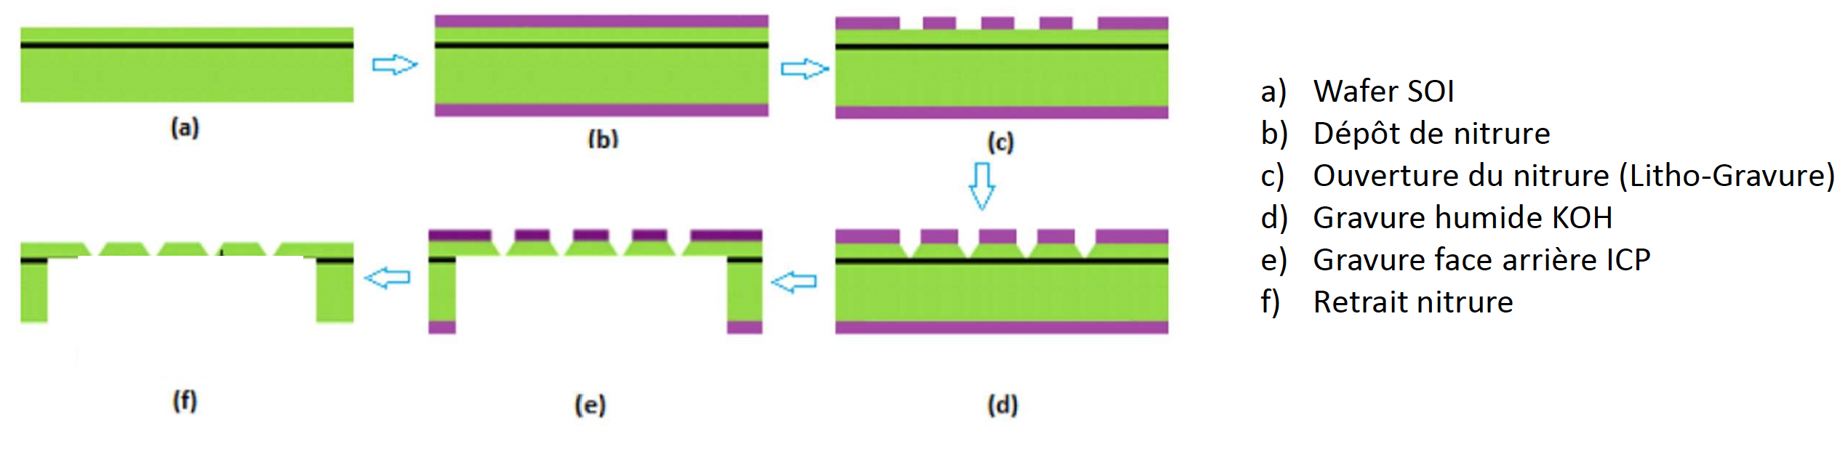
Highly granular Photocathode
A new generation of photocathodes with sub-micron diameter
with conic shape to exploit the NCP.
This is based on using electrochemical etching on Silicon wafer (INL)

Slide 7
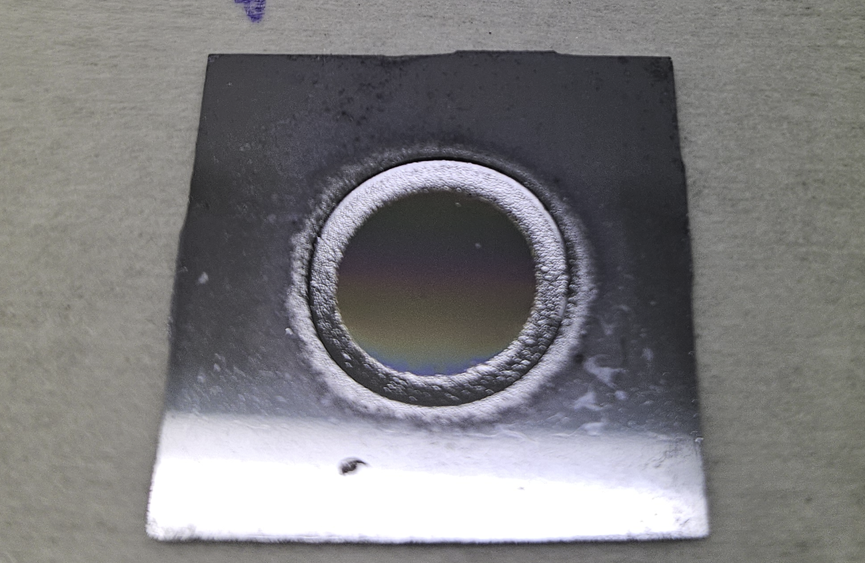
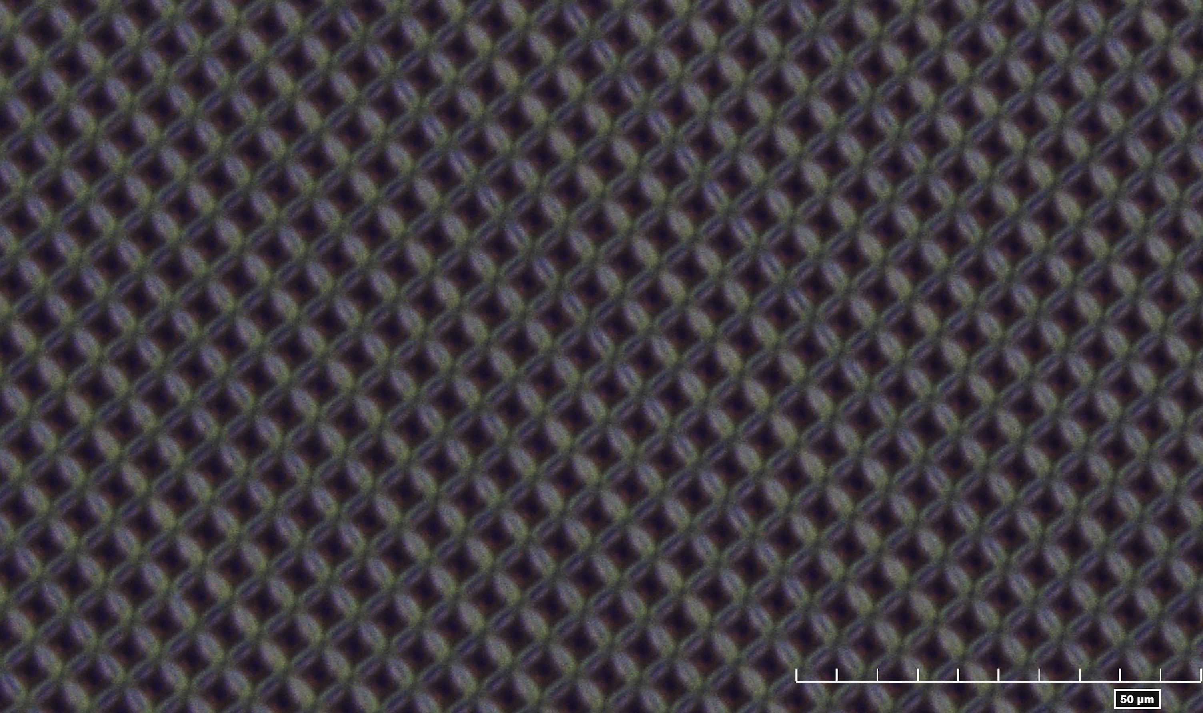
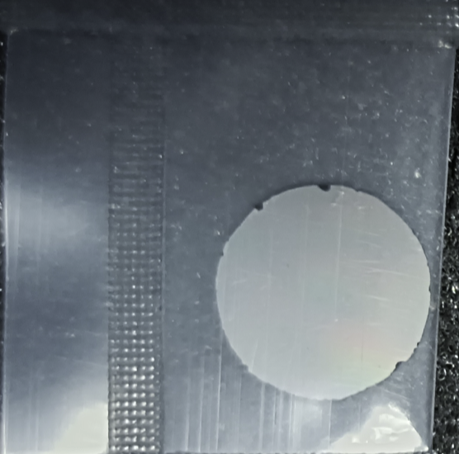
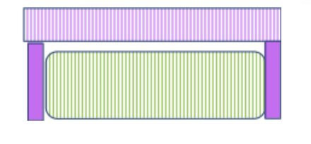
Highly granular Photocathode
1 cm radius
Photonis has produced a 1cm MCPs for us to be used with this future photocathode

Slide 8
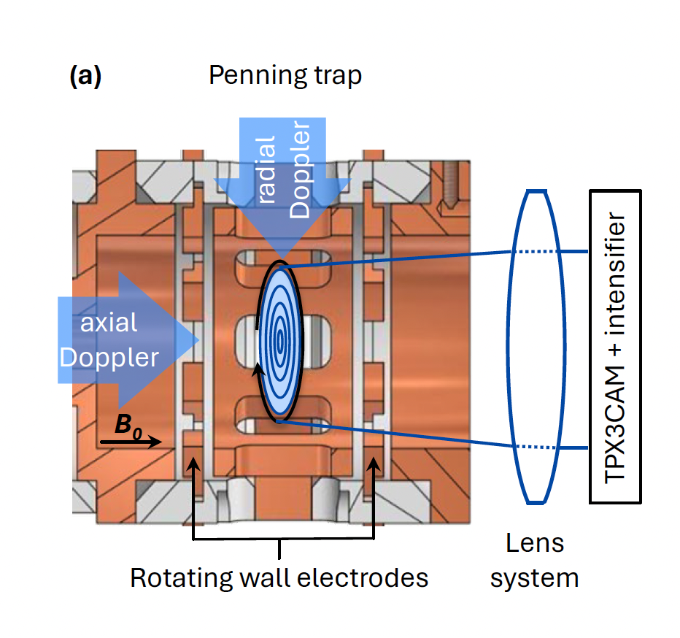
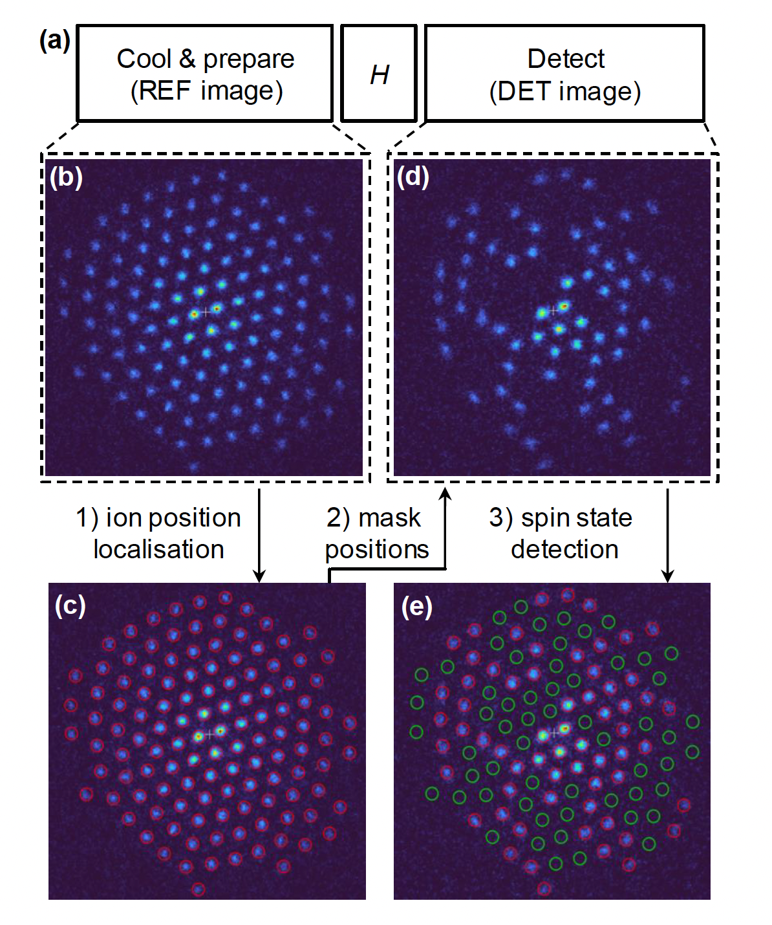
PICMIC and quantum technologies
arXiv:2303.10801v4 :Efficient site-resolved imaging and spin-state detection in dynamic two-dimensional ion crystals by R.N Wolf et al.
Study with Timepix3 → PICMIC could do much better
Controlling the quantum states always need an excellent photodetector device. PICMIC could provide the best one in standard conditions

