Slide 1
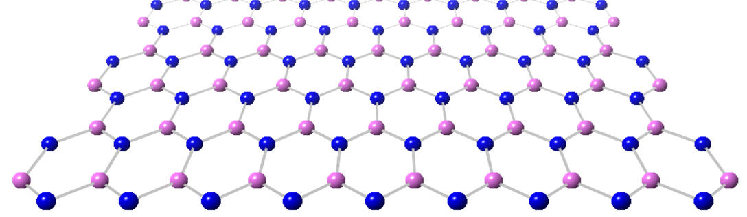



Les matériaux 2D et applications
Catherine JOURNET & Catherine MARICHY
Laboratoire des Multimatériaux & Interfaces
Activités quantiques à Lyon - 16 juin 2025
Notes:
Thank you mister chairman for this nice introduction and your kind invitation. It’s a real pleasure for me to be there to present this original study for the synthesis of two dimensional hexagonal boron nitride by a polymer route

Slide 2
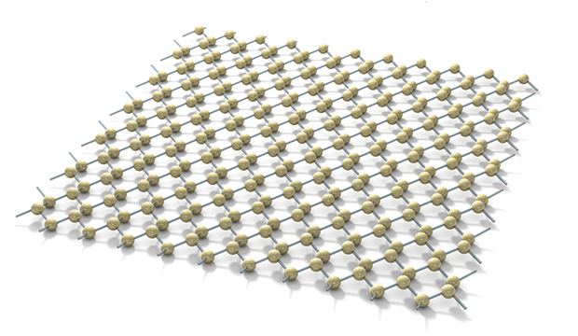
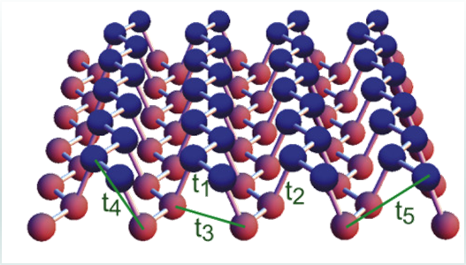
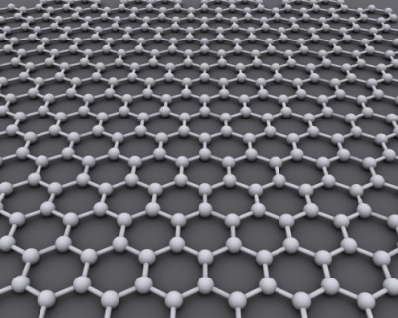
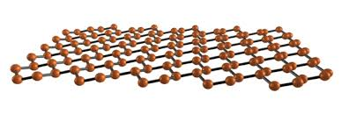
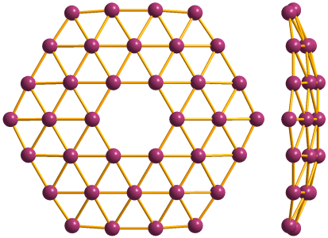
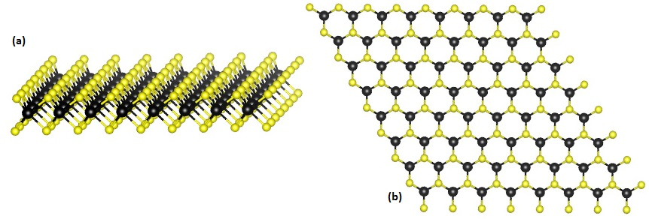
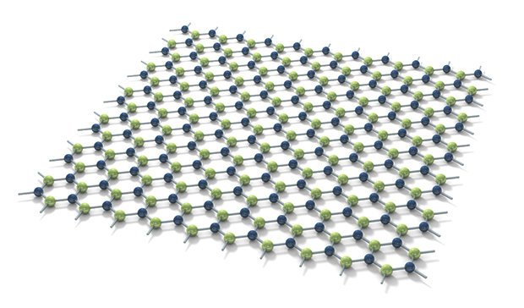
Introduction to 2D materials
Germanene 2013
Phosphorene 2014
Silicene 2012
Graphene 2004
Borophene 2015
M = Transition Metal
X = Chalcogene
TMD : Transition Metal Dichalcogenide MX₂
Hexagonal Boron Nitride
Activités quantiques à Lyon - 16 juin 2025
Notes:
Let’s me start with an introduction to 2D materials. Since the first exfoliation of graphene in 2004 by Novoselov and coworkers, different other 2D materials have been predicted and realized, some made of 1 element like silicene, germanene, phosphorene (also called black phosphorous) or borophene, the last one synthesized in 2015, and some made of 2 elements like the well-known TMDs (transition metal dichalcogenides) or the hexagonal boron nitride which is the one that we will discuss today.

Slide 3
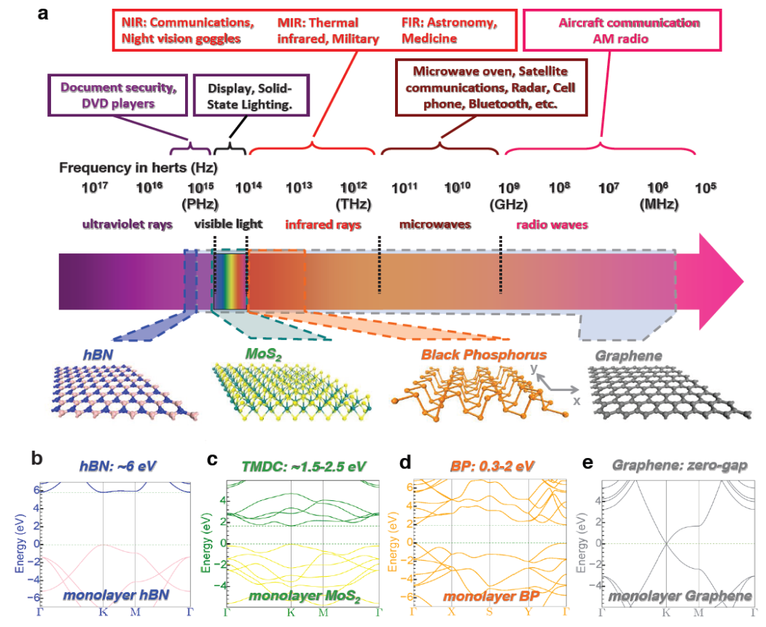
Introduction to hexagonal boron nitride (hBN)
Fengnian Xia, Nature Photonics 8, 899–907 (2014)
Activités quantiques à Lyon - 16 juin 2025
Notes:
2D material depending type different properties optical or electronic
From M, semi-M, SC to insulator

Slide 4
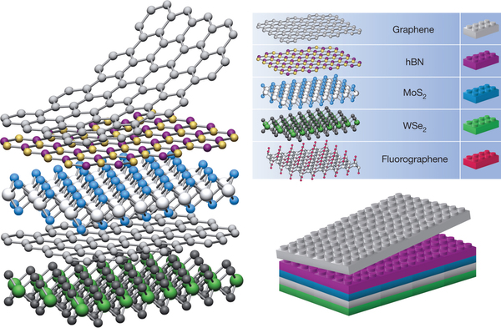
From 2D materials to Van der Waals heterostructures
A. K. Geim & I. V. Grigorieva, Nature, 499, 419–425 (2013)
Activités quantiques à Lyon - 16 juin 2025
Notes:
All these 2D materials display laminar crystalline structure in which the atomic planes are linked together by Van der Waals forces and so can easily be exfoliated into one or more layers. This kind of materials exhibits interesting properties related to their size restriction: electronic confinement, modifying both optical and electronic properties, and high surface to volume ratio that affects the mechanical and chemical properties. Therefore, 2D materials are highly attractive nanomaterials due to their potential for applications in micro-, and opto-electronics as well as renewal energy, catalysis and environment. They are also exciting because of their possibility to be stacked into Van der Waals heterostructures that combine and tune their chemical and physical properties
Possible to play with rotation between 2 layers of same 2D or different one to tune properties

Slide 5
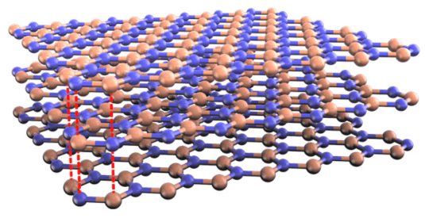

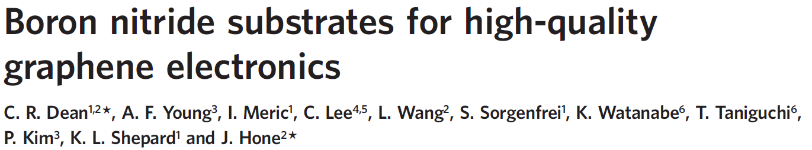
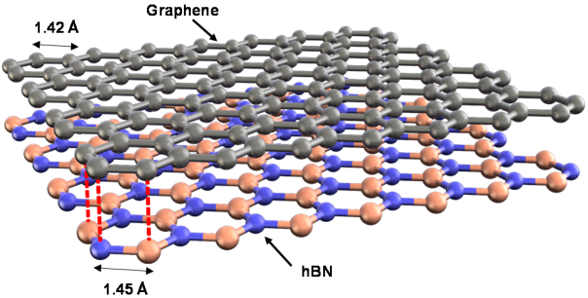
Specific skills @ LMI
Interest for hBN
Stable in air
High thermal and chemical stability
Low density
Excellent lubricant
Insulator
Materials, 2023, 16(5), 2005
Materials, 2023, 16(5), 2005
Specialist in boron chemistry since the 1980s
Activités quantiques à Lyon - 16 juin 2025
Notes:
On the lab, strong interest to hBN

Slide 6
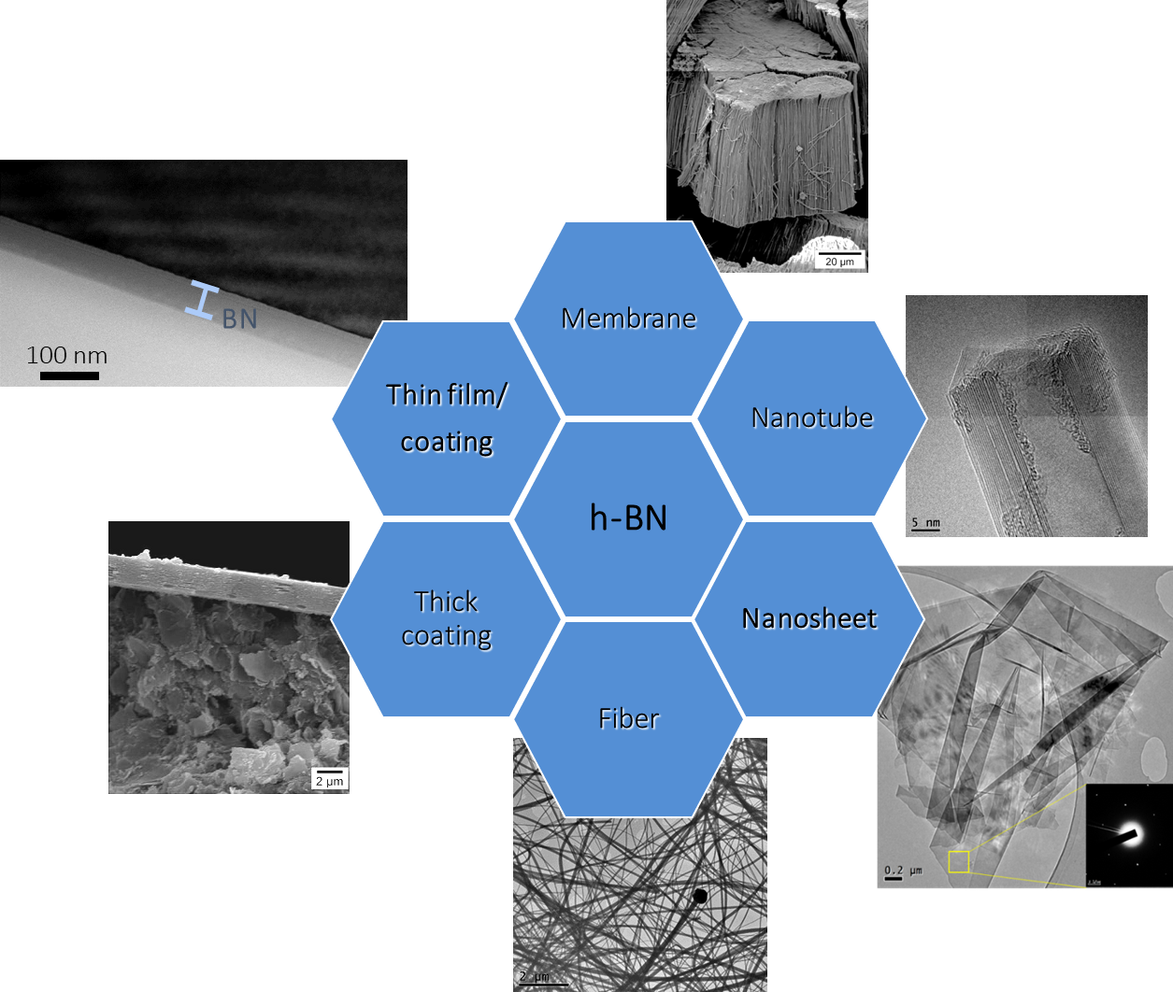
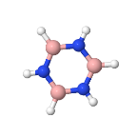
Specific skills @ LMI
Expert in boron nitride synthesis with different structures
Chemical synthesis approaches
Polymer Derived Ceramics
Chemical Vapor Deposition
Atomic Layer Deposition
Synthesis of tailored precursors
especially borazine based ones
Activités quantiques à Lyon - 16 juin 2025
Notes:
On the lab, strong interest to hBN

Slide 7

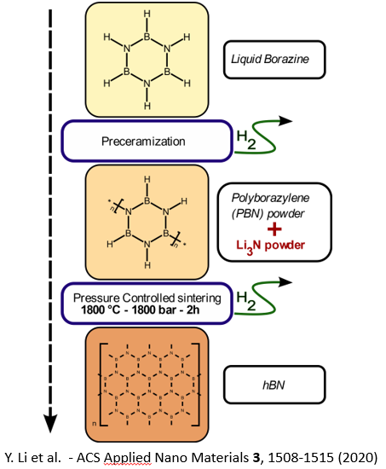
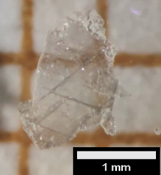
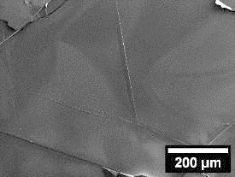
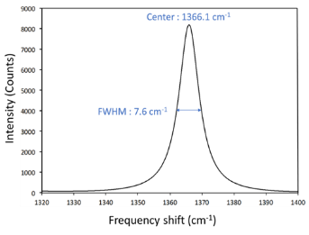

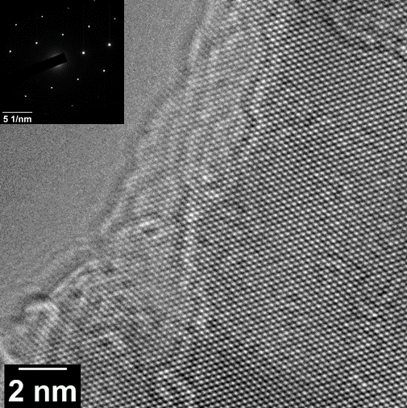

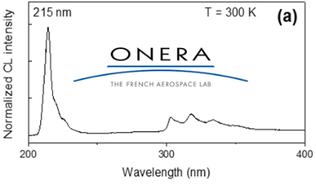


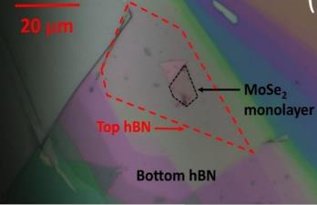
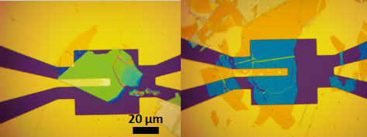



Selfstanding hBN crystals synthesis via the PDC route
Camille Maestre et al 2022 2D Mater. 9 035008
Fast and soft synthesis
Millimeter-scale hBN crystals
Good crystalline quality
Low defect/impurity density
A Pierret et al 2022 Mater. Res. Express 9 065901
TMDs Encapsulation
Au/hBN/Au capacitor
Activités quantiques à Lyon - 16 juin 2025
Notes:
Dispositif electronic et optic
On est reconnu au niveau national et européen pour cette compétence comme en témoigne les nombreux contrats

Slide 8
ALD approach based on PDC chemistry
2 step process
ALD on SiO₂/Si
Trichloroborazine
HMDS
Si
BN
ClSi(CH₃)₃
glue
100 nm
Purge
Purge
n ALD cycles
II- Annealing
BN films/nanostructures
ClSi(CH₃)₃
B/N = 0.95
2 μm
I- Deposition of polyborazine at 80 °C
ALD on polymer
Formation h-BN nanotubes
Hao et al., ChemNanoMat, 2017, 3, 656
Activités quantiques à Lyon - 16 juin 2025

Slide 9

Synthesis of boron nitride sheets with chemical or structural emissive defects using Polymer Derived Ceramics route
Doctoral Training Network : Quantum Futures
Objectives: Synthesis of 2D h-BN with a tuned concentration of either chemical or structural emissive defects
Expected results:
Development of a tailored doped single-source BN precursor containing a heteroatom (Lanthanides or carbon) as dopant.
Obtaining h-BN sheets chemically doped with lanthanide atoms or carbon.
Obtaining h-BN sheets with a controlled density and location of structural defects as vacancies.
Characterization of the incorporated or created defects in terms of density, nature and emission.
Activités quantiques à Lyon - 16 juin 2025
Notes:
Apporter propriétés quantiques ds ces materiaux de la meme facon que le n-vacancies dans le diamant

