Slide 1





Activités “Quantique” à l’INL
Hai Son NGUYEN, Nicolas CHAUVIN
Institut des Nanotechnologies de Lyon
Equipes:
Ingénierie et conversion de lumière
Matériaux Fonctionnels et Nanostructures

Slide 2
2
“Quantum” activities @ l’INL
I. Fabrication and characterization of quantum emitters
II. Photonic and Engineering light-matter interaction at the nanoscale

Slide 3
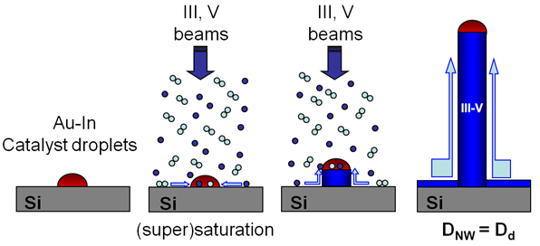
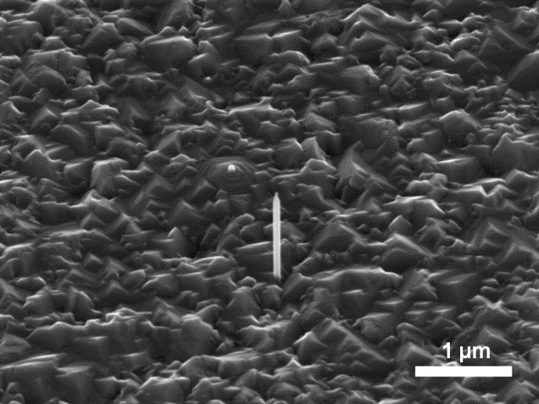
3
Quantum dot-Nanowire based single photon sources
Single Photon Source
Telecom band
Nanowire ≈ Waveguide
Far field optimized for single-mode fiber coupling
A. Mavel et al., J. Crystal Growth 458, 96-102 (2017)

Slide 4
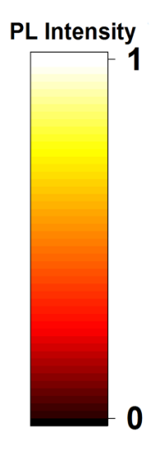
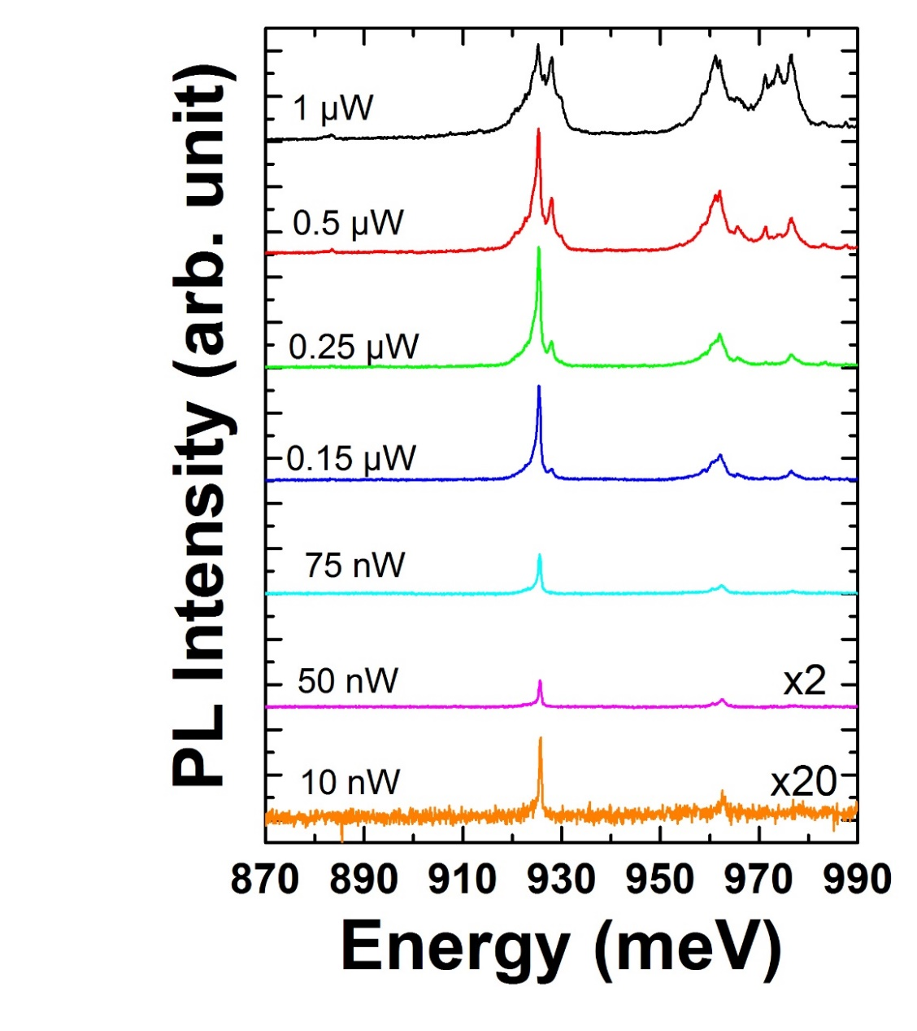

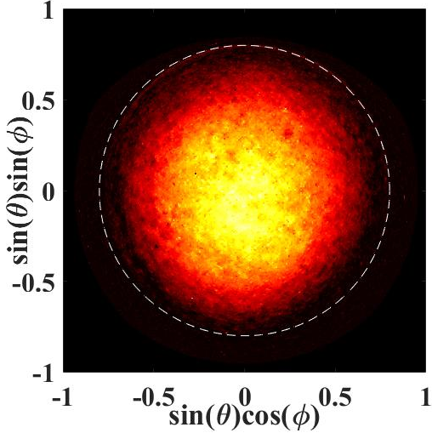
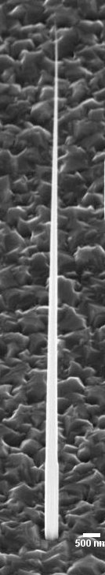

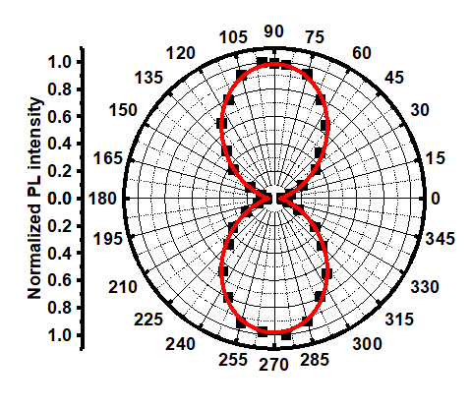
4
Quantum dot-Nanowire based single photon sources
g²(0)=0.05
α = 2°
R. Anufriev et al, Nanotechnology 26, 395701 (2015)
A. Jaffal et al, Nanoscale 11, 21847 (2019)
A. Jaffal et al, Nanotechnology 31, 354003 (2020)
A. Jaffal et al, Nanoscale 13, 16952 (2021)
Current topic: Wavelength tunability in QD-Nanowire based single photon sources
ANR SONATE (iLM, Institut Néel, CEA-PHELIQS)

Slide 5
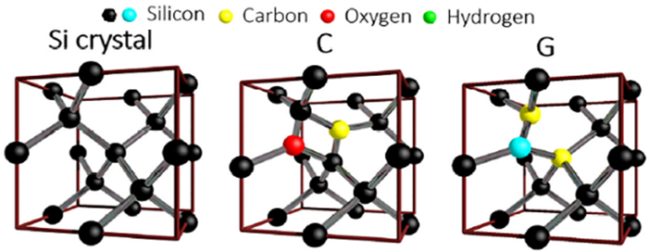
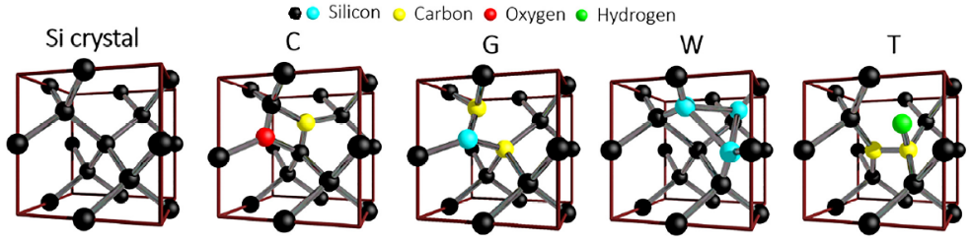
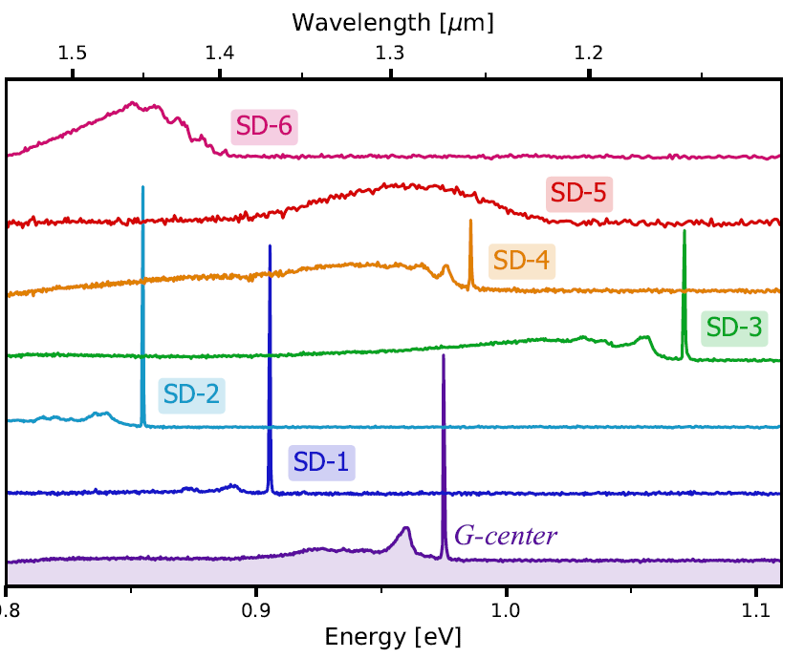
5
Color centers in Silicon
Khouri et al, J Appl Phys, 2022
Advantages:
Si platform → compatible with microelectronics
Single-photon emitters
Optimal coupling with SOI photonics
Baron et al, Phys. Rev. Lett. 2021

Slide 6
6
Color centers in Silicon
Khouri et al, J Appl Phys, 2022
Advantages:
Si platform → compatible with microelectronics
Single-photon emitters
Optimal coupling with SOI photonics
Strategy :
Deterministic creation:
→ FIB, laser irradiation, RIE…
2. Integration into photonic nanostructures
  → High Brightness, Purity,…
Collaborations :
IM2NP et LP3 (Marseille), L2C (Montpellier), CEA-PHELIQS (Grenoble)
Zadeh et al, Appl. Phys. Lett., 2021
ANR POINTCOM
ANR WOUAH

Slide 7
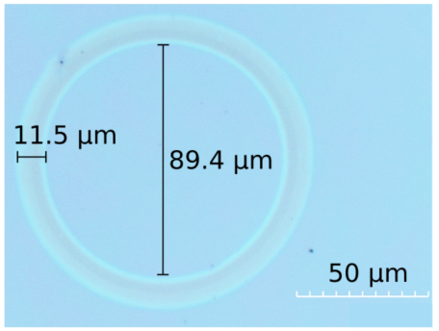
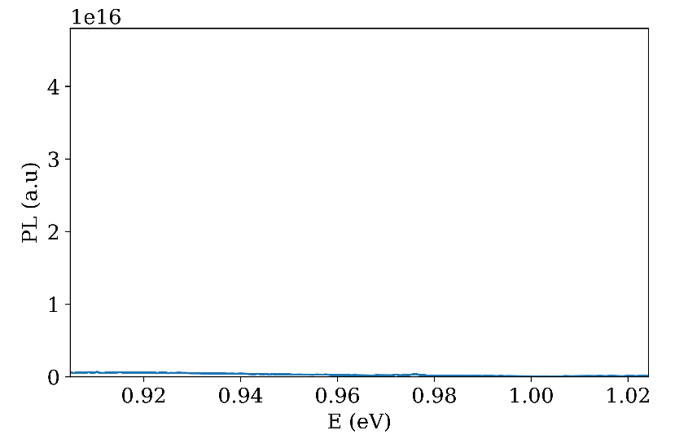
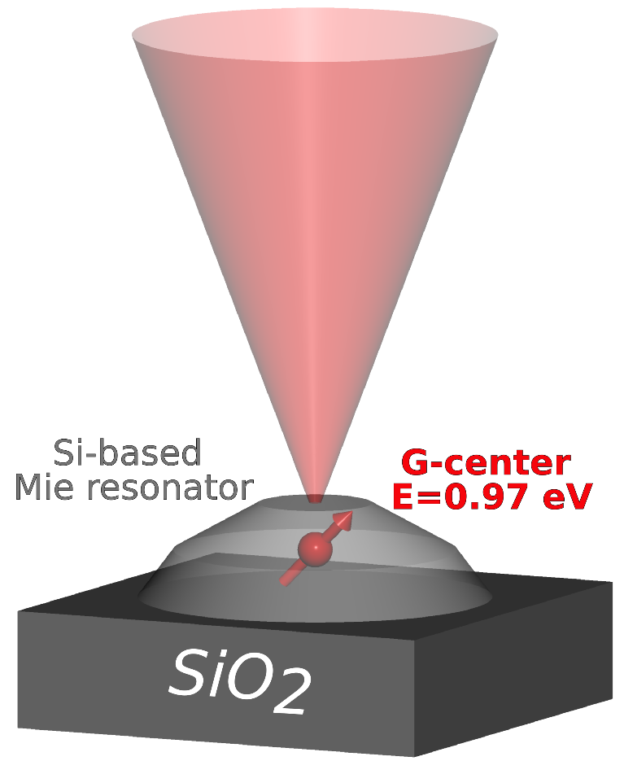
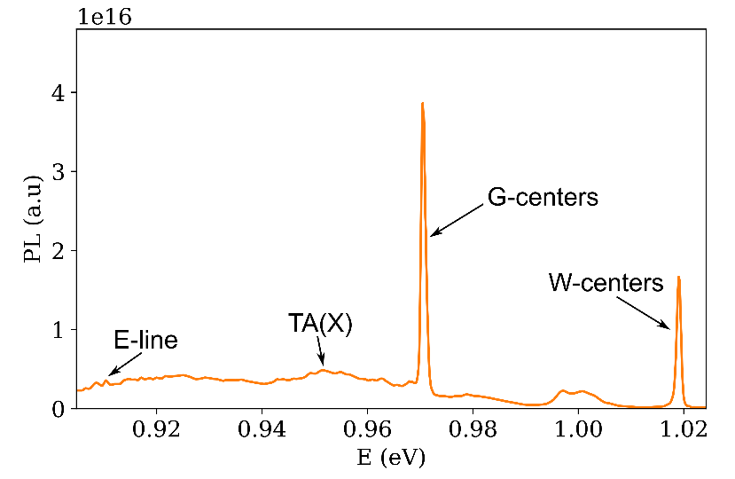
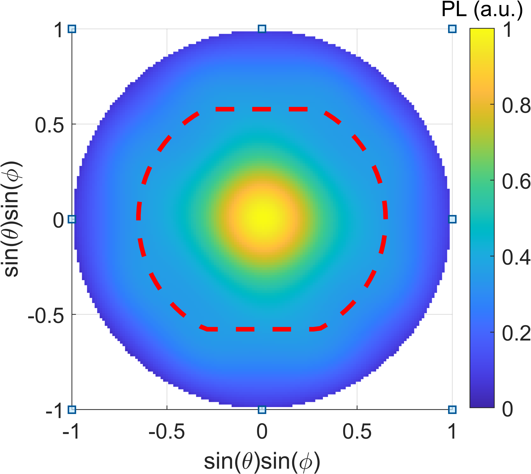
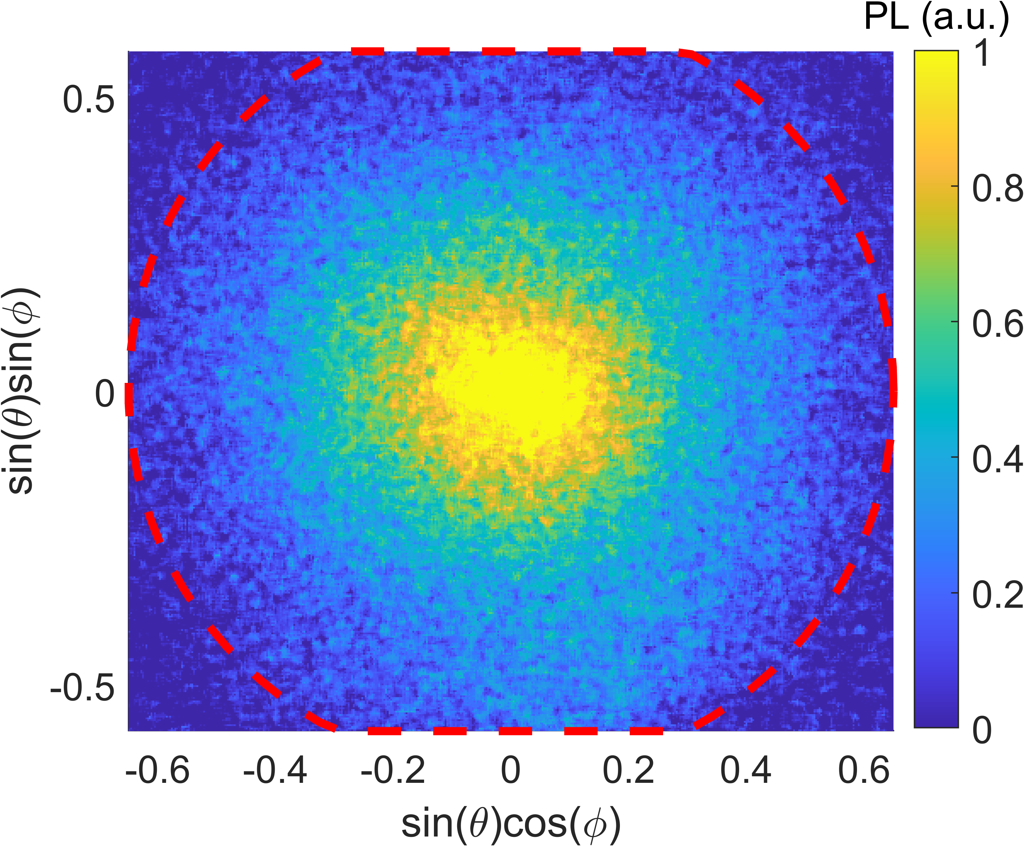
7
Color centers in Silicon at INL
Color centered induced by laser annealing
Optimization of the Far field radiation pattern
Si non modifié
Collab.: IM2NP (Marseille)
Collab.: LP3 (Marseille)
M. Khoury, PhD Thesis (2022)
Recristallisation
H. Quard et al, Phys. Rev. Applied 21, 044014 (2024)
M. Khoury et al, Adv. Optical Mater. 2201295 (2022)

Slide 8
8
“Quantum” activities @ l’INL
I. Fabrication and characterization of quantum emitters
II. Photonic and Engineering light-matter interaction at the nanoscale

Slide 9
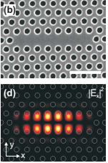
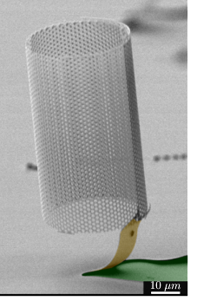
9
Engineering light-matter interaction at the nanoscale
Farfield
emission
Accelerating spontaneous emission
- Purcell effect
- Enhancing energy transfers
Tailoring the farfield radiation
- Extraction efficiency
- Directionality
- Polarization
- Dynamical modulation
Exploring non-Hermitian physics
- Bound states In the Continuum
- Exceptional Points
Triggering collective behaviors
- Bose Einstein condensation
- Superradiance
Pumping
Optical « cavity »
Photonic crystal
cavity
Photonic
cage
Resonant
Metasurface

Slide 10
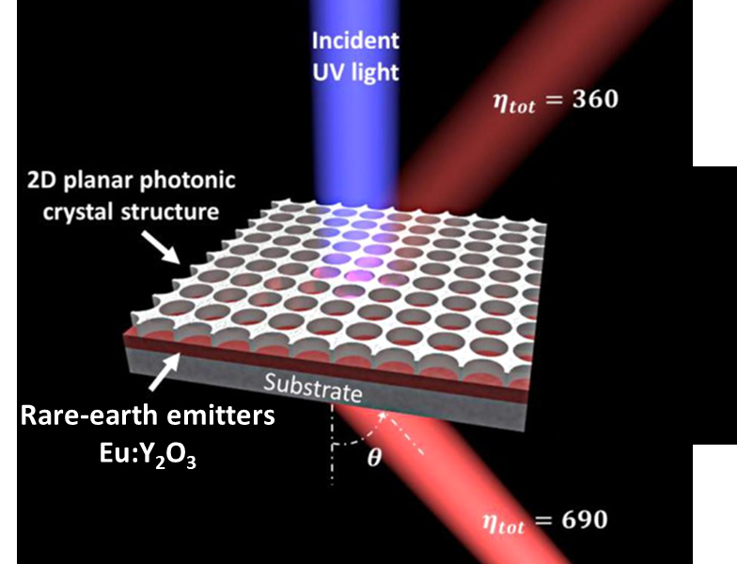
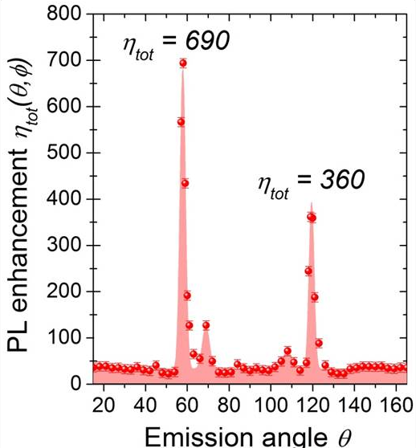
Dual resonant Photonic Metastructure to enhance rare-earth emission
10
Engineering photonic dispersion for Emission enhancement
Collaboration with
Institut of Light and Matter
Anne Pilonnet, Antonio Pereira
N-V Hoang et al., ACS photonics 4 (7), 1705-1712 (2017)
~1
29
24 (back emission)
12 (front emission)

Slide 11
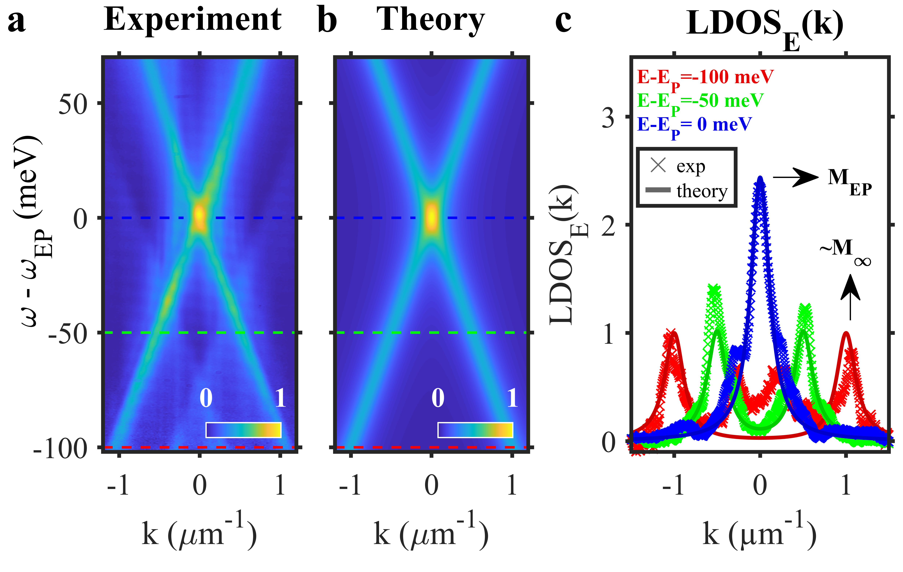
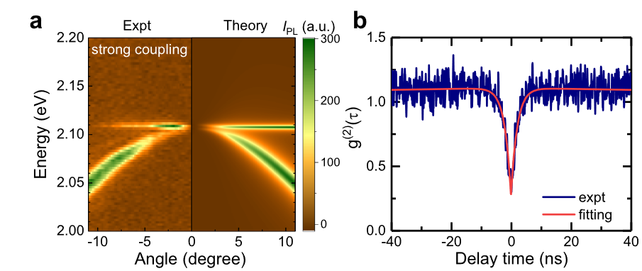
11
Quantum emitters at Non-hermitian singularities
LDOS enhancement at Exceptional Points
L. Ferrier et al.,
Physical Review Letters 129, 083602 (2022)
Strong coupling between Single photon source
and Bound states In the Continuum
T.H. Do et al.,
Nature Communications 15, 2281 (2024)

Slide 12
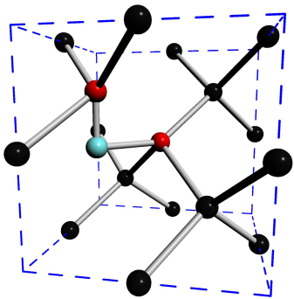
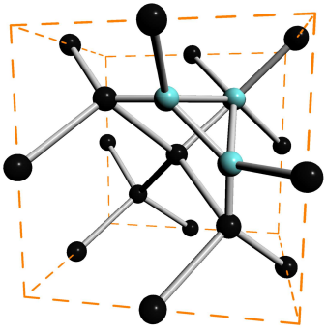
12
Conclusion
I. Fabrication and characterization of quantum emitters
InAs/InP QDs
G centers
C_{s}
Si_{i}
Si
Si
Si_{i}
W centers
II. Photonic and Engineering light-matter interaction at the nanoscale

