Slide 1
Study of Pulse Shape Discrimination (PSD): Measure the EM fraction in hadronic shower
Yingrui Hou (LPCA)

Slide 2
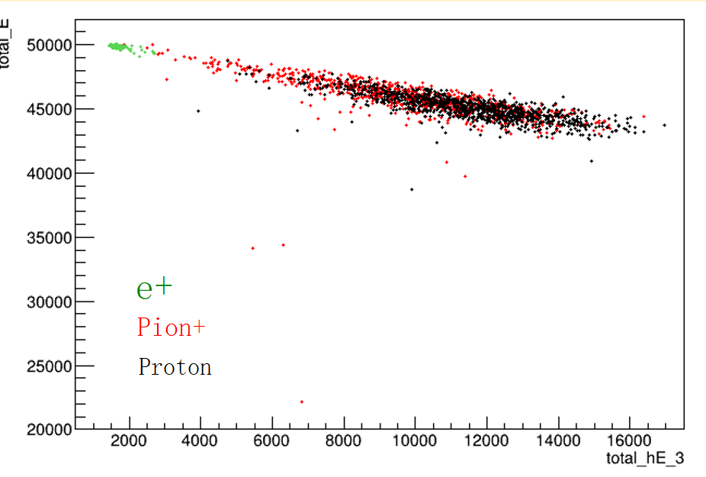
Possible improvement of hadron showers
Key point => The missing energy in hadron showers
What if the energy deposited by hadronic process has a correlation with the total deposited energy?
Setting up a simulation to validate the correlation
Assumptions in simulation
EM part:
All steps generated by $γ$ and $e^{±}$
Steps with dE/dx < 5 generated by hadrons
Hadronic:
Steps with dE/dx $≥$ 5 generated by hadrons

Slide 3
Possible improvement of hadron showers
Transfer the correlation to the corrected energy
$E_{dep}=aE_{dep}^{h}+E_{init}=a\left(E_{dep}−E_{em}\right)+E_{init}$
$E_{init}=\left(1−a\right)E_{dep}+E_{em}$
With some assumptions:
$E_{dep}∝n_{PE}$
$E_{em}∝n_{PE}^{em}$
$E_{dep}^{h}∝n_{PE}^{h}$
Then the EM fraction $f_{em}$: $n_{PE}f_{em}=n_{PE}^{em}$

Slide 4
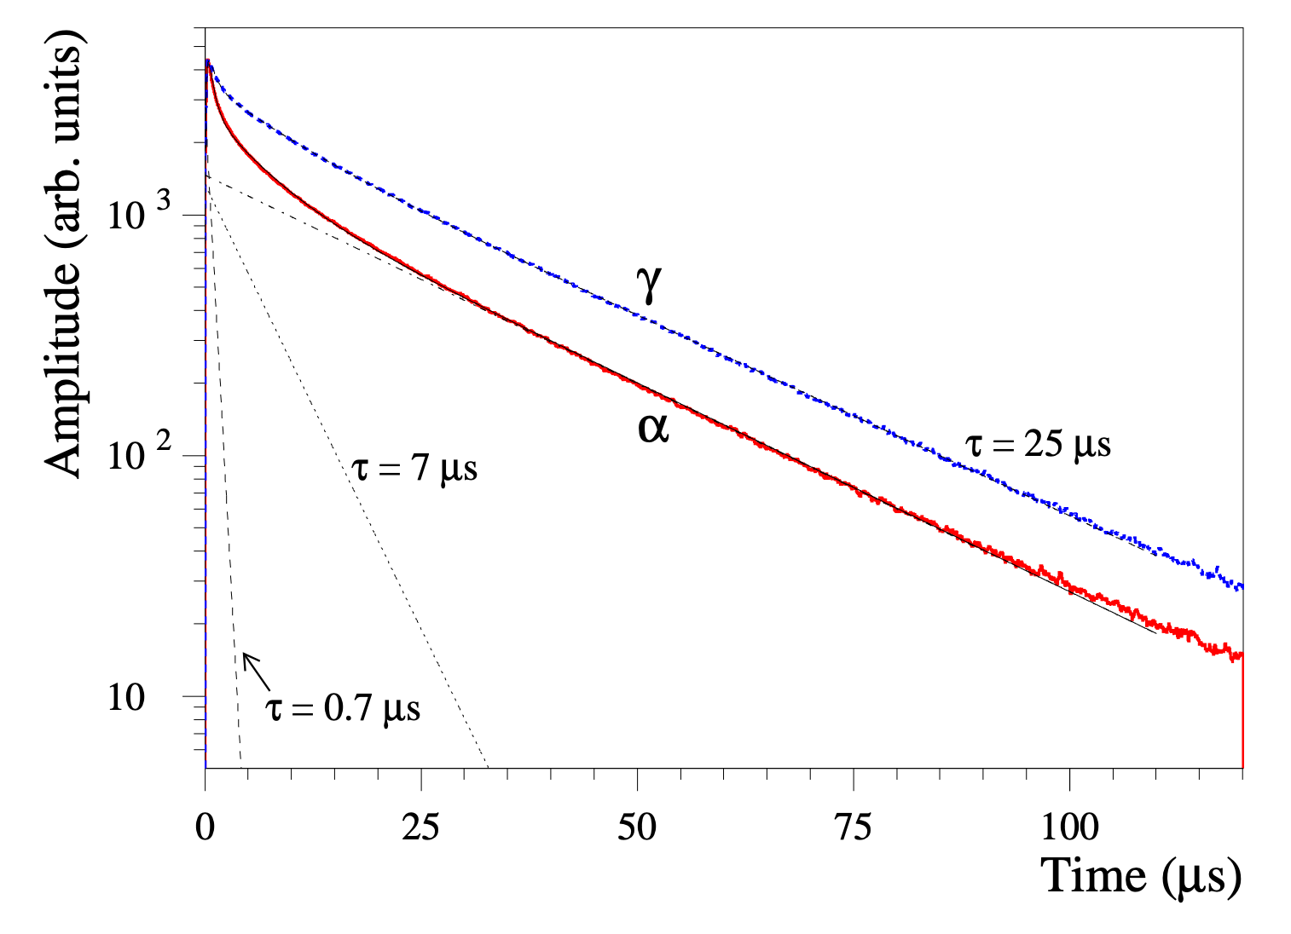
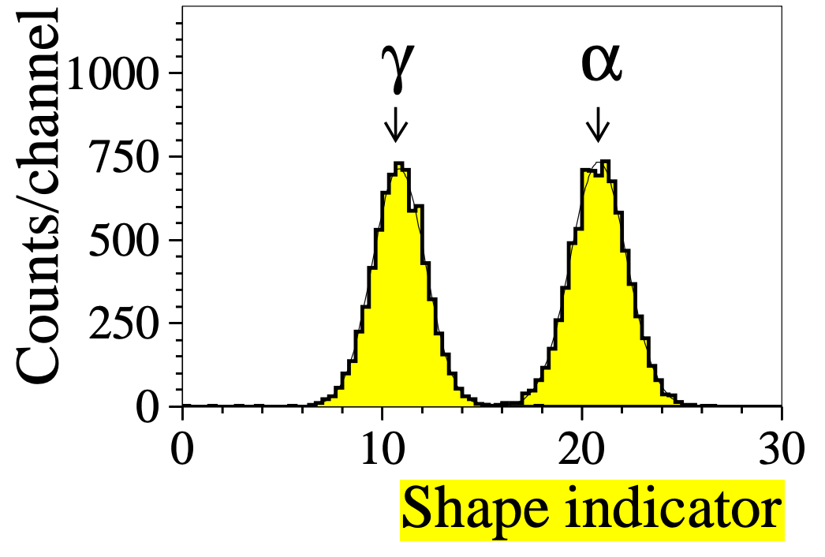
Possible improvement of hadron showers
Pulse Shape Discrimination (PSD)
Using the decay time shape difference (fractions of fast and slow components) to separate the hadronic and electromagnetic scintillation light.
arXiv:nucl-ex/0409014
An example with ZnWO4 crystal

Slide 5
Study with single $π^{+}$ simulation
Simulation setup
Geometry: ideal calorimiter
2m x 2m x 2m BGO crystal (make sure no energy leakage at current step)
Scintillator properties
Scintillating time shapes are taken from the measurements with cosmic ray ($γ$-like) and alpha source ($α$-like)
$γ$-like: $τ_{1}=0.07 μs \left(6\%\right)$, $τ_{2}=0.36 μs (94\%)$
$α$-like: $τ_{1}=0.046 μs \left(12\%\right), τ_{2}=0.36 μs (88\%)$
Light yield: 10000 Photons/MeV
Efficiency of optical photon to EP: 0.1% (10000 PE/GeV)
Time constants and fractions are changed based on particle type and dE/dx
dE/dx < 5 (hadron) + $γ$ + $e^{±}$: $γ$-like
dE/dx $≥$ 5 (hadron): $α$-like

Slide 6
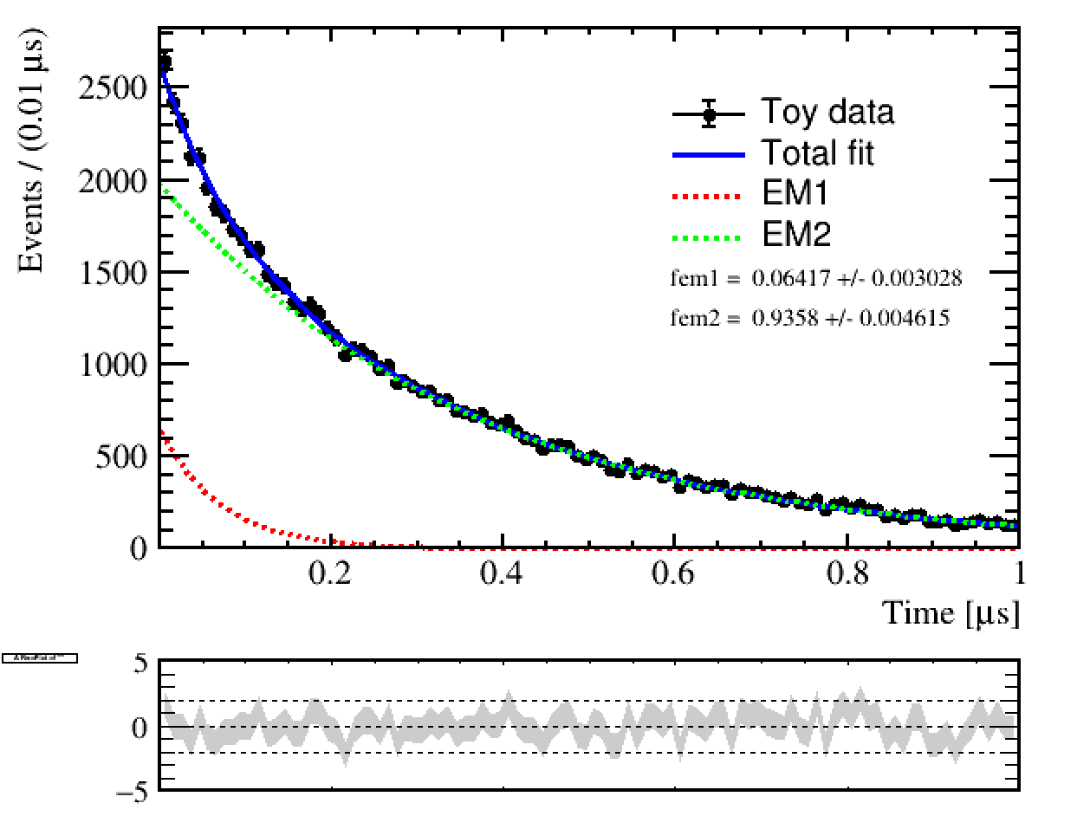
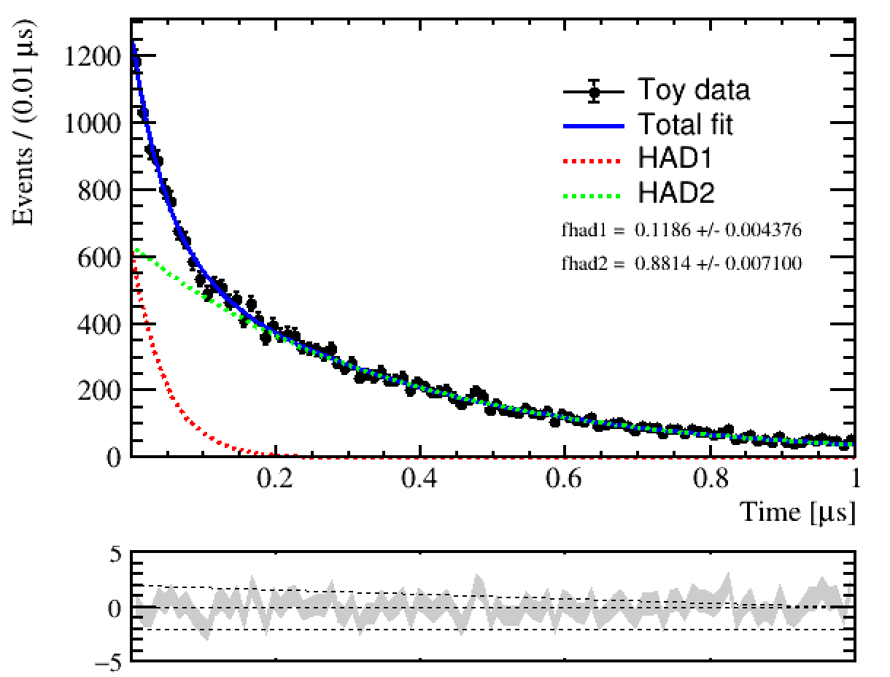
Fit to get the $f_{em}$
The time constants and fraction of each time component are fixed to input values + $f_{em}$ and $n_{PE}$ are float.
Validation check with fit to EM part and hadronic part
10 GeV pip
10 GeV pip

Slide 7
Fit to get the $f_{em}$
From this 10 GeV pip sample:
Input $f_{em}$: 0.7331159
Output $f_{em}$: 0.73 +/- 0.03
With the fits on 100 samples:
No significant bias has been observed
The $f_{em}$ from time fit is reliable to be used for the further energy correction

Slide 8
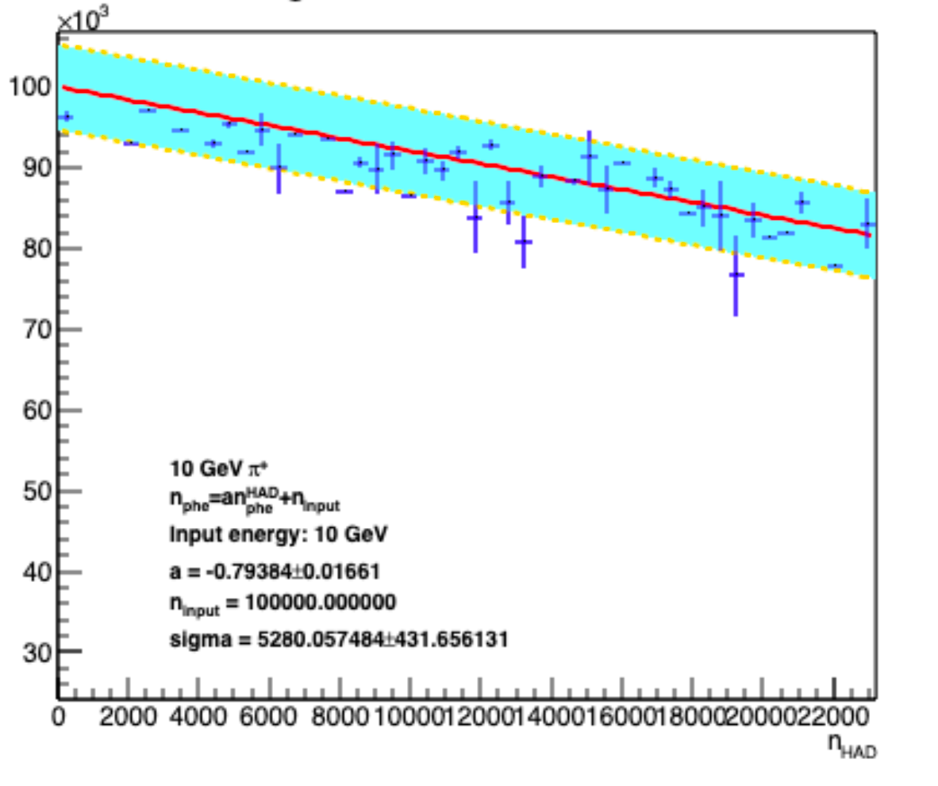
Fit to get the correlation
Measurable observables:
$n_{PE}$, $f_{em}⇒$ $n_{PE}^{em}$, $n_{PE}^{h}$
Re-build the correlation:
$n_{PE}=n_{PE}^{h}⋅a+n_{init}$
$n_{init}=n_{PE}\left[1−a\left(1−f_{em}\right)\right]$
$a$ is shared between different energy points
Correlations are checked independently in energies $⇒$ consistent among energies

Slide 9
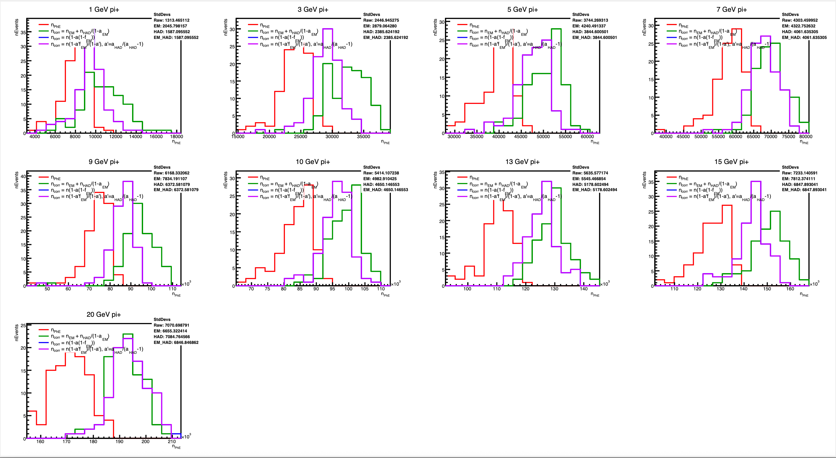
--Raw $n_{PE}$
--$n_{PE}$ corrected
Compare the raw and corrected distribution:
Corrected distribution is more Gaussian-like
Mean $n_{PE}$ is less biased, need a small correction to get the input energy back.

Slide 10
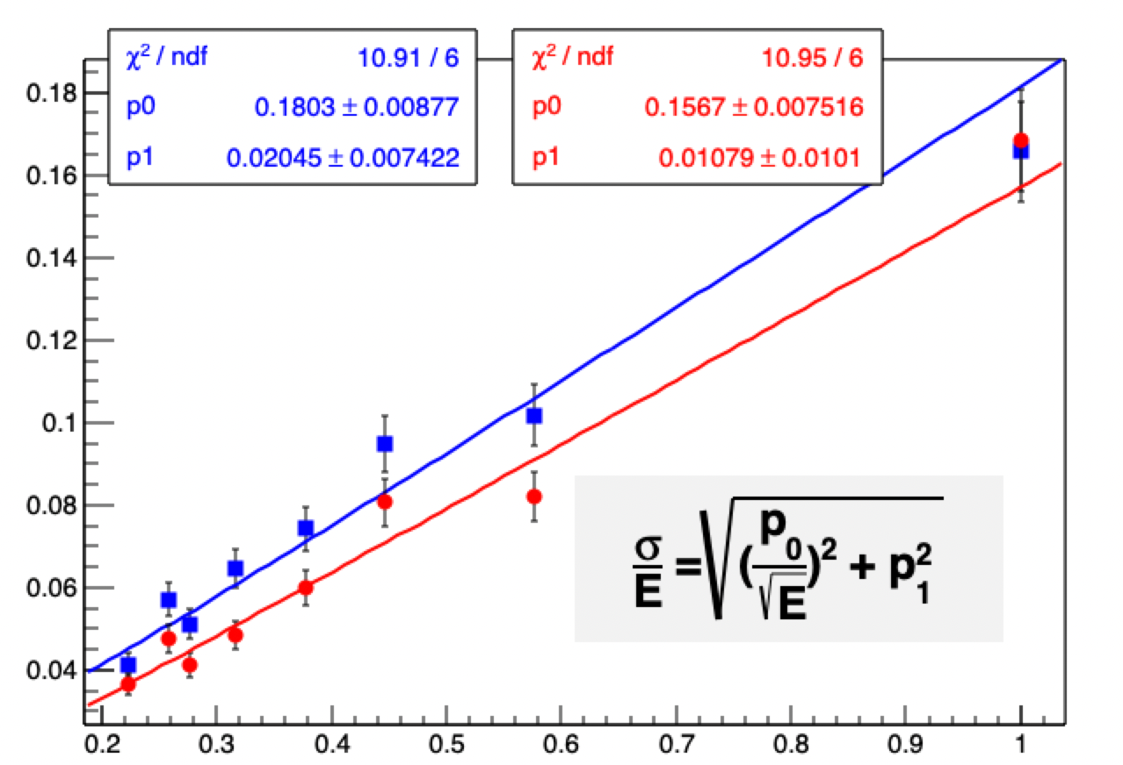
Comparison (very very preliminary)
Since the distribution for raw $n_{PE}$ can be described by Gaussian. So:
For corrected $n_{PE}$: $σ$ and E are from fit
For raw $n_{PE}$: $σ$ and E are the standard deviation and mean of the distribution
The $\sqrt{E}$ is taken from the input energy
~13% resolution improvement

Slide 11
Summary and future plans
The preliminary proof-of-principle of applying PSD method on hadron shower has been done.
Comparison to the total deposited energy shows a 13% improvement in the energy resolution, with an (very) ideal calorimeter geometry.
More effect should be considered in the further study
The time shape of proton is expected to be a mixture of $γ$-like and $α$-like.
Parameters are measured by a proton test beam recently.
The energy resolution dependency of the PSD method on the shower depth ( $z$ in the calorimeter) is on the to-do list
Extend the possibility to use the energy measurement from the other calorimeters in the same detector.

