Slide 1





European context
David Rousseau
IJCLab-Orsay
rousseau@ijclab.in2p3.fr @dhpmrou
Notes:
XXX Add poster

Slide 2

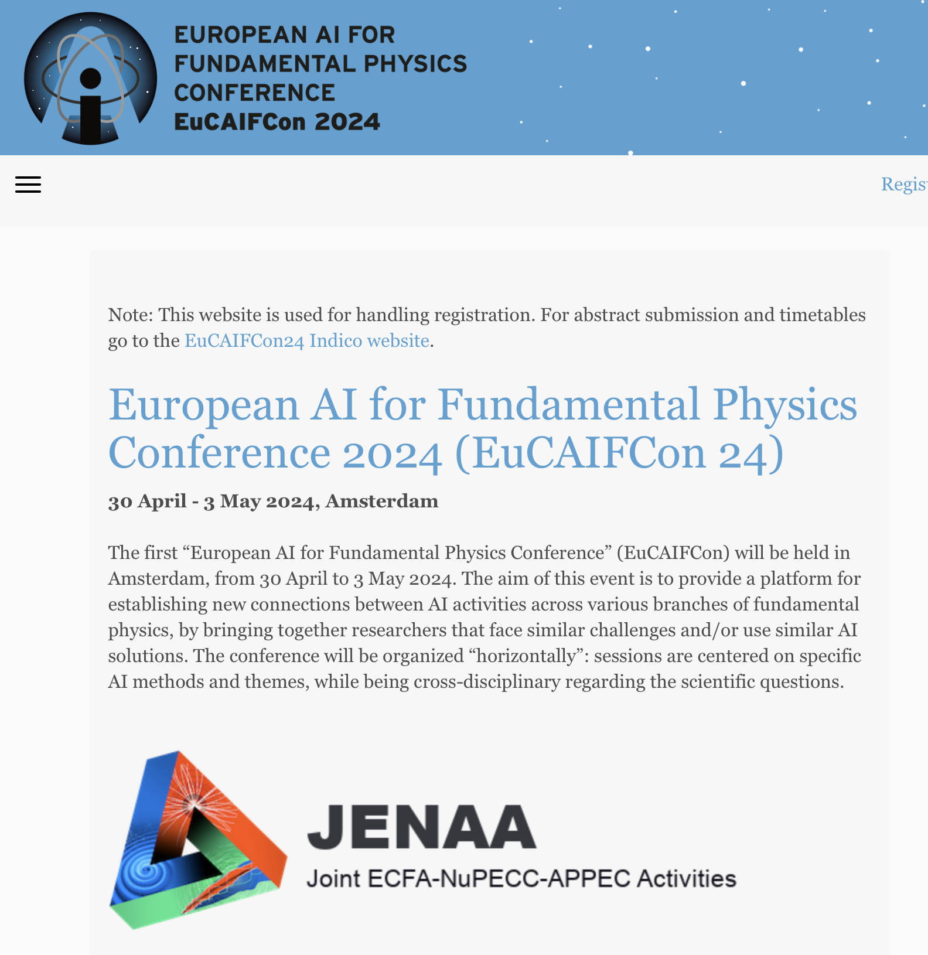
EuCaif, EuCaifCon
https://eucaif.org
Summer 2026 Heidelberg
Fellows, next conference
then 18 months periodicity, Paris 2027-8?
fdfdfdf

Slide 3
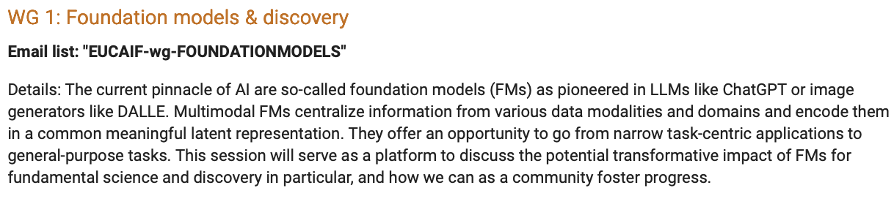
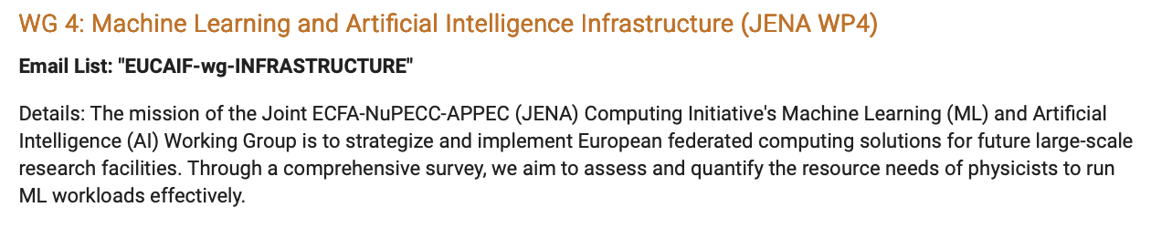
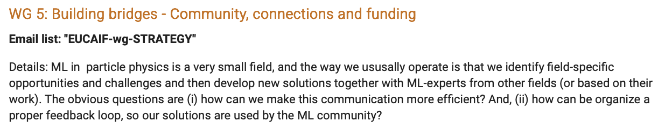
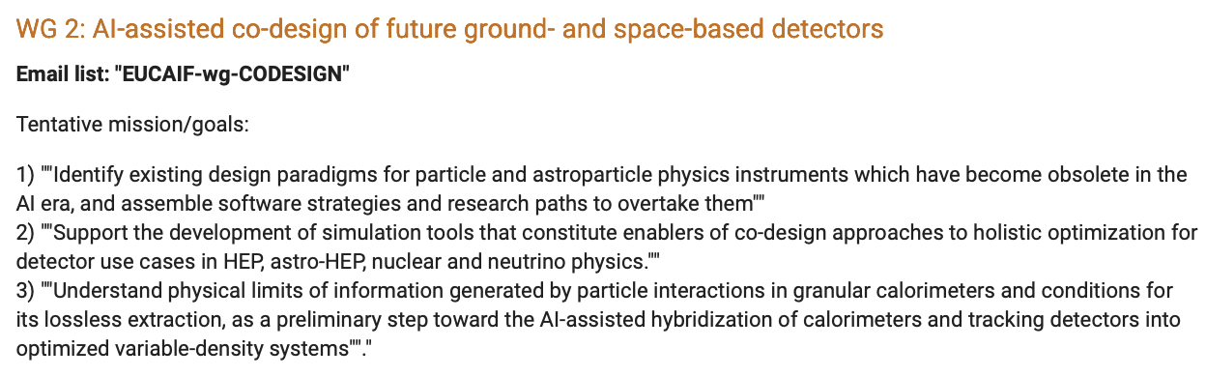
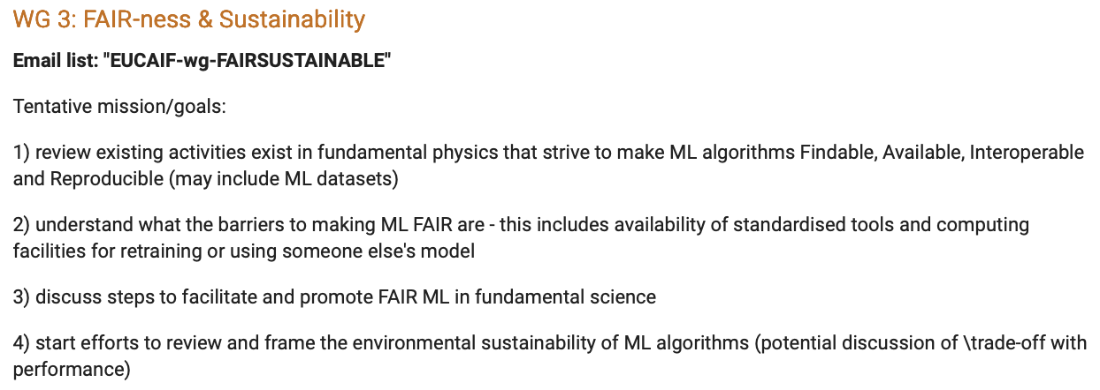
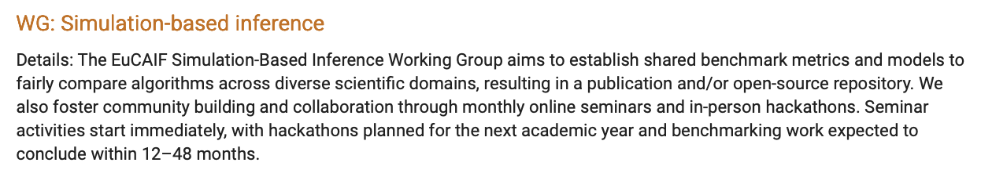
EUCaif WG

Slide 4
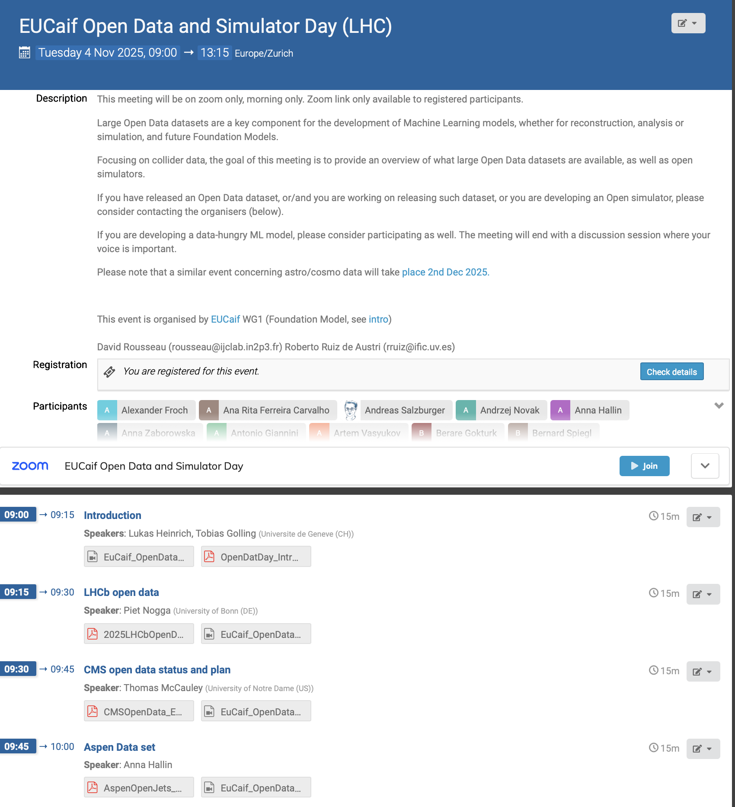
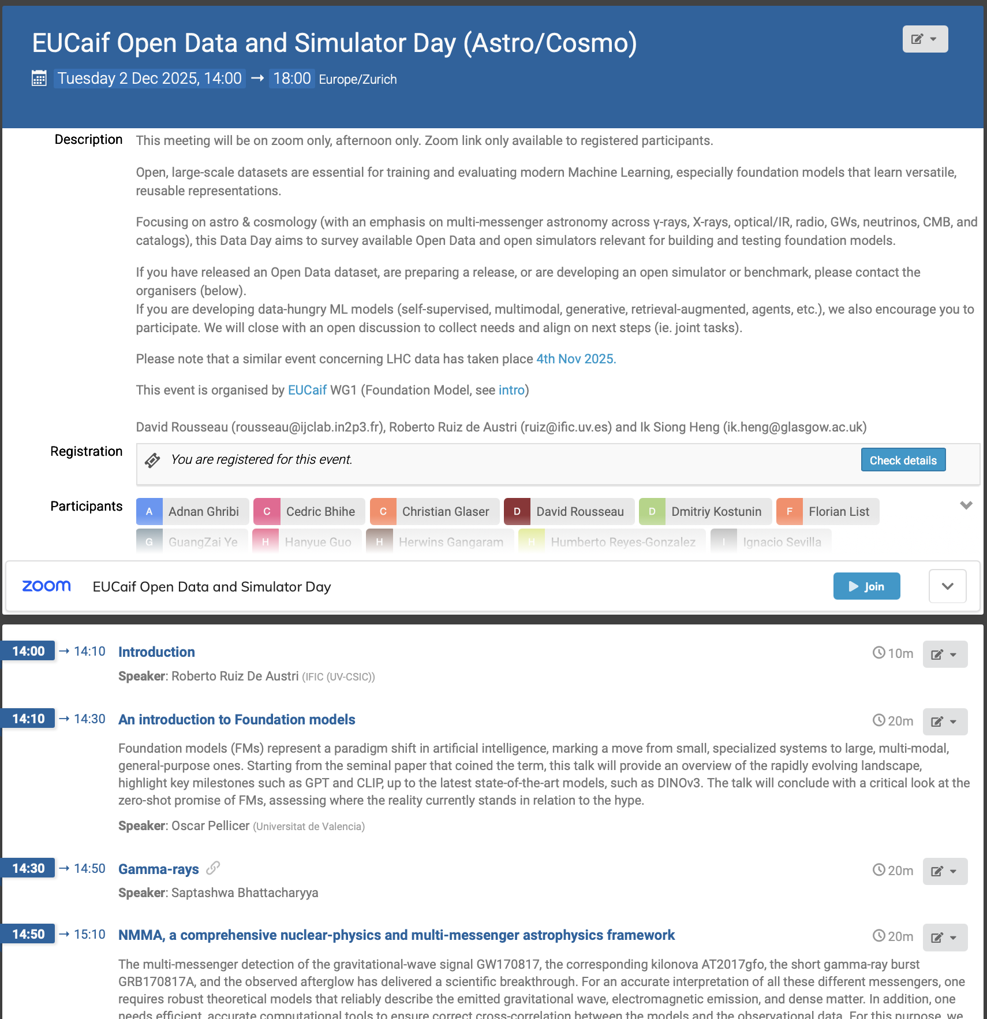
EUCaif WG1 Data Days 4 (Foundation models)

Slide 5
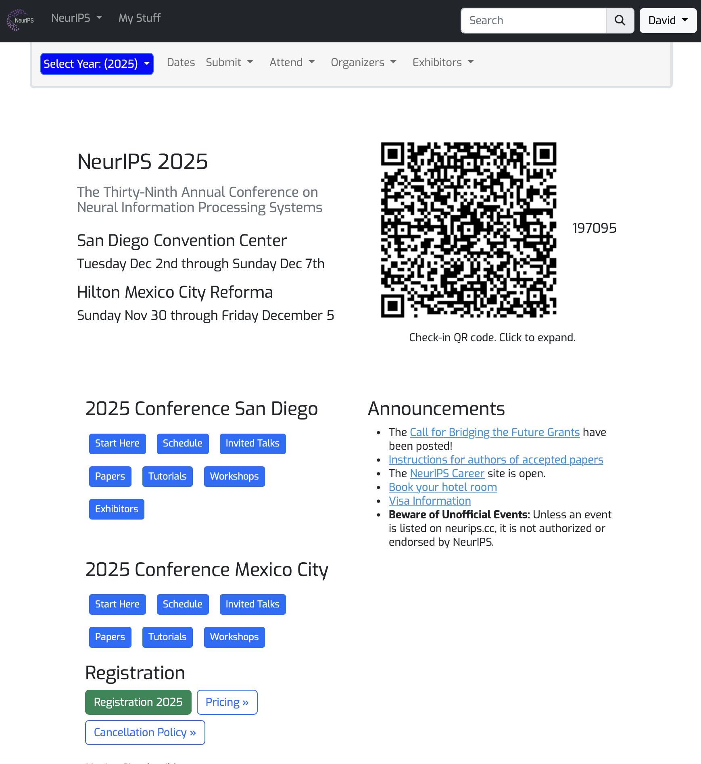
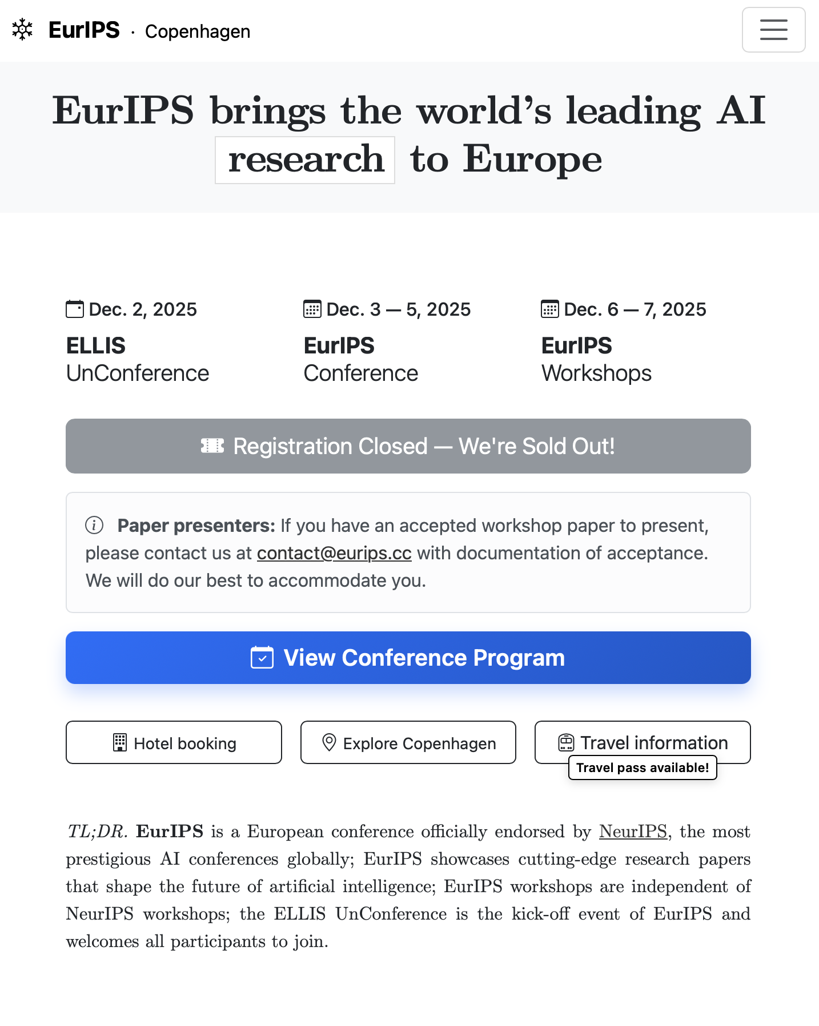
EuRIPS @ CopenHagen
Next EurIPS maybe more intergrated and in Paris

Slide 6
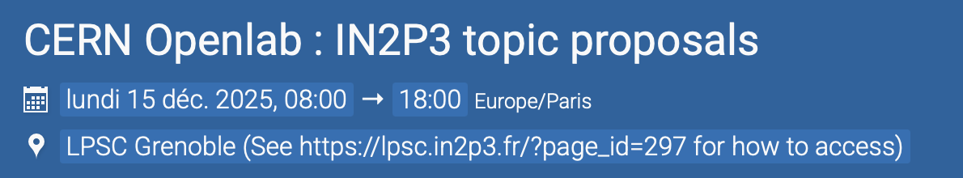
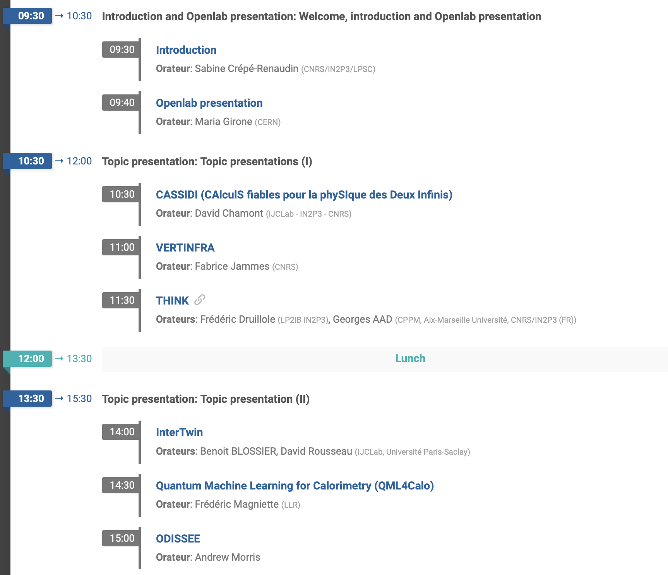

CERN OpenLab

