Slide 1










HiggsML Uncertainty Challenge
Wahid Bhimji, Paolo Calafiura, Ragansu Chakkappai, Po-Wen Chang, Yuan-Tang Chou, Sascha Diefenbacher, Jordan Dudley, Steven Farrell, Aishik Ghosh, Isabelle Guyon, Chris Harris, Shih-Chieh Hsu, Elham E Khoda, Benjamin Nachman, Peter Nugent, David Rousseau, Benjamin Thorne, Ihsan Ullah, Yulei Zhang
IN2P3/IRFU Machine Learning workshop 2025.
November 27th

Slide 2
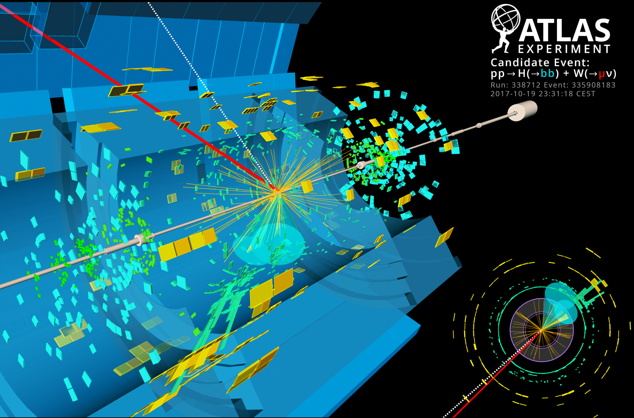
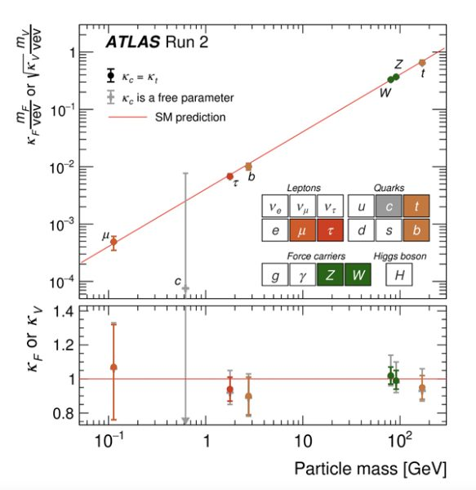
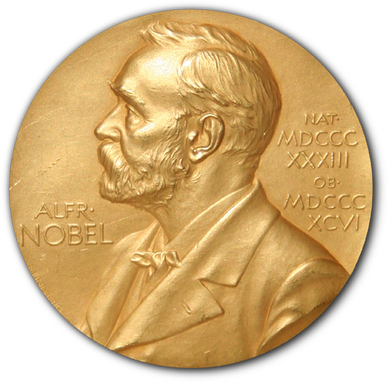

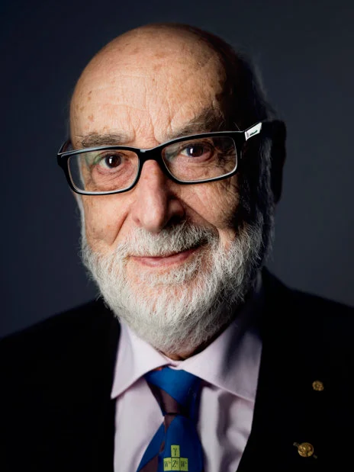
Higgs Boson
The Higgs mechanism give mass of fundamental particles
Proposed in 1964
Discovered in 2012 at ATLAS and CMS experiment in LHC
2013 Nobel Physics Prize
Peter W. Higgs
François Englert

Slide 3
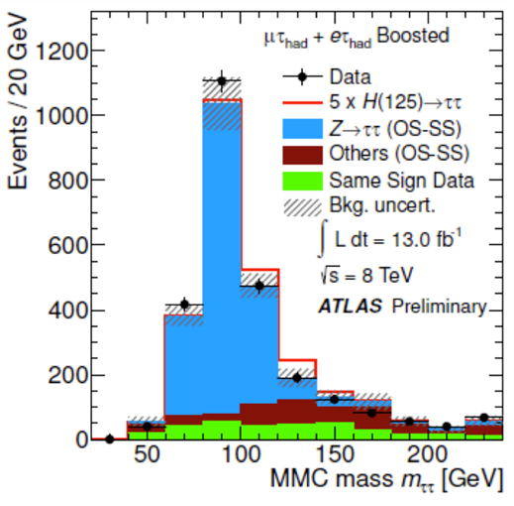
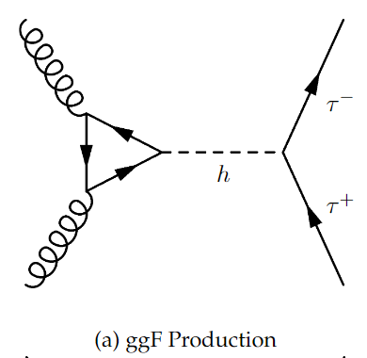
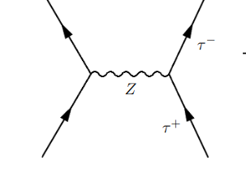
Introduction - H → ττ
Higgs to tau tau - interesting chanel to study
Measures higgs coupling to leptons
Tau lepton is unstable => decays to produce neutrinos

Slide 4
Introduction - ML in HEP
MET
τ_{had}
Neutrinos can’t be measured in ATLAS
Classification of Signal and background is difficult
Use of ML help us improve signal significance
τ_{lep}
Sub-leading jet
Leading jet

Slide 5
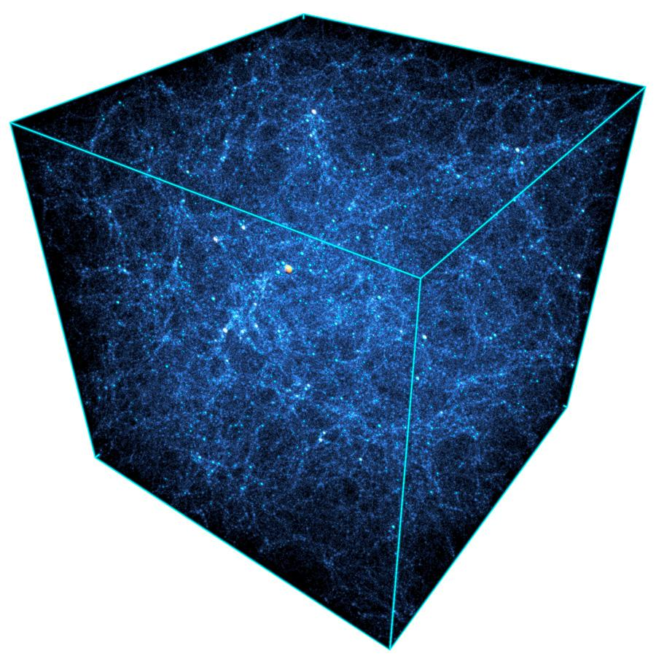
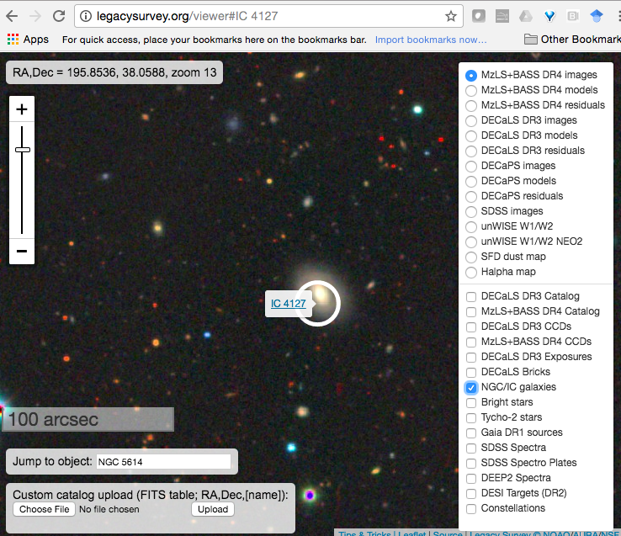
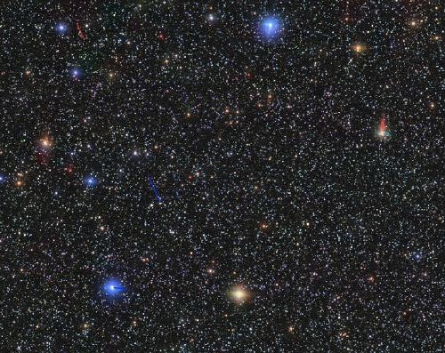
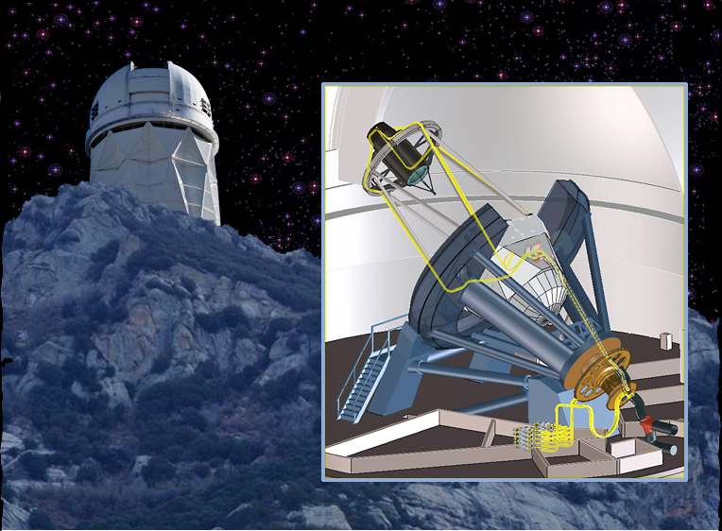
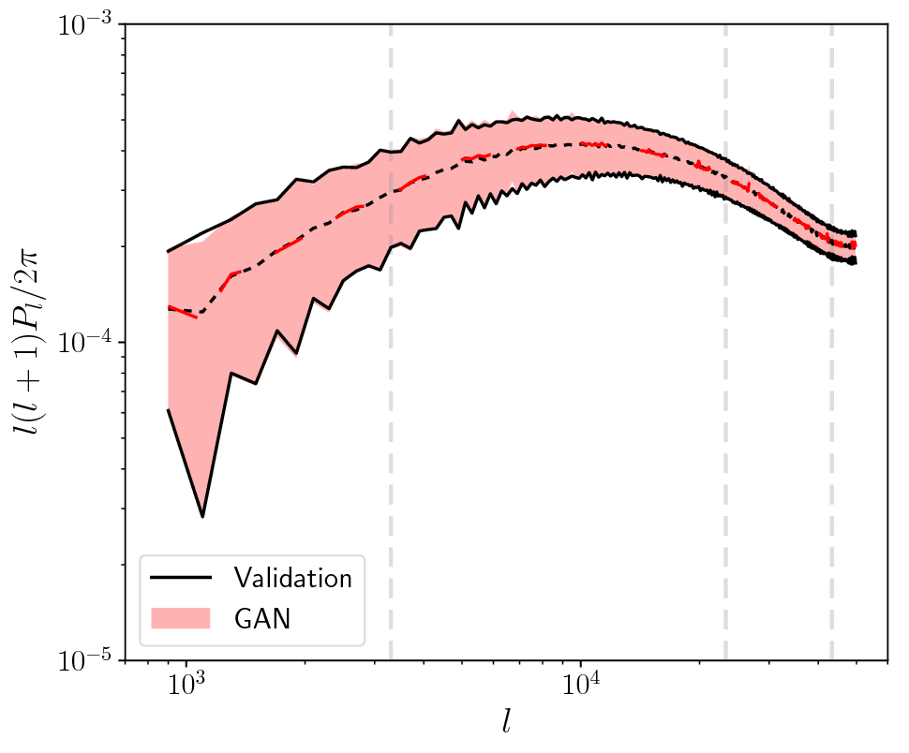
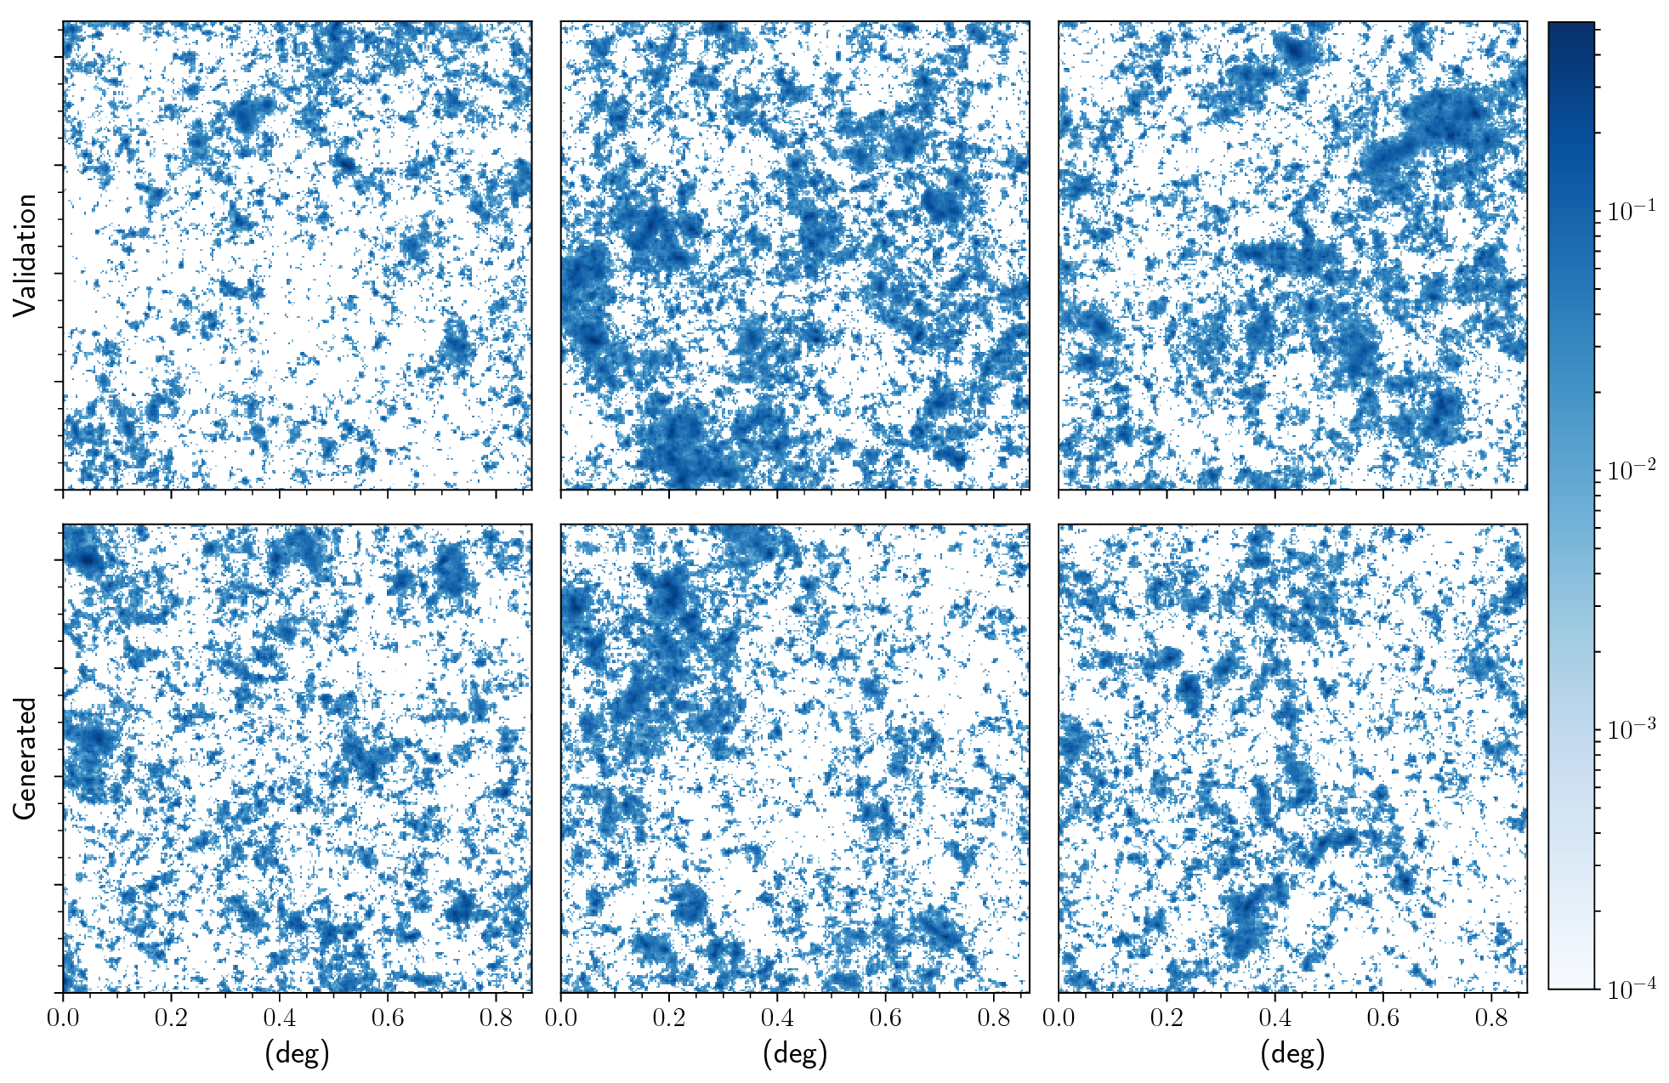
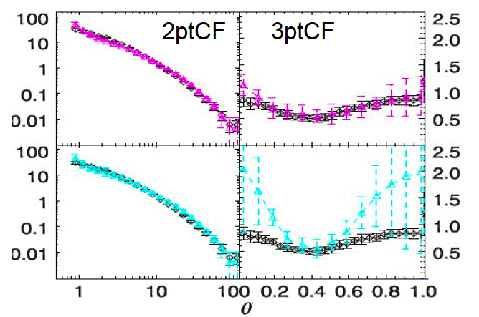
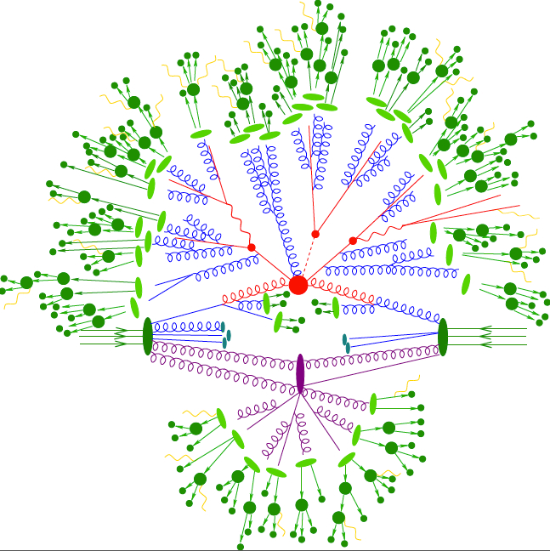
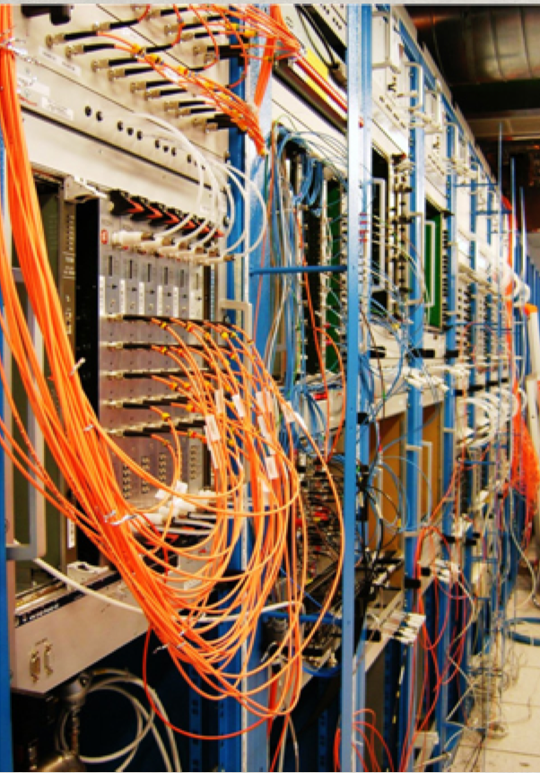
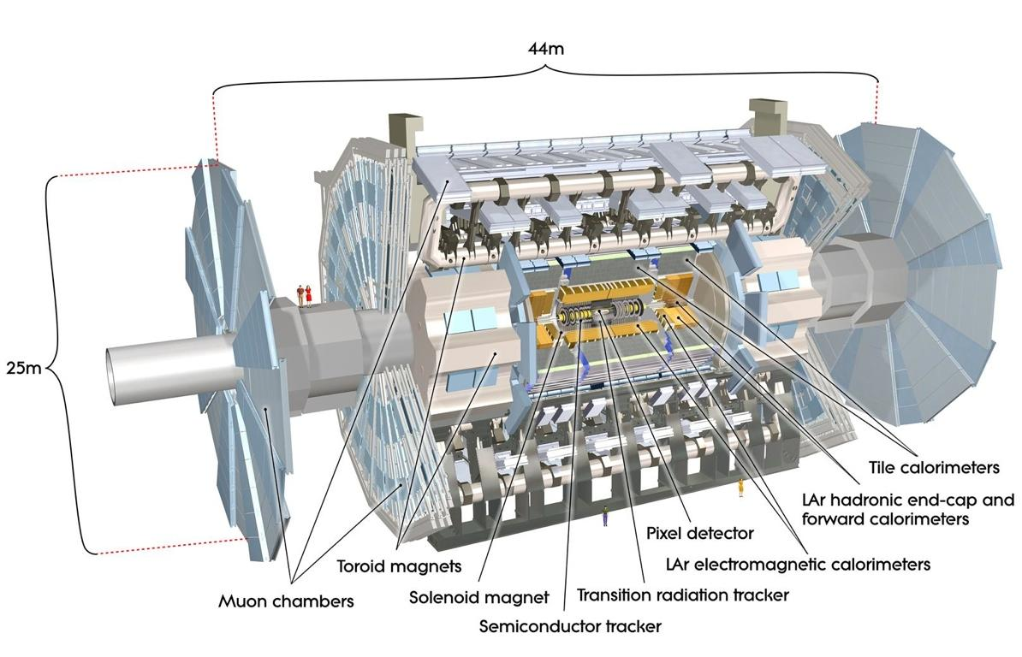
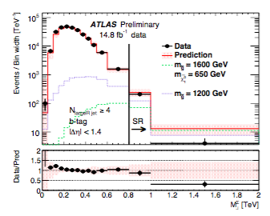
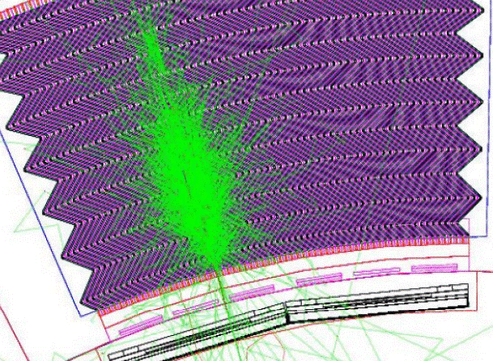
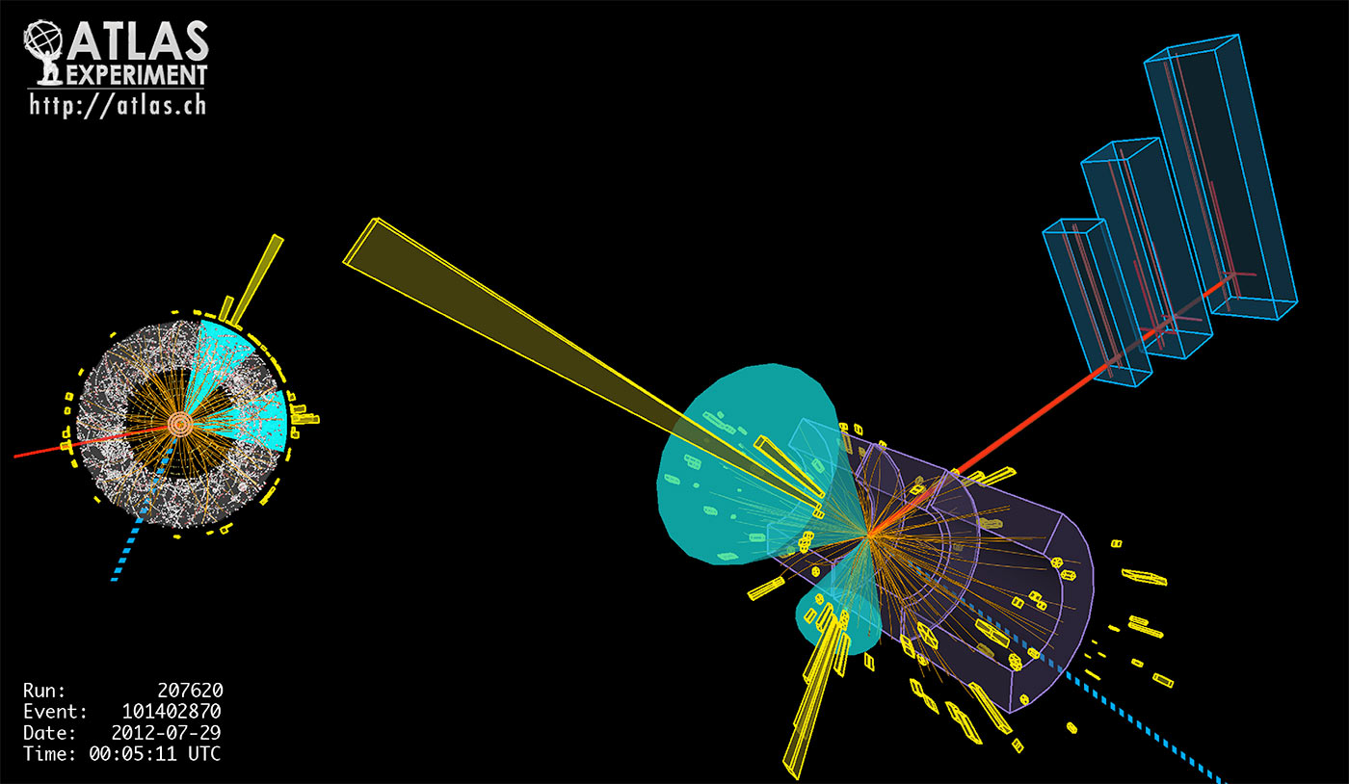
Bias and Uncertainty in Physics
Exp/Obs reconstruction
Differences between simulation and data can bias measurements

Slide 6

Bias and Uncertainty in ML in HEP
ML methods in HEP are often trained based on simulation which has estimated systematic uncertainties (“Z”)
These are then applied in data with the different detector state Z=?
Simulation with Z = 1.0
Data
with Z = ?
Apply
Train
Common baseline approach: Train classifier on nominal data (e.g. Z=1) and estimate uncertainties with alternate simulations. Shift Z and look at impact or perform full profile likelihood
Simulation
with Z = 0.95
Simulation with Z = 1.0
Simplistic estimate of uncertainty
Simulation
with Z = 1.05

Slide 7
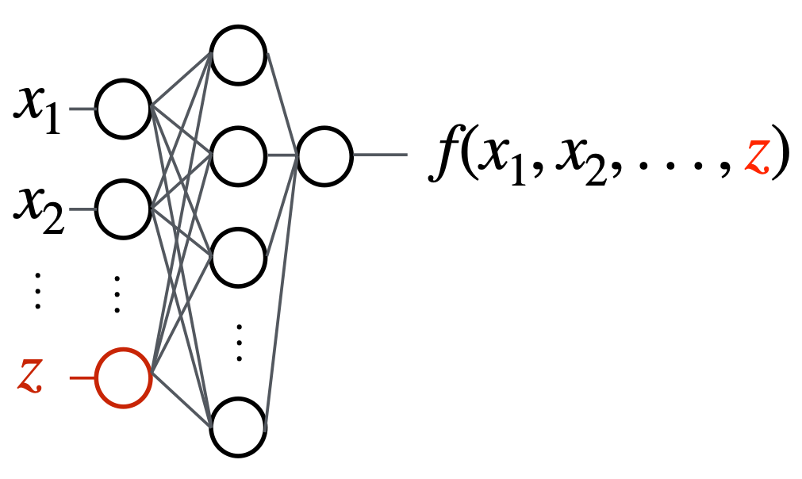
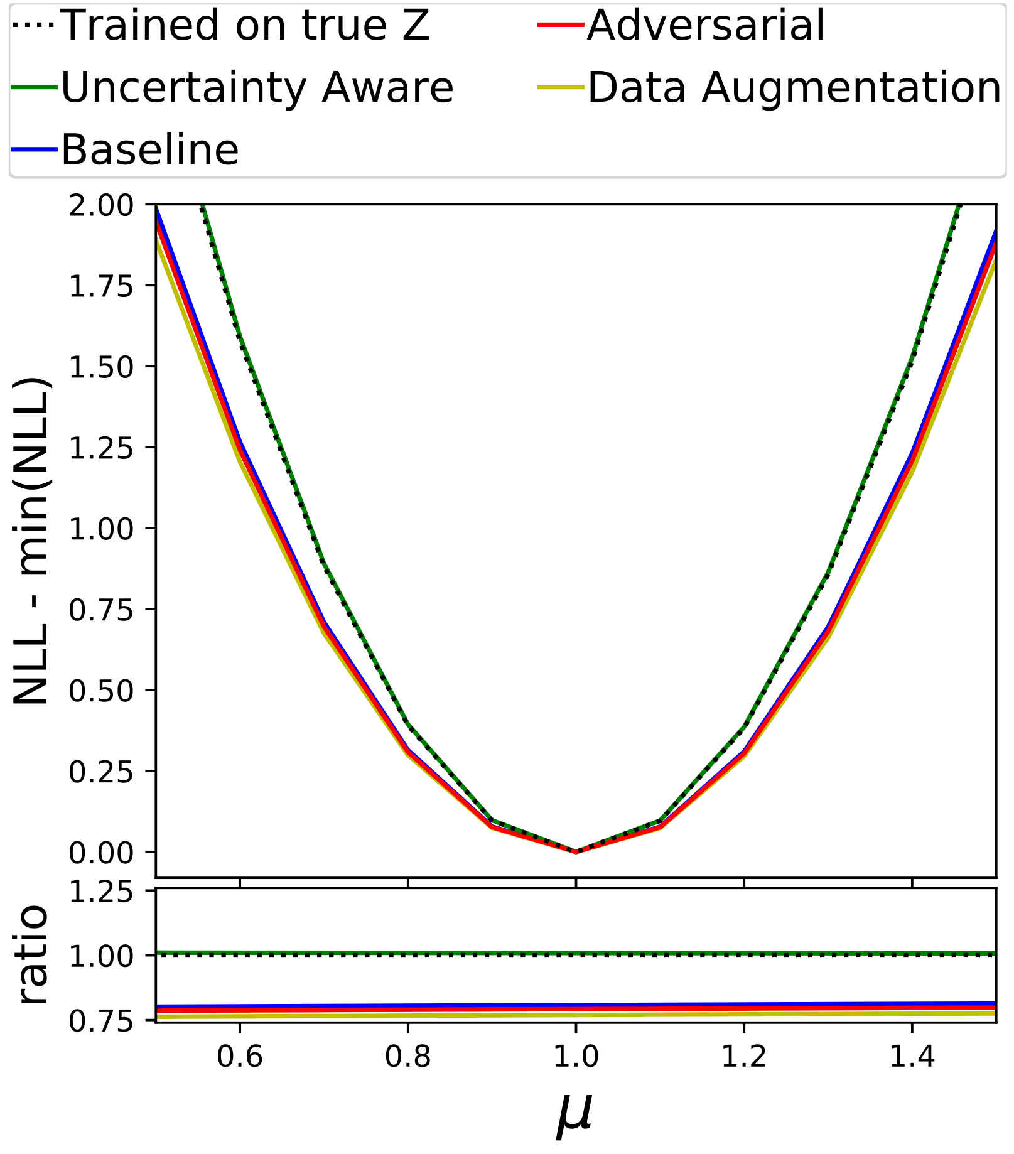
Landscape of Uncertainty Aware Learning
“pivot” Louppe, Kagan, Cranmer : arXiv:1611.01046
“Uncertainty-aware” approach of Ghosh, Nachman, Whiteson PhysRevD.104.056026
Parameterize classifier using Z
Measured on “Toy” 2D Gaussian Dataset and dataset from HiggsML Challenge modified to include systematic on tau-energy scale
Performs as well as classifier trained on true Z
Other novel approaches e.g. (not comprehensive)
Inferno: arxiv:1806.04743
Direct profile-likelihood: e.g. arxiv:2203.13079
(Neuro) Simulation Based Inference has to include Z: arXiv:1911.01429
Many Methods Developed But No Common BenchMark
Narrower is better
(Signal Strength)

Slide 8
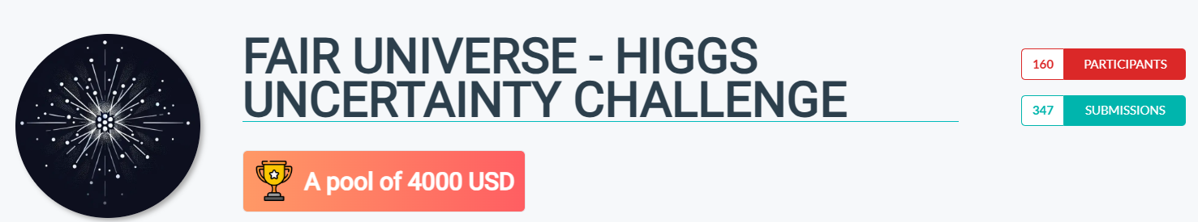
Fair Universe: HiggsML Uncertainty Challenge
Full HiggsML Uncertainty Challenge ran from September 2024 to March 2025
Accepted as NeurIPS competition 2024 (most important ML conference)
Dedicated workshop at NeurIPS 2024 at Vancouver
Final results presented in May 2025 at CERN(satellite event of IML - 2025)
Finally published in the Dataset and Benchmark track of NeurIPS 2025.

Slide 9


Fair Universe: HiggsML Uncertainty Challenge
 | 2014 | 2024
Data Source | ATLAS Open Data (Sample of real data) | New simulated dataset
Data Quantity | 800,000 | 340,000,000
Parameterized systematics | ❌ | 6 Systematics
Inference | Classification accuracy | Signal strength (𝜇) CI with pseudo-experiment
Metric | Z - Classification Significance | New metric aimed at CI Coverage

Slide 10
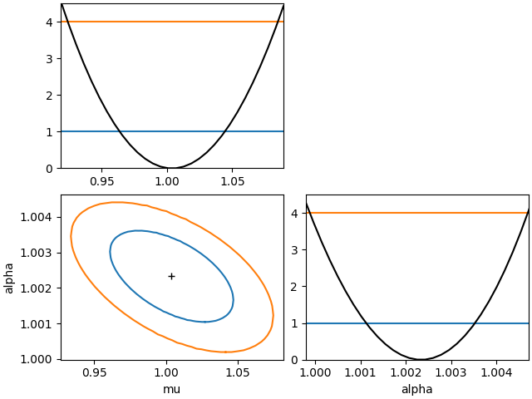

Challenge Objective
Participants submit code of their model
Trained Model must predict :
𝝁_{hat} : best mu estimate
[𝝁₁₆, 𝝁₈₄] : 68% Confidence Interval
Tests done on shifted dataset
Model giving the smallest Well Covering Confidence Interval Wins

Slide 11

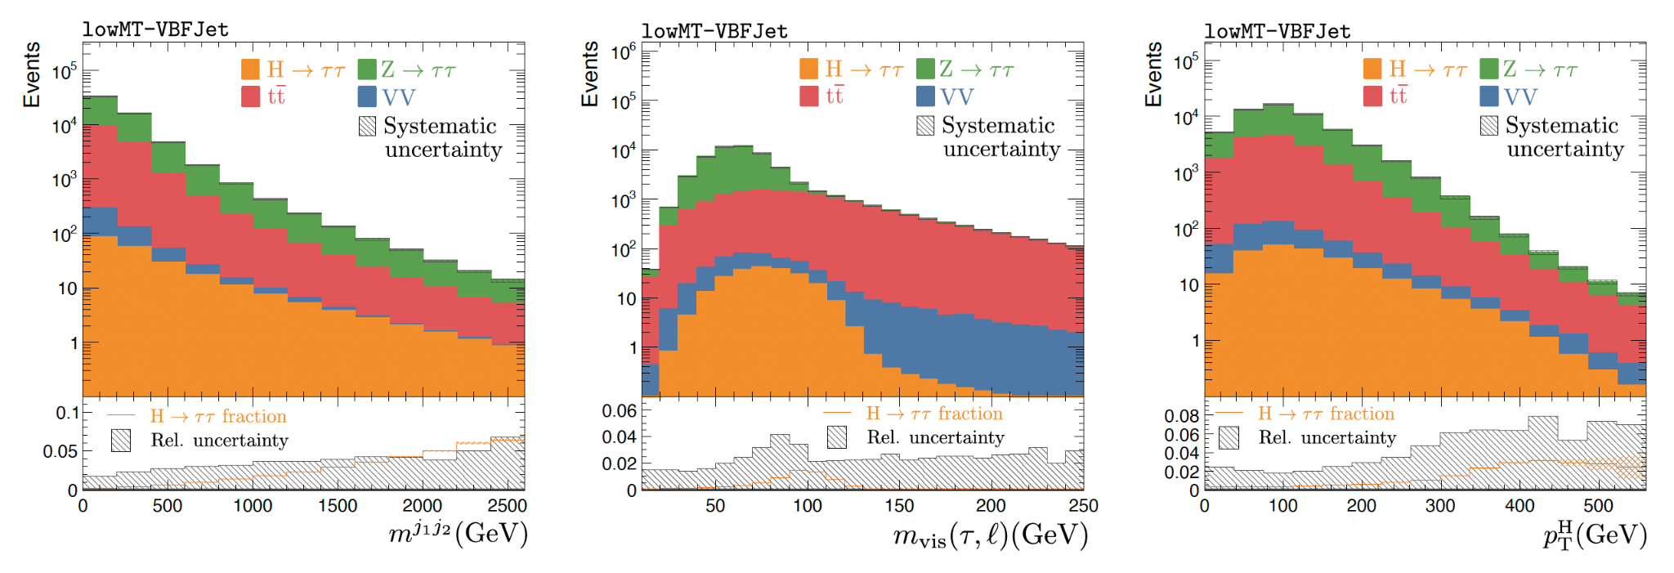
Challenge Dataset
Generated data with fast simulation with Pythia LO and Delphes detector simulation
Using the updated Delphes ATLAS card
Generated ~280 Million Events after initial cuts equivalent to 220 X 10fb-1
Data Organised into tabular form with 28 features per event.
Dataset permanently released on Zenodo in May 2025 for Future Benchmarks
https://zenodo.org/records/15131565

Slide 12
Challenge Datasets - Systematics
MET
Apply parameterized systematics (Nuisance Parameters) :
Feature distortions:
Tau Energy Scale (and correlated MET)
Jet Energy Scale (and correlated MET impact)
Additional randomised Soft MET
Event category normalisation
Background overall normalisation
Di-boson background normalisation
ttbar background normalisation
τ_{had}
l
Sub-leading jet
Leading jet

Slide 13
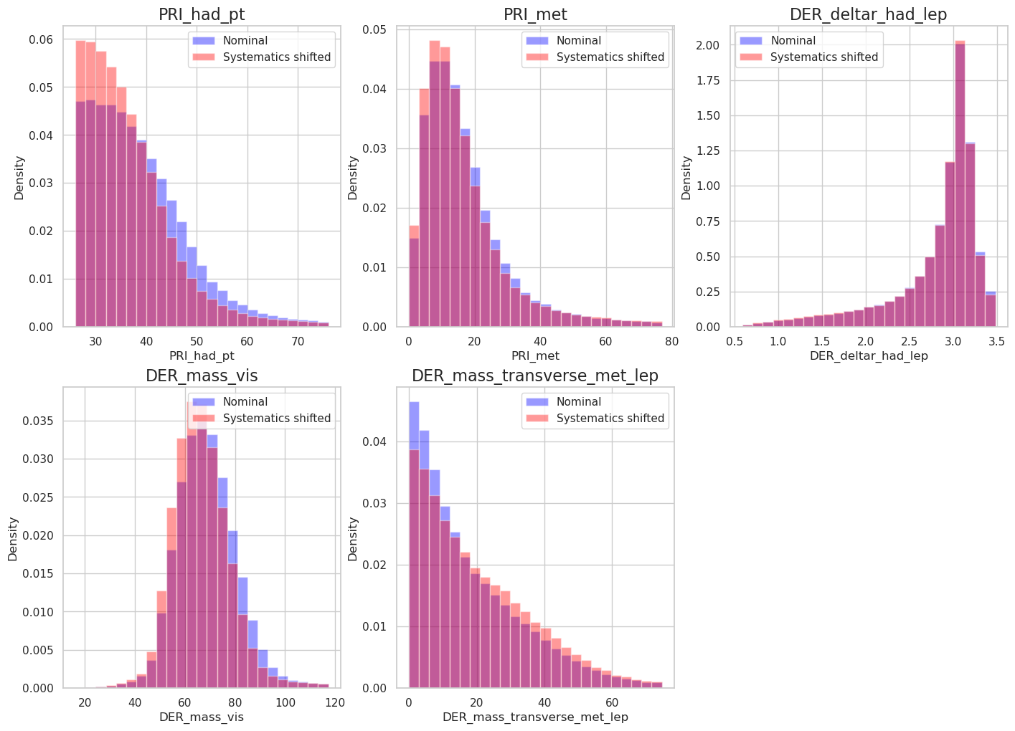
Tau Energy Scale Systematics Applied
Histogram between nominal (TES = 1) and shifted (TES = 0.9)
TES = 0.9, is an exaggeration, in practice it is sampled with a gaussian of 1 +/- 0.01

Slide 14
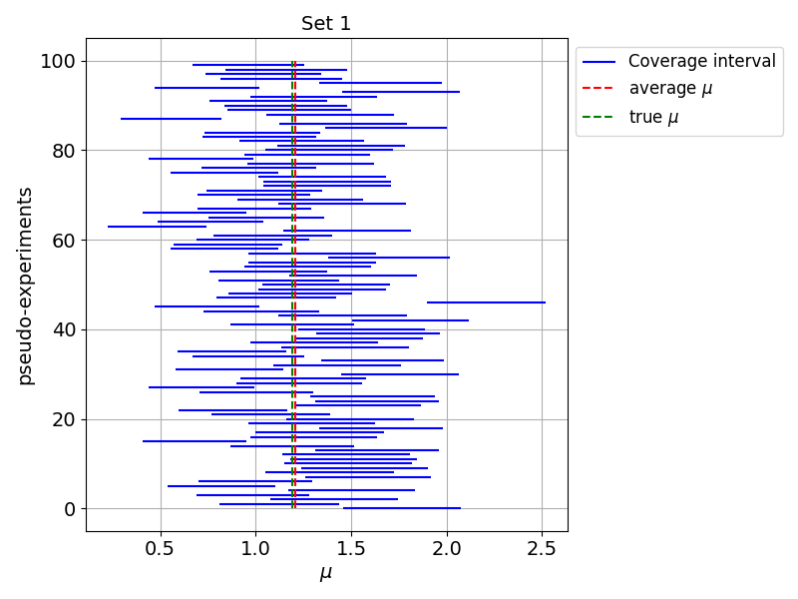
Coverage Evaluation
Form multiple pseudo-experiment test sets: different signal strengths (𝝁) and systematics
100𝝁 times 100 pseudo-experiments
Task: predict uncertainty interval [𝝁₁₆, 𝝁₈₄]
E.g. 68% quantile of likelihood or assume 1σ
100 pseudo experiments
Each with different systematics
100 sets each with different values of 𝜇
Notes:
Interval can also be used for cosmology basian setting

Slide 15
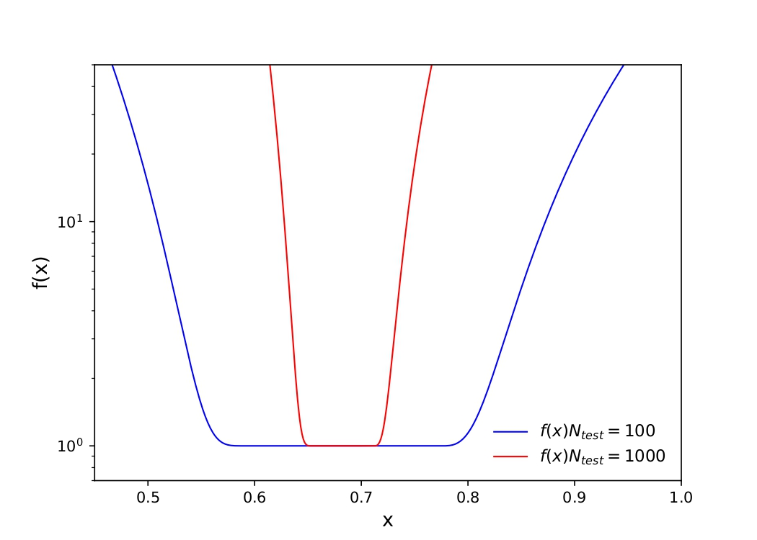
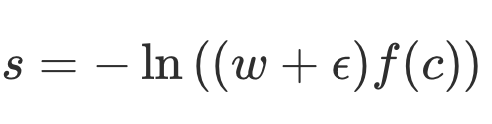
Coverage Evaluation
Form multiple pseudo-experiment test sets: different signal strengths (𝝁) and systematics
100𝝁 times 100 pseudo-experiments
Task: predict uncertainty interval [𝝁₁₆, 𝝁₈₄]
E.g. 68% quantile of likelihood or assume 1σ
Scoring formula
Mean width
Coverage penalty
Notes:
Interval can also be used for cosmology basian setting

Slide 16
Results

Slide 17

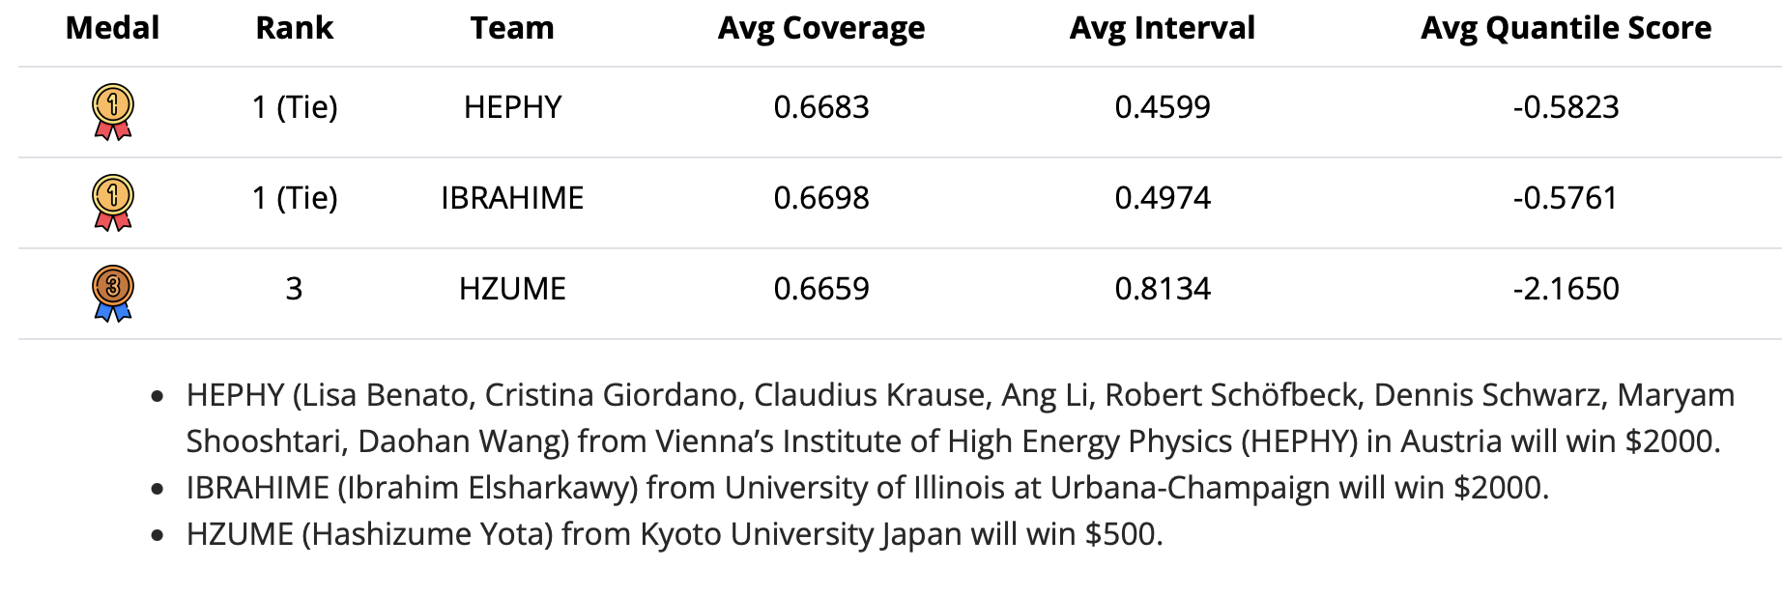
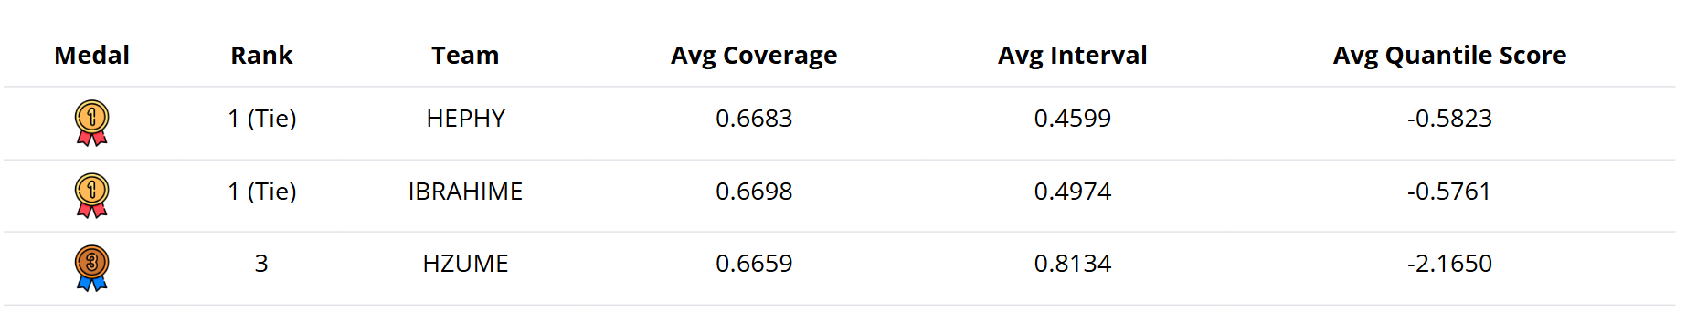
Winners
Notes:
Interval can also be used for cosmology basian setting

Slide 18









CONTRASTIVE NORMALIZING FLOWS
FOR UNCERTAINTY-AWARE PARAMETER ESTIMATION
IBRAHIM ELSHARKAWY
UNDER THE GUIDANCE OF PROF. YONI KAHN
arXiv link : https://arxiv.org/abs/2505.08709

Slide 19
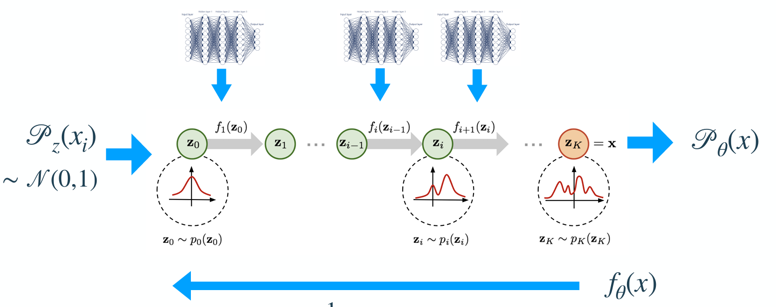
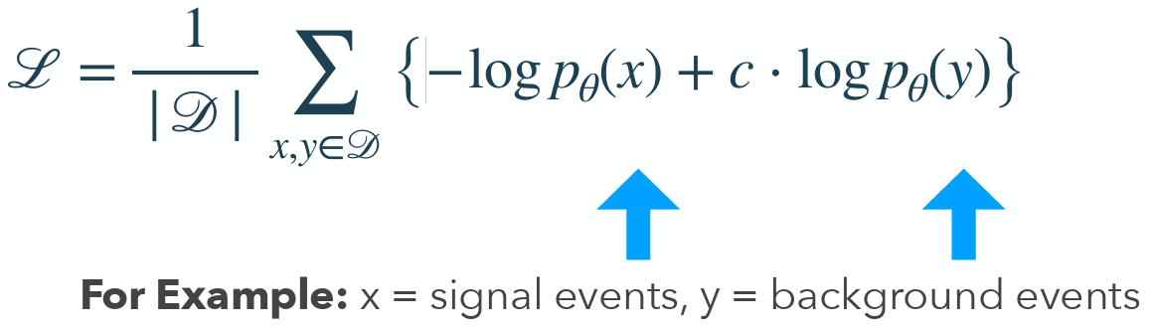
Contrastive Normalizing Flows
Hyper parameter
For tuning signal like vs Background like

Slide 20
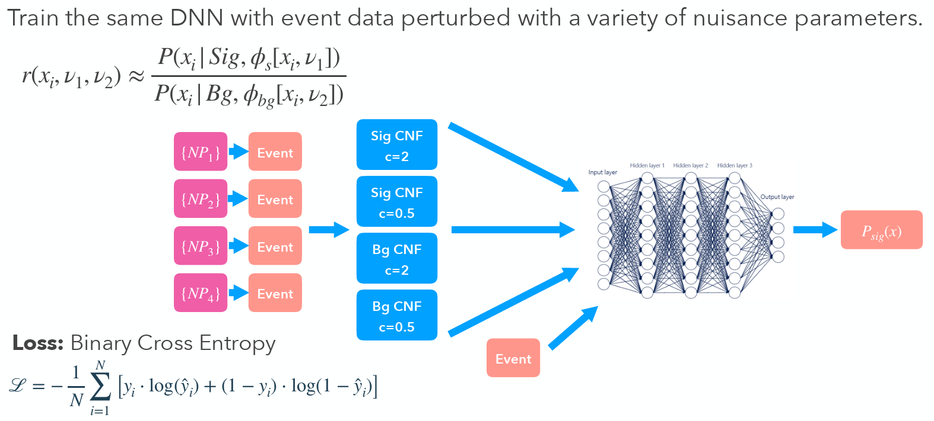
DNN Training with CNF
Score Histogram
and MLE
and 1-sigma Error Bars
Inverse Neyman Construction
Learn more at: https://arxiv.org/abs/2505.08709

Slide 21
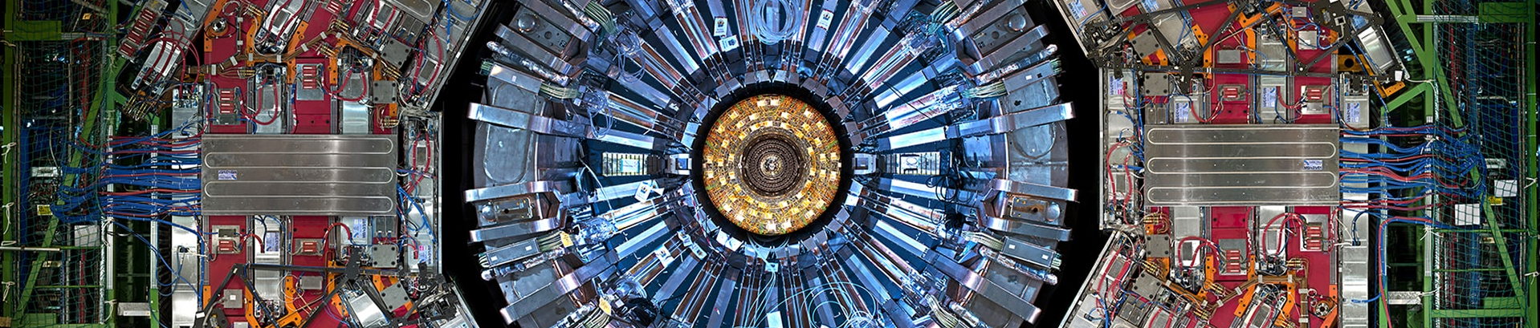

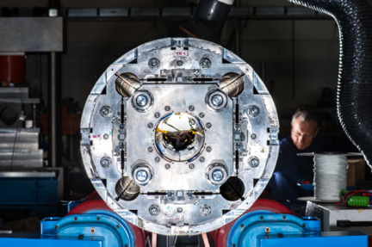
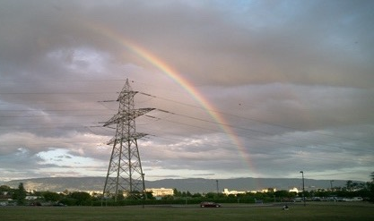
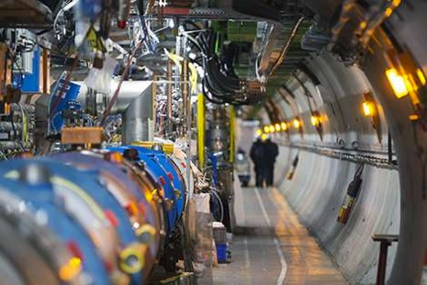
UNBINNED MEASUREMENTS WITH REFINABLE SYSTEMATICS
HEPHY Vienna
Lisa Benato, Cristina Giordano, Claudius Krause, Ang Li, Robert Schöfbeck, Dennis Schwarz, Maryam Shooshtari, Daohan Wang
Full tall at EPS-HEP : Accepted by Phys RevD

Slide 22
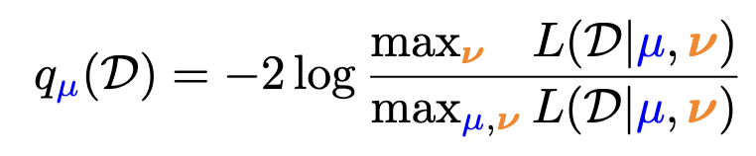
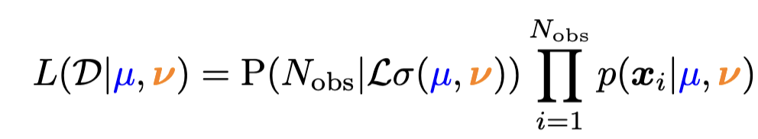
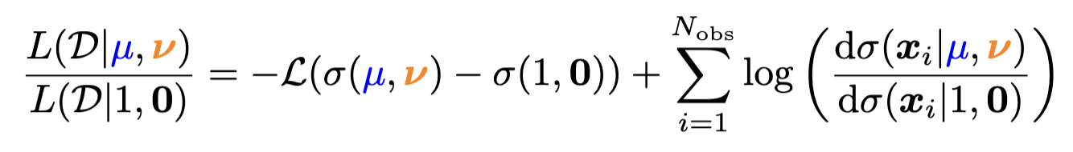

Test Statistic
Profile log-likelihood test statistic
Extended likelihood (for one selection)
… and its (log-) ratio
Need to evaluate the differential cross section ratio (DCR) and the inclusive cross section for new observed data ( 𝓓 ) and as a function of the model parameters.
(μ, 𝜈) = (1,0) is the “nominal” parameter point

Slide 23
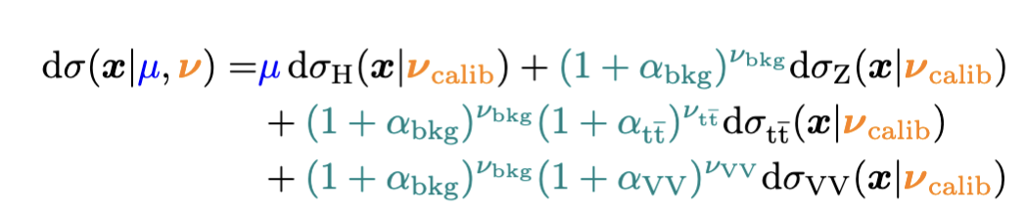
ML Surrogates
NB1: Still avalid measure
NB2: The additive ansatz facilitates to refinable modeling.
Form ratio wrt total nominal (a choice)
model systematics per-process (another choice)
ML surrogate for systematics
Likelihood-ratio trick

Slide 24
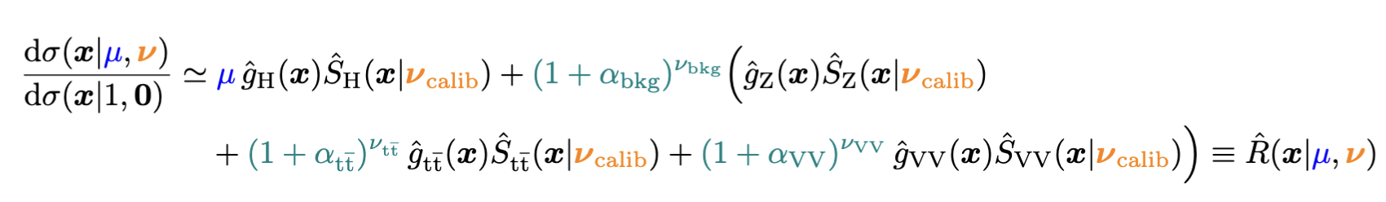
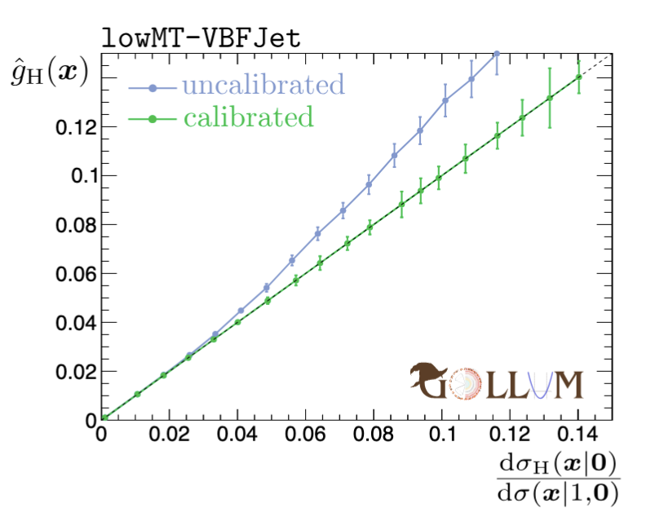
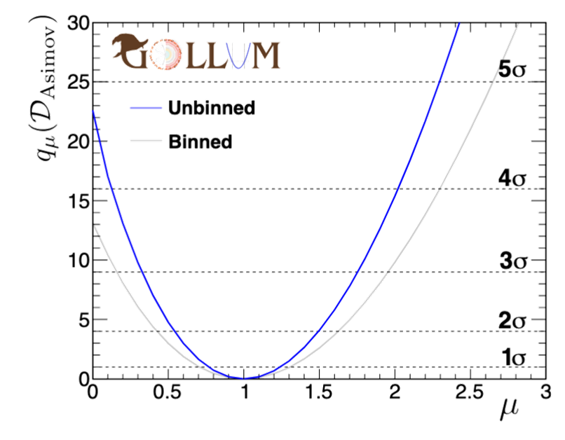
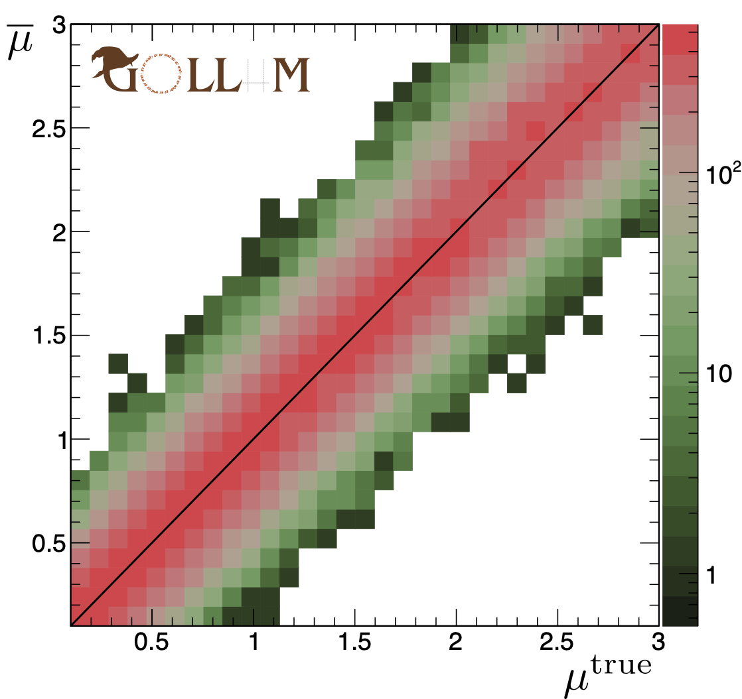
Building the NLL
Repeat for Z, tt, VV & put it together:
DCR =
= surrogate

Slide 25
Conclusion
AI challenge which addresses Systematic Uncertainty in HEP problem.
Large Public Data Set with ~280M Events (signal + background)
New Scoring to take Coverage and Confidence interval into account.
Large Computing Infrastructure as back_end
Exciting submissions which could be applied to future HEP analysis
New long term permanent benchmark will be launched Soon.
Help and feedback: #higgsml-uncertainty-challenge channel on the Fair Universe Slack
Ongoing information Google Group: Fair-Universe-Announcements
Collaborations, questions, comments: fair-universe@lbl.gov

Slide 26
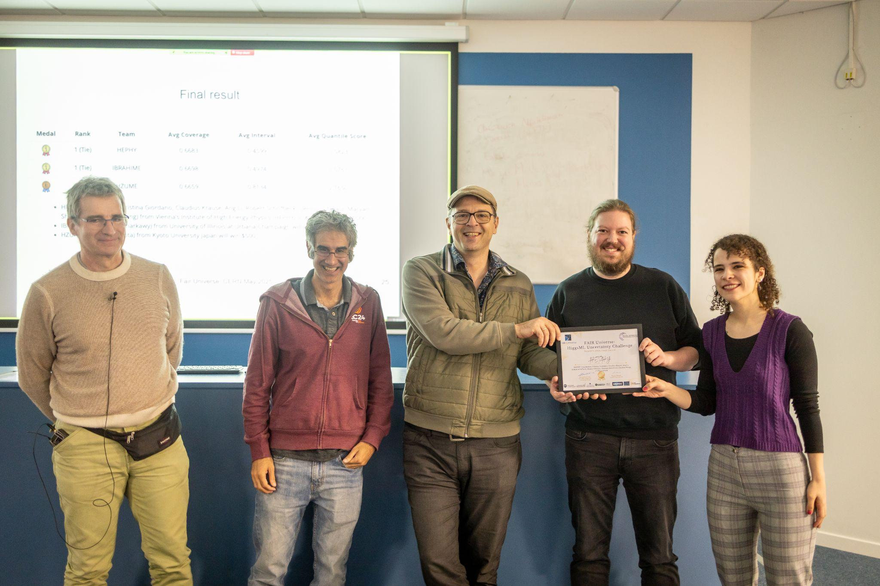
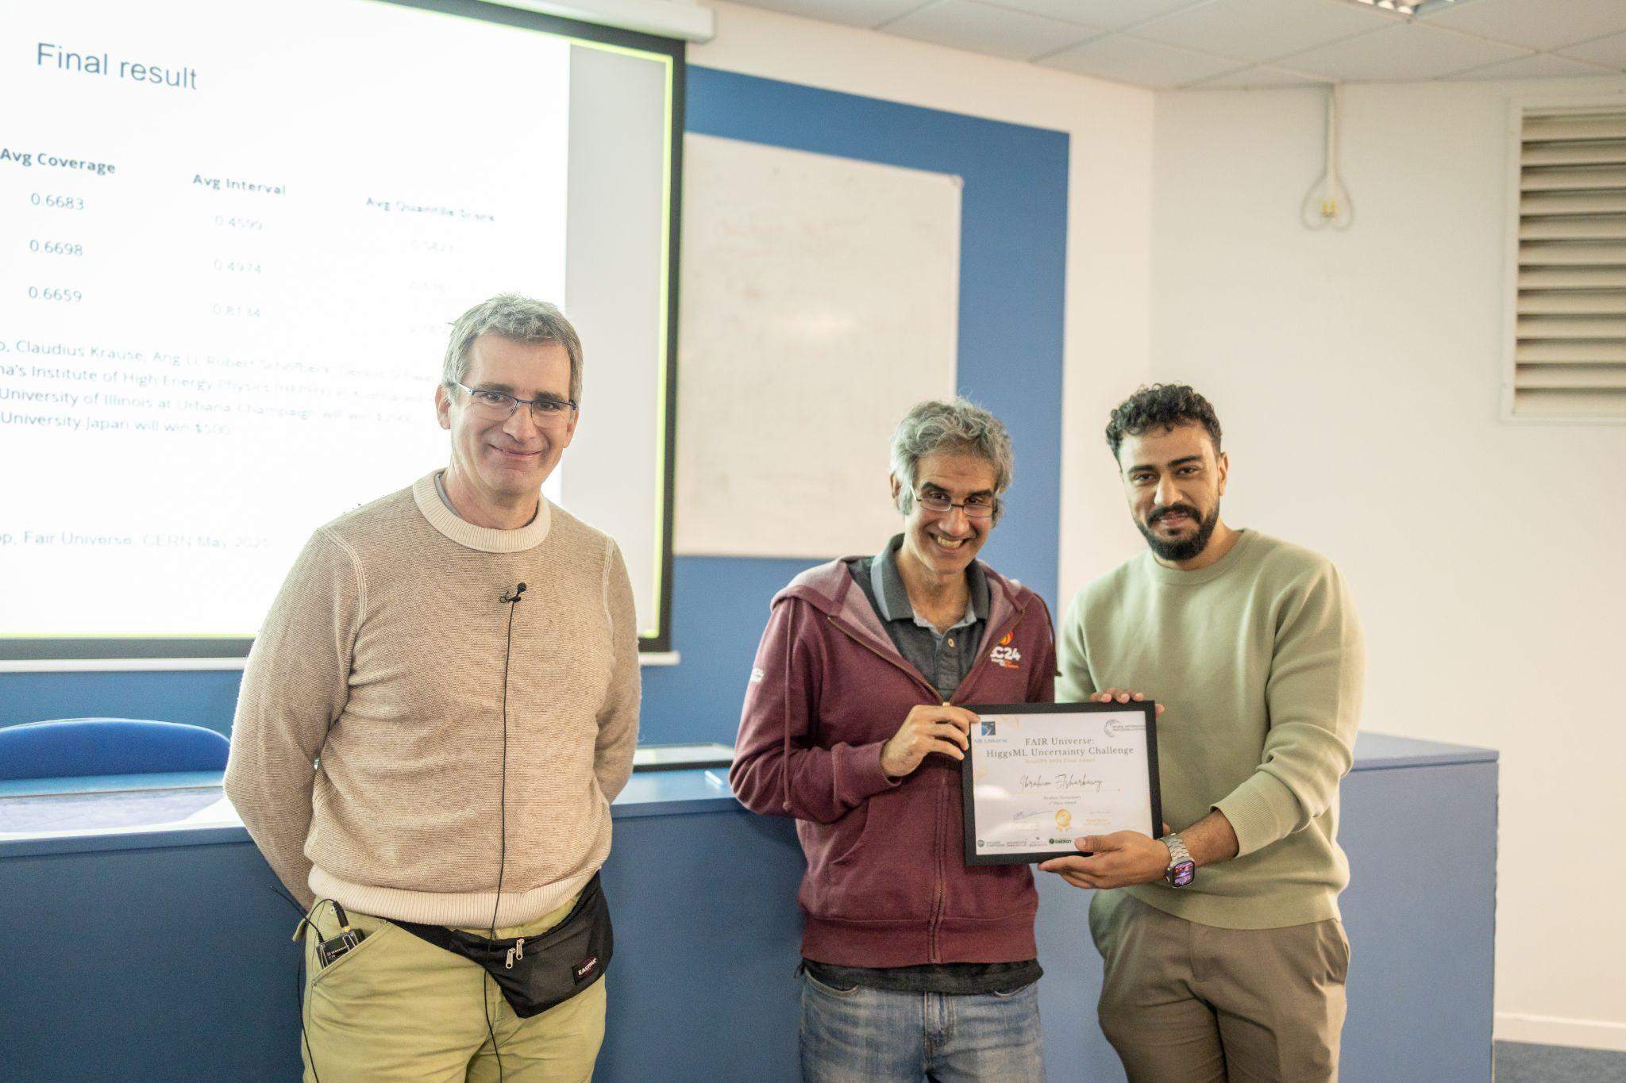
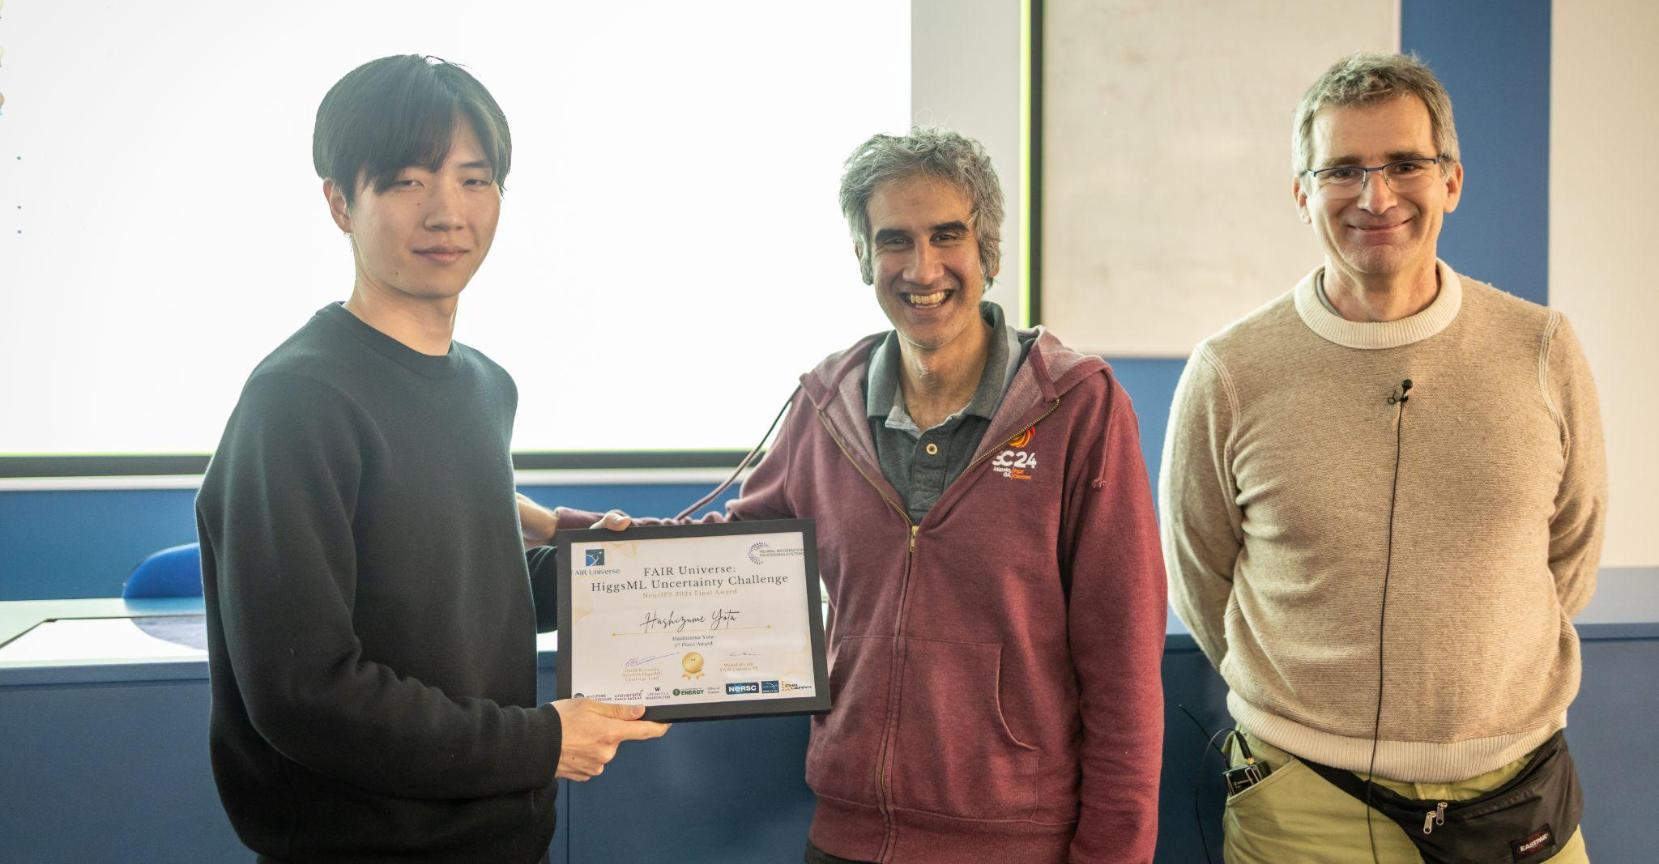
Thank you for your attention!

Slide 27
Back-up

Slide 28
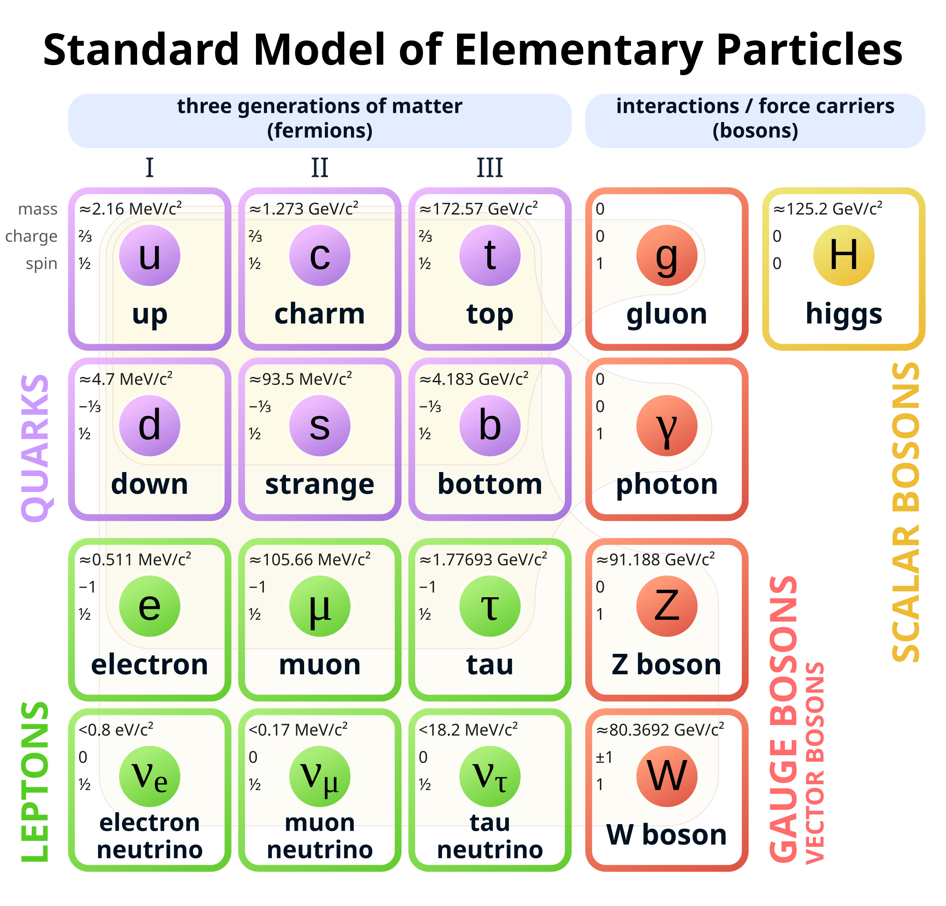
The Standard Model of Particle Physics
Bosons: 0- or 1-spin
Gauge bosons 🡨 mediate interactions
Higgs boson 🡨 mass term for fermions
Fermions: ½-spin
Quarks 🡨 Strong (and weak) force
Leptons 🡨 Weak force
Notes:
Yukawa coupling of fermions to the Higgs field is proportional to their mass

Slide 29
Background on Fair Universe Project
3 year US Dept. of Energy, AI for HEP project. Aims to:
Provide an open, large-compute-scale AI ecosystem for sharing datasets, training large models, fine-tuning those models, and hosting challenges and benchmarks.
Organize a challenge series, progressively rolling in tasks of increasing difficulty, based on novel datasets.
Tasks will focus on measuring and minimizing the effects of systematic uncertainties in HEP (particle physics and cosmology).
This funding went to LBL, NERSC, U Washington, and Chalearn (Isabelle Guyon's Non-Profit US Organisation).

Slide 30



Uncertainty Quantification Metric
Interval width (w) averaged over N test sets
Coverage (c): fraction of time 𝝁 is contained
Combined using a coverage function f(x):
N dependance for equivalent ideal coverage
Penalizes undercoverage more
Final score (s) designed to avoid large values or gaming
See also Sascha Diefenbacher’s AISSAI Workshop presentation
Notes:
negative and log to avoid large scores add an epsilon to avoid returning mu_84 = mu_16

Slide 31






Competition Flow
Phase 1
Phase 2
Get Public Data
Train model
Compete with other best submissions and win the competition
Make sure to not re-train in fit function
Prepare zip with model.py and pre-trained model
Submit your model to the competition website
Leaderboard is updated once a day
Best submission is taken to Phase 2
Repeat till phase ends

Slide 32

Final evaluation on 1000 x 100 p-e

Slide 33



Final evaluation on 1000 x 100 p-e
Sampled 10,000 times (with replacement) 100 trial of 100 pe each
Computed the Interval, Coverage and Quantile Score for each trial
Analysed the results.
Did NOT find enough precision to separate HEPHY’s and Ibrahim’s models
Declared a Tie.

Slide 34
Large-compute-scale AI ecosystem … hosting challenges and benchmarks.

Slide 35


Codabench Platform
Codabench - open source platform for AI benchmarks and challenges
Originally (CodaLab) Microsoft/Stanford now a Paris-Saclay/LISN led community
> 600 challenges since 2013
Completely open-ended competition design.
Allows code submission as well as results e.g. for evaluation timing or reproducibility
Also data-centric AI “inverted competitions”
Queues for evaluation can run on diverse compute resources
Platform itself can be deployed on different compute resources
Ranked best challenge platform for ML by ML contests
Notes:
Also easy data-centric AI “inverted competitions” for running of AI models on different datasets

Slide 36


Fair Universe Platform:
Codabench-NERSC integration

Slide 37

Basic Algorithm
Divide data into train_set and holdout_set
Use train_set to Train the simple dense NN
Define S_i and B_i : predicted score bin content
Construct for S_i (𝛂) and B_i(𝛂) functions from holdout_set
Combine define Binned Negative Log Likelihood function as function of NPs and 𝝁
For Each pseudo experiment
Predict score for pseudo experiment
Use Minuit to find value of mu, sigma_mu and NP
Returns
mu_hat
p16 = mu - sigma_mu
p84 = mu + sigma_mu

Slide 38
NN with L2 regularization using PyTorch
PyTorch NN Classifier is Trained to distinguish Signal (Higgs) from Background (Z)
32 features,
Architecture
3 Hidden layers with 100 nodes
1 Output node
ReLU Activation between layers
L2 Regularization during training
Model return score between 0 (background) and 1(signal),
Input layer
Hidden layer
Output layer

Slide 39



Parameterisation of S(𝛼)
With the help of the holdout_set for we get values of S and B for each NP in each bin.
A polynomial function is used to fit them. This function is later used in the NLL formalism

Slide 40




Parameterisation of B(alpha)

Slide 41

Profile μ and 𝛼 simultaneously
L here is the likelihood estimator which depends on μ and 𝛼, where 𝛼 is a vector of 5 NP thus the μ at which L is maximum or t is minimum is the predicted μ,

Slide 42

Analysis in Particle Physics
Adapted from: R. Winterhalder

Slide 43
Bias and Uncertainty in Physics
Calibration
Systematic uncertainties
Event generation
Jet tagging
Adapted from: R. Winterhalder
Differences between simulation and data can bias measurements

Slide 44
Bias and Uncertainty in Physics
Exp/Obs reconstruction
Differences between simulation and data can bias measurements

Slide 45

3rd Place Solution
Decision-Tree Aggregated Features
and Hybrid Bin-Classifier/Quantile-Regressor
Yota Hashizume (hzume)

Slide 46

Overview
2-stage, GPU-free GBDT-based model
First stage
Aggregated features
Used 2 models (①,②)
Second stage
Estimate 68% confidence interval by using aggregated features
Used 2 models (③,④) and merged their outputs
https://indico.cern.ch/event/1523250/contributions/6456344/attachments/3070079/5431138/higgsml-3rd-place.pdf

