Slide 1
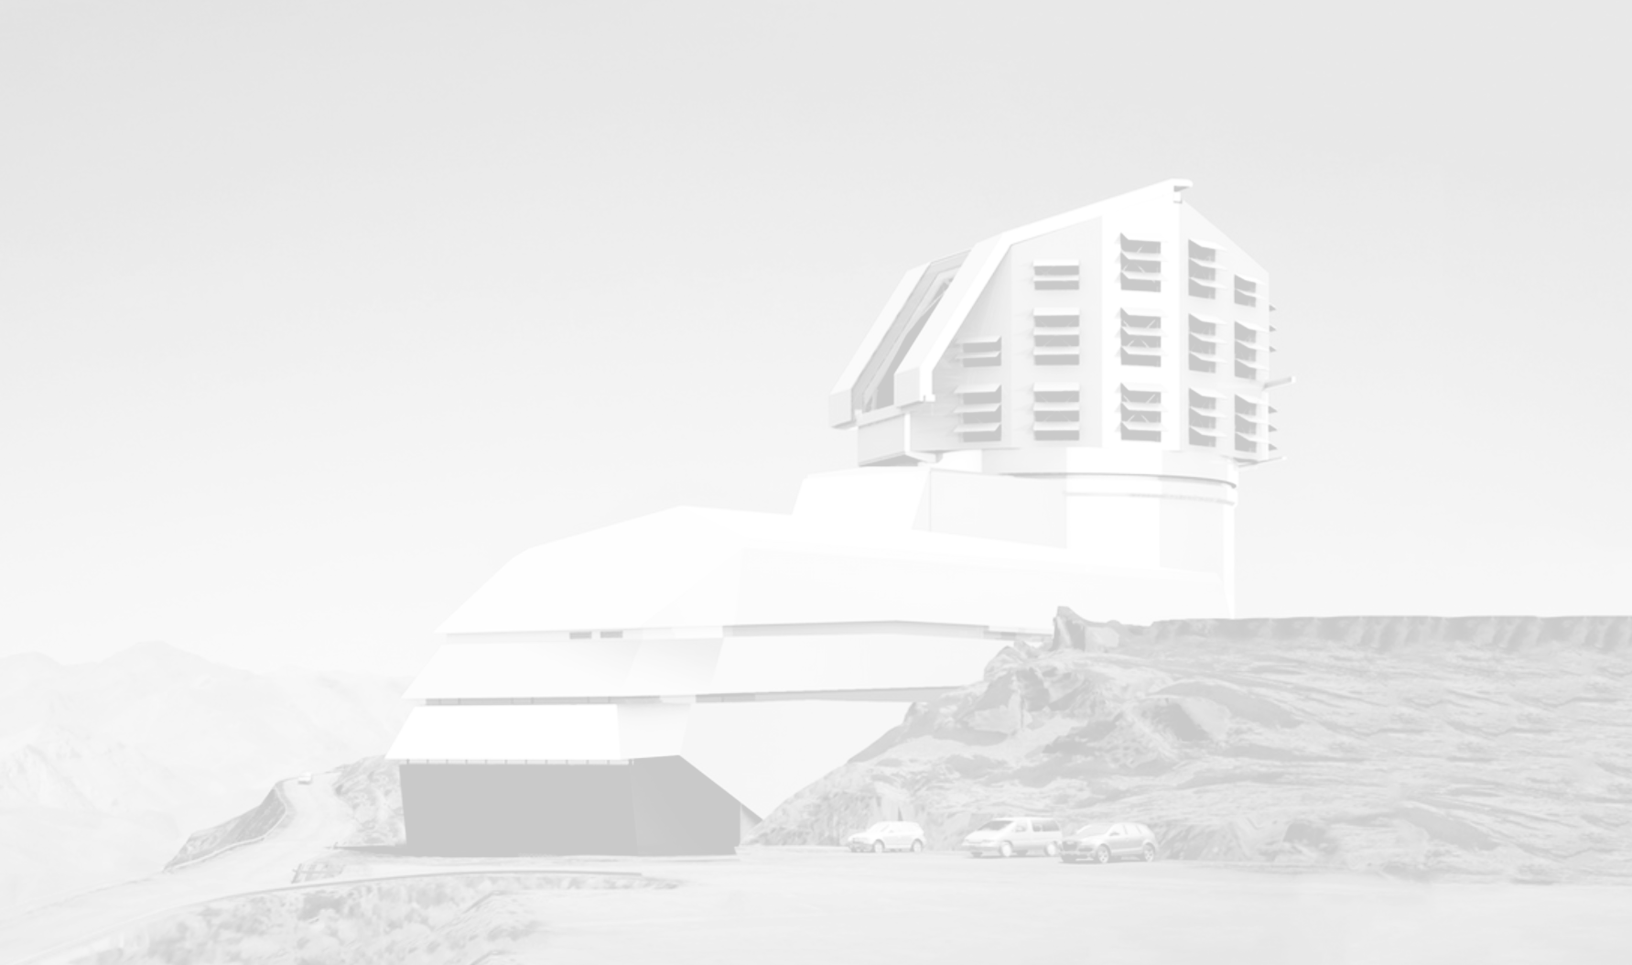



Probabilistic inference of galaxy properties using multi-modal variational autoencoders in the era of LSST
Kirill Grishin
Eric Aubourg, Cécile Roucelle, Cyrille Rosset
IN2P3/IRFU ML workshop, Caen

Slide 2
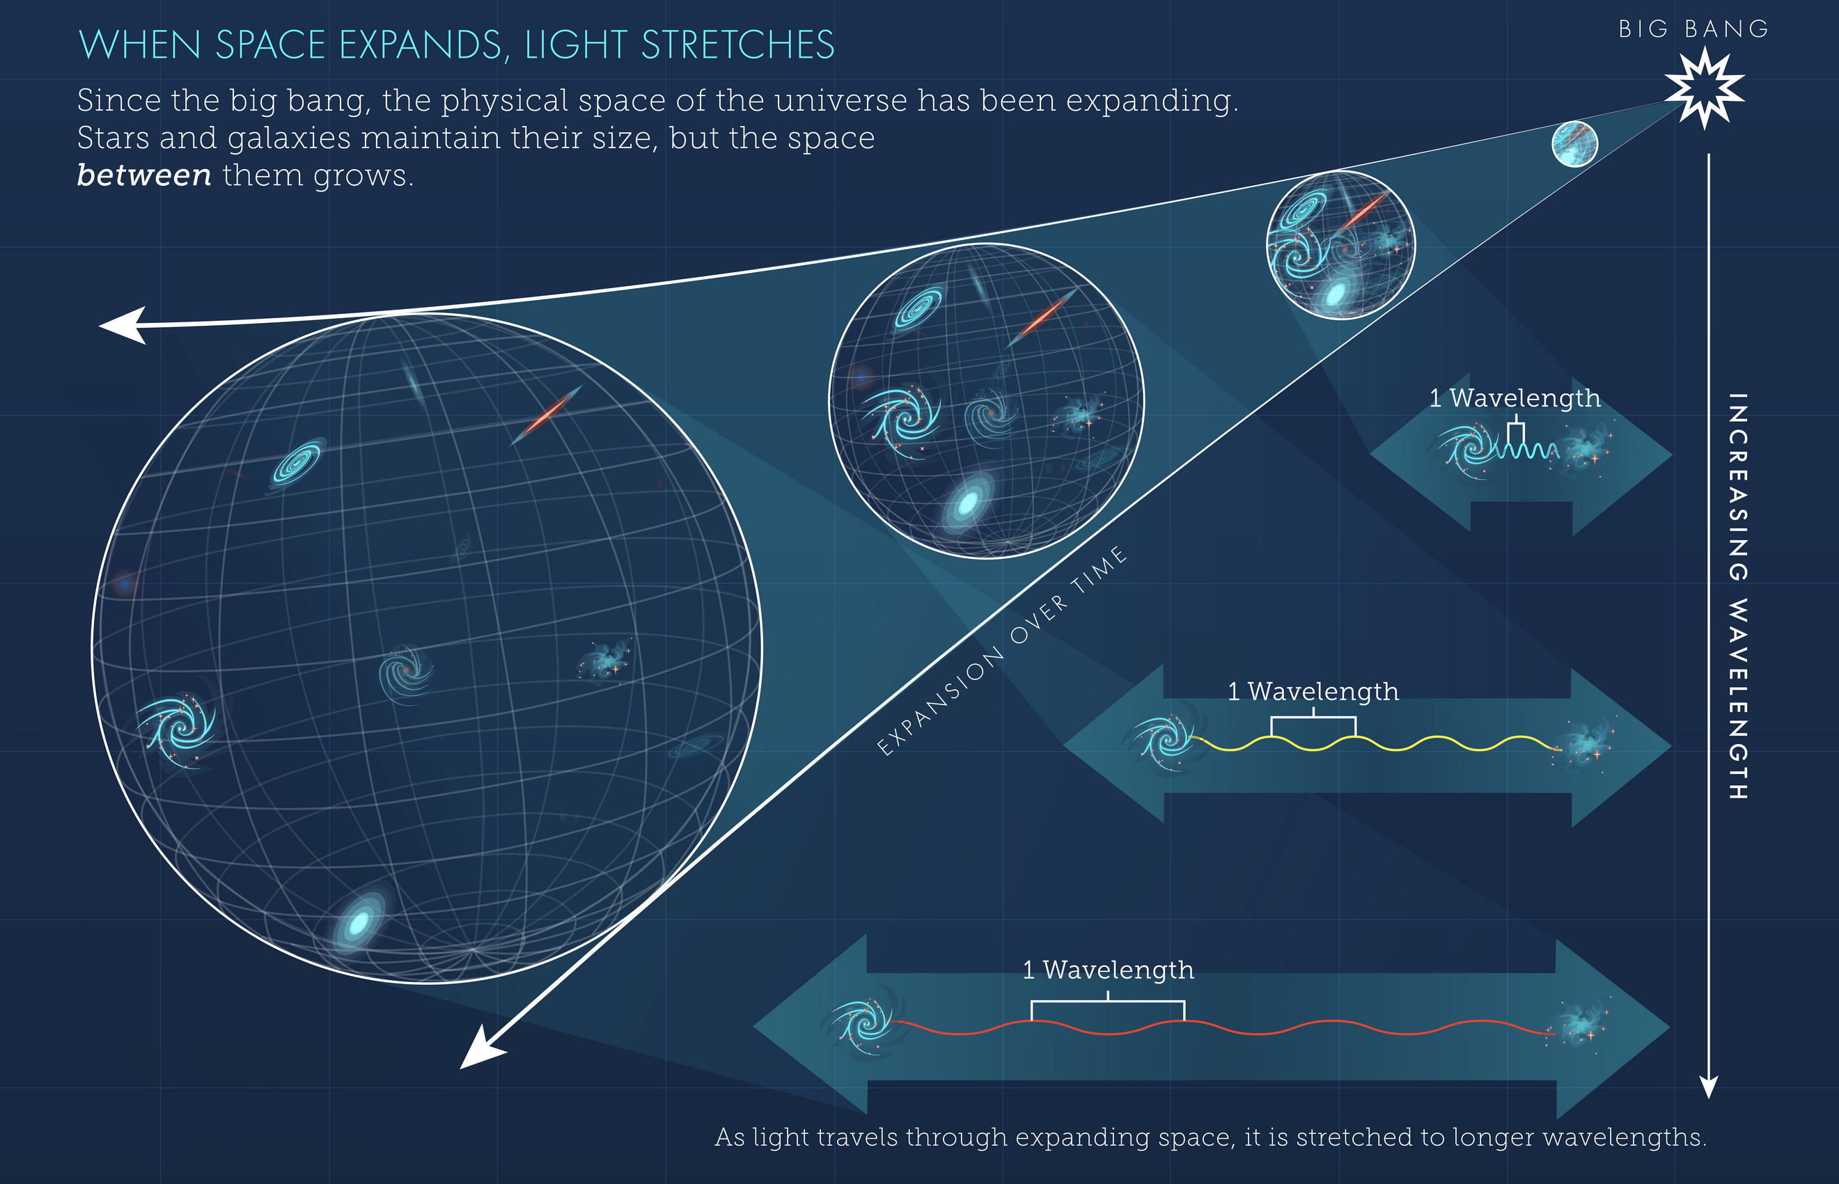
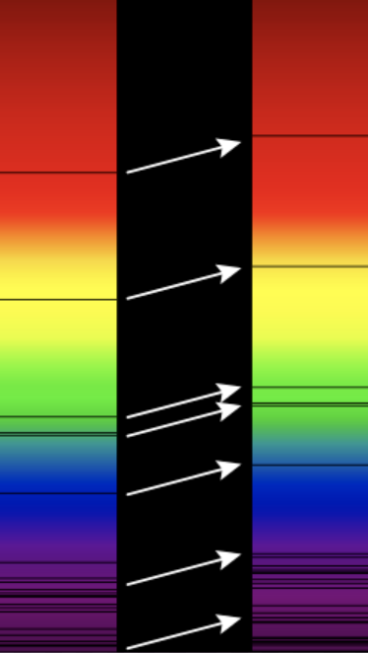
What do we measure?
3D Distribution of galaxies encodes the cosmological parameters
Our primary goal is to measure the redshift of galaxies – a measure of its distance to us.

Slide 3
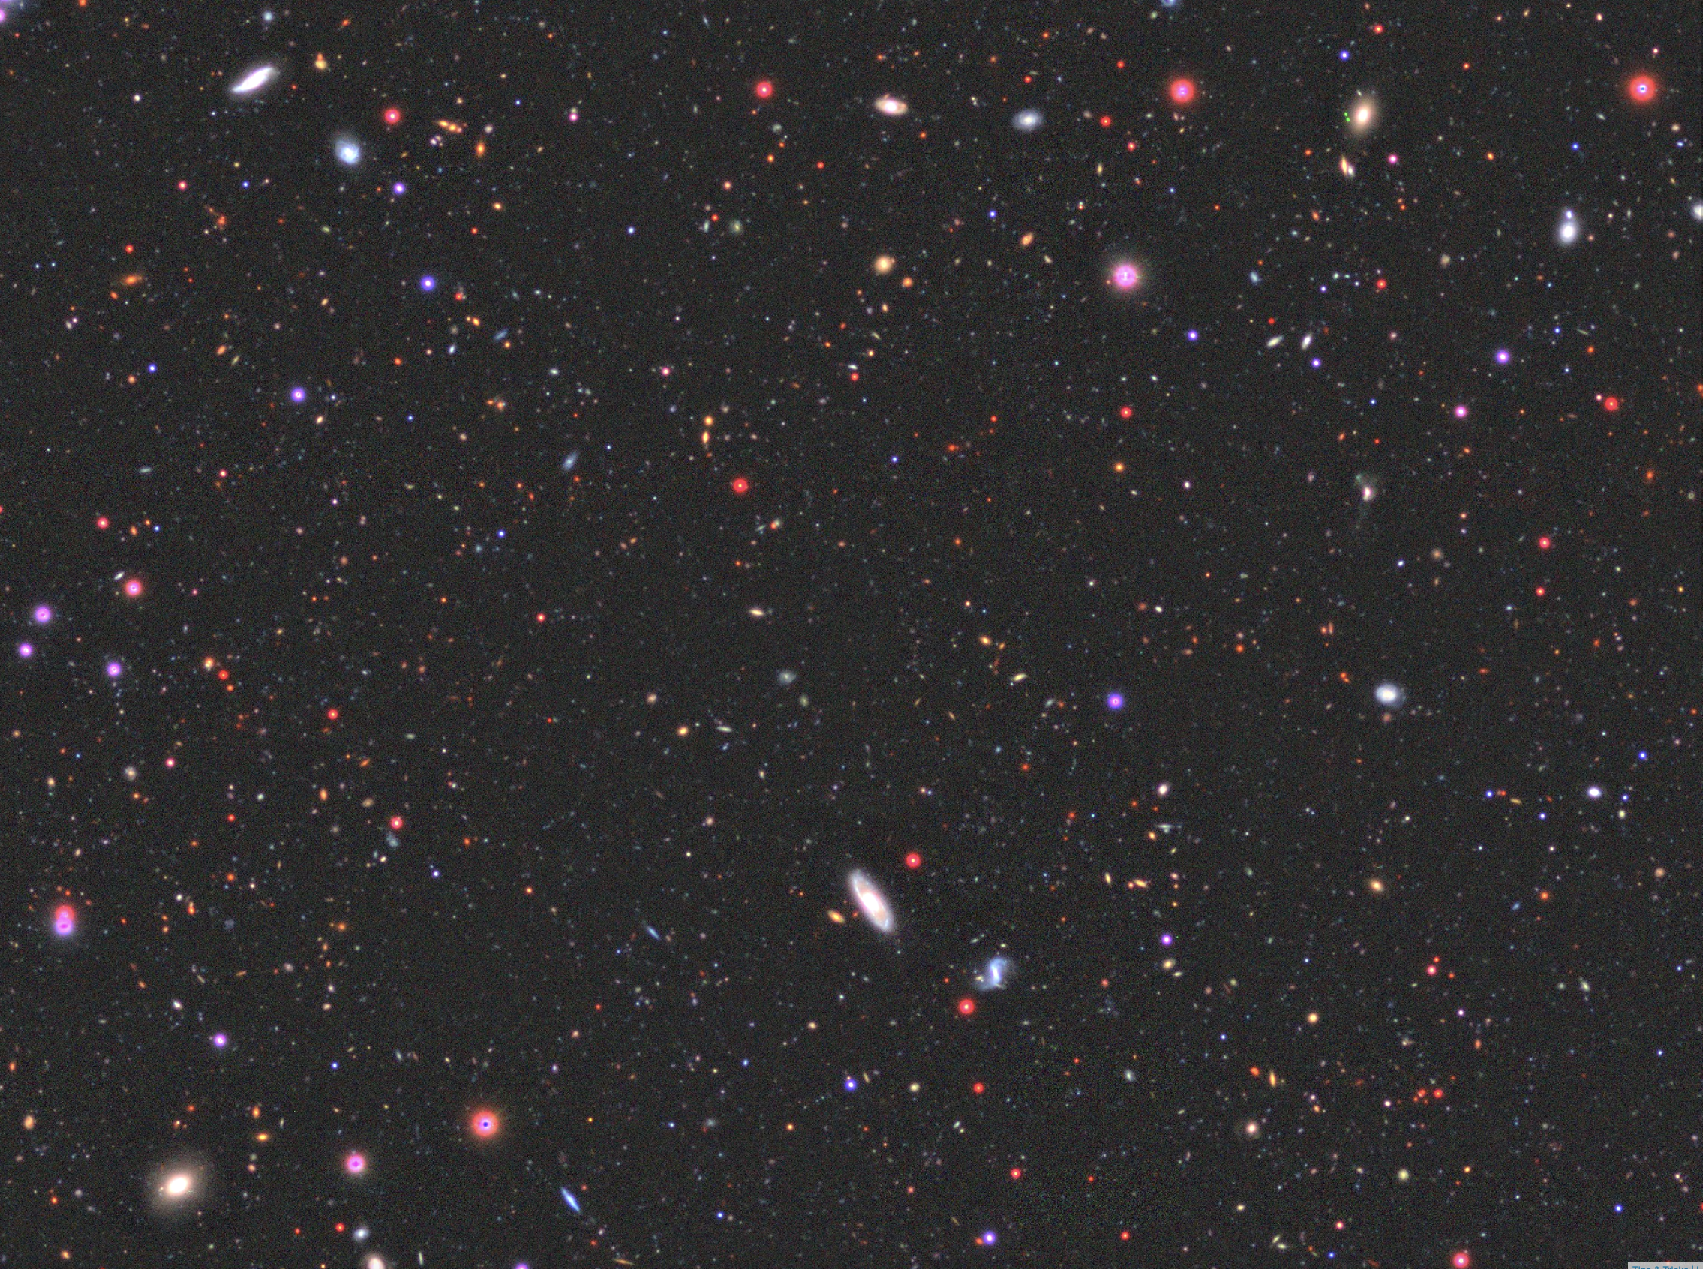

Slide 4
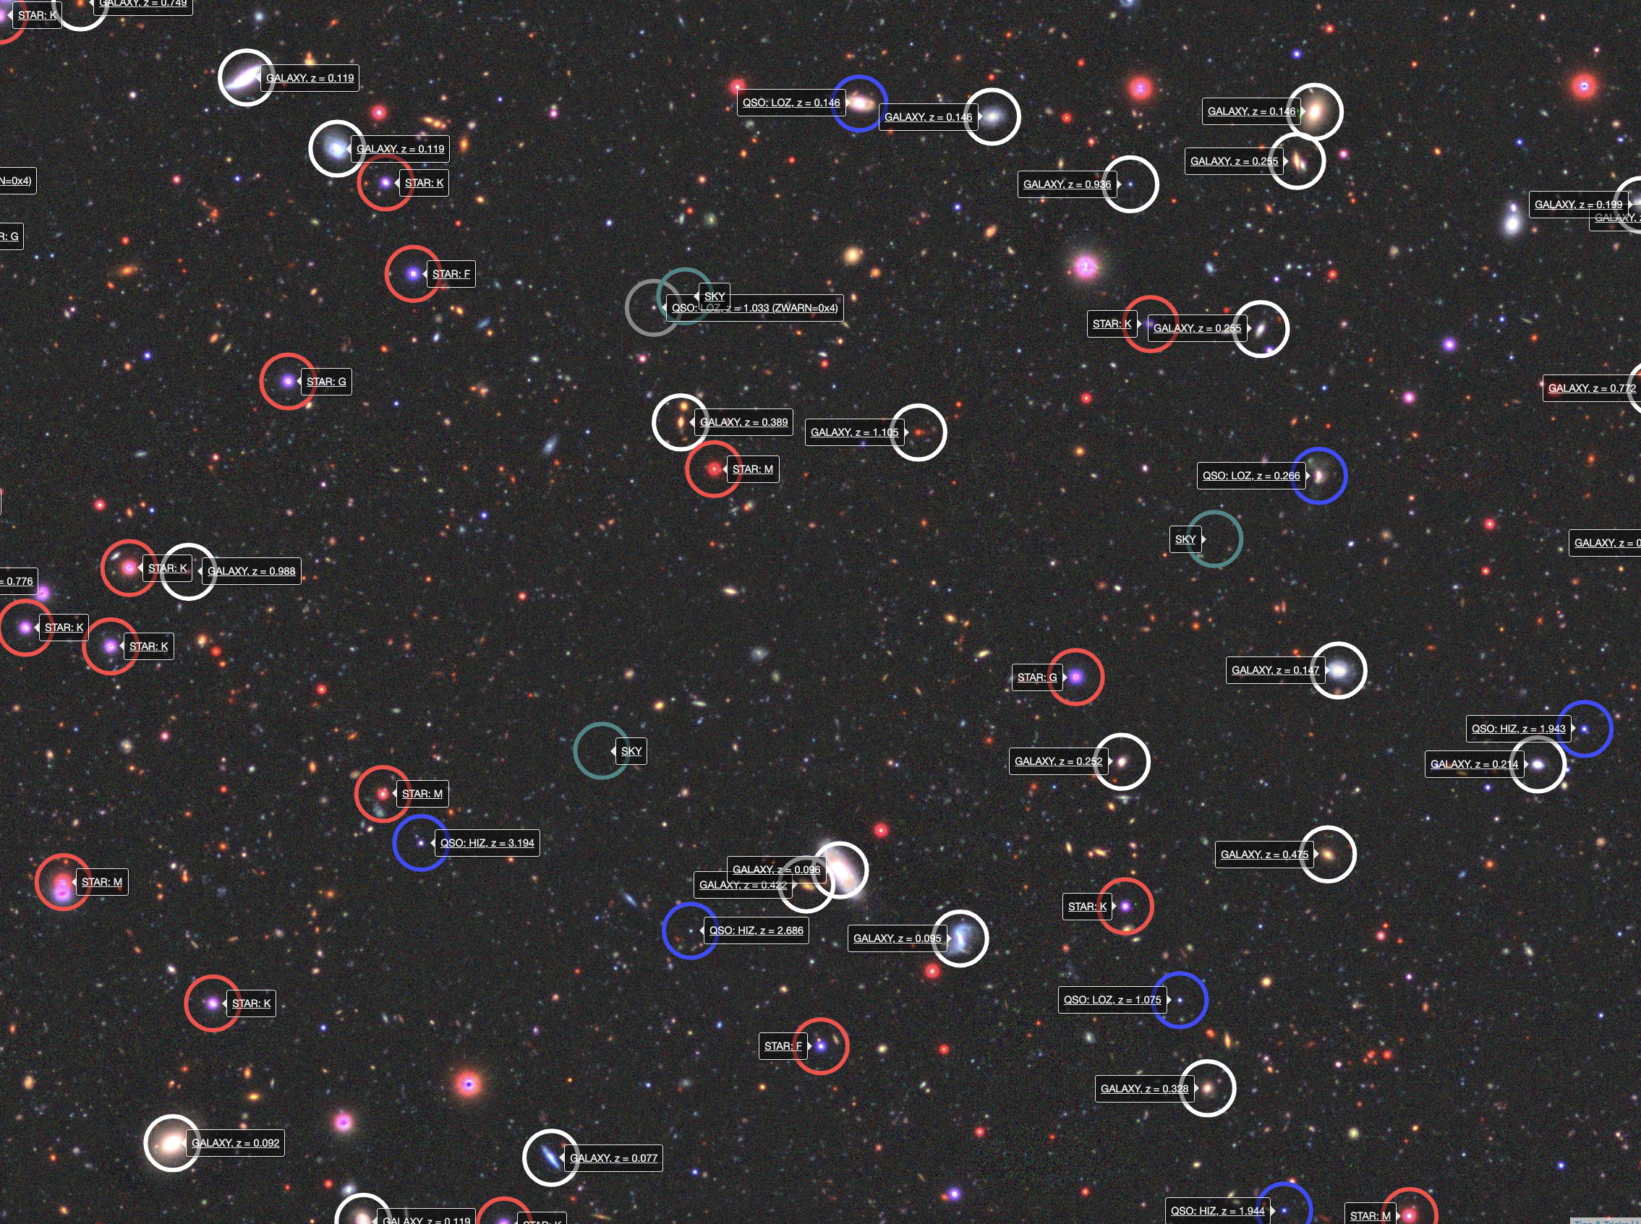

Slide 5
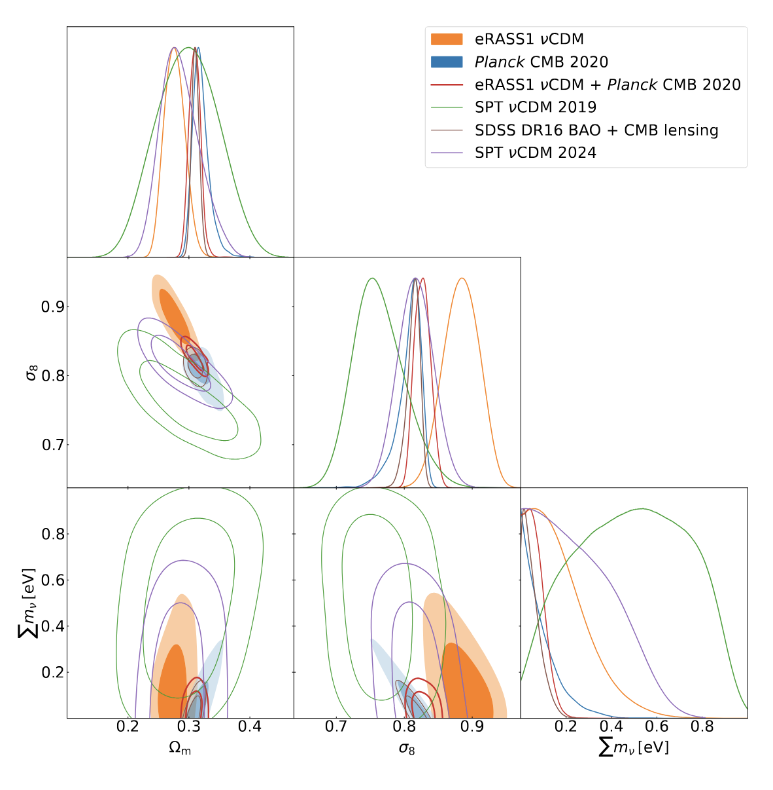
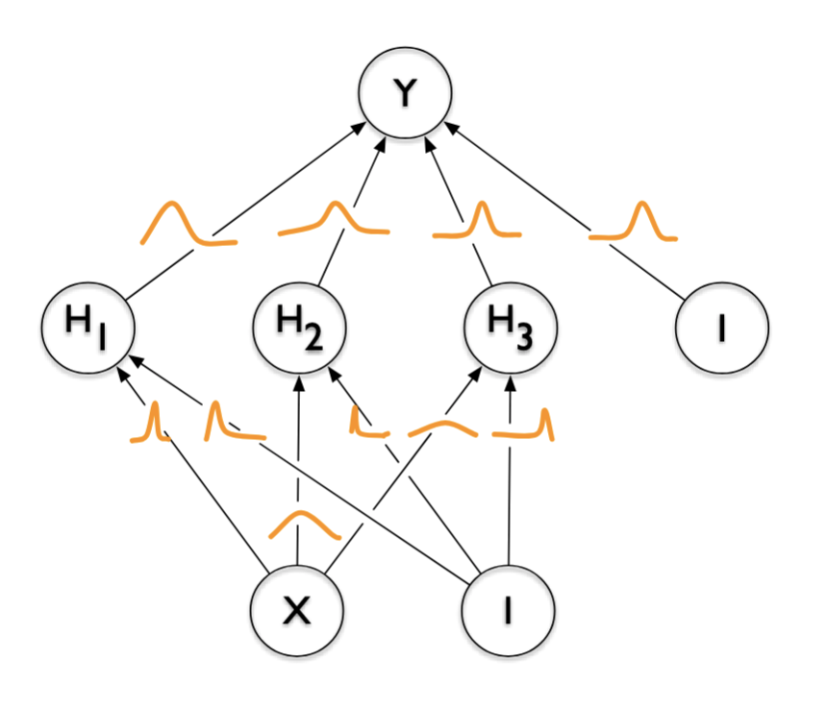
Motivation
We want to work not just with values and error bars but with the inferred distributions to account for degeneracies & systematics.
Blundell+2015
Ghirardini+2024

Slide 6
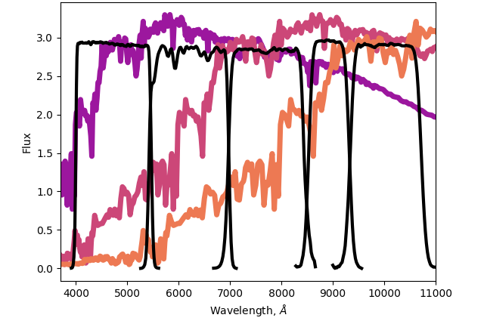
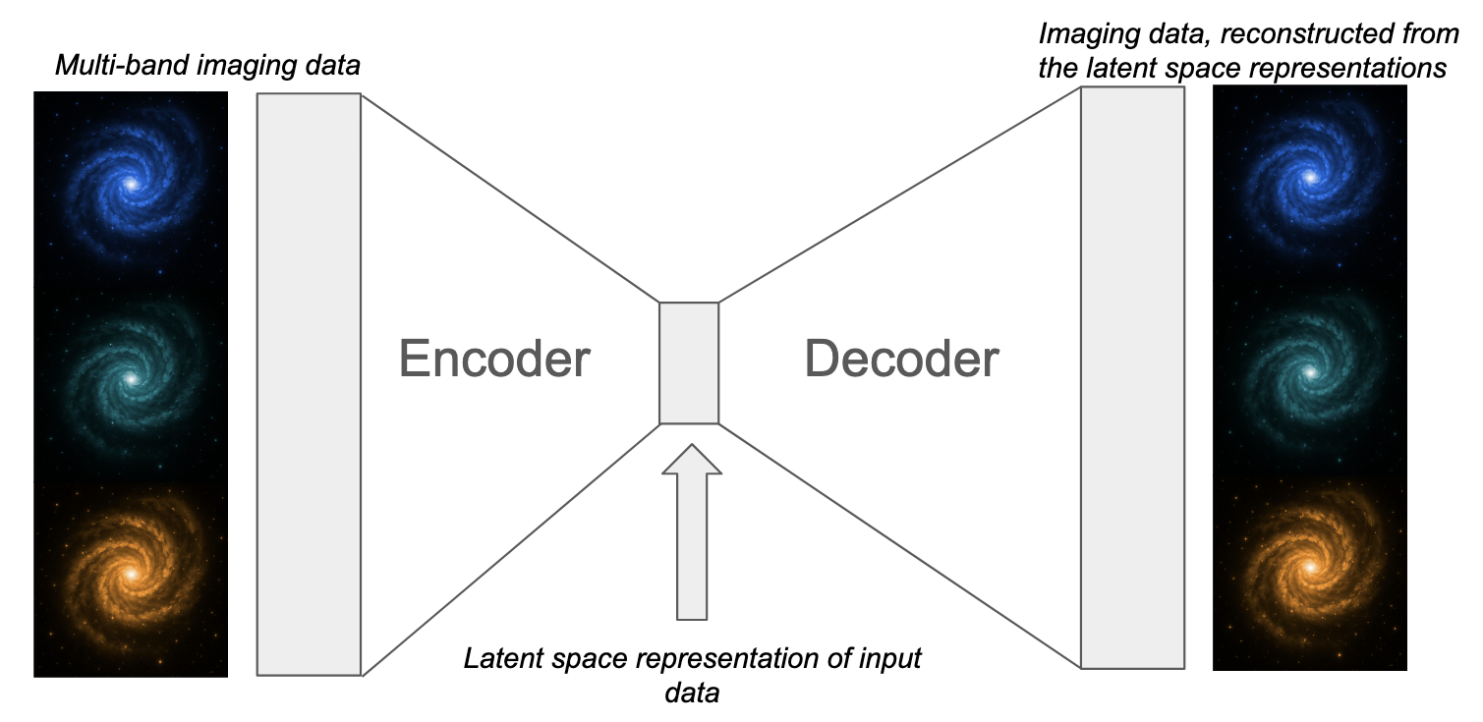
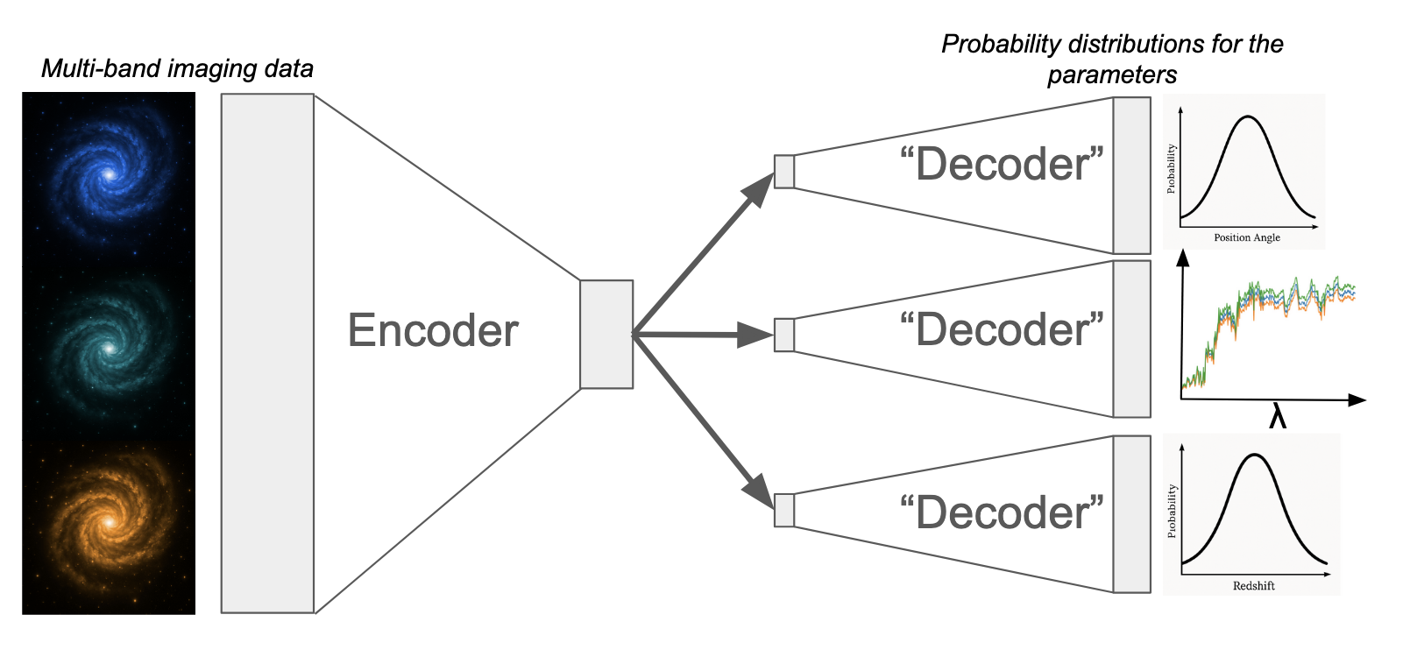
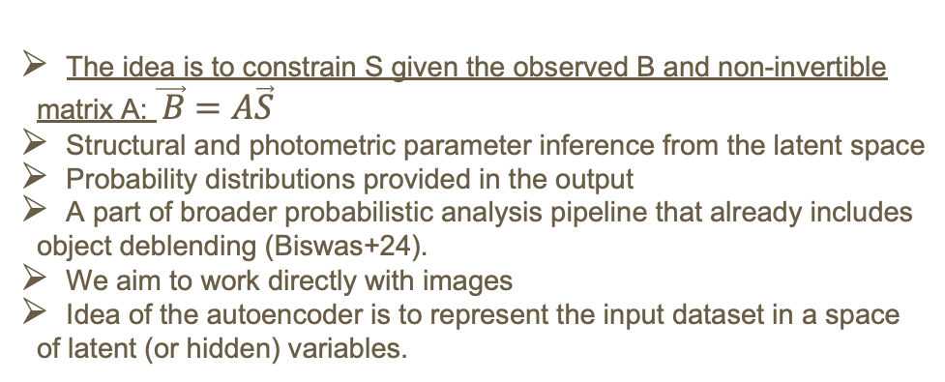
Architecture of the network
The idea is to constrain S given the observed B and non-invertible matrix A: $\vec{ B}=A\vec{S}$
Structural and photometric parameter inference from the latent space
Probability distributions provided in the output
A part of broader probabilistic analysis pipeline that already includes object deblending (Biswas+24).
We aim to work directly with images
Idea of the autoencoder is to represent the input dataset in a space of latent (or hidden) variables.

Slide 7
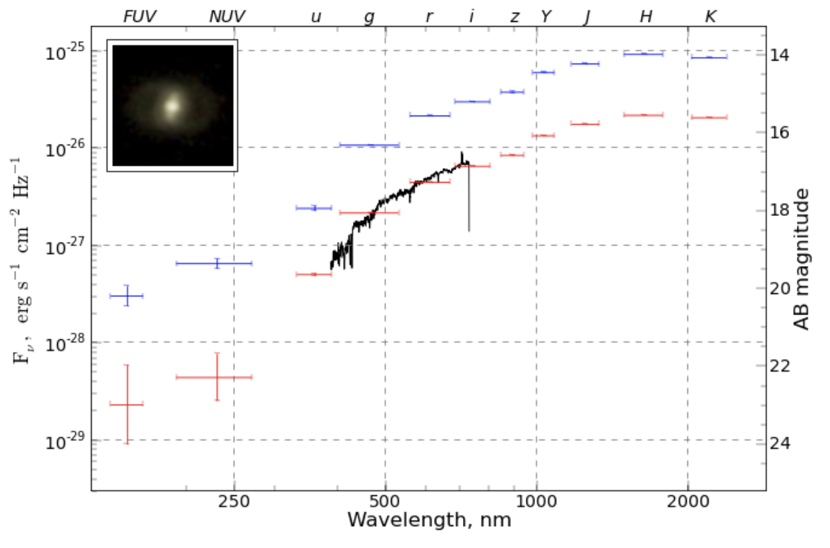
Multi-modal approach for the redshift part
This approach can be validated already on the photometric measurements for galaxies
We aim to infer probability distributions for redshift and stellar populations
The further step is to transfer it to the images

Slide 8
Training dataset: mock photometric measurements
We use CIGALE code (Boquien+19) to generate low-res spectra of galaxies and mock photometric measurements
Our dataset covers wide range of possible SF histories – from the recent starburst to quenched/quiescent galaxies

Slide 9
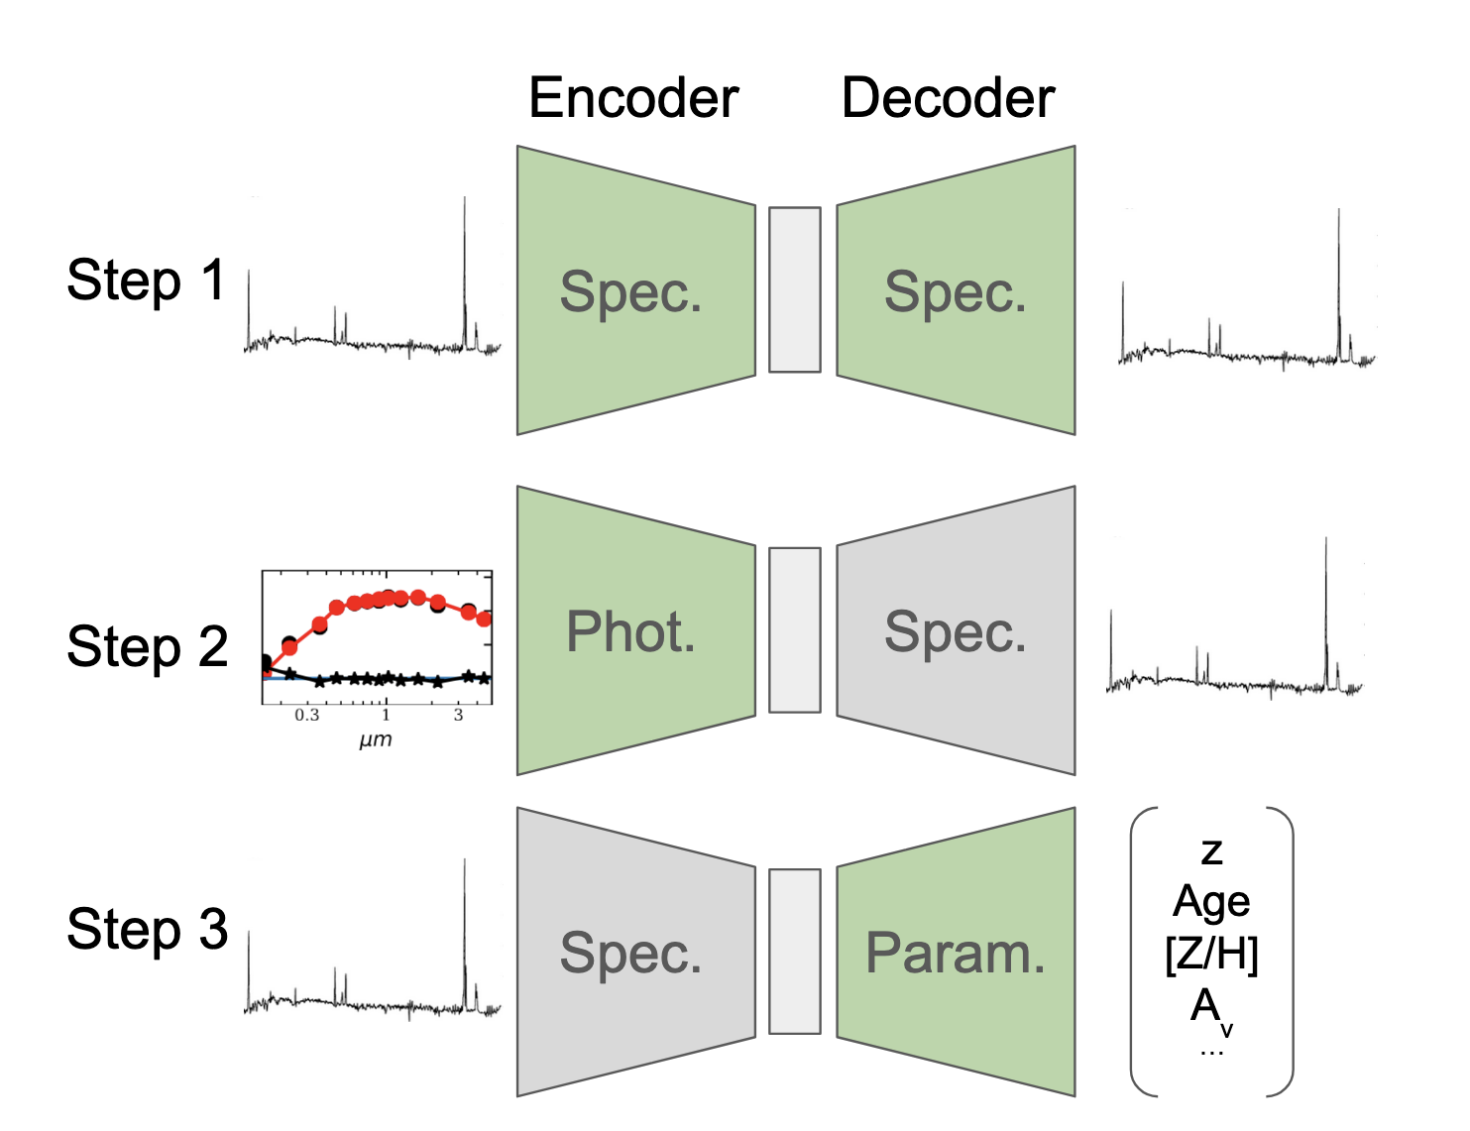
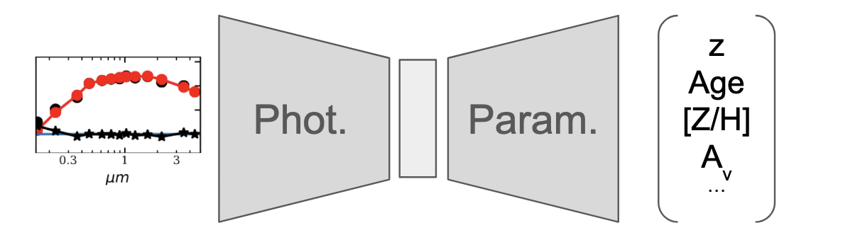
Training strategy
Training steps:
Classical training of the spectral VAE.
Training only the encoder of the photometric VAE, spectral decoder is fixed.
  For step 2 loss function is computed directly in the latent space
Training the parameter decoder, photometry VAE encoder fixed.
Train:
Apply:

Slide 10
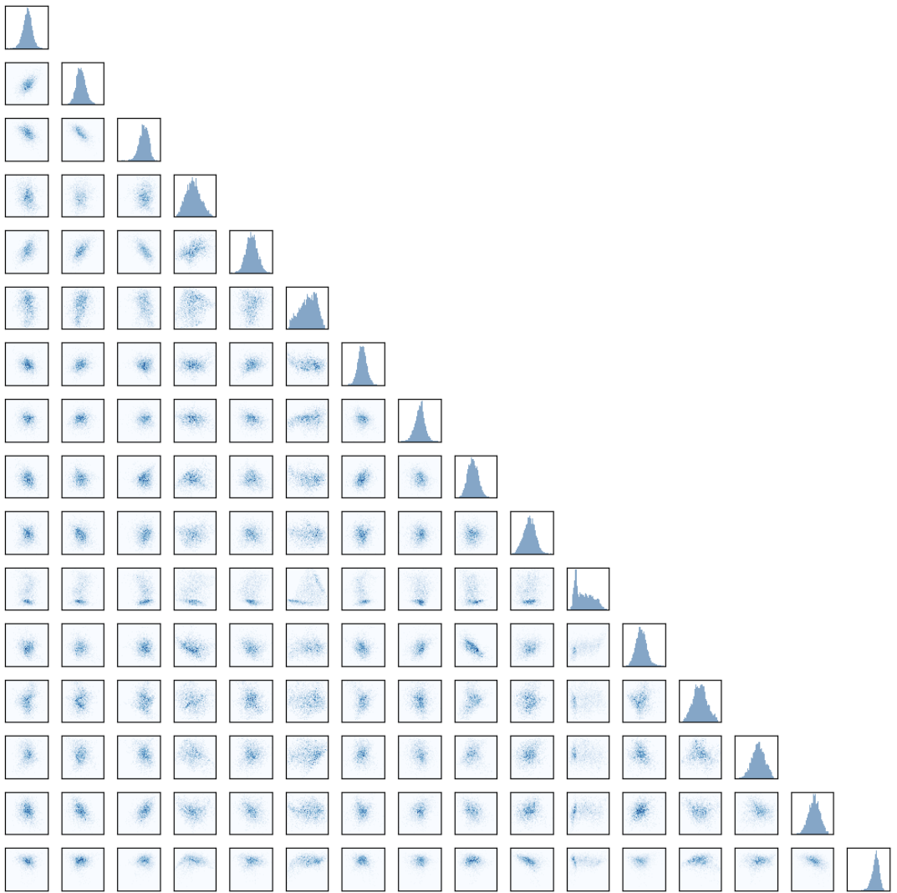
Latent space: spectroscopic modality
Spectral VAE includes three layers – avoiding overtraining
Latent space consists of 64 elements
Distributions are close to Gaussians

Slide 11
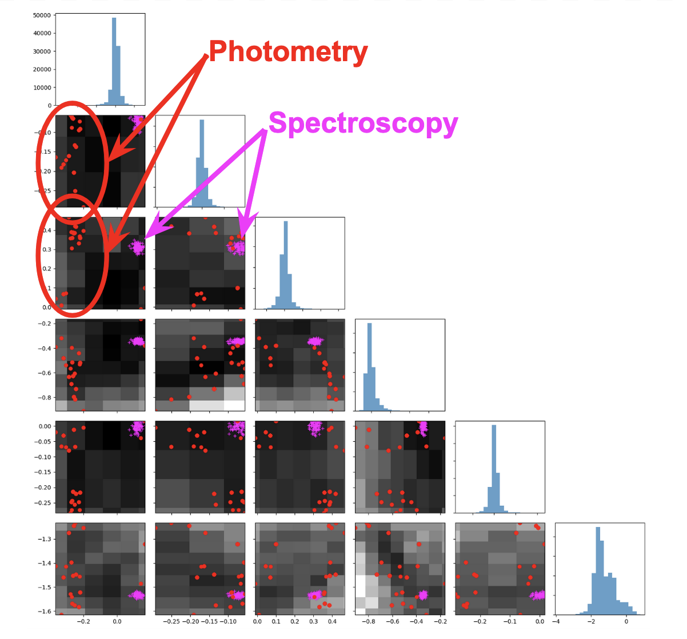
Latent space: photometric modality
Photometric encoder includes three layers
We used MC-dropout instead of inferring just (μ, logσ²) – non-gaussian distributions
Easy transfer to another filter set -- only this part should be modified/retrained.

Slide 12
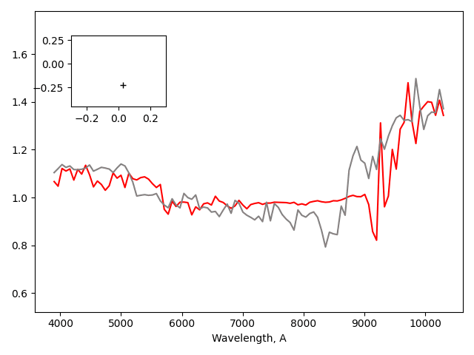
Latent space: sampling using photometric modality
Photometric encoder includes three layers
We used MC-dropout instead of inferring just (μ, logσ²) – non-gaussian distributions
Easy transfer to another filter set -- only this part should be modified/retrained.

Slide 13
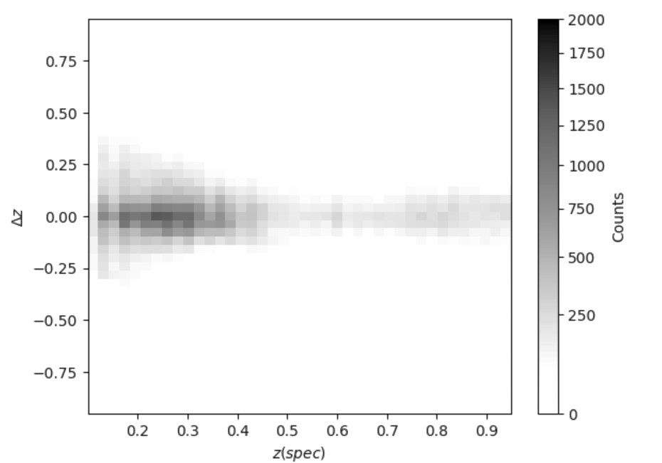
Validation of the results
Dataset: HSC SSP + DESI DR1
0.05 < z < 1.4
Achieved scatter: Δz/(1+z)∼0.05
Two distinct sub-populations: quiescent and star-forming galaxies

Slide 14
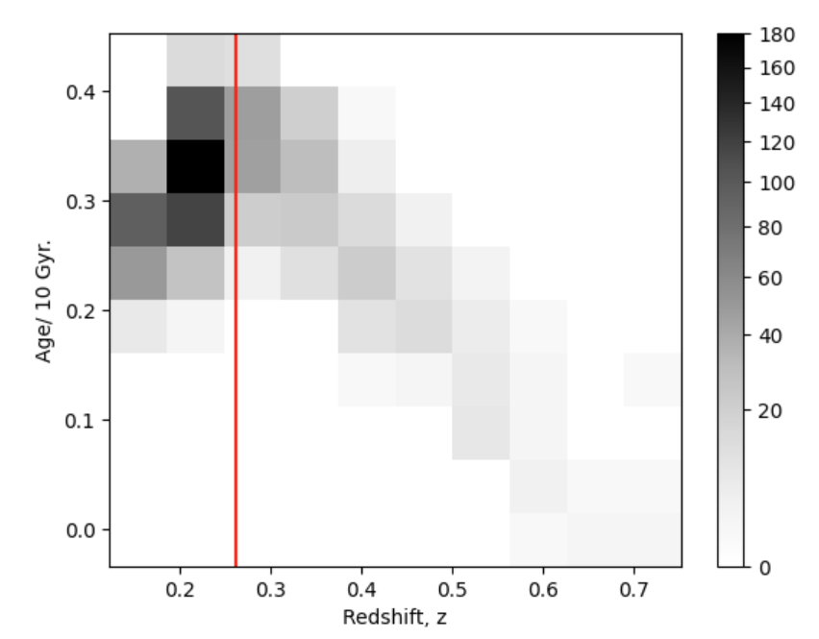
Obtained distributions
Possibility for joint probability distributions, e.g. of redshift and stellar population age.
Sampling these distributions is computationally cheap for individual objects and, hence, easily scalable.

Slide 15
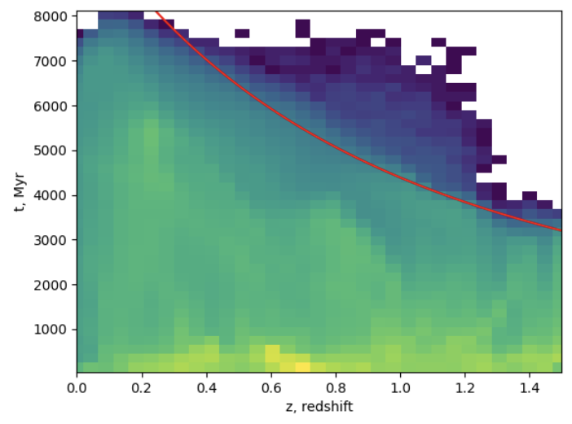
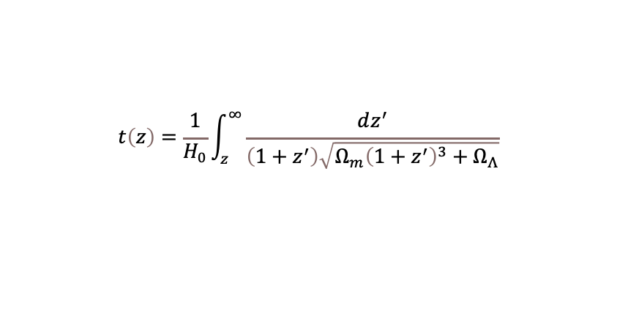
Going beyond z-photo only
Redshift might be not the only value interesting for the cosmology.
Probabilistic analysis may use mean stellar age and analyze it jointly with priors given the age of the Universe.
$$t\left(z\right)=\frac{1}{H_{0}}\int_{z}^{∞}{\frac{dz^{′}}{\left(1+z^{′}\right)\sqrt{Ω_{m}{\left(1+z^{′}\right)}^{3}+Ω_{Λ}}}}$$

Slide 16
Conclusions
The application of multi-modal VAEs for inferring photometric properties of galaxies demonstrates several key advantages:
Efficient training: Multi-modal VAEs can be effectively trained using a staged approach, where individual components are trained separately.
Compact latent representation: The dimensionality of the latent space can be significantly reduced, helping to avoid degeneracies while preserving meaningful physical information.
Training on mock data: Training exclusively on mock datasets proves to be effective, offering greater flexibility and enabling straightforward transfer of network weights to real observations.

