Slide 1
Deep Learning and Bayesian Optimization for
Enhanced Sensitivity and Real-Time Control in
GANIL Experiments
Maurycy Rejmund and Antoine Lemasson
GANIL

Slide 2
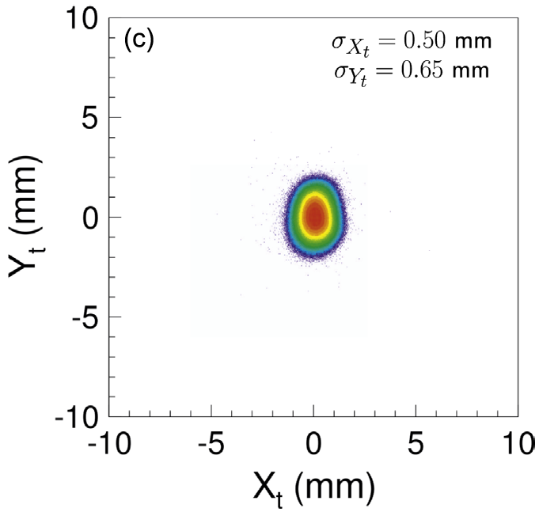
Experimental Challenges at GANIL: Beam
GANIL creates and accelerates stable and radioactive beams of heavy ions.
Beam spot
Ions range from carbon to uranium, with sizes of a few femtometers (10⁻¹² mm).
They form beams about 1 mm² in size, consisting of 10-⁹ s long pulses every 10⁻⁷ s.
The beam intensities range from a few to 10¹¹ ions per second, and their trajectories are several tens of meters.
The machine learning approach can optimize the ion source, beam forming, and guiding equipment, ensuring beam quality and stability crucial for the experiments.

Slide 3
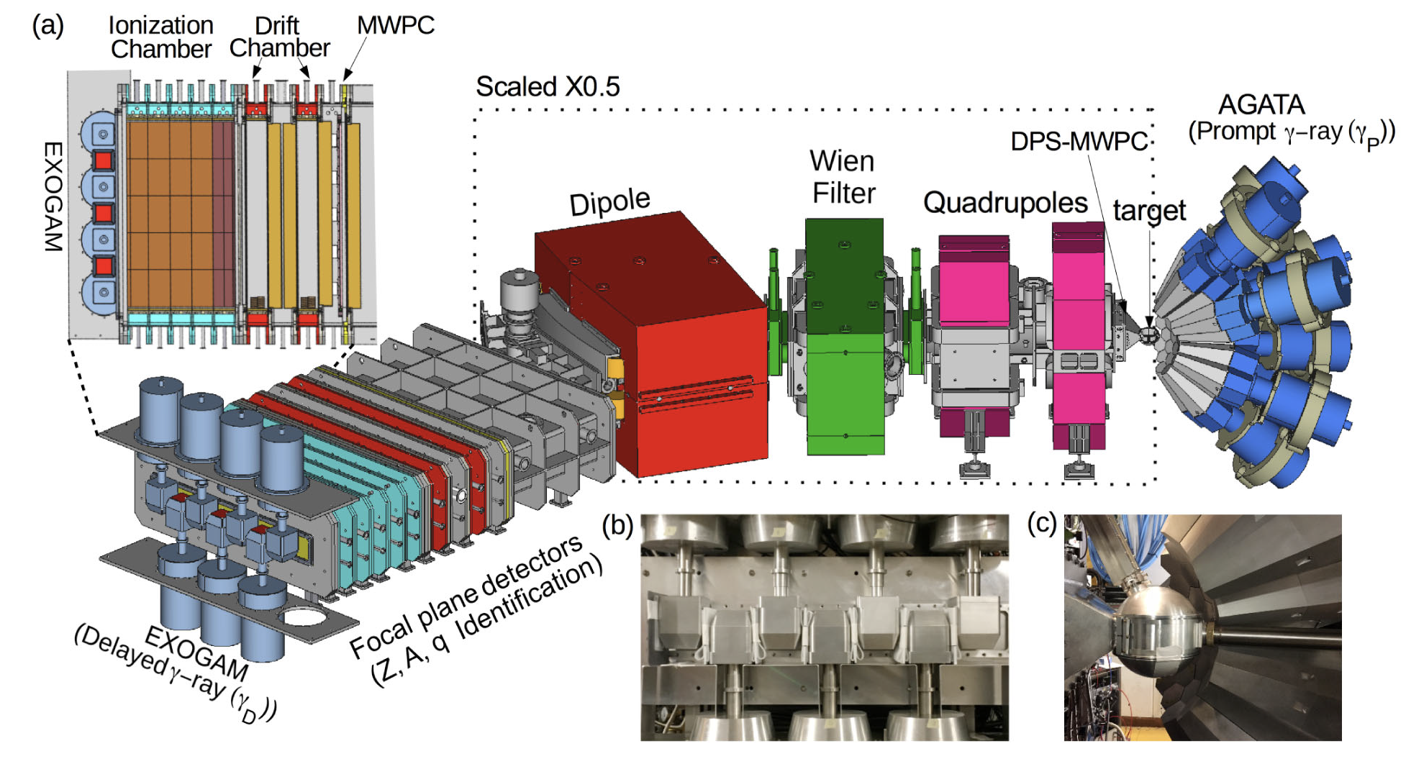
Experimental Challenges at GANIL: Experiment
Beams induce nuclear reactions on target material nuclei. Experimental equipment detects produced nuclei, charged particles, neutrons, or gamma rays.
The target size is about 1 cm², with a thickness of less than 10⁻² mm.
The equipment volume ranges from 1 cm³ to over 10 m³.
Hundreds of detectors can process thousands of parameters.
The number of detected events ranges from a few to beyond 10⁴ per second.
VAMOS++ + AGATA + EXOGAM setup
The machine learning approach optimizes online and offline analysis of experimental data, ensuring standardized, optimal, and reproducible results with unprecedented efficiency.

Slide 4
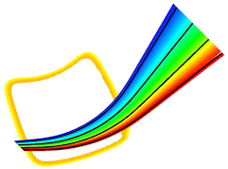


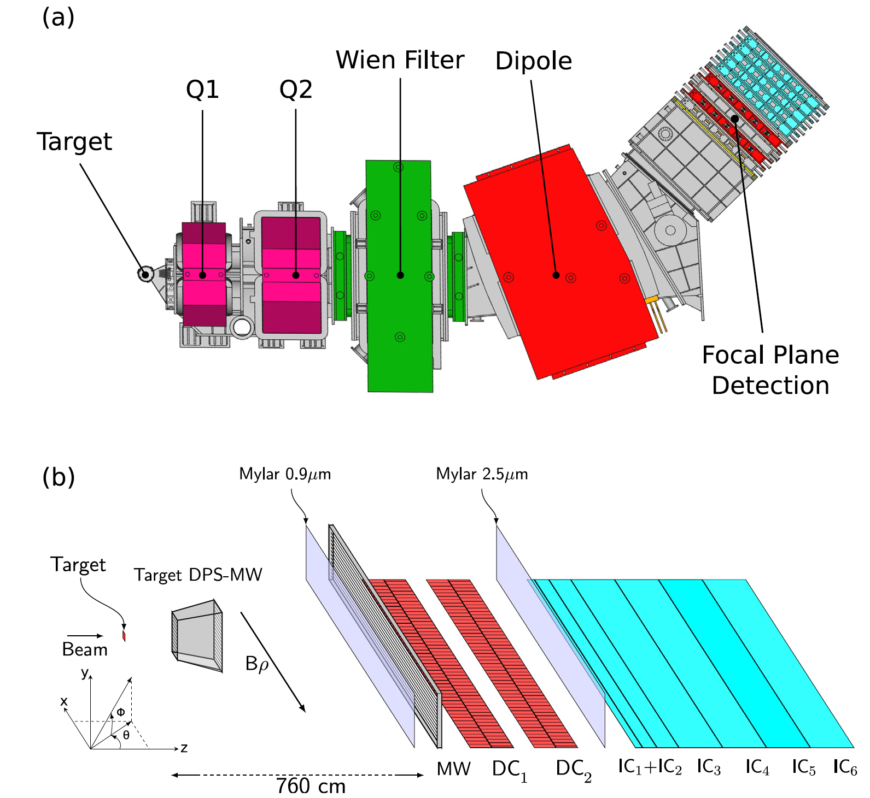
Tracking the Trajectory of Ions in VAMOS++
VAMOS++ (Variable Mode Spectrometer) identifies reaction products on an event-by-event basis, providing atomic mass number (A), atomic charge state (Q), and atomic number (Z) information.
VAMOS++ concept:
A : Numerical correction of the distorted image after magnetic dipole decomposition.
Q, Z : Energy measurements
Magnetic elements (quadrupoles and dipoles) efficiently transport reaction products, but the resulting image, which provides atomic mass number information, is strongly distorted.
Standard magnetic ray-tracing code calculates ion trajectories, but it’s time-consuming and incompatible with online and offline analysis.
A time-efficient and high-resolution numerical method is necessary to correct the distortion of the measured image.
VAMOS++ setup

Slide 5
Tracking the Trajectory of Ions in VAMOS++
The classical numerical correction relies on a four-dimensional lookup table.
At the entrance of magnets
At the exit of magnets
Measured are:
  the ﻿horizontal and vertical angles of the incoming reaction products θ_{i}, ɸ_{i},
  ﻿the horizontal position and angle of the outgoing products x_{f}, θ_{f},
Reconstructed are:
  ﻿the relative magnetic rigidity δ = B⍴/B⍴₀
  the relative trajectory length in the spectrometer ε = l/l₀
VAMOS++ setup
Magnetic rigidity is a measure of the resistance of a particle to deflection by magnetic field, defined as the particle’s momentum divided by its charge.
A four-dimensional lookup table is very time-efficient, but a zero-compressed one occupies 1 GB of memory.

Slide 6

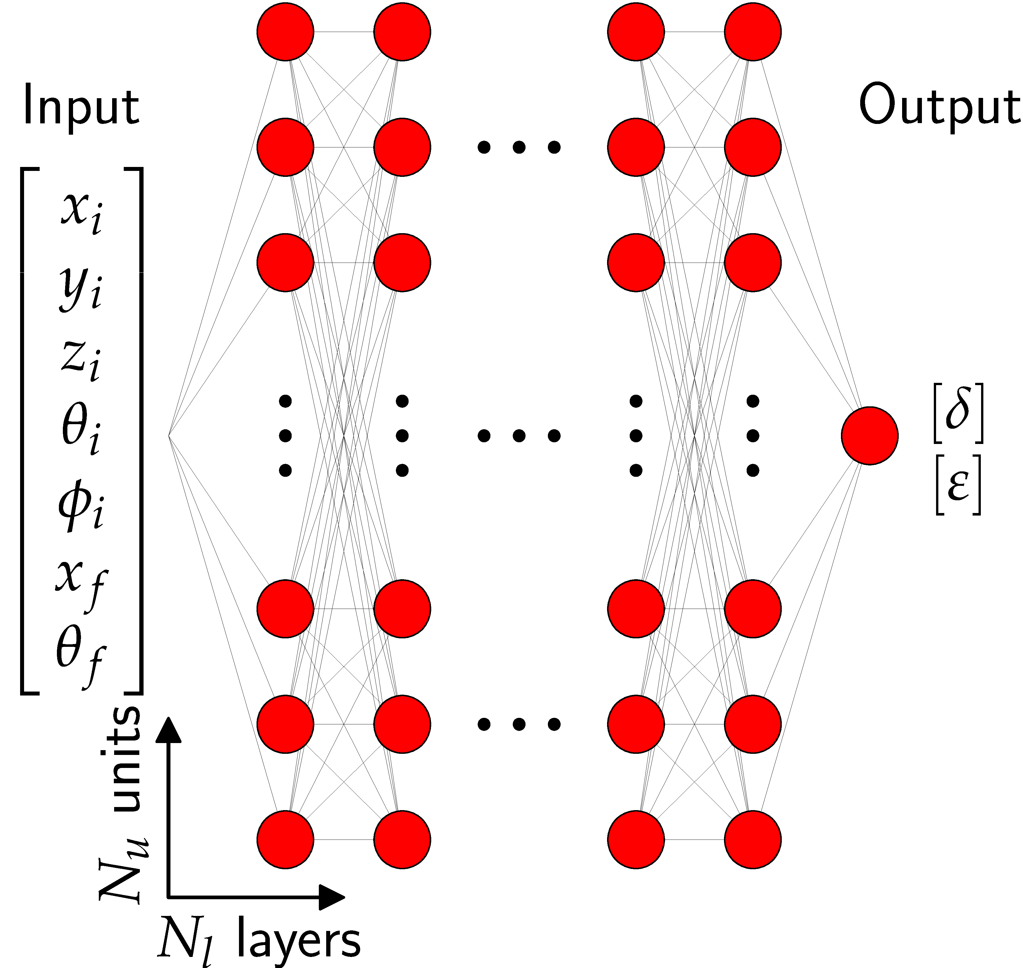

Application of the Neural Networks : Model
To use extended gas volume as a target, the tree-dimensional interaction position must be incorporated into the reconstruction method. Extending the classical method is not possible.
Nucl. Instr. and Method A 1076, 170445 (2025)​
arXiv:2503.18959
Rec7NN Software :
The optimal network architecture is N_{l} x N_{u} = 6 x 32
Theoretical training dataset:
  Standard magnetic ray-tracing code calculates 2x10⁸ ion trajectories randomly distributed over the seven-dimensional phase space, 90% training + 10% validation.
  => Dataset available on Zenodo :
Experimental validation dataset:
  10⁷ events obtained experimentally with the thin target
﻿The training is terminated when the resolution, FWHM(A)/A, obtained for the experimental validation dataset no longer shows any further improvement.
﻿The model exhibits remarkable speed, enabling the treatment of approximately 1.4 x 10⁶ events per second and minimal memory consumption.

Slide 7
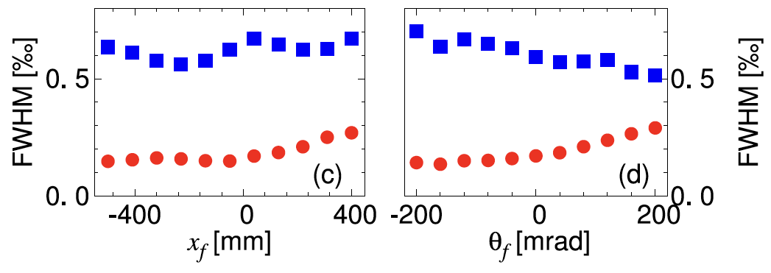
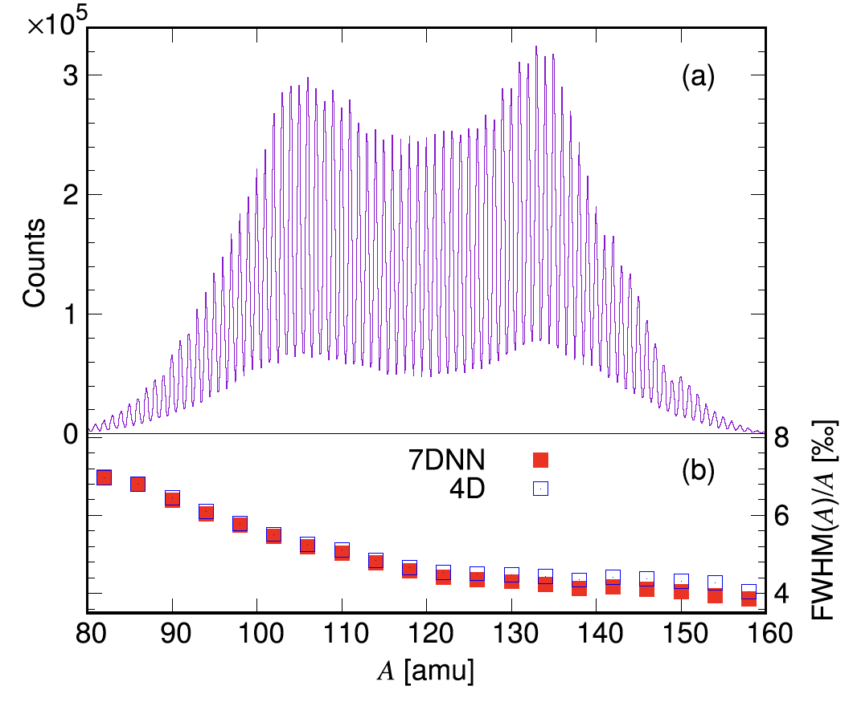

Application of the Neural Networks : Results
Evaluate the model’s performance by comparing the resolution FWHM(var)/var for the theoretical and experimental datasets.
ε
δ
The FWHM(δ)/ δ and FWHM(ε)/ ε are evaluated for the theoretical dataset as a function of input variables x_{f}, θ_{f} resulting in a mean values of about FWHM(δ)/ δ = 0.6 ‰ and FWHM(ε)/ ε = 0.2 ‰.
The FWHM(A)/A are evaluated for the experimental dataset resulting in FWHM(A)/A = 4 ‰ for the heaviest ions and FWHM(A)/A = 7 ‰ for the lightest ions.
  The experimentally obtained resolution is dominantly limited by the performance of the timing detectors.
A of fission fragments detected in VAMOS++
The obtained resolution is comparable or superior to previously used methods
Nucl. Instr. and Method A 1076, 170445 (2025)​
arXiv:2503.18959

Slide 8
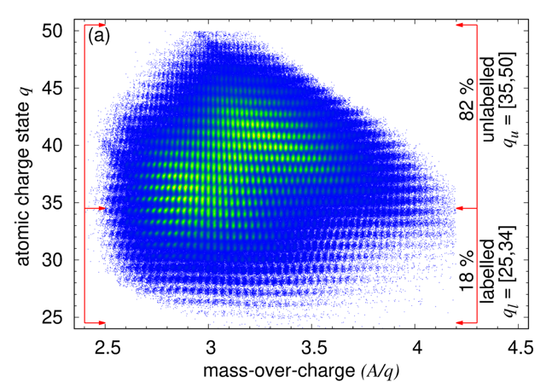
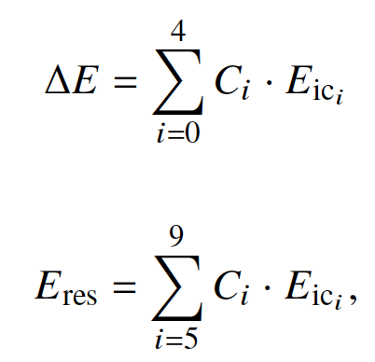
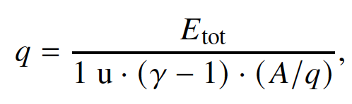
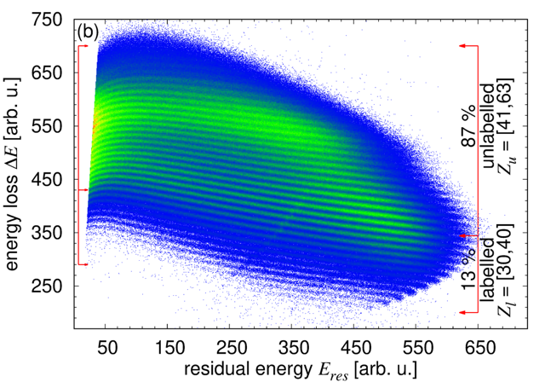
﻿Analysis of Atomic Charge State Q and Atomic Number Z
Q and Z are obtained by iteratively analyzing the correlations of energies deposited in the segmented ionization chamber layers, accounting for any imperfections in the detection system.
Segmented ionization chamber
﻿The first order energy calibration is typically performed during online data analysis.
Correlations of partially label experimental events for the lowest best-resolved Z and Q.
Unlabeled events have the training target value at each learning step, v_{t} = ⌊v_{p} + 0.5⌋.
M. Rejmund and A. Lemasson
JINST 20 P08022 (2025)
arXiv:2507.07109v2
The labeled events make up only 18% (lowest Qs) and 13% (lowest Zs) of the training data.

Slide 9
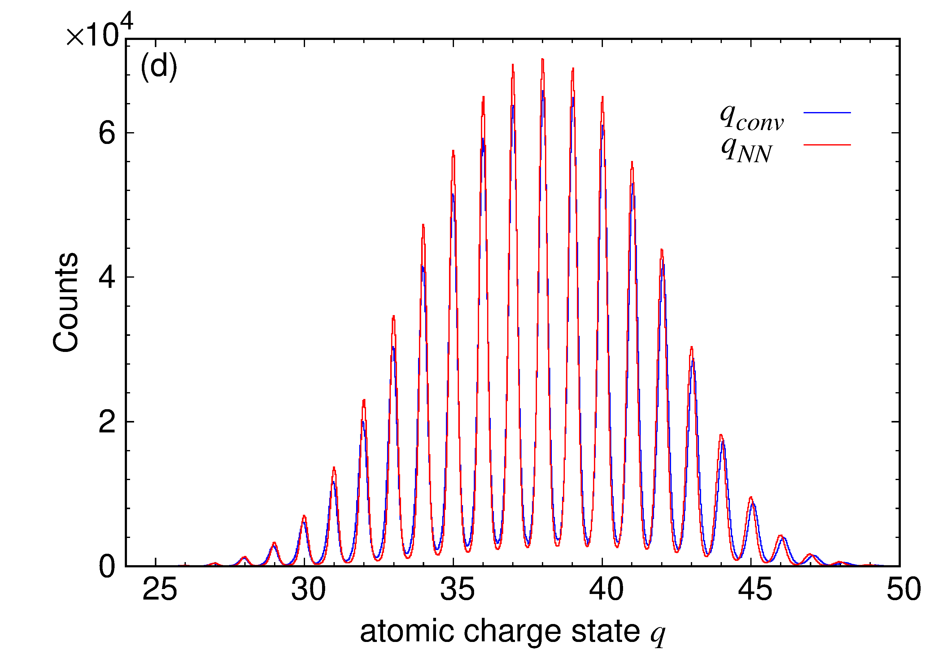
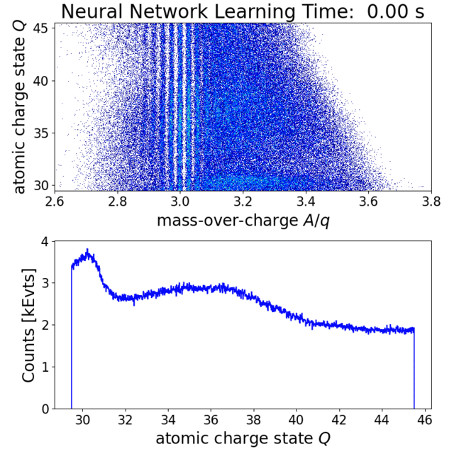
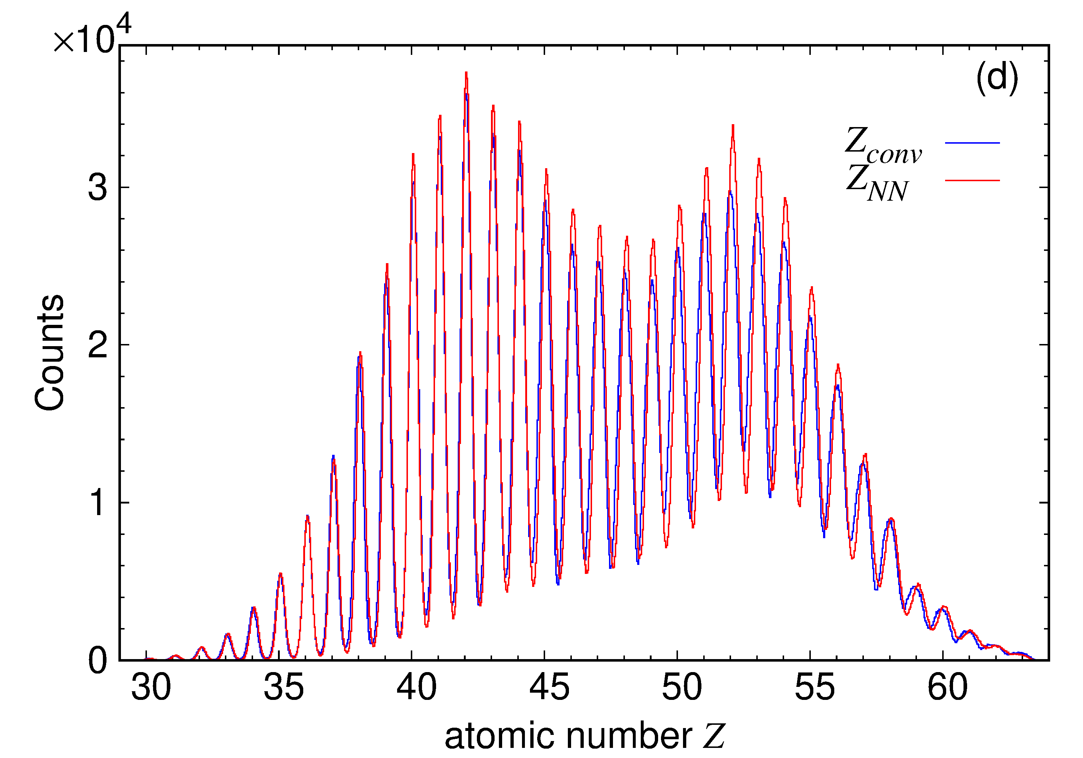
Application of the Neural Networks : Results
M. Rejmund and A. Lemasson ​
JINST 20 P08022 (2025)​
arXiv:2507.07109v2 ​
​
The training is performed on the experimental data using 5 x 10⁷ events.
The optimal network architecture is N_{l} x N_{u} = 8 x 32
The input values:
  Raw energies E_{ic}
  Positions on the detectors at the entrance and the exit of VAMOS++
  ﻿for Q only: the reciprocal of the mass-over-charge, (A/q), and of the Lorentz term, (ɣ − 1)
The dependencies on other parameters are removed.
The obtained resolution is superior to conventional methods.

Slide 10
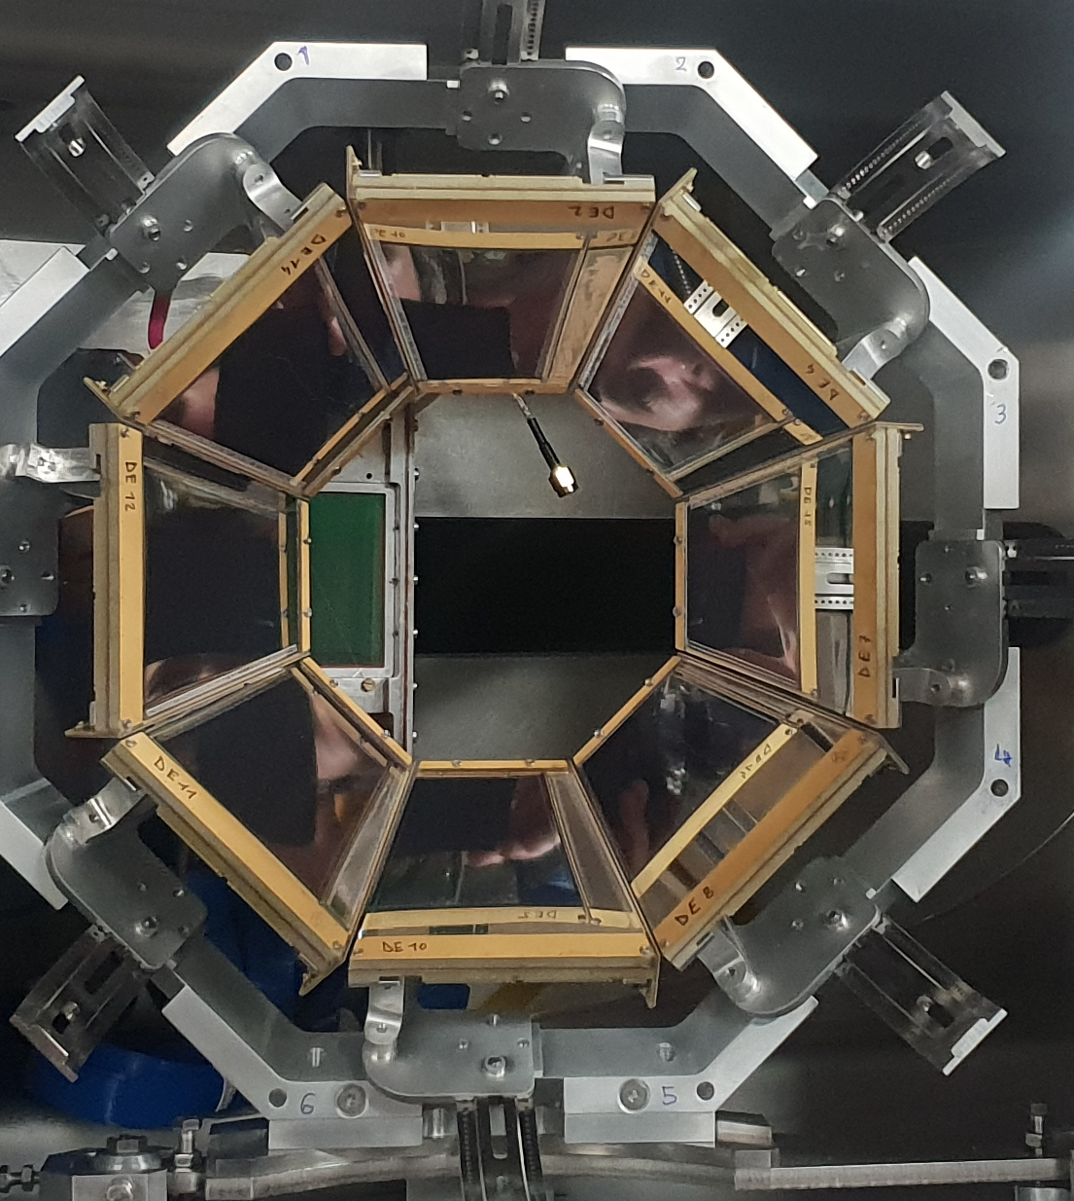
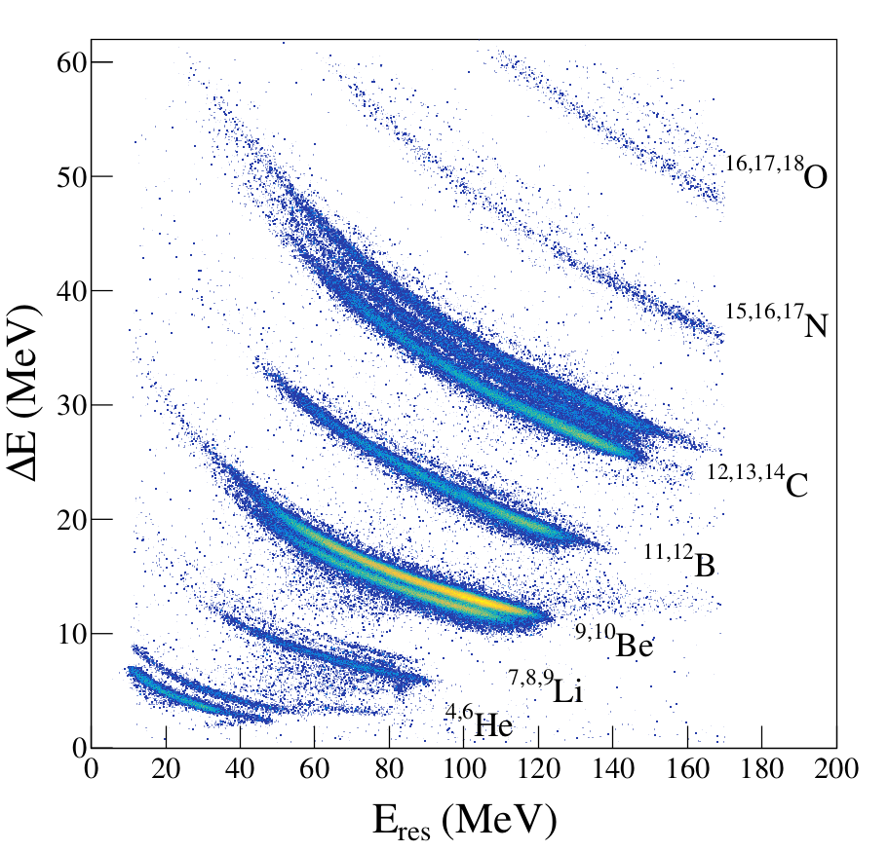
Particle Identification Using Silicon Telescopes: PISTA
Neural networks can be used to identify light ions in highly segmented solid silicon detector telescopes (500um strip size), simultaneously identifying the Z and A.
PISTA array
E
ΔE
¹²C target
¹²C (recoil)
²³⁸U beam

Slide 11
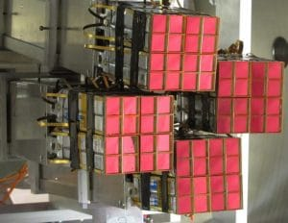
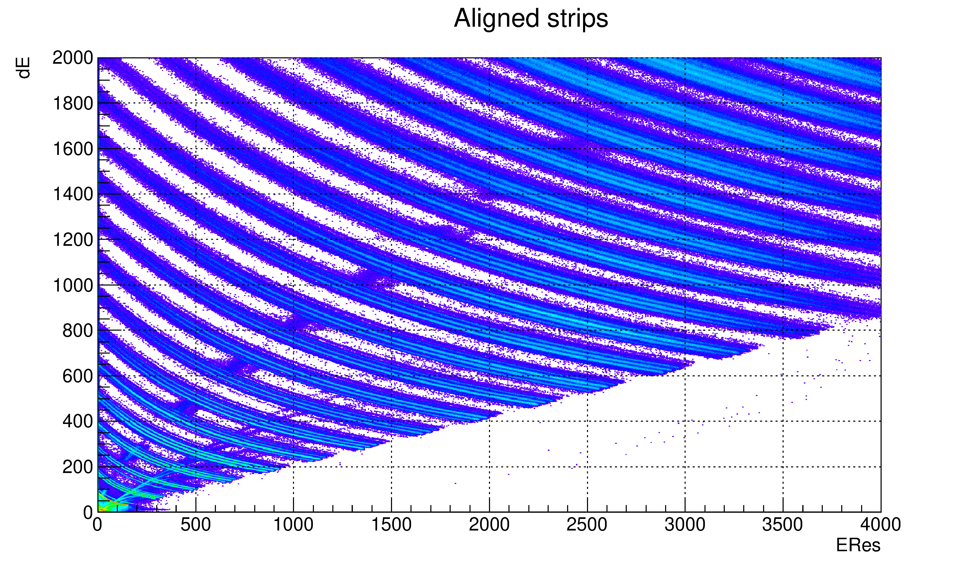
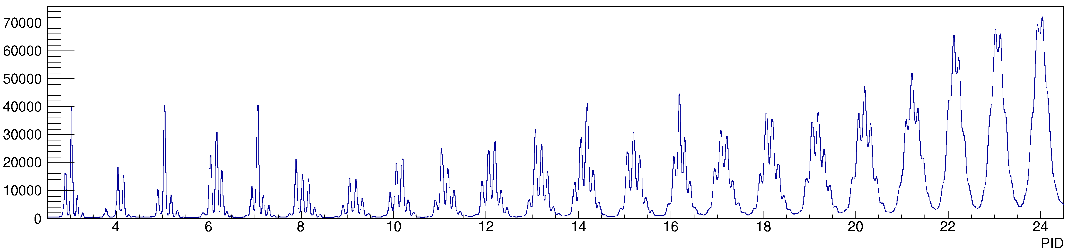
Particle Identification Using Silicon Telescopes: FAZIA
Neural networks can be used to identify heavier ions in
solid silicon detector telescopes.
FAZIA array
E884 GANIL expt​
C. Ciampi et al.​
(2025)
Li Be B C N O F Ne Na Mg Al Si P S Cl Ar K Ca Sc Ti V Cr

Slide 12
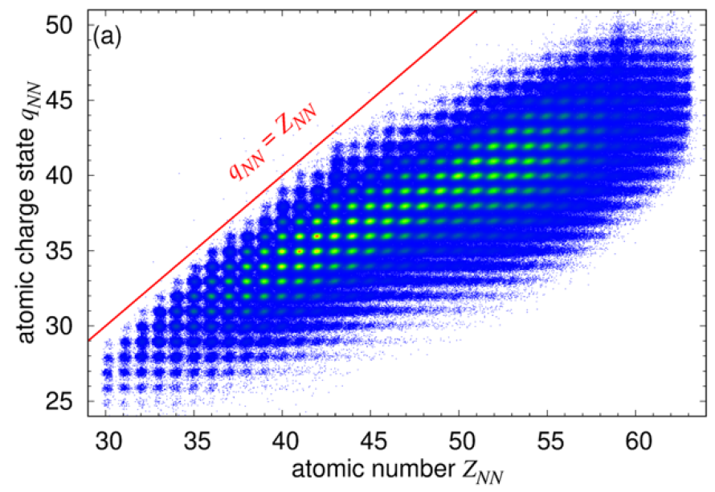
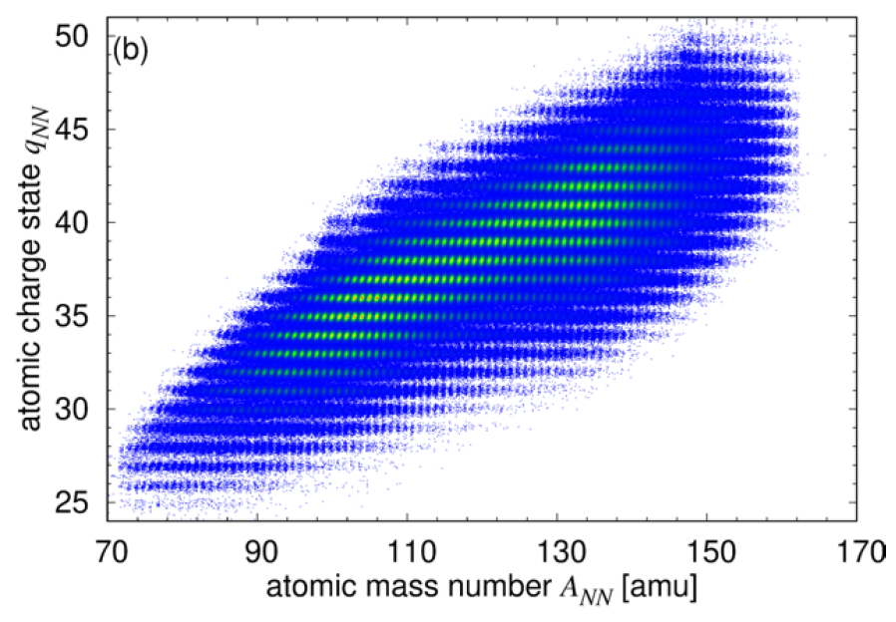
Neural Networks as Everyday Working Tool ...
Neural networks-based approaches are intended for everyday work, from online analysis during experiments to final results and publication.
Neural networks-based approaches guarantee the efficient acquisition of results that are:
  Standardized,
  Optimal,
  Highly reproducible
Automating, reducing human factor in repetitive task.

Slide 13
Optimization of Multiparametric Systems Using Autonomous Real-Time Learning Agents
The machine learning approach can optimize the ion source, beam forming, and guiding equipment, ensuring beam quality and stability crucial for the experiments. Beams of ions ranging range from carbon to uranium, are about 1 mm² large in size and their trajectories are of several tens of meters.
General requirements
Agent requirements:
Autonomous,
Unbiased,
No pre-training,
No memory,
No physics knowledge.
Learning process: Learns in real time.
Optimization goal: Achieve optimal results in a minimal number of steps (tens).
Workflow
Agent initialization: Starts in a random state.
Agent constraints: Receives the number of parameters and their ranges.
Agent-environment interaction:
Interacts step-by-step with the environment ,
Receives feedback on the quality of actions.
Here the application to the portion of the beam transport is studied.

Slide 14
Beam transport: Quadrupole Triplet
A simulated portion of a beam transport line, including a quadrupole triplet,
is optimized using Bayesian Optimization.
incoming beam
quadrupole triplet
outgoing beam and profiler
Beam Generation: Beam is generated randomly with parameters:
  Positions and widths: x_{i}, σ(x_{i}), y_{i}, σ(y_{i}),
  Angles and widths: θ_{i}, σ(θ_{i}), ɸ_{i}, σ(ɸ_{i}).
Agent Interaction: Agents interact with the equipment step-by-step, receiving feedback based on measured values on the profiler:
  Positions and widths: x_{o}, σ(x_{o}), y_{o}, σ(y_{o}).
Agent Optimization: After exploration, agents initiate optimization based on the received feedback.

Slide 15
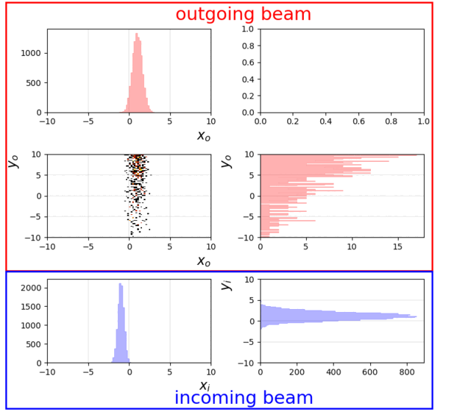
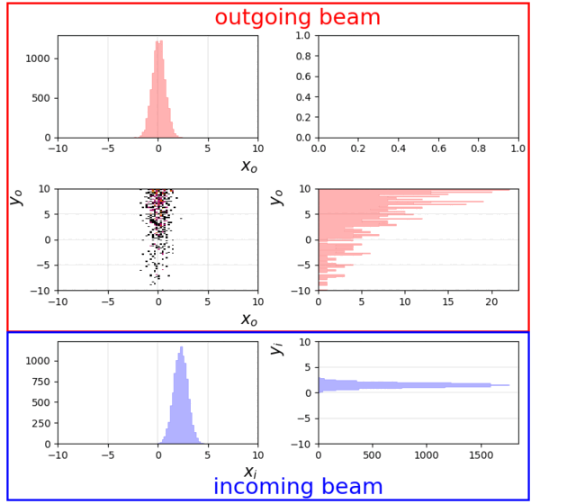
Beam transport: Quadrupole Triplet
A simulated portion of a beam transport line, including a quadrupole triplet,
is optimized using Bayesian Optimization.
incoming beam
quadrupole triplet
outgoing beam and profiler
Convergence Time: The agent converges to an optimum setting in less than 20 steps.
Step Duration: Each step takes approximately 10 seconds for setting currents and profiler readout.
Total Optimization Time: The optimal setting is obtained in less than 200 seconds.
Next step: Optimize separator or spectrometer.

Slide 16
Summary & Outlook
Simple models yet very effective
  Small computational costs
  Speed up of analysis from several month to weeks
  Transformative methods
Generative ML for VAMOS++ Simulations
  Acceptance
  Experiment design / optimization
Implementation of BO methods in real world
  Coupling with equipments
  Future spectrometers
  (S³ , High Resolution Separator DESIR, ...)
Anomaly detection at VAMOS++
First Implementation of DNN
at VAMOS++ large acceptance spectrometer
  Trajectory Reconstruction in Spectrometer
  Particle Identification (Z, Q)
  Improved quality
  Improved reliability and efficiency
Application to Particle Identification
in Silicon ΔE/E telescopes
Investigations on the application
of Bayesian Optimization
to Beam Transport optimization

Slide 18
Bayesian Optimization
Bayesian Optimization is a strategy for optimizing expensive-to-evaluate functions.
It operates by building a probabilistic model of the objective function and using this model to select the most promising points to evaluate next.
This approach is particularly useful in scenarios where the objective function is unknown, noisy, or costly to evaluate, as it aims to minimize the number of evaluations required to find the optimal solution.

Slide 19
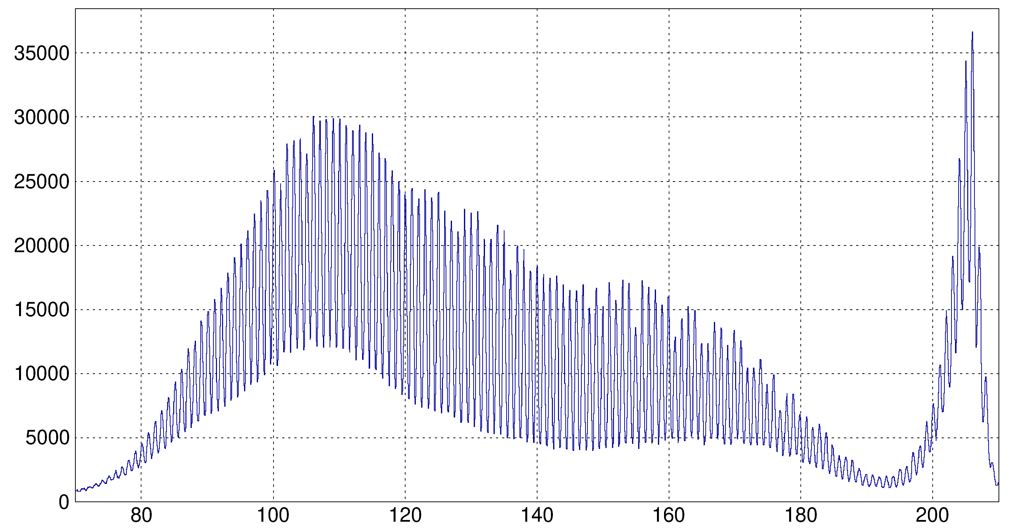
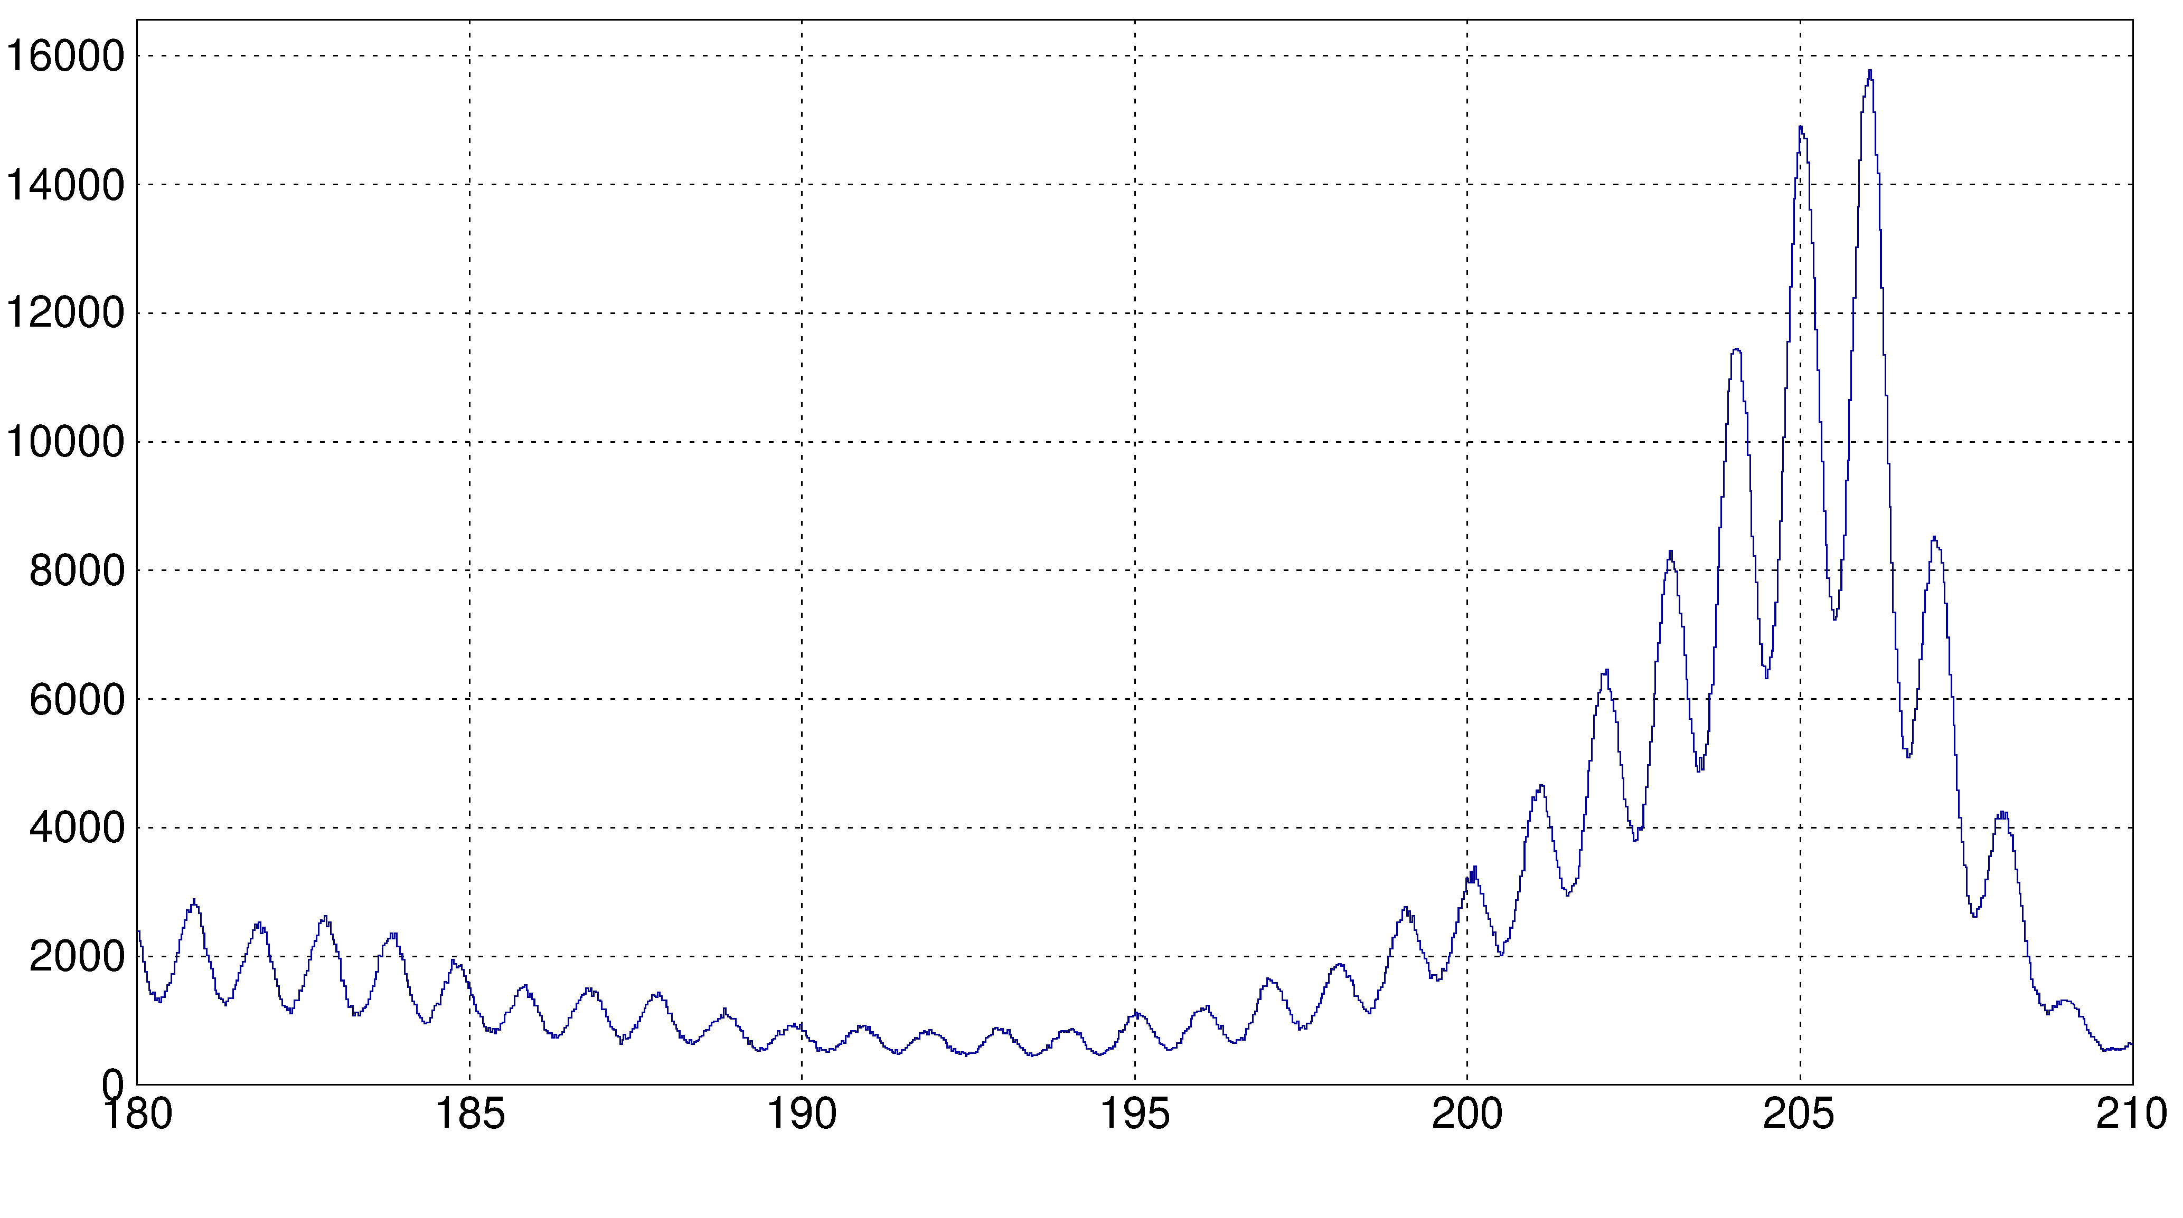
Results with the cell

Slide 20
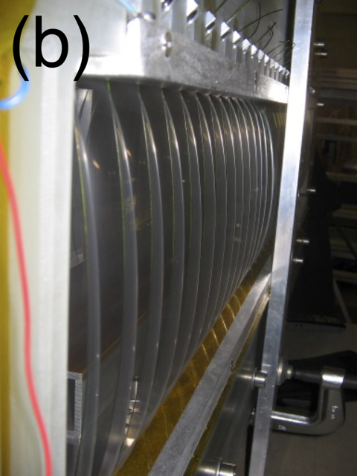
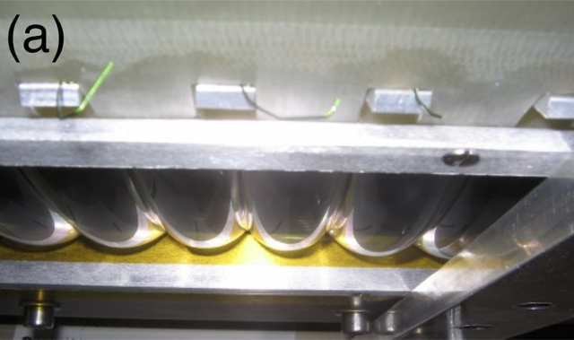
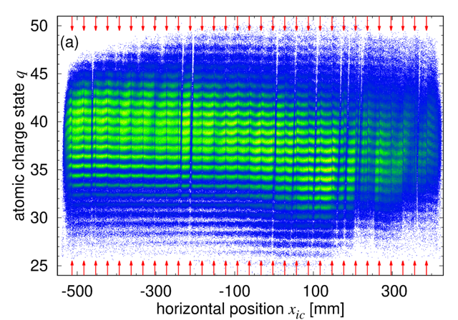
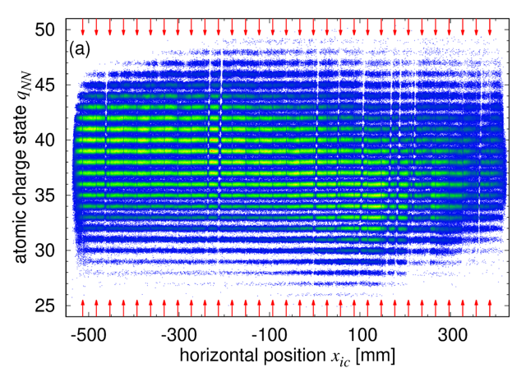
Ionization chamber windows

