Slide 1


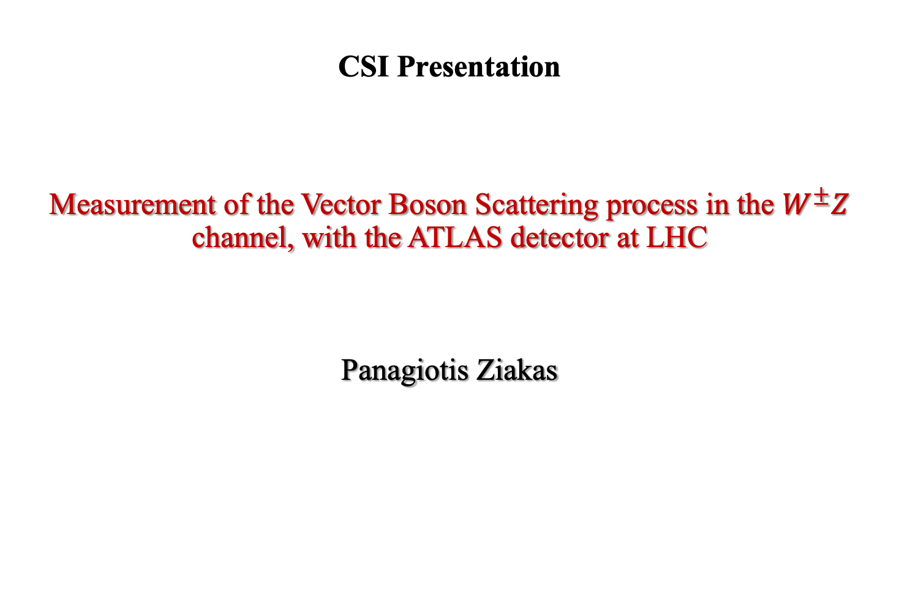
CSI Presentation
Measurement of the Vector Boson Scattering process in the $W^{±}Z$ channel, with the ATLAS detector at LHC
Panagiotis Ziakas

Slide 2
Contents
Introduction
The VBS process
Why is VBS important?
VBS topology
QCD Background Modelling
LO generation
NLO generation
Qualification Project
Validation Plots
Prospectives and next steps
Preliminary results
Doctoral School Training

Slide 3
Introduction

Slide 4
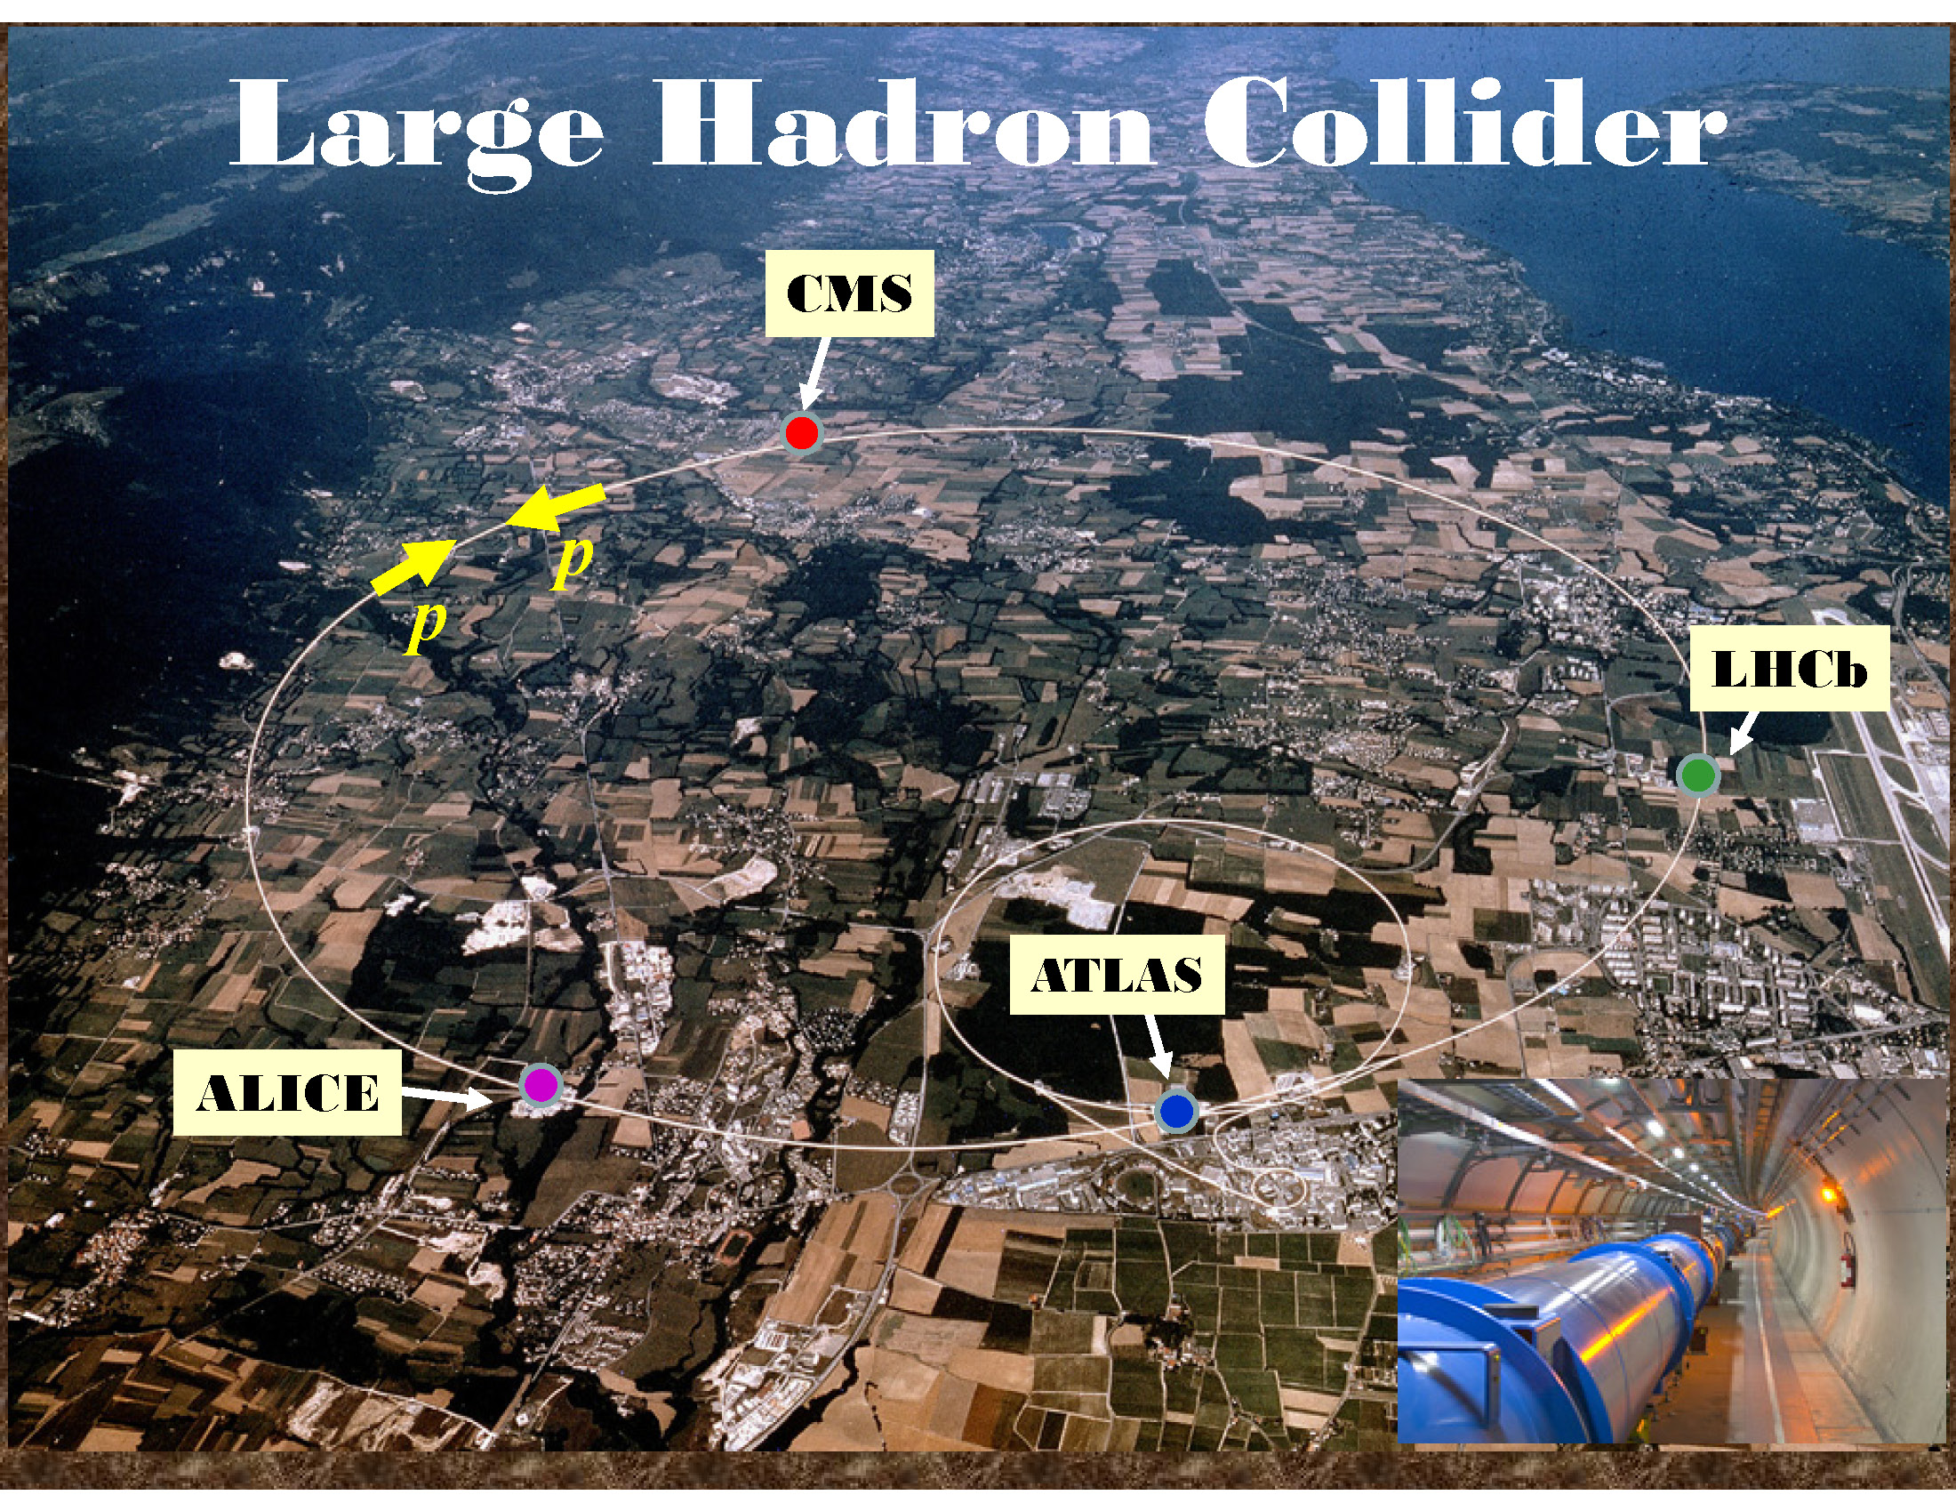
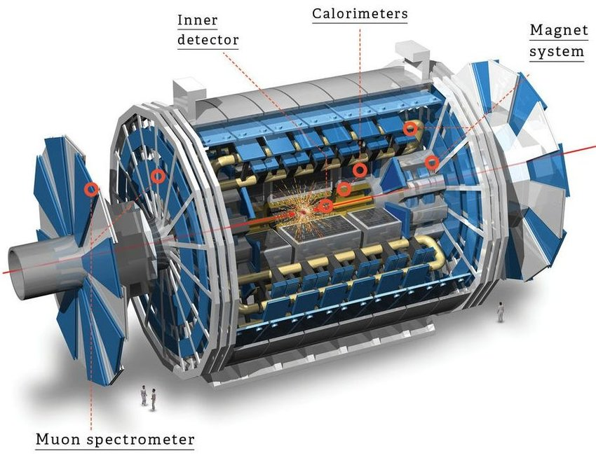
Large Hadron Collider & ATLAS experiment
Deeper understanding of the existing processes & exploration of New Physics
Higgs boson Discovery
Observation and precise measurements of rare processes

Slide 5
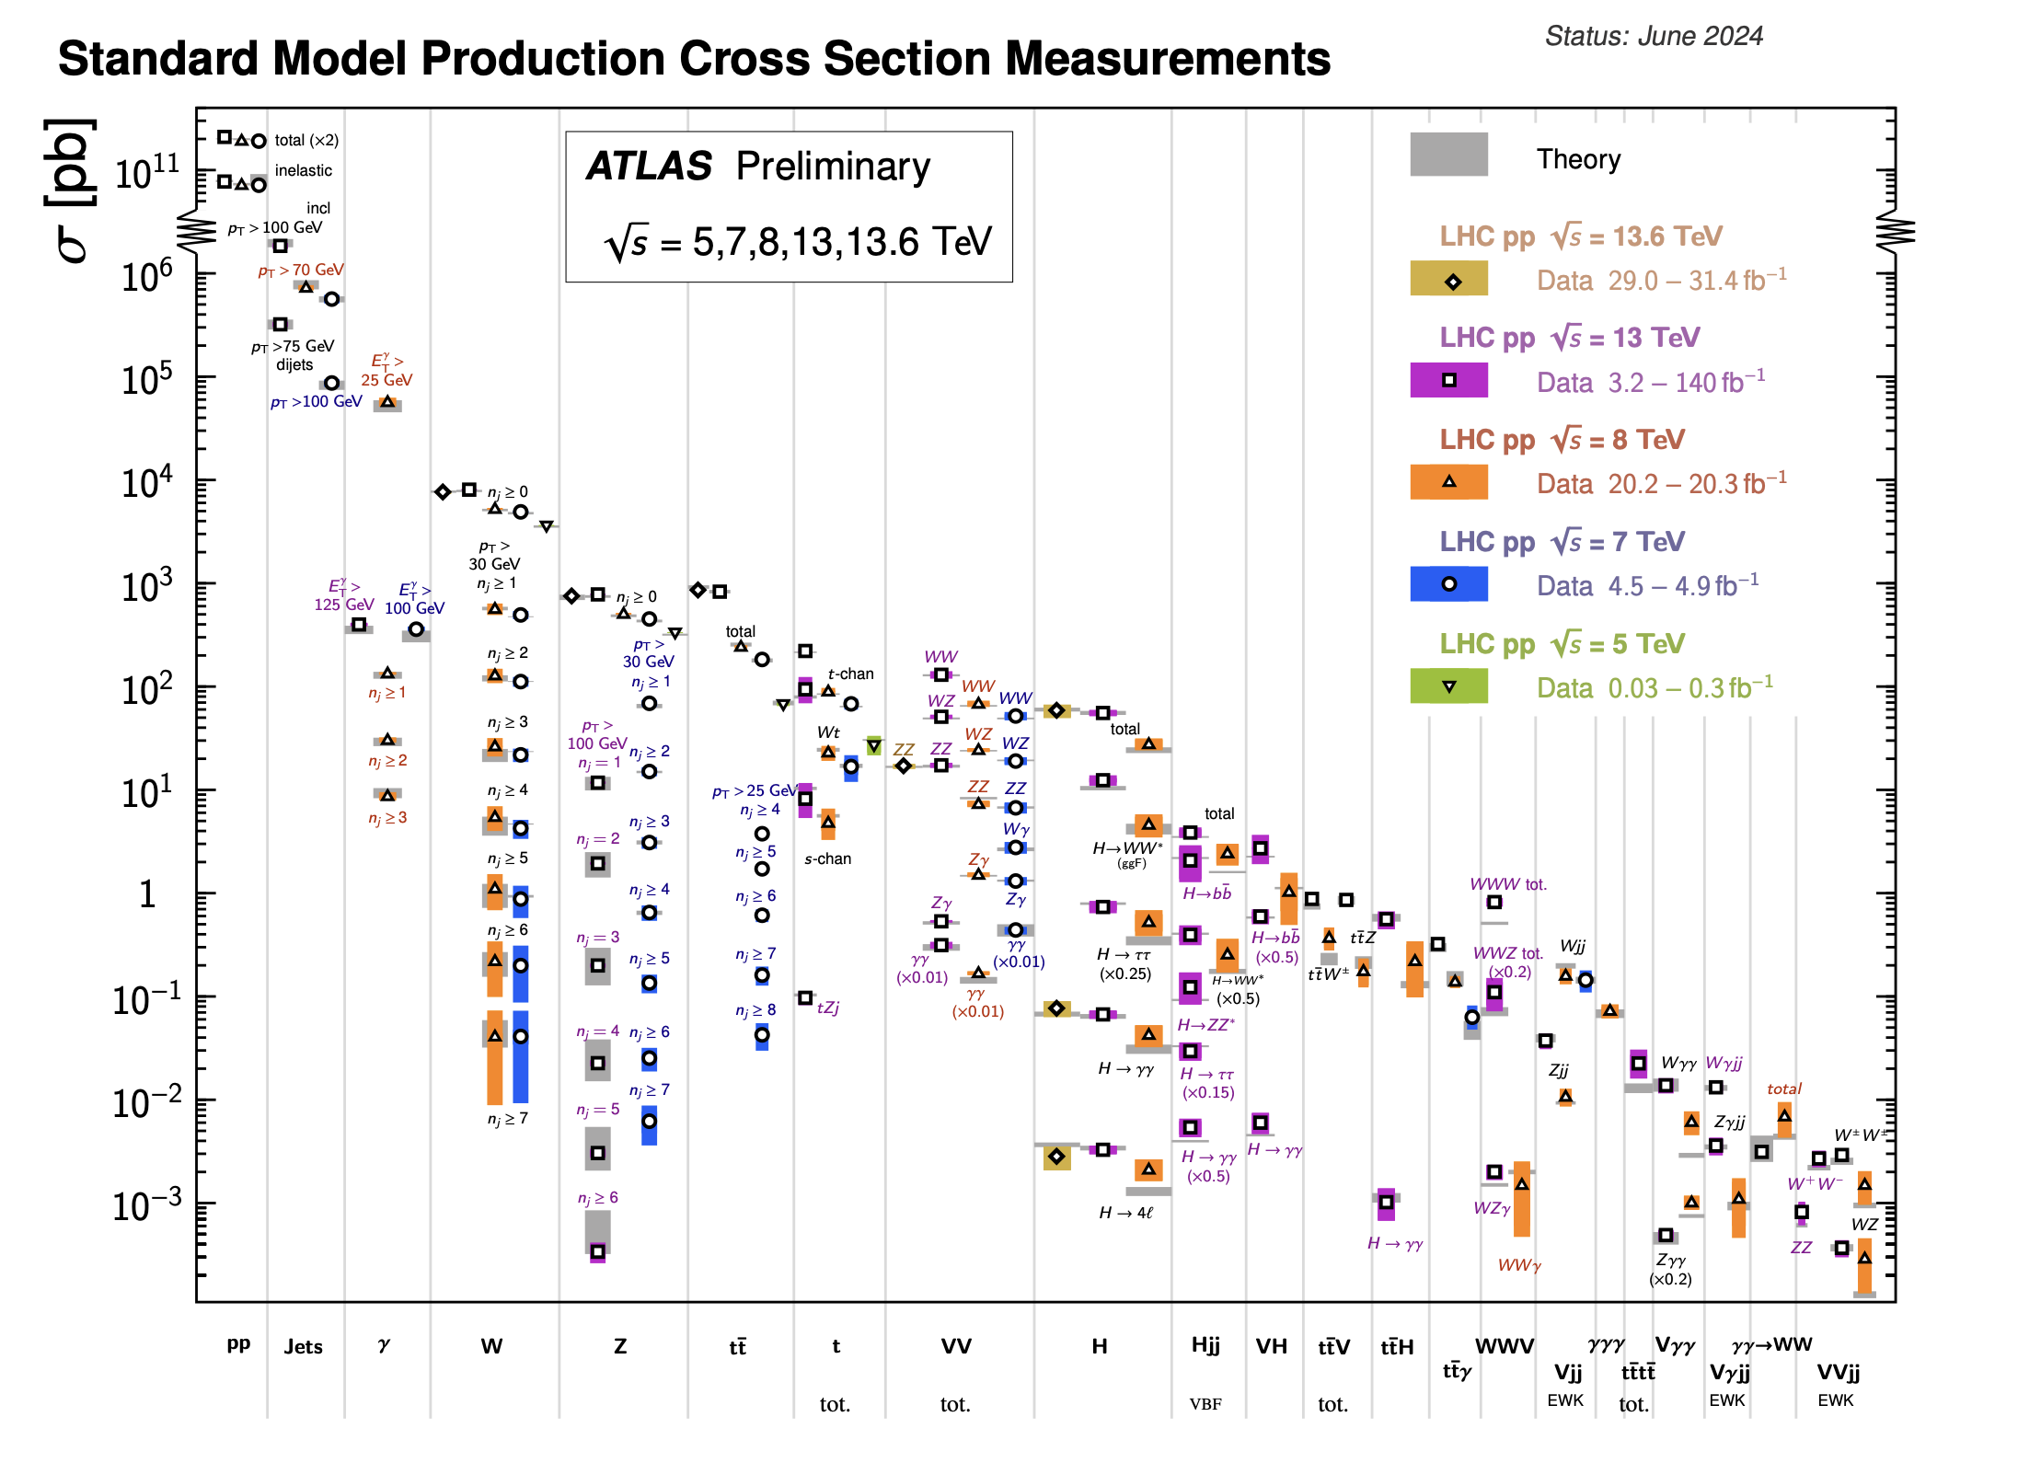
VBS as a rare process
Vector Boson Scattering (VBS)
ATL-PHYS-PUB-2024-011
Rare but very important process!
EW symmetry breaking
Vector boson self -couplings

Slide 6
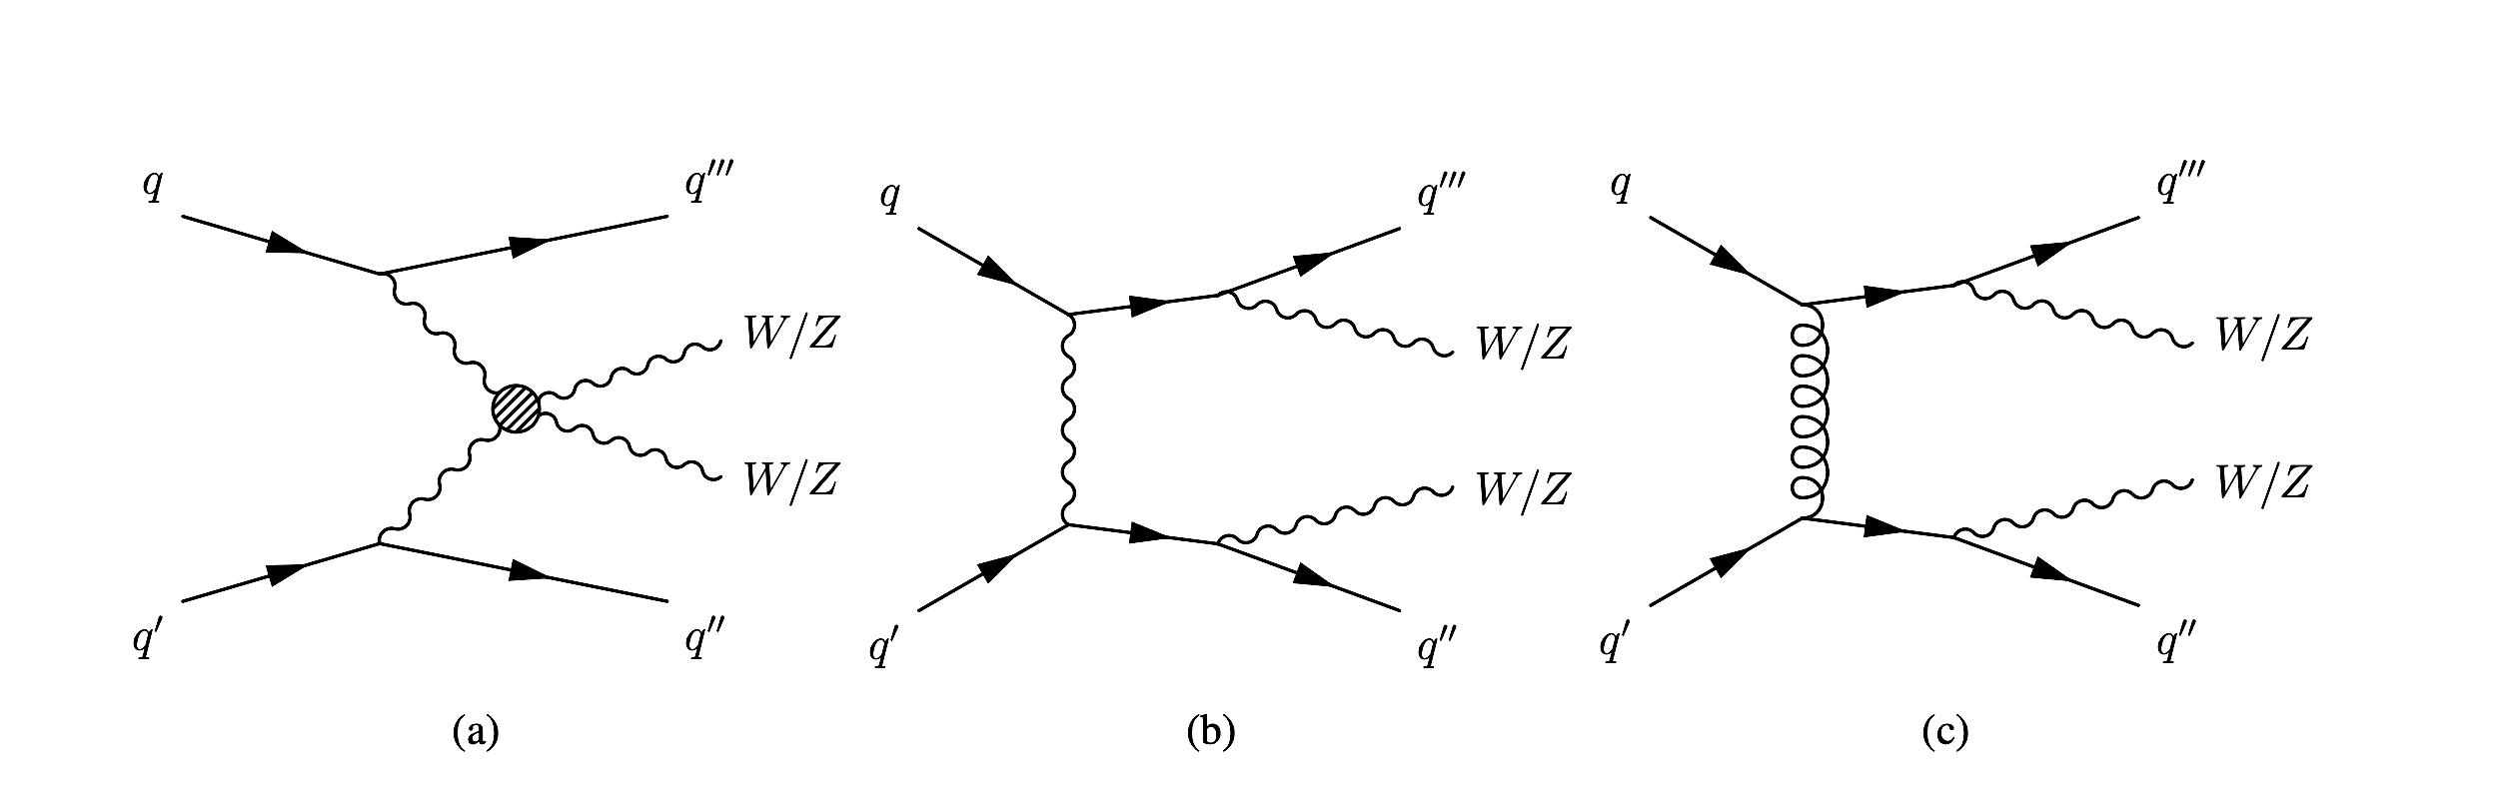
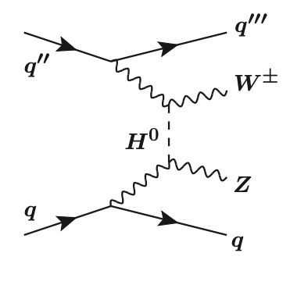
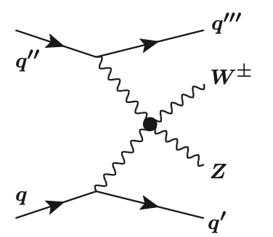
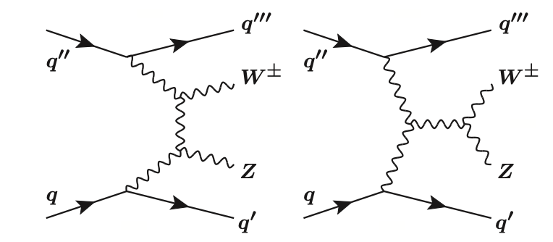


The Vector Boson Scattering process
$\sim a_{EW}$
$\sim a_{EW}$
EWK VVjj via VBS

Slide 7
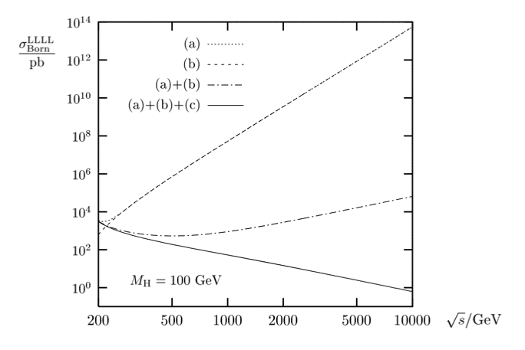
Polarized WZ production
Longitudinaly polarized boson prodcuction offers an excellent test of the electroweak symmetry breaking!
without higgs diagrams
without quartic coupling
full calculation
Unitarity violation if Higgs coupling deviates from SM!

Slide 8
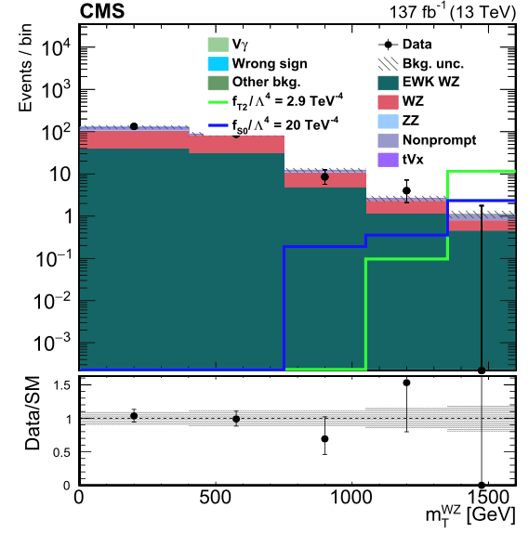
Quartic Gauge Coupling measurement
Quartic Gauge Coupling (QGCs)
Beyond SM theories predict enhanced couplings!
Any deviation might signal the existence of new physics!
Sensitivity to the presence of new Physics!

Slide 9
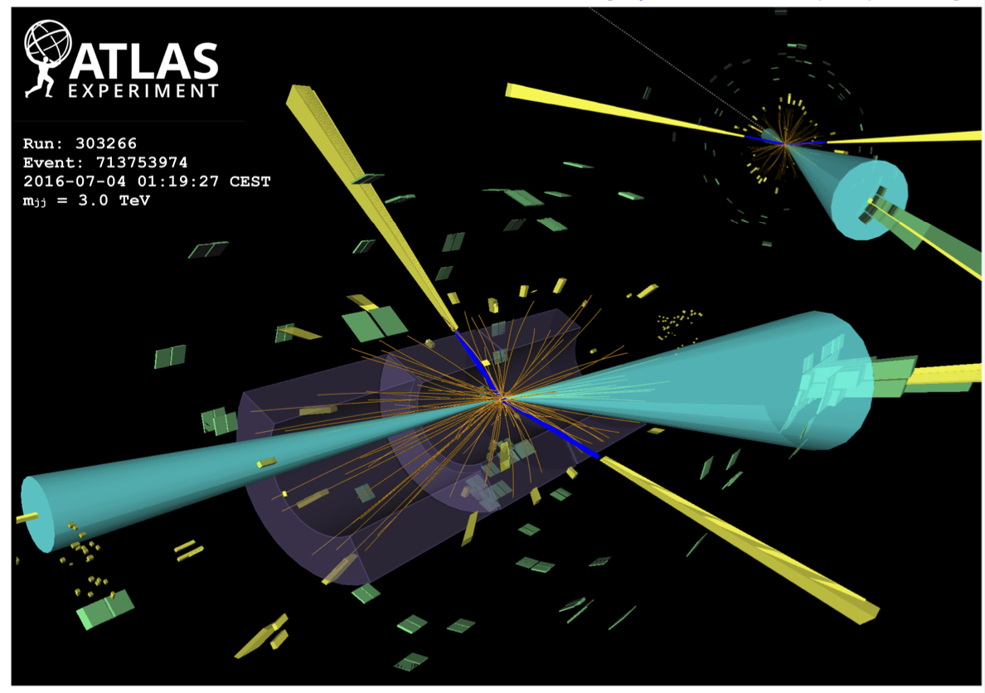


VBS event topology
Two oppositely charged leptons from Z (yellow)
One lepton and one neutrino from W ( yellow)
Two high energy forward jets (blue)
Additional jets due to higher order effects
WZ VBS Signal Region
$\sim a_{s}$
Major background source!
Fortunately, different topology!
$\sim a_{s}$
QCD VVjj

Slide 10
QCD background modeling

Slide 11
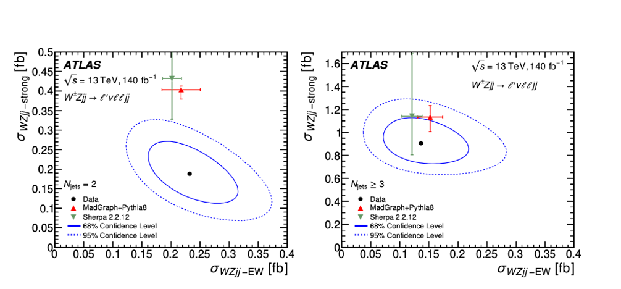
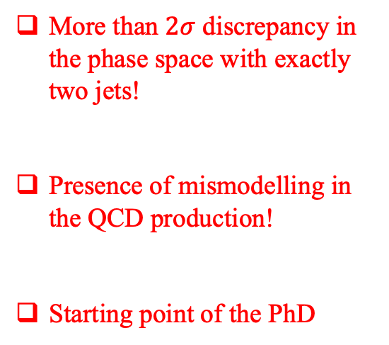
QCD background mismodeling
VBS (WZ) first observed by the ATLAS LAPP group at 2018
EW-QCD simulataneous measurement in different subregions
More than $2σ$ discrepancy in the phase space with exactly two jets!
Presence of mismodelling in the QCD production!
Starting point of the PhD
JHEP06(2024)192

Slide 12

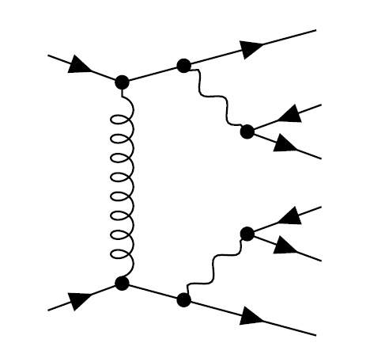
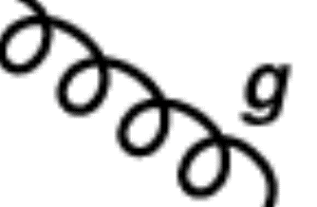
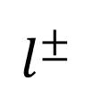


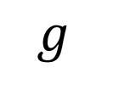

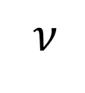
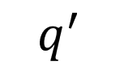
Generated Samples
Generator: MG5_aMC@NLO + Pythia8
LO generation (13TeV)
LO + 1j
LO + 2j
LO + 3j
Comparison against the Reference Sample: $pp→WZ→lllv+0, 1, 2j@NLO, \sqrt{s}=13 TeV$

Slide 13
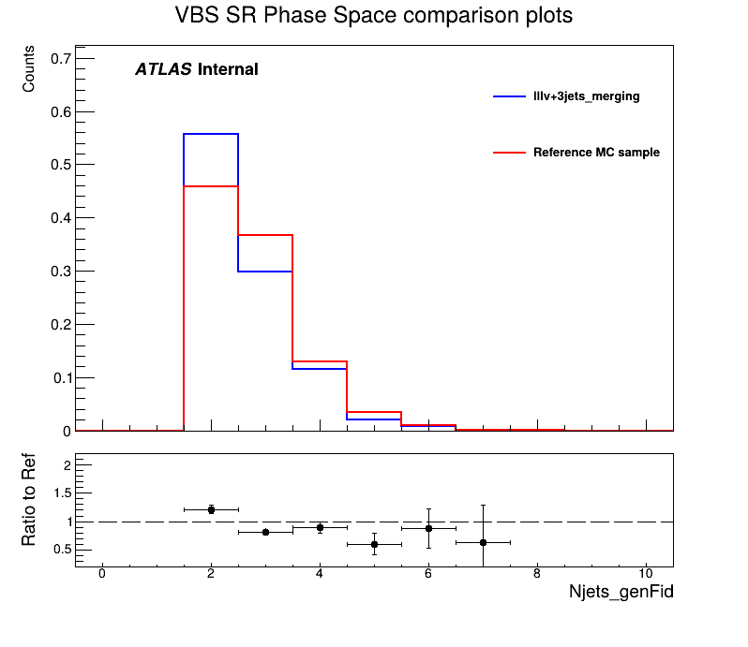
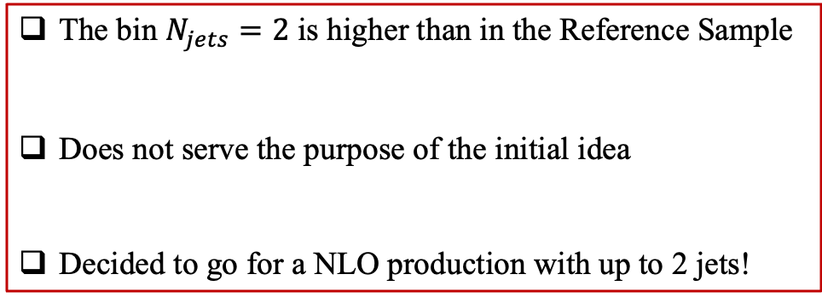
LO generation
The bin $N_{jets}=2$ is higher than in the Reference Sample
Does not serve the purpose of the initial idea
Decided to go for a NLO production with up to 2 jets!
Private Sample
Official Sample

Slide 14
Generated Samples
Generator: MG5_aMC@NLO + Pythia8
Different order/accuracy than the official
NLO generation (13.6 TeV)
Comparison against the official Sherpa 2.2.16 Sample: $pp→WZ→lllv+0, 1j@NLO+2,3j@LO, \sqrt{s}=13.6 TeV$

Slide 15
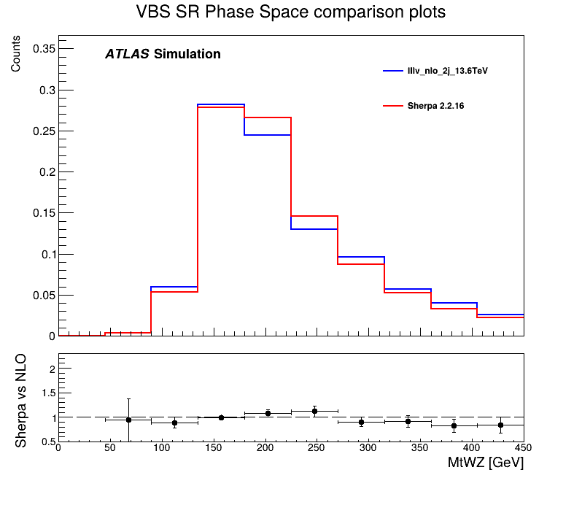
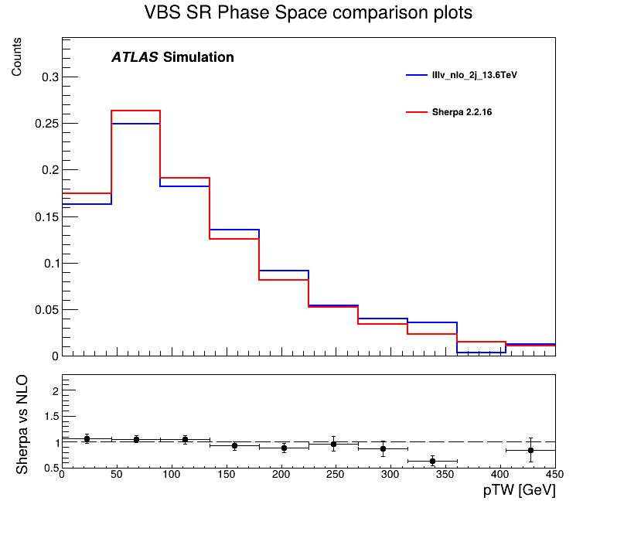
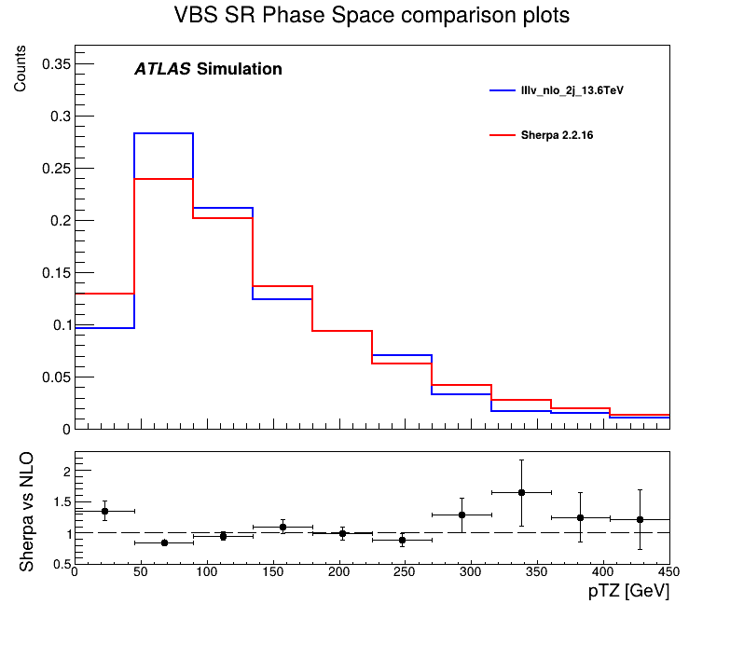
NLO generation
Private Sample
There seems to be agreement between the predictions of the two samples!
Official Sample

Slide 16
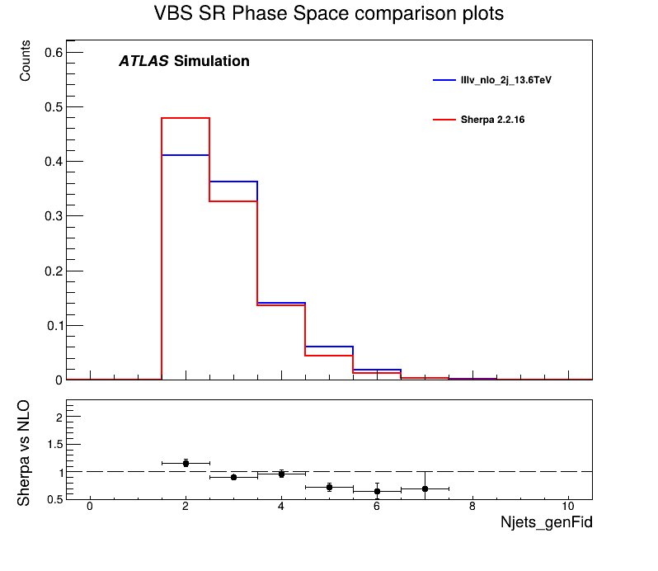
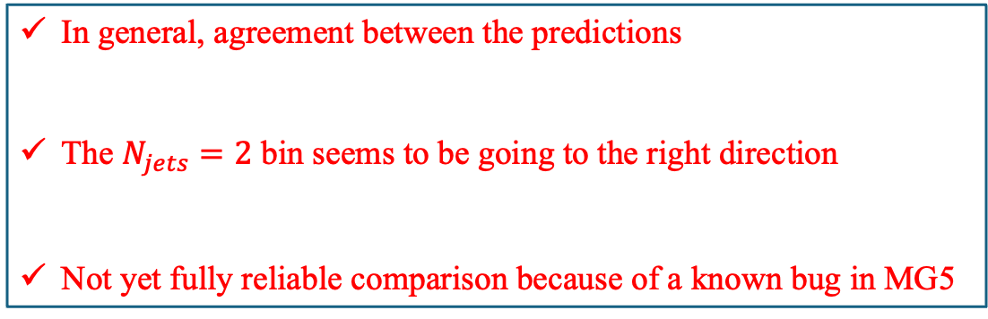
NLO generation
In general, agreement between the predictions
The $N_{jets}=2$ bin seems to be going to the right direction
Not yet fully reliable comparison because of a known bug in MG5
Private Sample
Official Sample

Slide 17
Qualification Project

Slide 18
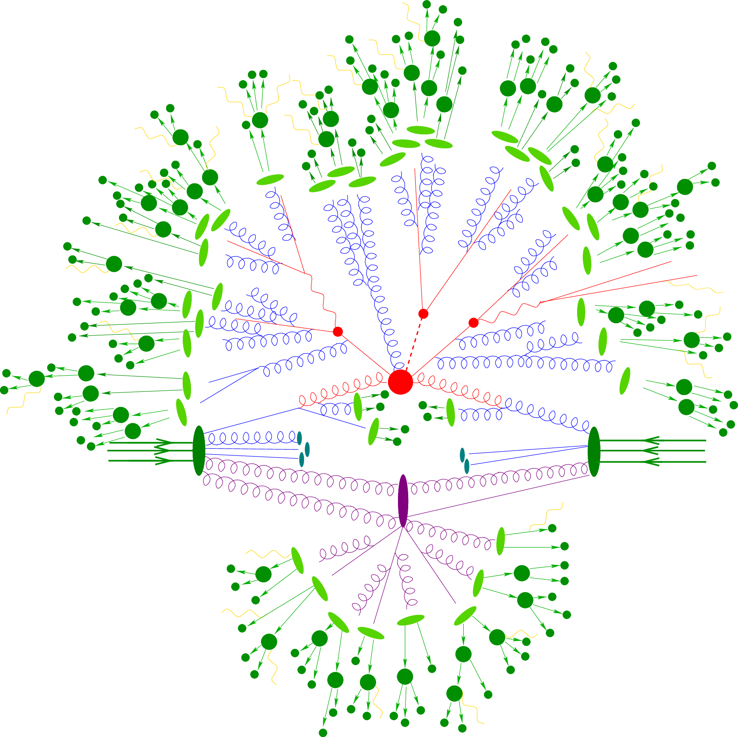

Qualification Project
Qualification Project: 1st year ATLAS PhD students project in order to qualify and become ATLAS authors
Duration: 1 year
My Qualification Project
Use the MG5_aMC@NLO Monte Carlo generator to improve QCD initiated $VV+2jets$ simulations for several diboson channels:
$WZ→lllv$
$ZZ→llll$
$ZZ→llvv$
$ssWW →lvlv$
$osWW →lvlv$

Slide 19
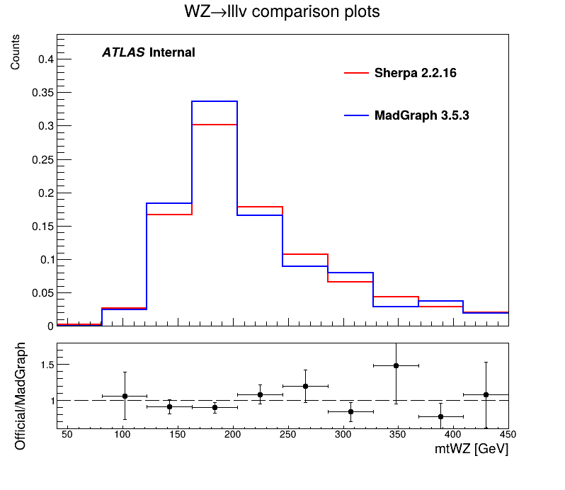
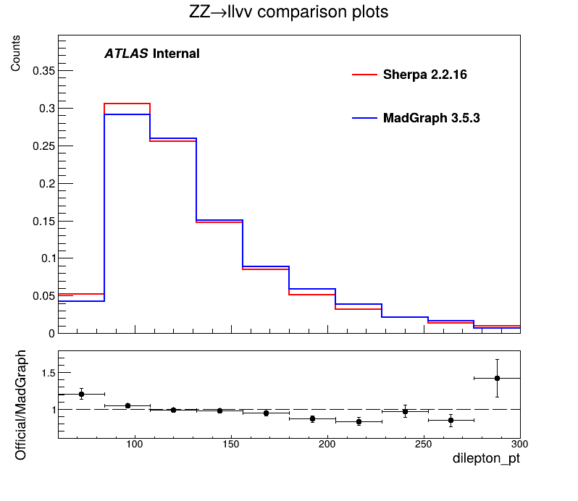
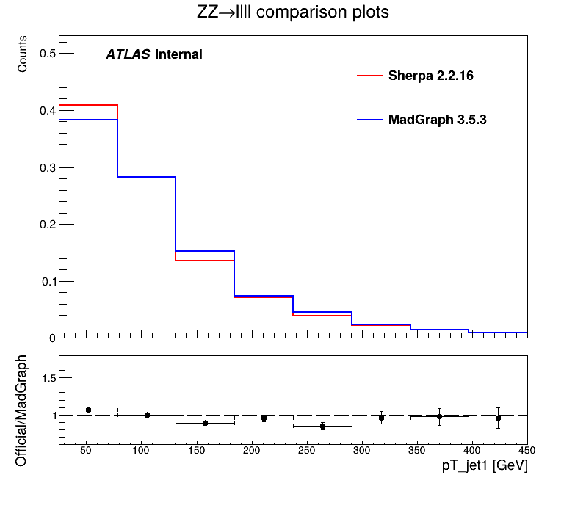
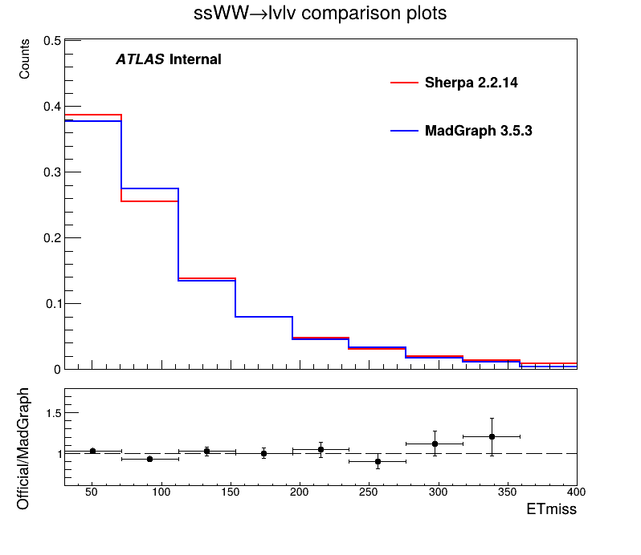




Validation Plots
$$m_{T}^{WZ}$$
$$p_{T}^{dilep}$$
Private Sample
Official Sample
$$p_{T}^{j1}$$
$$E_{T}^{miss}$$

Slide 20
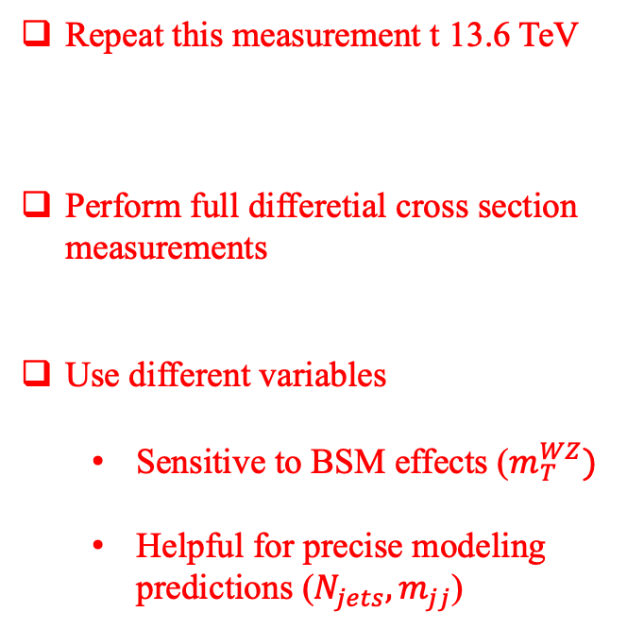
Prospectives and next steps
VBS (WZ) first observed by the ATLAS LAPP group at 2018
EW-QCD simulataneous measurement in different subregions
Repeat this measurement t 13.6 TeV
Perform full differetial cross section measurements
Use different variables
Sensitive to BSM effects ($m_{T}^{WZ})$
Helpful for precise modeling predictions ($N_{jets},m_{jj}$)
JHEP06(2024)192

Slide 21
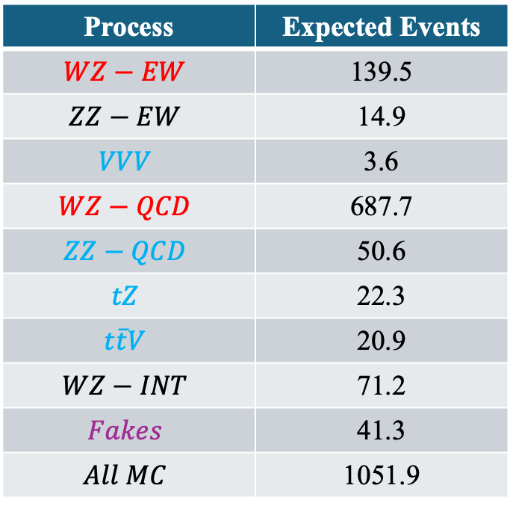
Preliminary Results
Just started working with 2022-2024 data but still in a preliminary stage!
Process | Expected Events
$$WZ−EW$$ | 139.5
$$ZZ−EW$$ | 14.9
$$VVV$$ | 3.6
$$WZ−QCD$$ | 687.7
$$ZZ−QCD$$ | 50.6
$$tZ$$ | 22.3
$$t\overline{t}V$$ | 20.9
$$WZ−INT$$ | 71.2
$$Fakes$$ | 41.3
$$All MC$$ | 1051.9
Measure simultaneously
Constrain in dedicated CRs
Measured using data
Run2: 108 events (observed)
Full Run3: 340 events

Slide 22
Doctoral School Training
Successfully registered training hours:
Physics in the XXIst Centrury (13 March – 22 May 2025, 20 hours)
Français Langue Etrangère (20 January – 18 April 2025, 45 hours)
Constuire son Projet Professionnel (26 March – 27 March 2025, 12h)
Journée de rentrée des doctorants (14 November 2024, 4h)
Summer Schools:
Gray Scott Computing School (L.A.P.P., Annecy, 23 June – 4 July 2025)
Talks and conferences:
Physique ATLAS France (Conference, Annecy, 26 May – 28 May 2025)
Congrès Général de la Société Française de Physique (Talk: Studying the VBS process, Troyes, 30 June – 4 July)
WZ leptonic weekly meeting (Frequently presenting progress)
PMG Weak Boson meeting (Frequently presenting progress for my QP)
Shifts in the ATLAS Control Room

Slide 23
Backup Slides

Slide 24
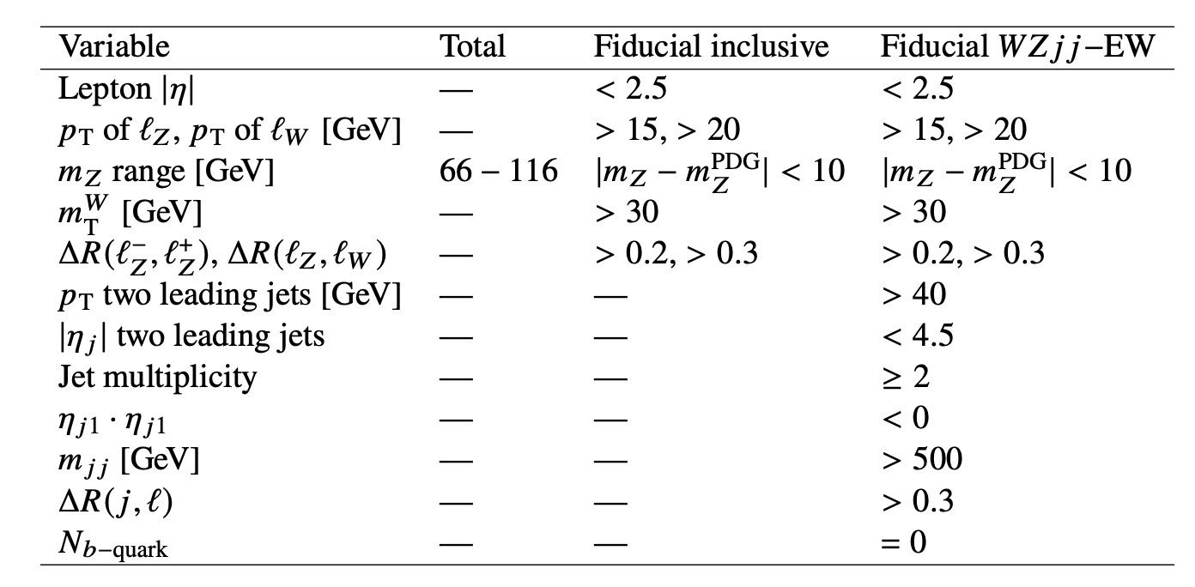
Phase Spaces
Fiducial Inclusive
Fiducial WZjj – EW Signal Region

Slide 25
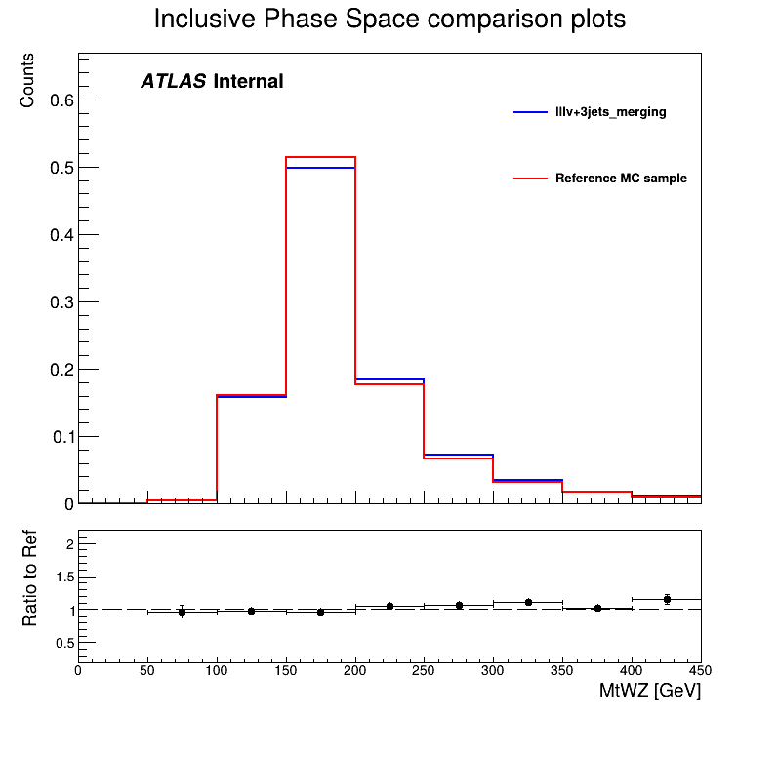
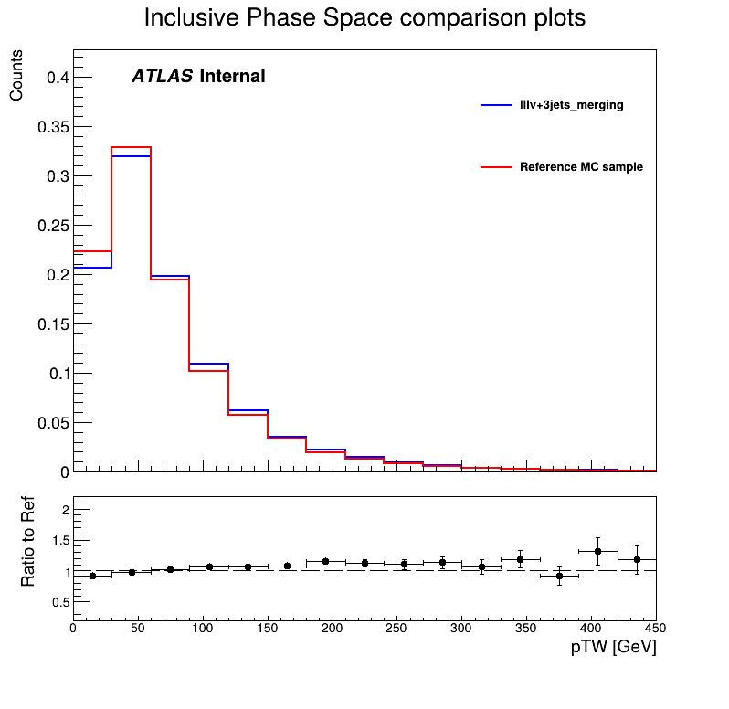
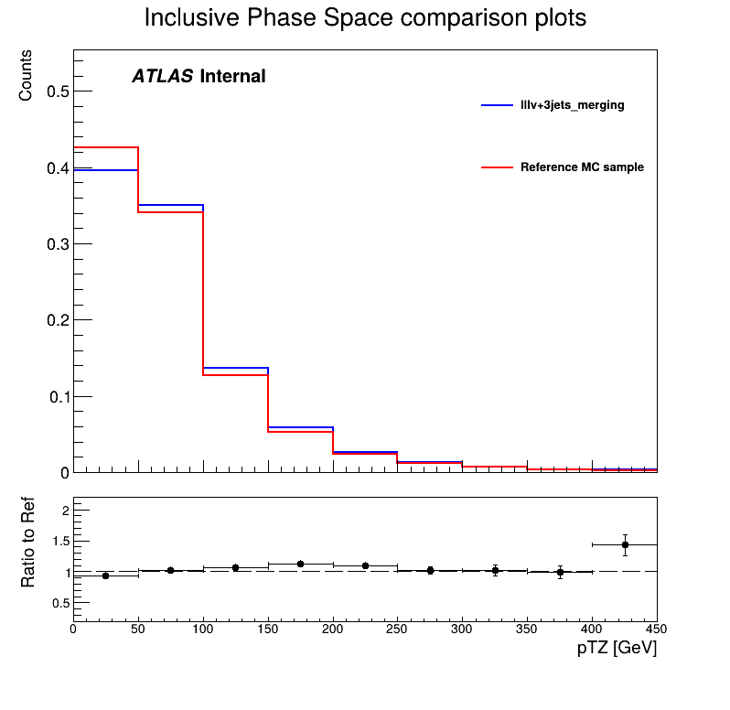
WZ Inclusive Phase Space
Good agreement between the predictions of the two samples in the WZ Inclusive Phase Space!

Slide 26
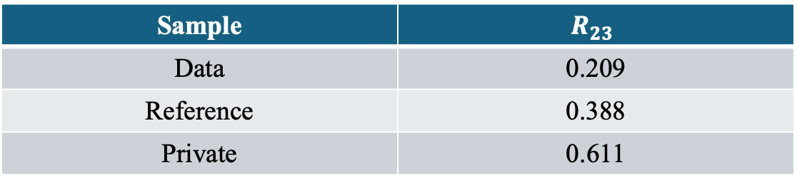

$R_{23}$ values
$$R_{23}= \frac{σ_{N_{jets }= 2}}{σ_{N_{jets} > 2 }}$$
The LO sample predictions seem to be really off!
Sample | $$R_{23}$$
Data | 0.209
Reference | 0.388
Private | 0.611
Therefore the idea of LO generation was abandoned, and we will proceed with the NLO generation!

Slide 27
Private Sample vs Reference Sample at 13TeV

Slide 28
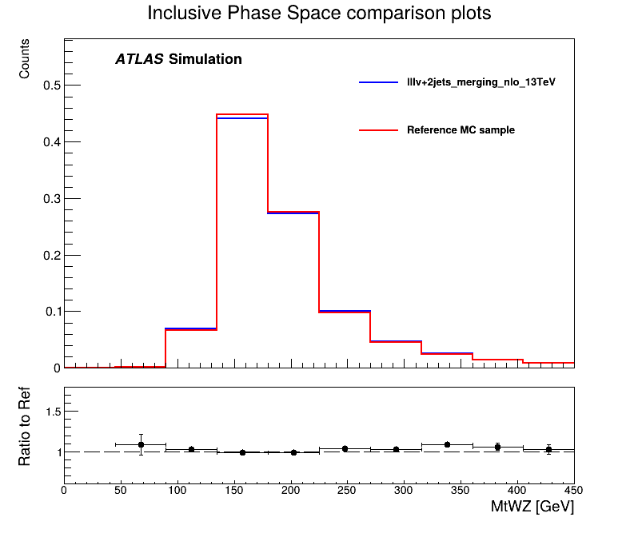
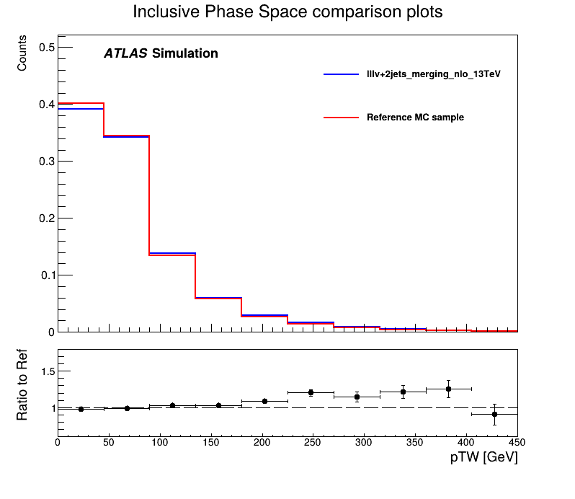
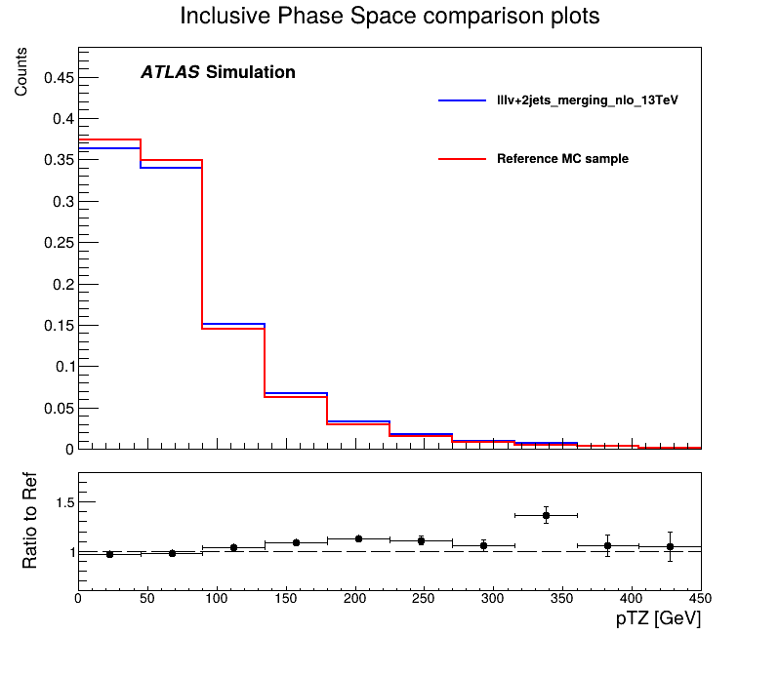
WZ Inclusive Phase Space
Good agreement between the predictions of the two samples in the WZ Inclusive Phase Space!

Slide 29
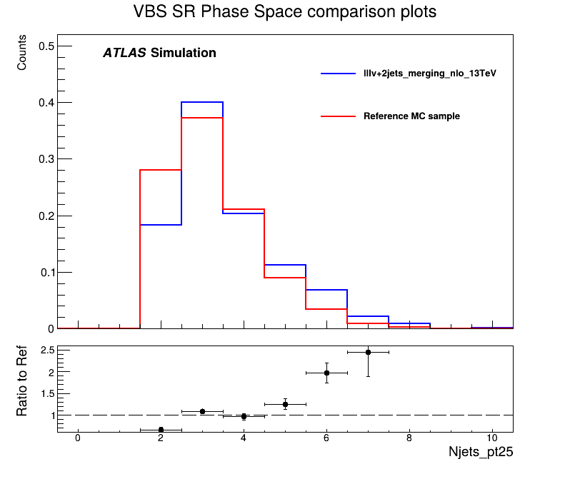
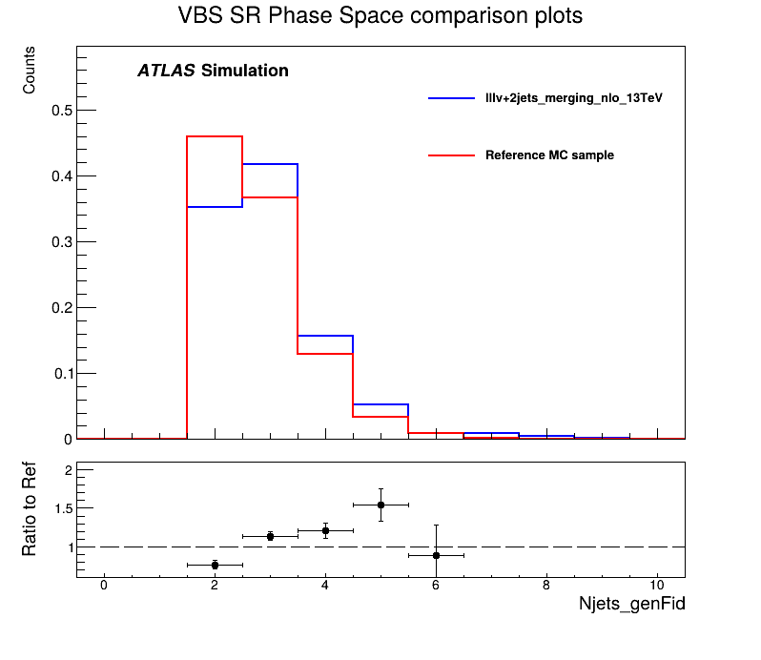
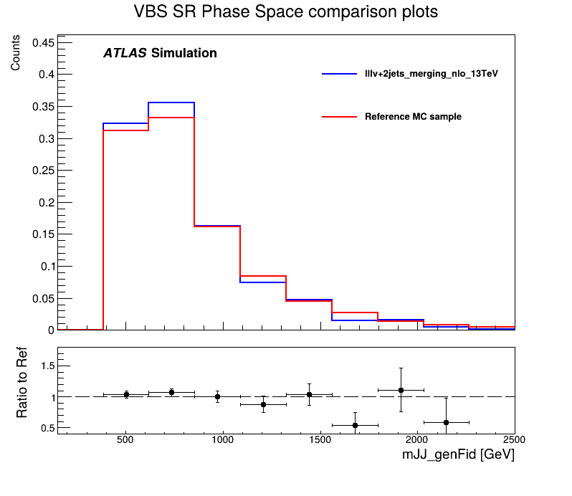
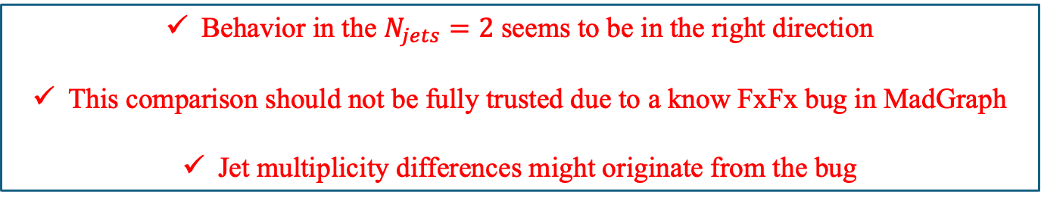
WZ VBS Signal Region
Behavior in the $N_{jets}=2$ seems to be in the right direction
This comparison should not be fully trusted due to a know FxFx bug in MadGraph
Jet multiplicity differences might originate from the bug

Slide 30
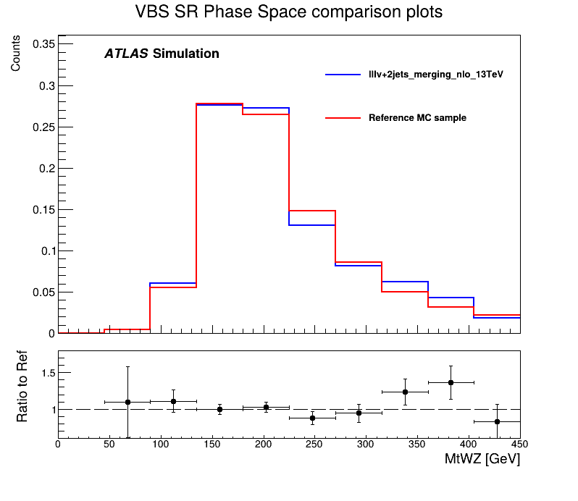
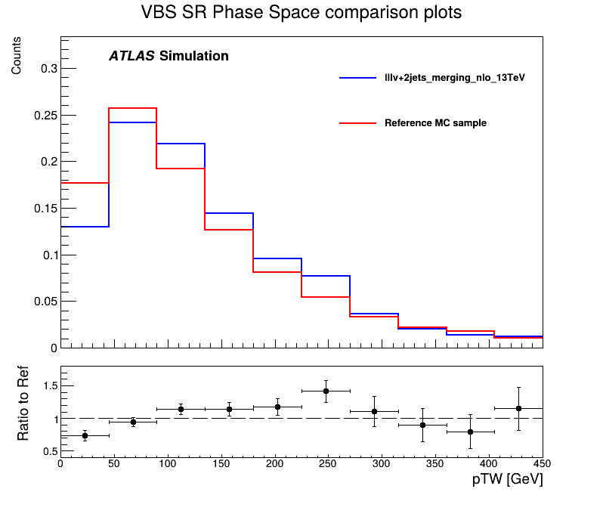
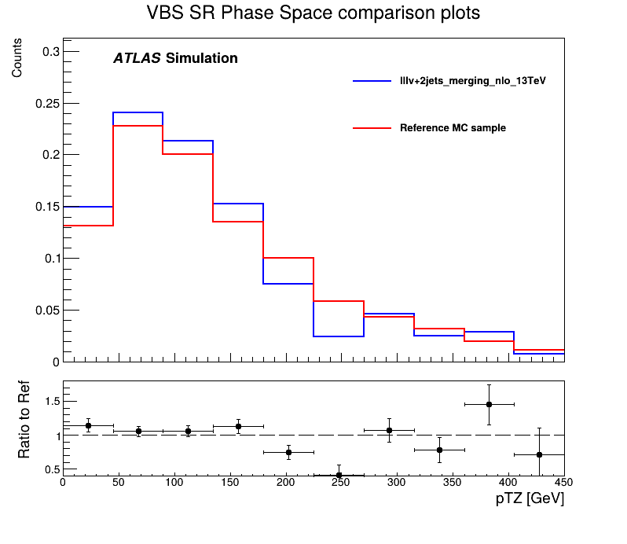
WZ VBS Signal Region
Although there is a clear lack of statistics, there seems to be agreement between the predictions of the two samples in the WZ VBS SR!

Slide 31
Private Sample at 13.6 TeV vs 13 TeV

Slide 32
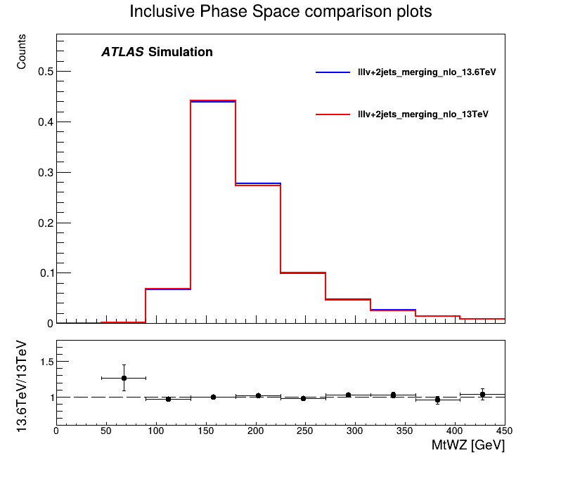


WZ Inclusive Phase Space
Good agreement between the predictions of the two samples in the WZ Inclusive Phase Space!

Slide 33



WZ VBS Signal Region
Although there is a clear lack of statistics, the change in energy seems to have a negligible effect on the distirbutions

Slide 34

Generated Samples
Idea: Replicate the NLO effect by generating the LO process and adding jets to the matrix element
Tools for generation
Samples generated
Matrix Element: MG5_aMC@NLO
Parton Shower: Pythia8
Matching/Merging Algorithm: CKKW-L
$pp→WZ→lllv+0j, \sqrt{s}=13 TeV$
$pp→WZ→lllv+0, 1j, \sqrt{s}=13 TeV$
$pp→WZ→lllv+0, 1, 2j, \sqrt{s}=13 TeV$
$pp→WZ→lllv+0, 1, 2, 3j, \sqrt{s}=13 TeV$
Comparison against the Reference Sample: $pp→WZ→lllv+0, 1, 2j@NLO, \sqrt{s}=13 TeV$

Slide 35

Generated Samples
Tools for generation
Samples generated
Matrix Element: MG5_aMC@NLO
Parton Shower: Pythia8
Matching/Merging Algorithm: FxFx
$pp→WZ→lllv+0, 1, 2j, \sqrt{s}=13 TeV$
$pp→WZ→lllv+0, 1, 2j, \sqrt{s}=13.6 TeV$
Comparison against the Reference Sample: $pp→WZ→lllv+0, 1, 2j@NLO, \sqrt{s}=13 TeV$
Comparison against the Sherpa 2.2.16 Sample: $pp→WZ→lllv+0, 1@NLO+2,3j@LO, \sqrt{s}=13.6 TeV$

Slide 36

Gridpack and Event Generation
Generation Steps
Gridpack generation
Matrix element calcutations
Feynman digrams
Events generation
Actual MC events

