Slide 1

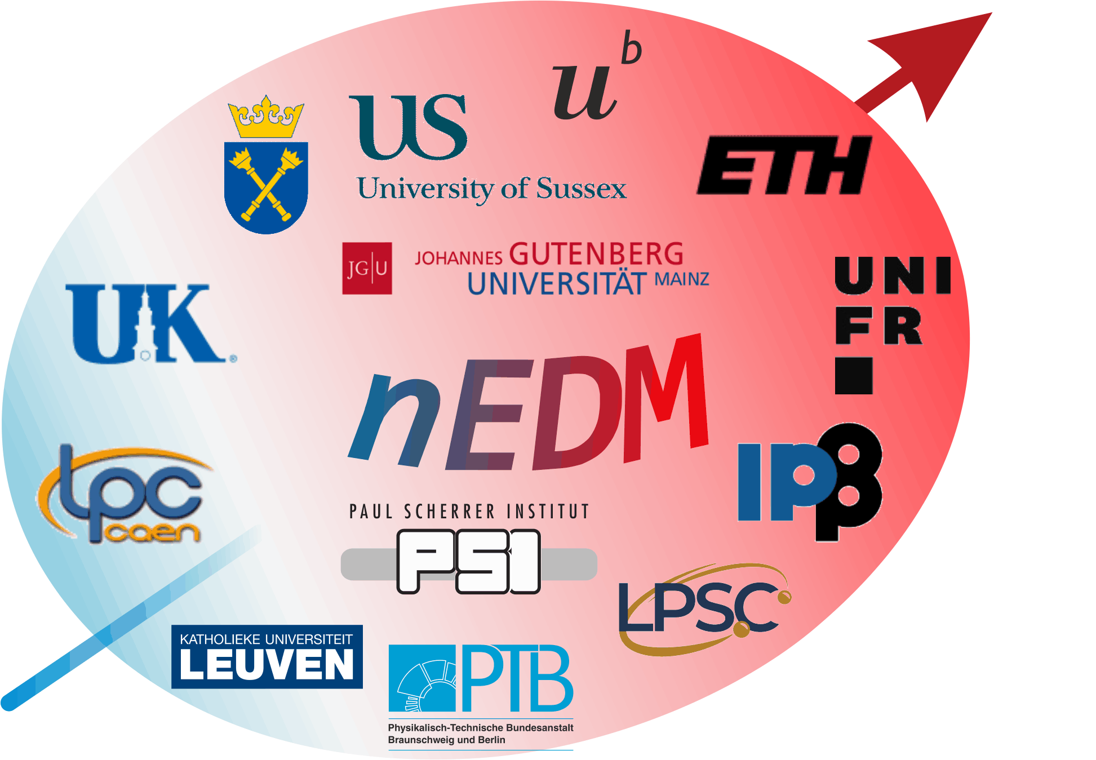

Measuring the neutron Electric Dipole Moment for CP violation searches with the n2EDM experiment
Katia Michielsen, LPSC Grenoble, neutrons ultra froids
7th November 2025

Slide 2
Outline
Context
Overview of the n2EDM experiment
Hg co-magnetometer
n2EDM status and outlook

Slide 3
I- Context What is the Electric Dipole Moment ? - a CP-violation probe - a new physics probe
I – Context
Shakarov criteria for matter-antimatter asymmetry during baryogenesis
C and CP violation
Baryon number violation
Out of equilibrium
One can quantify the sensitivity of observables to new physics using Effective Field Theories (EFT).

Slide 4
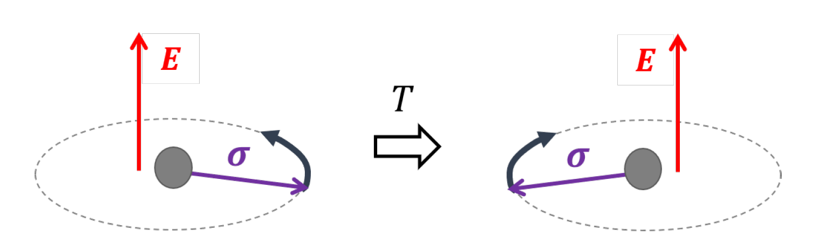
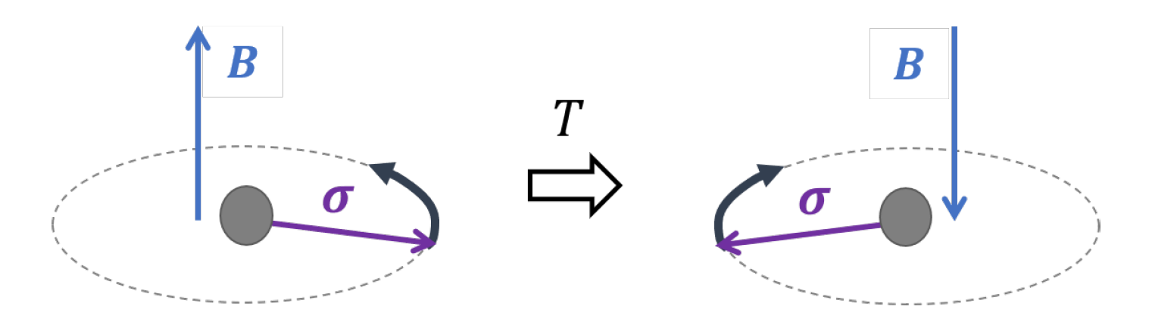
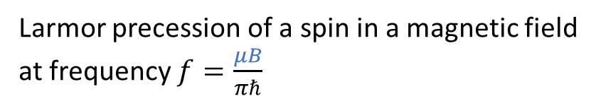
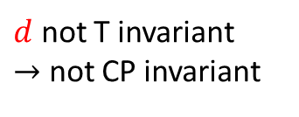
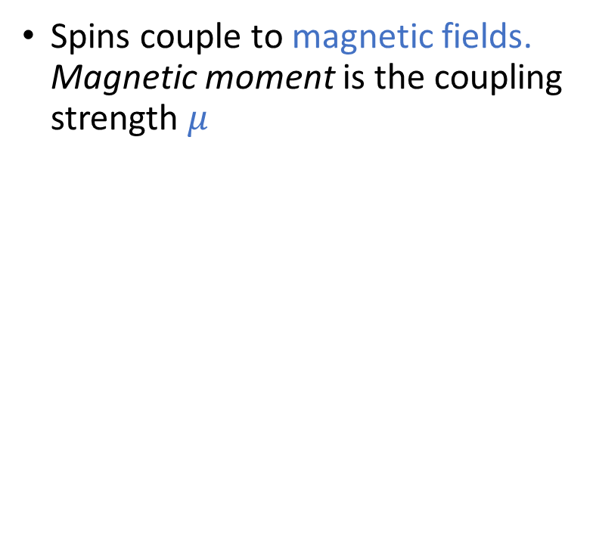


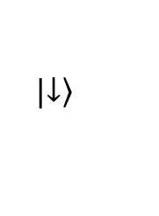

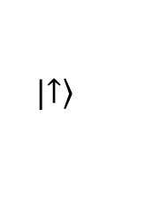
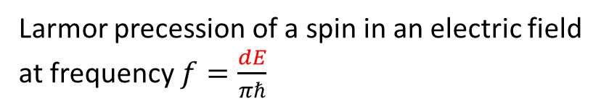
What is an Electric Dipole Moment?
I - Context
Spins couple to magnetic fields. Magnetic moment is the coupling strength $μ$
Spins couple to electric fields. EDM is the coupling strength $d$
Non-relativistic limit of the fermion-photon interaction:
$$H=−μ σB −d σE$$
Energy
$$|\left.↑\right\rangle$$
$d$ not T invariant
$→$ not CP invariant
$$ℏω=2μB$$
$$|\left.↓\right\rangle$$
Larmor precession of a spin in a magnetic field
at frequency $f=\frac{μB}{πℏ}$
Larmor precession of a spin in an electric field
at frequency $f=\frac{dE}{πℏ}$
Notes:
Comment faire le lien avec une distribution de charge à l’intérieur du noyau??

Slide 5
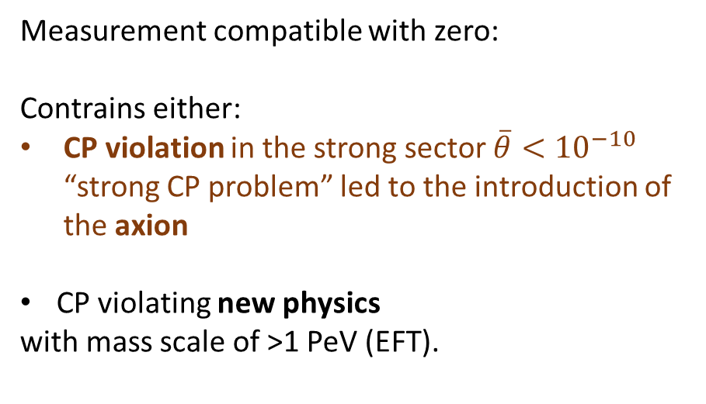
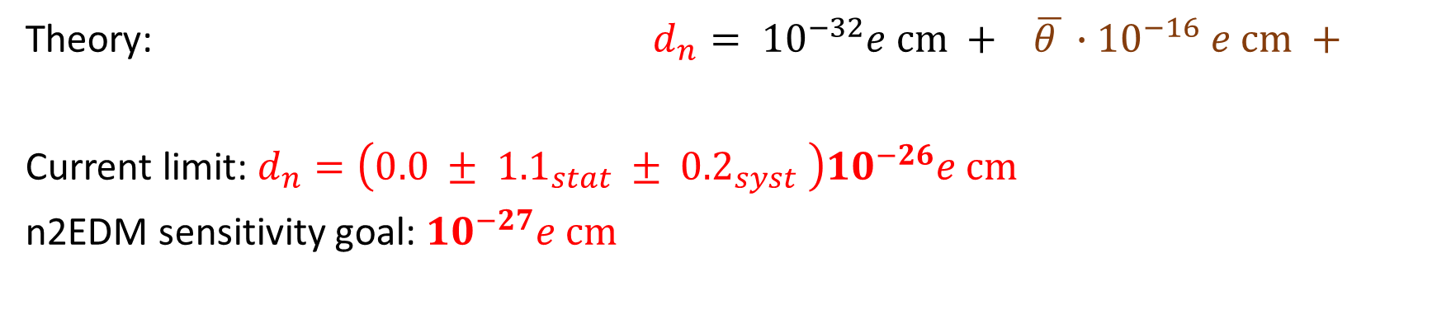
What do we know about the nEDM?
I - Context
Theory: $d_{n}= {10}^{−32}e cm + \overline{θ }∙{10}^{−16} e cm +$
Current limit: $d_{n}=\left(0.0 ± {1.1}_{stat} ± {0.2}_{syst} \right){10}^{−26}e cm$
n2EDM sensitivity goal: ${10}^{−27}e cm$
weak interaction
strong interaction
new physics?
Measurement compatible with zero:
Contrains either:
CP violation in the strong sector $\overline{θ}<{10}^{−10}$ “strong CP problem” led to the introduction of the axion
CP violating new physics
with mass scale of >1 PeV (EFT).
Non-zero measurement:
But where from??
Complementary EDM measurements required:
proton, electron, muon EDM
Measurement of the Permanent Electric Dipole Moment of the Neutron, nEDM collaboration, 2020

Slide 6

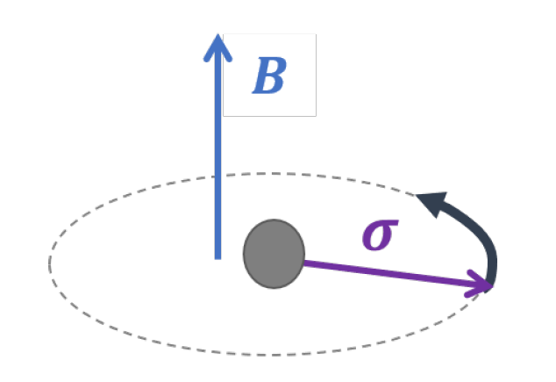

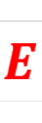
II- How do we measure the neutron EDM at
I – Context II – n2EDM overview
1. Measurement concept

Slide 7
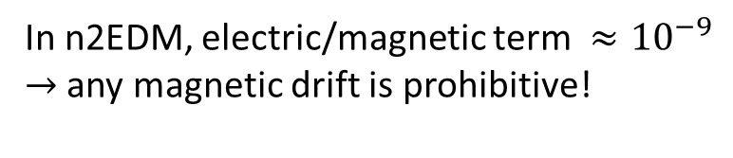


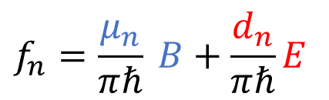
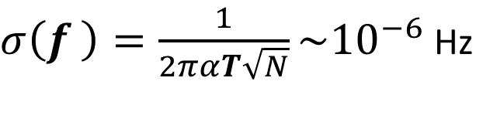
nEDM measurement concept
I – Context II – n2EDM overview
I – Context II – n2EDM
Larmor precession frequency measurement.
in a weak magnetic field and strong electric field.
$$1 μT$$
We measure the neutron spin at the end of a precession duration of 3 min.
$$15 kV/cm$$
$σ\left(f_{ }\right)=\frac{1}{2παT\sqrt{N}}\sim {10}^{−6}$ Hz
$$f_{n}=\frac{μ_{n}}{πℏ} B+\frac{d_{n}}{πℏ}E$$
In n2EDM, electric/magnetic term $≈{10}^{−9}$
$→$ any magnetic drift is prohibitive!
Measurement of the Permanent Electric Dipole Moment of the Neutron, nEDM collaboration, 2020

Slide 8
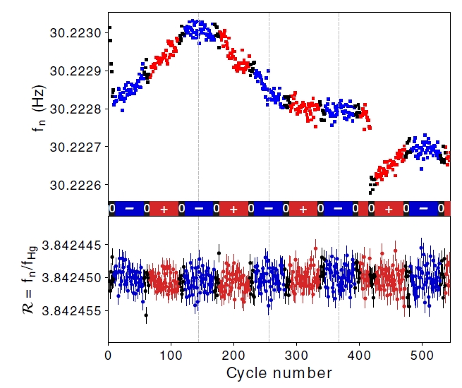

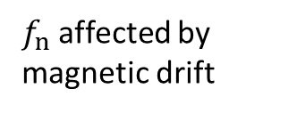
nEDM measurement concept
I – Context II – n2EDM overview
I – Context II – n2EDM
Larmor precession frequency measurement.
in a weak magnetic field and strong electric field.
$$1 μT$$
$f_{n}$ affected by magnetic drift
$$15 kV/cm$$
$$f_{n}=\frac{μ_{n}}{πℏ} B+\frac{d_{n}}{πℏ}E$$
$f_{n}$ after correction
In n2EDM, electric/magnetic term $≈{10}^{−9}$
$→$ any magnetic drift is prohibitive!
Effect of the magnetic field drift in the nEDM experiment
Measurement of the Permanent Electric Dipole Moment of the Neutron, nEDM collaboration, 2020

Slide 9


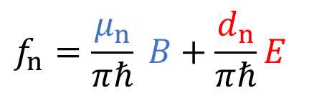
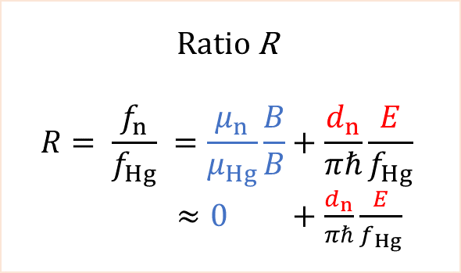
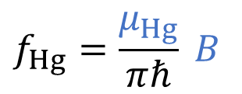
Measure the neutron EDM: frequency ratio
I – Context II – n2EDM overview
I – Context II – n2EDM
$$1 μT$$
Ratio R
$$R= \frac{f_{n}}{f_{Hg}} =\frac{μ_{n}}{μ_{Hg}}\frac{B}{B}+\frac{d_{n}}{πℏ}\frac{E}{f_{Hg}}$$
$≈0 +\frac{d_{n}}{πℏ}\frac{E}{f_{Hg}}$
$$15 kV/cm$$
Measurement:
(destructive)
spin asymmetry
continuous
optical reading
$$f_{n}=\frac{μ_{n}}{πℏ} B+\frac{d_{n}}{πℏ}E$$
$$f_{Hg}=\frac{μ_{Hg}}{πℏ} B$$
Hg co-magnetometer
Reduced limit on the permanent electric dipole moment of Hg 199. Graner, Brent, et al. PRL (2016) :Hg EDM ${|d}_{Hg}|<{7,4 10}^{−30} e$ cm

Slide 10
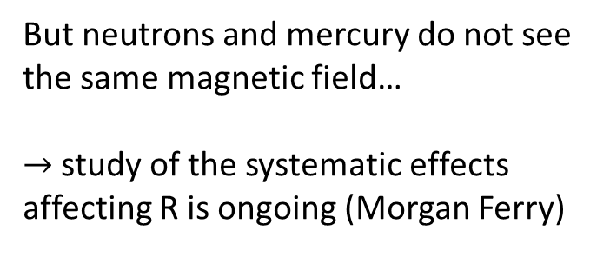
Measure the neutron EDM: frequency ratio
I – Context II – n2EDM overview
I – Context II – n2EDM
$$1 μT$$
Ratio R
$$R= \frac{f_{n}}{f_{Hg}} =\frac{μ_{n}}{μ_{Hg}}\frac{B}{B}+\frac{d_{n}}{πℏ}\frac{E}{f_{Hg}}$$
$≈0 +\frac{d_{n}}{πℏ}\frac{E}{f_{Hg}}$
$$15 kV/cm$$
Measurement:
(destructive)
spin asymmetry
continuous
optical reading
$$f_{n}=\frac{μ_{n}}{πℏ} B+\frac{d_{n}}{πℏ}E$$
But neutrons and mercury do not see the same magnetic field…
$→$ study of the systematic effects affecting R is ongoing (Morgan Ferry)
$$f_{Hg}=\frac{μ_{Hg}}{πℏ} B$$
Hg co-magnetometer
Reduced limit on the permanent electric dipole moment of Hg 199. Graner, Brent, et al. PRL (2016) :Hg EDM ${|d}_{Hg}|<{7,4 10}^{−30} e$ cm

Slide 11

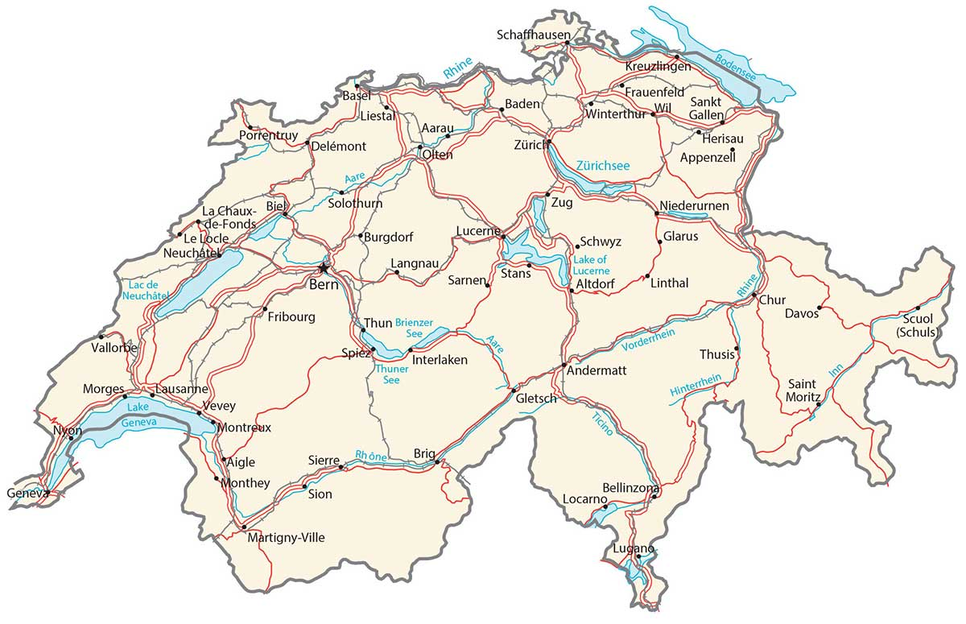
II- How do we measure the neutron EDM at
I – Context II – n2EDM overview
2. Experimental setup

Slide 12
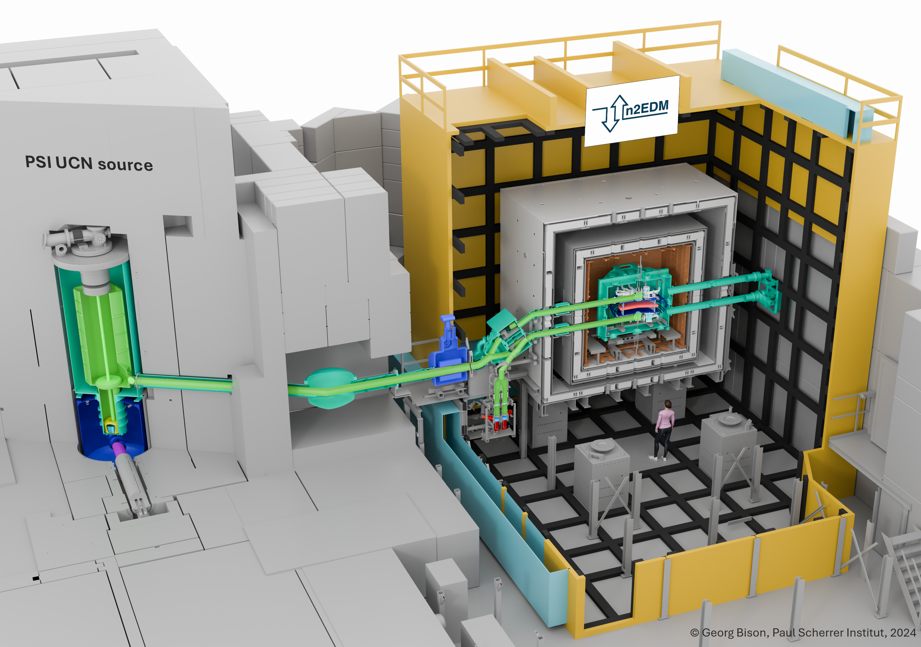
I – Context II – n2EDM overview
Active magnetic shield
Passive magnetic shield
Superconducting
magnet
Switch
Vacuum vessel
UCNs
Solid D
Proton beam on Pb target
UCN spin detectors

Slide 13
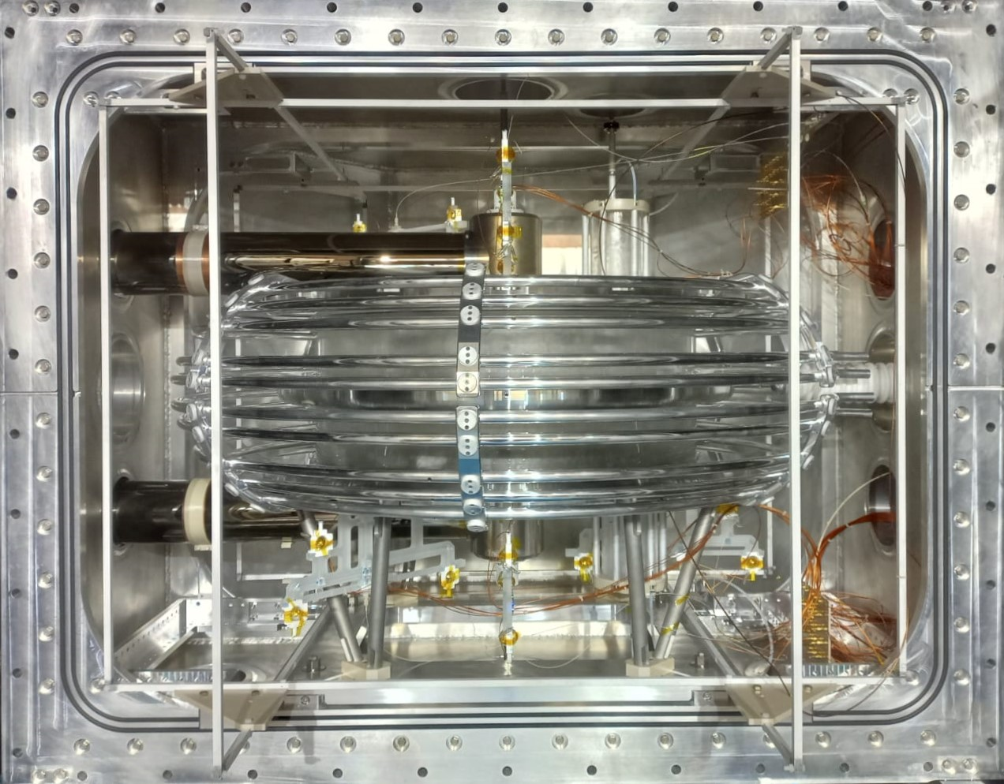
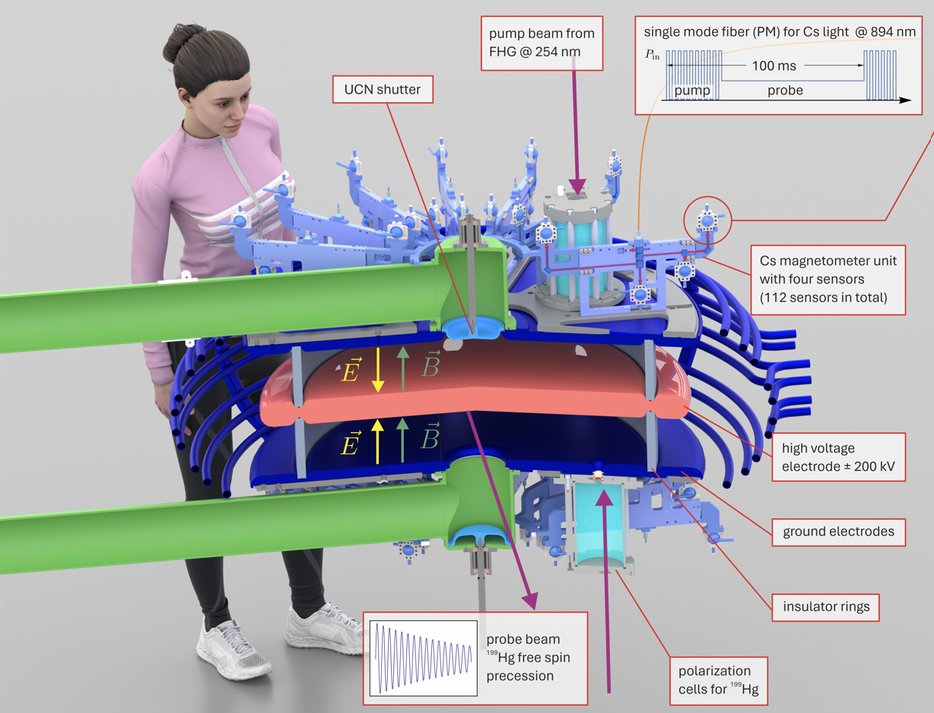
I – Context II – n2EDM overview
Photograph of the n2EDM precession chambers , october 2025
n2EDM precession chambers design scheme with subsystems.
contributions
Switch (UCN guiding)
Hg polarisation chambers
Hg injection system
Hg spectroscopy cells
Magnetic field mapper
Data Monitoring Interface

Slide 14
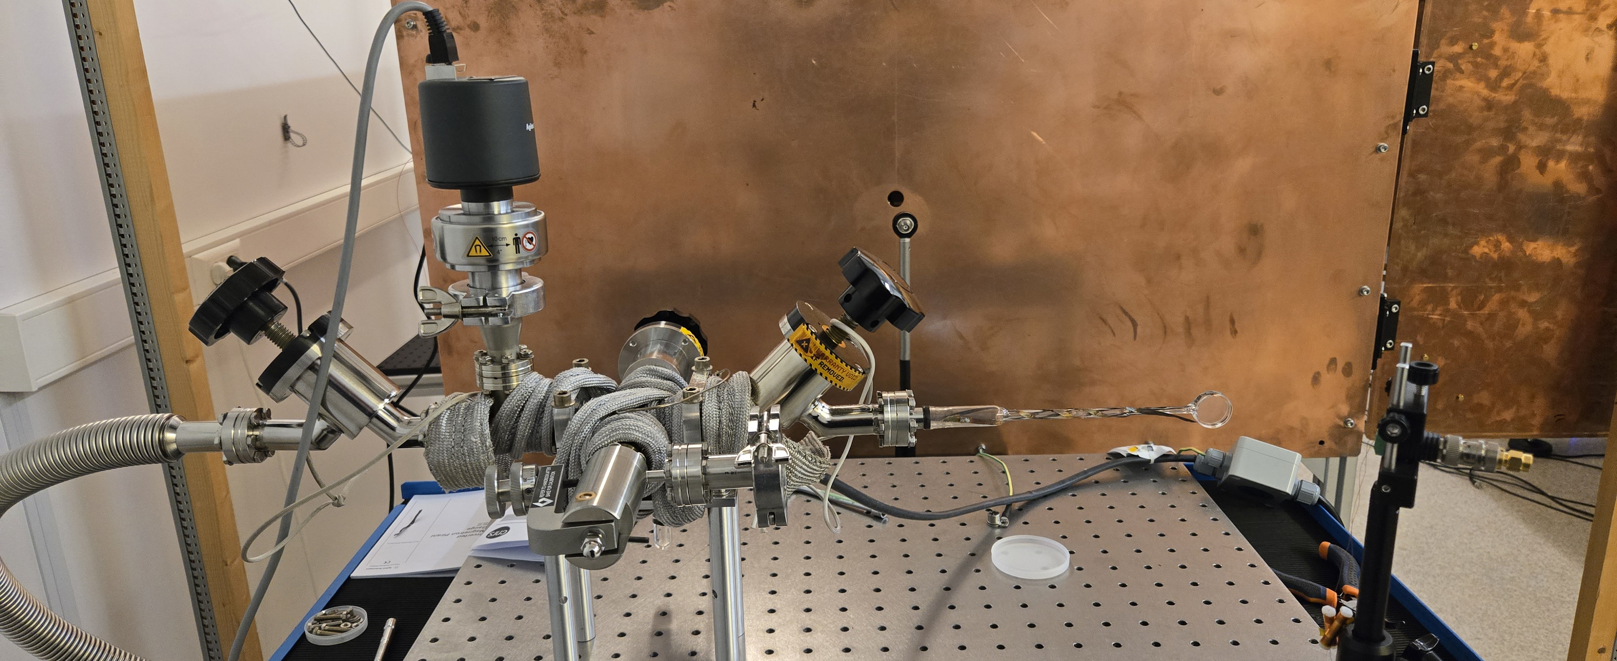

Enriched $^{199}Hg$ spectroscopy cell (L4M, LPSC)

Slide 15
III- The Hg co-magnetometer
I – Context II – n2EDM overview III – Hg co-magnetometer
Concept, setup and performances.

Slide 16
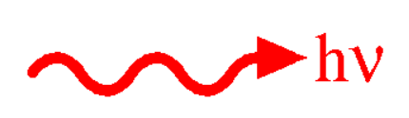



Measuring magnetic fields with Hg vapour
I – Context II – n2EDM overview III – Hg co-magnetometer
Hg precession
Transmitted light modulated at $f_{Hg}$
$$f_{Hg}=\frac{μ_{Hg}}{πℏ} B$$
relevant$^{199}Hg$ quantum states
UV resonant light
Excited states
-1/2
1/2
spin 1
Ground states
1/2
-1/2

Slide 17
Optical reading of Hg precession in n2EDM
I – Context II – n2EDM overview III – Hg co-magnetometer
Optical fiber
nEDM: Circularly polarised probe.
One signal per chamber.
Polarising optics
Optical fiber
Polarisation cells
Monitor
photo-diode
Precession chambers
UV probe light
circular
polarization
Probe
photo-diodes
Optical tower
Vacuum vessel
UV pump light
Optical fiber

Slide 18
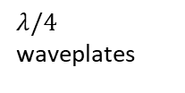
Optical reading of Hg precession in n2EDM
I – Context II – n2EDM overview III – Hg co-magnetometer
Optical fiber
Polarising optics
Optical fiber
Polarisation cells
Monitor
photo-diode
$λ/4$ waveplates
p polarization transmitted
Precession chambers
UV probe light
linear
polarization
circular polarization
Optical tower
s polarization
reflected
n2EDM: linearly polarised probe.
Two signals for each chamber.
Cancellation of common noise.
Vacuum vessel
Probe
photo-diodes
UV pump light
Optical fiber

Slide 19
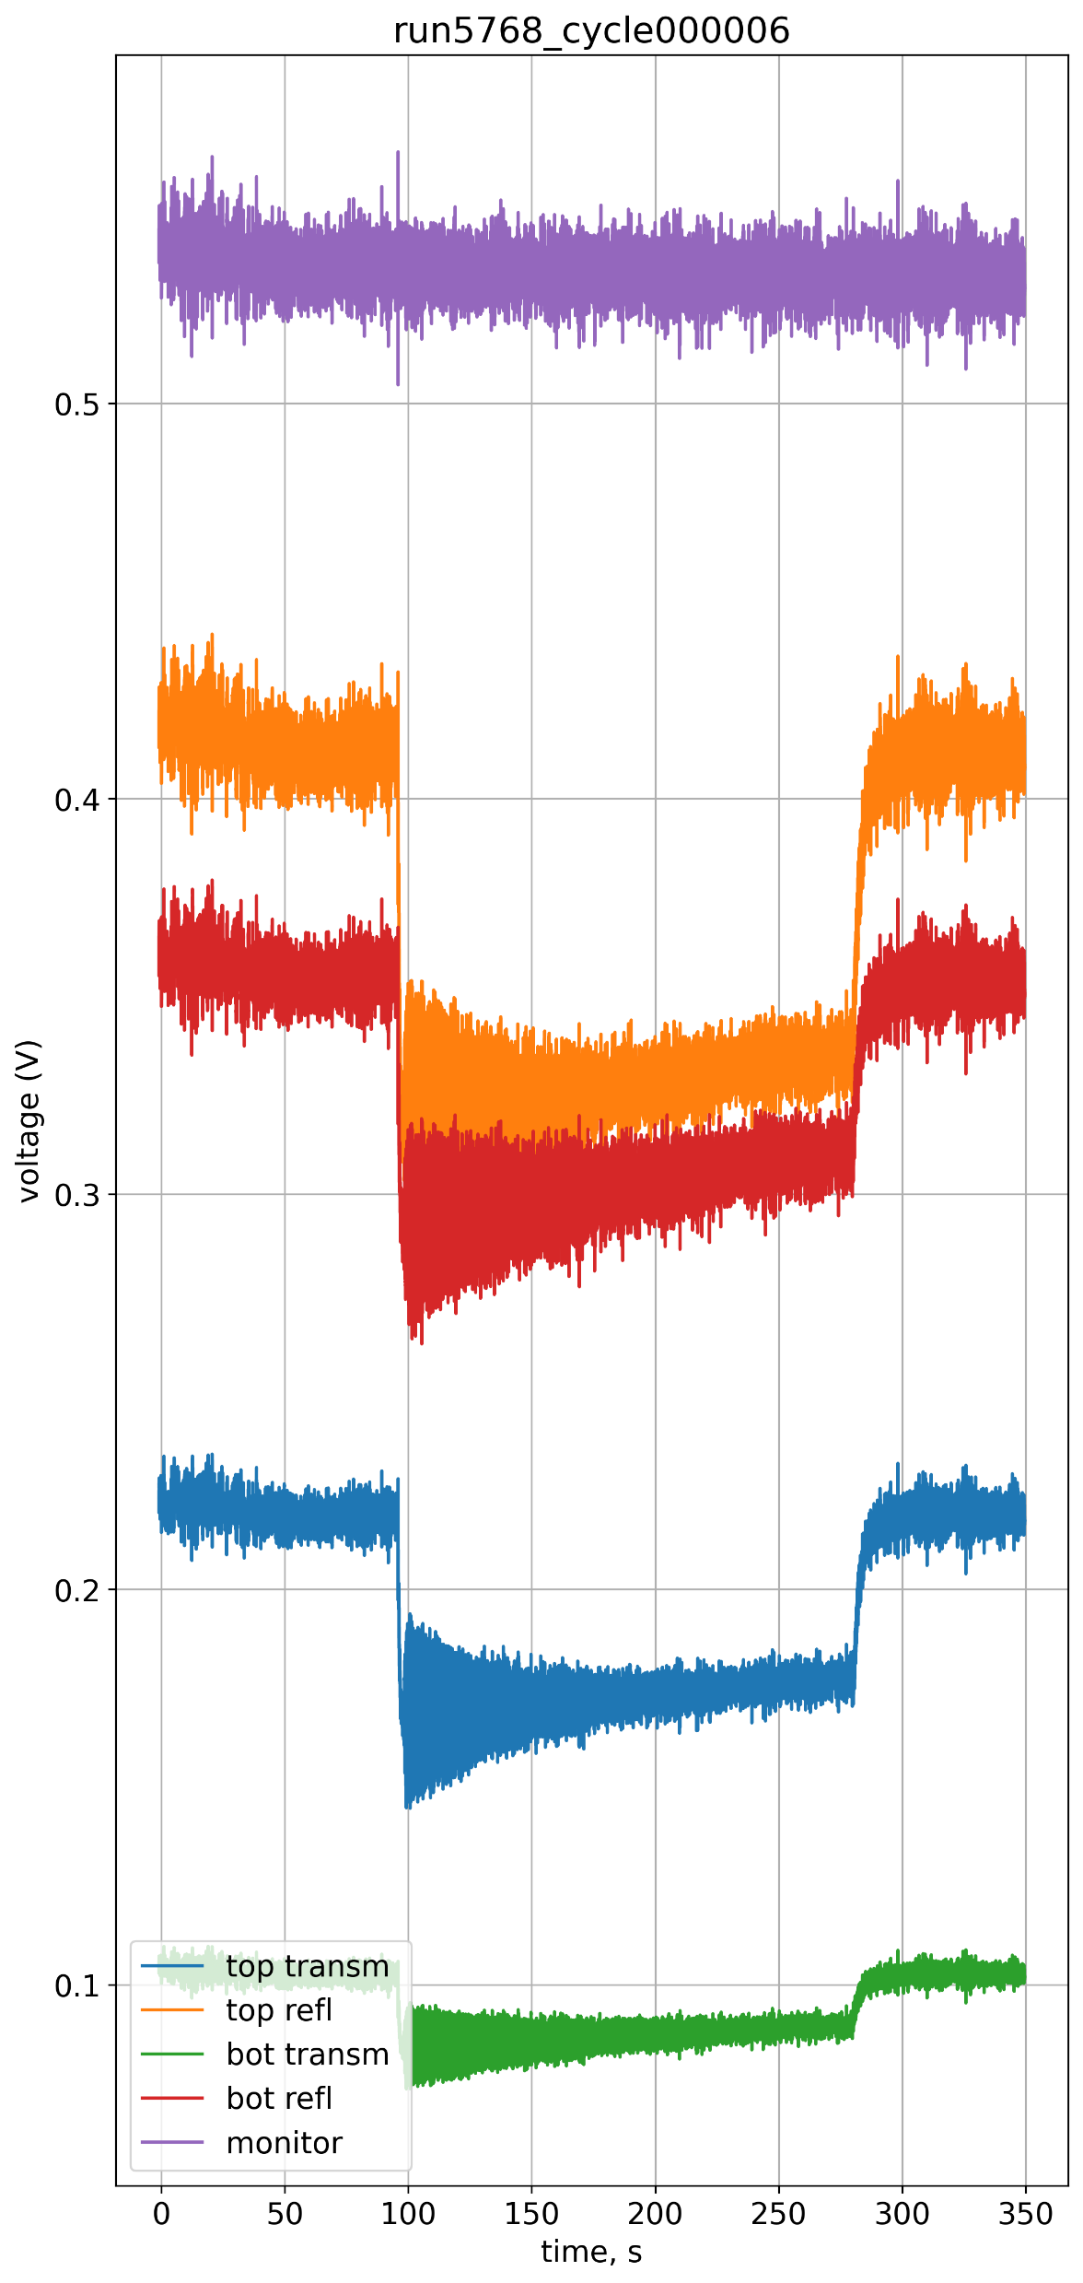
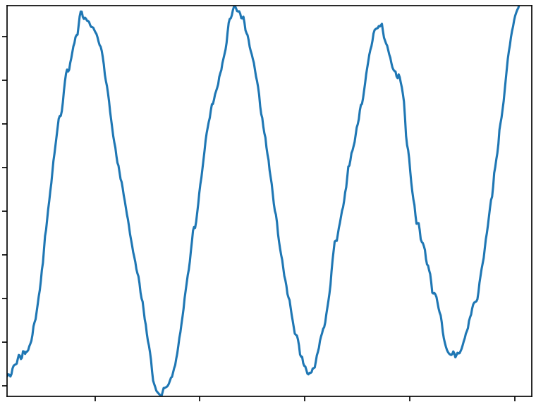
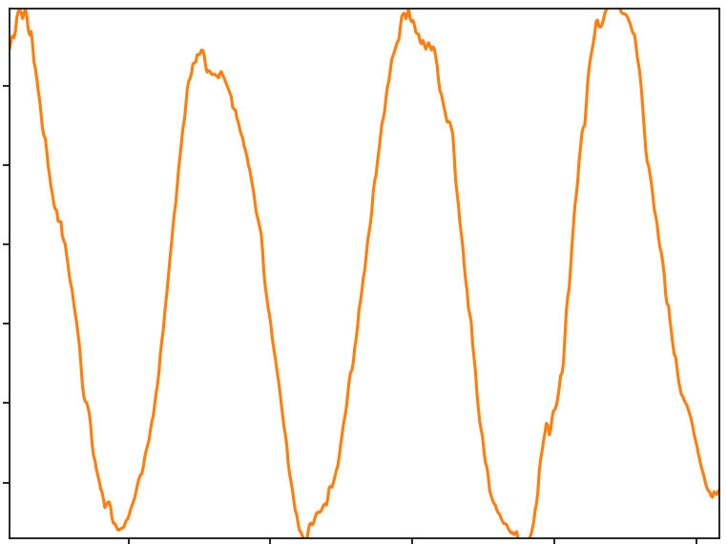
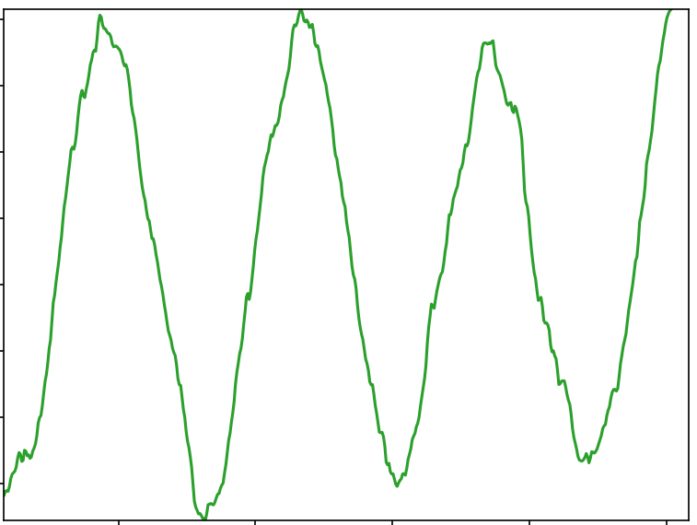
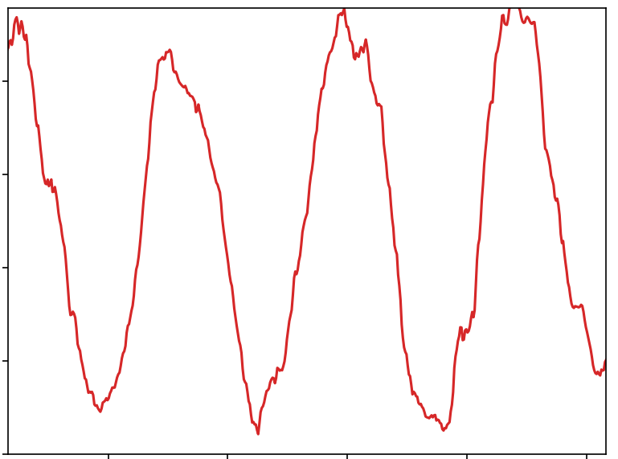




Probe photo-diode signals
I – Context II – n2EDM overview III – Hg co-magnetometer
$^{199}Hg$ spin during precession
Excited states
-1/2
1/2
UV light
spin 1
TOP chamber
Ground states
1/2
-1/2
$$+$$
reflected
$^{199}Hg$ spin during precession
transmitted
BOT chamber
Excited states
-1/2
1/2
spin -1
reflected
transmitted
Ground states
1/2
-1/2

Slide 20
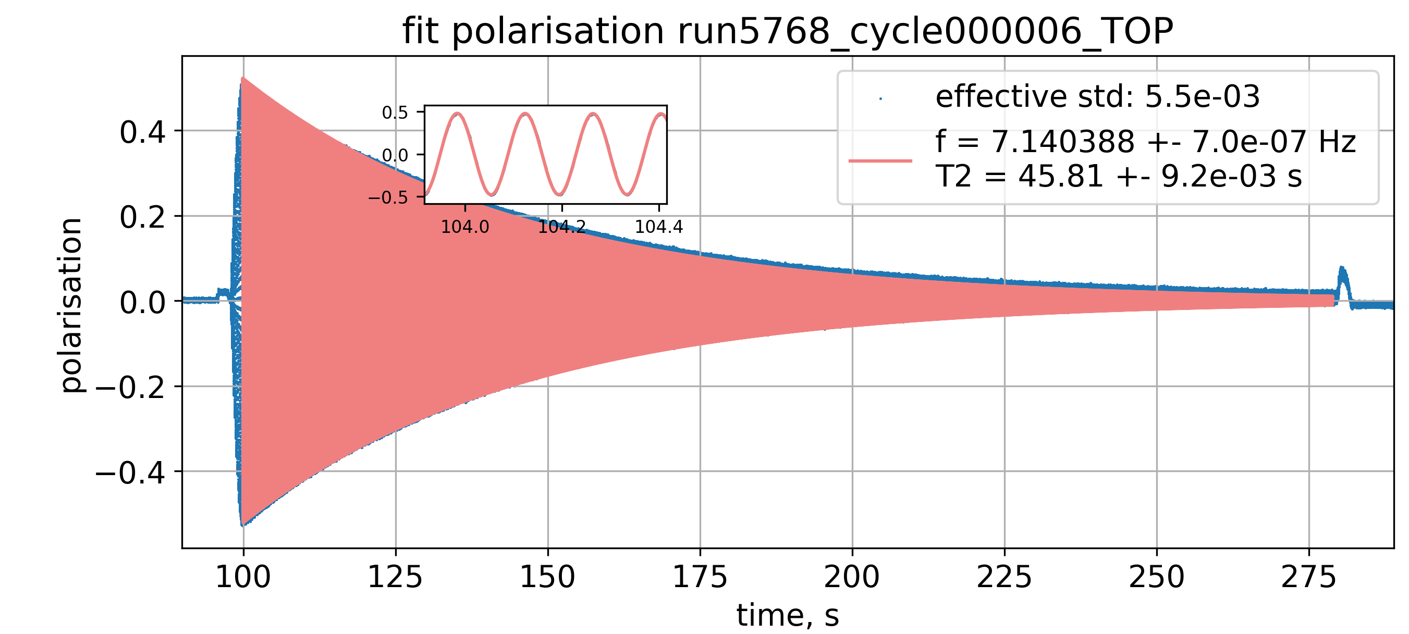
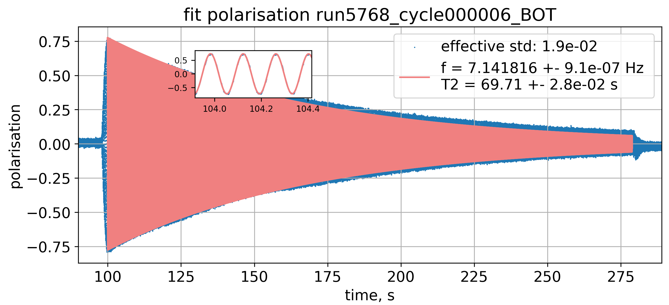
Probe photo-diode signals
I – Context II – n2EDM overview III – Hg co-magnetometer
$^{199}Hg$ spin during precession
Excited states
-1/2
1/2
UV light
spin 1
TOP chamber
Ground states
1/2
-1/2
$$+$$
reflected
$^{199}Hg$ spin during precession
transmitted
BOT chamber
Excited states
-1/2
1/2
spin -1
reflected
transmitted
Linearly polarised probe lowered the uncertainty by a factor 3.
Ground states
1/2
-1/2

Slide 21

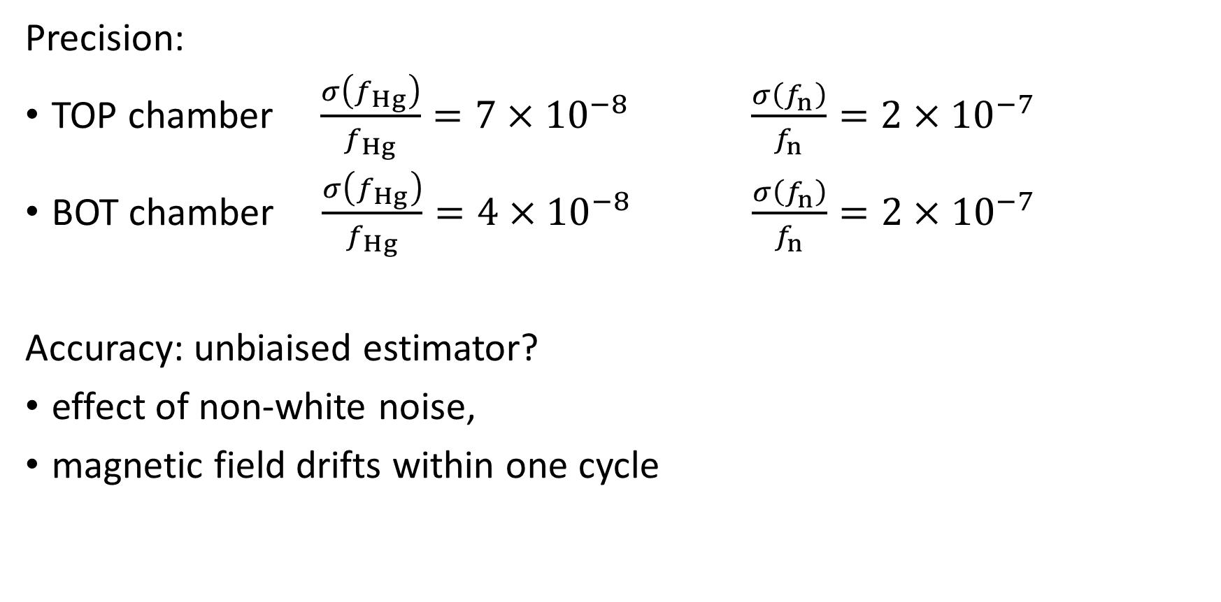
Performance of the Hg magnetometer
I – Context II – n2EDM overview III – Hg co-magnetometer
Precision:
TOP chamber $\frac{σ\left(f_{Hg}\right)}{f_{Hg}}=7×{10}^{−8}$ $\frac{σ\left(f_{n}\right)}{f_{n}}=2×{10}^{−7}$
BOT chamber $\frac{σ\left(f_{Hg}\right)}{f_{Hg}}=4×{10}^{−8}$ $\frac{σ\left(f_{n}\right)}{f_{n}}=2×{10}^{−7}$
Accuracy: unbiaised estimator?
effect of non-white noise,
magnetic field drifts within one cycle
status
ongoing

Slide 22
n2EDM status and outlook
I – Context II – n2EDM overview III – Hg co-magnetometer IV – Conclusion
UCN production, detection, polarization, spin transport
Magnetic shielding and characterization
Magnetic field generation and characterization
Electric field
Hg co-magnetometer injection, polarization, optical reading
Cs magnetometers installation, polarisation & optical reading
Operational
Not yet operational
2025
n and Hg
2025
EDM test run
2026
systematics
2026
EDM
2027-2028
Accelerator shutdown
2029-Magic EDM
Today
Neutrons available
Neutrons unavailable

Slide 23
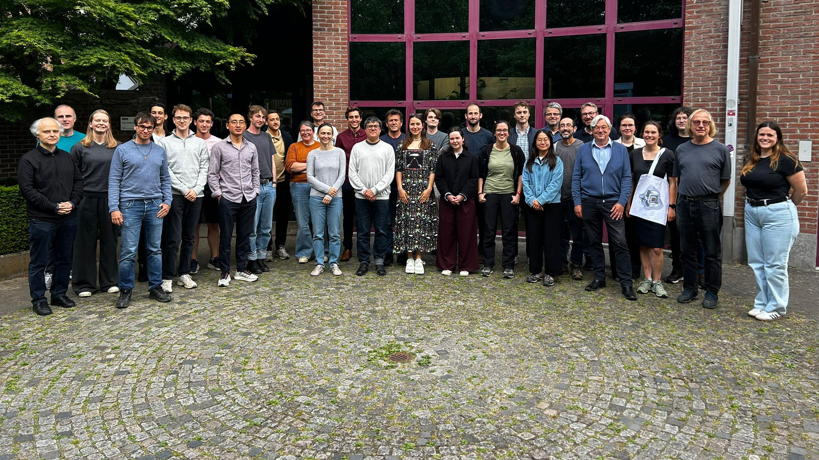
Thank you for your attention!
Questions?

Slide 24
Additional slides

Slide 25




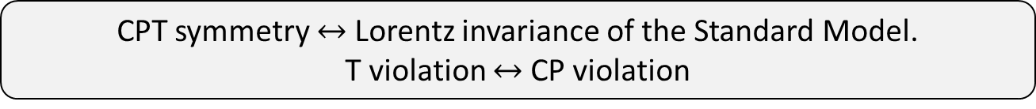

An EDM violates Charge Parity symmetry.
I - Context
Observable = magnetic moment $μ$
Observable = electric moment d
$$μ>0$$
$$μ>0$$
$$d>0$$
$$d<0$$
T-invariant
not T-invariant
CPT symmetry $↔$ Lorentz invariance of the Standard Model.
T violation $↔$ CP violation

Slide 26
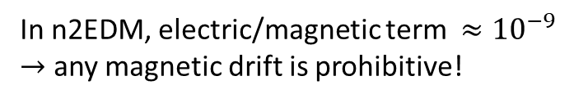



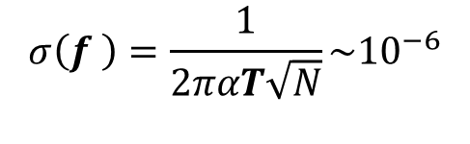







Measure the neutron EDM: Ramsey method of oscillatory fields
I – Context II – n2EDM overview
I – Context II – n2EDM
Larmor precession frequency measurement.
in a known magnetic field and strong electric field.
$\frac{π}{2}$ spin flip
$$f_{RF}$$
$\frac{π}{2}$ spin flip
$$f_{RF}$$
Spin asymmetry
$$\frac{{N_{↑}−N}_{↓}}{N_{↑}+N_{↓}}=−αcos⁡[\frac{\left(f_{RF}−f_{n}\right)}{Δν}]$$
$$E$$
$$B$$
$$1 μT$$
$$15 kV/cm$$
$$σ$$
$$σ$$
$$f_{n}=\frac{μ_{n}}{πℏ} B+\frac{d_{n}}{πℏ}E$$
$$σ\left(f_{ }\right)=\frac{1}{2παT\sqrt{N}}\sim {10}^{−6}$$
In n2EDM, electric/magnetic term $≈{10}^{−9}$
$→$ any magnetic drift is prohibitive!

Slide 27
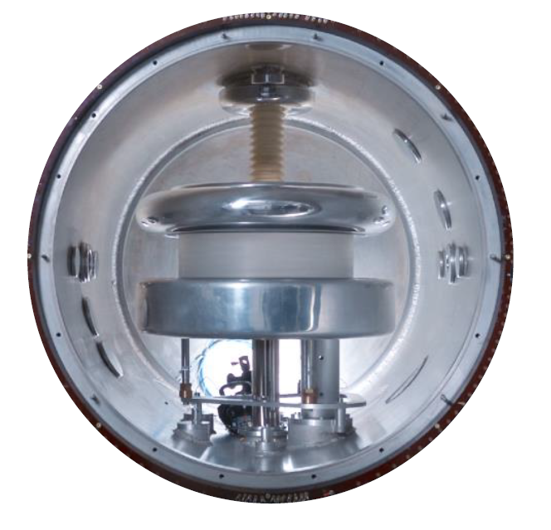
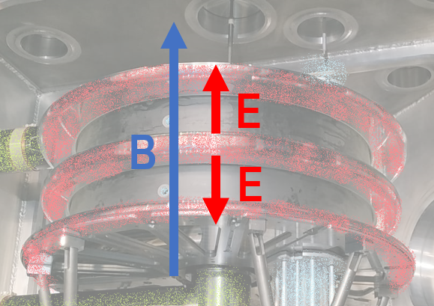
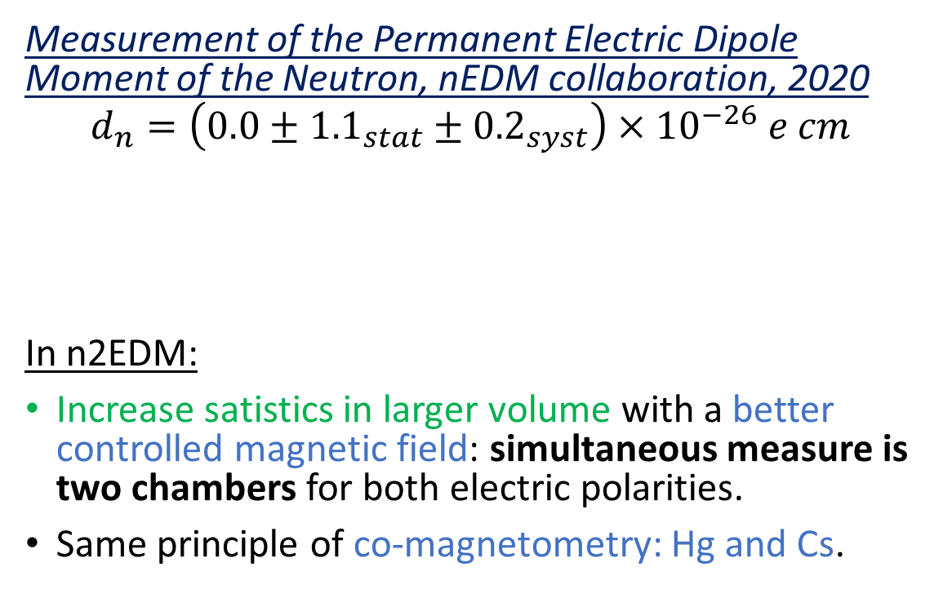
Current most sensitive measurement: nEDM at PSI
Measurement of the Permanent Electric Dipole Moment of the Neutron, nEDM collaboration, 2020
$$d_{n}=\left(0.0±{1.1}_{stat}±{0.2}_{syst}\right)×{10}^{−26} e cm$$
In n2EDM:
Increase satistics in larger volume with a better controlled magnetic field: simultaneous measure is two chambers for both electric polarities.
Same principle of co-magnetometry: Hg and Cs.
B
E
Number of neutrons
Homogeneity of B

Slide 28
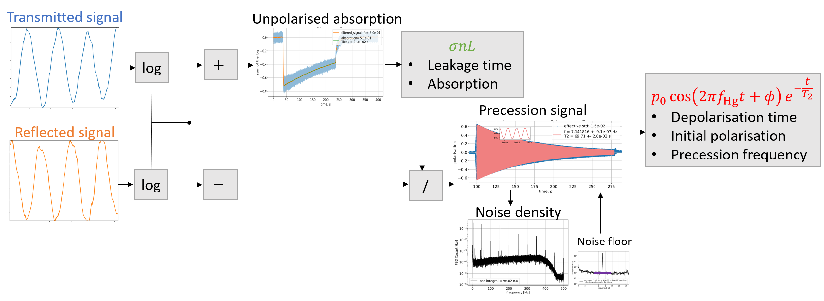
The mercury co-magnetometer

Slide 29





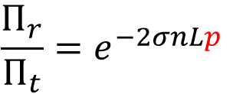
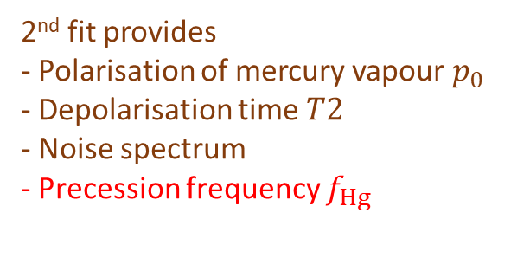
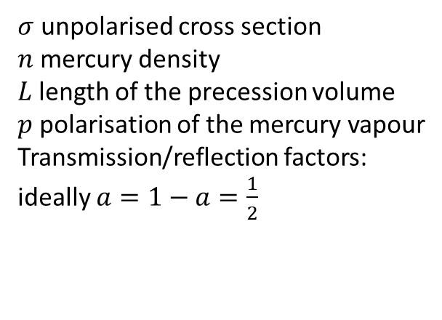

Linearly polarised light: two signals oscillating with opposite phase
$$Π_{r}Π_{t}=a(1−a)e^{−2σnL}$$
Derive $σn_{0}e^{−t/T_{leak}}L$
$$Π_{t}=a Π_{0}^{ }e^{−σnL(1+p)}$$
$$Π_{r}=(1−a)Π_{0}^{ }e^{−σnL(1−p)}$$
$$\frac{Π_{r}}{Π_{t}}=e^{−2σnLp}$$
Derive $p$ knowing $σnL$
$σ$ unpolarised cross section
$n$ mercury density
$L$length of the precession volume
$p$ polarisation of the mercury vapour
Transmission/reflection factors:
ideally $a=1−a=\frac{1}{2}$
$$−\frac{1}{2σnL}\ln\left(\frac{Π_{r}}{Π_{t}}\right)=p_{0}\cos\left(2πf_{Hg}t+φ\right)e^{−\frac{t}{T2}}$$
2nd fit provides
- Polarisation of mercury vapour $p_{0}$
- Depolarisation time $T2$
- Noise spectrum
- Precession frequency $f_{Hg}$
1st fit provides
- Absorption
- Leakage time of precession chamber

Slide 30

nEDM, one of the most sensitive probes to CP-violating new physics
Comparison of the sensitivity of different observables with the Standard Model Effective Field Theory: all coupling constants to one.
Example: dimension 6 operators
$$\sum{\frac{c_{i}}{Λ^{2}}} O_{i}^{(6)}$$
Set to 1
measured
13 TeV
derived
Figure by Adam Falkowski, Lectures on SMEFT EPJC (2023)

Slide 31









2. Offline control of the magnetic field: mapping
I – Context II – n2EDM overview 2.
Fluxgate moving in cylindrical coordinates provides $B_{ρ}$, $B_{φ}$, $B_{z}$.
Composed of non-magnetic parts to measure the remnant field, and the generated $B_{0}$.
$${δG}_{1}>25 pT$$
$${δG}_{3}>20 pT$$
French technical contribution
$${δG}_{5}<20 pT$$

Slide 32



I – Context II – n2EDM overview
I – Context II – n2EDM
E
B
E
BOT
TOP
neutrons
mercury
neutrons
mercury
$\frac{f_{↑↓}}{f_{↑↓}} −\frac{f_{↑↑}}{f_{↑↑}}=\frac{μ_{n}}{μ_{Hg}} \left(\frac{B_{↑↓}}{B_{↑↓}}−\frac{B_{↑↑}}{B_{↑↑}}\right)$+ $\frac{d_{n}}{πℏ}\left(\frac{E_{↑↓}}{f_{↑↓}}−\frac{E_{↑↑}}{f_{↑↑}}\right)$
-

Slide 33
I – Context II – n2EDM overview 1.
Coil generating B field
B
E
Top ground electrode
E
HV electrode
Bottom ground electrode
UCN guide
Polarization cell
Vacuum vessel

Slide 34



I – Context II – n2EDM overview 1.
E
B
E
$$f_{↑↑} =\frac{μ_{n}}{πℏ}B_{↑↑}−\frac{d_{n}}{πℏ}E_{↑↑}$$
$$f_{↑↓}{−f}_{↑↑}=0+2\frac{d_{n}}{πℏ}E_{↑↑}$$
neutrons top
neutrons bottom
$$f_{↑↓} =\frac{μ_{n}}{πℏ}B_{↑↓}+\frac{d_{n}}{πℏ}E_{↑↓}$$
But there is a vertical magnetic gradient…

Slide 35







Observation of gravitational shift on
I – Context II – n2EDM overview III- n2EDM results
$$R=\frac{f_{ }^{n}}{f_{ }^{Hg}}$$
Neutrons have a lower center of mass than Hg atoms because of gravity
$→$ R slightly depends on the vertical gradients $G_{TB}$
top chamber
$$B$$
bottom chamber
Susceptibility to vertical gradient
Result:
Provides information of the energy spectrum of neutrons!
$$\frac{{dR}_{T,B}}{dG_{TB }}=R_{0}\frac{<z_{T,B}>}{<B>}$$
Preliminary
$<z_{T}> =−0.161\left(4\right)$ $cm$
$<z_{B}> =−0.214(6)$ cm

Slide 36








R- curve: sensitivity to earth rotation
I – Context II – n2EDM overview III- n2EDM results
$$θ$$
Measured period: $24±1$ hours
$B$ in the lab!
$μ_{Hg}>0$ and $μ_{n}<0$
Laboratory referential is rotating (earth rotation)
Depending on $B$ one frequency is enhanced, the other is diminished.
$$R= \frac{f_{n}}{f_{Hg}}=|\frac{μ_{n}}{μ_{Hg}}|(1±δ_{earth})$$
Earth rotation
$$δ_{earth}=f_{earth}cos\left(θ\right)\left(\frac{1}{f_{n}}+\frac{1}{f_{Hg}}\right)$$
$≈{10}^{−6}$
Magnetic field up
Magnetic field down
Result:
Rotation period
$24±1$hour

Slide 37



1. Neutron Spin Analyzer: measure
I – Context II – n2EDM overview 1.
I – Context II – n2EDM
$$\frac{{N_{up}−N}_{down}}{N_{up}+N_{down}}$$
Simultaneous detection of both spin components in gaseous detector:
Analyzing foil: spin down transmitted (spin up reflected).
Two arms: - one with a spin flipper: detects spin up neutrons
- one without: detects spin down neutrons
spin ↓ detection
spin ↑ detection

Slide 38




2. Magnetic field specifications
I – Context II – n2EDM overview 2.
$$B\left(x,y,z\right)=\sum_{l,m}{G_{lm}Π_{l,m}(x,y,z)}$$
Expansion in harmonic modes :
Non uniformities (modes $l≥1$) affect the frequency ratio $R$.
Odd-modes result in an EDM-like signal
Gradient terms
$G_{00}$: Uniform vertical magnetic field
$G_{10}$ : vertical gradient
$G_{lm}$ $l≥2$: non uniformities
Legendre polynomials
Specifications | fT/cm | Measured by…
Mode 1 of the magnetic field | $$δG_{1}<25$$ | Hg, online
Mode 3 of the magnetic field | $$δG_{3}<20$$ | Cs, online
Mode 5 of the magnetic field | $$δG_{5}<20$$ | Mapper, offline
The design of the n2EDM experiment. nEDM Collaboration, EPJ C, 2021

Slide 39




Measuring magnetic fields with Hg vapour
Polarized Hg
Hg precession
Transmitted light modulated at $f_{Hg}$
$\frac{π}{2}$ spin flip
$$B$$
$$S=S_{0}e^{−κσp_{0}cos⁡(2πf_{Hg}t+φ)}$$
$$σ$$
Vapour spin polarization
$$f_{Hg}=\frac{μ_{Hg}}{πℏ} B$$
relevant$^{199}Hg$ quantum states
UV resonant light
Excited states
-1/2
1/2
spin 1
Ground states
1/2
-1/2

