Slide 1
SIDIS-3D-EXP
SIDIS observables for TMDs

Slide 2
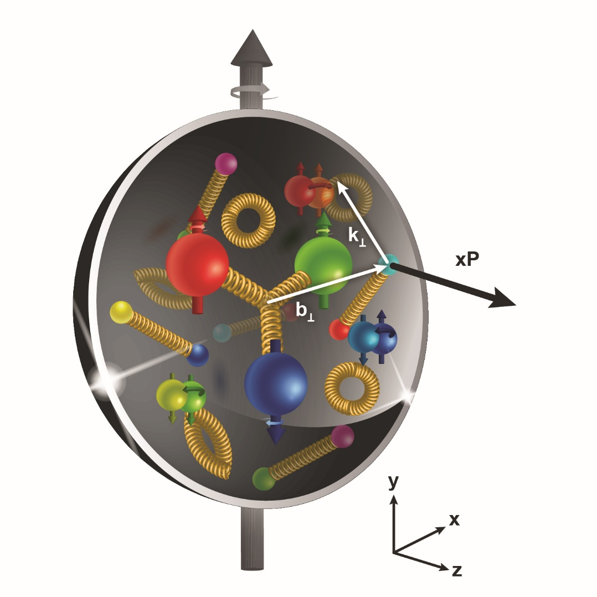
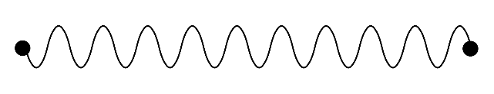


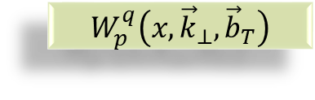

Transverse structure of the Nucleon
Confinement Scale
$$W_{p}^{q}\left(x,{\vec{k}}_{⊥},{\vec{b}}_{T}\right)$$
Transverse momentum
Longitudinal momentum
Transverse position
$$ℓ′$$
Photon Virtuality Q²
$$ℓ$$
Hard Scale
High Energy Probe

Slide 3
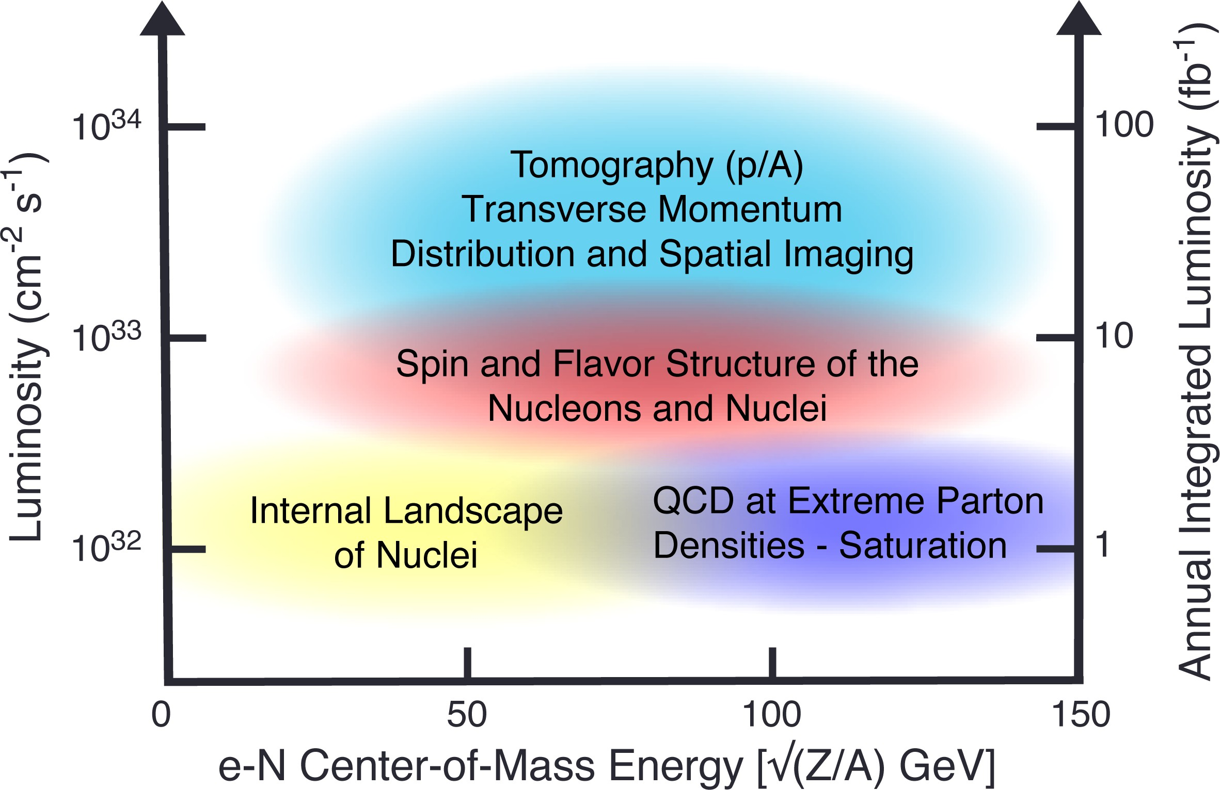
A future sherif in town
Semi-inclusive deep inelastic scattering is the “golden channel” for the study of the internal structure of the hadrons (p, D, PID for flavor separation)
The first polarized eA collider with variable center-of-mass energy, outstanding luminosity, … i.e. the EIC is coming, and it will start be operational in about 10 year

Slide 4
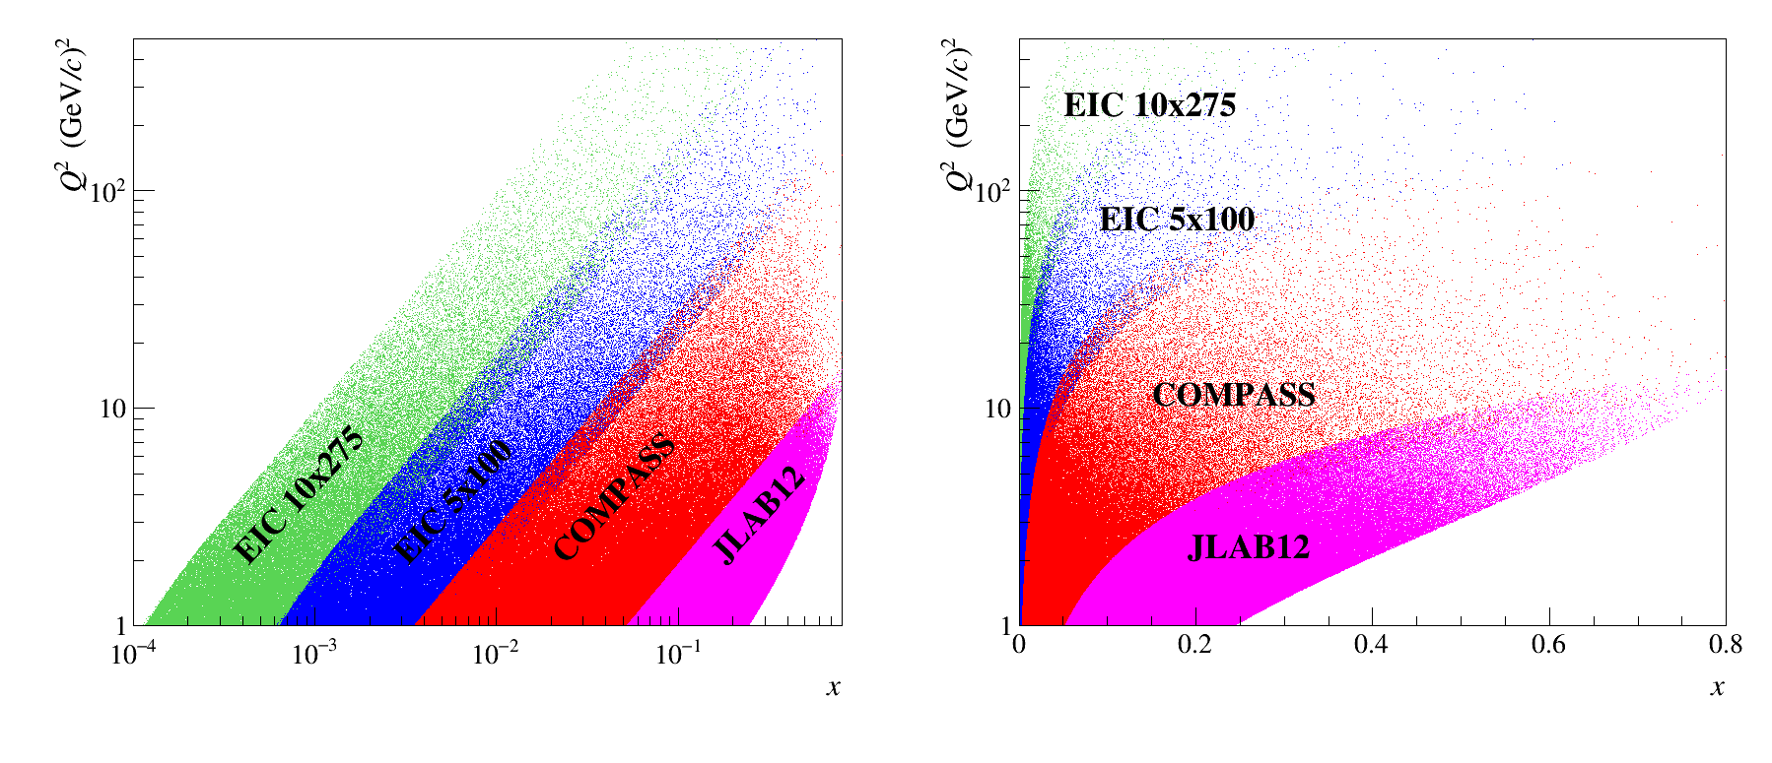
The phase space

Slide 5
The TEAM for SIDIS-3D-EXP
Experimentalists: expert in the field are collaborating in the future ePIC experiment @ EIC and members either of COMPASS or CLAS12
  INFN (Ferrara, Frascati, Torino, Trieste), Charles University (Prague), National Centre for Nuclear Research (Warsaw), IRFU(Saclay)
Phenomenologists: leaders in the extraction of TMD PDFs and FFs from global analysis
  INFN (Pavia, Torino)
Together with the partner institutions in JLab and Yerevan
We plan for a coordinated efforts aimed to improve the mapping of TMDs and more specifically the u and d quarks, in a 3D momentum space

Slide 6
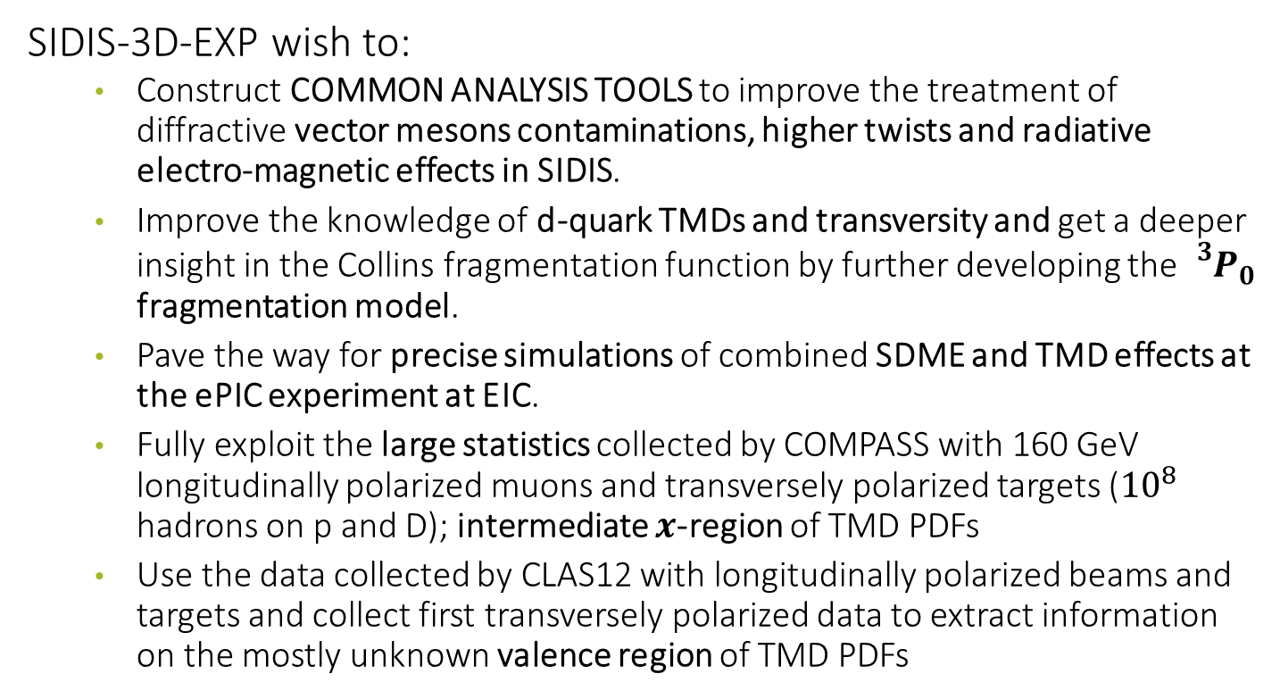
In mode detail:
SIDIS-3D-EXP wish to:
  Construct COMMON ANALYSIS TOOLS to improve the treatment of diffractive vector mesons contaminations, higher twists and radiative electro-magnetic effects in SIDIS.
  Improve the knowledge of d-quark TMDs and transversity and get a deeper insight in the Collins fragmentation function by further developing the ${}_{}^{3}{P_{0}}$ fragmentation model.
  Pave the way for precise simulations of combined SDME and TMD effects at the ePIC experiment at EIC.
  Fully exploit the large statistics collected by COMPASS with 160 GeV longitudinally polarized muons and transversely polarized targets (${10}^{8}$ hadrons on p and D); intermediate $x$-region of TMD PDFs
  Use the data collected by CLAS12 with longitudinally polarized beams and targets and collect first transversely polarized data to extract information on the mostly unknown valence region of TMD PDFs

Slide 7
Facts we need to emphasis
The full year of deuteron data collected by COMPASS in 2022, as well as those collected in 2010 with protons will very likely remain unique for the next decade.
CLAS12 is preparing for collecting transversely polarized data before 2030.
There is a strong need to form young scientists capable of dealing with the future challenges posed by EIC high precision analysis
Europe has a leading role in the field of TMDs, and we have developed strong collaboration between experimentalists and theoreticians.
All the knowledge acquired will be made available in the Virtual Access facility 3D Portal.
The WP will use TSA at CERN and eventually BNL for data analysis and simulation, meetings and workshops organized by the participants.

Slide 8
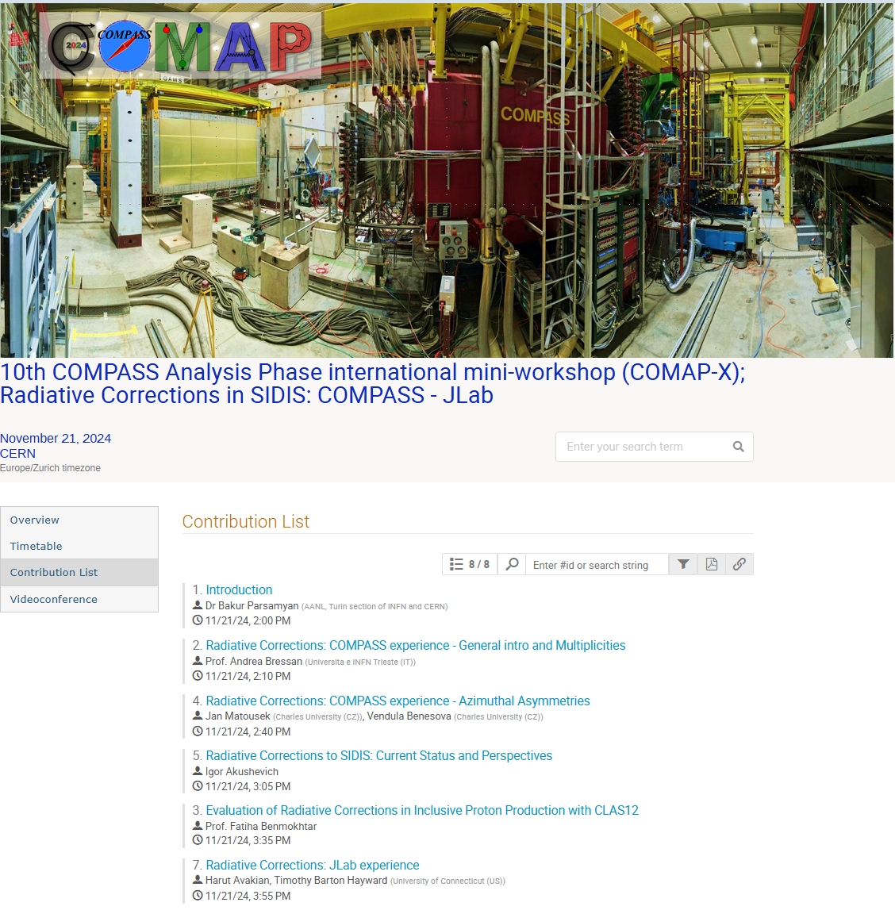
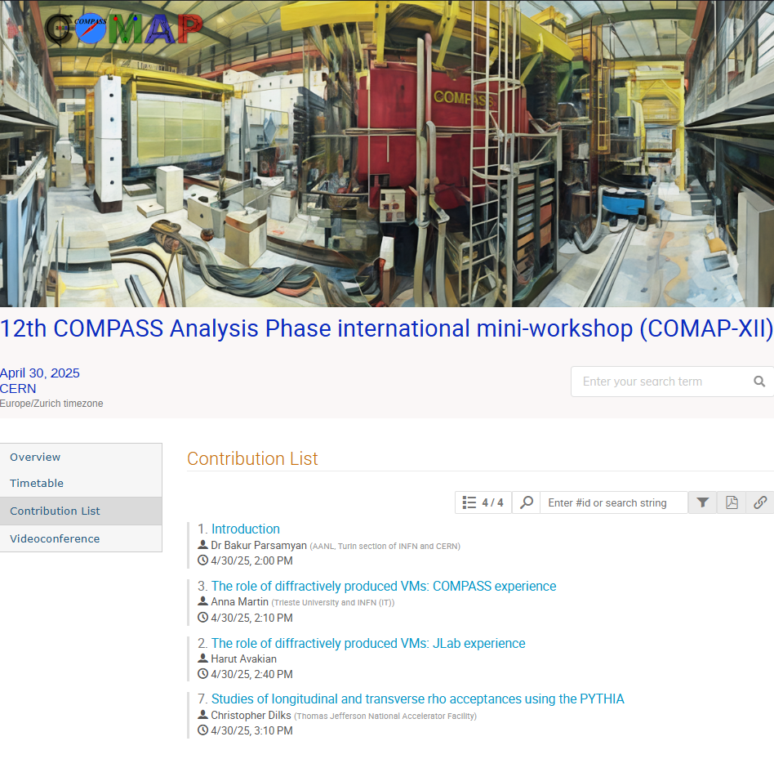
Very real tasks

Slide 9
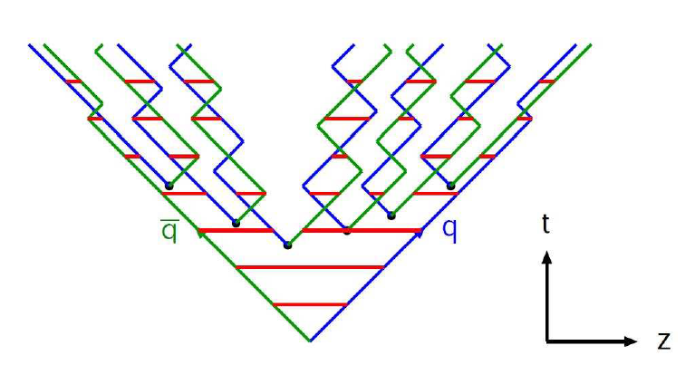
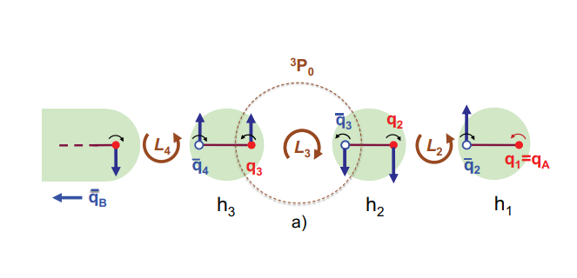



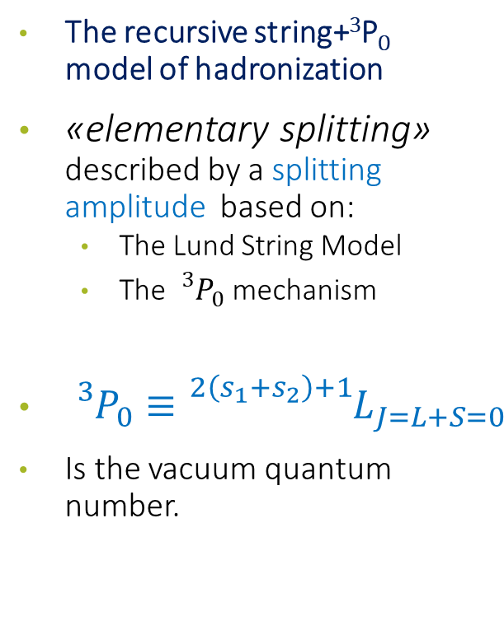















StringSpinner: polarized quarks in PYTHIA
StringSpinner [Kerbizi, L$\ddot{o}$nnblad, CPC 272 (2022) 108234]
The recursive string+³P₀ model of hadronization
«elementary splitting» described by a splitting amplitude based on:
  The Lund String Model
  The ${}_{}^{3}{P_{0}}$ mechanism
${}_{}^{3}{P_{0}≡}{}_{}^{2\left(s_{1}+s_{2}\right)+1}{L_{J=L+S=0}}$
Is the vacuum quantum number.
$$l′$$
$$l$$
$$γ^{∗}$$
$$q$$
$$\hat{σ}$$
$$π$$
$$q_{2}$$
$$K$$
from PYTHIA
$$ρ$$
$$π$$
$$π$$
$$ω$$
$$π$$
PDF
beam remnants
$$π$$
$$h_{N}$$
$$π$$
$f_{1}^{q}(x,Q^{2})$
$h_{1}^{q}\left(x\right)$ from parametrizations

Slide 10
Budget
Budget is:
  90% for contract for hiring co-funded PostDocs (50% sharing)
  10% for travels and meetings
We need a group of people that can dedicate large fraction of their time to do these cross-experiments cross-theory-groups activities
In person meetings will be mandatory for planning and monitor progress

Slide 11
Details of the proposed tasks
Task1: SSA/wTSA Analysis of COMPASS data (INFN-TS-TO, CU):
Multi dimensional measurements of TSA and wTSA on deuteron and proton
Task2: Unpolarized cross sections Analysis of COMPASS data: (INFN-TS, CU, NCNR)
Endeavor to understand the flavor-dependence of the partonic transverse momentum and the Boer-Mulders function.
Explore the use of new tools for measuring single and hadron pair production.
Task3: Unpolarized cross sections and SSA Analysis of CLAS12 data (INFN-FE, INFN-LNS)
Multi dimensional measurements with enhanced sensitivity to the valence
Task4: Run preparation for CLAS12 transversely polarized data (INFN-FE, INFN-LNS)
Design of the best experimental configuration and impact study
Task5: Theory support (INFN-PV, INFN-BO)
Interpretation of the new data including effect of VM and higher twist
Impact studies of new data, preparation for future measurements
Task6: General and common effort to (all participating institutions):
Develop common analysis tools and chains for COMPASS and CLAS12 to investigate deeply their dependence
Develop and test GPU-based algorithms for the analysis of SIDIS observables.
Develop and use of MC event generators with TMD PDFs and spin effects in the fragmentation with String-Spinner developments.
Perform impact studies via full simulations and reconstructions using the software stack that is presently developed by the ePIC collaboration at the EIC.

Slide 12
Thank you

Slide 13
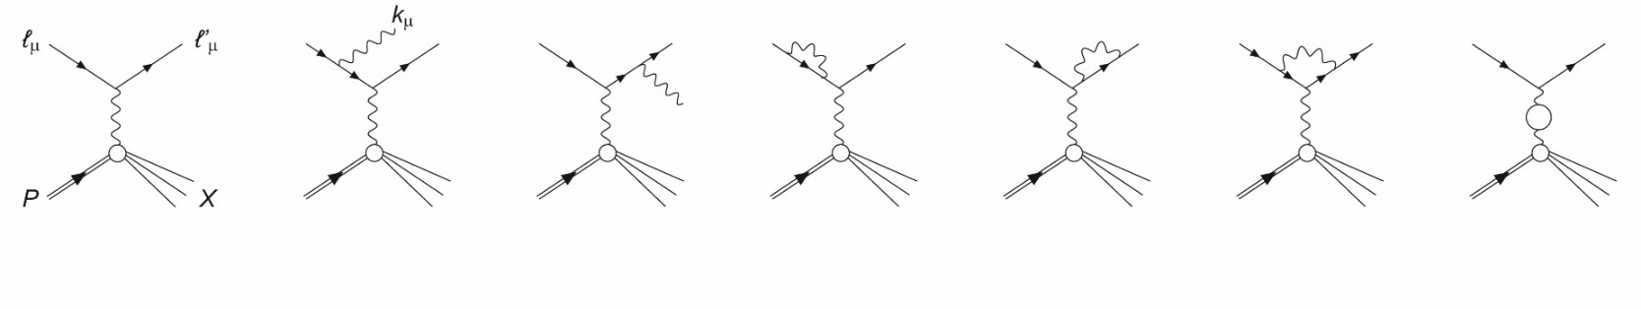
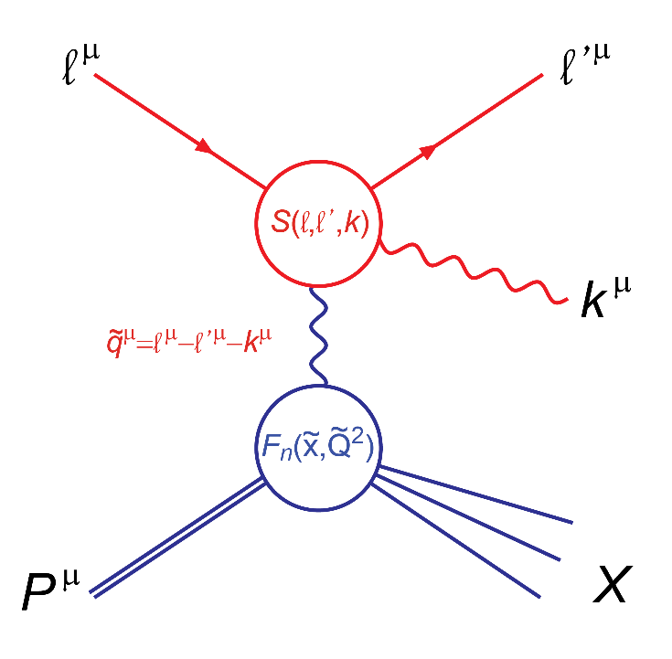
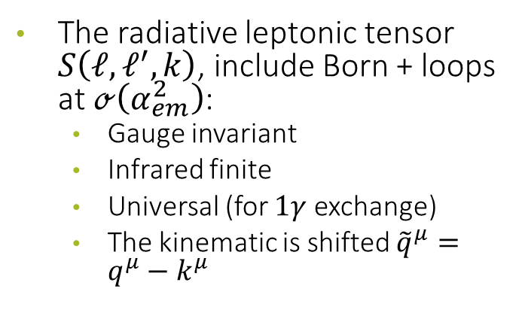
LEPTONIC RADIATION
Feynman diagrams for leptonic radiation
The radiative leptonic tensor $S\left(ℓ, ℓ^{′},k\right)$, include Born + loops at $ℴ\left(α_{em}^{2}\right)$:
  Gauge invariant
  Infrared finite
  Universal (for $1γ$ exchange)
  The kinematic is shifted ${\tilde{q}}^{μ}=q^{μ}−k^{μ}$

Slide 14
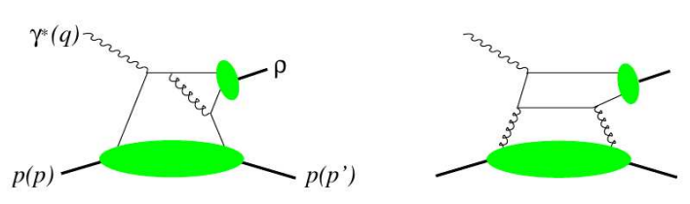
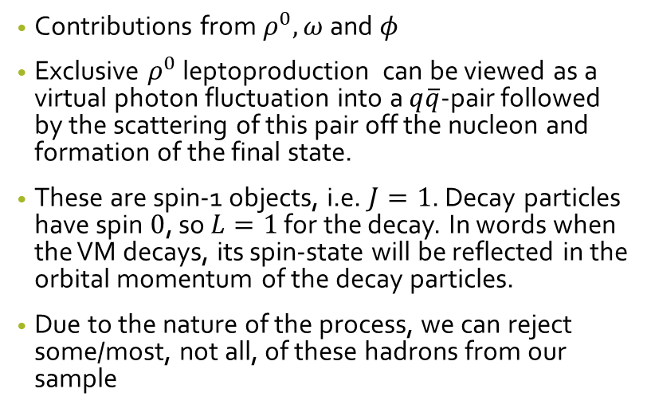
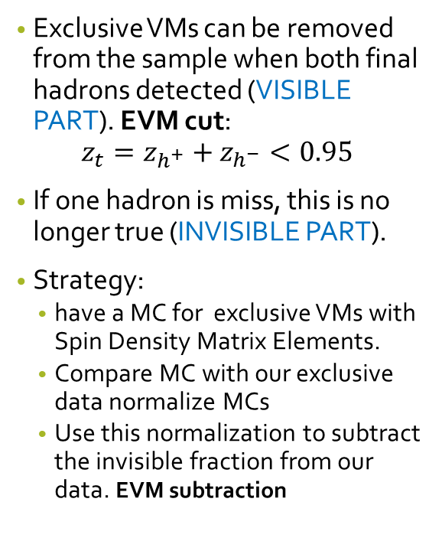
Example: background from exclusive VMs
Exclusive VMs can be removed from the sample when both final hadrons detected (VISIBLE PART). EVM cut:
$$z_{t}=z_{h^{+}}+z_{h^{−}}<0.95$$
If one hadron is miss, this is no longer true (INVISIBLE PART).
Strategy:
  have a MC for exclusive VMs with Spin Density Matrix Elements.
  Compare MC with our exclusive data normalize MCs
  Use this normalization to subtract the invisible fraction from our data. EVM subtraction
Contributions from $ρ^{0}, ω$ and $φ$
Exclusive $ρ^{0}$ leptoproduction can be viewed as a virtual photon fluctuation into a $q\overline{q}$-pair followed by the scattering of this pair off the nucleon and formation of the final state.
These are spin-1 objects, i.e. $J=1$. Decay particles have spin $0$, so $L=1$ for the decay. In words when the VM decays, its spin-state will be reflected in the orbital momentum of the decay particles.
Due to the nature of the process, we can reject some/most, not all, of these hadrons from our sample

Slide 15
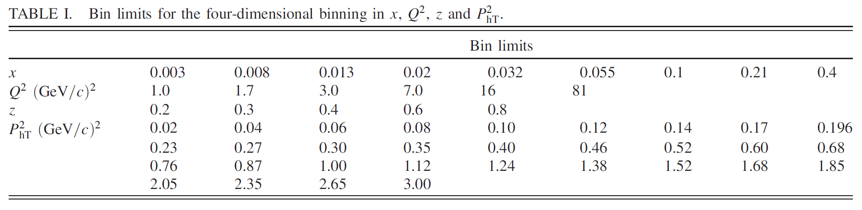
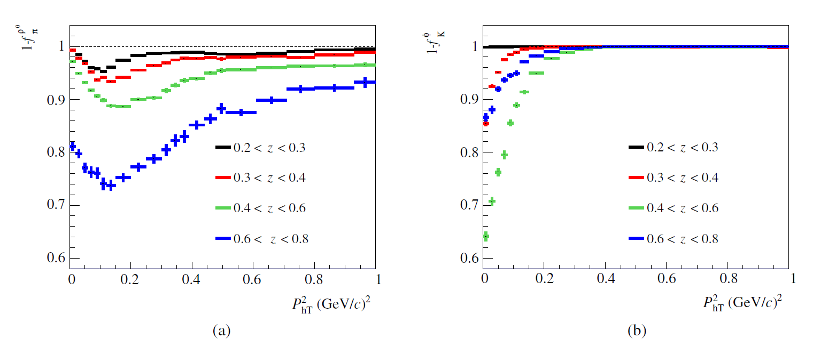
2nd publication on $P_{hT}$ distributions (2018);
Improved binning
Subtraction of Diffractive Vector Mesons

Slide 16
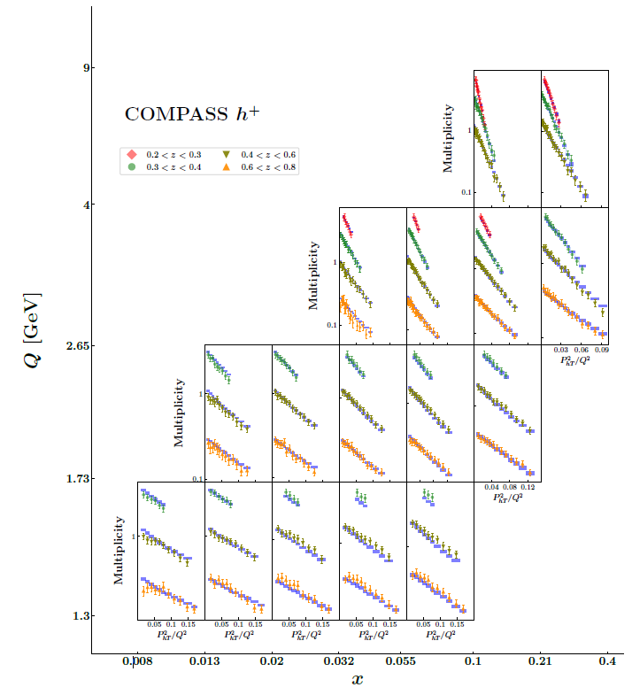
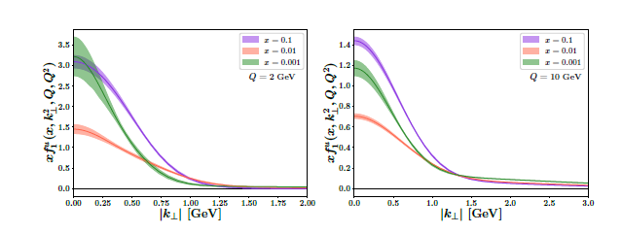
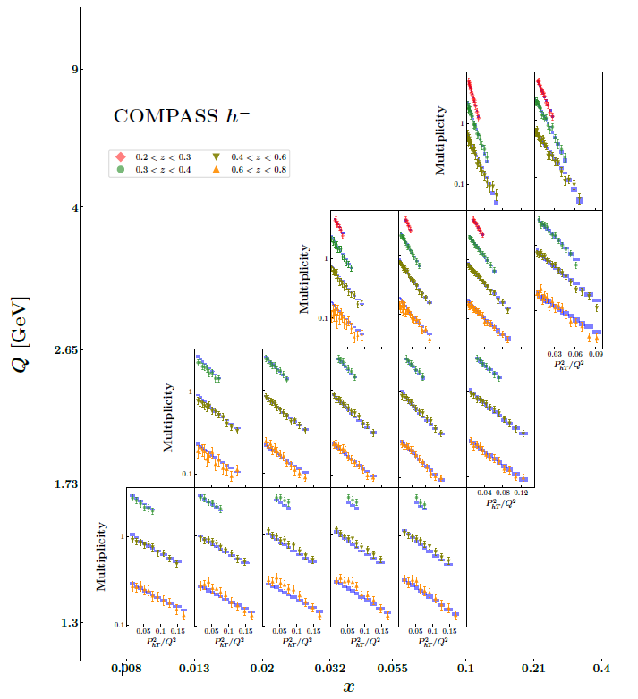
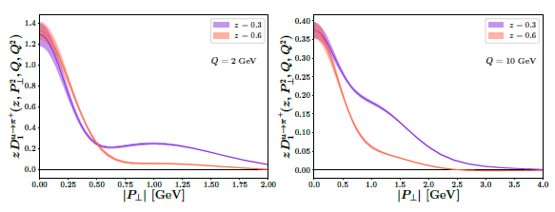
Phenomenological fits
arXiv:2206.07598v1 [hep-ph] 15 Jun 2022

Slide 17
Collins asymmetries for $π$ and $K$ @ COMPASS
Satisfactory description also for kaons

Slide 18


Collins asymmetries for $π$ and $K$ @ HERMES
Smaller $π^{−}$asymmetries for x>0.2 in simulations
$π^{0}$ in simulations as expected by isospin

Slide 19
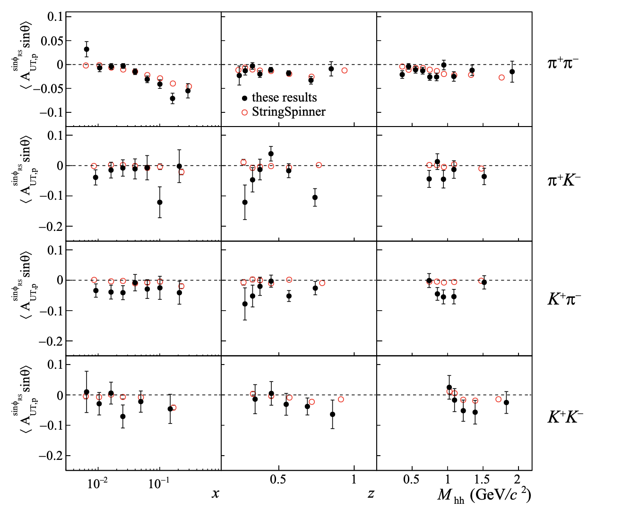
Dihadron asymmetries

