Slide 1

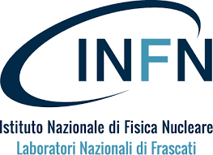





NUCATOLE
NUClear Astrophysics Towards the clarification of Lingering Experimental problems
M. La Cognata (PI)
F. De Oliveira Santos, D. Lattuada, J.P. Fernandez Garcia, A. Moro, S. Pisano, S. Typel, A. Tumino

Slide 2
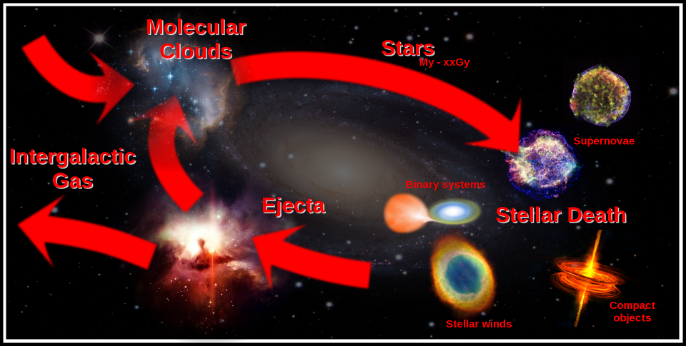
Nuclear astrophysics is vast
Nuclear astrophysics is an interdisciplinary field connecting several areas of science
+ Early Universe
Plasma physics
Nuclear physics
Weak interactions
Atomic physics
Applied physics
(e.g. Atomic mass spectrometry)
Gravitation and gravitational waves
Heavy ion collision
Nuclear EOS
Hadron physics
Our aim is to supply labs providing TNA with novel tools to study the Universe linking low-energy nuclear physics with plasma physics and hadron physics and train younger generations in this multidisciplinary field

Slide 3
Nuclear astrophysics is complicated
Cross sections can be very low
Signal to noise ratio is approaching zero
Target and beams can be hardly available
Target nuclei can be very short lived (e.g. in the rapid neutron captures in Sne)
Reactions may be induced by neutrons, neutrinos, photons
Exotic environments are investigated
The early Universe (QGP? Chiral symmetry restoration?)
Compact objects (nuclear EOS, hadronic d.o.f., quark deconfinement, MM astronomy)

Slide 4
New tools are necessary
1. Indirect methods in nuclear astrophysics
A critical field of investigation is the final stages of stellar evolution, especially in the case of massive stars ending up in compact objects
Key reactions include fusion of heavy nuclei (e.g. ¹²C+¹²C),
reaction between neutrons and unstable nuclei close to the neutron
drip line, and photodissociation reactions
Indirect methods offer a distinct advantage in
their study (examples: Trojan Horse Method,
Asymptotic Normalization Coefficient, and
Coulomb Dissociation)
Indirect methods generally require fixed beam energies to span the whole excitation function including energies of astrophysical interest, and much larger energies than the astrophysical ones, thanks to specific kinematic conditions.
Both features perfectly align with the capabilities of most RIB facilities (like GANIL, CERN-ISOLDE, and GSI-FAIR)
In the case of neutrons+RIBs, indirect methods is the only way to study such processes experimentally.

Slide 5
New tools are necessary
2. Reactions in laser-induced hot and dense plasmas
One of the main issues in nuclear astrophysics is the smallness of cross sections. While astrophysical environments compensate for this with a large number of interacting nuclei, laboratory experiments suffer from a drastically reduced signal-to-noise ratio.
While indirect methods make it possible to measure larger cross sections, the increase in the number of interacting species can be achieved by measuring reaction cross sections in hot and dense plasmas. These plasmas are produced in the interaction of high-power lasers with specifically designed targets, such as cryogenic systems.
A distinctive advantage of this approach is the possibility to investigate nuclear reactions under conditions similar to the astrophysical ones, where electron screening by plasma electrons plays a role. Such conditions are very different from the laboratory ones and laser-induced plasmas are a unique environment where these processes can be studied.
Nuclear reactions in plasmas can be studied using two complementary approaches: the generated plasma can act as a target while a standard beam (stable or radioactive) can be used to induce the reaction of astrophysical importance (as is done at GSI); or, nuclear reactions can occur in the plasma itself, given the high temperatures and densities (a capability anticipated at LNF).

Slide 6
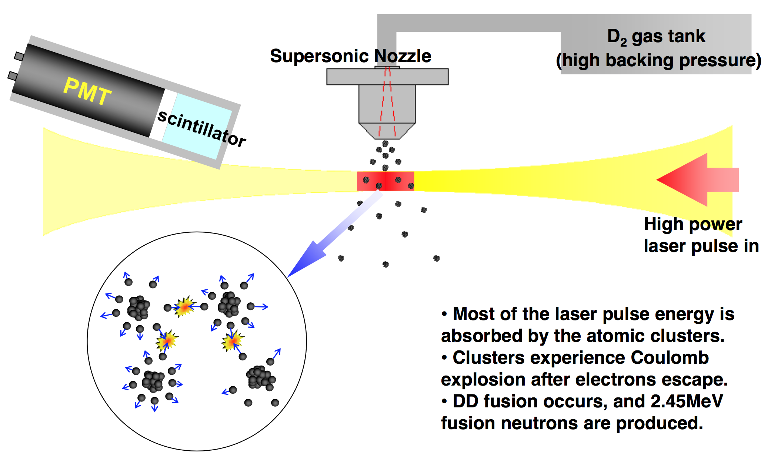

Slide 7
New tools are necessary
3. Theoretical developments
A common thread in such advances in nuclear astrophysics is the need of more advanced theoretical frameworks, for which we will establish connections with GSI, ECT* and the University of Seville.
For reaction among heavy ions, the off-shell propagation of the
transferred particle needs to be considered explicitly before it
interacts with the second nucleus in the initial state of the THM
reaction to participate in the reaction of astrophysical interest:
moving beyond plane-wave approximation
For the rapid neutron capture, we need to study multi-resonant
reactions entering the Hauser-Feshbach statistical regime.
This is an example of the type of study that is
needed: while low energies of astrophysical
interest are out of reach, the use of non-tested models may lead to results contradicting
theoretical models already available
Notes:
Theory calculations using the Feynman path-integral method (Bonasera and Natowitz PRC(R) 2020) and including some l=0 resonances, lead to S-factor values (green color) in agreement with results from the THM experiment (orange circles), highlighting the role of resonances
«We evaluate the ¹²C+¹²C fusion reaction rate using a microscopic model, the antisymmetrized molecular dynamics. Using the model, we calculated the fusion cross sections treating coupling of the entrance (¹²C+¹²C) and exit channels (alpha+²⁰Ne and p+²³Na). We obtained resonances that enhance the fusion cross sections in low-energy regions, which rejects the hindrance model.»

Slide 8
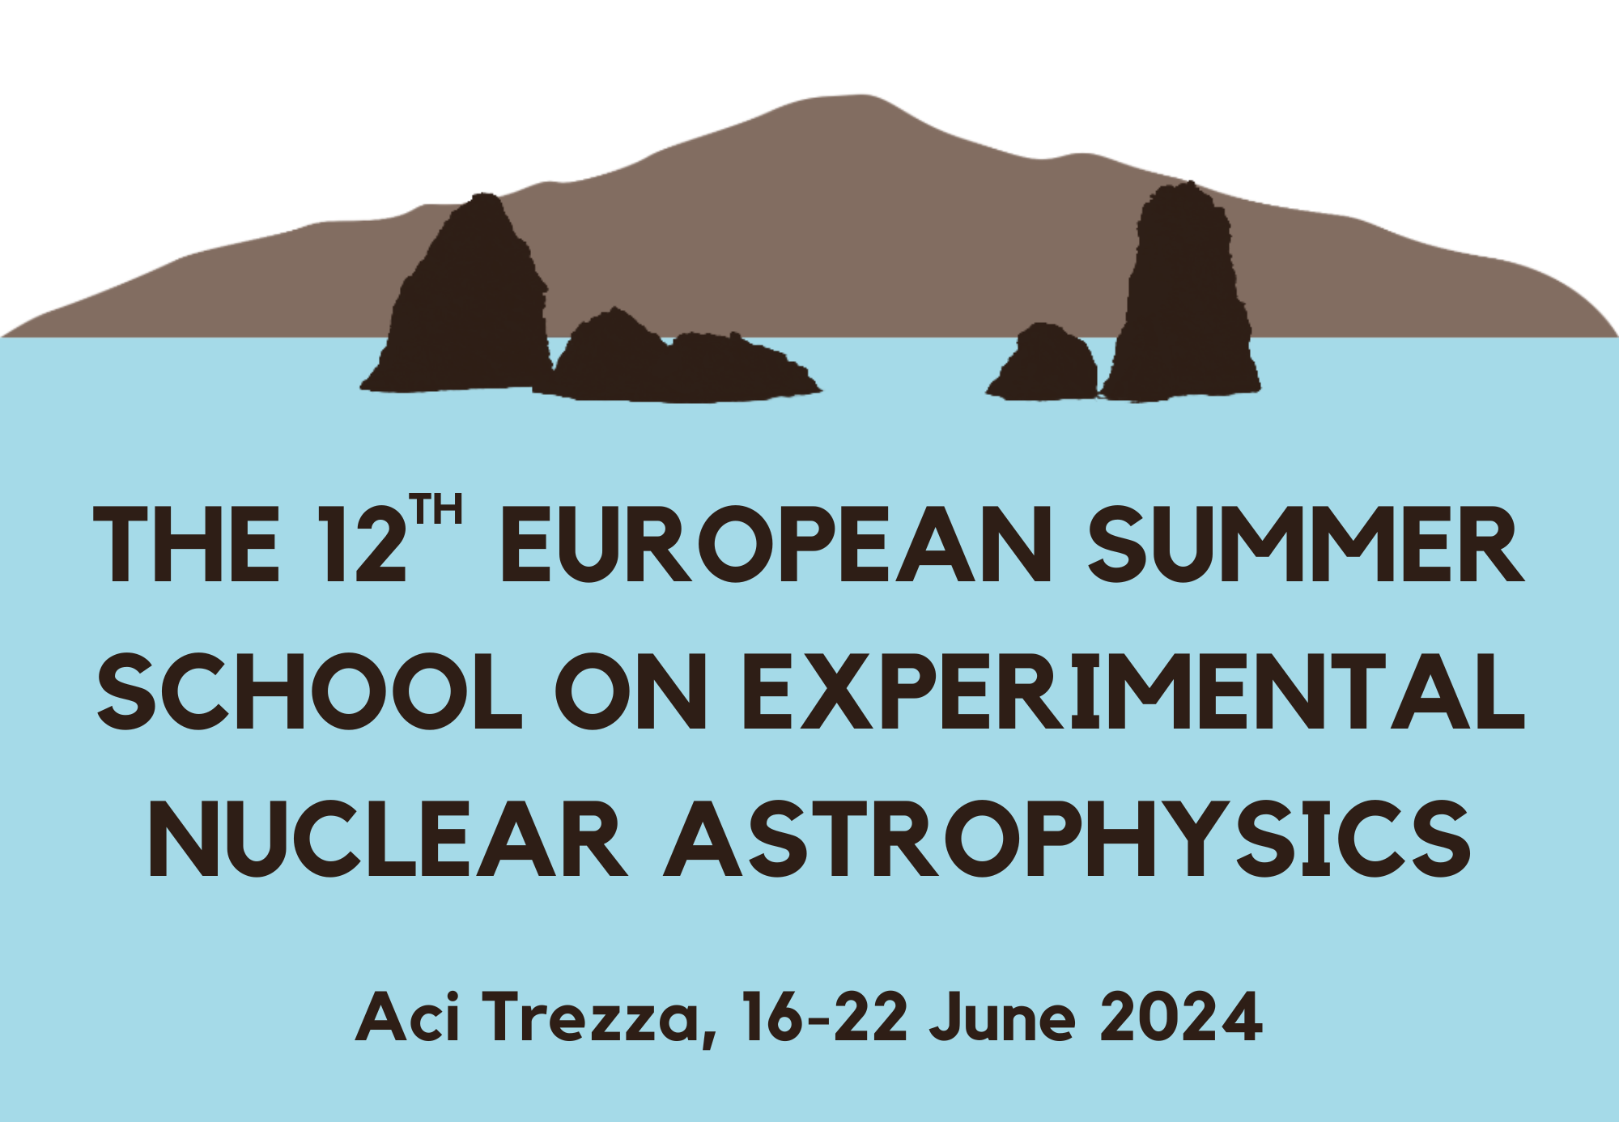
New people are necessary
4. Training of younger generations and outreach
The research activity will be complemented by a strong focus on training young scientists in the field of nuclear astrophysics. Given the highly interdisciplinary nature of nuclear astrophysics, specialized schools are necessary to provide future researchers with the tools to identify key open issues, carry out experiments and assess the astrophysical impact of their findings.
Training through devoted schools will be complemented by outreach activities, with the aim of disseminate the research results as well as to attract younger people, especially women and minorities, to science.

Slide 9
Other details
Previous networks
- CHETEC-INFRA, EUROLABS, ENSAR
Budget
Excluding transnational access to labs for experiments, our budget is approximately € 200.000. This includes € 100.000 for tools and consumables (interaction chamber for plasma studies, detector systems and plasma diagnostics), € 85.000 for a two-year postdoctoral position, and € 15.000 to support two editions of the ESSENA school.
Foreseen TA infrastructures are: GANIL; CERN/ISOLDE; GSI/FAIR, ECT*, LNF Frascati (Italy)

