Slide 1




Optical Simulation using python
Analysis of tilt-to-length coupling for LISA
GDR Ondes Gravitationnelles: workshop "développement des détecteurs »
Maxime Vincent
Astroparticule & Cosmologie

Slide 2
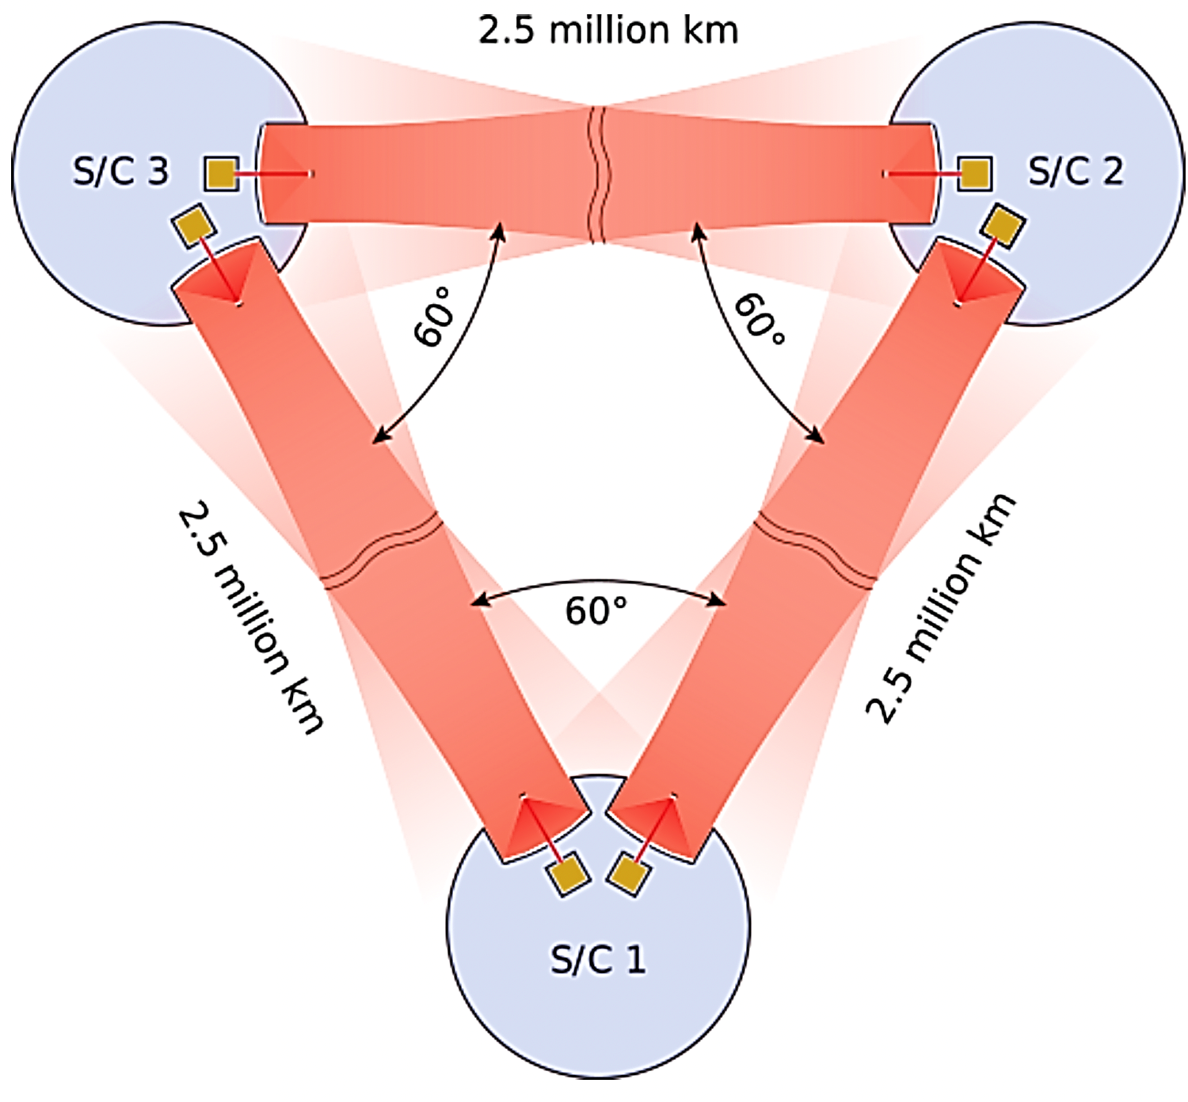
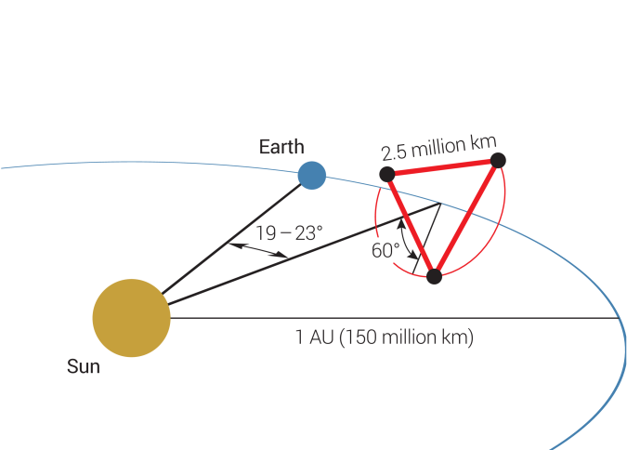
LISA : a few reminders
Three satellites constellation in a triangular formation, forming 3 interferometers with 2.5 MKm arms
Split measurement : TM-SC, SC/SC, SC/TM
Frequency band : 0.1 mHz to 1 Hz
Heterodyne interferometry
  5-25 MHz frequency offset between two beams
  results in sine wave oscillating at ∆f with a phase proportionnal to the variations in OPL
OPD measurement stability requirement : 10 pm/√Hz at 1mHz
Laser frequency stability : 30 Hz/√Hz

Slide 3
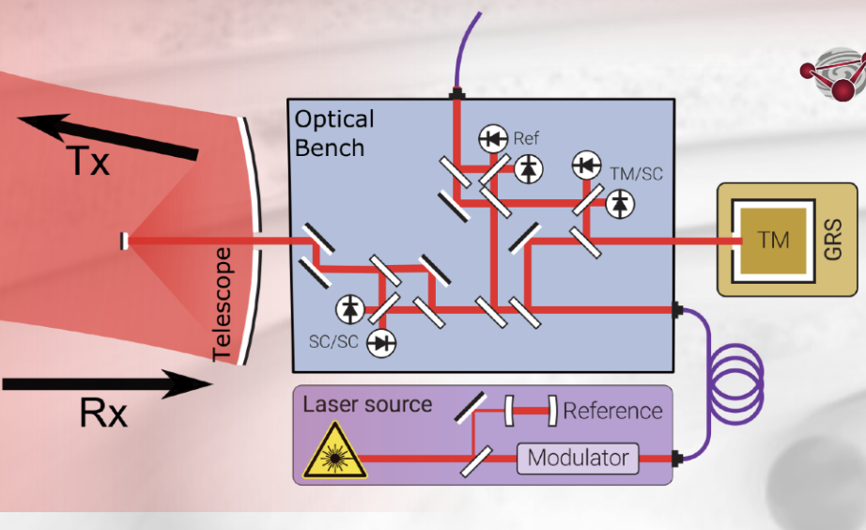
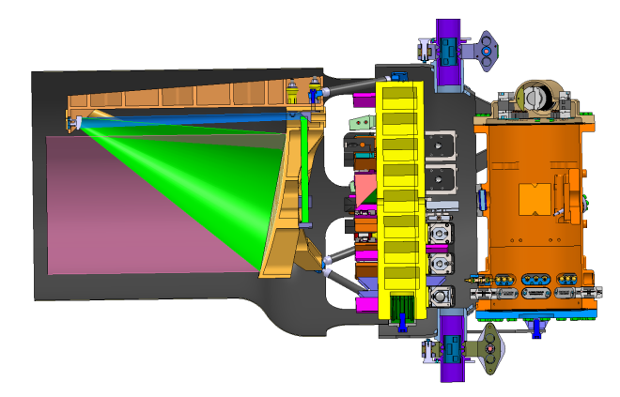

Slide 4
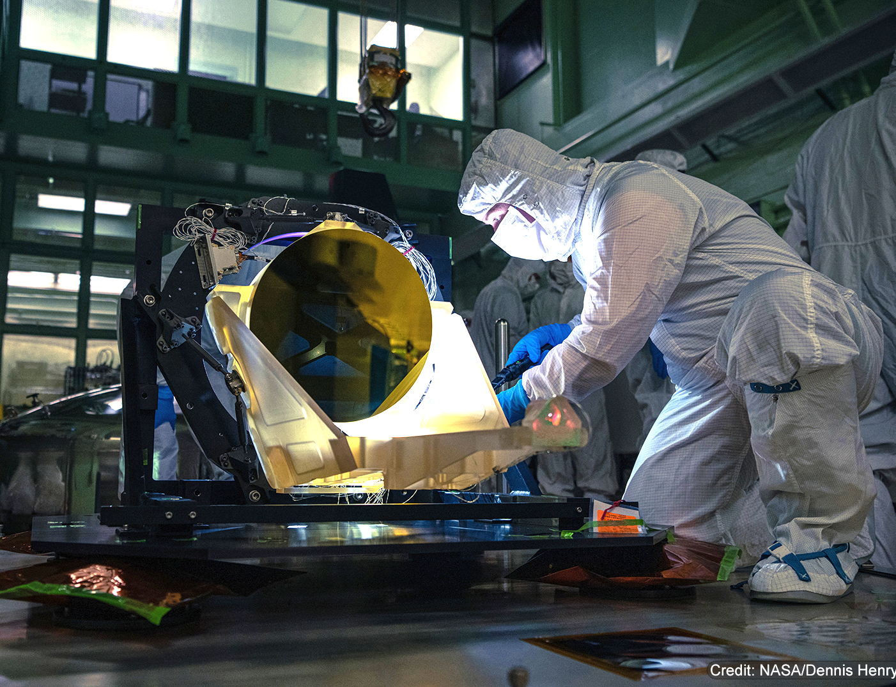
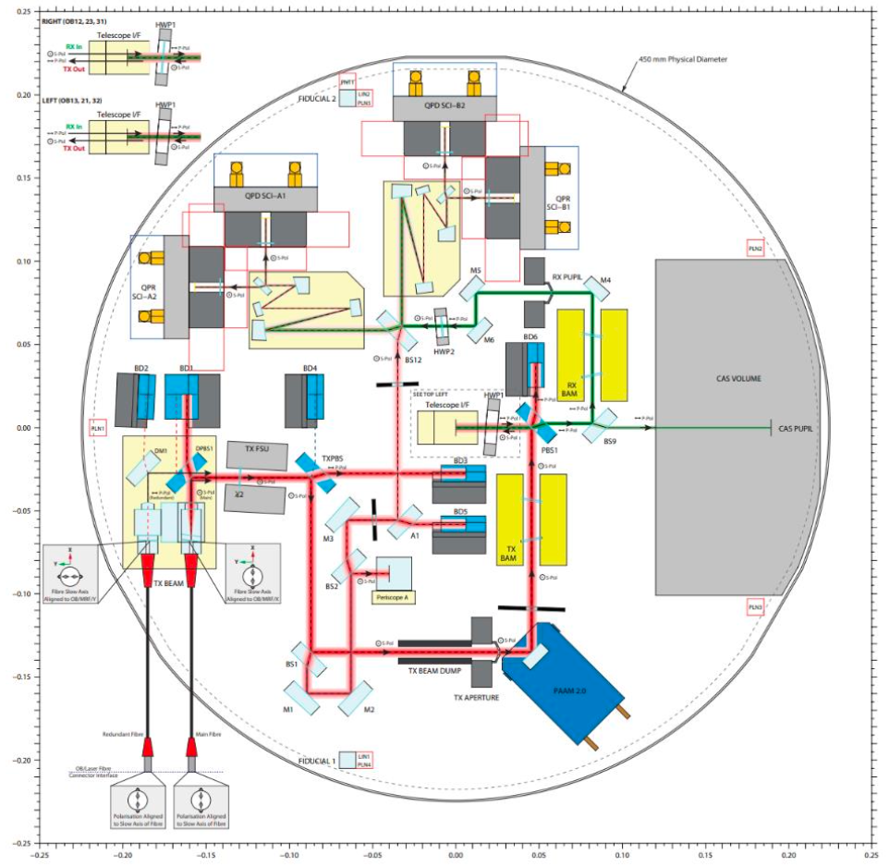
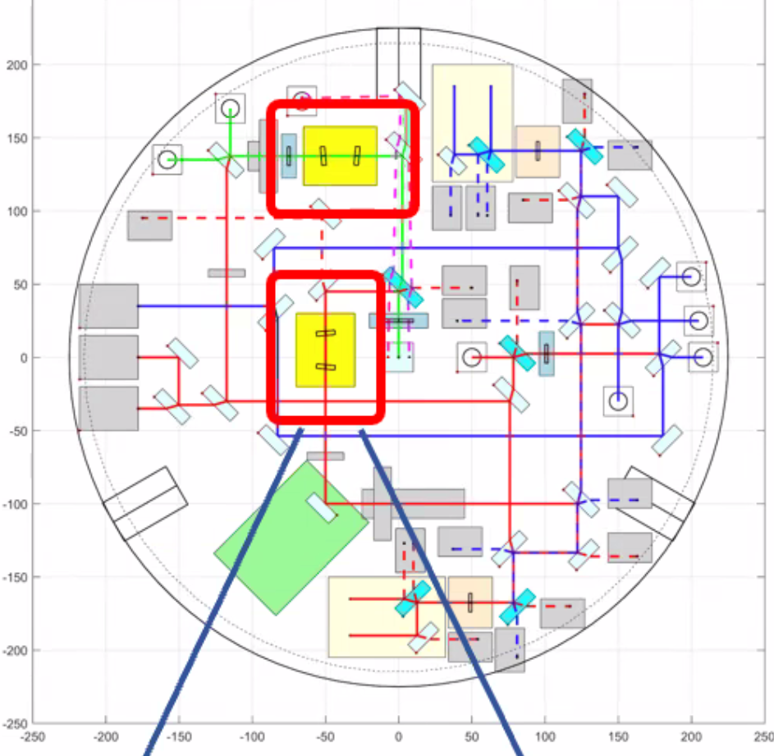
Side A
Side B
Telescope engineering unit
Two sided zerodur optical bench

Slide 5
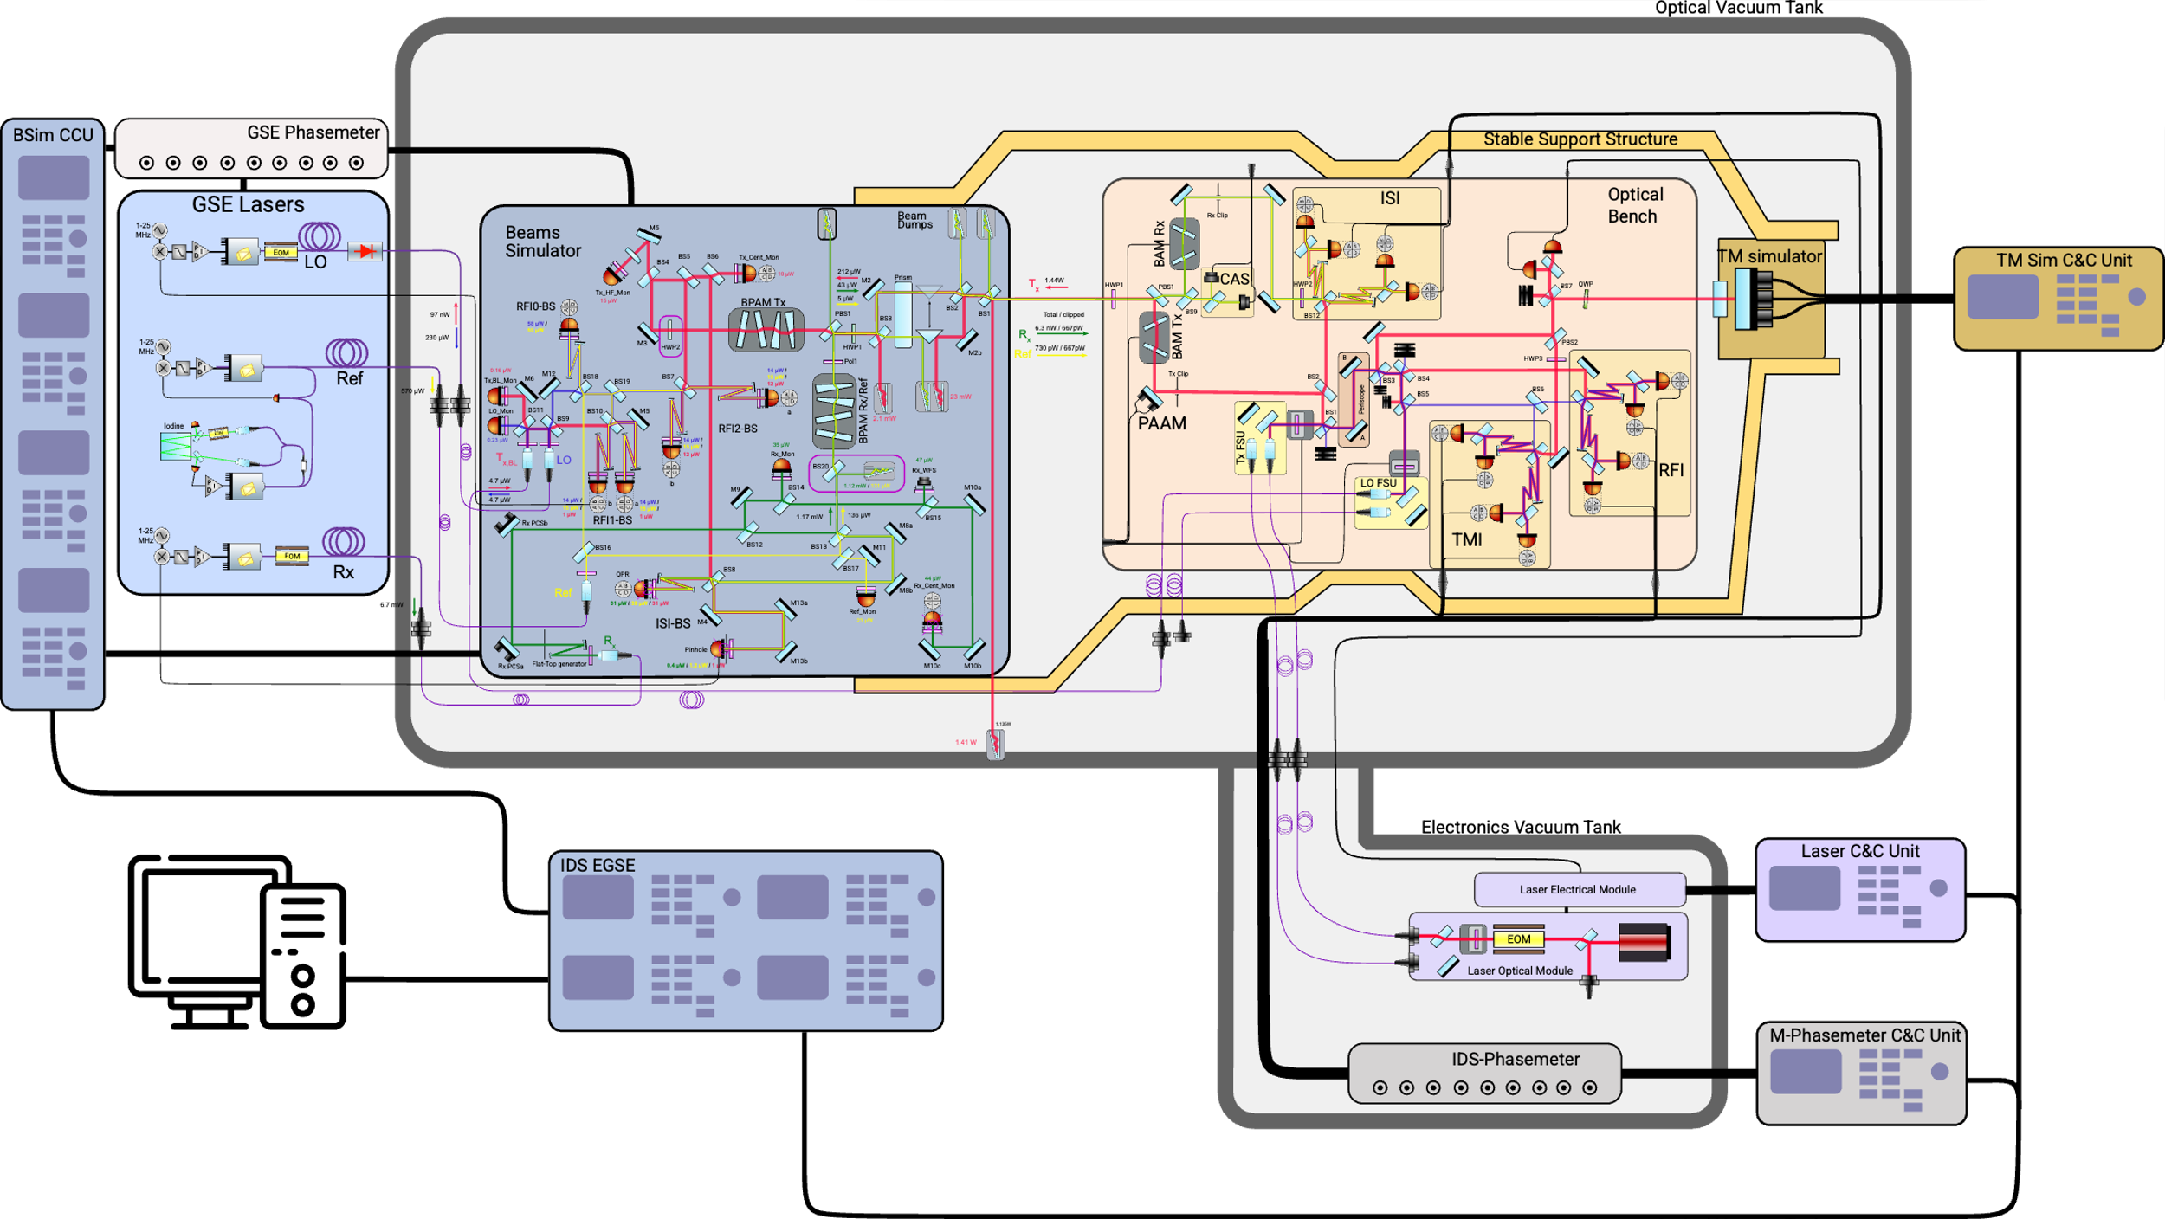
IDS Test Set Up

Slide 6
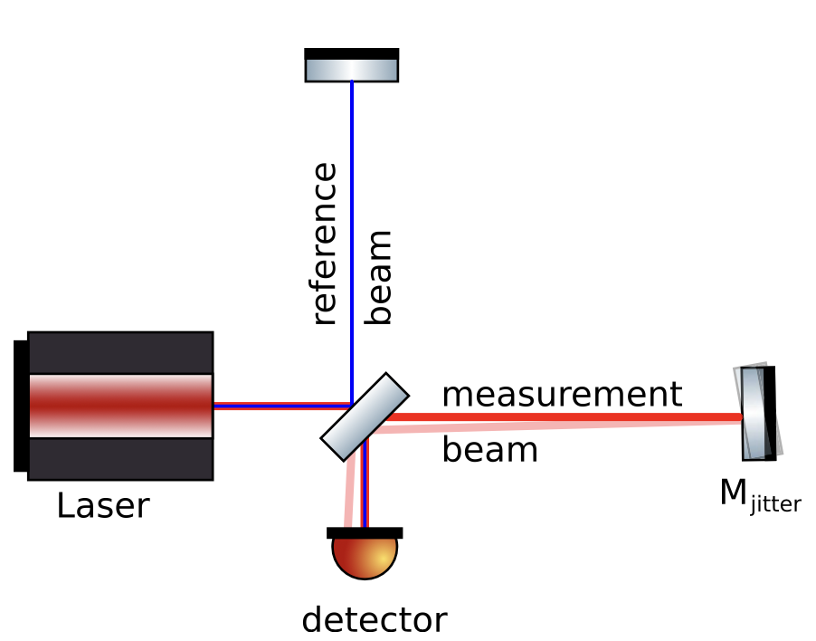
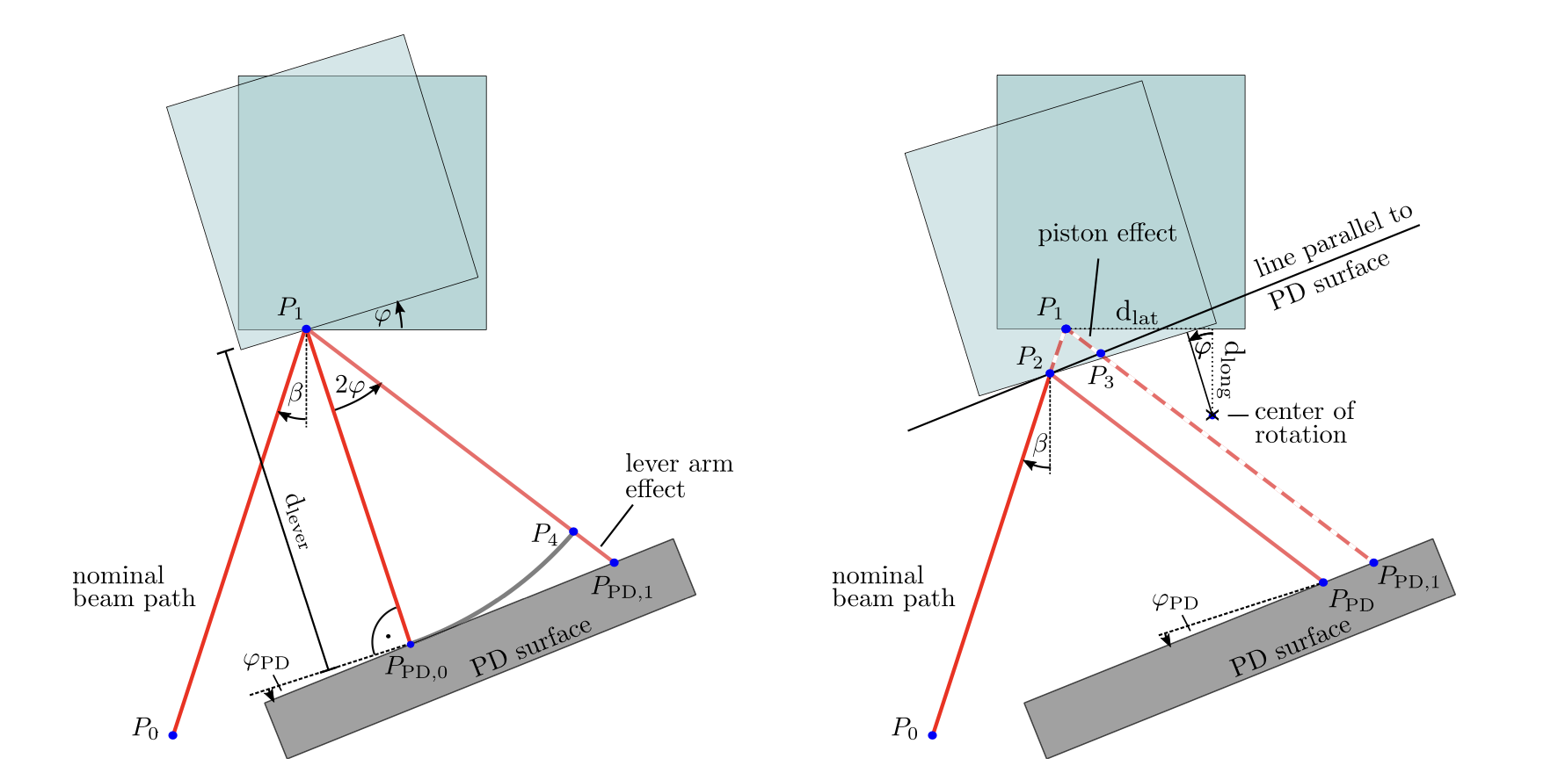
Tilt to Lenght coupling
The LISA spacecrafts will have some residual angular and lateral jitter
There is a coupling between this residual jitter and the phase read out of the interferometer which gives us the optical path length difference of the arms
The response of the interferometer will be different as a function of the angle between beams, the alignment of the beams or the beam properties
Two types of coupling : geometric and non geometric
Marie-Sophie Hartig et al 2022 J. Opt. 24 065601
Notes:
the IDS must be capable to perform acquisition for up to 2µrad off-pointing of the spacecraft (which corresponds to 268µrad on OB space)

Slide 7
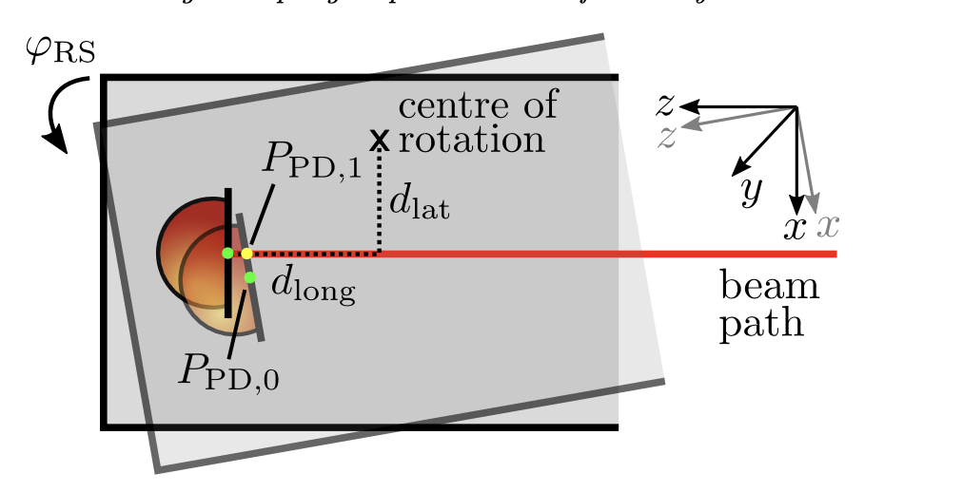
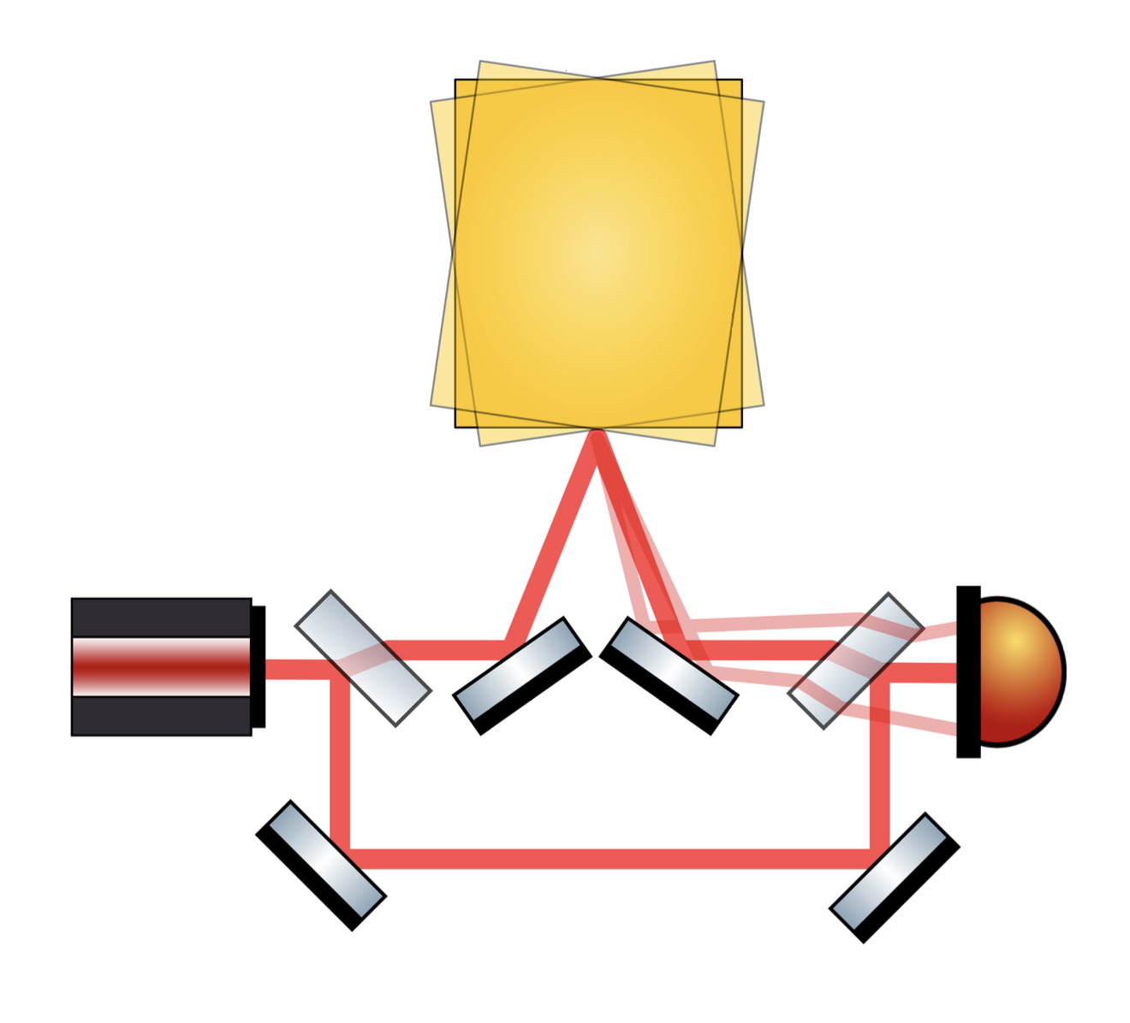
Tilt to Lenght coupling
Geometric tilt to lenght coupling : direct alteration of the optical path lenght of the laser beam
Fully dependant on design and independant of beam type
Angular jitter of the interferometric beam affects it’s geometric path thus adding an unwanted aditionnal OPL component
This coupling can be minized by having dedicated imaging systems and adequat design of the interferometer
Marie-Sophie Hartig et al 2022 J. Opt. 24 065601

Slide 8
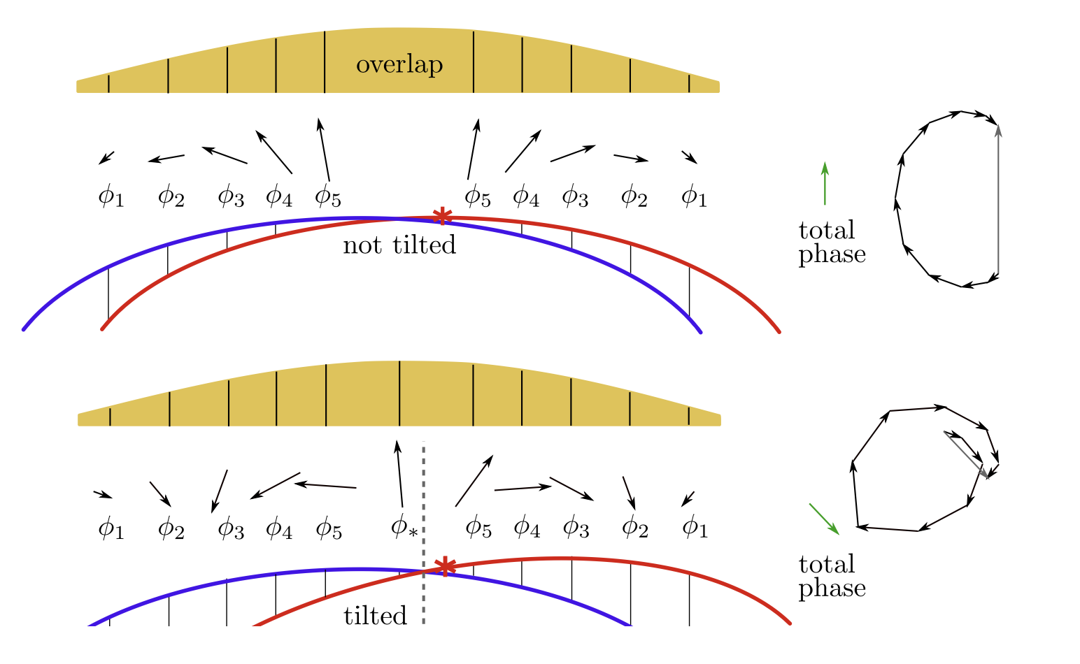
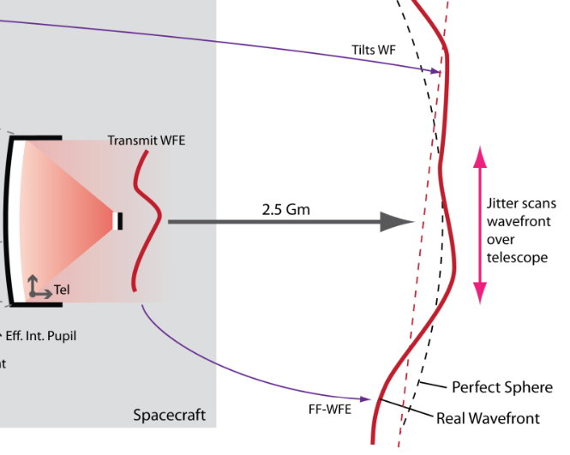
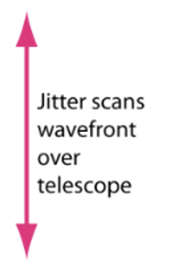
Tilt to Lenght coupling
Non geometric TTL is every contributor to the coupling that does not originate from direct spatial OPD changes
The jitter of one of the beams will induce changes in the interference pattern
The phase integrated over the quadrant of the photoreceptor might be different inducing a variation in the read out of the interferometer
Some sources of N-G TTL : wavefront curvature differences, intensity distribution, waist position wrt to QPD, WFE, beam overlap, QPD geometry (Single element or quadrant photoreceiver)
arXiv:2207.06278v3
Different local wavefront curvature
due to wavefront error and spacecraft jitter

Slide 9
Tilt to Lenght coupling
Non geometric TTL is every contributor to the coupling that does not originate from direct spatial OPD changes
The jitter of one of the beams will induce changes in the interference pattern
The phase integrated over the quadrant of the photoreceptor might be different inducing a variation in the read out of the interferometer
Some sources of N-G TTL : wavefront curvature differences, intensity distribution, waist position wrt to QPD, WFE, beam overlap, QPD geometry (Single element or quadrant photoreceiver)
arXiv:2207.06278v3
Different local wavefront curvature
due to wavefront error and spacecraft jitter

Slide 10
Tilt to Lenght coupling
Non geometric TTL is every contributor to the coupling that does not originate from direct spatial OPD changes
The jitter of one of the beams will induce changes in the interference pattern
The phase integrated over the quadrant of the photoreceptor might be different inducing a variation in the read out of the interferometer
Some sources of N-G TTL : wavefront curvature differences, intensity distribution, waist position wrt to QPD, WFE, beam overlap, QPD geometry (Single element or quadrant photoreceiver)
arXiv:2207.06278v3
Different local wavefront curvature
due to wavefront error and spacecraft jitter

Slide 11
Tilt to Lenght coupling
Some example values
In LISA pathfinder the residual jitter between TM and OB was 10 nrad/sq(Hz)
The specification for the TTL of one IDQS unit is 34 µm/rad
This yields a OPL noise of : OPL = TTL*Jitter = 34 µm/rad = 10 nrad/sq(Hz) = 0.34 pm / sq(Hz) for 1 IDS
There are 6 IDS spaning the entire constellation, but the combination of the different contributions are not so straigth forward due to the data analysis techniques

Slide 12
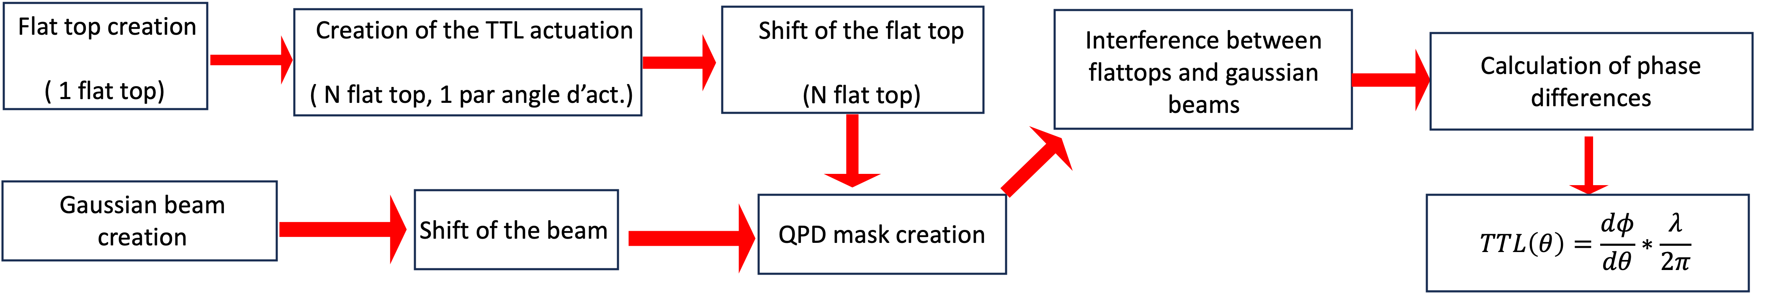
Tilt to Lenght simulator
Using the python library PROPER for physical optical propagation that was developped by NASA for the JWST.
EM field propagation using Fourier transform : takes into account diffraction aspects, in far and near field
Main objective of the simulation tool: propagate two laser beams (intensity and phase profil at the choice of the user : gaussian or flat top) on a given distance while putting a tilt on one of the beams , and calculate the interference on a QPD or SEPD
By taking several tilt angles, one can create an angular actuation sequence and get the relative angle between actuation and retrieve the TTL coefficient.

Slide 13
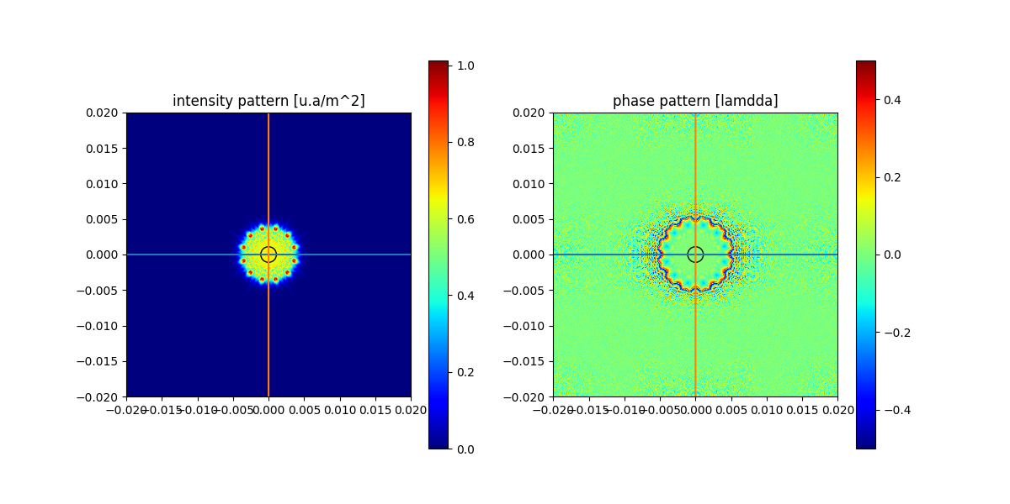
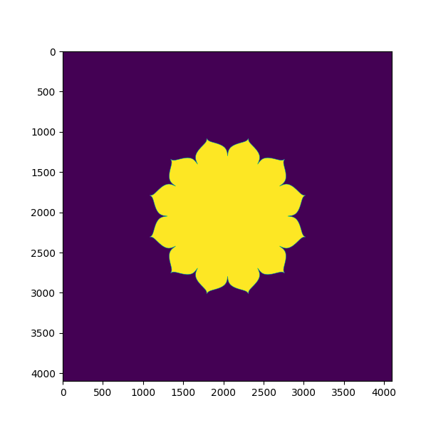
Apodization aperture mask

Slide 14
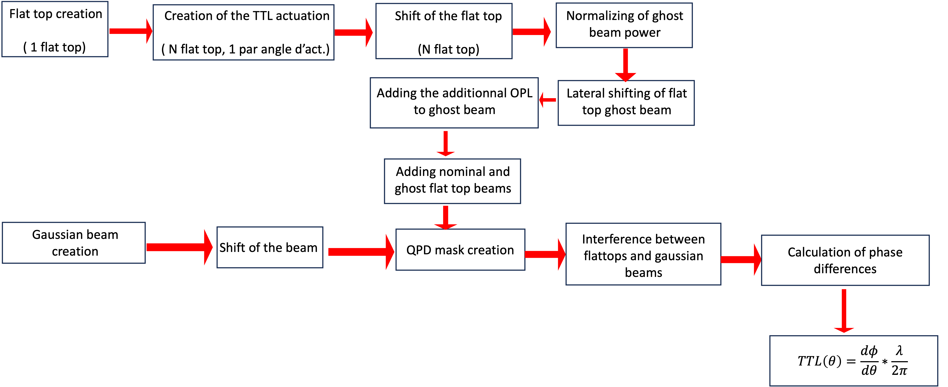
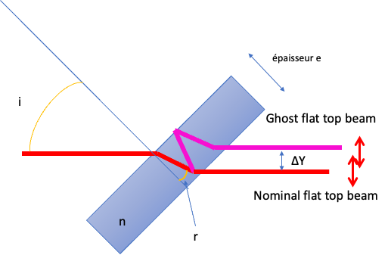
Ghost beam induced TTL
One of the beams of the BSim is a ~10 mm flat top to be representative of the far field beam coming frm the distant space craft; when passing through a beam splitter a double reflected ghost beam can be generated
If the lateral separation is not sufficient, the ghost beam can highly deteriorate the quality of the nominal beams wave front, thus potentially inducing a TTL coupling contribution
A theoritical approach was studied, but it was difficult to grasp the entire problem, so I adapted the simulation tool to this problem.
Figure 7 - réflexion parasite dans une lame a face parallèle

Slide 15
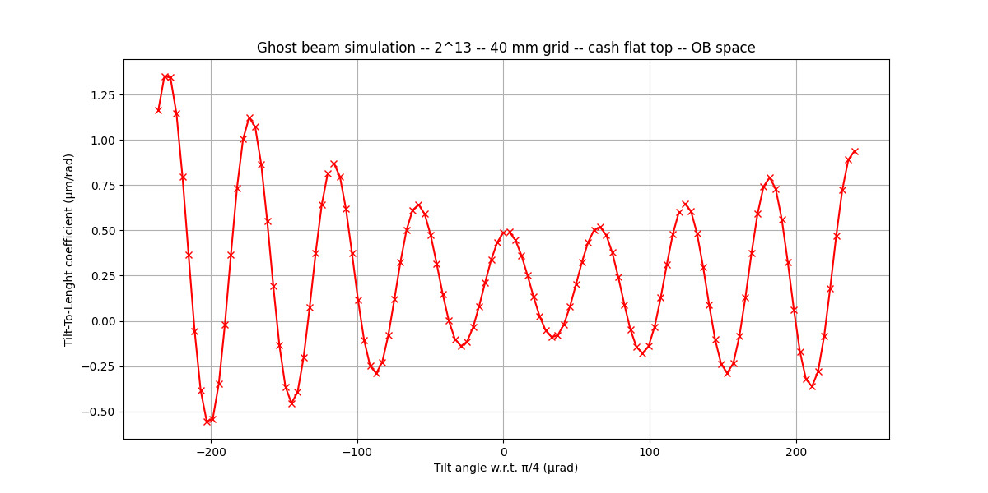
Example of the first/last beam splitter of BSim BS1
Simulation parameters are the following :
Thickness of BS = 10 mm
Radius of the beam = 5 mm
45° incidence angle
R1=99.7% (surface) ,
R2=0.3% (internal)
40 mm simulation grid
4 µm resolution (4096*4096 pts grid)
Figure 9 - Coefficient de couplage TTL engendré par une réflexion parasite qui se superpose au faisceau nominal lors du passage dans BS1

Slide 16
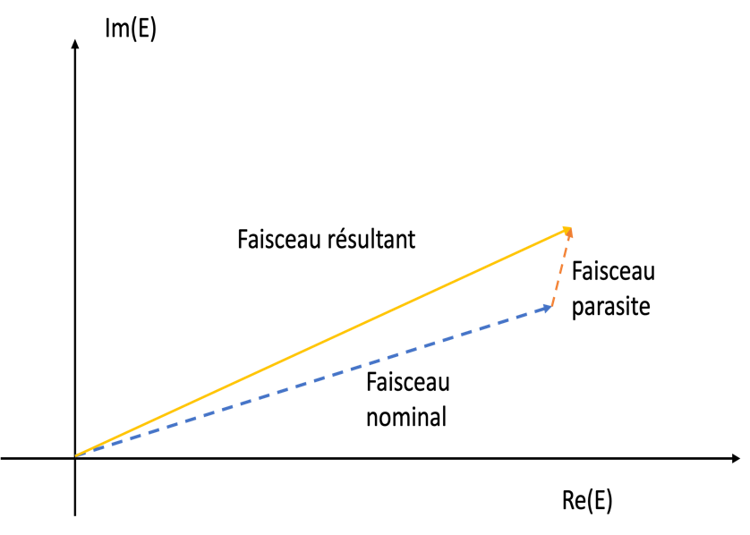
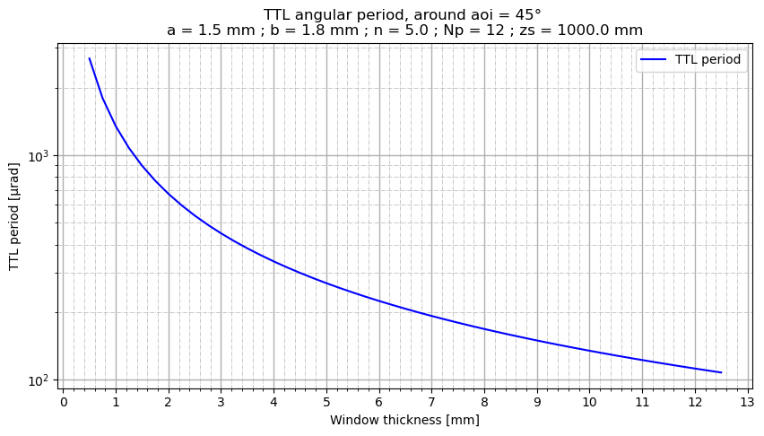
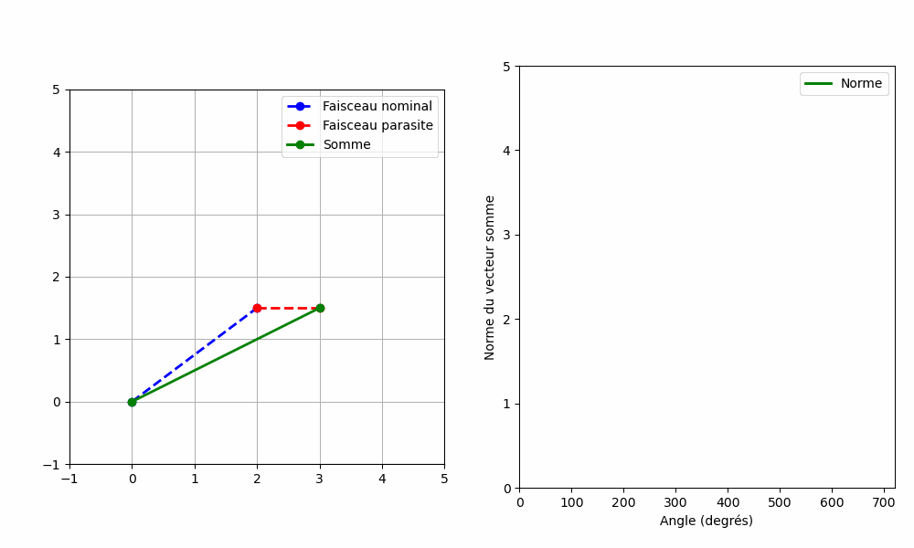
Ghost beam double reflexion
The thickness of glass the beam has to travel through is a function of the incidence angle of the beam.
The ghost beam has to travel more than twice the OPL than the nominal beam in glass, so it’s phase will cycle much faster than the nominal beam.
The oscillation in TTL coupling w.r.t. actuation angle originates from the interference bewteen ghost and nominal beam that is more or less destructive
Figure 10 - Visualisation de la partie réelle et complexe du champ électrique du faisceau nominal et de sa réflexion parasite
Figure 11 - Période d'oscillation de la valeur du couplage TTL causé par la réflexion parasite de la séparatrice en fonction de l'épaisseur de cette dernière

Slide 17
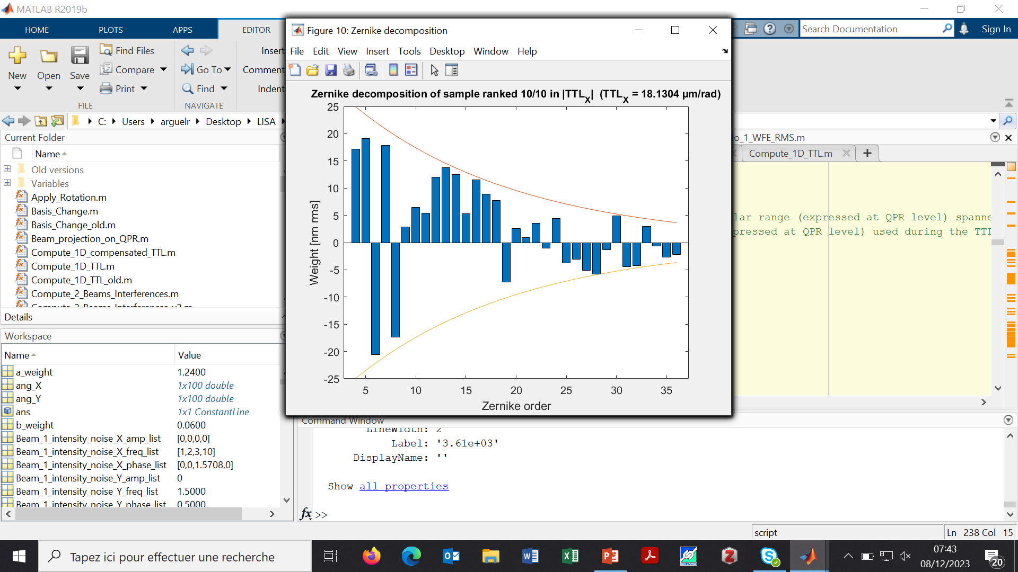
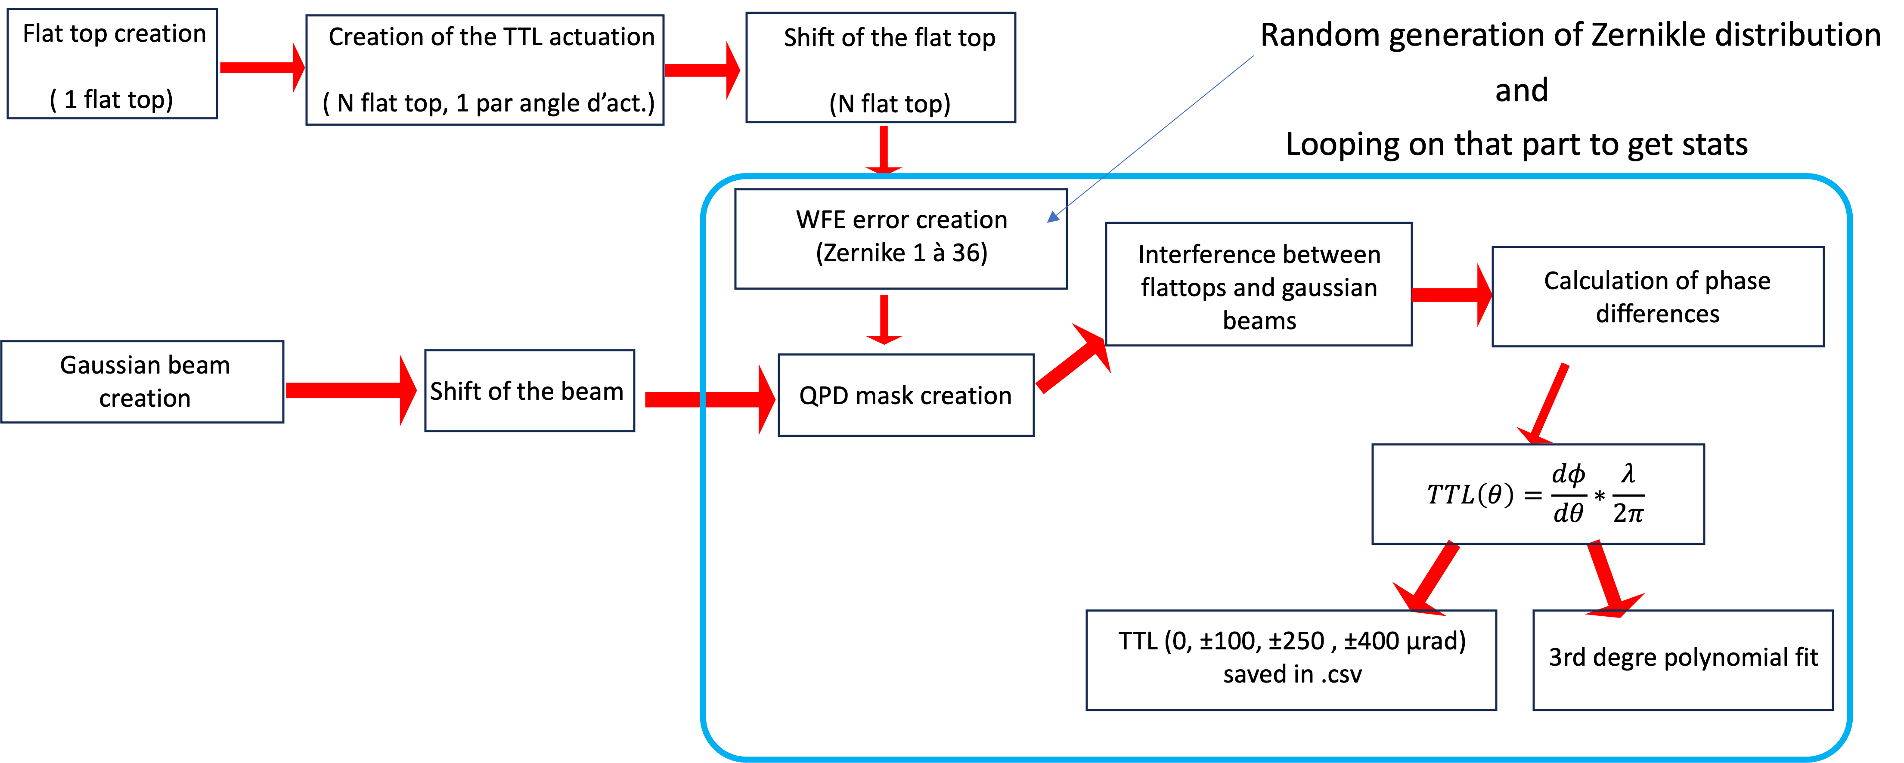
WFE induced TTL
The Zernike distribution chosen followed a decreasing exponential shape to best represent real life optical surfaces that exhibits more surface error defects at low spatial frequency than at higher.
The parameters of this distribution and modality for the Monte Carlo sampling of the zernike amplitudes are the same as the one used in the UKATC OB and CNES teams study
The overall wavefront error is normalized to reach λ/30 RMS WFE, as specified for the BSim and OB.

Slide 18
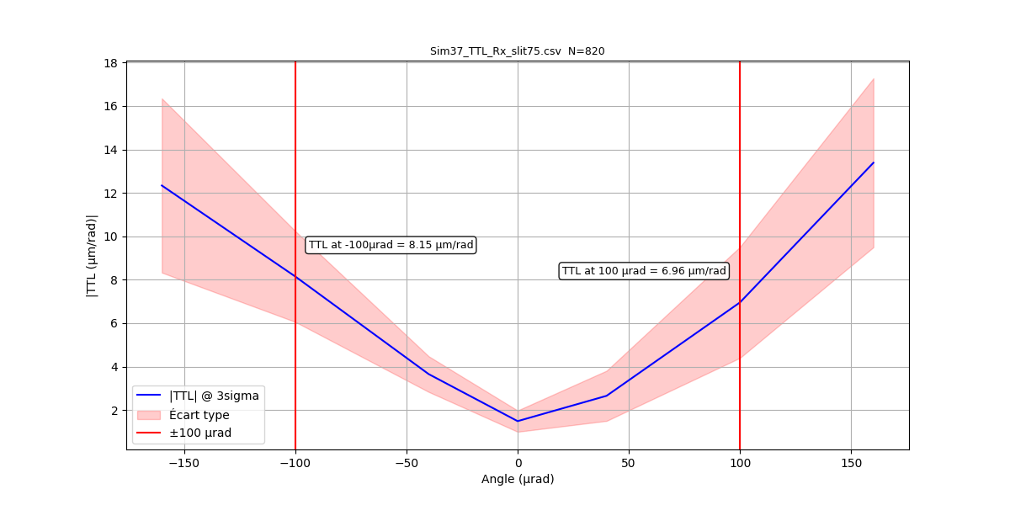
Simulation parameters :
Radius of QPD [m] : 1.12 mm
Dead zone slit size[m] : 75 µm (2.5 * 30 µm)
Longueur d’onde [nm] : 1064 nm
Sim grid size [mm] : 40 mm
Nb of points (2^n) : 2^12 * 2^12
Ref beam waist size[m] : 1.12 mm (Tx)
Rx beam raidus [m] : 5 mm
Apodisation mask radius [m] : 5 mm
Méthode de création du flat top : proper
TTL angular actuation [µrad, espace OB] : ± 160
Number of angular actuation steps : 16
Direction de l’actuation TTL (X ou Y) : X
WFE :
WFE on Rx beam [m RMS] : 1064/30 nm
Number of Zernike coefficient applied : 4 à 37
Application zone of WFE [m] : 2.74 mm
Figure 17 - Distribution statistique (valeur à 3 sigma) de la valeur absolue couplage TTL induit par une WFE de L/30

Slide 19
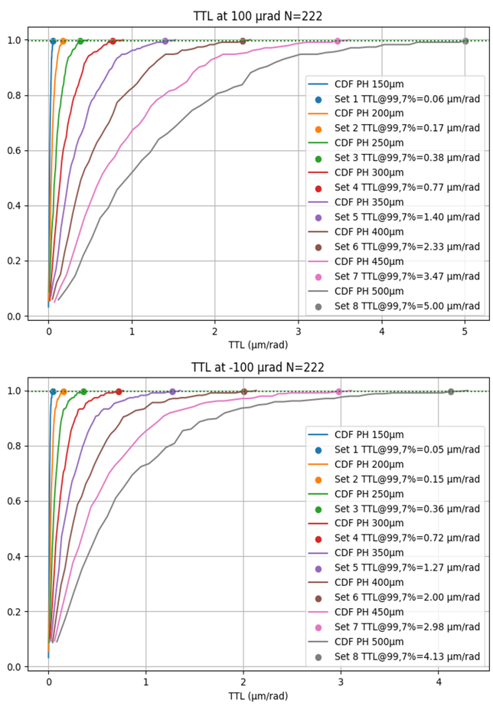
Pinhole size influence
Picometric performance measurement and TTL measurements will be done using a pinhole phtoreceiver to minimize the WFE distorsion
The size of this pinhole has a strong influence on the coupling, the smaller the pinhole is, the smaller the coupling will be but the smaller the flux will also be (inducing a shot noise increase)
Thus we need to know the maximum size allowable for the pinhole w.r.t. the TTL coupling induced
It seems that the maximum size we could accept is 300 µm, with less than 2 µm/rad TTL coupling induced.

Slide 20
Conclusion
Creation of a tool to assess the influence of different optical effects on TTL coupling
Enables to include diffraction and propagation effects that play an important role
Consolidated specification coming out of this tool :
      Total wavefront error on the flat top beam must not exceed λ/30 RMS to reach test spec
      Coating quality for optics on the flat top beam path for ghost beam mitigation
      Minimal thickness required for some optics for ghost beam mitigation
      Size of the pinhole photoreceiver to limit TTL coupling
Next step : creation of an optical simulation tool to model the full optical bench with gaussian beam geometrical propagation and physical propagation for performance and tolerancing analysis of BSim

Slide 21
Few words on Proper
Proper is a python / IDL / matlab library developped and tested by NASA and with a public source code
It is really to use and integrate in exploratory and RnD codes
Basically is a set of wavefront propagation tools that allow for diffraction studies
Includes a set of procedures for apertures ( any shape : circular, hexagonal, elliptical…)
Includes a set of procedures for wavefront aberations (PSD, defformable mirrors, Zernikes…)
The PROPER routines implement common Fourier transform algorithms (angular spectrum & Fresnel approximation) to propagate a wavefront in near and far-field conditions
The procedures automatically determine which algorithm to use depending on the properties of the pilot beam
Follows the method described by Lawrence (Applied Optics and Optical Engineering, V. 11 [1992]), which is also used by other programs (e.g. ZEMAX and GLAD)

