Slide 1
Optical simulations methods for low-losses stable recycling cavities of Advanced Virgo+
Ward Amar, Raffaele Flaminio
Laboratoire d’Annecy de physique des particules
GdR ‘detectors development’ workshop – 10th June, 2025

Slide 2
Table of content
Motivation
Optical simulation tools
Optical simulation methods:
  1- Astigmatism losses in the stable recycling cavities
  2- Optimization of P/SR1 mirrors radius of curvature
  3- Calculation of the squeezing losses in the signal recycling cavity
Summary and conclusion

Slide 3
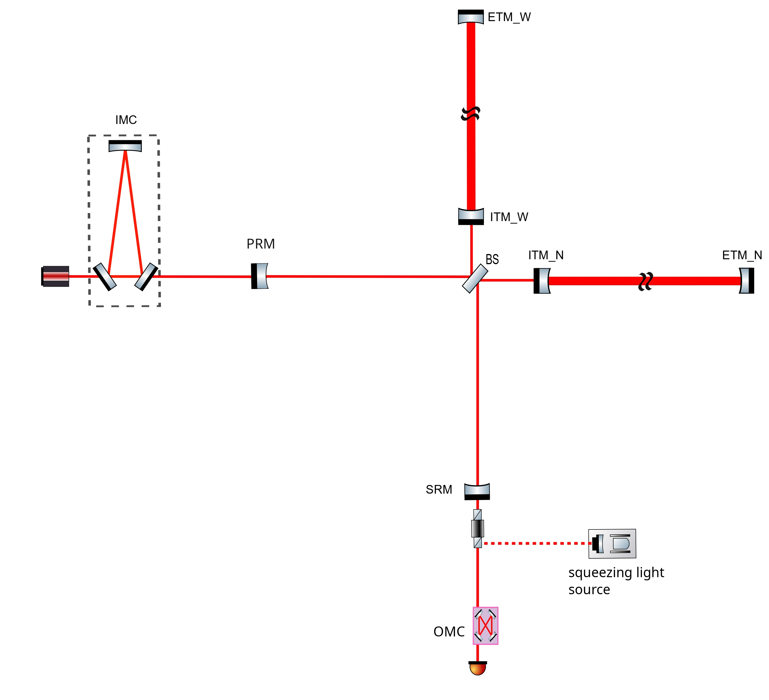
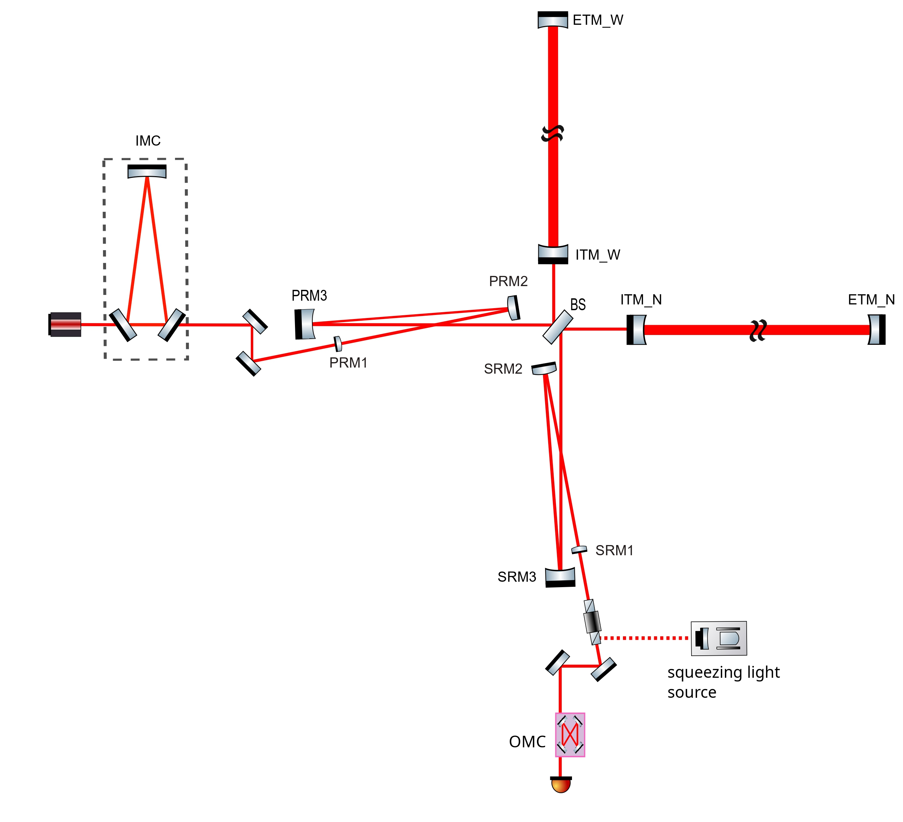
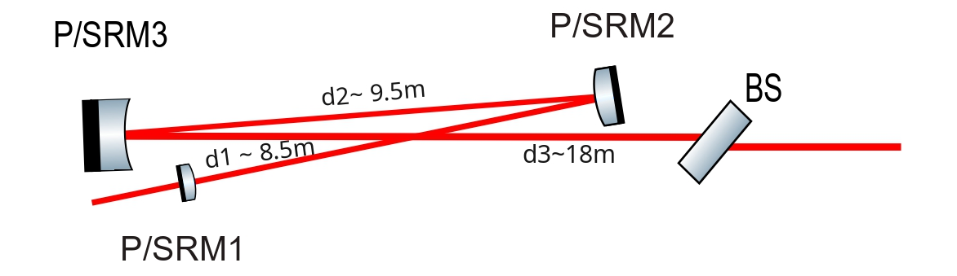
Motivation
The upgrade of the Virgo detector to Advanced Virgo + requires study of the new stable recycling cavities.
  The power recycling cavity (PRC)
  The signal recycling cavity (SRC)
The stable cavities design is constrained by the limited space.
The design of the stable cavities contains:
  Nonzero angles of incidence (astigmatism losses)
  Strongly curved mirrors
Power recycling cavity (PRC)
Signal recycling cavity (SRC)
RoC= -1,9 m
Θ =3,74ᵒ
RoC= 20,2m
Θ =1,08ᵒ
RoC= -5,2 m
Θ =0ᵒ

Slide 4
Optical simulation tools: OSCAR and SIS
We are using FFT based simulation codes developed within the LVK collaboration: OSCAR and SIS.
The two codes are integrated in MATLAB.
OSCAR: Developed at LMA
  Advantage: simple and flexible to use.
  Difficulties:
    Long locking duration~ 2hours → The code becomes slower when:
      Adding imperfections on the mirrors.
      Simulating the modulation sidebands.
    Injection from the dark port → not straightforward.
SIS: Developed at Caltech
  Advantages:
    Fast calculation ( lock duration ~8min).
    Possibility to inject beam from the dark port.
  Difficulty: We found that the SRC was not locked at the right position (locked on HOM)→ We solved the issue by locking the SRC with a beam injected from the dark port.
HOM dominated beam
Inject TEM00 beam
Thanks to Hiroaki Yamamoto (SIS) and Jerome Degallaix (OSCAR) for their valuable inputs and help with conducting the simulations.

Slide 5
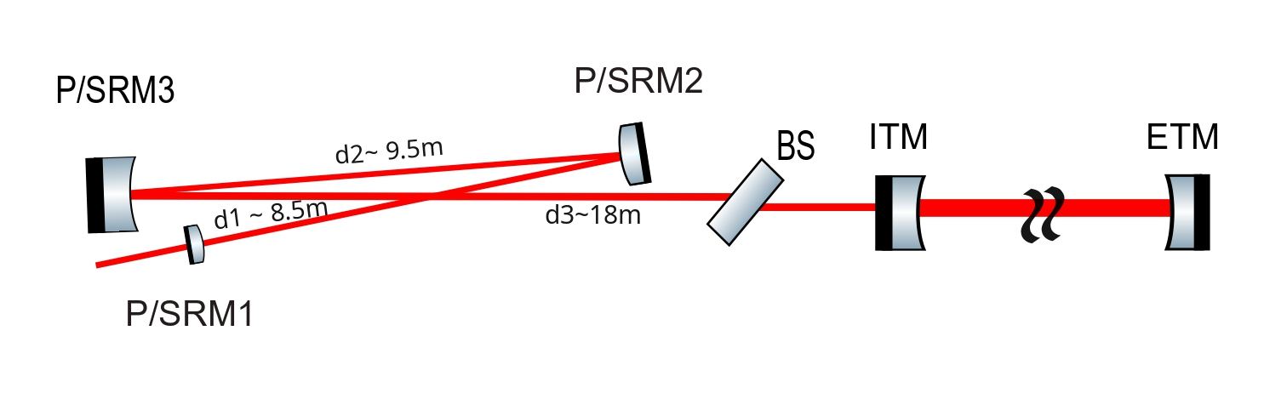
Optical simulation methods
We aim to optimize the design of the stable cavities by minimizing the losses. We follow three methods to calculate the stable cavities losses.
Calculation of the astigmatism losses: propagation through the recycling cavity. We study the beam high order modes on P/SR1.
Mirror’s RoC optimization:
round trip propagation in the recycling cavity. We optimize the P/SR1 RoC by maximizing the matching between the Fabry-Perot cavity and recycling cavities.
Squeezing losses in the SRC:
we simulate the locked interferometer. We inject beam from the dark port to simulates the losses experienced by the squeezed vacuum beam.
Squeezing Losses
Beam matching
HOM decomposition

Slide 6
Method 1: The calculation of astigmatism losses

Slide 7
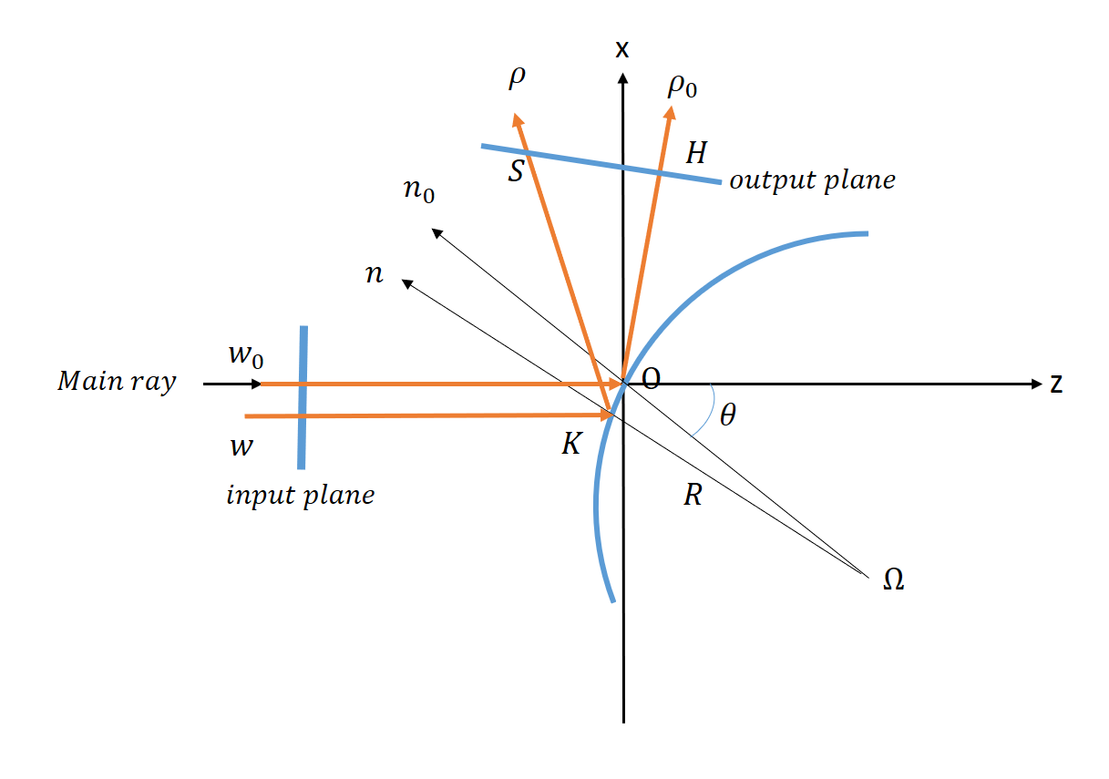

Method 1: Accurately simulating the mirror interface*
The field reflected by mirror’s surface is calculated by multiplying the input beam by the reflection operator: $R\left(x,y\right)=r\exp\left(iks\left(x,y\right)\right)$
  Where $s\left(x,y\right)$is the beam optical path
  $$s\left(x,y\right)=f\left(x,y\right)−\frac{x\sin\left(2θ\right)−f\left(x,y\right)\cos\left(2θ\right)}{2\sin\left(2θ\right)\left(\sin\left(θ\right)+\frac{x}{R}\right)g\left(x,y\right)−\cos\left(2θ\right)\left(1−2g{\left(x,y\right)}^{2}\right) }$$
  where $f\left(x,y\right)=Rcos\left(θ\right)−\sqrt{R^{2}\cos^{2}\left(θ\right)−2Rxsin\left(θ\right)−x^{2}−y^{2} }$ and $g\left(x,y\right)=\sqrt{\cos^{2}\left(θ\right)−2xsin\left(θ\right)−{(x}^{2}−y^{2})/R^{2} }$
By developing equation (1) to the second order Taylor expansion in x and y:
  $$s\left(x,y\right)≅\frac{x^{2}}{Rcosθ}+\frac{y^{2}cosθ}{R}$$
OSCAR code uses equation (2) for simulating the reflection of the beam on curved surfaces.
We implemented equation (1) in OSCAR code to accurately simulate the mirror surface.
--- (1)
Exact equation
--- (2)
approximated equation
* P. Hello and J-Y Vinet. Simulation of beam propagation in off-axis optical systems. Journal of optics, 27(6):265, 1996.

Slide 8
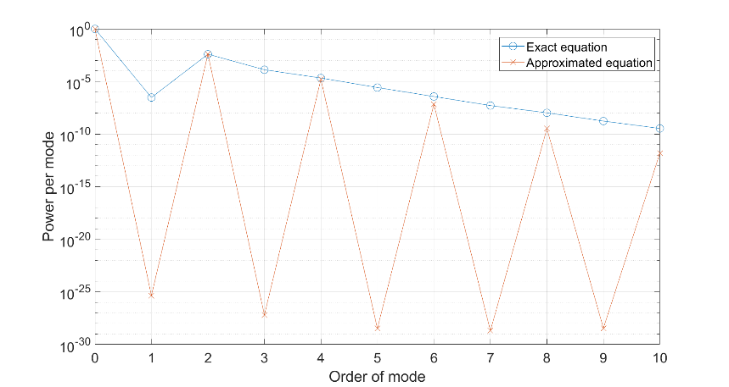
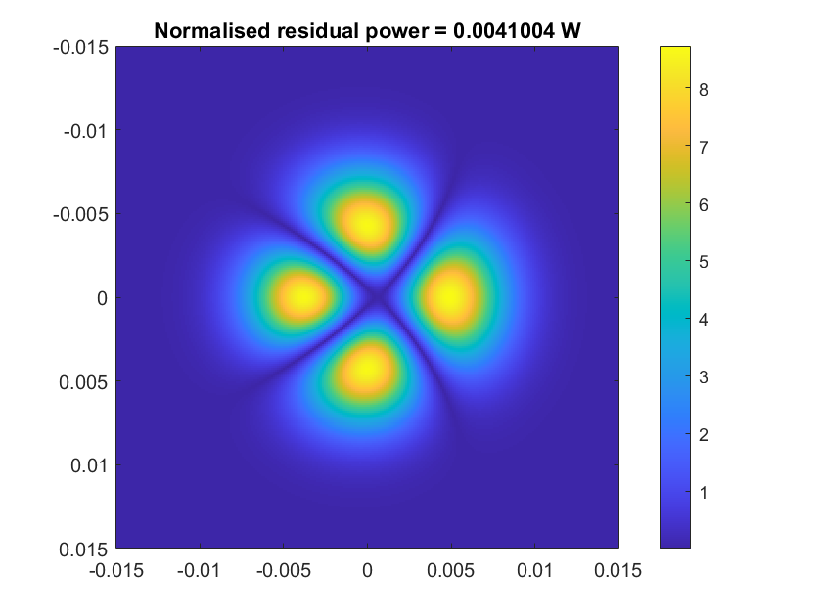
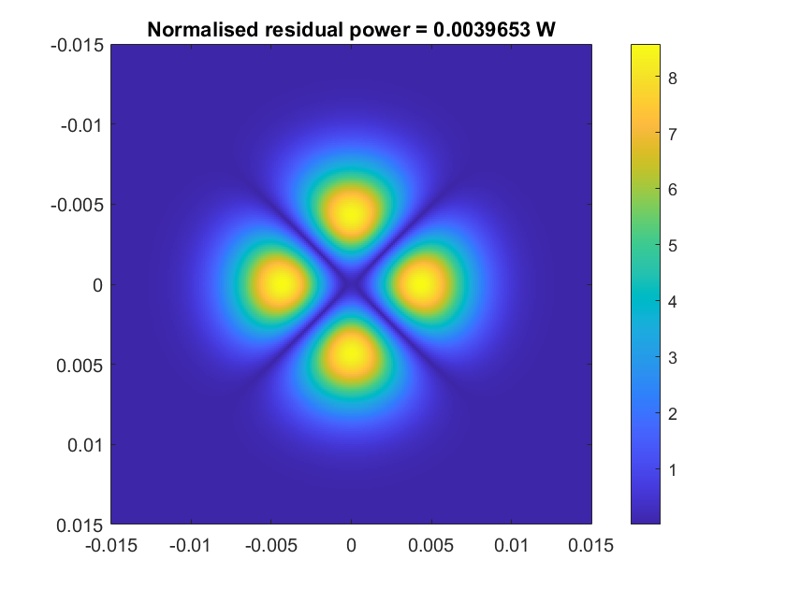

Method 1: The calculation of astigmatism losses
P/SR3 is a strongly curved mirror that reduces the beam size by about a factor of 10.
The beam is reflected on P/SR3 with an angle of incidence and is propagated toward P/SR2.
We study the high-order modes shape on P/SR2 and the modal decomposition.
$$E_{in}$$
Exact equation
HOM power= 4360 ppm
Approximated equation
HOM power =3960ppm

Slide 9
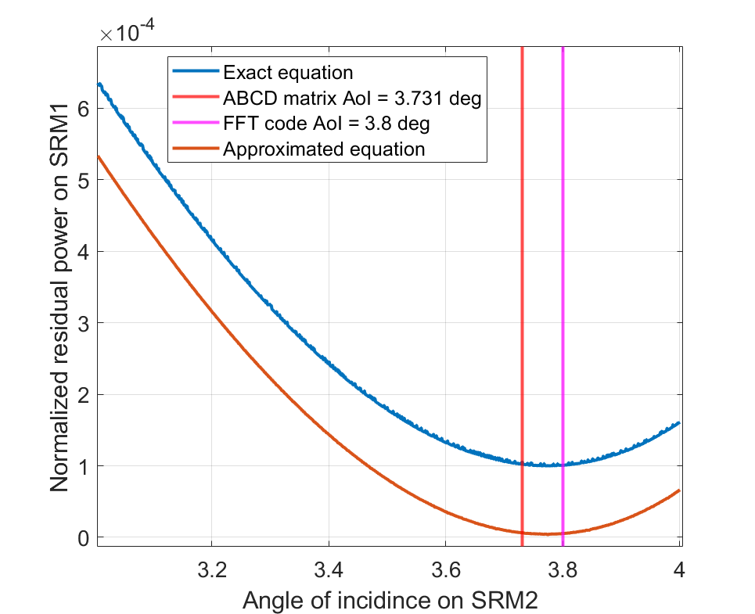
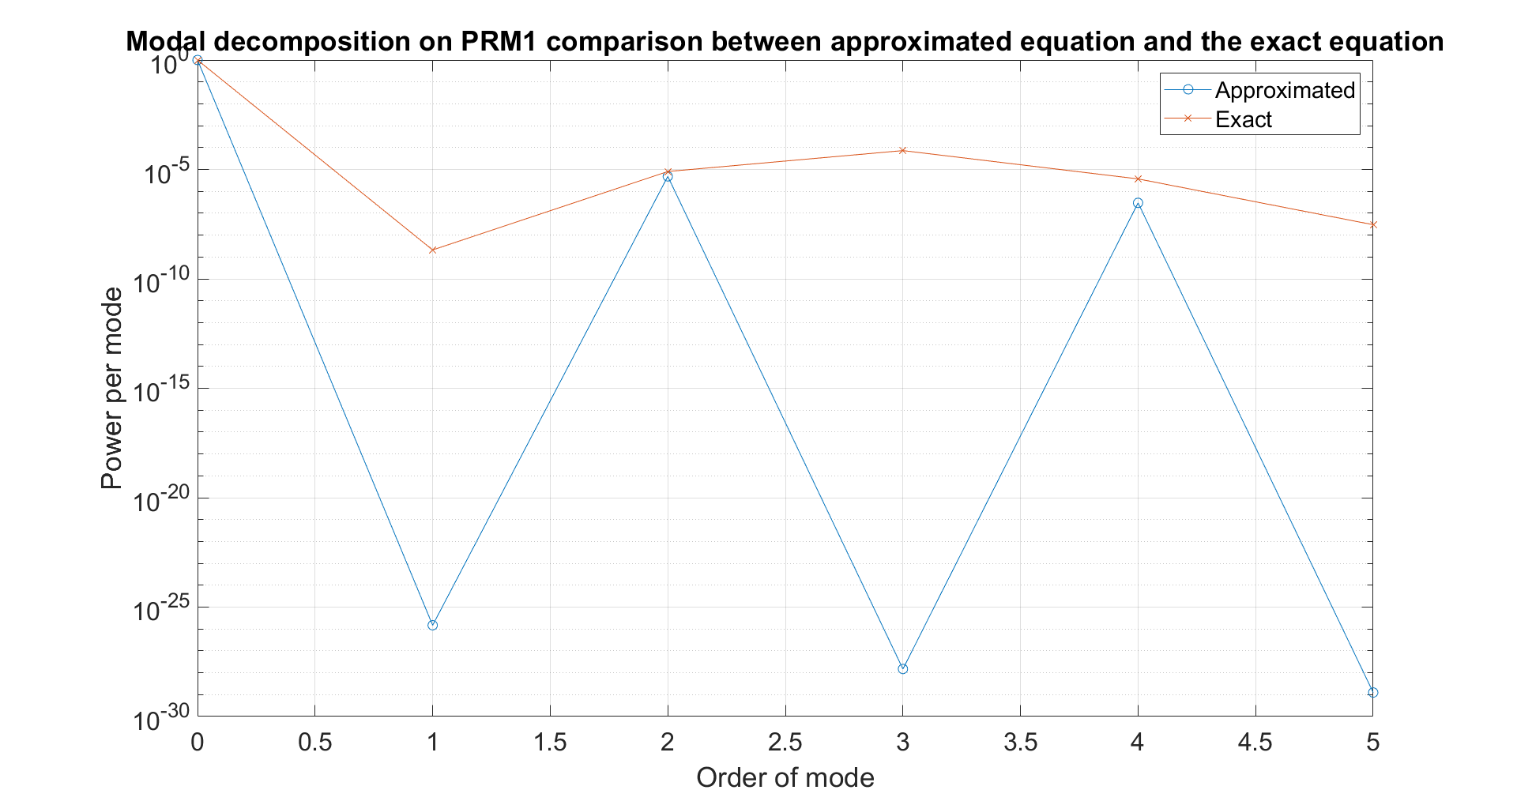
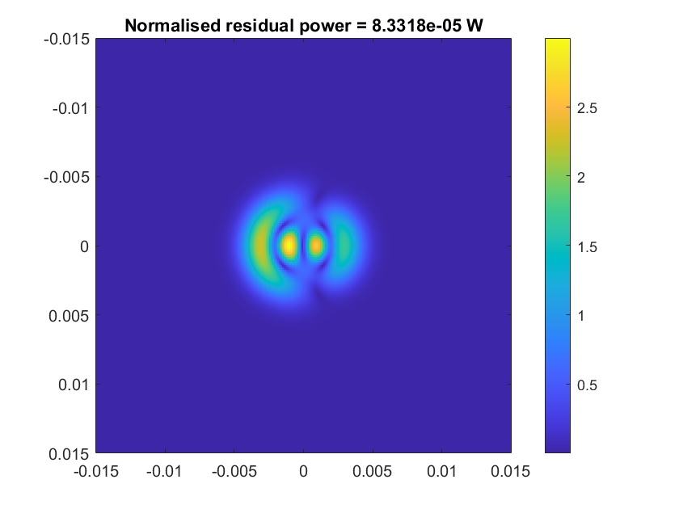
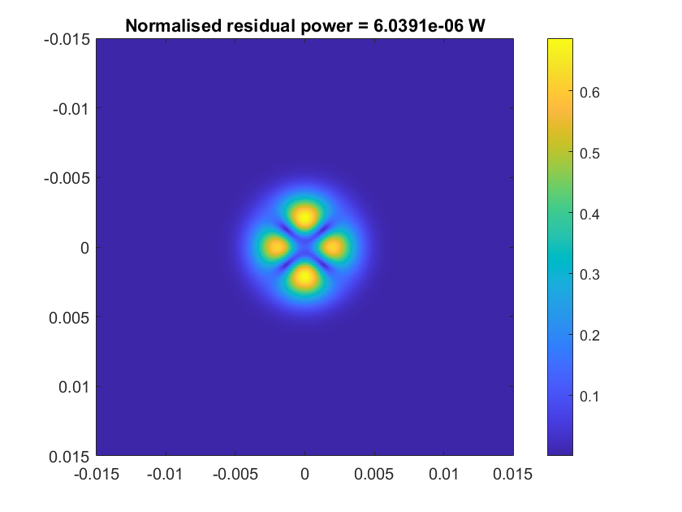

Method 1: The calculation of astigmatism losses
We can compensate for the astigmatism losses by reflection on P/SR2.
The beam is reflected on P/SR2 then is collimated and incident on P/SR1.
We optimize the angle of incidence on P/SR2.
We study the modal decomposition and the high-order modes beam shape on P/SR1.
$$E_{in}$$
Exact equation
HOM power= 83 ppm
Approximated equation
HOM power =6 ppm

Slide 10
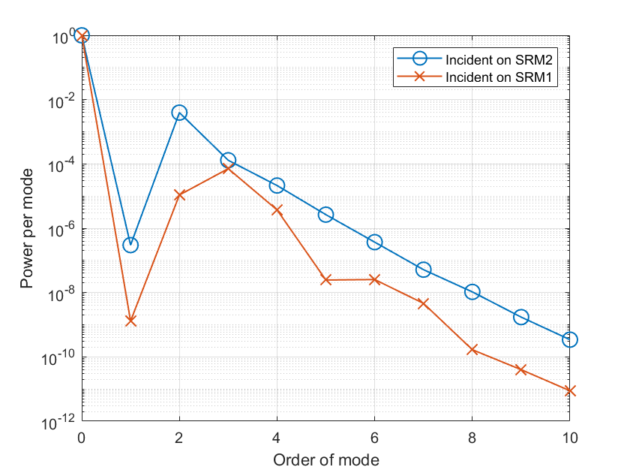
Method 1: Calculation of astigmatism losses summary
Beam on P/SR2 after reflection on P/SR3:
  Losses ~ 4000ppm
  Dominant 02 mode
Beam on P/SR1 after reflection on P/SR3 and P/SR2
  Losses ~ 83ppm
  Dominant 03 mode
Modal decomposition on SR2 and SR1 mirrors comparison.
  Astigmatism compensation by a factor of 50

Slide 11
Method 2: P/SR1 mirrors radius of curvature optimization

Slide 12
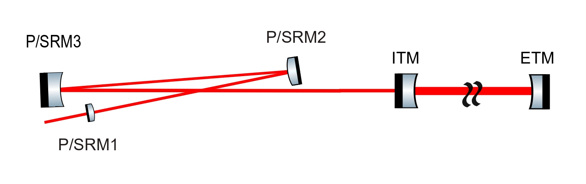
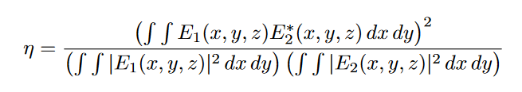


Method 2: P/SR1 mirrors radius of curvature optimization
With this method we study the matching between the arm FP cavity and the P/SRC.
E1 makes a round trip in P/SRC. The field incident on ITM after one round trip is E2.
$$E_{2}$$
$$E_{1}$$
We studied the overlap between Input field E1 and E2 on ITM.
Overlap =
We decrease the overlap losses by tuning the RoC of P/SR1.

Slide 13
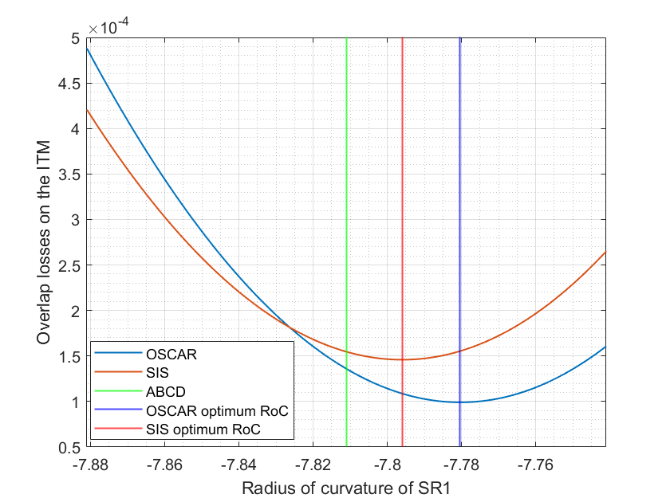
Method 2: P/SR1 mirrors radius of curvature optimization
We decrease the coupling losses by optimizing the radius of curvature of P/SR1
We found a RoC uncertainty ~ 0.3% between the two simulation codes.
Cavity | Conceptual design RoC (ABCD) | Optimum Roc P/SR1 – OSCAR | Optimum Roc P/SR1 – SIS
PRC | -5,209m | -5,190 m | -5,197m
SRC | -7,811m | -7,7804m | -7,796m

Slide 14
Method 3: Squeezing losses in the SRC

Slide 15
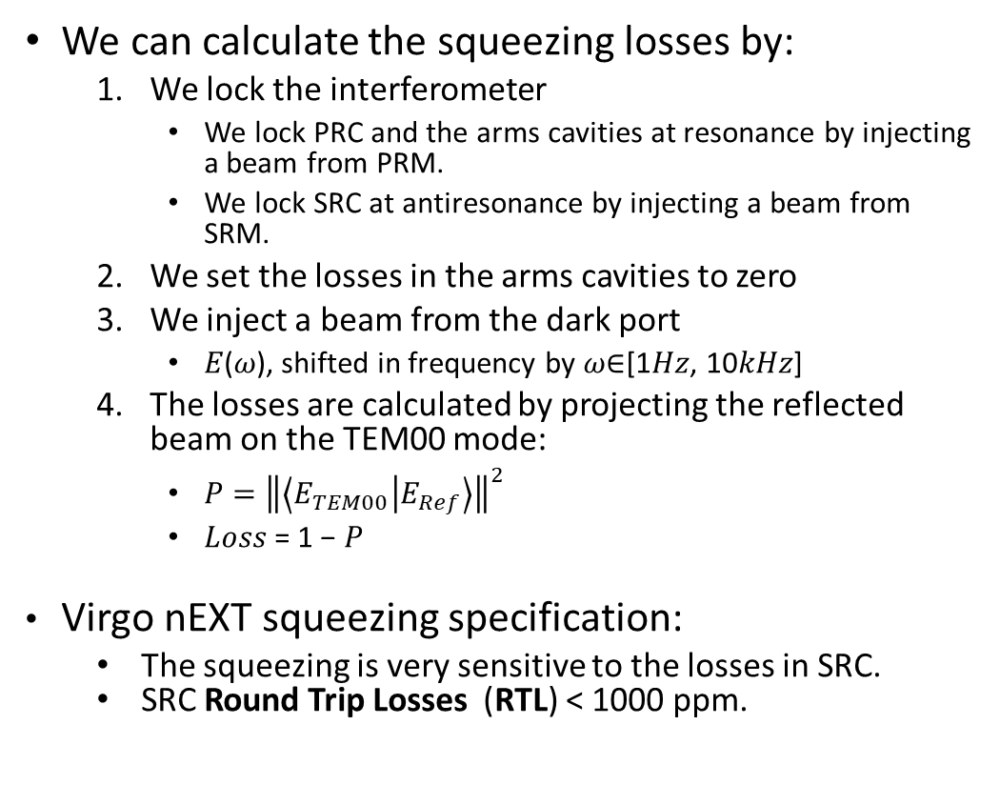



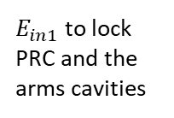
Method 3: Locked interferometer simulation – squeezing losses
We can calculate the squeezing losses by:
  We lock the interferometer
    We lock PRC and the arms cavities at resonance by injecting a beam from PRM.
    We lock SRC at antiresonance by injecting a beam from SRM.
  We set the losses in the arms cavities to zero
  We inject a beam from the dark port
    𝐸(𝜔), shifted in frequency by 𝜔∈[1𝐻𝑧, 10𝑘𝐻𝑧]
  The losses are calculated by projecting the reflected beam on the TEM00 mode:
    $P={\left\|\left\langle E_{TEM00} | E_{Ref}\right\rangle \right\|}^{2}$
    𝐿𝑜𝑠𝑠 = 1 − 𝑃
Virgo nEXT squeezing specification:
  The squeezing is very sensitive to the losses in SRC.
  SRC Round Trip Losses (RTL) < 1000 ppm.
$E_{in1}$ to lock PRC and the arms cavities
$$E(ω)$$
$E_{in2}$ to lock SRC
$$E_{ref}$$

Slide 16
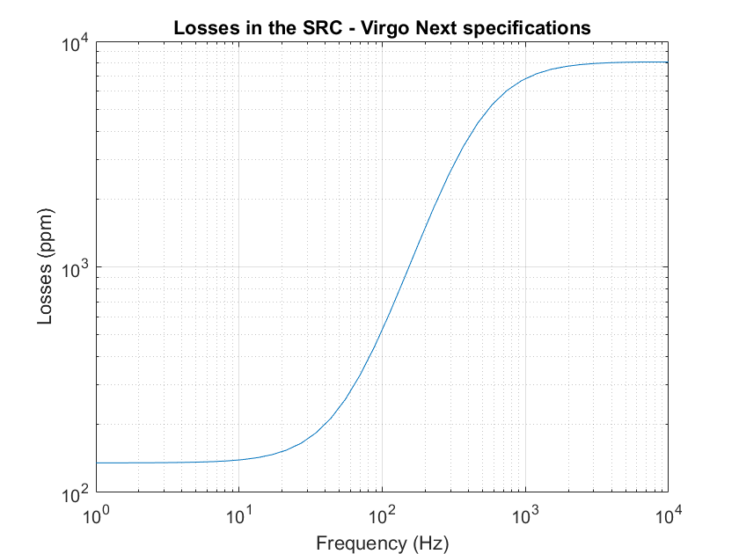
Method 3: Locked interferometer simulation – squeezing losses
We set the angles of incidence to zero.
We add scaler RTL in the SRC by setting the transmission of SRM3 to 500 ppm. This corresponds to the Virgo nEXT specification of the RTL =1000 ppm.
We scan the SRC losses at different frequencies.
We consider this curve as our reference for the losses in the SRC.
SRC at resonance
Losses ~ 8000ppm
(SRC gain ~ 8)
SRC at anti-resonance

Slide 17
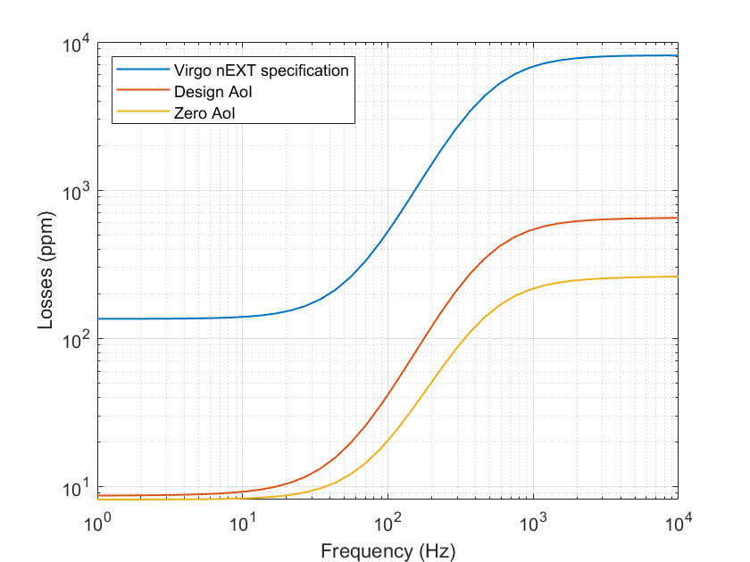
Method 3: Locked interferometer simulation – squeezing losses
We can compare the Virgo nEXT reference curve to the losses of the cavity with perfect mirrors.
Design AoI
(effect of astigmatism)
Normal AoI
(effect of spherical aberration)

Slide 18
Method 3: Locked interferometer simulation – squeezing losses
We are interested in studying the losses due to the mirrors surface roughness. The losses becomes most critical at high frequency. We can accelerate the simulations by calculating the losses at f = 3KHz.
3KHz
Design AoI
(effect of astigmatism)
Normal AoI
(effect of spherical aberration)
Notes:
Add slides about the maps results
Advancedd Virgo recycling

Slide 19
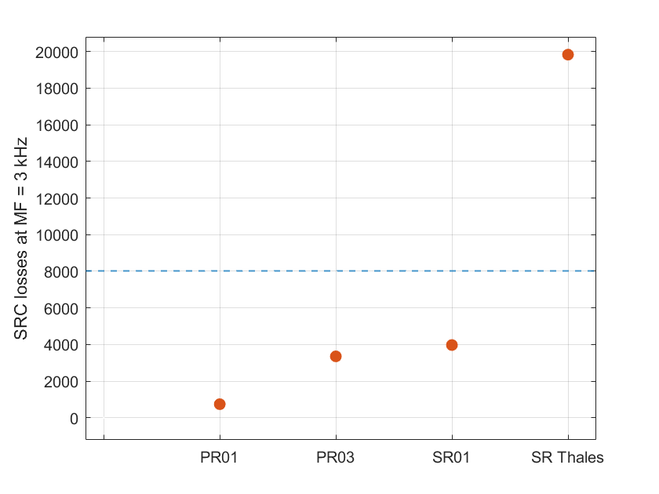
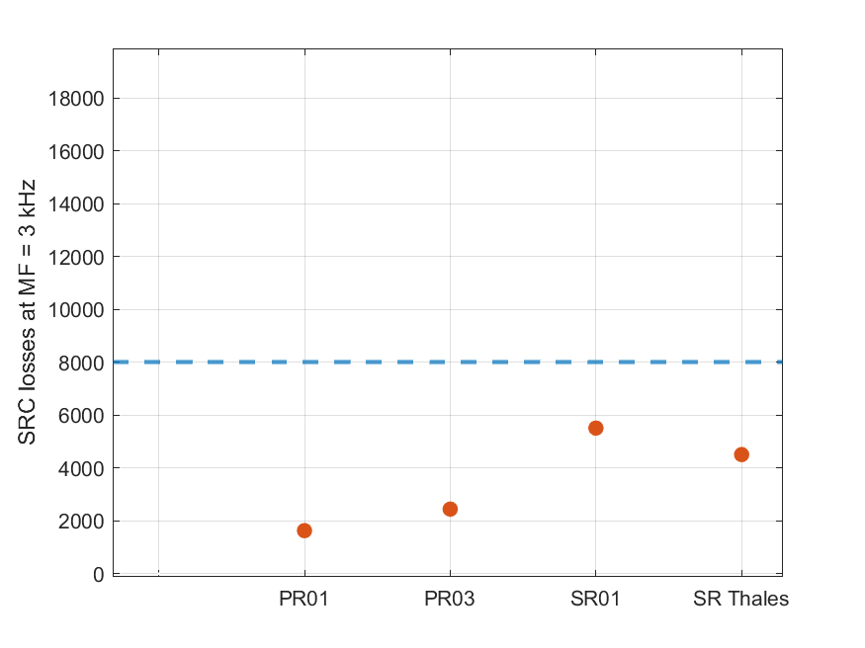
Method 3: Squeezing losses due to mirrors surface roughness
We generate random virtual maps with linear PSD in log-log scale.
We study the losses introduced by each mirror due to the surface roughness, and we found that SR3 is the most critical mirror to the losses.
We use the four measured maps of Advanced Virgo recycling mirrors on SR3 and we calculate the losses.
The first three mirrors give squeezing losses below the limit except the Thales map ( no IBF polishing).
Mirror map | PR01 | PR03 | SR01 | SR_Thales
RMS(nm) | 0,395 | 1,214 | 0,825 | 2,48
If we scale the maps to 1 nm RMS over the central area, we get squeezing losses that satisfy the requirment.
This method contributed to defining the preliminary design RMS values of the stable cavities mirrors.
Mirror map | PR01 | PR03 | SR01 | SR_Thales
RMS(nm) | 1

Slide 20
Summary and conclusion
We showed the limits of the paraxial equation for simulating the beam reflection on tilted curved mirrors.
  This emphasize the importance of simulating the exact mirrors surface.
FFT simulation codes provided useful insights on the design developments of the stable cavities.
  Characterizing the stable cavities losses.
  Verified astigmatism compensation technique.
  Give first look at the squeezing losses in the signal recycling cavities.
  Give preliminary design values for the mirrors surface RMS.
OSCAR and SIS require more investigation for the small discrepancies found in the RoC optimization.
Future work: next step should be finding a new method of studying the radiation pressure noise.
  This goal requires learning how to inject two beams at the same time to the locked interferometer.
  This requires pushing the codes to new limit of calculations.

Slide 21
Thank you!

