Slide 1
Insights into the structure and decay channels of 4He using NFS neutron beam and ACTAR TPC apparatus.
A. Chbihi, X. Ledoux, T. Roger
GANIL

Slide 2
outline
Motivation to study α particle.
NC-GSM predictions, open quantum system.
Experiment to constrain theory.
Conclusion

Slide 3
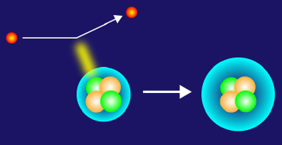

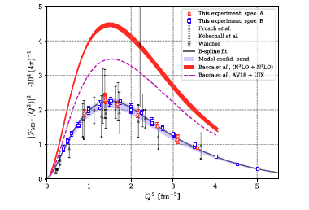
Why study the α particle?
inelastic e- scattering 4He(e-,e-’)
4He nucleus is one of the most extensively studied atomic nuclei, given the small number of constituents (4 nucleons), it can be accurately described by state-of-the-art theoretical calculations, based on χEFT.
Still disagreement to reproduce the proton-decaying from the GS to the first excited state
Recent experiment was performed at Mainz Microtron (MAMI) to investigate this resonance via inelastic e- scattering ( 4He(e-,e-’) 4He*).
The new experiment improves significantly the precision (the red boxes).
Surprisingly, the measured value for this transition is only half of what χEFT had predicted, raising doubts about previous models that treat 4He as a closed quantum system.
credit : A. Stonebraker
N3LO
S. Kegel et al., Phys. Rev. Lett. 130, 152502, 2023).

Slide 4
Why study the α particle?
inelastic e- scattering 4He(e-,e-’)
Is it a vibrational monopole transition “breathing” mode of the 4 nucleons ?
or
molecular like state [p+3H] or mixture with other states ?
credit : A. Stonebraker
S. Kegel et al., Measurement of the α-particle monopole
transition form factor challenges theory: A low-energy
puzzle for nuclear forces?, Phys. Rev. Lett. 130, 152502
(2023).

Slide 5
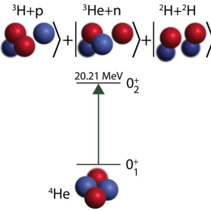
Open quantum system
Recent calculation using coupled channel representation of the No Core Gamow Shell Model (NCGSM) which treats 4He nucleus as an open quantum system.
This approach took into account 3 reaction channels : [p+t], [3He+n] and [d+d], in order to solve the N-body problem more accurately.
This study treats the 4He nucleus as a system where two particle interact, providing a more accurate explanation of its behavior.
N. Michel, W Nazarewicz and M. Ploszajczak .
PRL 131, 242502 (2023); 133, 239901 (2024).)

Slide 6
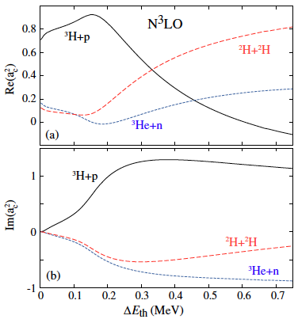
NCGSM Results on 4He
The occupation of real part of the probability of the 3 channels, p, n and d as function of ΔΕ_{th} ,
the 3 channels are correlated: an increase in the occupancy probability of one channel typically results in a decrease in the other.
At ΔΕ_{th} <150 keV the [3H+p] channel is dominant (95%)whereas the weights of closed channels n and d are small.
At ΔΕ_{th} ≈ 400 keV, the [3H+p] occupation drops to 32% and the [2H+2H] channel becomes dominant.
At ΔΕ_{th} ≈ 780 keV the neutron channel opens up, while the proton channel amplitude is very small and the wave function is dominated by the the deuteron component.
The statistical uncertainty is on Re (a_{c}² ) increases (Im (a_{c}² )) because of the different life times that the resonance state can have.
Top: Occupation Re(a_{c}² ) of orthogonalized p, n and d channels vs ΔΕ_{th} (shifted with p-t channel’s threshold)
Bottom: Corresponding imaginary channel occupation Im (a_{c}² ).

Slide 7
Result on the monopole transition form factor
Im (a_{c}² ) amplitudes are of the same order of magnitude as Re(a_{c}² )
Thus there is a large statistical uncertainty on channel occupations around ΔΕ_{th} ≈120 keV.
NCGSM-CC predicts a large decay width, Γ ≈ 260 keV at ≈ 120 keV.
Consequently the monopole form factor is not fairly sensitive to the interactions, threshold positions and resonance energy, hence is not an ideal observable to constraining nuclear interactions.
N. Michel, W Nazarewicz and M. Ploszajczak .
PRL 131, 242502 (2023); 133, 239901 (2024).)

Slide 8
How to confirm the NCGSM prediction ?
Need to measure the branching ratio of the 3-channels, p, n and d as function of Ε∗
Verify experimentally the NCGSM prediction of the occupation of real part of the probability of the 3 channels.

Slide 9
proposed experiment
To validate the NCGSM-CC predictions, an experimental study of the branching ratio of different alpha particle decay channel as function of E* is required.
We propose the experiment 4He(n,n’)4He*
The neutron beam is provided by the LINAC-NFS facility using the converter 7Li for monoenergetic neutron of E_{inc} = 31 MeV.
  Cross section measurement and invariant/missing mass of channels : [3H+p], [3He,n] and [d,d].
  We will obtain the [d+t] or 4He + n channel provided by the reaction n+4He->5He*
For the [d+d] the neutron incident energy threshold is at 30 MeV therefore, we will use the Be converter which provides a continuous neutron beam up to 40 MeV.

Slide 10
Target and detection
ACTAR TPC demonstrator filled with pure 4He gas will be used at the same time as target and detector. It will permit to identify the charged particles in the exit channel.
Three auxiliary Si-walls, positioned at the front and on the 2-sides surrounding the active volume. Particle identification with ΔE-E technique.
The signal left in ACTAR TPC will be correlated to the energy deposit in the Si-detectors. For the particles with lower energies (<1. MeV), the identification will rely on the correlation between the total energy loss in the active volume with the range of the particle in the gas.
As a consequence, it will be possible to identify the decay channels, and hence measure their branching ratio that have not been previously measured.

Slide 11
simulation with Hipse; Denis Lacroix
n + 4He @ 30 MeV
Invariant mass for the channel [p +t]
Kinematics of proton in [p+t]
triton
Kinematics of deuteron in [d+t]
triton

Slide 12
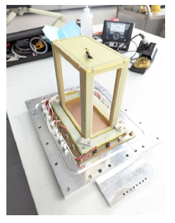
simulation with Hipse; Denis Lacroix

Slide 13
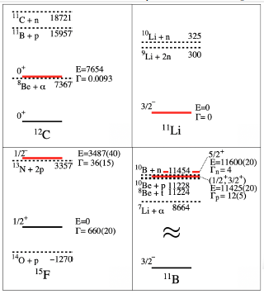
Other physics cases
near-threshold states and origin of clustering
other cases: 6He, 6Li, 7Be, 7Li, 11O, 170, 20Ne,...
various clustering: 2H, 3H, 3He, 2p, 2n,
astrophysical relevance,
7Be and 7Li play important role in the big-bang nucleosynthesis and nuclear astrophysics.
3H(4He,γ)7Li is Crucial for the determination of the primordial 7Li abundance.
In nuclear astro. puzzling abundance of 6Li and 7Li isotopes.
Recent GSM description of 7Be and 7Li coupling [4He+3He, 6Li+p] and [4He+3H, 6Li+n], respectively.
Other cases: 6He, 6Li, 7

Slide 14
Conclusion
It is necessary to measure the branching ratio of the channels : [p+ 3H], [n+3He] and [d+d] simultaneously as function of E*.
The reaction 4He(n,n’)4He* with NFS neutron beam and ACTAR-TPC is ideal.
It will allow to deduce the weight of the [p+t], [n+3He] and [d+d].
Constraints on NCGSM-CC calculations and other theories.

Slide 16
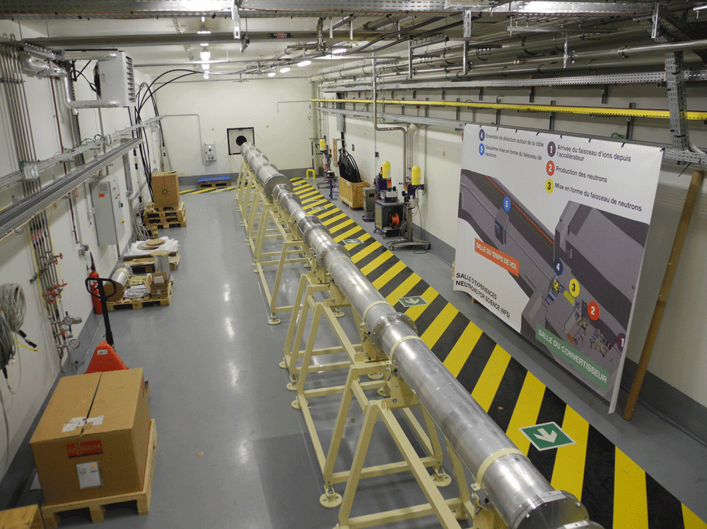
New insight into the structure of ⁴He nuclei, LoI15_24
Devoted to the study of first excited state, the 0+_2 resonance of 4He, and properties of this wave function around the first (open) particle emission threshold, i.e. p+t.
In the open quantum system framework (the Gamow shell model), wave function of 0+_2 is expanded in the reaction channels corresponding to lowest particle emission thresholds, ie p+t (open channel), n+3He (closed channel), d+d (closed channel) which all of them build the wave function of this resonance.
NCGSM-CC predicts a large decay width, Γ ≈ 260 keV at ≈ 120 keV.
Consequently the monopole form factor is not ideal observable to constrain nuclear interaction.
N. Michel, W Nazarewicz and M. Ploszajczak .
PRL 131, 242502 (2023)).
Occupation Re(a_{c}² ) of orthogonalized p, n and d channels vs ΔΕ_{th}
Expected results:
1 - Branching ratio for 3-channels.
2 – Excited states (positions & widths)
To validate the NCGSM-CC predictions, an experimental study of the branching ratio of different alpha particle decay channel as function of E* is required.
We propose the experiment 4He(n,n’)4He*
n-beam from NFS
at 31 MeV and 0-40 MeV
Actar demo, 4He pure gas

Slide 17
threshold issues
for the branching ratio, the efficiency is 78% at worst for En = 31 MeV and 88% for En = 40 MeV
for the channel d+d efficiency is close to 99%

