Slide 1
α-clustering in neutron-rich oxygen isotopes
GANIL proposal E894_24
J. Benlliure for the INDRA-FAZIA collaboration
Instituto de Física Corpuscular (CSIC – Univ. Valencia), Spain

Slide 2
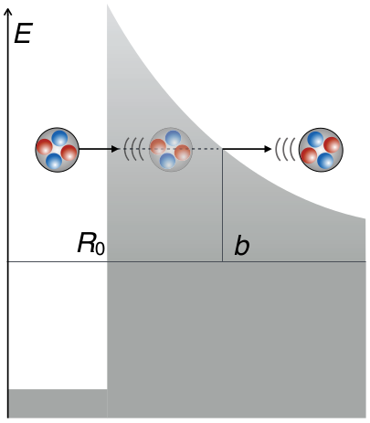
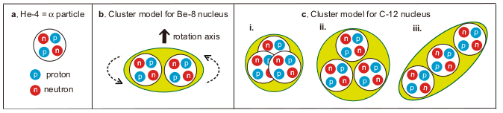
Motivation
Nucleon correlations in nuclei and nuclear matter
α-decay is not only the first manifestation of the subatomic structure of matter, but also the first evidence for nucleon correlations and clustering in nuclei.
Despite the success of the Gamow model in describing α-decay, today it is still challenging to describe theoretically the probability of α-preformation in nuclei.
In parallel, the α-clustering model has been used since the 1930’s to explain the structure of α-conjugate nuclei.
T. Otsuka et al.
Nature Communications 13, 2234 (2022)
The merging of these two pictures and its implications for the description of the equation of state of nuclear matter have motivated an intense experimental and theoretical research programme in the last decades.
José Benlliure
GANIL PAC, November 2024
Notes:
2

Slide 3
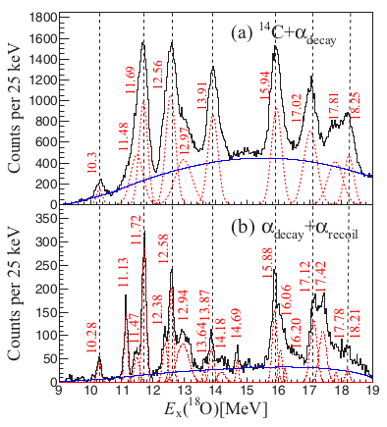
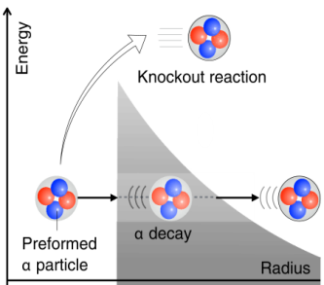
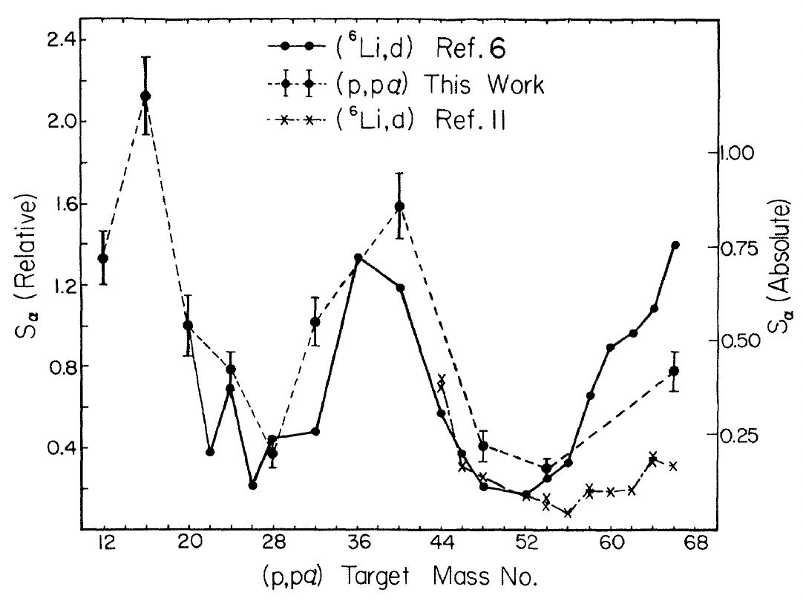
Motivation
Cluster structure and cluster states
The cluster structure of excited states is usually investigated by means of inelastic scattering, fusion or break-up reactions.
These experiments allow for the identification of cluster structures from the associated rotational bands in α-conjugated nuclei (⁸Be, ¹²C, ¹⁶O, …), but also in nuclei far from stability where the additional neutrons can stabilise cluster configurations (¹²Be, ¹⁸O, …).
⁹Be(¹³C,¹⁸O→¹⁴C+α)α
B. Yang et al. Phys. Rev. C 99, 064315 (2019)
The spatial development of α-clusters in the ground state of nuclei has been directly observed by using α-knockout or α-transfer reactions, which provide similar spectroscopic factors.
Advanced model calculations showed that these reactions probe the formation of α-clusters at the nuclear surface where the density of matter is below the cluster dissolution threshold, the Mott density.
T.A. Carey et al. Phys. Rev. C 29, 1273 (1984)
José Benlliure
GANIL PAC, November 2024
Notes:
3

Slide 4
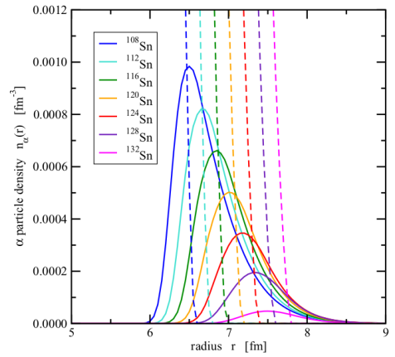
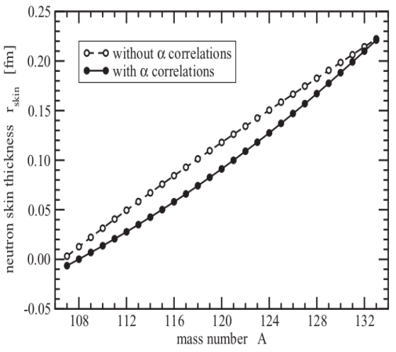
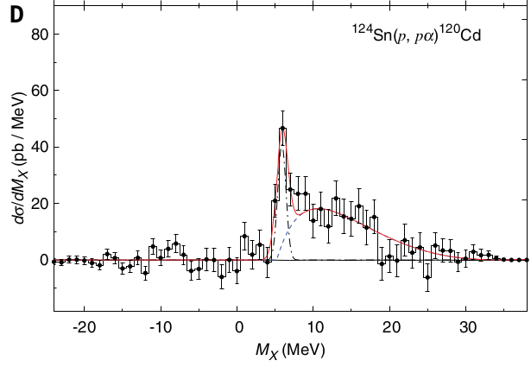
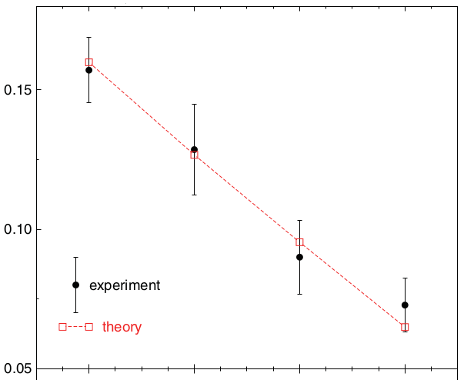
Motivation
Clusters in dilute asymmetric nuclear matter
Clustering is expected to affect the structure of nuclei, in particular the development of skin or halo phenomena.
RMF calculations, including few-body correlations, have shown a reduction in the probability of finding α-clusters on the surface of the nucleus and a smaller thickness of the skin in neutron-rich tin isotopes. This finding also impacts the determination of the L parameter providing the first order dependence of the symmetry energy on the density.
S. Typel Phys. Rev. C 89, 064321 (2014)
The formation of α-clusters on the nuclear surface of neutron-rich tin isotopes has recently been observed in quasi-free α-knockout reactions.
The observed reduction of the α-knockout cross section with the neutron excess also confirms the effect of α-clustering on the neutron skin thickness.
σ_{p,pα} (nb)
112
116
120
124
Mass number (A)
J. Tanaka et al, Science 371, 260 (2021)
José Benlliure
GANIL PAC, November 2024
Notes:
4

Slide 5
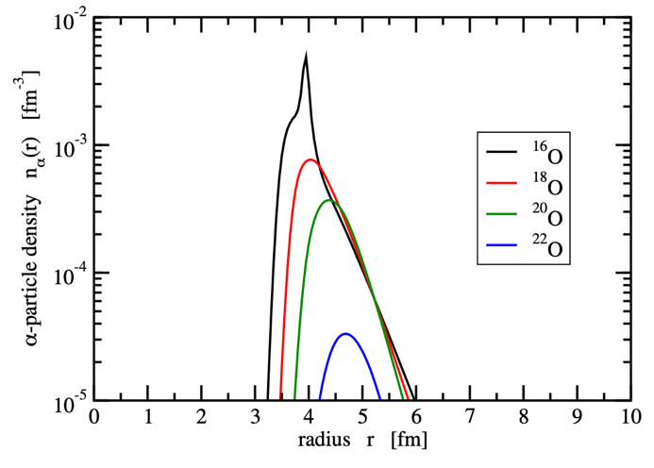
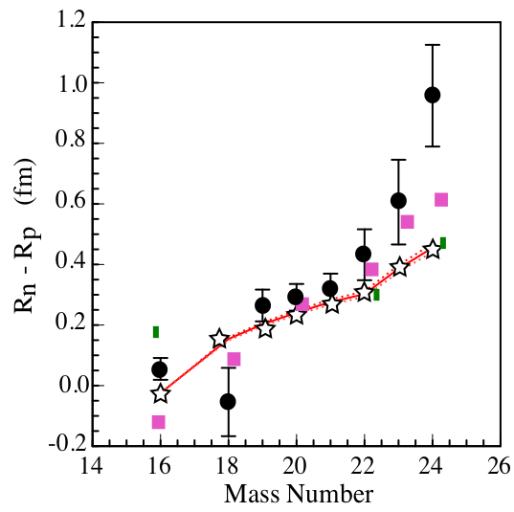
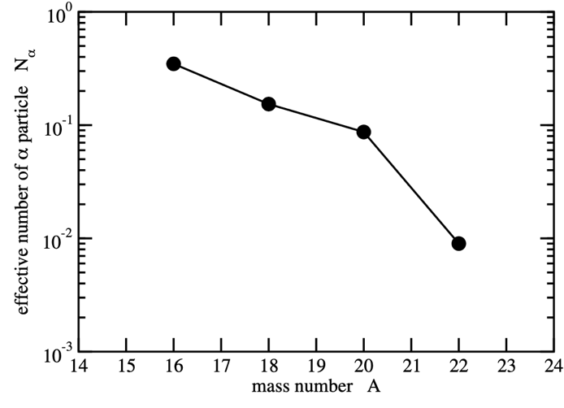
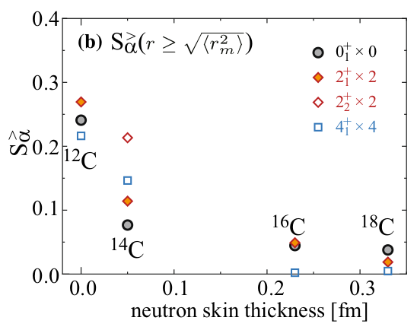
Motivation
α-clusters in light neutron-rich nuclei
S. Typel, private communication.
Oxygen isotopes
The same model calculations used to describe the evolution of the density of α-particles at the periphery of Sn isotopes predict an even stronger effect in lighter nuclei. This effect is clearly visible in neutron-rich oxygen isotopes covering the same range of neutron skin thickness as the previously investigated tin isotopes.
This effect on light nuclei has also been confirmed by calculations using the AMD for different carbon isotopes. In this case, a similar reduction in the α-clustering with the neutron skin thickness, is predicted.
S. Kaur et al., PRL 129,
142502 (2022)
S. Typel, private communication.
Q. Zhao et al., Eur. Phys. J. A (2021)
José Benlliure
GANIL PAC, November 2024
Notes:
5

Slide 6
Proposed experiment
To investigate α-clustering in the ground states of ¹⁶O, ¹⁸O, and ²⁰O using α-transfer reactions induced by these nuclei on deuterium at 7,5 MeV/nucleon, using a CD₂ target and taking advantage of the INDRA/FAZIA coupling to identify all possible α-transfer channels.
The excellent capabilities of the FAZIA detector in terms of isotope identification, multi-hit capability and energy resolution, will allow us to measured not only transfer reactions to the ground state of the final nuclei, but also to unbound excited states, increasing the statistics collected in the experiment.
Unbound states in the projectile and target remnants will be identified by reconstructing their invariant mass and/or missing mass with the FAZIA detector.
As a by-product, the same measurements can be used to study α-clustering in unbound excited states states in ¹⁸O and ²⁰O by using inelastic scattering reactions, but also any other unbound state decaying by emission of protons or other clusters, p,d, t, ³He...
José Benlliure
GANIL PAC, November 2024
Notes:
6

Slide 7
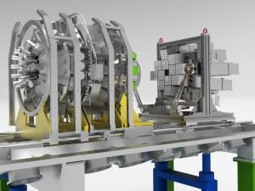
Feasibility
INDRA+FAZIA setup
The coupling of the INDRA and FAZIA detectors offers unique capabilities for the investigation of clustering effects in nuclei.
Full isotopic identification of fragments.
Multi-hit capability to study multi-cluster events.
Good energy and angular resolution (invariant mass).
Large geometrical acceptance.
Relatively high counting rates and beam intensities.
The simulated detection efficiency for complete events is about 70%, and if we include the reconstruction of unbound states, the estimated overall efficiency is about 60%.
José Benlliure
GANIL PAC, November 2024
Notes:
7

Slide 8
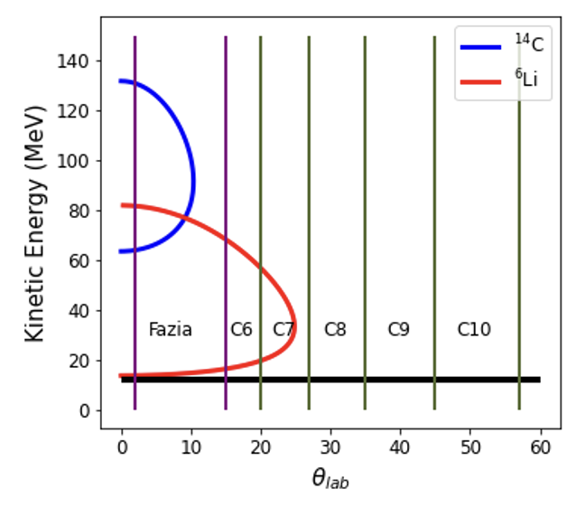
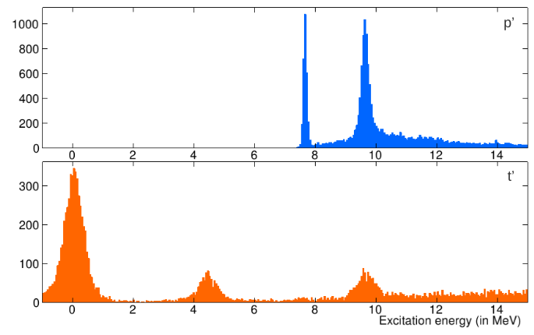
Feasibility
Reaction channel identification
d(¹⁸O,¹⁴C)⁶Li @ 7,5 MeV/nucleon
Due to the inverse kinematics for reactions induced on deuterium, most of the reaction products (projectile and target remnants) will be detected within the FAZIA acceptance with full isotopic identification, high energy resolution and high angular resolution.
Reactions with deuterium in the CD₂ target will be identified by selecting events with a total detected charge Z=9.
The α-transfer to the ground state of the two final fragments, ^{xx}C and ⁶Li, will be selected by the isotopic identification provided by FAZIA.
The α-tranfer to final unbound excited states will be identified by reconstructing the invariant mass from the detected fragments. This unique feature will allow us to investigate transfer to excited states, to have access to clustering effects in these excited states and to increase the statistics of the experiment, in particularly for the ²⁰O beam. The most relevant channels, for the ¹⁶O beam, will be:
d(¹⁶O,¹²C)⁴He+d, d(¹⁶O,3⁴He)⁶Li and d(¹⁶O,3⁴He)⁴He+d
Inelastic collisions with the ¹²C in the CD₂ target, will be identified by the total detected charge, Z=12.
¹²C+¹²C: invariant mass
¹²C+¹²C: missing energy
Courtesy of D. Gruyer
José Benlliure
GANIL PAC, November 2024
Notes:
8

Slide 9
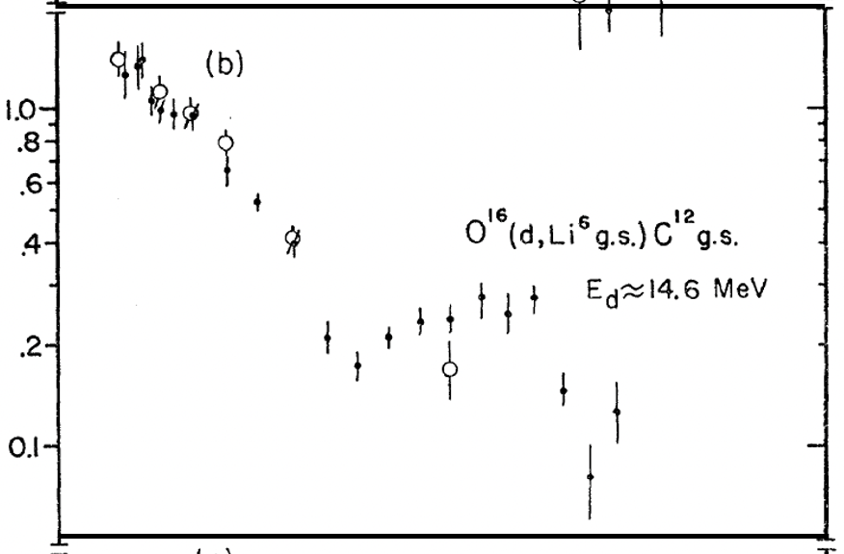
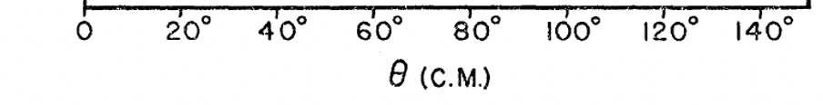
Feasibility
Expected α-transfer cross sections
Reaction cross sections were estimated using the following inputs:
d(¹⁶O,¹²C_{g.s.})⁶Li_{g.s.} σ = 4.5 mb (measured data).
d(¹⁶O,¹²C_{g.s.})⁴He+d σ ~ 10 mb (Hipse calculations and data).
d(¹⁶O,3⁴He)⁶Li_{g.s.} σ ~ 40 mb (Hipse calculations and data).
d(¹⁶O,3⁴He)⁴He+d σ ~ 1 mb (Hipse calculations and data).
d(¹⁸O,¹⁴C_{g.s.})⁶Li_{g.s.} σ = 3.1 mb (Fresco calculations).
Other channels induced by ¹⁸O and ²⁰O are taken from ¹⁶O scaled down by the predicted reduction of α-particles at the nuclear surface.
The expected total cross sections for transfer to the ground state or
the more probable unbound excited states are:
dσ/dΩ (mb/sr)
W.W. Dahenick et al, PR 136, 1325 (1964)
A. Moro, private communication.
Reaction | Cross section
d(¹⁶O,¹²C)⁶Li + d(¹⁶O,¹²C)⁴He+d + d(¹⁶O,3⁴He)⁶Li | ~ 55 mb
d(¹⁸O,¹⁴C)⁶Li + d(¹⁸O,¹⁴C)⁴He+d + d(¹⁸O,3⁴He+2n)⁶Li | ~ 25 mb
d(²⁰O,¹⁶C)⁶Li + d(²⁰O,¹⁶C)⁴He+d + d(²⁰O,3⁴He+4n)⁶Li | ~ 10 mb
José Benlliure
GANIL PAC, November 2024
Notes:
9

Slide 10
Beam time request
We request three different beams: ¹⁶O, ¹⁸O, and ²⁰O to scan the expected reduction of α-clusters at the nuclear surface over a sufficiently wide range of skin thickness (0.2 fm) and suppression factor (4).
To compensate for the limited intensity and smaller expected cross sections for ²⁰O, we propose to use two different CD₂ target thicknesses of 250 and 500 μgr/cm². An additional C target will be used with the ¹⁶O and ¹⁸O beams to investigate the background produced with the CD₂ target.
The requested beam time and the expected statistics, taking into account the reaction cross sections, beam intensities and the event reconstruction efficiency (60%), are as follows:
Beam | Intensity | Target thickness | UTs requested | Total statistics
¹⁶O | 10⁸ pps | 250 μg/cm² | 3 (CD₂) + 1(C) | ~ 6 10⁵ + 4 10⁵
¹⁸O | 10⁸ pps | 250 μg/cm² | 3 (CD₂) + 1(C) | ~ 3 10⁵ + 2 10⁵
²⁰O | 5 10⁴ pps | 500 μg/cm² | 18 | ~ 700
Two additional UTs are required for calibrations.
José Benlliure
GANIL PAC, November 2024
Notes:
10

Slide 11
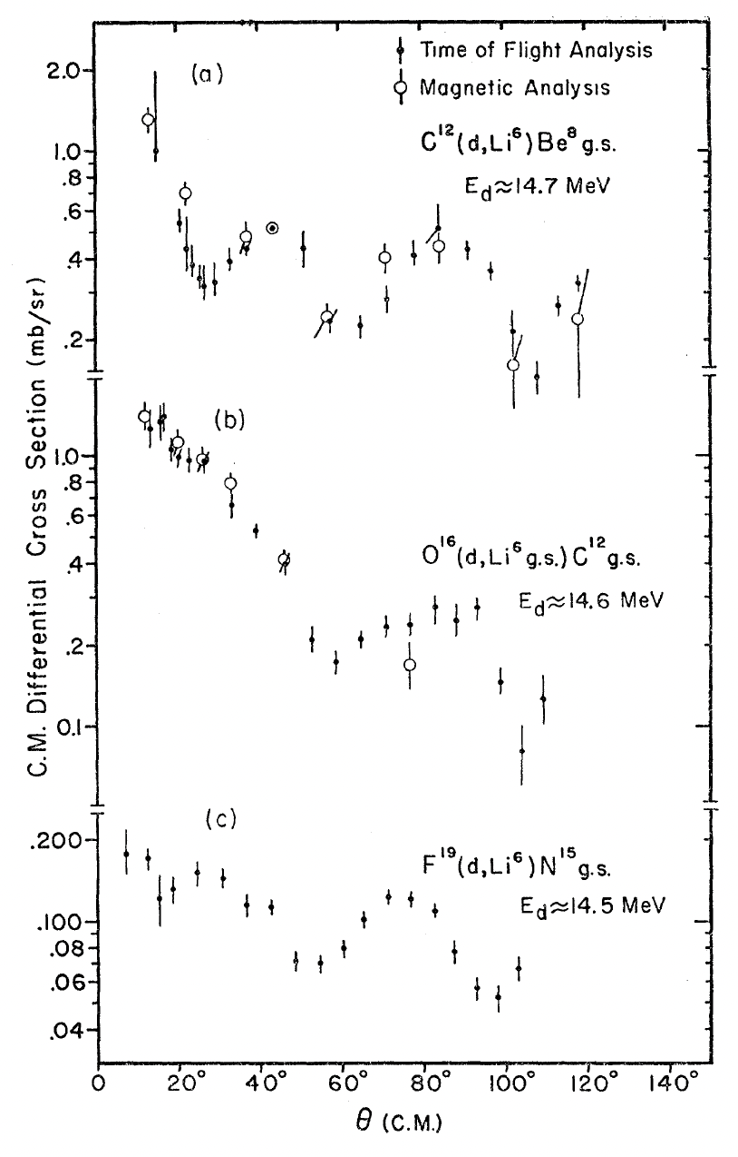
José Benlliure
GANIL PAC, November 2024
Notes:
11

Slide 12
José Benlliure
GANIL PAC, November 2024
Notes:
12

