Slide 1
Impact of projectile-target size asymmetry on the isospin equilibration rate extracted from quasiprojectile breakup reactions
INDRA-FAZIA collaboration
E884_23
Gabriella Naddeo

Slide 2
Aim of the experiment
Understanding of how the processes related to the dynamics of Heavy Ion Collisions (HIC) are governed by the Nuclear Equation of State (NEoS)
NEoS -> binds thermodynamic properties of pressure, temperature, density, chemical potential, and internal energy.
focus on $E_{sym}$ term in NEoS is the energy penalty associated with having excess nucleons of one type, that influences neutron-proton equilibration and the collision dynamics too. A. Jedele et al., Phys. Rev. C 107, 024601 (2023)
HIC at intermediate energies allow to explore the behavior of nuclear matter at subsaturation densities.
H. Wolter et al., Prog. Part. Nucl. Phys. 125, 103962 (2022) tests robustness of transport models predictions.
The data interpretations within different reaction models still poses some challenges, making necessary further advanced investigations and high-quality experimental data to test the strength of transport model predictions.
2
Analysis of the relation between the evolution towards isospin equilibration inside the deformed QP* before its breakup and the preceding step of the reaction

Slide 3
ternary reaction channel, as PLF* breakup, could provide:
In midperipheral Heavy ion reactions at Fermi energy -> enough overlap between projectile and target material that leads to strongly deformed intermediate state
low density neck between primary PLF* and TLF* featuring neutron enrichment
System can pass through the break in PLF* and TLF*, and then the rupture of PLF* in light (LF) and heavy (HF) fragment can occur
analysis of the relation between the evolution towards isospin equilibration and the preceding steps of the reaction
to study the interplay among different transport phenomena
3
Notes:
3

Slide 4
Isospin transport in the breakup channel
Before PLF*-TLF* separation
Isospin drift : neutrons are driven to low-density neck regions (LF)
After the PLF*-TLF* separation, PLF* is characterized by
Isospin diffusion : internal equilibration occurring inside the PLF* prior to the split HF-LF
α : alignment angle between the HF-LF $\overset{→}{𝓋_{rel}}$ and $\overset{→}{𝓋_{CM}}$of HF-LF
A. Jedele et al., Phys. Rev. Lett. 118, 062501 (2017).
α used as a «clock» for the breakup timescale
leads to a debate on the interpretation of α angle:
AMD model : don’t fully support the hypothesis of a correlation between the α angle and the time elapsed from the PLF*-TLF* separation to the PLF* breakup S.Piantelli et al., Phys. Rev. C 107, 044607 (2023).
CoMD model : claims that an indication of such correlation can be found
B. Harvey et al., Phys. Rev. C 102, 064625 (2020).
4
Notes:
4

Slide 5
Rodriguez Manso et al., Phys. Rev. C 95, 044604 (2017)
${<∆>}_{HF,LF}$ as a function of the α angle:
${}_{}^{70}{Zn+}{}_{}^{70}{Zn}$ , ${}_{}^{64}{Ni+}{}_{}^{64}{Ni}$ -> HF , LF with $<∆>$/α correlations essentially identical
${}_{}^{64}{Zn+}{}_{}^{64}{Zn}$ -> less neutron-rich so $<∆>$/α shifts to lower values but the rate constant and the change from initial to final value are the same.
${}_{}^{64}{Zn+}{}_{}^{64}{Zn}$ , ${}_{}^{64}{Zn+}{}_{}^{64}{Ni}$ -> same initial composition for HF, composition of LF more neutron-rich for the system with the neutron-enriched target
equilibration rate constants seem to be indipendent of the system:
expected dependence of the equilibration rate on the details of the NEoS and not on the composition of the system or the chemical potential involved
5

Slide 6
K. Brown et al., Phys. Rev. C 87, 061601(R) (2013)
Comparison of the LF isospin equilibration in different reactions with same projectile ${}_{}^{64}{Zn}$ on three targets: ${}_{}^{27}{Al}$, ${}_{}^{64}{Zn}$, ${}_{}^{209}{Bi}$ characterized by different sizes and isospin contents
shows different conclusions:
LF composition and its isospin equilibration rate depends on the system
Justified as a consequence of different isospin gradient in PLF*, due to the neutron-enrichment of LF side depending on the target hit
6

Slide 7
Proposed experiment -> Reactions actually analysed
Beam energy: 35 MeV/nucleon
${}_{}^{70}{Zn}$ (N/Z=1.33) + ${}_{}^{28}{Si}$ (N/Z=1.00) ${}_{}^{70}{Zn}$ (N/Z=1.33) + ${}_{}^{70}{Zn}$ (N/Z=1.33) ${}_{}^{70}{Zn}$ (N/Z=1.33) + ${}_{}^{208}{Pb}$ (N/Z=1.54) | ${}_{}^{70}{Zn}$ (N/Z=1.33) + ${}_{}^{27}{Al}$ (N/Z=1.07) ${}_{}^{70}{Zn}$ (N/Z=1.33) + ${}_{}^{70}{Zn}$ (N/Z=1.33) ${}_{}^{70}{Zn}$ (N/Z=1.33) + ${}_{}^{209}{Bi}$ (N/Z=1.51)
${}_{}^{208}{Pb}$ -> ${}_{}^{209}{Bi}$ : ${}_{}^{209}{Bi}$ is the only isotope available in nature, while ${}_{}^{208}{Pb}$ is one of the three available with (abundance = 52.4%) so the production of a target with higher purity is more expensive
${}_{}^{28}{Si}$ -> ${}_{}^{27}{Al}$: greater ease of production a target of ${}_{}^{27}{Al}$
Symmetric system is our direct comparison with literature
Rodriguez Manso et al., Phys. Rev. C 95, 044604 (2017)
Asymmetric systems present different neutron reservoir provided by targets and different isospin imbalance inside PLF*
final aim:
Study to what extend the evolution towards isospin equilibration inside the deformed PLF* before its breakup depends on the preceding step of the reaction
7

Slide 8
Features of the reactions analysed
Reaction | Energy (MeV/nucl) | Trigger Multiplicity | Collected statistics | Data taking period
$${}_{}^{70}{Zn+}{}_{}^{70}{Zn}$$ | 34.8 | $$M_{tot}≥1$$ | $159x{10}^{6}$ events | 30/05 -> 02/06, 08/06 (beam stop for 1UT) | 8 UTs
$${}_{}^{70}{Zn+}{}_{}^{70}{Zn}$$ | 34.6 | $$M_{tot}≥1$$ | $441x{10}^{6}$ events | 30/05 -> 02/06, 08/06 (beam stop for 1UT)
$${}_{}^{70}{Zn+}{}_{}^{209}{Bi}$$ | 34.6 | $$M_{tot}≥1$$ | $815x{10}^{6}$ events | 02/06 -> 05/06 07/06->08/06 | 10 Uts
$${}_{}^{70}{Zn+}{}_{}^{27}{Al}$$ | 34.6 | $$M_{tot}≥1$$ | $521x{10}^{6}$ events | 05/06 -> 07/06 | 6 UTs
$${}_{}^{70}{Zn+}{}_{}^{197}{Au}$$ | 34.8 | $$M_{tot}≥1$$ | $8.7x{10}^{6}$ events | 30/05 | 0.5 UTs
$${}_{}^{70}{Zn+}{}_{}^{197}{Au}$$ | 34.6 | $$M_{tot}≥1$$ | $7.6x{10}^{6}$ events | 30/05
$${}_{}^{70}{Zn+{CH}_{2}}$$ | 34.6 | $$M_{tot}≥1$$ | $22.3x{10}^{6}$ events | 09/06 | 0.25 UTs
$${}_{}^{70}{Zn+}{}_{}^{12}C$$ | 34.6 | $$M_{tot}≥1$$ | $11.9x{10}^{6}$ events | 09/06 | 0.25 UTs
$${}_{}^{12}{C+}{}_{}^{12}C$$ | 13.7 | $$M_{tot}≥1$$ | $200x{10}^{6}$ events | 15/06 ->17/06 | 5 UTs
$${}_{}^{12}{C+}{}_{}^{197}{Au}$$ | 8.75 13.75 | $$M_{tot}≥1$$ | 20$x{10}^{6}$ events 32 $x{10}^{6}$ events | 30/05 16/07->17/06 | 0.25 UTs
8

Slide 9
Beam: ${}_{}^{70}{Zn}$
Target: ${}_{}^{70}{Zn}$
Measuring period: 30/05 -> 02/06 (beam stopped for 1UT on 31/05) , and 08/06
first targets -> fragiles, breakup before the experiment started
subsequent targets -> manufactured by Ganil , have increased thickness mounted on the lateral target holder with smaller diameter
9
Notes:
9

Slide 10
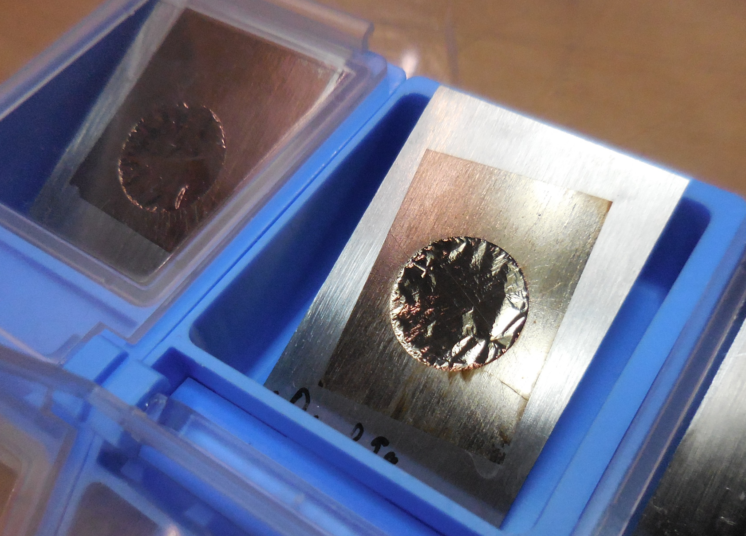
Target: ${}_{}^{209}{Bi}$
Beam: ${}_{}^{70}{Zn}$
Target on the principal target holder, with a larger diameter
Grazing angle: 6.4°
Self supporting
Manufactured by both Ganil and LNS
10
Notes:
10

Slide 11
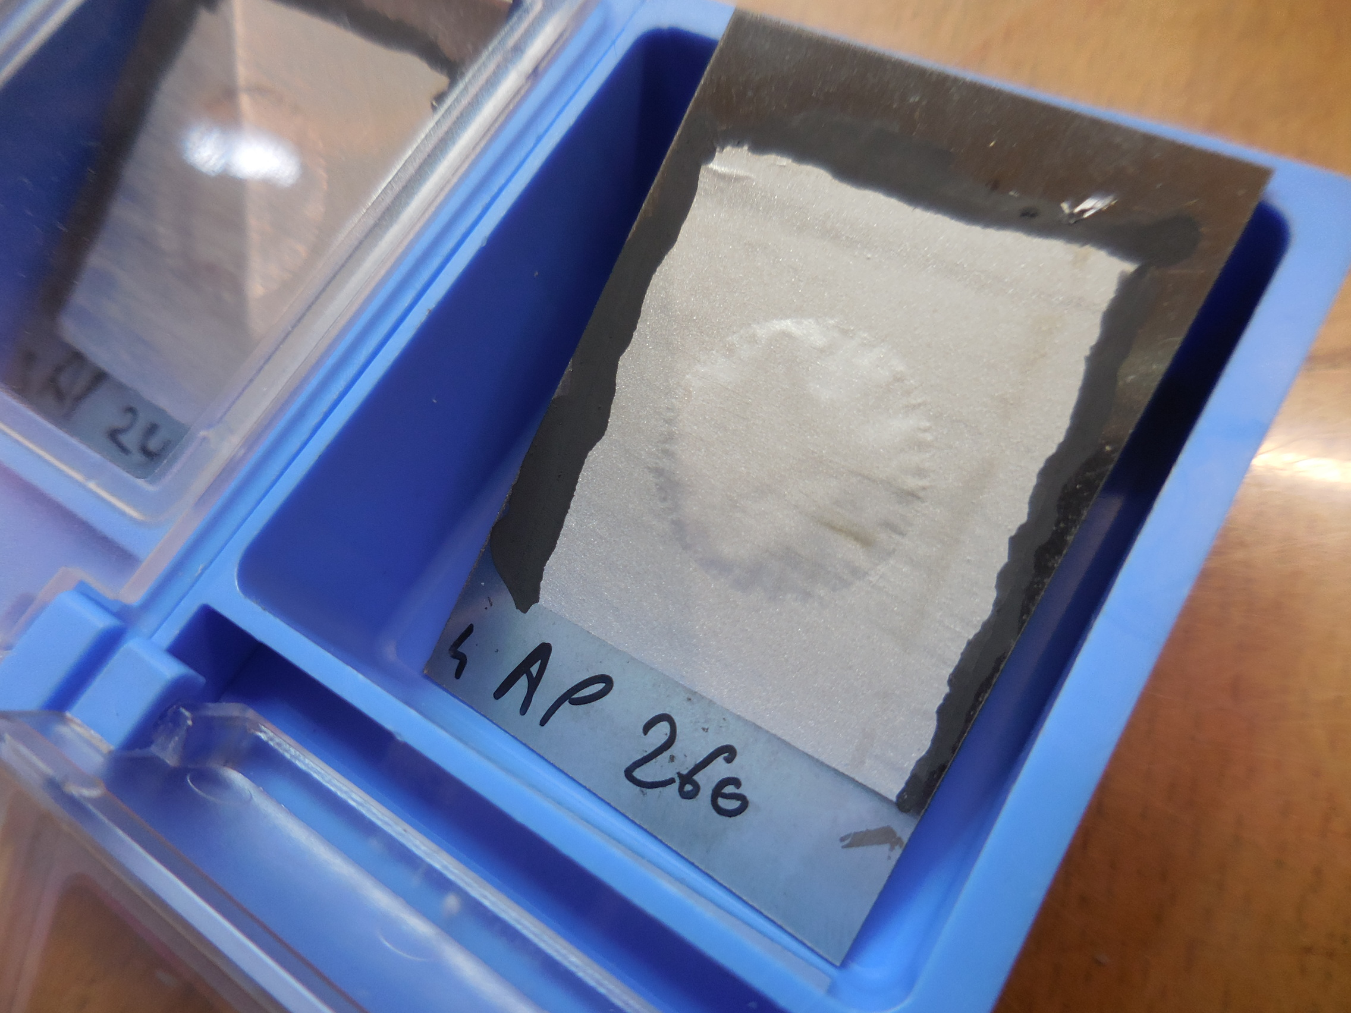
Target: ${}_{}^{27}{Al}$
Beam: ${}_{}^{70}{Zn}$
Target on the principal target holder, decentration with respect to the beam
Grazing angle: 1.26°
Almost no elastic observed on FAZIA
Good statistic already with only 6BTU (instead of 8BTU)
11
Notes:
11

Slide 12
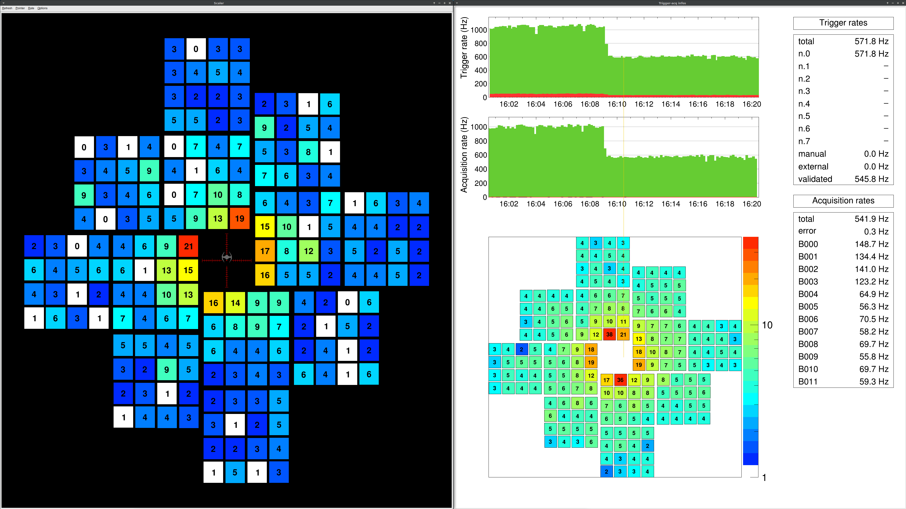
INDRA-FAZIA performance
great overall functioning, despite not working detectors:
2 Si1
7 Si2
4 CsI
12
Notes:
12

Slide 13
Particle Identification procedure
Particle identification techniques exploited with the INDRA-FAZIA apparatus are mainly:
ΔE-E method -> mechanism of kinetic energy dissipation of charged particles in matter, following Bethe-Bloch formula for specific energy loss:
$$S=−\left|\frac{dE}{dx}\right|∝\frac{Z^{2}}{𝓋^{2}}∝\frac{Z^{2}A}{E}$$
Applied to the ΔE-E identification in:
Si1-Si2 and Si2-CsI(Tl) in FAZIA
Si-CsI in INDRA
PSA method -> dependence of the time evolution of the induced signal on the ionisation density along the track of the incident particle inside the detector.
(See talk by I.Dekhissi, A.De Rosa)
13
Notes:
13

Slide 14
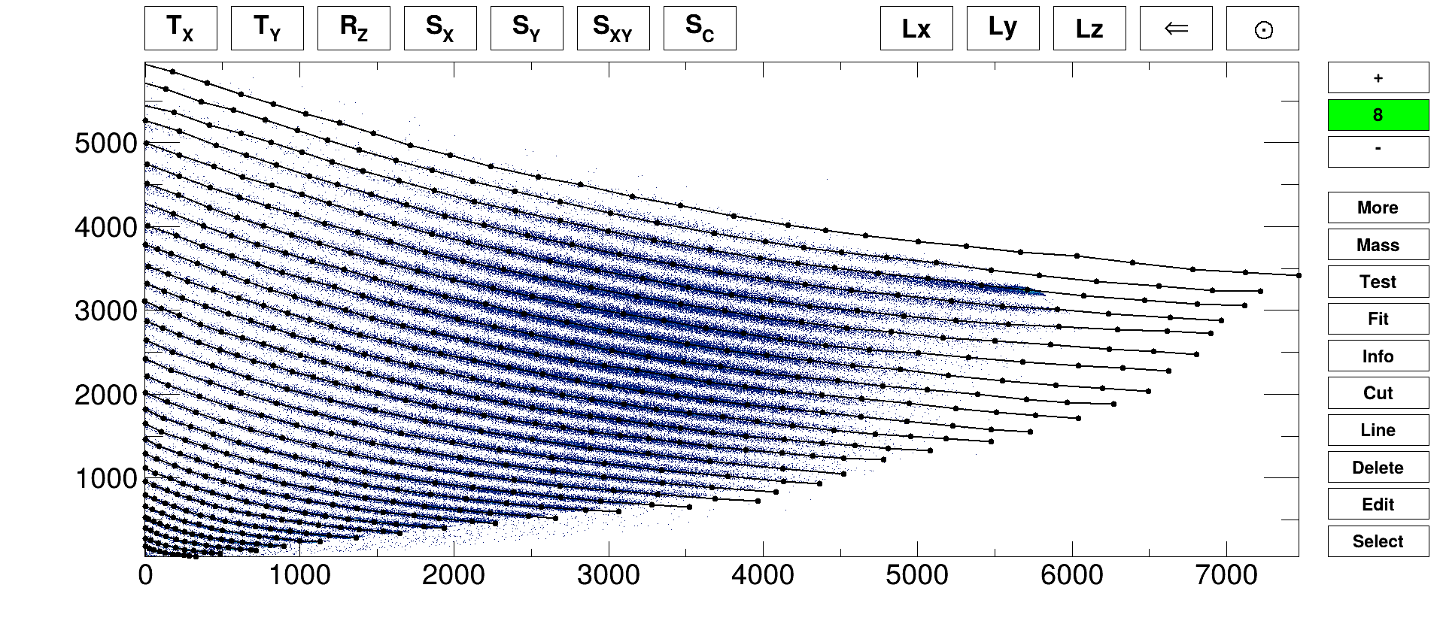
Si1-Si2 ΔE-E identification with FAZIA telescope 111
Using of Kaliveda software: a graphical tool to “click” a certain number of points on each ridge, in order to achieve a segmented line that follows each group of Z as accurately as possible.
Only one line is drawn for each element
The first grid is superimposed and adapted to all the others ΔE-E matrix
14
Notes:
14

Slide 15
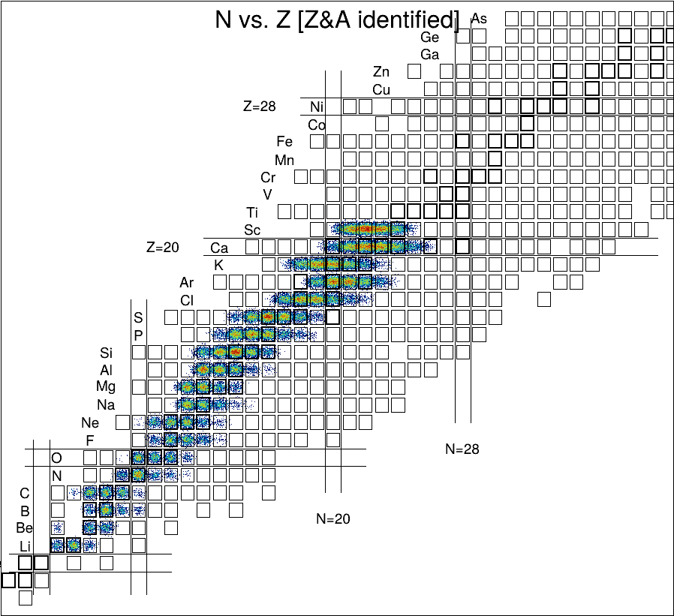
Drawn all the lines, KaliVeda assigns a PID value to each fragment by interpolating between the PID values of the closest Z-lines.
The PID value of each fragment must be translated into a charge and mass number by defining a PID interval for each peak, to which the “correct” (Z; A) is linked
The single peaks within the groups indicate different isotopes
A corresponding nuclide chart is then created
15
Notes:
15

Slide 16
Tasks distributions
Tasks
Si1-PSA
Si1-Si2 | Gabriella Naddeo
Si2-CsI | Andrea Dallavecchia
Si-CsI (INDRA) | John Frankland
CsI-PSA (INDRA) | Maxime Henri
Calibration (INDRA) | Si: Eric Bonnet
Calibration (FAZIA)
16
Notes:
16

