Slide 1
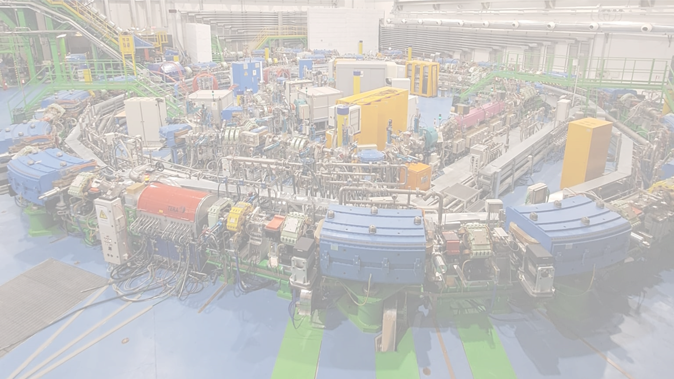
Recent results from
FAZIA@CNAO
Sandro Barlini, Andrea Stefanini,Catalin Frosin and Lucia Baldesi
FAZIA days June 2025

Slide 2
Main Objective
The aim was to study the efficiency of the FAZIA CsI(Tl) scintillators for high energy light charged particles
a significant decrease in identification efficiency has been reported for thick CsI(Tl) when used for energetic light particles
impinging particles can undergo nuclear interactions:
  transmutation of the colliding nucleus
  scattering of the particle out of the crystal
part of the initial energy not released in the crystal
  affect the energy measurement
  affect the identification of the particle
➡ Incomplete Energy Deposition (IED) event
IED contribution increases with the particle energy
given an energy, the IED contribution depends on the geometry
LCPs detection and identification mainly based on the CsI(Tl) ➡ the effect of IED cannot be neglected when energetic LCPs are produced
…but also: what happens in the Fazia detectors when the rate is very high (>1KHz)?

Slide 3
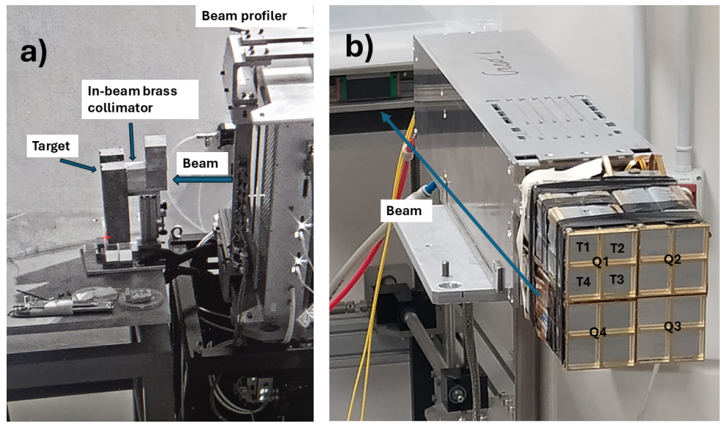
FAZIA @ CNAO
Setup
We wanted to extend the previous study by evaluating the efficiency under realistic experimental conditions.
beam spot dimension at the target position from 10 to 25 mm FWHM
  before the target brass collimator 5 cm thick with a 10 mm diameter aperture.
beam profiler not used
  massive blocks of copper and lead arranged around the brass collimator.
a complete FAZIA block placed, in air, at 1 m from the target
polar angles from 1° to 5°

Slide 4
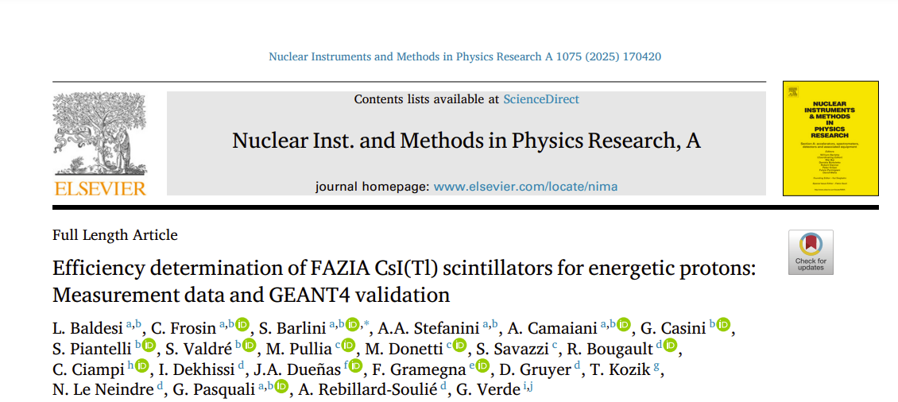
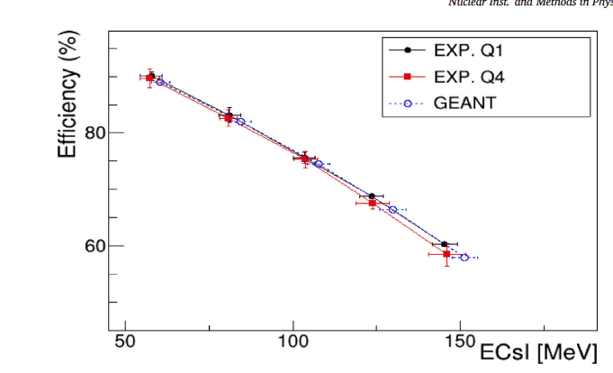

Published
Main results: Experimental Efficiency vs. Energy in CsI in the «standard» FAZIA configuration well described by a GEANT4 simulation!
N_{CED} from CsI(Tl) PSA
N_{CED} +N_{IED} from dE vsE
.. but is this effect «relevant» in our FAZIA@GANIL experiment?

Slide 5
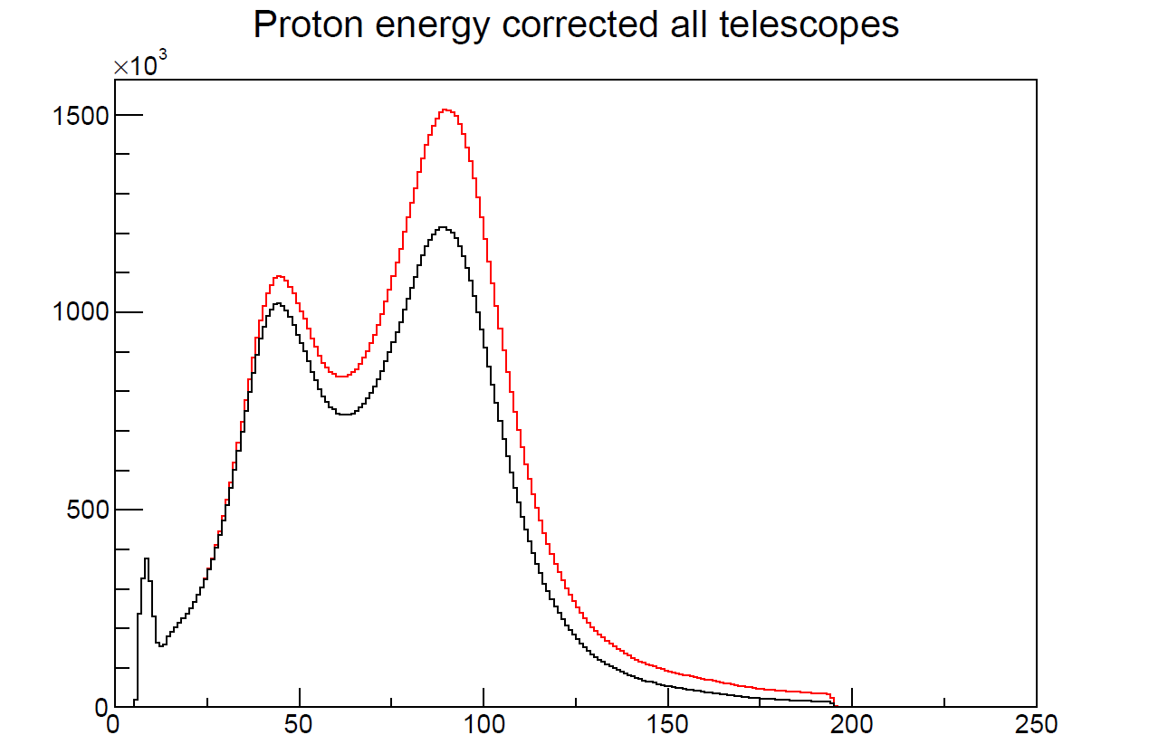
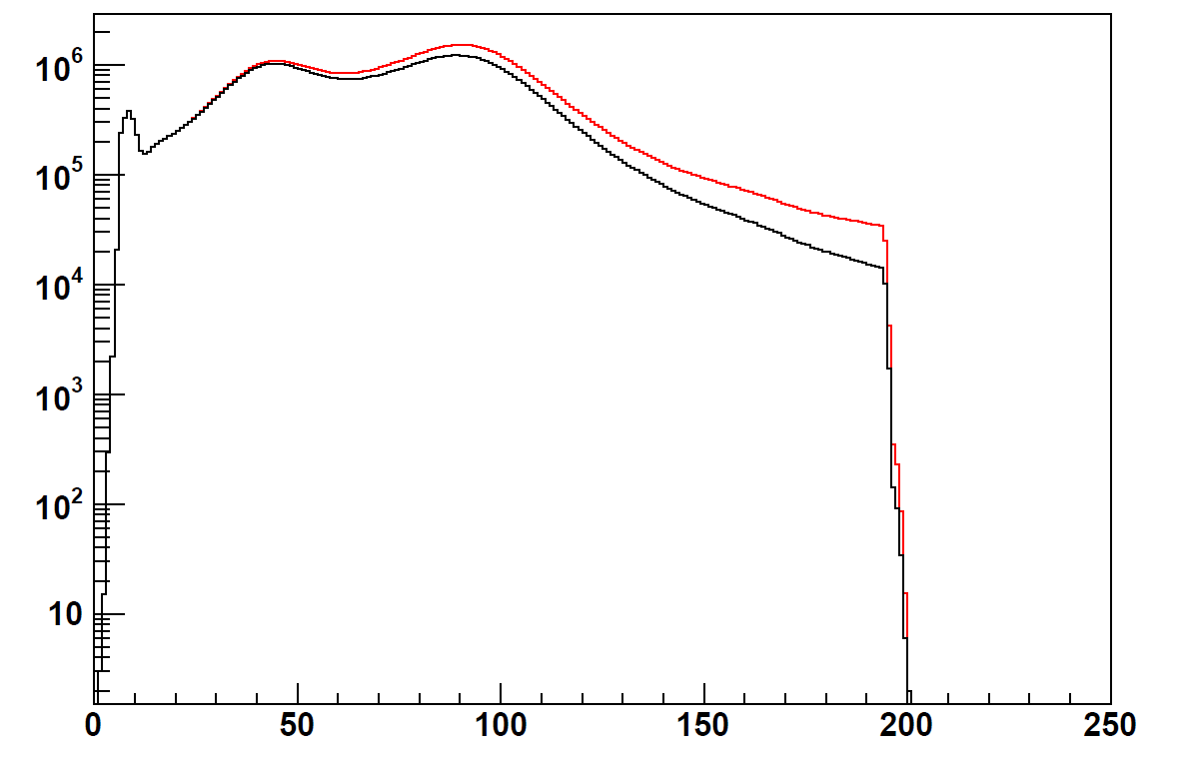
The most problematic case: E818 ⁵⁸Ni+⁵⁸Ni@74AMeV
NO SELECTION!!!!!
Preliminary!!!
Counts
black no correction
red corrected
Cut due to the finite length of CsI(Tl) (10 cm)
Protons not fully stopped
Counts
Etot (MeV)
…about multiplicity, the total number of protons increases from 8.69 10⁷ to 10.39 10⁸ particles (i.e. a factor 1.19)
Etot (MeV)

Slide 6
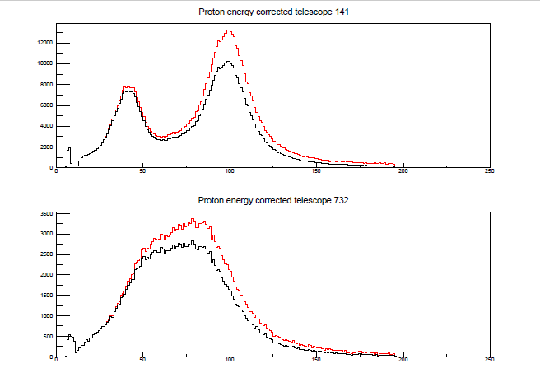
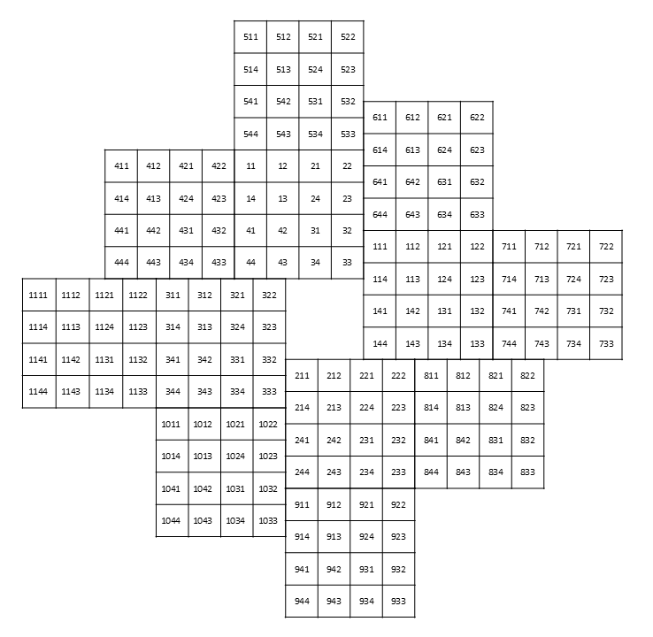
The most problematic case: E818 ⁵⁸Ni+⁵⁸Ni@74AMeV
Preliminary!!!
NO SELECTION!!!!!
Counts
black no correction
red corrected
Etot (MeV)
1114
Counts
Etot (MeV)
…about multiplicity, for tele 141 there is a factor 1.23, for tee 1114 a factor 1.19

Slide 7
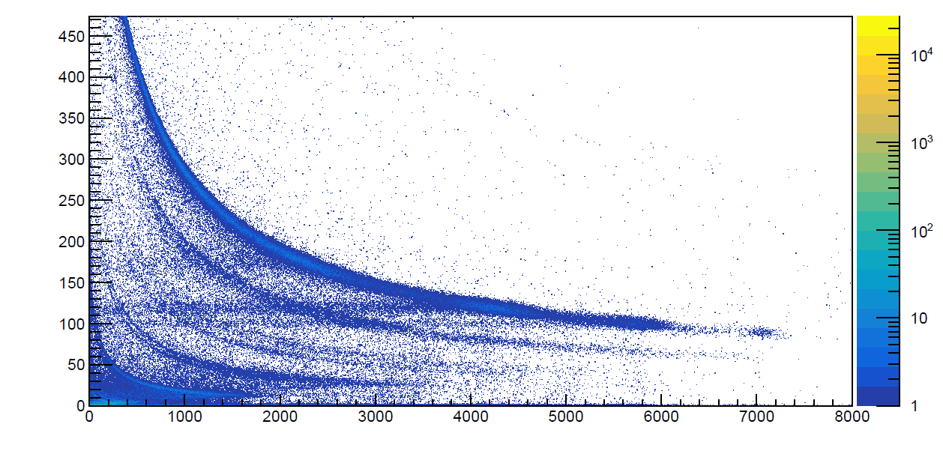
FAZIA @ CNAO: what about α-particles?
We start from the ¹²C+¹²C reactions at 150, 200, 250 and 300 AMeV to generate a continuous energy distribution of α particles. Still problem of high rate!!
No condition!!
As example, this is the 11 telescopes
fQH1+fQ2 (a.u.)
Carbon beam (150,250,300 AMeV)
..very dirty!
sQ3max (a.u.)

Slide 8
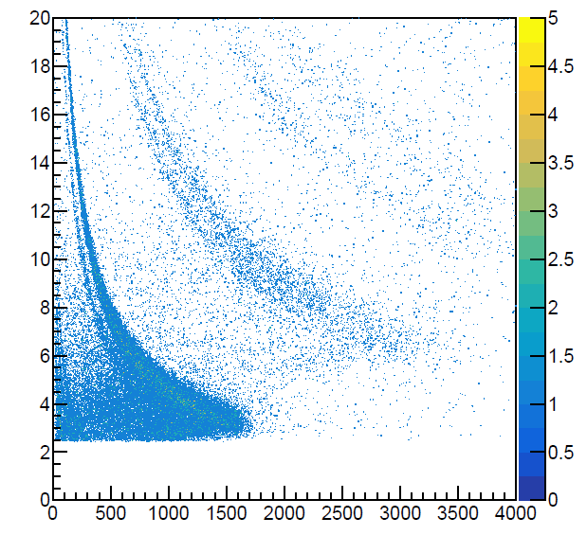
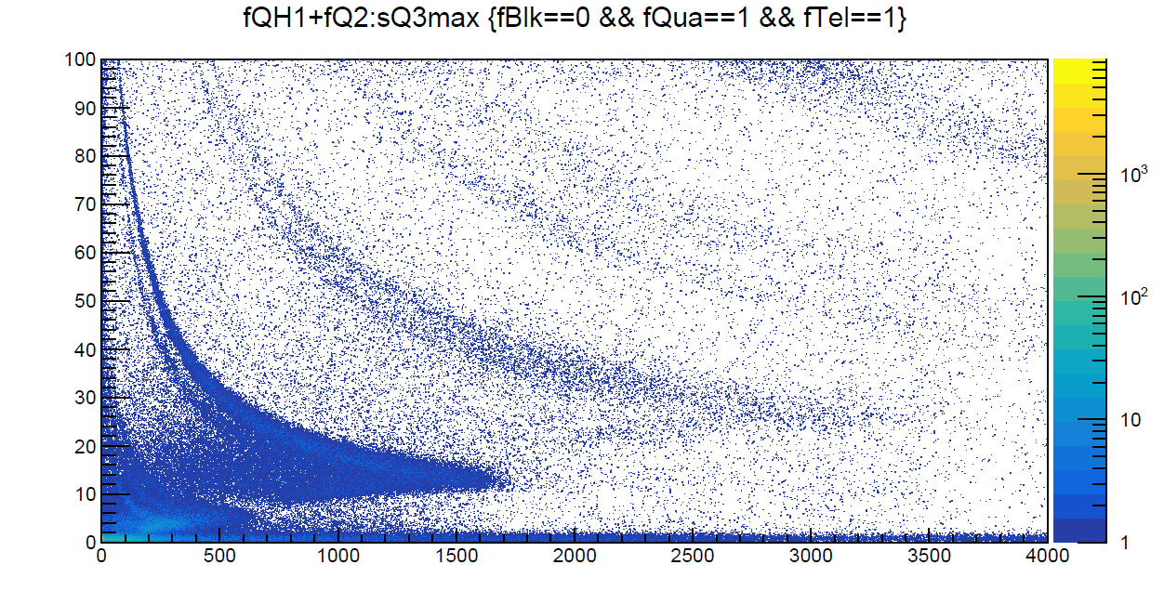
FAZIA @ CNAO: what about α-particles?
Zoom on dE-E with all conditions!!
Zoom on dE-E with no conditions!!
fQH1+fQ2 (MeV)
fQH1+fQ2 (a.u.)
⁴He
sQ3max (a.u.)
Baseline conditions
Cut on tcfd
Condition to remove «evident» pile-up
Problem: you cannot separate the ³He contribution in terms of IED!!
Z=1
sQ3max (a.u.)

Slide 9
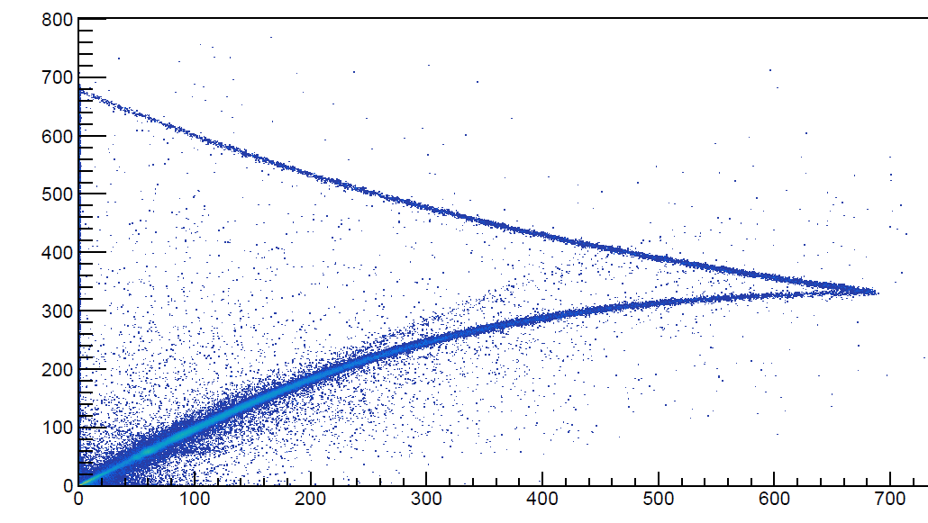
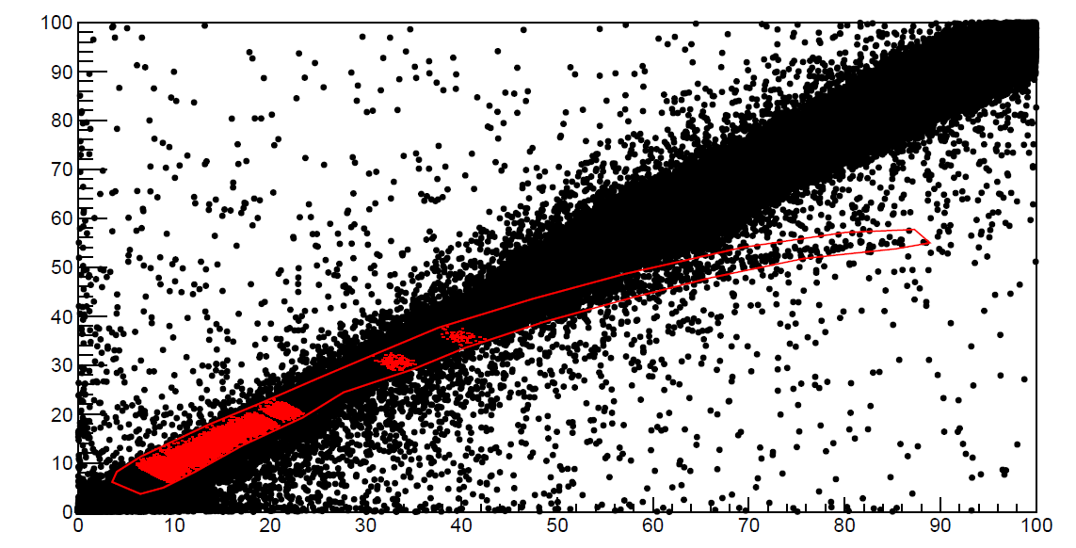
FAZIA @ CNAO: what about α-particles?
Zoom on Si1 vs Si2 with no conditions!!
Heavier fragments p.t.
fQH1(a.u.)
fQH1(a.u.)
Carbon line
Alpha particles selection
Alfa particles line
fQ2 (a.u.)
fQ2 (a.u.)
A cut on the Si1+Si2 energy corresponds to a «diagonal» cut here. There is a strong mixing beetween alpha and heavier p.t. ions. Moreover, with a simple cut on Si1+Si2, some not p.t. events are present!!

Slide 10
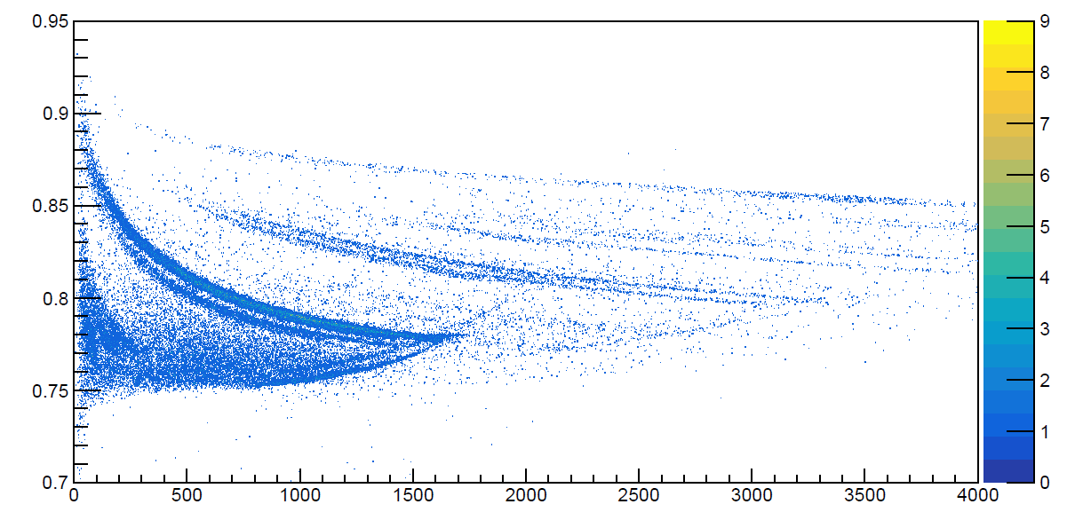
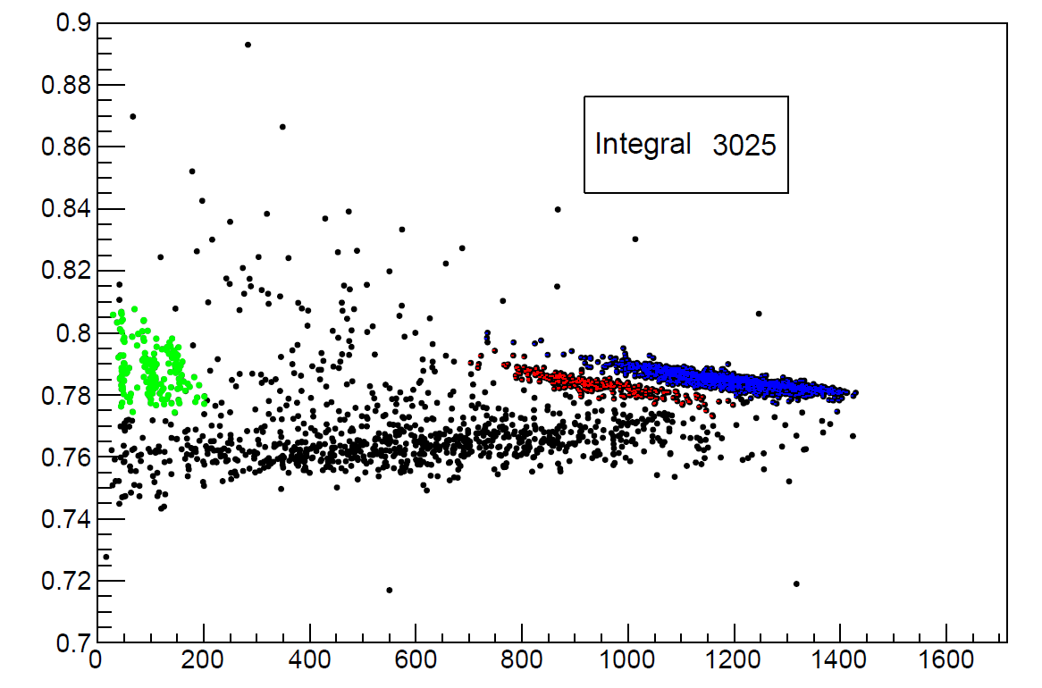

FAZIA @ CNAO: what about α-particles?
Experimentally:
sQ3fast/sQ3max
Cleaning conditions (baseline, Tcfd, and pile-up) + graphical cut in Si1 vs. Si2)
Then, for each «selected» dE (Si1+Si2) interval:
Complete Energy Deposition events counted in CsI(Tl) PSA for Z=2 and Z=1
(N_{CED})_{Z=2} = (N_{CED})_{3He}+ (N_{CED})_{4He}
(N_{CED})_{Z=1}
(N_{tot})_{Z=2} = from the dE selection
efficiency for Z=2
Of course, for the energy values we keep the mean of the energy distribution of Z=2 (so we need to calibrate the CsI for ³He and ⁴He !)
Alpha p.t. the CsI!
sQ3max (a.u.)
Cut on dE: 3.9 MeV ≤ Si1+Si2 <4.1MeV
$$ε=\frac{{(N_{CED})}_{Z=2}}{{(N_{tot})}_{Z=2}−{(N_{CED})}_{Z=1}}$$
sQ3fast/sQ3max
sQ3max (a.u.)

Slide 11
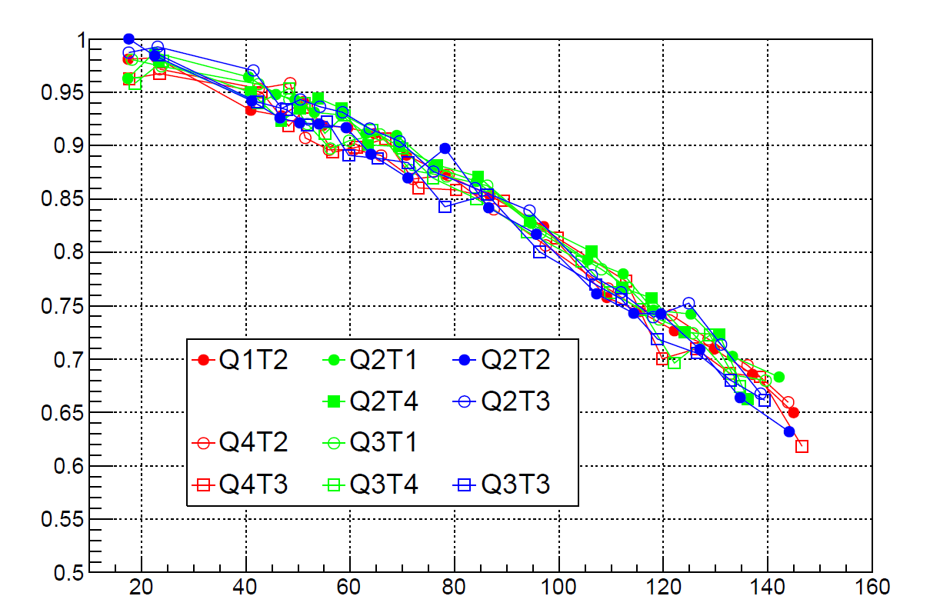
FAZIA @ CNAO: what about α-particles?
Increasing rate…
Experimental final results:
Efficiency
T1
T2
T2
T1
Q1
Q2
Beam
T4
T3
T4
T3
T1
T2
T1
T2
Q4
Q3
T4
T3
T4
T3
Using dedicated cuts and energy calibrations, the final results for the last 3 Columns are coherent within ±3%
ECsI (MeV/n)

Slide 12
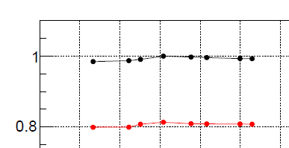
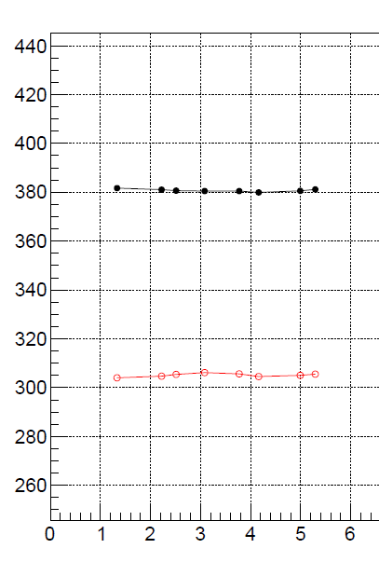
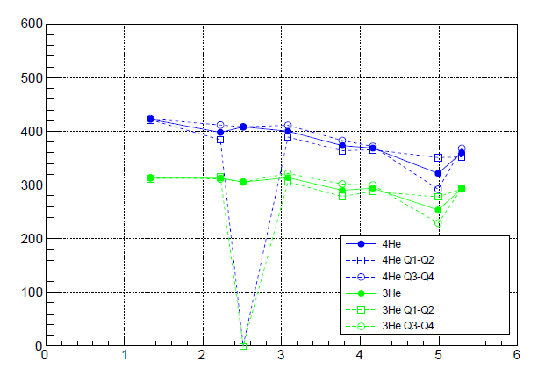
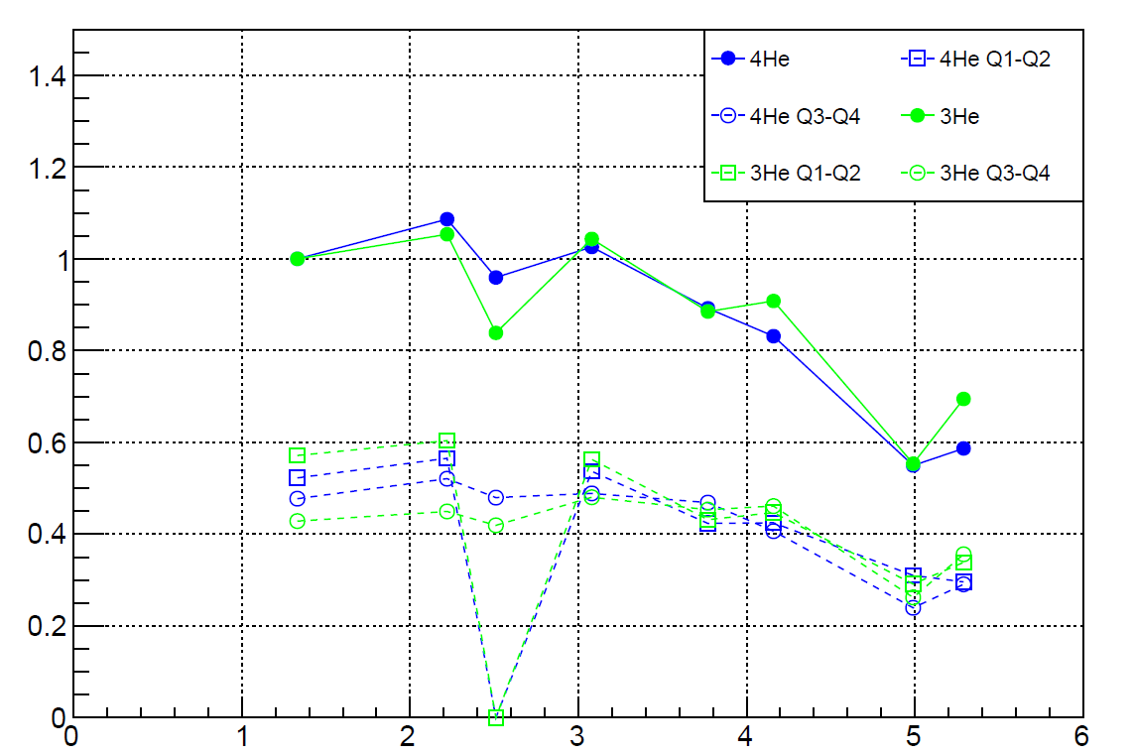
FAZIA @ CNAO: α particles
GEANT4 simulations
Two different GEANT4 simulations for ³He and ⁴He including:
the ³He or ⁴He interaction process
the full experimental set-up
  geometry of the FAZIA block
  dead layers and passive collimator
  ³He and ⁴He particles are directly created after the target, with angular and energy distributions similar to the experimental ones.
  The 3He/4He ratio is calibrated in order to obtain a similar (N_{CED})_{3He}/(N_{CED})_{4He} with respect to the experimental data
Angular Distr.
GEANT
Energy Distribution
⁴He
³He
Exp. data
«Mean» ECsI (MeV)
«Mean» ECsI (MeV)
Count (a.u.)
θ
θ
θ

Slide 13
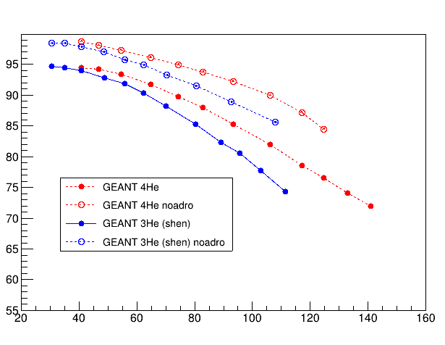
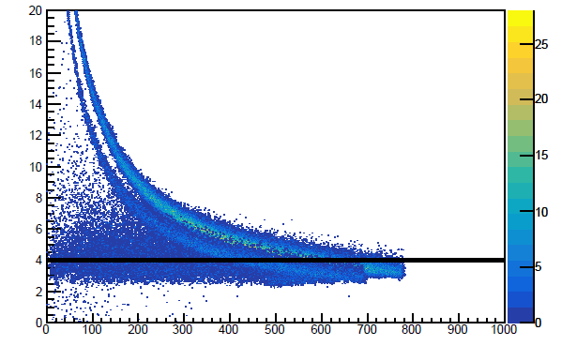
GEANT4 results:
FAZIA @ CNAO: α particles
GEANT4 simulations
Efficiency
Example of one telescope
dE (MeV)
Event selection with the same «cut» on Si1+Si2
ECsI (MeV/n)
ECsI (MeV)
With respect to protons, the scattering contribution to inefficiency is lower!
In any case, the ³He «geometrical» efficiency is lower with respect to ⁴He
N_{CED} events in GEANT are selected directly in the program looking to their energy loss!

Slide 14
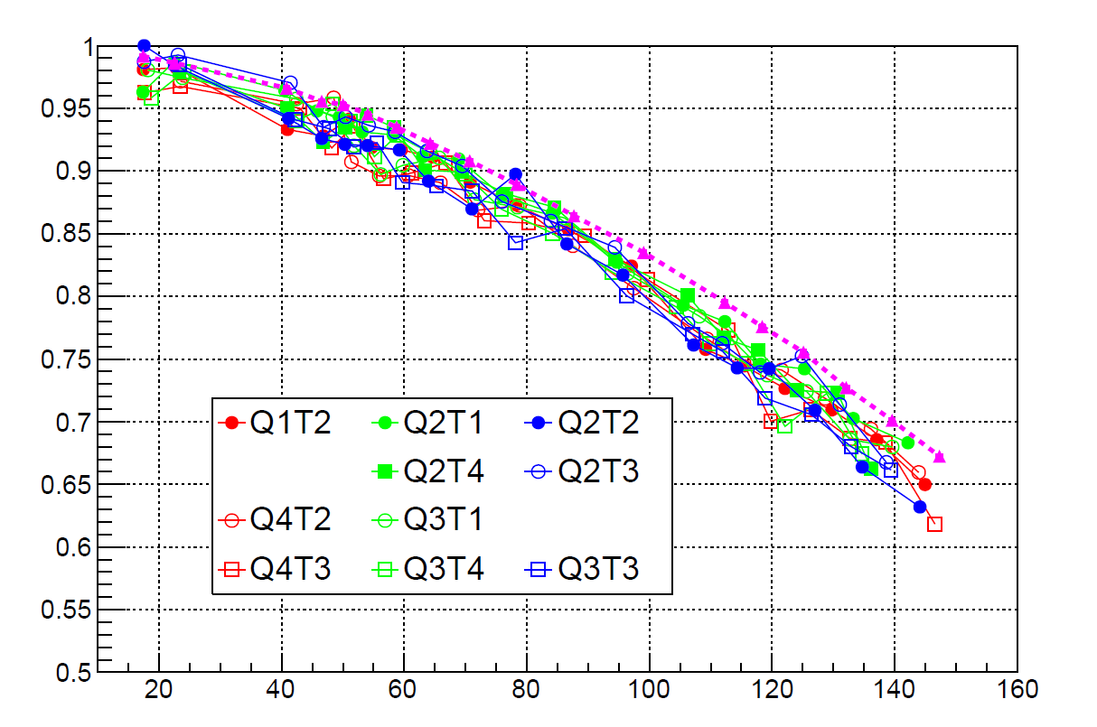
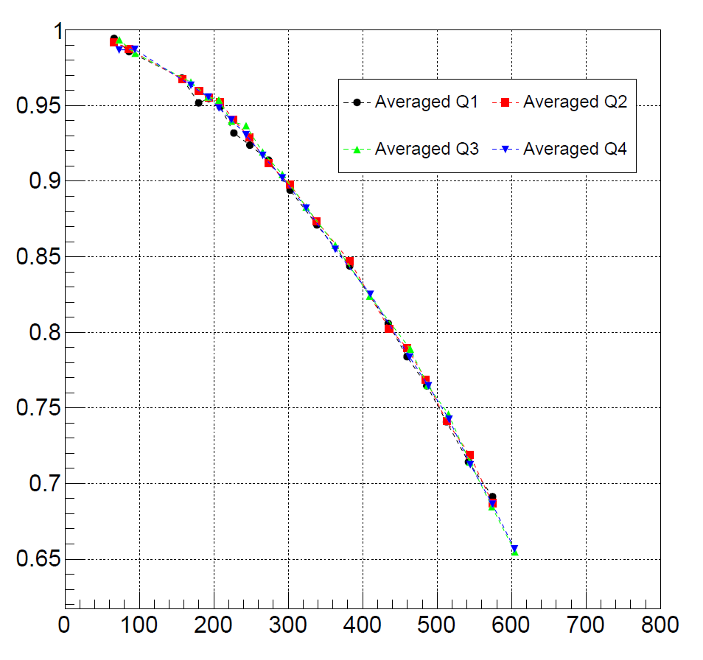
FAZIA @ CNAO: α particles
GEANT4 simulations
From the point of view of GEANT4 simulation, the quartet behaviour’s is very similar…
Efficiency
GEANT4
Efficiency
ECsI (MeV/n)
.. the simulated efficiency is slightly over (3-4%) the experimental data
We are trying to change the nuclear cross section (using for example «shein» option as for protons»
ECsI (MeV)

Slide 15
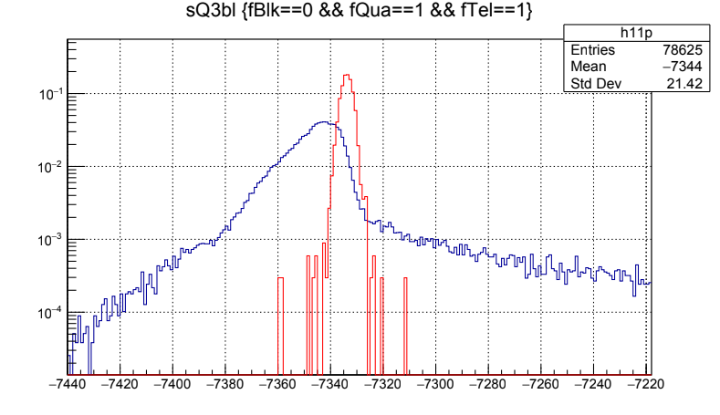
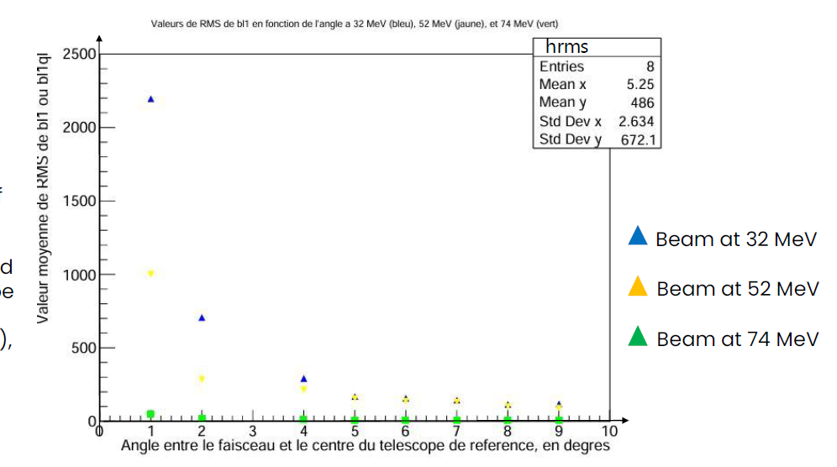
FAZIA @ CNAO: what are we learning about high rate condition?
Baseline distribution CNAO exp.
..but similar effects also in Ni+Ni@32,52,74 MeV!
RMS value of the baseline distribution as a function of the angle
Lower the energy, higher the rate and consequently the RMS of the baseline distribution
cosmic rays
Thanks to Enola Roberts, ENSICAEN
Baseline effects could affect the LO measurement:
if high rate ➡ baseline distribution very different from that observed at low rates, such as in cosmic ray run
  right tail: pile up
  left tail: the baseline can take lower values compared to those observed in low-rate conditions. So the «real» baseline value is accesible only with LOW rate!!

Slide 16
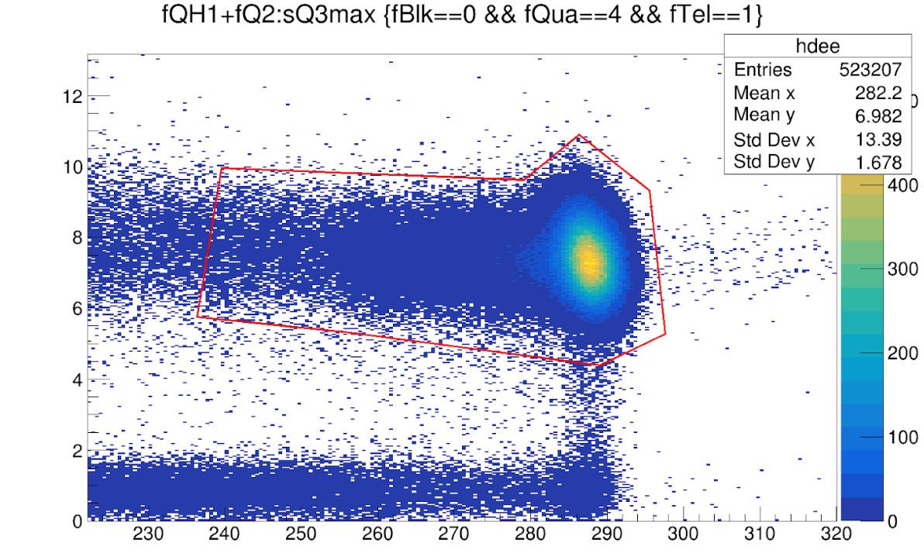
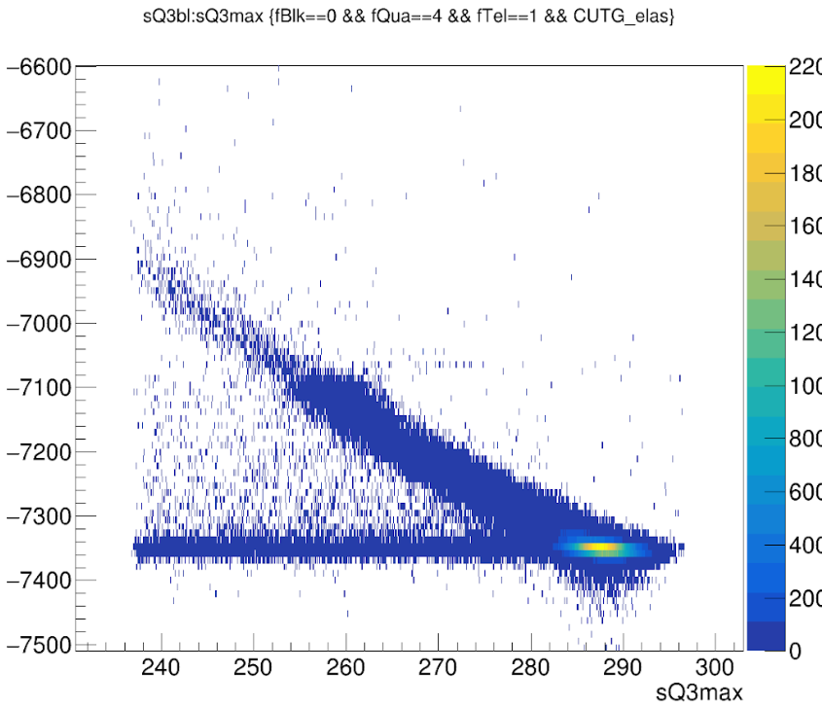
FAZIA @ CNAO: what are we learning about high rate condition?
dE vs E plot @CNAO: proton elastic peak is not «well» isolated
Baseline vs. Energy for the red selection: elastic energy is correlated to the baseline value!
Si1+Si2 (a.u.)
Baseline value
sQ3max (a.u.)
An increasing of rate can produce a loosing of energy resolution!
.. can this problem affect also the identification capability of FAZIA?

Slide 17
FAZIA @ CNAO: what are we learning about high rate condition?
⁵⁸Ni+⁵⁸Ni@32,52,74 AMeV
FOM for Si1vs Si2 identification between proton and deuteron as a
function of the angle with respect to the beam
It is evident as the most near to the beam telescope where elastic beam is present are suffering pile-up problem, affecting the energy measurement and consequently also the identification capability!
.. of course in any case we are well below the threshold of FOM=0.7…
Thanks to Enola Roberts, ENSICAEN

Slide 18
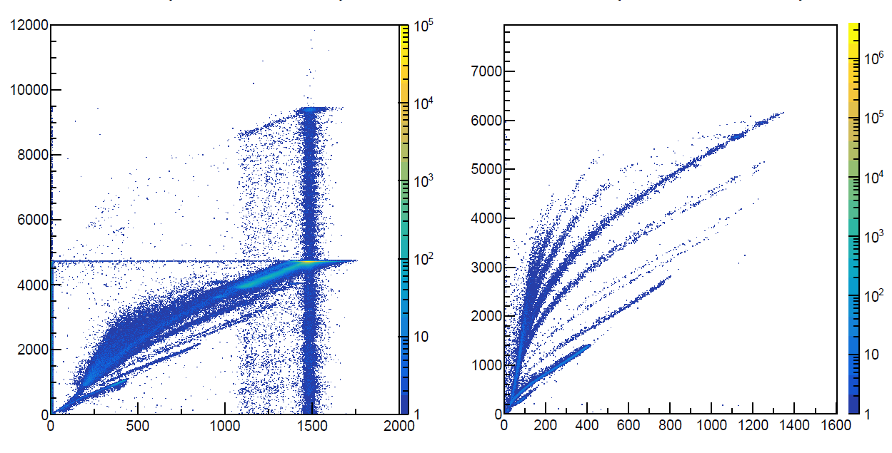
FAZIA @ CNAO: what are we learning about high rate condition?
¹²C+¹²C@8.75 AMeV
Telescope 1114
Telescope 212
QL1 (a.u.)
High rate
QL1 (a.u.)
Low rate
Double ¹²C
Similar effect due to high rate?
¹²C Pile-up
Out-of-time ¹²C
I1max (a.u.)
I1max (a.u.)

Slide 19
Conclusion and outlook
Using proton beam @CNAO data, a first paper about proton efficiency for the FAZIA block has been published. The effect is sensible at least for ⁵⁸Ni+⁵⁸Ni@74AMeV in terms of energy spectra and multiplicity
Using carbon beam@CNAO data, the same work has been done to estimate alpha-particle efficiency. The agreement between exp. data and GEANT4 is still good.
High-rate condition tested @CNAO are present also in our «standard» experiment when the elastic reaction is detected: Ni+Ni@32,52 AMeV and ¹²C+¹²C@8.75AMeV show similar behavior with respect to CNAO in terms of baseline distribution. This can affect energy value calculation and consequently also identification capability
For the future:
GEANT simulation to test different cross section to obtain a better agreement between exp.data and simulation
Test (with Simone) of an off-line procedure to obtain a pole-zero cancellation in order to minimize the effect of high rate in the energy measurement

