Slide 1
Reaction dynamics in the ⁵⁸Ni+⁵⁸Ni system at intermediate energies ⁵⁸Ni+⁵⁸Ni @ 32, 52 and 74 MeV/nucleon
Lucia Baldesi
FAZIA Days 25-27 June 2025

Slide 2
⁵⁸Ni+⁵⁸Ni @ 32, 52 and 74 AMeV
The E789 and E818 experiments
E789 experiment (2019): ^{58,64}Ni+^{58,64}Ni at 32 and 52 AMeV
E818 experiment (2022): ³⁶Ar,⁵⁸Ni+⁵⁸Ni at 74 AMeV
⁵⁸Ni+⁵⁸Ni at 32, 52 and 74 AMeV: evolution of the dynamics with the incident energy in semi-pheripheral collisons
Selection QPr and QPb channels
What AMD model suggests about these reactions
General characteristics of the channels of interest
Isospin drift signals?
Calorimetry and source characterization

Slide 3
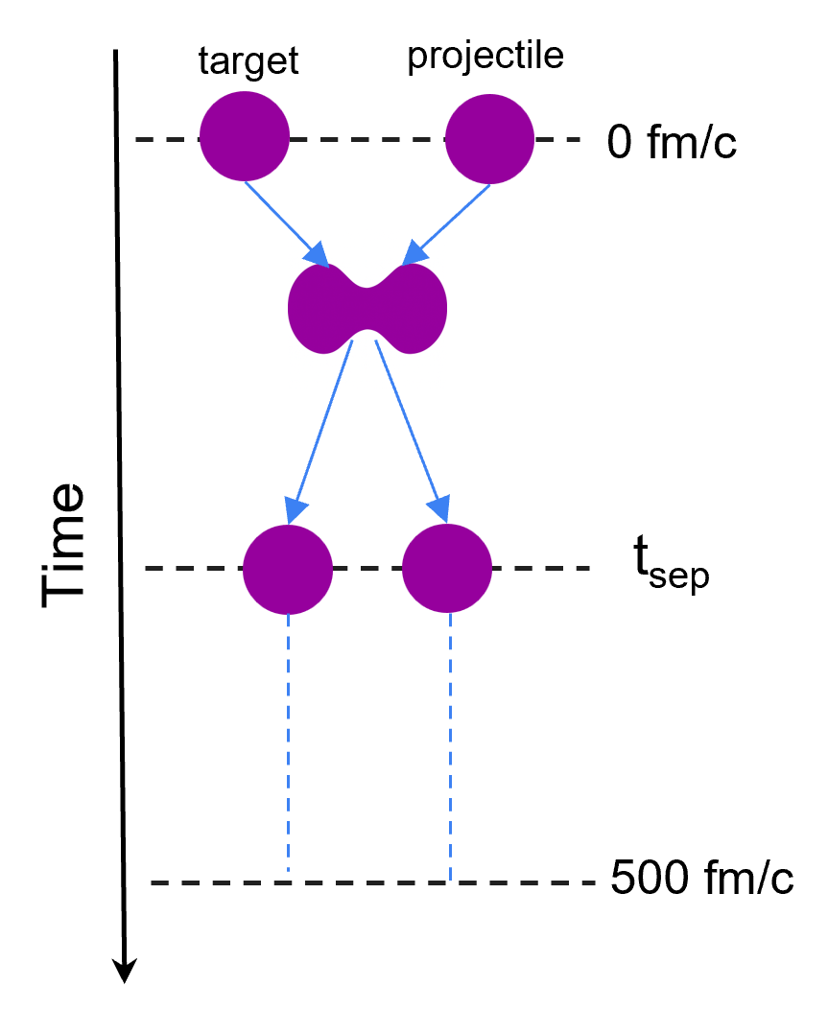
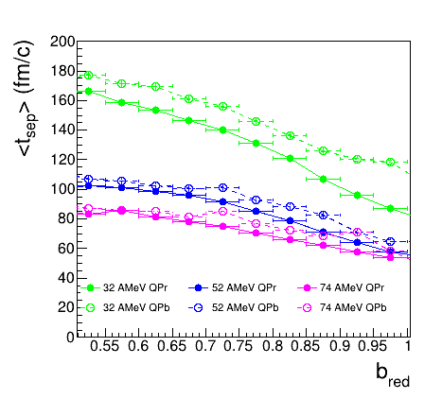
The dynamical phase within AMD
AMD simulation typically stopped at 500 fm/c but the actual interaction time ends well before
we can apply the fragment reconstruction algorithm every 20 fm/c
separation time: first time step when at least two heavy fragments re-emerge from a single hot reacting system
Selection of the QPr and QPb channels
QPr channel: two heavy fragments with Z>14, one forward and one backward in the c.m. reference frame, with only LCPs and IMFs in coincidence.
QPb: two forward emitted Z>4 fragments in the c.m. reference frame, whose charge number sum is at least 15
<t_{sep}> vs b_{red}
well below 500 fm/c
increases with the reaction centrality
scales correctly with the beam energy
slightly longer for the breakup channel with respect to the evaporative one (C. Ciampi, PRC 108, 054611 (2023))
AMD+GEMINI++ 4π
the separation time corresponds (in AMD) at the end of the dynamical phase
we can investigate the QP* looking at the properties of the fragments at this time.

Slide 4
The dynamical phase within AMD
AMD+GEMINI++ 4π
QPr channel
QPb channel
t_{sep}
500 fm/c
seconday fragments
t_{sep}
500 fm/c
seconday fragments

Slide 5
The dynamical phase within AMD
AMD+GEMINI++ 4π
QPr channel
QPb channel
t_{sep}
500 fm/c
seconday fragments
t_{sep}
500 fm/c
seconday fragments

Slide 6
The dynamical phase within AMD
AMD+GEMINI++ 4π
QPr channel
QPb channel
t_{sep}
500 fm/c
seconday fragments after GEMINI++
t_{sep}
500 fm/c
seconday fragments after GEMINI++

Slide 7
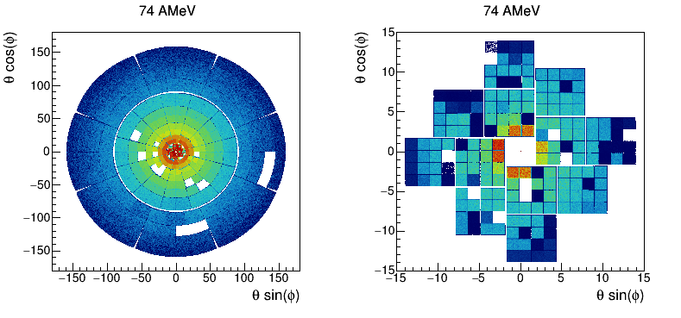
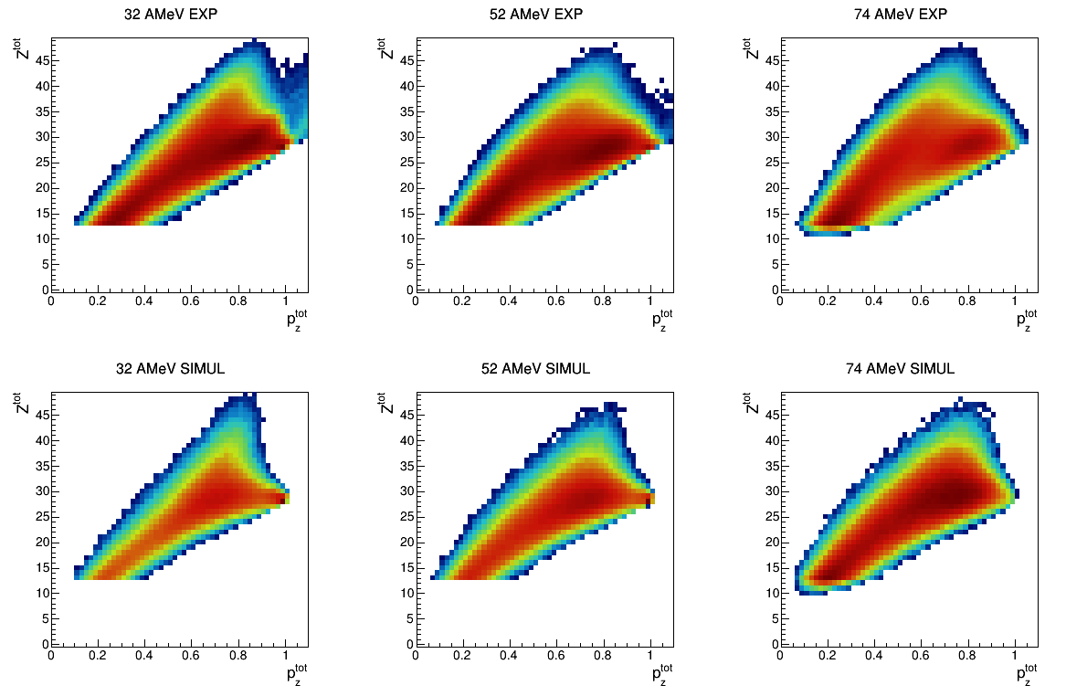
The experimental data
Data reduction
Particle identification and calibrations are completed
Z^{tot} vs p_{z}^{tot}/p_{beam}
32 AMeV 52 AMeV 74 AMeV
exp
Event selection
selection of C. Ciampi, PRC 106, 024603 (2022)
events with a trigger pattern M ≥ 2 in FAZIA
the most incomplete events have been discarded by imposing a total detected charge Ztot ≥ 12
The weird events have been discarded by imposing Ztot<Zp+Zt, Atot<Ap+At, ptotz/pbeam<1.1
AMD+GEMINI++

Slide 8
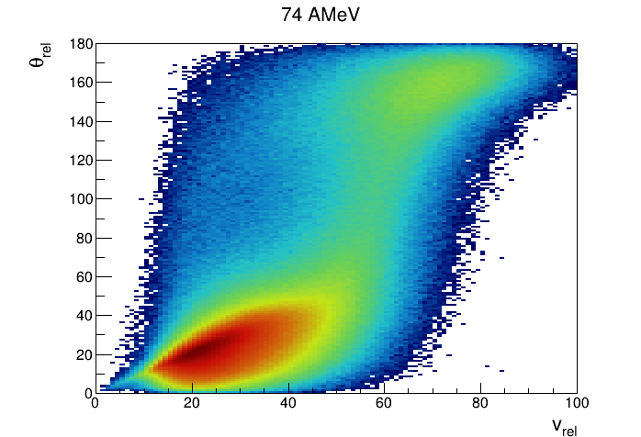
Channels of interest
Definitions
LCP: Z=1,2
IMF: Z=3,4
BF: Z>4
QP: Z>14
QP
QP remnant
M_{BF}=1
Z_{BF}>14
v_{z}^{cm} (BF)>0
QP breakup
M_{BF}=2
Z_{rec}= Z_{HF}+Z_{LF} >14
v_{z}^{cm} (rec)>0
θ_{rel} < θ_{max}
12 mm/ns < v_{rel} < v_{max}
Multifragmentation
Z_{biggest} <7
ΣZ > 14
CM
beam
74 AMeV
QT
QP
θ_{rel}
CM
beam
QT
 | 32 AMeV |  | 52 AMeV |  | 74 AMeV
 | exp | AMD filt | exp | AMD filt | exp | AMD filt
QPr | 39% | 45% | 27% | 32% | 20% | 21%
QPb | 4.3% | 3.5% | 3.2% | 2.8% | 2.2% | 2.6%
MultiFrag | 1.9% | 1.4% | 6.2% | 7.4% | 12% | 13%
The percentages are calculated with respect to the total number of selected events
The sum of the percentages doesn't give 100 because many events don’t fit in any of these categories
Strong increase of MultiFrag event type

Slide 9
QP remnant and QP breakup channels
no centrality selection
QPr channel
exp vs AMD+GEMINI++
QPb channel

Slide 10
Centrality estimation
reduced momentum: $p_{red}=\left(\frac{p_{z}^{QP}}{p_{beam}}\right)$
well correlated for p_{red}>0.4 → good sorting parameter for the selection of semi-peripheral collisions
small average differences among the energies → could influence some details in the conclusions
AMD+GEMINI++ filtered
QPr channel
b_{red} vs p_{red} correlation
AMD+GEMINI++

Slide 11
General characteristics of the QP as a function of p_{red}
QPr channel
<Z> vs p_{red}
<Z> vs p_{red} if idA
<N> vs p_{red} if idA
<N>/Z vs Z if idA
<N/Z> vs p_{red} if idA
32 AMeV
52 AMeV
74 AMeV
■ exp
□ simul
exp vs AMD+GEMINI++

Slide 12
General characteristics of the QP as a function of p_{red}
QPr channel
<Z> vs p_{red}
<Z> vs p_{red} if idA
<N> vs p_{red} if idA
<N>/Z vs Z if idA
<N/Z> vs p_{red} if idA
32 AMeV
52 AMeV
74 AMeV
■ exp
□ simul
At 32 and 52 AMeV, ⟨Z⟩ decreases when considering only the QP identified in mass.
At 74 AMeV, the total ⟨Z⟩ and the ⟨Z⟩ for mass-identified QP are very similar
750 μm silicon detectors.
Si1+Si2 vs CsI correlation, instead of Si2 vs CsI.

Slide 13
General characteristics of the QP as a function of p_{red}
QPr channel
<Z> vs p_{red}
<Z> vs p_{red} if idA
<N> vs p_{red} if idA
<N>/Z vs Z if idA
<N/Z> vs p_{red} if idA
32 AMeV
52 AMeV
74 AMeV
■ exp
□ simul
exp vs AMD+GEMINI++

Slide 14
General characteristics of the QP as a function of p_{red}
QPb channel
<Z> vs p_{red} if idA
<N> vs p_{red} if idA
<N>/Z vs Z if idA
<N/Z> vs p_{red} if idA
32 AMeV
52 AMeV
74 AMeV
■ exp
□ simul
exp vs AMD+GEMINI++

Slide 15
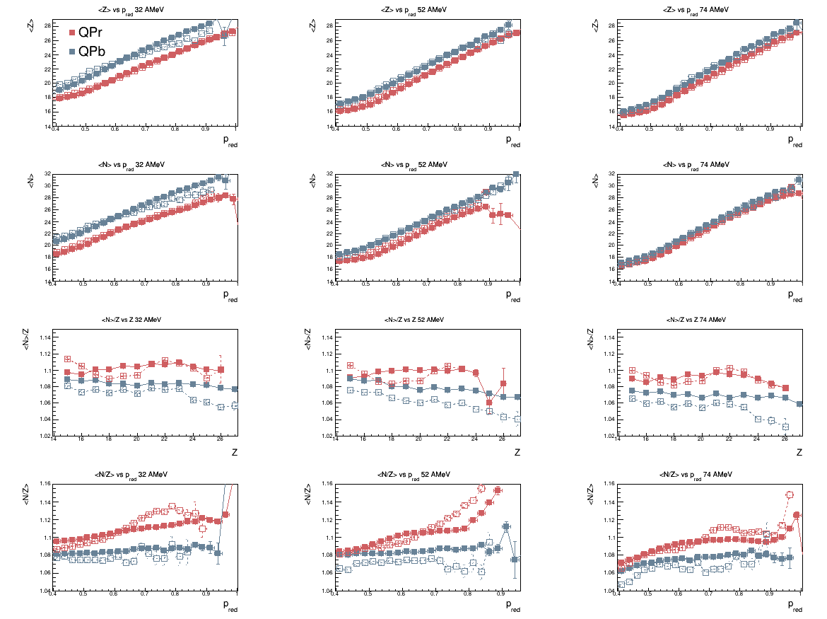
General characteristics of the QP as a function of p_{red}
■ exp
□ simul
exp vs AMD+GEMINI++
QPr vs QPb

Slide 16
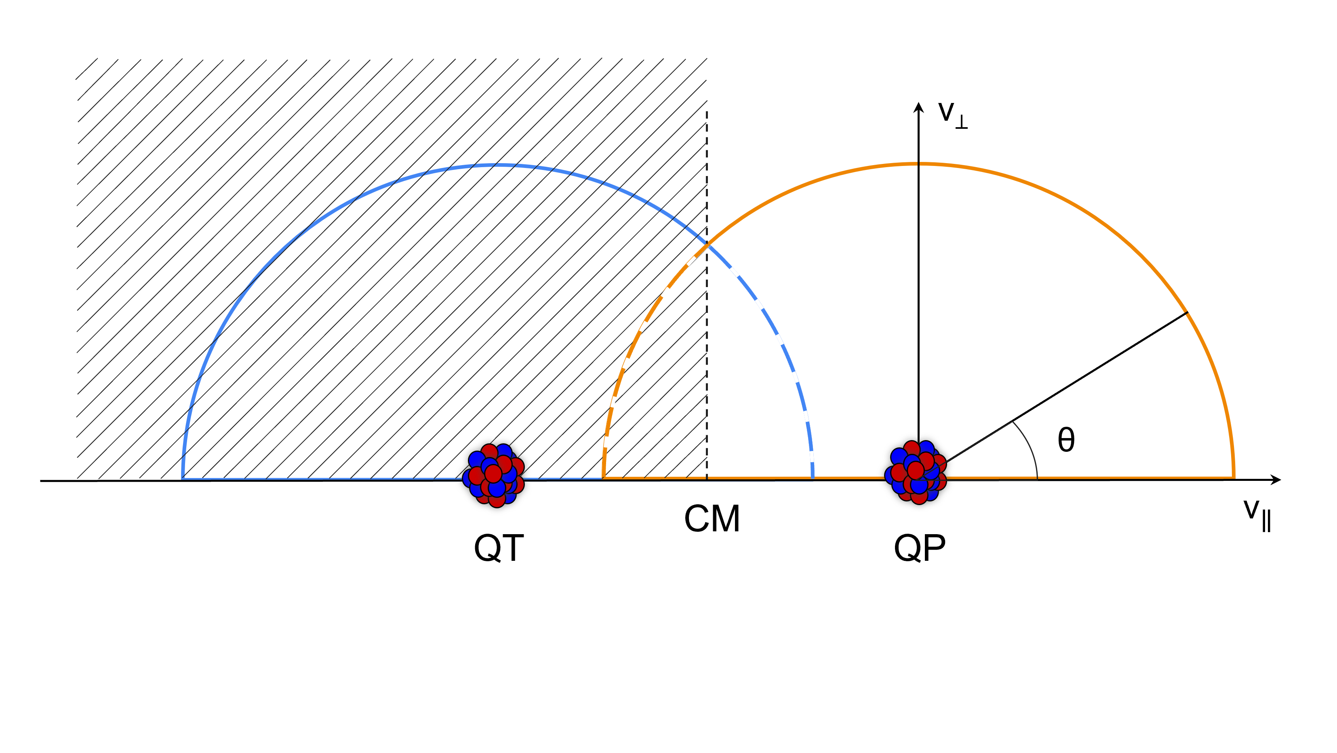
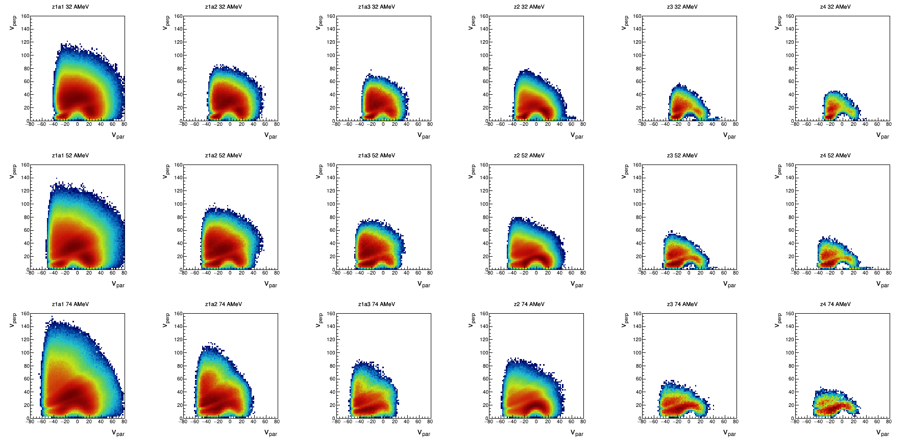
Charged particles in coincidence with the QP
Charged particles (LCPs and IMFs) in coincidence with the QP can provide rich information on the reaction dynamics
p d t Z=2 Z=3 Z=4
p_{red}>0.4
particles emitted fwd in the c.m. reference frame
v// vs v⟂: velocity components (in the QP reference frame) // and ⟂ to the QP-QT separation axis
characteristic circles around the QP position indicating a Coulomb emission from these source
additional contribution at v// intermediate between those of QP and QT
74 AMeV 52 AMeV 32 AMeV
exp

Slide 17
Isopsin of charged particles in coincidence with the QP
the isotopic composition of the LCPs and IMFs is generally studied a function of their emission pattern
We can select the QP decay emissions by considering the particles forward emitted with respect to the QP remnant. This selection can be expected to feature less contamination from dynamical contributions
Particles backward emitted with respect to the QP but forward emitted with respect to the CM of the whole system, are related to both dynamical and statistical contributions.
Since the symmetry of the reaction, the characteristics of the particles emitted fwd in the c.m must have the same average characteristics as the bwd ones.
Various isospin-sensitive observables can be built to inspect the characteristics of the light emissions
FWD
(evaporation)
BWD
(evaporation + mid-velocity)
QP
CM
beam

Slide 18
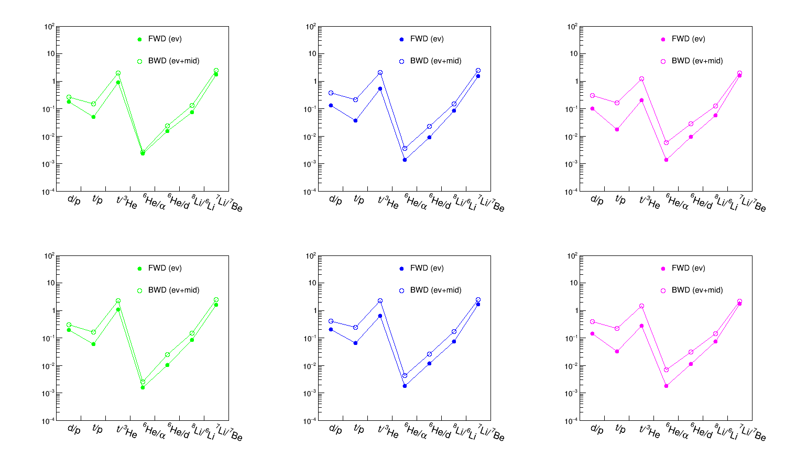
Isopsin of charged particles in coincidence with the QP
Isobaric and isotopic yield ratios
(the neutron-rich ejectile always at the numerator)
FWD
(evaporation)
BWD
(evaporation + mid-velocity)
QP
32 AMeV 52 AMeV 74 AMeV
CM
beam
neutron enrichment in the backward emissions
neutron enrichment on the mid-velocity emissions
possibly related to the isospin drift mechanism
tension for larger effect with increasing beam energy
QPb channel QPr channel
exp

Slide 19
Isopsin of charged particles in coincidence with the QP
FWD
(evaporation)
BWD
(evaporation + mid-velocity)
isospin ratio for complex particles:
where the ν index numbers the different complex particles in the ith event, and the outer sum runs over all the events in the selected pred bin.
Free protons are excluded (as well as free neutrons), while d, t, ³He, ⁴He, ⁶He, ⁶Li, ⁷Li, ⁸Li, ⁹Li, ⁷Be, ⁹Be, and ¹⁰Be are taken into account as complex particles
QP
E. Galichet, PRC 79, 064614 (2009)
CM
beam
QPr channel QPb channel
<N/Z>_{CP} built with fwd emitted particles are lower than those built with bwd emitted particles
indication that the midvelocity emission is more neutron-rich for the complex particles
<N/Z>_{CP} of bwd particles little dependent on the beam energy
<N/Z>_{CP} of fwd particles dependent on the beam energy
exp

Slide 20
Isopsin of charged particles in coincidence with the QP
FWD
(evaporation)
BWD
(evaporation + mid-velocity)
isospin ratio for complex particles:
where the ν index numbers the different complex particles in the ith event, and the outer sum runs over all the events in the selected pred bin.
Free protons are excluded (as well as free neutrons), while d, t, ³He, ⁴He, ⁶He, ⁶Li, ⁷Li, ⁸Li, ⁹Li, ⁷Be, ⁹Be, and ¹⁰Be are taken into account as complex particles
QP
E. Galichet, PRC 79, 064614 (2009)
CM
beam
QPr vs QPb
to our knowledge: first attempt for this comparison
independently of the channel, the emission of CP from the overlap region seems n-richer
exp

Slide 21
Calorimetry
Comparing the particles emitted forward and backward with respect to the QP, the neutron enrichment of the mid-velocity emissions has been highlighted (in both QPr and QPb channels)
goal: study the reaction dynamics in the experimental case, although unfortunately we can only measure the secondary fragments.
→ calorimetry to disentangle the contributions from evaporation and midvelocity emission, both in terms of yields and energies, accessing the primary emitting sources.
It is first necessary to correct the data for the inefficiency of the experimental apparatus
For this purpose we need a model
AMD+GEMINI++
Few statistics
Each primary event x100
HIPSE
More statistics
Only for 74 AMeV
Comparing the filtered and unfiltered simulations, an average correction factor for each cell in space (v//, v⟂) for each element for each centrality interval has been found.
NOTE: thus, we correct only CP emissions for the selected QP events.

Slide 22
Efficiency correction
experimental v// vs v⟂ correlations (in the QP frame) for protons and p_{red}=0.6-0.7
before the efficiency correction
efficency maps from the ratio between the number of protons of the filtered and unfiltered AMD+GEMINI++ simulations
after the efficiency correction

Slide 23
Validation of the efficiency correction
we consider all the particles emitted in the forward in the c.m. reference frame (corrected for the efficiency)
symmetric collisions → the fwd particles have the same average characteristics as the bwd ones
check the quality of the applied efficiency corrections: by adding up the Z,N,E of forward-emitted LCPs and IMFs to those of the QP residue, we should reproduce, on average, the projectile characteristics

Slide 24
Validation of the efficiency correction
QPr channel
$$\left\langle Z\right\rangle =\left\langle Z^{QP}\right\rangle +\left\langle Z^{fwd}\right\rangle$$
$$\left\langle N\right\rangle =\left\langle N^{QP}\right\rangle +\left\langle N^{fwd}\right\rangle$$
$$\left\langle E_{cm}\right\rangle =\left\langle E_{cm}^{QP}\right\rangle +\left\langle E_{cm}^{fwd}\right\rangle$$
$$\left\langle Z^{fwd}\right\rangle =\sum_{i}{Z_{i}∗\left\langle M_{i}\right\rangle }$$
$$\left\langle N^{fwd}\right\rangle =\sum_{i}{N_{i}∗\left\langle M_{i}\right\rangle }$$
$$\left\langle E_{cm}^{fwd}\right\rangle =\sum_{i}{\overline{k_{cm}^{i}}}\left\langle M_{i}\right\rangle −Q_{tot}$$
we consider all the particles emitted in the forward in the c.m. reference frame (corrected for the efficiency)
symmetric collisions → the fwd particles have the same average characteristics as the bwd ones
check the quality of the applied efficiency corrections: by adding up the Z,N,E of forward-emitted LCPs and IMFs to those of the QP residue, we should reproduce, on average, the projectile characteristics
● tot exp
○ tot simul
■ QP exp
□ QP simul
74 AMeV 52 AMeV 32 AMeV
exp vs AMD+GEMINI++
free neutron
emission DEDUCED
EFFECT OF IED PROTONS?
to be investigated
emitted neutrons in clusters

Slide 25
Validation of the efficiency correction
QPr channel
Particle multiplicities vs p_{red}
74 AMeV
exp vs AMD+GEMINI++
In exp, there are fewer free neutrons than in the AMD+GEMINI++ simulation
Similarly, in exp there are fewer free protons compared to AMD+GEMINI++ simulation
The simulation favors the emission of free protons and neutrons over that of clusters.

Slide 26
_{First attempt ever done!}
QPb channel
Validation of the efficiency correction
$$\left\langle Z\right\rangle =\left\langle Z^{QP}\right\rangle +\left\langle Z^{fwd}\right\rangle$$
$$\left\langle N\right\rangle =\left\langle N^{QP}\right\rangle +\left\langle N^{fwd}\right\rangle$$
$$\left\langle E_{cm}\right\rangle =\left\langle E_{cm}^{QP}\right\rangle +\left\langle E_{cm}^{fwd}\right\rangle$$
$$\left\langle Z^{fwd}\right\rangle =\sum_{i}{Z_{i}∗\left\langle M_{i}\right\rangle }$$
$$\left\langle N^{fwd}\right\rangle =\sum_{i}{N_{i}∗\left\langle M_{i}\right\rangle }$$
$$\left\langle E_{cm}^{fwd}\right\rangle =\sum_{i}{\overline{k_{cm}^{i}}}\left\langle M_{i}\right\rangle −Q_{tot}$$
we consider all the particles emitted in the forward in the c.m. reference frame (corrected for the efficiency)
symmetric collisions → the fwd particles have the same average characteristics as the bwd ones
check the quality of the applied efficiency corrections: by adding up the Z,N,E of forward-emitted LCPs and IMFs to those of the QP residue, we should reproduce, on average, the projectile characteristics
● tot exp
○ tot simul
74 AMeV 52 AMeV 32 AMeV
exp vs AMD+GEMINI++
■ QP exp
□ QP simul

Slide 27
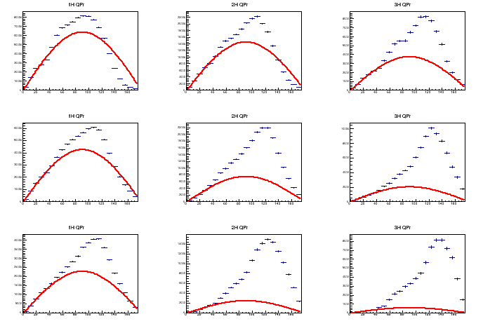
Evaporative and midvelocity emissions
QPr channel- p_{red}=0.5-0.6
To disentangle the midvelocity emission from the sequential evaporation of the QP, we look at the angular distributions of θ, the polar angle between the charged particle in the QP frame and the QP-QT separation axis
The angular distributions clearly suggest the superposition of two emission components, one from the QP and one from “midvelocity.”
for pure evaporation one expects approximately a sin(θ) distribution
one finds a large excess at backward angles which is ascribed to midvelocity emissions
The evaporative multiplicities were extrapolated from the experimental data measured in the range 0°≤ θ ≤ 30°, where the angular distribution can be considered enough clean
The multiplicities associated with the midvelocity emissions were determined from the difference between the total multiplicities and the evaporative ones.
p d t
74 AMeV 52 AMeV 32 AMeV
exp
NOTE: the midvelocity yields increases with E_{beam}

Slide 28
Evaporative and midvelocity emissions
S. Piantelli, PRC 74, 034609 (2006)
A. Mangiarotti, PRL 93, 232701 (2004)
Neutron yields:
$\left\langle M_{n}\right\rangle =A_{proj}−\sum_{i}{A_{i}∗\left\langle M_{i}\right\rangle }−\left\langle A_{QP}\right\rangle$
Evaporation
$\left\langle A_{ev}\right\rangle =\sum_{i}{A_{i}∗\left\langle M_{i}^{ev}\right\rangle }$ + $\left\langle M_{n}^{ev}\right\rangle$
$\left\langle E_{ev}\right\rangle =\sum_{i}{\overline{k_{QP}^{i,ev}}}\left\langle M_{i}^{ev}\right\rangle +\sum_{i}{\overline{k_{QP}^{n,ev}}}\left\langle M_{n}^{ev}\right\rangle −Q_{ev}$
Midvelocity
$\left\langle A_{mid}\right\rangle =\left(\sum_{i}{A_{i}∗\left\langle M_{i}\right\rangle }+\left\langle M_{n}\right\rangle \right)−\left\langle A_{ev}\right\rangle$
$\left\langle E_{mid}\right\rangle =\left\langle E_{cm}^{fwd}\right\rangle −\left(\left\langle E_{ev}\right\rangle +\left\langle K_{transl}\right\rangle \right)$
$\left\langle K_{transl}\right\rangle = \frac{1}{2}amu\left\langle A_{ev}\right\rangle \left\langle v^{2}\right\rangle$
$\overline{k_{QP}^{i,ev}}$ is the average (efficiency corrected) kinetic energy of the evaporated charged particles of the ith species (in the QP frame)
$Q_{ev}$ is the Q value for disassembling the average primary QP* into the average secondary QP plus as many particles as given by their respective evaporative multiplicities.
As the kinetic energies of $\left\langle E_{cm}^{fwd}\right\rangle$are evaluated in the c.m. reference frame and those of $\left\langle E_{ev}\right\rangle$ in the QP frame, the translational kinetic energy $K_{transl}$of the whole pattern of evaporated particles (due to the motion of the source) was taken into account

Slide 29
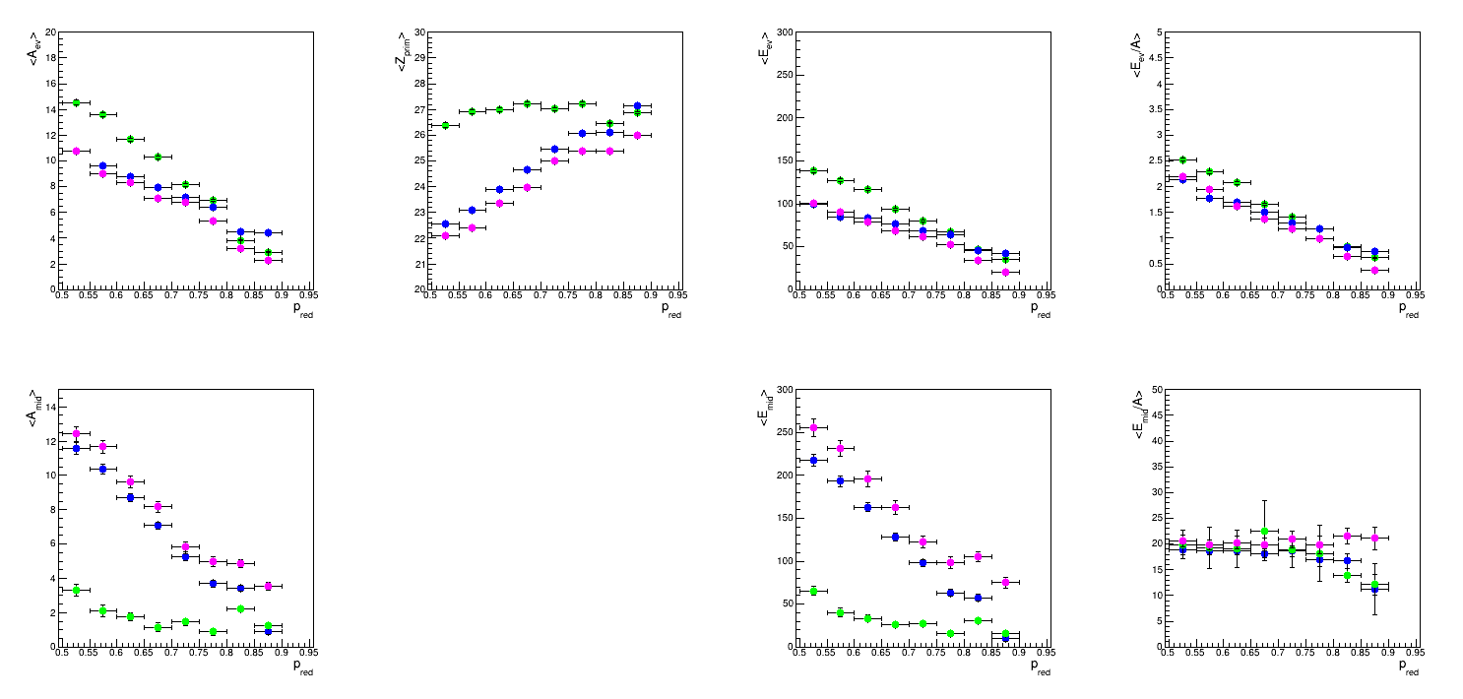
Evaporative and midvelocity emissions
exp
QPr channel
<A_{ev}> vs p_{red}
<Z_{QP*}> vs p_{red}
<E_{ev}> vs p_{red}
<E_{ev}>/ <A_{QP*}> vs p_{red}
32 AMeV
52 AMeV
74 AMeV
Evaporative component
it evolves with energy
it evolves with centrality
<E*/A> of the QP* evolves with the centrality of the reaction and almost independent of the incident energy (thermal scaling)
Midvelocity component
it evolves with energy
t evolves with centrality
the energy density is independent of both centrality and incident energy (non-thermal behaviour)
<A_{mid}> vs p_{red}
<E_{mid}> vs p_{red}
<E_{mid}>/ <A_{mid}> vs p_{red}

Slide 30
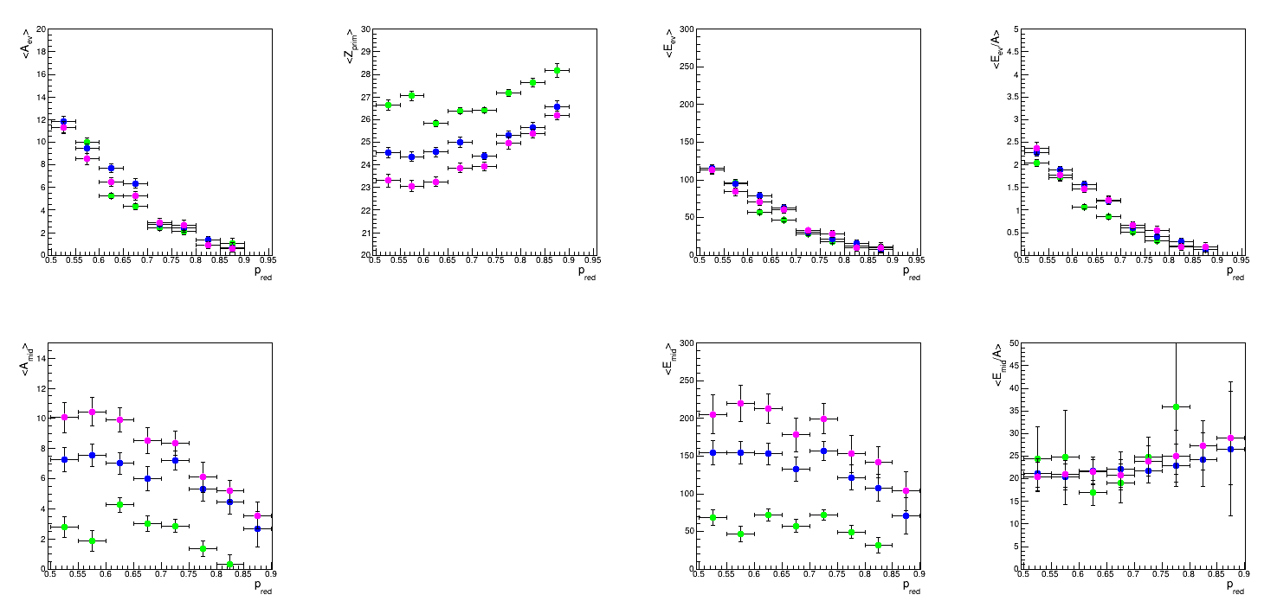
Evaporative and midvelocity emissions
exp
QPb channel
very first investigation of this type in this channel
<A_{ev}> vs p_{red}
<Z_{QP*}> vs p_{red}
<E_{ev}> vs p_{red}
<E_{ev}>/ <A_{QP*}> vs p_{red}
Evaporative component
it evolves with energy
it evolves with centrality
<E*/A> of the QP* evolves with the centrality of the reaction and almost independent of the incident energy (thermal scaling)
Midvelocity component
it evolves with energy
t evolves with centrality
the energy density is independent of both centrality and incident energy (non-thermal behaviour)
32 AMeV
52 AMeV
74 AMeV
<A_{mid}> vs p_{red}
<E_{mid}> vs p_{red}
<E_{mid}>/ <A_{mid}> vs p_{red}

Slide 31
Evaporative and midvelocity emissions
AMD+GEMINI++
To validate our procedure we can compare the results obtained from the calorimetry with those obtained by the investigation on the separation time (i.e. direct model output without "artifacts")
NOTE the different centrality parameter
calorimetry
500 fm/c t_{sep}
With the calorimetry we obtain something in between tsep and 500 fm/c

Slide 32
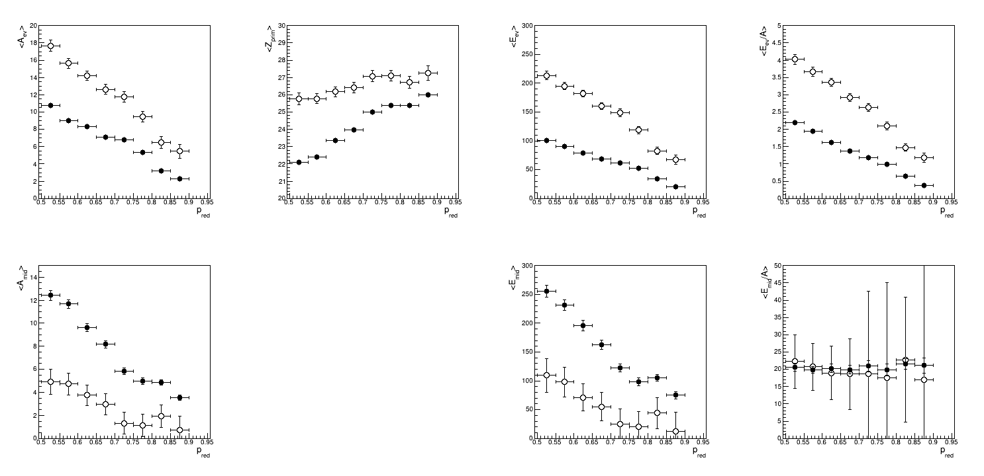
Evaporative and midvelocity emissions
exp vs AMD+GEMINI++
QPr channel
● exp
○ simul
At 74 AMeV (and at 52 AMeV) AMD+GEMINI++ predicts a hotter QP, resulting in the production of more evaporated particles
Correlated to that, the exp data show more "dynamical" emission (larger yield). Interestingly the energy density of the midveleocity emission is well reproduced by AMD
74 AMeV

Slide 33
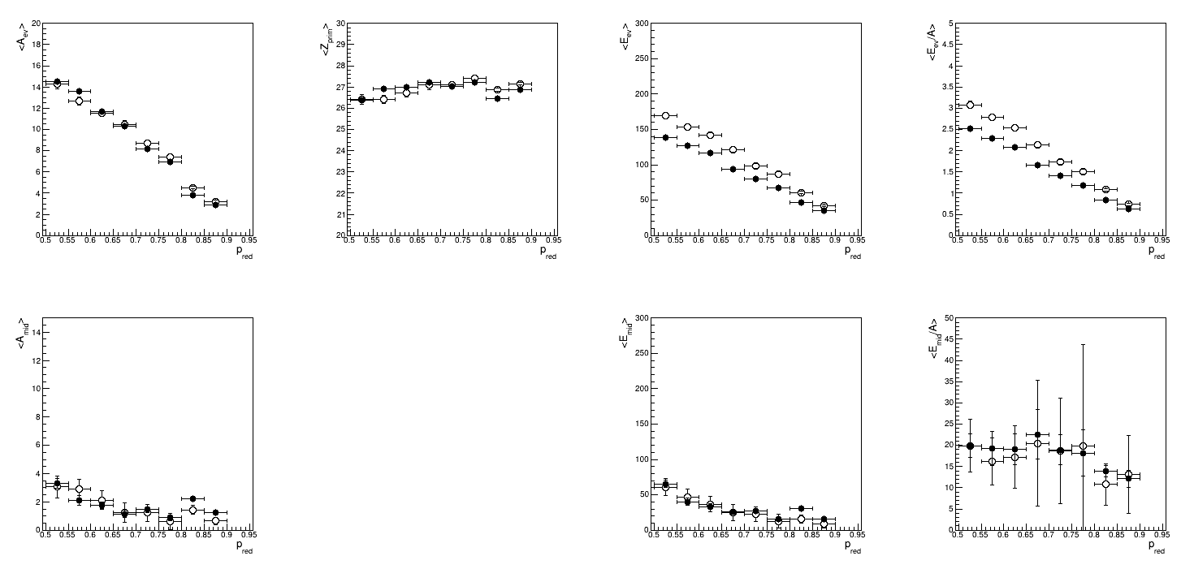
Evaporative and midvelocity emissions
exp vs AMD+GEMINI++
QPr channel
● exp
○ simul
At 32 AMeV the AMD+GEMINI++ results are in much better agreement with the experimental ones
32 AMeV

Slide 34
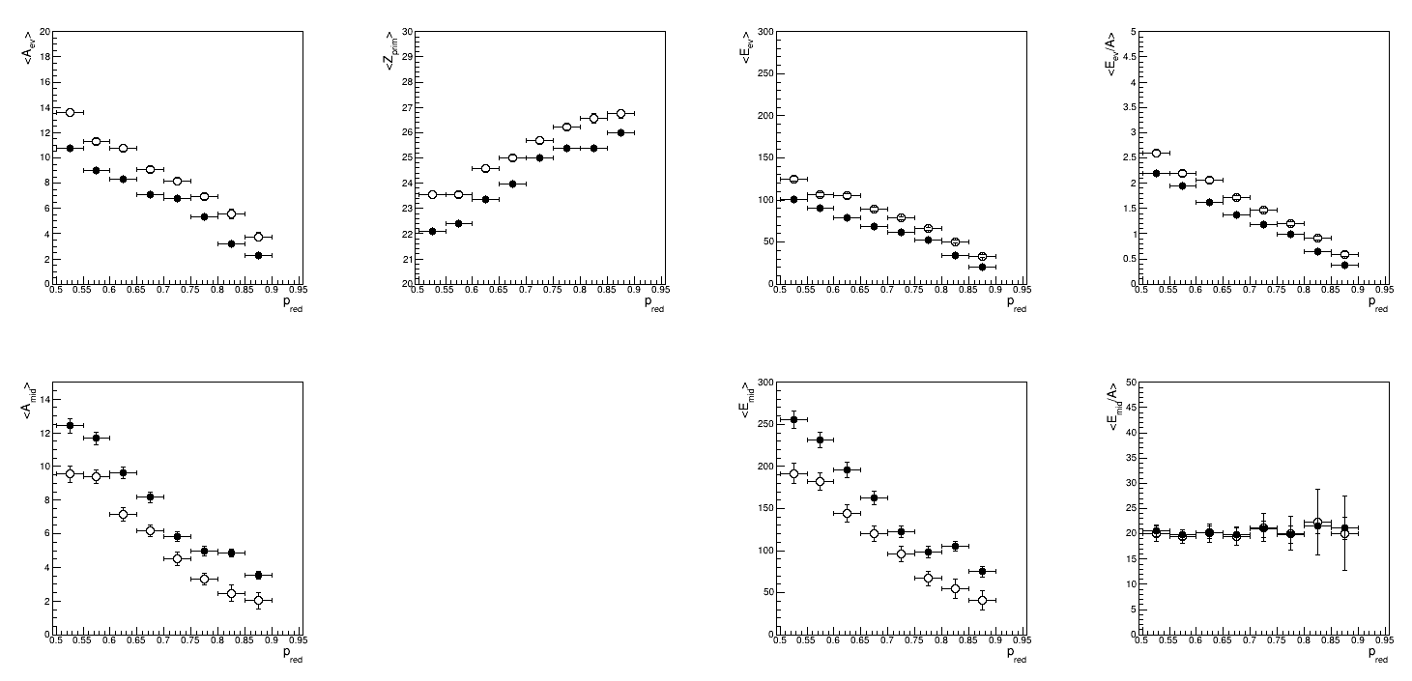
Evaporative and midvelocity emissions
exp vs exp
Efficiency correction with AMD+GEMINI++ vs HIPSE
QPr channel
● exp corr with AMD
○ exp corr with HIPSE
74 AMeV
good reconstruction of the initial projectile in both cases
the different efficiency correction leads to differences in the estimation of the evaporative and midvelocity components
discrepancies within 2 mass units
the efficiency correction has an effect on the results
the overall conclusions remain unchanged

Slide 35
Conclusions
Study of the reaction dynamics
the largest differences are observed between 32 AMeV and 52 AMeV, while above the reaction dynamics shows only slight differences
neutron enrichment of the midvelocity component
separation of the evaporative and midvelocity components
The evaporative emission by a thermal source seems a firm conclusion for QP, independent of the final state
Midvelocity emission is scarce at 32 and is sizable at 52 and 74 AMeV
The AMD+GEMINI++ reproduces well the QP characteristics, but predicts less midvelocity emission than observed experimentally
Future perspectives
Further investigation of the evaporative and mid-velocity components
isospin content of the ev and mid
apparent temperature of these sources with Maxwellian fit on the kinetic energy spectra to reinforce the calorimetric results
see effect of introducing IED inefficiency on the calorimetric results
Break up channel
origin: dynamical or statistical
Multifragmentation channel (see Remi's talk for ArNi)

