Slide 1

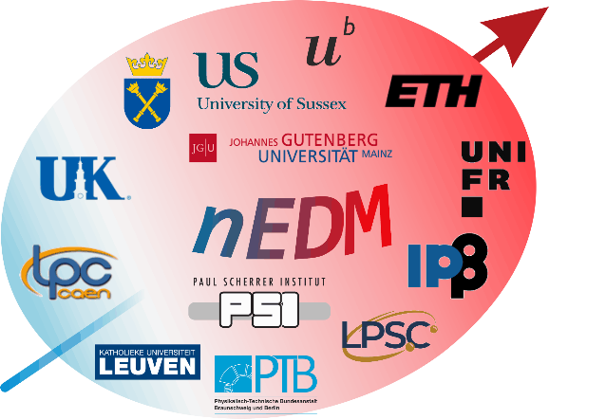

Ultra Cold Neutrons and mercury spins in magnetic fields. n2EDM experiment
Morgan Ferry, Katia Michielsen
LPSC (Grenoble)
13th November 2025

Slide 2
I - Context

Slide 3
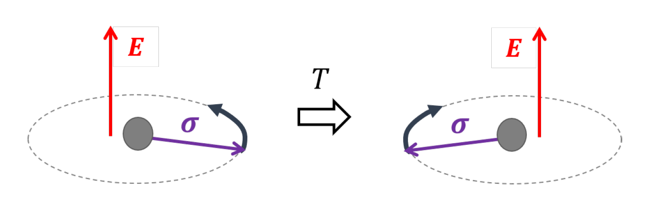
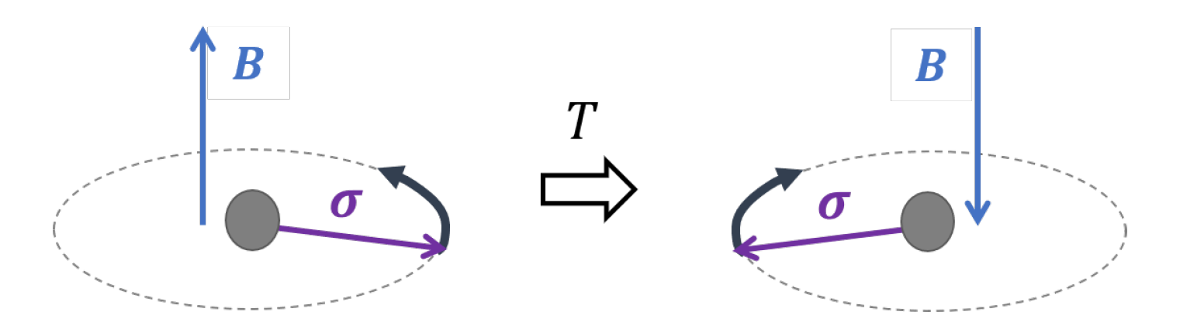
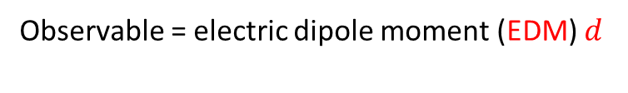

What is an EDM ?
I - Context
Coupling of the spin to the magnetic field
Coupling of the spin to the electric field
Observable = magnetic moment $μ$
Observable = electric dipole moment (EDM) $d$

Slide 4




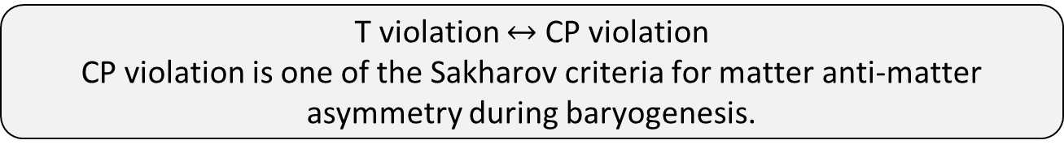

An EDM violates Charge Parity symmetry.
I - Context
Coupling of the spin to the magnetic field
Coupling of the spin to the electric field
Observable = magnetic moment $μ$
Observable = electric dipole moment (EDM) $d$
$$μ>0$$
$$μ>0$$
$$d>0$$
$$d<0$$
T-invariant
not T-invariant
T violation $↔$ CP violation
CP violation is one of the Sakharov criteria for matter anti-matter asymmetry during baryogenesis.

Slide 5
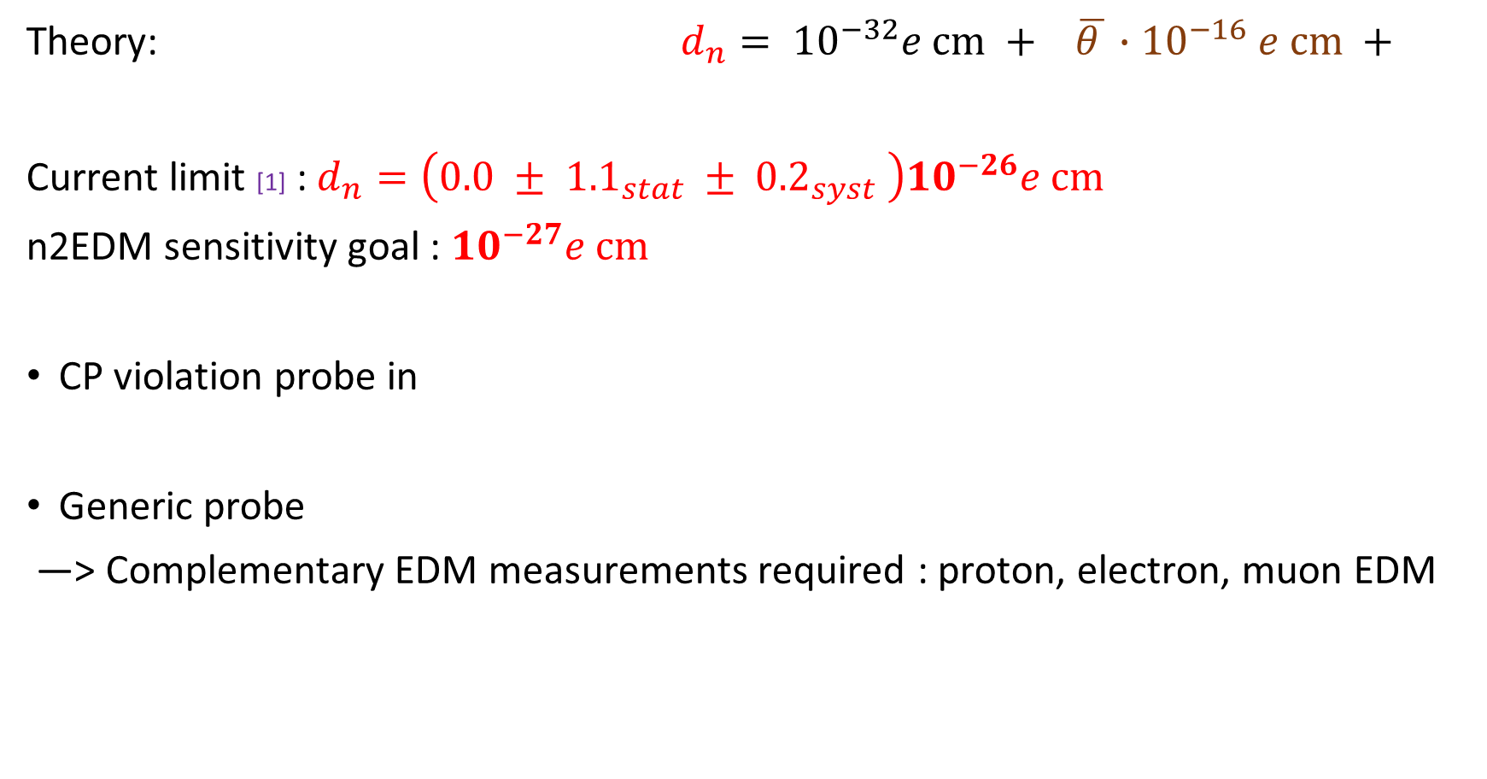

What do we know about the nEDM?
I - Context
Theory: $d_{n}= {10}^{−32}e cm + \overline{θ }∙{10}^{−16} e cm +$
Current limit [1] : $d_{n}=\left(0.0 ± {1.1}_{stat} ± {0.2}_{syst} \right){10}^{−26}e cm$
n2EDM sensitivity goal : ${10}^{−27}e cm$
CP violation probe in
Generic probe
—> Complementary EDM measurements required : proton, electron, muon EDM
weak interaction
strong interaction
new physics?
strong sector : $\overline{θ}<{10}^{−10}$ “strong CP problem”—> introduction of axion
new physics with mass scale of > 1 PeV (EFT)
[1] : Measurement of the Permanent Electric Dipole Moment of the Neutron, nEDM collaboration, 2020

Slide 6
II – n2EDM overview

Slide 7
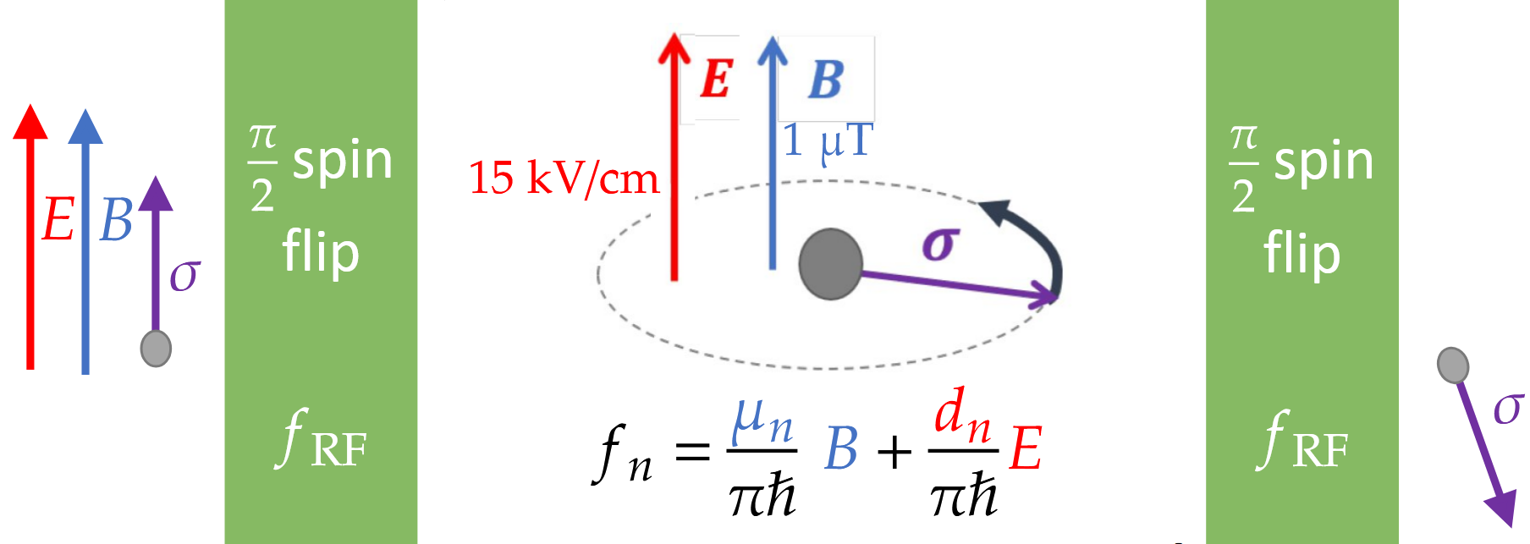

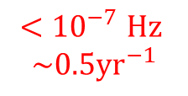


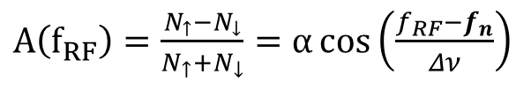
Larmor precession frequency measurement
I – Context II – n2EDM overview
Ramsey method of oscillatory fields : 2 spin flips
Measure in a known magnetic field and strong electric field.
Free precession duration T=180s
Spin Asymmetry :
$A\left(f_{RF}\right)=\frac{N_{↑}−N_{↓}}{N_{↑}+N_{↓}}=α\cos\left(\frac{f_{RF}−f_{n}}{Δν}\right)$
Number of neutrons spin aligned/anti-aligned with B
$σ\left(f_{n}\right)=\frac{1}{2παT\sqrt{N}}∼{10}^{−6}$ Hz
$$\sim 30Hz$$
$${<10}^{−7}Hz$$
$${\sim 0.5yr}^{−1}$$

Slide 8
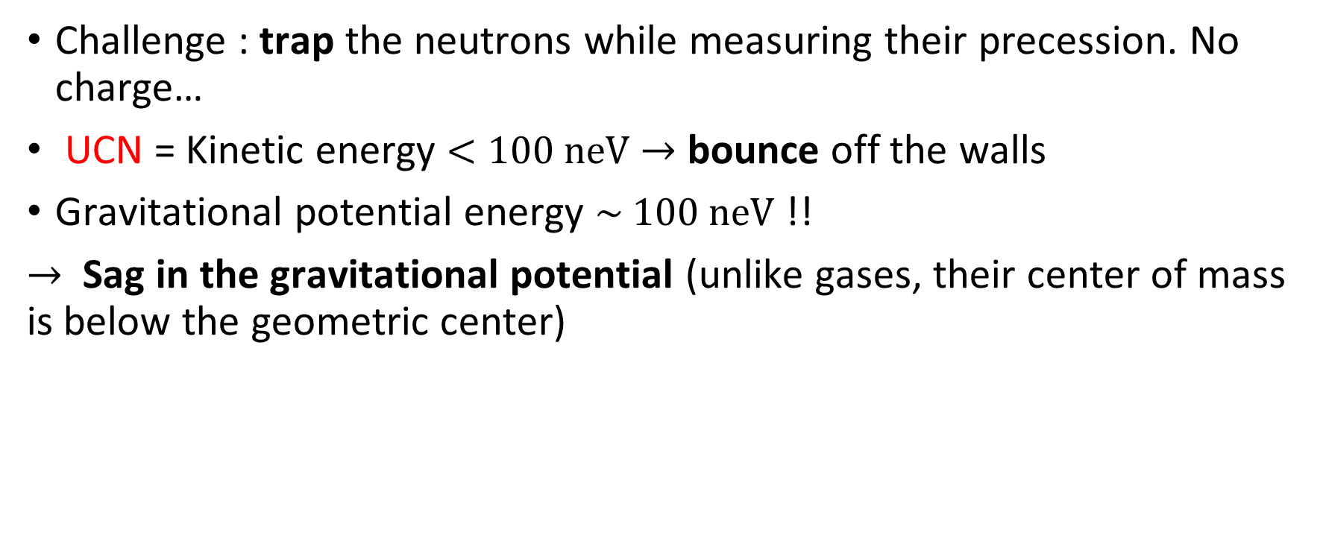

The use of Ultra Cold Neutrons (UCN)
I – Context II – n2EDM overview
Challenge : trap the neutrons while measuring their precession. No charge…
UCN = Kinetic energy $<100 neV$ $→$ bounce off the walls
Gravitational potential energy $\sim 100 neV$ !!
$→$ Sag in the gravitational potential (unlike gases, their center of mass is below the geometric center)
Precession chamber
Center of mass shift $〈z〉<0$
UCNs

Slide 9
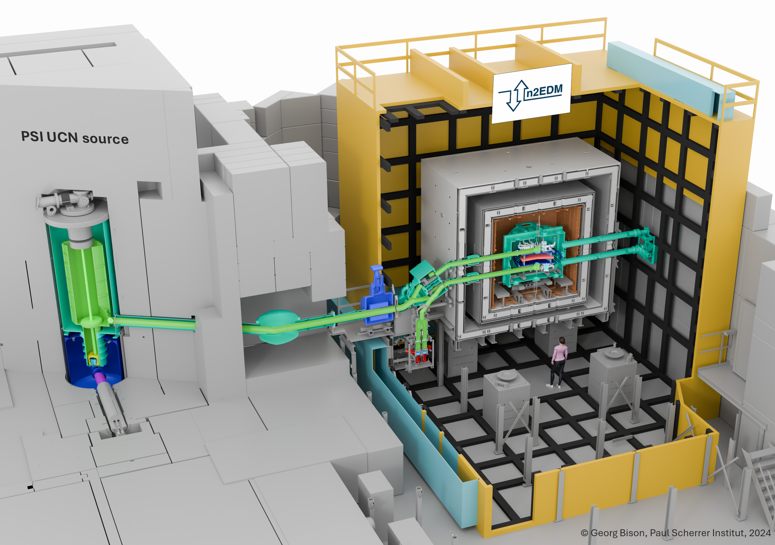
I – Context II – n2EDM overview
Active magnetic shield
Passive magnetic shield
Superconducting
magnet
Switch
Vacuum vessel
UCNs
Solid D
Proton beam on Pb target
UCN spin detectors

Slide 10
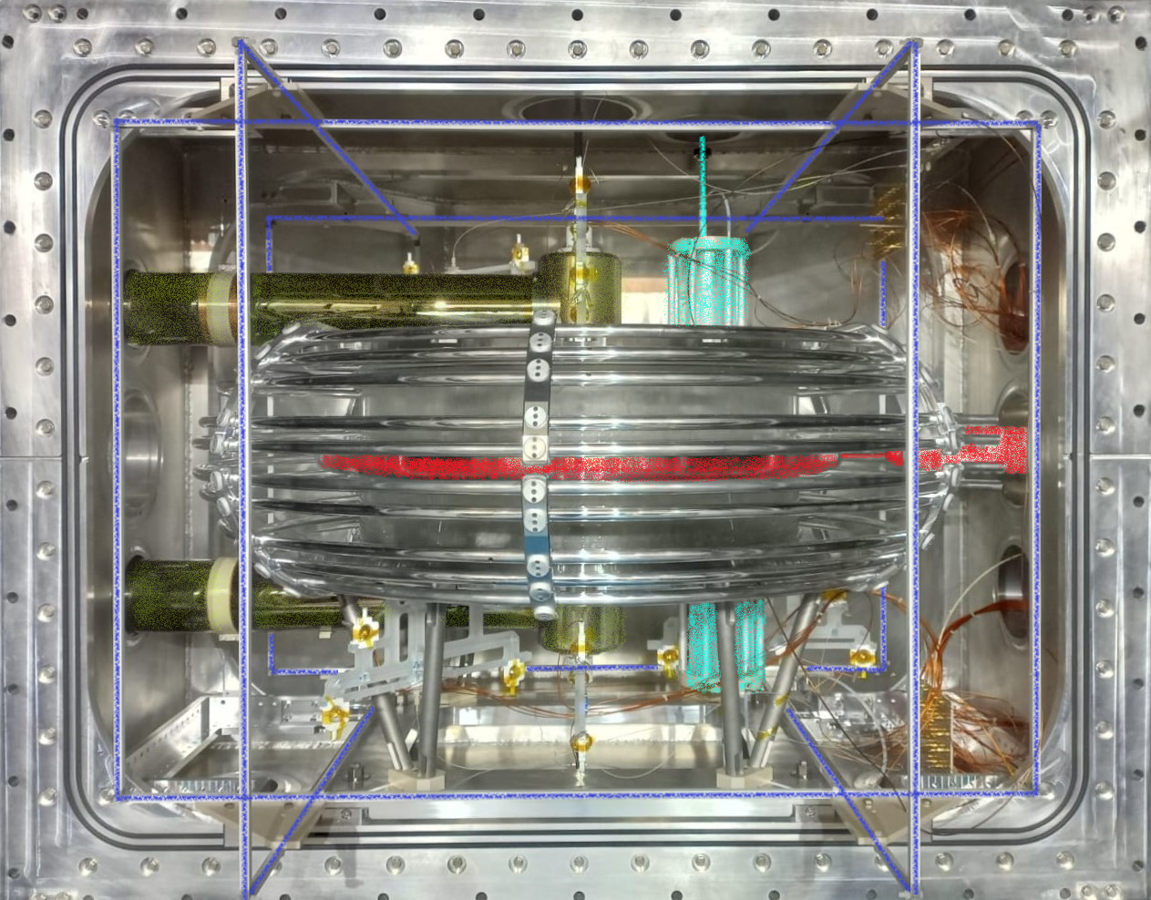
Experiment overview
I – Context II – n2EDM overview
Hg polarisation
chamber
2 precession chambers :
UCN guide
TOP
Ground cage
HV electrode
BOTTOM
Cs cells
Spin flip coils

Slide 11
III- The Hg co-magnetometer
Concept, setup and performances.

Slide 12
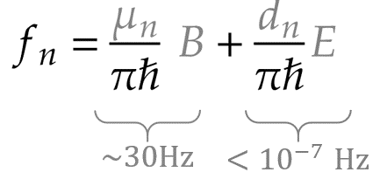
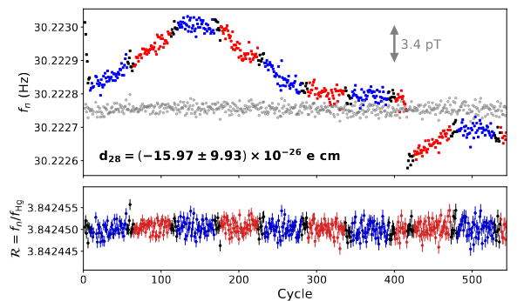
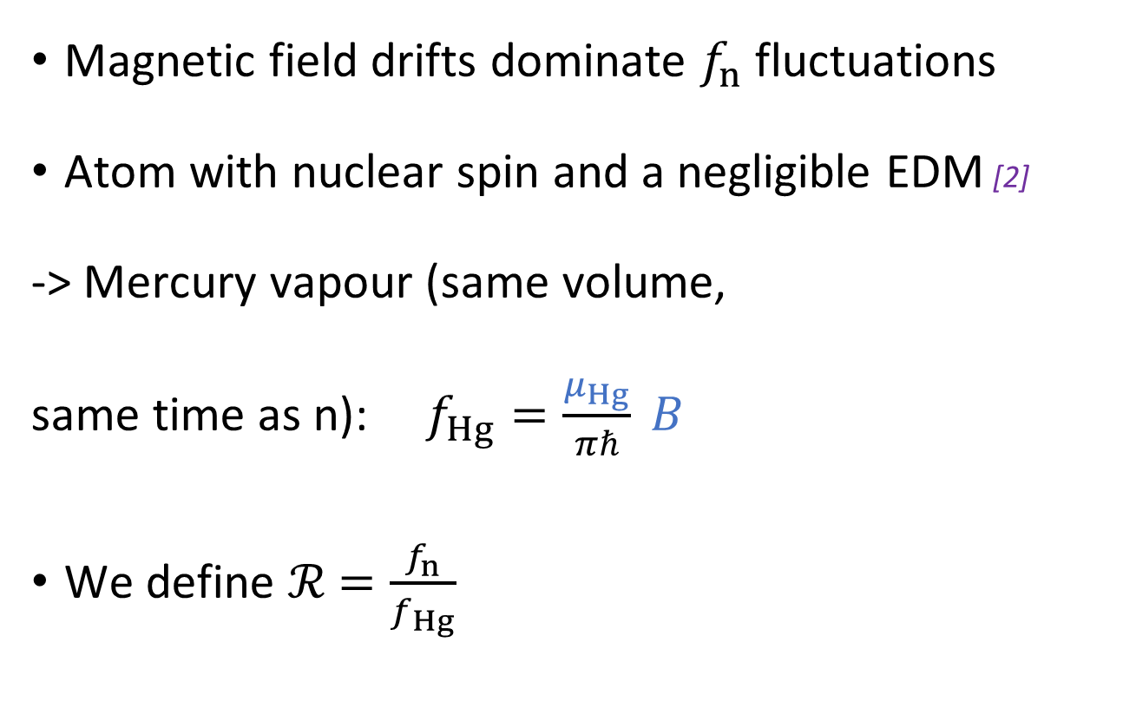
Why do we need a co-magnetometer?
I – Context II – n2EDM overview III – Hg co-magnetometer
Magnetic field drifts dominate $f_{n}$ fluctuations
Atom with nuclear spin and a negligible EDM [2]
-> Mercury vapour (same volume,
same time as n): $f_{Hg}=\frac{μ_{Hg}}{πℏ} B$
We define $ℛ$ $=\frac{f_{n}}{f_{Hg}}$
L. Ferraris, 2020
[2] Reduced limit on the permanent electric dipole moment of Hg 199. Graner, Brent, et al. PRL (2016) :Hg EDM ${|d}_{Hg}|<{7,4 10}^{−30} e$ cm

Slide 13
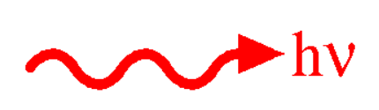






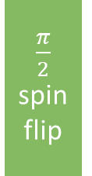

Hg magnetometry concept in n2EDM
I – Context II – n2EDM overview III – Hg co-magnetometer
Polarized Hg
Hg precession
$\frac{π}{2}$ spin flip
$$B$$
$$f_{Hg}=\frac{μ_{Hg}}{πℏ} B$$
$$σ$$
T =180 s
Optical pumping
Precession
time
relevant$^{199}Hg$ quantum states
relevant$^{199}Hg$ quantum states
Excited states
-1/2
1/2
Excited states
-1/2
1/2
Absorption/transmission modulated at the precession frequency.
spin 1
spin 1
Ground states
Ground states
1/2
-1/2
1/2
$$B$$
-1/2
$$B$$

Slide 14
Hg magnetometry implementation in n2EDM
I – Context II – n2EDM overview III – Hg co-magnetometer
Optical fiber
Polarising optics
Optical fiber
Polarisation cells
Monitor
photo-diode
Precession chambers
UV probe light
circular
polarization
Probe
photo-diodes
Optical tower
Vacuum vessel
UV pump light
Optical fiber

Slide 15
Hg magnetometry implementation in n2EDM
I – Context II – n2EDM overview III – Hg co-magnetometer
Optical fiber
Hg vapour is polarised prior to injection
Polarising optics
Polarisation chamber
Optical fiber
Monitor
photo-diode
Precession chambers
UV probe light
circular
polarization
Probe
photo-diodes
Optical tower
Vacuum vessel
UV pump light
Optical fiber

Slide 16
Hg magnetometry implementation in n2EDM
I – Context II – n2EDM overview III – Hg co-magnetometer
Optical fiber
Hg vapour is polarised prior to injection
Hg and neutron precession occur simultaneously
Polarising optics
Polarisation chamber
Optical fiber
Monitor
photo-diode
Precession chambers
UV probe light
circular
polarization
Probe
photo-diodes
Optical tower
Vacuum vessel
UV pump light
Optical fiber

Slide 17

Hg magnetometry implementation in n2EDM
I – Context II – n2EDM overview III – Hg co-magnetometer
Optical fiber
Hg vapour is polarised prior to injection
Hg and neutron precession occur simultaneously
Modulated transmitted light is continuously recorded.
Polarising optics
Polarisation chamber
Optical fiber
Monitor
photo-diode
Precession chambers
UV probe light
circular
polarization
Probe
photo-diodes
Optical tower
Vacuum vessel
UV pump light
$$f_{Hg}=\frac{μ_{Hg}}{πℏ} <B>$$
Optical fiber

Slide 18
Optical reading of Hg precession
I – Context II – n2EDM overview III – Hg co-magnetometer
Optical fiber
nEDM: Circularly polarised probe.
One signal per chamber.
Polarising optics
Optical fiber
Polarisation cells
Monitor
photo-diode
Precession chambers
UV probe light
circular
polarization
Probe
photo-diodes
Optical tower
Vacuum vessel
UV pump light
Optical fiber

Slide 19
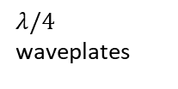
Optical reading of Hg precession
I – Context II – n2EDM overview III – Hg co-magnetometer
Optical fiber
Polarising optics
Optical fiber
Polarisation cells
Monitor
photo-diode
$λ/4$ waveplates
p polarization transmitted
Precession chambers
UV probe light
linear
polarization
circular polarization
Optical tower
s polarization
reflected
n2EDM: linearly polarised probe.
Two signals for each chamber.
Cancellation of common noise.
Vacuum vessel
Probe
photo-diodes
UV pump light
Optical fiber

Slide 20
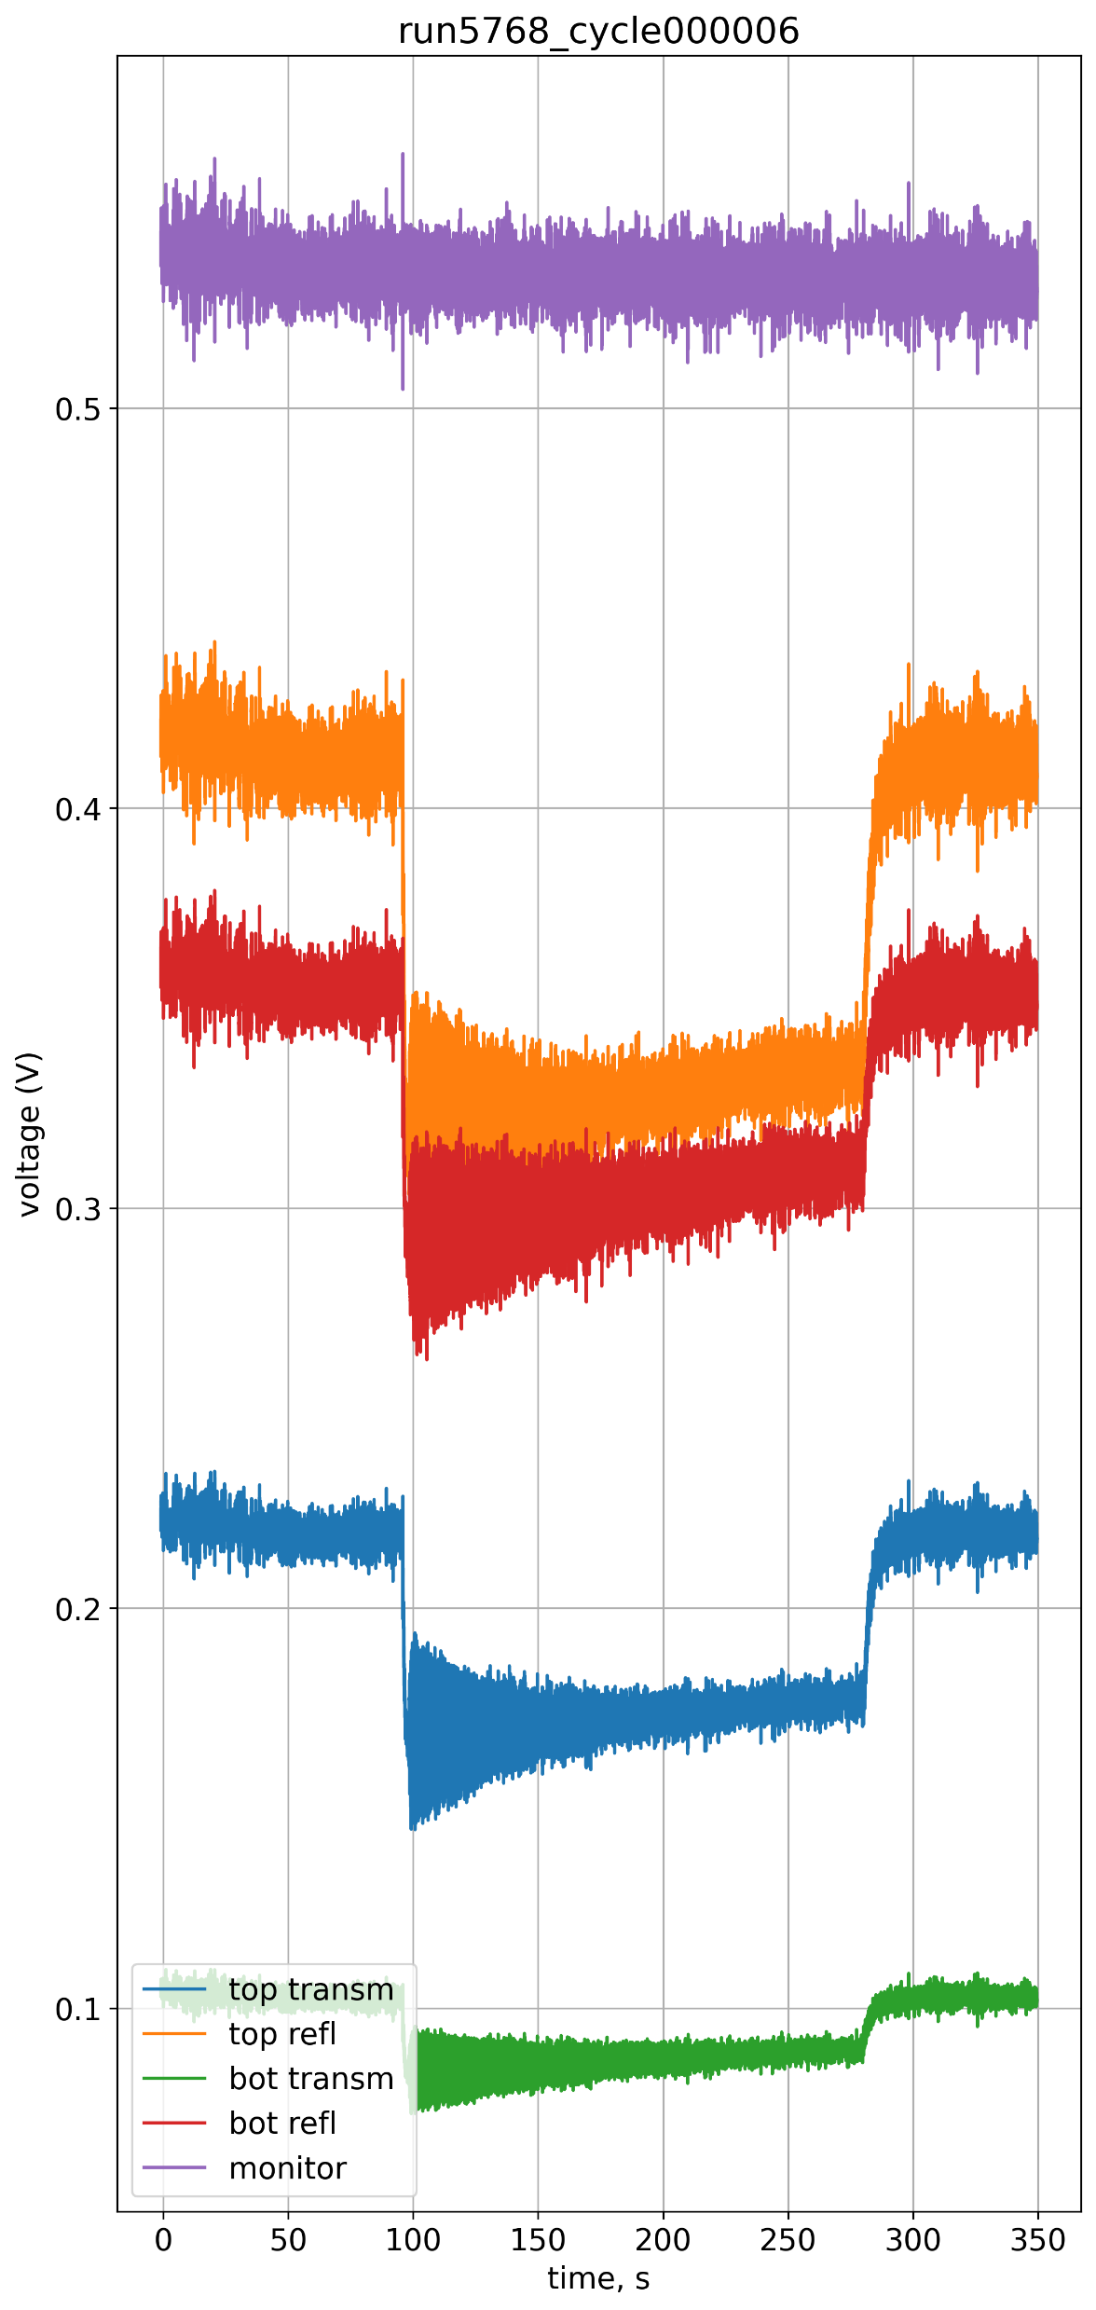
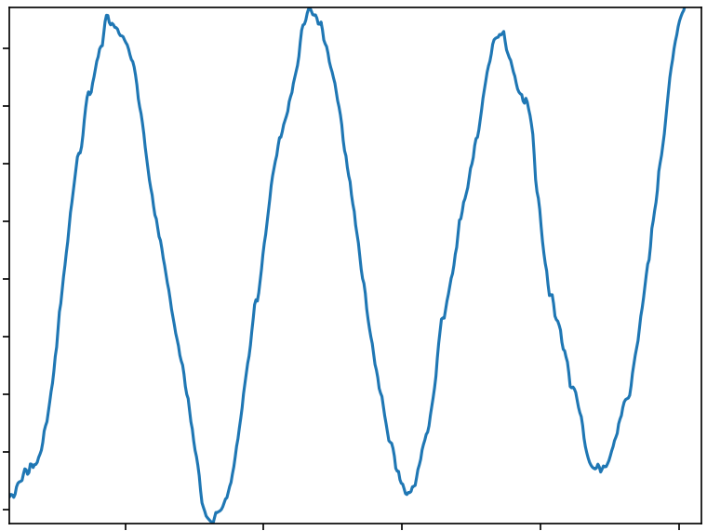
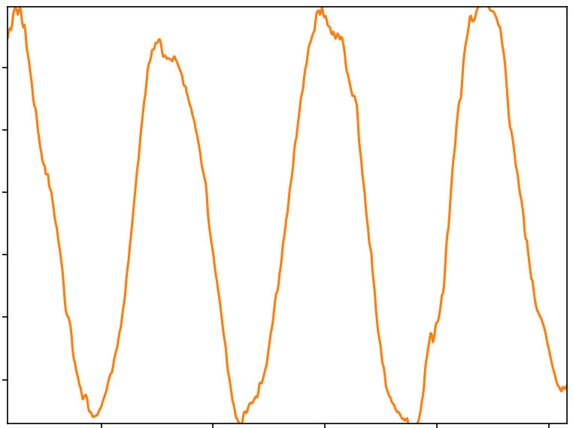
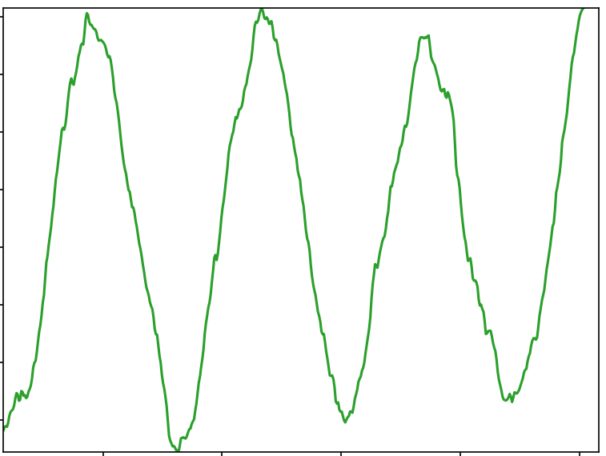
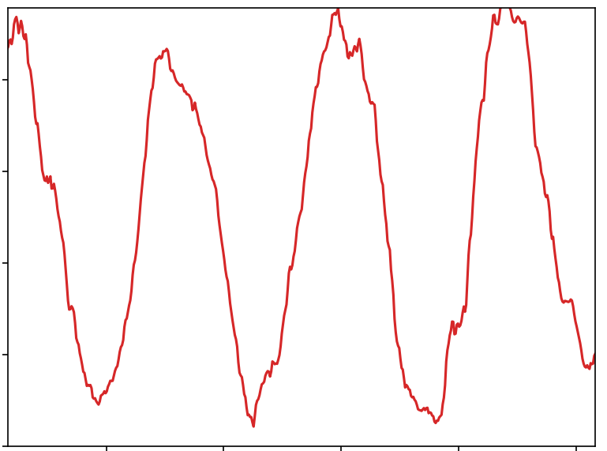




Optical reading of Hg precession
I – Context II – n2EDM overview III – Hg co-magnetometer
$^{199}Hg$ spin during precession
Excited states
-1/2
1/2
UV light
spin 1
TOP chamber
Ground states
1/2
-1/2
$$+$$
reflected
$^{199}Hg$ spin during precession
transmitted
BOT chamber
Excited states
-1/2
1/2
spin -1
reflected
transmitted
Ground states
1/2
-1/2

Slide 21
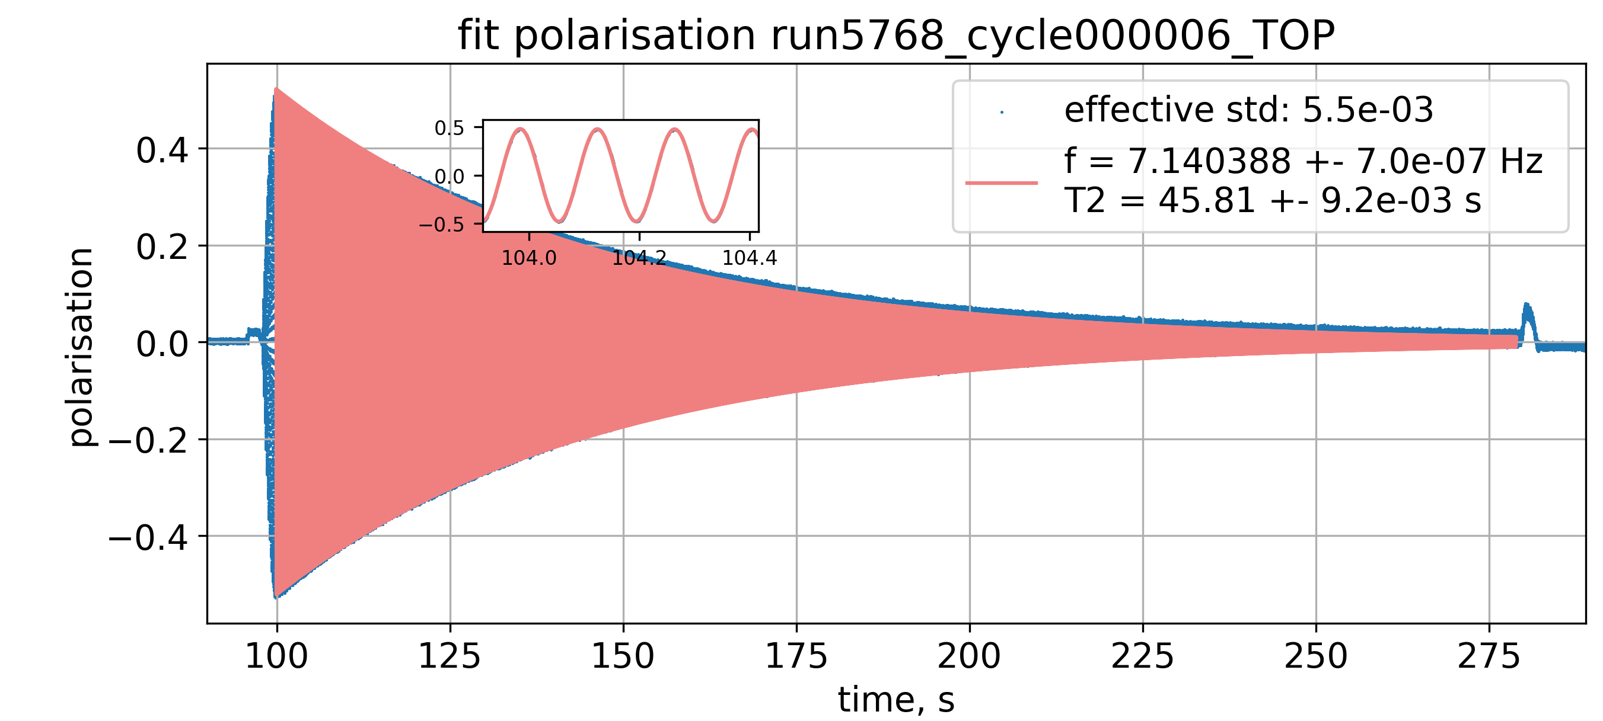
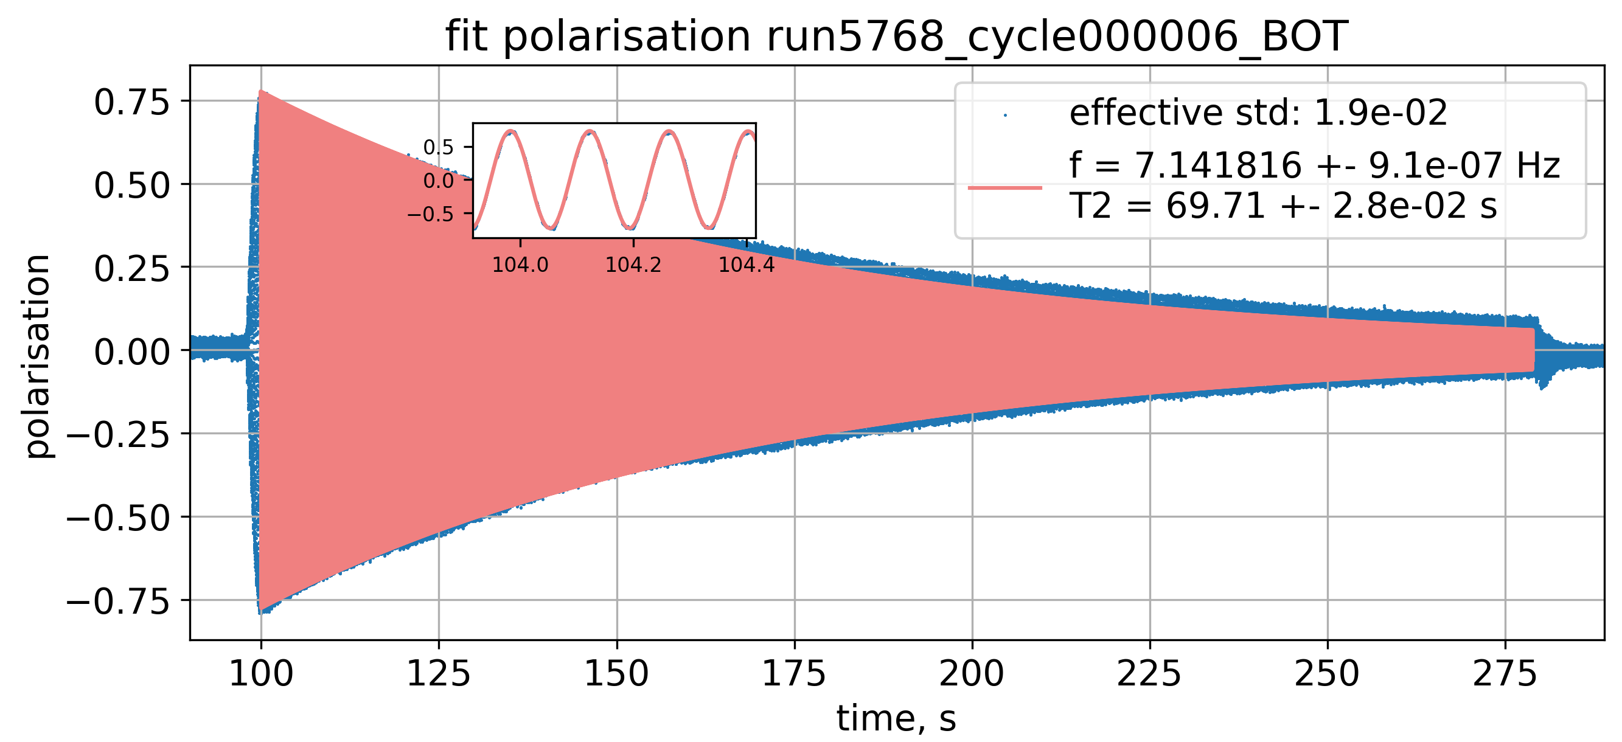
Optical reading of Hg precession
I – Context II – n2EDM overview III – Hg co-magnetometer
$^{199}Hg$ spin during precession
Excited states
-1/2
1/2
UV light
spin 1
TOP chamber
Ground states
1/2
-1/2
$$+$$
reflected
$^{199}Hg$ spin during precession
transmitted
BOT chamber
Excited states
-1/2
1/2
spin -1
reflected
transmitted
Linearly polarised probe lowered the uncertainty by a factor 3.
Ground states
1/2
-1/2

Slide 22



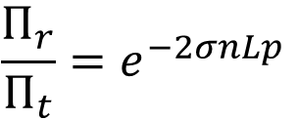
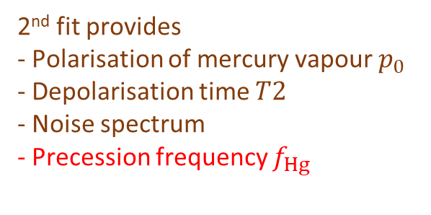
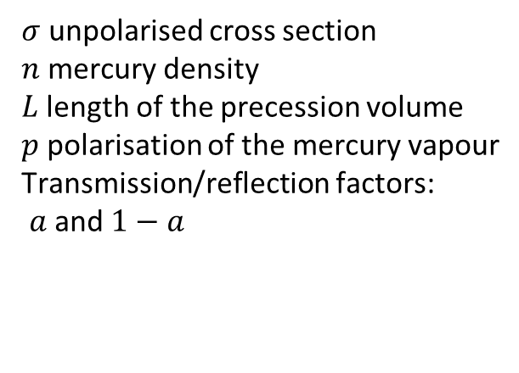
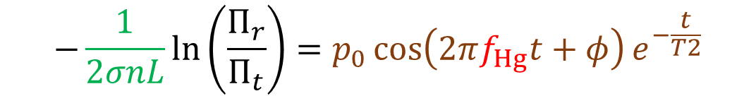


The great combination with linearly polarised light
I – Context II – n2EDM overview III – Hg co-magnetometer
Transmitted power
$$Π_{r}Π_{t}=a(1−a)e^{−2σnL}$$
Derive $σn_{0}e^{−t/T_{leak}}L$
$$Π_{t}=a Π_{0}^{ }e^{−σnL(1+p)}$$
Reflected power
$$Π_{r}=(1−a)Π_{0}^{ }e^{−σnL(1−p)}$$
$$\frac{Π_{r}}{Π_{t}}=e^{−2σnLp}$$
Derive $p$ knowing $σnL$
$σ$ unpolarised cross section
$n$ mercury density
$L$length of the precession volume
$p$ polarisation of the mercury vapour
Transmission/reflection factors:
$a$ and $1−a$
$$−\frac{1}{2σnL}\ln\left(\frac{Π_{r}}{Π_{t}}\right)=p_{0}\cos\left(2πf_{Hg}t+φ\right)e^{−\frac{t}{T2}}$$
2nd fit provides
- Polarisation of mercury vapour $p_{0}$
- Depolarisation time $T2$
- Noise spectrum
- Precession frequency $f_{Hg}$
1st fit provides
- Absorption
- Leakage time of precession chamber

Slide 23
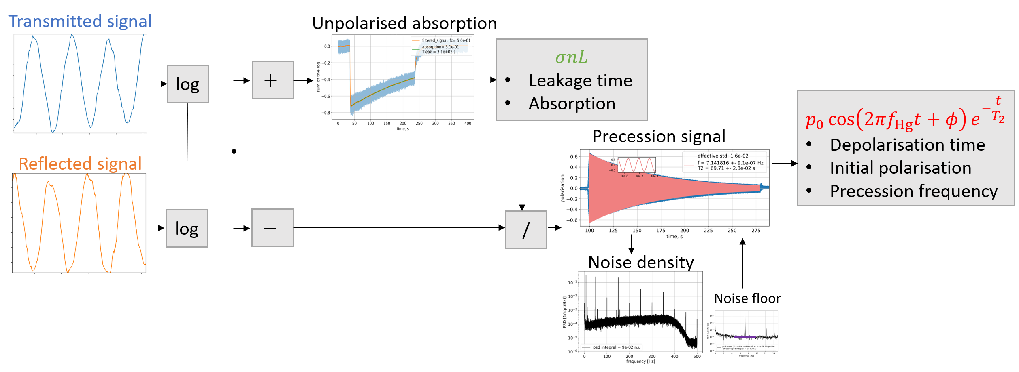
Hg precession analysis: summary
I – Context II – n2EDM overview III – Hg co-magnetometer

Slide 24


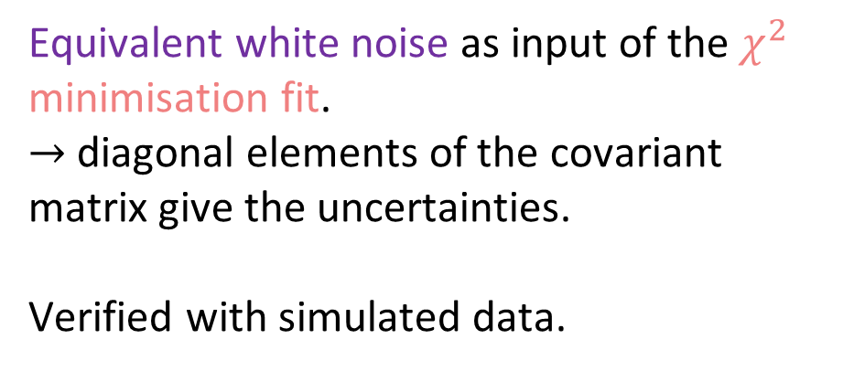
Uncertainty derivation of precession frequency
I – Context II – n2EDM overview III – Hg co-magnetometer
Philosophy: filtering without filtering
$→$ Only the noise at the frequency of the signal affects our estimator
Equivalent white noise as input of the $χ^{2}$ minimisation fit.
$→$ diagonal elements of the covariant matrix give the uncertainties.
Verified with simulated data.

Slide 25
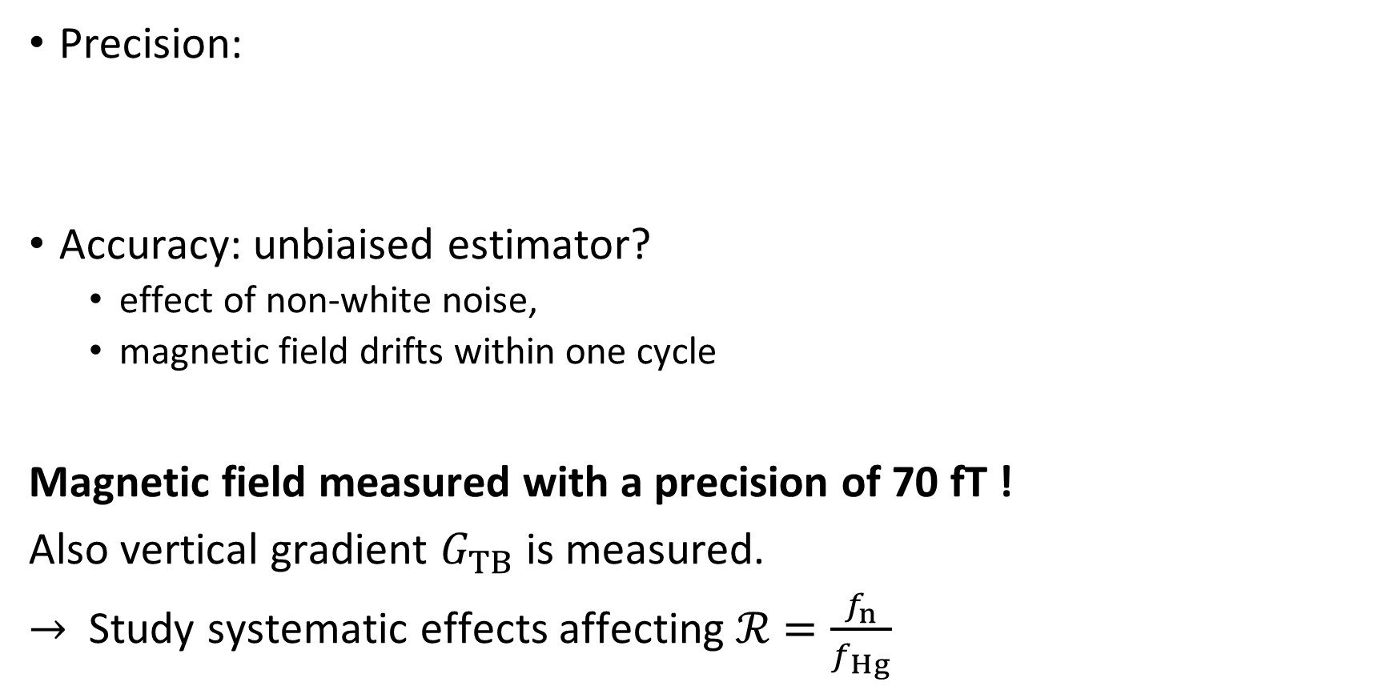
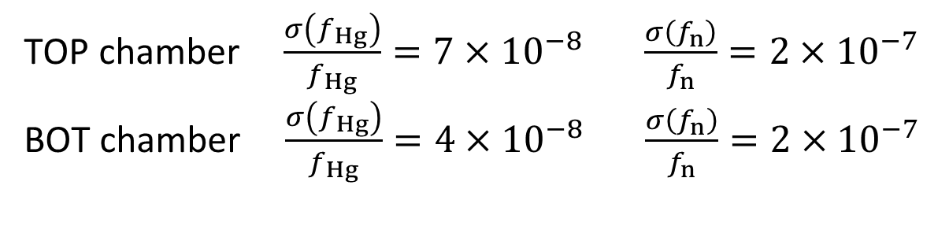
Performance of the Hg magnetometer
I – Context II – n2EDM overview III – Hg co-magnetometer
status
Precision:
Accuracy: unbiaised estimator?
effect of non-white noise,
magnetic field drifts within one cycle
Magnetic field measured with a precision of 70 fT !
Also vertical gradient $G_{TB}$ is measured.
$→$ Study systematic effects affecting $ℛ$ $=\frac{f_{n}}{f_{Hg}}$
TOP chamber $\frac{σ\left(f_{Hg}\right)}{f_{Hg}}=7×{10}^{−8}$ $\frac{σ\left(f_{n}\right)}{f_{n}}=2×{10}^{−7}$
BOT chamber $\frac{σ\left(f_{Hg}\right)}{f_{Hg}}=4×{10}^{−8}$ $\frac{σ\left(f_{n}\right)}{f_{n}}=2×{10}^{−7}$
ongoing

Slide 26
IV – Physics cases

Slide 27
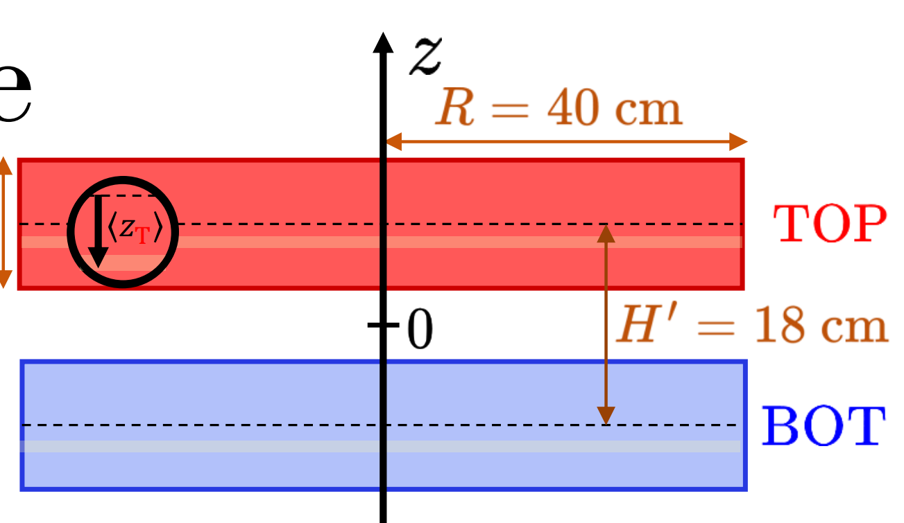
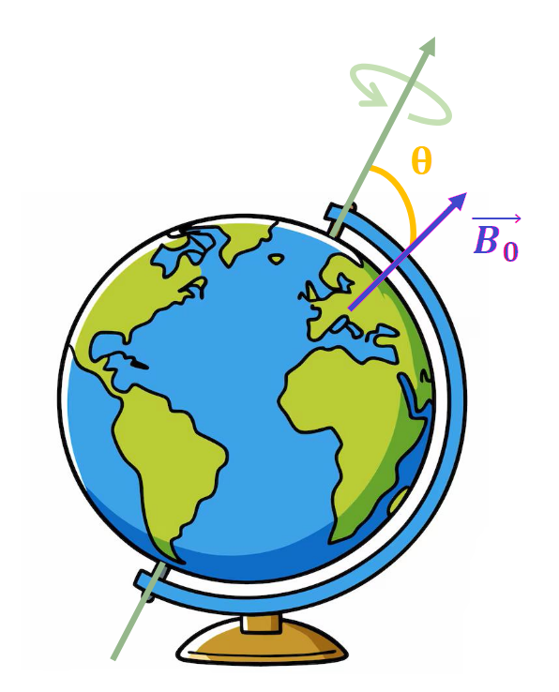


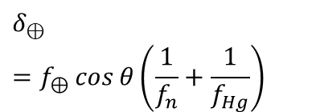
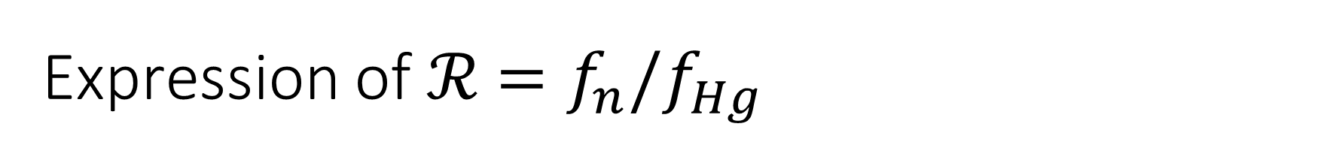

Expression of $ℛ$ $=f_{n}/f_{Hg}$
I – Context II – n2EDM overview III – Hg co-magnetometer IV - Physics cases
Gravitational shift effect :
${ℛ_{T,B}^{↑,↓}}_{ }=\frac{γ_{n}}{γ_{Hg}}\left[1+\frac{\left\langle z_{T,B}\right\rangle }{B}G_{TB}∓δ_{⊕}\right]$
At first order, $ℛ \sim \frac{γ_{n}}{γ_{Hg}}$
...but there are some minor corrections that depend on :
$G_{TB}$ : vertical magnetic gradient
Chamber $TOP, BOT$
$B$ orientation $↑,↓$
$${\sim 10}^{−7}$$
$${\sim 10}^{−6}$$
Earth rotation effect :
neutron & Hg gyromagnetic ratios
$$δ_{⊕}=f_{⊕}\cos{θ\left(\frac{1}{f_{n}}+\frac{1}{f_{Hg}}\right)}$$

Slide 28
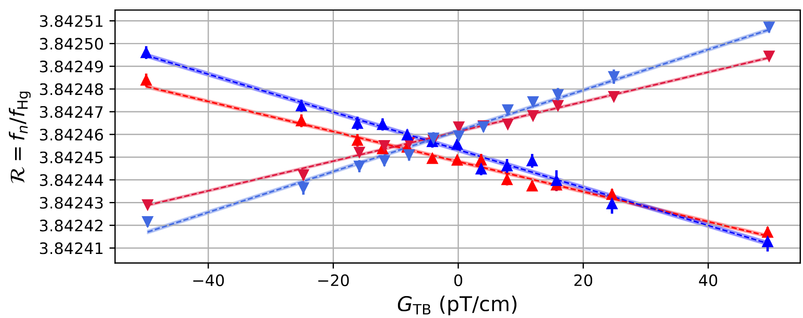
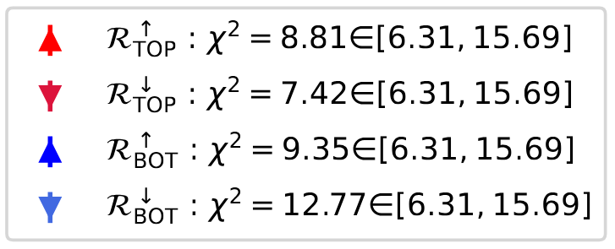
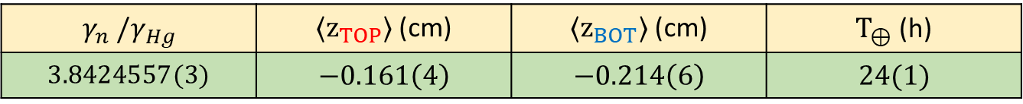

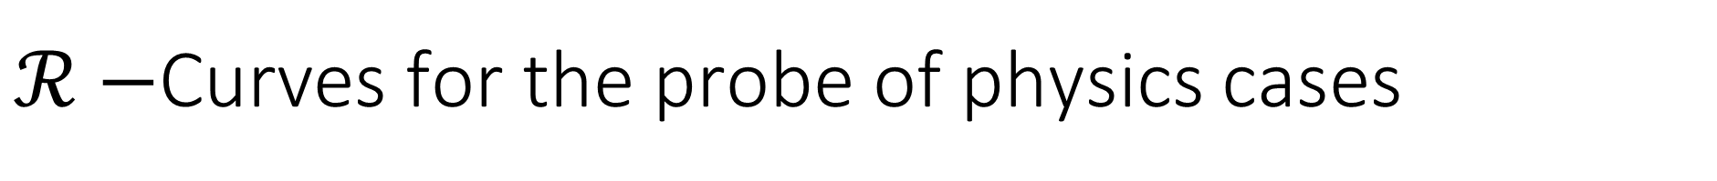
$ℛ−$Curves for the probe of physics cases
I – Context II – n2EDM overview III – Hg co-magnetometer IV - Physics cases
$ℛ−$ Curves : ${\begin{aligned}ℛ_{T,B}^{↑,↓}=\frac{γ_{n}}{γ_{Hg}}\frac{\left\langle z_{T,B}\right\rangle }{B}G_{TB}+\frac{γ_{n}}{γ_{Hg}}(1∓δ_{⊕}) \\ \end{aligned}}_{ }$
d
Measure $ℛ_{T,B}^{↑,↓}$ for different values of $G_{TB}$ (coils) for each chamber and B $↑,↓$
$= a_{T,B}{ G}_{TB}+ b^{↑,↓}$ $→$ 4 affine functions $ℛ_{TOP}^{↑}$,${ ℛ}_{TOP}^{↓}$,${ ℛ}_{BOT}^{↑}$,${ ℛ}_{BOT}^{↓}$ VS $G_{TB}$
$$γ_{n} /γ_{Hg}$$ | ${〈z}_{TOP}〉$(cm) | ${〈z}_{BOT}〉$ (cm) | $T_{⊕}$ (h)
$$3.8424557(3)$$ | $$−0.161\left(4\right)$$ | $$−0.214\left(6\right)$$ | $$24(1)$$
Compatible with [1]
Compatible with [2]
[1] : A measurement of the neutron to 199Hg magnetic moment ratio, nEDM collaboration, 2014
[2] : Ultracold neutron energy spectrum and storage properties from magnetically induced spin depolarization, n2EDM collaboration, 2025

Slide 29
Conclusion
First data-set not limited by Hg uncertainty
Gravitational shift and Earth rotation measurements
Newer of more precise data —> access to new systematic effects
nEDM data taking at the end of 2025

Slide 30
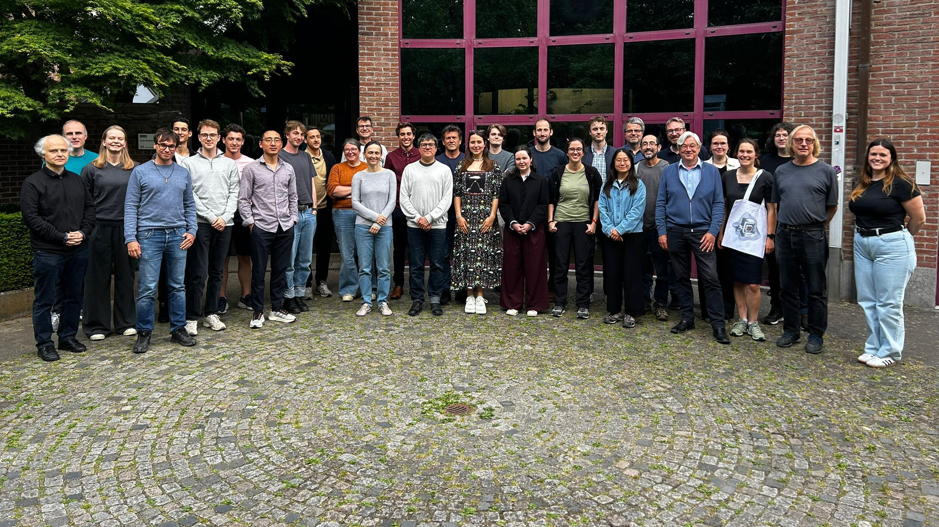
Thank you for your attention!
Questions?

Slide 31
Additional slides

Slide 32
n2EDM status and outlook
I – Context II – n2EDM overview III – Hg co-magnetometer IV – Conclusion
UCN production, detection, polarization, spin transport
Magnetic shielding and characterization
Magnetic field generation and characterization
Electric field
Hg co-magnetometer injection, polarization, optical reading
Cs magnetometers installation, polarisation & optical reading
Operational
Not yet operational
2025
n and Hg
2025
EDM test run
2026
systematics
2026
EDM
2027-2028
Accelerator shutdown
2029-Magic EDM
Today
Neutrons available
Neutrons unavailable

Slide 33

n2EDM Experiment overview
Vacuum vessel with
Precession chambers
Superconducting
magnet
UCN source

Slide 34
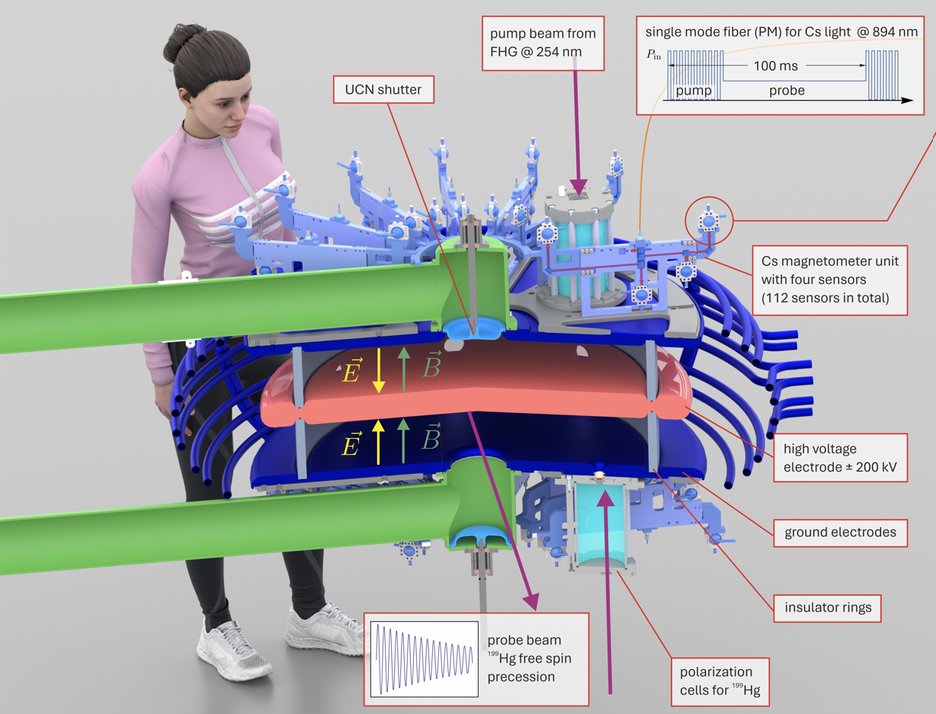
n2EDM Experiment overview

Slide 35
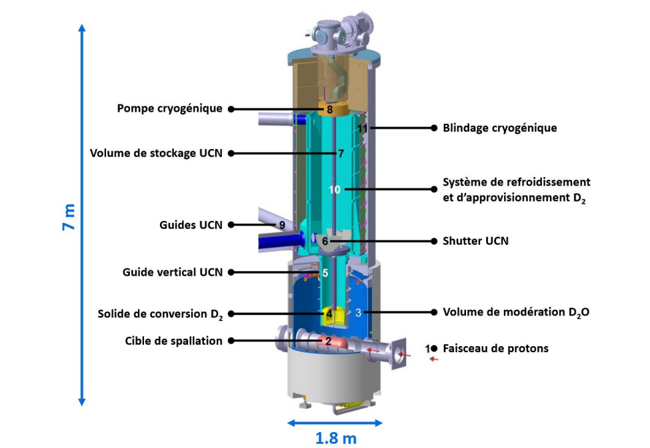
UCN production

Slide 36
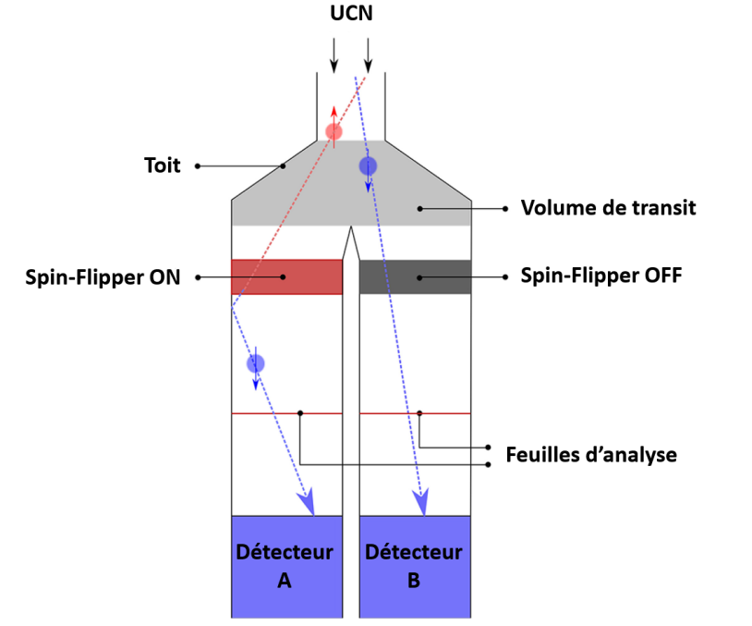
UCN spin detectors

Slide 37
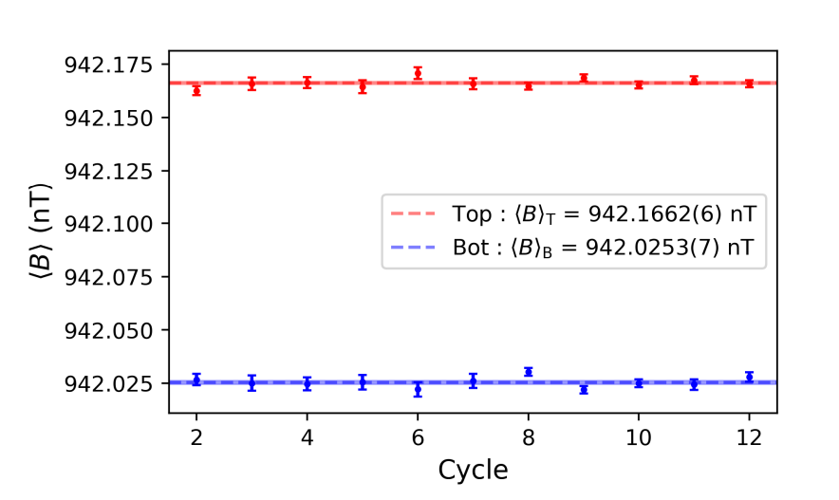
Magnetic field measurement in the presence of gradient

Slide 38
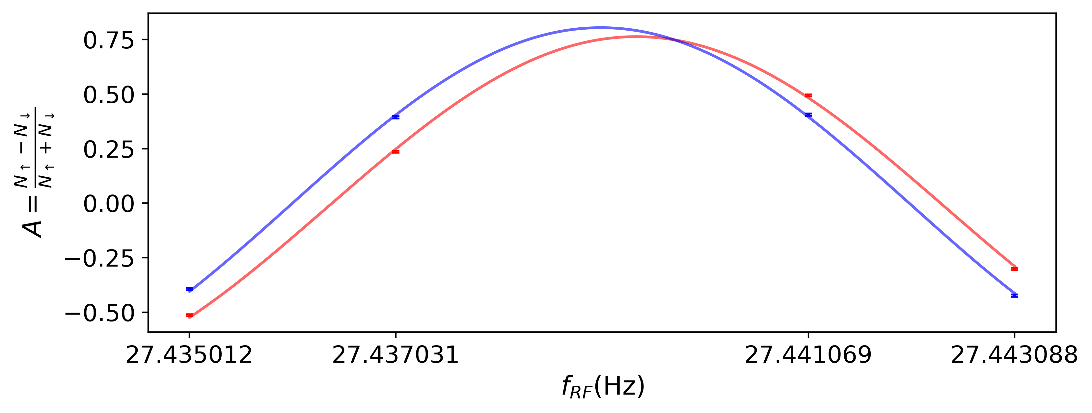


Spin asymmetry fit
$$A=\frac{{N_{↑}−N}_{↓}}{N_{↑}+N_{↓}}=αcos⁡[\frac{\left(f_{RF}−f_{n}\right)}{Δν}]$$

