Slide 1
Part. B1 – Scientific Proposal

Slide 2
1) Excellence of Science
2) Excellence of training

Slide 3
I. Excellence of Science

Slide 4
1.1 – Excellence of the Research Project and Objectives
1.1.1 – Introduction and overview
- Describing the « Big Pictures »
- Link with EU Policies
- Why is the Consortium the best to address the objectives of the project?
- Intersectoral, Interdiscplinary, cohesive point of view
- Why ? / Why now ?
- Key Specific Research and Innovation Objectives

Slide 5
1.1 – Excellence of the Research Project and Objectives
1.1.2 – Pertinence and Innovations of the Research Program
- What is the SOA and how to go beyond ?
- How do we distinguish ourselves from other similar project ?
- What is the gap existing in your research area ?
- How the project contribute to fill this gap ?

Slide 6
1.2 – Methodology
1.2.1 – Overall Methodology
- How will the Research Program allow us to achieve the Project Research Objectives?
- Explaining in details how the Research Objectives will be achieved
( Equipement, Techniques, tests…)

Slide 7
1.2 – Methodology
1.2.2 – Integration of Methodology and disciplines
- How interdisciplinary is the research Conducted ? (MSCA Keyword)
- How is the Consortium the best to address the Project Objectives
(Cohesive, Interdisciplinary, Intersectoral)
- If applicable, explain the training provided by the Associated Partners

Slide 8
1.2 – Methodology
1.2.3 – Gender Dimensions
- Are sex/gender norms embedded in the concepts, theories and models used by your
research field?
- Does the chosen methodology(ies) ensure that sex/gender are considered and investigated ?
- Will the project respect gender equality issues when it will be in progress
- Does the Recruitment procedure of the Doctoral Candidate respect gender equality ?

Slide 9
1.2 – Methodology
1.2.4 – Open Science Practices
- provide concrete information on how you plan to comply with the mandatory, and
when relevant, recommended open science (OS) practices

Slide 10
1.2 – Methodology
1.2.5 – Data Management Plan
- How the data generated will respect the FAIR Principle
( Findability, Accessibility, Interoperability, Reusable)
- Mandatory Deliverable (1 Page)

Slide 11
II - Excellence of Training

Slide 12
Training Programme – Quality & Credibility (1.3)
Good Practices
Types of Skills to Be Developed
Plan a final conference, summer schools, hybrid events, Kick-off
Encourage virtual training only as a complement
Consider ECTS credits and a Career Development Plan
Training should match recruitment and research timeline
Type of skills | Training Methods
Core scientific skills | Individual research project+local supervision
Advanced scientific skills | Network-wide events ( schools, workshop)
Transferable skills | Communication, project management, entrepreneurship
Open Science and innovation | FAIR data, citizen science, etc.
Gender and diversity | Specific dedicated modules

Slide 13
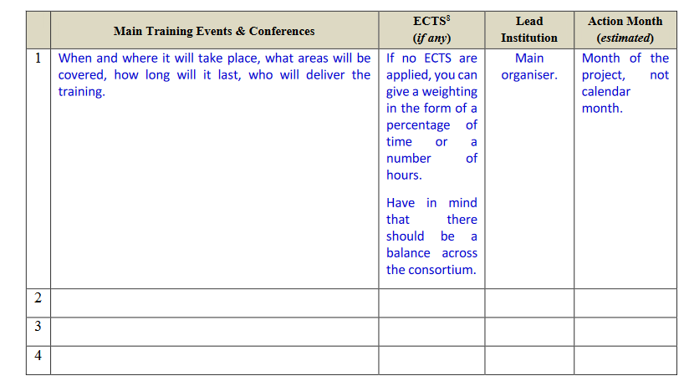
Training Programme – Quality & Credibility (1.3)
Commission Expectations
A structured and coherent training programme is expected.
It must combine:
Local training (doctoral schools) : Individual research+ Graduate school
Network-wide training (events, secondments) ( table to be filled)
Focused on core, advanced, and transferable skills
Integration of Open Science, gender, and diversity aspects
International – Interdisciplinary – Intersectoral
Key Principles
In what ways the training programme will be international, interdisciplinary, and intersectoral ?
How the training will be both ambitious and realistically achievable ?
What elements should be included in a career development plan to best support each researcher’s growth?

Slide 14
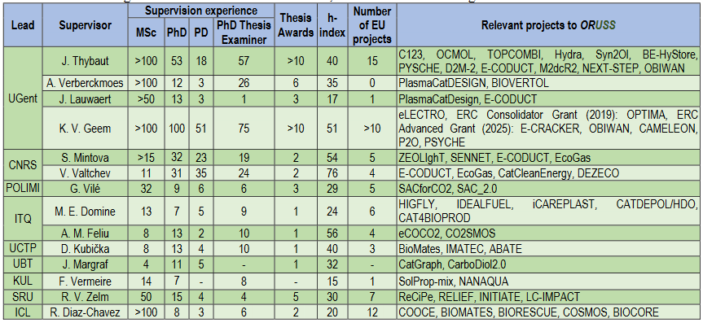
Training Programme – Quality of the Supervision (1.4)
1.4.1 – Qualification and Experience of the Supervisor
CONSORTIUM’S EXPERTISE:
- Demonstrate collective supervision experience via Hard Proof (table below)
- Include academic & non-academic supervisors
- Include associated partners (mentors & co-supervisors)
- Plan mentoring for less experienced supervisors

Slide 15
Training Programme – Quality of the Supervision (1.4)
1.4.2 – Quality of the Supervison Arrangement
- How the PhD Will be supervised and mentored in the institution
- Do you plan annual meeting to asses the progress meeting
- What will be set up to monitor the progress of the PhD (Career Development Plan)

Slide 16
Thank you !

