Slide 1
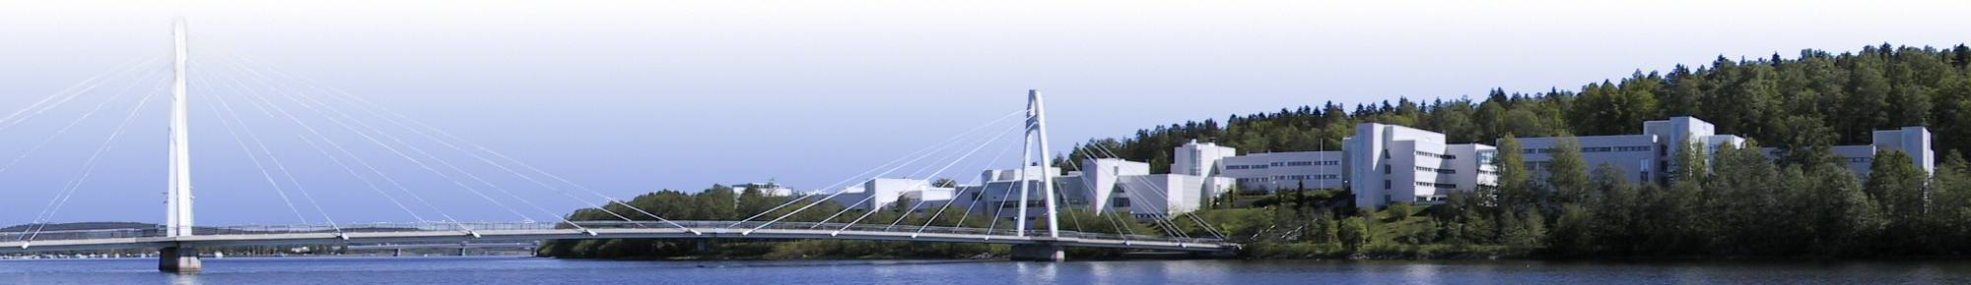
LaISLa Doctoral Network
Work Package 5
Lanthanides for the study of nuclear structure
Iain D. Moore (on behalf of the WP5 team)
Department of Physics,
University of Jyväskylä, Finland

Slide 2

Content
General overview
Nuclear structure and the lanthanides
PhD thesis topics and supervisors
Possible deliverables (still under construction)
LaISLA DN Workshop, June 30th – July 3rd, 2025

Slide 3
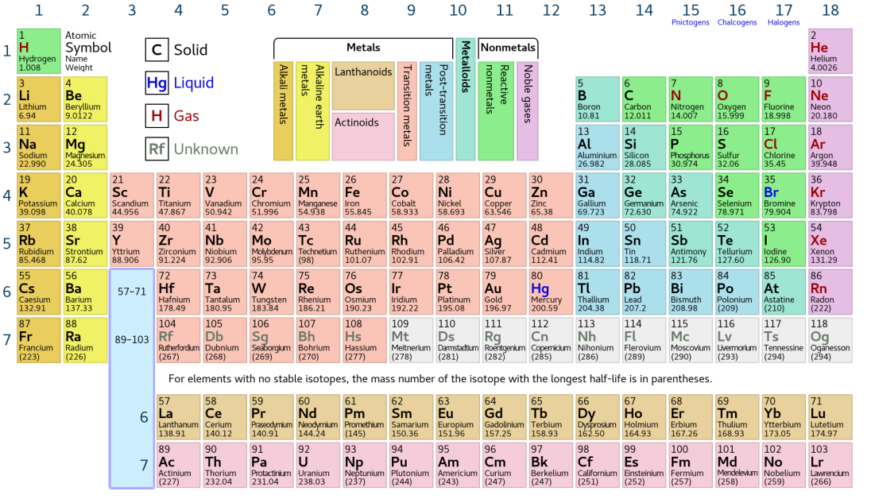
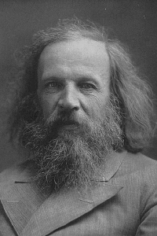
The Periodic Table of the Elements
Groups
Periods
LaISLA DN Workshop, June 30th – July 3rd, 2025

Slide 4
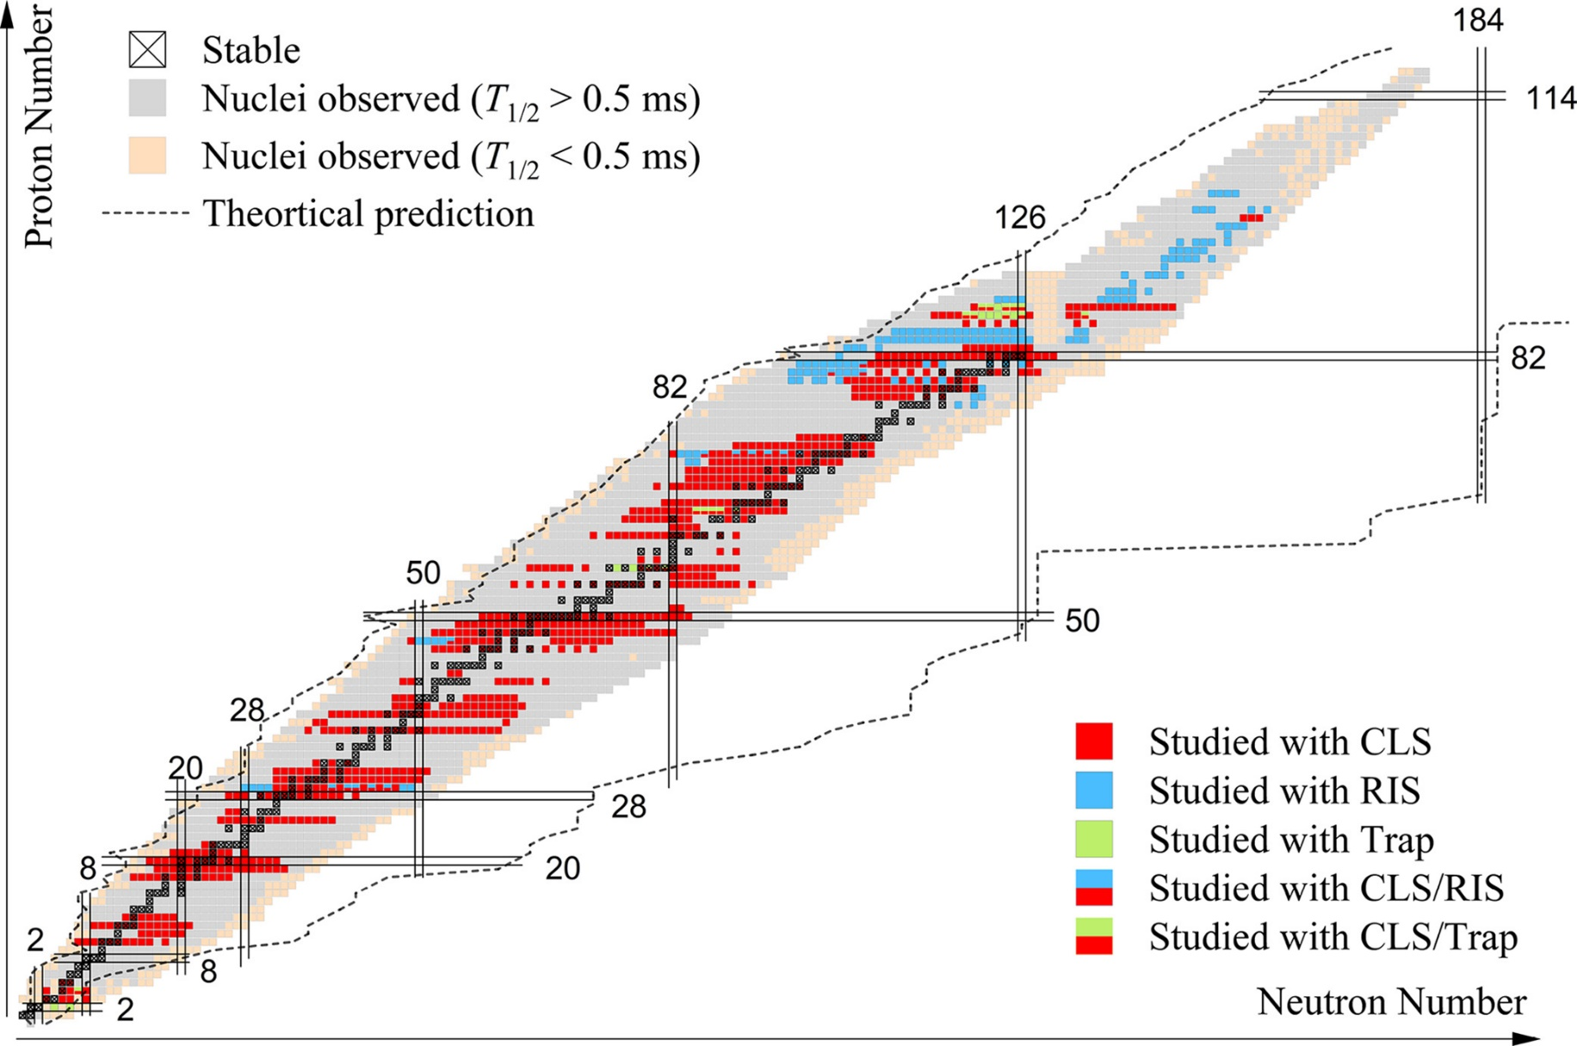
Laser spectroscopy and the nuclear landscape
Latest review: X.F. Yang et al., PPNP 129 (2023) 104005
The lanthanide elements:
from Z = 57 to Z = 71
LaISLA DN Workshop, June 30th – July 3rd, 2025

Slide 5
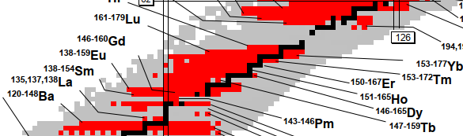
Current status of the lanthanides as of 2025
N = 82
Towards the proton dripline
Note the clear lack of data for neutron-rich isotopes:
possible to access some of these elements in nuclear fission
LaISLA DN Workshop, June 30th – July 3rd, 2025

Slide 6
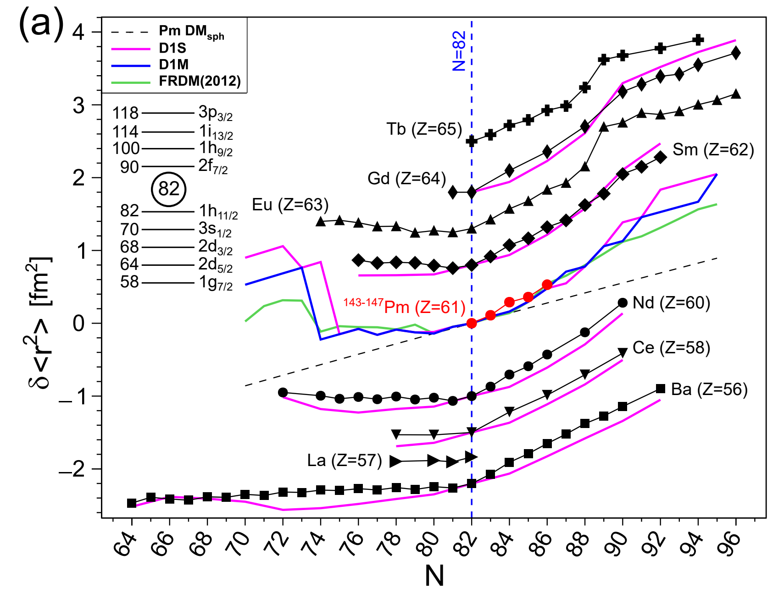
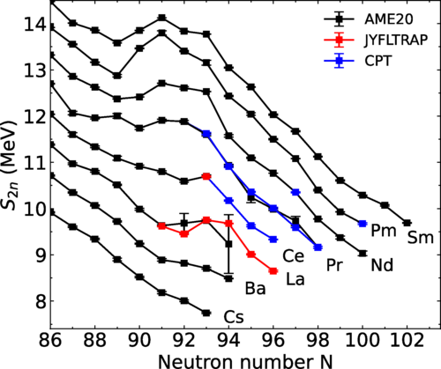
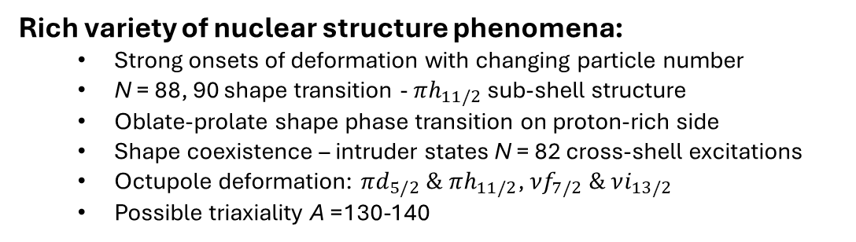
Nuclear structure in the lanthanides
High-resolution ¹⁴³⁻¹⁴⁷Pm using PI-LIST at Mainz
Rich variety of nuclear structure phenomena:
  Strong onsets of deformation with changing particle number
  N = 88, 90 shape transition - $πh_{11/2}$ sub-shell structure
  Oblate-prolate shape phase transition on proton-rich side
  Shape coexistence – intruder states N = 82 cross-shell excitations
  Octupole deformation: $πd_{5/2} \& πh_{11/2}$, $νf_{7/2} \& νi_{13/2}$
  Possible triaxiality A =130-140
D. Studer et al., EPJ A 56 (2020) 69
Two-neutron separation energies of ¹⁴⁸⁻¹⁵³La at JYFLTRAP
A. Jaries et al.,
Phys. Rev. Lett. 134 (2025) 042501
Evidence of structure change
Ground and isomeric state properties: fundamental benchmarks
  Radii – nuclear size variations, “bulk” deformation effects
  Magnetic moments & spins – s-p configurations, mixed-parity states
  Quadrupole moments – isolating static quadrupole components
  Close collaboration with nuclear theorists in the network
LaISLA DN Workshop, June 30th – July 3rd, 2025

Slide 7
PhD topics and supervisors
PhD 12: Nuclear-model developments (Tomás Rodriguez, U-Sevilla; co-supervisor M. Kortelainen, U-Jyväskylä)
Thesis title: ``Beyond mean-field studies of the structure of lanthanide isotopes´´
PhD 13: Improvement of the laser spectral resolution of lanthanides using PI-LIST (James Cubiss, U-Edinburgh; co-supervisor K. Chrysalidis, CERN)
Thesis title: ``Studying rare-earth isotopes at CERN using the PI-LIST´´
PhD 14: Laser spectroscopy of neutron-rich lanthanides in the N = 88 region (Iain Moore, U-Jyväskylä, co-supervisor M. Reponen)
Thesis title: ``Laser spectroscopy of lanthanide elements for nuclear structure studies´´
PhD 15: Absolute charge radii measurements via muonic spectroscopy at PSI (Andreas Knecht, PSI, co-supervisor to be defined)
Thesis title: ``Muonic atom x-ray spectroscopy on lanthanides´´
LaISLA DN Workshop, June 30th – July 3rd, 2025

Slide 8
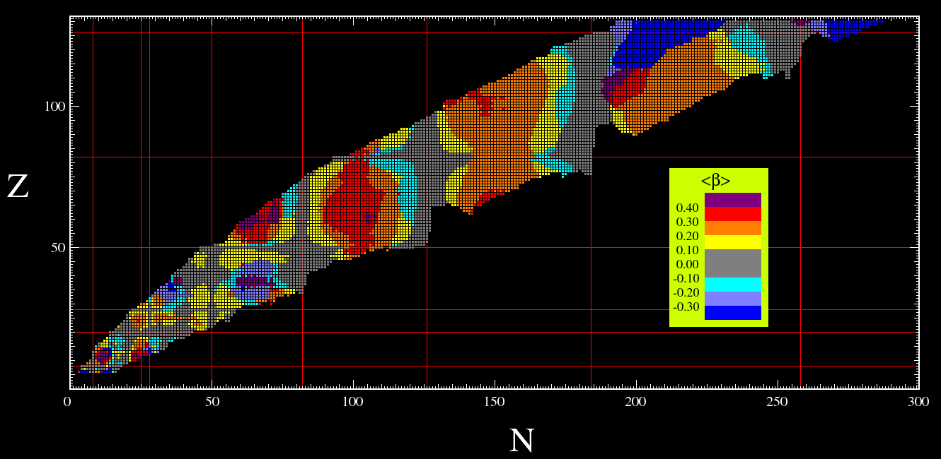
Beyond mean-field studies (PhD 12)
MOTIVATION
- Region with a large variety of nuclear deformations and shape evolution suitable to study:
⇒ microscopic origin of deformation.
⇒ quantum phase transitions.
⇒ microscopic particle-plus-vibration/rotation models for odd systems.
CEA-DAM AMEDEE database Gogny D1S
- Region enclosing three major shells, hard to reach with shell model and/or ab initio methods
CEA-DAM AMEDEE database Gogny D1S
⇒ variational approximations.
GOALS AND METHODOLOGY
- Theoretical framework: projected generator coordinate method (PGCM) with energy density functionals (EDF)
- Predictive EDFs (Gogny, Fayans) for a wide variety of nuclear observables (masses, radii, spectra, e.m. properties)
- Variational approach to the exact solution of the nuclear many-body problem
- Challenges to be addressed by the PhD student:
- Wave functions of the nuclear states are linear combinations of intrinsic states with different shapes
- Calculation of spectra of even-even nuclei including time-reversal symmetry breaking states
⇒ search for a quantitative agreement of the experimental data
⇒ search for isomeric states
- Development of PGCM-EDF techniques to compute spectra of odd-nuclei (collaboration with JYU)
NuPECC LRP-2024
- Comparison with experimental data / collaborative efforts within WP5
LaISLA DN Workshop, June 30th – July 3rd, 2025

Slide 9
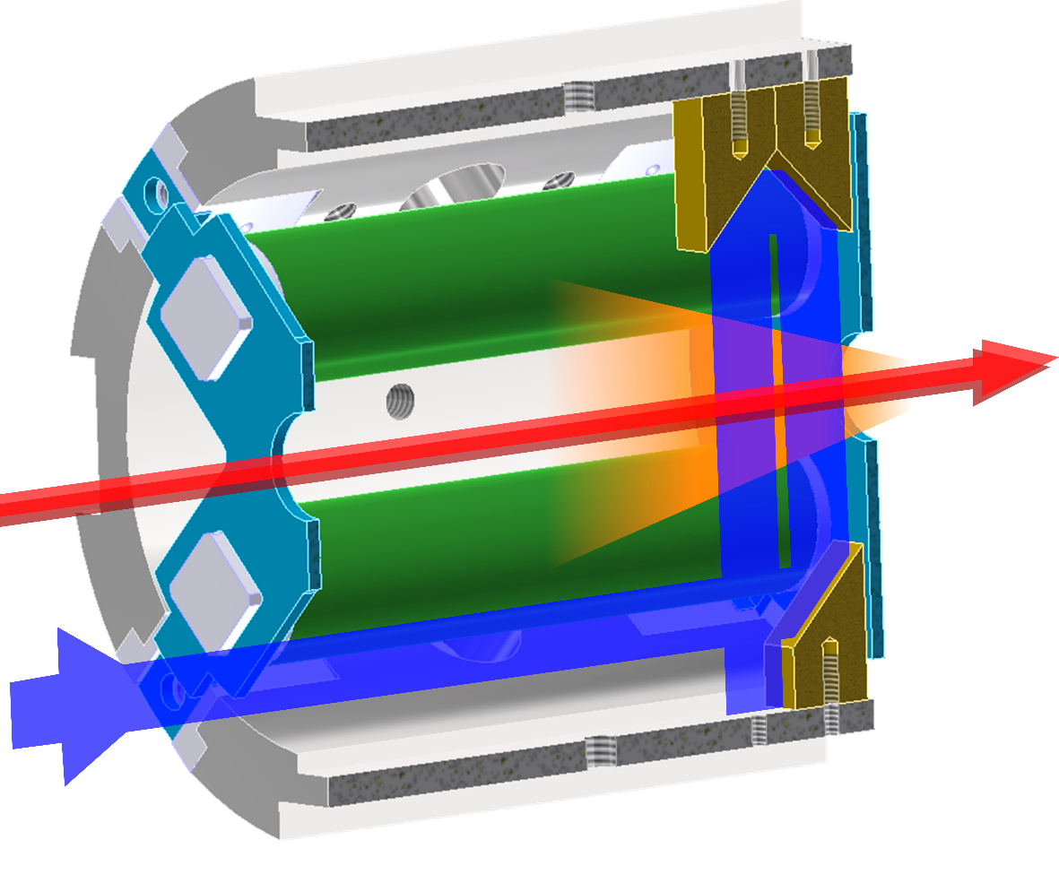
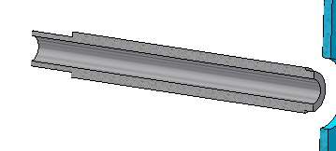
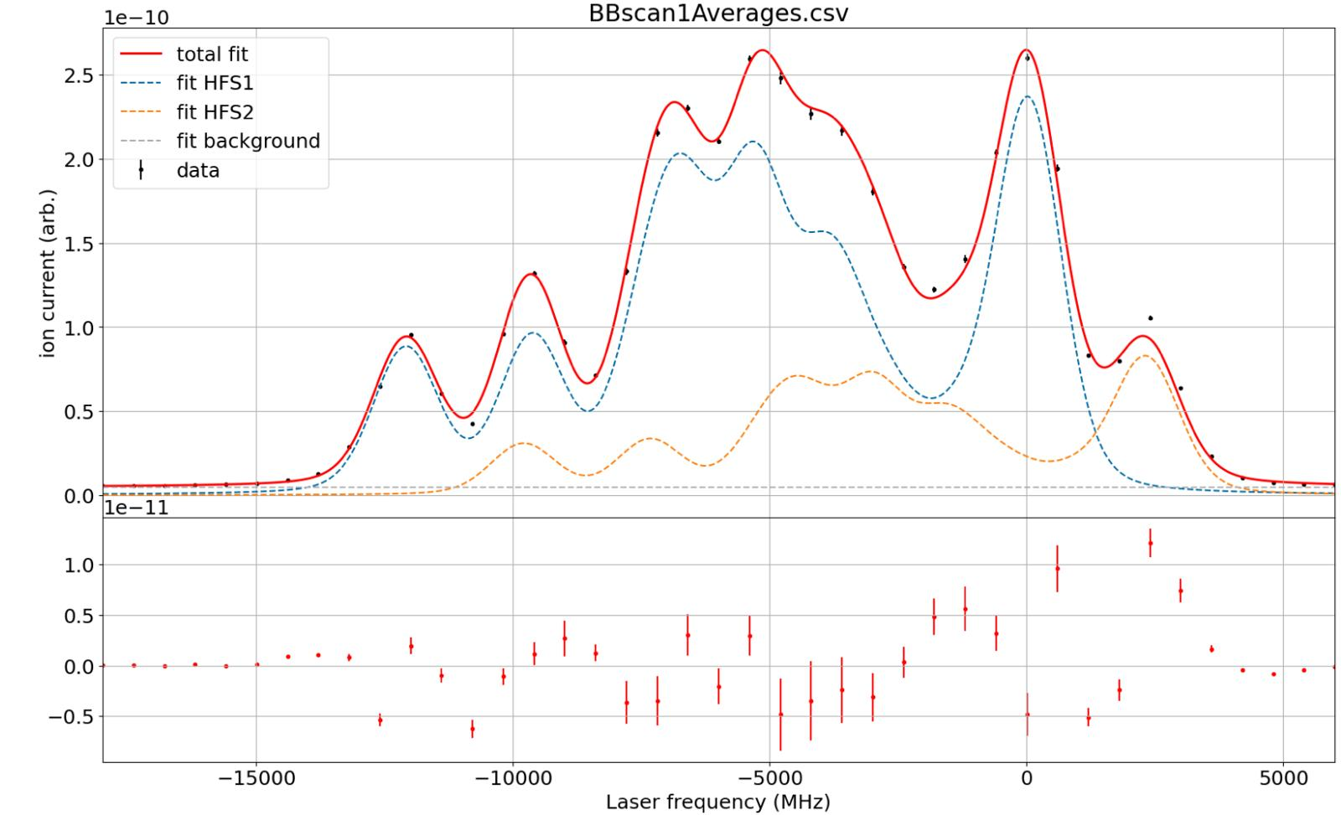
Studying rare-earth isotopes at CERN using PI-LIST (PhD 13)
Complementary production method to IGISOL
  High-E protons on thick target – high-intensity spallation products for very neutron deficient nuclei
  Limited by chemistry – typically slow release of lanthanides from target
Laser ionisation schemes at ISOLDE
  Many designed for efficiency rather than spectroscopy
  Development possible at “offline 2” – stable isotopes only, e.g., Gd, Ce, Pr and Sm…
  Partner with IGISOL for RIB tests depending on cases
  Atomic theory could be critical ingredient, i.e. overlap with PhD-8 of WP4
In-source spectroscopy with PI-LIST
  Established in-source method at sensitivity frontier (down to ~1 ion/sec from target)
  PI-LIST gives order of magnitude improvement in resolution – recently achieved 350 MHz (compared to typical ~3 GHz)
  Complementary data on decays and masses from various detection techniques.
  Significant laser-ionised contamination at A~150
Associated PhD projects outside of LaISLa
  Investigating A~150 contamination
  In-source laser desorption techniques
  Molecular extraction and breakup in source
R. Heinke et al., Hyperfine Interactions 238, 6 (2017)
IS770 –
courtesy of K. Chrysalidis.
LaISLA DN Workshop, June 30th – July 3rd, 2025

Slide 10
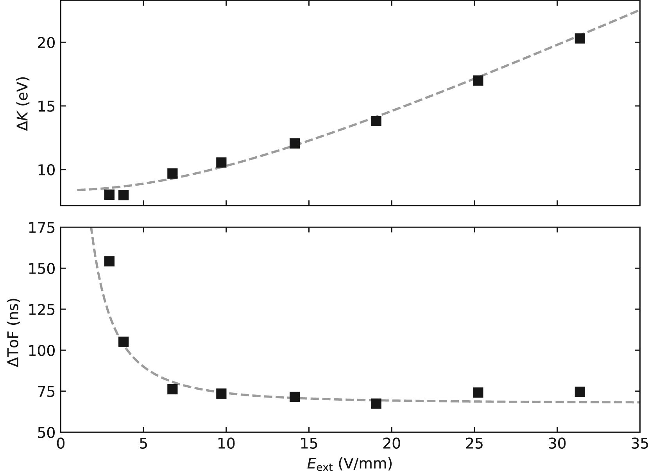
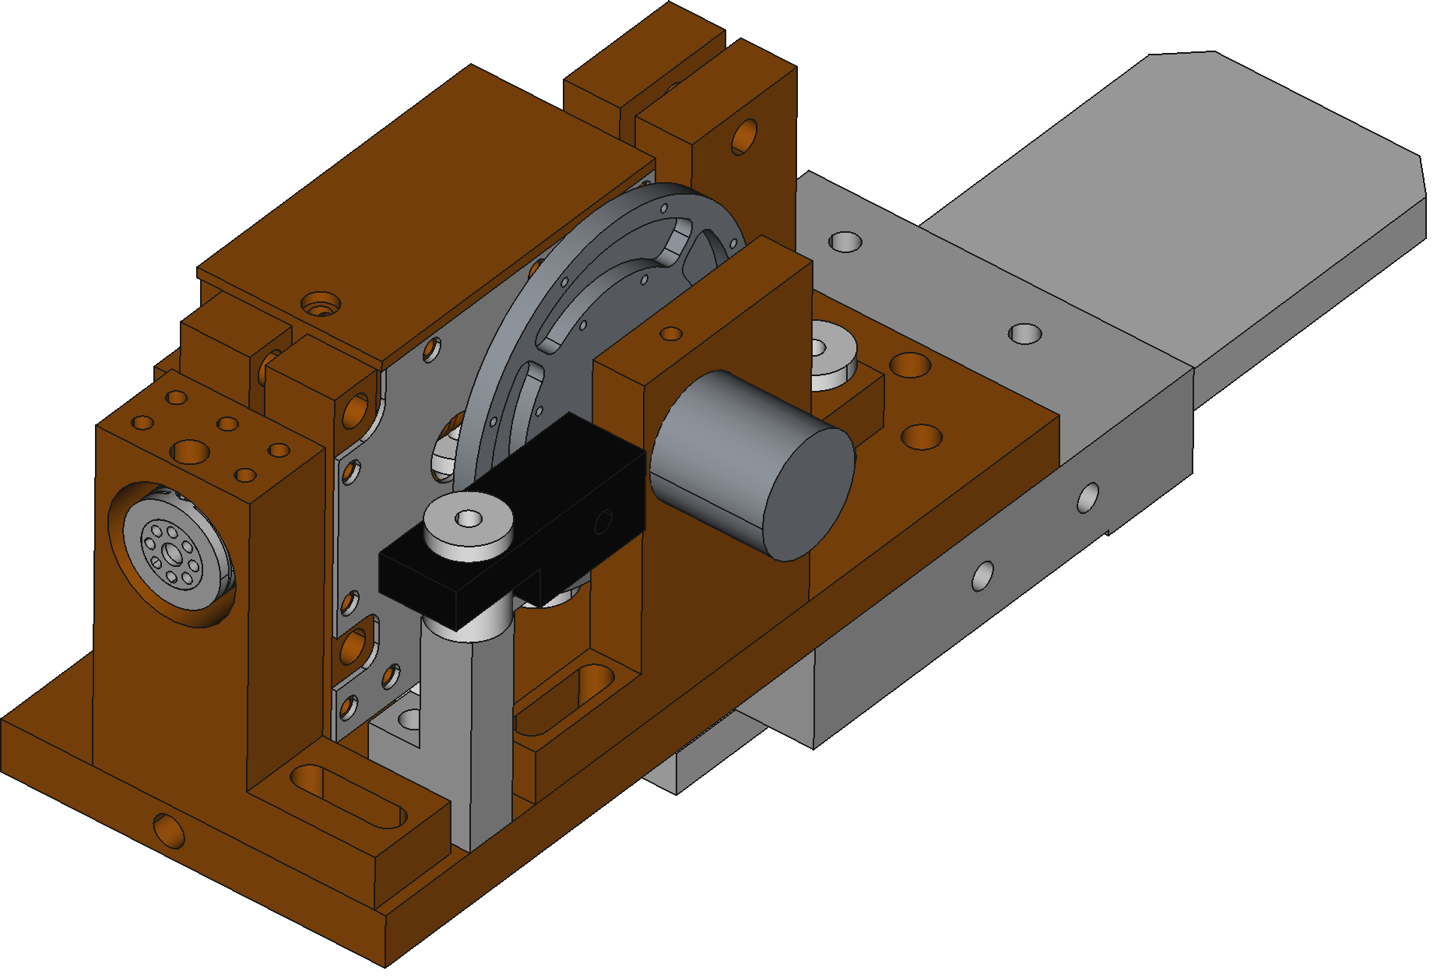
Laser spectroscopy at IGISOL (PhD 14)
Energy dispersion increased to ~10 eV
High-resolution collinear laser spectroscopy of neutron-rich lanthanide isotopes produced in fission. Use the data to benchmark theoretical methods applied within the network. Links to atomic (WP4) and nuclear theory.
Technical goal to improve the sensitivity of the collinear method using sub-microsecond ion bunches from the “mini” RF cooler-buncher and to verify the consistency of the method with the main buncher.
Explore the feasibility of reverse-extraction from the MR-TOF mass spectrometer combined with collinear laser spectroscopy.
Development of the hot cavity catcher method with appropriate catcher materials suitable for the extraction of lanthanide isotopes with a reasonable time delay, e.g. for neutron-deficient thulium. Overlap with technical developments ISOLDE-CERN (WP2).
Temporal width of 75 ns achieved, improved by factor of 200
V. Virtanen et al., Nucl. Instr. and Meth. A 1072 (2025) 170186.
LaISLA DN Workshop, June 30th – July 3rd, 2025

Slide 11
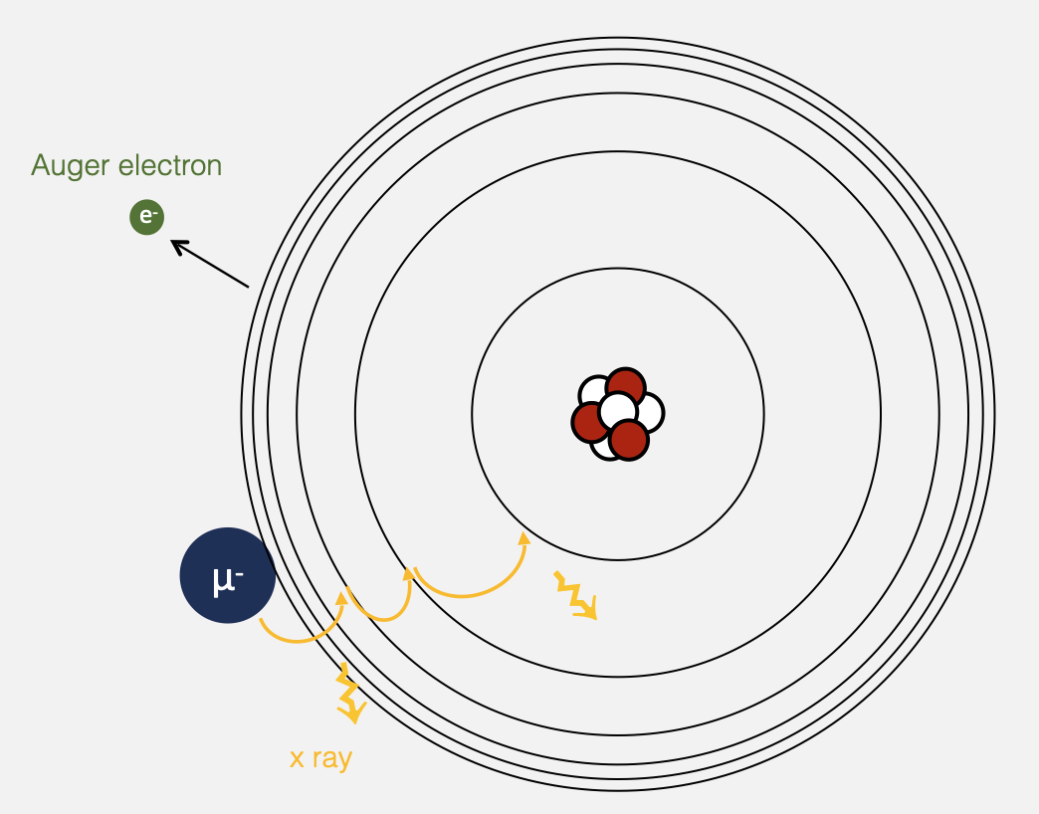
Muonic atom x-ray spectroscopy (PhD 15)
Due to the close proximity of the muon to the nucleus, finite nuclear size effects are enhanced by a factor of 10⁷.
Muonic atom x-ray spectroscopy is the ideal tool to measure absolute charge radii by comparing the measured transition energies to precision calculations. This is complementary to optical spectroscopy (changes in charge radii).
Within the project we aim to measure the absolute charge radii of:
  La-137/138/139
  Pm-147
  The three measured lanthanum isotopes provide the absolute benchmark to extract reliable, absolute charge radii of the full isotopic chain.
  Promethium does not have any stable isotopes and no absolute charge radius measurements were performed so far. The measurement of Pm-147 leads to a first absolute anchor point for the full isotopic chain.
We note off-line atomic spectroscopy studies of Pm planned at GSI – PhD 10, WP4.
LaISLA DN Workshop, June 30th – July 3rd, 2025

Slide 12
Deliverables – to be discussed
Deliverable
D5.1
D5.2
D5.3
D5.4
D5.5
D5.6
Deliverable | Deliverable title | Lead beneficiary | Due date
D5.1 | User manual of the PGCM code with time-reversal symmetry breaking intrinsic wave functions | U-Sevilla | X
D5.2 | Report on development of ionization schemes for lanthanide elements | U-Edinburgh | X
D5.3 | Report on offline collinear laser spectroscopy of lanthanide elements | JYU | X
D5.4 | Report on the use of Monte Carlo simulations for release-time measurements from a hot catcher | JYU | X
D5.5 | tba | PSI | X
Deliverables to be produced as scientific reports. They need to be achievable, and will be distributed throughout the project timeframe.
JYU. Since 1863.
LaISLA DN Workshop, June 30th – July 3rd, 2025

Slide 13
Summary
Work Package 5 is looking simply delicious!
Links to other WP’s can be identified (e.g., atomic theory & atomic spectroscopy WP4, laser technology WP3, target material development of WP2).
Deliverables are to be discussed, but likely will be all scientific reports. Easy to define!
Thank you to my dear colleagues Tomás, James and Andreas for their super material!
LaISLA DN Workshop, June 30th – July 3rd, 2025

