Slide 1
WP3 - Novel technologies for the spectroscopy of lanthanides

Slide 2
Overview of the PhD projects
Thesis | PI and coPI | Secondments | Deliverables | Synergies
4. Laser cooling of a negative lanthanide | R. de Groote D. Hanstorp (to check) | Stockholm Hubner | Report on use of negative ion trap | Laser technology (PhD 7) Atomic theory (PhD8)
5. Development of double resonance spectroscopy in a supersonic gas jet for the S3LEB spectrometer. | N. Lecesne R. de Groote | KUL (3 months) Hubner (x weeks) | Report on secondment Report on application to lanthanide | Atomic theory (PhD8)
6. Ultra-trace analysis of Lanthanides | K. Flanagan ? | SMILES @ Arronax? | RIS schemes to add to e.g. RILIS database? | Pm studies (PhD 10, 15)
7. Laser technology development for high-resolution spectroscopy | H. Korbinian D. Hanstorp | KUL Gothenburg | Dataset obtained on lanthanides obtained with laser | PhD 7 and 5

Slide 3
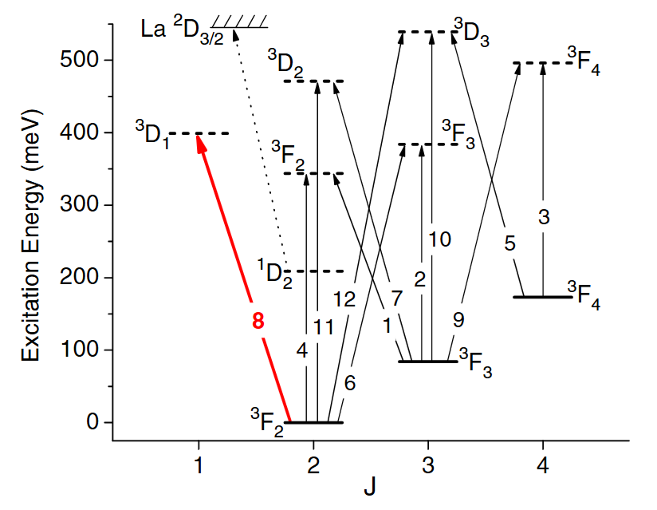
4. Laser cooling of a negative lanthanide
Many species of positive ions are routinely cooled to sub-kelvin temperatures
Negative ions: challenging
Only a few cases with bound transitions
La⁻: the perfect test case?
Applications of this technology:
Sympathetic cooling anti-matter
Sympathetic cooling of other negative ions, followed by photodissociation, to produce cold atomic samples

Slide 4
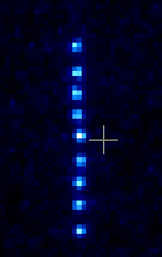
Objectives and expected results
Demonstrate trapping of La⁻ ions
Photo-detachment spectroscopy with cw OPO laser of trapped ions (PhD 7)
Explore laser-cooling of La⁻ ions
Challenges: low transition strength, requires repumps
Sr⁺ ion crystal @ Leuven starting with 10 keV beam!
Deliverables
Internal manual on the tuning of La- ion trap
(Deliverable of PhD 7)

Slide 5
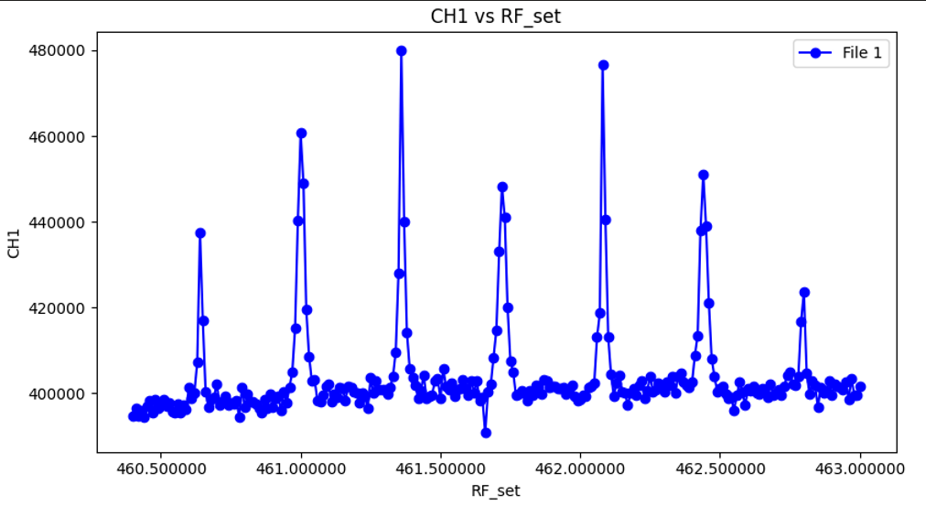
5. Development of double resonance spectroscopy in a supersonic gas jet for the S3LEB spectrometer.
Laser-rf double resonance spectroscopy yields a ‘transit-time’ limited linewidth
10 kHz on thermal beam
Supersonic gas jet?
Challenges:
External B-fields
Low production rates

Slide 6
Objectives and expected results
Demonstrate laser-rf in S3LEB with alkali metal
Characterize laser-rf in S3LEB with lanthanide atom
Precision improvement? Efficiency?
First on-line experiment with lanthanide
Deliverables
Report on secondment (transfer knowledge KUL -> GANIL)
Report on first offline work with a lanthanide

Slide 7
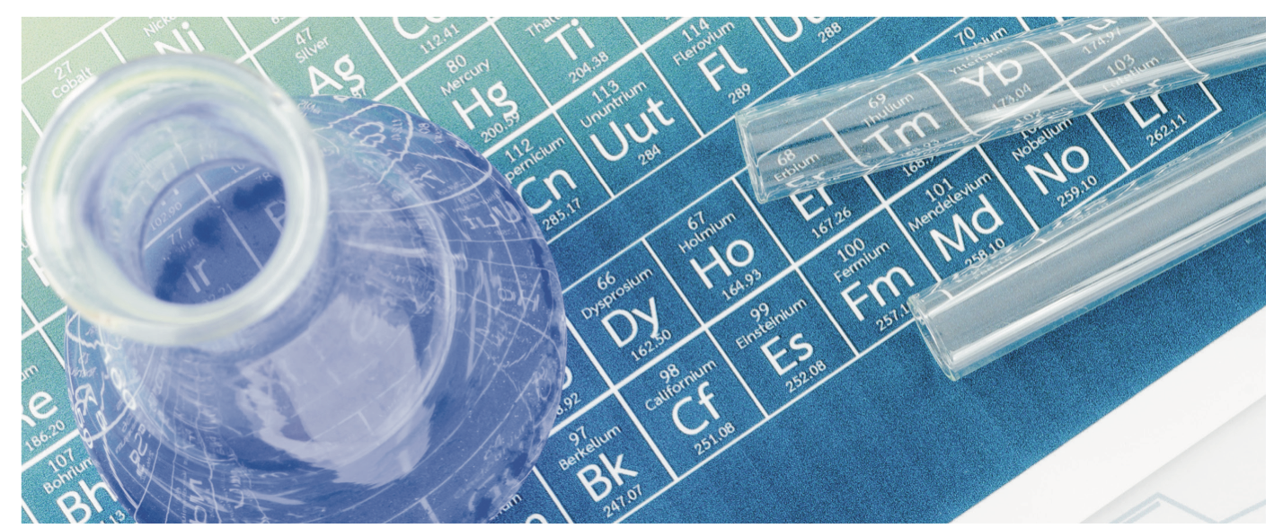
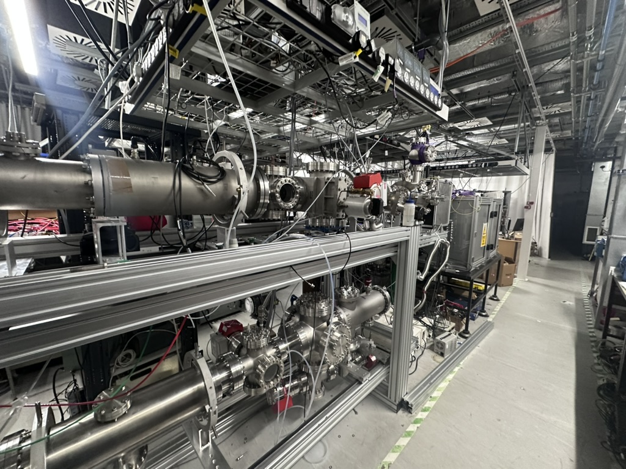
6. Ultra-trace analysis of Lanthanides
Challenge: develop new tools to monitor leaching of lanthanides in the environment from landfill sites.
Complex chemistry and range of half-lives make them ideal as radiotracers.
Developing new analytical tools for the analysis of radiogenic REE isotopes in bulk REE matrices
Project will develop new resonance ionization schemes to be used together with inductively coupled mass spectrometry (ICP-MS) and RIMS methods to detect isotopes such as ¹⁵¹Sm and ¹⁴⁵⁻¹⁴⁷Pm as well as other long-lived and low Q-beta radioisotopes.
Dioni I. Cendón Science of the Total Environment 830 (2022) 154706

Slide 8
LaISLA-ITN ESR project @ HÜBNER Photonics, Dr. Korbinian Hens, 2025-06-17
7. Development of a NARROW LINEWIDTH solid-state tunable CW laser
based on the C-WAVE™ concept with customized linewidth and stand-alone resonant frequency
doubling unit for the UV wavelength range, optimized for lanthanide research

Slide 9
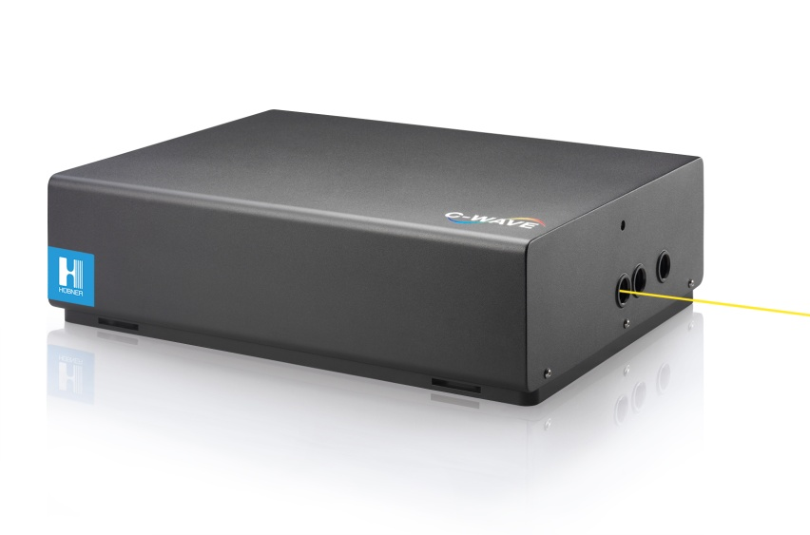
LaISLA | ESR (#7) project
Development of a narrow linewidth solid-state tunable CW laser based on HUB’s existing C-WAVE™ concept with customized linewidth and stand-alone resonant frequency doubling unit for the UV wavelength range, optimized for lanthanide research.
M1-M6
Production & validation of a narrow linewidth tunable laser source prototype
M21-M26
Conceptual design of a narrow linewidth tunable CW laser source based on C-WAVE™
M6-M18
Design and setup of a resonant frequency doubling unit for UV wavelengths
Implementation and validation of the outcomes at the DESIREE and/or CERN-ISOLDE facility (Dag Hanstorp, UGOT; Katerina Chrysalidis, CERN)
M19-20
Test customized C-WAVE system within spectroscopy experiments at KU Leuven (Ruben de Groote, KU Leuven )
M27-36
M27-M30
Optimization and automation of the tunable CW laser light source

