Slide 1
WP 2 – (Radio) lanthanide production for society
PSI (Zeynep Talip) , CERN (Simon Stegemann), KUL (Thomas Cocolios)

Slide 2
Overview – the central questions
Which materials are best suited for not only producing but efficiently extracting lanthanides?
Which form can lanthanides be best extracted in (atomic, molecular)?
How can the throughput at the ion source level be increased in order to allow faster collection of medically relevant activities?
How can the isotopic separation be improved on, in order to be able to deliver pure enough samples, suitable for medical applications?
Is there a possibility to monitor the purity and usefulness of the provided samples "live" to avoid lengthy post-collection analysis?

Slide 3
Final result
“white paper” putting together all the results which will focus on:
Is it possible to design a new type of facility, which takes into account the results of the ESRs and is able to deliver these high activities with good enough purity for direct application in Medicine?

Slide 4
Projects
PSI – Improving the separation purity
KU Leuven – Throughput optimization
CERN – New materials

Slide 5
Improving the separation purity
Based at PSI – supervisor Zeynep Talip
Secondment to Mainz (work at RISIKO mass separator)
Central problem to solve: sample purity in the lanthanides not high enough for direct applications in medicine
Aim: improve the mass separation purity for medical applications
Better isotope selectivity in ionization schemes (development)
Simulation of ion optics for optimized beam transport and injection
Optimize emittance of the ion beam (?)
Help design new high throughput mass separator with good resolution for PSI (?)

Slide 6
Throughput optimization
Based at KU Leuven – supervisor Thomas Cocolios
Secondment to CERN (MEDICIS, OffLine2)
Central problem to solve: (laser) ion sources are limited in throughput thereby limiting collection speed

Slide 7
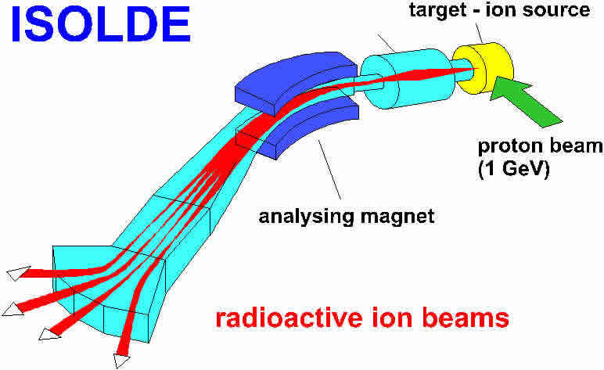
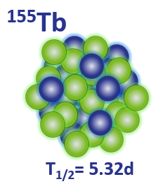
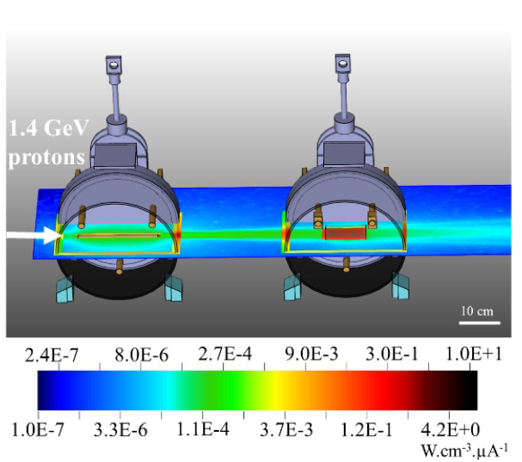
Radioisotope production at MEDICIS
Delivered sample activity
7-20MBq
Initial sample activity 30MBq
RILIS
Mass
separation
~50%
efficiency
IP
=
Sample preparation
+
~ 1-5d
Ionization
< 1d
Handling and transportation
Ground state
16-26
MBq
16-26
MBq
Collection at MEDICIS
8-23
MBq
Target irradiation
~ 1-5d
< 1d
B. Webster et al. Chemical Purification of Terbium-155 from Pseudo-Isobaric Impurities in a Mass Separated Source Produced at CERN
Slide by R. Mancheva

Slide 8
Throughput optimization
Based at KU Leuven – supervisor Thomas Cocolios
Secondment to CERN (MEDICIS, OffLine2)
Central problem to solve: (laser) ion sources are limited in throughput thereby limiting collection speed
Aim: Improve the ion source geometry to increase extraction
Continue work already under way for MEDICIS
Plasma simulations
Test and design of new ion source geometries
Investigations into (new) materials which can reduce surface ionization and increase laser ion confinement

Slide 9
New materials
Based at CERN – supervisor Simon Stegemann
Secondment to Duisburg-Essen (work in home institute for material production)
Central question/problem to solve: extraction of produced lanthanides from currently available target materials is inefficient/ impossible

Slide 10
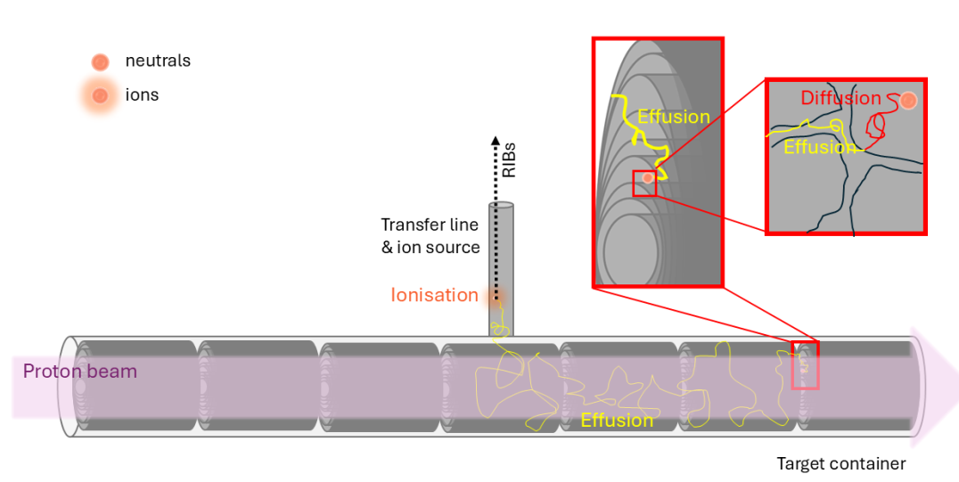
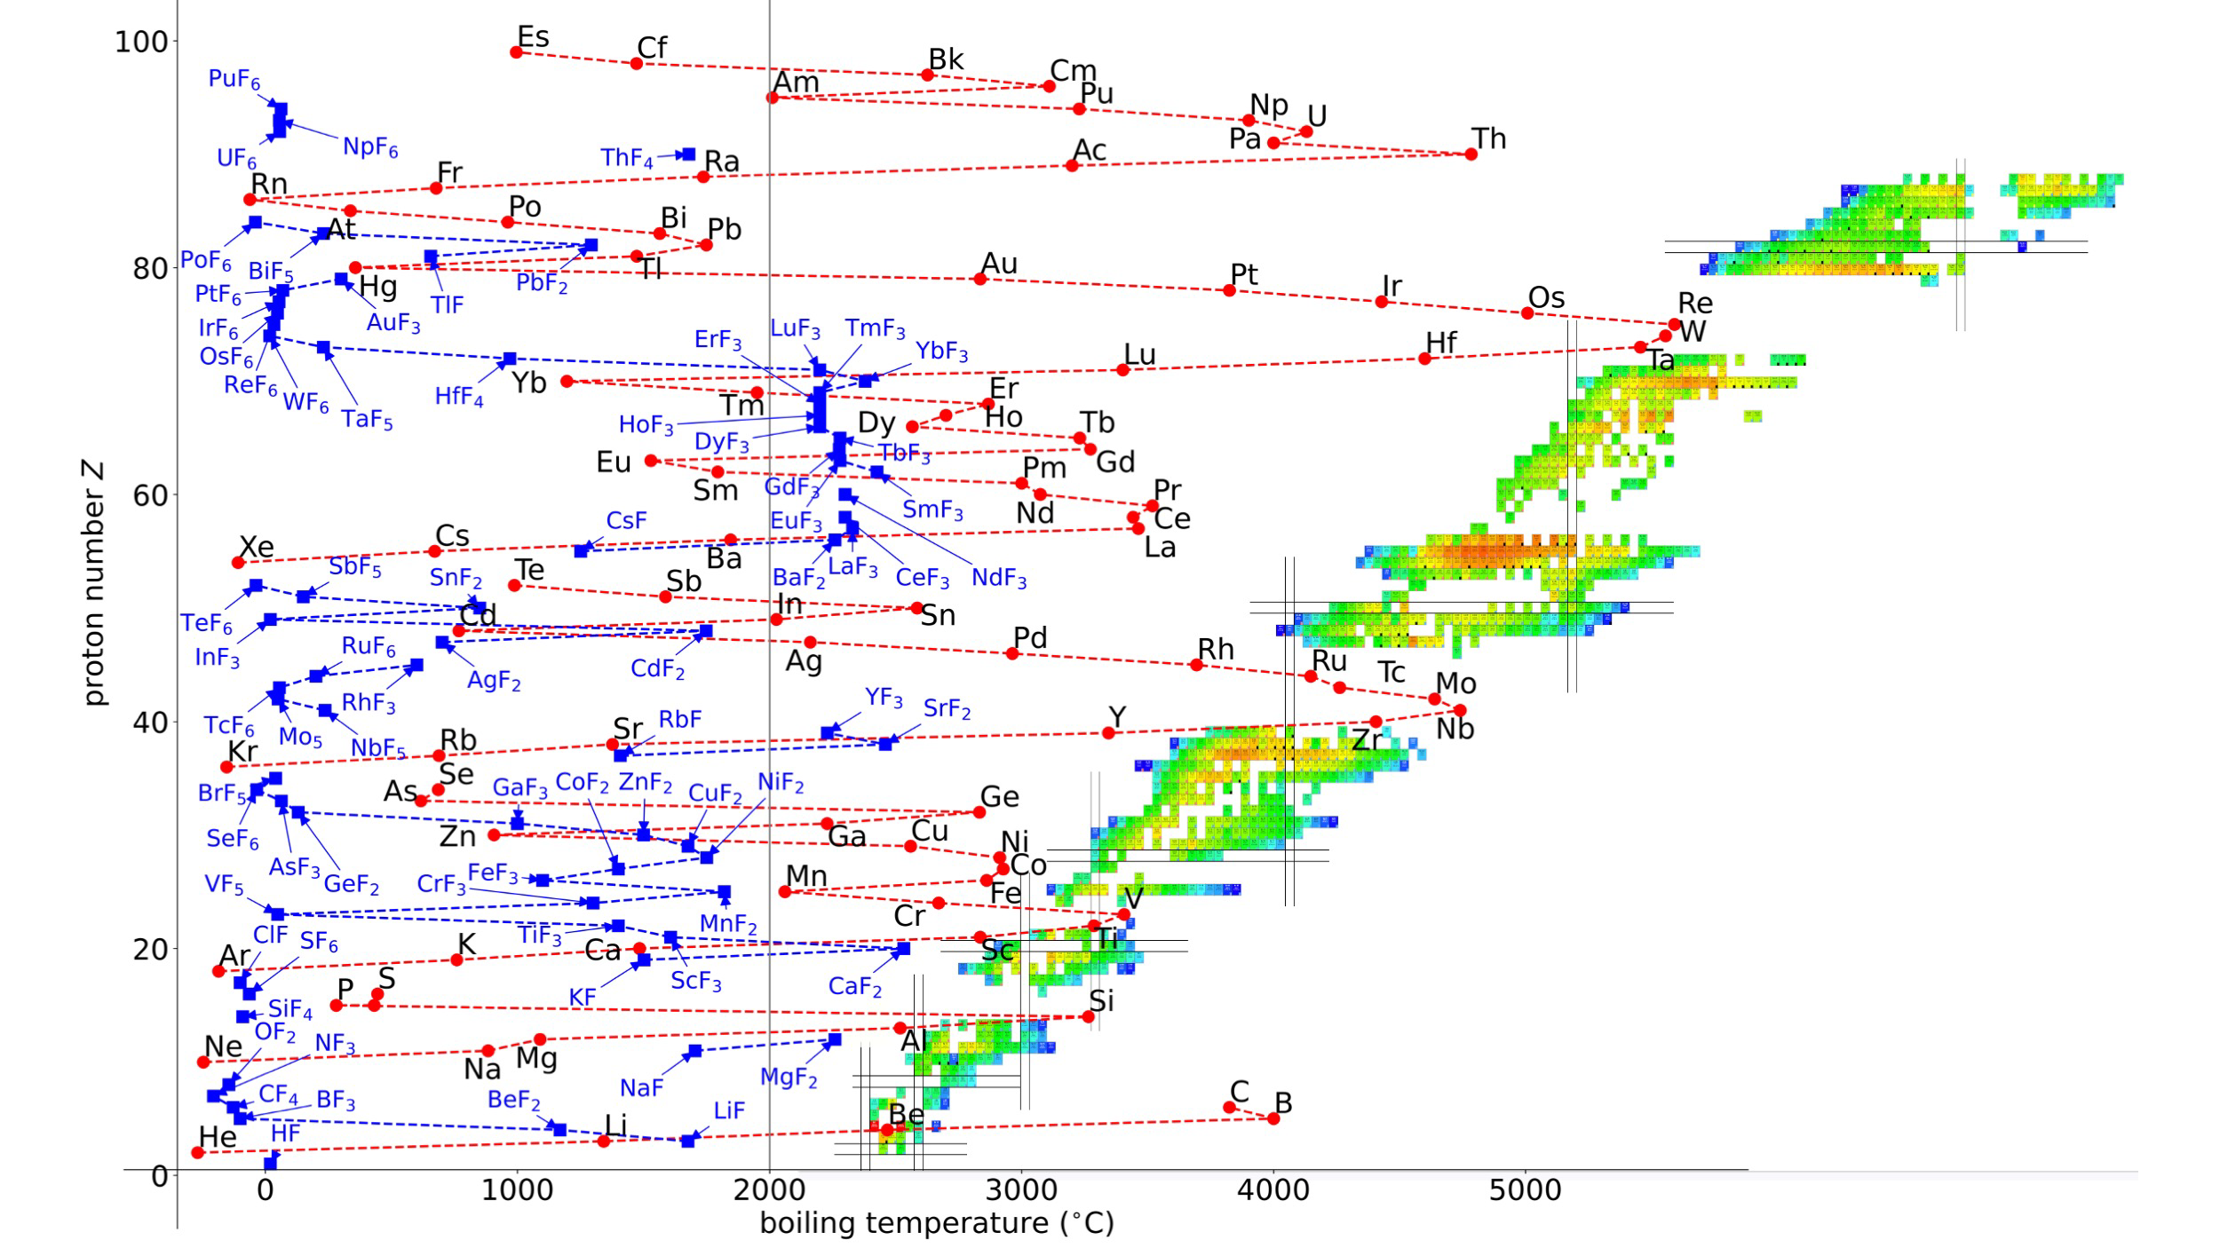
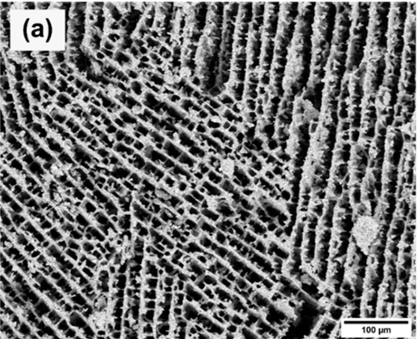
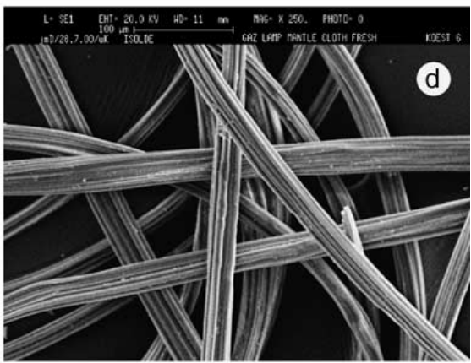
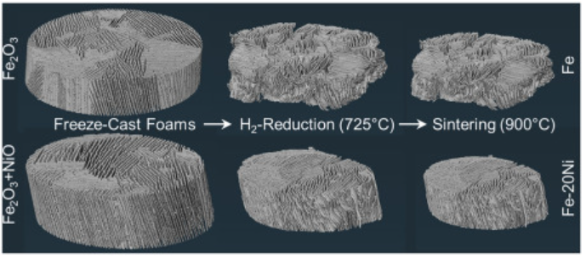
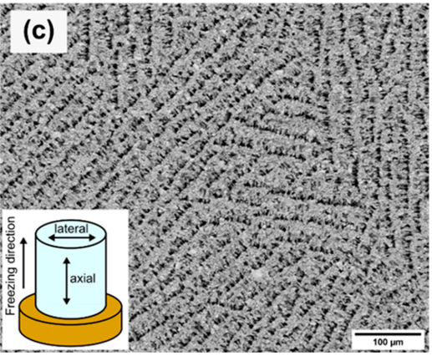
New materials
Fibers?
Freeze cast?
3D printing?
Slide content: S Stegeman & M. Au

Slide 11
New materials
Based at CERN – supervisor Simon Stegemann
Secondment to Duisburg-Essen (work in home institute for material production)
Central question/problem to solve: extraction of produced lanthanides from currently available target materials is inefficient/ impossible
Aim:
produce and test new target materials, e.g. from casting, 3D printing, …
compare production, release and form to “standard” materials

Slide 12
The final result of the WP?
New target materials
New ion source(s)
Efficient extraction of beams
High resolution mass separation
High quality samples for medical applications
The facility of the future?

