Slide 1
Part. B1 – Scientific Proposal

Slide 2
1) General Presentations
2) Project proposal section
3) Part. B2
4) Award Criteria

Slide 3
I.General informations

Slide 4
Proposal Max Length : 34 Pages as a Whole
Start Page = 1 page
Table of Content = 1 Page
Information for Non-Academic Beneficiary + Declaration Table = 2 Pages Max
Proposal Excellence, Impact, Implémentation = 30 Pages Max
For proposal : Min 11 Size
For Table : Min 9 Size
For Footnotes and reference : Min 8 Size

Slide 5
II - Project Proposal Section

Slide 6
A) Excellence Part
1. Clarity and quality of the research objectives : the project has clear and well-defined objectives : The focus is on what exactly needs to be studied, and the goals are realistic and relevant.
2. Soundness of the concept and methodology : the scientific concept is strong and logical : The methodology is solid, with the right tools and steps to answer the research questions in a credible way.
3.Level of innovation : the project is innovative : It goes beyond the current state of the art and brings new ideas, new approaches, or a new perspective in the field.
4.Interdisciplinary and intersectoral dimension : it connects different academic fields – and sometimes also intersectoral, involving academic and non-academic partners.This helps to make the research richer and more impactful.
5. Quality of supervision and host institution : the supervision and the host institution are of high quality. The researcher will be guided by experienced professionals and will work in a strong scientific environment, with great training opportunities.

Slide 7
B) Impacts Part
2.1 - Contribution to structuring doctoral training at the European level
- Non-Academic Sector contribution
- Sustainability of the training programme
2.2 – Carreer Perspectives and Employability
- Training programmes for career perspectives
- Short/Medium/Long term perspectives
- Link to European Policy
2.3 – Dissemination, Exploitation and Communication
- Activities / Conferences / Targeted Publication / Workshop ect…
- Potential of the project results for Commercialisation
- How to reach a Broad Audience and what will be done
- Intellectual Property ( if relevant )
2.4 – Economic / Social and Scientific Impact

Slide 8
C) Implementation Part
3.1 – Table on WorkPackage + Milestones + Deliverable + Risk + DC
- Milestone = Control points in the project helping to chart progress
- Deliverables = Report sent to the European Commission
- Risks = a plausible event or issue that could have an impact on the ability of the project to achieve its objectives / Don’t forget the Non-Scientific Risks
3.2 – Quality and capacity of the Consortium
- In what ways does the Consortium contribute the required expertise and infrastructure to the project?

Slide 9
III - Part. B2

Slide 10
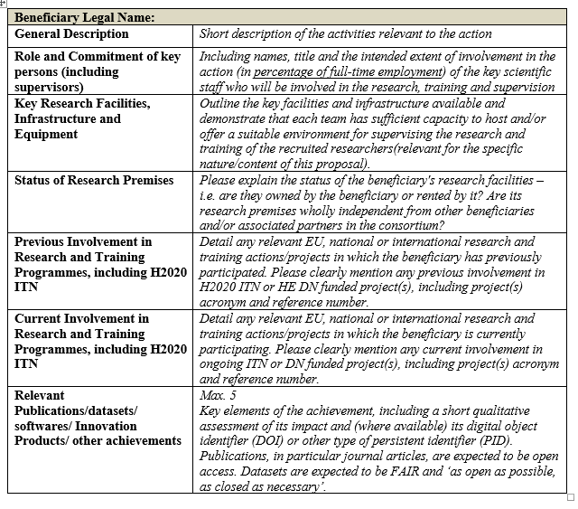
Part. B2
No page Limit
With Part. B1
Pre-filled

Slide 11
IV - Letter of Understanding (LOU)

Slide 12
Letter of Understanding - LOU
1 – Signed by the Legal Representative of your Institution
2 – Validation of the Involvement of the project by the Insitution
3 – Confidentiality Aspect
4 – DDL : Max September

Slide 13
V - Award Criteria

Slide 14
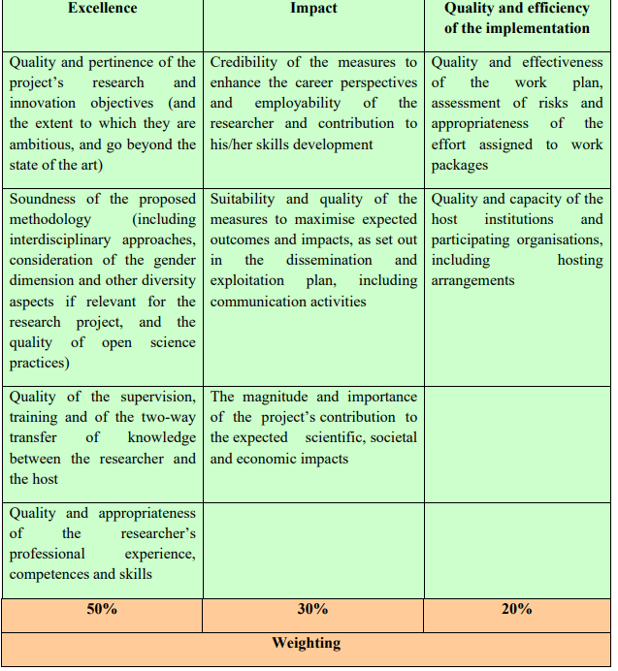
D) Award criteria
Is the work plan clear and well structured?
– Is there good management of resources and risks?
– Are the partners well chosen and do they complete each other?

Slide 15
D) Award criteria

Slide 16
D) Award criteria
For Excellence
Be very clear about your objectives and your method.
Explain each choice with recent sources.
Show what makes your project unique and innovative.
For Impact
Say clearly who will benefit from your research: scientists? companies? citizens?
Explain how you will share your results (conferences, articles, social media).
Include open science and important European social issues.
For Implementation
Present a simple and structured plan: who does what, when, and how.
Talk about risk management, monitoring, and show that your partner is reliable.

