Slide 1
AGATA Project
STARE
(Serial Transfer And Readout over Ethernet)

Slide 2
Plan
STARE Firmware
STARE Production Status
12 Links Crate for Readout
Tests production

Slide 3
IJCLab Orsay
INFN & U. Milano
STARE
IFIC Valence

Slide 4
STARE characteristics
FMC Vita57.1 connector
Input data rate from pre-processing : 4 x 10 Gbps serial (AURORA)
Network Bandwidth up to 4 x 10 Gbps in parallel.
Spare LVDS I/O with the pre-processing for future use
Full clock management inside the SOM and the FMC carrier.
1 Gbps IPBus for slow control.

Slide 5
Data processing (1 * 10Gb/s)
Aurora interface
Data manger
Splicer
UDP interface
(David Zidler – Zurich)
10 Gb/s
Aurora
64 bit
@156,25 Mhz
64 bit
@156,25 Mhz
10 Gb/s
Ethernet SFP
Paquets de X KB
Y Paquets de 8 KB
Standalone data generator
Data check
_ Slow control
_ EEPROM
_ Clock manager
_ Spare LVDS link
Generators available (compute by Ipbus, independant, rate ajustable) :
_ byteANDpackage_counter : data can be checked by SQM ; size of event 8 Bytes -> 256 MBytes
_ 2 Rams of 8KB : can be fill by Ipbus ; TS and EV is managed by firmware
_ adf_DTH : particular format asked by Olivier S.

Slide 6
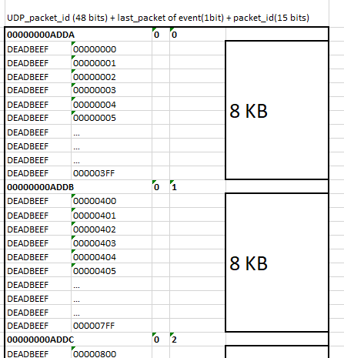
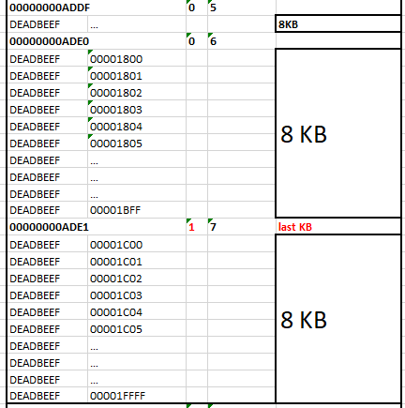
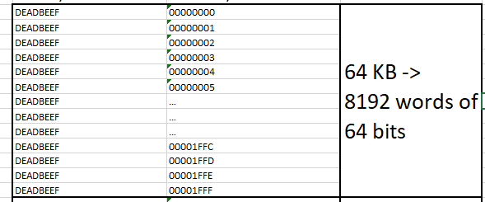
Splicer
Splice X KB of one event on paquets of 8 KB
Add header
Sent paquets to UDP transmiter IP

Slide 7
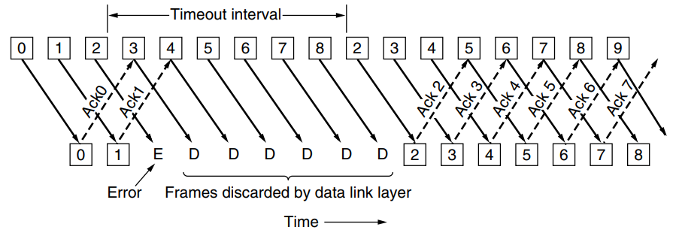
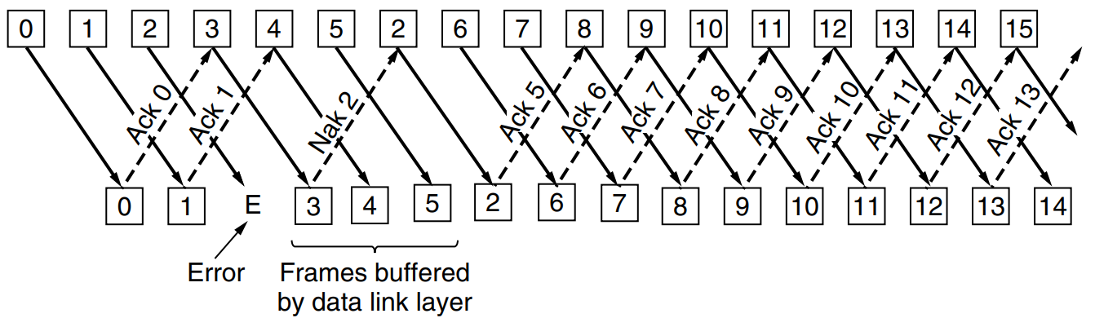
RUDP (if mandatory - see tests)
Reuse of D.Zidler’s code
Modification of frame size
Managed by slowcontrol (via EEPROM) :
_ MAC @ of each SFP
_ IP @ of each SFP (no DHCP)
_ other network stuff (IP server, port, gateway, etc)
Later improvement : RUDP : resent lost paquets
UDP interface
(David Zidler – Zurich)
64 bit
@156,25 Mhz
10 Gb/s
Ethernet SFP
X Paquets de 8 KB

Slide 8
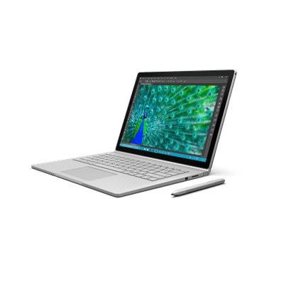
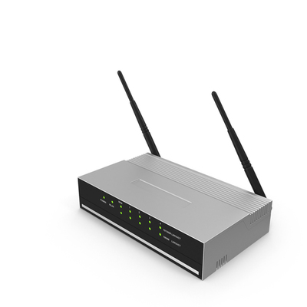
IP_Bus SlowControl (CERN + LPSC Grenoble)
STARE
_XML module description
_Python scripts
_uHAL
IP Bus Protocol
Adress
Data
Ipbus interface
1G Ethernet
Ipbus fabric
Slave
EEPROM
Slave
Splicer
network
Slave
Prog_bitstream (new)
PACE
Slave
Slave
PACE_SPI_bridge
Slave
Ipbus fabric
Ipbus interface
SPI
SPI protocol
Slave

Slide 9
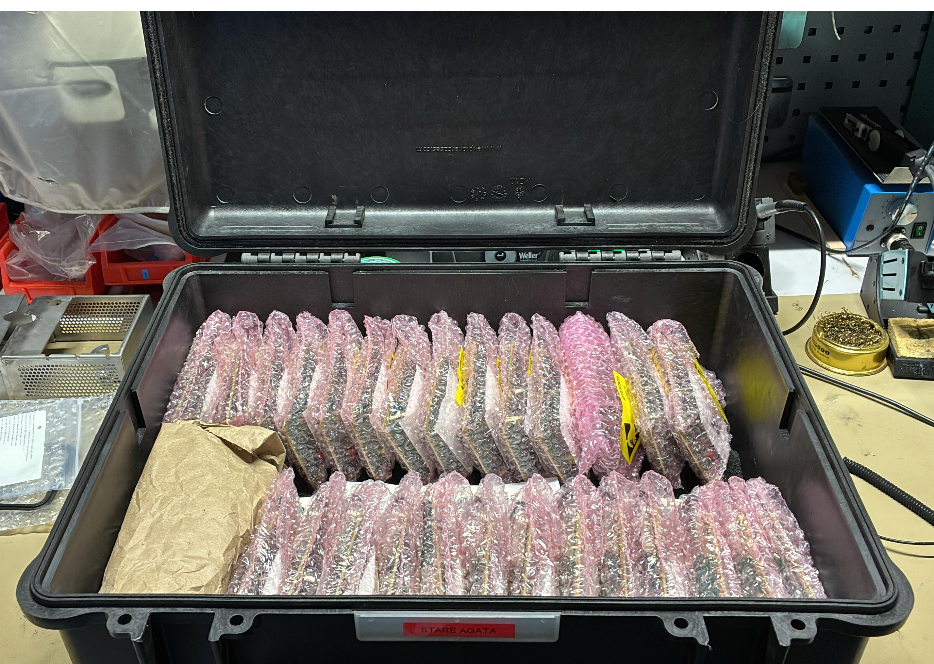
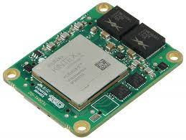
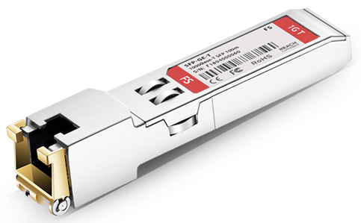
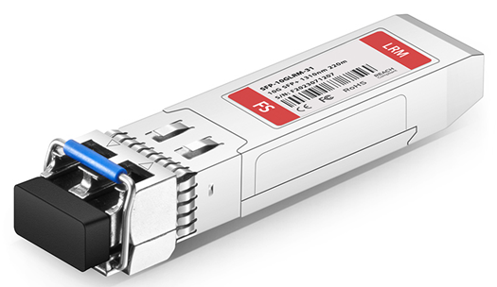
Production
Manufacturer : STAE
150 Stare produced (+10 Pre-production)
63 SOM mounted but 5 cards fails (at least 2 differents issues -> under investigation)
15 SOM just arrived, not yet transfered to STAE
Needed (without spare) :
_ 72 SOM
_ 91 SFP -> RJ45
_ 260 optical SFP

Slide 10
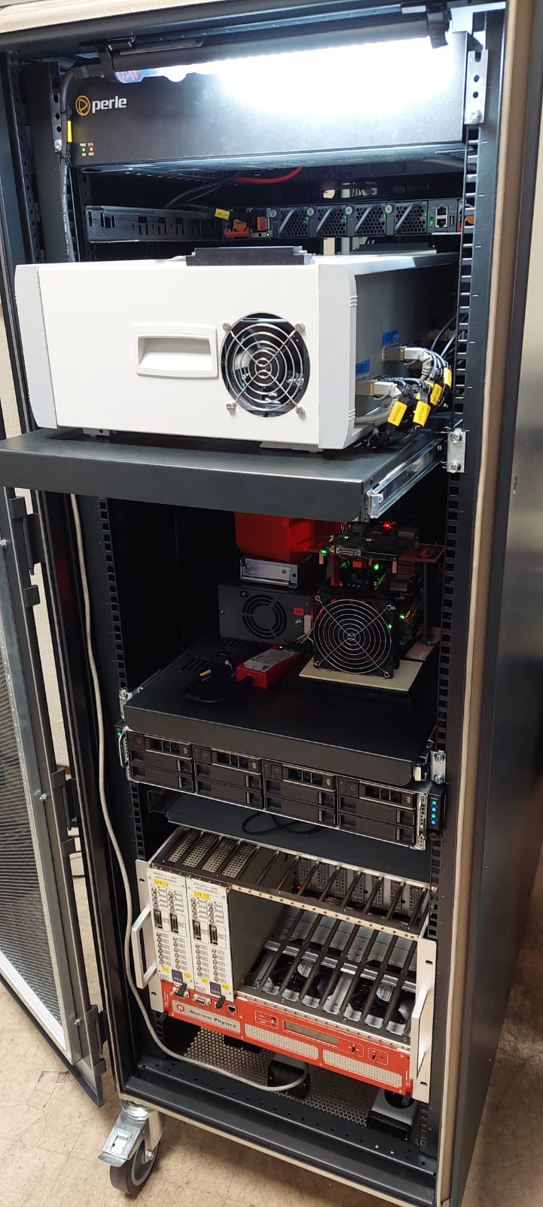
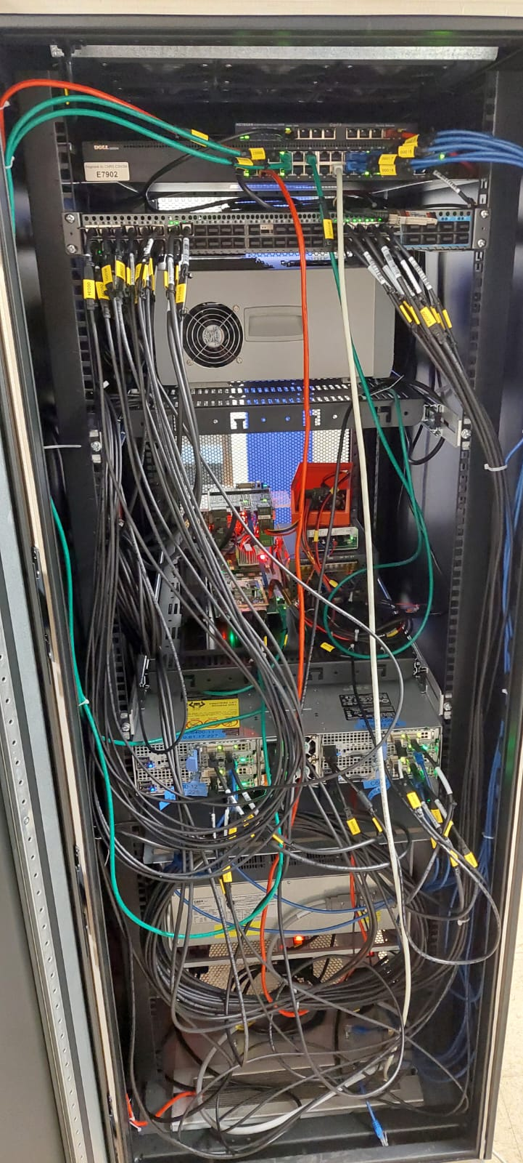
12 Links Bay for Future Development
STARE Data Readout
Power Switch for remote control
A new Bay to be designed to house all the STARE facilities
New PACE crate with cooling, Fans, PS mechanics to fix the backplane and up to 38 channels.
12 links Stare bench
100 Gbps switches
Power switch
8 DAQ servers (4 are there already)
External control via mini-PC
Cristal emulator (pulser + faninfanout + single_diff)
100 Gbps Optical Switche
STARE 12 links
PACE Test Bench (in a crate *)
Up to 2 Pizza boxes
(8 DAQ servers)
Cristal emulator *
* Missing some parts

Slide 11
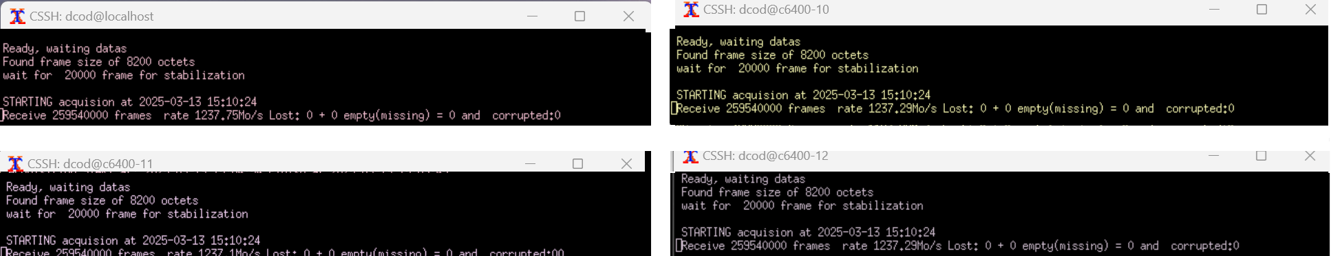
Tests – 8*10Gbps
Stare boards generate 8*10Gbps
Acquisition on C6400 is OK for 1*10 Gbps per server -> 40 Gbps acquissition OK
More than 10 Gbps on one server is usually not possible, but some times it can works (???)
Acquisition test between building and more switches : is RUDP mandatory ?
Acquisition with a 25 Gbps network board on C6400
Validation from digitizer, PACE, STARE to PSA requires a hight resolution pulser.

Slide 12
MERCI

