Slide 1


Top quark physics From the LHC to FCCee
Jeremy Andrea,
IPHC, CNRS, CERN

Slide 2

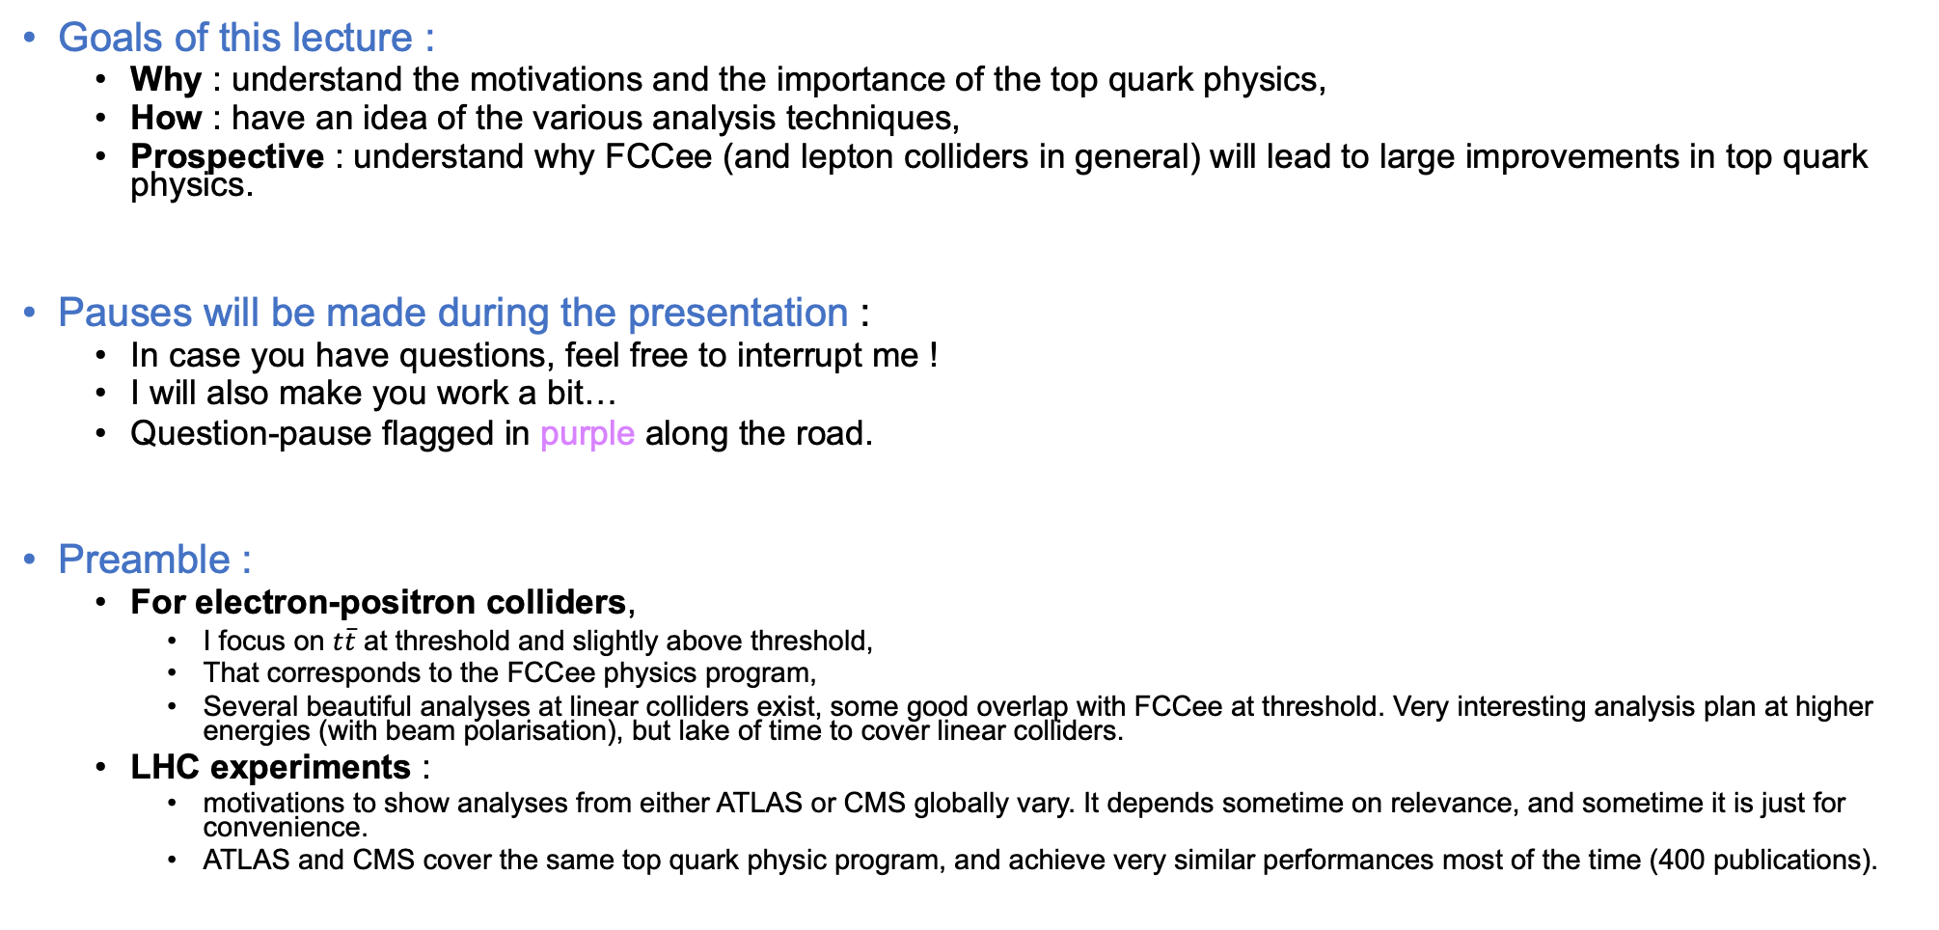
Introduction
Goals of this lecture :
Why : understand the motivations and the importance of the top quark physics,
How : have an idea of the various analysis techniques,
Prospective : understand why FCCee (and lepton colliders in general) will lead to large improvements in top quark physics.
Pauses will be made during the presentation :
In case you have questions, feel free to interrupt me !
I will also make you work a bit…
Question-pause flagged in purple along the road.
Preamble :
For electron-positron colliders,
I focus on $t\overline{t}$ at threshold and slightly above threshold,
That corresponds to the FCCee physics program,
Several beautiful analyses at linear colliders exist, some good overlap with FCCee at threshold. Very interesting analysis plan at higher energies (with beam polarisation), but lake of time to cover linear colliders.
LHC experiments :
motivations to show analyses from either ATLAS or CMS globally vary. It depends sometime on relevance, and sometime it is just for convenience.
ATLAS and CMS cover the same top quark physic program, and achieve very similar performances most of the time (400 publications).

Slide 3
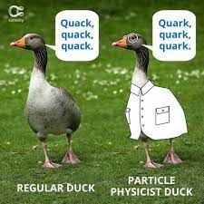
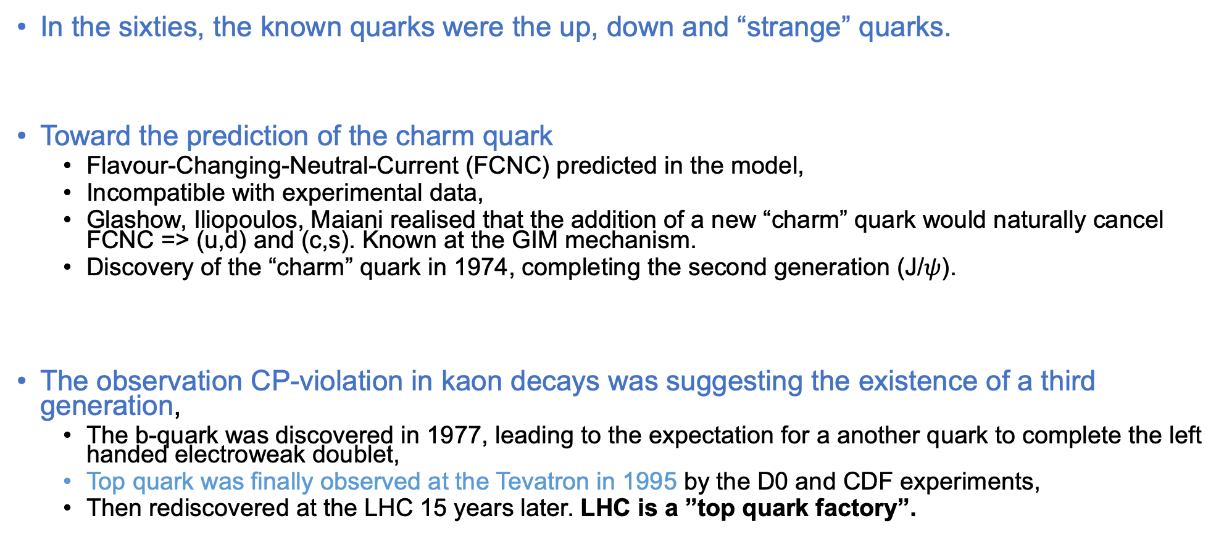
A little bit of history
In the sixties, the known quarks were the up, down and “strange” quarks.
Toward the prediction of the charm quark
Flavour-Changing-Neutral-Current (FCNC) predicted in the model,
Incompatible with experimental data,
Glashow, Iliopoulos, Maiani realised that the addition of a new “charm” quark would naturally cancel FCNC => (u,d) and (c,s). Known at the GIM mechanism.
Discovery of the “charm” quark in 1974, completing the second generation (J/$ψ$).
The observation CP-violation in kaon decays was suggesting the existence of a third generation,
The b-quark was discovered in 1977, leading to the expectation for a another quark to complete the left handed electroweak doublet,
Top quark was finally observed at the Tevatron in 1995 by the D0 and CDF experiments,
Then rediscovered at the LHC 15 years later. LHC is a ”top quark factory”.

Slide 4
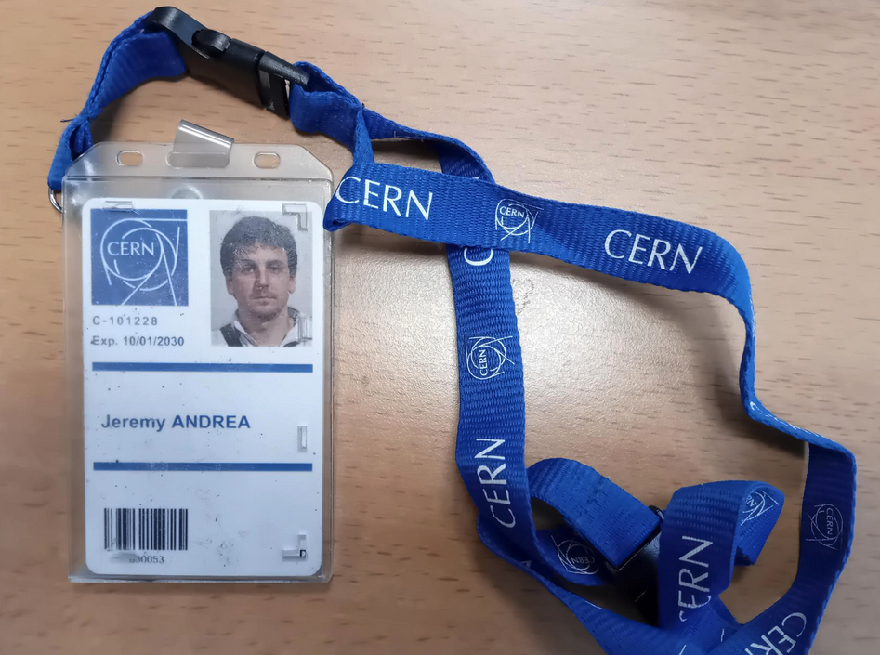
ID card of the top quark
10/09/2008
Top QUARK

Slide 5
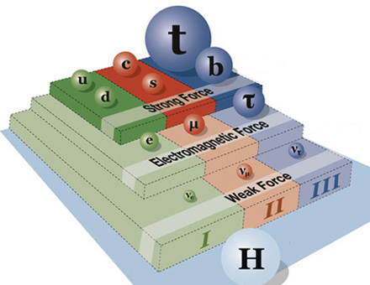
Top quark within the Standard Model
Its a quark :
Sensitive to QCD, couplings to gluons.
Electric charge of +2/3 e
Couples with the photons.
EWK interaction :
Couples to W bosons, flavour changing charged current,
Couples to the Z boson.
It has a masse of ~172.5 GeV, heaviest particle known.
Couples to the Higgs boson.

Slide 6
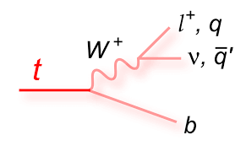
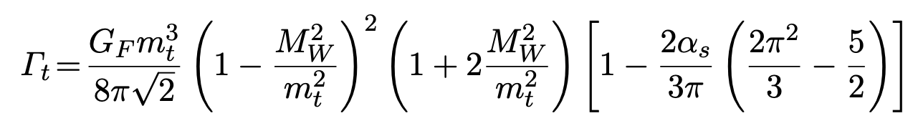
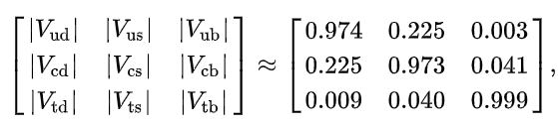
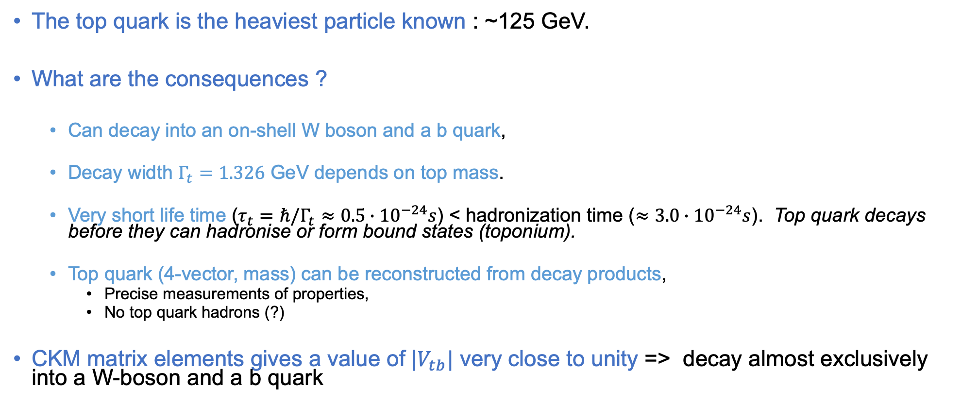
What’s makes the top quark special : mass and decay
The top quark is the heaviest particle known : ~125 GeV.
What are the consequences ?
Can decay into an on-shell W boson and a b quark,
Decay width $Γ_{t}=1.326$ GeV depends on top mass.
Very short life time ($τ_{t}=ℏ/Γ_{t}≈0.5∙{10}^{−24}s$) < hadronization time ($≈3.0∙{10}^{−24}s$). Top quark decays before they can hadronise or form bound states (toponium).
Top quark (4-vector, mass) can be reconstructed from decay products,
Precise measurements of properties,
No top quark hadrons (?)
CKM matrix elements gives a value of |$V_{tb}|$ very close to unity => decay almost exclusively into a W-boson and a b quark

Slide 7
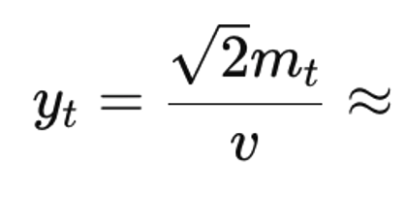
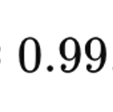
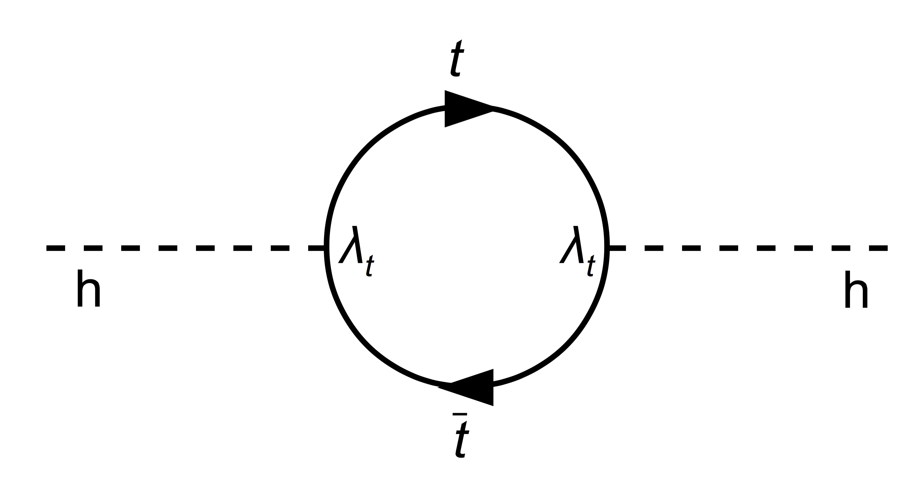



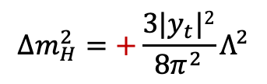
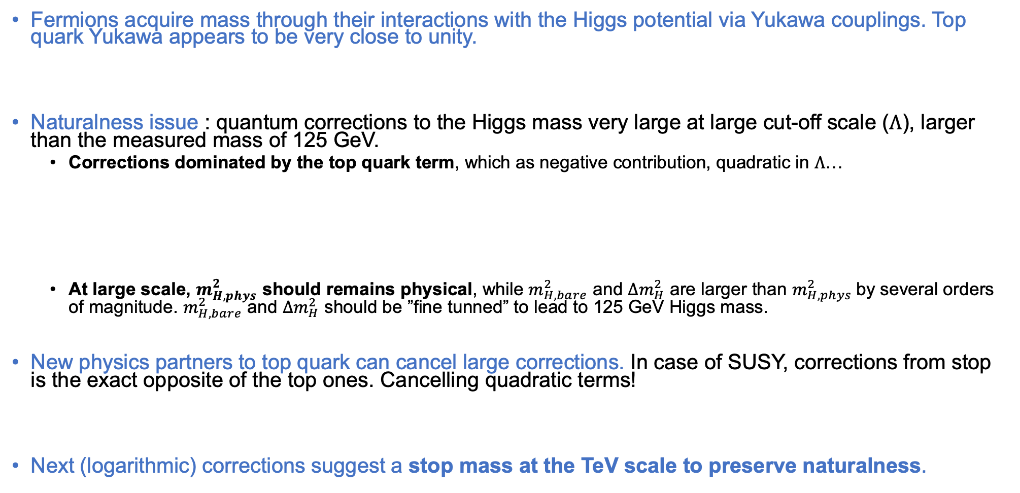
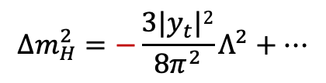
Top quark yukawa and naturalness
Fermions acquire mass through their interactions with the Higgs potential via Yukawa couplings. Top quark Yukawa appears to be very close to unity.
Naturalness issue : quantum corrections to the Higgs mass very large at large cut-off scale ($Λ$), larger than the measured mass of 125 GeV.
Corrections dominated by the top quark term, which as negative contribution, quadratic in $Λ$…
At large scale, $m_{H,phys}^{2}$ should remains physical, while $m_{H, bare}^{2}$ and $∆m_{H}^{2}$ are larger than $m_{H,phys}^{2}$by several orders of magnitude. $m_{H, bare}^{2}$ and $∆m_{H}^{2}$ should be ”fine tunned” to lead to 125 GeV Higgs mass.
New physics partners to top quark can cancel large corrections. In case of SUSY, corrections from stop is the exact opposite of the top ones. Cancelling quadratic terms!
Next (logarithmic) corrections suggest a stop mass at the TeV scale to preserve naturalness.
$$ℒ_{yukawa}=\frac{y_{t}v}{\sqrt{2}}\overline{ψ_{t}}ψ_{t}+\frac{y_{t}}{\sqrt{2}}h\overline{ψ_{t}}ψ_{t}$$
$$∆m_{H}^{2}=−\frac{3{|y}_{t}|2}{8π^{2}}Λ^{2}+…$$
$$∆m_{H}^{2}=+\frac{3{|y}_{t}|2}{8π^{2}}Λ^{2}$$

Slide 8

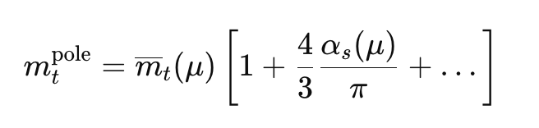
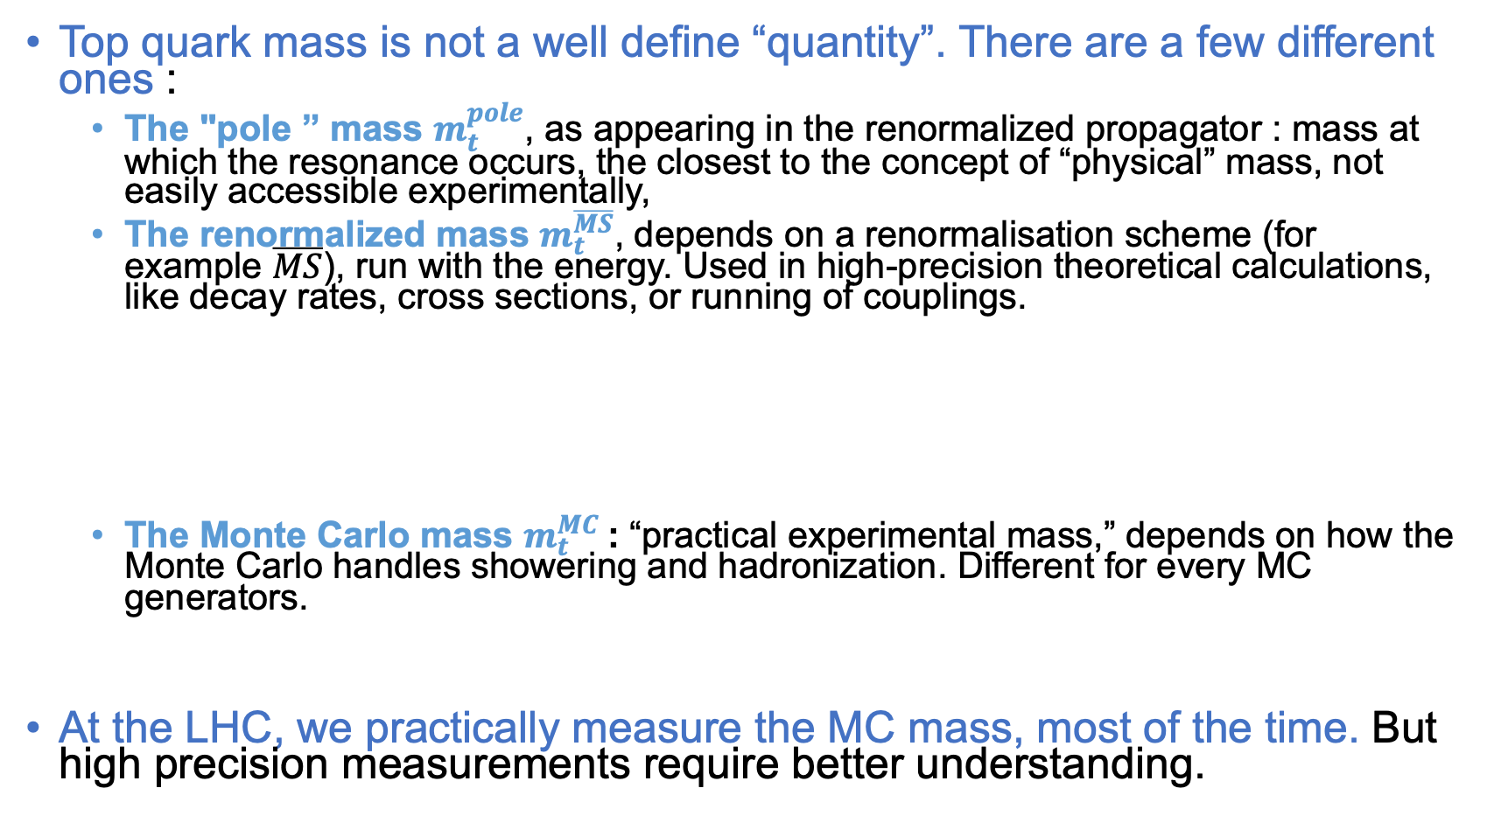
Top quark mass puzzle
Top quark mass is not a well define “quantity”. There are a few different ones :
The "pole ” mass $m_{t}^{pole}$, as appearing in the renormalized propagator : mass at which the resonance occurs, the closest to the concept of “physical” mass, not easily accessible experimentally,
The renormalized mass $m_{t}^{\overline{MS}}$, depends on a renormalisation scheme (for example $\overline{MS}$), run with the energy. Used in high-precision theoretical calculations, like decay rates, cross sections, or running of couplings.
The Monte Carlo mass $m_{t}^{MC}$: “practical experimental mass,” depends on how the Monte Carlo handles showering and hadronization. Different for every MC generators.
At the LHC, we practically measure the MC mass, most of the time. But high precision measurements require better understanding.
About 200 MeV precision

Slide 9
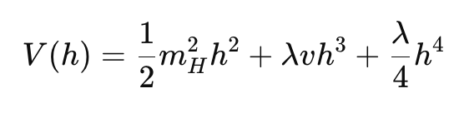
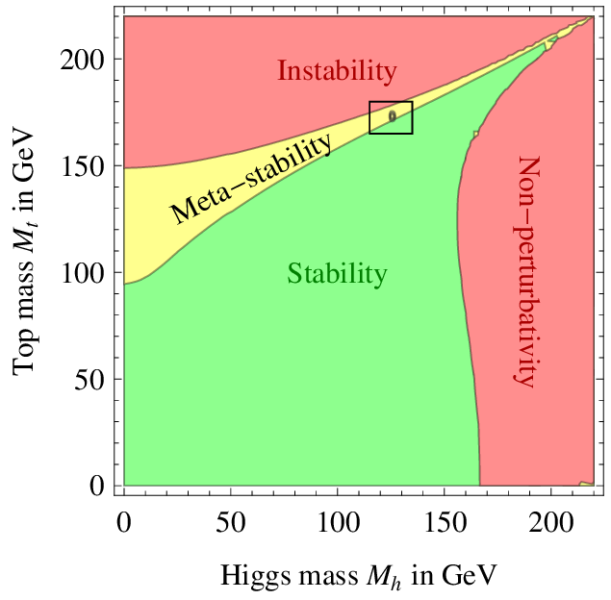
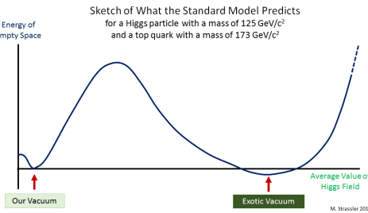
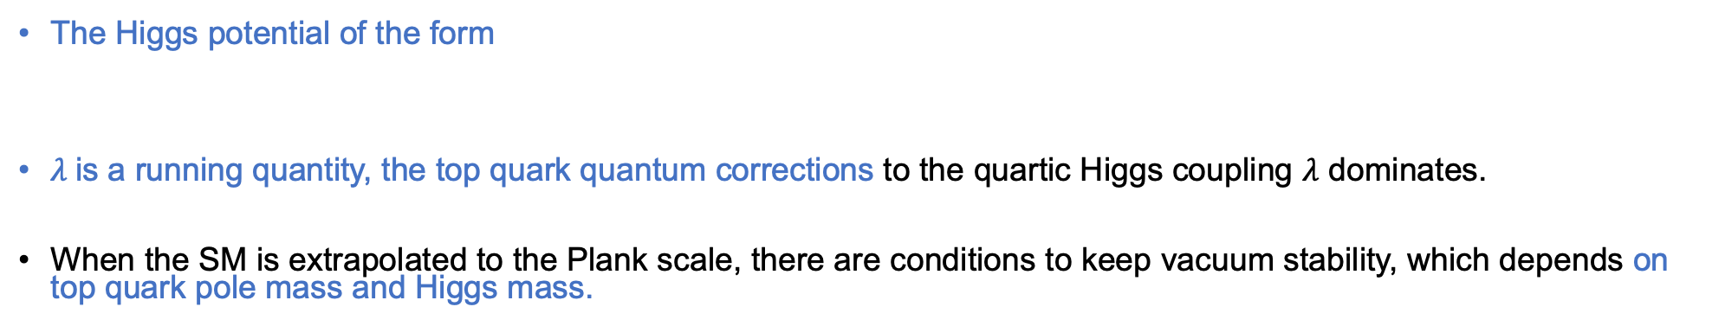
Top quark and vacuum stability
Phys. Lett. B716 (2012) 214
The Higgs potential of the form
$λ$is a running quantity, the top quark quantum corrections to the quartic Higgs coupling $λ$ dominates.
When the SM is extrapolated to the Plank scale, there are conditions to keep vacuum stability, which depends on top quark pole mass and Higgs mass.
Matt Strassler link

Slide 10
Top quark and vacuum stability
https://arxiv.org/pdf/1207.0980
The Higgs potential of the form
$λ$is a running quantity, the top quark quantum corrections to the quartic Higgs coupling $λ$ dominates.
When the SM is extrapolated to the Plank scale, there are conditions to keep vacuum stability, which depends on top quark pole mass and Higgs mass.
Assumes no new physics
Matt Strassler link

Slide 11




Top quark production
$$t$$
$$t$$
$$t$$

Slide 12
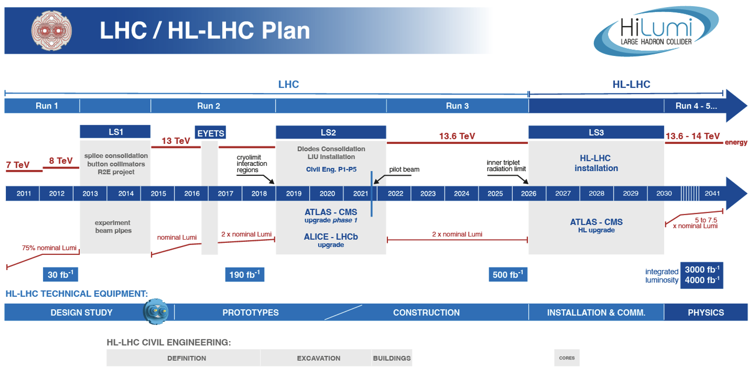
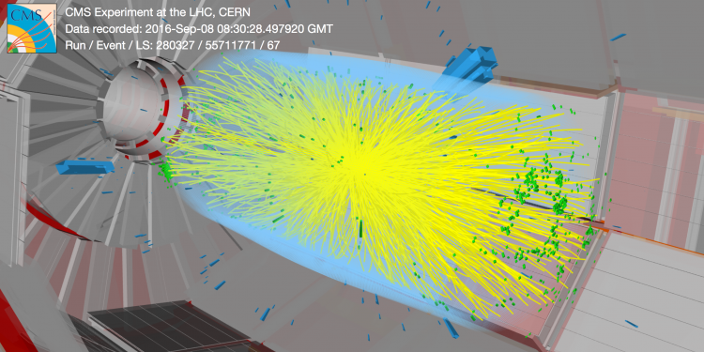
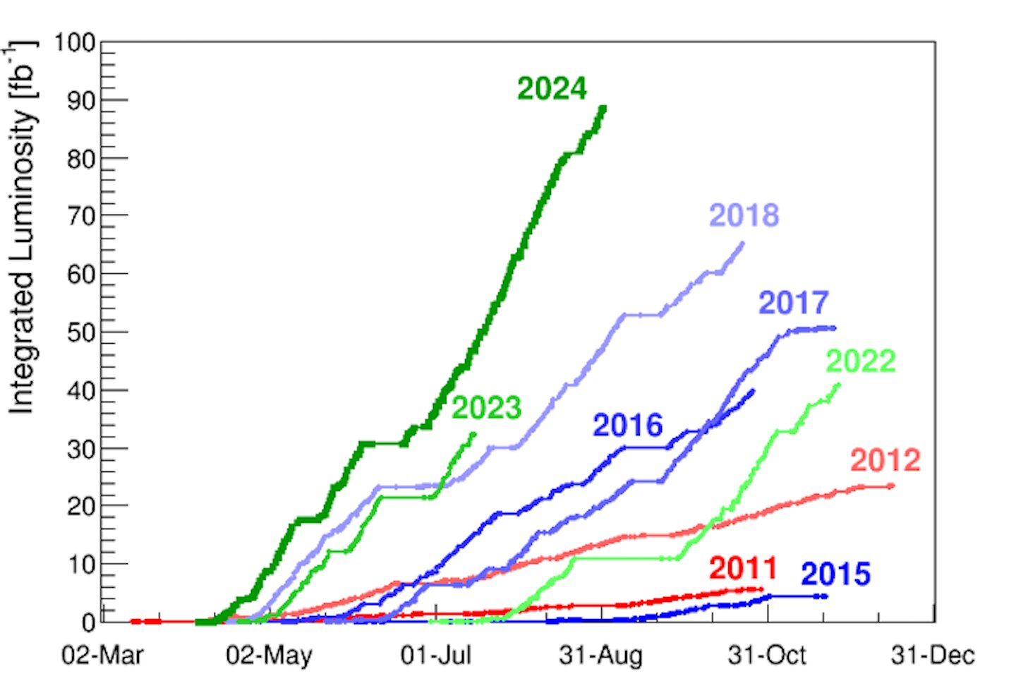
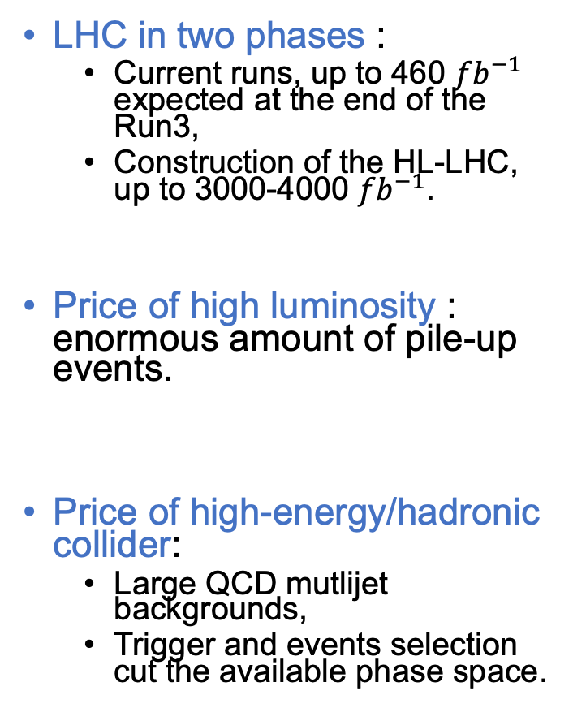
Runs at the LHC and HL-LHC
LHC in two phases :
Current runs, up to 460 ${fb}^{−1}$ expected at the end of the Run3,
Construction of the HL-LHC, up to 3000-4000 ${fb}^{−1}$.
Price of high luminosity : enormous amount of pile-up events.
Price of high-energy/hadronic collider:
Large QCD mutlijet backgrounds,
Trigger and events selection cut the available phase space.

Slide 13
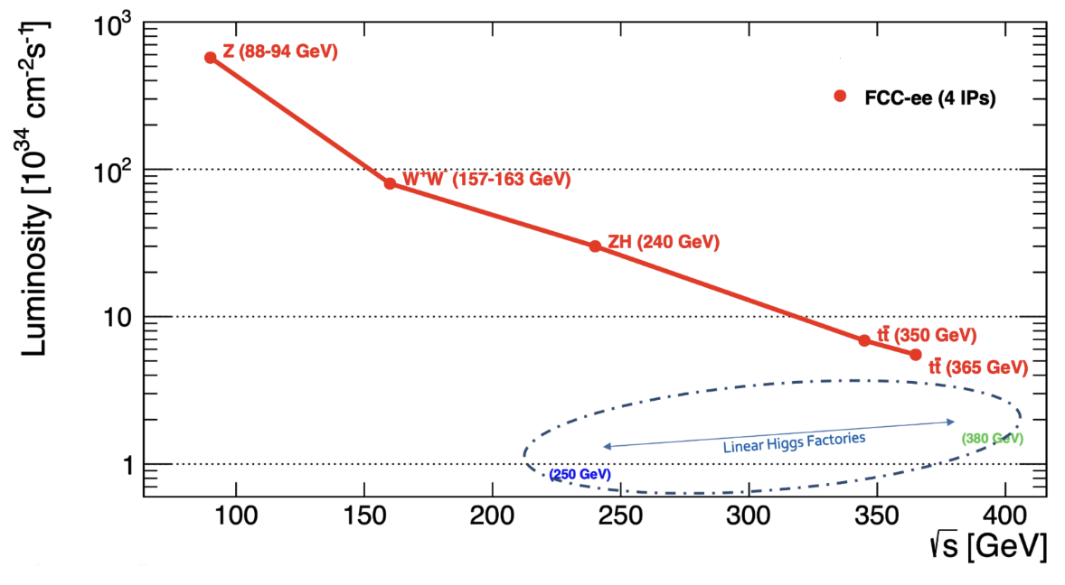




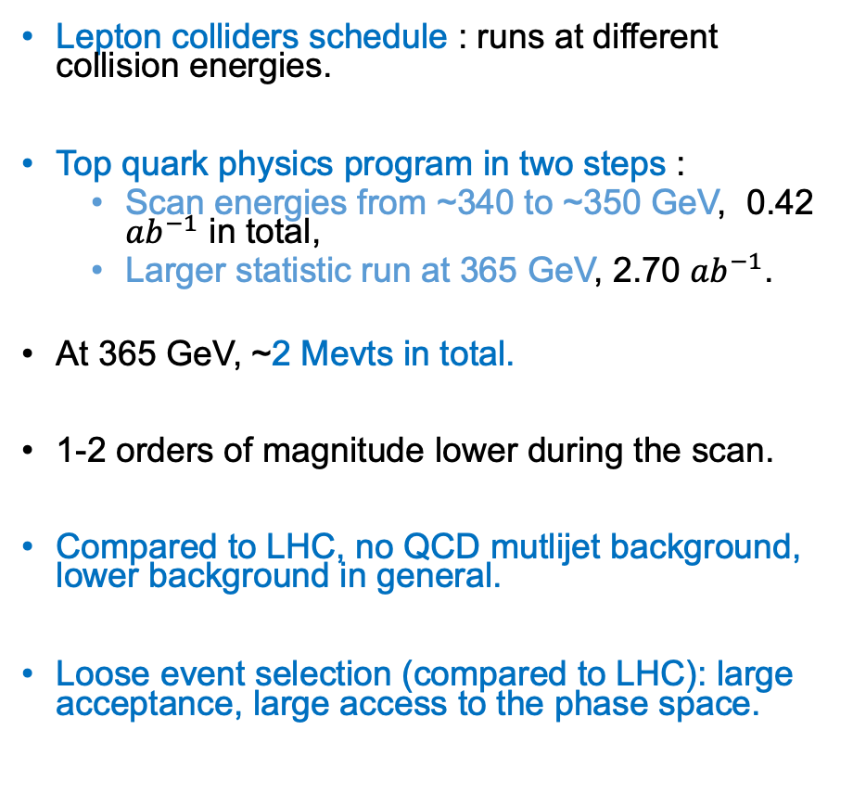
Runs at the FCCee
Lepton colliders schedule : runs at different collision energies.
Top quark physics program in two steps :
Scan energies from ~340 to ~350 GeV, 0.42 ${ab}^{−1}$ in total,
Larger statistic run at 365 GeV, 2.70 ${ab}^{−1}$.
At 365 GeV, ~2 Mevts in total.
1-2 orders of magnitude lower during the scan.
Compared to LHC, no QCD mutlijet background, lower background in general.
Loose event selection (compared to LHC): large acceptance, large access to the phase space.
Z(4 ys)
WW
(2y)
ZH(3y)
LS
(1y)
tt(4 ys)
205${ ab}^{−1}$
19 ${ab}^{−1}$
11 ${ab}^{−1}$
0.4+3 ${ab}^{−1}$
After $e^{+}e^{−}$ phase, the FCChh (p-p) collider would be installed, with collisions at 100 TeV and ~20 ${ab}^{−1}$ over 25y of operations

Slide 14
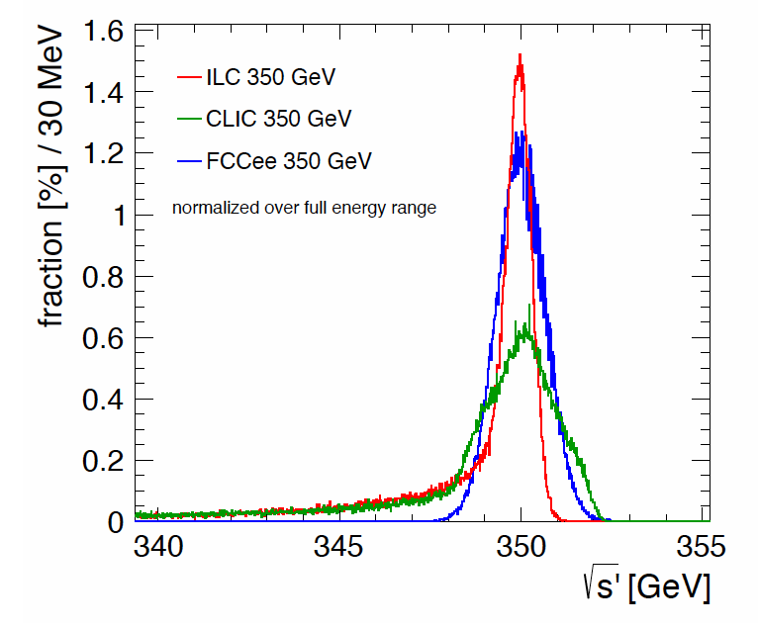
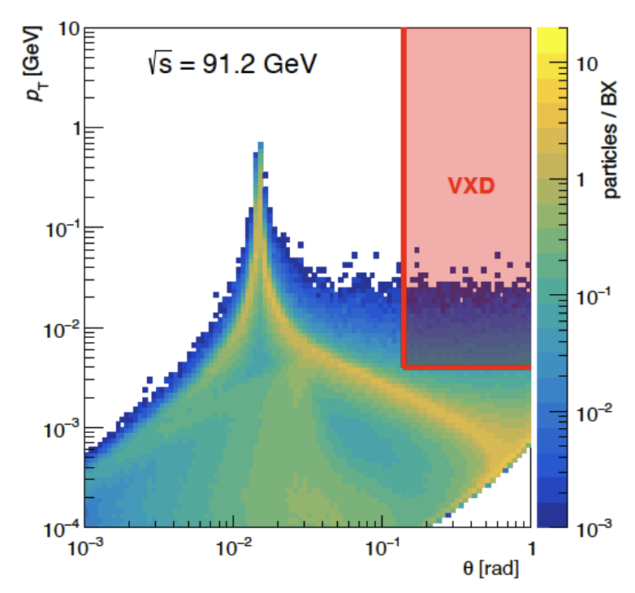
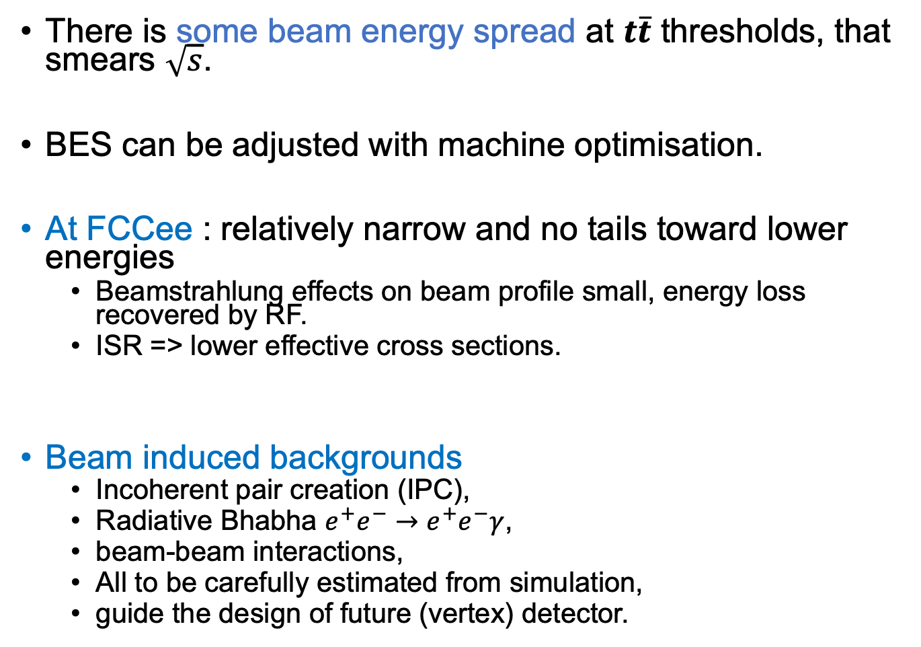
Beam characteristics and impact on $t\overline{t}$ at FCCee
F.Simon, PoS (ICHEP 2016) 872
There is some beam energy spread at $t\overline{t}$ thresholds, that smears $\sqrt{s}$.
BES can be adjusted with machine optimisation.
At FCCee : relatively narrow and no tails toward lower energies
Beamstrahlung effects on beam profile small, energy loss recovered by RF.
ISR => lower effective cross sections.
Beam induced backgrounds
Incoherent pair creation (IPC),
Radiative Bhabha $e^{+}e^{−}→e^{+}e^{−}γ$,
beam-beam interactions,
All to be carefully estimated from simulation,
guide the design of future (vertex) detector.
M.Boscolo link

Slide 15
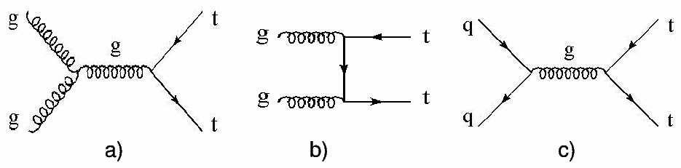

Dominant production mode : top quark pairs ($t\overline{t}$) at the LHC/FCChh
Q: cross section calculation?

Slide 16
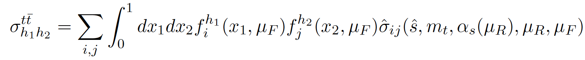
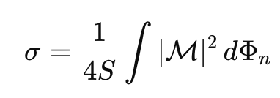
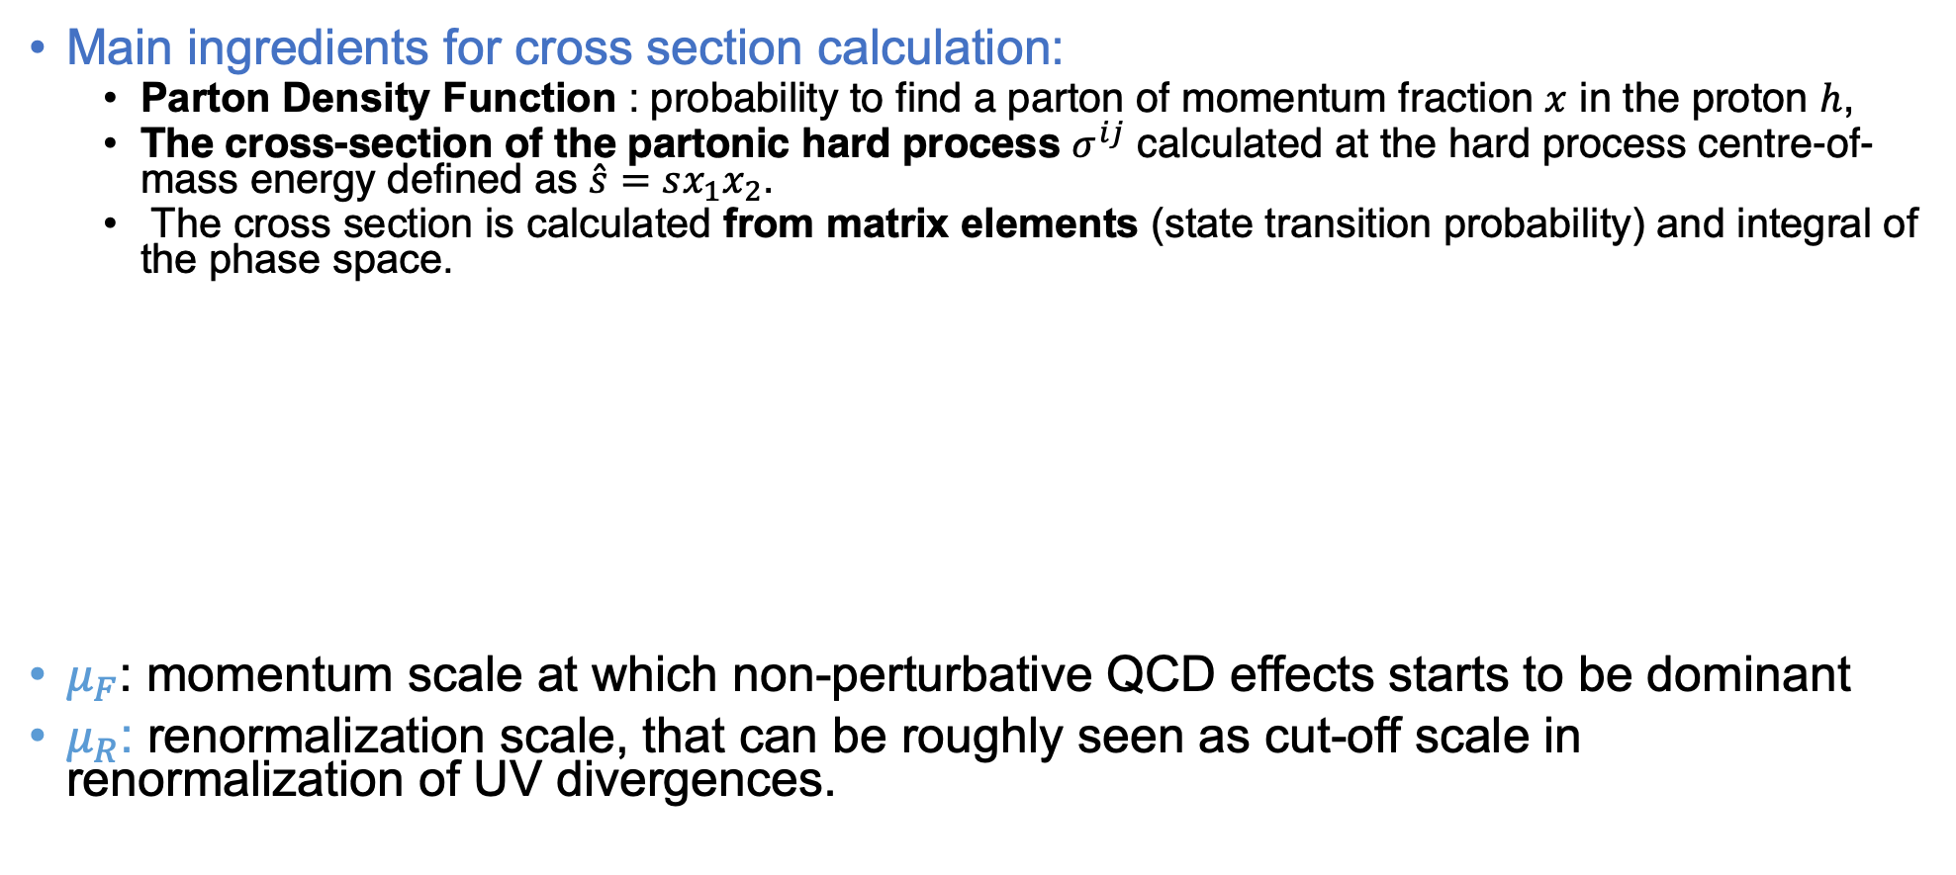
Top quark production at hadronic colliders
Main ingredients for cross section calculation:
Parton Density Function : probability to find a parton of momentum fraction $x$ in the proton $h$,
The cross-section of the partonic hard process $σ^{ij}$ calculated at the hard process centre-of-mass energy defined as $\hat{s}=sx_{1}x_{2}$.
The cross section is calculated from matrix elements (state transition probability) and integral of the phase space.
$μ_{F}$: momentum scale at which non-perturbative QCD effects starts to be dominant
$μ_{R}$: renormalization scale, that can be roughly seen as cut-off scale in renormalization of UV divergences.
Matrix element
flux
Phase space

Slide 17
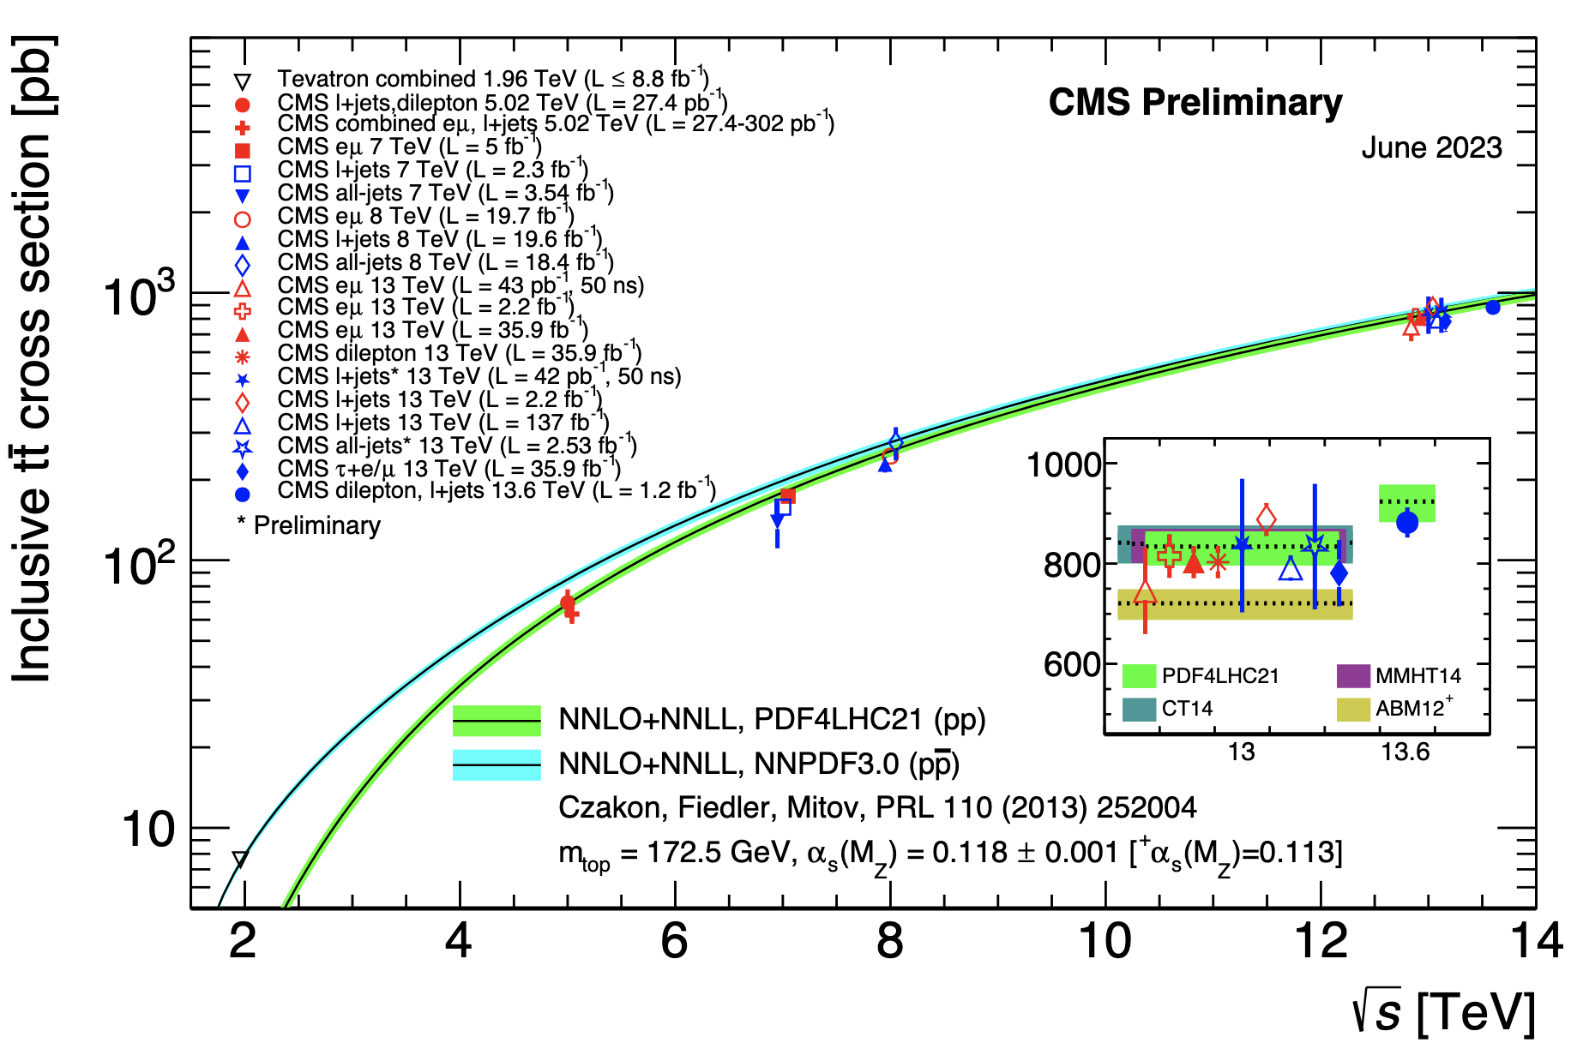

$t\overline{t}$ cross sections at the LHC

Slide 18
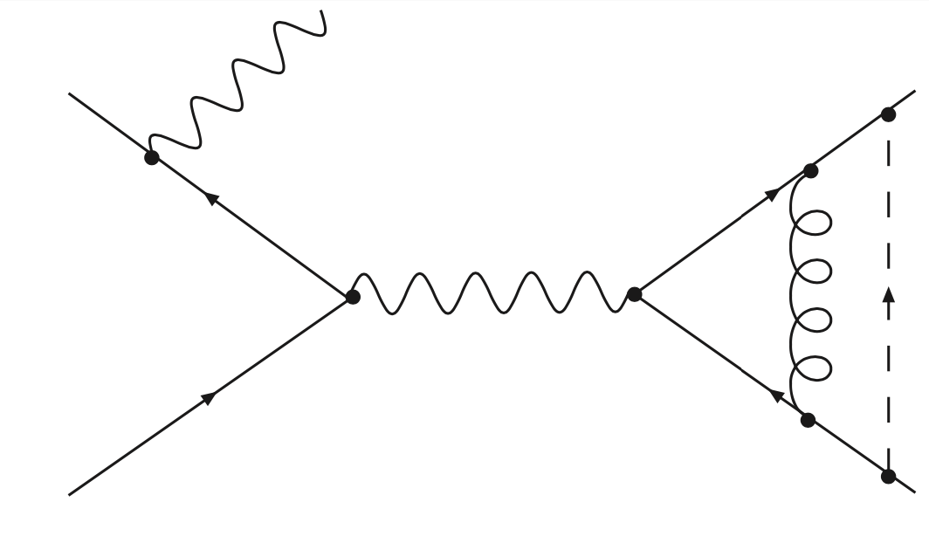








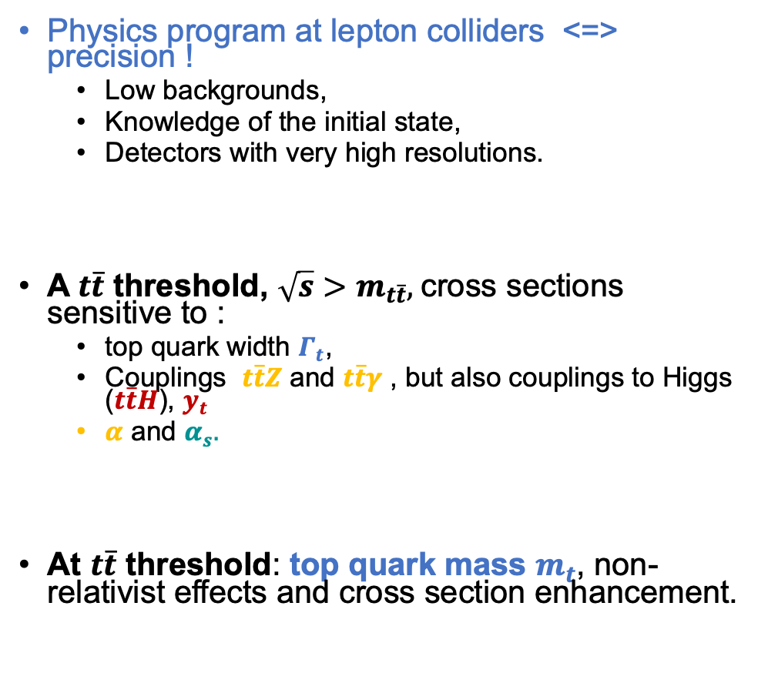



Top quark production at $e^{+}e^{−}$collider
Physics program at lepton colliders <=> precision !
Low backgrounds,
Knowledge of the initial state,
Detectors with very high resolutions.
A$t\overline{t}$ threshold, $\sqrt{s}>m_{t\overline{t}},$cross sections sensitive to :
top quark width $Γ_{t}$,
Couplings $t\overline{t}Z$ and $t\overline{t}γ$ , but also couplings to Higgs ($t\overline{t}H$), $y_{t}$
$α$ and $α_{s}.$
At $t\overline{t}$ threshold: top quark mass $m_{t}$, non-relativist effects and cross section enhancement.
$$α_{s},t\overline{t}g$$
$$t$$
$$e^{+}$$
$$Z/γ^{∗}$$
$$g$$
$$H$$
$$e^{−}$$
$α,t\overline{t}Z$, $t\overline{t}γ$
$$\overline{t}$$
$$y_{t},t\overline{t}H$$

Slide 19
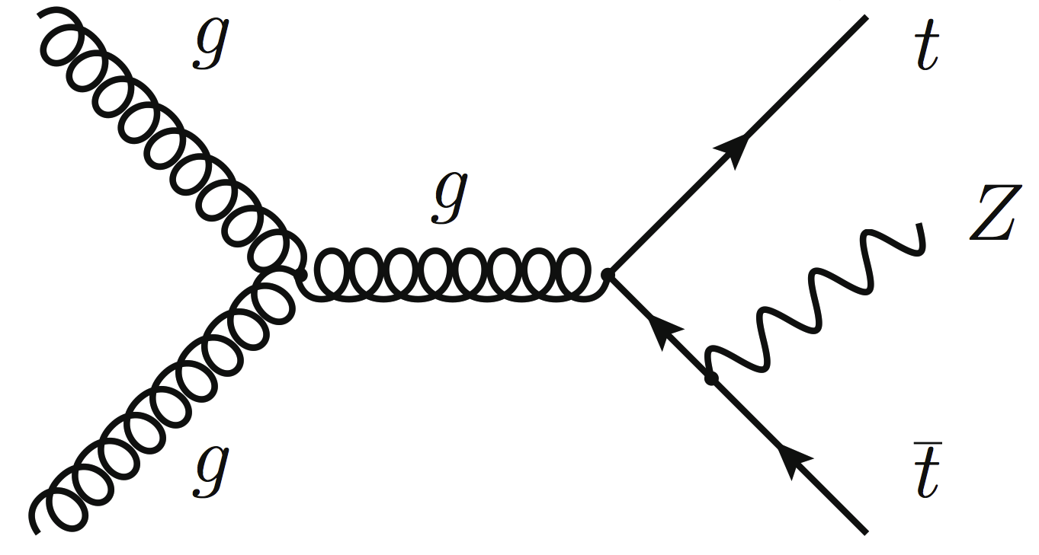
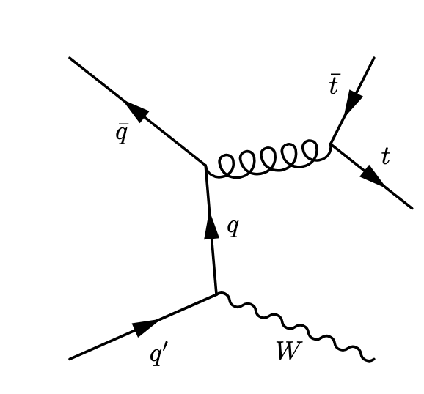
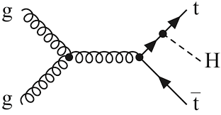
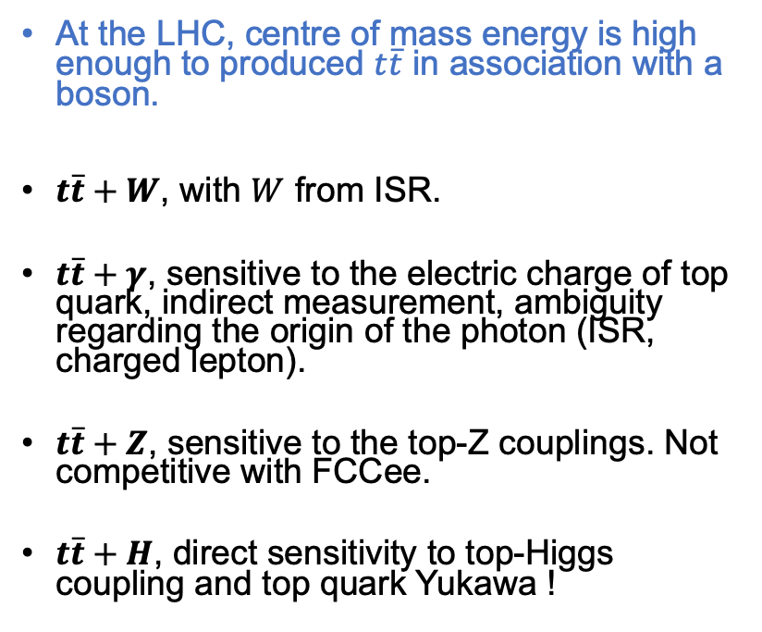


$t\overline{t}$ associated production
$$γ$$
At the LHC, centre of mass energy is high enough to produced $t\overline{t}$ in association with a boson.
$t\overline{t}+W$, with $W$ from ISR.
$t\overline{t}+γ$, sensitive to the electric charge of top quark, indirect measurement, ambiguity regarding the origin of the photon (ISR, charged lepton).
$t\overline{t}+Z$, sensitive to the top-Z couplings. Not competitive with FCCee.
$t\overline{t}+H$, direct sensitivity to top-Higgs coupling and top quark Yukawa !

Slide 20
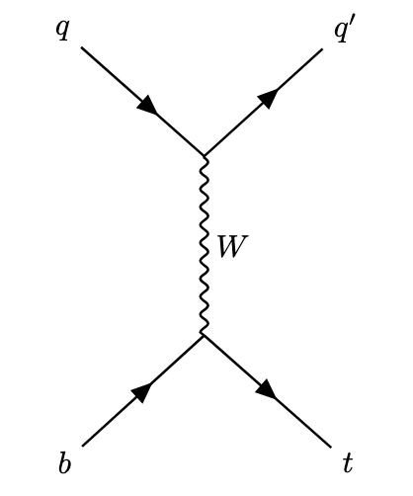
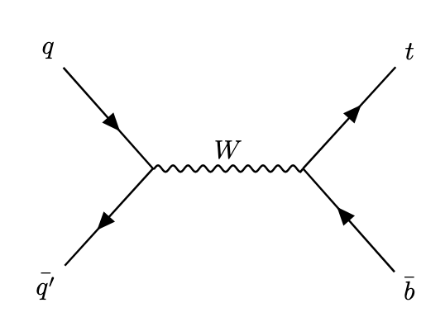

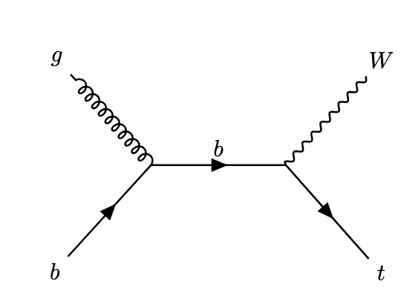
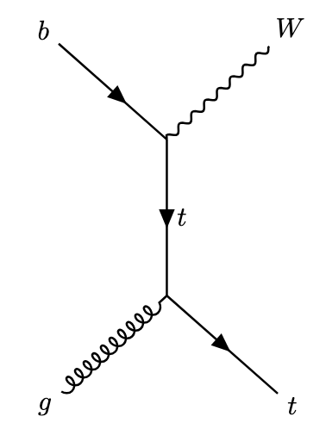
Single top quark
Q: highest cross section ?

Slide 21
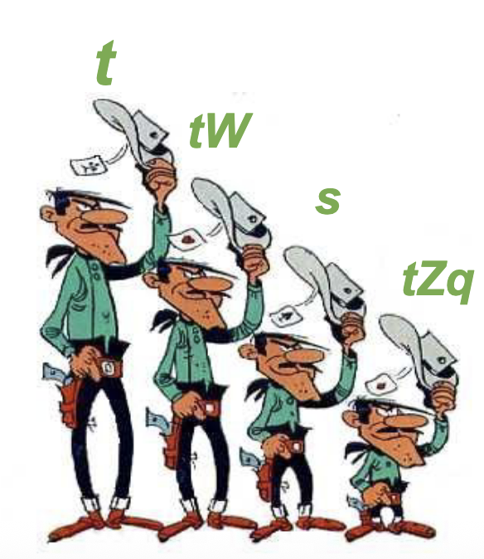
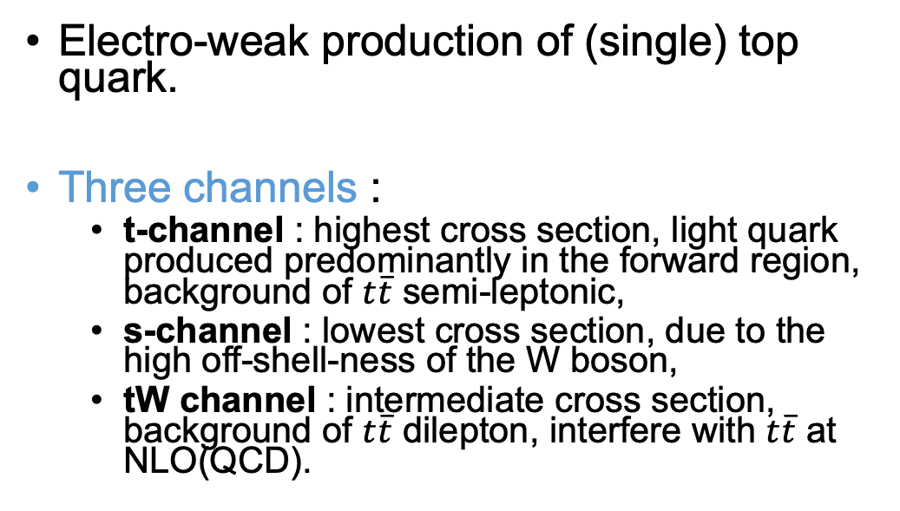
Single top quark
Electro-weak production of (single) top quark.
Three channels :
t-channel : highest cross section, light quark produced predominantly in the forward region, background of $t\overline{t}$ semi-leptonic,
s-channel : lowest cross section, due to the high off-shell-ness of the W boson,
tW channel : intermediate cross section, background of $t\overline{t}$ dilepton, interfere with $t\overline{t}$ at NLO(QCD).
Q: draw single top diagram at FCCee

Slide 22
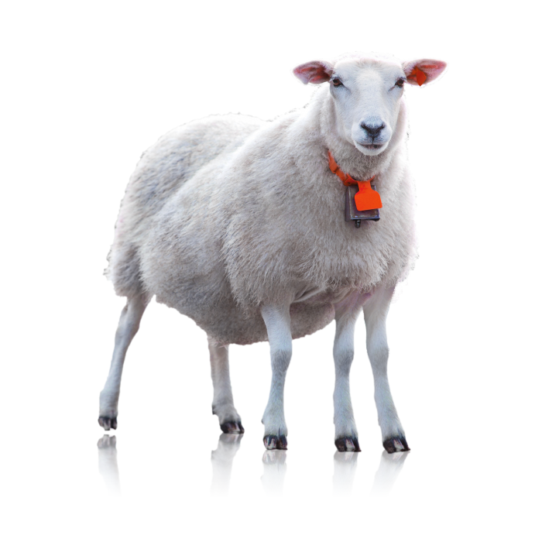
Single to at FCCee does not exist at 240 GeV

Slide 23
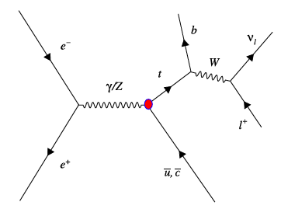

Unless it comes from new physics

Slide 24
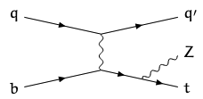



Single top associated production
Associated production of single top quark (mainly in the t-channel) and bosons.
Provide extra sensitivity to $tγ$ and $tZ$, even if less sensitive than $t\overline{t}$ channel.
$tHq$ is sensitive to the sign of the top quark Yukawa through interference of diagrams.
$$γ$$

Slide 25



$t\overline{t}$ and $W^{+}W^{−}b\overline{b}$ interferences
$t\overline{t}$ process refers to $W^{+}W^{−}b\overline{b}$ with double resonant top quark.
Other processes leads to the same final state of $W^{+}W^{−}b\overline{b}$ at the NLO in QCD, especially for the single top $tWb$ process.
Single tW channel, the initial b-quark can come from the PDF, or from a gluon splitting. B-quark in the final state usually at low $p_{T}$, not passing the jet selections.
Splitting between $t\overline{t}$ and $tWb$ at NLO(QCD) is tricky : treatment of interferences, off-shell top quarks. Diagram subtraction ($t\overline{t}$ resonant contributions removed from cross section calculation), diagram removal ($t\overline{t}$ resonant diagram removed at matrix element level).
2 resonnant top quarks
Single top tW
0 resonnant top
Q: what are the conditions to have interferences ?

Slide 26

Single top cross section at LHC

Slide 27

Summary of cross sections

Slide 28

Top quark decay channels

Slide 29




$t\overline{t}$ decay channels
As ${|V}_{tb}|\sim 1$, top quark almost always decay into a W boson and a b-quark. This leads to 3 different classes of decay channels :
Dilepton : $W→lν$, $W→lν$,
Lepton+jets (semi-leptonic) :$W→lν$, $W→q\overline{q′}$,
Full hadronic : $W→q\overline{q′}$, $W→q\overline{q′}$.
At the LHC :
Dileptonic channels are cleaner, precise inclusive xs => low backgrounds contamination and large luminosity compensate the lower Br, event reconstruction difficult,
Full hadronic challenging because of the large QCD- multijet background,
Semi-leptonic channel shows a good compromise.
At lepton colliders :
small backgrounds for all channels, mainly from WW,
higher selection efficiency,
precise knowledge of the initial state = more precise events reconstruction.

Slide 30




$t\overline{t}$ in the single-lepton channels
Experimental signatures ?
Dominant backgrounds ?

Slide 31




$t\overline{t}$ in the single-lepton channels
1 charged lepton, 2 light jets, 2 b-jets, missing E(ET).
Dominant backgrounds :
At the LHC : W+jets, single top, WW, QCD,
At the FCCee : WWbb (…) diboson.
At FCCee, there is an extra constrain from the precise knowledge of $\sqrt{s}$.
@LHC : >30% of $t\overline{t}$ events have at least one extra jet !
Kinematics reconstruction
Use b-tagging to identify the most probable b-jets,
Use W mass constrain to identify the most probable jets from W-hadr,
Use W mass constrain to calculate the neutrino 4-momentum, no need to have a constrains on the top mass,
Kinematic fit if top mass known.

Slide 32



$t\overline{t}$ in the full-hadronic channels
Experimental signatures ?
Dominant backgrounds ?

Slide 33



$t\overline{t}$ in the full-hadronic channels
4 lights jets, 2 b-jets
Dominant backgrounds :
At the LHC : QCD, QCD, QCD, QCD… Very difficult to extract signal from backgrounds, large cut on the phase space.
At FCCee : WWbb (…) diboson, dijet.
@LHC : >30% of $t\overline{t}$ events have at least one extra jet !
Events reconstruction,
Difficulties from the combinatorics, particularly at the LHC,
Kinematic system can be fully reconstructed without constrains,
Kinematic fit knowing top quark mass and W constrains

Slide 34

$t\overline{t}$ in the dilepton channels
Experimental signatures ?
Dominant backgrounds ?

Slide 35

$t\overline{t}$ in the dilepton channels
Experimental signatures: 2 charged leptons with opposite charges, 2 neutrinos, 2 bjets.
Dominant backgrounds:
At the LHC : Z+jets, single top tW, dibosons, $t\overline{t}$ lepton+jets.
At the FCCee : WWbb (…), dibosons
Events reconstruction.
Kinematic fits much more challenging : 6 knowns (neutrinos momentum) requires 6 constrains
At LHC : requires a top mass constrains !
At FCCee : no need for top mass constrains (initial state known!).
Usually leads to lower resolutions.

Slide 36

Summary of $t\overline{t}$ channels
 | LHC |  |  |  | FCC ee
 | Stat. | Bkg. | Event reco | Analysis | Stat. | Bkg. | Event reco | Analysis
dilepton | low | low | difficult | Large luminosity, low background =>golden channel for inclusive cross section. more sensitive to spin correlation (spin analysis power of charged leptons) | low | same | Difficult At FCCee easier than at LHC | Limited by statistic.
Lepton+jets | medium | medium | good | Optimal reconstruction, golden channel for mass and differential cross section measurements | medium | same | good | Golden channel in most analyses.
full-hadronic | large | large | difficult | Poor sensitivity overall |  | same | No extra QCD jets, better jet resolution and b-tagging performance. | Golden channel in most analyses.

Slide 37
Top quark MC generation
Q: what are the different steps for MC generation?

Slide 38


Events generation
Analyses relies on MC generators, made of several steps (here for $t\overline{t}H$).
Hard interaction.
Top quark and Higgs decays,
Hard QCD radiation,
soft QCD radiation
Secondary interaction, underlying events,
Final state partons hadronise,
Hadrons decay.
Hard process generator : MG5, aMCNLO, Powheg…
Pythia, Herwig
Pythia, Herwig

Slide 39
Events generation
Analyses relies on MC generators, made of several steps (here for $t\overline{t}H$).
Hard interaction.
Top quark and Higgs decays,
Hard QCD radiation,
soft QCD radiation
Secondary interaction, underlying events,
Final state partons hadronise,
Hadrons decay.
Hard process generator : MG5, aMCNLO, Powheg…
Pythia, Herwig
Pythia, Herwig

Slide 40
Events generation
Analyses relies on MC generators, made of several steps (here for $t\overline{t}H$).
Hard interaction.
Top quark and Higgs decays,
Hard QCD radiation,
soft QCD radiation
Secondary interaction, underlying events,
Final state partons hadronise,
Hadrons decay.
Hard process generator : MG5, aMCNLO, Powheg…
Pythia, Herwig
Pythia, Herwig

Slide 41
Events generation
Analyses relies on MC generators, made of several steps (here for $t\overline{t}H$).
Hard interaction.
Top quark and Higgs decays,
Hard QCD radiation,
soft QCD radiation
Secondary interaction, underlying events,
Final state partons hadronise,
Hadrons decay.
Hard process generator : MG5, aMCNLO, Powheg…
Pythia, Herwig
Pythia, Herwig

Slide 42
Events generation
Analyses relies on MC generators, made of several steps (here for $t\overline{t}H$).
Hard interaction.
Top quark and Higgs decays,
Hard QCD radiation,
soft QCD radiation
Secondary interaction, underlying events,
Final state partons hadronise,
Hadrons decay.
Hard process generator : MG5, aMCNLO, Powheg…
Pythia, Herwig
Pythia, Herwig

Slide 43



Events generation
Analyses relies on MC generators, made of several steps (here for $t\overline{t}H$).
Hard interaction.
Top quark and Higgs decays,
Hard QCD radiation,
Secondary interaction, underlying events,
Final state partons hadronise,
Hadrons decay.
Highest possible precision in theoretical calculations and MC generators is a key to achieve high precision measurements.
No deep bibliography on precision calculation is done for this lecture. But some ”grosso-modo” elements.
For generation :
NLO QCD is accessible from several generators (aMC@NLO, Powheg, Whizard),
NLO EWK starts to arrives?
Theoretical calculations reached now $N^{3}LO$ in QCD, and some EWK corrections. Case by case dependent.
Collaborations between theorists and experimentalists absolutely critical.
Hard process generator : MG5, aMCNLO, Powheg…
Pythia, Herwig
Pythia, Herwig

Slide 44



Specificities of the single top generation
5FS
Origin of the initial-state b quark ambiguous in generation, 2 different Flavour Schemes (FS) :
5 FS : b-quark as part of the PDF of the protons,
4 FS : protons contains only light-flavoured quarks in the sea, b-quark arises from virtual gluons.
In the 5FS, uncertainty associated to the PDF can be relatively large because b-quark PDFs are not necessarily well known.
In the 4FS : higher sensitivity to QCD renormalization and factorization scales.
Important for the t-channel signature, as the pseudo-rapidity of the “recoiling” jet $η_{j′}$ is sensitive to the PDF.
$η_{j′}$in the 4FS better described the data,
inclusive cross-sections are more accurately described with the 5FS.
4FS

Slide 45


Systematic sources from MC generator
$t\overline{t}$ modelling and related uncertainties, estimated by
generating samples with the same MC program, and varying generation parameters. The observed change of acceptance/shape of these samples taken as a systematic,
Comparisons of different MC generators, not supported by all experiments. Differences in MC predictions between different generators are very complicated to understand. Might not even be conservative.
Typical generator/modelling uncertainties in top quark physics
Parton Density Function, following the LHAPDF prescriptions,
Renormalisation and factorisation ($μ_{R}$, $μ_{F}$) scale variations up and down by a factor of 2 (divided by 2, multiplied by 2),
MC generators : for example, compare predictions from Powheg+Pythia with aMC@NLO+Pythia,
Parton shower : for example, compare predictions from Powheg+Pythia with Powheg+Herwig,
Mis-modelling of the top quark $p_{T}$,
Top quark mass (sometimes).
The predominance of one systematic over another is analysis-dependant, usually Renormalisation and factorisation and top quark $p_{T}$ dominated.

Slide 46

$t\overline{t}$ cross section

Slide 47

From data to inclusive cross section
Number of $t\overline{t}$ produced at a collider
$$N_{t\overline{t}}=σ_{t\overline{t}}∙L$$
In data, we do not have access to $N_{t\overline{t}}$, but to $N_{t\overline{t}}^{vis}$
$$N_{t\overline{t}}^{vis}=σ_{t\overline{t}}∙𝒜∙ε_{sel}∙L$$
Integrated luminosity
Cross section
Acceptance
Selection efficiency
Either with a counting experiment, or a likelihood fit (signal strength $μ$), the acceptance is taken from MC generators and
the selection efficiency is taken from simulation (after applying corrections, usually called scale factors).

Slide 48



Inclusive cross sections
Inclusive cross section (opposed to differential), $σ(pp/ee→t\overline{t})$.
Motivations :
Understand $t\overline{t}$ processes in terms of signal selection, background estimation and data driven techniques,
Playground to estimate dominant systematics, and try to reduce them,
Comparisons with SM predictions.
Comparisons with the theoretical cross section calculation => needs to correct for acceptance and selection cut efficiencies
From visible/fiducial phase space to full phase space, relies on MC generator,
The looser are the selection cuts, the lower are systematic uncertainties.
CDR FCCee

Slide 49


Inclusive cross section at the LHC
JHEP08(2016)029
Select events in the $eμ$ channels (smaller Z+jets background, highest statistics).
Select 2 isolated leptons,
Require at lest 2 jets,
Fit various distributions to constrains systematics with nuisance parameters,
$N_{bjet}$ to constrain b-tagging systematics, and backgrounds,
$N_{add−jet}$ and $p_{T}$of extra jets to constrain modelling uncertainties.
Cross section measure in the visible (fiducial) phase space.
Extrapolated to the full phase space based on MC predictions. Leads to higher systematic uncertainties.

Slide 50




Inclusive cross section at the LHC
Only 2% of the full phase space : Br and Acceptance

Slide 51


Non-prompt lepton backgrounds
Heavy flavour jets can contain charged leptons (semi-leptonic decays of b/c hadrons).
The charged leptons usually are displaced (~large $d_{0}$), have low $p_{T}$ and are not isolated (close to hadronic) activities.
“prompt” lepton refers to charged leptons from W or Z decays.
”non-prompt” leptons refers to charged leptons from heavy flavour hadrons.
neutrinos
Charged lepton
B-jet
Combination of $d_{0}$, $p_{T}$ and Iso cuts
to reject non-prompt leptons.

Slide 52


Non-prompt lepton backgrounds
”non-prompt” leptons might still pass the $d_{0}$, $p_{T}$ and Iso cuts.
Short flight distance of the b-hadron,
Low hadronic activity
Hadron reconstruction efficiency and resolution,
Lepton and jets resolution
Etc… etc…
The probability of “non-prompt” leptons passing prompt selection is tiny, but the QCD multijet cross section is huge at the LHC.
Usually, “non-prompt” backgrounds are not well simulated, these backgrounds needs to be estimated with data-driven techniques.
neutrinos
B-jet
Charged lepton

Slide 53


Non-prompt lepton background estimate
Phys. Lett. B711 (2012) 244-263
Most methods uses the extrapolation of a fake rate measured in a background enriched region into the signal region. Fake-rate, tight-to-loose ratio, matrix method, ABCD method etc…
Matrix method :
Define a ”loose” lepton selection (loose ID or isolation),
Number of background events estimated by solving the equation system :
Systematics of 30-50%, estimated usually from closure test on a background enriched sample.
Overall moderate impact, as the contamination of non-prompt lepton backgrounds can be reduced significantly with tight cuts.
Estimated from background enriched region,
Low $N_{\left(b\right)jets}$ or low miss-$E_{T}$
Estimated from Z events

Slide 54



Inclusive cross section at the FCCee
Arxiv 2503.18713
Measurement of the $WWb\overline{b}$ cross section at the FCCee.
Performed from runs taken at threshold, and above threshold => include resonant and non resonant top quarks and interferences.
One cross section measurement per points in $\sqrt{s}$.
Uses semi-lepton and full hadronic channels.
Cross section extracted from likelihood fit of the $N_{jets}$ distributions in different $N_{bjets}$ categories (0, 1, $≥$2).

Slide 55






Inclusive cross section at the FCCee
Not existing at FCCee
Tot bkg ~1.7%
$t\overline{t}$ cross section uncertainties from ~3.5% at LHC reduces to 2.31% to 0.12% FCCee !
CAVEAT : FCCee study does not contains some experimental systematics (JES, lept eff.) and modelling; but should be small contributions.
Not existing at FCCee

Slide 56







Differential cross sections
Eur. Phys. J. C76 (2016) 538
Differential cross section measurements $dσ/dX$ ( $X$ being the observable) are powerful tools for deep probing of $t\overline{t}$ events and validation of the MC generators.
Requires large statistics and full event reconstruction => semi-leptonic channels.
Event reconstruction performed, leading to the top quark 4-momenta.
The W+jets background is estimated using the charge asymmetry method :
The QCD multi-jet background is estimated using the matrix method.
$r_{MC}$ charge asymmetry from MC
$D_{±}$ number of events with positive and negative leptons

Slide 57



Differential cross sections (2)
Eur. Phys. J. C76 (2016) 538
Large variety of variables can be explored (sensitive to PDF, signal modelling, higher-order corrections, new physics).
Related to reconstructed top: $p_{T}^{t}$, $η_{T}^{t}$,
Related to the $t\overline{t}$ system : $m_{t\overline{t}}$,$p_{T}^{t\overline{t}}{, y}_{t\overline{t}}$, ${∆φ}_{t\overline{t}}$ etc…
Variables accessible only in the visible phase space, and at reconstruction level.
Not usable by theorists to confront their calculations to data,
Needed to infer the variables parton-level or particle-level.
Unfolding :
Uses the detector-level event distribution, from which the backgrounds are subtracted first,
Uses correction matrix (estimated from the MC) to invert the effects of acceptance and efficiencies,
parton level : unfold the reconstructed top quarks to the parton top quark,
particle level : unfolded top quarks decay products (reco jets to gen jets, reco lepton to gen lepton etc…) and do the top reconstruction with gen objects. Allows for exploring the fiducial phase space.

Slide 58





Differential cross sections (3)
Examples of differential cross sections in the fiducial (visible) and full phase spaces.
Tensions observed in some variables, in particular the top quark $p_{T}$.
Lead to an extra systematic uncertainty in the CMS papers.

Slide 59



Discovery of the toponium
2503.22382
Top quark decays before they hadronise, but non-relativistic QCD (NRQCD) predicts bound states enhancement at $t\overline{t}$ mass threshold ($\sqrt{x_{1}x_{2}s}≈2m_{t\overline{t}}$).
Top and anti-top interact via QCD between each other before decaying,
Leads to the existence of “remanent” pseudo-scalar state similar to a bound state toponium,
Lead to an excess of events with anti-correlated top quark spins.
Stolen from K.Hagiwara(link)
Stolen from B.Fuks (link)

Slide 60

Discovery of the toponium
2503.22382
A bit of context : BSM analysis (dilepton) searching for non-SM $m_{t\overline{t}}$ resonances found an excess at low $m_{t\overline{t}}.$
$C_{hel}$ and $C_{han}$ are variables related to $t\overline{t}$ spin correlation (see later).
Anti spin correlation

Slide 61
Single top cross section

Slide 62







$t$-channel cross section
Eur. Phys. J. C 2020, 80 370
The largest cross section (1/3 of $t\overline{t}$ at 7 TeV). Single leptonic channel (full hadronic, mission impossible).
Signal extraction :
Multi-region fit of signal enriched (2j1b) and background enriched (2j0b) regions. Dominant background: $t\overline{t}$, W+jets.
BDT discriminant in the signal region ($η\left(j^{′}\right)$ used in first analysis).
Dominant systematics : $t\overline{t}$ and W+jets background modelling, signal modelling. Cross section relative to $t\overline{t}$ diminish with $\sqrt{s}$.
Cross section can be used to determine $|V_{tb}|$
Universe 2023, 9(10), 439

Slide 63



Single top differential cross section
Eur. Phys. J. C 2020, 80 370
Single top with high statistics allows for differential cross section measurement.
Difficulties : signal is extracted from multivariate analysis (BDT).
Signal should be extracted in bins of top quark $p_{T}$,
Avoid correlations between the BDT training variables and top quark $p_{T}.$
Analysis strategy :
Define a BDT with variables loosely correlated to top quark $p_{T}$,
Train BDTs in different bins of top quark $p_{T}$,
Performed the signal extraction in each bin,
Unoflding at particle level,
Similar approach for other variables.
Some tensions in the first bin ?

Slide 64





$tW$-channel
J. High Energy Phys. 2023, 7, 046
Golden channel : dilepton (single-lepton more challenging).
Dominant background : $t\overline{t}$ !
After dilepton selection ($eμ$) similar approach that t-channel is used :
Fit of discriminant distributions in various signal and background regions, defined in bins of $N_{jet}$ and $N_{bjet}$
Repeat by bins of m$(l−j)$, sensitive to interference.
Unfolded to particle level.
Main systematics : $t\overline{t}$ and signal modelling, JES.
Good agreement with SM predictions. Even if some tensions observed for CMS at 150 GeV.
Eur. Phys. J. C 2018, 78, 18

Slide 65




$t\overline{t}−tW$ interference
Phys. Rev. Lett. 2018, 121, 152002
Analysis dedicated to highlight $t\overline{t}−tW$ interferences.
Determine if observed leptons and jets are compatible with an on-shell top
$t\overline{t}$ in dilepton can not be reconstructed without a top quark mass constrain,
Define the mass of a lepton and a b-jet as a proxy for the top quark mass.
Ambiguity (combinatorics) in determining lepton-bjet pairs from the same top quark:
At LO for double resonant top quarks :
$m_{bl}^{minimax}<\sqrt{m_{t}^{2}−m_{W}^{2}}$
The differential cross section above this kinematic endpoint has increased sensitivity to interference effects.
Best description in the Powheg $llννbb$ process

Slide 66
Top quark mass

Slide 67




Top quark mass
Eur. Phys. J. C 78, 891 (2018)
Top quark mass reconstructed from decay products.
Shape of the $m_{t}$ distribution difficult to model from a theoretical predictions : how to extract the top quark mass ? Two methods :
1) Have the best possible model (function) to fit.
Calibrate the response of the fit based on MC simulation,
Calibration based on MC samples generated with different $m_{t}^{MC}$,
$m_{t}$ is measured with respect to $m_{t}^{MC}$,
2) Comparisons (likelihood) of top mass distribution reconstructed in data with the ones in MC, generated with different $m_{t}^{MC}$.
$m_{t}$ is measured with respect to $m_{t}^{MC}$,
Dominant systematics : Jet Energy Corrections, Colour reconnection, generator, ISR/FSR. Total systematics <1 GeV.
In such analysis, the measured mass is the MC mass $m_{t}^{MC}$.

Slide 68





Direct measurement of top mass from decay products (above threshold)
CLIC, EPJC 73 (2013) 2530
Direct mass measurement from top quark decay products can also be performed at FCCee.
Comparisons with CMS top reconstruction at 13 TeV, 35.9 ${fb}^{−1}$.
Estimations of the uncertainties (CLIC@380 GeV) :
stat: 30-40 MeV for 1${ab}^{−1}$,
moderate impact of JES : 2% variation of light and b jets = 200 and 350 MeV,
JES related uncertainties can be greatly reduced by including the perfect knowledge of the initial state into the events reconstruction.
Direct top mass measurement can be competitive with the threshold scan measurement ?
CMS-17-007
CMS-17-008

Slide 69




Top quark mass from cross section
JHEP08(2016)029
Top quark (pole) mass can also be determined from cross section measurements.
Requires theoretical predictions of $σ_{t\overline{t}}$ as a function of the top quark mass.
Here shown at different energies and combined.
Leads to uncertainties $>$2 GeV level, not competitive with other methods. But
Measurement of the top quark pole mass (not MC mass),
Has different sensitivities to systematics (combinations).
Many other alternative methods exists, leading to different sensitivity to systematics => combinations.

Slide 70


combinations
Projections for HL : reach a precision of 200 MeV (ATL-PHYS-PUB-2025-018 CMS-HIG-25-002)

Slide 71











Top quark physic at $e^{+}e^{−}$ colliers
Physics program at lepton colliders <=> precision !
Low backgrounds,
Knowledge of the initial state,
Detectors with very high resolutions.
Above $t\overline{t}$ threshold (differential) cross sections sensitive to :
top quark width $Γ_{t}$
Couplings $t\overline{t}Z$ and $t\overline{t}γ$ , but also couplings to Higgs ($t\overline{t}H$), $y_{t}$
$α$ and $α_{s}.$
At $t\overline{t}$ threshold : non relativist effects and cross section enhancement.
top quark mass $m_{t}$,
A lot of physics measurements possible with the deep analysis of the $t\overline{t}$ cross section vs $\sqrt{s}$
$$e^{−}$$
$$\overline{t}$$
$$Z/γ^{∗}$$
$$e^{+}$$
$$t$$
CDR FCCee
$$α_{s}$$
$$y_{t}$$
$$m_{t}$$
$$Γ_{t}$$

Slide 72




Beam effects/ISR
F.Simon, PoS (ICHEP 2016) 872
ISR and beam effects on the threshold measurement :
ISR and Beam Backgrounds : reduce the energy in the $e^{+}e^{−}$centre of mass => tails toward lower energies.
Beam Energy Spread (BES) : enlarges the $\sqrt{s}$ distribution. BES ~0.19% per beam.
At FCCee BES : $\sqrt{s}$ distribution symmetric and gaussian with very good approximation.
ISR
BES
BS
J.A.
J.A.
365 GeV
350 GeV
365 GeV
Comparisons with pythia to be done

Slide 73




Top mass measurement from $t\overline{t}$ threshold
arXiv:2503.18713
Extraction of the top mass $m_{t}$ (in the PS mass scheme), the top quark width $Γ_{t}$ and top quark Yukawa $y_{t}$.
Measurements on fast simulation of $WWb\overline{b}$ cross section vs $\sqrt{s}$. Rescaled to expected luminosity and using method presented in previous slides.
”line shape” interpretation :
Based on predictions from theoretical calculation ($N^{3}LO$ +ISR, including BES smearing),
Predictions made for different parameters $m_{t}^{PS}$, $Γ_{t}$ and $y_{t}$,
Comparisons of predictions (fit) with ”measured” cross sections.
“High” sensitivity on $m_{t}^{PS}$, $Γ_{t}$ at $t\overline{t}$ threshold, larger relative sensitivity on $y_{t}$ above threshold.

Slide 74





Top mass measurement from $t\overline{t}$ threshold
arXiv:2503.18713
Simultaneous fit of $m_{t}^{PS}$, $Γ_{t}$.
HL-LHC projections
FCCee projections
Conversion from potential subtracted mass $m_{t}^{PS}$ to $\overline{MS}$ mass $m_{t}^{\overline{MS}}$can add uncertainties up to 7-23 MeV.
Uncertainties well below 100 MeV can be achieved for both $m_{t}^{\overline{MS}}$and $Γ_{t}$.
3D fit including $y_{t}$ also tested, leads to % level of experimental uncertainties, but large uncertainty from renormalisation. Requires improvements of predictions. ~3% achievable ? (competitive with HL-LHC)

Slide 75

$t\overline{t}H$ and Yukawa couplings

Slide 76







$t\overline{t}H$ and $tHq$
JHEP. 2013, 22 (2013)
Measurements of associated production of top and Higgs give direct access to top-H couplings.
Usually interpretated in the “kappa” framework. $κ_{t}$ and $κ_{v}$ as modifiers of the ttH and VVH SM couplings.
In the $t\overline{t}H$ channel, cross section proportional to $κ_{t}^{2}$
Single top associated production has 2 diagrams contributions ($t\overline{t}H$ and $WWH$ couplings). The cross section is of the form :
$κ_{t}^{2}\left|A\right|+κ_{V}^{2}\left|B\right|+κ_{t}κ_{V}|A∙B|$.
Single top+H give access to the sign of $κ_{t}$(relative to $κ_{V}$) through interference terms.
$$κ_{V}$$
$$κ_{t}$$

Slide 77




$t\overline{t}H$ and $tHq$
Eur. Phys. J. C 81 (2021) 378
Several analysis existing in different final state, usually by decay modes of the Higgs boson : $γγ$, $b\overline{b}$, multi-lepton, etc…
Here simultaneous measurements of ttH and tHq in the multi-lepton channels, same sign.
Multilepton signal extracted from a fit machine learning discriminants.

Slide 78


$t\overline{t}H$ and $tHq$

Slide 79


$t\overline{t}H$ and $tHq$
Summary plot CMS
Summary plot ATLAS

Slide 80





$t\overline{t}H$ prospectives at HL-LHC
ATL-PHYS-PUB-2025-018, CMS-HIG-25-002
Projections made extrapolating results from the run2.
Overall precision of the order 3.4%.
Sensitivity on $κ_{t}$ also present in Higgs production and decays.
Probe of new physics in the $t\overline{t}t\overline{t}$ process, rare but benefit large luminosity.

Slide 81







$t\overline{t}H$ at FCChh
J. Phys. G: Nucl. Part. Phys. 43 035001
Large statistics, golden channel $b\overline{b}$, To reduce systematics, measure ratio to the $t\overline{t}Z$ process $σ(t\overline{t}H, H→b\overline{b})/σ(\overline{tt}Z, Z→b\overline{b}$):
Close processes, especially in terms of initial stat and energy scale,
Large cancelation of systematics uncertainties (PDF, modelling, luminosity etc…).
At FCChh, top quarks and Higgs have a larger probability to be boosted => possibility to use dedicated top tagging and Higgs tagging algorithms. Powerful handle to extract the signal.
It is believed that a 1% uncertainty on $y_{t}$ can be reached at FCChh.
Precision on $y_{t}$ at LC of same order of a few %

Slide 82
Top quark properties

Slide 83







$t\overline{t}$ Spin correlation
Top quark lifetime << hadronization timescale << the spin decorrelation time.
While top quarks are not polarised, the SM predicts spin correlations in the $t\overline{t}$ system,
The spin information of the top quark is transferred directly to its decay products,
Charge lepton from W decays carry almost the full spin information =>dileptonic channel Golden channel,
Expressed in term of “helicity basis” :
$θ$ : angles between the direction of a lepton in the rest frame of its top quark parent the top-quark direction in the centre-of-mass rest frame. $C=−c_{l^{±}}c_{l^{±}}A_{basis}$, and $c_{l^{±}}$=0.999 for charged leptons.
Another simple variable sensitive to spin correlation $∆φ(l^{+}l^{−})$.
Double cos $θ$ distribution from POWHEG at 7 TeV.
JA
Top quark polarisation
Spin correlation
JA

Slide 84





$t\overline{t}$ spin correlation
Eur. Phys. J. C 80 (2020) 754
Probing of spin correlation with $∆φ(l^{+}l^{−})$ unfolded to the parton level.
Spin correlation varies with the events kinematics : measurements as a function of $m_{t\overline{t}}$. Could highlight New physics.
Search for $\tilde{t}\overline{\tilde{t}}$, with $\tilde{t}→t{\tilde{χ}}_{1}^{0}$ and $m_{\tilde{t}}\sim$ $m_{t}$,
favoured by naturalness,
signature very close to $t\overline{t},$
Can be searched for in deviations from $t\overline{t}$ spin correlation predictions

Slide 85


$t\overline{t}$ spin correlation
Eur. Phys. J. C 80 (2020) 754
Probing of spin correlation with $∆φ(l^{+}l^{−})$ unfolded to the parton level.
Spin correlation varies with the events kinematics : measurements as a function of $m_{t\overline{t}}$. Could highlight New physics.
Search for $\tilde{t}\overline{\tilde{t}}$, with $\tilde{t}→t{\tilde{χ}}_{1}^{0}$ and $m_{\tilde{t}}\sim$ $m_{t}$,
favoured by naturalness,
signature very close to $t\overline{t},$
Can be searched for in deviations from $t\overline{t}$ spin correlation predictions
$t\overline{t}$ spin correlations also present at FCCee

Slide 86
Top quark EFT and indirect searches

Slide 87















Fermi’s model neutron decay
A little bit of history:
In 1911, Hahn and Meitner shown that the energy of the electron in $β$ decays ware varying. That is inconsistent with energy conservation in $n→p+e^{−}$.
In 1930, Pauli propose that energy is shared in the reaction $n→p+e^{−}+\overline{ν_{e}}$.
In 1932, Fermi proposed a model describing such process, based on the Lagragian, which in terms of quark field reads :
Contact interactions.
Fermi’s model not renormalizable, not described by gauge theory.
Glashow, Salam and Weinberg : replace 4-fermions interactions by the exchanges of a vector boson
Q: Feyman diagram of Fermi’s interaction ? Is it a fundamental interaction of nature ? What’s it connection to the Standard Model
W propagator of the form $1/(q_{W}^{2}−m_{W}^{2}$)
In the limit of $q_{W}^{2}≪m_{W}^{2}$, as in nuclear physics :
Propagator $\sim −1/(m_{W}^{2}$),
Interaction effectively of contact interactions of the form $g_{W}^{2}/(m_{W}^{2}$) => Fermi constant $G_{F}$.
$$u$$
$$u$$
$$d$$
$$d$$
$$g_{W}$$
$$e^{−}$$
$$G_{F}$$
$$\overline{ν_{e}}$$
$$W^{−}$$
$$g_{W}$$
$$\overline{ν_{e}}$$

Slide 88


Fermi’s model neutron decay
A little bit of history:
In 1911, Hahn and Meitner shown that the energy of the electron in $β$ decays ware varying. That is inconsistent with energy conservation in $n→p+e^{−}$.
In 1930, Pauli propose that energy is shared in the reaction $n→p+e^{−}+\overline{ν_{e}}$.
In 1932, Fermi proposed a model describing such process, based on the Lagragian, which in terms of quark field reads :
Contact interactions.
Fermi’s model not renormalizable, not described by gauge theory.
Glashow, Salam and Weinberg : replace 4-fermions interactions by the exchanges of a vector boson
W propagator of the form $1/(q_{W}^{2}−m_{W}^{2}$)
In the limit of $q_{W}^{2}≪m_{W}^{2}$, as in nuclear physics :
Propagator $\sim −1/(m_{W}^{2}$),
Interaction effectively of contact interactions of the form $g_{W}^{2}/(m_{W}^{2}$) => Fermi constant $G_{F}$.
$$u$$
$$u$$
$$d$$
$$d$$
$$g_{W}$$
$$e^{−}$$
$$G_{F}$$
$$\overline{ν_{e}}$$
$$W^{−}$$
$$g_{W}$$
$$\overline{ν_{e}}$$

Slide 89



Search of new physics through EFT
Same applies for heavy new physics particle : new vertices arise from the contributions of new particles (new physics) living at the loop level.
If the new particles are heavy enough => modelling of the loop by a new interaction vertex.
Can probe new physics at mass scale well above $\sqrt{s}$, complementary approach to direct searches
EFT contributions added to the SM via new operators and couplings (Wilson coefficient).
EFT global approach
Identify all possible coefficient of dimension 6
Evaluate their impact on physics observables (cross section, distributions etc…),
Combine…

Slide 90





$t\overline{t}Z$ cross section measurement
https://arxiv.org/pdf/2312.04450
Measurement of the $t\overline{t}Z$ cross section in dilepton, trilepton and tetra lepton channels.
Machine learning technique (NN) used to discriminate signal from backgrounds.
Dominant systematics : background, JES, b-tagging, modelling.
Events reconstructed and unfolded the parton and particle levels.

Slide 91





$t\overline{t}γ$ cross section measurement
https://arxiv.org/pdf/2403.09452
Measurement for $t\overline{t}γ$ cross section, in the dilepton and lepton+jets channel.
$γ$ can come from the charged lepton (decay) or from the top quarks (production).
Sensitivity on $t\overline{t}−γ$ coupling comes from production, discrimination between production and decay done by means of a NN.
Measurement uncertainty dominated by systematics, in particular modelling.
Differential cross section at particle level.

Slide 92






EFT interpretation of $t\overline{t}Z$ and $t\overline{t}γ$
https://arxiv.org/pdf/2403.09452
Lagrangian terms for EFT couplings of top quark to $Z$ or $γ$(denoted $X$).
$C_{2,V/A}^{Z}$ and $C_{2,V/A}^{γ}$ are expressions of $C_{tZ}$ and $C_{tγ}$, themselves linear combinations of same Wilson coefficient $C_{tW}$ and $C_{tB}$(dipole operators). $t\overline{t}Z$ and $t\overline{t}γ$ observables are modified by the same Wilson coefficients : joined fit !
Cross sections becomes the sum SM + EFT components :
$σ_{i}$ interference between one EFT vertex with SM (dominant) and $σ_{ij}$ interference of 2 EFT diagrams ($i=j$ quadratic term, $i≠j$ cross term)

Slide 93



EFT interpretation of $t\overline{t}Z$ and $t\overline{t}γ$
$t\overline{t}γ$ helps to constrain degeneracies in $t\overline{t}Z$.
Combinations of $t\overline{t}γ$ and $t\overline{t}Z$ is the only correct approach and gives the best constrains.
Data found to be consistent with the SM.

Slide 94









Toward a global fit, and importance of FCCee
JHEP 09 (2024) 091
Ratio of uncertainties compared to current fit (LEP, SLD, LHC run2).
Operators combination is not only true for $t\overline{t}γ/t\overline{t}Z$. It exists for many signatures and operators.
A global fit approach is required, combining many analyses and determining sensitivity in a generalized approach => SMEFIT
Take measurements from many sources,
Re-interpret in terms of EFT,
Perform a global fit (for linear and quadratic terms).
Inclusion of HL-LHC projections improves significantly sensitivity overall.
Inclusion of FCCee projections very significantly improves on fermions couplings to vector and Higgs bosons, vector bosons couplings to Higgs.
Direction production from $t\overline{t}Z/γ^{∗}$

Slide 95


Toward a global fit, and importance of FCCee
JHEP 09 (2024) 091
Ratio of uncertainties compared to current fit (LEP, SLD, LHC run2).
Comparisons with inclusion of prospective for different FCCee energy runs.
Impact of the $t\overline{t}$ runs logically improved top quark related coefficient.
Impact of $t\overline{t}$ physics program at FCCee is significant !

Slide 96


EFT and top FCNC
Flavour Changing Neutral Currents (FCNC) :
Forbidden at tree level,
Exist in the SM via loops, but heavily suppressed => GIM mechanism, ($Br\left(t→qX\right)<{10}^{−11})$,
Can be largely enhanced in the presence of new physics $Br\left(t→qX\right)≈$ ${10}^{−10}−{10}^{−3}.$
Interests in top-FCNC searches, both on the experimental and theory sides, since decades (HERA, LEP2, Tevatron, LHC).
A lot of progresses at the LHC :
High luminosity and $(t\overline{t})$ cross section => large boost of sensitivity,
More elaborate data-analysis techniques,
Higgs discovery => top-FCNC involving a Higgs boson, large variety of decay channels.

Slide 97






Top-FCNC at LHC
Top-FCNC implying a SM neutral boson. Signatures with possible BSM boson not considered here.
Two diagram “classes” considered.
At decay : in $t\overline{t}$ events, SM produced, one top quark decays with FCNC, the other one decays as in the SM.
At production (single top): sensitive to quark content of the proton, charge asymmetries in $tXu/tX\overline{u}$, lower cross sections for $tXc−tX\overline{c}$, lower ”relative to $t\overline{t}$-FCNC” cross sections at 13 TeV compared to 7/8 TeV.
$tgq$ not searched for in the $t\overline{t}$ events, highly unfavourable S/B.
Large variety of signatures : Single lepton, multi-leptons, multi (b) jets, tau leptons, photons etc…
t$H$q-FCNC
t$g$q-FCNC

Slide 98

Top FCNC summary
Extensive physics program to search for top quark FCNC at production and decay at the LHC.
Sensitivity high enough to be able to start constraining new physics models.

Slide 99

Top quark physics at 240 GeV
At 240 GeV : not enough energy for on-shell $t\overline{t}$ production.
No single top production exists in the SM => single top production necessarily BSM.
Single top production possible through top-quark FCNC couplings to $γ, Z, H$.
Sensitivity at FCCee exists for $tγ$ and $tZ$-FCNC couplings.
Even at 240 GeV, limits can be competitive with the current LHC limits,
Further improvement expected from $t\overline{t}$ events…
PLB 775(2017) 25-31

Slide 100


Conclusions
An overview of the top quark physics has been given.
Many analysis were actually not shown today !
Studies of the top quark is critical for a better understanding of the EWK vacuum (stability), Higgs mass naturalness, and many other Standard Model observables.
Precision measurements in the top quark sector allow to perform indirect searches for new physics in the EFT approach.
The LHC is a top quark factory.
A very wide range of analysis performed,
Large statistics allow for differential measurements,
Precisions dominated by systematics, many of which are due to the intrinsic nature of an hadronic collider.
Prospective for future colliders :
FCCee (and other electron-positron colliders) provides unique opportunities to push forward the probing of the top quark,
Line shape analysis analysis,
Huge sensitivity to EFT,
FCChh will give the ultimate precision on top-higgs couplings.

Slide 101

« je ne fais pas payer la topissitude »
Kung Fu panda.
Do top quark physics, that’s fun.

