Slide 1
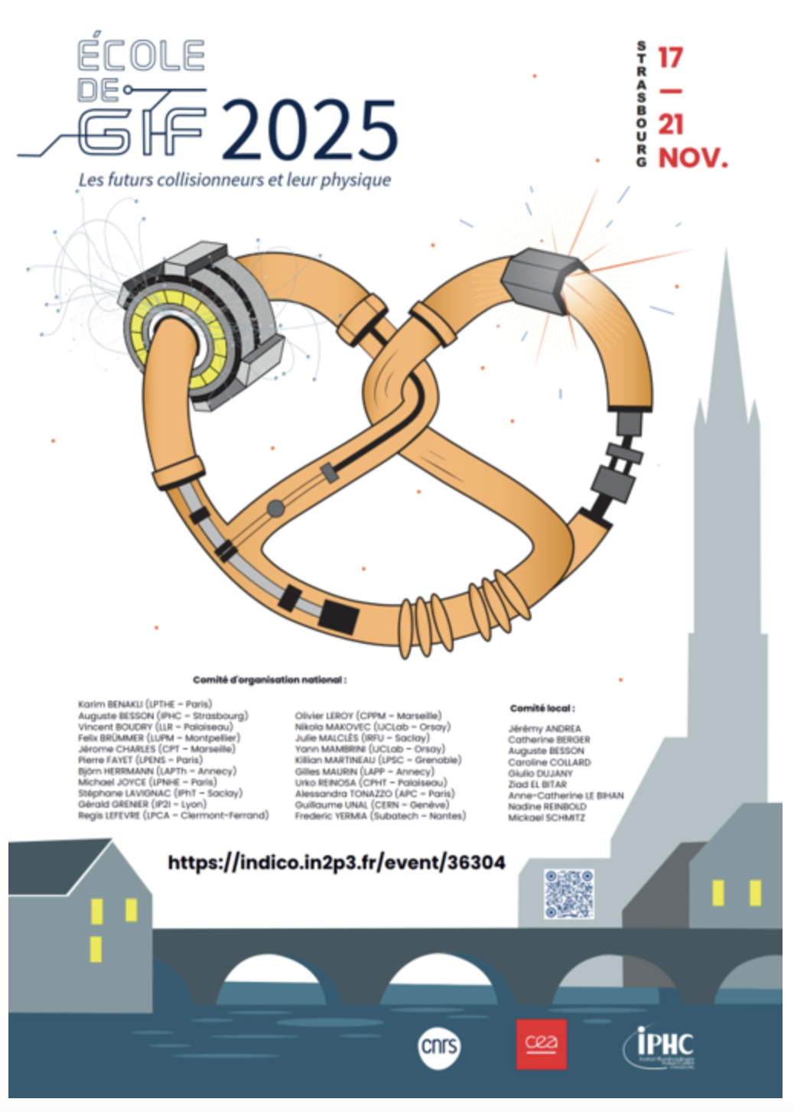
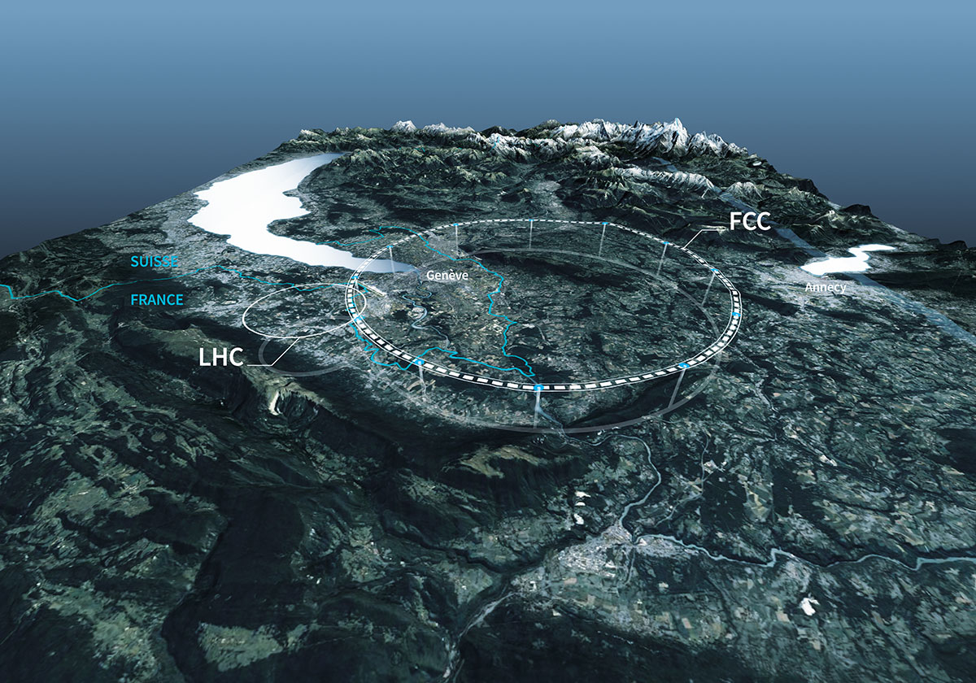
Design and characteristics of detectors
for future colliders
D. Contardo, IP2I CNRS-IN2P3

Slide 2
Several collider technical proposals exist at different stages of advancement*
focus here is on colliders considered for ESPP 2026
lepton: ILC-LCF, CLIC, LEP3, FCC-ee, Muon-Collider
hadron: LHeC, FCC-hh
Lepton colliders from Snowmass ht3ps://arxiv.org/abs/2208.06030 with LEP3 added
LEP3
luminosity is a main driver of detector design
per IP, 10⁷ s/ year
Community preference ESPP 2020 & 2026**: FCC-ee followed by FCC-hh
largest energy coverage and physics potential with only two colliders in the same tunnel
* see A. Fauss-Golfe, ** see C. Diaconu

Slide 3
Outline
Generic detector concept premise
A glimpse to the past and present
Conceptual Detectors, subsystem characteristics & technologies
  e-e colliders
  e-h/A, h-h/A, μ-μ colliders
Programmatic of detector preparation
Methodologies to develop concepts and prepare technologies
Outlook

Slide 4
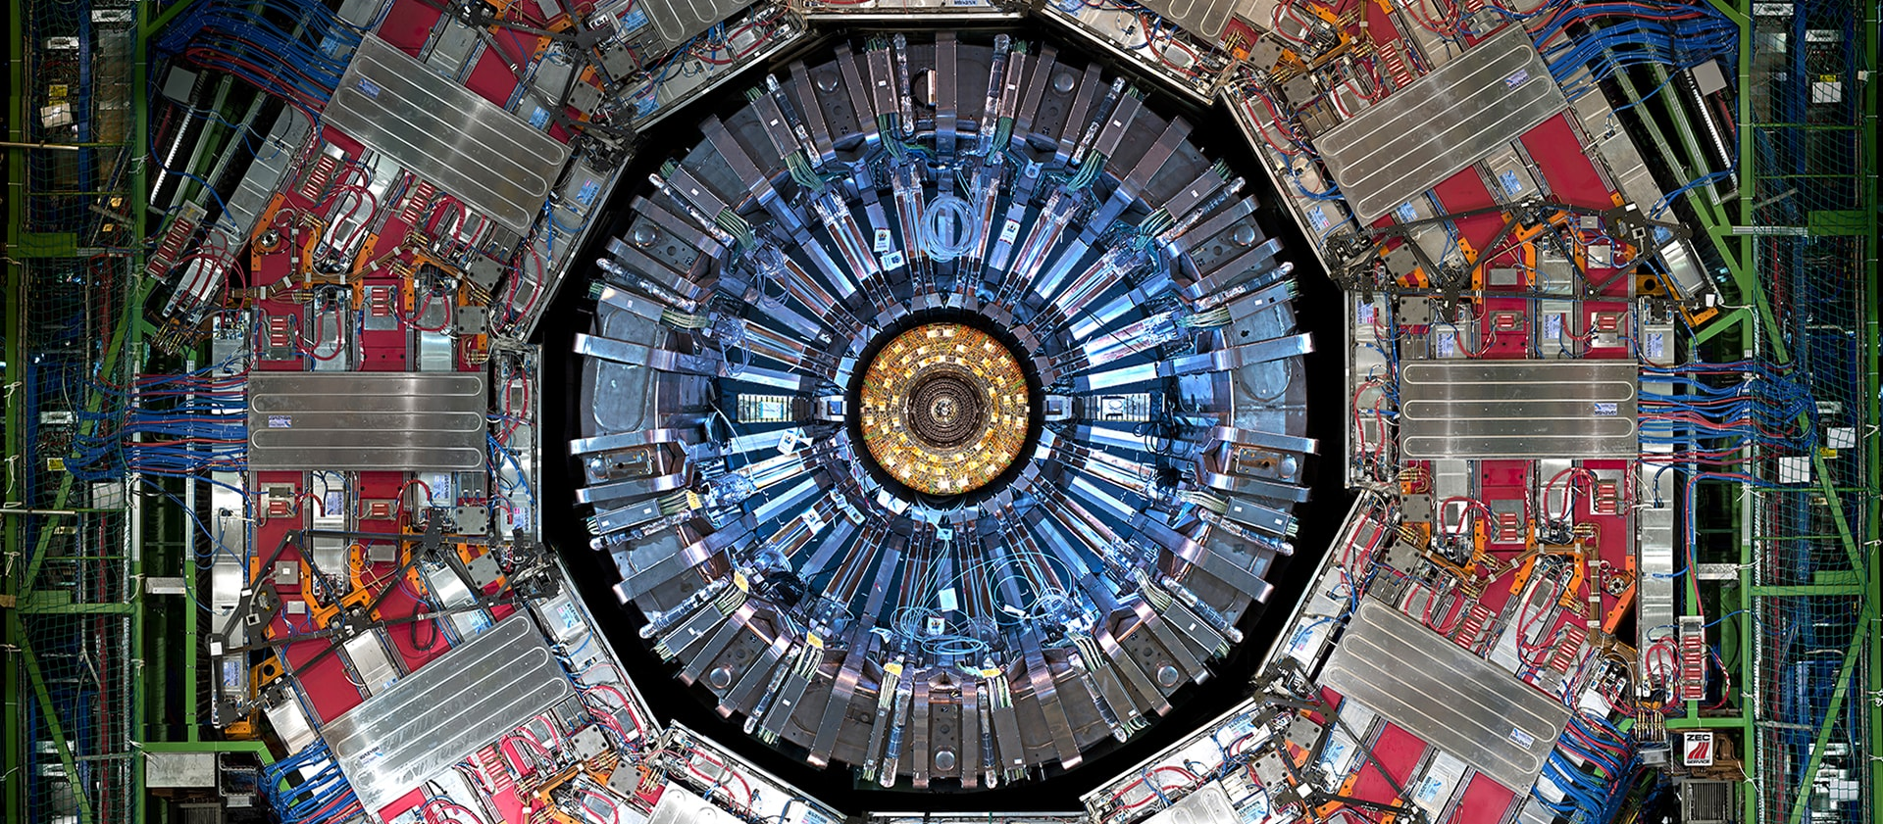
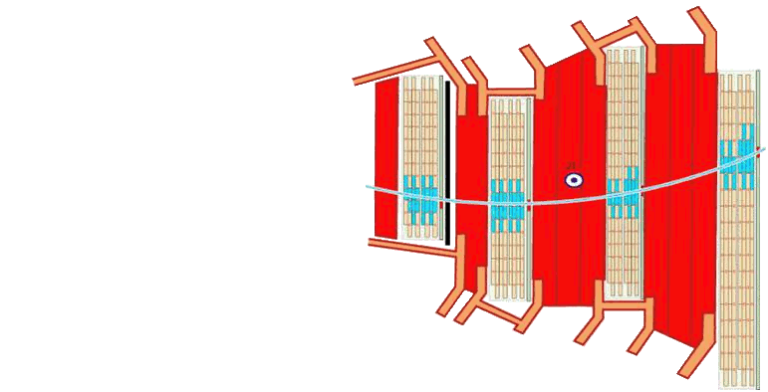
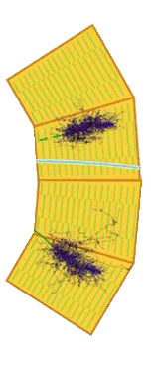
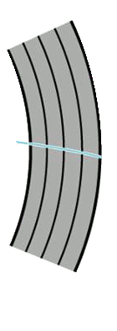
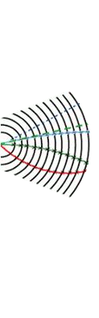
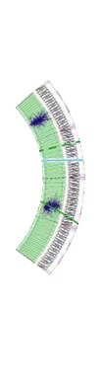
Subsystems defined & ordered by particle-matter interaction
ideally measure & identify all, and only, particles produced in each beam collision
not represented in example below Cerenkov light device for Particle IDentification (typically before calorimetry)
Front view of the CMS detector barrel part
γ
h⁰
μ
Muon Chambers
Electromagnetic Calorimeter
Solenoid
Hadronic Calorimeter
Tracker
e±
h±

Slide 5
Outline
Generic detector concept premise
A glimpse to the past and present
Conceptual Detectors, subsystem characteristics & technologies
  e-e colliders
  e-h/A, h-h/A, μ-μ colliders
Programmatic of detector preparation
Methodologies to develop concepts and prepare technologies
Outlook

Slide 6
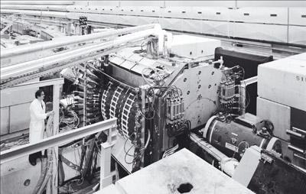
R108
open axial field magnet
UA1
UA2
The story of “modern” detectors starts at the ISR
OPAL
DELPHI
ALEPH
L3
ISR Circular p-p in the 1970s - 62 GeV at luminosity ≃ 10³¹ cm-²s-¹
revolution of electronics tracking w/ MWPCs
R108 precursor detector - 4π with a solenoid magnet

Slide 7
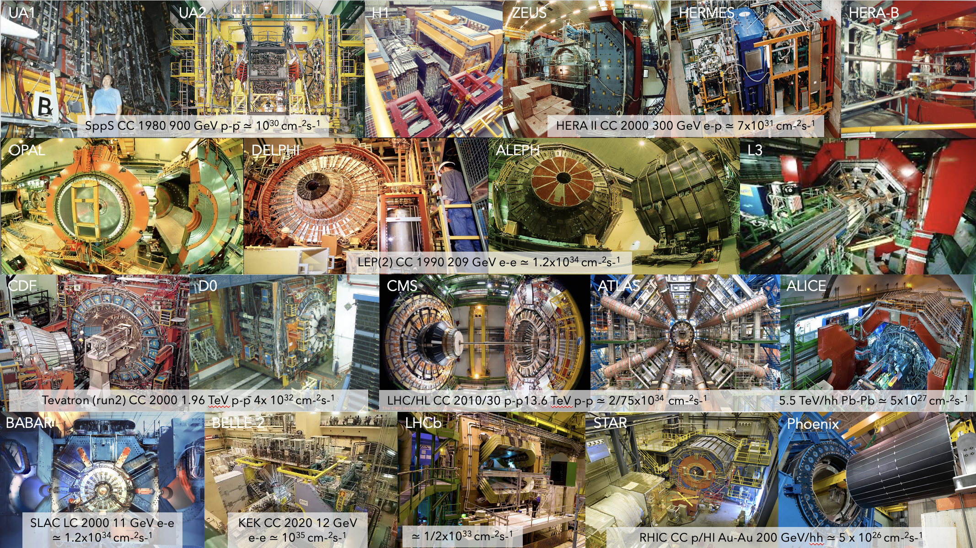
8 large colliders with 20 detectors in about half a century

Slide 8
Detector configurations driven by physics signals/final state

Slide 9
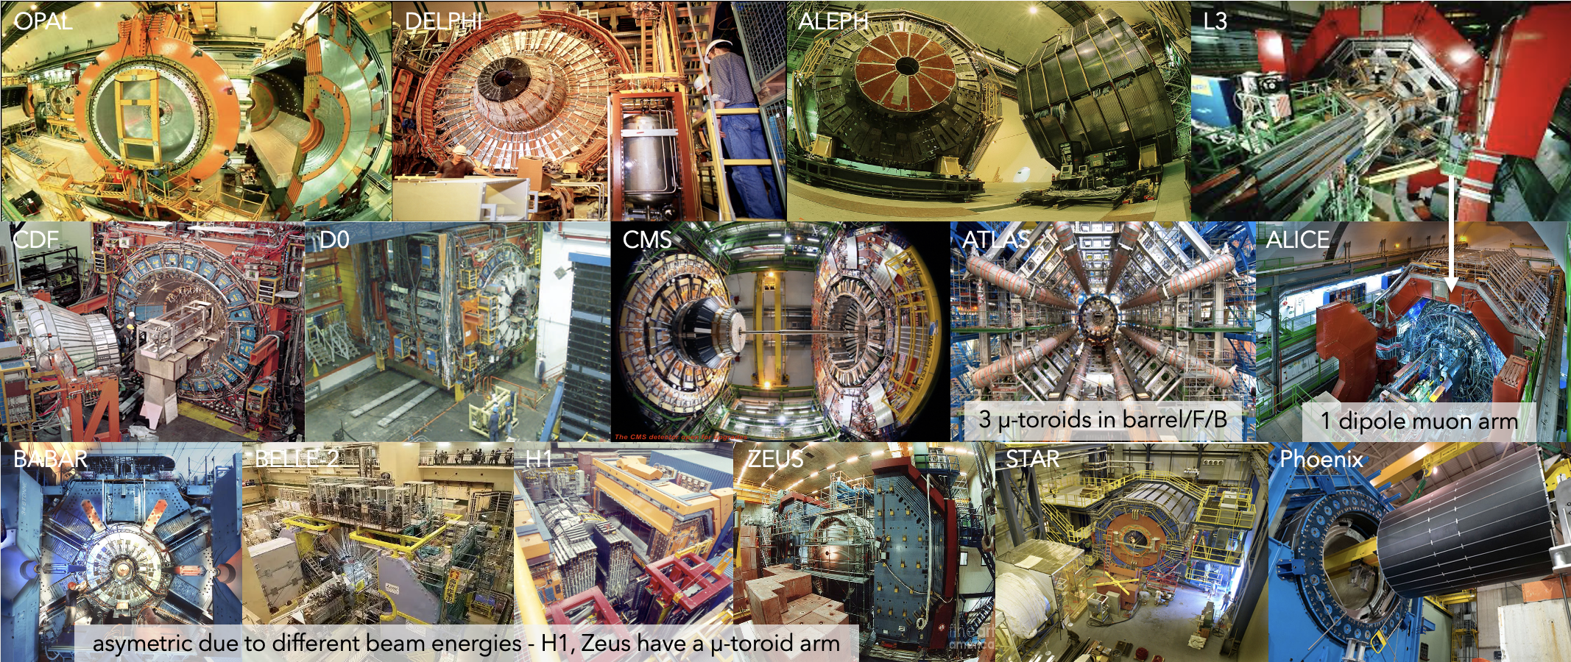
15 “general purpose” detectors
4π/hermetic configurations using solenoid magnets
Hermeticity is large 𝜂 coverage, no cracks within subsystems (for acceptance, energy resolution (especially missing))

Slide 10
Different calorimetry configurations inside/outside solenoid
E/H-calo outside: OPAL, DEPLHI, ALEPH, CDF, D0, ATLAS; E-calo inside H-calo outside: BABAR, BELLE-2 Phoenix; E/H-calo inside: L3, H1, ZEUS, STAR, ALICE, CMS

Slide 11
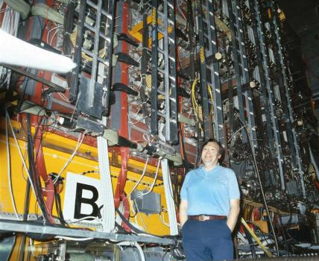
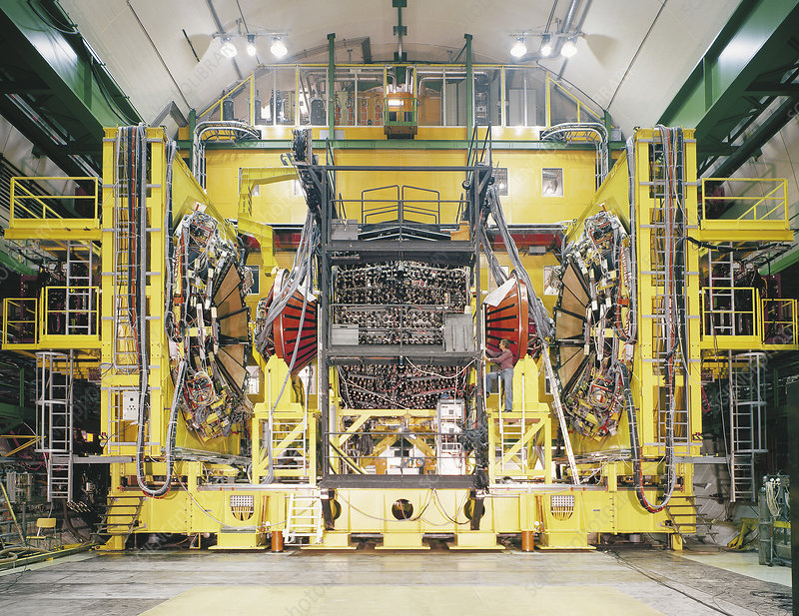
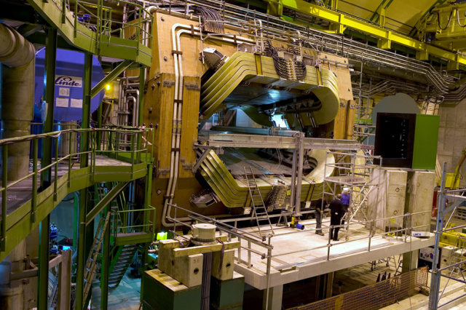
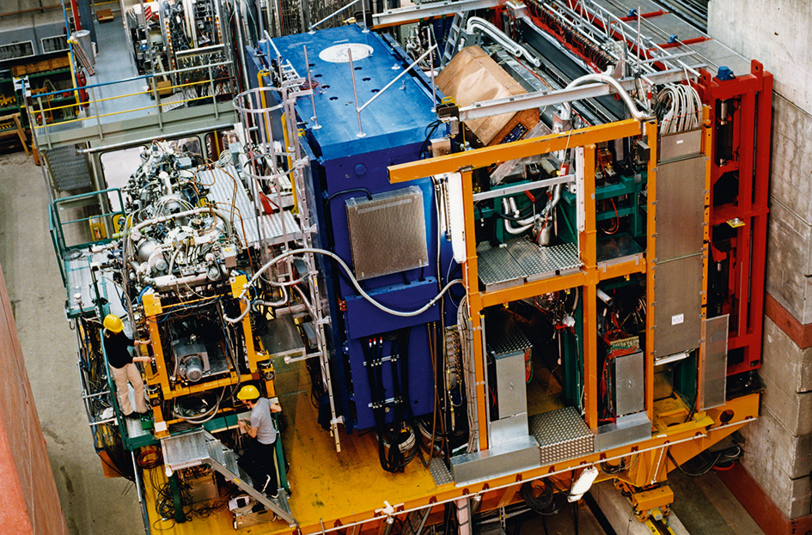
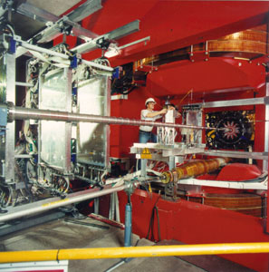
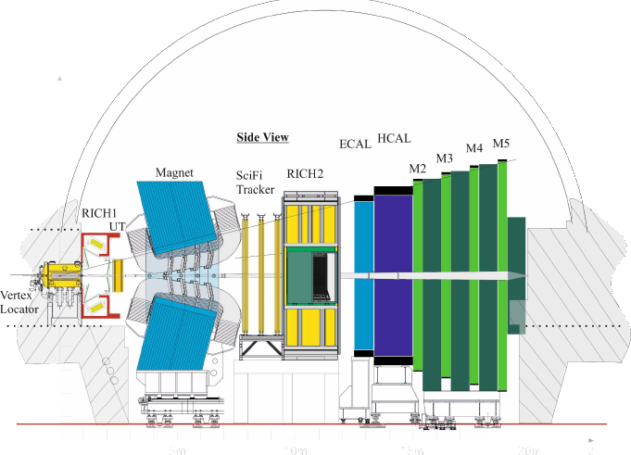
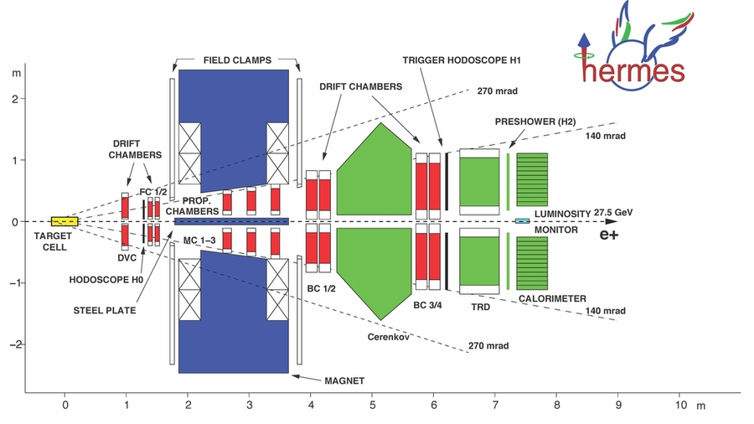
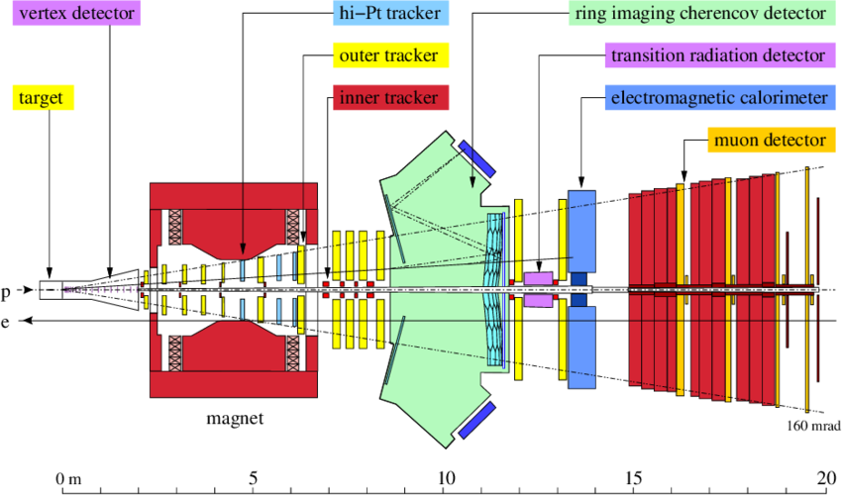
5 “dedicated” detectors (non-hermetic)
UA1 focus on tracking with E-calo inside and H-calo outside of dipole magnet
UA2 focus on calorimetry with both E-calo and H-calo integrated in a toroid
Hermes, HERA-B, LHCb use dipoles in forward region (beam asymmetry/forward boost)
UA1
UA2
LHCb
HERMES
HERA-B
Similar sequence of subsytems as for general purpose detectors:
VD, tracking around/inside dipole, RICH before/after dipole, calorimeters, muons

Slide 12
Other considerations for detector design
Tolerance, characterisation and quality control of components
  considering calibration (systematic uncertainties), failure risks…
Easiness of production, assembly and maintenance
  balancing simplicity and performance
  enabling access to subsystems (opening of detector)
Redundancy, operation margins and ability to upgrade
  mitigating failures risks, monitoring operation conditions
  adapting to evolving beam conditions, physics program, technology progress
cost efficiency
No ideal detector concept so far
  all future concepts (as of today) features only SuperConducting Solenoid(s)
  subsystems concepts are similar to those used in past experiments, but with new technologies and new paradigm to reach precise 5D measurement (x,y,z,t,E)
At least 2 detectors needed for all colliders
  running simultaneously at Circular Colliders (increased stastistics)
  ≠ detector optimizations with ≠ systematic uncertainties
    4 detectors at FCC-ee best given extensive physics program & precision goals

Slide 13
Outline
Generic detector concept premise
A glimpse to the past and present
Conceptual Detectors, subsystem characteristics & technologies
  e-e colliders
  e-h/A, h-h/A, μ-μ colliders
Programmatic of detector preparation
Methodologies to develop concepts and prepare technologies
Conclusion

Slide 14
14
Main different beam related constraint at e-e colliders
ILC/CLIC bunch trains are separated by 200/10 ms (w/ 550/0.5 ns bunch spacing)
  allow electronics power pulsing (switchoff between trains) avoiding active cooling
  CLIC requires event time stamping ≲ 5 ns (not needed at other colliders)
FCC-ee bunch spacing down to 20 ns does not allow power pulsing
  challenge of low power electronics to avoid active cooling and/or to mitigate effect on X/X₀ in tracker and on sampling fraction in high depth segmentation calorimeters
FCC-ee luminosity at Z-pole limits the B-field to 2T (as of today)
FCC-ee at Z-pole huge background of Incoherent Pair Production in F/B regions
  severe constraints on Vertex Detector (rates) & Tracking Gas Detector (operation)
FCC-ee at the Z-pole is the most constraining for detector performance & operation
    detectors also include PID features not originally considered in LCs
    specific constraints arise to reach systematic uncertainties ≲ statistical

Slide 15
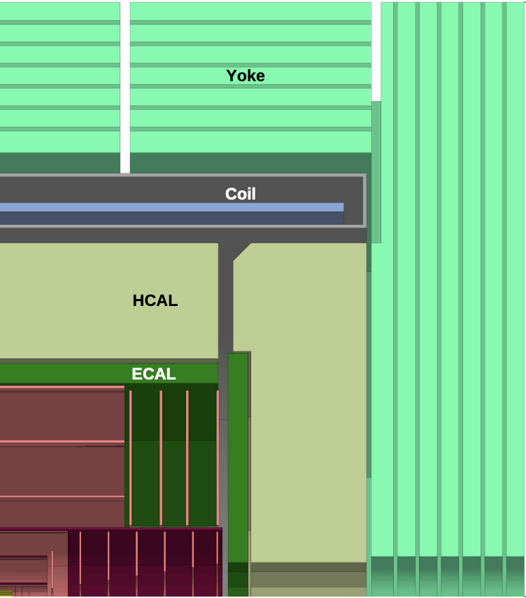
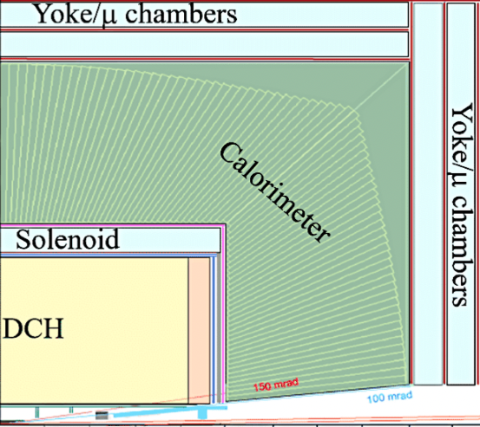
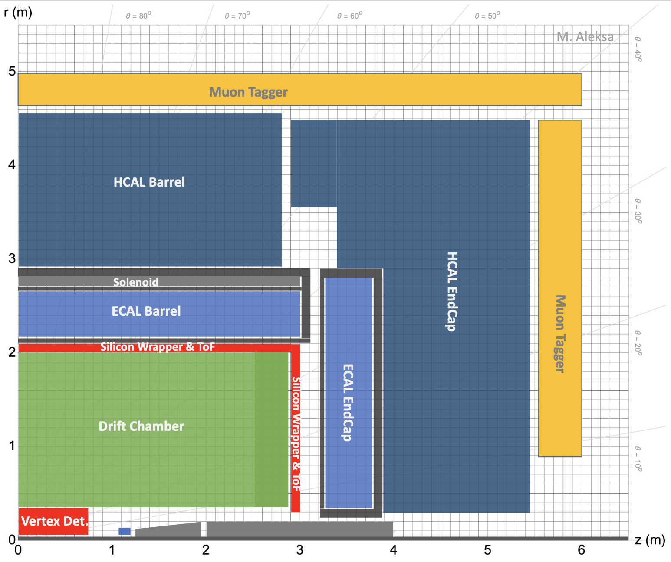
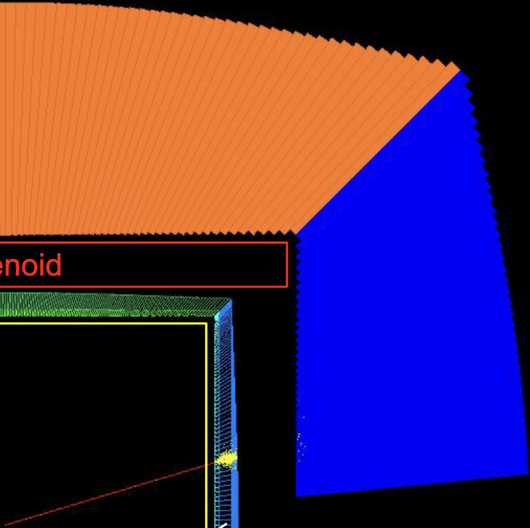
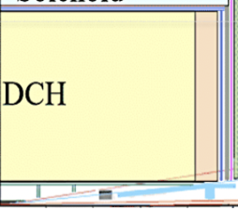
Representative conceptual detectors for e-e colliders
CLD inspired form CLICdet inspired from SiD-ILC
ILD-versatile desgin for ILC and FCC-ee
  E/H-calo inside SCS - PFlow concept
IDEA
ALLEGRO
  E-calo inside SCS, H-calo outside
developed for FCC-ee considering Tera-Z
CLD
ILD
IDEA
ALLEGRO
TPC
CEPC ref. detector is a mix of CLD & ILD for tracking
Tracking can be exchanged in different concepts, other mix of subsystems can be considered*
* in back-up exemple of CEPC (e-e CC in China) detector reference

Slide 16
16
FCC-ee at Z-pole is the most constraining
but detectors should serve all foreseen CM energy conditions
considering B-field, Beam Background, calorimeter depth in desgin*
ex. scaling from ILC-ILD and SiD detector concepts to FCC-ee CLD
Scaling factors
* Size of the detector as is an element of cost optimisation

Slide 17
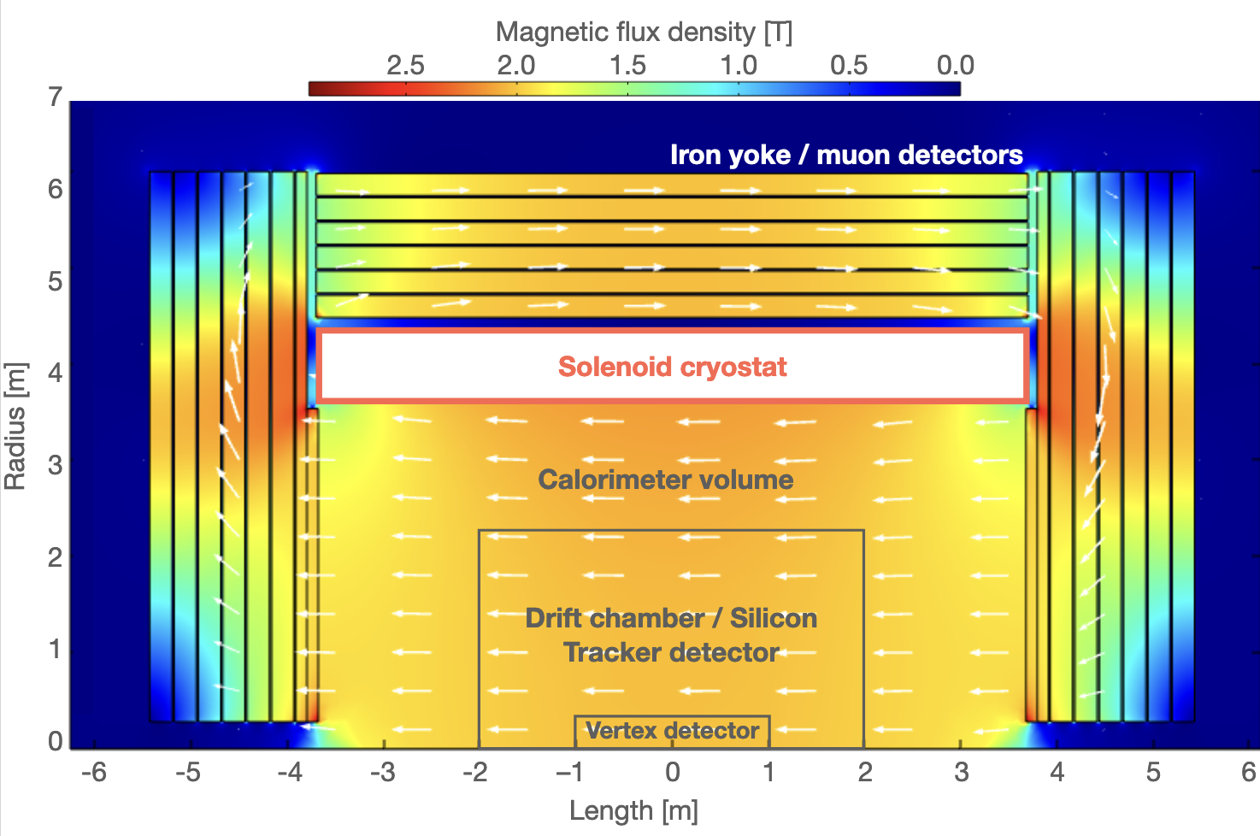
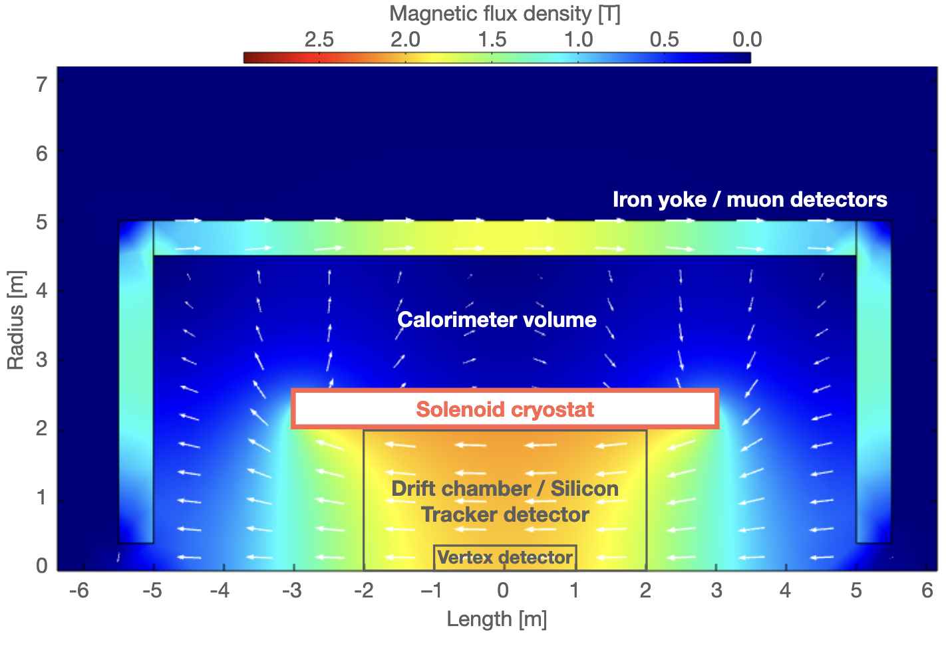
17
SuperConducting Solenoid
at FCC-ee Z-pole B-field limited to ≃ 2T
but at ZH higher values should be considered to improve mass precision
muon momentum precision requires stability/mapping of field better than 10⁻⁶
E/H-calo inside
CMS-like up to 4T
E/H-calo outside (smaller magnet)
must be thin(lighter), H-calo could serve as return yoke yoke
Ongoing R&D targets < 0.5-1X₀ and ≃ 0.1 λ
high-strength Al-stabilized NbTi SC cable and light vacuum vessel*; High Temperature SCS
progress can determine calorimetry configuration (vs field) and optimize cost

Slide 18
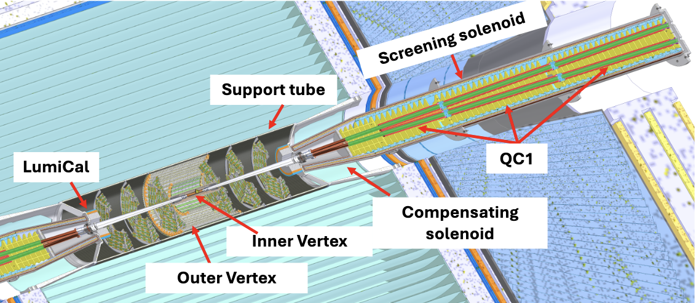
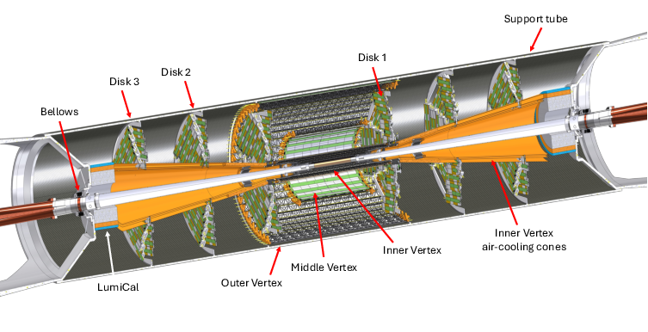
18
Machine Detector Integration
at e-e colliders beam focusing requires elements inside the detector volume
FCC-ee example
complex magnetic scheme : focusing quadrupoles with screening solenoid & compensationg solenoid to avoid detector field effect on beam emittance
  needs to be compact to minimize acceptance impact on detector (100 mrad cone)
  ongoing study ”non local solenoid compensation “ could allow 2.5 T and reduced SR* background
complex mechanics and service design for Vertex Detector and Luminosity Calorimeter
  LumiCal construction and metrology ⊥ precision to 1 μm for absolute luminosity normalisation at 10⁻⁴ (relative at 10⁻⁵ by physics channel/energy scan points) from radiative BHABHA measurement
* Synchrotron Radiation

Slide 19
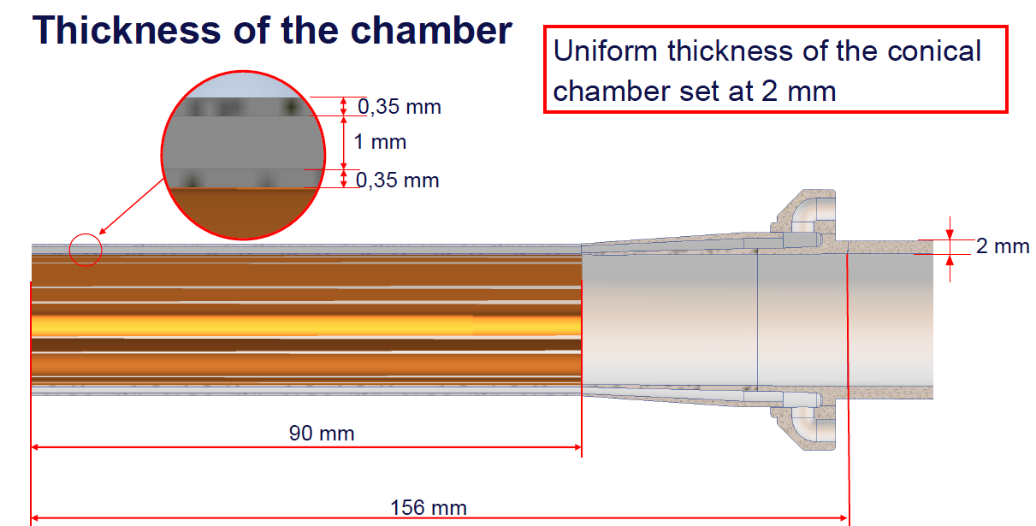
The Beam Pipe must have a radius & X/X₀ as low as possible
Determines 1st VD layer proximity to beam line - critical to the track origin precision
  CLIC/ILD/FCC-ee BP radii are 2.96/1.3/1 cm
BP X/X₀ is a second major driver to the track origin precision
ex. half view fo the central BP at FCC-ee (half view)
Be (62%) - Al (38%)
Paraffin cooling (T_{max} 18º)
0.65% X/X₀
5 μm Au coating reduce heat load & SR background
2.34 cm
central
conical
ongoing R&D on materials to reduce X/X₀ and studies to integrate BP and 1st VD layer
at lower luminosities-higher (beam energies) a smaller r and lighter BP may be possible

Slide 20
Subsystem technologies considered in current FCC-ee concepts
CLD ILD’
IDEA
ALLEGRO
Muons* MPGD, MWPC, RPC, Scint.
ECAL High Granularity Si/W Crystal Liquified Noble Gaz
HCAL Scint./MPGD/RPC Dual Readout Scint. Tile
Tracking Full Si Tracker Si-VD + TPC + Si-layers Si-VD + DCH + Si-layers
PID RICH in front of ECAL** TPC + Timing Layers DCH + Timing Layers
TPC
not exhaustive of technologies and susbsytem new proposals emerging in ESPP 2026 contributions
* tagging a priori sufficient , technology choice rather than a desgin consideration (not purpose of this presentation)
** considered in between Tracking and ECAL not represented in the CLD scheme above

Slide 21
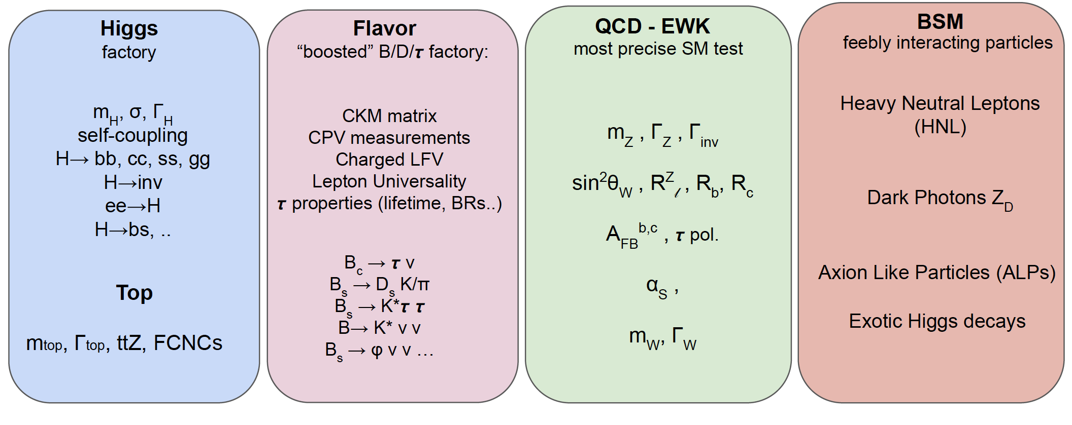
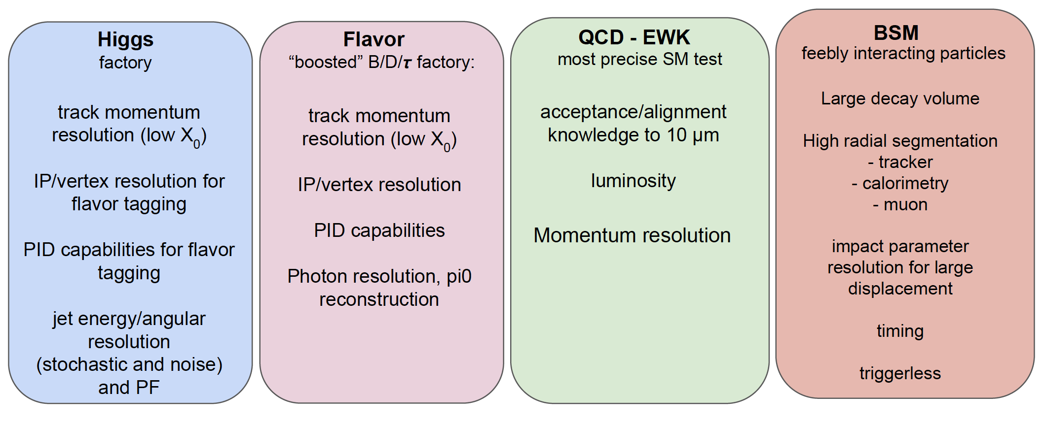
Highlights physics & their detector requirements at FCC-ee
Form M. Selvaggi lecture,
see also backup for quantitative requirements

Slide 22
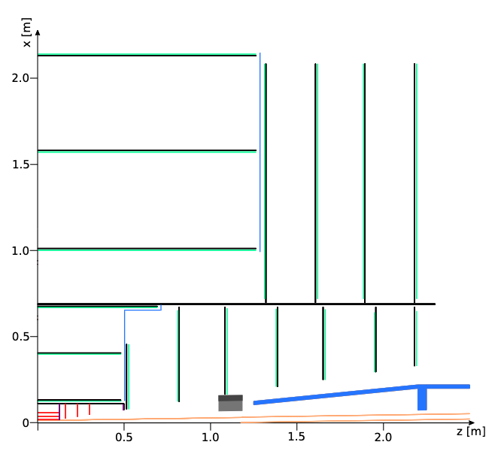
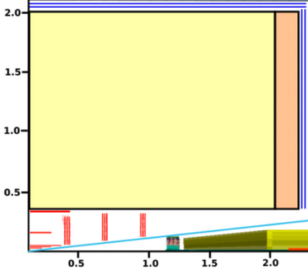
Tracker concepts
FCC-ee CLD Full Si Trk
IDEA-ALLEGRO Si/DCH
ILD FCC-ee adapted Si/TPC*
Outer Tracker region / Wrapper Layers 2 layers/disks similar to IDEA
Central Tracker region
FST Drift Chamber TPC
Intermediate Tracker region Si layers
Vertex Detector region up to about 4 - 5 cm
3 layers 3 disks 3 long layers 6 long layers
configuration optimisation layers lengths & positions (spacing/grouping), both barrel & endcap
ex. CLD VD features barrel layers & disks possibly in doublets, IDEA only longer barrel single layers
* Study otpion copying CLD VD and intermediate tracker

Slide 23
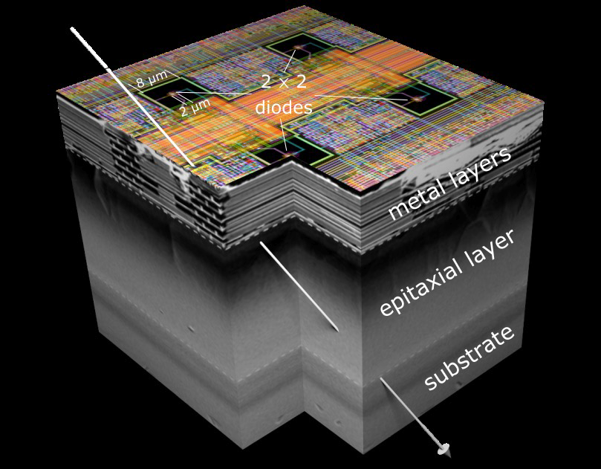
Vertex Detector characteristics - sensors
precision in track origin (σ_{D0} ≃ a ⊕ b/(sinθ)^{3/2})*, primary/secondary/tertiary vertex positions
figure of merits : σ_{hit}, X/X₀, hermeticity
FCC-ee, most constraining, target hit resolution σ_{hit} ≲ 3 μm, X/X₀ ≲ 0.1% /layer
one technology option: Monolithic CMOS in fine node process**
  small diode pitch ≲ 20 μm, thin sensors ≲ 50 μm, 10 x 28 cm possible (12” wafers)
  low electronics power consumption ≲ 100 mW/cm² to allow airflow cooling
    depending on channel density, RO architecture and rates
at FCC-ee Z-pole hit rates O(200) MHz/cm² *** (domin. by Incoherent Pair Creation)
  continuous readout easier for normalisation appears feasible
  but huge data flows require reduction before recording w/ hardware trigger and/or at computing
    all based on AI implementation (considering performance and on/off-detector resource needs)
Irradiation (total) is within ballpark of current process NIEL O(10¹⁶) neq.cm² & TID O(300) Mrad
  a VD upgrade could be considered at ZH energy to mitigate degradation and possibly allow benefit from improved beam pipe and sensor technology
* D₀ Impact Parameter distance of closest approach to beam line σ_{D0} a/b significant of asymptotic precision σ_{hit} & Mult. Scatt. X/X₀ (θ polar angle)
** R&D ongoing on different node process with different properties for S/N…
*** assuming 5 pixel hit clusters and safty factor 3, needs r,𝜂 full simulation w/ proper dogotosation

Slide 24
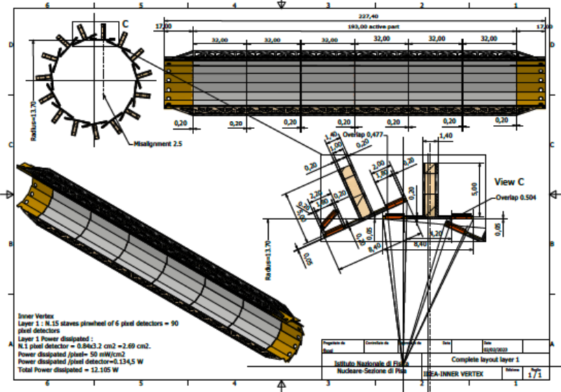
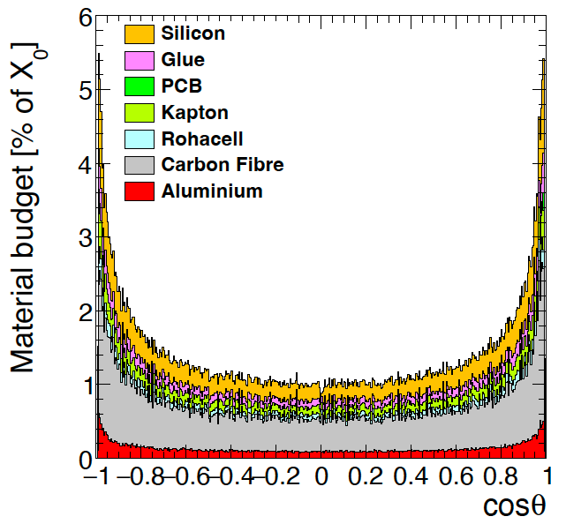

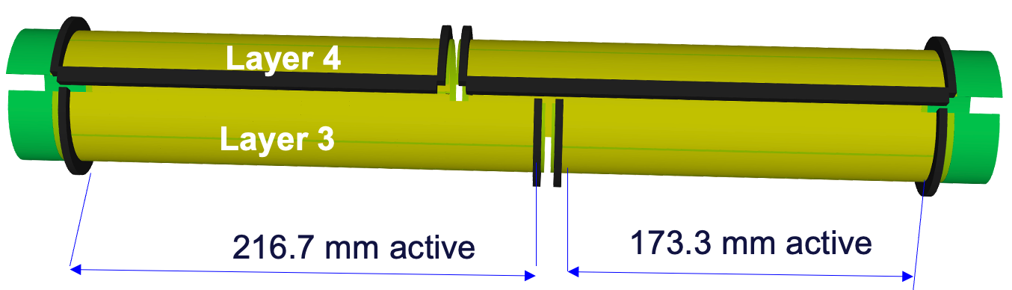
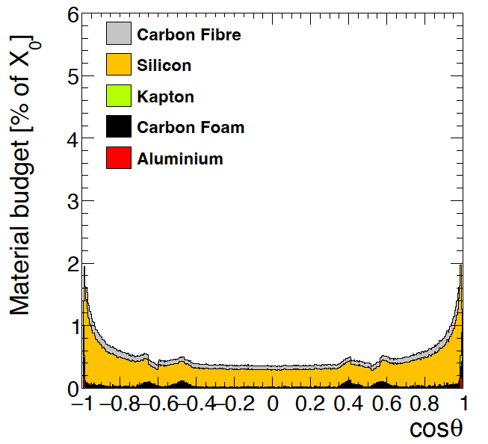
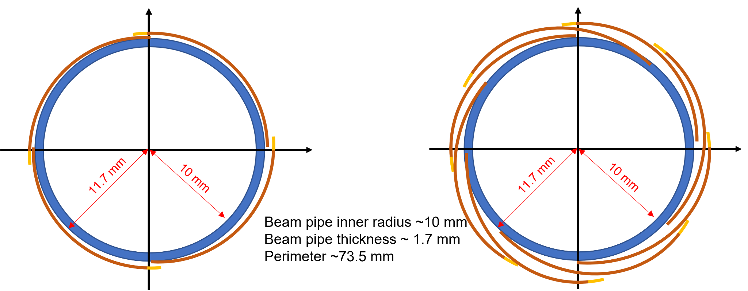
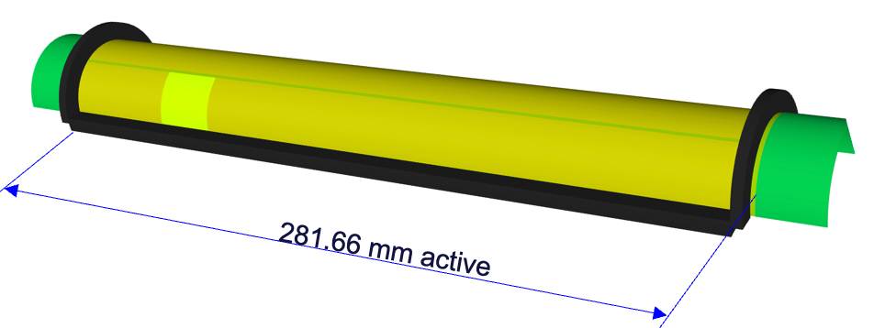
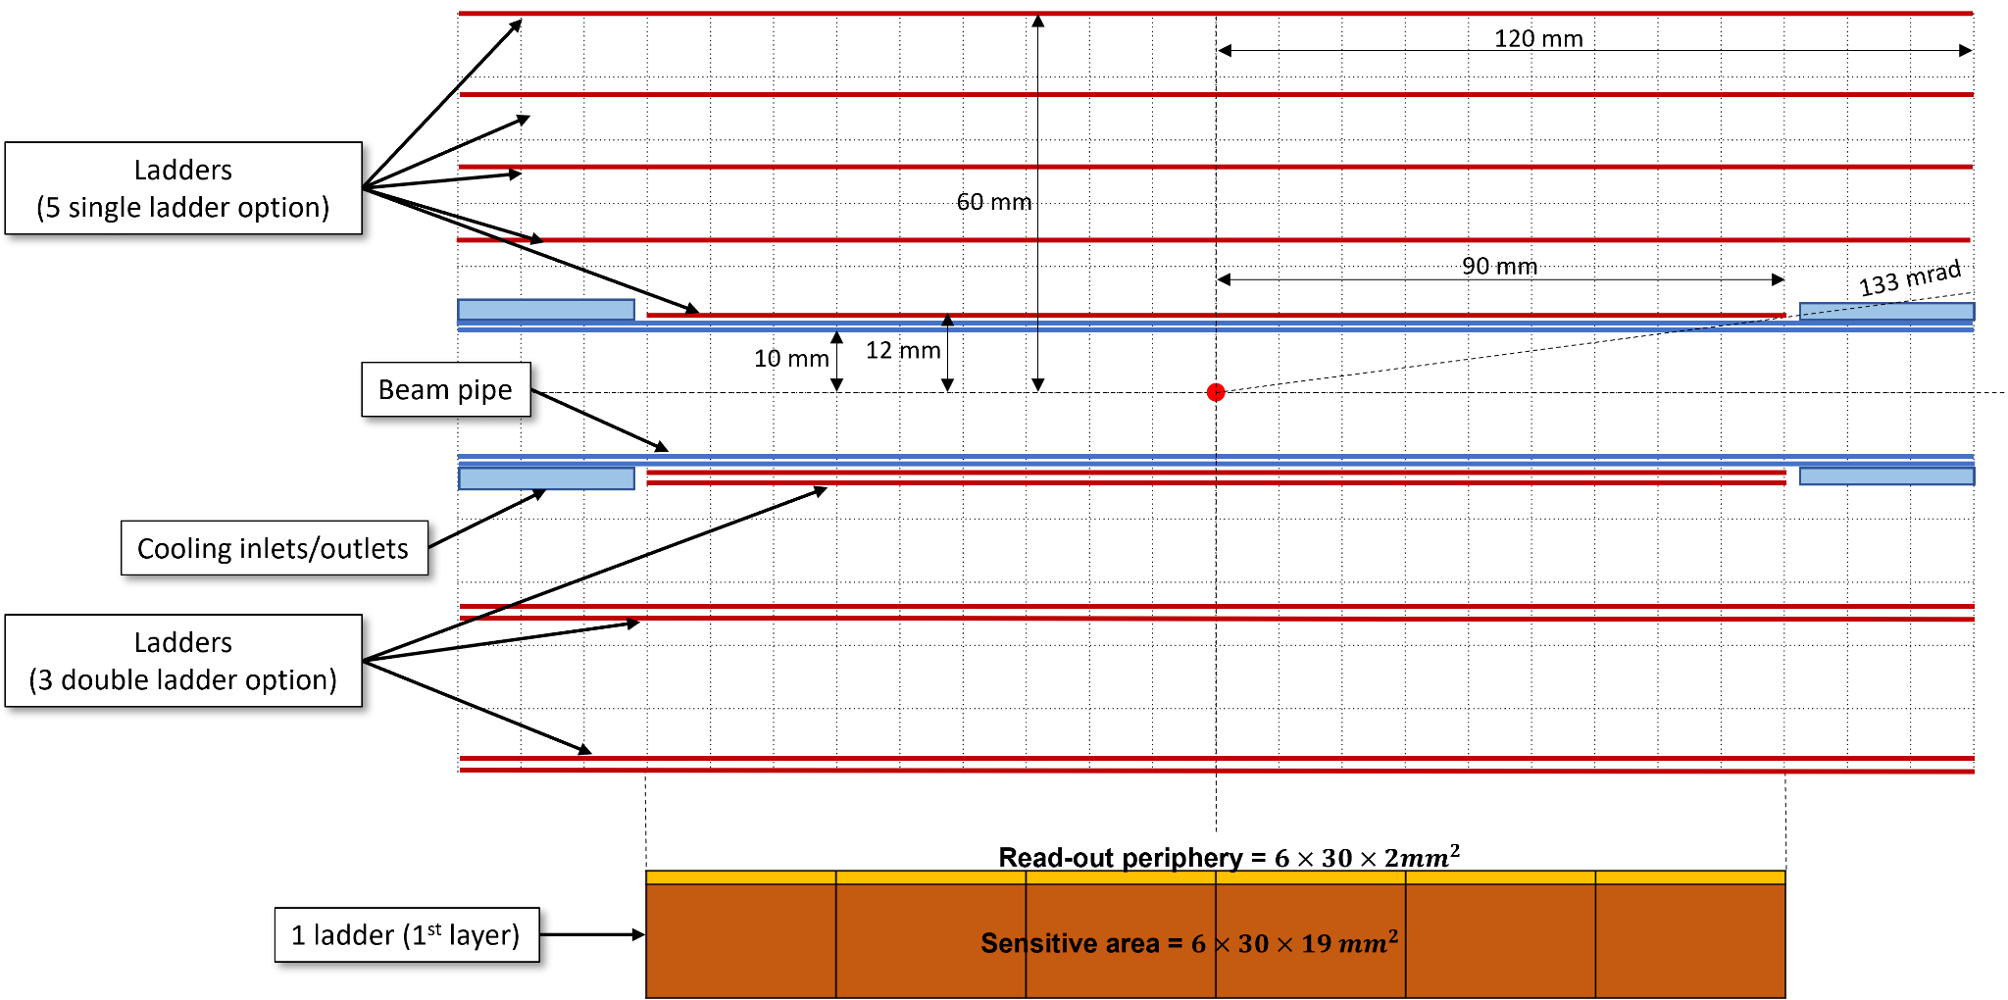
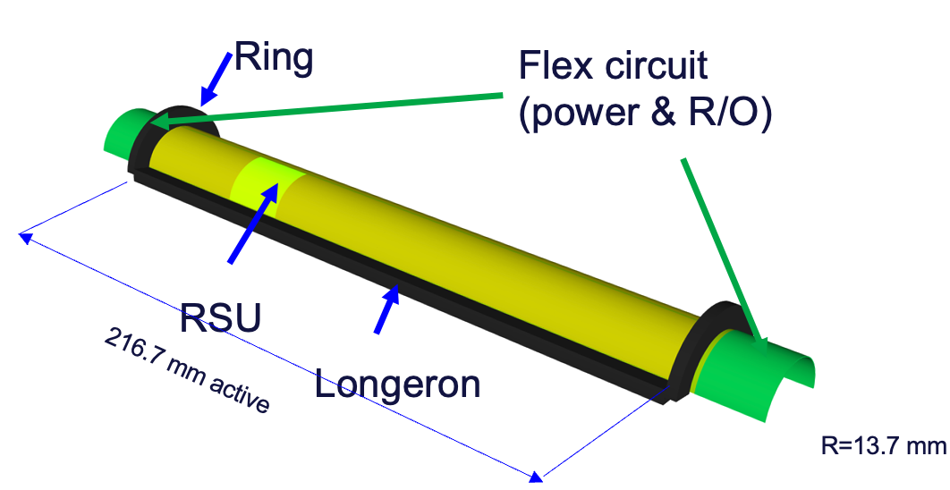
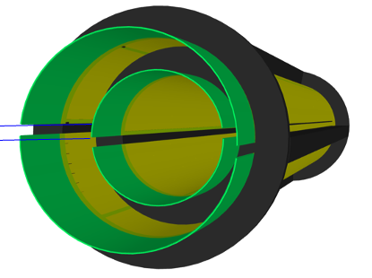

Vertex Detector characteristics - system
figure of merits : X/X₀, hermeticity
ex. FCC-ee initial engineering design (top) and 2 new concepts (bottom)
small sensor in staves
air-cooling
0.25% X/X₀ per layer
small sensors bent and abutted
avoid cracks
doublet vs single layer options
air-cooling
R =27 – 33.65 mm
ALICE ITS3-like
large bent sensor
air-cooling
0.075 % X/X₀ per layer
R =20.35 mm
R =13.7 mm

Slide 25
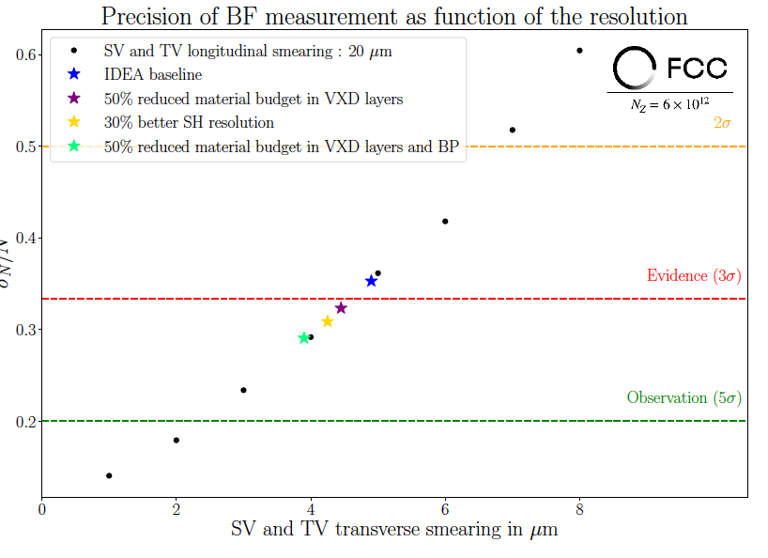
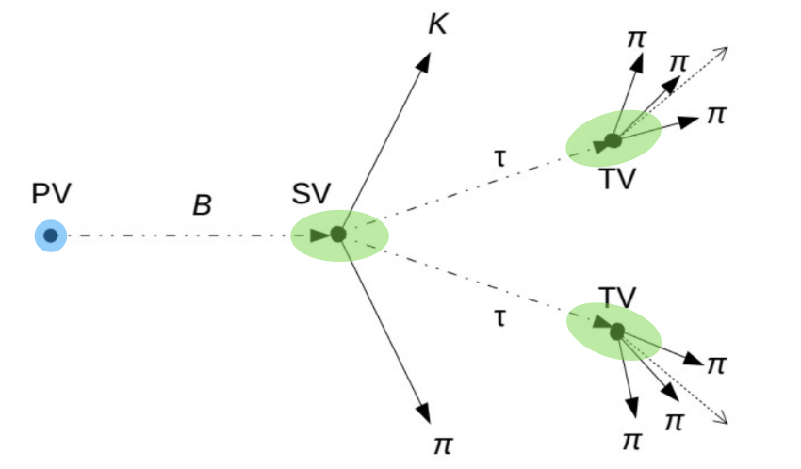
Vertex Detector characteristics - asymptotic performance*
benchmark B → K∗ττ discovery is challenging asymptotic performance is not reached
  would benefit from improvement in VD Single Hit resolution & lower X/X₀ both in VD & Beam Pipe
* Asymptotic performace is a typical approach to determine optimal detector specifications versus cost

Slide 26
Tracking intermediate and central regions
track momentum precision σ(p_{T})/p_{T} ≃ a.p_{T} ⊕ b/√sin(θ)
decays with far vertices within the tracking volume Ks, Λ and Long Leaved Particles
figure of merits: σ_{hit}, X/X₀, hermeticity and number of hits
FCC-ee, most constraining, targets 2 x 10⁻⁵.p_{T} (GeV) ⊕ 0.2%
Intermediate tracking region similar to VD
  σ_{hit} can be slightly released to 5-7 μm both ⊥ and //
    MCMOS technology remains the best technical solution
  lower channel density & hit rates lead to lower power density but in larger layer areas
    maintaining low X/X₀ ≲ 0.5% becomes a challenge w/ and/or w/o active cooling
Central tracking region
  low rates & released precision in z/r (barrel/endcap) allow to consider different technologies
    Drift Chamber and Time Projection Chamber (large gas volume); straw tubes (isolated cells)
    Silicon sensor layers
    Scintillating fibre layers
Outer tracker region / Wrapping Layers (gas central tracker)
    Silicon layers

Slide 27
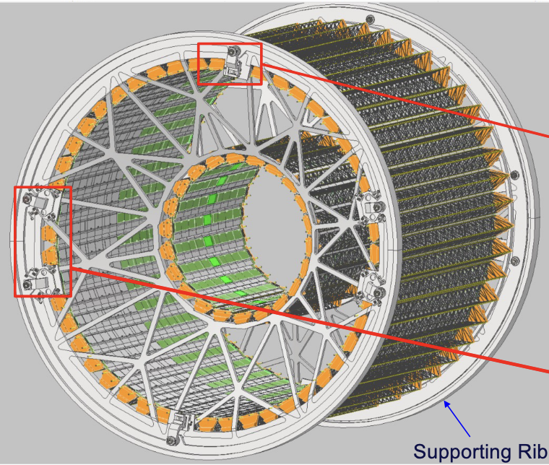
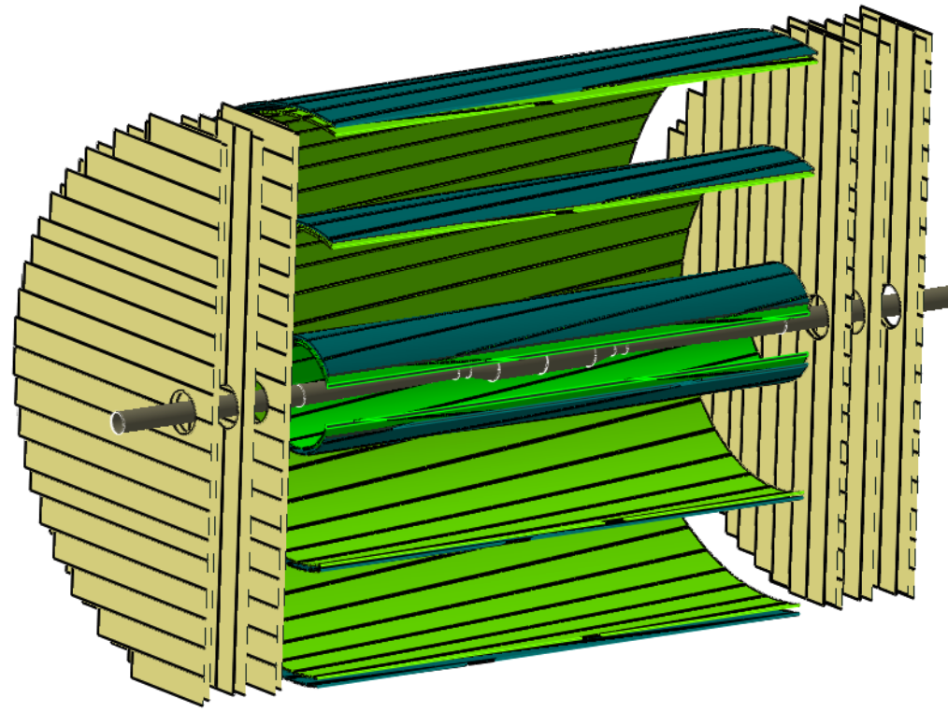
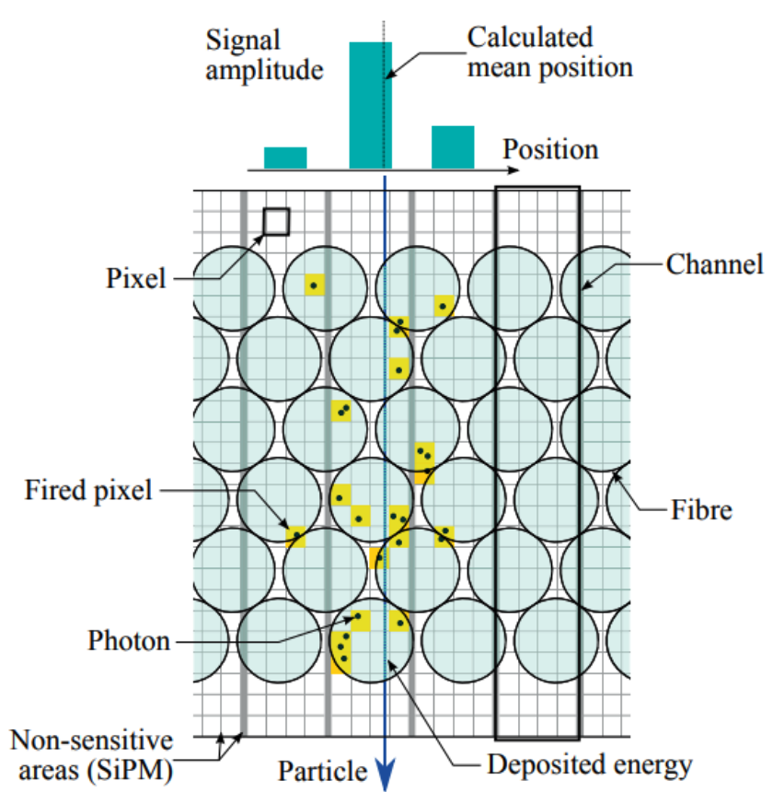
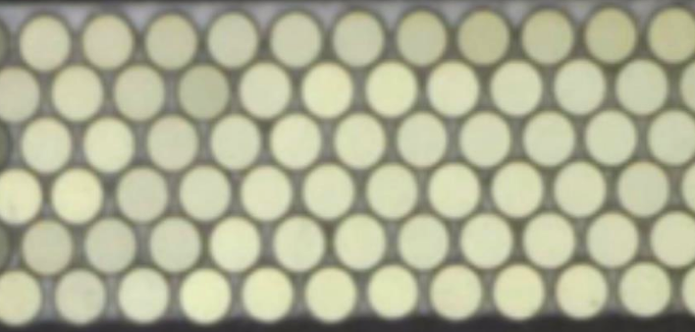
Central Tracking region - Si/Scint. fibers layers
Silicon sensor layers
  hit position precision targets 7-10 μm ⊥, and 90 μm //* (also for Wrapping Layers)
    MCMOS likely better for X/X₀, Hybrid sensor macro pixels can also be considered
  areas reach 60(15) m² in barrel(endcap) regions
    low X/X₀ major challenge for mechanical structure & cooling
      can influence sensor technical choice through electronics power consumption
ex. IDEA concept for Intermediate Tracker layers based on ALICE ITS2 staves of 0.35% X/X₀
Scintillating fibre layers (recent proposal)
  hit position precision ≃ 100 μm ⊥, // needs some stereo
ex. LHCb fiber layer mat 2.4 m
w/ 6 x 250 μm fibres, X/X₀ ≃ 1.03 %
* Could be optimised in r/𝜂

Slide 28
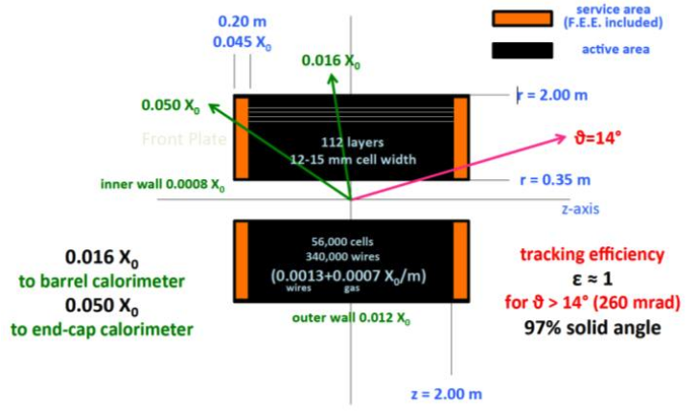




Central Tracking region – Gas Detectors
ex. IDEA Drift Chamber
  112 radial space points with position precision ≃ 100 μm ⊥, and ≃ 1 mm //
  1.6(5)% total X/X₀ barrel(endcaps)
ex. ILD Time Projection Chambers (not yet demonstrated to sustain IBF* at FCC-ee Z-pole)
  ≳ 100 radial space points with position precision of ≃ 100 μm ⊥, and ≃ 1 mm //
  5(25)% total X/X₀ barrel(endcaps)
FCC-ee Straw Tubes (flexible layer configuration could be interleaved with Si layers)
  100 layers (space points) with position precision of ≃ 100 μm ⊥, and ≃ 1 mm //
  1.4% total X/X₀ in barrel
All provide large momentum range Particle IDentification through dE(dN)/dx measurement*
IDEA DCH
ILD TPC
FCC-ee Straw Rubes
* Ion Back Flow induce field distorsions with impact on resolution
** Integrated charge measurement and/or number of primary interactions in gas

Slide 29



Tracking regions - asymptotic performance
track momentum resolution - efficiency to identify Ks far vertices
Advantage is to central tracking w/ Gas Detectors
X/X₀ to be consolidate (all options especially in F/B regions)
Si-sensor Wraping Layer improves Gas Detector precision
* BES stands for Beam Energy Spread momentum precision limit, it is monitored with dimuon production mass measurement

Slide 30



Particle IDentification - case of Gas Detector central tracking
flavour tagging in Higgs decay to c/s quarks & extensive flavour program at FCC-ee Z-pole
figure of merit: π, K, p separation ≳ 3σ in a momentum range ≃ 150 MeV to 40 GeV
gas detectors are blind for PID at π, K dE/dx crossing
Time of Flight measurement at 2m covers this region with ≃ 100 ps precision*
ex. IDEA DCH
2T B-field
3T B-field
30 ps at 15 cm would allow to extend momentum range below the DCH radius cut-off (middle)
at 3T ToF would have to be placed at r < 2 m w/ improved precison to avoid radius cut-off
or it could be completed with an inner layer at 35 cm (right)
power consumption impact on X/X₀ will define ability to implement inner timing
* a redundant layer would lead to 70 ps precision

Slide 31

Particle IDentification - case of Full Silicon Tracker
Requires a RICH* detector located between Tracker & E-calo
ex. ARC system proposed for FCC-ee
Dual RICH system combining aerogel and gas with same SiPM readout
ARC must be thin & light to minimize impact on tracker/calorimer radii, and PFlow efficiency*
* RICH detectors provide PID through cerenkov light rings measurement
** PFlow is the software reconstruction technique combining Tracker, E-calo & H-calo data to substract MIP & 𝛾 energy from H-calo measurment

Slide 32
Other Time of Flight motivations - technology options
mass and lifetime determination of new massive particles
independent control of BES and correlation of vertex position to collision energy*
figure of merits: time resolution and radius of layer
≲ 50 ps precision is adequate for mass estimate if t₀ of the collision is not determined**
If t₀ is determined, ≃ 10 ps would allow reaching asymptotic performance for mass
  t₀ determination requires a measurement close to the beam line***
  extremely challenging for precision & power consumption not to jeopardise D₀ precision
Technologies and implementations for Time of Flight measurement
Si-sensor MCMOS (w/ or w/o amplification) or Si-Hybrid LGADS w/ amplification
  different optimisations of timing & position precision, and subsequent power consumption
Si/W E-calo layers (w/ similar sensor technologies as above) can provide timing for PID
E-calo with scintillating device can provide ToF for PID
* the collision energy is correlated with the position of the colliding particles in the bunch
** due to bunch length the collision time smearing is ≃ 36 ps
*** precision on vertex t₀ can benefit from number of tracks produced in the collision

Slide 33


Calorimeter characteristics
E-calo σ(E)/E ≃ few%/ √E (GeV) for B-meson, 𝜏 and EW physics,
H-calo ≃ σ(E)/E 3-4% for Z/W/H classification and multi-jet events
figure of merits: compactness, ⊥ & // segmentation (π₀ - 𝛾 separation)
CALICE concept developped for ILC applies to other collliders*
  ≃ 30 layers of Si/W E-calo and 50 layers of Scint-MPGD-RPC/Steel provides best 4D shower topology at expense of compactness σ(E-calo)/E ≃ 16%/√E ⊕ 1%, σ(H-calo)/√E ≲ 45%
  SiD simulation studies indicate /2 improved resolution with MCMOS digital mip counting**
  timing precision of Si-sensors can bring 5th dimension and both energy and mip counting
    implementation should be eased in a Luminosity Calorimeter configuration
CALICE prototype test beam Si/W + RPC SDHCAL
CMS HL-LHC encap calo
LumiCal
* requires adaptation for cooling and rates that can impact performance,
** SiD more favorable to improvement since no active cooling at ILD, timing me

Slide 34



Calorimeter characteristics – optical concepts
IDEA: Dual Readout concept*
  homogenous segmented crystal E-calo provides best σ(E)/E ≃ 3%/√E ⊕ 1%
  fiber sampling calorimeter H-calo provides best stand alone σ(E)/E ≃ 30/√E ⊕ 1%
  ongoing study to provide H-calo depth segmentation through signal wave form sampling
New GRAiNITA homogenous (shashlik-like) E-calo concept
  crystal grains contain light around WLS fibers, expected to provide σ(E)/E ≃ 2%/√E ⊕ 1%
  ongoing study of DR readout and depth segmentation through signal wave form sampling
Other new concepts
  homogenous glass scintillators H-calo to reach σ(E)/E ≃ 15%/√E
  depth segmentation of homogenous E-calo w/ quantum dots
IDEA calorimetry concept & test beam of segmented crystal
two 1st thin crystal layers provide ToF for PID
GRAiNITA concept & 1st small size demonstrator
* Dual Readout measure elctromagnetic (Cerenkov) and hadronic (scintillation) components of showers allowing energy calibration compensation

Slide 35



Calorimeter characteristics - Liquified Noble Gas concept
ALLEGRO: E-Calo based on ATLAs LAr concept
  modified to increase ⊥ and // segmentation by x 10 provides a good compromise between segmentation & resolution σ(E)/E ≃ 8%/√E ⊕ 0.5% ( LAr/Pb) with efficient π₀/𝛾 separation
  ongoing studies of Kr and W absorber benefits, light cryostat and cold electronics readout
  H-calo with scintillating tiles combined w/ LNG E-calo σ(E)/E ≃ 35%/√E ⊕ 3%
Barrel concept
PCB 11 // segmentation
Integration w/ solenoid cryostat

Slide 36
Outline
Generic detector concept premise
A glimpse to the past and present
Conceptual Detectors, subsystem characteristics & technologies
  e-e colliders
  e-h/A, h-h/A, μ-μ colliders
Programmatic of detector preparation
Methodologies to develop concepts and prepare technologies
Outlook

Slide 37

Conceptual design for EIC ePIC
up to 18 GeV e & 275 GeV h/A adjusted for CM 30 -140 GeV, luminosity up to ≃ 10³⁴ cm²s⁻¹
medium term timeline - operation start 2033
H-Calo forward
  W/SCiFi
H-Calo backward
  Crystals
Barrel E-Calo
  MCMOS & SCiFi
  σ(E)/√E ≃ 5.3%/√E ⊕ 1%
Tracking
MPGD
  cylindrical MicroMegas
  μR-well
MCMOS (ALICE ITS3)
p/A
e
Powerfull PID
ToF AC-LGADS
RICH
  barrel DIRC
  backward proximity focusing aerogel
  forward dual radiator
8.5 m x 5.5 m
Asymetric design w/ calorimetry inside SCC
several new technology 1st time use in a large scale experiment

Slide 38

Conceptual design ALICE-3
LHC beam condition p-p 13.6 TeV ≃ 10³⁰ cm²s⁻¹, 6.8 x Z for Ions ≃ 6 x 10²⁷ cm²s⁻¹
medium term timeline - operation start 2036
Tracking
Vertex Detector MCMOS
  Inside beam pipe retractable
  target σ_{hit} ≃ 2.5 μm X/X0 0.1% / layer
Central tracking
  MCMOS 60 m²
Muon tagging
Scintillators or RPC, MPGDs
E-calo crystals inside SCS
PID
2 LGADS layers in tracker 19 & 85 cm
  σ_{t} ≃ 20 ps
Proximity focusing aerogel RICH
  projective geometry
several new technology 1st time use in a large scale experiment

Slide 39

Conceptual design for LHeC e-p/A
50 GeV e and h/A energy adjusted to selected CM energy, luminosity ≃ 10³⁴ cm²s⁻¹
intermediate project toward FCC, timeline for operation 2044-2050
Muon-tagging
RPC or DT
Barrel calo (ATLAS like)
LAr E-calo inside SCS
H-calo scint. tiles
Alternative considered
Sci/Pb(Fe) E-calo(H-calo)
Tracker configuration close to CMS Phase-2 design
with MCMOS VD
Endcap calo (CMS phase-2 like)
Si/W(PB/Cu) F(B)
Asymetric design, solenoid shares cryostat with dipoles driving beams for head-on collisions

Slide 40


Conceptual design FCC-hh
p-p ≃ 85 TeV, luminosity ≃ 3 x 10³⁵ cm²s⁻¹
timeline for operation ≳ 2050
SCS challenges
  stored energy, alternative thin SCS inside calo.
  weight, no return yoke
alternative w/ dipole in F/B regions
H-calo depth 12 lambda
10% at 1TeV at LHC
https://agenda.infn.it/event/42594/contributions/242609/attachments/126368/186542/Hadron-Collider-WS-20241002.pdf

Slide 41

Major detector challenges for (all) subsystems at FCC-hh
≃ 30 GHz collision rate, <1000> per bunch crossing separated by 120 μm & 0.4 ps
  require high granularity & 5D measurement ≲ 10 ps to identify vertex & associated particles*
≳ 1Pbps data (≃ 10xHL-LHC) & physic rates (100 MHz jets p_{T} > 50 GeV, 400(W)/120(Z)/11(t) kHz)
  require high bandwidth data links and fast data selection on/off detector
Irradiation x 10 to 30 larger than at HL-LHC (x 100 at largest 𝜂 calorimeters)
  require new materials (also for electronics)
  NGL calorimetry only technology expected to survive (as of today) in F/B regions
  inner elements may have to be replaced several times during operation
difficult to anticipate technology progress on the long time scale of the project, completely new technologies will be needed particularly for radiation tolerance needing R&D attention already today
* MS in Beam Pipe may be critical

Slide 42


Conceptual design for Muon Collider
3.2 – 7.6 TeV, luminosity up to ≃ 10³⁴ - 10³⁵ cm²s⁻¹
long term timeline for operation ≳ 2050 -2070 at 3.2 – 7.6TeV
Muon Collider has a huge beam brackground from muons interacting in accellarator elements
  requires to identify tracks coming from IP with doublet layers
  requires precise timing O(10) ps in tracking to eliminate out of time hits
3.2 TeV CLIC-like
7.6 TeV MAIA
SCS 3.7 T → 5 T shielding outside calo from BIB
Calo depths increased
  E-calo CMS-like
  H-calo ATLAS like
Tacking
  VD innermost double layer to select hits from IP
  σ_{hit} similar to FCC-ee
  σ_{t} ≲ 30 ps
  TID HL-LHC/5
  NIEL HL=LHC/3

Slide 43
Outline
Generic detector concept premise
A glimpse to the past and present
Conceptual Detectors, subsystem characteristics & technologies
  e-e colliders
  e-h/A, h-h/A, μ-μ colliders
Programmatic of detector preparation
Methodologies to develop concepts and prepare technologies
Outlook

Slide 44
44
Overall steps and timeline for a detector preparation
typically starting when collider projects are considered in a strategy process
ex. below FCC-ee proposed at ESPP 2013, prioritized at ESPP 2020, Detector R&D roadmap in 2021
Simulations: continuous development of computing framework and reconstruction software
Phys. requirements
fast simulation
GEANT simulation with full detector geometry
“blue sky” R&D
TRL3
DRD program
TRL6
engineering
TRL8
production/installation
2023
DRD collborations
2028 - 2029
FCC appr. - CDR
2040 - 2041 subsystems EDR
2045
2025 ESPP LoI
2035 – 2036
subsytems TDR (funding approval)
Typical production/installation time ≃ 5 + 5 years
substantial ≳ 10 year lapse with commercial technologies at time of operation
on FCC-ee timescale only ≃ 10 years to catch-up with existing ones not yet accessible today
Technology Readiness Level defined by NASA qualify level of R&D maturity, blue sky “game changer” new technologies with low TRL
Letter of Intent initial concept ideas; Conceptual Design Report; selected concepts, Detector Research and Development, exploration of technologies performance
Technical Design Report, choice of technologies; Engineering Design Report, final design of components for fabrication

Slide 45
Outline
Generic detector concept premise
A glimpse to the past and present
Conceptual Detectors, subsystem characteristics & technologies
  e-e colliders
  e-h/A, h-h/A, μ-μ colliders
Programmatic of detector preparation
Methodologies to develop concepts and prepare technologies
Outlook

Slide 46

Detector design optimization
an iterative and resource and time consuming process
ideally it anticipates the full detector in simulation from end to end
requires to develop of generic framework/software & computing resources (see S. Crépé-Renaudin)
1st ongoing attempts to link detector design parameters to physics reach w/ Machine Learning *
* mode project of Joint ECFA-NuPPEC-APPEC Activities)
13

Slide 47

schematic of generic problematic & trends in subsystems R&D
Typically R&D proceed through
sensor material & fabrication process developed with university labs, national research foundations, startups…
transfer to medium size companies with commercial interest and sufficient production capabilities
microelectronics needs difficult access to large companies (facilitated w/ frame contracts managed by CERN)
14

Slide 48

World wide framework for R&D
DRD collaborations hosted at CERN since 2023, w/ similar rules as experiments
DRD1
Gaseous Detector
M. Titov
E. Oliveri
DRD2
Liquid Detector
R. Guenette
J. Monroe
DRD3
Solid State Detector
G. Kramberger
G. Pellegrini
DRD4
Photon det.
and PID
M.Fiorini
G. Wilkinson
DRD5
Quantum,
emerging
techno.
M. Demarteau
M. Doser
DRD6
Calorimetry
R. Poeschl
R. Ferrari
DRD7
Electronics
on-detector
processing
F. Simon
F. Vasey
DRD8
Mechanics and
Integration
B. Schmidt
A. Mussgiller
training in instrumentation ECFA training panel & dedicated schools organised by DRDs
also several PostDoc positions proposed through DRD collaborations
14

Slide 49
Outlook
Preparation of detectors is a motivating challenge
Entire part of physicist work, valuable outside HEP field
It is a good time and unique opportunity to contribute establishing detector concepts and to develop future technologies at an early stage

Slide 50

Back-up

Slide 51

Highlights physics*/detector requirements at FCC-ee (1)
https://cds.cern.ch/record/2944678/files/Physics%20Briefing%20Book.pdf
By subsystems
* See M. Selvaggi

Slide 52

Highlights physics*/detector requirements at FCC-ee (2)
https://arxiv.org/pdf/2505.06781
By physics sectors
Representative physics benchmarks are selected to simulate detector performance
a global view of potential detector complementarity or dedicated focus has not yet emerged
* See M. Selvaggi

