Slide 1


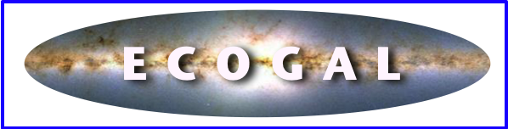
Turbulence in the interstellar medium and its links to the star formation process
Patrick Hennebelle
Noé Brucy, Tine Colman, Ugo Lebreuilly, Fabien Louvet, Tung Ngo, Antoine Verliat
Cédric Colling, Sam Geen, Olivier Iffrig, Eva Ntormousi, Juan Soler
Georges Abboudeh, Gabriel Verrier, Valentin Valucci
Frédéric Bournaud, Benoit Commerçon, Yueh-Ning Lee, Anaelle Maury,
Ralf Klessen, Sergio Molinari, Leonardo Testi

Slide 2
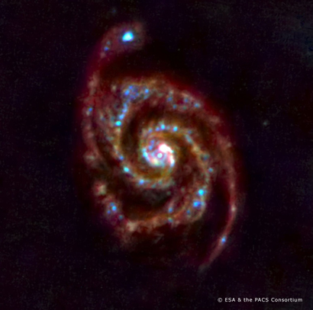
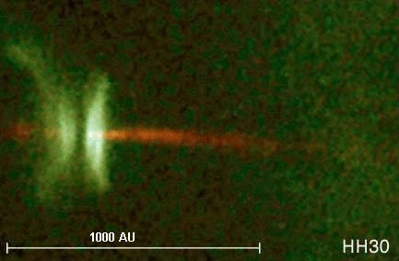
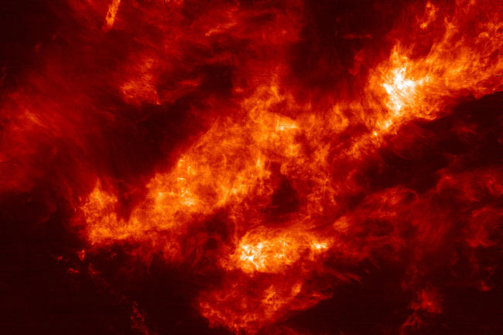
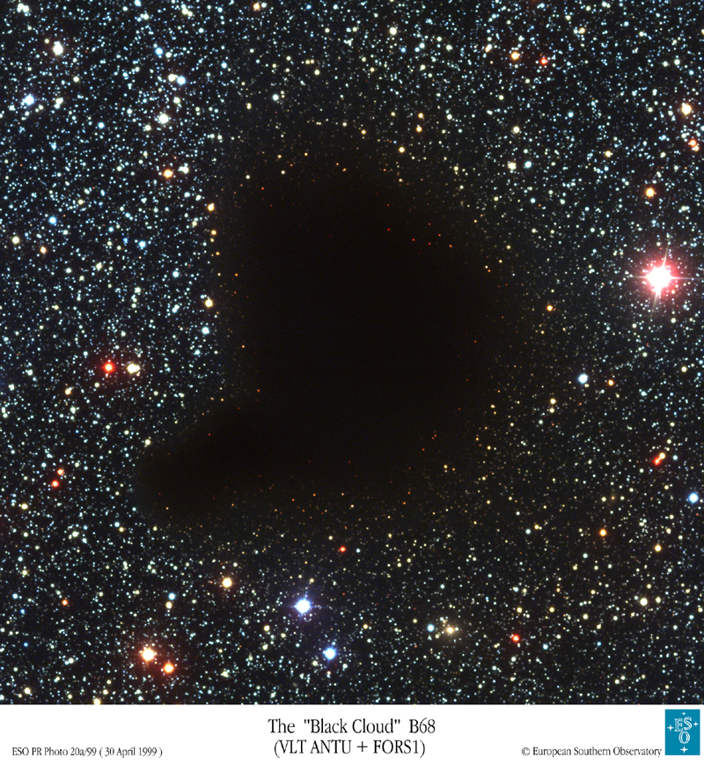
Large Scale Structures
Interstellar Cycle and Star Formation
Planets
Galaxies
Stars and Accretion Discs
~100,000 light years
light hours
Feedback
Efficiency ?
Protostars, Binarity Protoplanetary Discs ?
~100 light years
Star Formation Rate and Efficiency ?
Origin of the Stellar Initial Mass Function ?
Multiplicity and clustering ?
Fraction of ly
Molecular Clouds
Dense Cores

Slide 3
The Interstellar medium (ISM):
A Multi-scale and Multi-Physics environment
Huge dynamical range:
~10-15 orders of magnitude in space and time
~20-30 orders of magnitude in density
~6 orders of magnitude in temperature
Turbulence ~ Magnetic ~ Thermal ~ Radiation ~ Cosmic Rays
+ Gravity
≈1 eV cm⁻³
=> Energy equipartition
=> Strong coupling between several physical processes
=> Difficult to simplify and isolate the problems

Slide 4
The Gas in the ISM
The ISM is very inhomogeneous in density and temperature.
HIM: Hot Ionised Medium
ionised, 10⁶ K, 0.01 cm⁻³, 10⁸ solar masses
produced by supernovae explosions
WIM: Warm Ionised Medium
ionised, 8000 K, 0.5 cm⁻³, 10⁹ solar masses
WNM: Warm Neutral Medium
atomic neutral, 8000 K, 0.5 cm⁻³, 1.5 10⁹ solar masses
CNM: Cold Neutral Medium
atomic neutral, 70 K, 50 cm⁻³, 1.5 10⁹ solar masses
Molecular Hydrogen:
neutral, 10 K, 10³-10⁶ cm⁻³, 10⁹ solar masses
Comparable Pressure
Higher
pressure

Slide 5
-Observation of turbulence
-Supersonic isothermal turbulence
-the two-phase ISM turbulence
-the magnetized ISM
-the star formation rate and the Schmidt Kennicutt relation
-the multi-phase feedback regulated ISM and the need to drive turbulence
-SFR: an analytical model based on isothermal supersonic turbulence

Slide 6
-Observation of turbulence
-Supersonic isothermal turbulence
-the two-phase ISM turbulence
-the magnetized ISM
-the star formation rate and the Schmidt Kennicutt relation
-the multi-phase feedback regulated ISM and the need to drive turbulence
-SFR: an analytical model based on isothermal supersonic turbulence

Slide 7
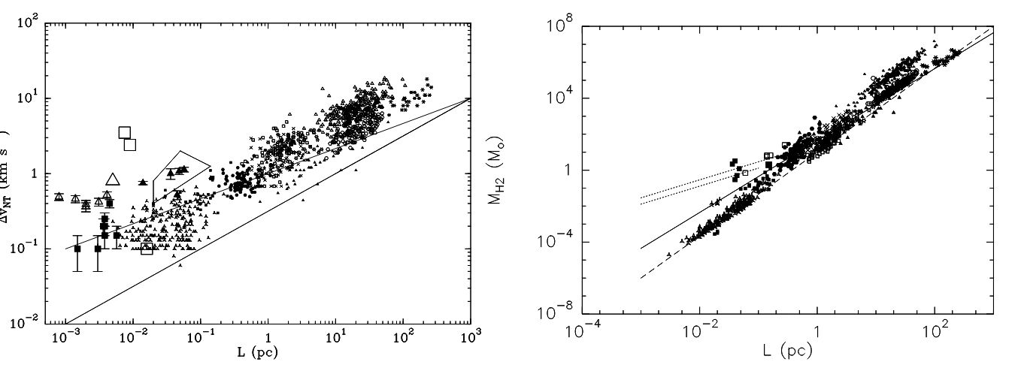
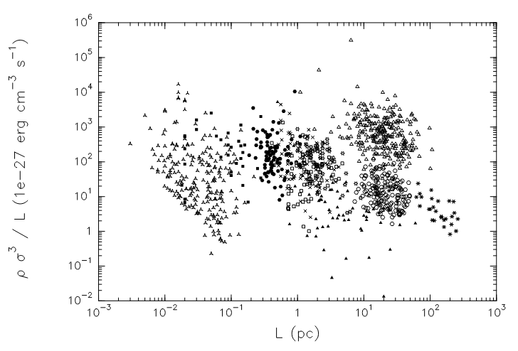
Evidence of turbulent motions in the interstellar medium
Velocity dispersion
Mass spectrum
Dissipation rate
H&Falgarone 2012

Slide 8
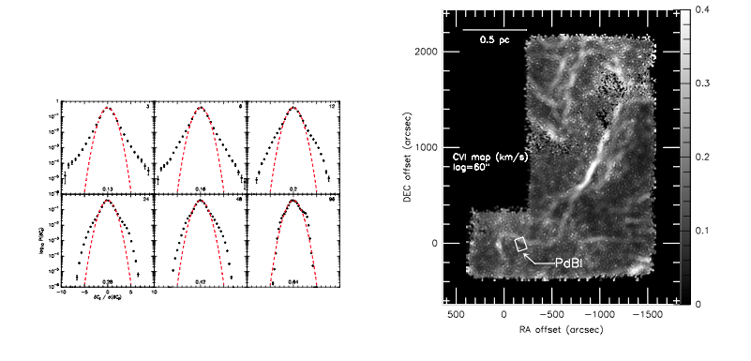
Example of Intermittency in Molecular clouds
Hily-Blant et al. 2008

Slide 9
Structure functions in molecular clouds
Hily-Blant et al. 2008

Slide 10
-Observation of turbulence
-Supersonic isothermal turbulence
-the two-phase ISM turbulence
-the magnetized ISM
-the star formation rate and the Schmidt Kennicutt relation
-the multi-phase feedback regulated ISM and the need to drive turbulence
-SFR: an analytical model based on isothermal supersonic turbulence

Slide 11
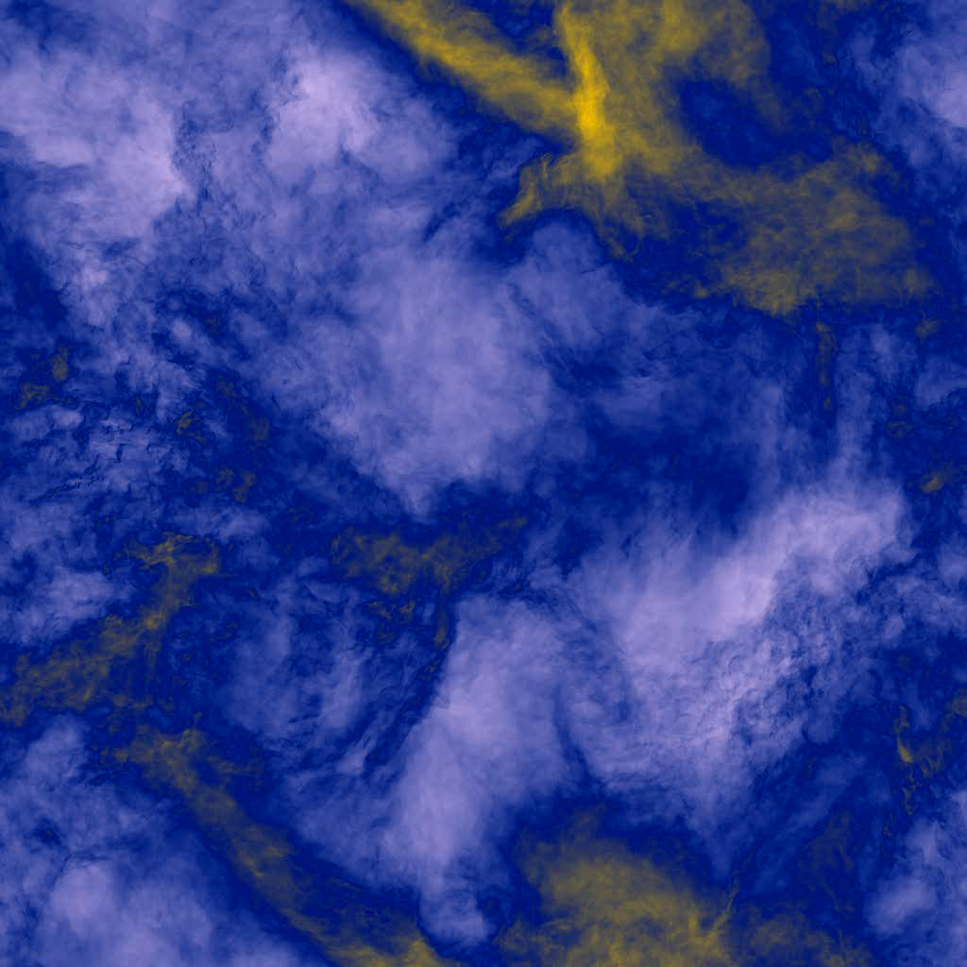
Supersonic isothermal turbulence
(amongst many others e.g. Scalo et al. 1998, Passot & Vazquez-Semadeni 1998,
Padoan & Nordlund 1999, Ostriker et al. 2001, MacLow & Klessen 2004, Beresnyak & Lazarian 2005, Kritsuk et al. 2007, Federrath 2013, 2022, Brucy+2024)
3D simulations of supersonic
isothermal turbulence with AMR
2048 equivalent resolution from
Kritsuk et al. 2007
Random solenoidal forcing is
applied at large scales ensuring
constant rms Velocity.
Typically Mach=6-10
Highly compressible flow
ρ/ρ₀ = M^2
Kritsuk et al. 2007

Slide 12
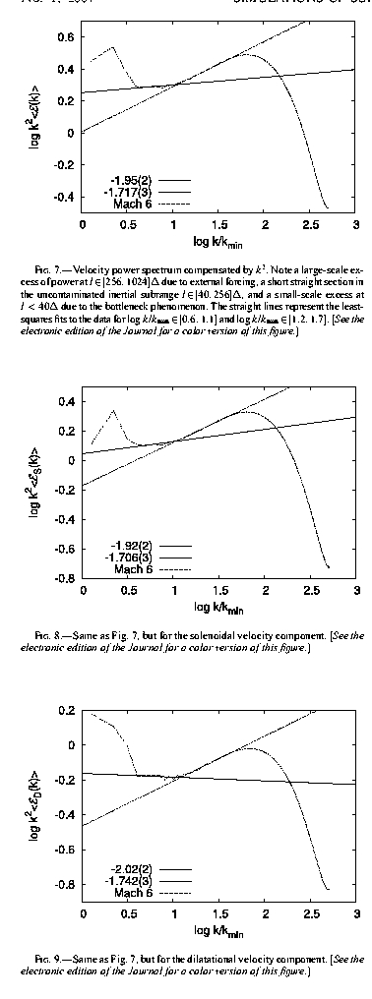
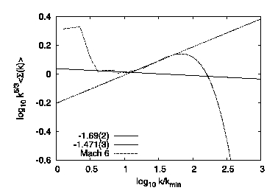
Compensated
powerspectra
-velocity
-incompressible
modes
-compressible
modes
Compendated
powerspectra of
corrected velocity
Inertial domain
Bottle neck effect
Value between around 1.9 between K41 and Burgers
Value 1.69 i.e. closer to K41
Kritsuk et al. 2007

Slide 13
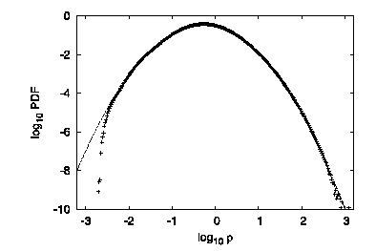
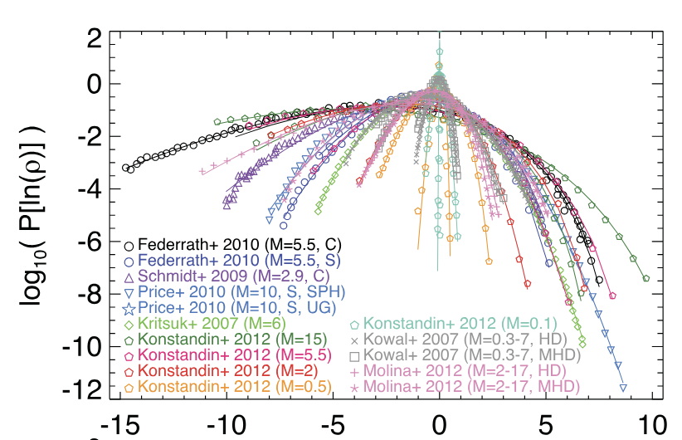
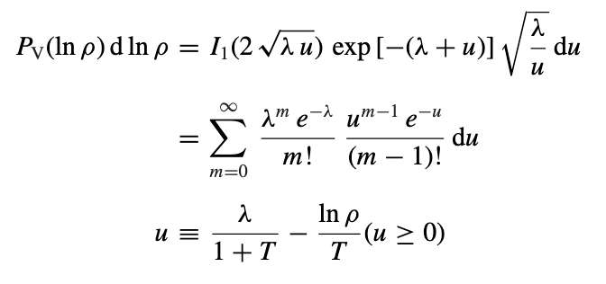
PDF of density field
(Padoan et al. 1997, Kritsuk et al. 2007, Hopkins 2013)
A lognormal distribution:
A log-Poisson distribution:
(Castaing 1998)

Slide 14
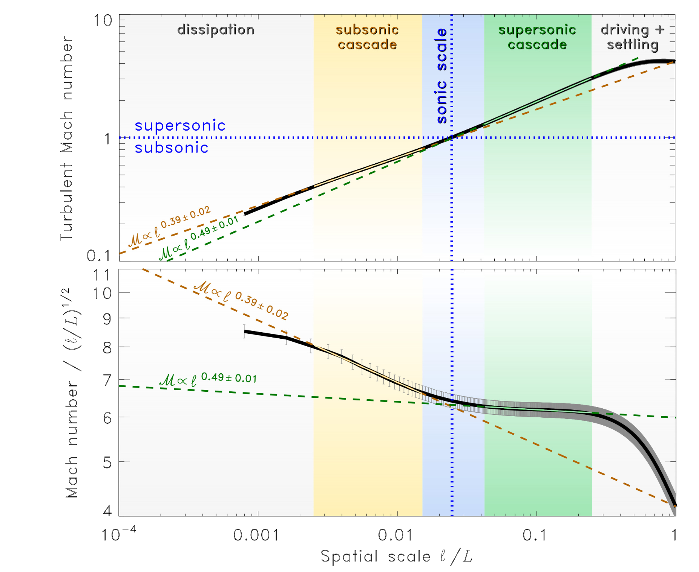
Transition between supersonic and subsonic turbulence
The biggest isothermal supersonic simulations done so far (Federrath+2011)
Federrath+2011

Slide 15

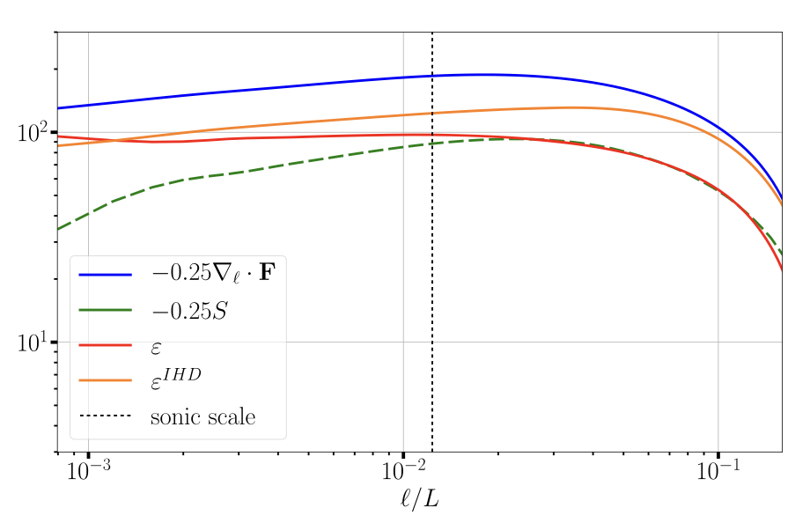
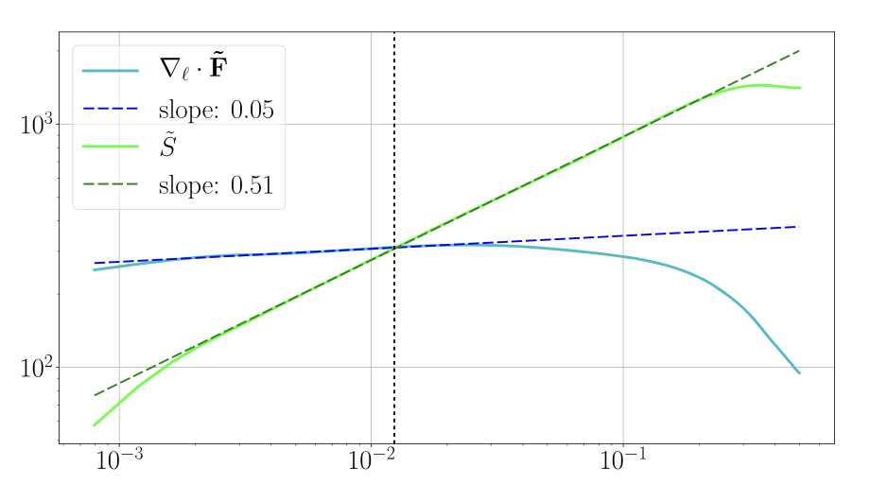
New analysis of compressible hydrodynamical cascade
Galtier & Banerjee 2011, Ferrand et al. 2020

Slide 16
-Observation of turbulence
-Supersonic isothermal turbulence
-the two-phase ISM turbulence
-the magnetized ISM
-the star formation rate and the Schmidt Kennicutt relation
-the multi-phase feedback regulated ISM and the need to drive turbulence
-SFR: an analytical model based on isothermal supersonic turbulence

Slide 17
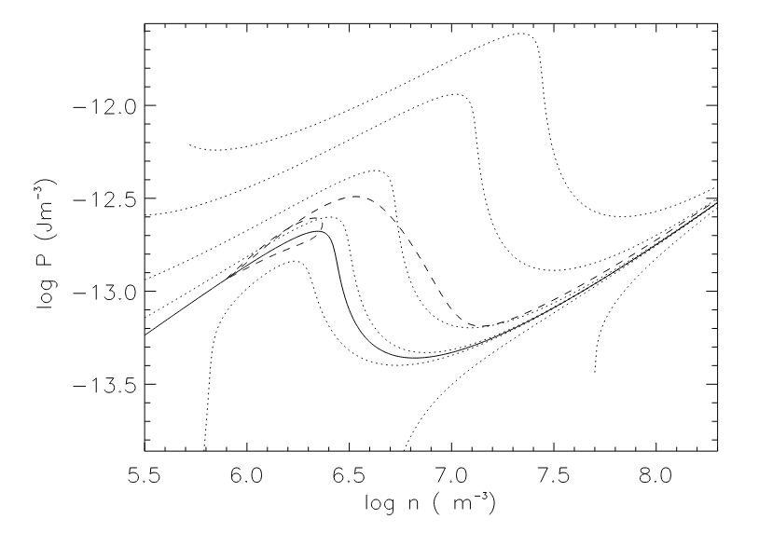
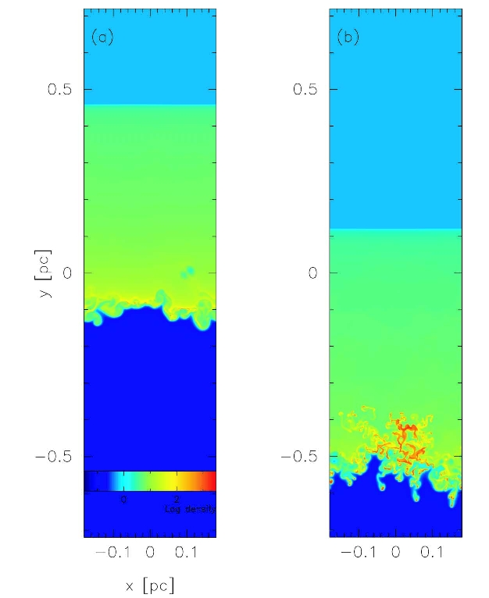
Thermal transition induced by the propagation of a shock wave
2D, cooling and thermal diffusion
The shock is unstable and
thermal fragmentation
occurs.
The flow is very fragmented
Complex 2-phase structure
The velocity dispersion
of the fragments is a fraction
of the WNM sound speed.
WNM
WNM
CNM
Shocked
WNM
1 pc
H & Pérault 1999
CNM
Koyama & Inutsuka 02

Slide 18
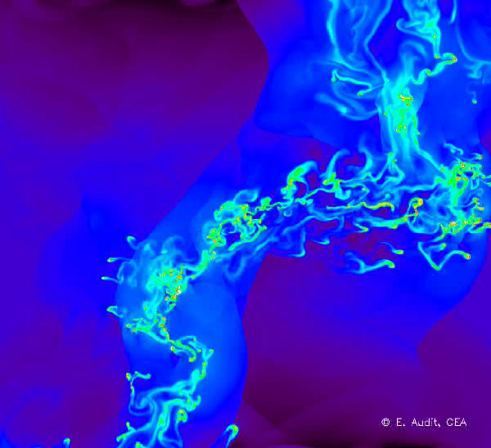
Turbulence within a bistable fluid
(Koyama & Inutsuka 02,04, Kritsuk & Norman 02, Gazol et al. 02,
Audit & H 05, Heitsch et al. 05, 06, Vazquez-Semadeni et al. 06)
-Forcing from the boundary
-Statistical stationarity reached
-complex 2-phase structure
-cnm very fragmented
-turbulence in CNM is maintained by interaction with WNM
20 pc
2500²
Audit & H 05

Slide 19
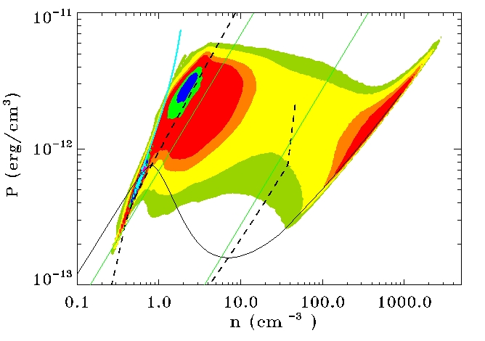
Influence of turbulence on the phase abundances
Intermediate behaviour between 2-phase and polytropic flow

Slide 20
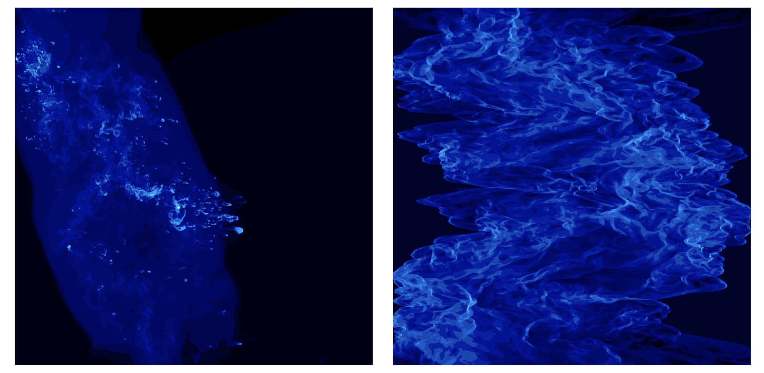
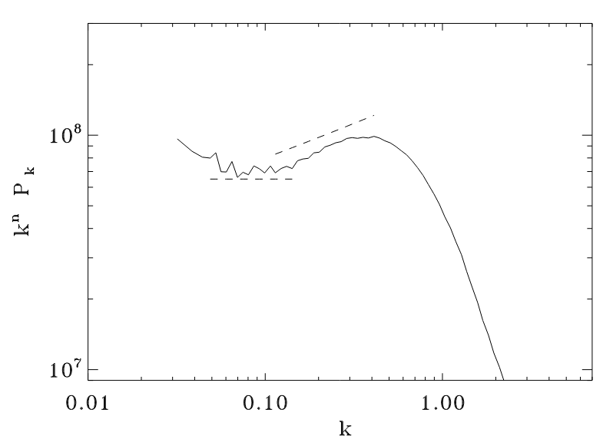
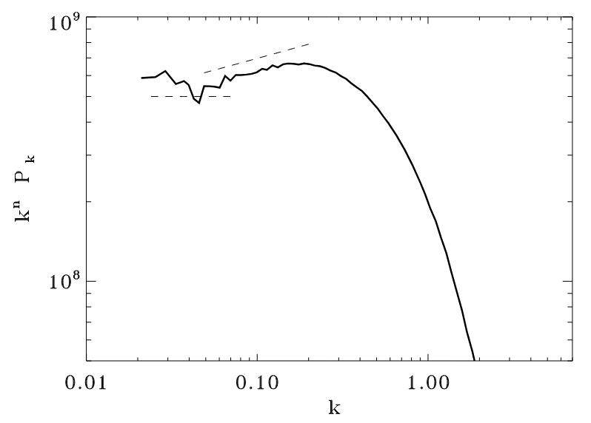
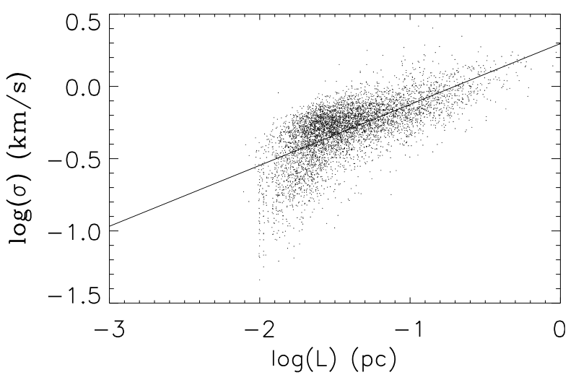
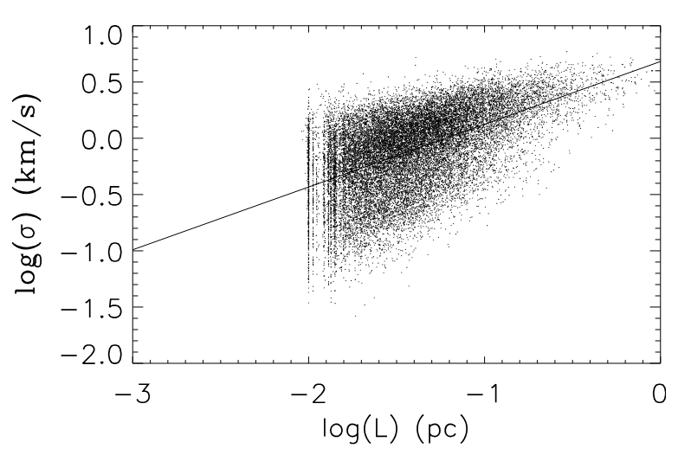
Comparison between cooling and isothermal simulations
cooling
isothermal
Powerspectrum
of log ρ
Velocity dispersion
of
dense clumps
Audit&H 2010

Slide 21
-Observation of turbulence
-Supersonic isothermal turbulence
-the two-phase ISM turbulence
-the magnetized ISM
-the star formation rate and the Schmidt Kennicutt relation
-the multi-phase feedback regulated ISM and the need to drive turbulence
-SFR: an analytical model based on isothermal supersonic turbulence

Slide 22
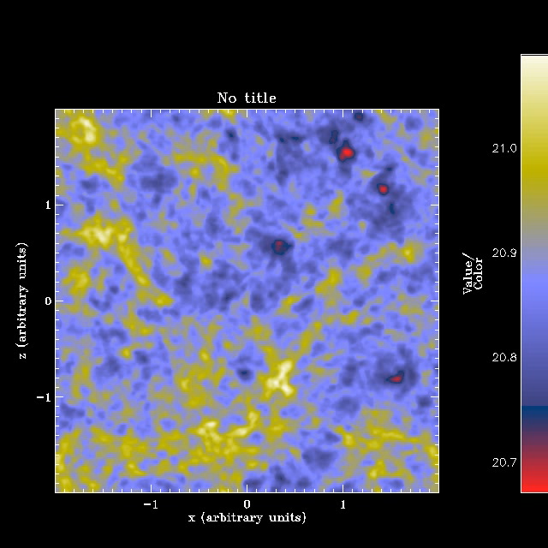
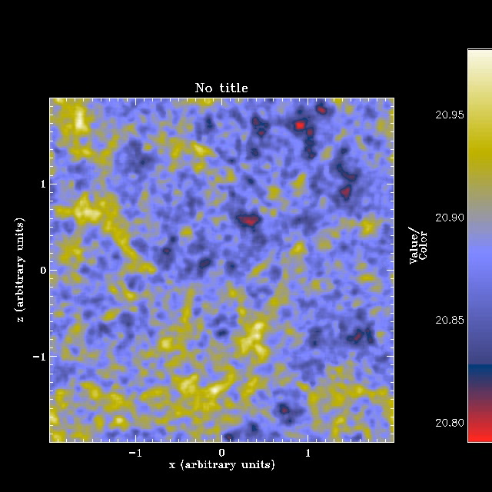
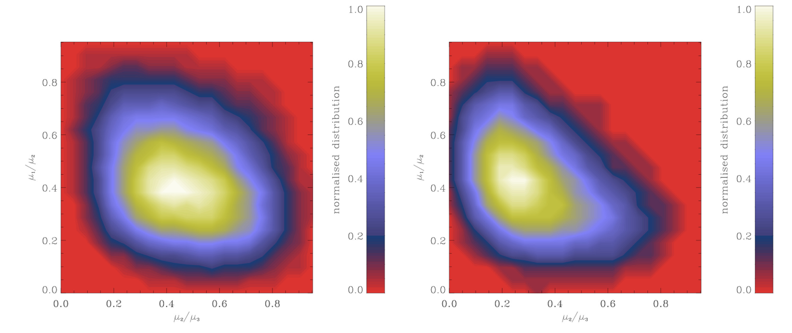
The impact of the magnetic field on the dense gas morphology
hydro
mhd
hydro
mhd
Clump of gas dense
aspect ratio

Slide 23
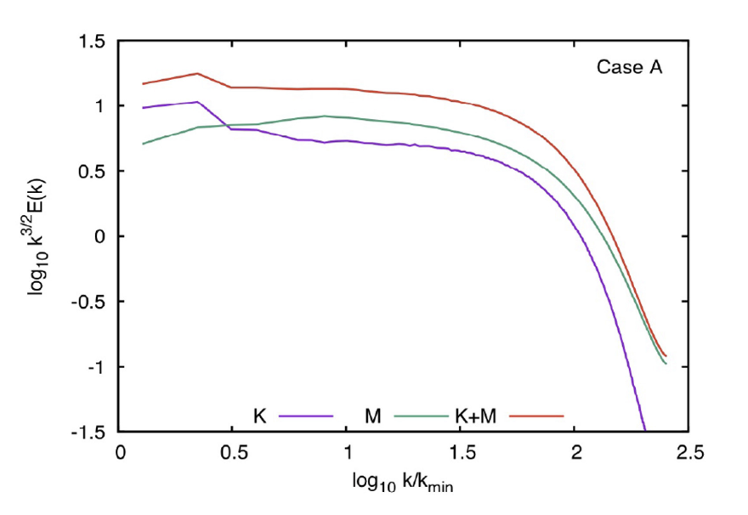
Powerspectrum in multiphase and magnetized interstellar gas
Kritsuk+2017

Slide 24
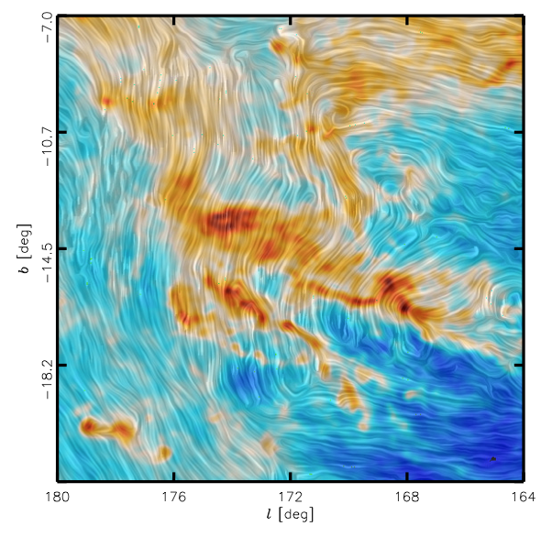
Integrated column density and magnetic field lines as seen by PLANCK
Planck collab. 2015

Slide 25
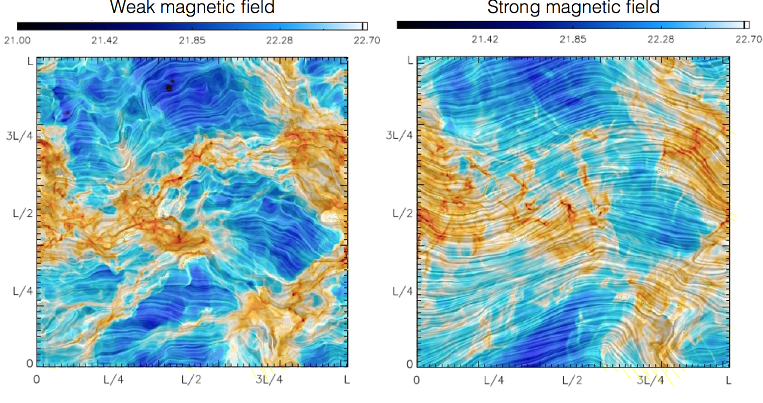
Simulations of molecular clouds: decaying turbulence, gravity,
magnetic field
β=P_{th}/P_{mag}=10
β=P_{th}/P_{mag}=0.1
Planck collab 2015
β= ?
Soler+2013
Soler & H 2017
Simulations
Observations

Slide 26
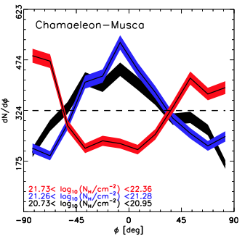

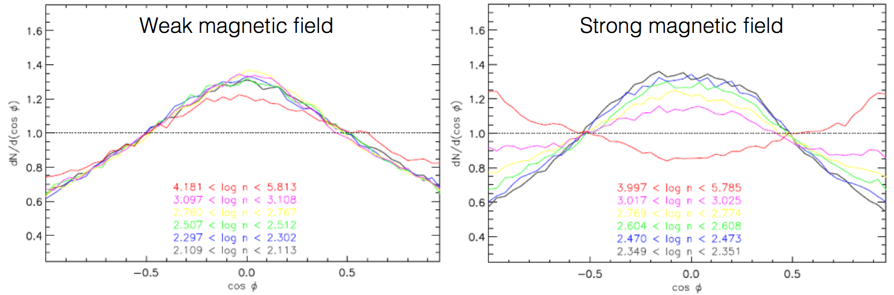

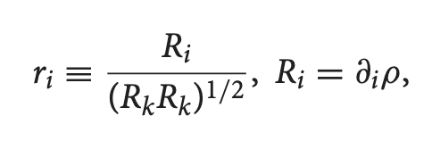
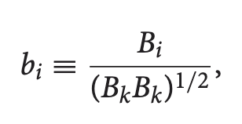
Angle distribution in Planck data and in simulations
Observed distribution of angle between B
and column density isocontour
distribution
Planck collab 2015
Simulations: distribution of
angle
β=10
β=0.1
distribution
Soler+2013
A theoretical explanation
Soler & H 2017

Slide 27
-Observation of turbulence
-Supersonic isothermal turbulence
-the two-phase ISM turbulence
-the magnetized ISM
-the star formation rate and the Schmidt Kennicutt relation
-the multi-phase feedback regulated ISM and the need to drive turbulence
-SFR: an analytical model based on isothermal supersonic turbulence

Slide 28
The star formation rate
“Naïve” estimate for the Milky-way
10⁹M_{s} of molecular gas / freefall time: few Myr = 100-1000 M_{s} yr⁻¹
But observationally: 2-3 M_{s} yr⁻¹
Self-gravity is far to be dominant… Star formation is very inefficient
Zuckerman & Evans 1974
The Schmidt-Kennicutt relation
Schmidt 1959, Kennicutt 1998
Σsfr α Σ^{1.4}
Kennicutt & Evans 2012

Slide 29
-Observation of turbulence
-Supersonic isothermal turbulence
-the two-phase ISM turbulence
-the magnetized ISM
-the star formation rate and the Schmidt Kennicutt relation
-the multi-phase feedback regulated ISM and the need to drive turbulence
-SFR: an analytical model based on isothermal supersonic turbulence

Slide 30
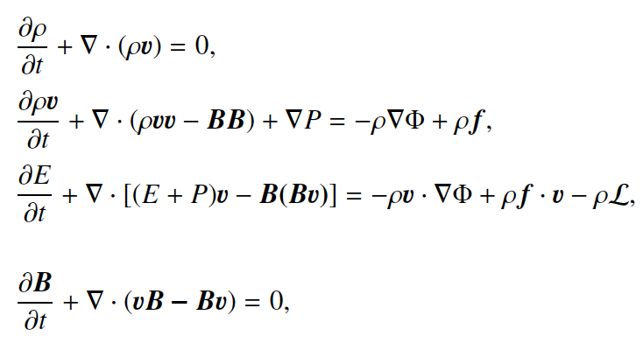
Model for star forming interstellar medium
RAMSES code is used (Teyssier 2002, Fromang+2006, Bleuler & Teyssier 2013, Rosdahl+2013)
MHD equations
External gravity due to stars and dark matter
Self-gravity, MHD turbulence, standard ISM cooling
Sink particles mimics star formation. Given the typical resolution their mass is typically 10³-10⁵ Ms => they represent clusters
Each time 120 Ms is accreted, a massive star forms and therefore its feedback is applied.
Mass distribution follows Salpeter.
When a massive star forms:
-the supernovae momentum is injected after a time that corresponds to the stellar age and at a distance proportional to its age.
-ionising radiation is treated (M1 method) and applies 4 Myr after the formation of the massive star.
-the UV heating is proportional to the star formation rate
Series of kpc simulations:
-resolution from 1-2 to 0.004 pc
-variations of physical and numerical parameters

Slide 31
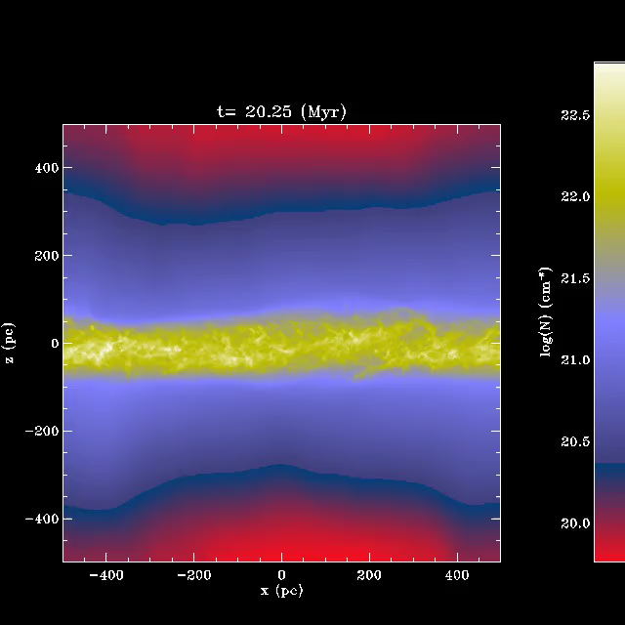
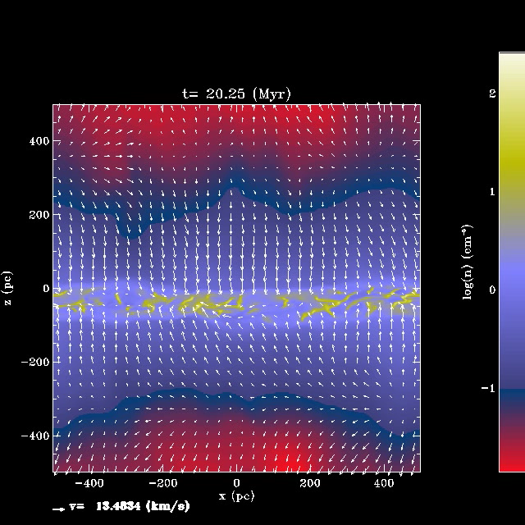
Supernovae regulated ISM (from few 100 pc to 1kpc)
(Slyz et al. 2005, de Avillez & Breitschwerdt 2005,2007, Joung & MacLow 2006, Ostriker+2010
Hill et al. 2012, Kim et al. 2011, 2017, H & Iffrig 2014, Gatto et al. 2014, Walch et al. ….)
External gravitational field (due to stars and DM), multi-phase ISM, self-gravity, magnetic field
Feedback (different schemes)
Column density
density
H&Iffrig 2014
1kpc

Slide 32
Influence of various processes on the SFR
Hydro
No feedback
MHD
No feedback
MHD
SN feedback
MHD
SN and HII
Density PDF
Total mass of stars
Expected SFR from SK relation
More feedback =>
more intermediate density gas
When all source of stellar feedback are included (plus shear), the star formation rate for a MW type galaxy is reasonably reproduced (possibly a bit too high).
Colling+2018

Slide 33
Trying to reproduce Schmidt-Kenicutt relation
Dependence of the SFR on the mean column density
N=1.4
Schmidt-Kenicutt slope is not reproduced!
Something is missing, at least for gas rich galaxies
N=1.4
N=2.6
Colling PhD
Brucy+2020,2024

Slide 34
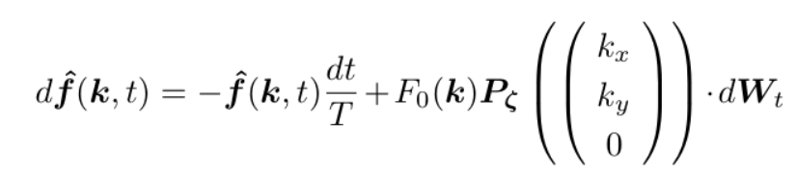
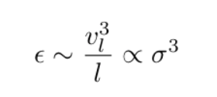
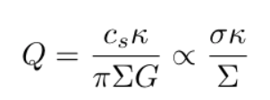


The role of externally driven turbulence
What sources of turbulence do we foresee?
The gas orbital energy of the galaxy which is tapped by gravitational instabilities
(Bournaud et al. 2010, Krumholz et al. 2018)
Maximum ε ? ε∼V_{rot}³/R => enormous source of free energy
How do we drive?
(Schmidt+2006,2009)
75% solenoidal modes – compressible forcing change our conclusion quantitatively
How intensively do we drive?
(incidently note that feedback provides “only” P_{inj} α Σ^{1.4})
Brucy+ApJ 2020, 2024

Slide 35
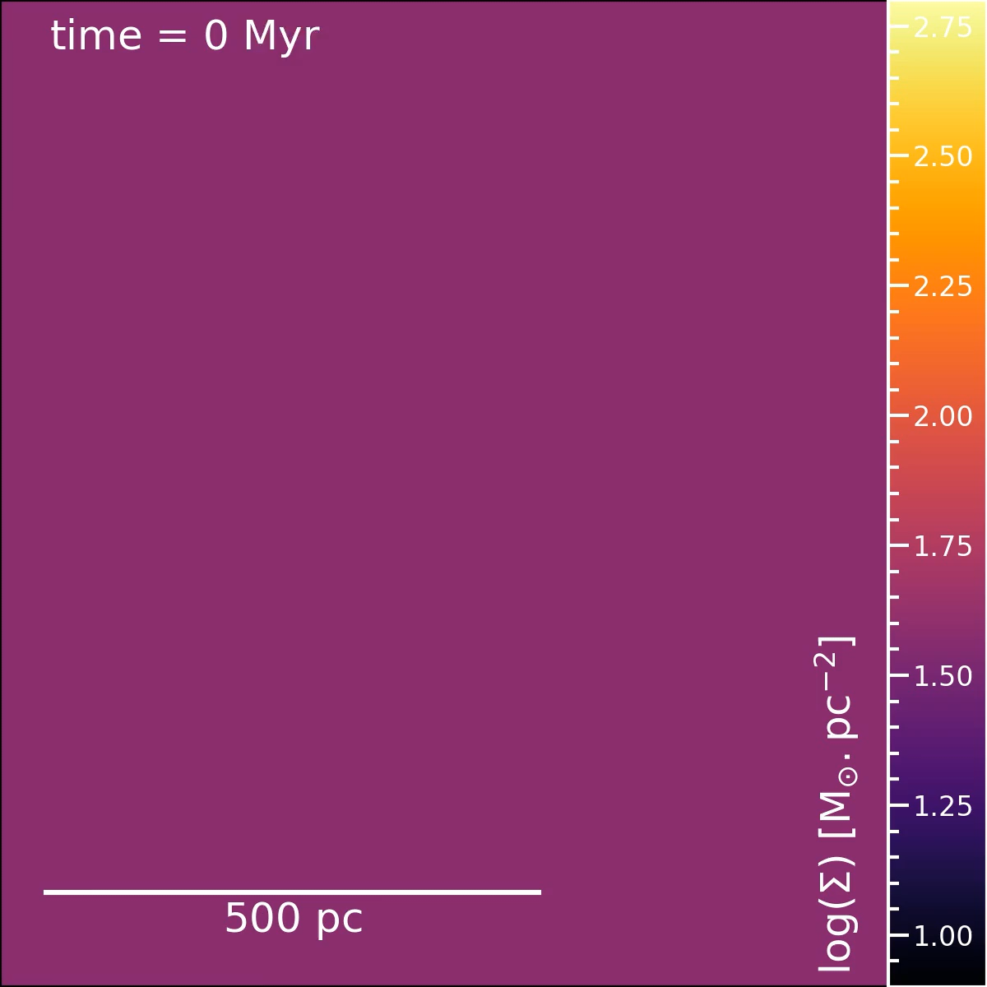
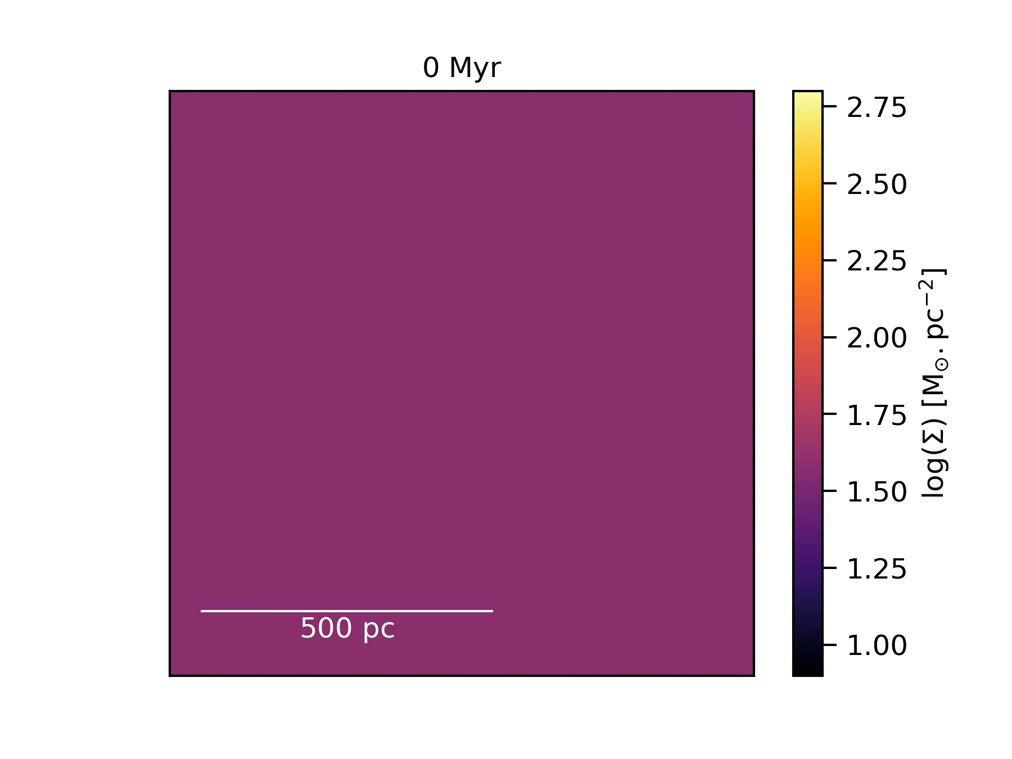
Without driving
With driving
Brucy+ 2020, 2024

Slide 36
Evidence for large scale driven turbulence I:
Externally driven turbulence can explain Schmidt-Kunnicutt relation
Brucy+2020
Recent analytical models and comparisons with simulations : H+2024, Brucy+2024

Slide 37
-Observation of turbulence
-Supersonic isothermal turbulence
-the two-phase ISM turbulence
-the magnetized ISM
-the star formation rate and the Schmidt Kennicutt relation
-the multi-phase feedback regulated ISM and the need to drive turbulence
-SFR: an analytical model based on isothermal supersonic turbulence

Slide 38
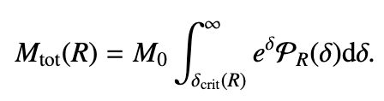
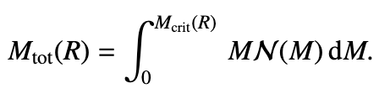
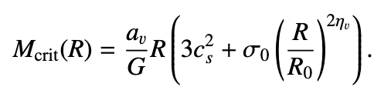
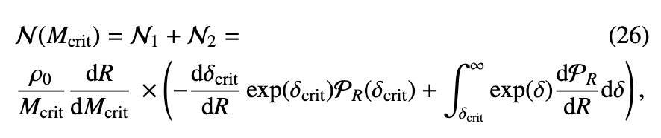
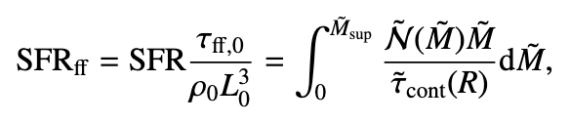
An analytical model to predict the star formation rate
Unstable mass at scale R from density PDF
Unstable mass at scale R from cloud spectrum
M_{crit}, ρ_{crit} from virial analysis:
Taking the derivative with respect to R:
Summing over the unstable cores divided
by the replenishment time
We get the SFR as a function Mach number, density PDF, density variance.
H+2024

Slide 39
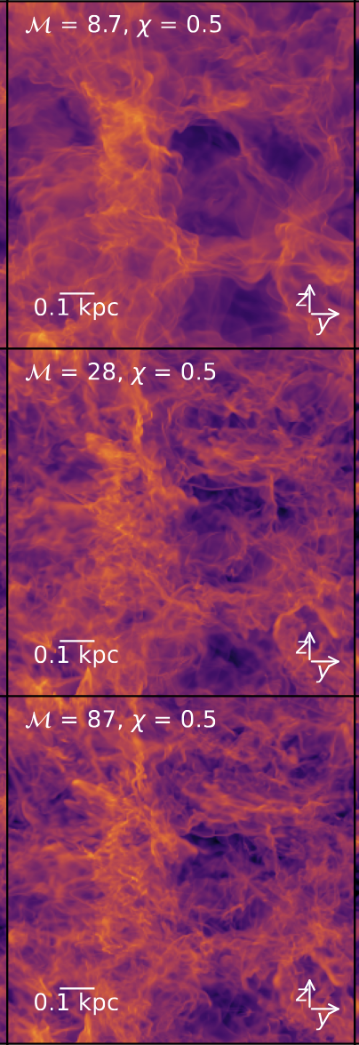


Density PDF and powerspectrum of log ρ as a function of Mach number
Density PDF
Power spectrum of log ρ
Brucy+2024

Slide 40

Predicted SFR as a function of Mach number for different
log ρ powerspectra
H+2024

Slide 41


SFR from simulations as a function of Mach number and comparison with the analytical model
Brucy+2024

