Slide 1




Mini-EUSO :
dead time map from pile-up
Phd Student
Photodetection and instrumentation for UHECR & SQM
detection from space
Enzio M’sihid
mail : msihid@apc.in2p3.fr

Slide 2
Plan
I. PILE-UP : QUICK RECAP
II. APPLICATION TO Mini-EUSO : UPDATE

Slide 3
Plan
I. PILE-UP : QUICK RECAP
II. APPLICATION TO Mini-EUSO : UPDATE

Slide 4
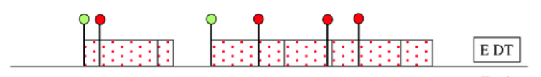
Pile-up
Recap
• Pile-Up refers to multiple events occuring within a time window too short for the system to distinguish them. Thus leading to a saturation on the maximum number of count that the electronic can observe within a GTU.
• Pile-Up in Extended Dead Time (EDT) refers to a specific type of electronics :
• No extra counts until the electronics gets at rest.
FROM : Uncertainty of nuclear counting , S. Pommé et al 2015 Metrologia 52 S3, doi:10.1088/0026-1394/52/3/S3
• We will consider Mini-EUSO to be in EDT (This hypothesis is good but will be improved for future simulation of its D1 histograms).

Slide 5
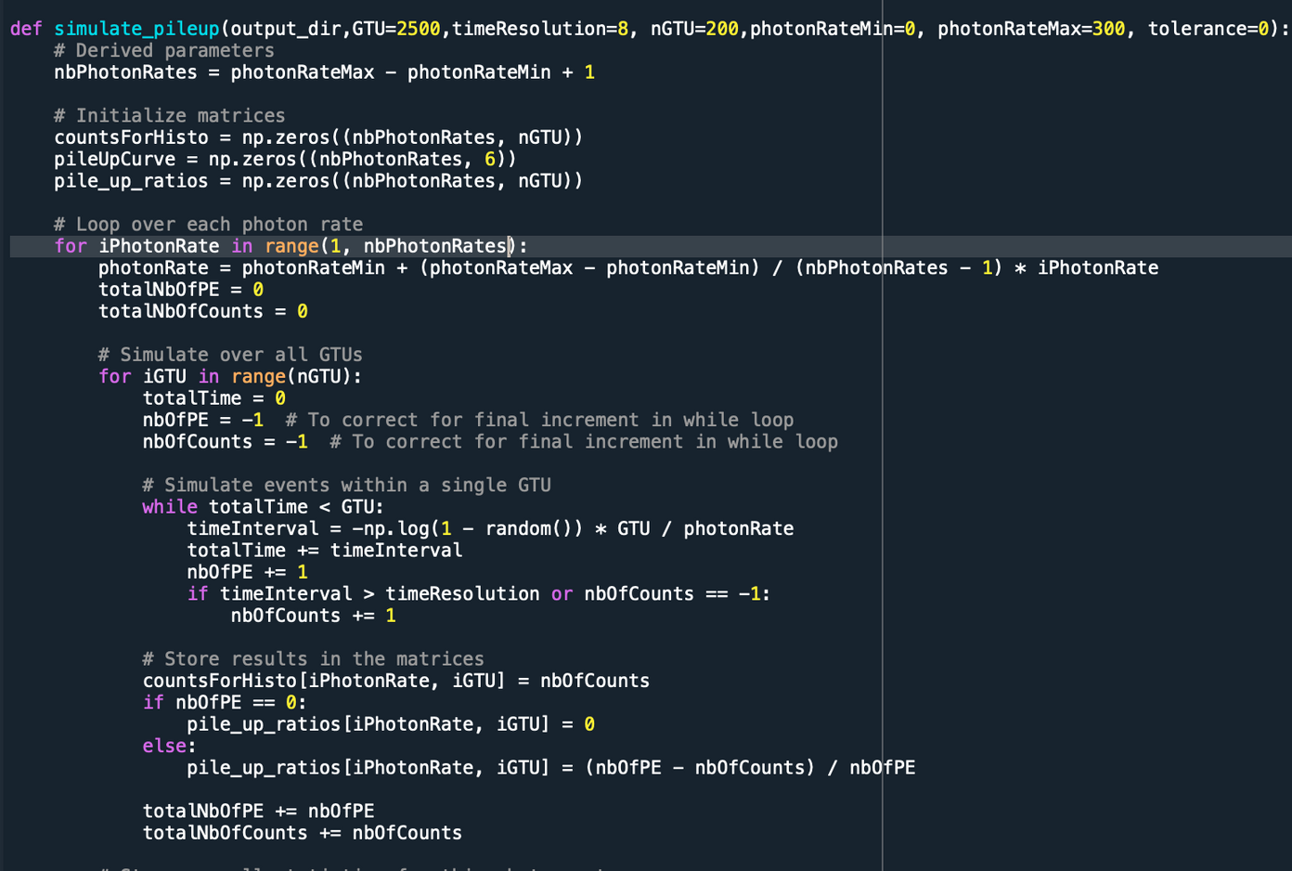

Pile-up
Simulation Recap
• Set a photon Rate
Poisson Distribution of ∆t in a GTU
∆t > τ : Count
∆t < τ : Missed
Repeat over nGTU
• Change photon rate
• τ = 6.0 to 12.0 by step of 0.5
• nGTU = 1000
• Result : (# Photon Rates , nGTU) 2D
array with # of Count as elements
• Photon Rates : int(0 to 2000)
# Photons sent during a GTU

Slide 6
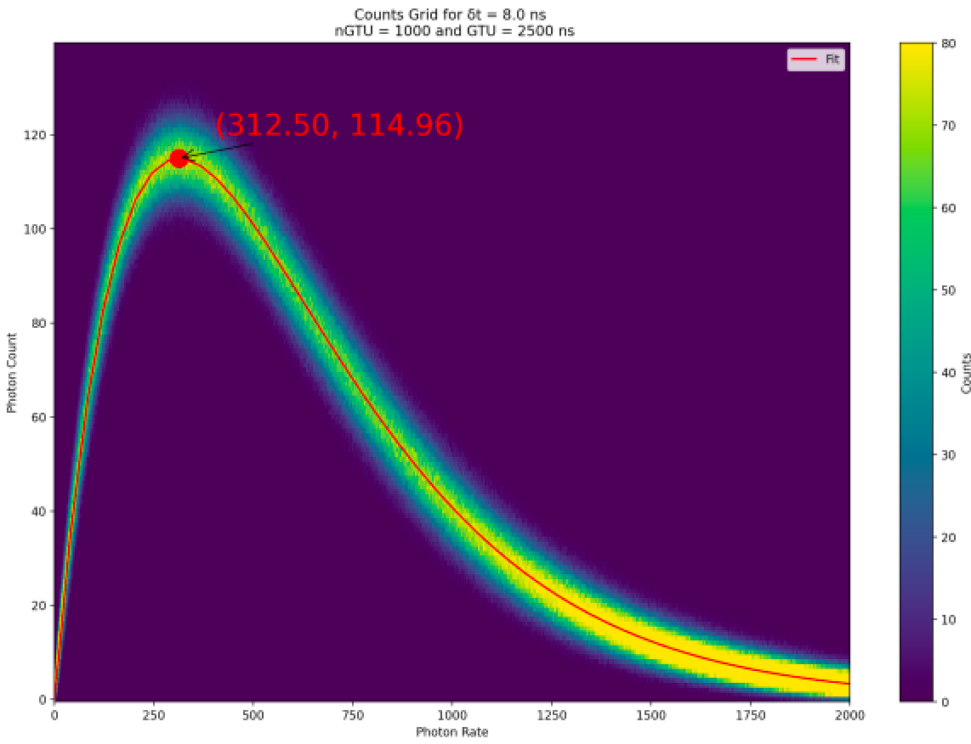

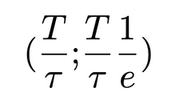
Pile-up
Simulation Recap
•
Get Count # of each Photon Rate
Counts Grid
• Each column has nGTU
• Mean and sigma
over the nGTUs
for each rate
• Coordinates of max :
• From this we can extract the histogram of the counts.
Even ∆t for all photons

Slide 7
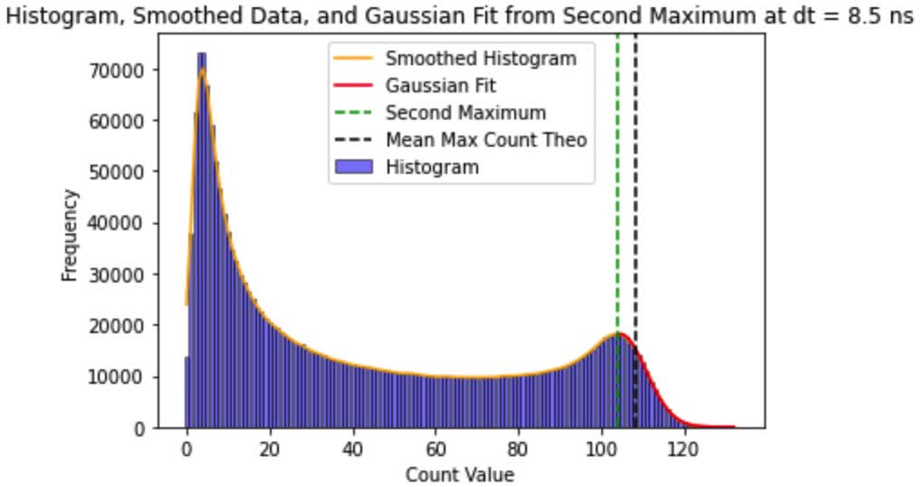
Pile-up
Simulation Recap
• All rates are equally possible in this simulation of Mini-EUSO’s D1 histograms.
• We look for a link between τ and this histogram’s shape. We used the index of the right bump.

Slide 8
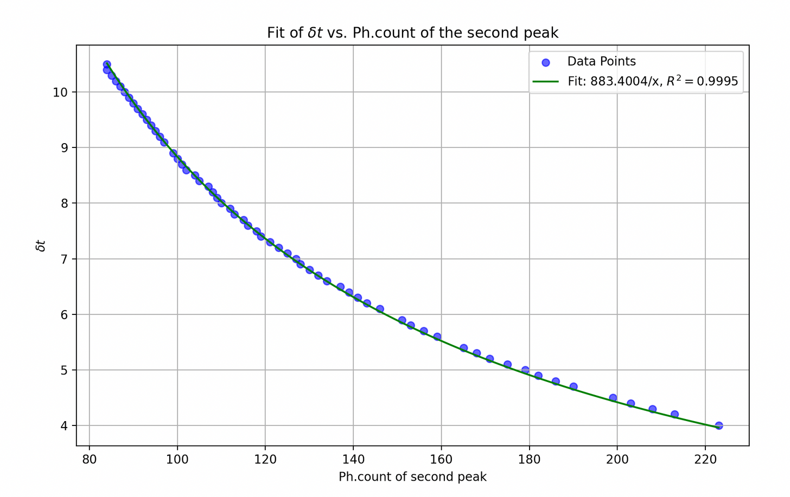
Pile-up
Simulation Recap
τ
• The fit of τ for the right bump is very good.
• Hence if we identify the right bump on Mini-EUSO’s histograms, we can retrieve it’s τ.
τ

Slide 9
Plan
I. PILE-UP : QUICK RECAP
II. APPLICATION TO Mini-EUSO : UPDATE

Slide 10
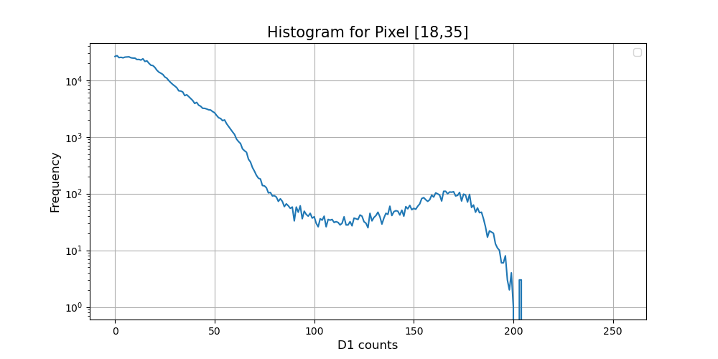
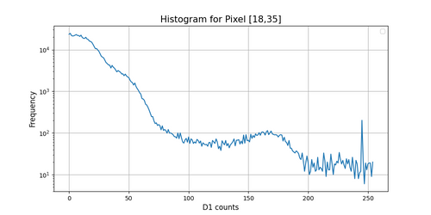
Mini-EUSO
Retrieve MINI-EUSO τ
We want to identify the index of this bump.
Including sessions 20 to 44 :
Including all sessions :
—>The tail of the histogram come from the first sessions.

Slide 11
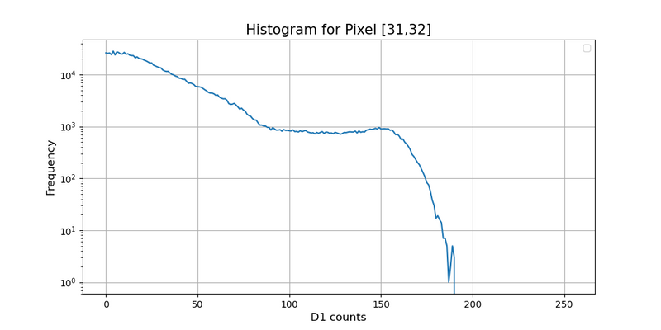
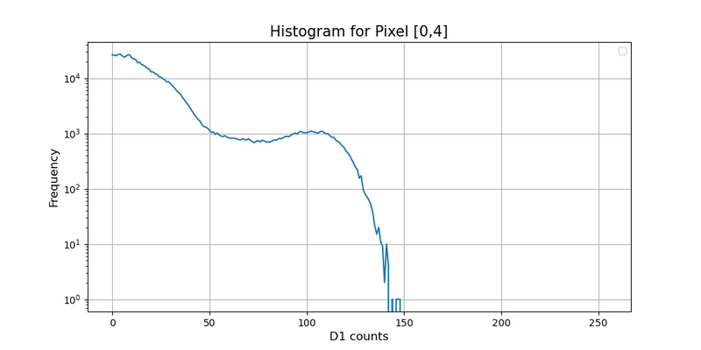
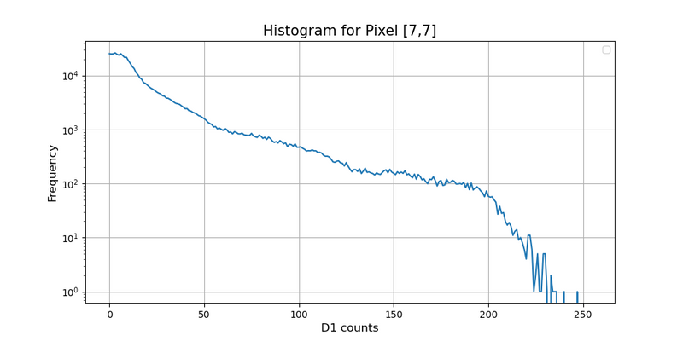
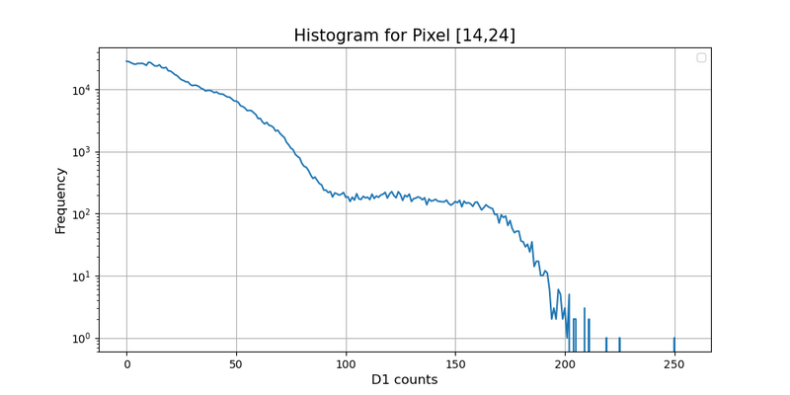
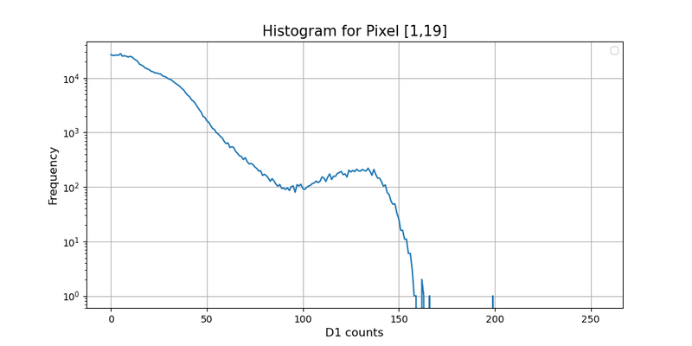
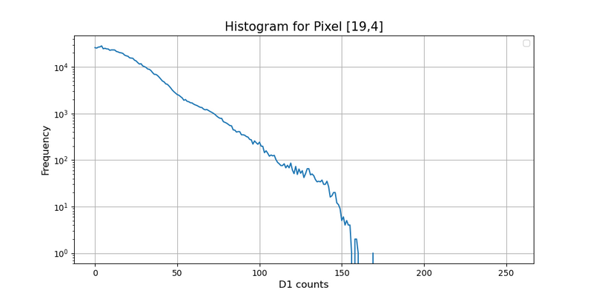
Mini-EUSO
Retrieve MINI-EUSO τ
• Previously we used basic python logics to retrieve the index (difficult because there’s a lot of different shapes).

Slide 12
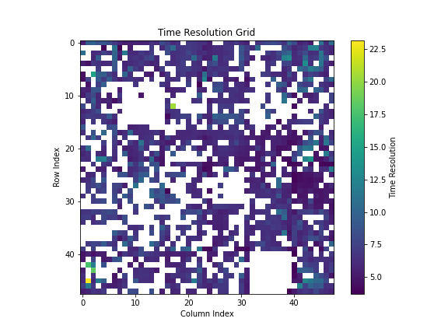
Mini-EUSO
Analysis on all Pixel — old results.
• The logic did not find an index for a lot of pixel’s histogram.
• We decided to use machine learning algorithms.

Slide 13


Mini-EUSO
Machine Learning pipeline to identify the index
I. Manually extract the correct ondex for several histograms (150 by hand)
II. Use this database to train several machine learning algorithm and look at there performance. We kept only Random Forest and XGBoost.
III. Fine tune each promising model using a grid search for the best hyper parameters.
MAE ~9-10 photons.
IV. Apply both models on all Mini-EUSO’s histograms (allows to check for consistency)
V. Use different random seeds in the model to check for each models consistency.

Slide 14
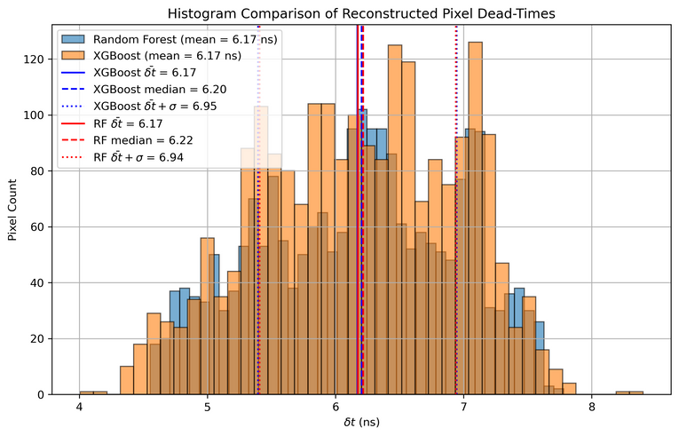
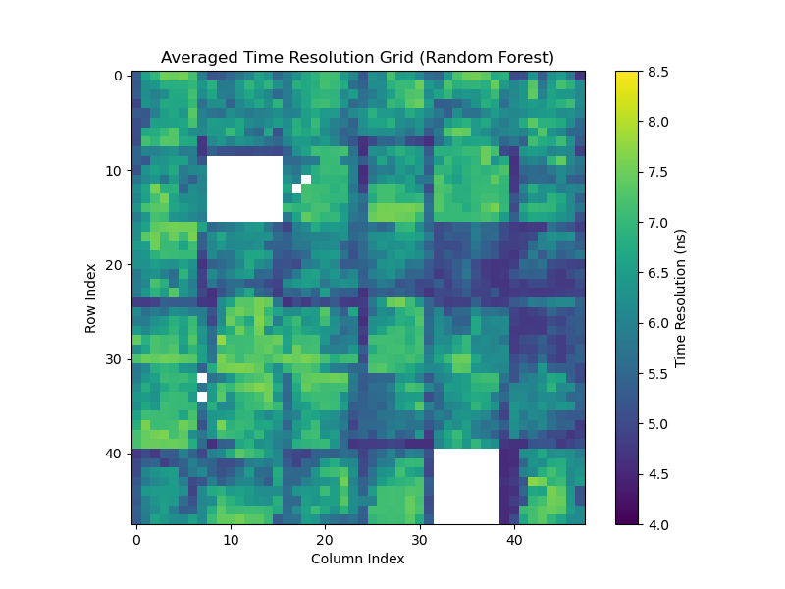
Mini-EUSO
Analysis on all Pixel
Dead pixels
Bit-shift pixels

Slide 15
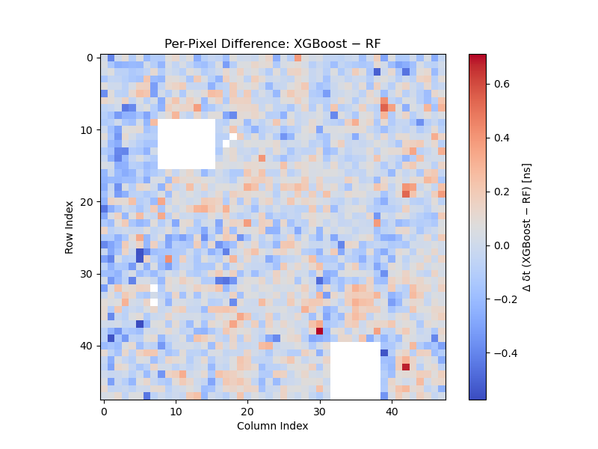
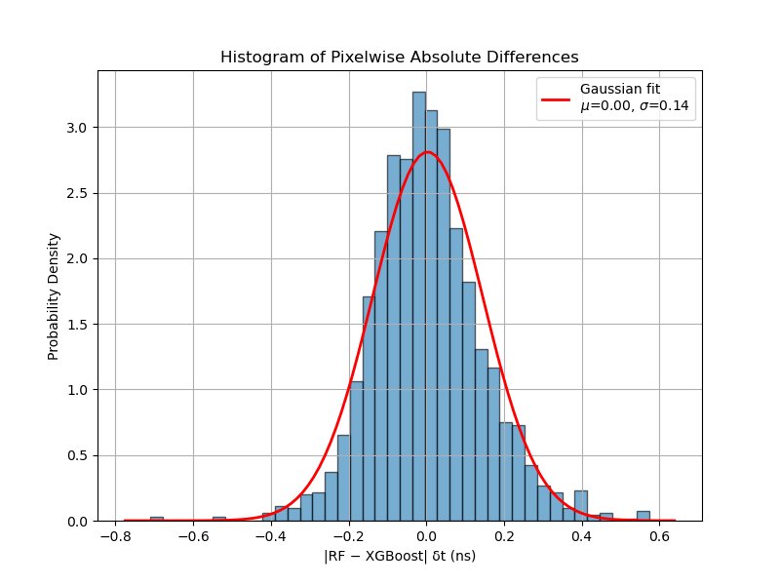


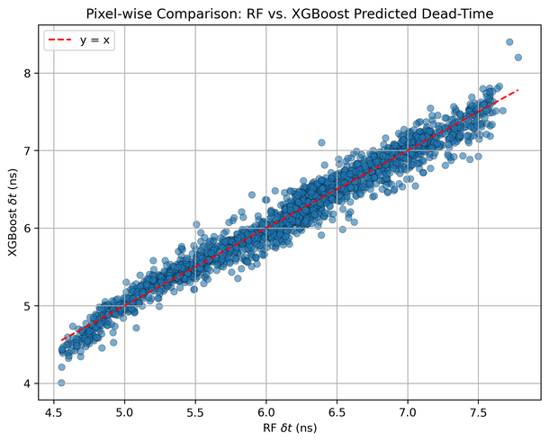
Mini-EUSO
Models comparison
Overall good consistency between the model’s predictions.
y = x ± 0.03

Slide 16
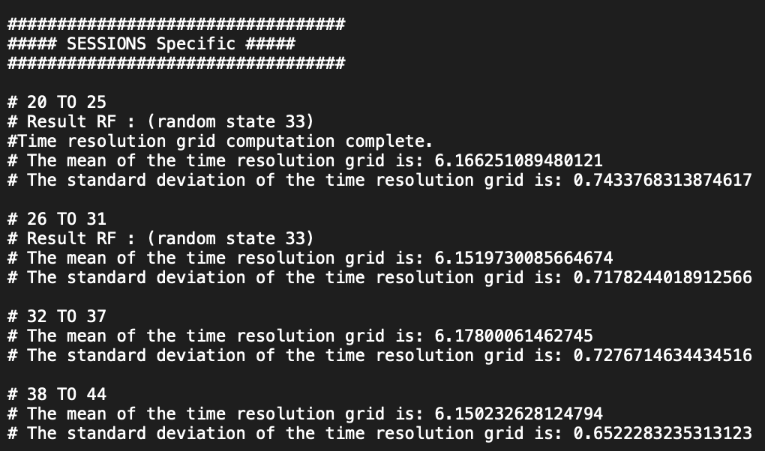
Mini-EUSO
General remark
• This simulation was conducted over different bits of sessions to check for a change in the dead time of the pixels. It looks quite stable overall.
• We can easily extract from the latter each individual pixel evolution if necessary.

Slide 17
Mini-EUSO
General remark
AJOUTER SLIDE SUR L’INCERTITUDE GENERALE de la RECONSTRUCTION :
• L’ENTRAINEMENT
• LE MODELE
VIRE LA PARTIE SIMULATOIN ET DIRE JUSTE : ON SIMULE PLEIN DE GTU AVEC RATE EQUIPROBABLE ET EN EDT= SIMULATION DES D1 HISTOGRAMS.

Slide 18




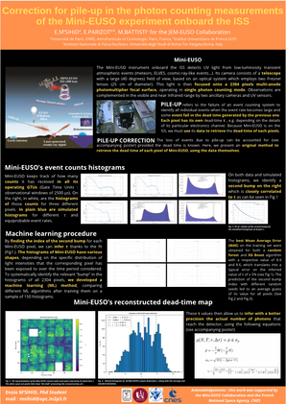
Conclusion
• We have a cleaner map of Mini-EUSO’s pixel’s dead time. Which can still be improved (EDT hypothesis, model training...).
• The latter will be useful for improving the un-pile-up procedure (see tomorrow’s pile-up presentation).
• Those results were presented partly in a poster at the ASAPP 2025 in Spain.

