Slide 1
Status in Russia
Pavel Klimov
SINP MSU
37th JEM-EUSO Collaboration Meeting
02.06-06.06.2025

Slide 2
Russian team
JEM-EUSO members
SINP MSU
P. Klimov,
A. Belov,
S. Sharakin,
M. Zotov,
G. Garipov,
I. Yashin,
D. Trofimov
R. Saraev
Space Regatta
O. Saprykin
+ students and young scientists
A. Murashov, V. Nikolaeva,
K. Sigaeva, K. Shchelkanov, A. Trusov
RSC Energia:
I. Churilo, V. Kuznetsov
JINR
A. Borodin, A. Blinov
INR RAS
G. Rubtsov, M. Kuznetsov

Slide 3
List of activities in 2025
EUSO-SPB2 (D. Trofimov, two papers on calibration has been prepared with his participation) +PhD thesis
Mini-EUSO (data analyses: meteors (M. Zotov), ELVES (S. Sharakin), sessions schedules).
Data will arrive soon
We need to repair locks, or may be not…
R.Saraev, S. Sharakin – talk on Wednesday about ELVES location
EUSO-TA: Zynq boards (A. Belov), neural networks application (M. Zotov)
M. Yu. Zotov, A. Trusov – talk in EUSO-TA session
Mikhail Zotov, Reconstruction of energy and arrival directions of UHECRs registered by fluorescence telescopes with a neural network, Moscow University Physics Bulletin (published) + Bulletin of RAS (in press)
PAIPS (pulsating aurora imaging photometers system)
Whole Russian team, talk on Friday about recent results
Small satellites MSU program
Detector SONET, talk of V. Kudryavtsev&A. Belov on Wednesday

Slide 4
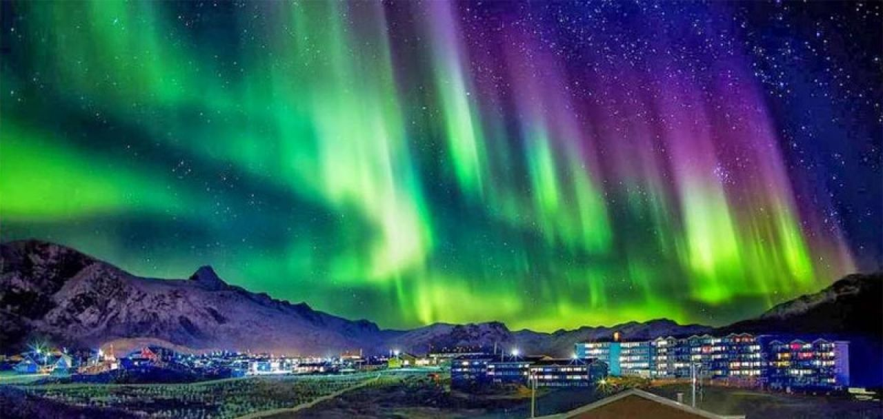
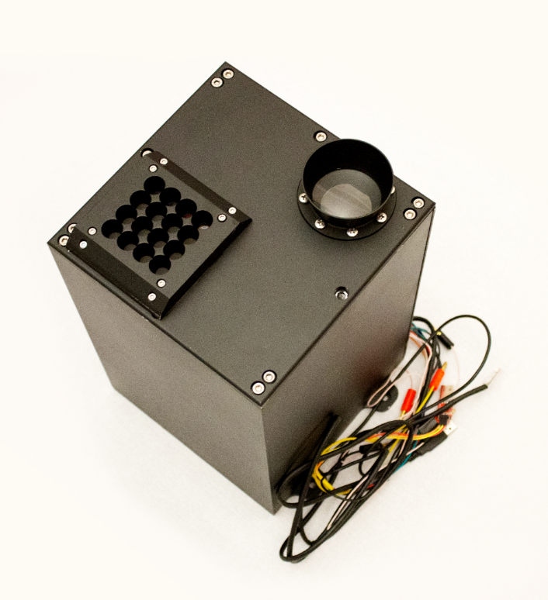
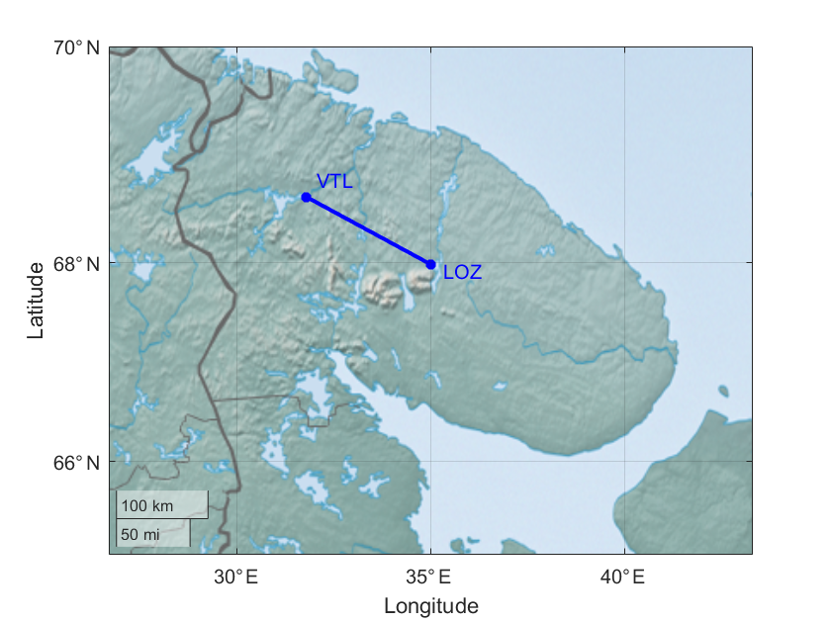
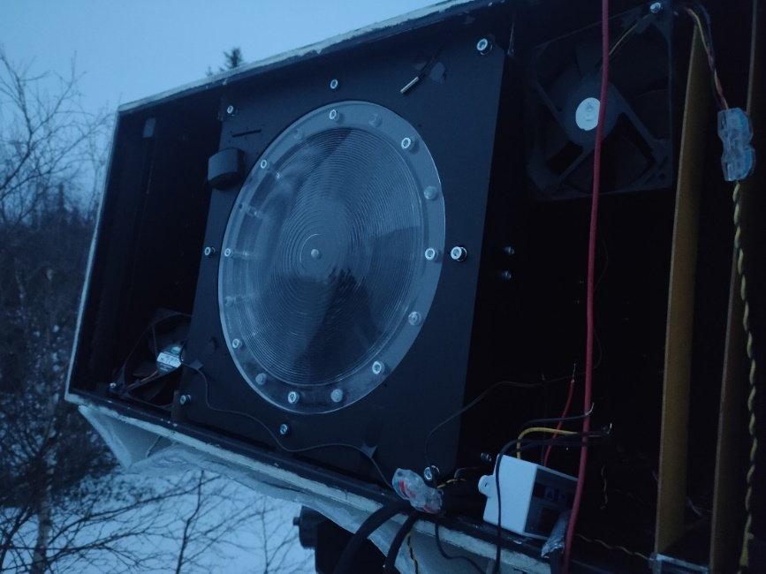
Pulsating Aurora Imaging Photometers Stereoscopic System (PAIPS)

Slide 5
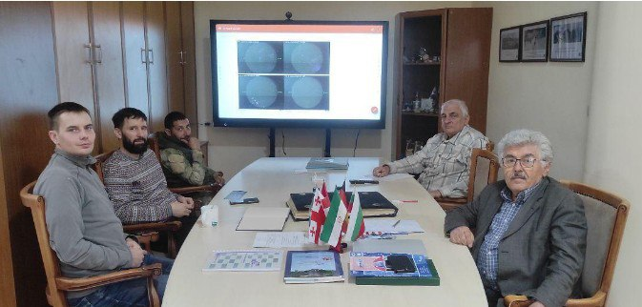

Slide 6
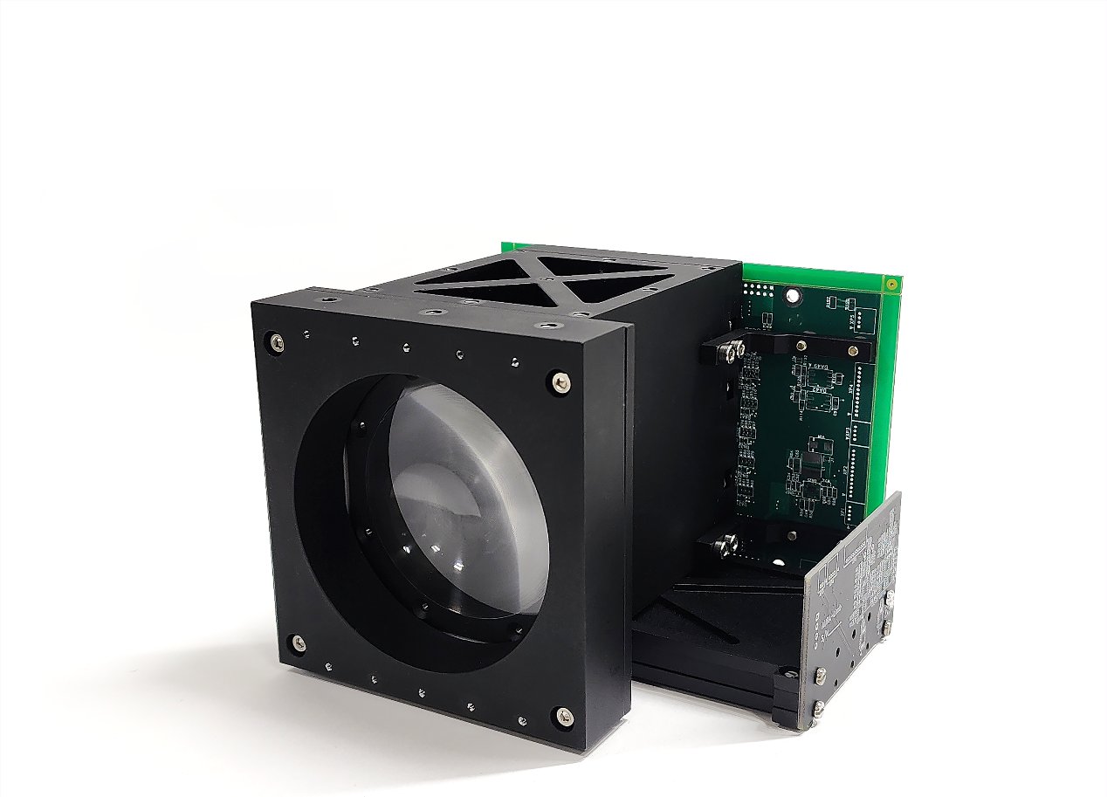
System of Optical measuremeNts of Energetic Transient phenomena: SONET
5 cm Fresnel lens (Edmund optics) + 64 SiPMs
4-channel spectrometer (337, 391, 777, 762 nm)
Limb camera (camera obscura with 6 SiPMs aligned in vertical direction)

Slide 7
ERA (Extreme Relativistic Astrophysics)
Motivation: K-EUSO for ISS is finished. POEMMA-like missions can’t be launched in 20XX in Russia. ROS status in unclear.
Main idea: Series of “small” satellites with low statistics each one, but simple and possible to launch in addition to main spacecraft. 10 small telescopes will have exposure equal to K-EUSO and the same threshold.
Detector: An improved TUS with smaller pixel, better mirror and Schmidt-type OS (TBD).
If launch pairs – a stereoscopic measurements are possible to improve event reconstruction and measure Xmax.
Status: Currently we are at the stage of idea and proposal to RAS. It may be supported and get some funds from 2026, but no guarantee.

Slide 8
Thank you for your attention!

