Slide 1




JEM-EUSO 37th Collaboration Meeting — Paris — June 2026
Pile-Up Statistics
Phd Student
Photodetection and instrumentation for UHECR & SQM
detection from space
Enzio M’sihid
mail : msihid@apc.in2p3.fr

Slide 2
Plan
I. PILE-UP EFFECT AND SIMULATION IN EDT
II. RENEWAL THEORY APPROACH
III. COMPARISON WITH EXPERIMENTAL DATA

Slide 3
Plan
I. PILE-UP IN EXTENDED DEAD TIME (EDT)
II. RENEWAL THEORY APPROACH
III. COMPARISON WITH EXPERIMENTAL DATA

Slide 4


Recap
Electronic Origin
Ph
64 x channels
∆t > τ
1
....
MAPMT
+
Pre-amp.
S
ASIC
1
Ph
Signal
to Count
2
S
2
....
∆t < τ
Photon
to Signal
∆t
time interval
(Poissonian)
∆t

Slide 5
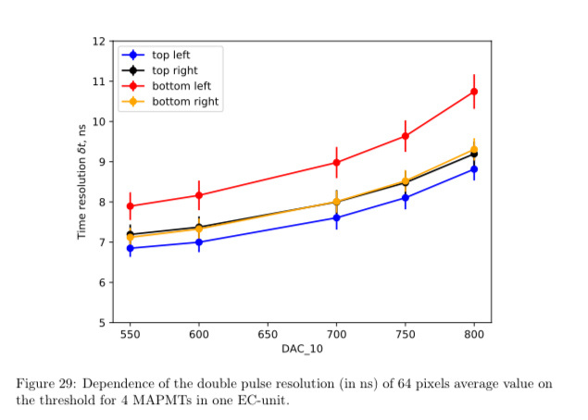

Recap
PILE-UP
Electronic Origin
2 Counts
∆t > τ
Dead Time : τ
Time Resolution
t
Threshold
∆t < τ
Q
1 Count
FROM : Daniil Trofimov, E.Parizot, & al., Characterization and absolute calibration of R11265 multi-anode photomultiplier tubes for the JEM-EUSO space and balloon program: II. Application to the EUSO-SPB2 photodetection modules ; Astroparticle Physics Journal ; Accepted ; 2025.
PILE-UP

Slide 6
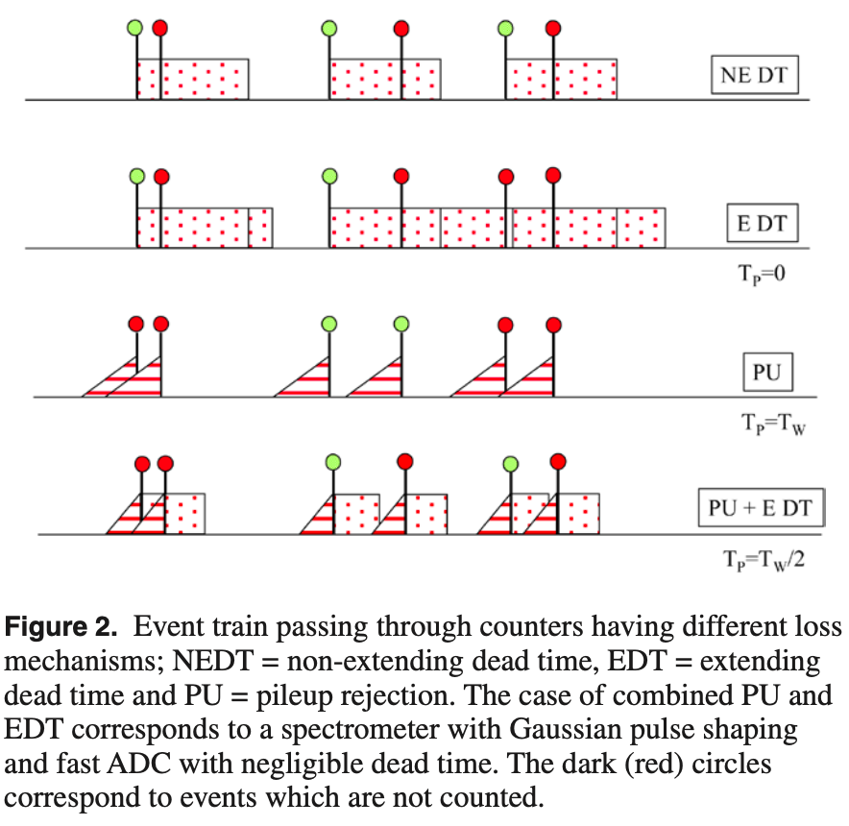
Recap
Pile-Up types
count
Our case
FROM : Uncertainty of nuclear counting , S. Pommé et al 2015 Metrologia 52 S3, doi:10.1088/0026-1394/52/3/S3

Slide 7
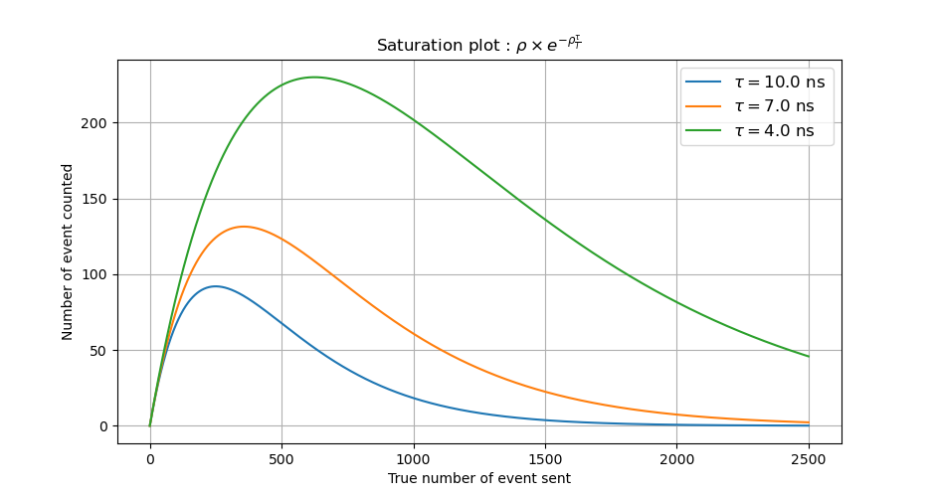
Recap
Average counts

Slide 8
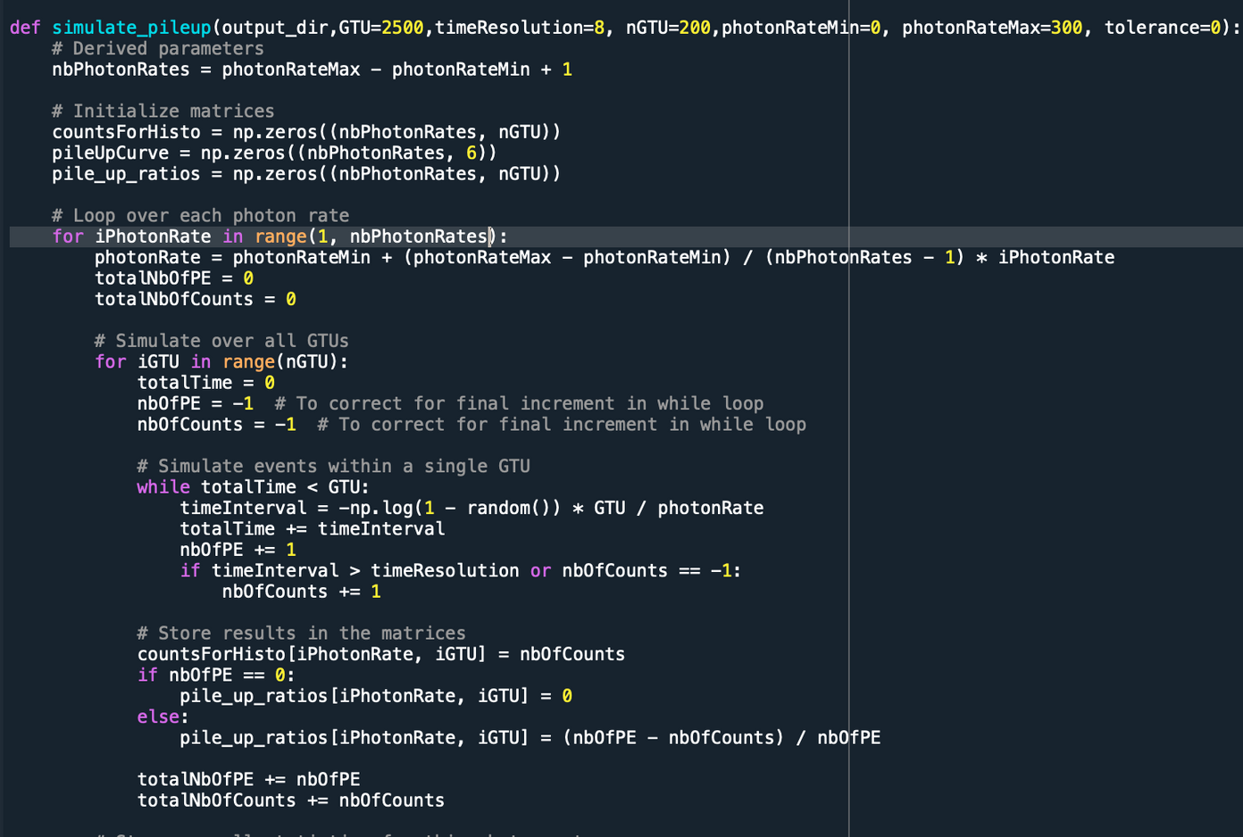

Simulation
Virtual Run
• Set a photon Rate
Poisson Distribution of ∆t in a GTU
∆t > τ : Count
∆t < τ : Missed
Repeat over nGTU
• Change photon rate
• τ = 6.0 to 12.0 by step of 0.5
• nGTU = 1000
• Result : (# Photon Rates , nGTU) 2D
array with # of Count as elements
• Photon Rates : int(0 to 2000)
# Photons sent during a GTU

Slide 9
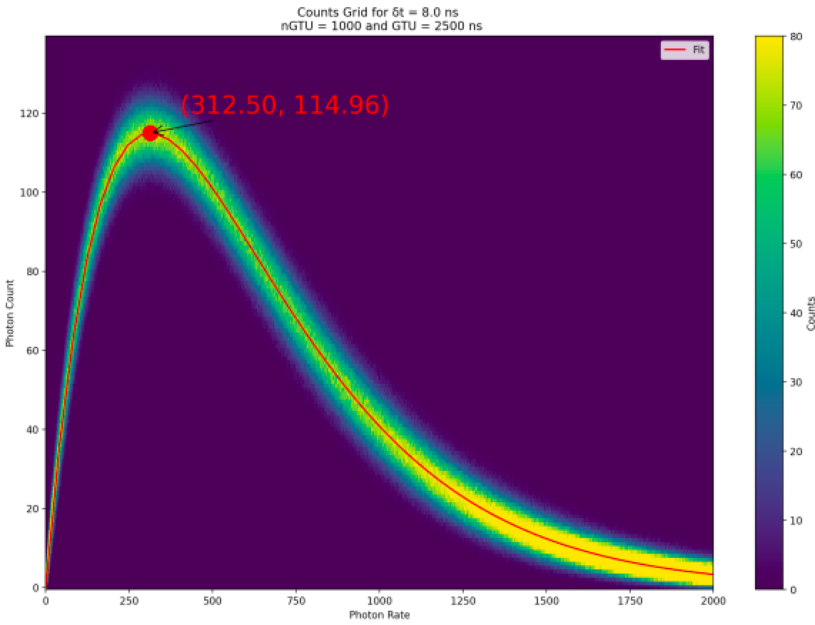

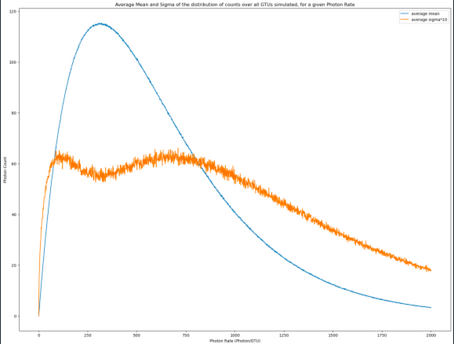
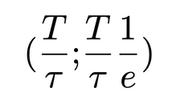
Simulation
Counts Grid
Saturation Curve
•
Get Count # of each Photon Rate
Counts Grid
• Each column has nGTU
• Mean and sigma
over the nGTUs
for each rate
Left
Right
• Coordinates of max :
Even ∆t between all photons

Slide 10
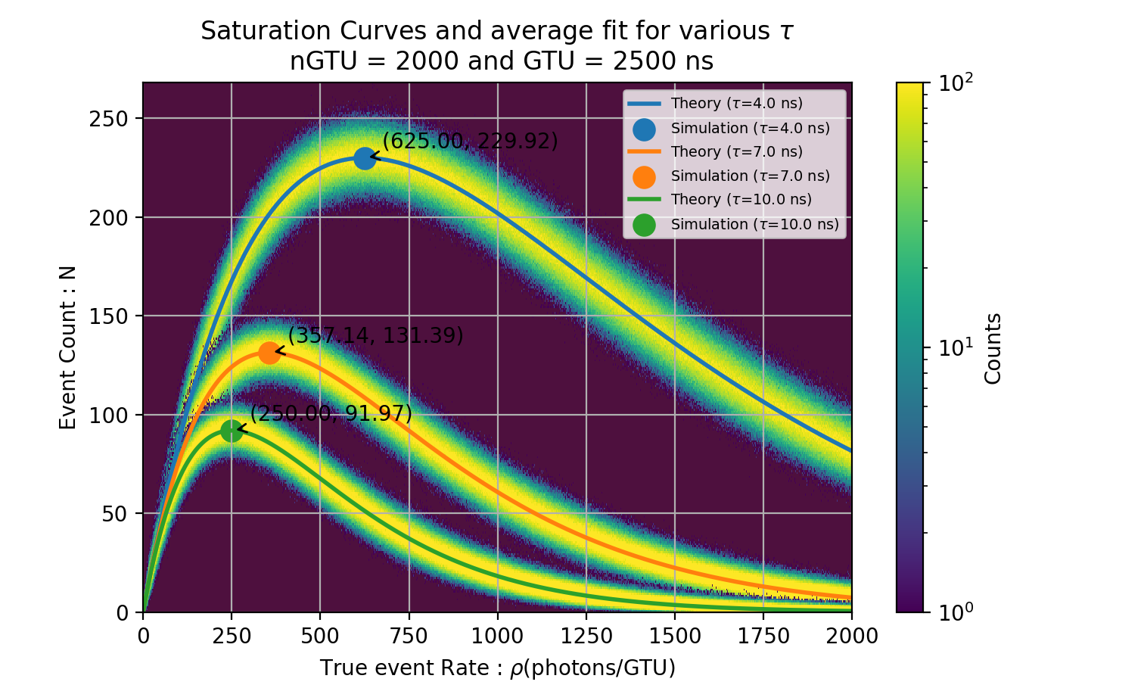
Simulation
Counts Grid
Saturation Curves

Slide 11
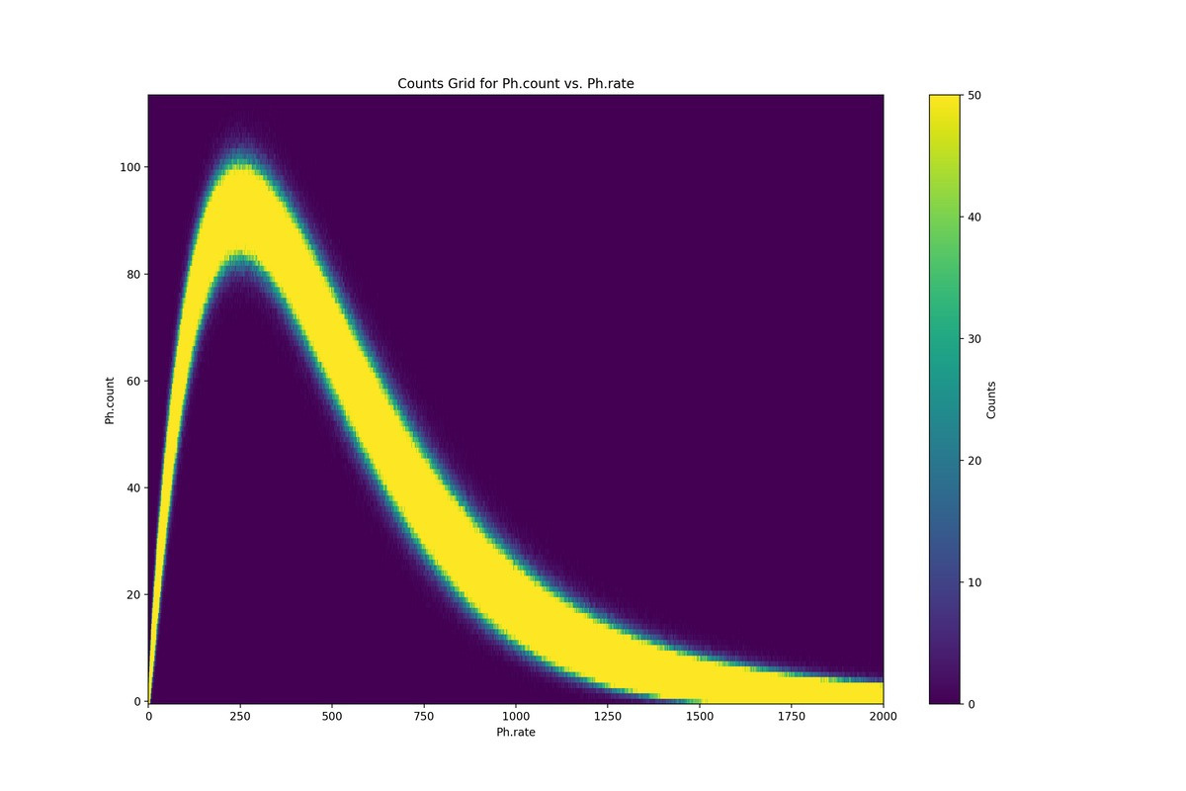

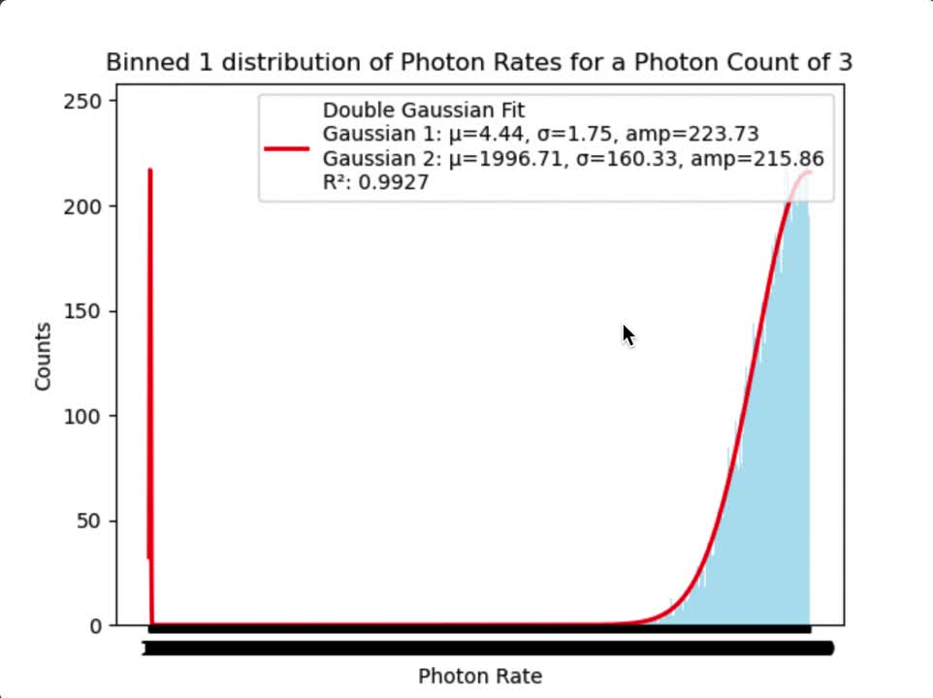

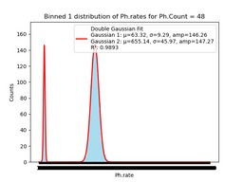
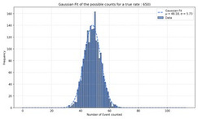
Simulation
Distribution of Photon counts and true rates
Simulated saturation plot
Number of event counted
True number of event sent

Slide 12
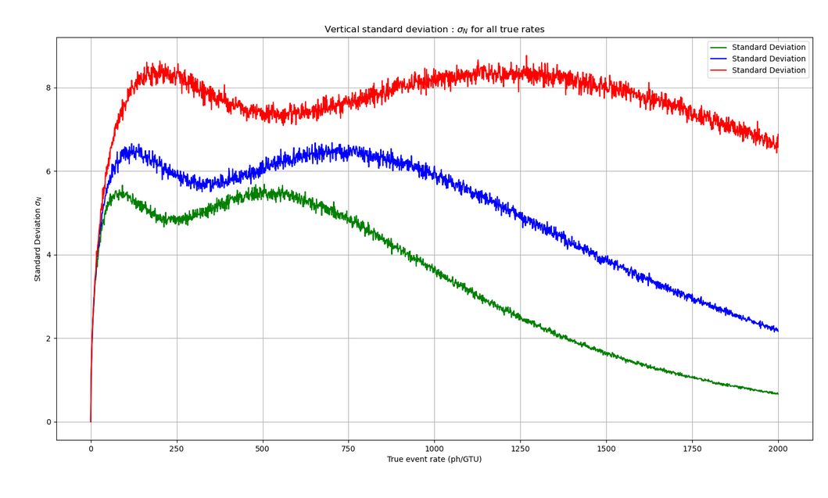
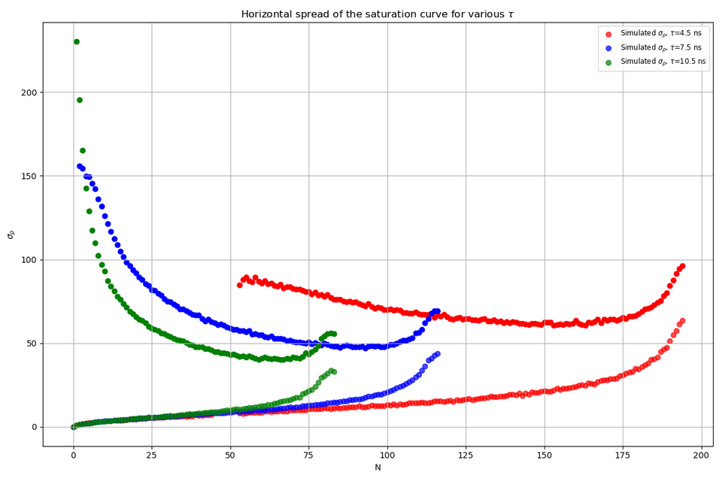

Simulation
Plotting the vertical and horizontal sigmas
Focus
Evolution of the standard deviation on N as a function of the true event rates, for different values of the dead time τ (in ns).
Evolution of the standard deviation on ρ as a function of the event counts, for different values of the dead time τ (in ns).

Slide 13
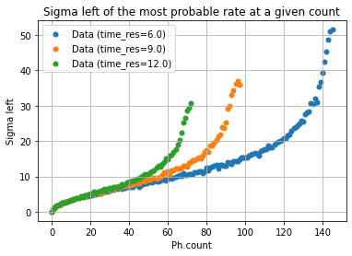
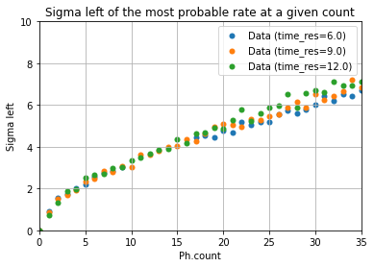
Simulation
Horizontal left sigma
• Small τ dependence for small counts

Slide 14
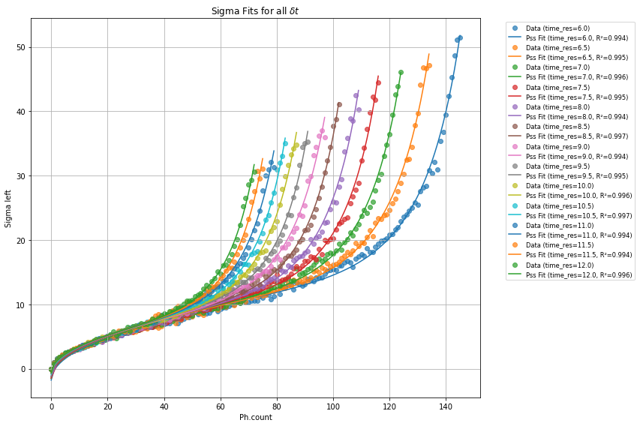
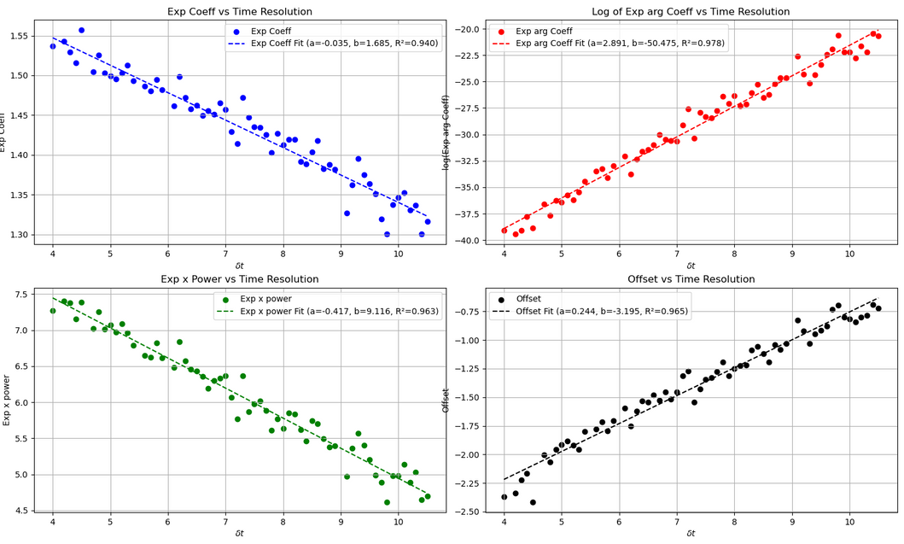

Simulation
Left horiztonal std fit and parameters fit
A
B
C
offset
Good, not perfect.

Slide 15
Plan
I. PILE-UP IN EXTENDED DEAD TIME(EDT)
II. RENEWAL THEORY APPROACH
III. COMPARISON WITH EXPERIMENTAL DATA

Slide 16

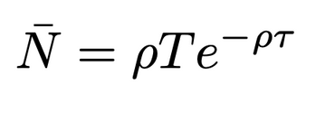



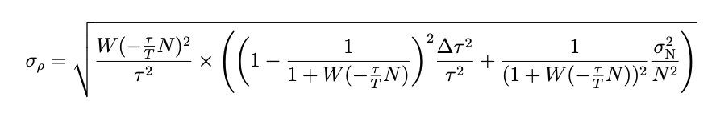

Lexicon
Renewal theory
τ : the dead-time, or minimum time to wait after an event arrived.
T : the time of Observation (e.g. 2500 ns here for the Mini-EUSO mission).
ρ : the true event rate arriving at the counter.
N : the number of counted events during T.
Studying
• Mathematical framework to study the distribution of time intervals between actually counted events. (Can be applied to any counting set-up).
Where W is the Lambert W function.
• We can derive the uncertainty on the number of event N for a true rate ρ (which corresponds to the vertical spread of the saturation curves) :
• We can infer the uncertainty on the true rate ρ for a number of measured events N (which corresponds to the horizontal spread of the saturation curves) :

Slide 17
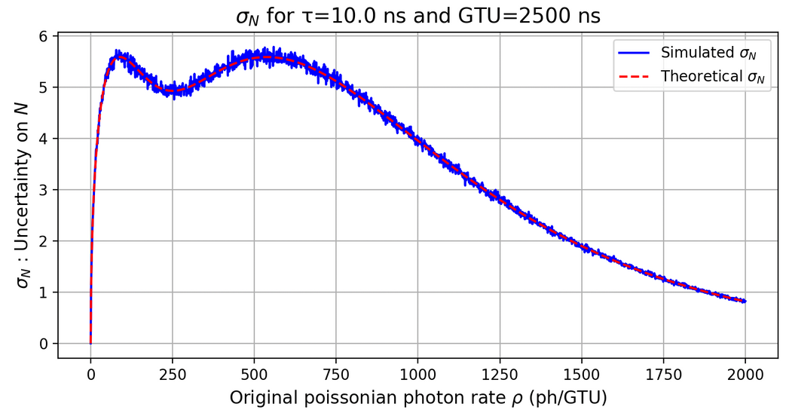
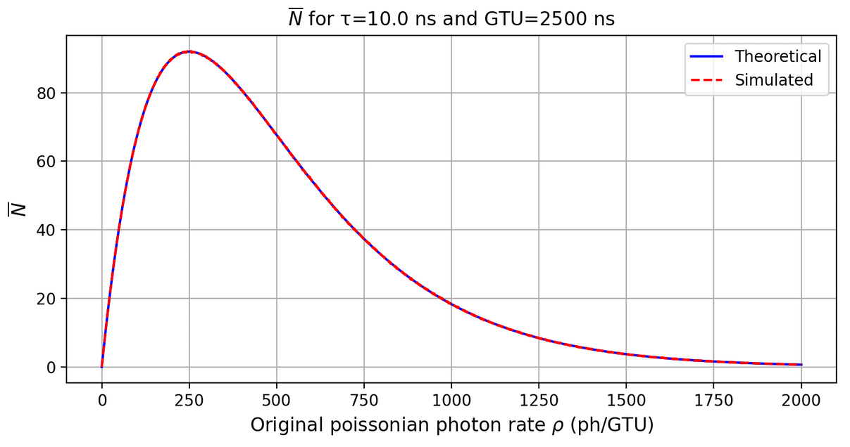
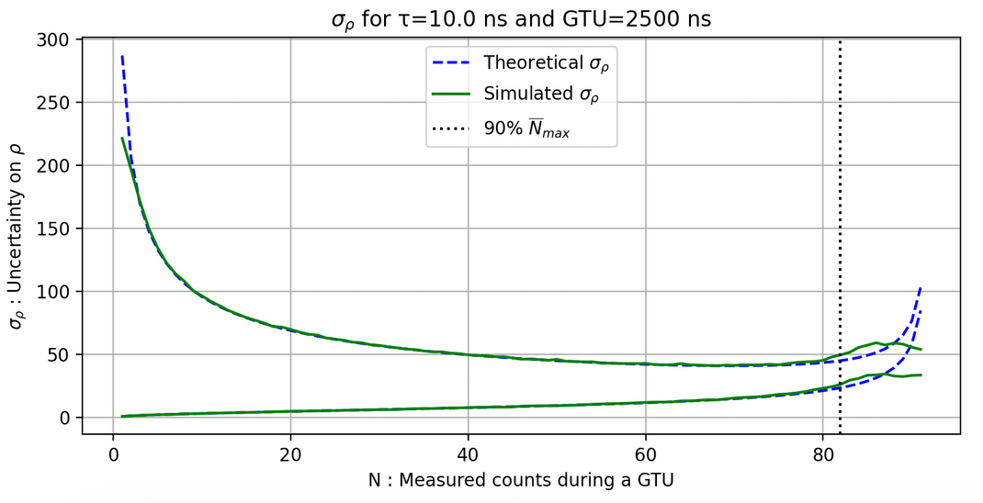
Renewal theory
Simulation and Theory Comparison
Example: For N=17 events measured during T=2500 ns, if τ=8.0 ns and ∆τ=0.3 ns, The theoretical formulas tells us that we actually received:
ρ = 18.0 ± 4.4 events or ρ = 1372 ± 114.1 events.

Slide 18
Plan
I. PILE-UP IN EXTENDED DEAD TIME(EDT)
II. RENEWAL THEORY APPROACH
III. COMPARISON WITH EXPERIMENTAL DATA

Slide 19
Experimental Data
Lightscan set-up
• We send a known number of photons on a pixel during n*GTUs (10000). We register for each GTU the number of counts observed to obtain stats. Then we increase the voltage and repeat. We continue the process until we are far beyond saturation.
GENERATOR
LED
MAPMT
ASIC
COMPUTER
NIST monitoring

Slide 20
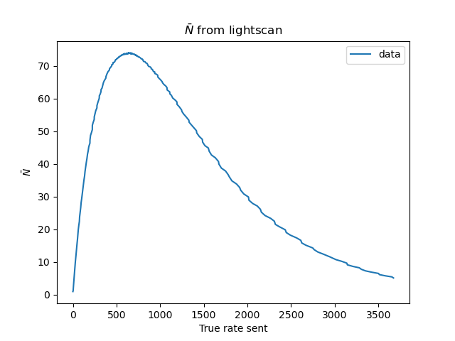
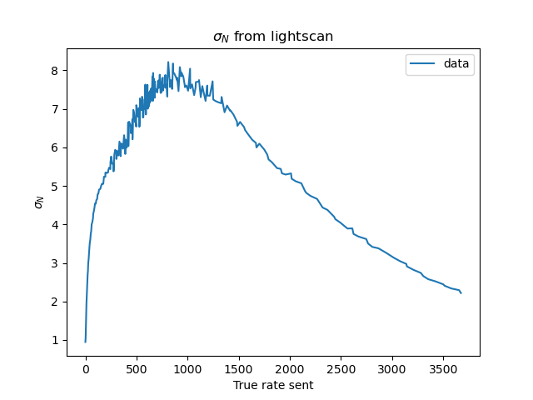
Experimental Data
Lightscan results over one pixel and nGTU = 10000 and fixed DAC.
≠

Slide 21

Experimental Data
Other Pile-Up type ?
Our case
Our case ?
FROM : Uncertainty of nuclear counting , S. Pommé et al 2015 Metrologia 52 S3, doi:10.1088/0026-1394/52/3/S3

Slide 22


Experimental Data
Pile-Up in PU+EDT ?
• From :
• To :
• Two parameters instead of one.
Let’s fit

Slide 23
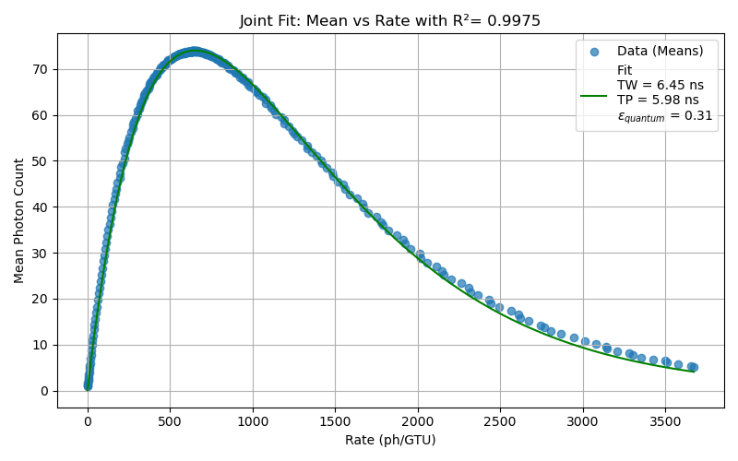
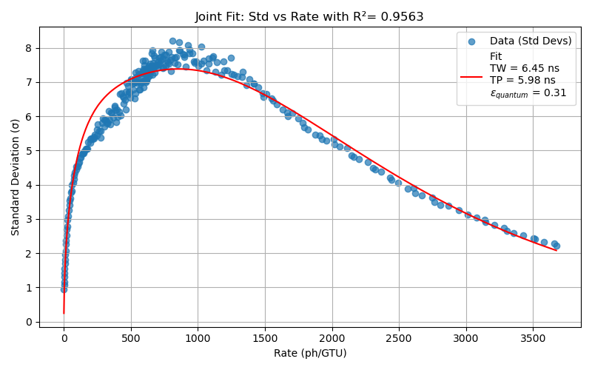
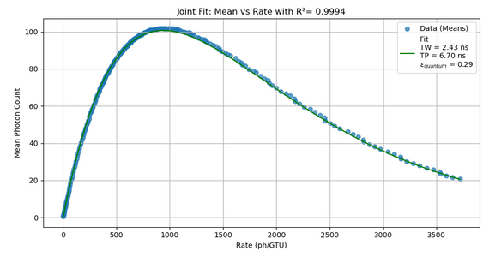
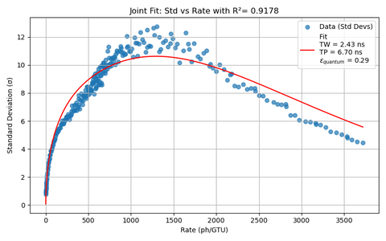
Experimental Data
Joint Fit for std and average
DAC 750
Same Pixel but at DAC 600
Not great

Slide 24
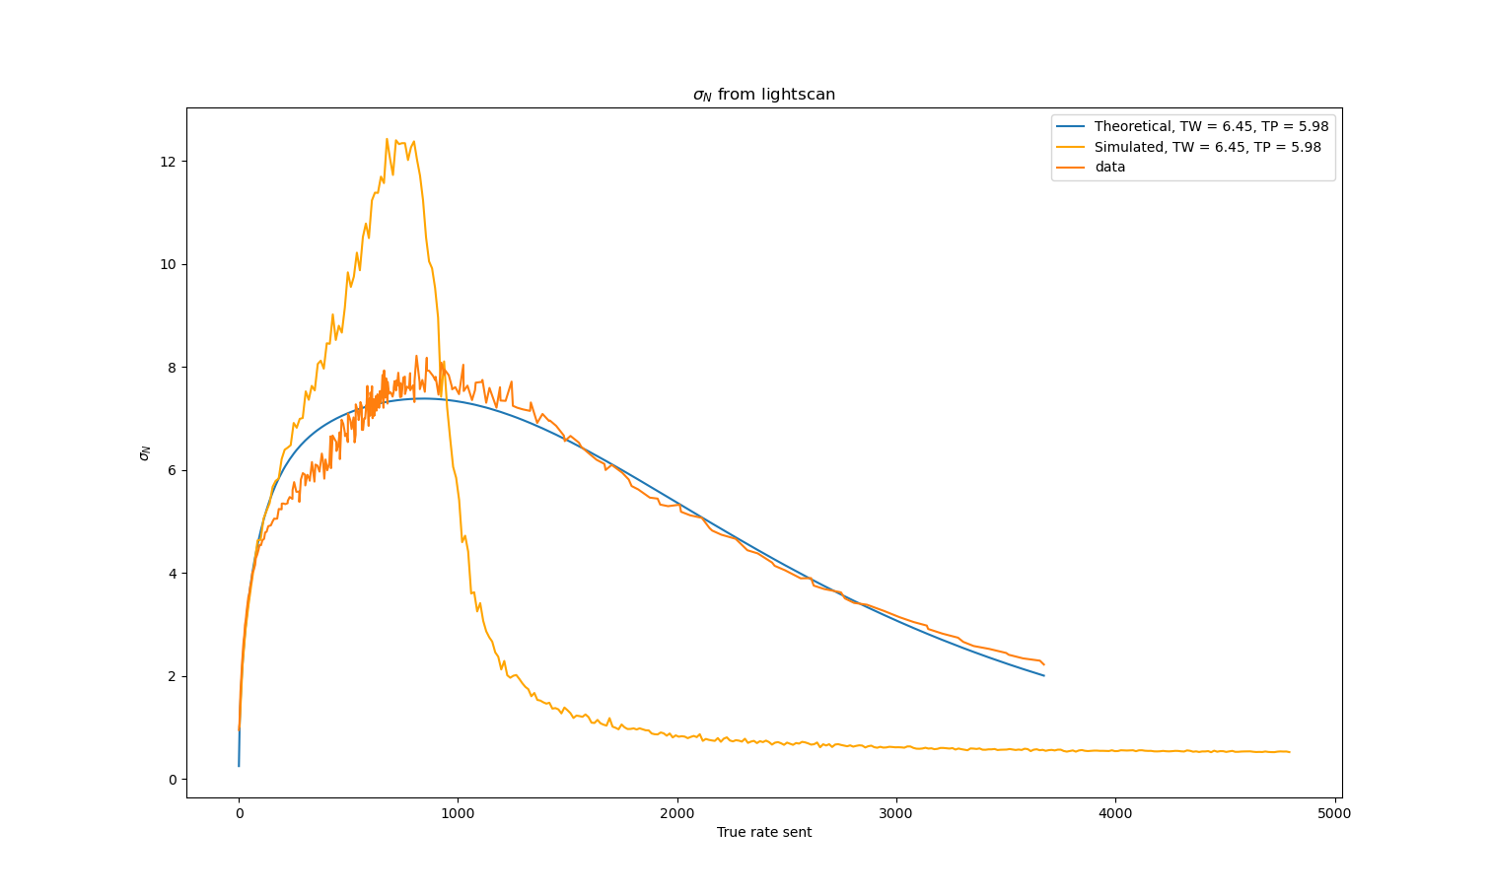
Experimental Data
Data v. Simulation v. Theory in PU+EDT
• We are exploring solutions.
• Better understanding of the ASIC.
• Modified PU+EDT.
• Twicking of the simulation to understand the Pile-UP process better...

Slide 25
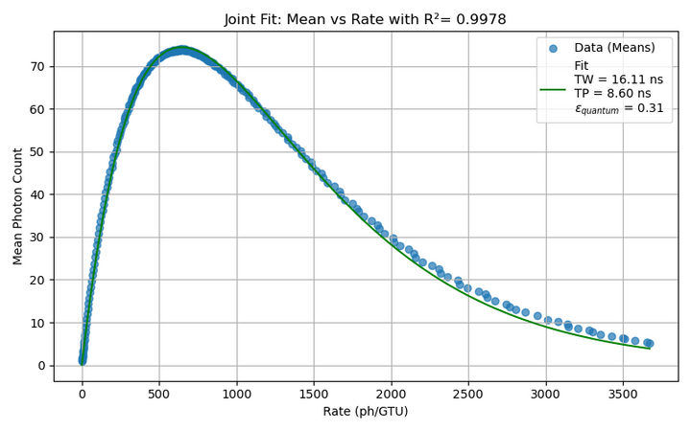
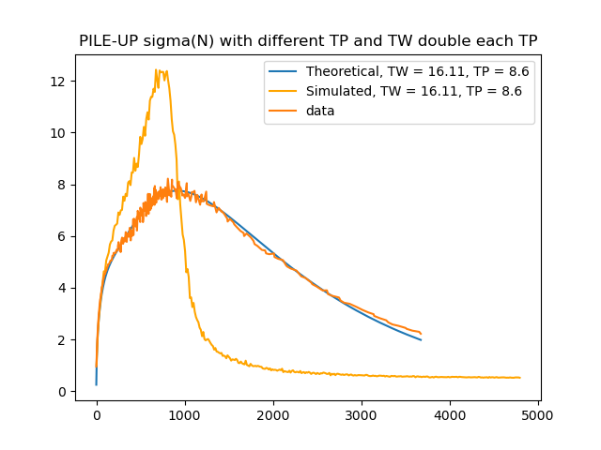
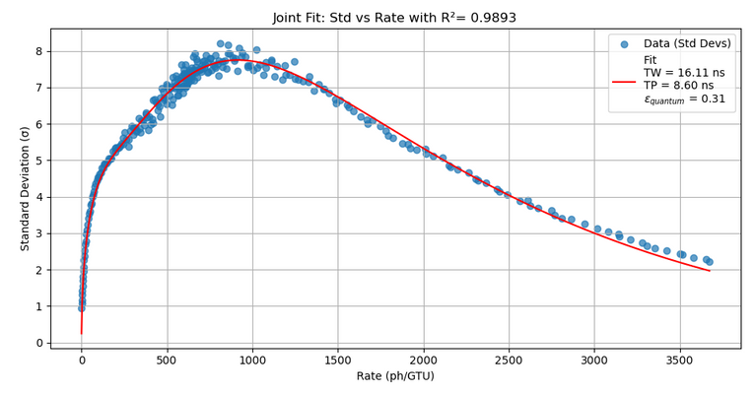

Experimental Data
Modified PU+EDT
• Trying a facter one half in N :
• The joint fit is better.
• The simulation still doesn’t match.
• And why would we have a ½ ?...

Slide 26
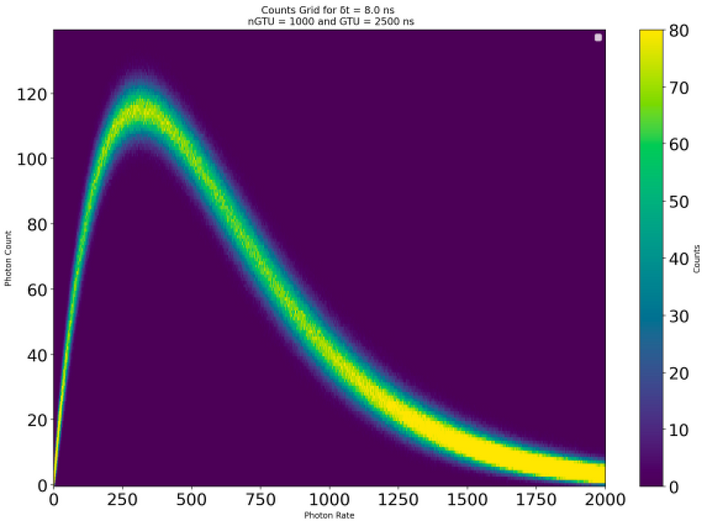
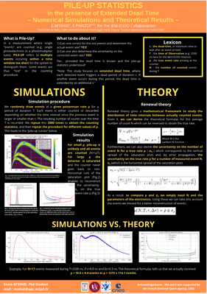
Conclusion
• Renewal Theory gives a good framework to study Pile-up.
• The process in EDT is understood (and works for extreme values).
• We have a working experimental set-up to test the MPAMTs in pile-up conditions.
• PBR’s electronics is trickier and requires more elaborate types of dead time. This research is ongoing.
• The ultimate goal remains :
• Those results were presented partly in a poster at the ASAPP 2025 in Spain.

