Slide 1
ELVES-location: A Bayesian Approach to Studying the Thunderstorm Atmosphere
Roman Saraev

Slide 2
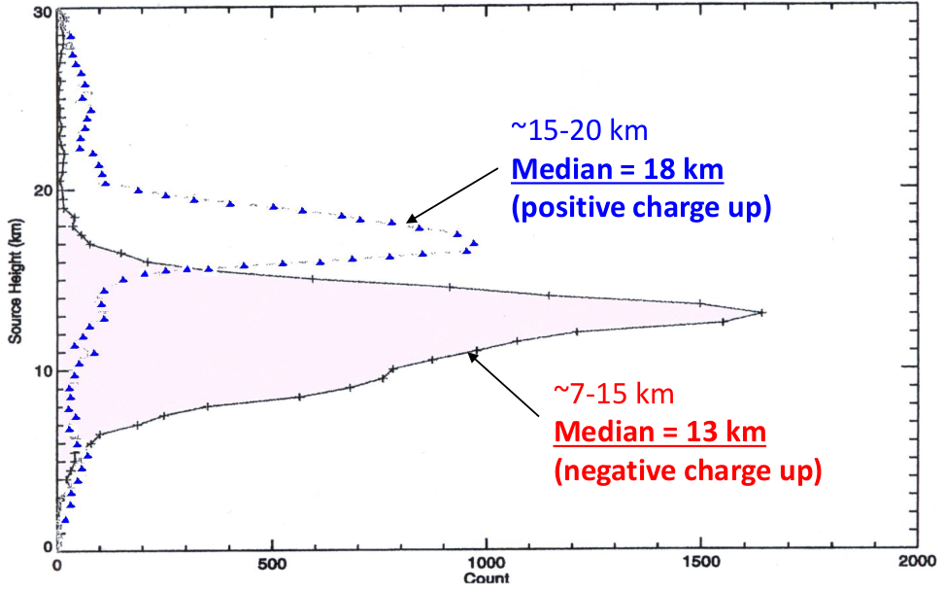
ELVE-location
Direct study of thunderstorm events (Lightnings, Narrow bipolar events,…) is complicated
Idea: studying such events via their “footprint” in ionosphere
  ELVES: Emission of Light and Very low frequency perturbations due to Electromagnetic pulse sources
Compact intracloud discharge
height distribution

Slide 3
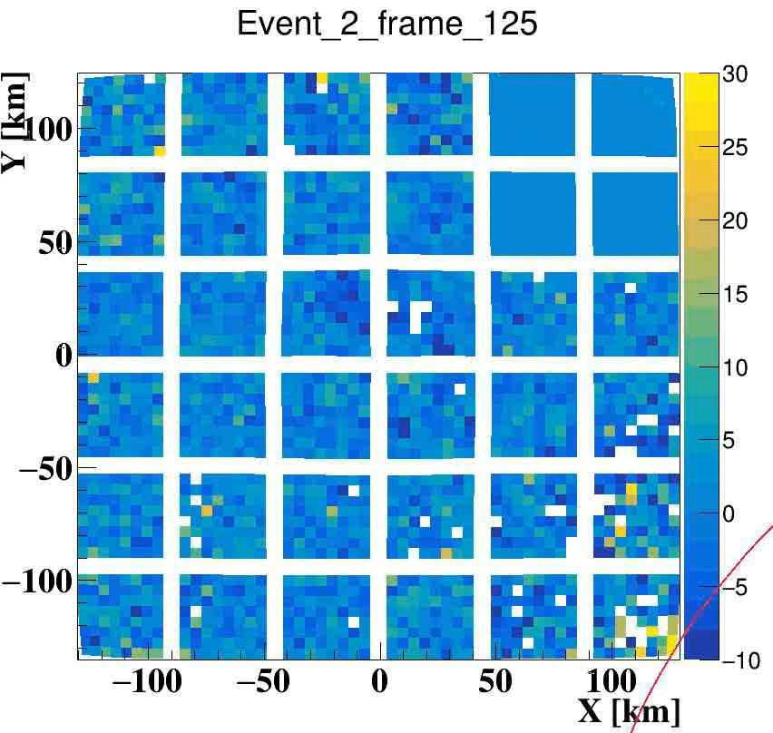
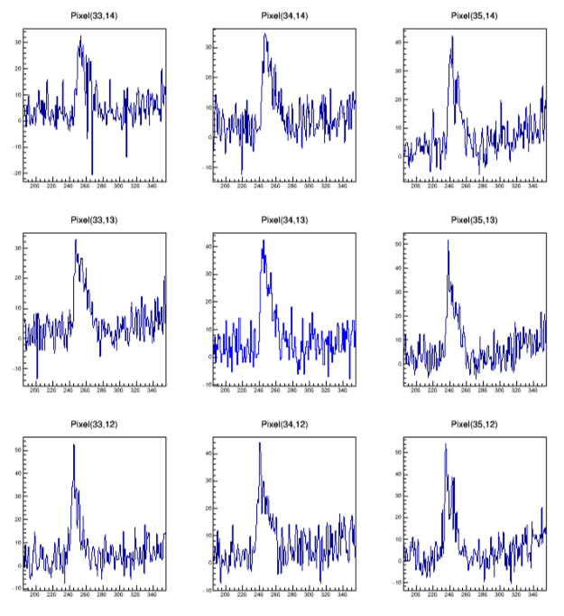
ELVES in Mini-EUSO
Event #2, 5th of December 2019
Bayesian Reco (1st attempt):
Sharakin, S., Barghini, D., Battisti, M. et al.,
ELVES Measurements in the Mini-EUSO Experiment Onboard the ISS and Their Reconstruction.
Cosmic Research, Pleiades Publishing, Inc. (New York, USA), v. 62 (2024)

Slide 4
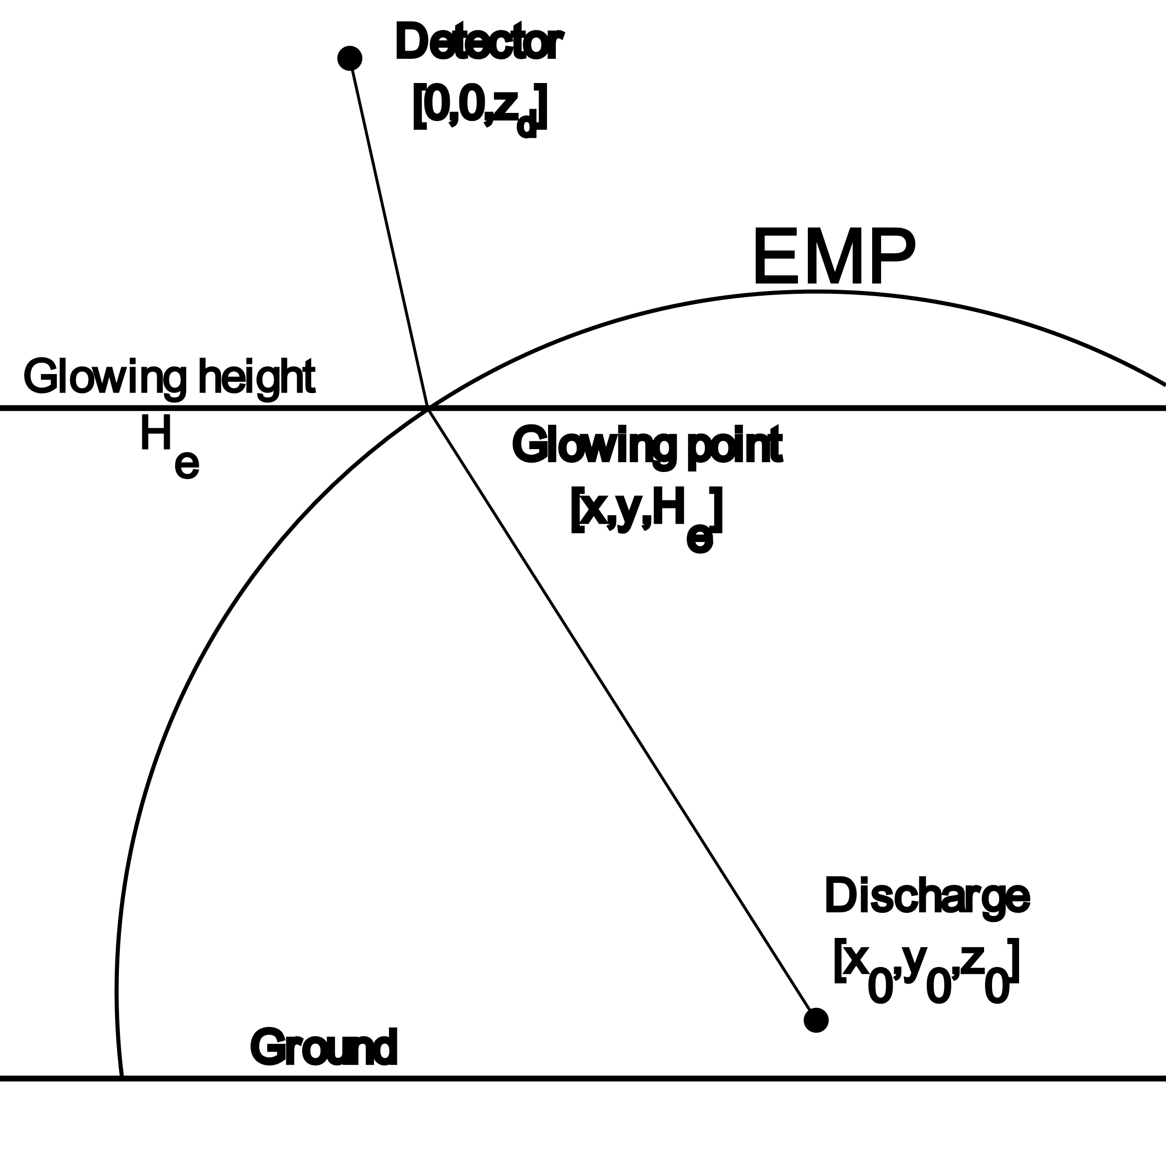
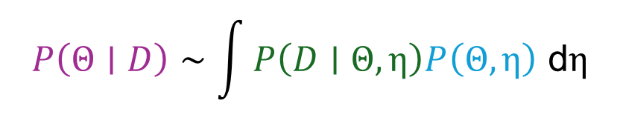
Bayesian inference
Probabilistic Model
Model parameters: Θ = Discharge characteristics (ex., x₀, y₀, z₀,…)
Nuisance parameters: η = { T₀, H_{e}, σ,… }
Observed data (measurements): D
p(Θ|D) — posterior probability
p(D|Θ) — likelihood
p(Θ) — prior probability
Probabilistic Inference (Bayesian)
$$P\left(Θ∣D\right)∼\int{P\left(D∣Θ,η\right)P\left(Θ,η\right) \text{d}η}$$

Slide 5
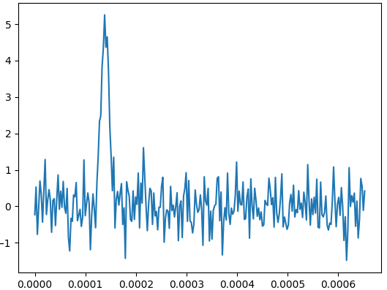
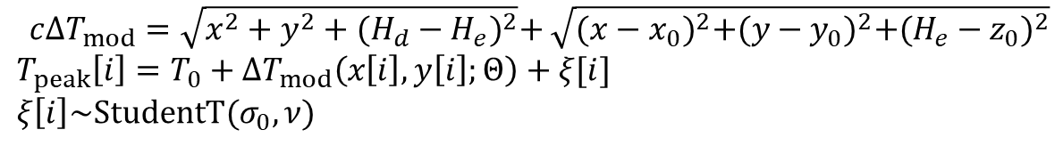
Kinematic vs. Dynamic models
Kinematic model
Parameters: Θ_{kin} = { x₀, y₀, z₀,… }
Data: D = { T_{peak}[i] }
Dynamic model
Parameters: Θ_{dyn} = Θ_{kin} + {α, φ_{α}, a_{emp},… }
Data: D = { S_{k}[i] }
$$c{ΔT}_{mod}=\sqrt{x^{2}+y^{2}+{(H_{d}−H_{e})}^{2}}+\sqrt{{(x−x_{0})}^{2}+{(y−y_{0})}^{2}+{(H_{e}−z_{0})}^{2}}$$
$$T_{peak}\left[i\right]=T_{0}+{ΔT}_{mod}\left(x\left[i\right],y\left[i\right];Θ\right)+ξ[i]$$
$$ξ\left[i\right]\sim StudentT(σ_{0},ν)$$

Slide 6
MC Simulator
Two applications:
ELVES events generation(various FOV localization, dipole orientation,….)
Reco-model (Simulation Based Inference)
  SBI: Using simulator instead of likelihood function (likelihood-free models): Approximate Bayesian Computation in PyMC-5.
  SBI requires lots of simulator calls => Simulator is implemented using CUDA for better performance

Slide 7
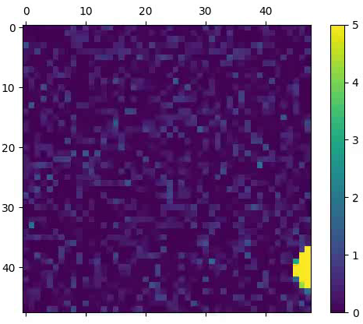
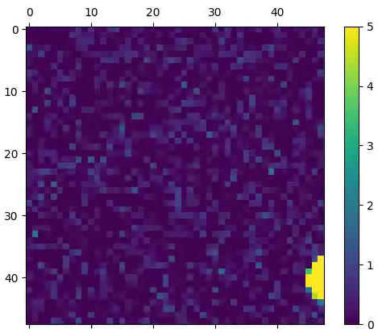


Simulated ELVES (MC)
Column 1: φ_{α} = 30 °
Column 2: φ_{α} = 120 °
Row 1: α = 90°
Location: (100,150,5) km
Rays count: N_{mc} = 128·10⁶
Row 2: α = 45°

Slide 8
Kinematic Reco: results
ELVES info |  | T0, GTU |  | X0, km |  | Y0, km |  | Z0, km
α, ° | φ_{α}, ° | mean | std | mean | std | mean | std | mean | std
90 | 30 | -0.12 | 0.03 | 100.08 | 0.05 | 150.33 | 0.09 | 4.57 | 0.12
 | 120 | -0.12 | 0.02 | 100.34 | 0.04 | 150.36 | 0.06 | 4.43 | 0.08
45 | 30 | -0.06 | 0.02 | 100.09 | 0.03 | 150.17 | 0.05 | 4.65 | 0.06
 | 120 | -0.05 | 0.02 | 100.16 | 0.03 | 150.23 | 0.05 | 4.56 | 0.06
True data |  | 0 |  | 100 |  | 150 |  | 5

Slide 9
Kinematic Reco
Pros: quick, requires less computational resources
Cons: Biased height estimation.
  Possible reason: Hypothesis (Peak time is the moment of time when ring passes over the pixel center) is wrong.
  Mitigation: Providing time estimation error to likelihood

Slide 10
Dynamic Reco: results (1)
ELVES info |  | T0, km |  | X0, km |  | Y0, km |  | Z0, km
α, ° | φ_{α}, ° | mean | std | mean | std | mean | std | mean | std
90 | 30 | -0.02 | 0.12 | 100.0 | 0.7 | 149.9 | 1.5 | 5.2 | 2.0
 | 120 | -0.03 | 0.10 | 100.0 | 0.6 | 149.9 | 1.2 | 5.2 | 1.7
45 | 30 | 0.00 | 0.10 | 100.0 | 0.6 | 149.9 | 1.3 | 5.1 | 1.7
 | 120 | 0.00 | 0.11 | 100.0 | 0.7 | 150.0 | 1.4 | 5.1 | 1.9
True data |  | 0 |  | 100 |  | 150 |  | 5

Slide 11
Dynamic Reco: results (2)
ELVES info |  | A0 |  | σ0 |  | σ_{PSF}, mm |  | α, ° |  | φ_{α}, °
α, ° | φ_{α}, ° | mean | std | mean | std | mean | std | mean | std | mean | std
90 | 30 | 20.0 | 2.0 | 0.47 | 0.05 | 2.0 | 0.1 | 90 | 4 | 31 | 8
 | 120 | 19.8 | 1.3 | 0.47 | 0.05 | 2.0 | 0.1 | 88 | 6 | 116 | 10
45 | 30 | 19.6 | 0.9 | 0.47 | 0.06 | 2.0 | 0.1 | 48 | 10 | 40 | 30
 | 120 | 19.3 | 1.1 | 0.47 | 0.06 | 2.0 | 0.1 | 49 | 8 | 118 | 16
True data |  | 20 |  | 0.5 |  | 2.0 |  | - |  | -

Slide 12
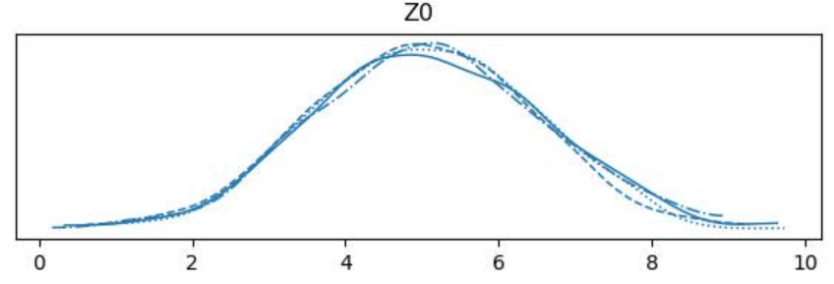
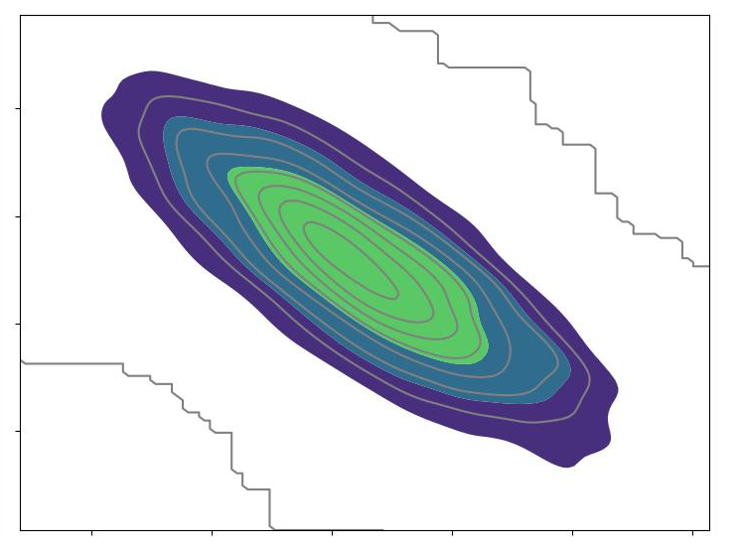
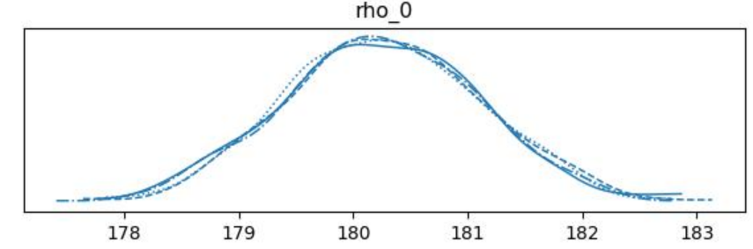
Reco results: posteriors
z₀ – ρ₀ correlation
z₀, km
Radial distance ρ₀, km

Slide 13
Conclusions
Discharge parameters can be reconstructed from ionosphere «footprints» (ELVES-location) using Bayesian Inference.
Kinematic model lacks reliability (height estimation bias), dynamic model extracts much more information from measurements data.
Dynamic model is extendable (ex., current function, H_{e} estimation, reflected ELVES and so on).
Cons: SBI is relatively slow, has its own hyperparameters, computation heavy, gives wider posterior estimations
  Computation time can be reduced by kinematic pre-reco.

Slide 14
Thank you for your attention!

