Slide 1
EUSO-SPB2 Highlights
Lawrence Wiencke
June 2th, 2025
EUSO Collaboration Meeting
Paris France

Slide 2
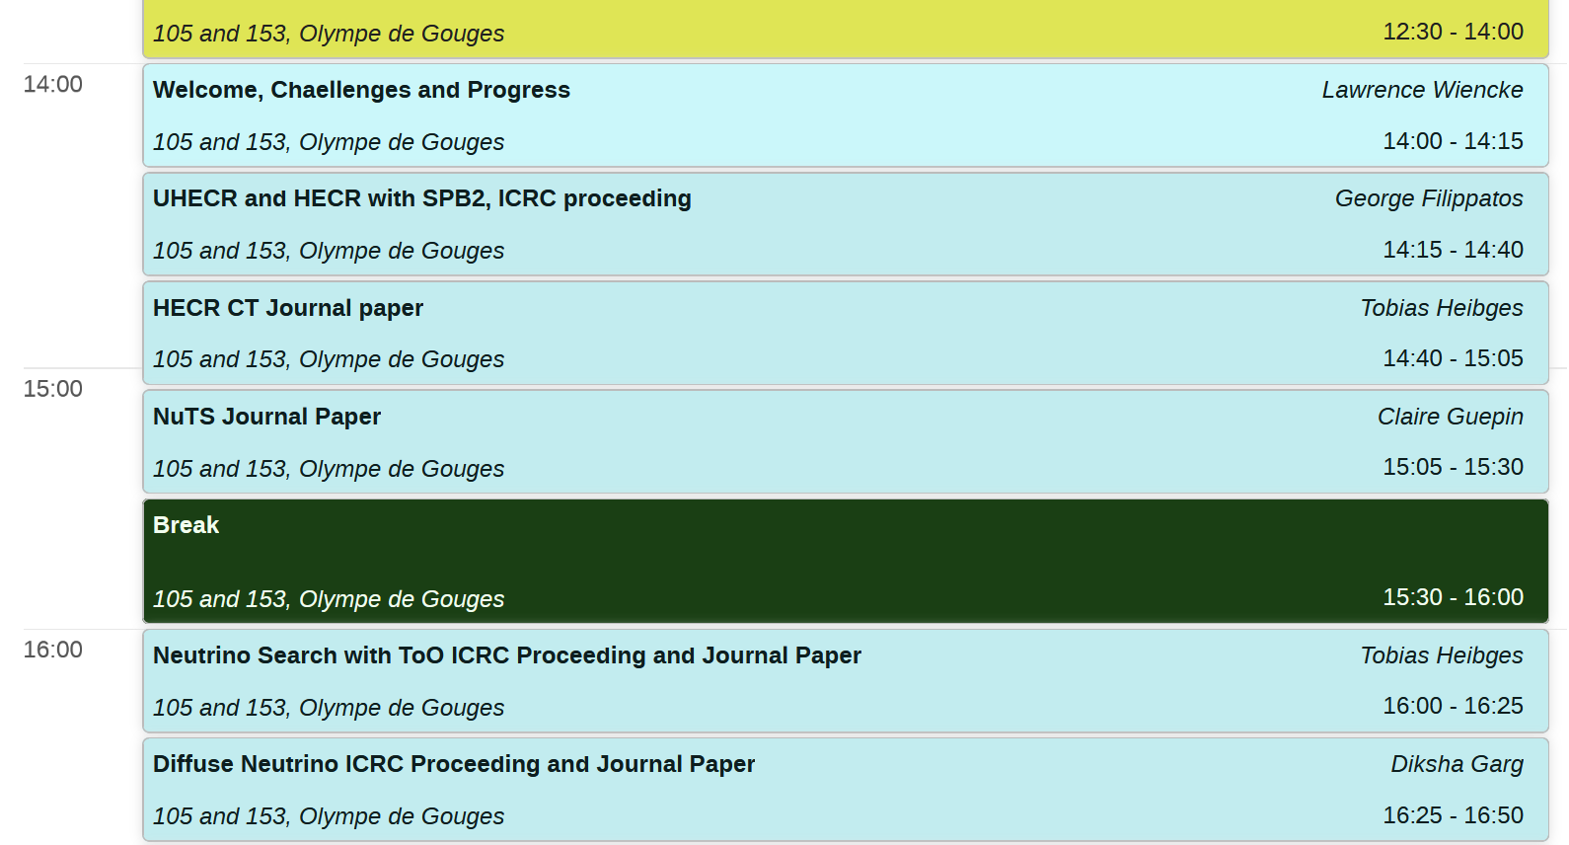
EUSO-SPB2 session on Wed. June 4th

Slide 3
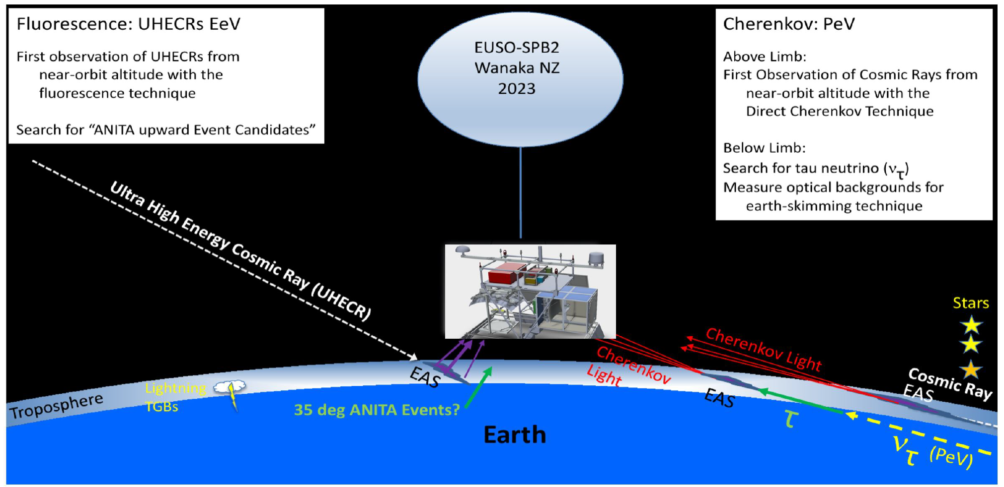
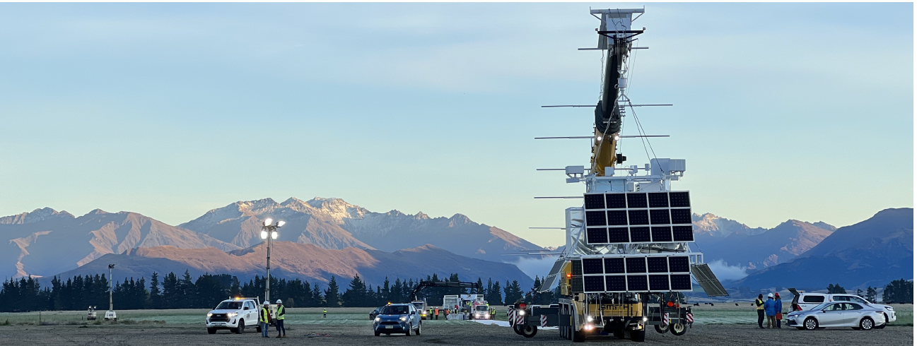
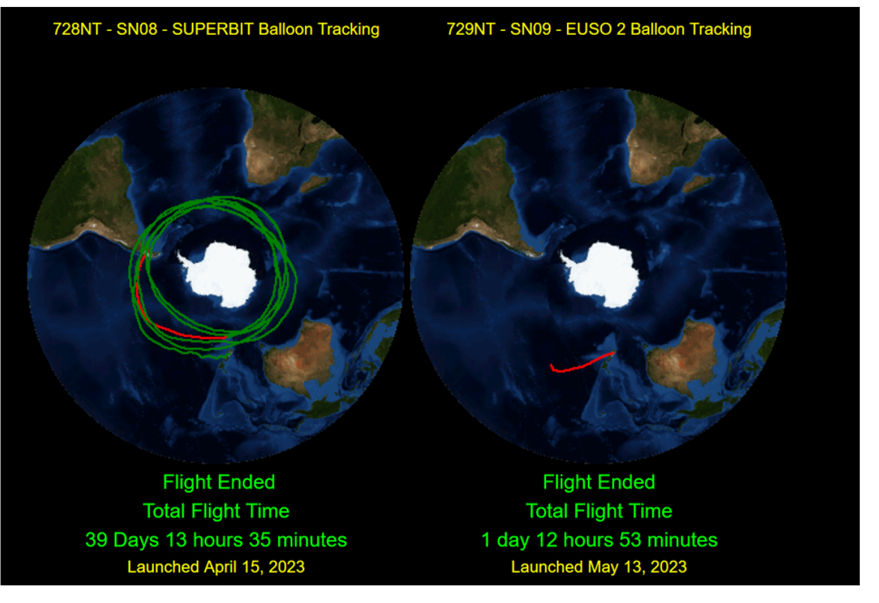
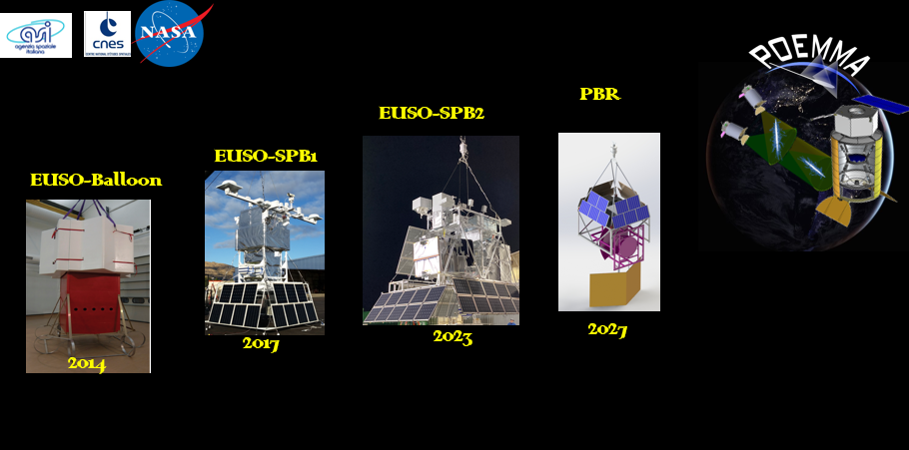
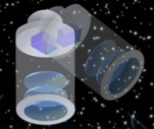
Launched May 13th Wanaka NZ
Aborted May 14th Pacific Ocean
M-EUSO

Slide 4
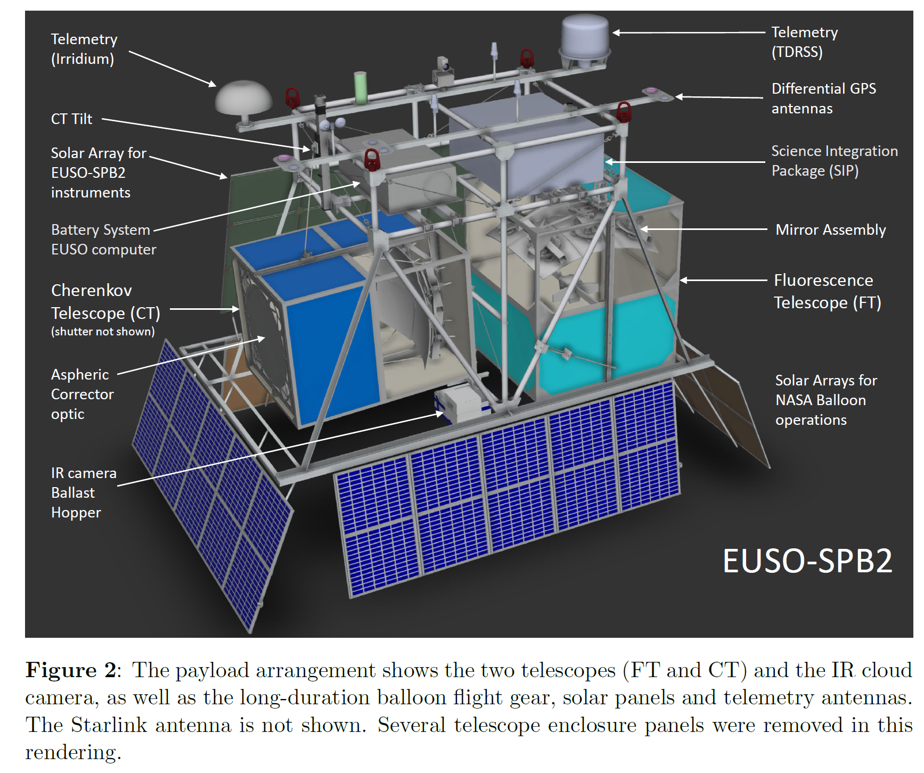

Slide 5
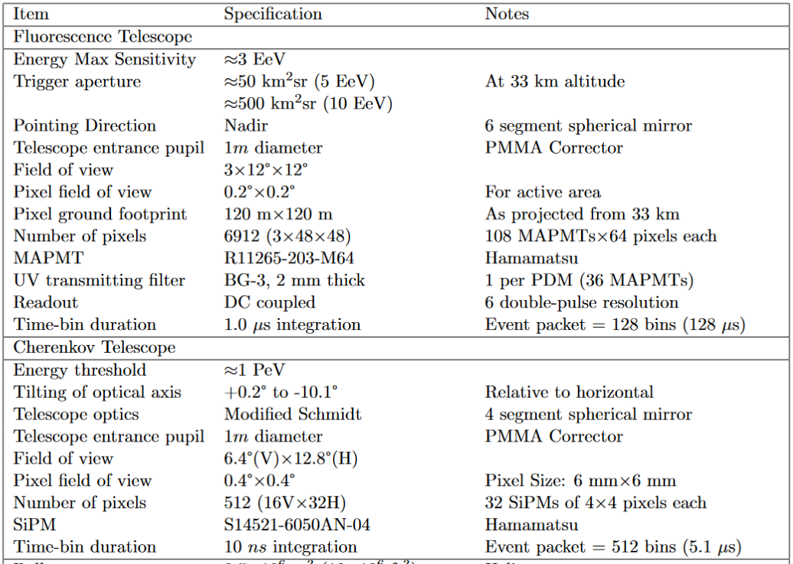
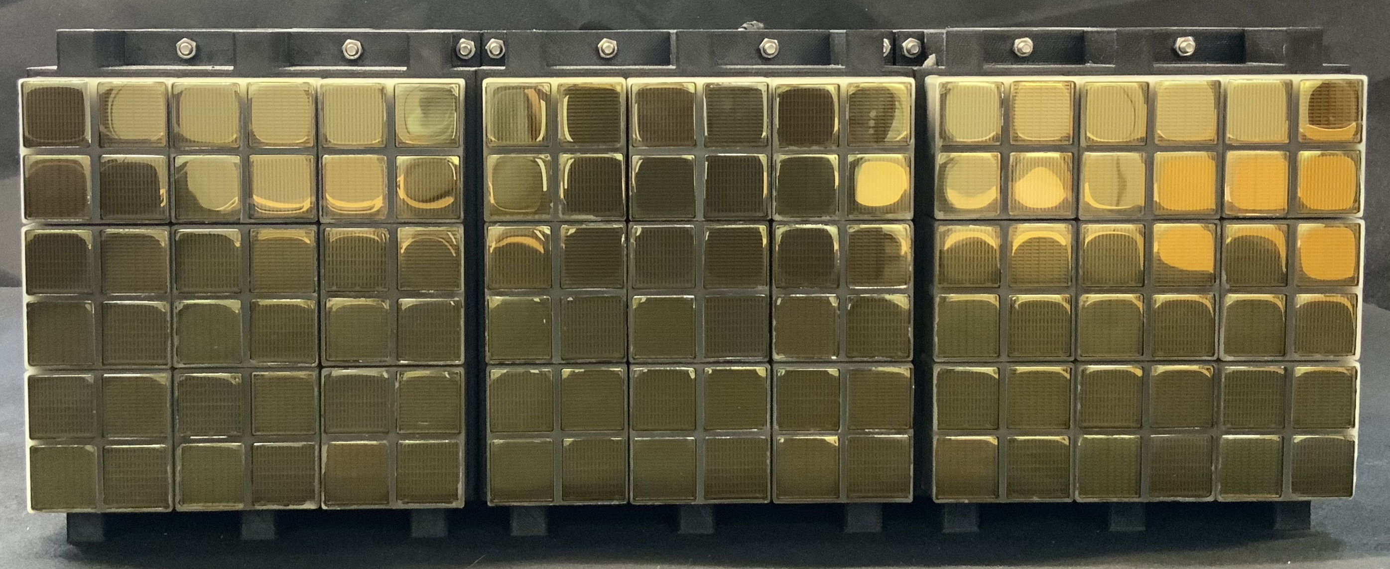
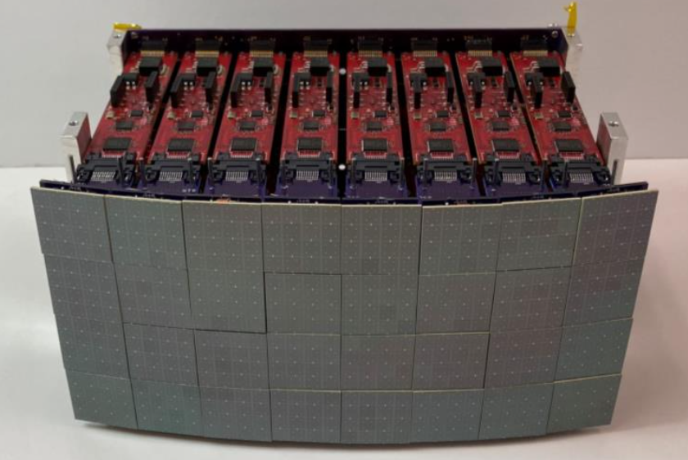
FT Camera
6912 pixels
CT Camera
512 pixels
NIMA 1070 (2025) 16999

Slide 6
1. The Maximum Energy of Shock-Accelerated Cosmic Rays, PhD thesis of Rebecca Diesing at the University of Chicago, May 2023; arXiv:2305.07697
2. Optics and preflight testing of the telescopes of the ”Extreme Universe Space Observatory on a Super Pressure Balloon II” (EUSO-SPB2) Payload PhD thesis of Viktoria Kungel, Colorado School of Mines, April 6th 2023. Mines Library Link to Kungel Thesis
3. The Extreme Universe Space Observatory on a Super Pressure Balloon II, Fluorescence Telescope on the Ground and (Briefly) in the Air, PhD thesis of George Filippatos at Colorado School of Mines, 8 November 2023. Mines Library Link Filippatos Thesis
4. Cherenkov Camera and search for diffuse neutrinos with EUSO-SPB2, PhD Thesis of Oscar Romero, Georgia Tech, 2024.
5. Cherenkov Camera and observation of HECR candidates with EUSO-SPB2, PhD Thesis of Eliza Gazda, Georgia Tech 2024.
6. Calibration of the MAPMTs of the JEM-EUSO missions, PhD thesis of Daniil Troimov, Universite Paris Cite,
Dec 9th 2024.
7. First results from the Cherenkov Telescope flown on EUSO-SPB2, PhD thesis of Tobias Heibges, Colorado School of Mines, March 31st 2025.
1. The targets of opportunity source catalog, prioritization, scheduler and related mechanics for the EUSO-SPB2 mission. MsC thesis of Hannah Wistrand at Colorado School of Mines, 12 April 2024.
2. Simulating the Cherenkov emission and geomagnetic effects of muons and muon-induced subshowers from extensive air showers for the EUSO-SPB2 mission, MsC thesis of Duncan Fuehne at Colorado School of Mines, 17 May 2024.

Slide 7
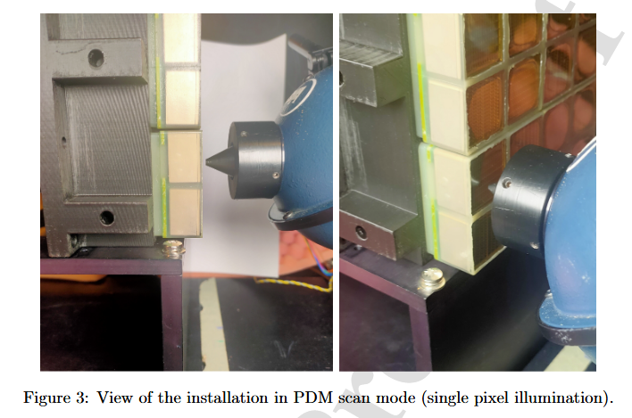
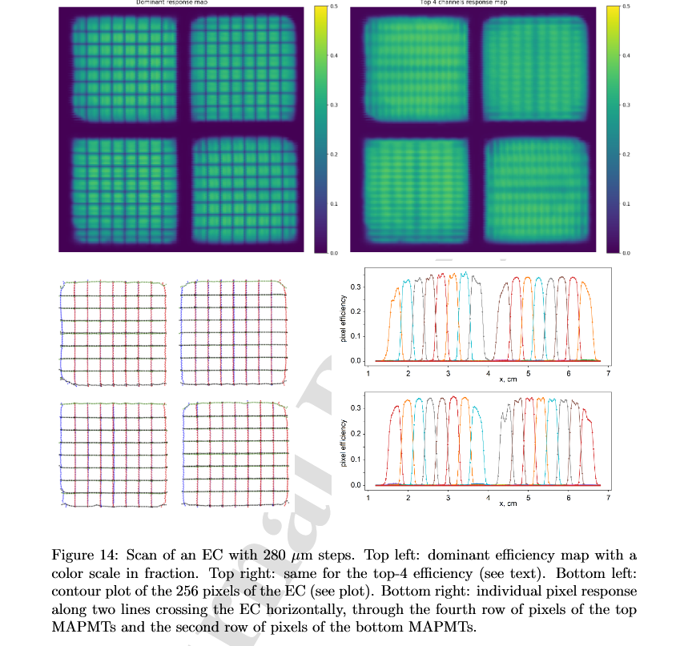
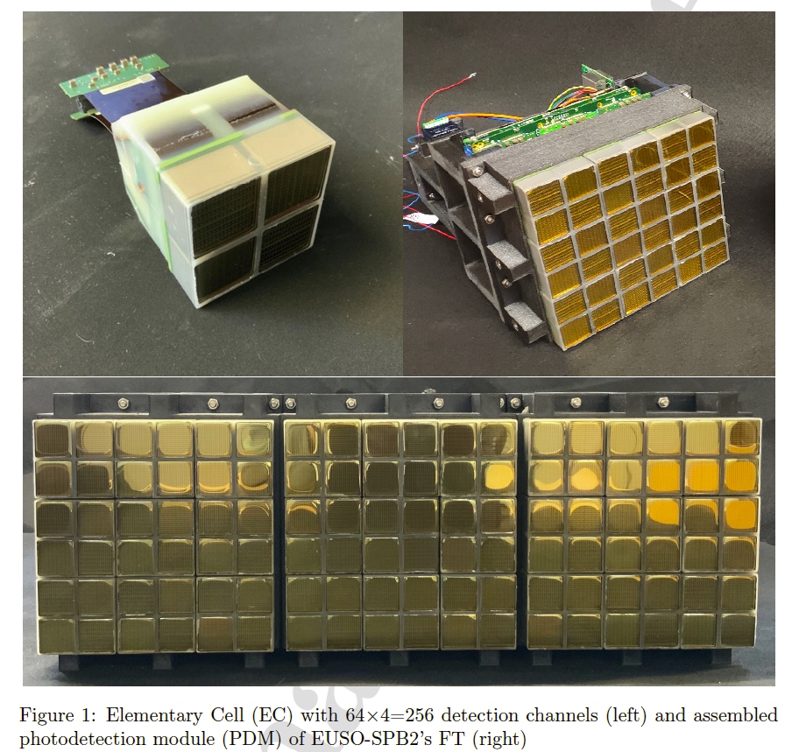
“Characterization and absolute calibration of R11265 multi-anode photomultiplier tubes for the JEM-EUSO space and balloon program, I Application to the EUSO-SPB2 Photo Detection Modules, D. Triomov et al., Astroparticle Physics May 2025

Slide 8
EUSO-SPB2 Publications
SPB2 – related journal papers Published
“Neutrino propagation in the Earth and emerging charged leptons with nuPyProp”, Diksha Garg et al., Journal of Cosmology and Astroparticle physics, Volume 2023, January 2023, 041 arXiv:2209.15581
Ultra-High-Energy Cosmic Rays: The Intersection of the Cosmic and Energy Frontiers, A. Coleman et al, Astroparticle Physics Volume 149, July 2023, 102819 arXiv:2205.05845:
“Characterization and absolute calibration of R11265 multi-anode photomultiplier tubes for the JEM-EUSO space and balloon program, I: Methods and generic features”, E. Parizot et al, Astroparticle Physics, 171 Sept 2025, 103112.
SPB2 – specific journal papers Published
“The Camera and Readout for the Trinity Demonstrator and the EUSO-SPB2 Cherenkov Telescope, M Bagheri et al. NIST A, 12 Jun 2024. NIST A 1070, Jan 2025 169999 arXiv:2406.08274
The EUSO-SPB2 Fluorescence Telescope for the Detection of Ultra-High Energy Cosmic Rays, J.H. Adams et al (EUSO-SPB2 group), Astroparticle Physics 165 Feb 2025 103046) arXiv:2406.13673
“Characterization and absolute calibration of R11265 multi-anode photomultiplier tubes for the JEM-EUSO space and balloon program, I Application to the EUSO-SPB2 Photo Detection Modules, D. Triomov et al., Astroparticle Physics (in press)
SPB2 – specific journal papers Submitted
“The Extreme Universe Observatory on a Super-Pressure Balloon II: Mission, Payload, and Flight”, J.H. Adams et al. (EUSO-SPB2 group), Submitted 5/28/2025, Journal of Cosmology and Astroparticle Physics (JCAP), arXiv: 2505.20762

Slide 9
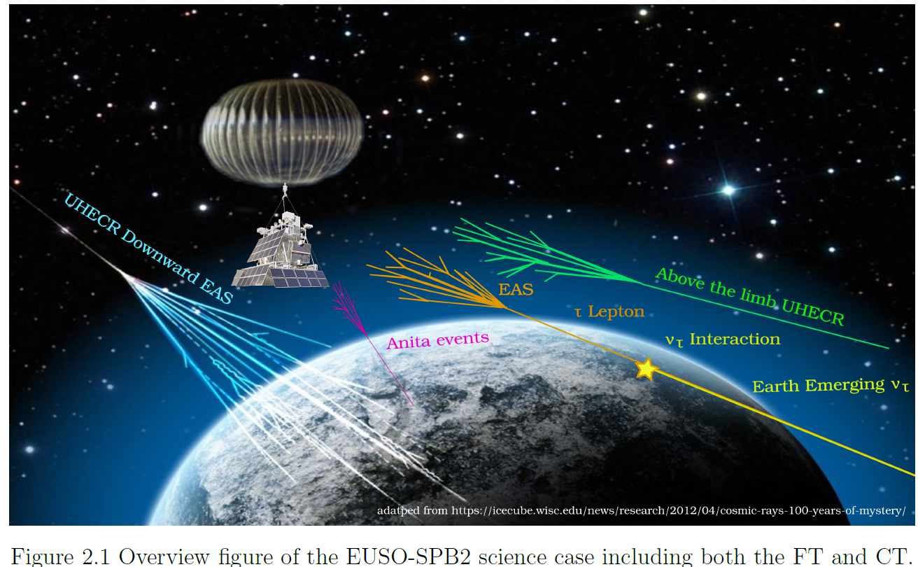

Slide 10
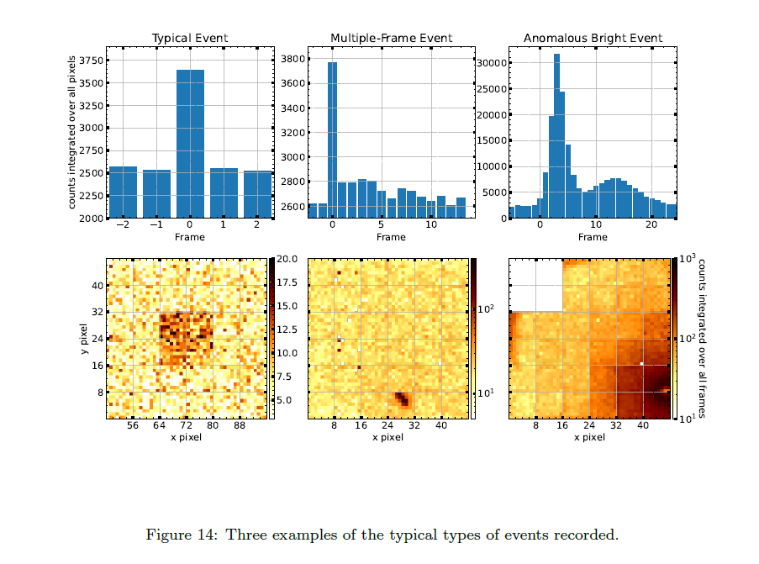
Search for UHECR’s with FT
Astroparticle Physics 165 Feb 2025 103046) arXiv:2406.13673

Slide 11
EUSO-SPB2 In Preparation
SPB2 –publications - in preparation
Observation of Cosmic Rays above the limb via Cherenkov Telescope on-board the EUSO-SPB2 mission
EUSO-SPB2 Cherenkov Telescope results for target of opportunity neutrino sources
EUSO-SPB2 Diffuse Neutrino Limit and Night Sky Backgrounds
SPB2 related short author papers in preparation
Scheduling follow-up observations of energetic transients with the neutrino target scheduler (NuTS)
Geomagnetic Field Deflections and Cherenkov Production of Muons in Horizontal Extensive Air Showers (D. Fuehne, T. Heibge)
ICRC 2025 Presentations/Proceedings in preparation (3)
EUSO-SPB2 Cherenkov Telescope: Overview and First Neutrino Constraints Heibges (Reno et al)
Using the Cherenkov Telescope onboard EUSO-SPB2 for Target of Opportunity searches of very high energy neutrino sources Venters, Guépin at al
EUSO-SPB2 Cosmic Ray Searches and Observations Filippatos

Slide 12
EUSO-SPB2 Graduate Student Theses
The Maximum Energy of Shock-Accelerated Cosmic Rays, PhD thesis of Rebecca Diesing at the University of Chicago, May 2023; arXiv:2305.07697
2. Optics and preflight testing of the telescopes of the ”Extreme Universe Space Observatory on a Super Pressure Balloon II” (EUSO-SPB2) Payload PhD thesis of Viktoria Kungel, Colorado School of Mines, April 6th 2023. Mines Library Link to Kungel Thesis
3. The Extreme Universe Space Observatory on a Super Pressure Balloon II, Fluorescence Telescope on the Ground and (Briefly) in the Air, PhD thesis of George Filippatos at Colorado School of Mines, 8 November 2023. Mines Library Link Filippatos Thesis
4. Cherenkov Camera and search for diffuse neutrinos with EUSO-SPB2, PhD Thesis of Oscar Romero, Georgia Tech, 2024.
5. Cherenkov Camera and observation of HECR candidates with EUSO-SPB2, PhD Thesis of Eliza Gazda, Georgia Tech 2024.
6. Calibration of the MAPMTs of the JEM-EUSO missions, PhD thesis of Daniil Troimov, Universite Paris Cite,
Dec 9th 2024.
7. First results from the Cherenkov Telescope flown on EUSO-SPB2, PhD thesis of Tobias Heibges, Colorado School of Mines, March 31st 2025.
1. The targets of opportunity source catalog, prioritization, scheduler and related mechanics for the EUSO-SPB2 mission. MsC thesis of Hannah Wistrand at Colorado School of Mines, 12 April 2024.
2. Simulating the Cherenkov emission and geomagnetic effects of muons and muon-induced subshowers from extensive air showers for the EUSO-SPB2 mission, MsC thesis of Duncan Fuehne at Colorado School of Mines, 17 May 2024.

Slide 14
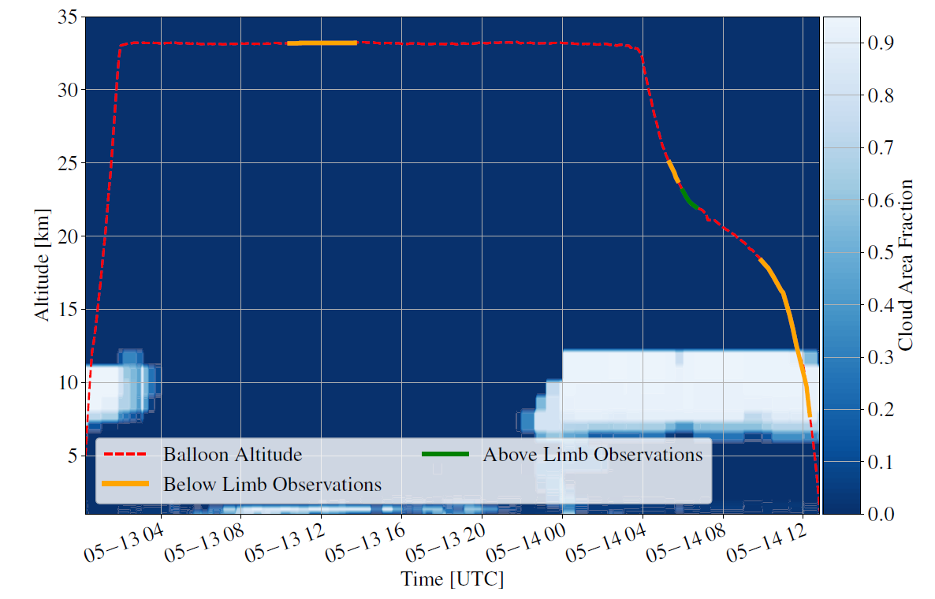
CT observing periods used for T. Heibges Thesis data analysis

Slide 15
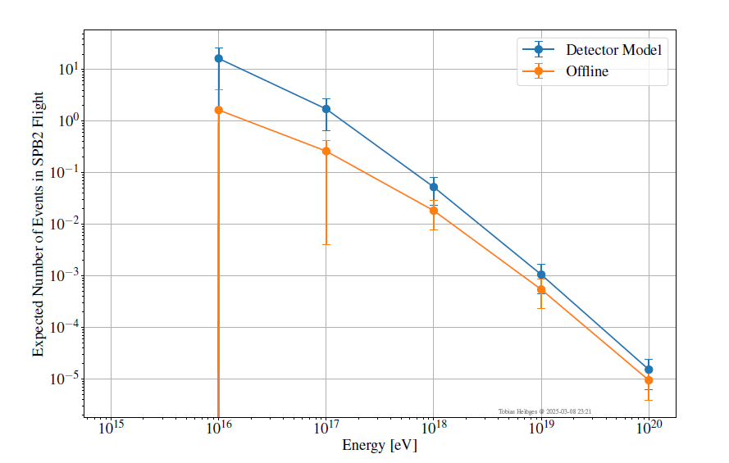
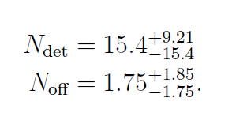
Simplified Simulation
Full Simulation
Expected number of EASs during the 45 minute above the limb observation period for EUSO-SPB2 on May 14th.
T. Heibges PhD Thesis

Slide 16
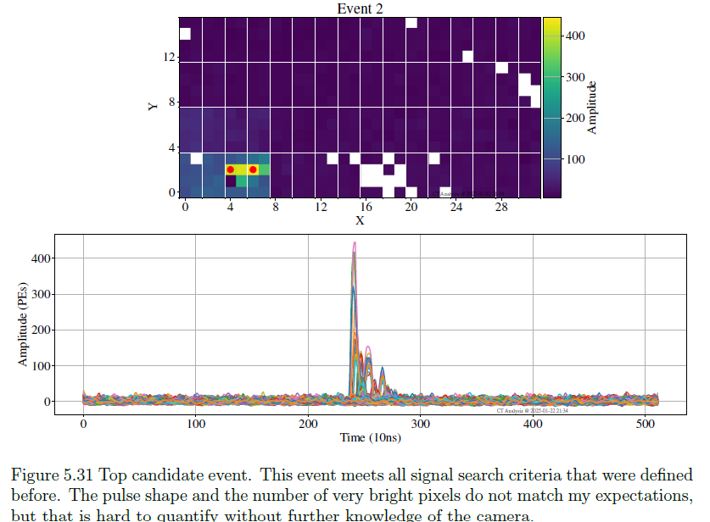
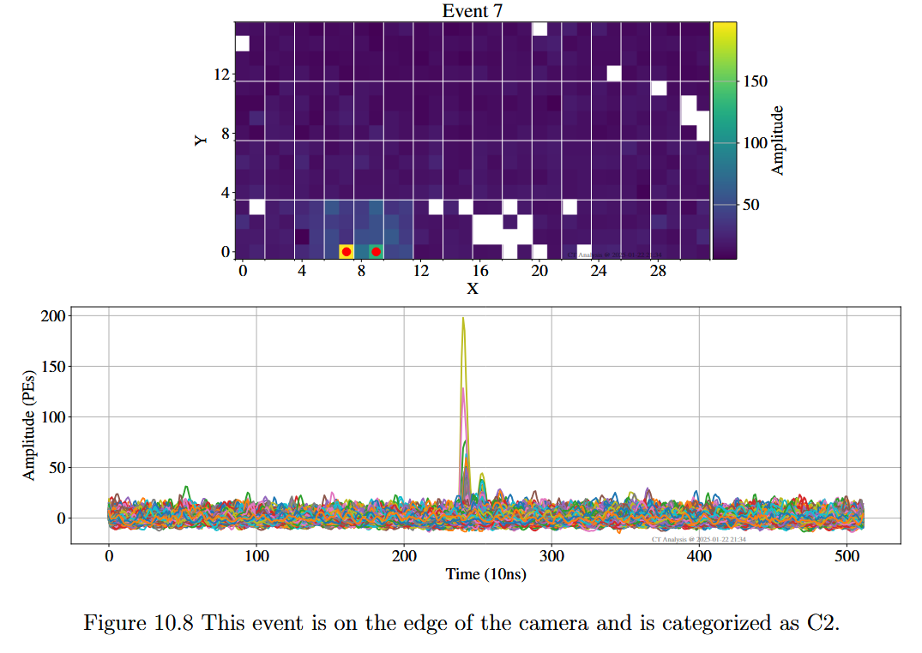
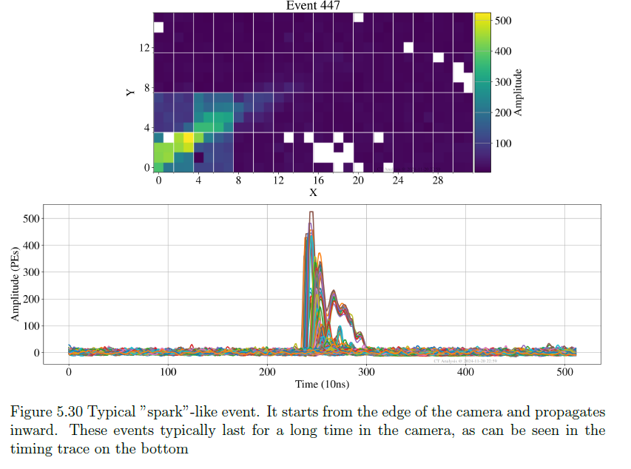
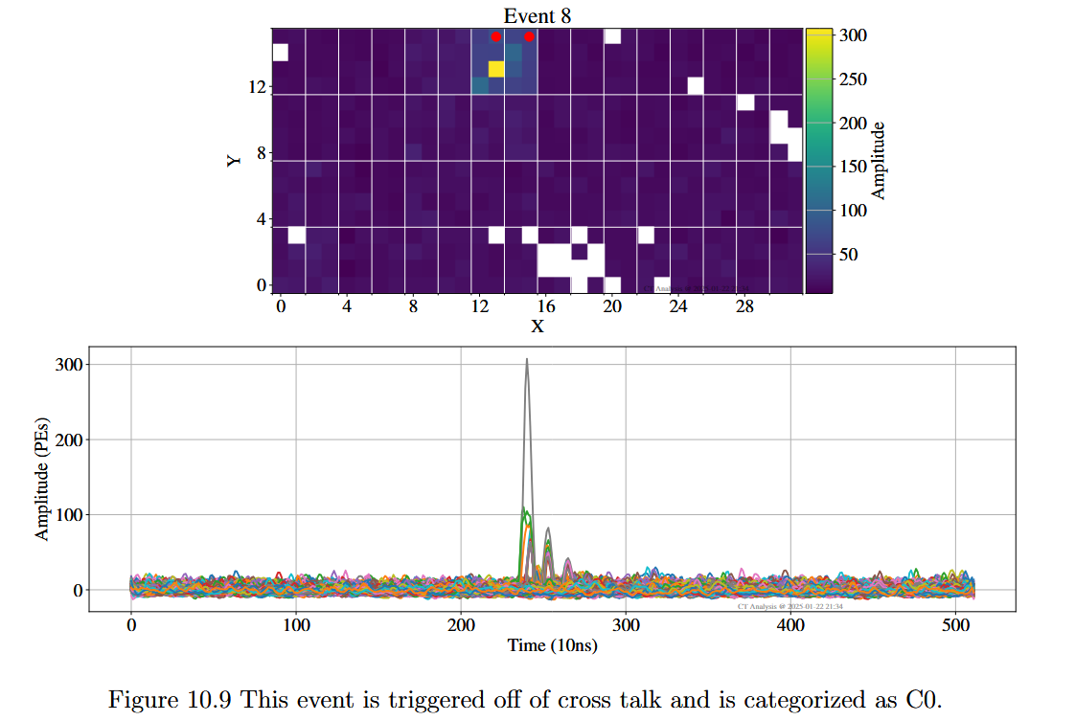

Slide 18
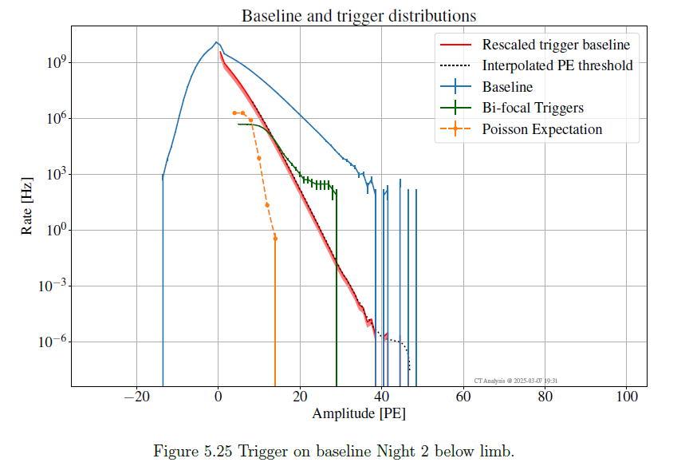

Slide 19
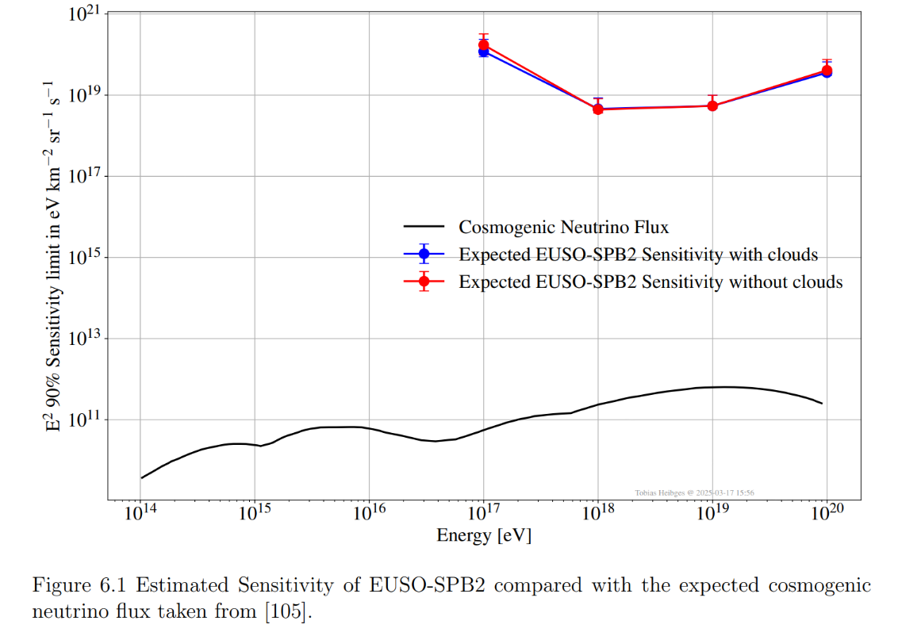
T. Heibges PhD Thesis

Slide 20
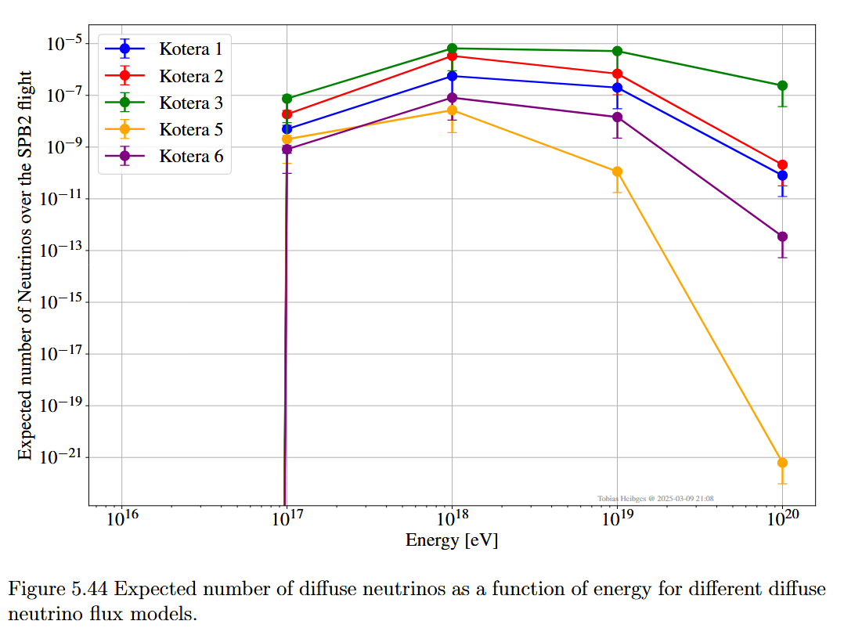
T. Heibges PhD Thesis

Slide 21
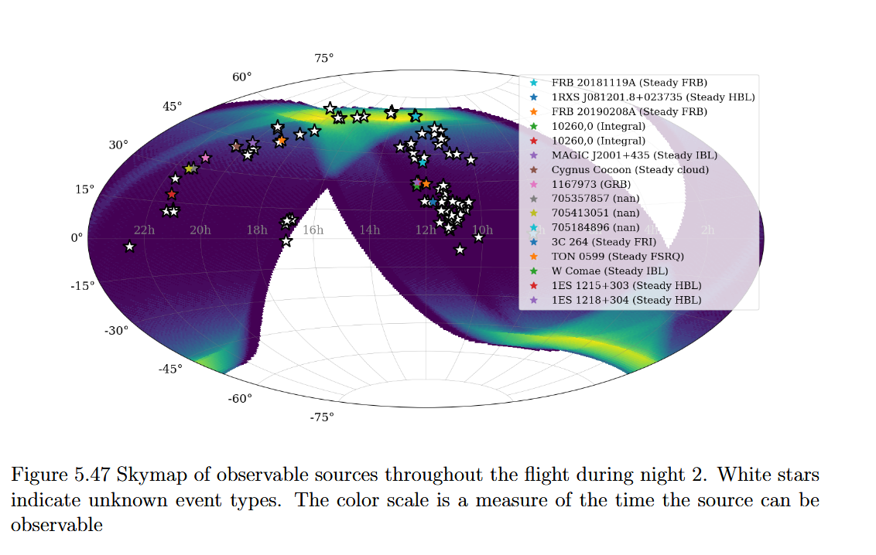
T. Heibges PhD Thesis

Slide 22
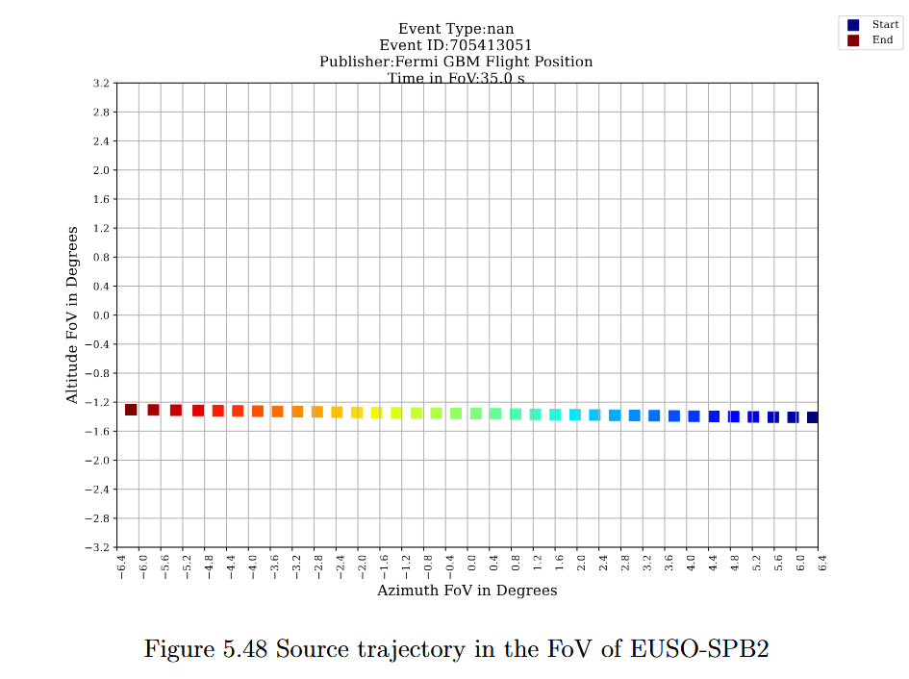

Slide 23
SPB2 –publications - in preparation
Observation of Cosmic Rays above the limb via Cherenkov Telescope on-board the EUSO-SPB2 mission
EUSO-SPB2 Cherenkov Telescope results for target of opportunity neutrino sources
EUSO-SPB2 Diffuse Neutrino Limit and Night Sky Backgrounds
SPB2 related short author papers in preparation
Scheduling follow-up observations of energetic transients with the neutrino target scheduler (NuTS)
Geomagnetic Field Deflections and Cherenkov Production of Muons in Horizontal Extensive Air Showers (D. Fuehne, T. Heibge)
ICRC 2025 Presentations/Proceedings in preparation (3)
EUSO-SPB2 Cherenkov Telescope: Overview and First Neutrino Constraints Heibges (Reno et al)
Using the Cherenkov Telescope onboard EUSO-SPB2 for Target of Opportunity searches of very high energy neutrino sources Venters, Guépin at al
EUSO-SPB2 Cosmic Ray Searches and Observations Filippatos

Slide 24
SPB2 –publications - in preparation
Observation of Cosmic Rays above the limb via Cherenkov Telescope on-board EUSO-SPB2 mission
EUSO-SPB2 Cherenkov Telescope results for target of opportunity neutrino sources
EUSO-SPB2 Diffuse Neutrino Limit and Night Sky Backgrounds
SPB2 related short author papers in preparation
Scheduling follow-up observations of energetic transients with the neutrino target scheduler (NuTS)
Geomagnetic Field Deflections and Cherenkov Production of Muons in Horizontal Extensive Air Showers (D. Fuehne, T. Heibge)

Slide 26
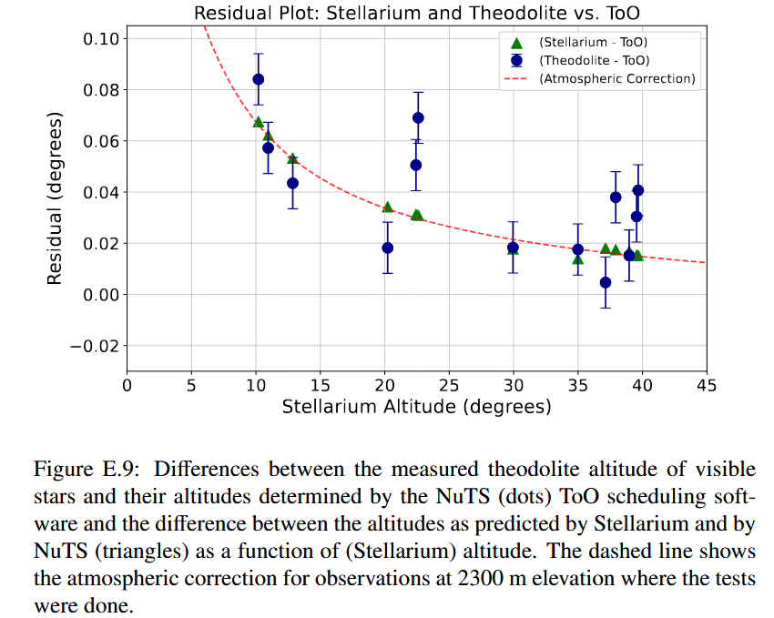
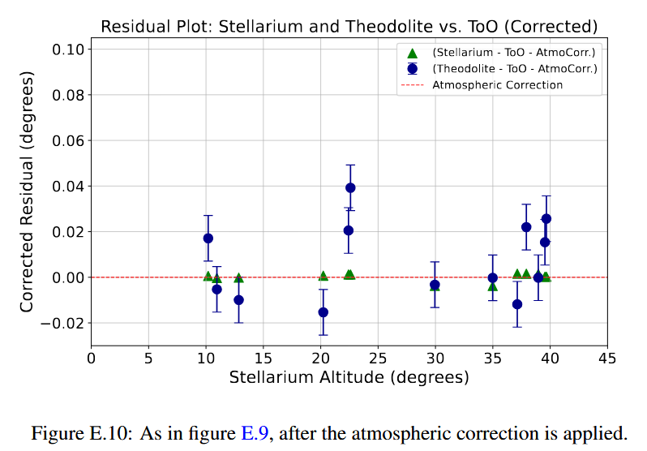

Slide 27
Acknowledgments
JEM-EUSO PCC (A. Haungs, M. Ricci) and the internal reviewers
Coordinators/corresponding authors of the EUSO-SPB2 papers
NuSpaceSim Group (J. Krizmanic and participants)
EUSO Offline Group (T. Paul, J. Eser and others)
GT group - CT Simulation Chain, and information about the CC (E. Gazda, N. Otte, O. Romero and all)
APC, Torino, Napoli – FC characterization (M. Bertania, G. Osteria, E. Parizot)
ToO Group - H. Reno, and participants
NERSC Computing through LBL E. Judd
Funding Agencies NASA, ASI

Slide 28
EUSO-SPB2 session on Wed. June 4th

Slide 29
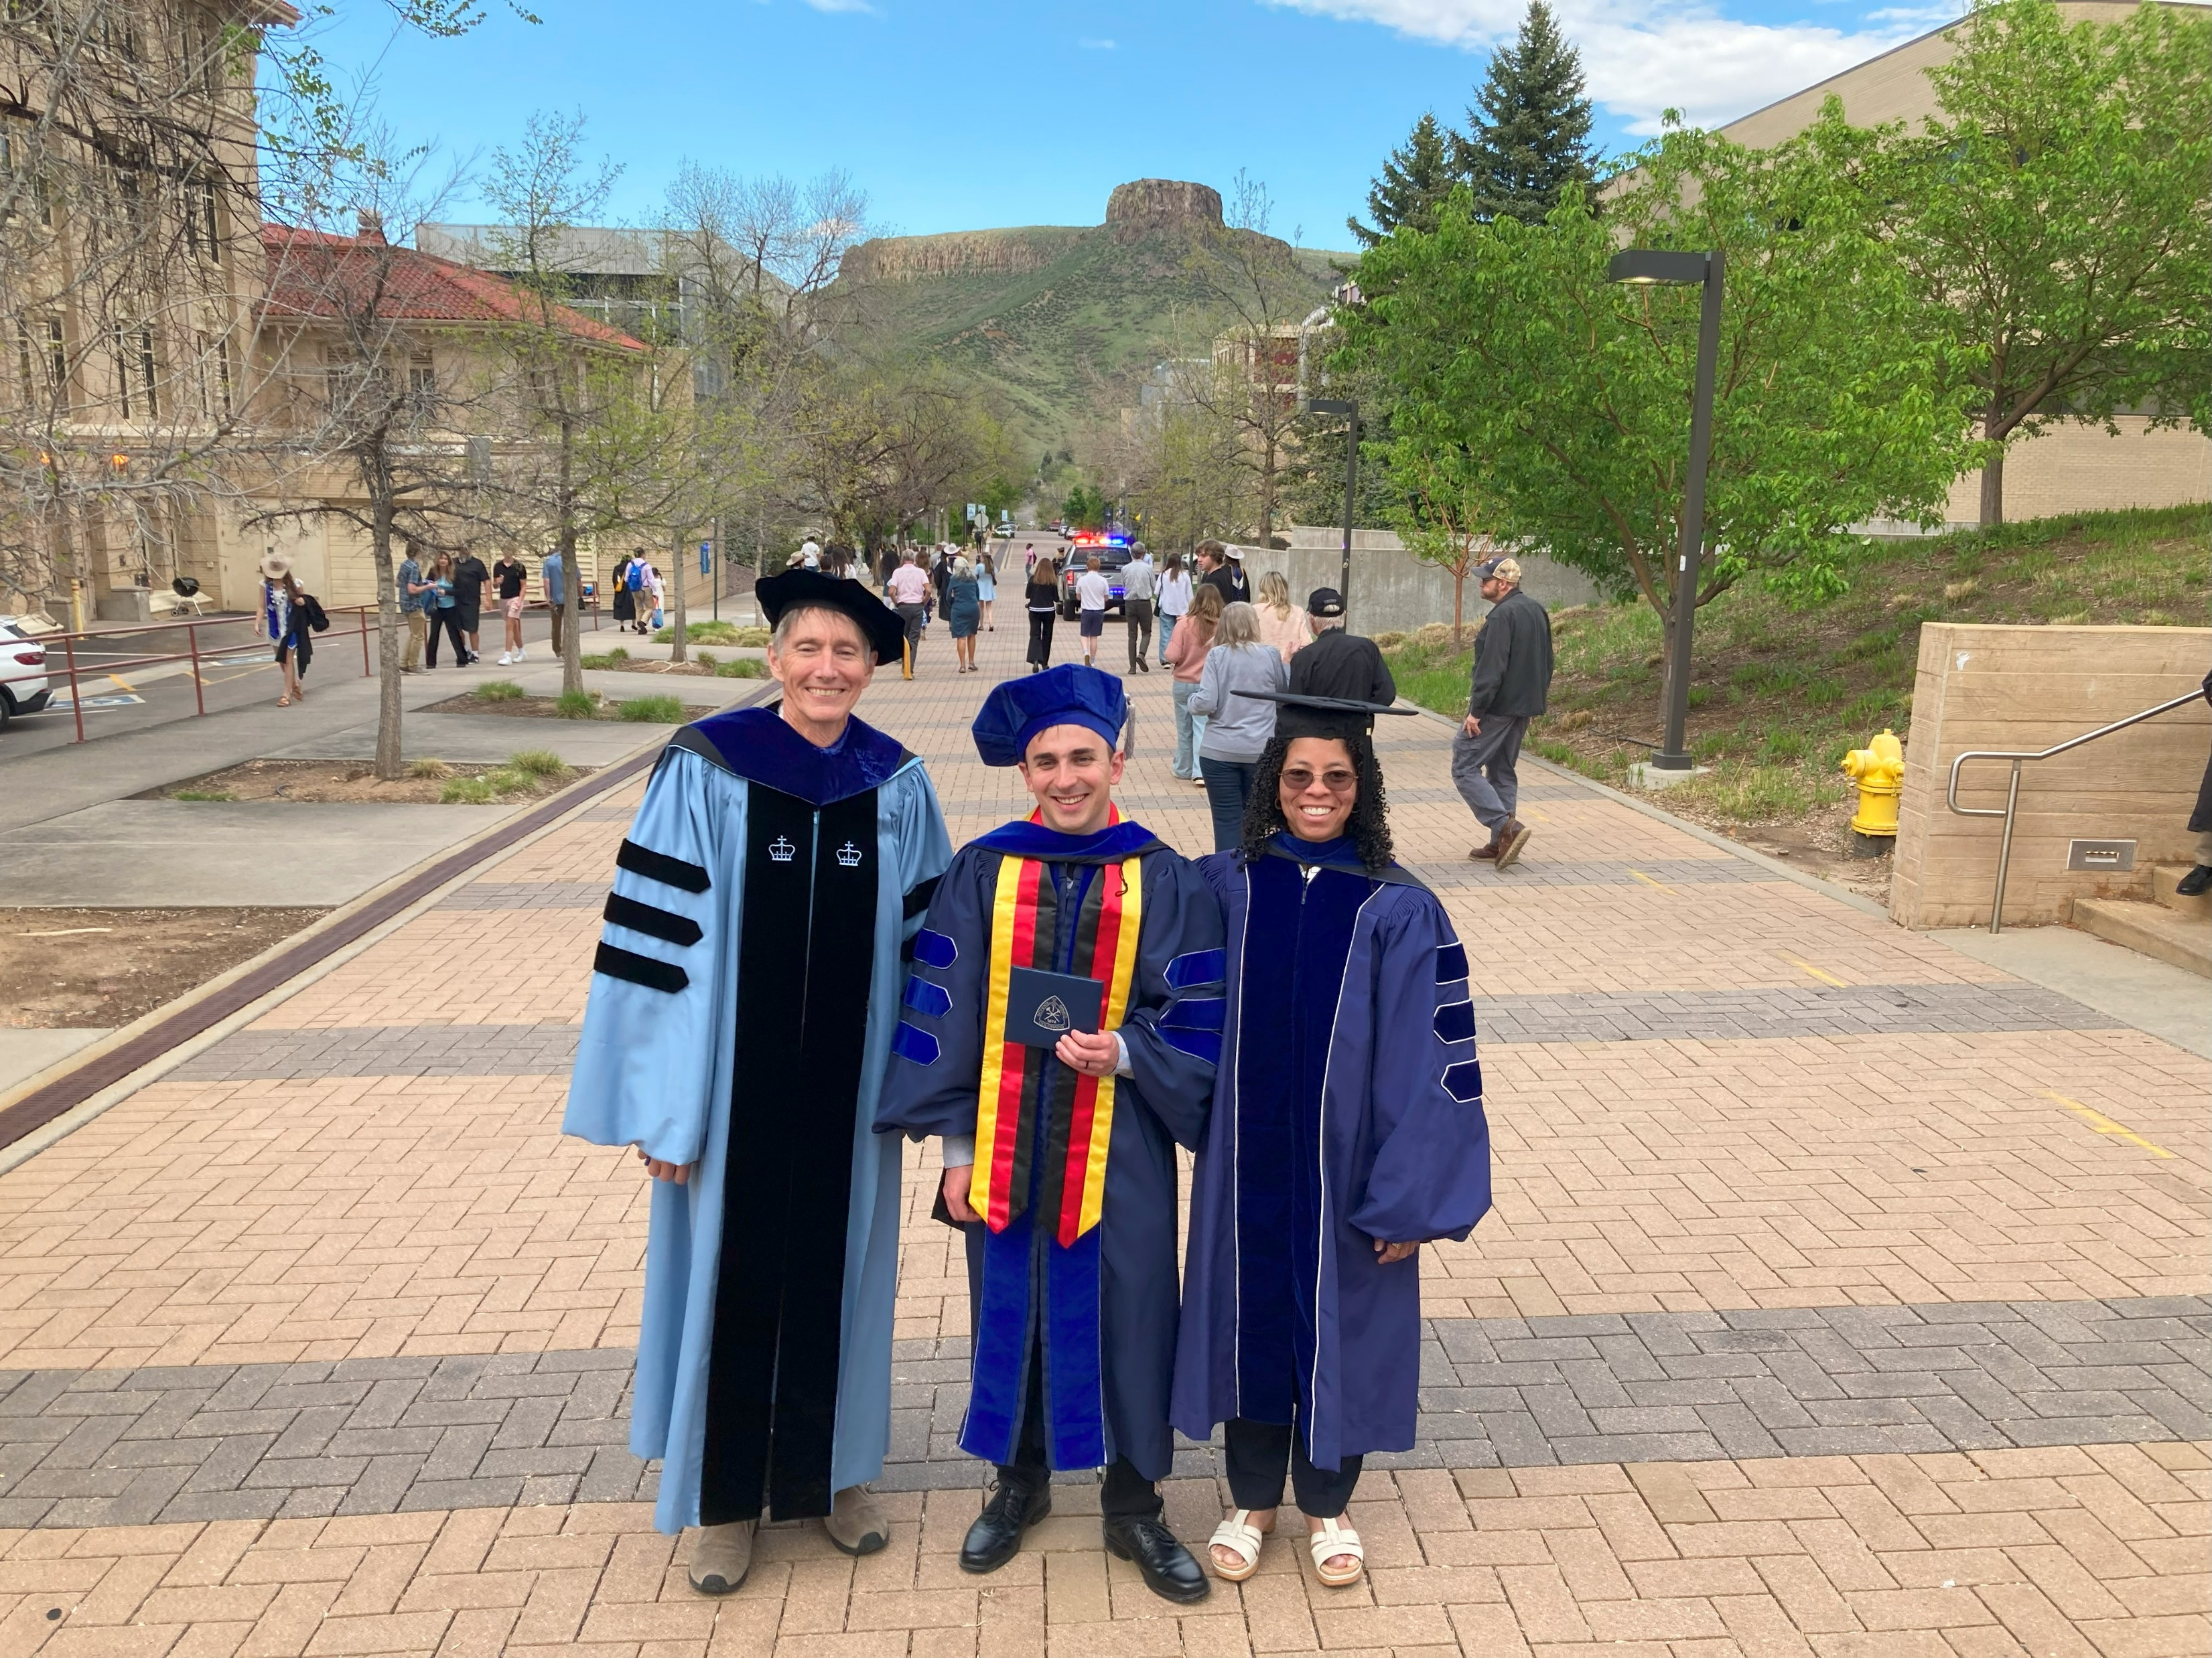
May 8th 2025 Tobias Heibges PhD (Center)
Advisors: Lawrence Wiencke (left) Toni Venters (Right)

Slide 30
