Slide 1



PBR
Tilting & Shutters
Lawrence Wiencke, Levi Bar-On, James Brague, Auston Froid, Josh Moses, Steve Meyers, Ben Stillwell
June 5th, 2025
EUSO Collaboration Meeting
Paris France

Slide 2
Take Home Message
We are on track
Lots of fabrication to do, and some design & procurement remaining
Working a solution to an 8g failure mode identified in FEA
Friendly request to finalize ST status bytes allocation so we can program this in. (We requested 50 bytes)

Slide 3
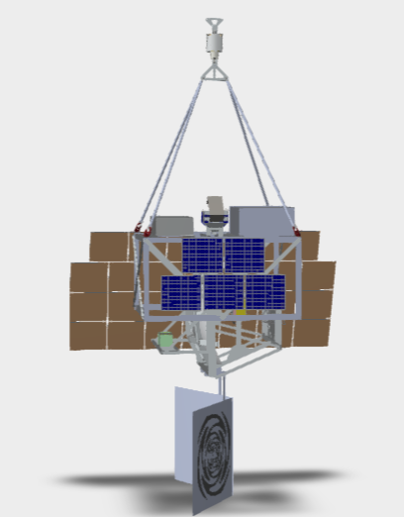
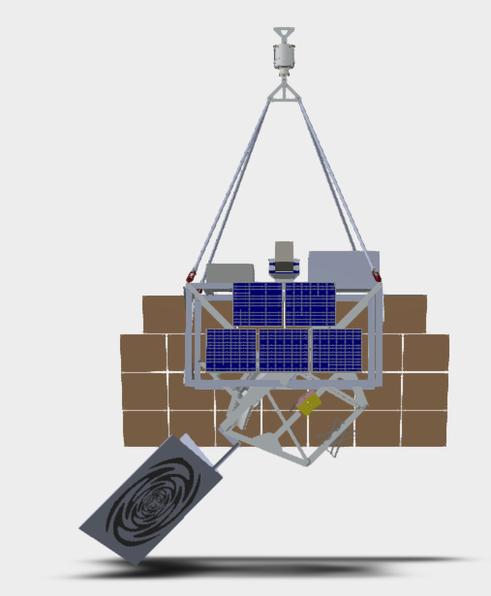
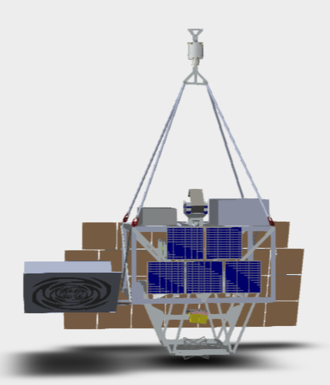
PBR Telescope Assembly Tilt System
Rotate elevation angle during flight for data taking at
many angles from +13 degrees to -90 degrees
0 degrees
-45 degrees
-90 degrees

Slide 4
PBR Shutter/Tilting
System Architecture
Inclinometer 1
Shutter (Upper)
power
network
Motor (1),
RTD(1)
Limit Switches (4)
Inclinometer (analog)
Power
RTD (1)
TEC (USB-GSE)
Controller
PLC
Inclinometer
2
Shutter (Lower)
Motor (1),
RTD (1)
Limit Switches (4)
RTDs
Inclinometer (analog)
Power (TEC, heater)
RTD (1)
TEC (USB-GSE)
Light Sensors (Port, Starb, In)
Motor (1),
RTD (1)
Limit Switches (4)
PLC Software
Update SBP2 version
Added limit switches, RTDs
Auto Close if N light sensors read light
!Open (open, ignoring light sensors)
More status bytes
Tilt Mechanism
14 DIO
8 Analog Inputs
8 RTD (Temperature Sensors)
10 DO (motor steps, direction)

Slide 5
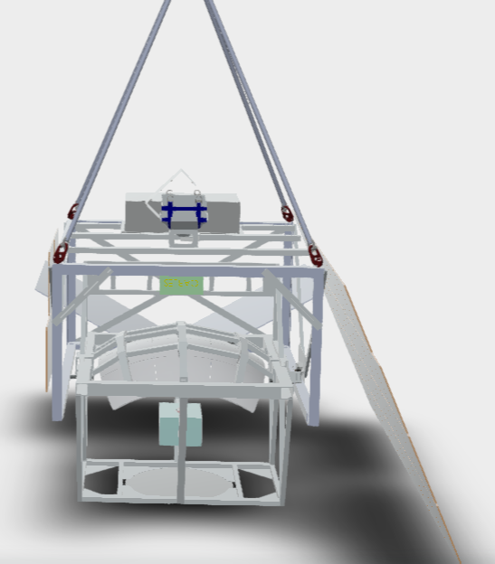
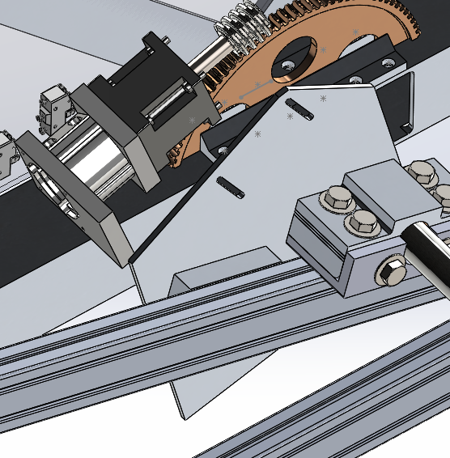
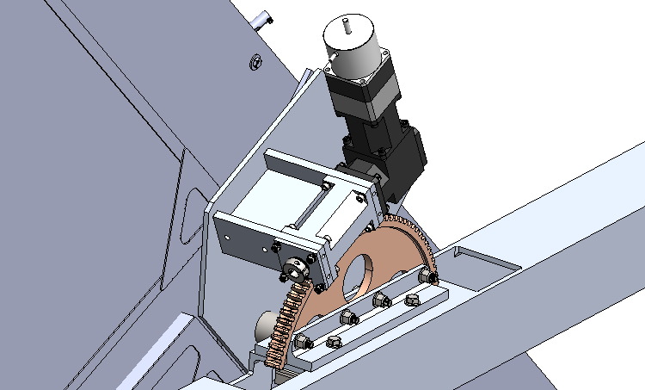

Slide 6
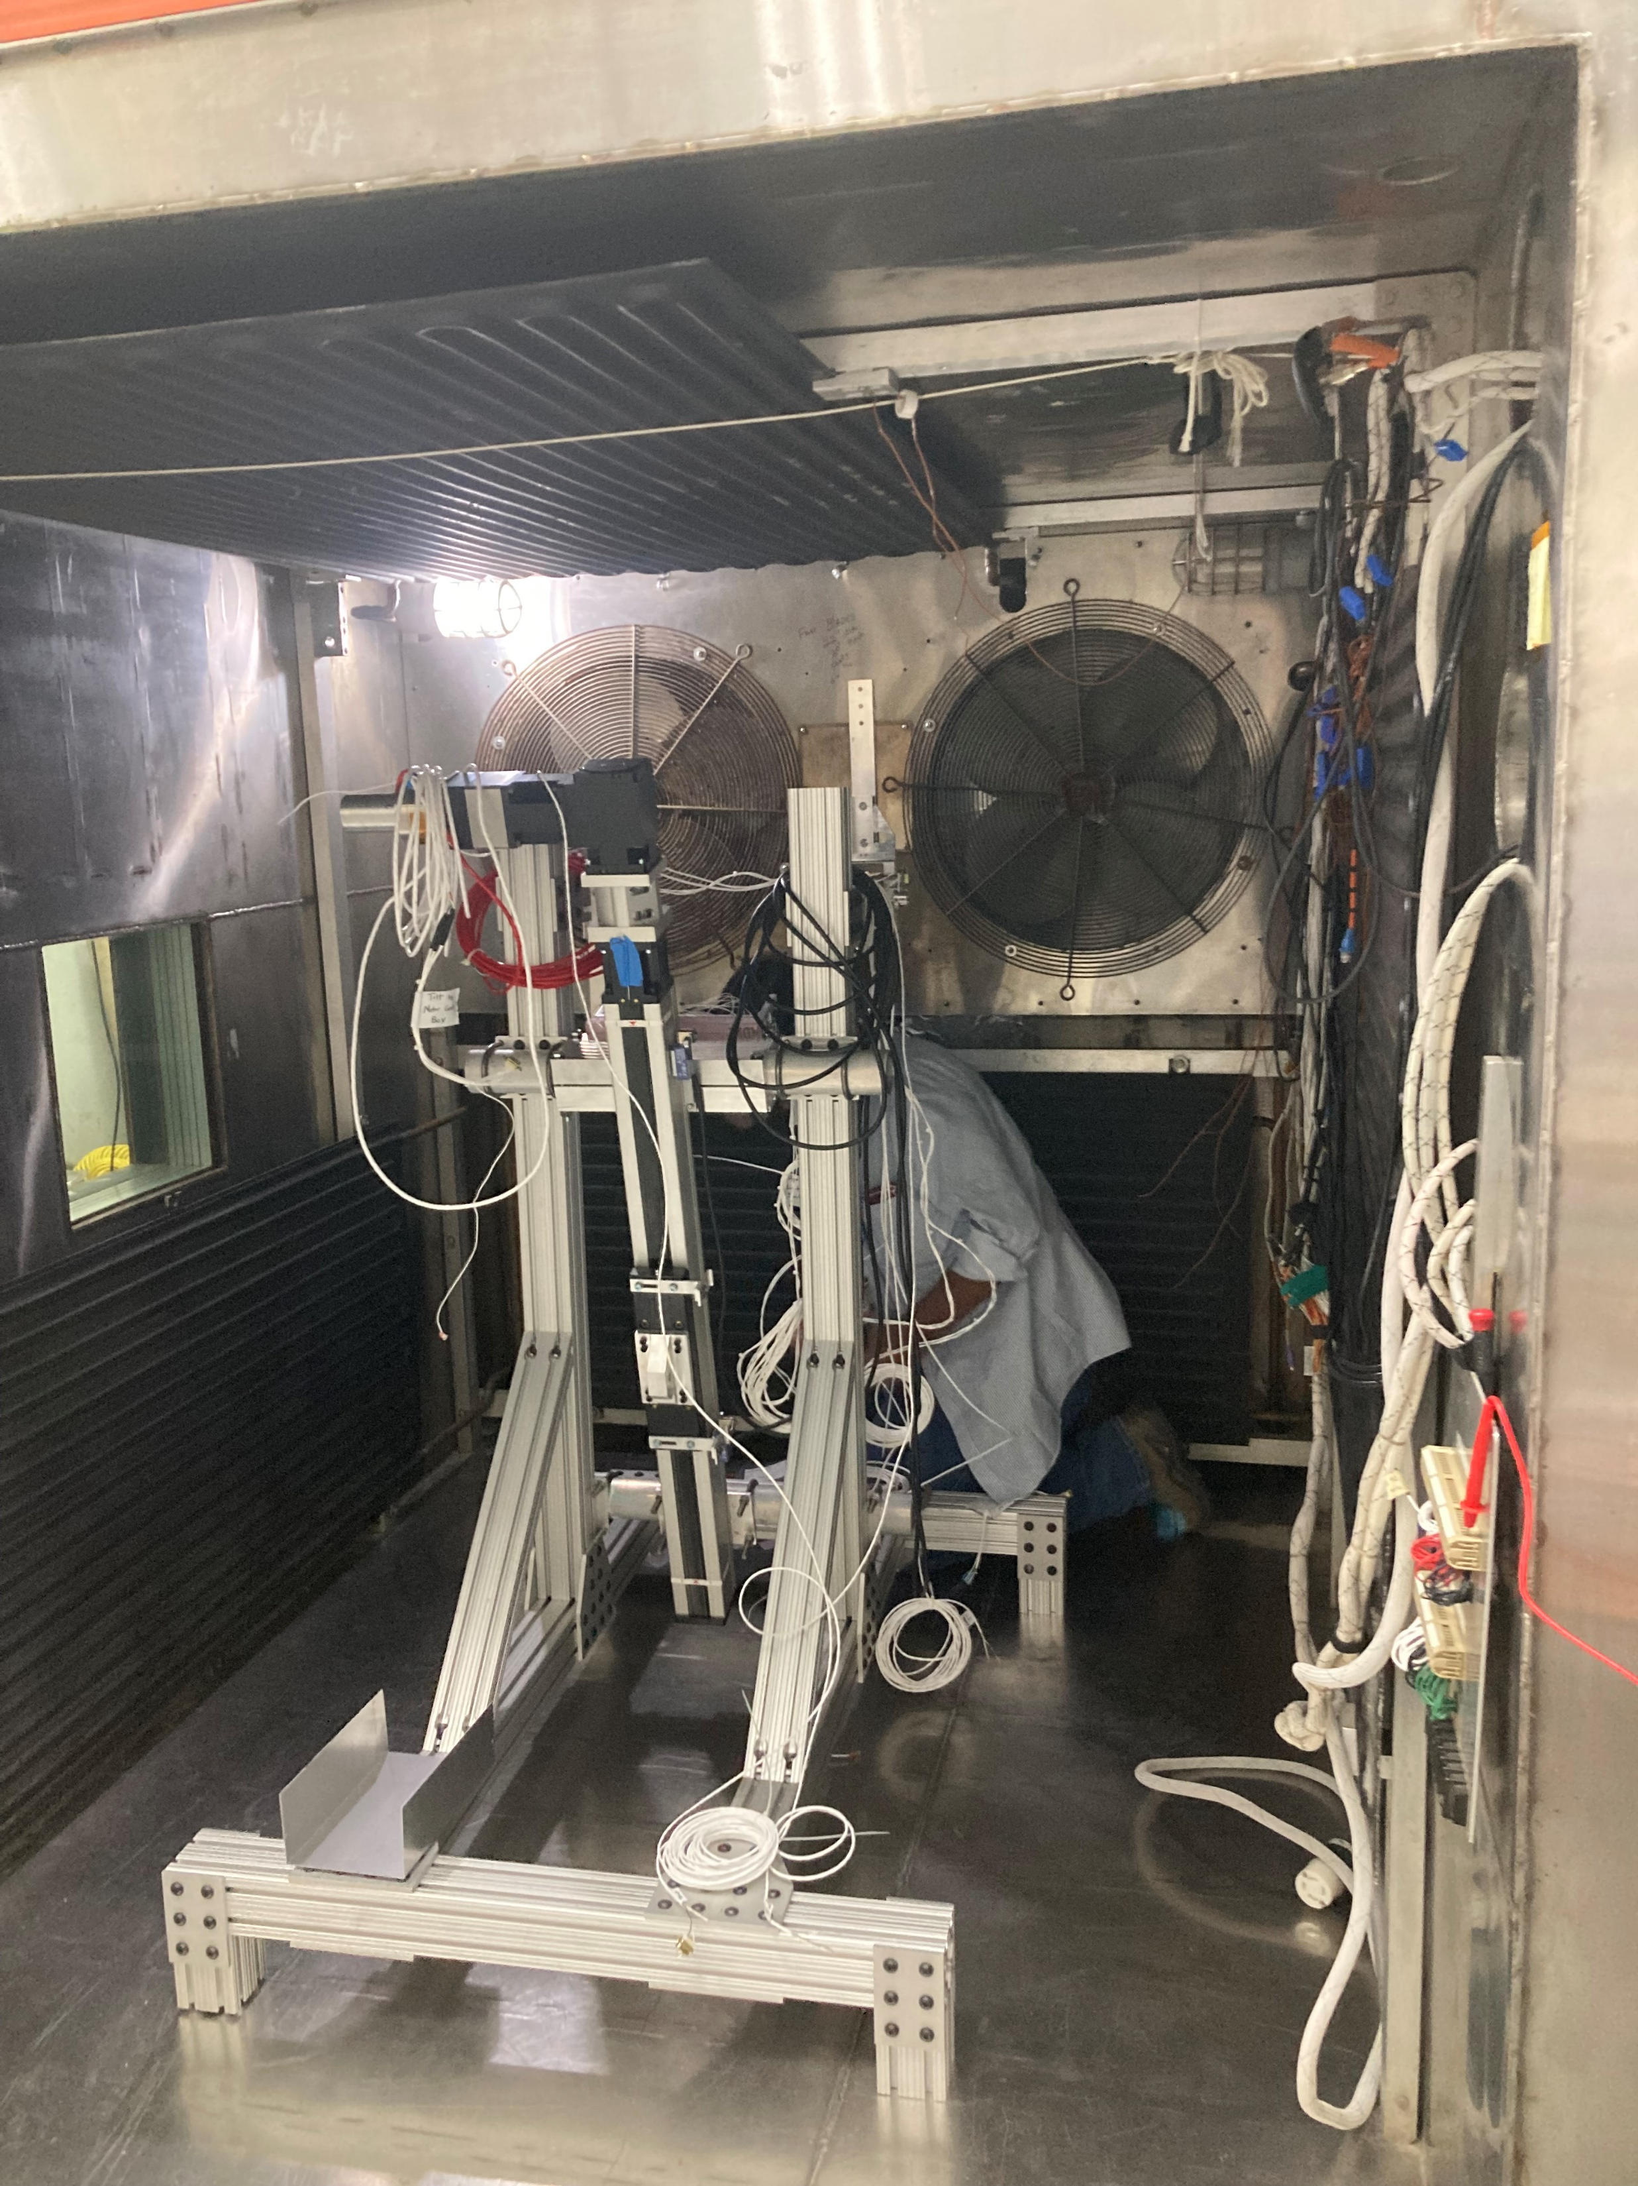
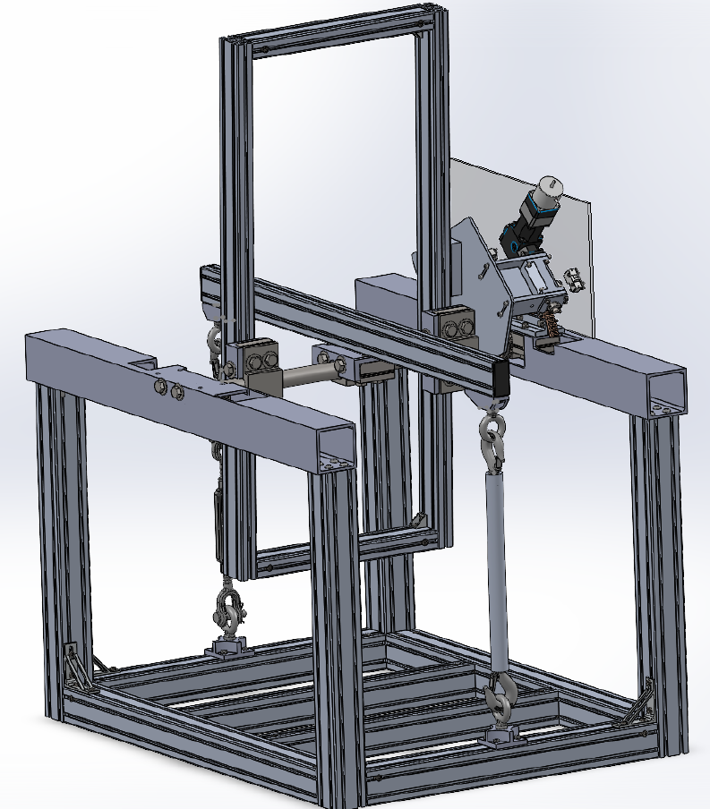
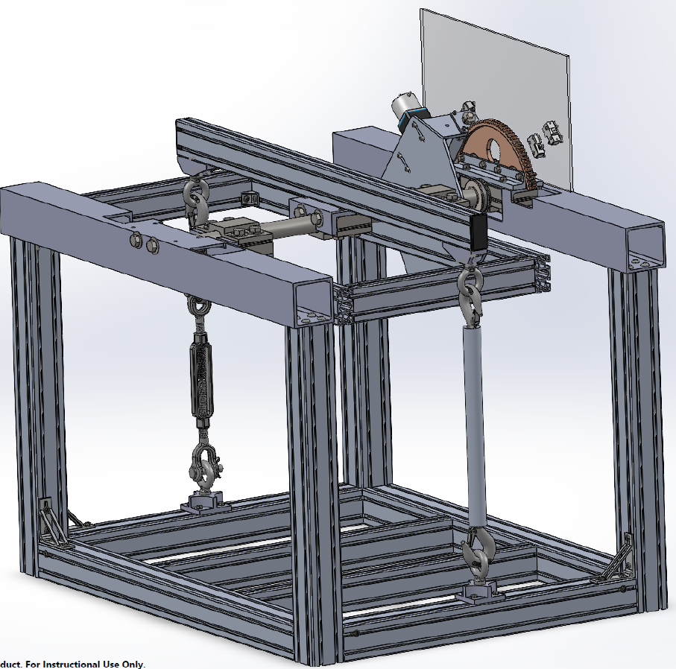
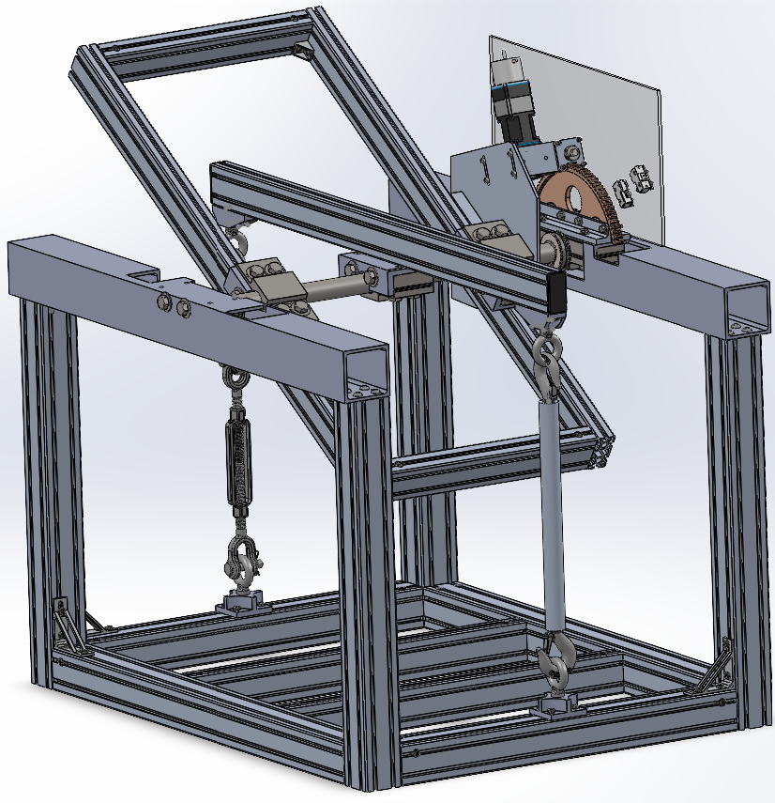
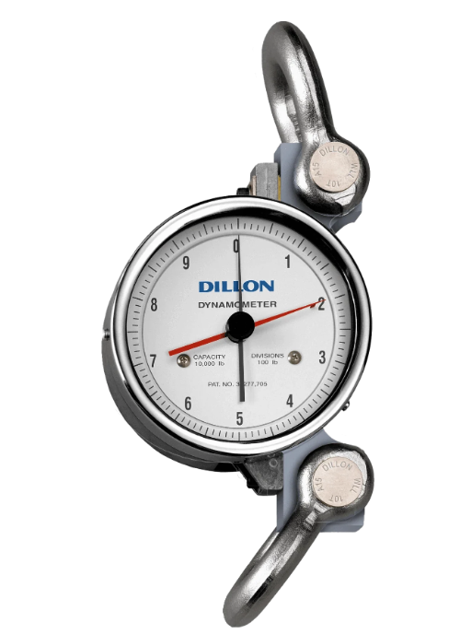
T-Vac tests of PBR telescope rotation mechanism in
CSBF BEMCO T/Vac chamber
Test bearing design, tilt mechanism at 7mbar, -40c, -50c, -60 c
Simulated load of 2000 lbs (telescope weight), 100 ft-lbs (imbalance of telescope)
Planning for Sept or Oct 2025 for tests. About 4 days @ CSBF
SPB2 Test Oct 2022
Test assembly is designed to fit inside the ~70”x~70”x~70” BEMCO chamber.
Telescope
Rotation
Mechanism
(flies)
100 lbs
64”
Turn buckle
Tension 1000 lbs
Test stand
(does not fly)
48(+7)”
32”
L. Wiencke Colorado School of Mines
5-27-2025

Slide 7
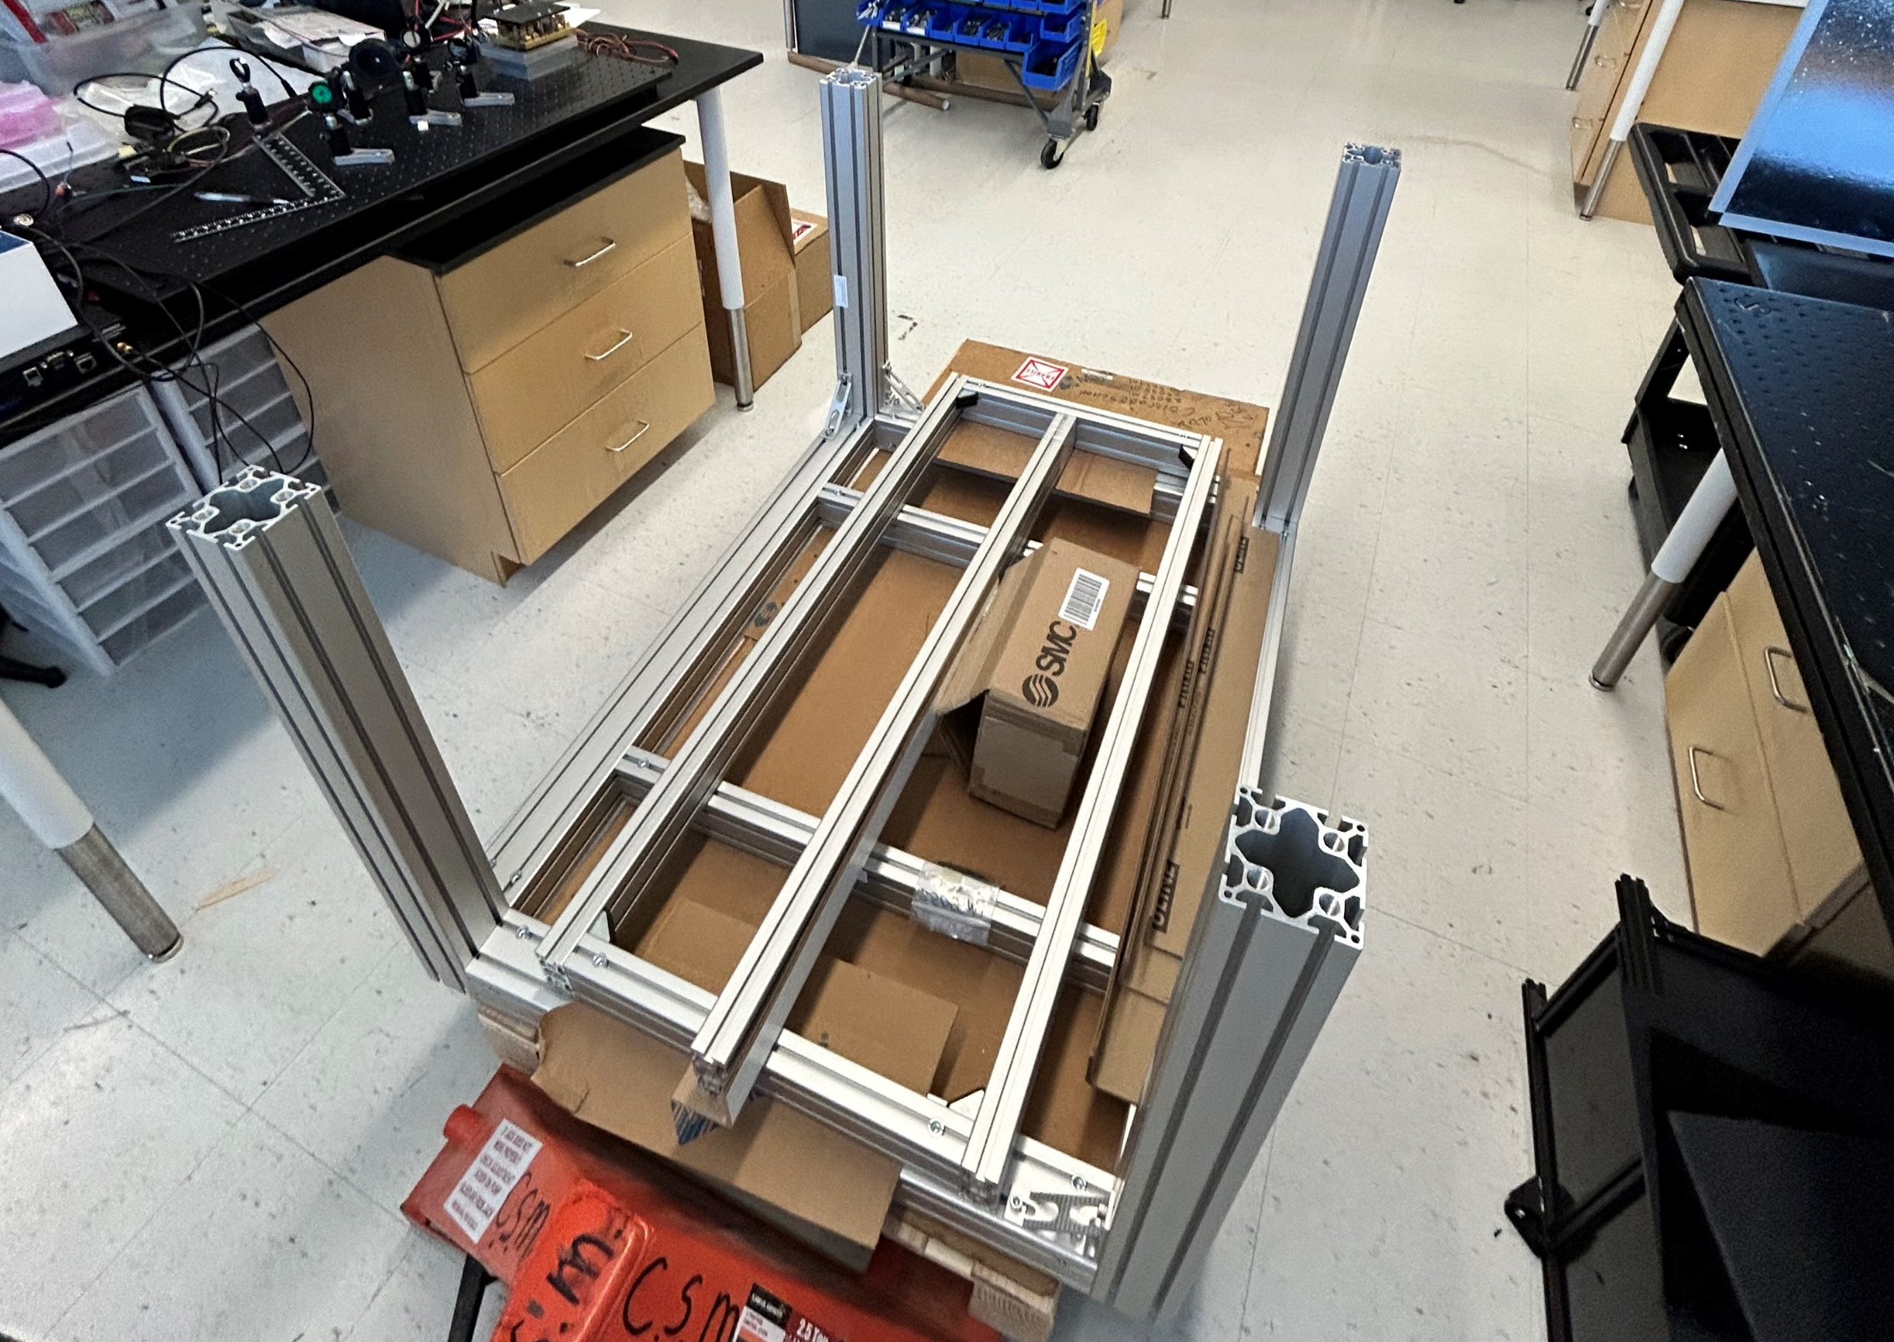
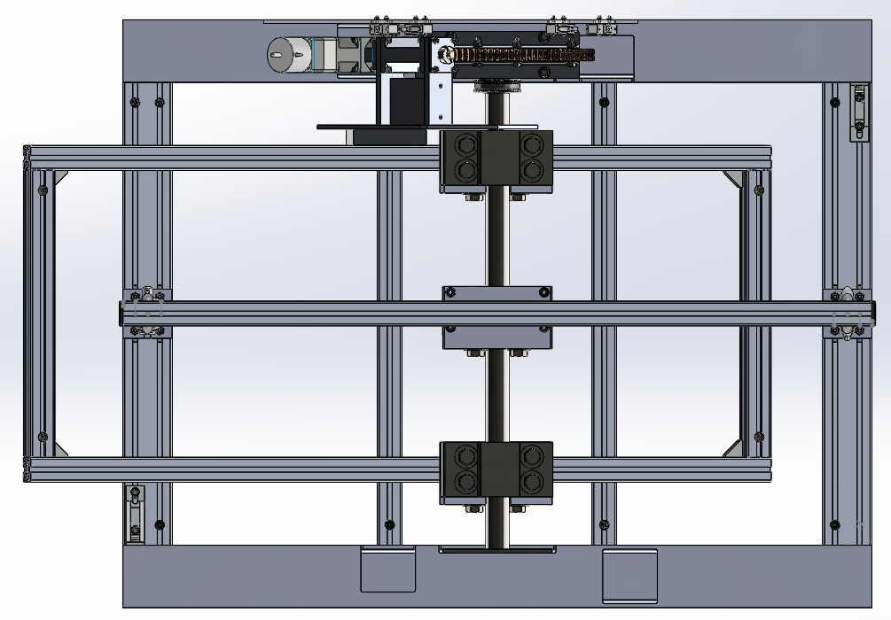

Slide 8
PBR Tilt Drive Mechanism Design –
Will tilt mechanism gears and structure survive worst-case loading?
Ben Stillwell (U. Chicago)
Worst-case torque due to
rotated mass (telescope plus
radio antenna) under load
cases prescribed by the
Structural Requirements
Document is:
(8g)(2000 lbm)(1 in)= 16,000 in-lb
Axial force on worm:
Ft,max = 16,000 in-lb/ 6.25 in = 2,560 lb
The tilt mechanism is attached to the telescope with 6x M6 alloy steel screws, the nearest of which is 5.5” from the rotation axis. Assuming they are all at this distance (conservative), the shear stress in the screw is:
(16,000 in-ln)/(5.5 in)/6/(π)/(0.09 in)^2 = 19 ksi
Yield strength of M6 class 8.8 alloy steel screw = 76.5 ksi

Slide 9
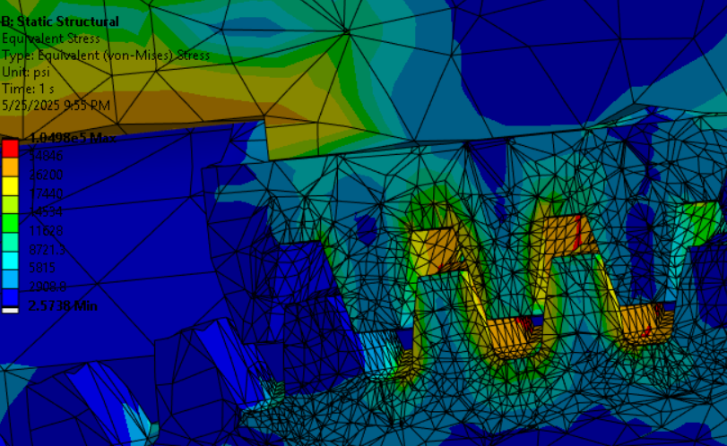
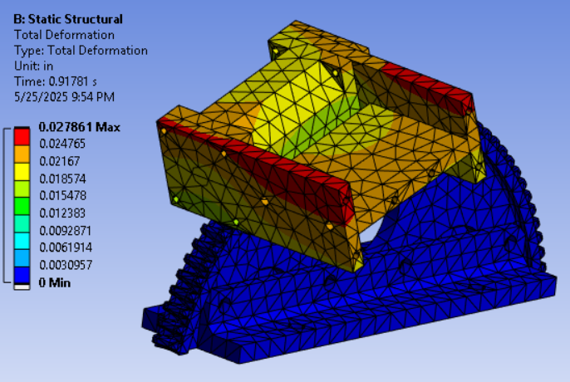
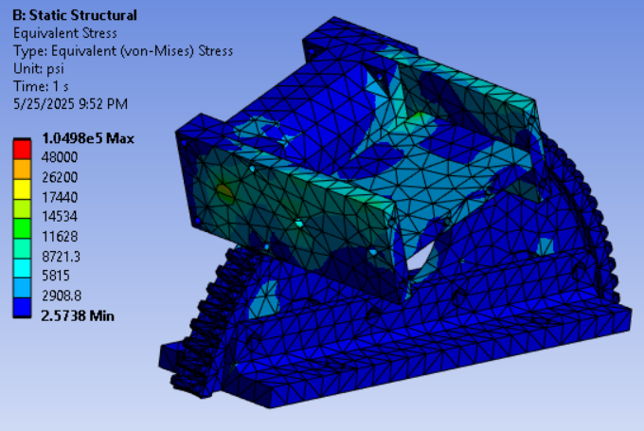
PBR Tilt Drive Mechanism Design –
Will tilt mechanism structure and mounting screws survive worst-case loading?
Ben Stillwell (U. Chicago)
Peak stresses in gear teeth at 8g ∼ 55,000 psi
Assuming worm wheel is C90700, yield strength =21,800 psi
Teeth would tolerate (21,800 psi/55,000 psi)8g = 3.2 g
Deformation and stresses in aluminum structure are low.

Slide 10
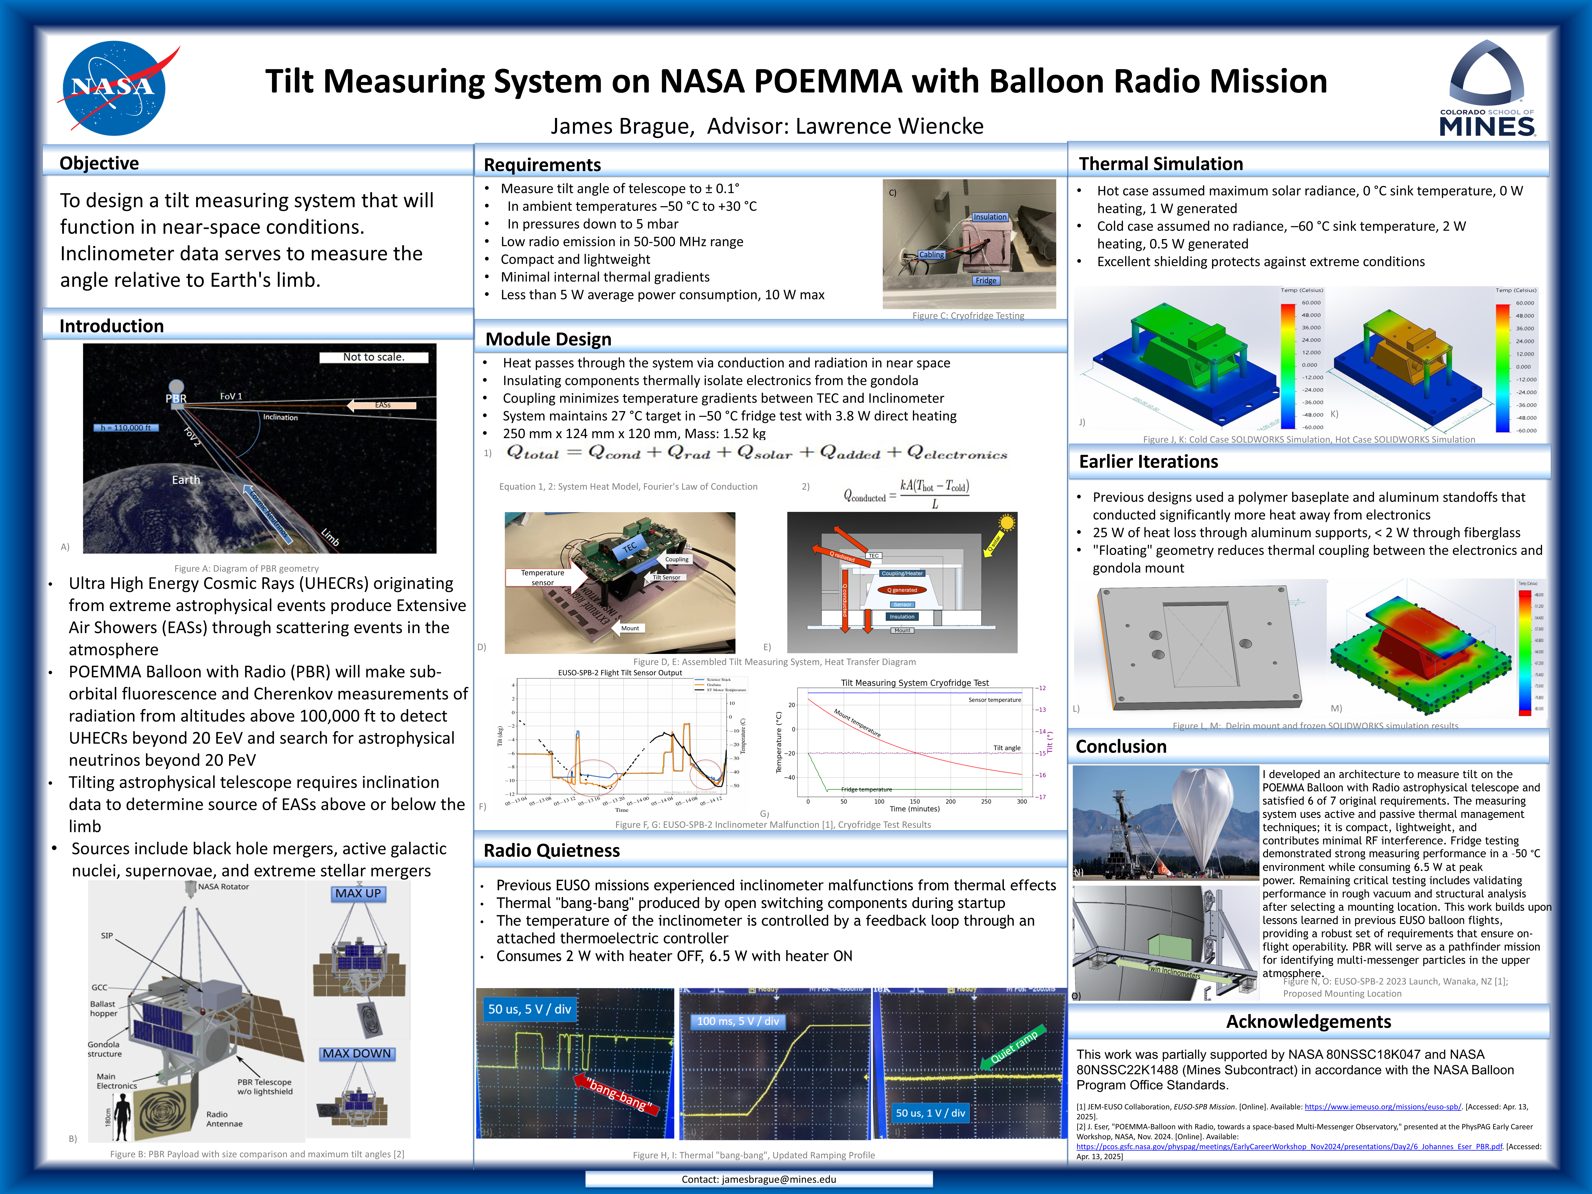

Slide 11
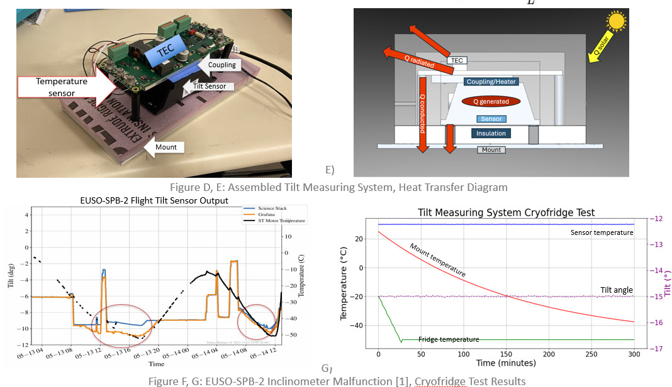

Slide 12
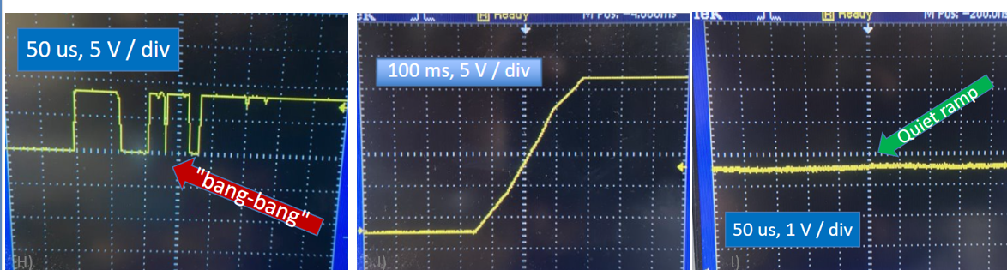
Reducing Radio Noise
James Brague
“Bang Bang”
Thermal Switch
$12
EUSO-SPB2
Swiss Thermoelectic
Controller
$600 + (tariff du jour)
PBR

Slide 13
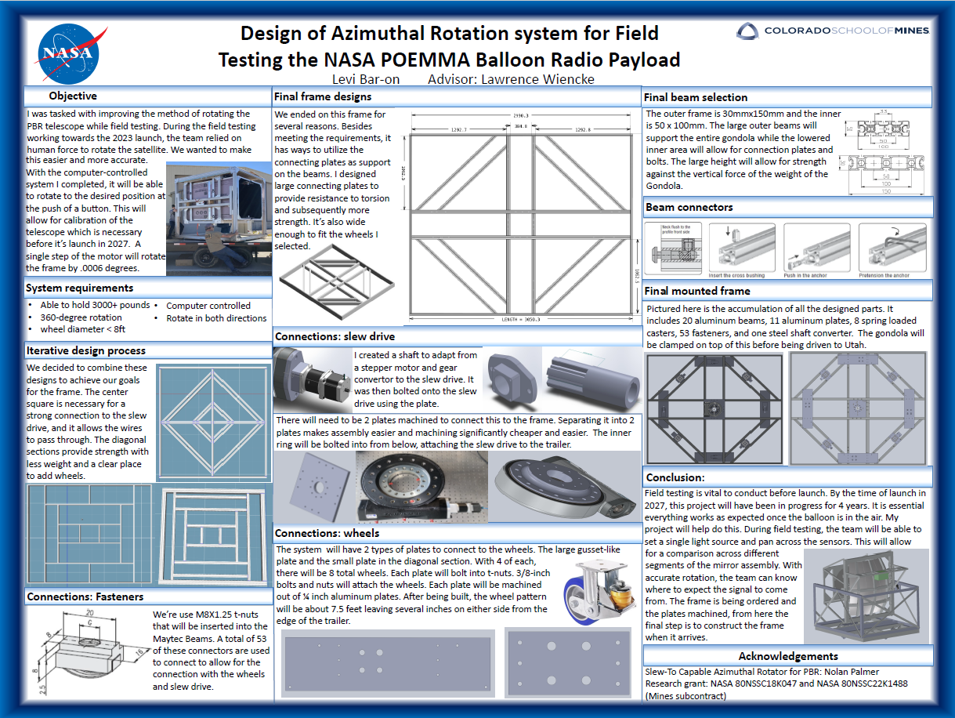

Slide 14
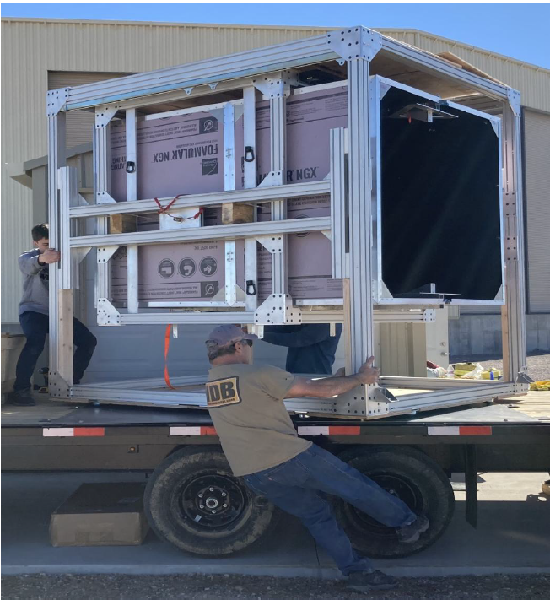
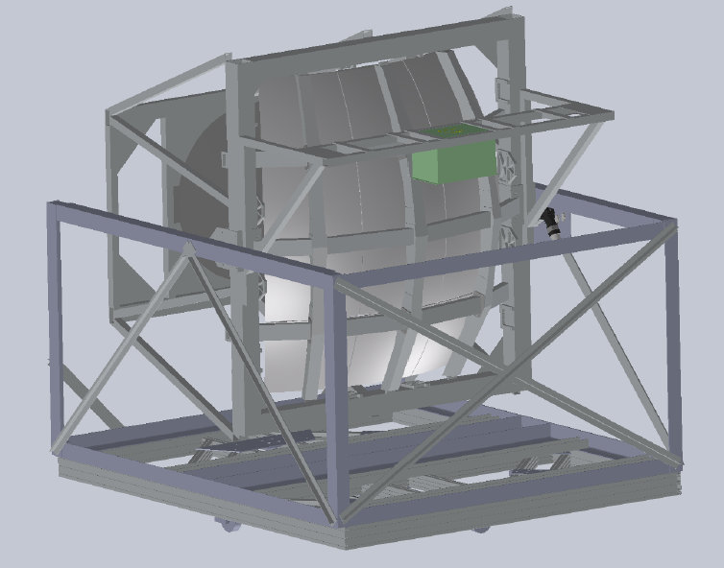
EUSO-SPB2 2022
PBR

