Slide 1


Software group report
F. Cafagna
INFN, Bari Department

Slide 2
Software group
Actual list of components:
  F. Sarazin, F. Cafagna, J. Eser, G. Osteria, C. Fornaro;
  FT: G. Fillipatos, A. Creusot, A. Sotgiu, C. De Santis, G. Masciantonio;
  CT: B. Panico, M. Mese, F. Perfetto, V. Scotti;
  GCC: P. Alldredge;
  Gamma/X: M. Casolino, L. Marcelli, M. Battisti, A. Sotgiu;
  UCIRC: S. Mayer;
  Radio: A. Cummings;
  Anybody else that would like to join!

Slide 3
Software group
Checkout the wiki page: https://gitlab.com/groups/jem-euso/pbr/-/wikis/home/Software/ , for minutes and updates.

Slide 4
Summary
The software group call is scheduled, fortnightly, on Wednesday, at 16:00 UTC.
The group mailing list: pbr-software@lists.infn.it
A collection of detector’s requirements is in progress.
We will keep the GCC interfaces to the subsystems, the same as the SPB2 ones, i.e. unidirectional TCP/IP link for the commands and status packets along with the data files (FTP).
A first share of the state message size, is done.
For the GCC emulator, a migration from a virtual machine to a Docker container is in progress.
A first scheme of the network layout, that includes a possible Starlink configuration, is done. We have an almost final picture of the SIP-Starlink configuration and the hardware we need.
The migration to the new version of tools and libraries is done.
Waiting for detector’s requirements as soon as the DAQs and readout electronics is going to be finalized.

Slide 5
Detector requirements
We reviewed detector requirements for FT and X/γ.
For FT there are no changes compared to SPB2.
We had a fruitful examination of X/γ working mode and requirements clarifying some open items.
Also for UCIRC there will be no changes compared to SPB2.
Next we will review the CC and Radio requirements.

Slide 6
GCC
At the moment we see no reason to change the communication protocol used in SPB2.
That is:
  GCC will asynchronously transmit commands, via TCP/IP, to every subsystem.
  GCC will listen for a state message transmitted by a subsystem.
  GCC will pull data files from each subsystem via SFTP.
The role of the GCC in the data download will be reviewed depending on the network scheme and download links that will be available.

Slide 7
GCC
The GCC emulator will be provided in form of a Docker container (https://en.wikipedia.org/wiki/Docker_(software) ), instead of a virtual machine.
For the state message should be available 484 Bytes. Here is a first share of this resource:
Compared with SPB2, sizes are reduced to fit the new subsystems.
Subsystem | Bytes
PW | 64
GCC | 64
X/Gamma | 58
Tilt | 50
FC | 62
CC | 62
Radio | 62
IR | 60

Slide 8
Network configuration
We had a meeting with Scott Miller and David Webb. They are working on the Starlink test flights in Wanaka.
They use an industrial VPN router, that handles the SIP subnets and play the role of the gateway between the Starlink network and the SIP networks.
Three LANs (Local Area Network) will be connected to the VPN router:
  CSBF;
  Wallops;
  Science team.
DHCP will not be provided. Fixed IP number must be used (As we always did for previous flights).
The router provides also a firewall. Outbound traffic is not blocked. Inbound traffic is whitelisted.

Slide 9
Network configuration
About a second Starlink. My understanding is:
  There is no “a priori” veto.
  IT must be on our budget (power and weight).
  We have to ask CSBF for another PoE (Power over Ethernet) board, as the one they are tested, but we need to provide our own VPN router, in case we decide to use it.
  The LAN must be separated.

Slide 10
Possible PBR network scheme

Slide 11
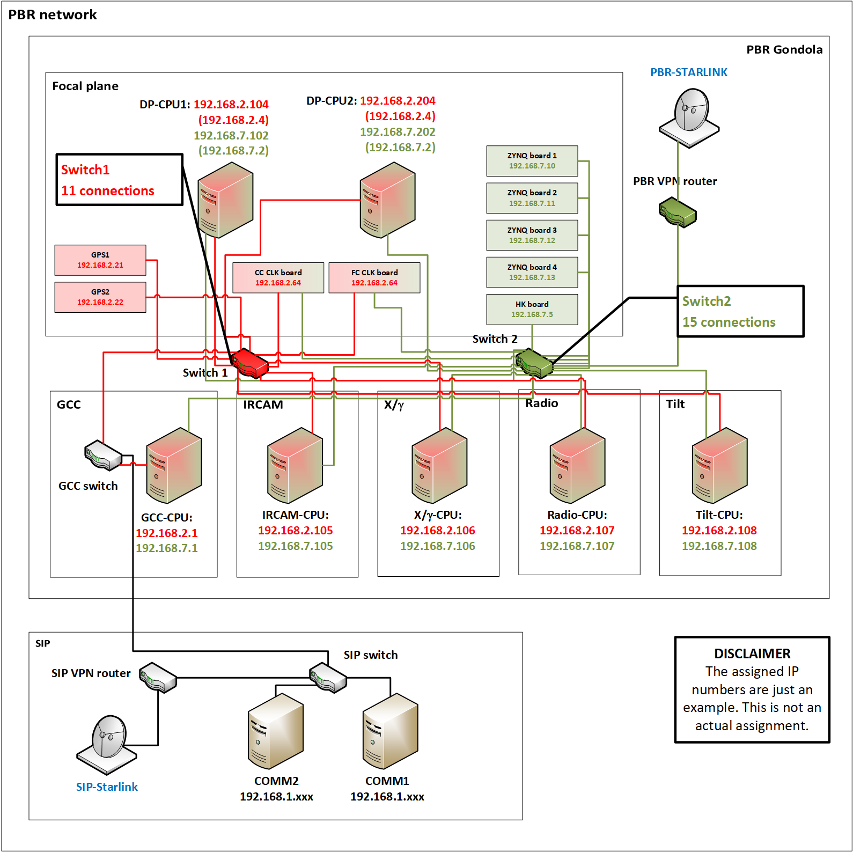
Possible PBR network scheme

Slide 12
Summary
The software group call is scheduled, fortnightly, on Wednesday, at 16:00 UTC.
The group mailing list: pbr-software@lists.infn.it
A collection of detector’s requirements is in progress.
We will keep the GCC interfaces to the subsystems, the same as the SPB2 ones, i.e. unidirectional TCP/IP link for the commands and status packets along with the data files (FTP).
A first share of the state message size, is done.
For the GCC emulator, a migration from a virtual machine to a Docker container is in progress.
A first scheme of the network layout, that includes a possible Starlink configuration, is done. We have an almost final picture of the SIP-Starlink configuration and the hardware we need.
The migration to the new version of tools and libraries is done.
Waiting for detector’s requirements as soon as the DAQs and readout electronics is going to be finalized.

Slide 13
Backups

Slide 14
Possible PBR network scheme

Slide 15
Data flow
SPB2 scheme, we need to design and implement a new one.

Slide 16
