Slide 1
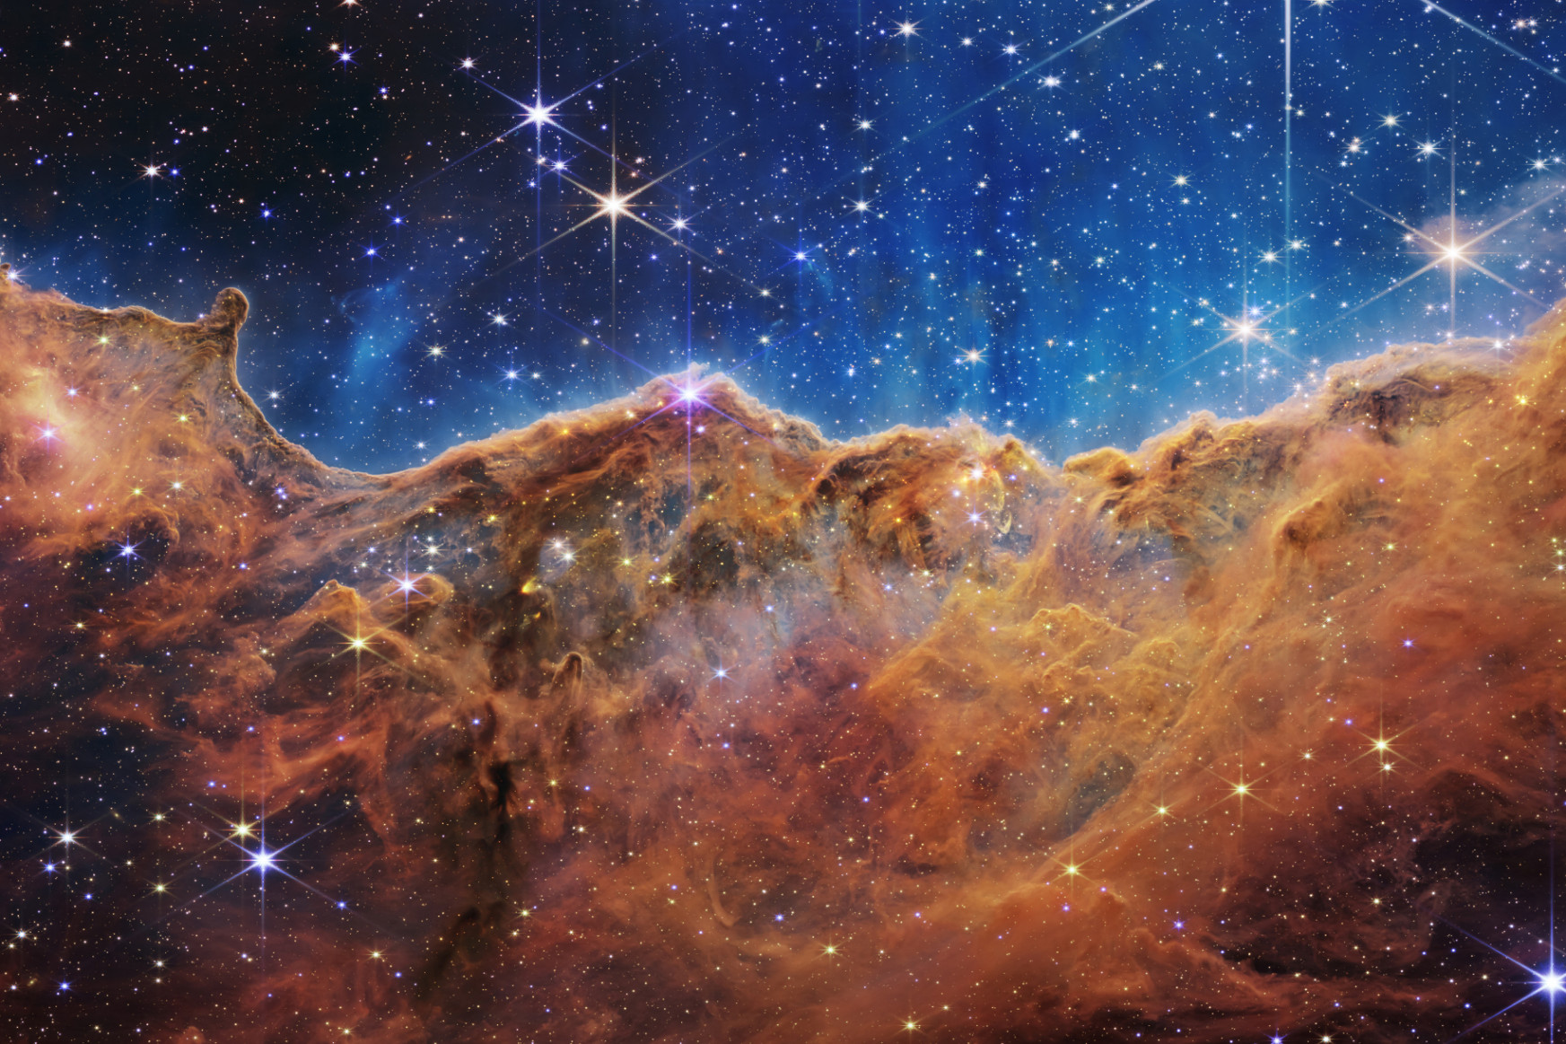

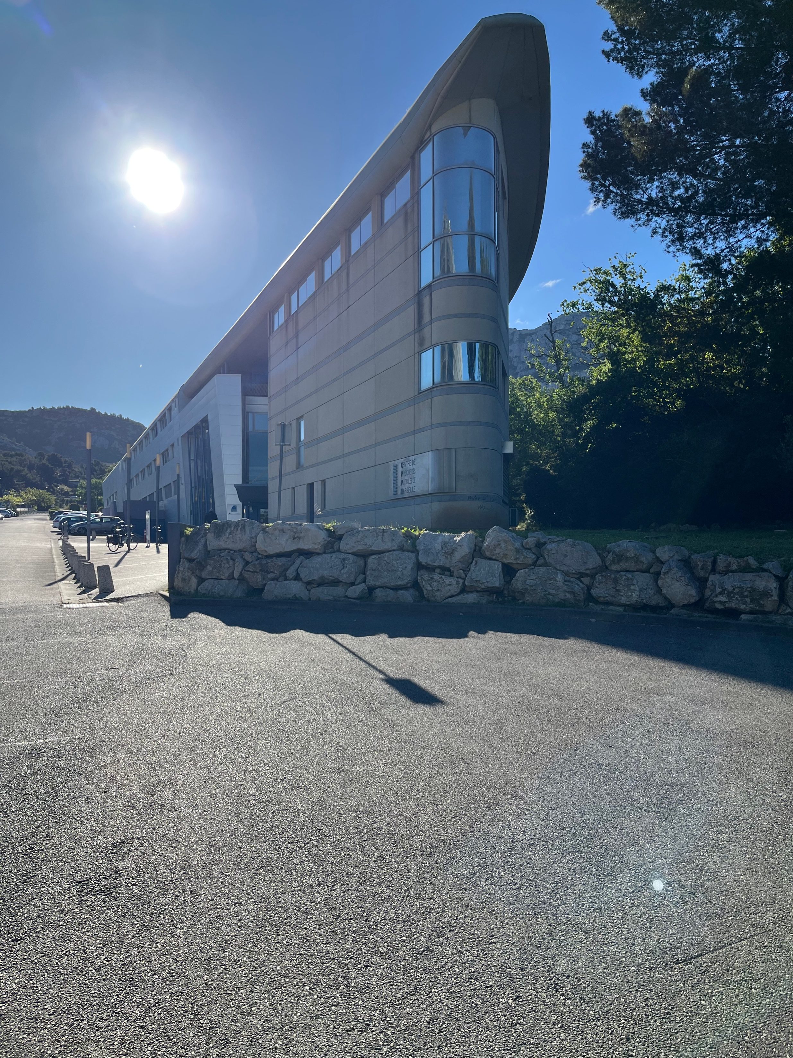

How to unravel early moments of the Universe with neutrinos:
Introduction to the PTOLEMY project
Chris Tully (Princeton University)
24 April 2025
Centre de Physique des Particles de Marseille, Aix-Marseille Université, Marseille, France
Research supported by
Notes:
I’m glad to be here today to present to you the PTOLEMY project. This is a new instrument that we believe will help unravel the early moments of the Universe.
For my part in this project, the last two years have been supported by the John Templeton Foundation. It is exciting to see the progress on the experiment and to discuss the scientific program.

Slide 2
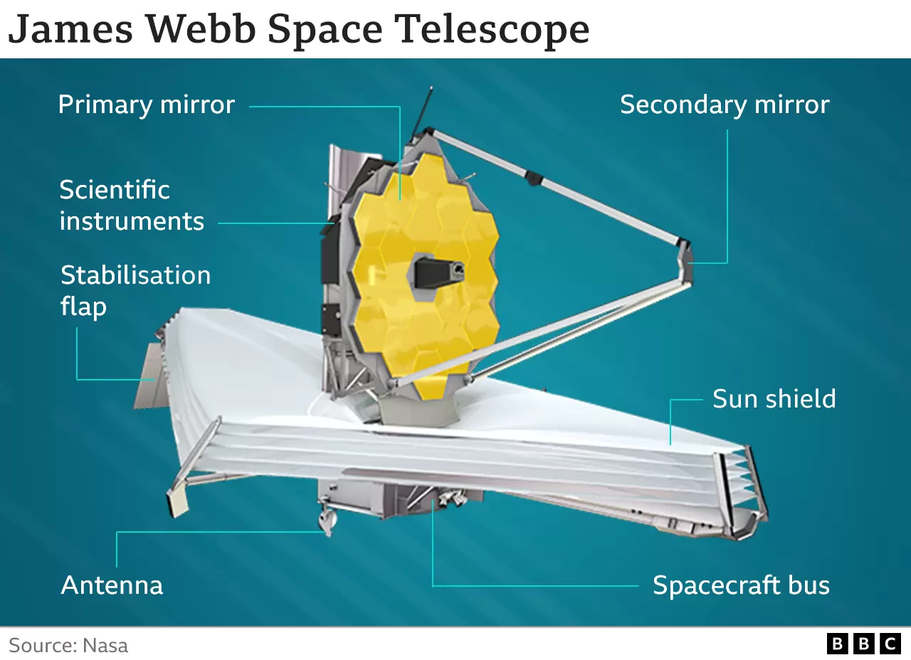
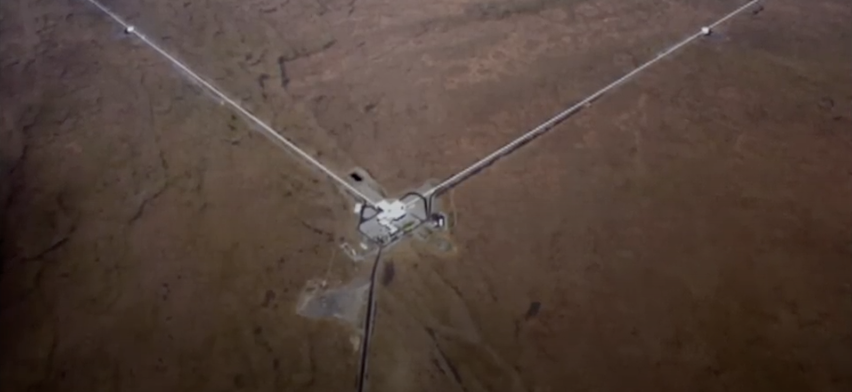
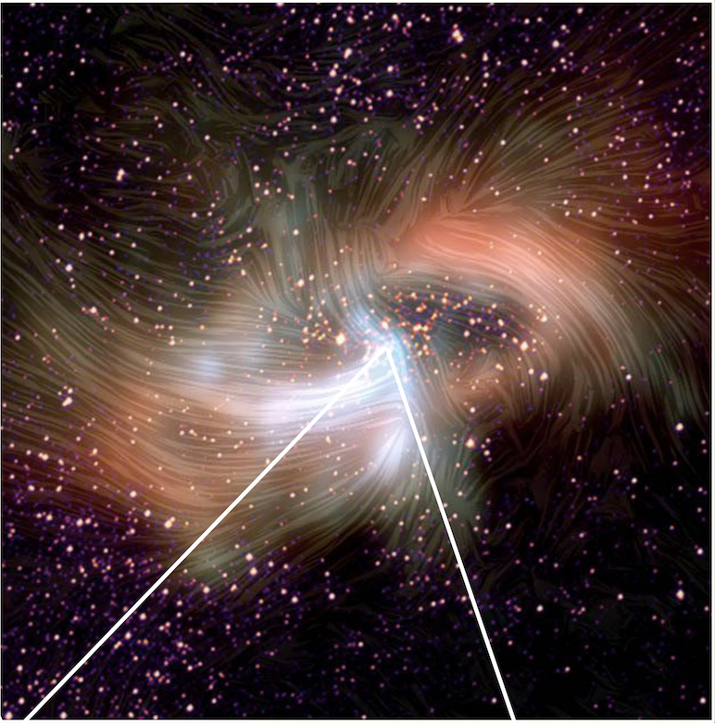
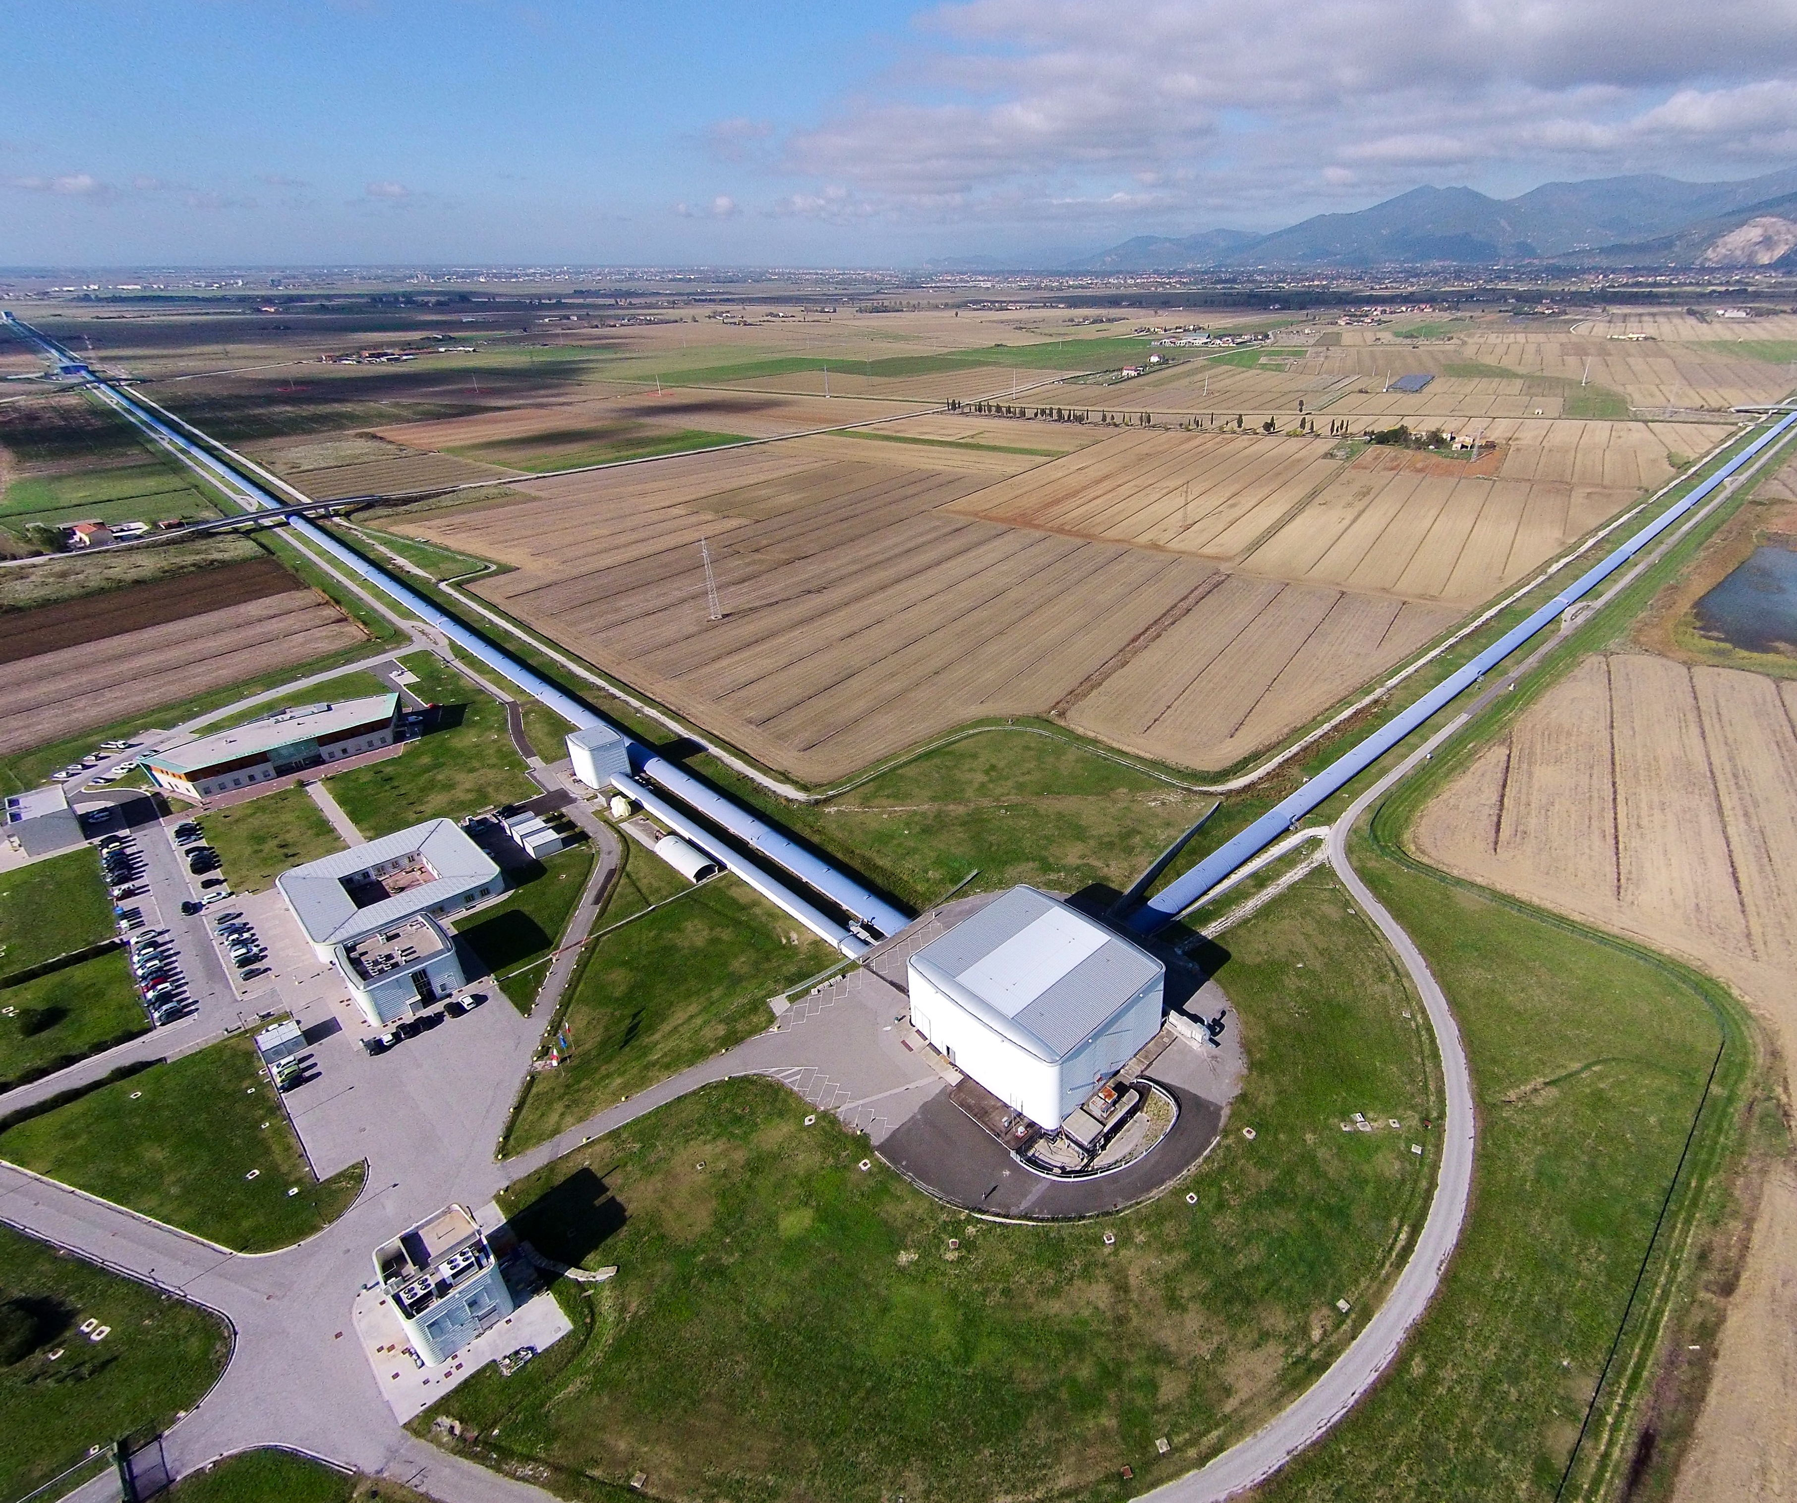
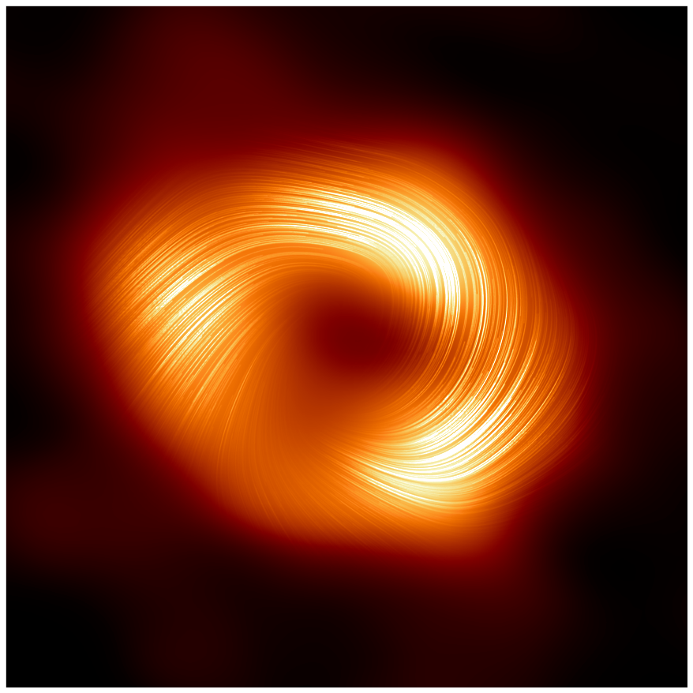
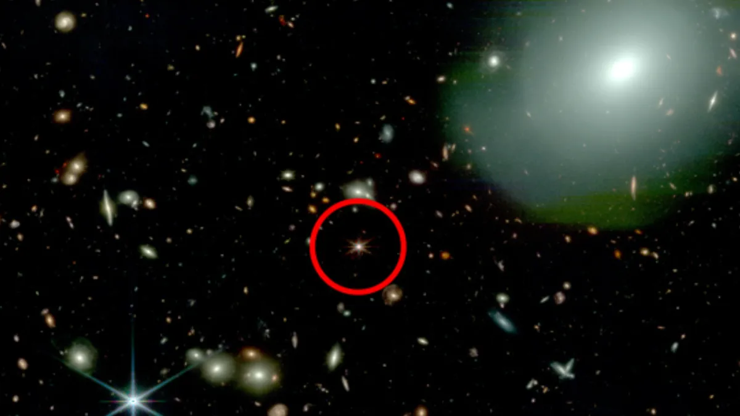
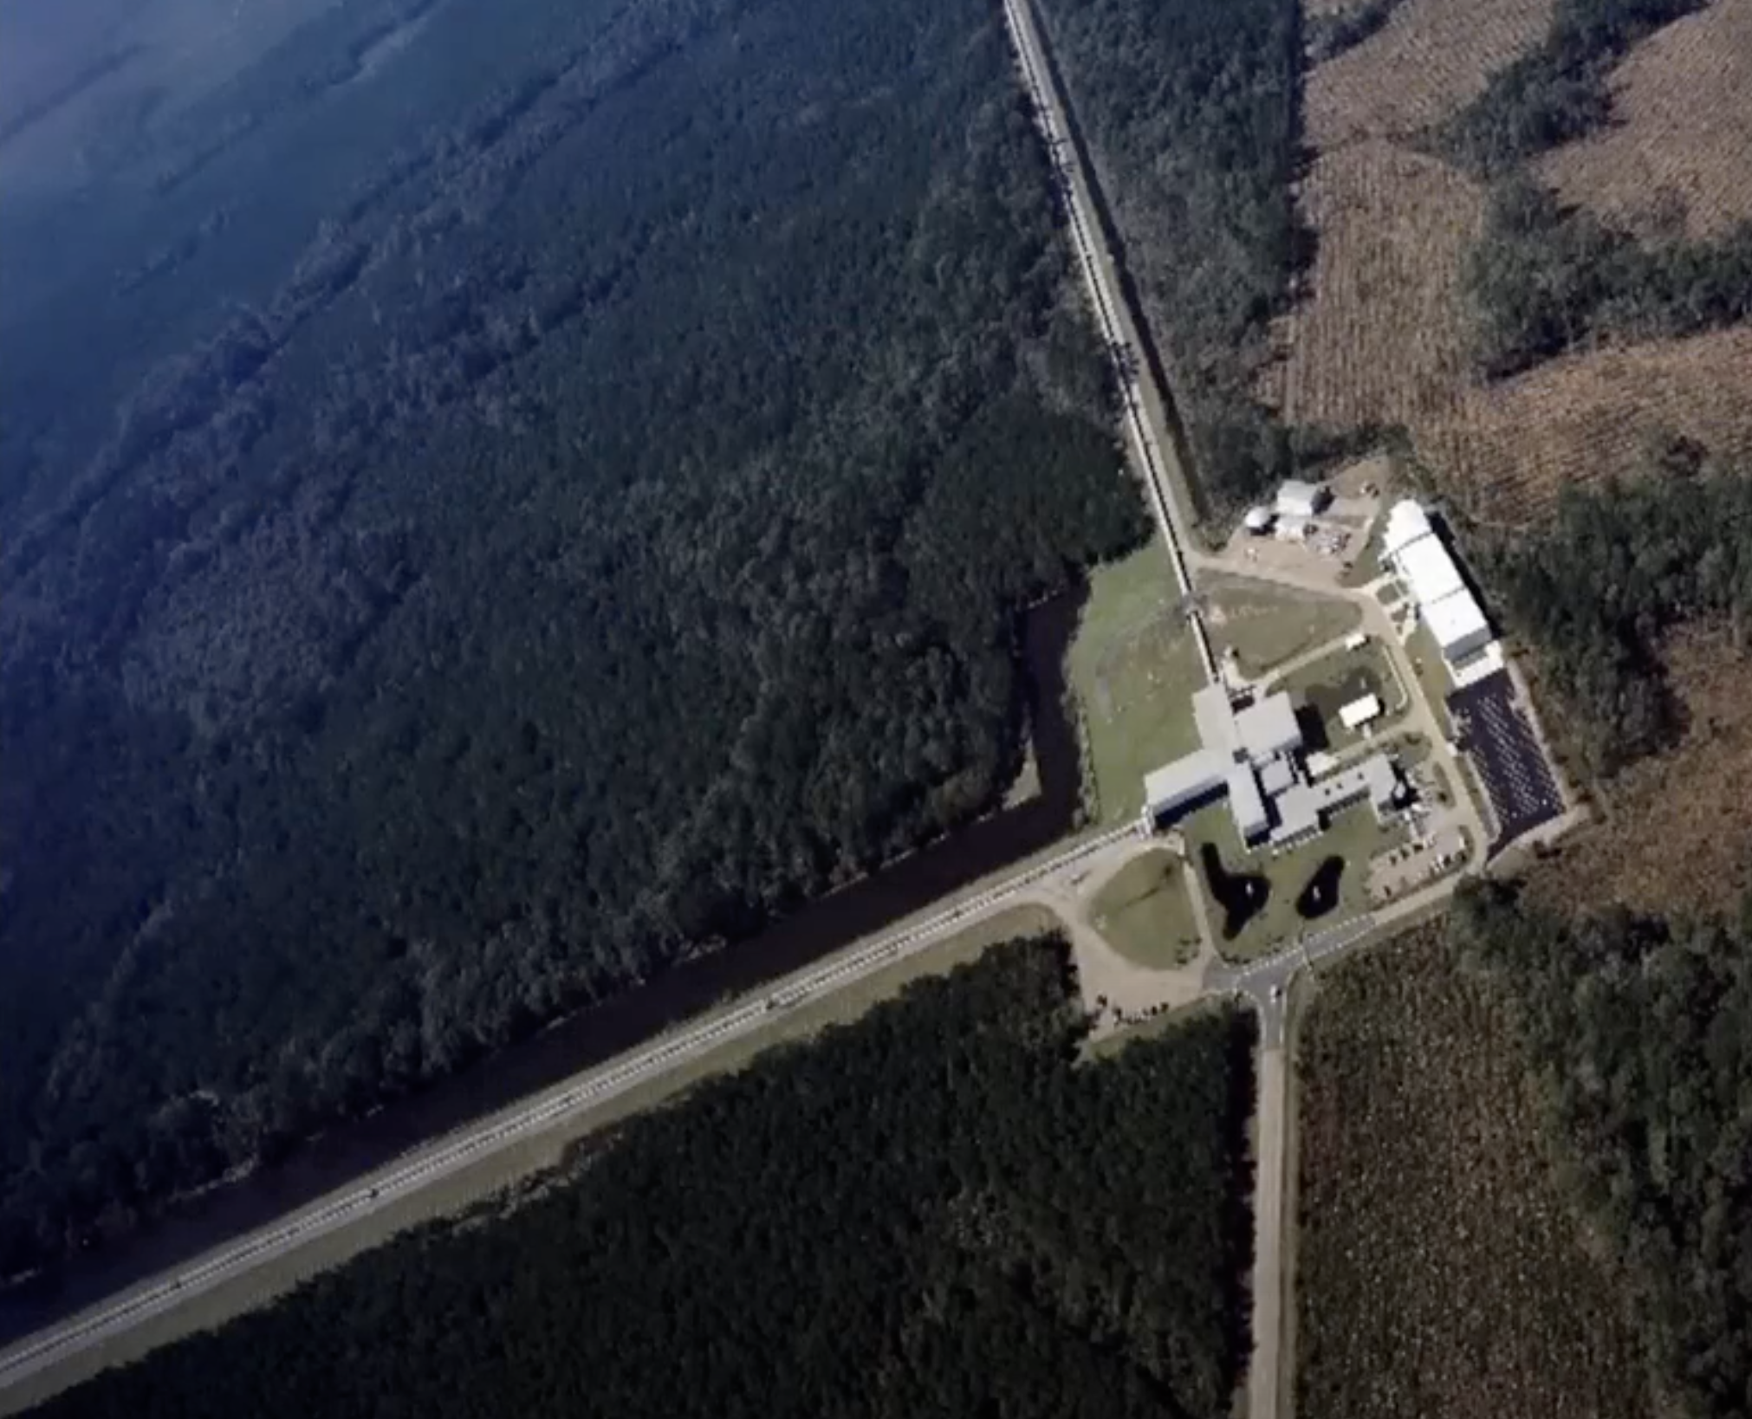
Era of Amazing New Telescopes
https://www.space.com/james-webb-space-telescope-ancient-black-hole-quasar
Event Horizon Telescope
Supermassive Black Hole
at Center of Milky Way Galaxy
Notes:
We are in an era of amazing new telescopes enabling us to see things we’ve never seen before. On the left is the James Webb telescope orbiting the Sun at the Lagrange 2 point and below an extremely early galaxy formed within the first few hundred million years after the Big Bang. In the middle are LIGO-Virgo gravitational wave interferometers having detected gravitational waves for the first time and seeing them from the signal of black hole merger and even neutrino star – black hole merger. On the right are images reconstructed from the Event Horizon Telescope looking at the galactic center of the Milky Way. The bottom is the accretion disk around the supermassive black hole at the center of the Milky Way with a polarization filter showing strong magnetic field lines influencing the light emission. In fact, it is now believed that most if not all galaxies have supermassive black holes at their center.

Slide 3
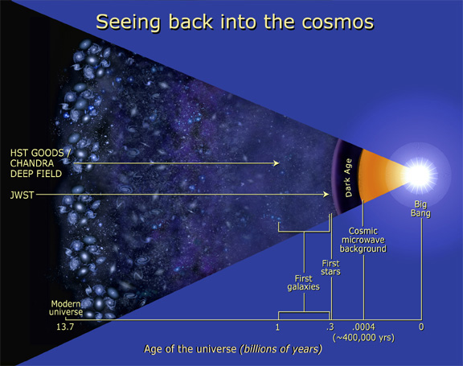
Notes:
When we look back as far as we can see with photons using the Webb telescope (JWST), then the farther we look, the more uniform we see the matter distribution of the universe. Gravitational instability is nominally a late universe effect and driven by free fall timescale over large distances. Stellar black holes are formed when stars run out of fuel to burn and collapse under gravitational pressure. That makes it strange for JWST to observe so many galaxies with supermassive black hole core at a time when we only expect to see the first stars. This is a great mystery and grows with every new observation.

Slide 4
Stellar Black Holes here
Where do early Supermassive Black Holes come from?
here?
Notes:
Where could supermassive black holes form so early? One idea is that they are left over from a previous cycle of the universe, and another is that they could form in the radiation dominated phase of the very early universe where molecular cooling is blocked from the high radiative energies and large massive regions maintain their kinetic energy as they fall in and directly form “primordial black holes”. The supermassive black holes could also have been seeded in a quantum era in which spacetime is being formed. This would suggest that the initial gravitational entropy is not low as suggested by Penrose, but rather is sprinkled into a uniform distribution of supermassive black holes. But how could we tell, this would be during a time where no light can shine directly to see what is happening?

Slide 5
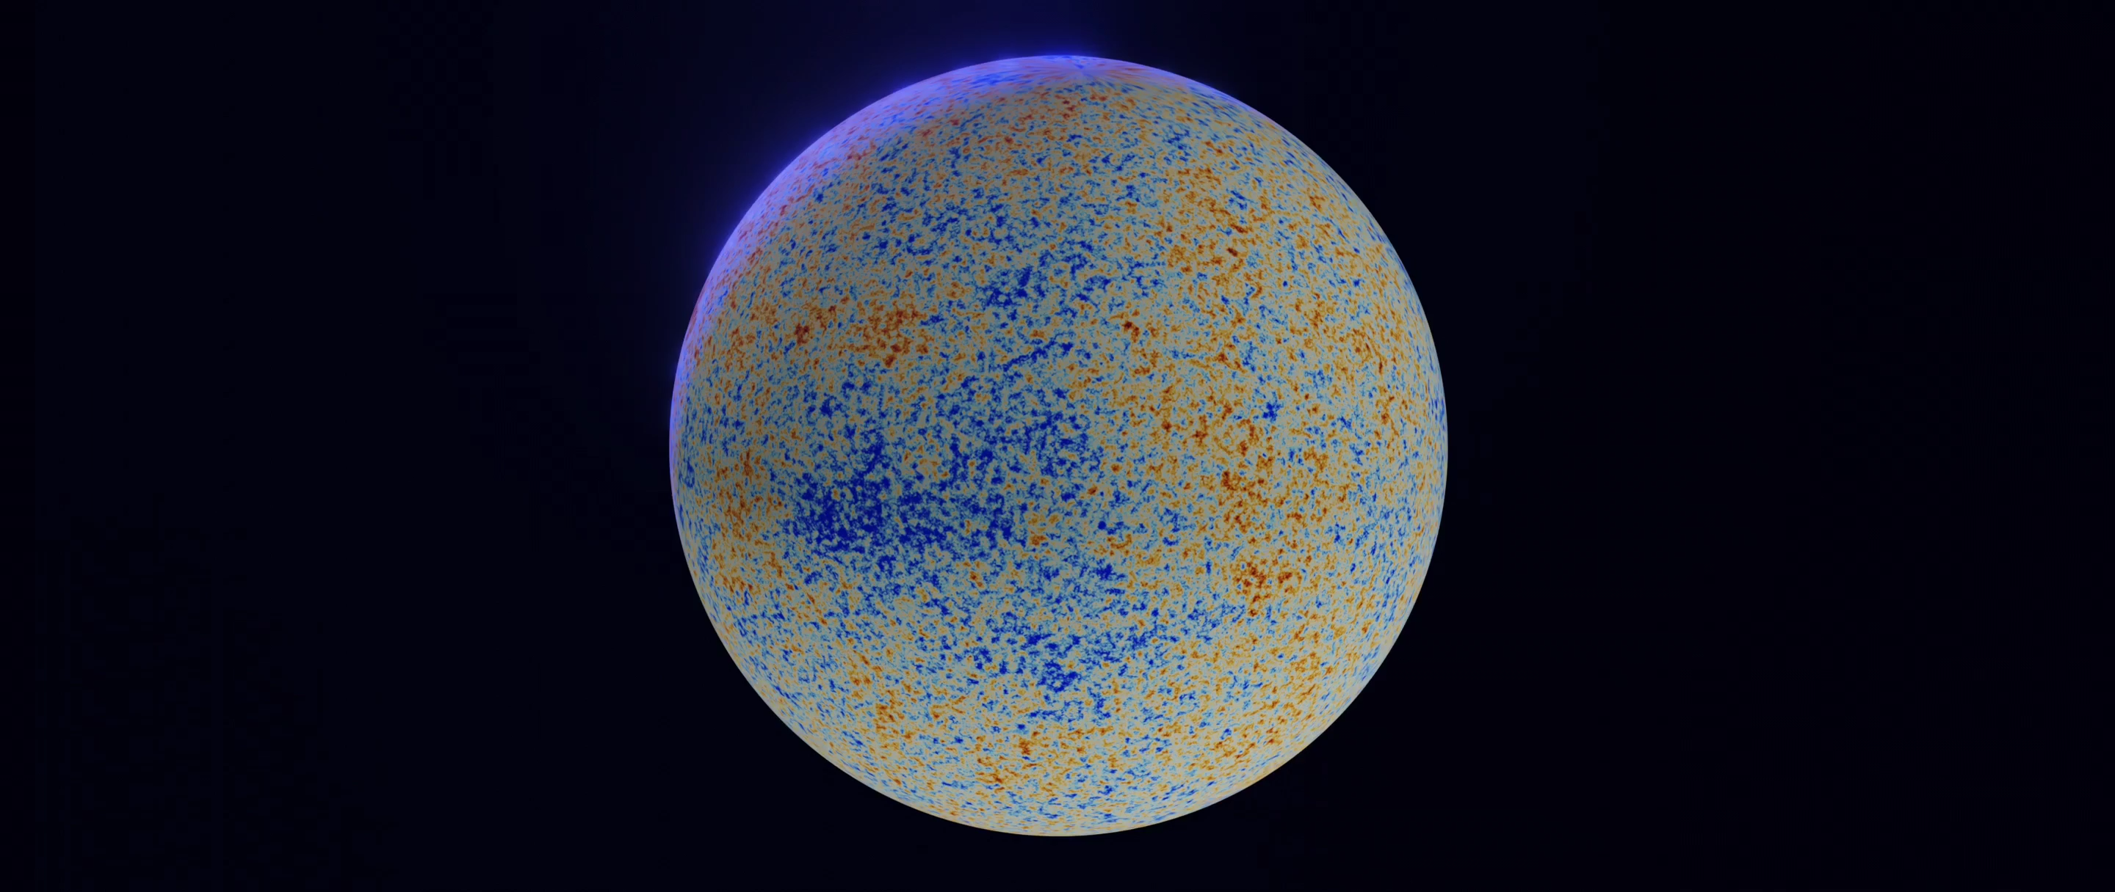
At 330,000 years, the Universe is smooth to 10 parts per million
Notes:
The earliest image from photons is shown here. It comes from approximately 400,000 years after the Big Bang and what we show is that the temperature of the Universe is extremely uniform to 10 parts per million everywhere we look. The small angular features are predicted by the physics of the hot plasma in the matter dominated physics before the plasma neutralizes to transparent gases.

Slide 6
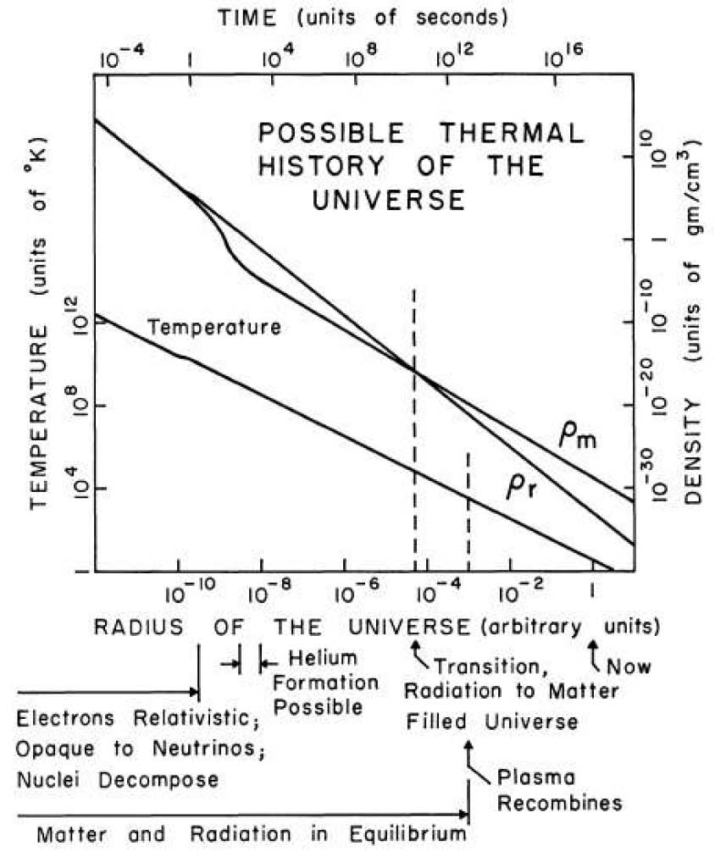
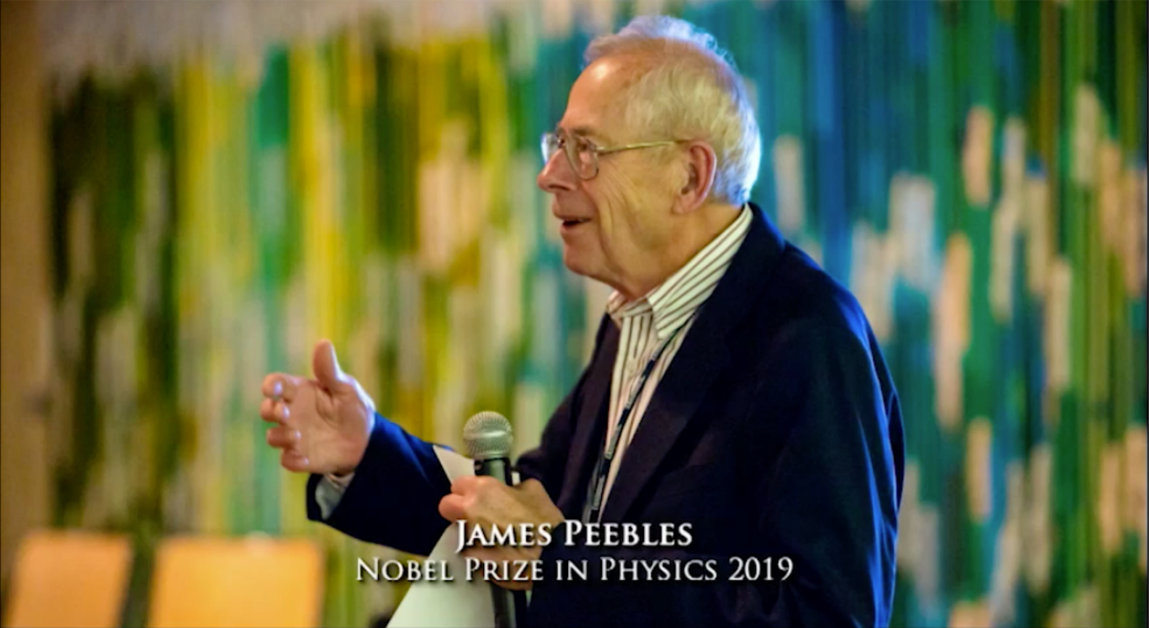
Cosmic Neutrino Background
Number density:
1 sec
n_{ν} = 112/cm³
Temperature:
Radiation ~1/a⁴
T_{ν} ~ 1.95K
Time of decoupling:
Matter
~1/a³
t_{ν} ~ 1 second
~50% of the Total Energy Density
of the Universe @ 1 sec
    neutron/proton ratio
    @start of nucleosynthesis
⁴He
²H
(³He)
⁷Li
Dicke, Peebles*, Roll, Wilkinson (1965)
Cosmology's Century (2020)
*
Notes:
We have an immensely successful thermal model of the early Universe, here shown from a paper published in 1965 that predicted that the sphere shown in the previous slide could one day be observed, not in the optical when it was formed at roughly 3000K, but over a thousand times lower, now measured to be 2.7K due to the expansion of the Universe predicted by Einstein’s equations. This theory predicted the acoustical waves that give rise to the large scale structure we see in the late Universe and that there was a time when the Universe was so hot and dense that the not only photons, but the light, neutral particles known as neutrinos dominate the total energy density of the Universe. At one second after the Big Bang when the neutrinos are nearly half the total energy density of the Universe, the Universe becomes transparent to neutrinos and they begin traveling in straight lines like photons travel through transparent material. From detecting the CMB, we know many properties of the relic neutrinos. Their presence is immensely important as it sets the scale for the cooling of the Universe which enabled the light elements to be fabricated in just enough time, within the first 3 minutes, to give us the neutrons as the fundamental nuclear ingredient to the rich range of atomic elements we have today.

Slide 7
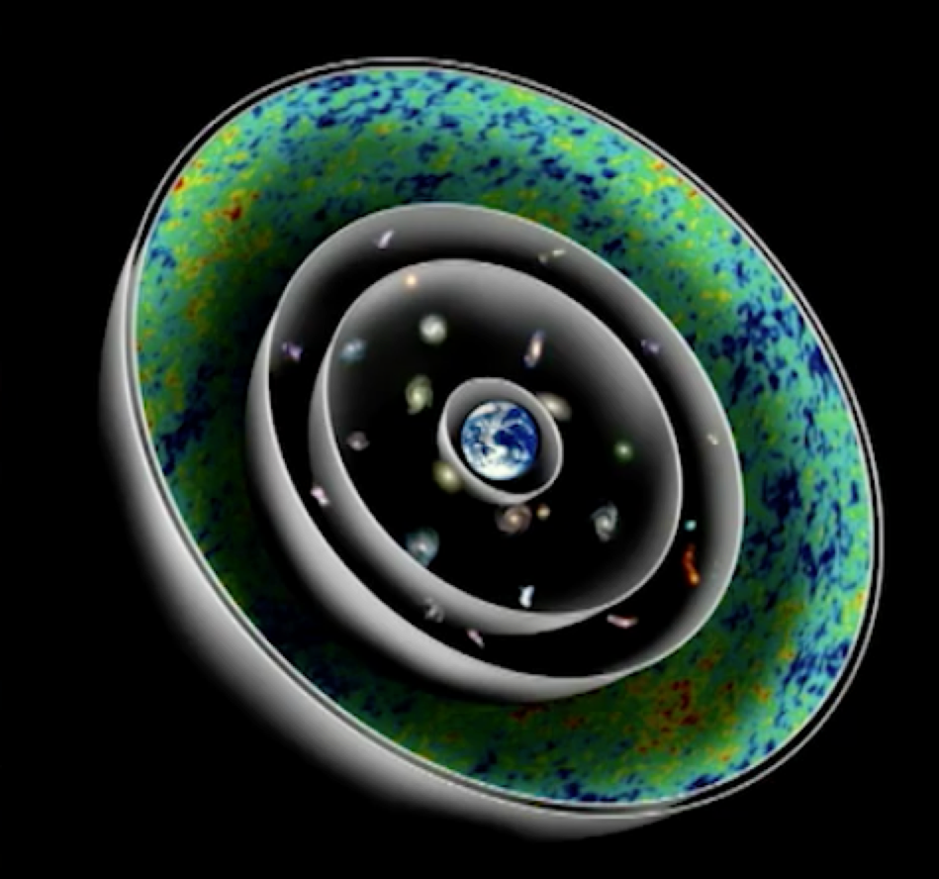
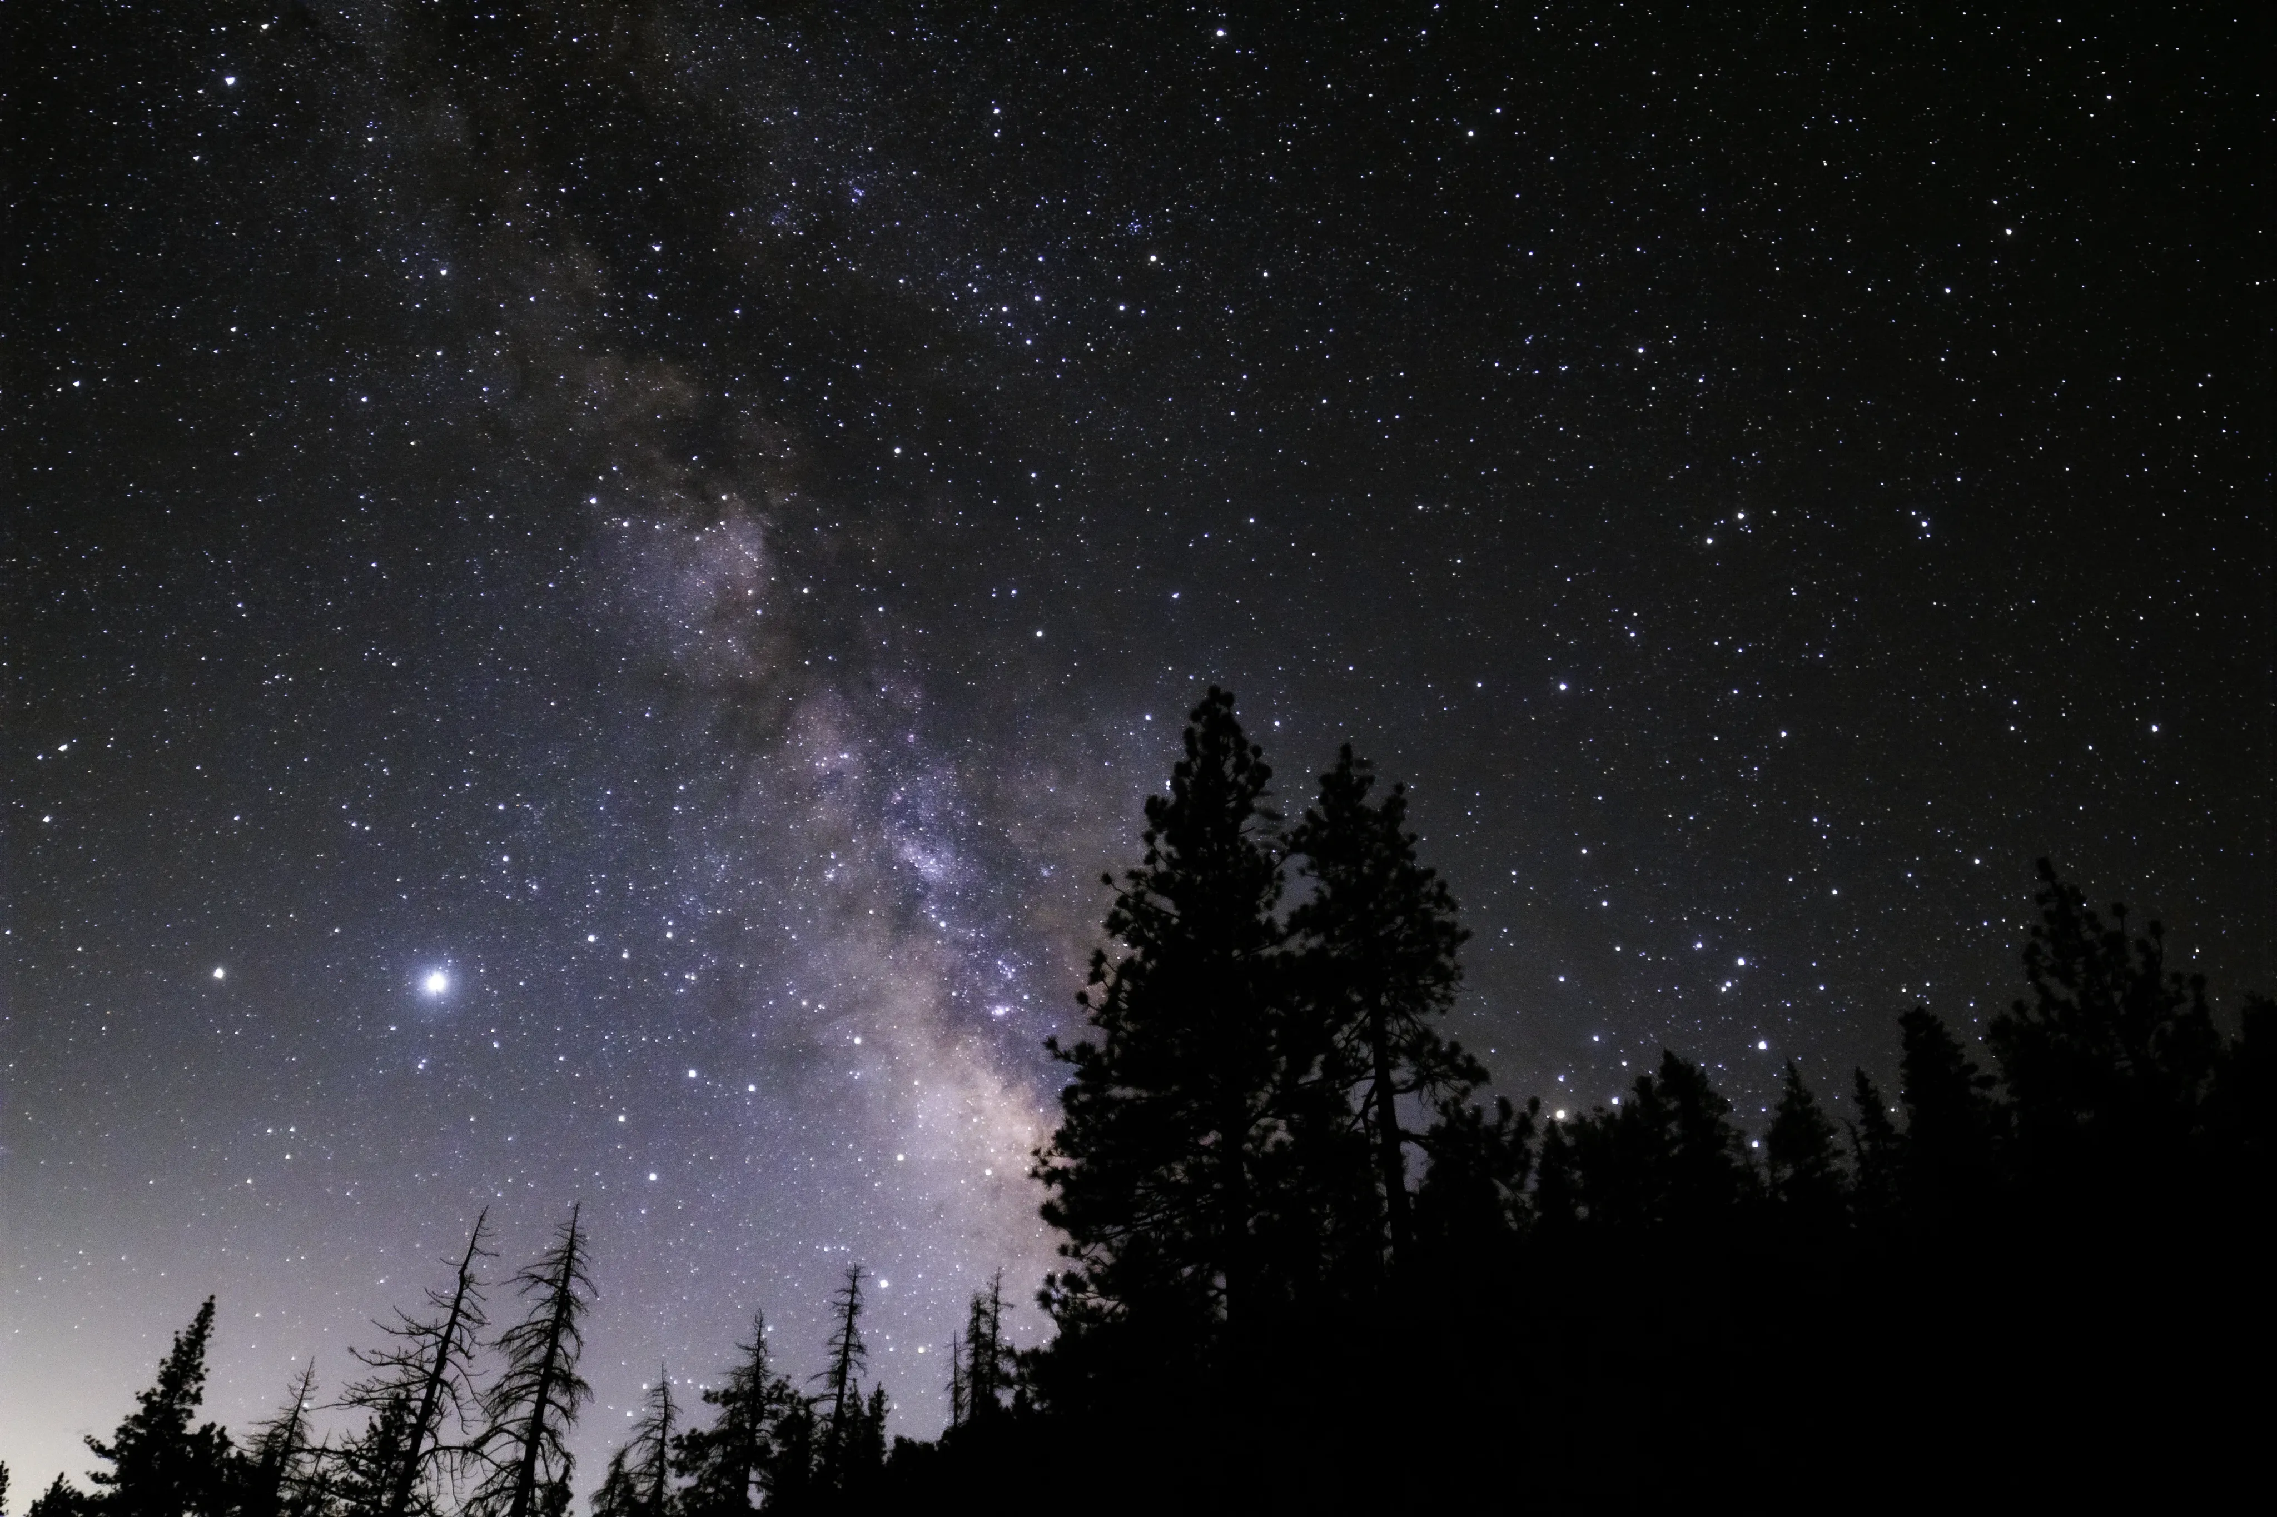
Looking Back in Time with Photons
Emission Time
-13.8x10⁹ years
-4x10⁹ years
-200x10⁶ years
-2x10⁶ years
All of this light arrives at the same time (t=0)
Notes:
When we look up a the night sky, we see a wave of coincident photons, the CMB photons emitted 13.8 billion years ago and now stretched in the microwave, but as they travel to us, they see the Universe aging and are joined by emissions along the way, for instance, of stars born 4 billion years ago, and star clusters and nebula 200 million light years away and the Andromeda galaxy 2 million light years away. That is what we see in the night’s sky - a mélange of many different time periods all at once.
What would the neutrinos see along their way to Earth over their journey starting one second after the Big Bang? You’d think they would see even farther away, but that would only be true if they were massless, we know that at least two of the three neutrinos have mass. When I was a student in the late 80’s, one of the first measurements we made at the LEP collider was to count the number of light neutrinos in Z boson decay. This created great certainty for what to expect in cosmology. I see the neutrino mass in the same way. The more we constrain with lab experiments, the more we can learn from cosmological observables.

Slide 8
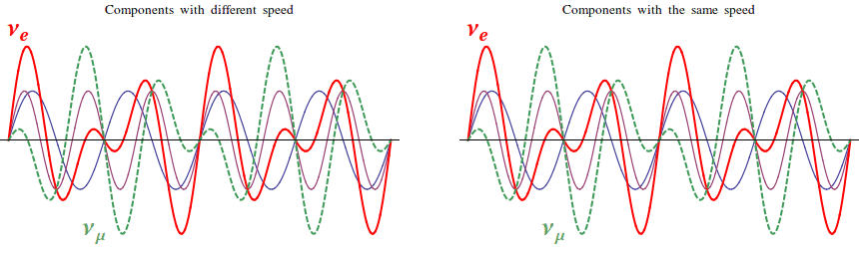
Neutrino Masses from Oscillations
Theory developed by
Bruno Pontecorvo
≈(0.05eV)²
??
3 mass eigenstates
X
3 flavors
(electron, muon, tau)
0
Notes:
It is known that some neutrino masses are non-zero from the theory developed by Bruno Pontecorvo who applied quantum mechanics to the production of neutrinos from processes that are so short in time that the energy uncertainty of the process spans the range of neutrinos masses. In those conditions, nature does not force the choice of one specific neutrino mass eigenstate, but necessarily allows all possible states to propagate coherently over long distances until only one gets projected out at the time of measurement. These states oscillate between each other.

Slide 9
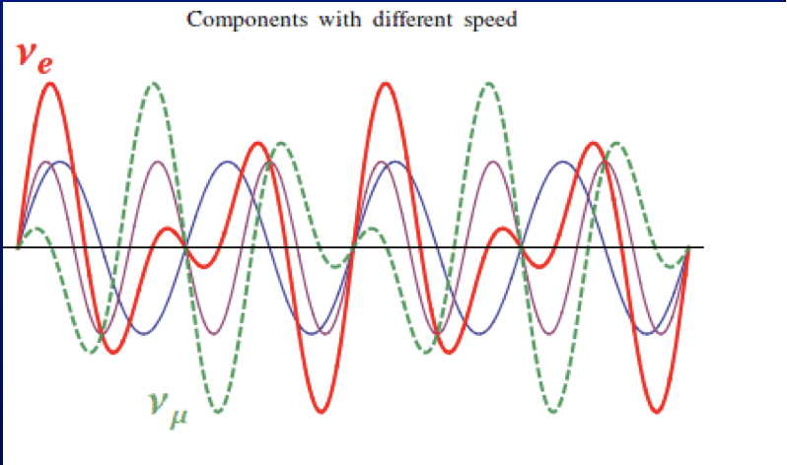
Neutrino Masses from Oscillations
Theory developed by
Bruno Pontecorvo
≈(0.05eV)²
??
3 mass eigenstates
X
3 flavors
(electron, muon, tau)
0
Notes:
It is known that some neutrino masses are non-zero from the theory developed by Bruno Pontecorvo who applied quantum mechanics to the production of neutrinos from processes that are so short in time that the energy uncertainty of the process spans the range of neutrinos masses. In those conditions, nature does not force the choice of one specific neutrino mass eigenstate, but necessarily allows all possible states to propagate coherently over long distances until only one gets projected out at the time of measurement. These states oscillate between each other.

Slide 10
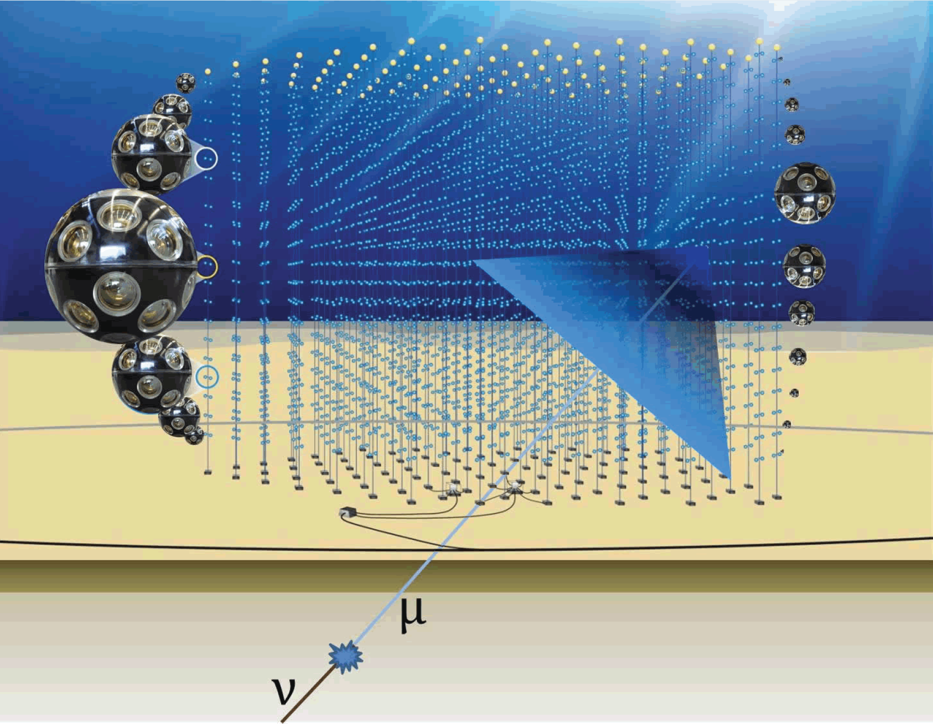
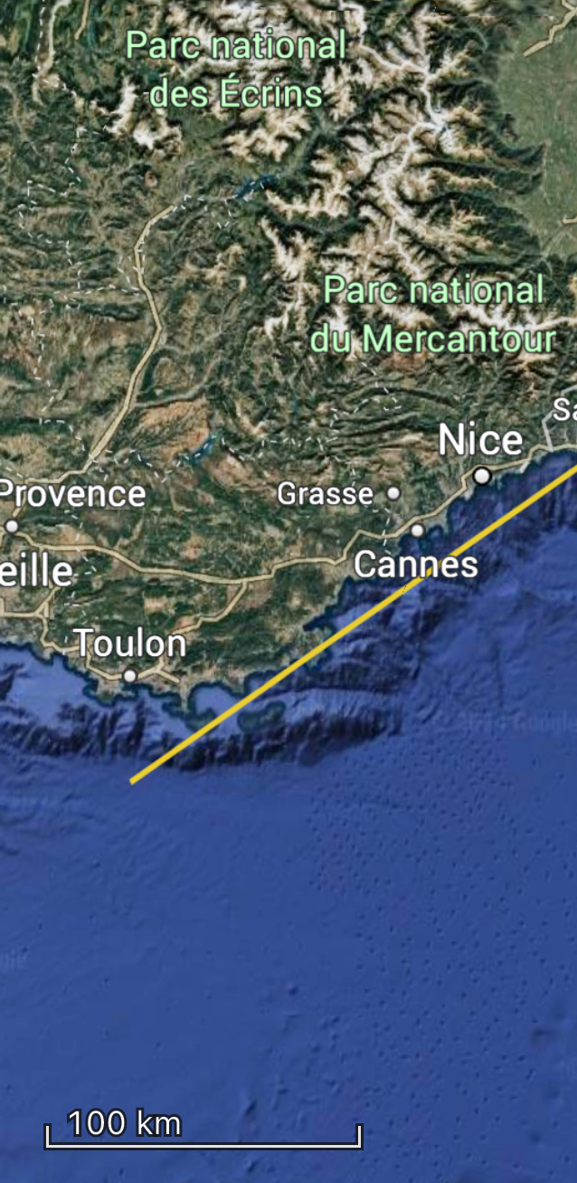
Neutrino Mass Oscillation Observatory
ORCA
Notes:
A new generation of neutrino mass oscillation experiments operates in open waters. I am so glad to be speaking here, at the heart of the KM3 project. Off the coast of France 2.5km underwater is the KM3Net ORCA observatory specially designed to measure neutrino mass oscillation from neutrinos created in the atmosphere from high energy protons, but not the atmosphere above our heads, the atmosphere on the other side of the the Earth with the neutrinos making their conversion to muons in the sea floor and producing Cherenkov light into an array of phototubes deep in the waters dark depths.

Slide 11
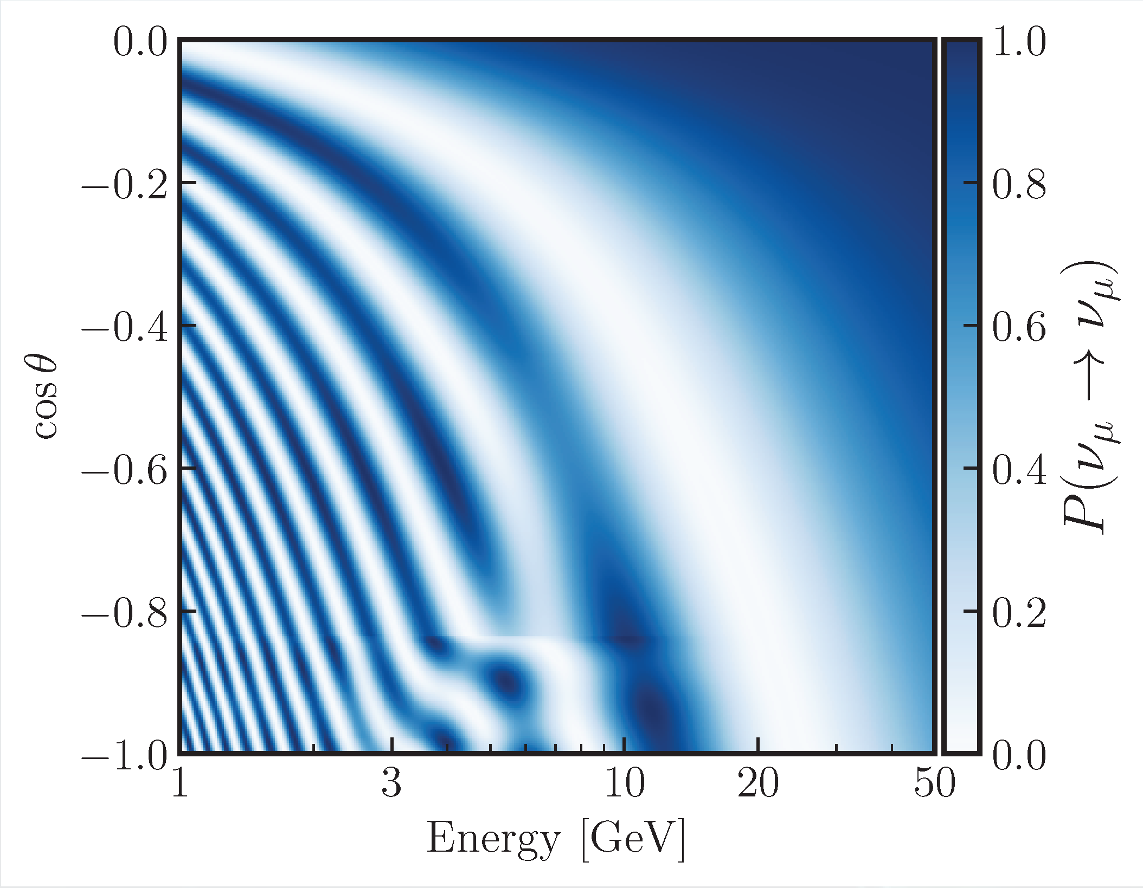
Neutrino Mass Oscillation Observatory
Pontecorvo Neutrino Mass Oscillations
ORCA
Notes:
And there are many waves of oscillations that can be observed, but these waves only tell us about the squared mass differences of the neutrinos, not their absolute masses. We will return to this.

Slide 12
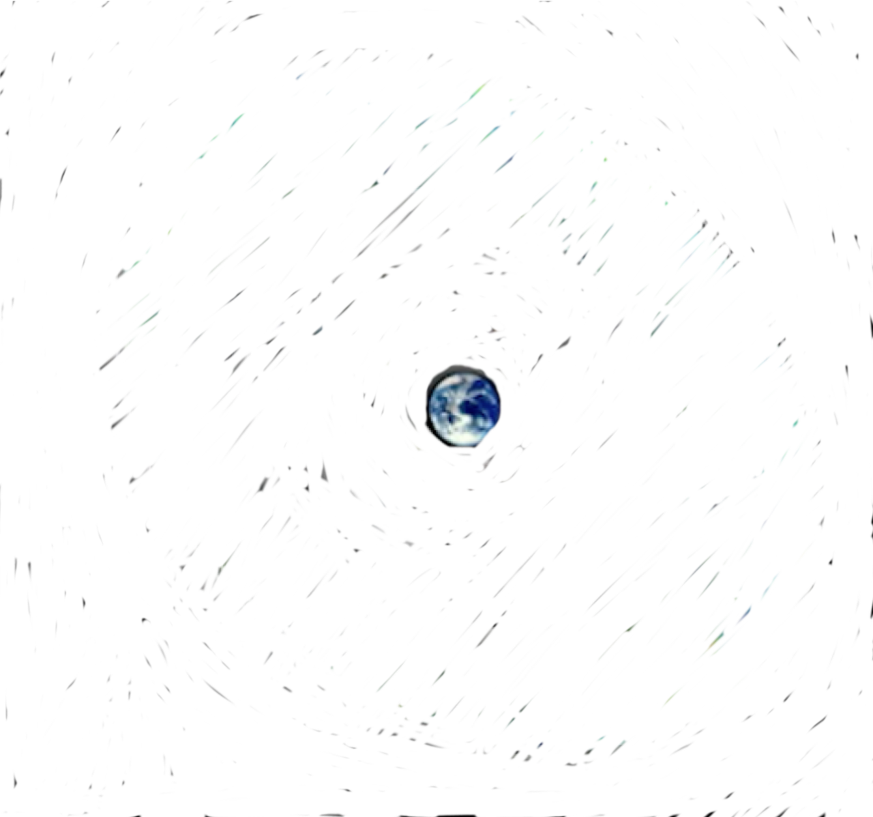
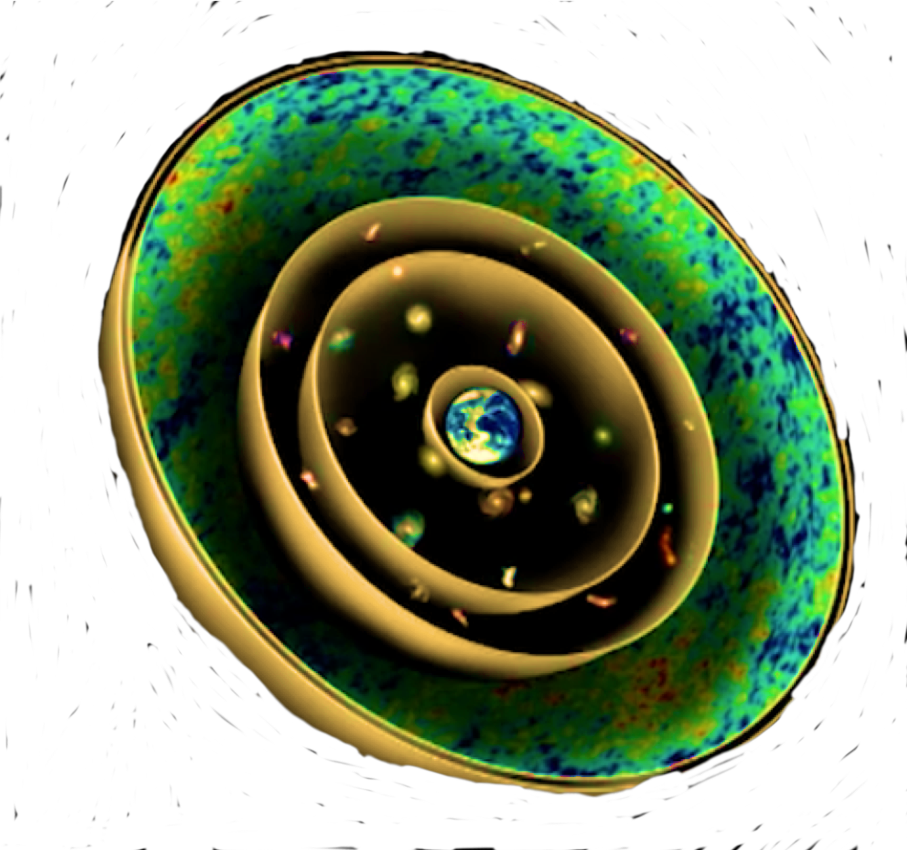
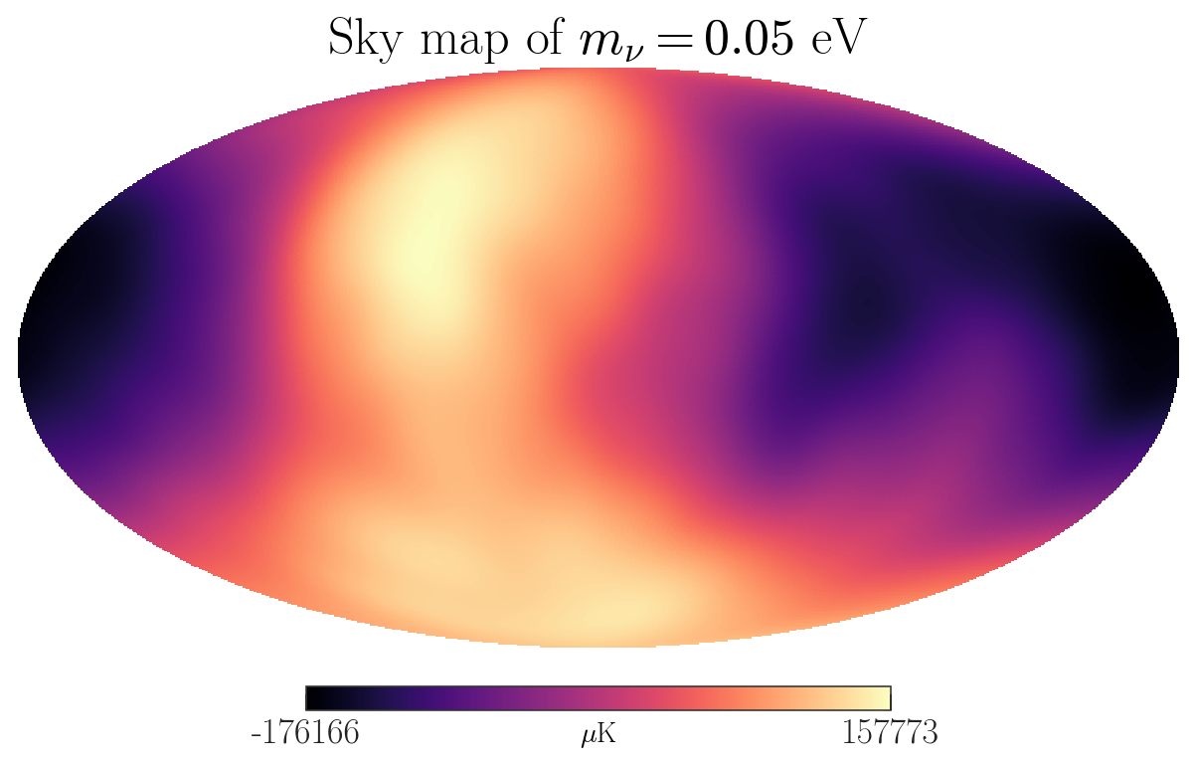
Massive Neutrino Timeline
Emission Time
-13.8x10⁹ years
(1 second after Big Bang)
No comparable flux from other sources
Starting radius more spread out due to mass
Neutrino Sky
Notes:
What does the Universe look like from the point of view of a massive neutrino? Neutrinos start out traveling at nearly the speed of light, but as the Universe expands, they slow down. They see the Universe aging as they travel, but at distances an order of magnitude closer to us than the photons. That means that we can see optically a much older version of the Universe than what the neutrinos experienced. If we spot a supermassive black hole in the path in the way of the neutrino from the Big Bang, then those neutrinos may have been captured or deflected by those black holes.

Slide 13
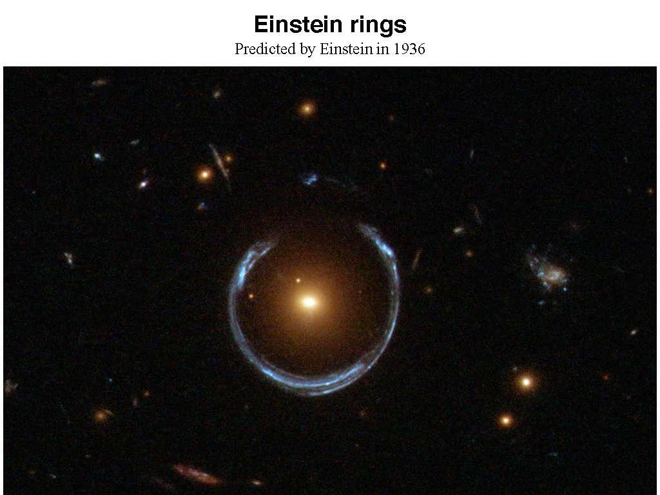
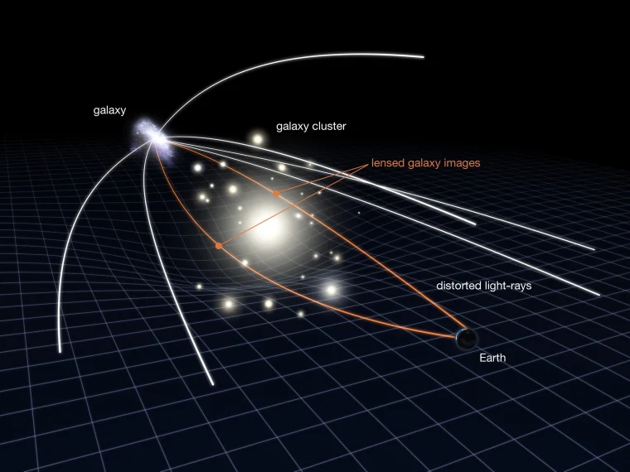
Notes:
What happens to light when the photons or light rays pass by a massive object is that they can be focused and in some cases smear the original image behind the black hole into a ring of light with multiple images for telescopes that view from Earth. These are known as Einstein rings.

Slide 14
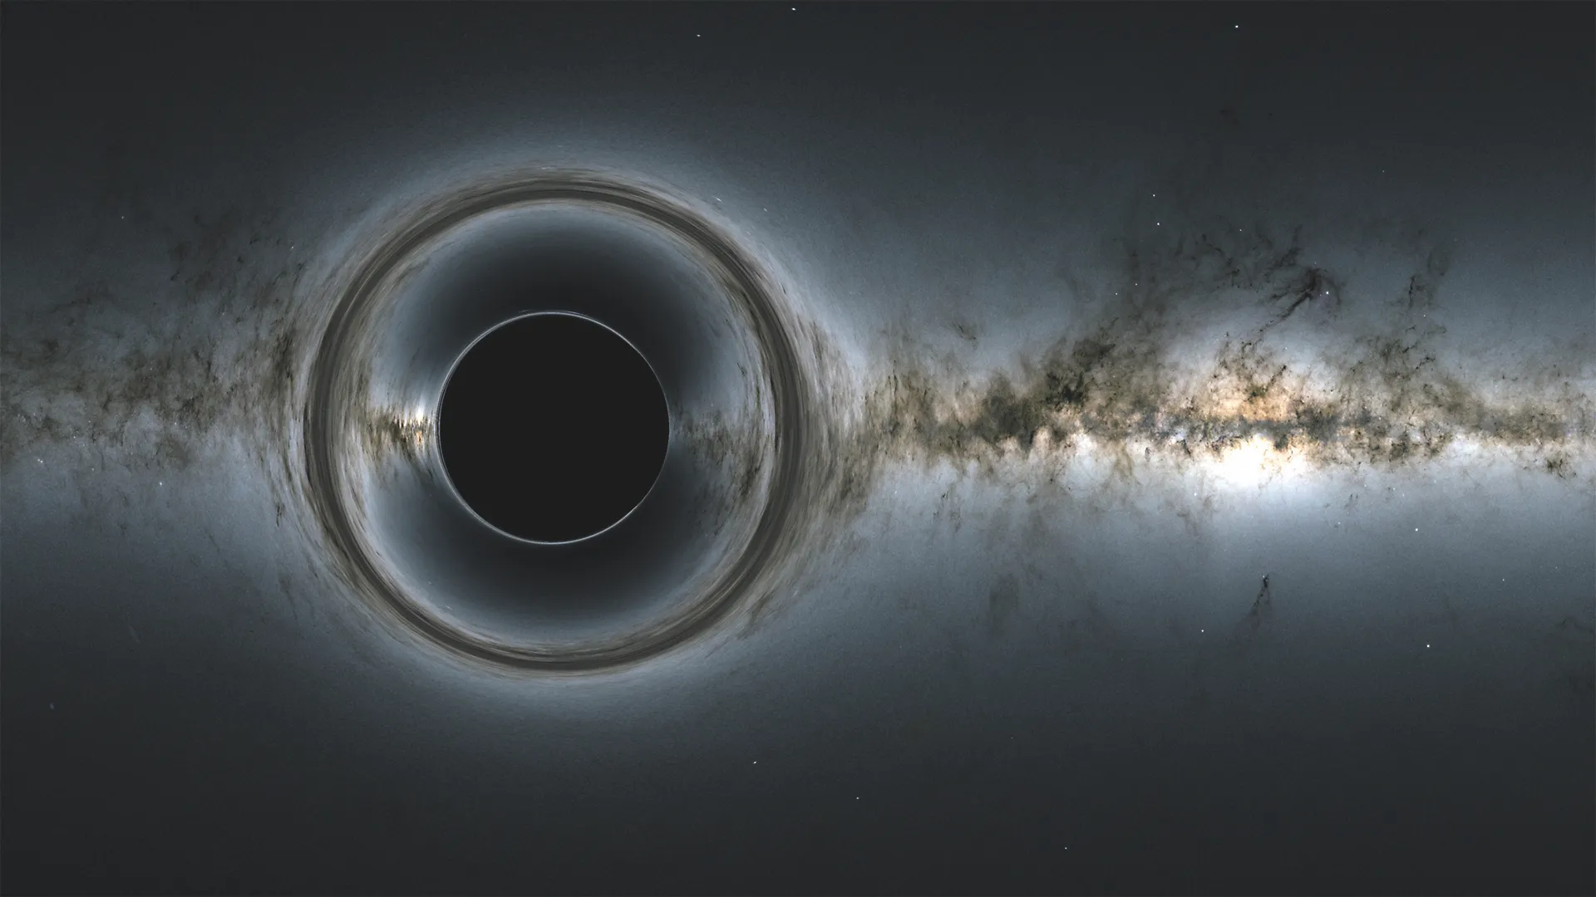


































Neutrino Rings?
from Primordial Black Holes
$$ν_{3}$$
$${\overline{ν}}_{2}$$
$$ν_{2}$$
$$ν_{1}$$
Three images of the same galaxy
$$ν_{1}$$
$${\overline{ν}}_{1}$$
$$ν_{1}$$
$${\overline{ν}}_{3}$$
$$ν_{2}$$
$$ν_{1}$$
$${\overline{ν}}_{2}$$
$$ν_{3}$$
$${\overline{ν}}_{3}$$
$$ν_{3}$$
$$ν_{2}$$
R
$${\overline{ν}}_{1}$$
$${\overline{ν}}_{1}$$
$${\overline{ν}}_{2}$$
$${\overline{ν}}_{3}$$
$${\overline{ν}}_{1}$$
$${\overline{ν}}_{1}$$
$$ν_{3}$$
$$ν_{2}$$
$$ν_{1}$$
$$ν_{2}$$
$${\overline{ν}}_{2}$$
$${\overline{ν}}_{2}$$
$${\overline{ν}}_{2}$$
$$ν_{3}$$
$$ν_{2}$$
$$ν_{2}$$
$${\overline{ν}}_{1}$$
$$ν_{1}$$
$$ν_{3}$$
$$ν_{3}$$
$$ν_{3}$$
$${\overline{ν}}_{3}$$
$${\overline{ν}}_{2}$$
$$ν_{2}$$
$${\overline{ν}}_{3}$$
Notes:
Here you can see three fairly distinct images of a galaxy in the Einstein rings. And, maybe, if we look at neutrino flux, we could see similar effects during that early period of radiation dominance where only neutrinos are free streaming through the Universe, creating their own rings or angular power spectrum from these effects. It may even be that the Universe at those early times looks like a kind of Swiss cheese, potted with supermassive black holes from a quantum era and yet yielding a similar nucleosynthesis in the space between. It is wonders like this that push us to imagine what the neutrinos can see and unravel about the youngest Universe.

Slide 15
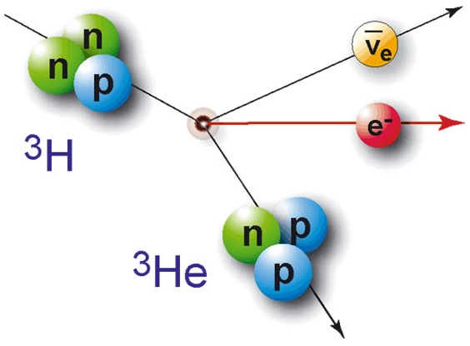
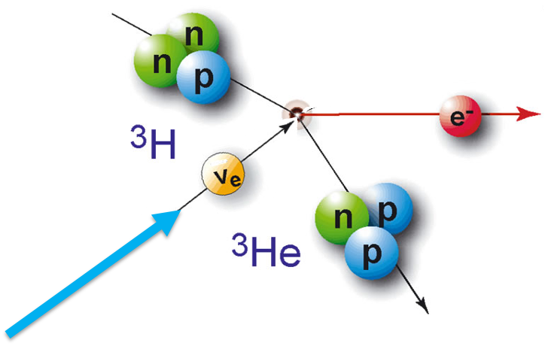
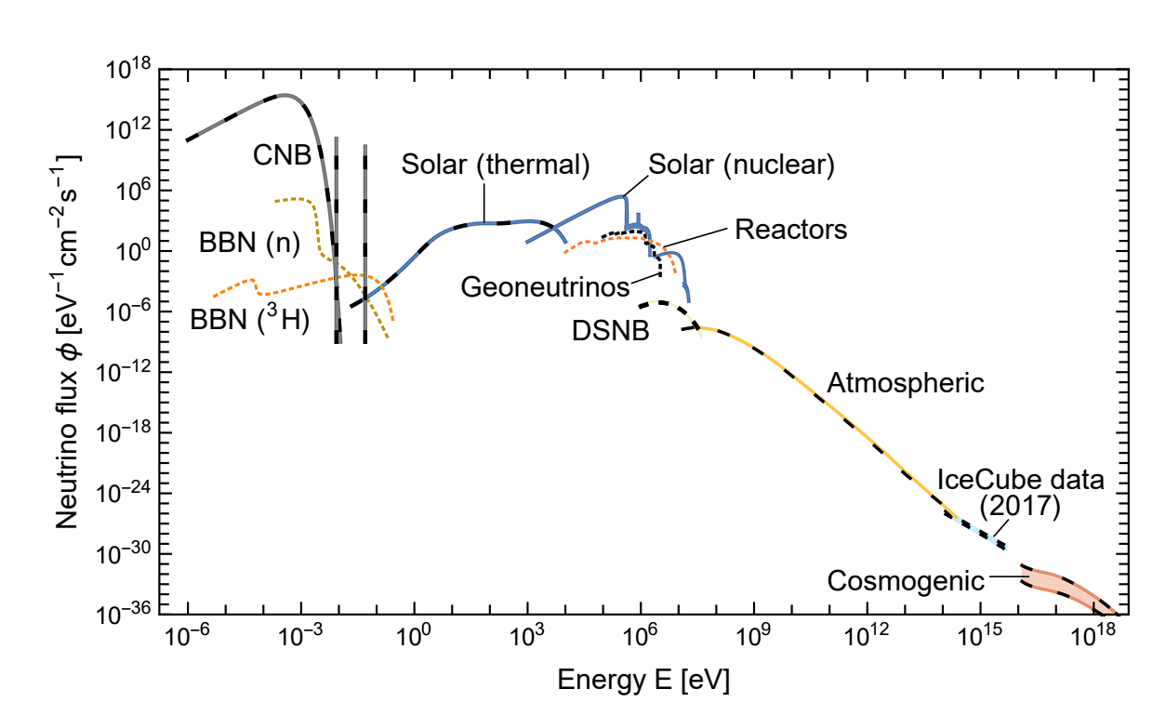
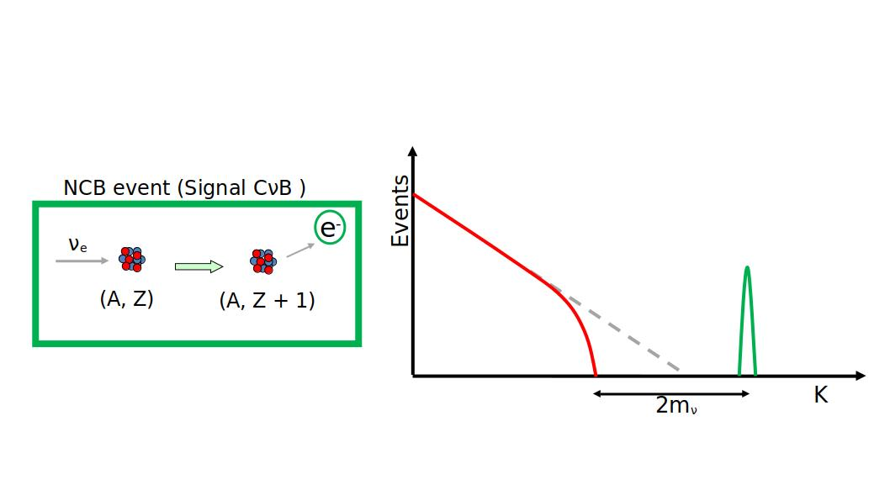
ptolemy - relic neutrino detection
PonTecorvo Observatory for Light Early-universe Massive-neutrino Yield
Beta-Decay
Neutrino Capture
Rev. Mod. Phys. 92, 45006 (2020)
DOI: 10.1088/1475-7516/2007/06/015
Signature of CνB
KM3
Neutrino Mass Effect on Endpoint
Predicted by Enrico Fermi
Notes:
How do we detect neutrinos? We do so through a nuclear transformation where we can convert a light element, in this case, tritium, into a helium-3 atom by the capture of a neutrino from the Big Bang. The mass of the neutrino, for which we don’t know it’s absolute value, would separate the relic neutrino capture signal to be a narrow peak of high kinetic energy electrons. Similarly, tritium, which is unstable to beta-decay, would produce a lower energy spectrum of electrons whose spectrum drops off near its endpoint because of the neutrino mass stealing away what would otherwise be available kinetic energy. Enrico Fermi predicted this effect. This, in turn, predicts a gap with a spacing of twice the neutrino mass between relic neutrino capture and maximal energy beta-decay electrons. I’ve included the world’s highest energy neutrino event from KM3.

Slide 16
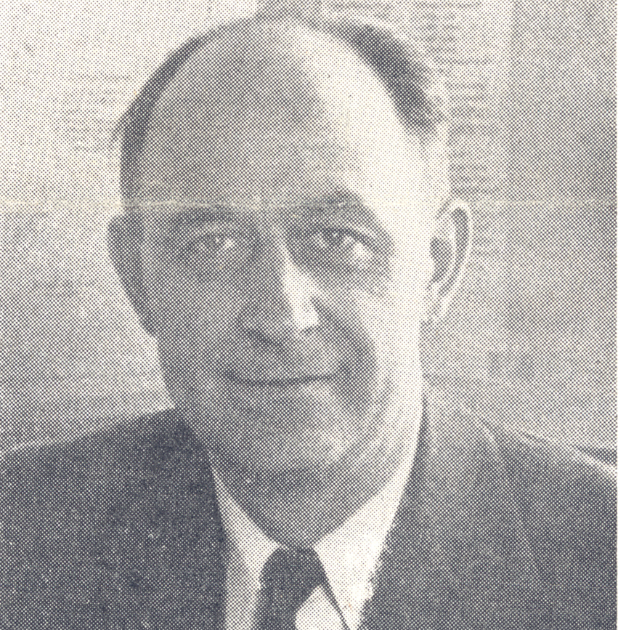
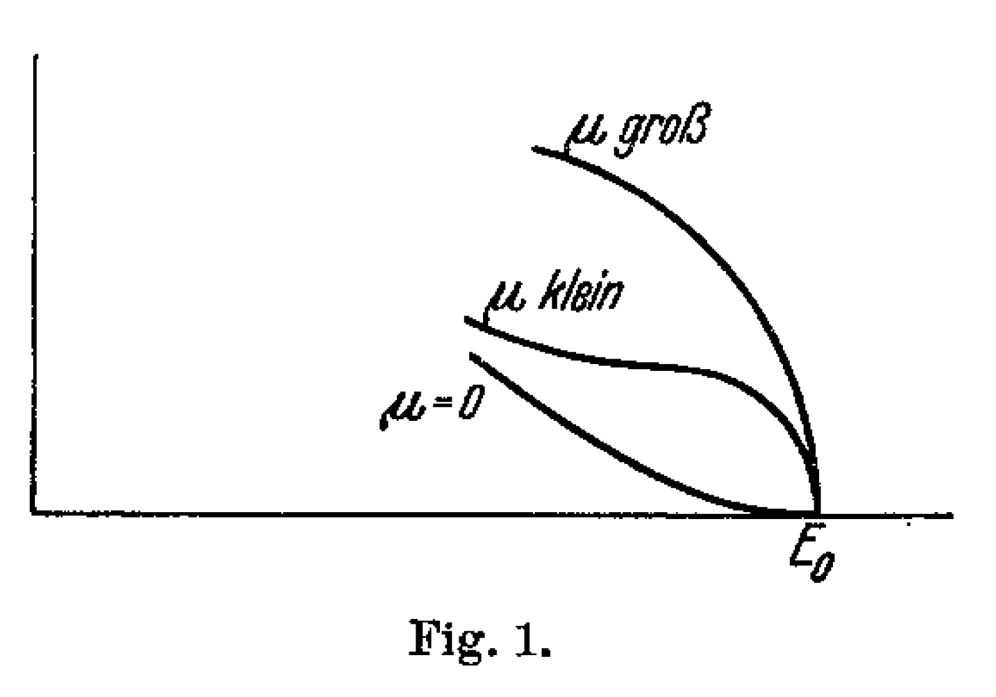
Idea of Enrico FErmi
91 year anniversary!
Fermi, E. Versuch einer Theorie der β-Strahlen. I. Z. Physik 88, 161–177 (1934).
https://doi.org/10.1007/BF01351864
The neutrino masses are so tiny, their effects are smaller than atomic transitions in normal materials.
(There is a reason that there are no units on this plot.)
Notes:
The effect on the beta spectrum predicted by Enrico Fermi 91 years ago gives a tell-tale signature for finite neutrino mass. Here you can see the shape for heavy, light and massless neutrinos. However, in Fermi’s time, there was no mass scale known for the neutrino – there is a reason why there are no units on this plot. In practice, the neutrino mess is limited by lab experiments to less than 0.45 eV and oscillations tell us that at least one is heavier than 0.05 eV. Those scales are smaller than atomic binding energies, so when we hold tritium with chemical bonds, the neutrino mass effect from Fermi appears subdominant to atomic effects and as we will see, the threshold effects appear multiple times.

Slide 17

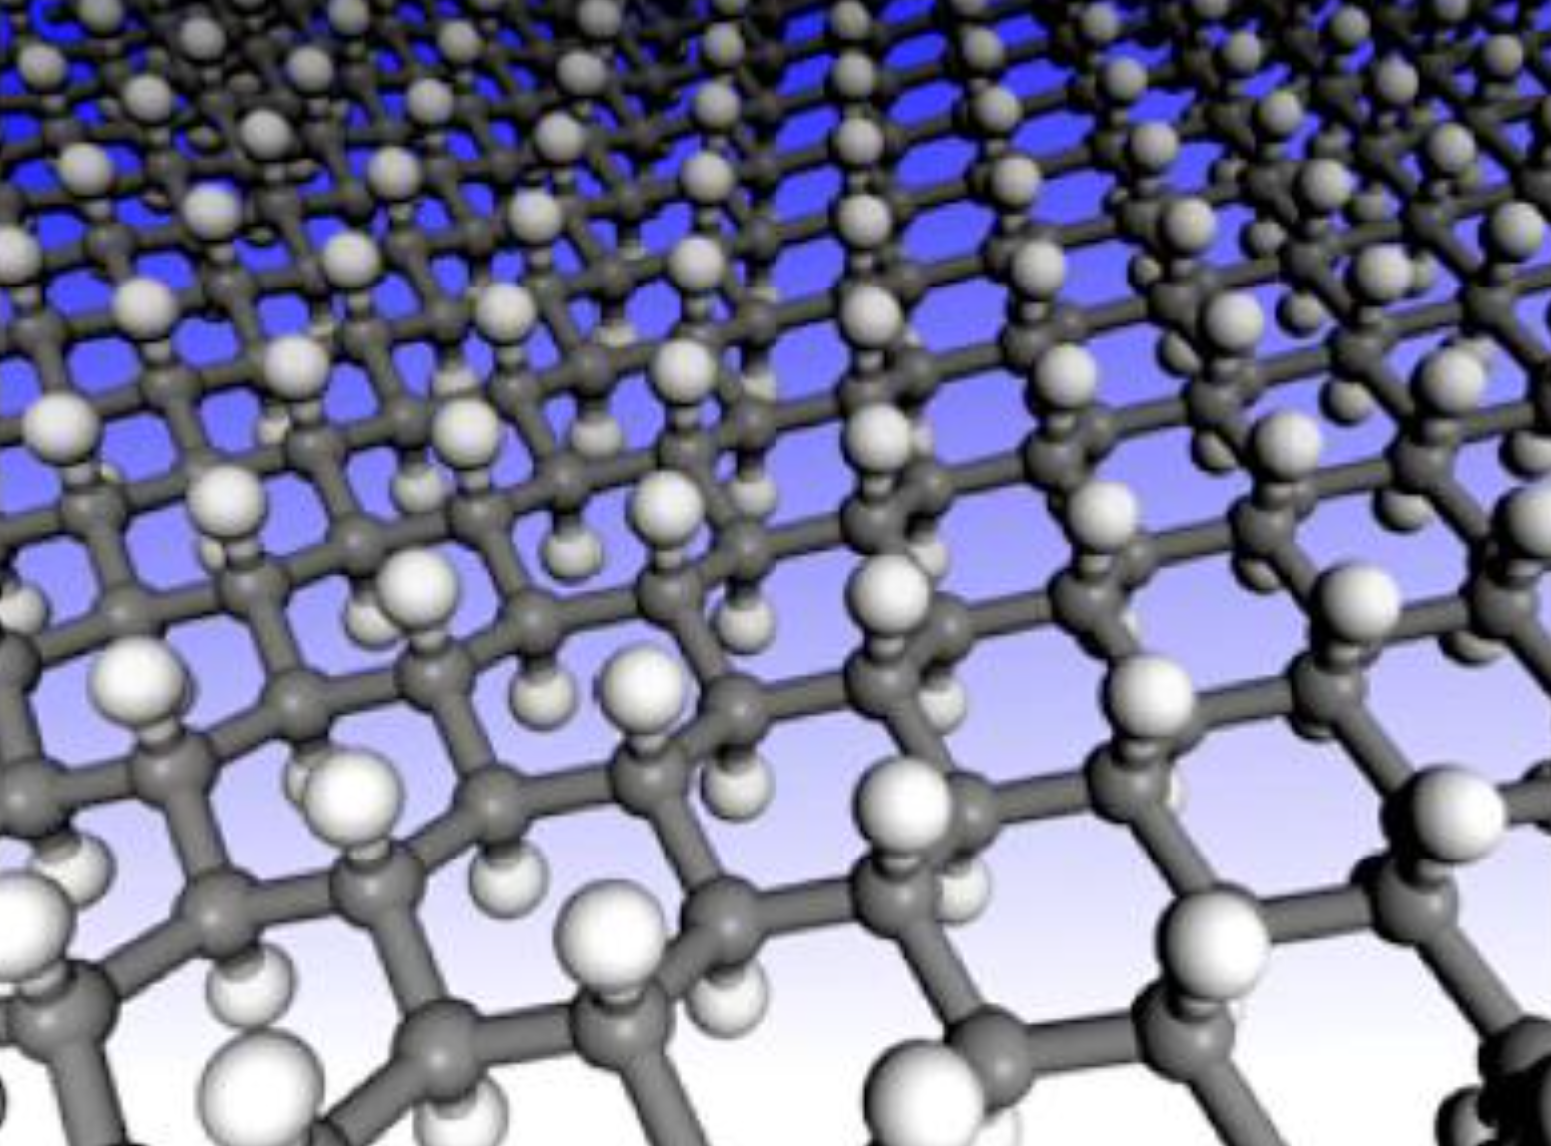
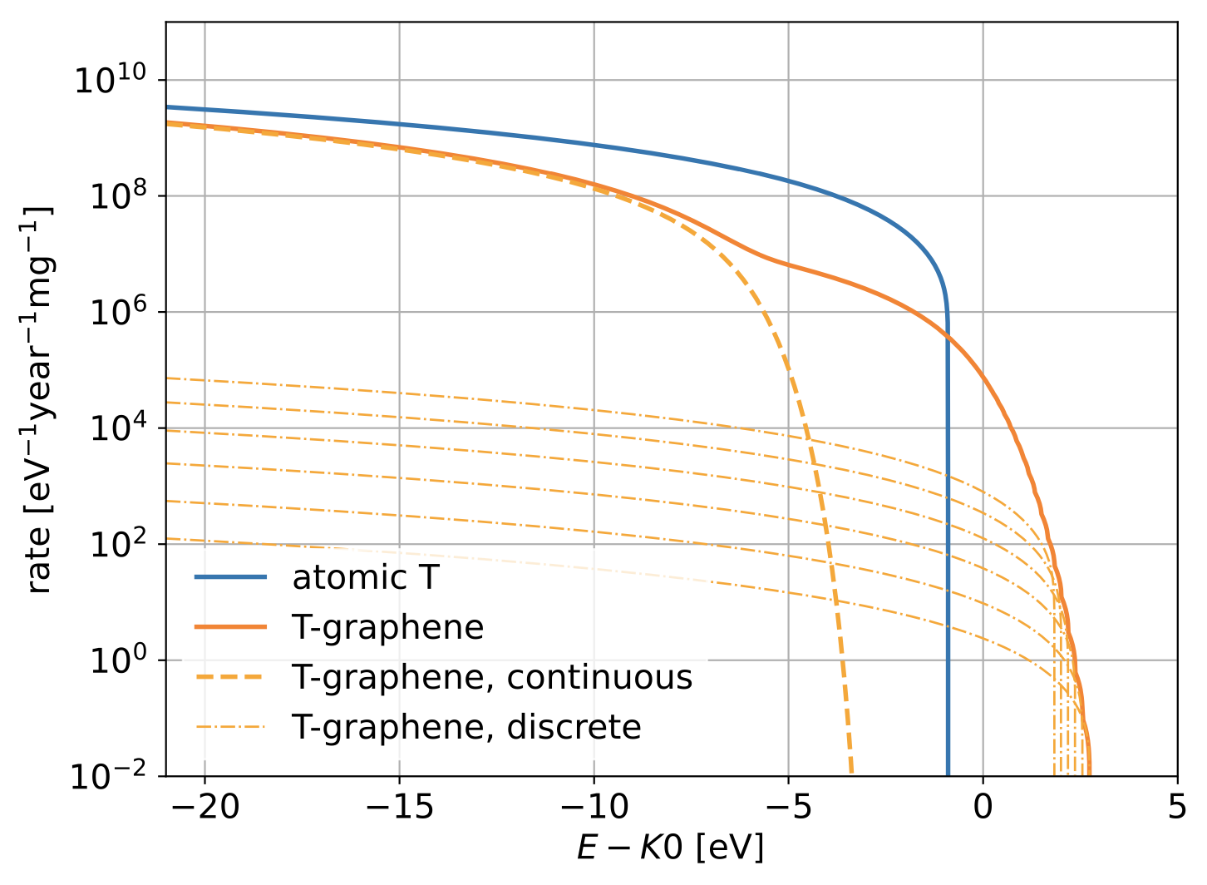
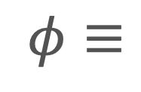

ptolemy: 2D Material - GrapheNE
Graphene w/Tritium
Quantum Steps
$$φ$$
~0.2eV
steps
Other graphene structures also under study
$$φ≡$$
“Atomic” work function
Notes:
The PTOLEMY experiment studies Graphene, a novel 2D material made only from Carbon atoms, as way of holding tritium against vacuum. This allows emitted electrons to pass directly into vacuum to avoid scattering effects. This material will capture the final state helium-3 element in some cases and these atoms fall into a spectrum of excited states that appear like steps in the energy spectrum of the endpoint electrons. And in some cases, the helium-3 clears the Graphene surface as a kind of “atomic” work function.

Slide 18
ptolemy: 2D Material - GrapheNE
Graphene w/Tritium
Quantum Steps
$$φ$$
~0.2eV
steps
Other graphene structures also under study
$$φ≡$$
“Atomic” work function
Notes:
The effect of Fermi appears every time there is a new energy threshold and as excited states grow in numbers with each step, the Fermi effect is a percentage effect on each step and in the much larger atomic work function threshold. This discovery allows us to measure neutrino mass effects across the spectrum and requires much less tritium than having to go to the extreme upper tip and collect events there. The atomic work function and steps introduce an endpoint shape that has more structure than Fermi predicted from neutrino mass alone. One wonders whether previous neutrino mass experiments that measure unphysical negative mass squared preferred values are in fact not accounting for atomic steps in their data, and it could be that our measurements will help with the re-analysis of that data. An important take-away from this talk is that the neutrino mass measurement for these systems for these tiny masses is equally a condensed matter experiment. PTOLEMY will have an energy resolution high enough to measure these steps directly.

Slide 19
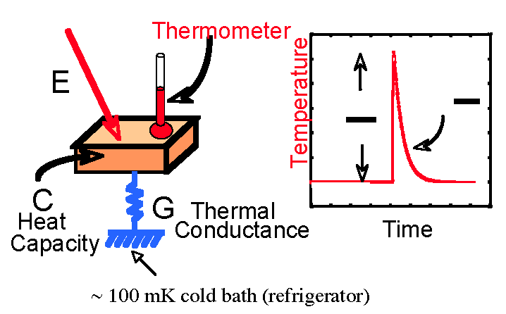
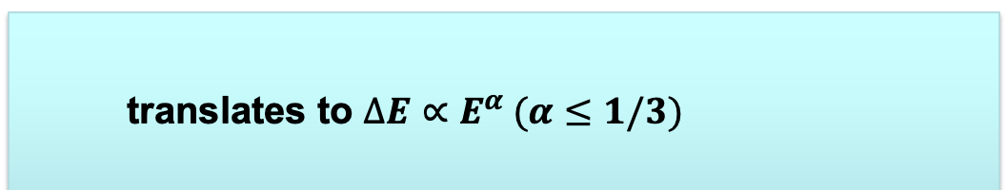

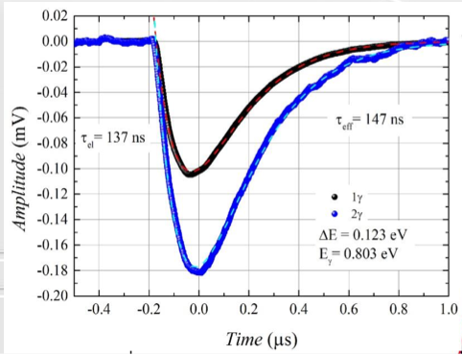
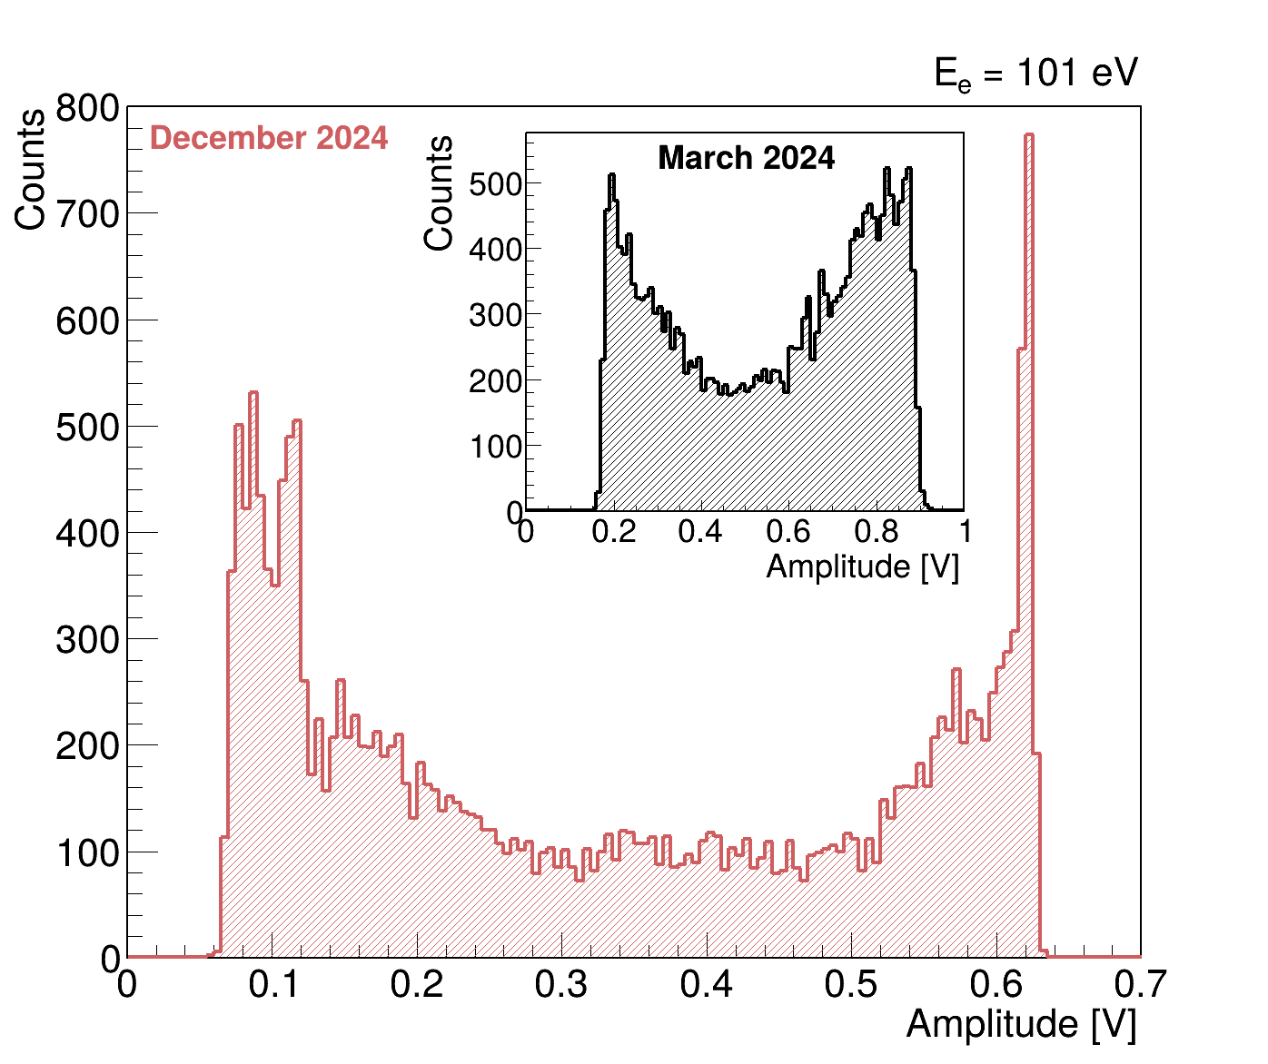
Micro-CaloRImeTER
𝝙EFWHM = 0.05 eV @ 10 eV
E
C
C
G
𝝙EFWHM = 0.022 eV @ 0.8 eV
Based on the expertise of the INRiM important results have been achieved on electron measurement with TES.
Key elements of the measurements: performing TES and new e-source based on nanostructures
arXiv:2405.19475v2
First measurement of electrons
at 100 V with resolution of ~1-1.5 eV
Best in the World!
Notes:
We do that with new generations of detectors, one is the transition-edge sensor, developed by INRiM, Torino, another is an electrostatic spectrometer, which I will show later. The TES detectors show the world’s best energy resolution performance on infrared photons – energies in the molecular scale. But what about electrons? It’s taken some time of development, but we now have the first results on low energy electrons using clever electron sources and these results yield the world’s highest absolute energy resolution at these scales. To make a neutrino experiment, the rates are low, so we need to do more than count hits in a micro-calorimeter.

Slide 20
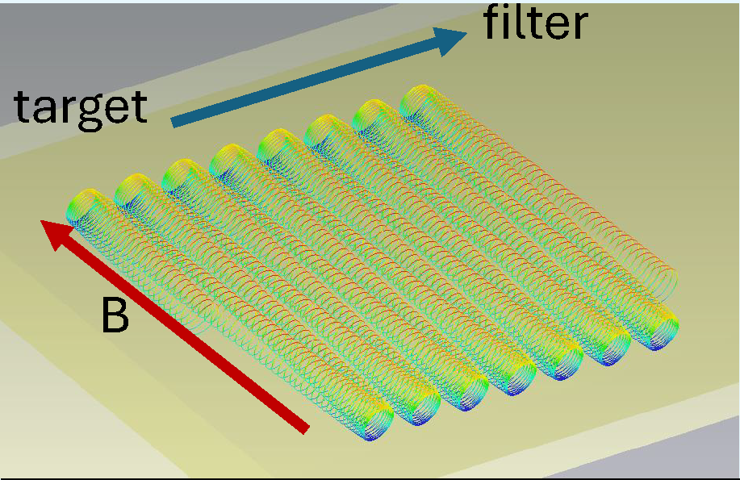
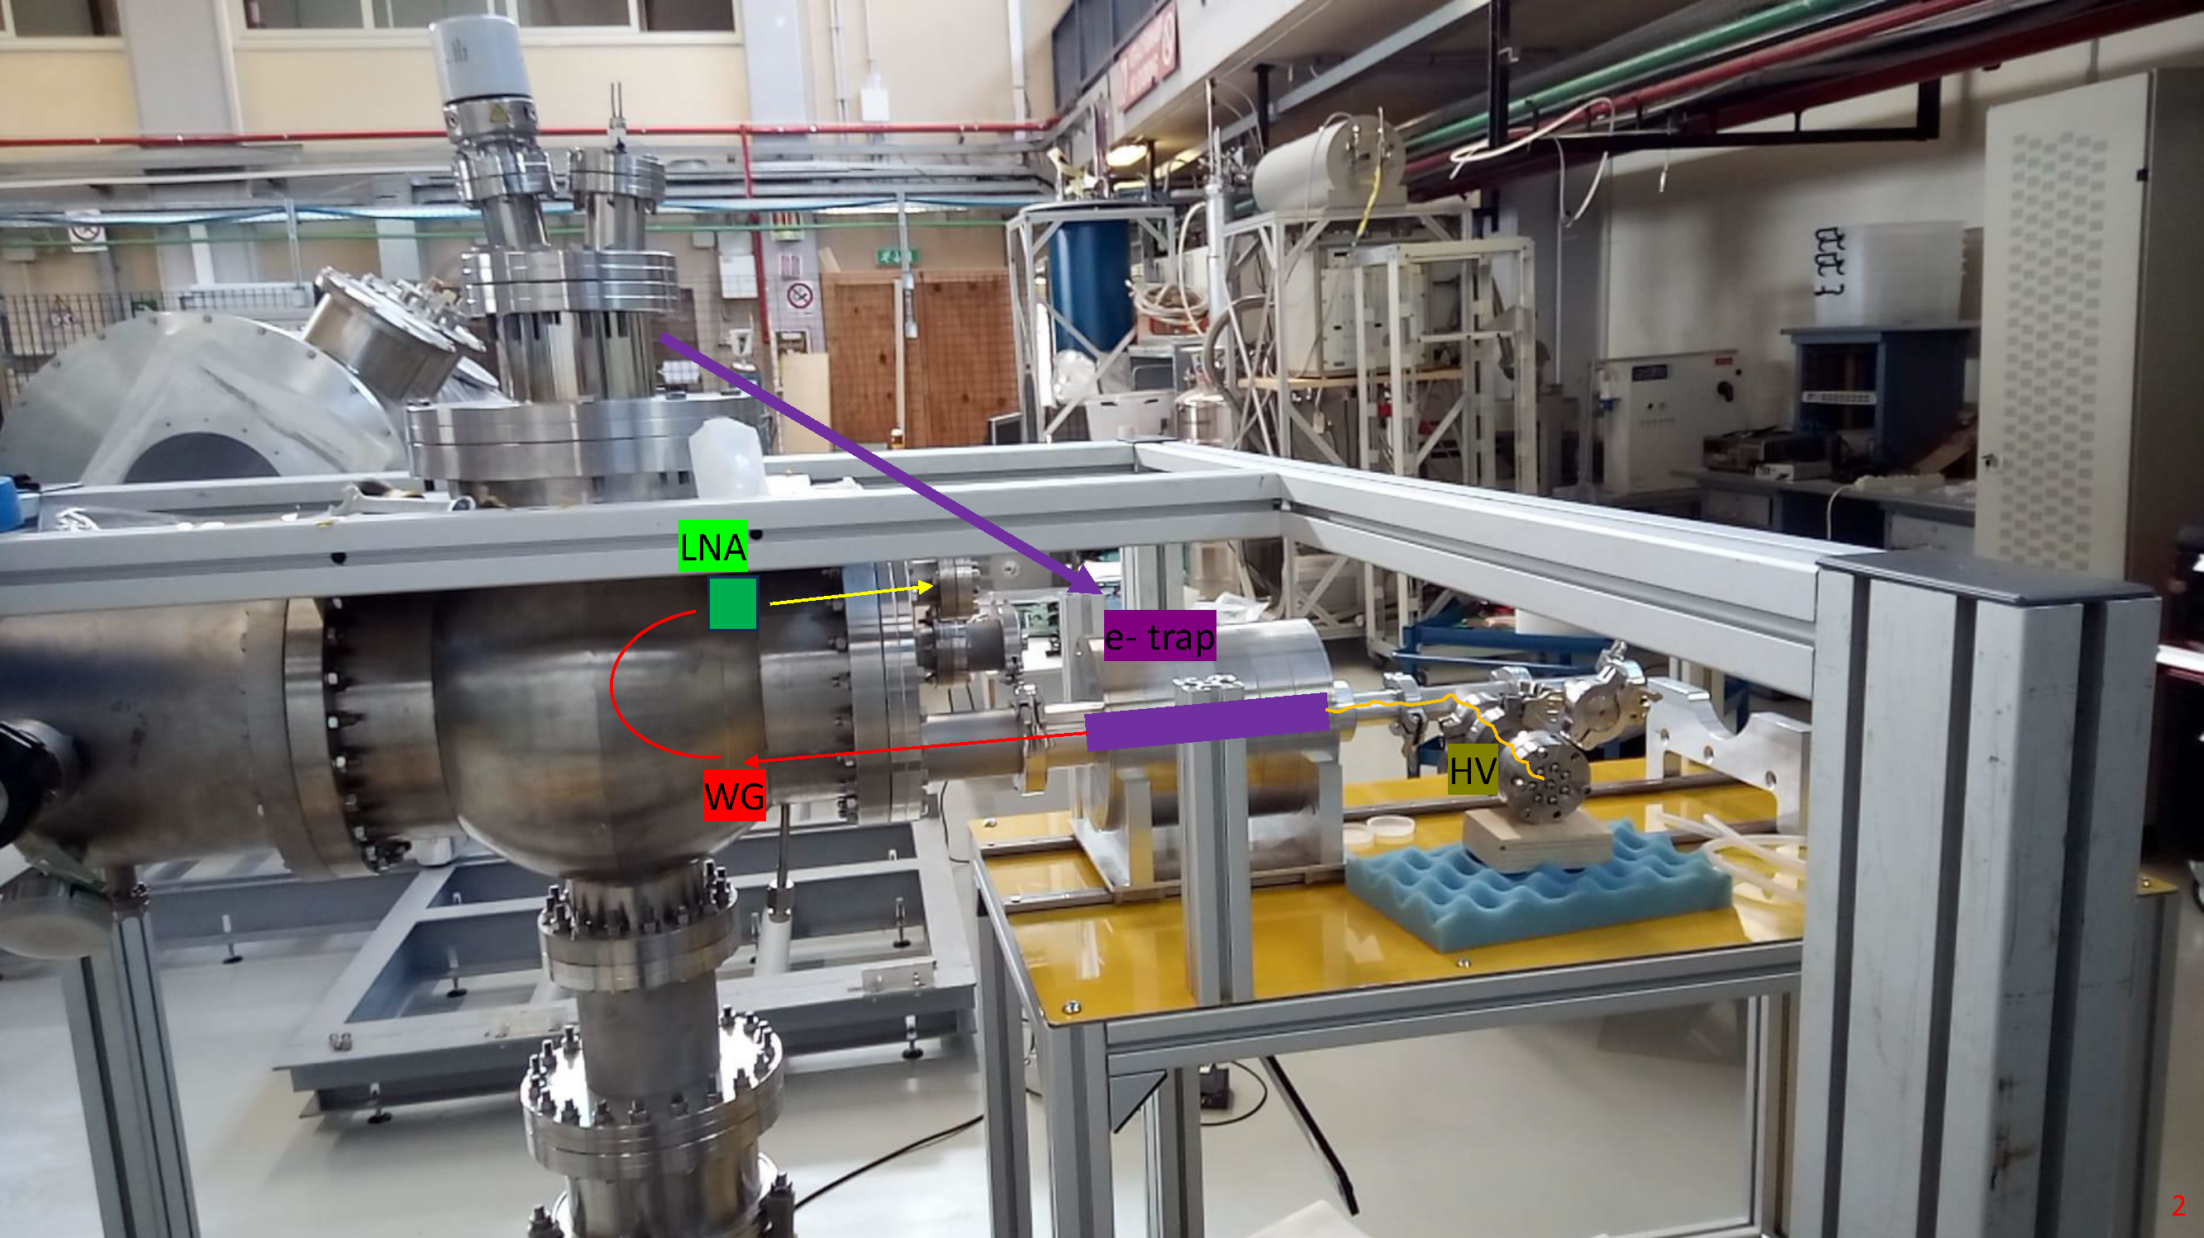
RF Measurements
Non-Destructive Electron Tag
Can we detect the (semi-relativistic) electron on its way to the micro-calorimeter?
Notes:
The need to suppress background led us to consider the semi-relativistic cyclotron motion of an electron in magnetic field. A new, non-destructive technique for tagging electrons, developed by the Project 8 collaboration, could be used to tag the electron between the graphene and the micro-calorimeter to reduce backgrounds. Here we show the bouncing motion of an endpoint electron in magnetic field as it drifts between the target and micro-calorimeter. These electrons will emit microwave radiation – like in your microwave, but much lower power.

Slide 21
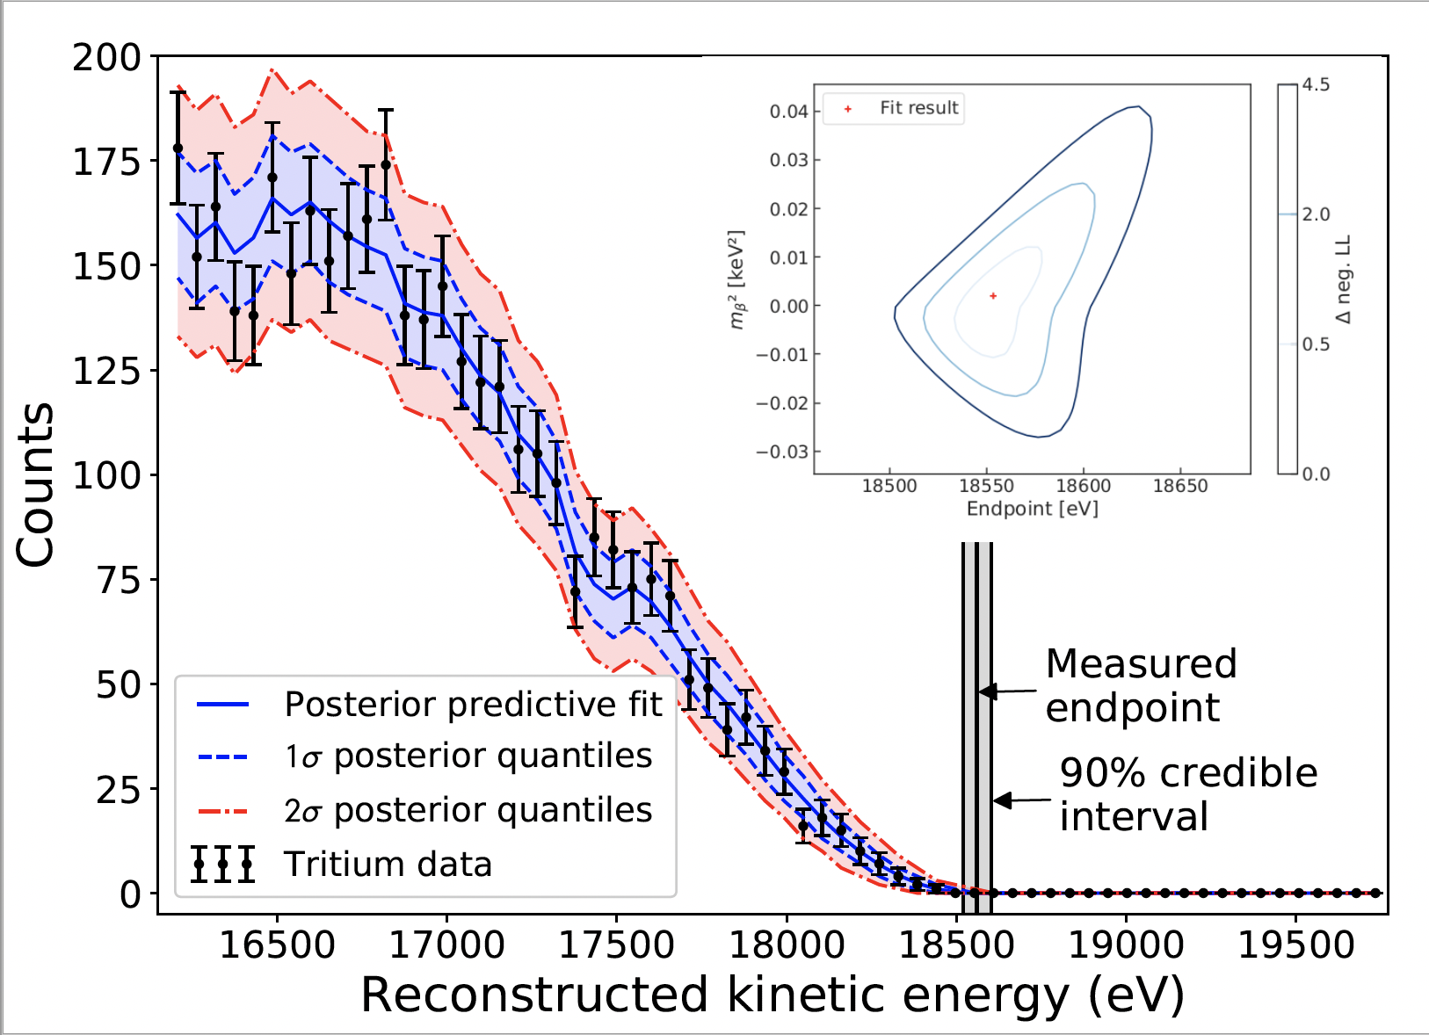
Recent Project 8 Tritium RF Measurement
RF measurement background levels extremely low.
No events observed above endpoint,
Setting upper limit on background rate
< 3x10⁻¹⁰ /eV/s (90% CL)
Background Rate
< 1 event per eV in 100 years!
https://arxiv.org/abs/2203.07349
21
Notes:
The Project 8 collaboration uses the relativistic shift of the cyclotron motion to derive the energy values of electrons measured this way and have measured the tritium endpoint spectrum. The background suppression is amazing. They saw the equivalent of less than 1 event per eV in 100 years at the endpoint. This is what we want, but for a drifting geometry.

Slide 22
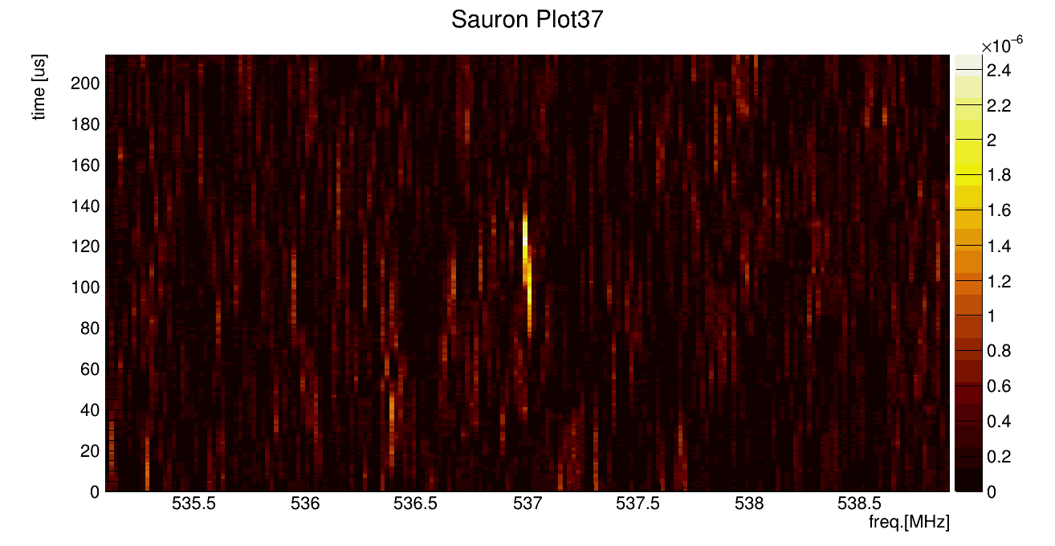
ACHIEVED!! RF Measurements
Non-Destructive Electron Tag
Can we detect the (semi-relativistic) electron on its way to the micro-calorimeter?
Notes:
RF detection of drifting electrons has been achieved at the LNGS! The bright streaks in this plot are electrons in drift motion in a waveguide connected to low noise amplifiers and readout electronics developed by the Dutch groups. Now how about the tritium on Graphene?

Slide 23
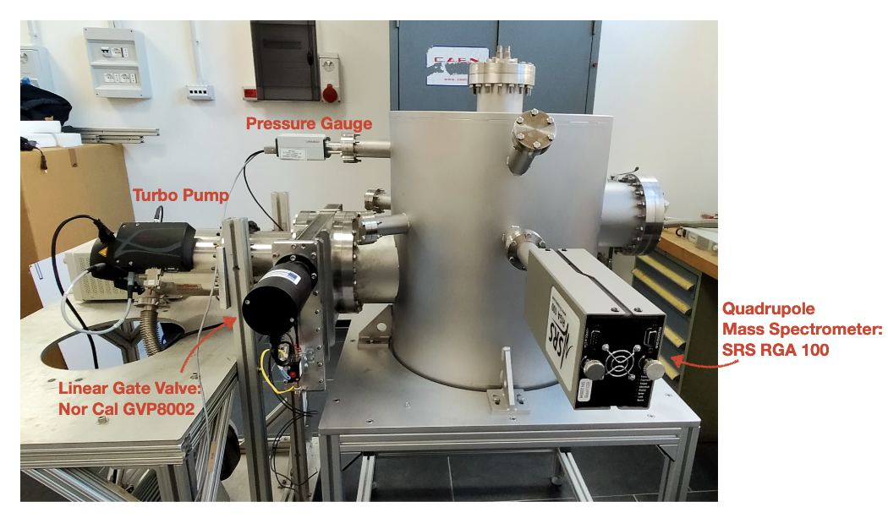
Fabrication of a Tritiated-Graphene Target/Source
Hydrogen and Deuterium loading on graphene at Roma1 and Roma3
atomic H as a tool to ‘pinch’ the sp² bonds towards a sp³ configuration
while maintaining the planar nature of graphene
H on Nanoporous Graphene (NPG):
sp³ C-H bond
T-chamber in Rome side view:
Betti et all, Nano Lett. 22, 2971 (2022)
UKAEA’s Active Gas Handling System (tritium for JET, EU Tokamak) for feasibility study & design requirement of a new T loading chamber
Notes:
23
Hydrogen and deuterium loading of nano-porous graphene has been achieved by the Roma and RomaTre groups using a special capillary cracker and loading setup, custom built in Italy. This is the world record for hydrogen loading on Graphene with more than 9 of every 10 carbon atoms attached to hydrogen. We are working on developing this chamber for use in a tritium facility.

Slide 24

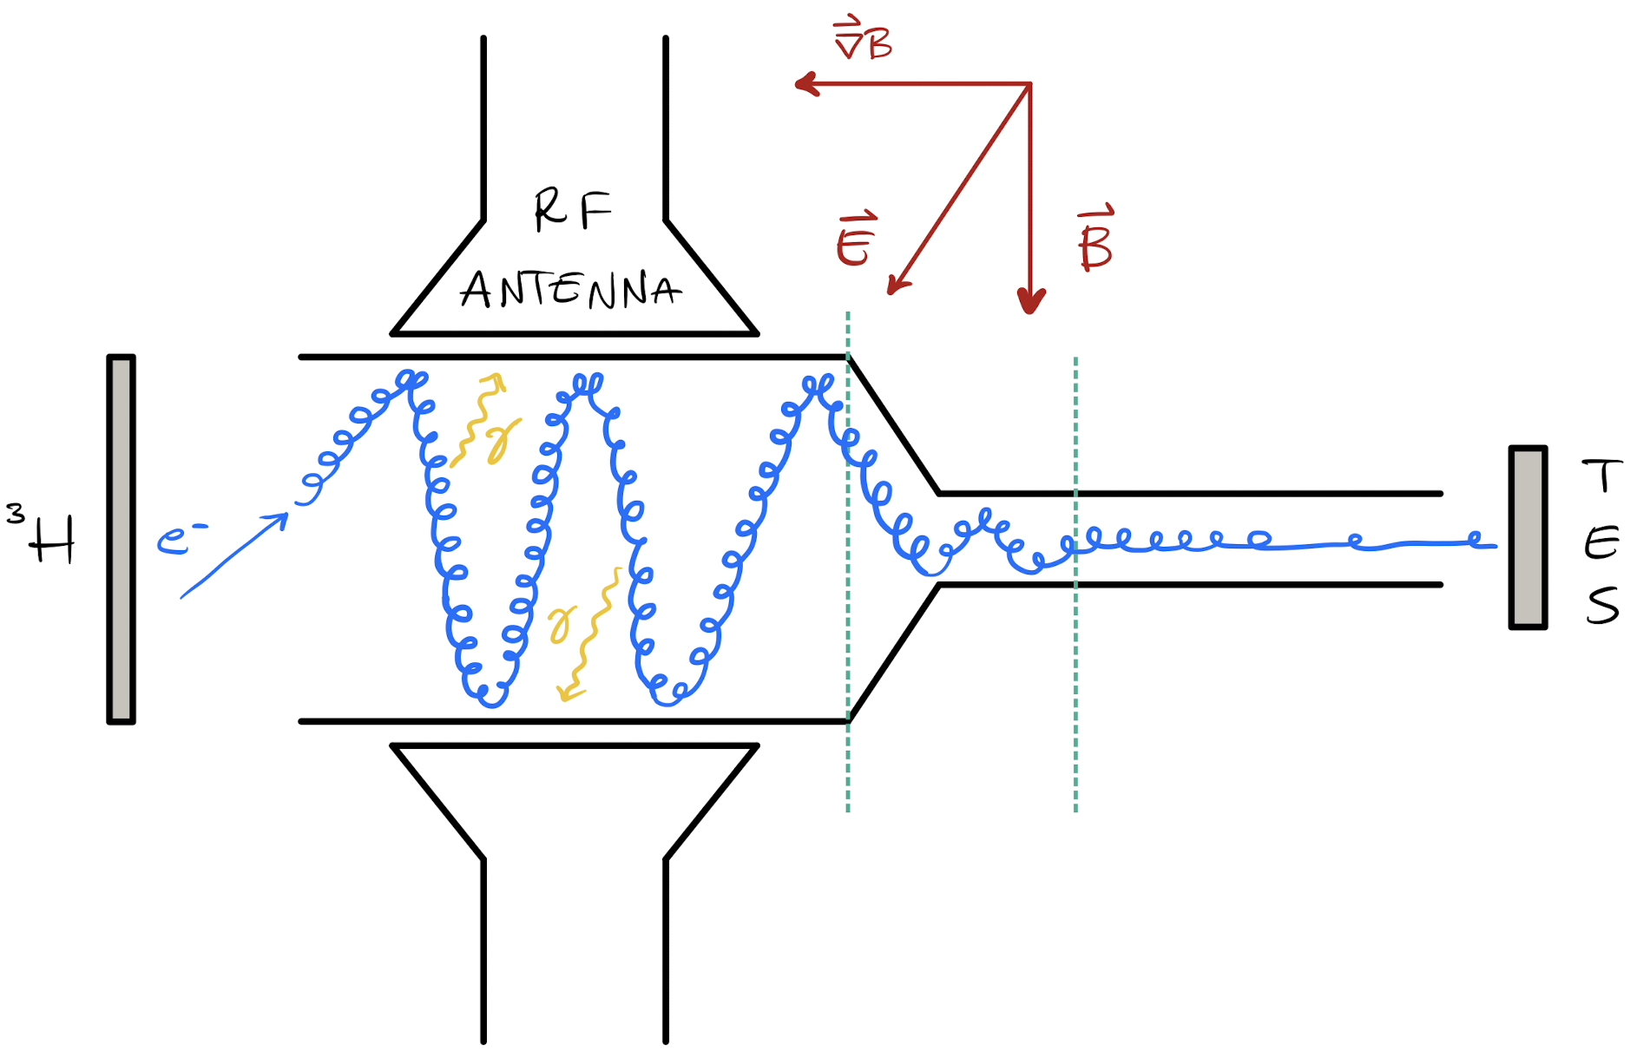
ptolemy: the idea
JINST 17 (2022) 05, P05021
A new electromagnetic filter idea based on RF detection and dynamic E setting
By A. Esposito
Notes:
Here now we go through the concept of the PTOLEMY experiment. Electrons begin on the Graphene target and emit into vacuum.

Slide 25

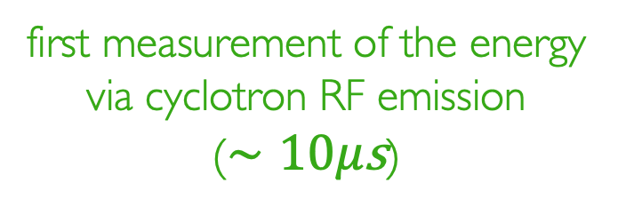
ptolemy: the idea
JINST 17 (2022) 05, P05021
A new electromagnetic filter idea based on RF detection and dynamic E setting
first measurement of the energy via cyclotron RF emission
($∼10μ\text{s}$)
By A. Esposito
Notes:
These electrons are transported into the high magnetic field of a magnet and the RF radiation is used to non-destructively tag them on their way toward the micro-calorimeter.

Slide 26

ptolemy: the idea
JINST 17 (2022) 05, P05021
A new electromagnetic filter idea based on RF detection and dynamic E setting
first measurement of the energy via cyclotron RF emission
($∼10μ\text{s}$)
enter if within $∼10\text{eV}$ from endpoint
By A. Esposito
Notes:
A new technique is used to trade the kinetic energy of the electron into electron potential so that the electrons transported to the microcalorimeter are in a smaller energy range to be measured.

Slide 27

ptolemy: the idea
JINST 17 (2022) 05, P05021
A new electromagnetic filter idea based on RF detection and dynamic E setting
𝜟V known to 1 ppm precision
ETot=q(VTES-Vsource)+ETES
collimate and slow down
first measurement of the energy via cyclotron RF emission
($∼10μ\text{s}$)
enter if within $∼10\text{eV}$ from endpoint
By A. Esposito
Notes:
The remaining kinetic energy/momentum of the electrons referenced to a precise voltage difference between target and detector are then measured to resolutions comparable to the neutrino mass. A special feature of the PTOLEMY magnetic geometry is that not only are we able to leverage zero-field TES, an electrostatic spectrometer is also possible for the precision energy measurement.

Slide 28

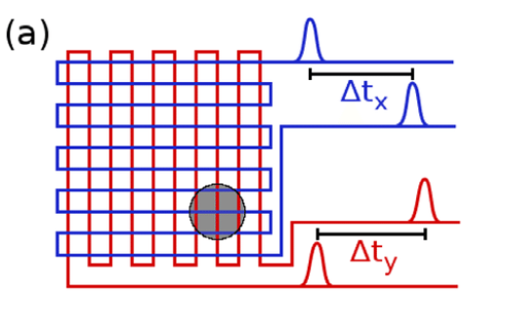

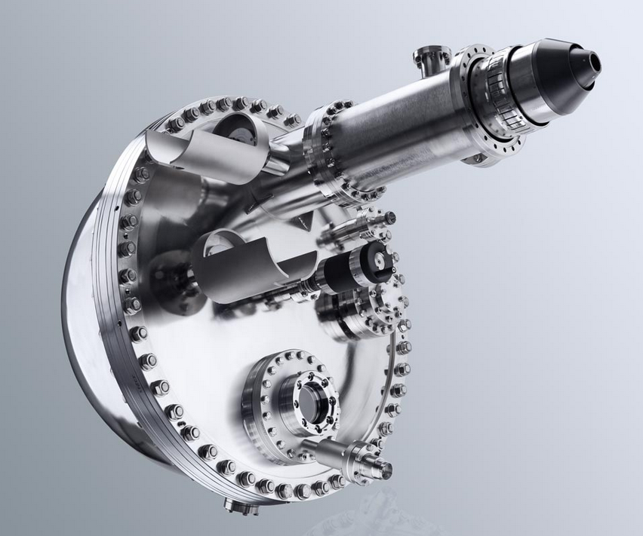










Precision energy measurement
from Condensed Matter/ARPES
Electostatic analyser
Electron optic basic equation
Helmholtz – Lagrange law
Electrostatic lenses
$$x_{t}θ_{t}\sqrt{E_{k}}=x_{a}θ_{a}\sqrt{E_{p}}$$
$$x_{t}$$
$$θ_{a}$$
$$x_{a}$$
E_{p} + δE
$$θ_{t}$$
E_{p}
Two concentric hemispheres
for the energy selection
$$E_{k}$$
$$E_{p}$$
$$M_{θ}M_{l}$$
E_{p}- δE
Energy resolution
(bandpass energy):
Ptolemy e.m. filter
Delay Line
MCP
$$\frac{∆E}{E_{p}}=\frac{x}{2R_{0}}+\frac{θ^{2}}{4}$$
Position sensitive detector (MCP+delay line)
allows parallel acquisition
ΔE: energy resolution
E_{p} : pass energy
x: slit width
R₀: mean radius
θ: accepted angle
preamp.
CFD
TDC
Anode
Specs Phoibos 225
~few meV energy resolution
Notes:
One great synergy between particle physics and condensed matter physics is in the possibility of using a spherical electrostatic spectrometer for the final electron momentum measurement, as one would use to probe the band structure in condensed matter physics using ARPES-like methods. We are able to time-multiplex the anode to achieve position sensitive detection with an MCP, expanding the phase space of the device. This phase space is very much like photoelectrons coming off a 3 inch photocathode – a familiar problem for KM3.

Slide 29


Detailed simulation of the PTOLEMY filter
Magnet 1 T field
RF region
Filter region
RF Measurement
Micro-Cal
Target
Wonyong C. Princeton University
Geometry relying on modularity approach to increase instrumented
target mass
Micro-calorimeter region
with focusing system to match beam and calorimeter array
Zero B Field FOCUSING
with Einzel lens (90 degress)
Microcalorimeter
Notes:
This is a full end-to-end simulation of this process. We see the target location and electron path into the high field magnet, the RF measurement region and then the electrodes guiding the electrons to the microcalorimeter. At the current stage of the project where we will be commissioning the filter transport, a novel new approach is being developed for electron analysis with Fermilab. A pixelated CCD/Skipper readout system with a GEM-like pre-accelerator on the surface will provide a momentum spectrometer with a silicon-based Faraday cup micro-array with a noise level that is a small fraction of one elementary charge.

Slide 30

End-to-End Drift Collimation and Transmission Results
Magnet 1 T field
RF region
Filter region
RF Measurement
Micro-Cal
Target
Wonyong C. Princeton University
10% Static Transport Achieved!!! Down to 160eV
Notes:
The results are phenomenal. With static electric and magnetic fields, no dynamical switching, we achieve 10% transport for a large fraction of the emitted solid angle of electrons from the target. We manage to drain the kinetic energy down to the levels that can be measured well by the TES below the 160 eV range. The left bottom shows a flat plateau where electrons are transported with 10% efficiency with the main losses at the start and end. I should mention that the acceleration process on the left is a novel new type of particle accelerator with great interest to the fusion community.

Slide 31



demonstrator MagneT
Being built and will be installed at the LNGS
Key element to realize the PTOLEMY Experiment
Construction ASG/Suprasys consortium of a SC dipole with
special attention to the fringe field
Under construction in Genova → Shipment to CERN → LNGS
Simulated B-map
Low Power MgB₂ Superconducting
Conduction-cooled Coils
Vacuum System
< 200 cm
Zero B field saddle point key feature of the field map
Notes:
The most important part of the experiment is being fabricated currently in Genova. This is a new generation of superconducting magnet using MgB2 coils that are conduction cooled. It’s highly energy efficient and produces through iron pole face shaping all the regions we need for the target, RF and a zero field region where we can shield and place the micro-calorimeter/electrostatic spectrometer - which need zero magnetic field to operate. Here we also show the vacuum system under development at LNGS.

Slide 32





















The PTOLEMY Collaboration
Notes:
PTOLEMY is a collaboration of people from all over with a common dream of measuring the youngest Universe.

Slide 33

The PTOLEMY Collaboration
14 May 2024, Pollica, Italy
Notes:
Here is a photo from Pollica in May 2024. I have to say that there is nothing more wonderful in science than to join together with people around the world who share common dreams and enthusiasm for this science. It has been a great honor to work in the group.

Slide 34
conclusion
PTOLEMY’s goal is to eventually detect the cosmic neutrino background
The detector prototype will be ready at LNGS by the end of this year
Prototype baseline option is: T embedded on graphene; New concept EM filter; electron energy resolution measured in several steps (SDD/electrostatic spec/TES). Ultimately operating with sub-eV energy resolution.
Ultimate goals of the Demonstrator: instrumented mass ~ hundreds of 𝜇g, energy resolution 50-100 meV, T storage solution will come from optimization of atomic T support structure. Time scale 5 years.
“Intermediate” physics program of Demonstrator: neutrino mass measurements (or limits) beyond what has been achieved by all previous experiments.
Submitted letter of intent to European Strategy for Particle Physics 2026 (#28)
Notes:
In conclusion, …read.

Slide 35
Backup

Slide 36

Sensitivity as a function of tritium mass
Remarks:
- the sensitivity is weakly dependent upon the energy resolution (500 meV is already a good starting point)
1 μg (7x7 cm²) already provides competitive sensitivity
- 100 μg (0.5 m²) can potentially probe the neutrino mass down to the IO scenario
(No syst. Uncertainty included)
In preparation a theory paper on solid state effects on the electron spectrum & consequent theory systematics on m_{ν} extraction
(A. Casale, A. Esposito G. Menichetti, V. Tozzini)

Slide 37


HV High precision stability (LNGS)
Vin
Vout
E
Differential Amp
Precision
Multimeter
HV Capacitor (?)
Diode
chain
Field
Mill
Climatic chamber - N2
Single board
(1 kV)
σ = 0.3 mV

