Slide 1
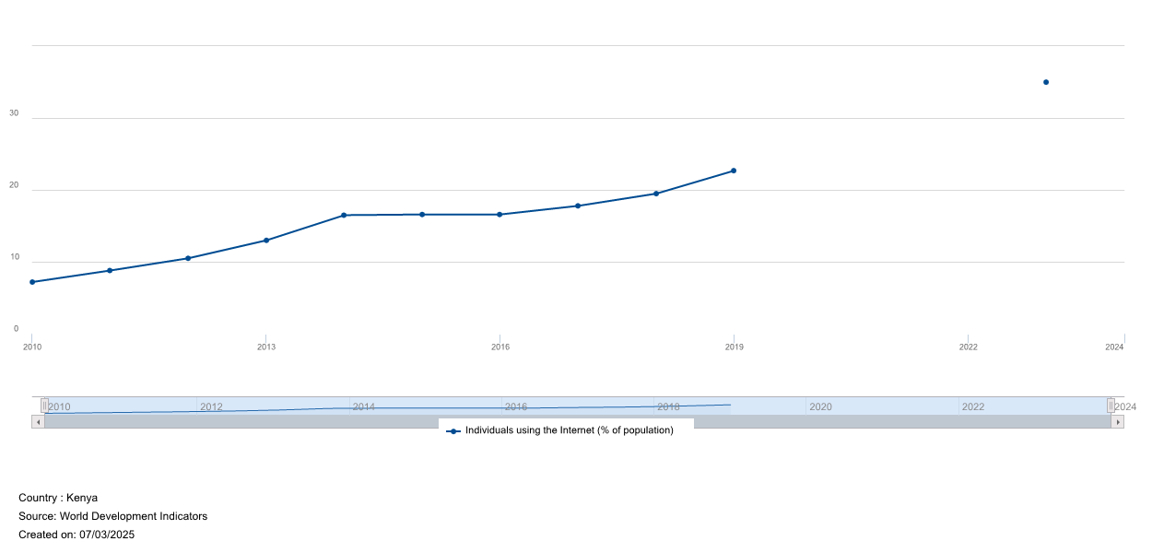
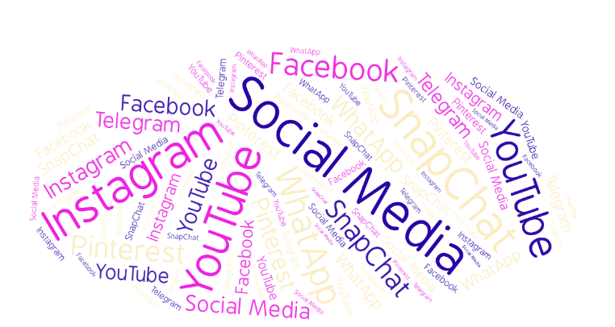
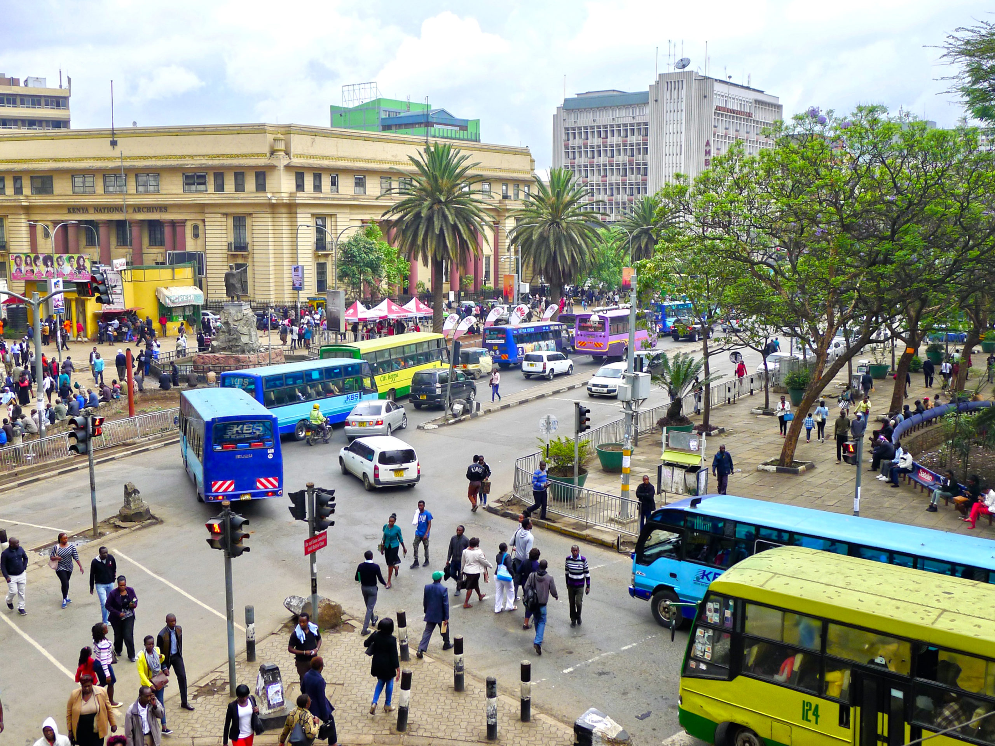

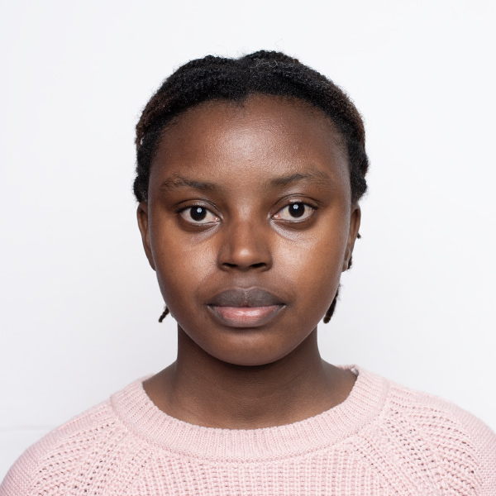
Examining the Influence of Social Media Platforms on Youth Clothing Purchases in Nairobi
Victoria Kiboi
Kenyatta University
Background
1. Introduction
This study aims to examine the impact of social media and peer influence via online influencers on clothing consumption among youth in Nairobi
Clothing is a basic necessity and means of self expression among the youth who look to social media to inform them on trends.
Consumption on clothing is one of the largest areas of discretionary spending among youth.
Kenya has been reported to have the highest social media usage per capita¹, with 69% of youth reporting to following influencers².
2. Problem statement
Social media has transformed consumption behavior, with youth highly engaged online - over 12 million active social media users, consuming content and engaging with influencers.
Social media has been shown to drive conscious consumption and overspending.
Limited research exists on how social media influencers shape clothing consumption among Kenyan youth, and the interaction between social media influence and core economic factors like price sensitivity and income remains underexplored.
Fig 1 Individuals using the Internet (% of population) - Kenya
Current Work
1. Objectives
3. Results
To determine the effect of social media engagement influence consumption of clothing and apparel among youth in Nairobi.
To examine how exposure to social media influencers affect consumption of clothing and apparel among youth in Nairobi.
To identify how microeconomic factors namely price and income affects the consumption of clothing and apparel among Nairobi youth.
Expected results are as follows:
Social media engagement is expected to positively influence clothing consumption among youth, particularly through exposure to fashion content and peer-driven trends..
Youth with high social media engagement may exhibit higher likelihood of impulse buying, even when it exceeds their planned budget or income constraints.
2. Methodology
Non-experimental cross-sectional survey will be used to examine how social media engagement, influencer marketing, price, and income influence clothing consumption at a single point in time.
The research will be quantitative, using a structured online questionnaire to collect primary data for statistical analysis. The questionnaire will be distributed online via google forms.
The target Population is youth aged 18-35 in Nairobi, and a sample size of 400 respondents (determined using Yamane’s formula). Regression will be used to conduct analysis.
Fig. 3 Social Media Word Cloud
Fig. 3 Archives: Nairobi CBD
Conclusion & Expectations
This study is expected to contribute to a better understanding of youth consumption in a digital economy and offer policy-relevant insights into promoting sustainable fashion choices and promoting digital literacy programs.
It contributes to global discussions on digital consumerism and informs policymakers and businesses on promoting responsible consumption and sustainable growth in Kenya’s fashion industry, in an era where fast fashion is a major contributor to the climate crisis .
References & Acknowledgment (if needed)
Kemp, S. (2024). Digital 2024 Global Overview Report. DataReportal. Retrieved from https://datareportal.com/reports/digital-2024-global-overview-report
Kibuacha, F. (2020, August 13). Report: Online influencers’ influence in Kenya and Nigeria. GeoPoll. Retrieved from https://www.geopoll.com/blog/community-influencers/
Contact: 20146.2023@students.ku.ac.ke
180-00520, Ruai

