Slide 1

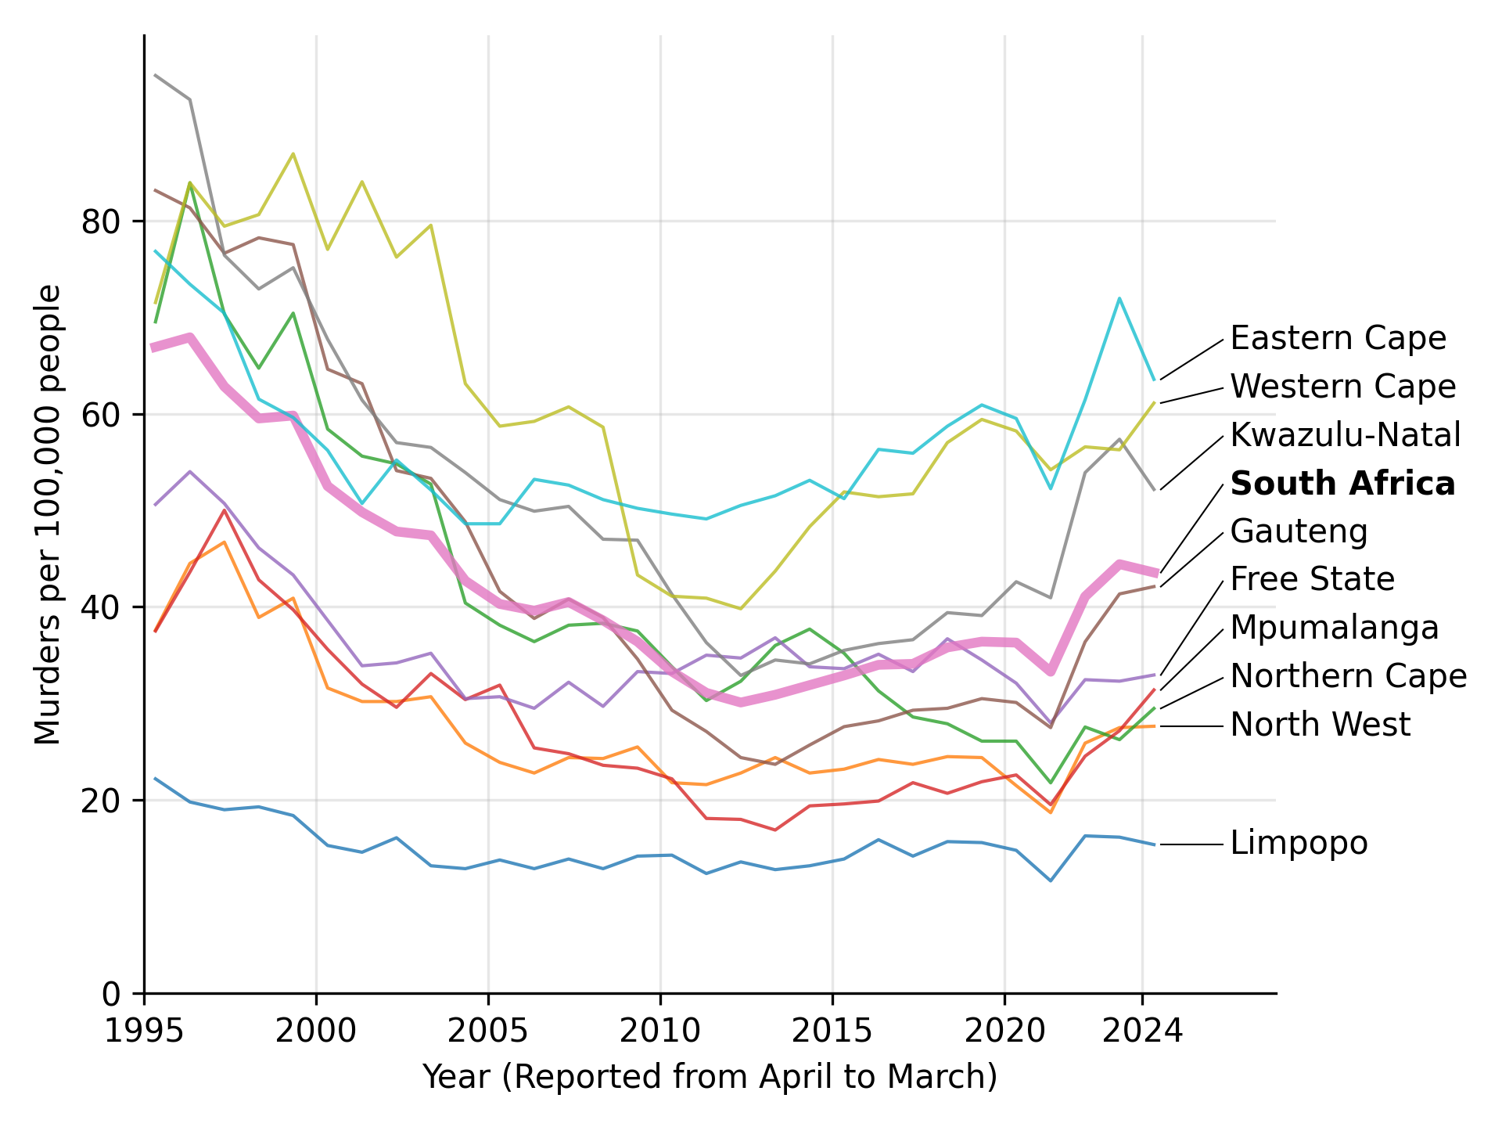
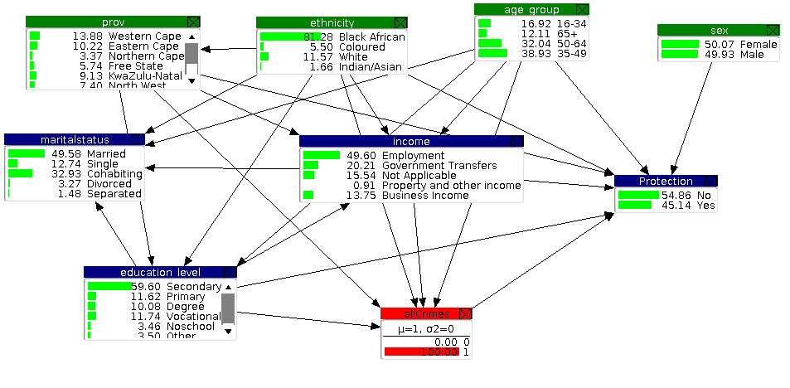
Statistical Analysis of Survey Microdata on the Level of Crime in SA.
Tabitha Masha^{1, 2}
¹African Institute of Mathematical Sciences, South Africa ²Stellenbosch University
Introduction
Results
1. Educational background)
Personal property theft was the most experienced crime.
Western Cape was a major hotspot for crimes especially personal property theft and Gauteng was a major hotspot for motorvehicle hijacking.
16-34 age group was the most vulnerable age group.
Individuals whose source of income was business income faced a higher risk of experiencing crime compare to other sources of income.
Higher education levels were associated with higher risk of crime victimization.
Crime victims were more likely to take actions against crime.
Sex and marital status had no notable effects in crime predictions.
Interactions between province, ethnicity, source of income or education revealed strong relationships in crime probabilities.
South Africa consistently faces high levels of crime, but its distribution is not uniform. There are differences based on where people live, their age, income, education, and ethnic group. There remains a gap in using advanced statistical methods to extract insights from crime experiences. To uncover hidden patterns or relationships, we apply tools like Bayesian networks to model the complex interdependence between variables.
Fig. 1 Distribution of crime in South Africa
2. Problem statement
Much of the existing research on crime in South Africa remains descriptive, offering limited insight into the crime trends and don't uncover the complex relationships among socio demographic factors on the likelihood of experiencing crime. There is therefore a need for advanced statistical models to reveal the interdependence between variables and crime.
Fig. 2 Bayesian network of crimes in general
Conclusions
In summary, this study bridges methodological gaps and uncovers insights into crime victimisation in South Africa. By using Bayesian Networks, I didn't just identify risk, I showed how factors like ethnicity, income source, age, and province interact to shape crime patterns.
These findings challenge previous assumptions, spotlight new at risk groups, and offer law enforcement actionable insights. Therefore, this is not only an analysis on crime patterns but also a decision support system that can be used by law enforcement and policy makers to provide an intuitive structure for visualizing how interventions in one area may indirectly influence crime rates through associated variables
3. Objectives
Analyse the relationship between socio demographic factors and crimes
Develop and apply statistical models including Bayesian networks and logistic regression to uncover the complex interrelationships among variables influencing crime experiences.
Methods
Exploratory data analysis which included frequencies, Pearson Chi square tests and standardized residuals.
Logistic regression which identified predictors of crimes
Bayesian networks which explored conditional dependencies among socio demographic factors and crime variables
Acknowledgments
Prof Julia Mortera – University of Roma Tre, Italy and University of Bristol, UK
Contact Details: mwikalit07@gmail.com

