Slide 1
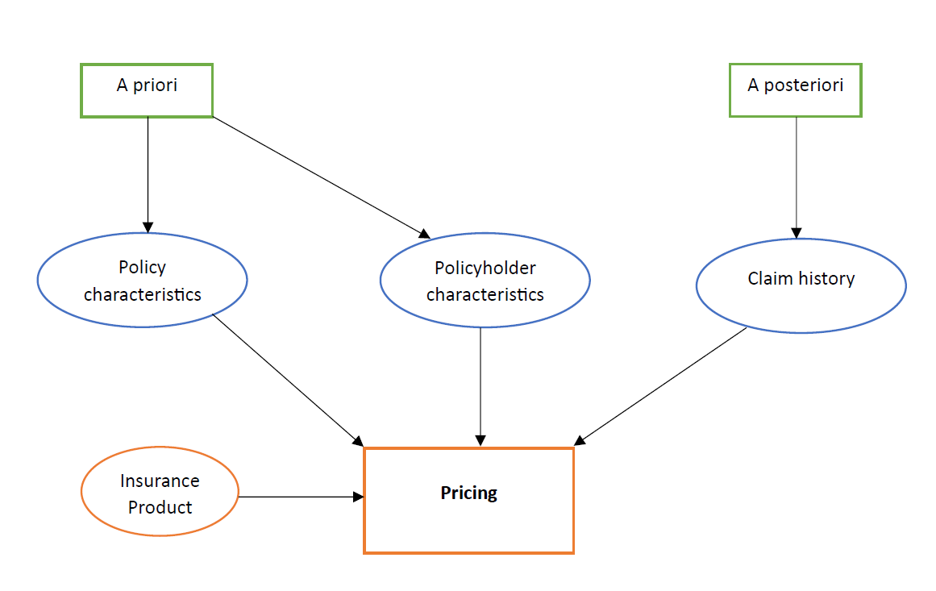
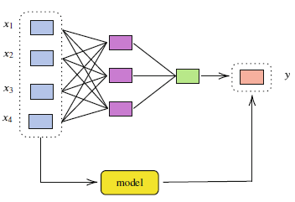
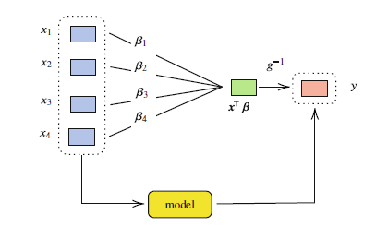

Predictive Models in Insurance Ratemaking
Simon Kamau
Egerton University, Department of Mathematics, Nakuru, Kenya
Background
1. Introduction (or educational background)
In traditional motor ratemaking, policyholders are classified according to observable risk factors such as age, gender, occupation, type and use of vehicle, and place of residence.
Unobservable characteristics, such as swiftness of reflexes, are believed to be revealed by the number of claims reported or obtained via vehicle telematics.
Actuaries use regression techniques to predict the expected number of claims from this information.
2. Problem statement
There have been considerations in banning the use of attributes that are beyond the control of the insured such as gender or race in insurance pricing.
Direct discrimination arises when such prohibited characteristics are used as rating factors.
Exclusion of such attributes is not a solution as there is a possibility of inferring protected attributes from other non-protected attributes (proxy discrimination).
Fig. 1 Flow chart of non-life insurance pricing.
Current Work
1. Objectives
3. Results
To apply ML predictive techniques in the presence of non-traditional data.
To develop discrimination-free insurance pricing models.
To compare predictive performance of traditional and ML techniques.
The project is ongoing.
2. Methodology
Fig. 3 An illustrative example of a single layer neural network. Source: Charpentier (2024).
Generalized linear models (GLMs) have been the most popular predictive technique for actuaries.
Other predictive models include neural networks, decision trees and ensemble approaches.
Fig. 2 An illustrative example of a GLM. Source: Charpentier (2024).
Conclusion & Expectations
We aim to construct a model that:
incorporates non-traditional data in insurance pricing.
generates discrimination-free prices.
has the best predictive performance.
References & Acknowledgment (if needed)
Contact: simon.muoria@egerton.ac.ke
536 – 20115, Egerton, Njoro.

