Slide 1
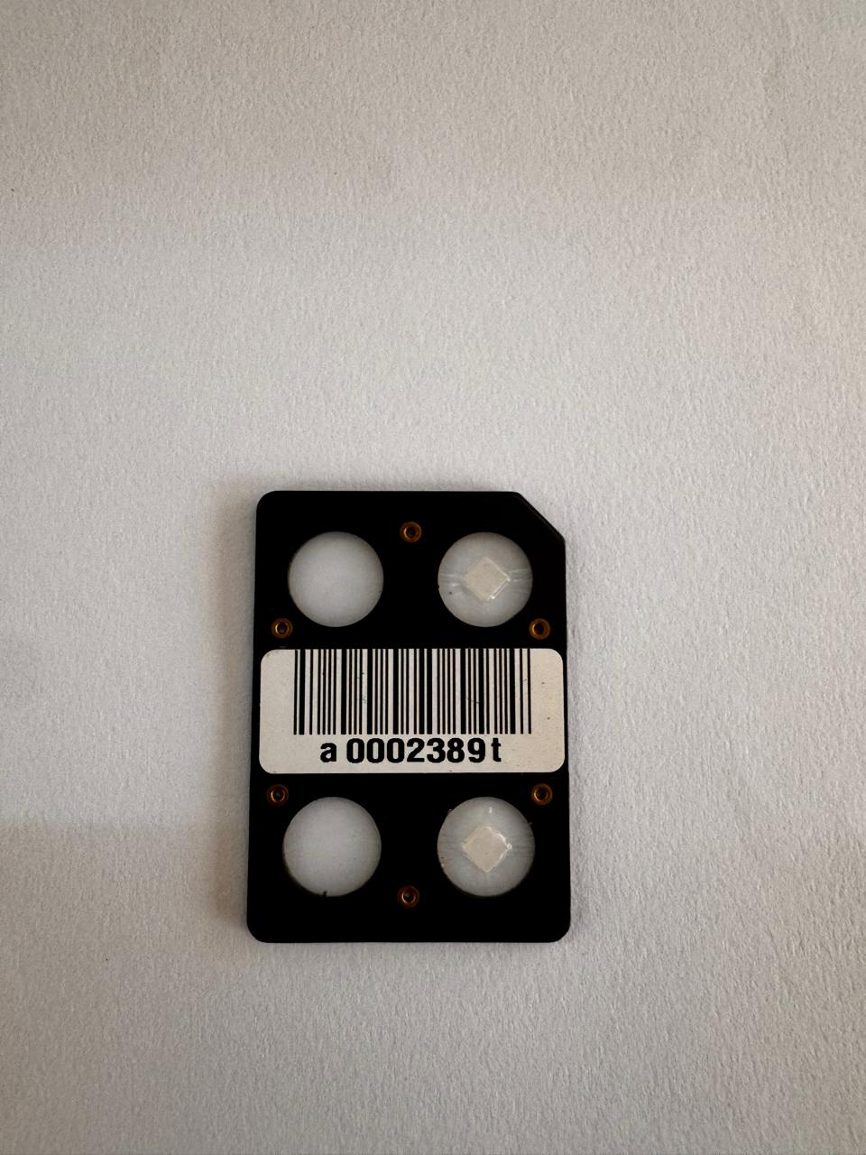

Preliminary Findings on Occupational Radiation Levels in Selected Health Facilities in Kitui County, Kenya
Muthama Matsitsi¹, Linturi James¹, Jeremiah Kebwaro², Felix Wanjala³
¹Department of Physical Sciences, South Eastern Kenya University, P.O BOX 170 - 90200 Kitui, Kenya, ²School of Pure and Applied Sciences, Karatina University, P.O BOX 1957-10101 Karatina, Kenya. ³International Atomic Energy Agency P.O BOX 100, Vienna, Austria
Background
1. Introduction (or educational background)
Ionizing radiations of natural origin are present in all environmental media (Air, water, soil) and they contributes to human population exposure primarily ²³⁸U, ²³²Th and ⁴⁰K. Additionally, extra radiation doses to human biota results from human activities like medical practices, agriculture, nuclear power and research industries. The combined contributions can be significant more so where the regulation and safety protocols are not compliant. Figure 1 is a presentation of various sources of radiation doses with their cumulative percentage contribution
2. Problem statement
The human population is continually exposed to doses of ionizing radiation from natural sources. The radiation of artificial origin also contributes to overall exposure. For occupational workers in radiology departments, the combined exposures can be significant based on multiple factors, shielding, exposure time. Sustained exposure to ionizing radiation has been associated with DNA damage particularly at doses exceeding 1 mSv/y (general public) and 20 mSv/y (occupational workers).The increasing use of radiological equipment, coupled with limited documentation on the shielding performance of x-ray machines in selected facilities prompted this study.
Fig. 1 Sources of radiations
Current Work
1. Objectives
3. Results
To determine the radiation levels in hospital wards and offices within selected Level IV and V medical facilities in Kitui County.
To monitor the occupational doses for medical workers in radiation rooms in selected Level IV and V medical facilities in Kitui County.
To optimize radiation doses for medical workers in Kitui Level V medical facility using the Monte Carlo GEANT4 toolkit.
Preliminary findings show that no average occupational dose exceeded the ICRP-recommended limit of ≤1.67 mSv/month, indicating exposures were well within safety limits. Average personal dose equivalents at Kitui Jordan Level V were higher than those at Mwingi Level IV and Kitui County Referral Hospital, likely due to additional diagnostic radiation modalities not present in the other facilities. Figure 3 shows average whole-body dose Hp(10) and skin dose Hp(0.07) across the hospitals
2. Methodology
Twenty(20) TLDs where acquired from Kenya Nuclear Regulatory Authority
Preparation of TLDs; Harshaw 8800 TLD reader in (KNH)
The TLDs heating to anneal data using standard protocol
TLD reader calibration factor (RCF) element correction coefficient (ECC)
TLD Field Deployment & monthly data collection
$$D=(Q×ECC)/RCF$$
Aluminum card
Notched identify corner
Fig.3 Average monthly personal dose Hp(10) and Hp(0.07)
Serial number
Table 1. Average personal dose values reported in May for studied facilities
Kitui Jordan Level V |  | Mwingi Level IV |  | Kitui County Level V
Hp (0.07) | Hp (10) | Hp (0.07) | Hp (10) | Hp (0.07) | Hp 10)
0.14±0.055 | 0.16±0.048 | 0.10±0.01 | 0.11±0.01 | 0.10±0.03 | 0.13±0.02
Bar code
TL element
Fig. 2 LiF; Mg, Ti TLD 100 mode used
Conclusion
The average personal dose equivalents for skin dose, Hp(0.07), and deep dose, Hp(10), were reported for the first month of the study. Dose variation across TLD badges was attributed to workload intensity, proximity to radiation sources, procedure frequency, and shielding inconsistencies. Overall, skin doses were lower than deep body doses, likely due to the use of lead aprons that shield superficial tissues. Kitui Jordan Level V Hospital recorded slightly higher doses, possibly due to additional modalities like fluoroscopy not used in the other facilities. The monthly Hp(10) range of (0.11 ± 0.01 - 0.16 ± 0.048) mSv, is comparable to Hp (10) of 0.21 mSv and (0.10–0.57) mSv reported by Omondi (2024) and Korir (2011) respectively
References & Acknowledgment (if needed)
Korir, G. K., Wambani, J. S., & Korir, I. K. (2011). Estimation of annual occupational effective doses from external ionising radiation at medical institutions in Kenya. SA Journal of radiology, 15(4).
Omondi, C., Chege, M., & Omondi, S. (2024). Assessment of Occupational Radiation Exposure for Radiotherapy Healthcare Workers at Kenyatta National Hospital Using Thermoluminescence Dosimeter LiF: Mg, Ti. Journal of Geoscience and Environment Protection, 12(7), 14-24.
Contact: muthamamatsitsi@students.seku.ac.ke
P.O BOX 170-90200
KITUI

