Slide 1
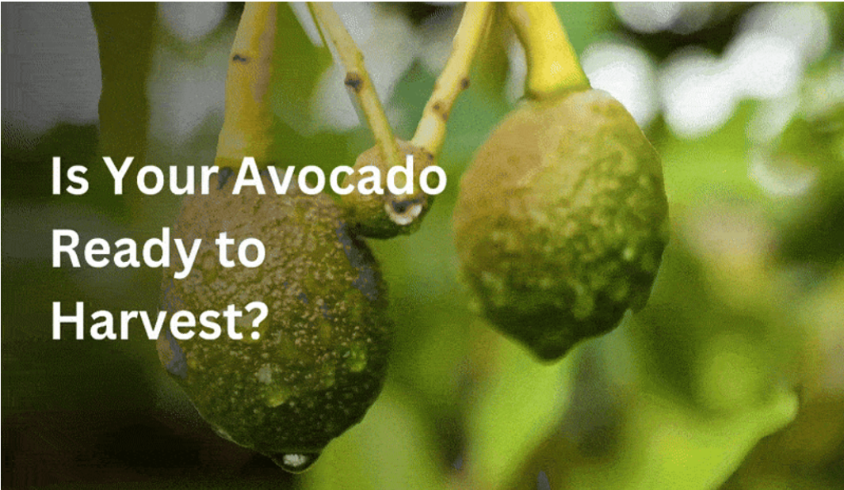
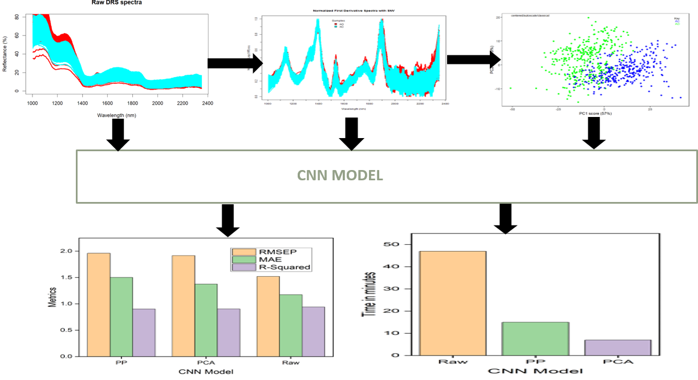
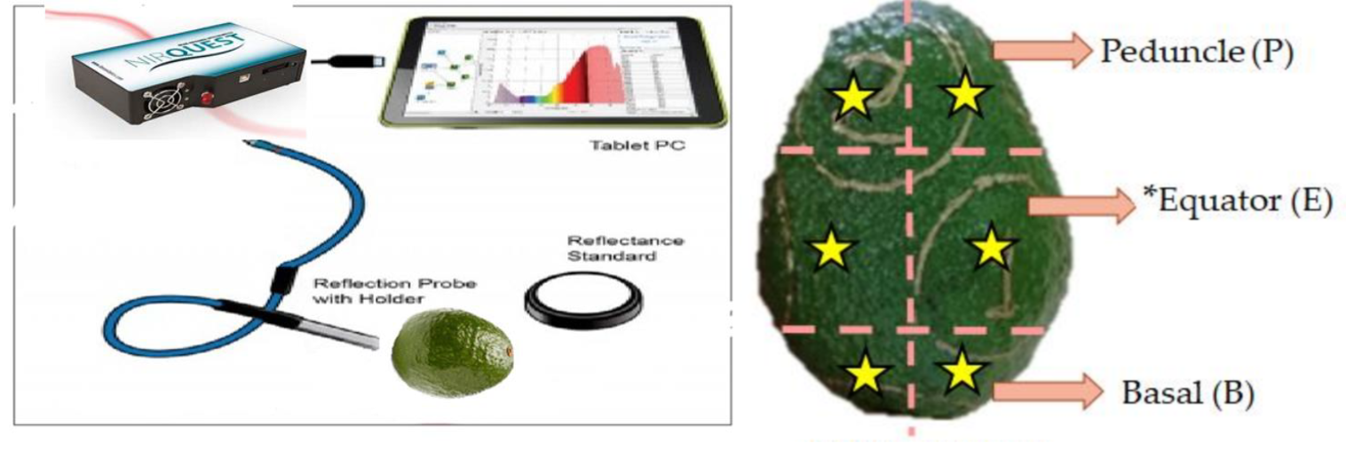
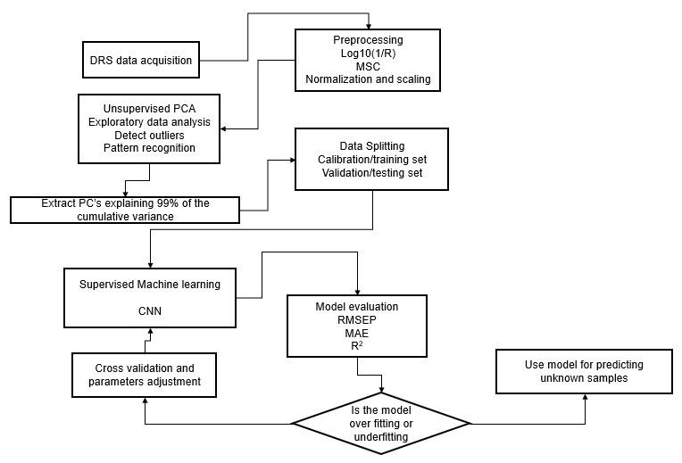

MACHINE LEARNING-ASSISTED NEAR INFRARED SPECTROSCOPY FOR RAPID, NON-DESTRUCTIVE ASSESSMENT OF HASS AVOCADO MATURITY.
Mercy Amondi¹ Zephania Birech²
¹ Maasai Mara University , School of Pure and Applied Sciences, Narok, Kenya,
² UNIVERSITY OF NAIROBI, FACULTY OF SCIENCE AND TECHNOLOGY,NAIROBI,KENYA.
Background
1. Introduction
Avocado is a globally significant crop, with approximately 8.06 million tonnes produced annually, and Kenya ranks sixth among the top producers [1].
Harvest maturity is important for ensuring good flavour, texture, shelf life, and reducing post-harvest losses caused by immature or overripe fruits [2].
Determining avocado maturity is challenging due to the minimal visible changes, and some indicators, such as seed coat colour require destructive testing methods [3].
2. Problem statement
Conventional maturity assessment (dry‐matter/firmness tests) is destructive, labour-intensive, and yields inconsistent results.
These methods cause delays and result in economic losses, making them unsuitable for large-scale production.
There is an urgent need for a rapid, accurate, non-invasive method to determine optimal harvest time.
Fig. 1 Despite similar external features, avocados may differ significantly in internal maturity.
Current Work
1. Objectives
3. Results
To design and optimize a non‑invasive Near-Infrared (NIR) method for rapid Hass avocado maturity assessment.
To measure the predictive performance of a Convolutional Neural Network (CNN) on raw spectral data, preprocessed spectral data, and Principal Component Analysis (PCA) transformed data.
2. Methodology
Fig. 2 Setup for diffuse reflectance.
Fig. 4 Flowchart showing optimization of NIR spectroscopy using a CNN model.
The CNN model performed best on raw spectra (R² = 0.94, RMSEP = 1.52), outperforming PCA (R² = 0.90, RMSEP = 1.97) and preprocessed (PP) data (R² = 0.90, RMSEP = 1.92), showing its strength in learning from rich spectral features without dimensionality reduction.
Fig.3 Flowchart summarizing the methodology used in this study.
Conclusion & Expectations
This study demonstrates the potential of Near-Infrared Reflectance Spectroscopy (NIR) with machine learning for assessing Hass avocado maturity.
Goal: Develop an affordable, compatible device for real-time field assessments by smallholder farmers.
References & Acknowledgment
https://www.fao.org/home/en, 2023.
https://doi.org/10.1186/s40100-017-0095-8
https://doi.org/10.3389/fpls.2022.895964
We extend our heartfelt gratitude to the University of Nairobi for graciously granting us access to their Laser Laboratory.
Contact: mercyamondi161@gmail.com

