Slide 1

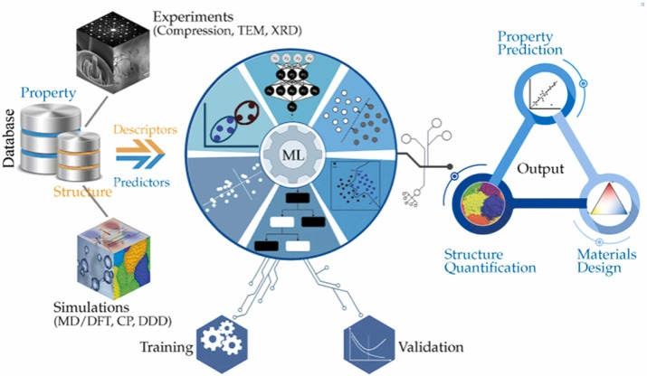
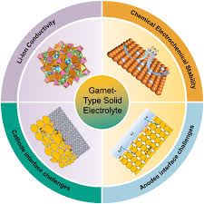


Computational Investigation of Iso- and Aliovalent Substitution Effects on Structural Stability, Defect Chemistry and Transport Properties in Garnet, Double Perovskite and Antiperovskite Materials
Mavyline Motari¹, Robinson Musembi¹
¹University of Nairobi, Department of Physics, Nairobi, Kenya
Background
1. Introduction
With the growing demand for clean and sustainable energy, the development of materials with tunable properties is essential for applications in energy conversion and storage. Of such materials, this research will look into:
Garnet-type materials – desirable for development of solid-state electrolytes (SSE) for application in Lithium-ion batteries.
Double perovskite materials – desirable as alternative to lead-free perovskite materials for solar cell application
Antiperovskite materials – materials for SSE with higher ionic conductivities for batteries.
Key interest is on materials with excellent optoelectronic properties for application in solar cell and materials with wide electrochemical stability for solid-state electrolytes in batteries.
2. Problem statement
Garnets, double perovskites, and antiperovskite materials have emerged as promising candidates for high performance energy storage and conversion systems due to their diverse crystal structures and tunable properties. However, their performance is highly sensitive to compositional modifications. While isovalent and aliovalent substitutions are known to influence structural stability, defect formation, and ion transport mechanisms, a comprehensive understanding of these effects across different material classes remains limited necessitating systematic computational investigations.
Fig. 1 Solar energy has immense potential as a renewable source of energy
Current Work
1. Objectives
ii) Performance of structural optimization to assess for stability.
iii) Incorporation of Machine Learning (ML) models to guide future simulations and experimental validation.
i) To investigate the impact of aliovalent doping for Garnet-type Oxides on lithium-ion conductivity and oxygen vacancy formation energies.
ii) To assess the role of isovalent and aliovalent substitution at the A-site on the double Perovskites material’s electronic structure and magnetic ordering.
iii) To examine how aliovalent substitution at the O-site of antiperovskites or Li-site affects lattice stability and lithium-ion transport.
iv) To compare trends across all three systems in terms of defect energetics, dopant solubility, and ion transport enhancement .
3. Expected Results
Trends in structural stability and ionic transport properties due to specific dopants.
Insights into dominant defect types due to different substitution.
Comparative analysis highlighting how substitution effects differ between garnets, double perovskites and antiperovskites.
2. Methodology
i) Use of first principle density functional theory (DFT) calculations to model substituted structure.
Fig. 2 Research themes for advancement of garnet-type materials for Li-ion batteries. Figure adapted from Zhao et. al 2025
Fig. 3 DFT and ML application in material property analysis for various applications. Figure adapted from Wan et. al 2021
Conclusion
Solar energy has immense potential as an alternative source of clean renewable energy.
Optimization of conversion technologies for solar energy using photovoltaics is paramount.
Li-ion batteries with high energy density, safety and flexibility are desirable especially for powering portable devices.
Computational methods for analysis of material properties in search of optimal properties for application in solar cells and Lithium ion batteries.
References
1. Thangadurai, V., Narayanan, S., & Pinzaru, D. (2014). Garnet-type solid-state fast Li ion conductors for Li batteries: critical review. Chemical Society Reviews, 43(13), 4714–4727
2. Xiang, W., & Tress, W. (2019). Review on recent progress of all‐inorganic metal halide perovskites and solar cells. Advanced materials, 31(44), 1902851.
Contact: mavyline.motari@gmail.com

