Slide 1
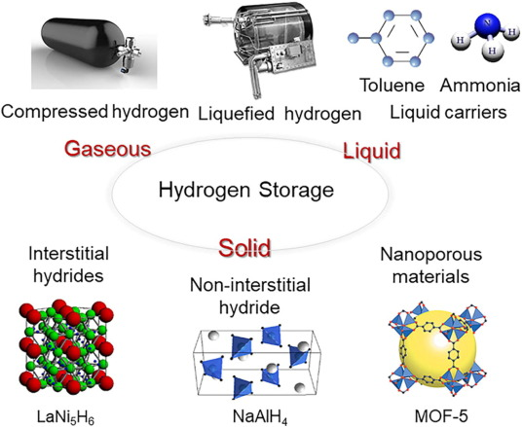

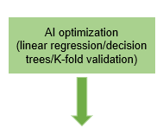
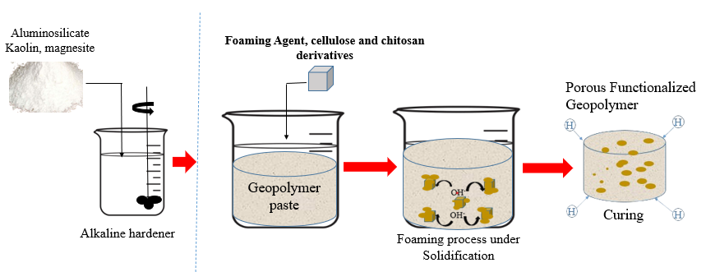

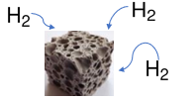


Synthesis of Functionalized Geopolymers and AI-Based Optimization of Synthesis and Storage Parameters for Onboard Hydrogen Applications
Julieth Kakwaya¹, Lenganji Simwanda², Umit Demirci³, Regina Mtei¹, Makungu Madirisha¹
¹University of Dar es Salaam, Chemistry Department, Dar es salaam, Tanzania, ²Czech Technical University, Structural Reliability Department, Prague, ³University of Montpellier, Chemistry Department, France
Background
1. Introduction
Highly porous with tunable surface chemistry
Safety
Heavy tanks
Boil-off loses
High cost
Energy intensive
Low storage capacity
Thermally stable
Few studies reported
2. Problem statement
Fig. 1 Geopolymer
Hydrogen storage remains costly, energy-intensive, and raises safety concerns.
Geopolymers (1) offer a tunable, low-cost alternative for H₂ storage but are still underexplored.
More broadly, the complex structure of solid adsorbents limits accurate prediction of hydrogen storage performance.
To bridge these research gaps, this study aims to synthesize functionalized geopolymers and uses AI to optimize the synthesis and the storage performance.
AI can speed up hydrogen storage material development by overcoming the limitations of slow, traditional testing methods.
Current Work
1. Objectives
Functionalize cellulose and chitosan for geopolymer modification
Synthesize functionalized geopolymers
Apply AI to optimize synthesis and storage performance
Test performance of the optimized functionalized geopolymers
2. Methodology
Conclusion & Expectations
This study explores low-cost, functionalized geopolymers as a safer and efficient alternative for hydrogen storage. It integrates AI to accelerate material and performance optimization, addressing key challenges in clean energy adoption. The following are the ongoing and future works
Finalize synthesis of functionalized geopolymers for hydrogen storage.
Hydrogen storage test
Optimize AI models to predict synthesis conditions and improve storage performance.
Contact:julieth.kakwaya@udsm.ac.tz kakwayajulieth@gmail.com
P.O.Box 35061, Dar es Salaam

