Slide 1
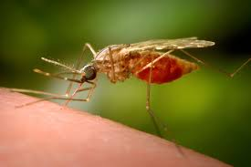
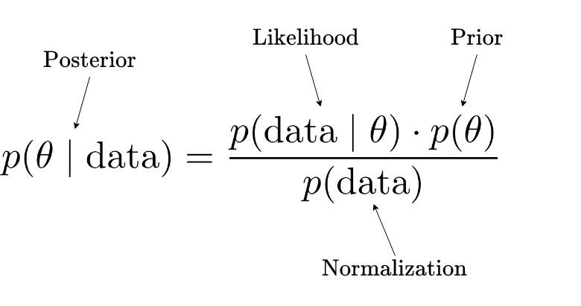
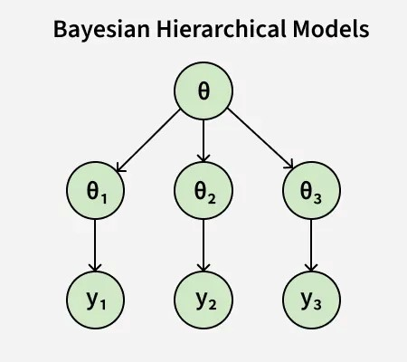



Bayesian Models for Mapping and Predicting Malaria Hotspots
Jacinta Wayua Muindi
University of Nairobi, Department of Mathematics, Nairobi, Kenya
Background
1. Introduction
Malaria is a significant public health concern in Kenya.
70% of Kenya’s population is estimated to be at risk of malaria
14 million people live in endemic areas
17 million people live in areas of epidemic and seasonal malaria [1].
Communicable diseases are the leading cause of outpatient visits and inpatient admissions in Kenya[1].
Timely detection and prediction of hotspots are crucial for effective intervention.
2. Problem statement
Fig. 1 From a bite to an outbreak
Lack of models incorporating uncertainty in disease prediction
Many available models rely on single-source epidemiological data (e.g., case counts), ignoring other key determinants of disease spread
Incomplete and Noisy Data – Bayesian methods are robust to missing or sparse datasets
Current Work
1. Objectives
Modeling approach
Bayesian inference – a statistical framework based on Bayes’ Theorem.
The framework provides a principled framework for incorporating uncertainty in predictions.
2. Machine learning models – To benchmark the performance of the Bayesian hierarchical models, two machine learning models will be trained and evaluated.
This study aims to:
Develop Bayesian spatial-temporal models integrating diverse data sources.
Leverage Bayesian inference to quantify uncertainty and enhance prediction.
Implement and validate models using real malaria data.
2. Methodology
Modeling approach
Bayesian hierarchical models – develop and evaluate different variants of Bayesian hierarchical models (different modeling assumptions and data structures)
Hierarchical models – statistical models that use a hierarchical structure to estimate parameters. They can handle different groups/sources of data and/or data with hierarchical structures.
Fig. 3 The Bayes theorem
3. Results
The expected results are:
More accurate models for identifying and forecasting malaria hotspots.
Data-driven insights for resource allocation and intervention planning.
Fig. 2 Bayesian Hierarchical Models Structure
Conclusion & Expectations
If malaria hotspots can be mapped and predicted accurately, it can help in decision-making, resource allocation, and generally, the mitigation efforts.
The findings of this study will contribute to epidemic preparedness and public health.
This study will support policymakers and other stakeholders in handling malaria.
References
[1] World Heath Organization. Country Disease Outlook: Kenya. 2023.
Contact: muindijacinta536@gmail.com

