Slide 1
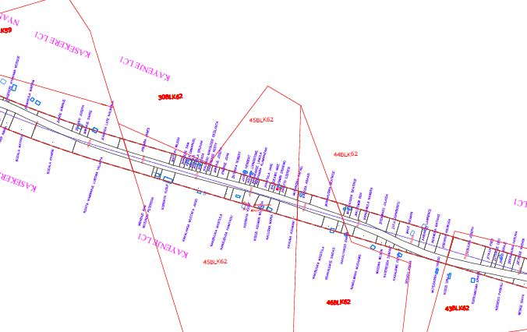

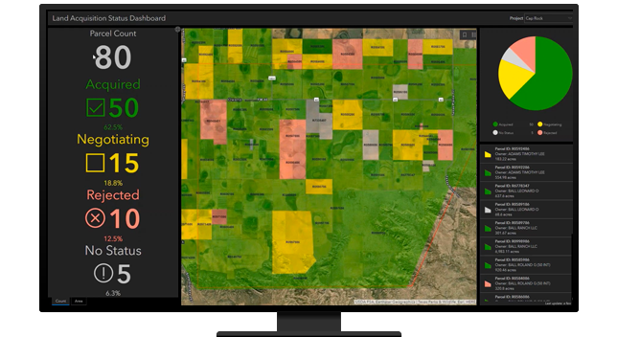

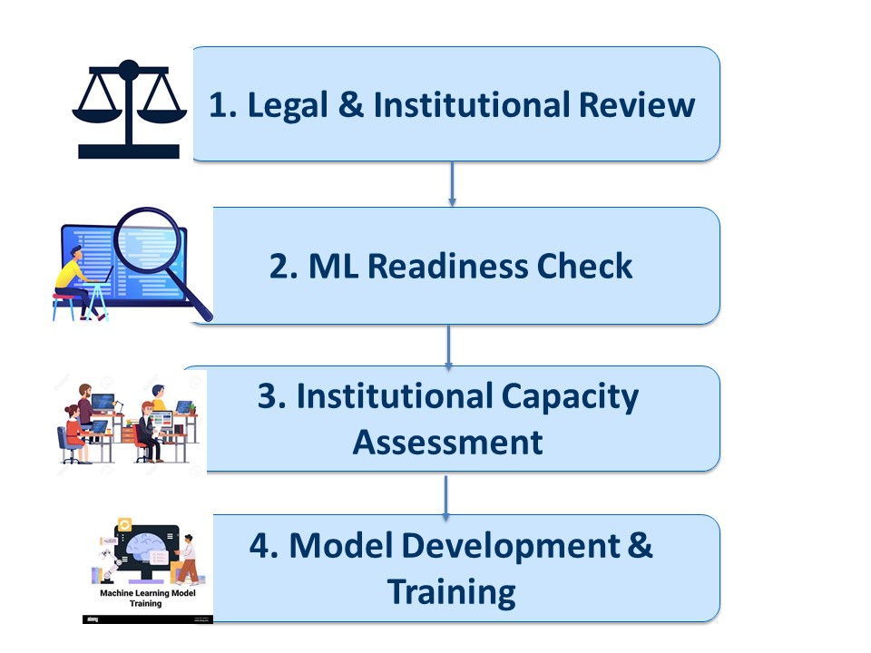

GeoAI & ML in NLIS; Enhancing Uganda’s Land Expropriation
PhD Candidate: Immaculate Asiimwe
Supervisors: Prof. Moses Musinguzi & Dr. Allan Mazimwe
¹Makerere University Kampala
Background
1. Introduction (or educational background)
Uganda’s drive toward infrastructure development, aligned with SDG 9, Vision 2040, and NDP III requires large-scale land expropriation for roads, dams, power lines, pipelines, and resettlement of displaced persons. Land expropriation involves vast geospatial and attribute data, yet current processes lack automation and advanced analytics.
2. Problem statement
Despite adoption of SDI in the National Land Information System (NLIS), critical and recurrent land administration components like mutation & transfer remain siloed. There's no ML-driven linkage to support efficient land acquisition workflows. The aim of this study is to design and train a machine learning model that automates spatial data handling, enhances data integration & retrieval and supports predictive modeling for land workflows while adding intelligence to SDI-based land administration
Fig. 1 Manually Input Spatial & Attribute Data (Land parcel, Name of owner, area to be acquired) displayed on a static strip Map.
Current Work
1. Objectives
3. Expected Results
1. To assess existing legal and institutional framework for land expropriation and SDI in Uganda
2. To assess the suitability of existing land acquisition datasets and workflows for use in Machine Learning.
3. To assess the technical Capacity of Uganda MDAs to integrate Machine Learning and SDI in the Land expropriation process
4. To develop and train a model for fast tracking land administration during land Acquisition.
Identified gaps in laws & workflows limiting ML/GeoAI adoption
Assessment of dataset suitability for machine learning
Technical capacity map of Uganda's MDAs
Prototype ML model for accelerating land acquisition processes
2. Proposed Methodology
Review existing legal & institutional framework supporting Land Expropriation
Perform Machine Learning Readiness Checks on Land Expropriation processes and datasets from different MDAs
Assess the Capacity and readiness of Uganda Ministries and MDAs to integrate Machine Learning in the Land Expropriation and National Land Information System.
Design a model and train it using available spatial/ attribute data.
Fig. 2 An illustration of the proposed methodology for the study
Fig. A dash board showing a map, summary statistics of land acquired and infographics; all being updated in real time.Source: esriuk.com
Conclusion & Expectations
Integrating ML into the National Land Information System will boost operational efficiency, improve data integration in land administration while supporting evidence-based decision-making during land expropriation.
References & Acknowledgment (if needed)
A.P. Frenţ, A.C. Badea, P.I. Dragomir (2022). Geospatial Data Management Related to Expropriation Works: Research Gate.
GSDI Association. (2004). Developing spatial data infrastructures: The SDI cookbook (Version 2.0). Global Spatial Data Infrastructure Association.
Musinguzi, M., Tickodri-Togboa, S.S. and Gerhard, B (2004). Opportunities and Challenges For SDI Development in Developing Countries - A Case Study Of Uganda: ResaerchGate
Musinguzi, M. (2011). A Tree Model for Diffusion of Spatial Data Infrastructures in Developing Countries: Semantic Scholar
Musinguzi, M., Tickodri-Togboa, S.S. and Gerhard, B (2012). Interoperability of GIS Data in Uganda: ResearchGate
Contact: myemail@my-univ.fr
My Postal address
May be my pictures

