Slide 1
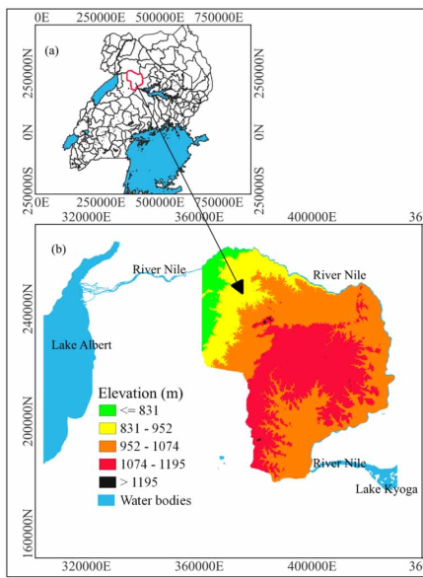
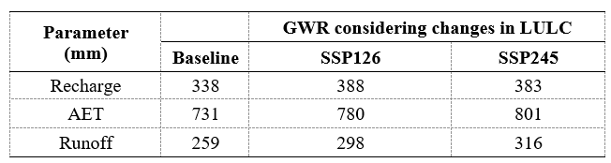
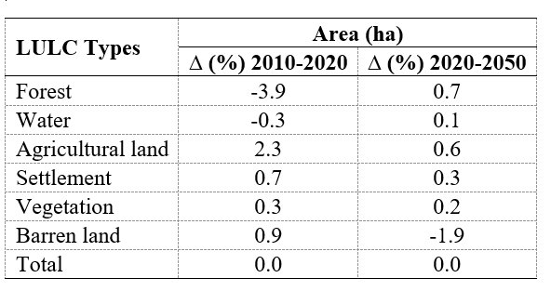
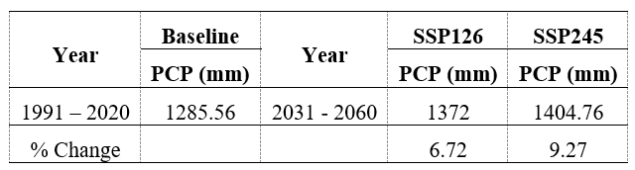

Groundwater recharge assessment under climate and land use change scenarios: A case study of Kiryandongo, Uganda
Gordian Rocky Mataba¹, Owino C. M Ochwo¹, Juma Rajabu Selemani¹, Gustavio Okwir²
¹Nelson Mandela African Institution of Science and Technology, Arusha, Tanzania, ²Gulu University, Gulu, Uganda
Background
1. Introduction
Groundwater is an important resource supporting domestic, industrial, and
agricultural needs. However, it faces major challenges from pollution, climate and land use changes, and inadequate management.
Climatic changes (temperature and precipitation) affects the hydrologic cycle with significant impact on ground water recharge.
Land use/land cover (LULC) changes affect recharge and runoff processes.
2. Problem statement
Kiryandongo district is facing shortage in water supply despite that groundwater is providing 88% of rural water supply in Uganda.
As a mitigation, borehole drilling for large scale abstraction requires sufficient, precise, and reliable information on groundwater resources in the area.
However, such information is scarce due to the limited number of studies
Fig. 1 Map of
the study area
Current Work
1. Objectives
3. Results
The main objective was to investigate the impacts of climate change on groundwater recharge in Kiryandongo through:
Assessment of the historical and future climate changes in Kiryandongo district in terms of precipitation and temperature.
Evaluation of the annual and seasonal groundwater recharge in Kiryandongo district using the WETSPASS model.
Mean annual groundwater recharge is expected to increase by 14.79% under SSP126 and 13.24% under SSP245 due to the combined effects of climate and land use/land cover.
There were significant changes in LU/LC in both baseline and future period.
The mean annual temperature is expected to rise by 1.05°C under SSP126 and 1.23°C under SSP245.
The annual mean rainfall is projected to rise by 6.72% under SSP126 and by 9.27% under SSP245.
2. Methodology
Wetspass-M hydrological model was used to assess the impacts of climate and LULC changes on GWR.
Statistical downscaling of current and future climatic data from CMIP6 (ACCESS-ESM1-5) under SSP126 and SSP245 emission scenario using the LARS-WG8) model.
Current (using R) and future (using GEE) land cover classification and change using Random Forest algorithm.
Table. 1. Comparison of the mean annual GWR, AET, and Runoff under combined effects of Climate and LULC changes (2050).
Table 1. Land use/land cover (LULC) changes from 2010 to 2050
Table. 3 Mean annual precipitation in the study region under baseline (BL), SSP126, and SSP245 emission scenarios
Conclusion & Expectations
The findings suggest significant changes in LULC between 2020 and 2050, which, along with climate change, will substantially influence the spatial distribution of groundwater recharge. However, LULC changes were found to have a greater impact on groundwater recharge (less recharge) than climate change (more recharge) when considered alone.
We recommend implementing strategies to enhance land management practices, including soil and water conservation techniques and sustainable urban planning, to improve groundwater recharge.
Promoting agroforestry, afforestation, and reforestation initiatives can increase vegetation cover, supporting water infiltration and ecosystem sustainability.
References & Acknowledgment
Contact: gordpawa@hotmail.com
P.O. Box 447
Arusha
Tanzania

