Slide 1
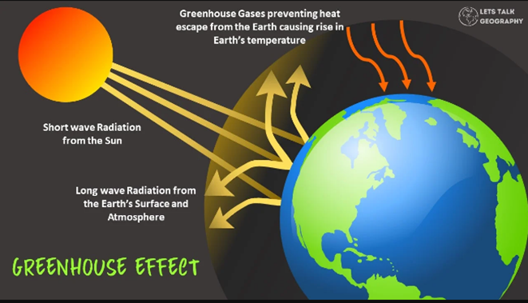
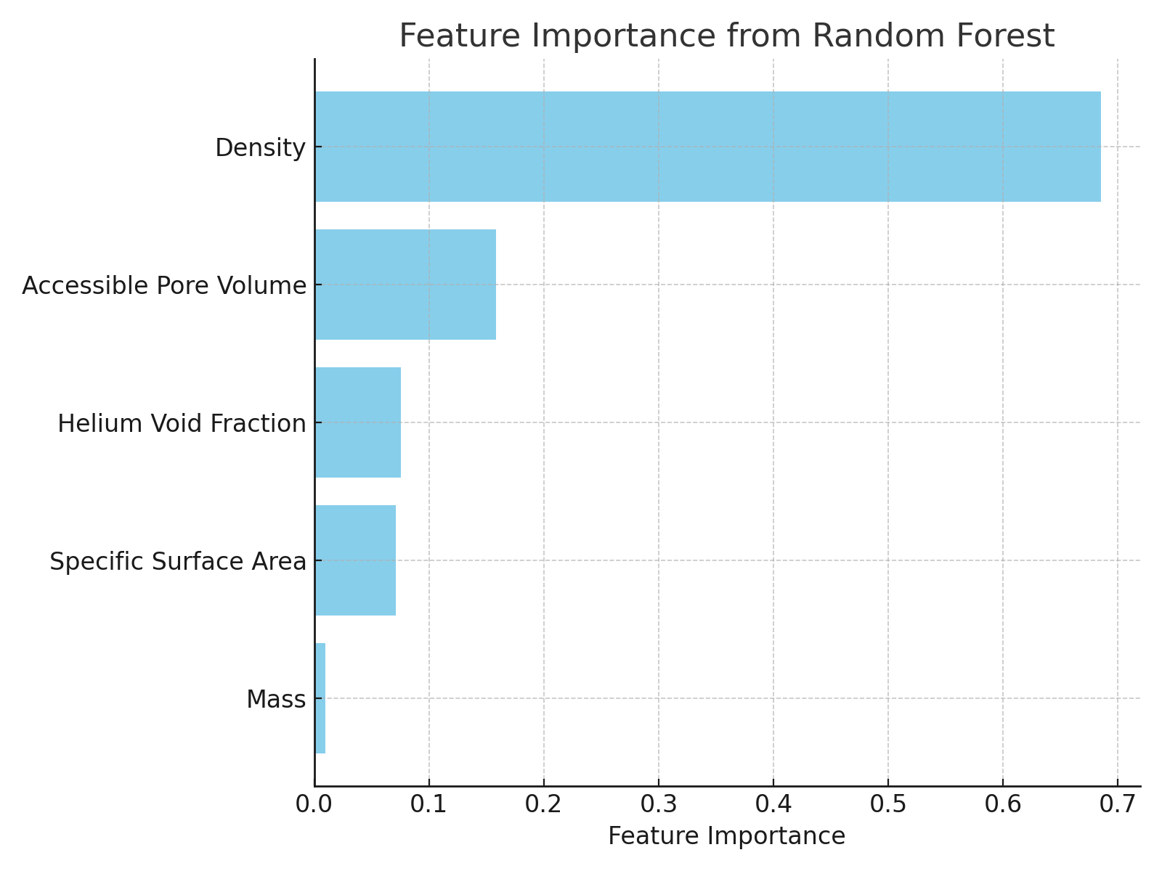
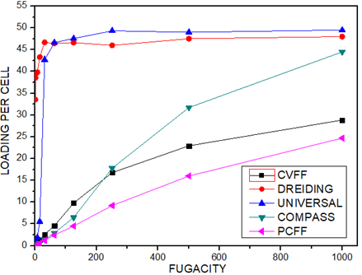


Carbon Capture by Zeolite Templated Carbons Using Molecular Simulation and Machine Learning
Felix Okello¹, Anthony Pembere²
¹JOOUST , Department of Physical Sciences, Bondo, Kenya ²JOOUST,Department of Physical Sciences, Bondo, Kenya
Background
1. Introduction
Massive amounts of CO₂ have been released into the atmosphere due to expanding usage of fossil fuels.
As a potential countermeasure to global warming, CO₂ capture technology has generated a lot of attention
Zeolite-templated carbon (ZTC) is a special type of ordered porous carbon which has nanographenes that resemble buckybowls
2. Problem statement
The earth's average temperature is being elevated due to enormous amounts of CO₂ into the atmosphere
Effective collection strategies are needed to minimize the concentration of CO₂
As a potential countermeasure to global warming, CO₂ capture technology has generated a lot of attention
Fig. 1 The greenhouse effect
Current Work
1. Objectives
3. Results
Screening of ZTCs for CO₂ storage
Use machine learning for feature Engineering
Comparative analysis of multiple machine learning models by Lazy Predict using Jupiter environment
Use machine learning to predict the structural feature with a large influence on CO₂ adsorption
Increase in temperatures reduces the adsorption capacities of ZTCs
A strong positive correlation is observed between the Accessible Pore Volume (APV) and %wt (0.94)
The Lars and Linear Regression models stand out with high R-squared values of 0.98 and low RMSE of 1.32.
2. Methodology
ZTCs structure were imported into the material studio software prior to sorption calculations.
The dataset was loaded into a Jupyter notebook environment,.
The Linear Regression model was trained using the training set, and predictions were generated on the test set
Fig. 2 Adsorption of CO₂ on FAU_2 using various forcefields
Fig. 3 The feature importance derived from the Random Forest model
Conclusion & Expectations
Machine learning models achieved high predictive accuracy (R² = 0.98), confirming the reliability of computational predictions.
The correlation analysis and feature importance ranking revealed density and APV as the most critical features
This research provides a robust predictive framework that not only accelerates material screening for carbon capture but also offers valuable insights for engineering high-performance adsorbents
Future studies should explore hybrid or functionalized ZTCs capable of maintaining high CO₂ uptake across a broader range of operating conditions, especially at elevated temperatures relevant to industrial applications
References & Acknowledgment (if needed)
Contact: otienofelix397@gmail.com
Postal Address: P.O BOX 338-40601 ,BONDO

