Slide 1

FCC-SEED
Vertex detector project
Jeremy Andrea, Auguste Besson,
IPHC, CNRS, Unistra
On behalf of the FCC-SEED project

Slide 2

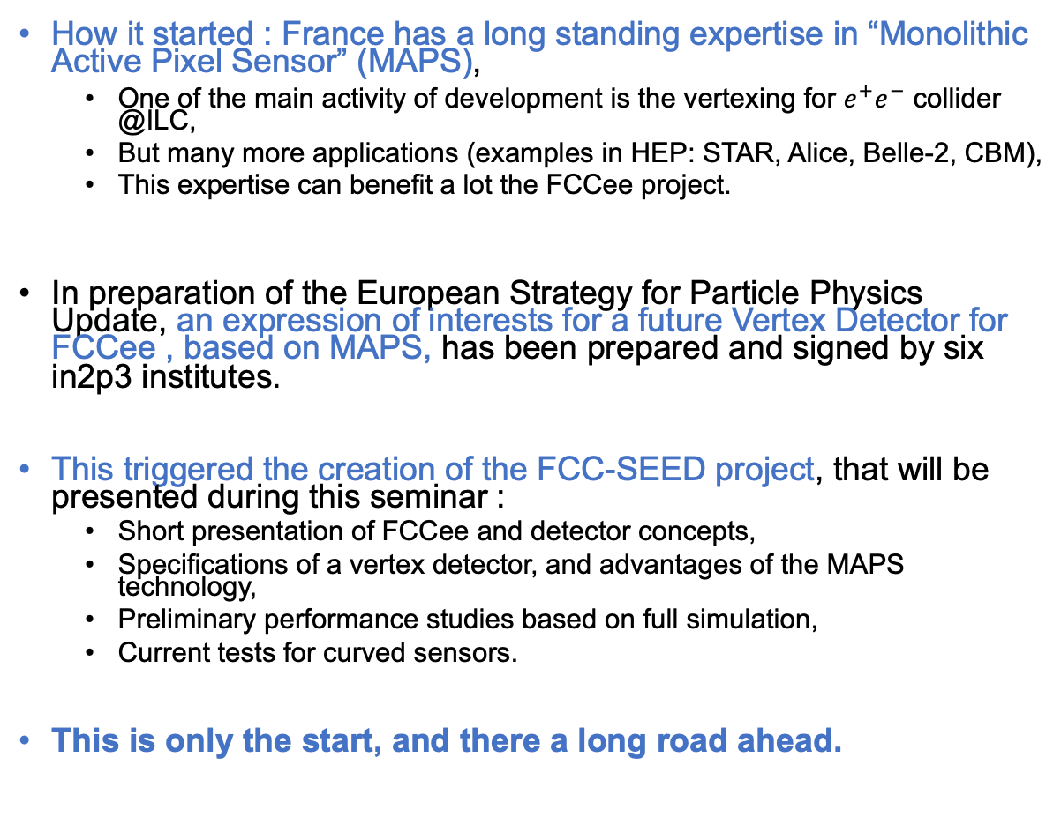
Introduction
How it started : France has a long standing expertise in “Monolithic Active Pixel Sensor” (MAPS),
  One of the main activity of development is the vertexing for $e^{+}e^{−}$ collider @ILC,
  But many more applications (examples in HEP: STAR, Alice, Belle-2, CBM),
  This expertise can benefit a lot the FCCee project.
In preparation of the European Strategy for Particle Physics Update, an expression of interests for a future Vertex Detector for FCCee , based on MAPS, has been prepared and signed by six in2p3 institutes.
This triggered the creation of the FCC-SEED project, that will be presented during this seminar :
  Short presentation of FCCee and detector concepts,
  Specifications of a vertex detector, and advantages of the MAPS technology,
  Preliminary performance studies based on full simulation,
  Current tests for curved sensors.
This is only the start, and there a long road ahead.

Slide 3
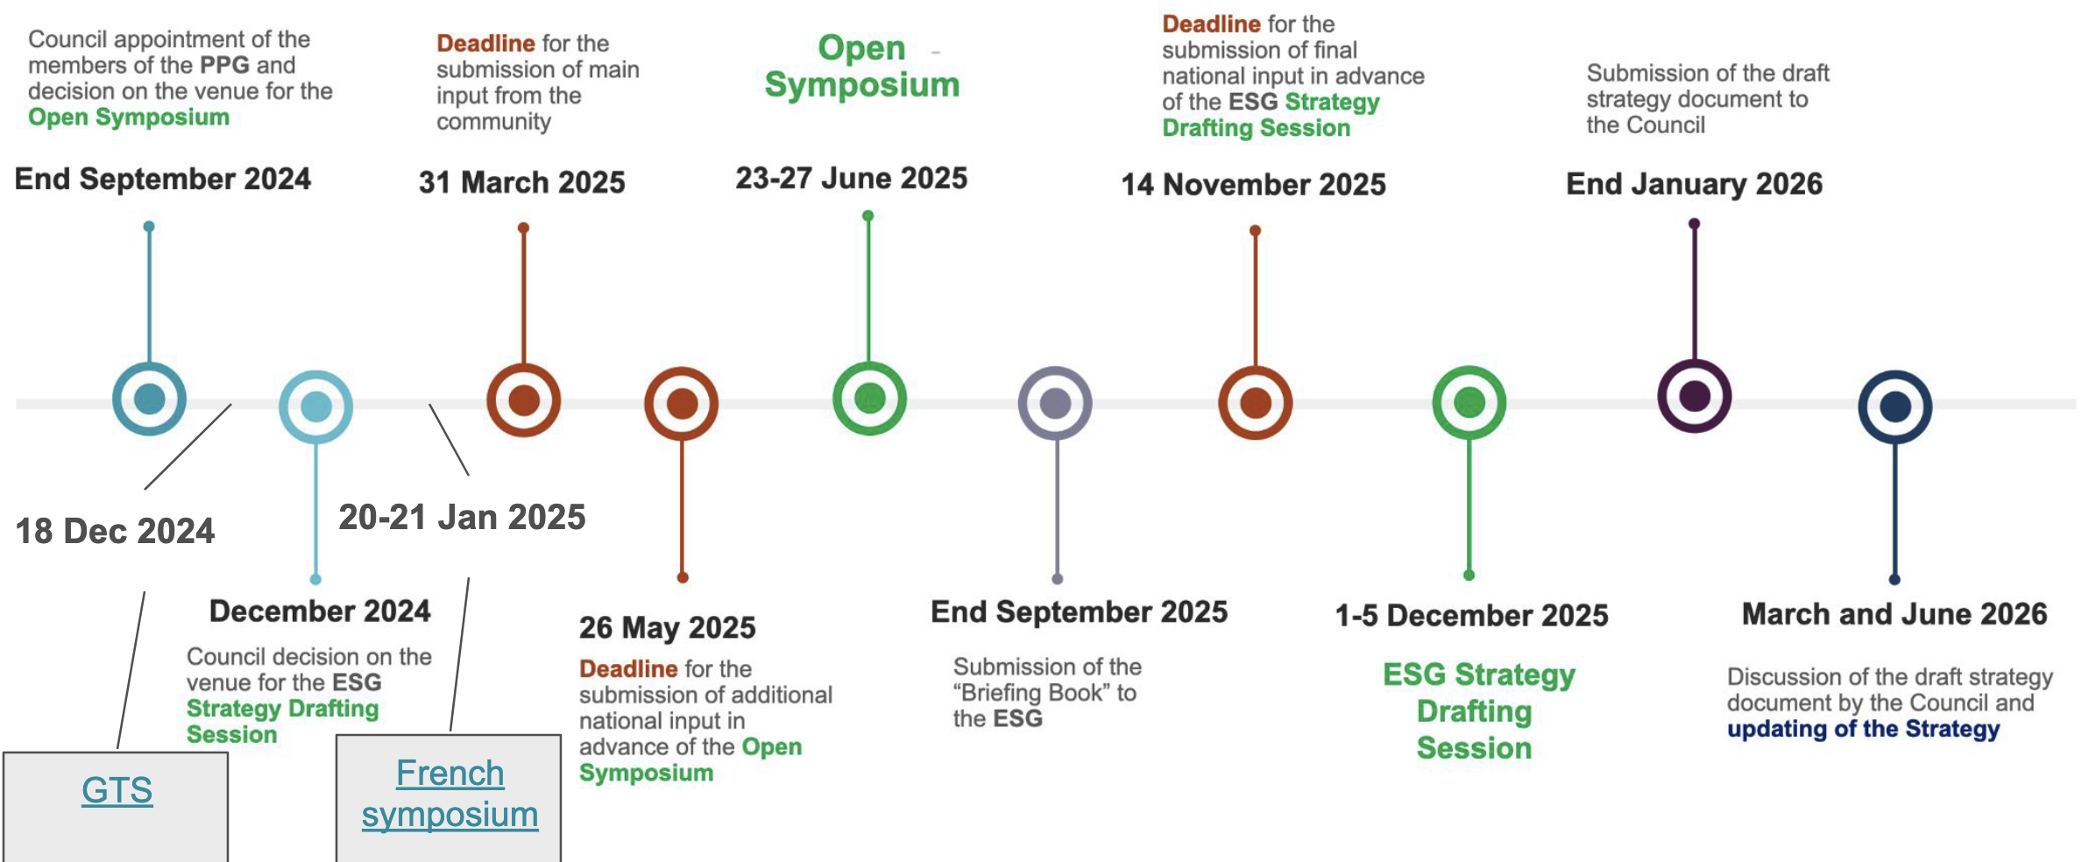

ESPPU timeline

Slide 4
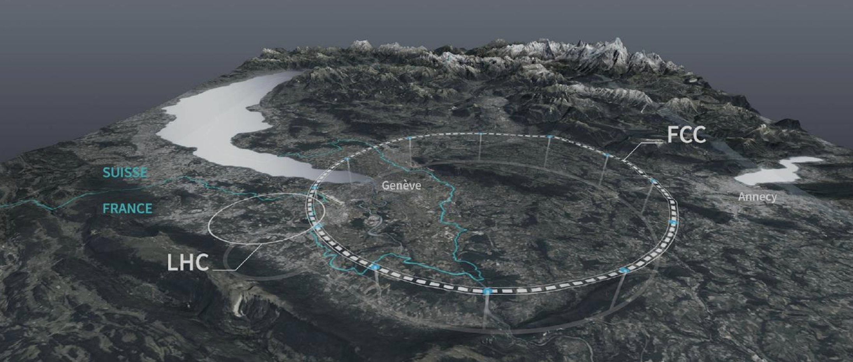
FCCee project

Slide 5
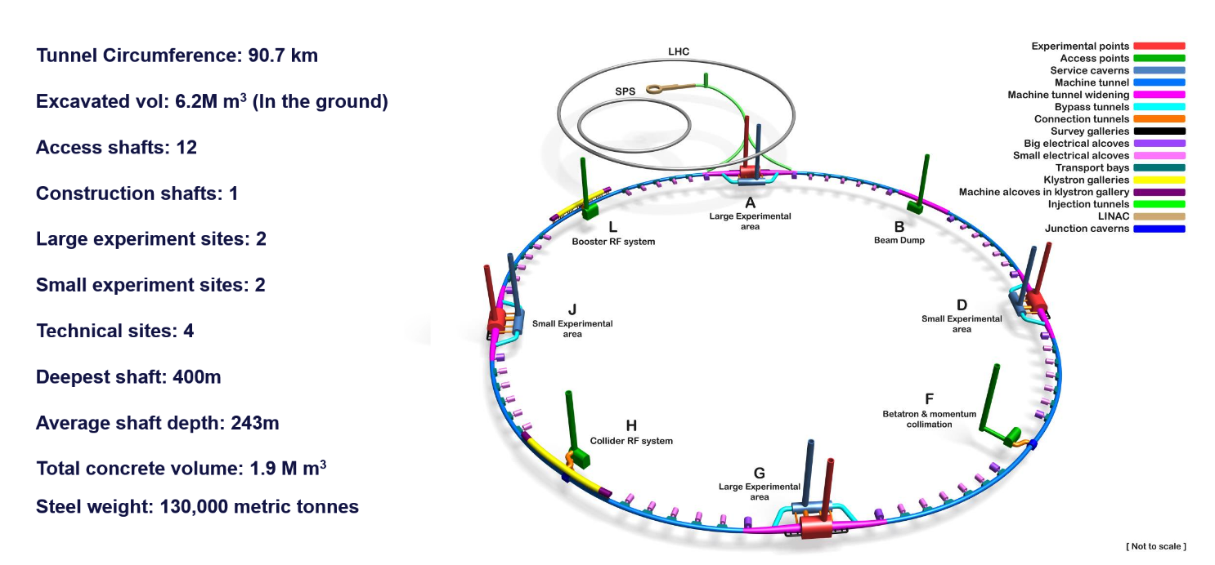
FCCee project
JEAN-PAUL BURNET, link

Slide 6
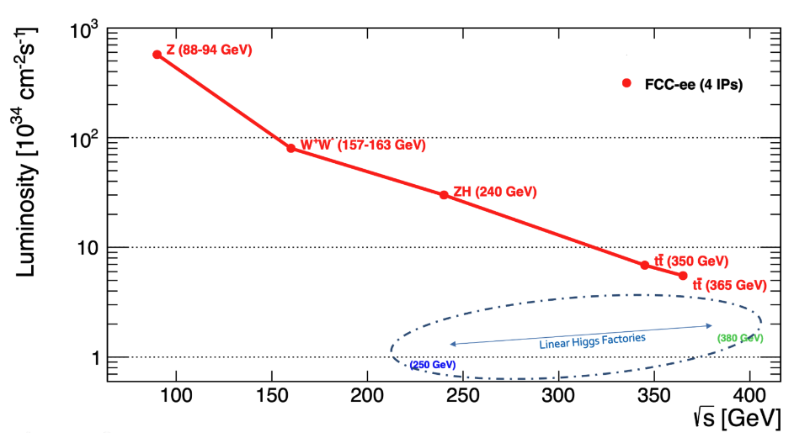
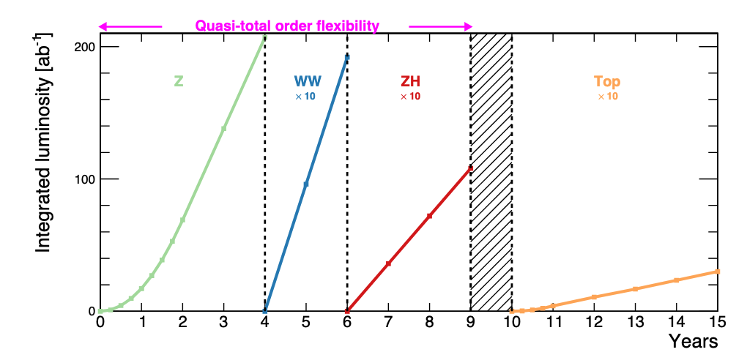
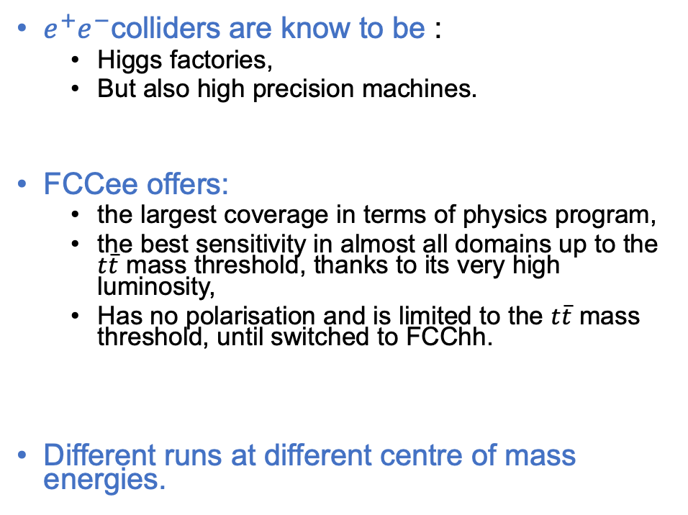
FCCee project
$e^{+}e^{−}$colliders are know to be :
  Higgs factories,
  But also high precision machines.
FCCee offers:
  the largest coverage in terms of physics program,
  the best sensitivity in almost all domains up to the $t\overline{t}$ mass threshold, thanks to its very high luminosity,
  Has no polarisation and is limited to the $t\overline{t}$ mass threshold, until switched to FCChh.
Different runs at different centre of mass energies.

Slide 7
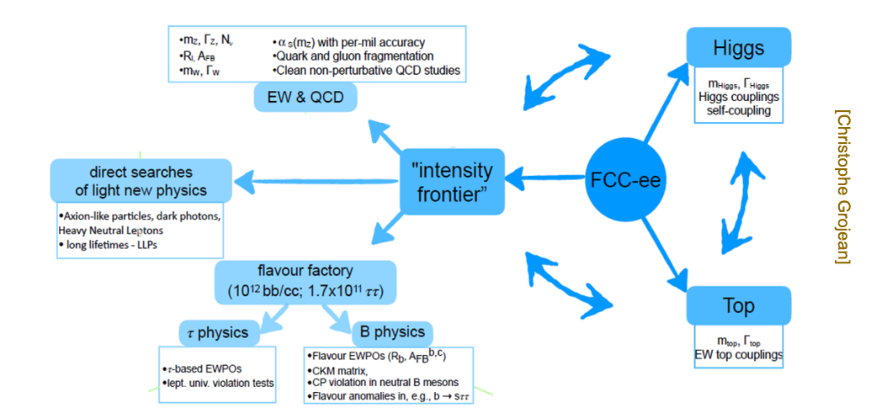
FCCee physics program
Christophe Grojean

Slide 8
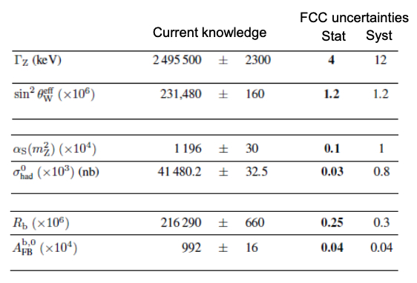
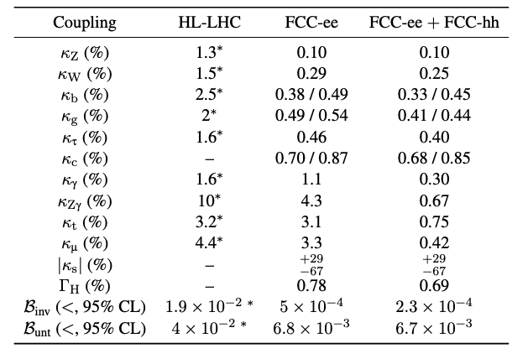



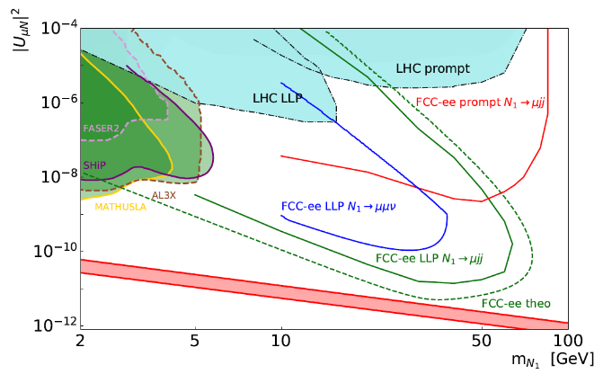
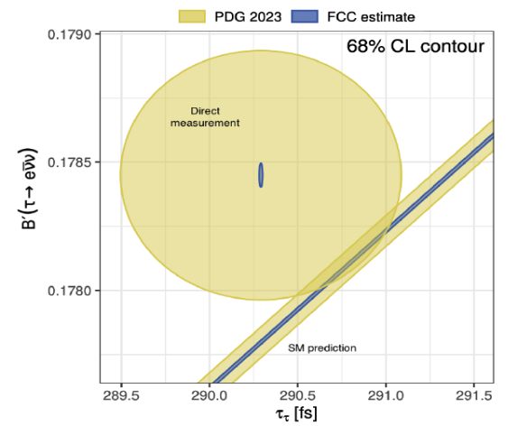

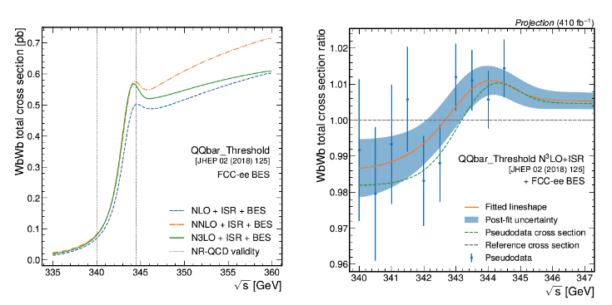

FCCee physics program
FCC feasibility studies, link.

Slide 9
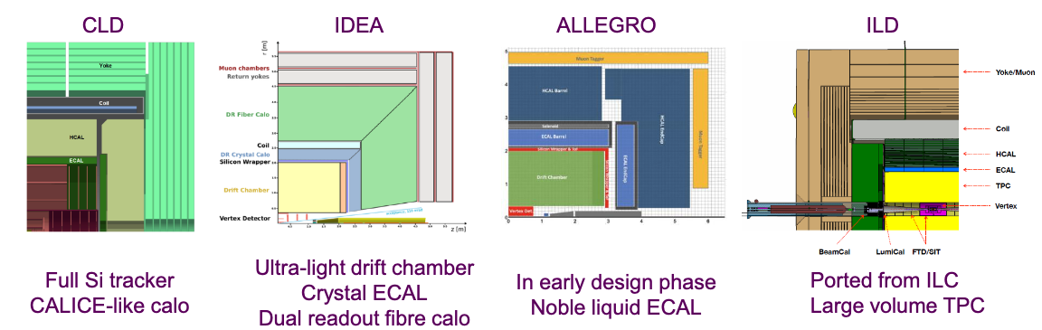
FCCee detector concepts
Existing detector concepts (not collaborations).
Different technologies choices, in particular for Tracker, PID and calorimetry.
Vertex detectors are usually based on the same technologies (MAPS), but might have different chips designs, mechanics or cooling approaches.
Guy Wilkinson, link
Only with FullSim available

Slide 10
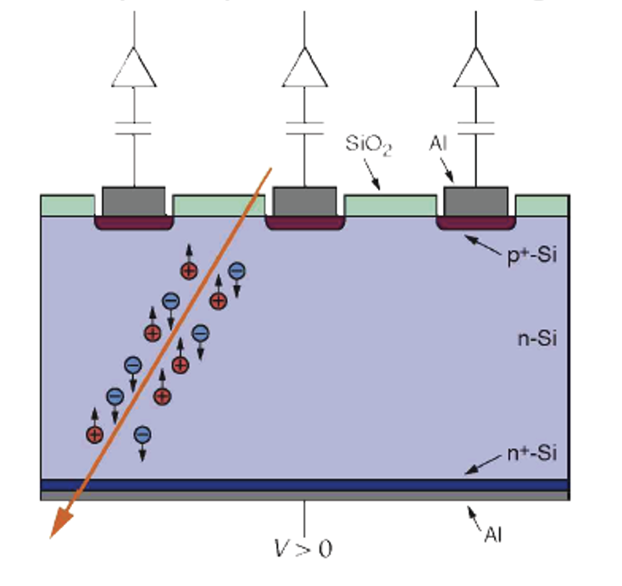
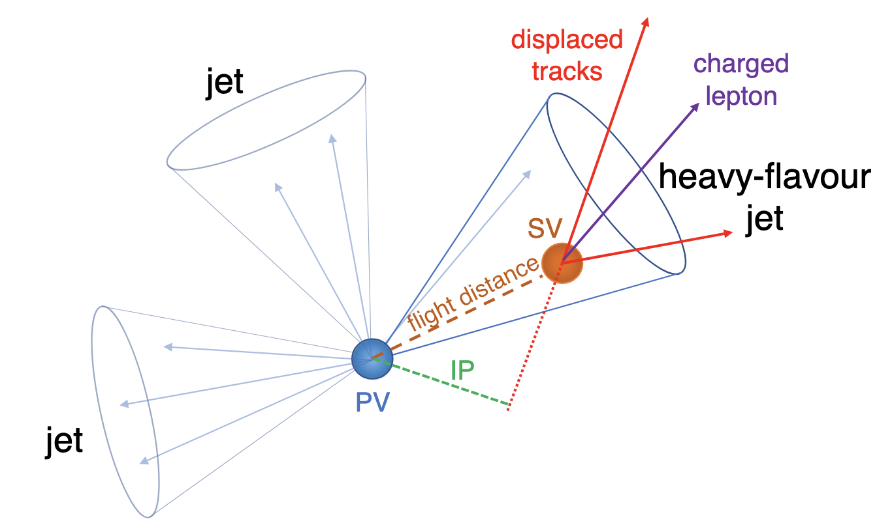
Tracking system : generalities
Reconstruction of the trajectories of charged particles.
Usually composed of 2 parts :
  Inner Tracker, of Vertex Detector=>
    Precise measurements of the impact parameters, (secondary) vertex reconstruction,
    Based on silicon semi-conductor
  Outer Tracker :
    Complete detector, resolution of transverse momentum and angles,
    Can be based on silicone detector, gaseous detector.
Positions (hits) of detection of the particles are linked together to reconstruction trajectories : tracking algorithms.
Tracks are key elements of events reconstruction:
  Leptons reconstruction,
  Particle flow,
  Jets reconstruction,
  Flavour identification.

Slide 11
Vertex detector specifications and performances

Slide 12
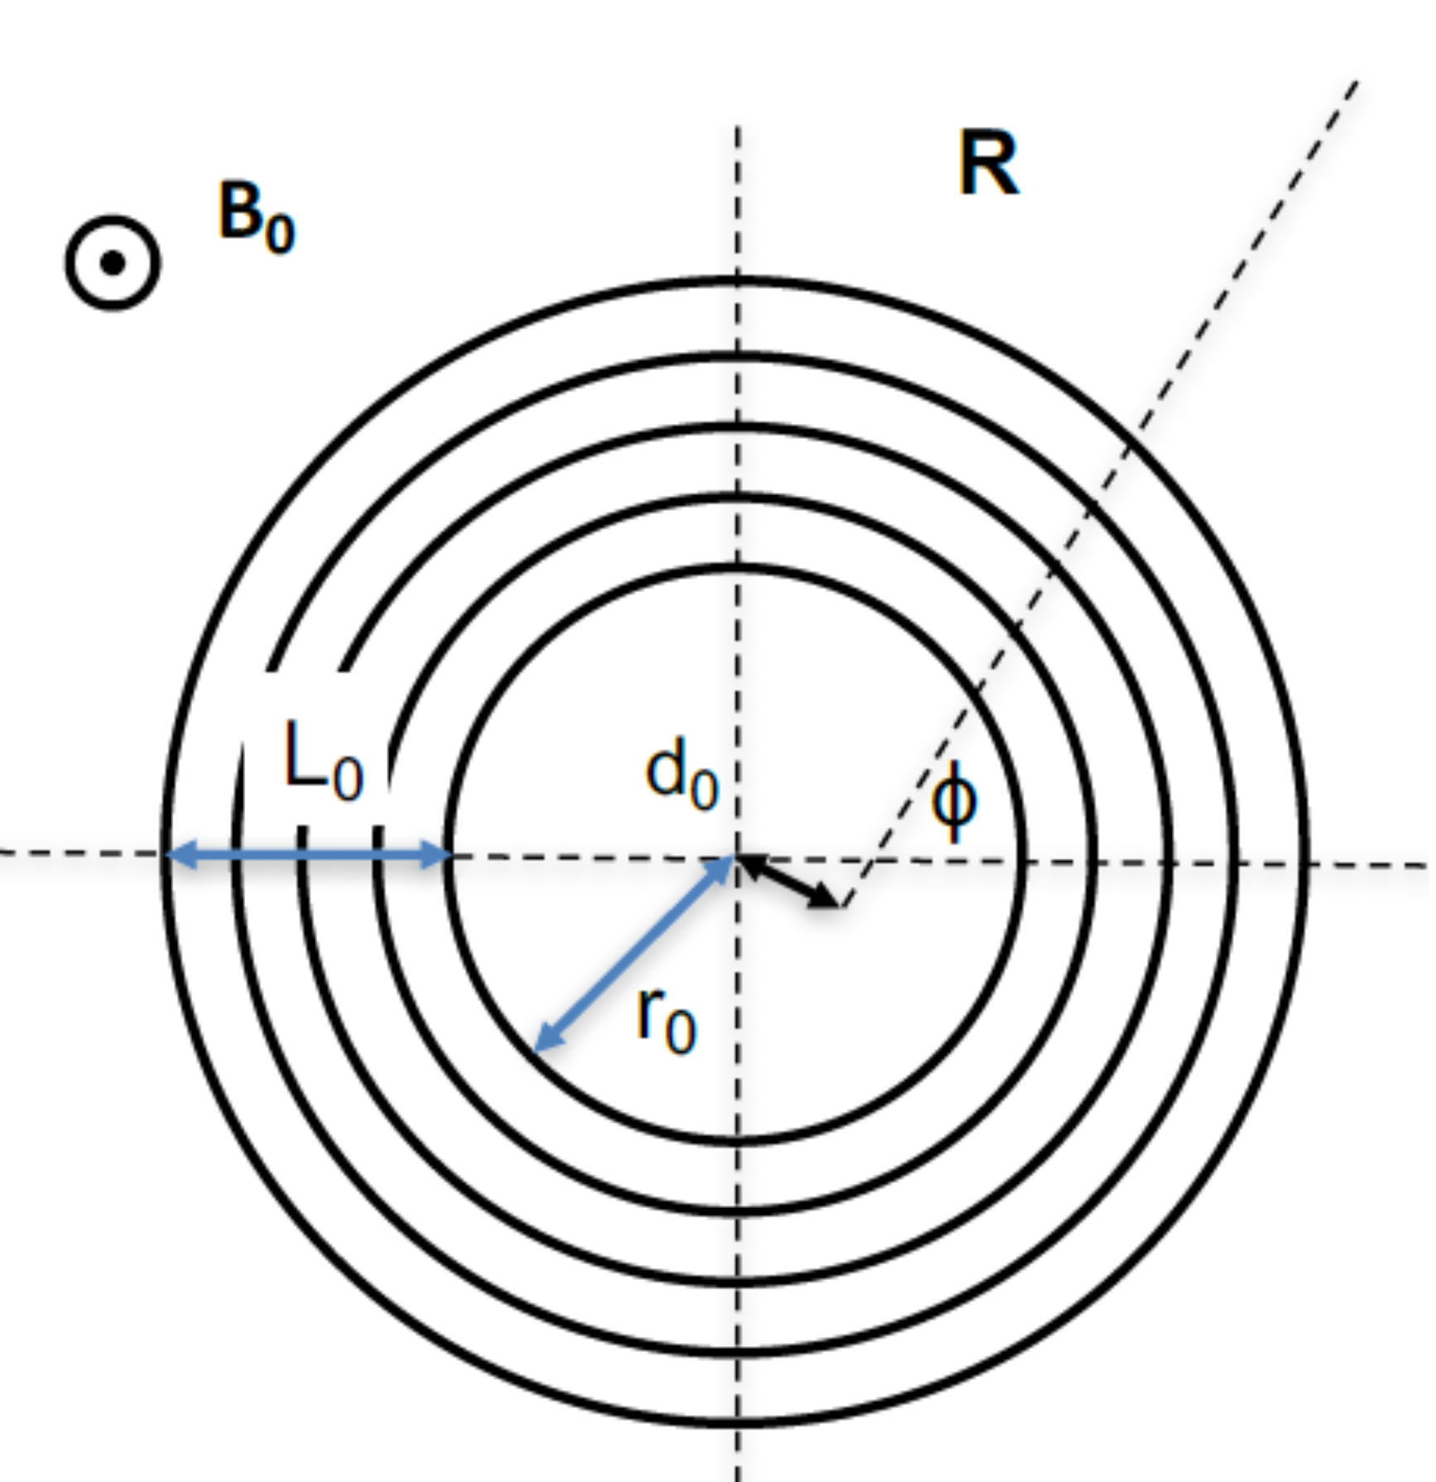
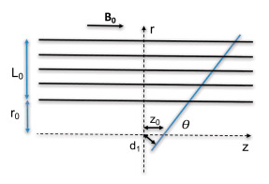




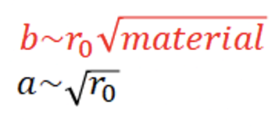





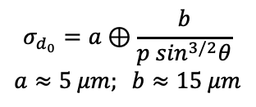
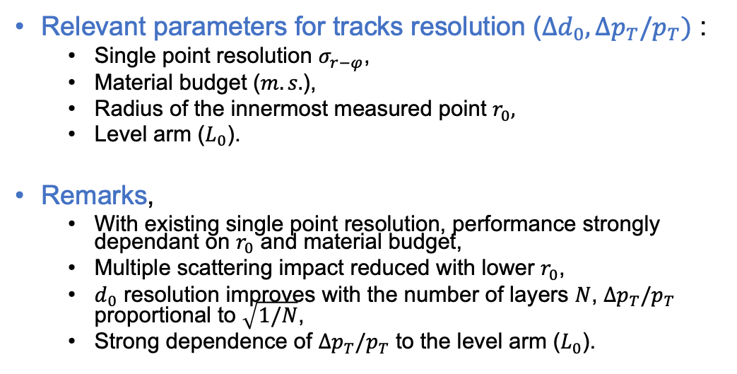
Main parameters of tracks resolution
Relevant parameters for tracks resolution ($Δd_{0}, Δp_{T}/p_{T})$ :
  Single point resolution $σ_{r−φ}$,
  Material budget ($m.s.$),
  Radius of the innermost measured point $r_{0},$
  Level arm ($L_{0}$).
Remarks,
  With existing single point resolution, performance strongly dependant on $r_{0}$ and material budget,
  Multiple scattering impact reduced with lower $r_{0}$,
  $d_{0}$ resolution improves with the number of layers $N$, $Δp_{T}/p_{T}$ proportional to $\sqrt{1/N}$,
  Strong dependence of $Δp_{T}/p_{T}$ to the level arm ($L_{0}$).
FCCee
$$σ_{d_{0}}=a⊕\frac{b}{p \sin^{3/2}θ}$$
$$a≈5 μm; b≈15 μm$$
ALICE ITS2
Material budget is a key parameter !

Slide 13
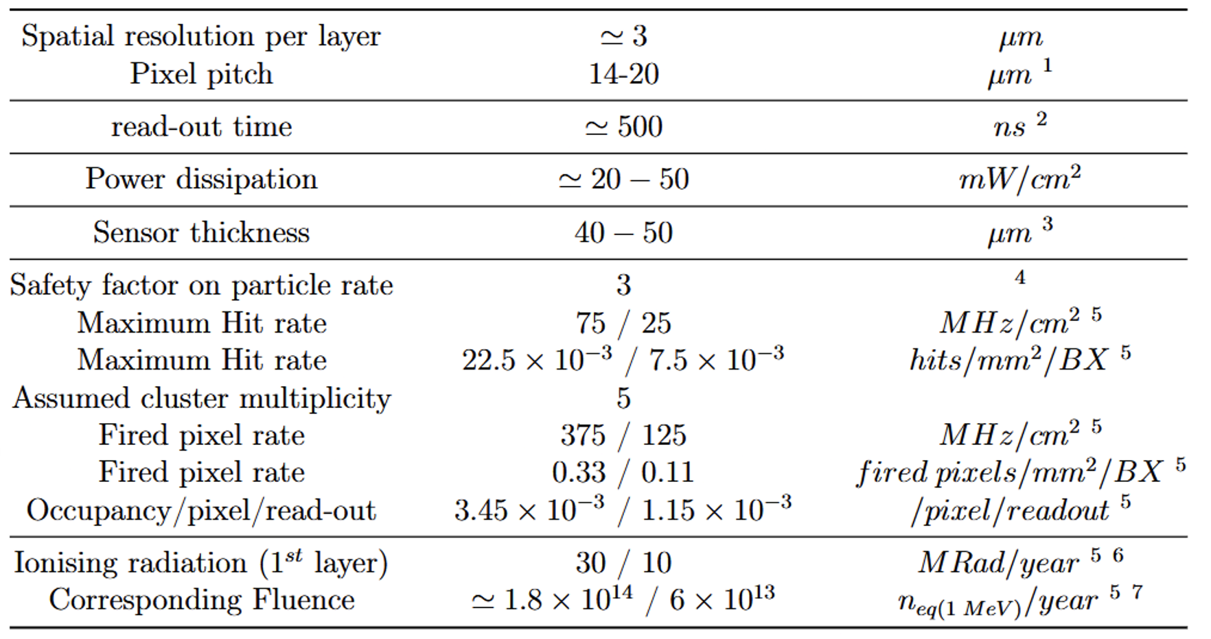
Vertex sensor specifications
Depends on charge shareing and encoding
Balance between power dissipation and particle rate
To be compatible with air cooling
Reduced material budget, allows for bending
Related to max particle rates at the Z energy
Expected max fluence per year

Slide 14
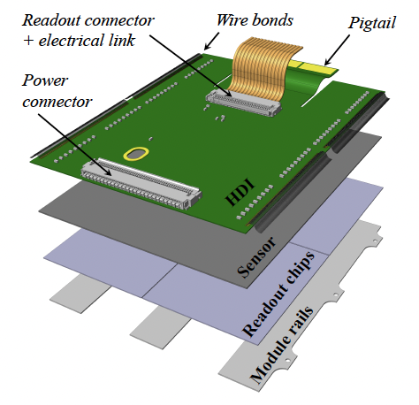
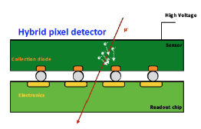
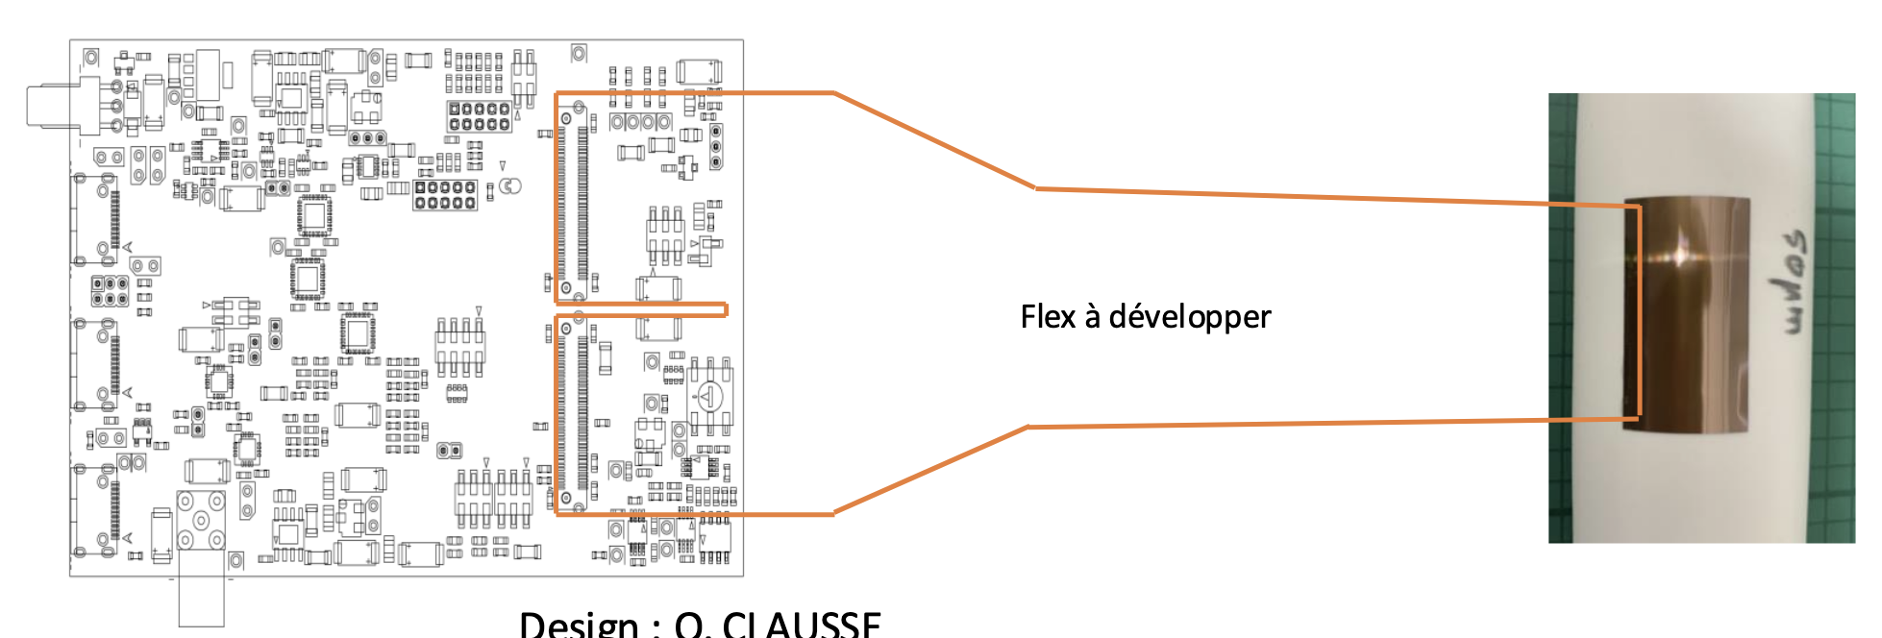
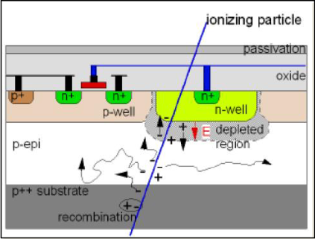
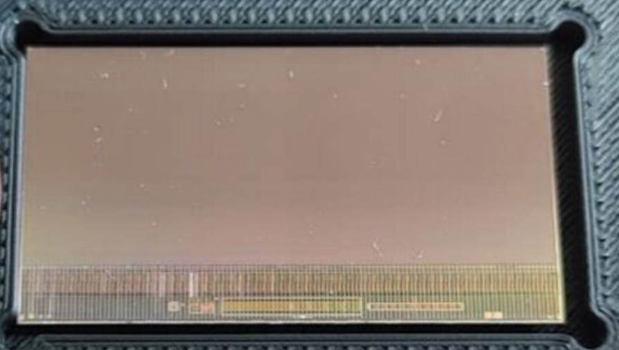
Vertex/Pixel detector technologies
CMS-IT, Pixel Hybrids (ex.)
Pixel module
3D and planar sensors, with 2 or 4 CROCs.
HDI : electrical connection (serial powering),
Optical conversion located on port-cards.
Mimosis, Monolithic Active Pixel Sensor (MAPS)
MAPS sensor
Integrating sensor and readout on the same silicon substrate,
Connection with the back-end board through a flex, wire-bonded to the sensor.
Flex

Slide 15
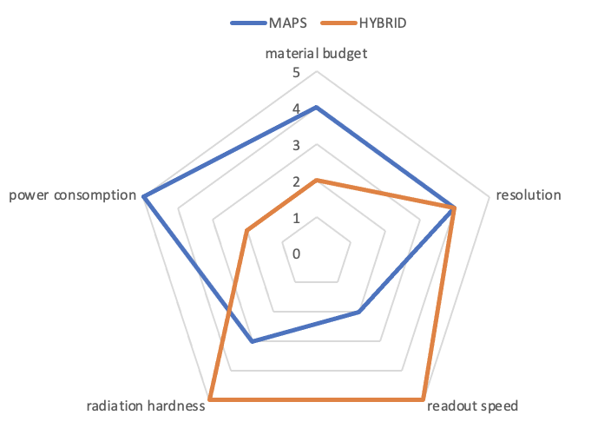
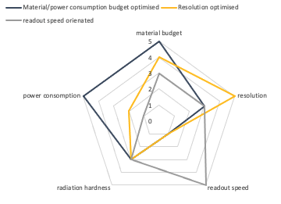
Vertex sensor specifications
Qualitative representations
Its all about balance
  Higher resolution (pitch/encoding) => increase power consumption => requires stronger cooling => increase of material budget.
Hybrids pixel modules developed for (HL)-LHC
  high radio-tolerance,
  resistance to SEU,
  sustain high rates of particles,
  large material budget,
  large power consumption (liquid cooling).
CMOS-MAPS based technologies :
  High granularities, high resolution,
  Low power consumption (air cooling possible ?),
  (very?) low material budget.
Qualitative representations (0 to 5), the pictures might change depending on R&D choices.

Slide 16
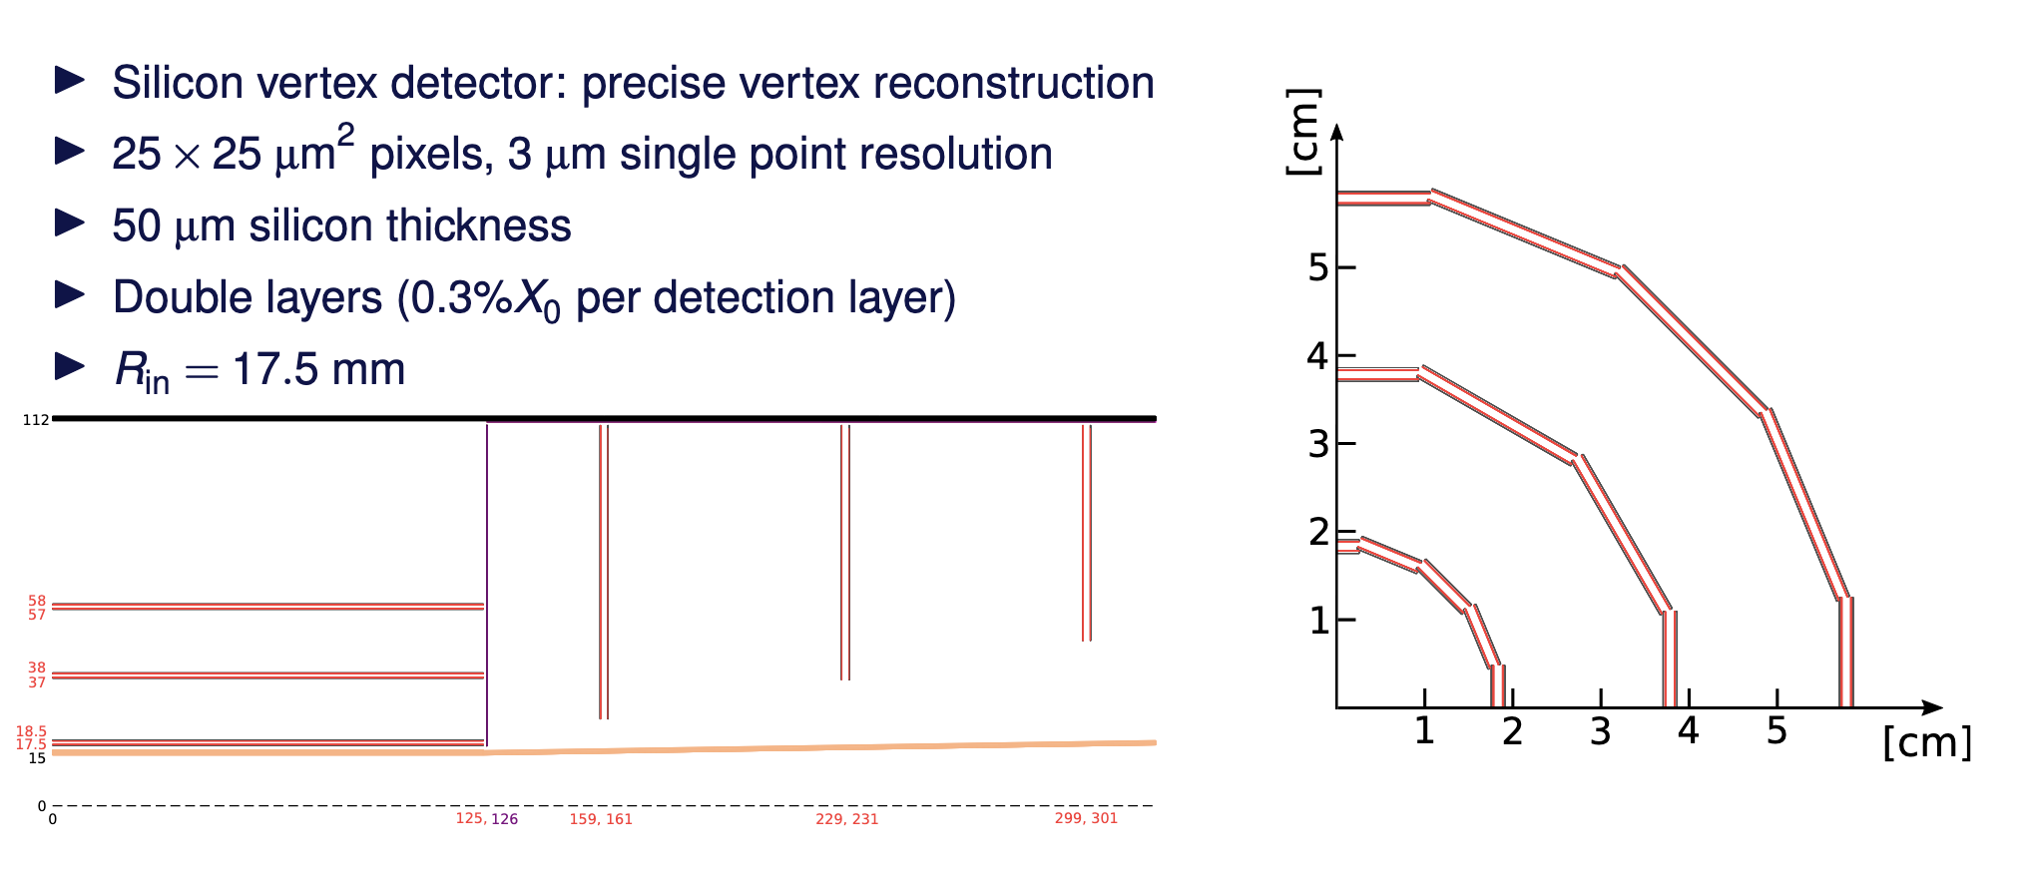

CLD vertexing
A.Sailer, link.
y
$$θ$$
x

Slide 17
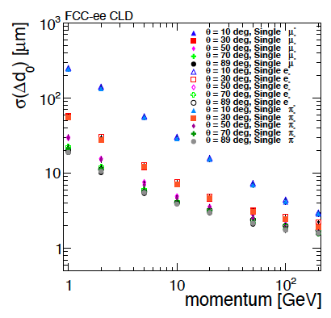
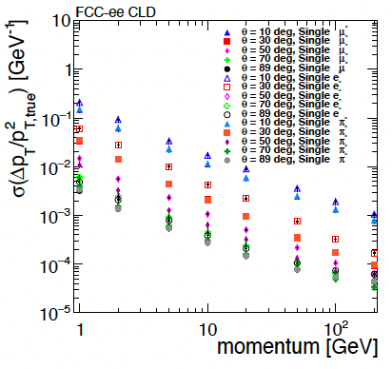
CLD Tracking performance
G.Sadowski
Approximate CMS barrel resolution in 2017

Slide 18
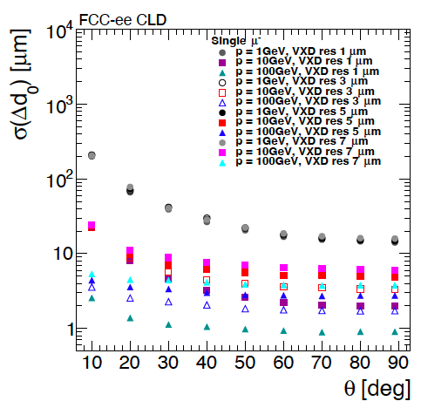
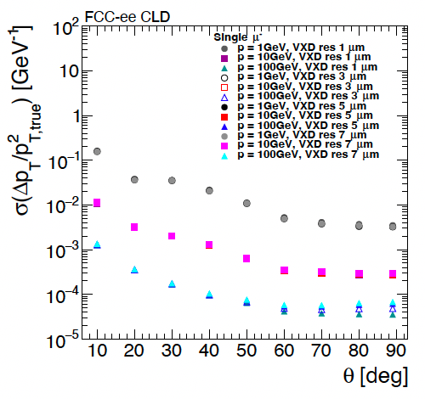
CLD Tracking performance changing single point resolution
G.Sadowski
Single point resolution (smearing) :
  does not affect significantly the $p_{T}$ resolution, except for track with high momentum in the central region,
  Large impact on $d_{0}$, except for low momentum track.

Slide 19
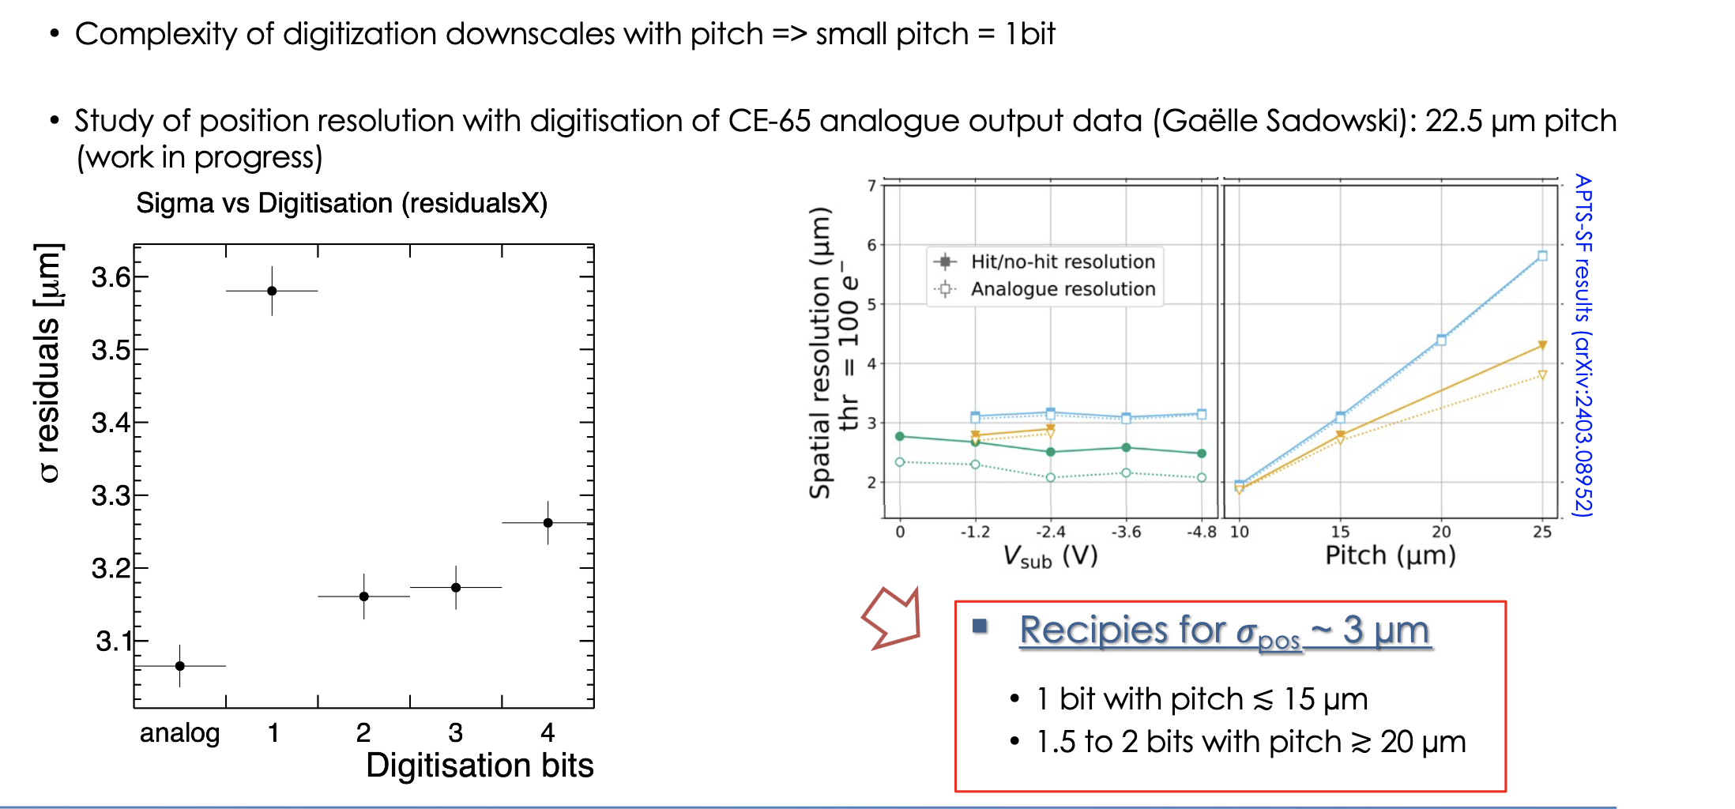

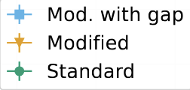
In pixel digisation : resolution vs power consumption
Jérôme Baudot, link.

Slide 20
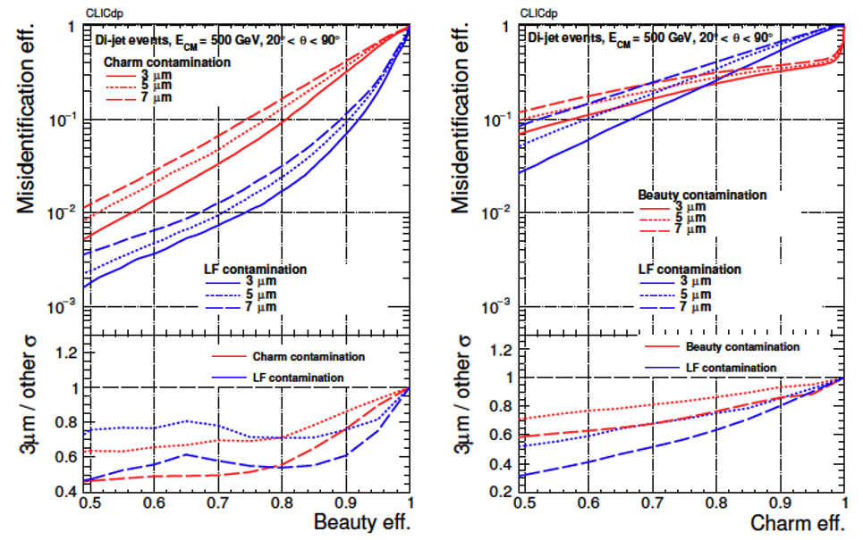
B-tagging performances

Slide 21
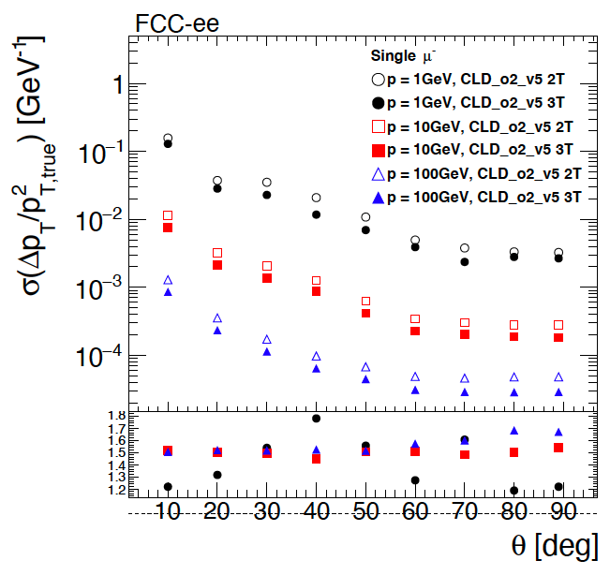
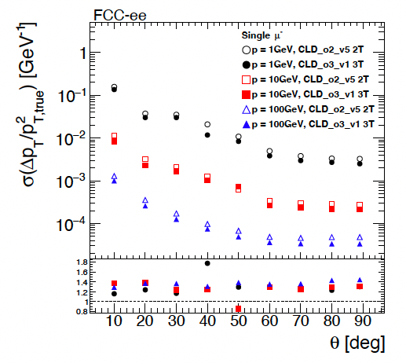
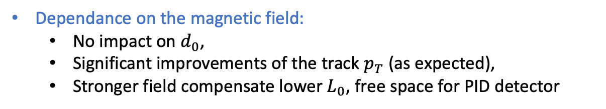
CLD Tracking performance
Impact of the B-field
G.Sadowski
Baseline Geometry, 3 vs 2T
Baseline Geometry@2T vs ~15% reduced $L_{0}@$3T
Dependance on the magnetic field:
  No impact on $d_{0}$,
  Significant improvements of the track $p_{T}$ (as expected),
  Stronger field compensate lower $L_{0}$, free space for PID detector

Slide 22
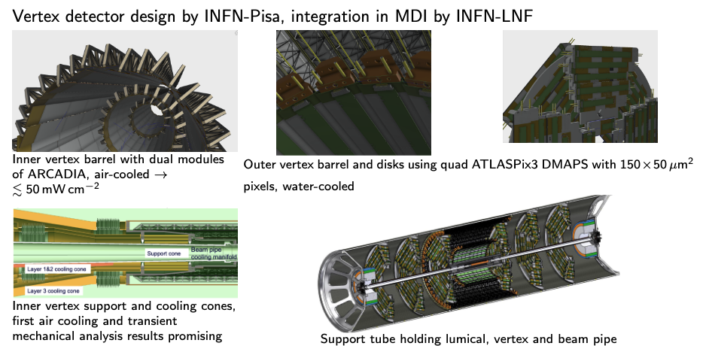
IDEA vertexing
Armin Iig, link

Slide 23
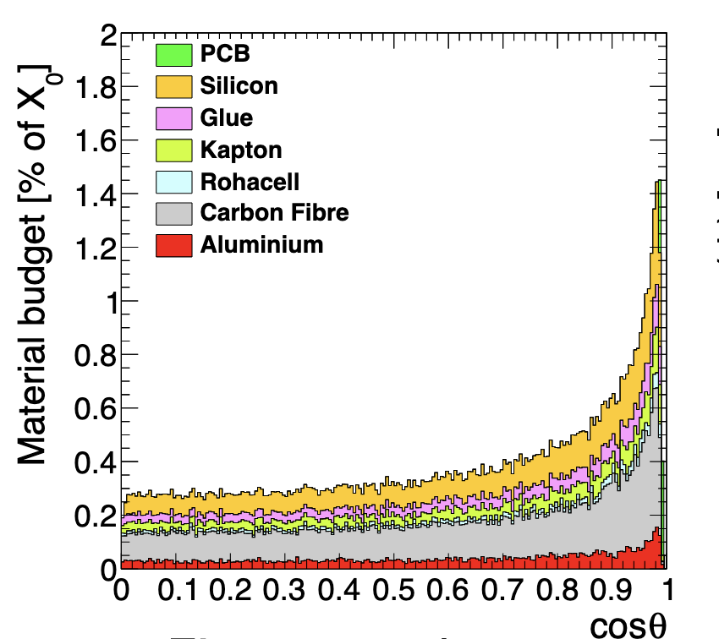
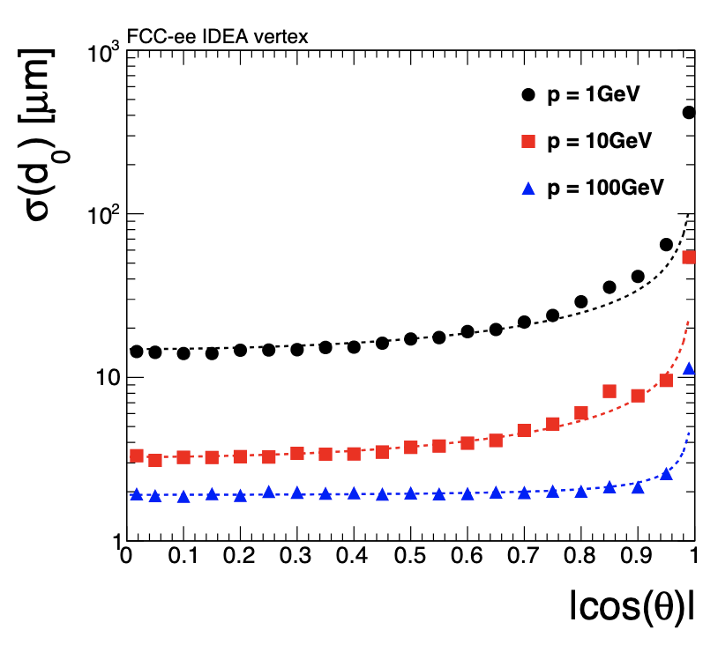
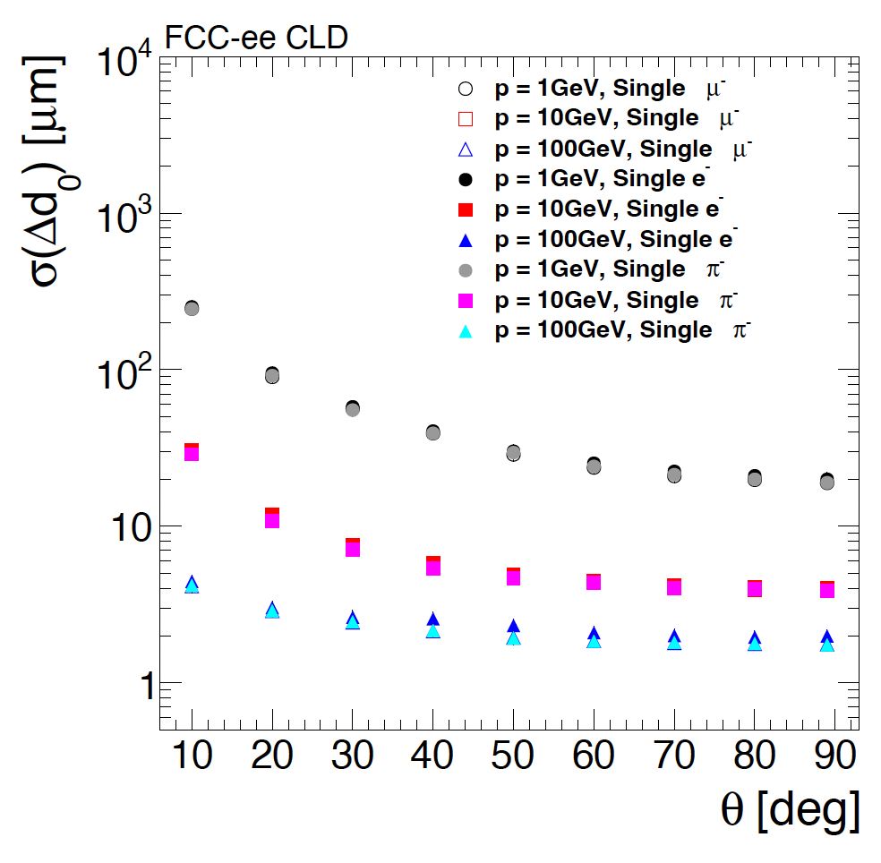
IDEA vertexing
IDEA Integrated into the CLD FullSim
Baseline CLD FullSim
Similar performance, IDEA better at 10 GeV

Slide 24
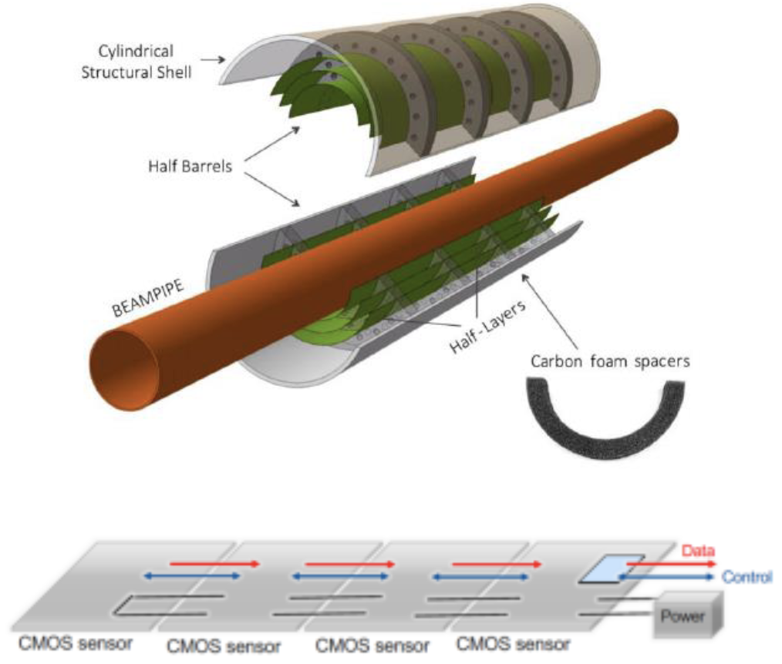
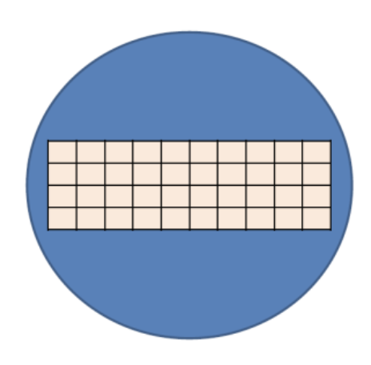
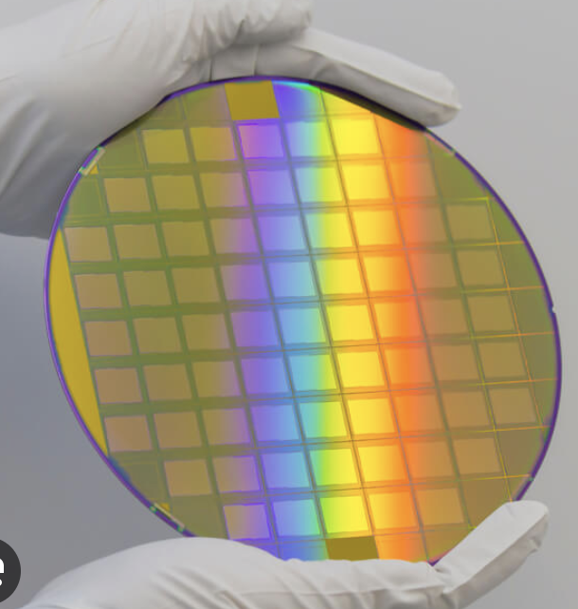
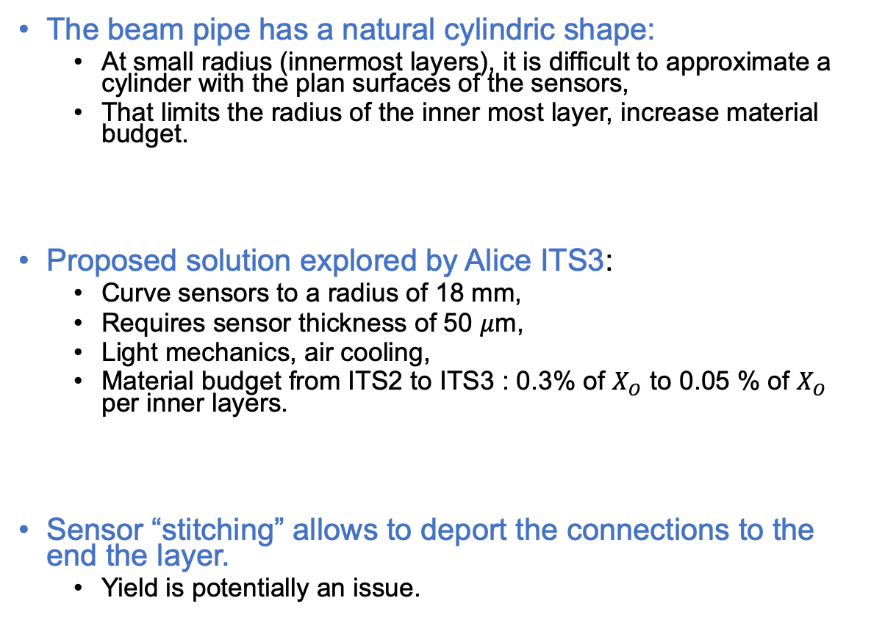
Pioneer work : Alice ITS3
The beam pipe has a natural cylindric shape:
  At small radius (innermost layers), it is difficult to approximate a cylinder with the plan surfaces of the sensors,
  That limits the radius of the inner most layer, increase material budget.
Proposed solution explored by Alice ITS3:
  Curve sensors to a radius of 18 mm,
  Requires sensor thickness of 50 $μ$m,
  Light mechanics, air cooling,
  Material budget from ITS2 to ITS3 : 0.3% of $X_{O}$ to 0.05 % of $X_{O}$ per inner layers.
Sensor “stitching” allows to deport the connections to the end the layer.
  Yield is potentially an issue.

Slide 25
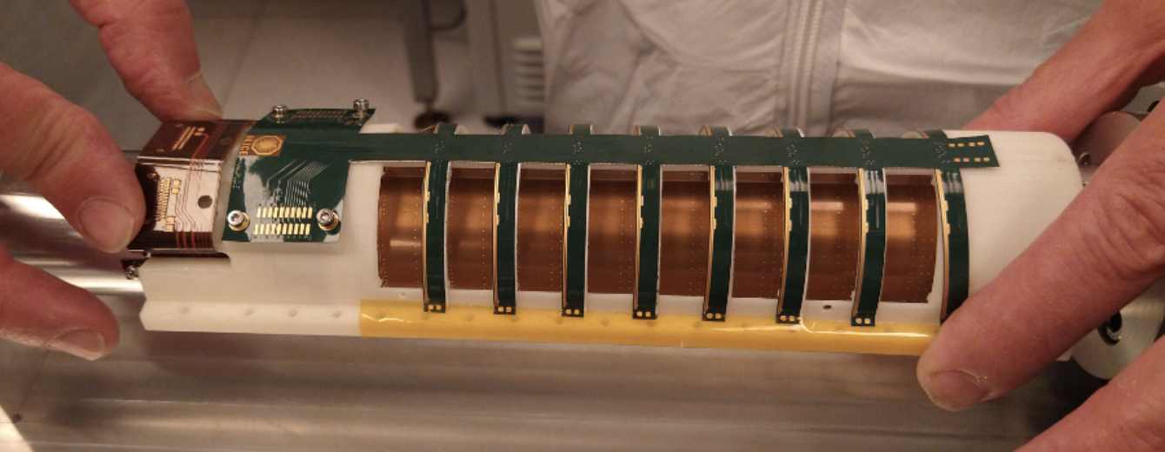
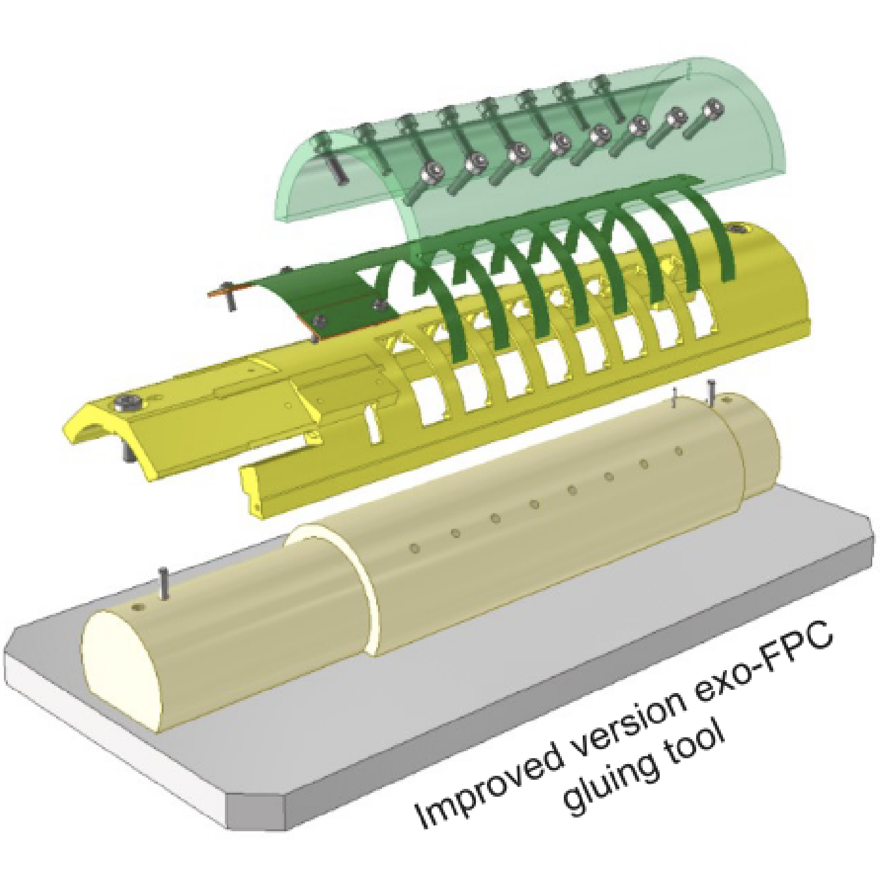


Alice Super-Alpide
Alice ITS3 backup plan : super-Alpide,
  Use Alice ITS2 Alpide chips,
  Use a wafer slice with few Alpide in a lines (9x2),
  Thinning the slice to 30-40 $μ$m,
  Bend the slide to the needed radius.
Requires specific mechanical structure, that allows for wire bonding of all chips.
  Where we started at IPHC
Location of the bonding pads on the chips makes thinks complicated.

Slide 26





Curved vertex for IDEA
The IDEA detector concept for FCC-ee, link
New light vertex detector concept for IDEA, based on stitched sensor and curved layers.
Layer 1 and 2 :
  2 half cylinders per layer,
  Non sensitive regions along the Z direction, compensated with phi rotation of Layer 1 wirh respect to Layer 2
Layers 3 and 4:
  4 half cylinders per layer, for layer 3 and 4,
  Dead regions in half rings region, compensated by locating them at different Z position.
Connectivity on both ends of the layers.

Slide 27

FCC-SEED
A vertex detector concept for FCCee
General Expression of Interests, not yet attached to a specific detector concept
27

Slide 28
FCC-SEED concept
Chip design
Pitch
Size/geometry
digitization
Readout speed/timing
Cables/flex
Integration
Assembly procedure
Mechanics
Geometry
Material budget
Material
Services supports
Cooling power
Cooling
Cooling type

Slide 29
FCC-SEED concept
Chip Design, Mechanics, Integration and Cooling are strongly inter-connected
Main FCC-SEED approach : develop things in coherent manner
Chip design
Pitch
Size/geometry
digitization
Readout speed/timing
Cables/flex
Integration
Assembly procedure
Mechanics
Geometry
Material budget
Material
Services supports
Cooling power
Cooling
Cooling type

Slide 30


FCC-SEED concept : Octopus
Octopus : asynchronous readout (pixel grouping) chip,
  balanced between pitch size and particle rates, lower power consumptions,
  based on TPSCO 65 nm.
DRD3 project, 10 labs involved, international collaboration.
Different steps :
  Chip demonstrator,
  Large chips for beam telescope application,
  Version targeting FCCee-like specifications.
No new chips to bend/tests until then => rely the one existing chips Mimosis (see later).
Fadoua Guezzi Messaoud, link1 link2

Slide 31


FCC-SEED : geometry concept
Option 1 : single layers
Option 2 : double layers
Based on large size curved sensors (DRD8)
  Smallest possible radius, first hits as close as possible to the collision point,
  Minimization of the material budget.
New geometry under study
  Snail-like shape, slight sensor overlap,
  Allow for a full r-phi coverage.
Options to be explored :
  Possibility of stitching,
  Double sided vs single sided layers,
  Layers radius and numbers,
  Cooling options.
Coherent developments of sensors, mechanic, integration and simulation.
Option 1
Option 2

Slide 32
FCC-SEED : geometry concept first thoughts
z
y
Flex
Mechanical supports.
Include the flex?
Wire bonding on the side
Might make the stitching not needed,
No dead region in phi,
Makes the design of the mechanics and the flex quite challenging.
Wire bond
Wire bond
x
Beam pipe
Bend sensor
R=12mm
Assembly of quarters (hemi) of cylinders : assemble individual frames together around the beam pipe

Slide 33

FCC-SEED in full simulation
Armin Iig, link
NEW

Slide 34

FCC-SEED : setting up the program
Goals for mechanics and integration: work toward a robust vertex concepts for FCCee (or other e+e- colliders) in the coming ~5 years.
Mains topics to worked on :
  Master curved sensor fabrication and testing,
  Explore mechanical options, type of material, stress and colling, etc…
  Design a full mechanical geometry, to be tested in full simulation,
Iterative process !
Curved sensor, 3 steps identified :
  Step 1 : functional single curved Mimosis,
  Step 2 : ”Super-Mimosis”,
  Step 3 : demonstrator of a full layer 1.
A.Besson

Slide 35



MIMOSIS
Desiging of a new chip is a long process. To move forward, we are bending/testing already existing sensors : MIMOSIS (CBM experiment @ FAIR), IPHC (PICSEL, C4PI platform).
MIMOSIS : based on Alpide architecture.
Fulfil already a significant amount of specs : milestone toward $e^{+}e^{−}$ colliders.
Functional versions Mimosis 1 or 2.1 are good candidates for bend sensor testing.

Slide 36


Curved sensors
Working plan :
  Prepare and install sensor bending bench, with different radius options (12-15-18mm), and different sensor thicknesses (30-50 microns).
  Practice bending with dummy sensors, then real functional single sensors (Mimosis), perform connectivity and setup DAQ, and tests.
  Bending of a wafer slice (Mimosis), connectivity and tests,
  Move toward a larger scale demonstrator of the 1st Layer in a few years from now.
MIMOSIS-2.1
M.Goff

Slide 37



Bending bench – clean room setup
O.Clauss, F.Agnes
Fixed suction table,
  preparation of the sensor,
Mobile suction table,
  Linear displacement in XYZ, Angular displacement in $θ−φ$,
  Pickup the sensor on 1, and precise positioning on the cylinder
Bending of equipped silicon, motor for mandrel rotation, camera for alignment,
PC for camera display and other measurements.
3
2
4
1

Slide 38






Sensor Bending
Millar film
Sensor
Sensor support
Mandrell
counterweight

Slide 39



After bending
Several tests performed, mainly on non-operational silicon pads or chips.
Half-cylinder 3D printed supports placed on mandrel 3D printed => large flexibility for performing tests.
Conclusion of the bending feasibility:
  Large size silicon pieces bended successfully,
  Bending at R=18mm successful with 50-60 microns thickness,
  No issues observed with 3D printed cylinder and support.
Further plan:
  Tests bending at R=18, 15 and 12 mm,
  With sensor thickness of 50, 40 and 30 microns (30 microns might not be feasible with Mimosis),
  Move to metallic mandrel for the bending of final functional sensors.

Slide 40



ANSYS simulation
Glass thickness of 100 µm >>> 500 MPa
Glass thickness of 50µm >>> 200 MPa
Glass thickness of 30µm >>> 145 MPa
M.Krauth
Rolling leaf of glass
Simplified model
Rotative cylinder of diam. 36 mm
Maintained with a force of 50 N
l+dl
S2 ~ E.dl/l
l
Idealized constrains
= S1+S2
Glass :
E~70 GPa
Sigma MAX ~40à200MPa
Glass of thickness of 30µm >>> S1+S2~130MPa
S1 ~ F/S
Mechanical characteristic of the sensor : mechanical tests ?

Slide 41

Preliminary mechanical studies, and to do
Step 1 : study the physics performance with general geometry.
Then several mechanical studies required
  CAD implementation,
  Simulation of mechanical and thermal deformations,
  Thermal simulation for air cooling,
  Choice and mechanical tests of material,
  Study fabrication, mechanical assembly,
  Supports for services.
Very first example of design.
Studies to be started sept 2025 (arrival of an apprentice engineer at IPHC).
M.Krauth

Slide 42





Design of a flex cable and board for curved mimosis testing
Test board and flex for tests :
  Design and fabrication done,
  First tests performed mid-May/beginning of June,
  Flex and board validated!
First tests to be performed on MIMOSIS vs curved-MIMOSIS :
  A/D power consumption,
  Noise and s-curves,
  Test with source and beam (CYRCé then DESY).
Carte Msis_prox
For the final detector, the flex design is a key element.
  Should allow for a robust and easy bonding,
  Should be well integrated within the mechanics,
  Should be as small and as light as possible.

Slide 43

JS Pelle, G.Claus, M.Goffe
Test bench for Mimosis testing
Le slow control & DAQ
  NI PXIe crate
  CPU + DAQ board FlexRio (FPGA)
  SW tourney under Windows 7 Pro
  DAQ : GUI executable (C++ Builder)
  SC : GUI Python Q
DATA board transmission links to Mimosis / DAQ, 8 links at 320 Mb/s.
S3 board (Slow control Steering Synchro)
provides slow control I2C and clock to Mimosis
Mimosis is mounted on a “Proximity board”
Possibility to have a DAQ based on cheaper FPGA under study. Software being made more user friendly

Slide 44





Beam test and irradiation facility : CYRCé@IPHC
Cyclotron : initially meant for irradiation and production of radio nuclei.
Beam characteristics :
  25 MeV Protons (low energy, large energy deposition),
  Large intensities : allows for irradiation
  Low intensities : few fA (~$6∙{10}^{3}$ protons per second), allows for test beam
  Beam structure : bunches 85 MHz (~twice the LHC), which can be reduced to 42.5 MHz (kicker).
Irradiation facility (in bunker):
  Irradiation line installed and operational since July24,
  Successful irradiation of CMS IT modules prototype (CROCv1) to 5x${10}^{15}$ neq/${cm}^{2}$,
  Irradiation time of 1.5 hours.
Test facility (in exp. area):
  Operational since 2020,
  Well suited for rate studies and efficiencies measurements,
  Limited precision due to multiple-scattering.

Slide 45
Outlook and next steps
Single curved Mimosis well advanced. Beam test schedule at DESY for the end of 2025.
But a lot remains to be done :
  Chip R&D as part of DRD3,
  Tests and optimisation of the geometry with Full Simulation,
  Mechanical designs,
  Electronics and flex designs,
  Cooling !
  Etc… etc…
Three steps plan:
  Single Mimosis curved => gaining expertise, characterise the curved sensor performance,
  Curved Mimosis ladder => first design of mechanics, and integration plan,
  Demonstrator of an entire curved Layer 1 => toward more final designs,
  In parallel, long term activities required on full-simulation, impact on physics benchmark analysis.
Program made possible thanks to the C4PI platform !

Slide 46

Long road ahead…
FCC-SEED is a new (and young) vertex concept for FCCee :
  based on curved sensor and original design, thanks to chip design and integration choices,
  plan to study coherently chip designs, mechanics, cooling and integration,
  generic : can be ported/adapted to any detector concepts,
  collaboration to be extended abroad.
While dedicated chip designs happens, use existing chips (Mimosis) for mechanical and integration studies.
So far, six in2p3 laboratories shown interests, the activities are (slowly) ramping up.
  FCCee start targeted to ~2040,
  Specific R&D and construction usually takes ~10 years,
  => we have ~5 years to make preliminary feasibility studies, and have a more mature project.

Slide 47
Backups

Slide 48
Task diagram
Curved Mimosis
Bending
Mechanic
Integration
Testing
Design of the bending setup
Mechanical simulation
Simulation of silicone mechanical deformation
Overall concept
Drawings
Documenting bending procedure
Support design and fabrication
Design of hemi-cylinder shell, with opening for tests with particle, with different radius (12, 15, 18) and 1mm width
Design of Flex
Fabrication of Flex
Flex gluing
wire bonding
Design and installation of test setup
Test data taking
Interpretation
sensor installation and gluing
Fabrication and usage of the bending setup
Bending on a 3D printed cylinders
Production and quality control of metallic mandrels
surface finish
metrology
Mechanical tests for different diameter and different detector thickness
Mimosis Irradiation
Sensors production
Cut non functional Mimosis and different width, for bending testing : 30, 40 and 50 microns
Cut functional Mimosis with width of 30, 40 and 50 microns
Develop FPGA-based DAQ
Cooling and temperature monitoring
Production and quality control of 3D printed plastic mandrel
metrology
Surface finish
Produce mandrels with radius of 12, 15 and 18 (mechanical tests)
Produce mandrels with radius of 11, 14 and 17 (functionall tests)
Fabrication and validation of the supports
Determine fluence
Irradiate sensors
Test irradiated sensors
Determine test to be done without particles
Take data without particles
Determine tests to b done with particles
Take data with particles
Deploy DAQ system in different labs
Fan cooling
Functional Mimosis : tests for different diameter and different detector thickness
Production
Bent sensor project part of GRAMM MP and DRD8

Slide 49


Slide 50


Slide 51

Super Alpide
Alperen Yuncu, link

Slide 52

Mimosis
F.Morel, link

Slide 53

A.Besson, ECFA Paris 2024

Slide 54

Top mass : target
Objectives of top mass measurement :
  Test of the SM, yukawa couplings and top mass,
  Confront pole mass to the “MC” mass (differences of a coupe f hundreds MeV),
  Study of the stability of the vacuum, differentiations between stable and meta-stable universe.
JHEP08 98 (2012)

Slide 55




Beam background

Slide 56

Rates of electron pair backgruonds

Slide 57


Slide 58


Slide 59


Machine-Detector Interface
F.Fransesini link

