Slide 1




Molecular Clusters under Extreme Conditions
Hector Lissillour
Interactions Particules Matière Group (IPM)
Supervisor : Michel Farizon

Slide 2
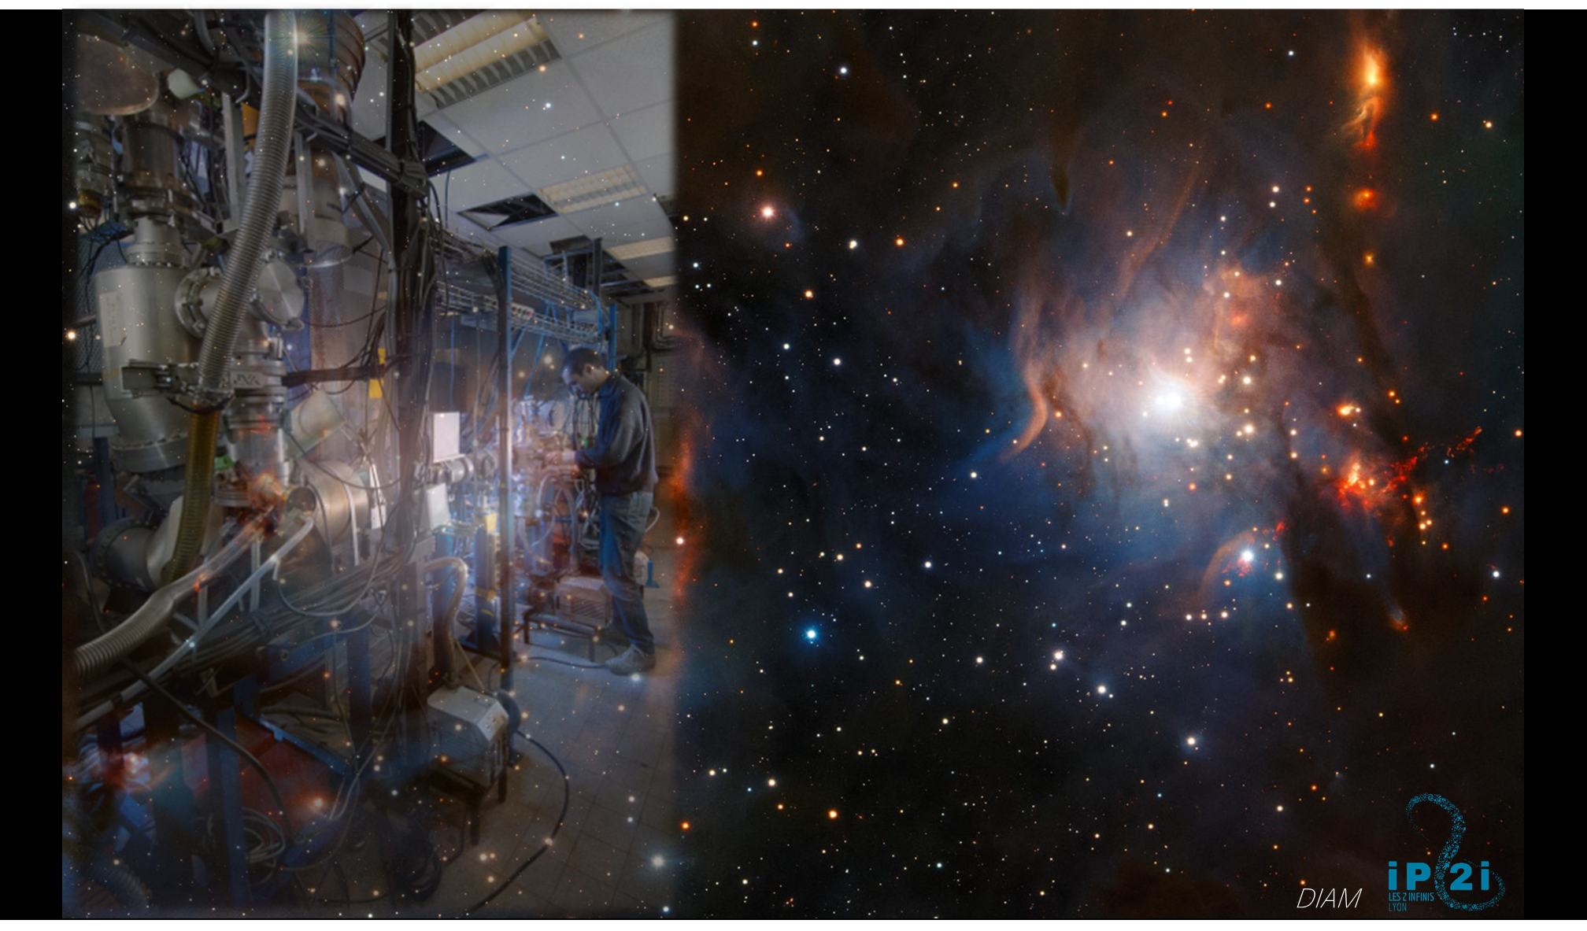
Notes:
In this presentation, we will explore molecular clusters and how they behave under extreme conditions.
On the one hand, we'll look at the importance of laboratory astrophysics experiments, and how these quantitative experimental data can be used to constrain statistical models of energy redistribution in small protonated clusters.

Slide 3
0
Introduction
1
Astrophysical context
2
Experimental Setup
3
Theoretical Methods
4
Conclusion

Slide 4
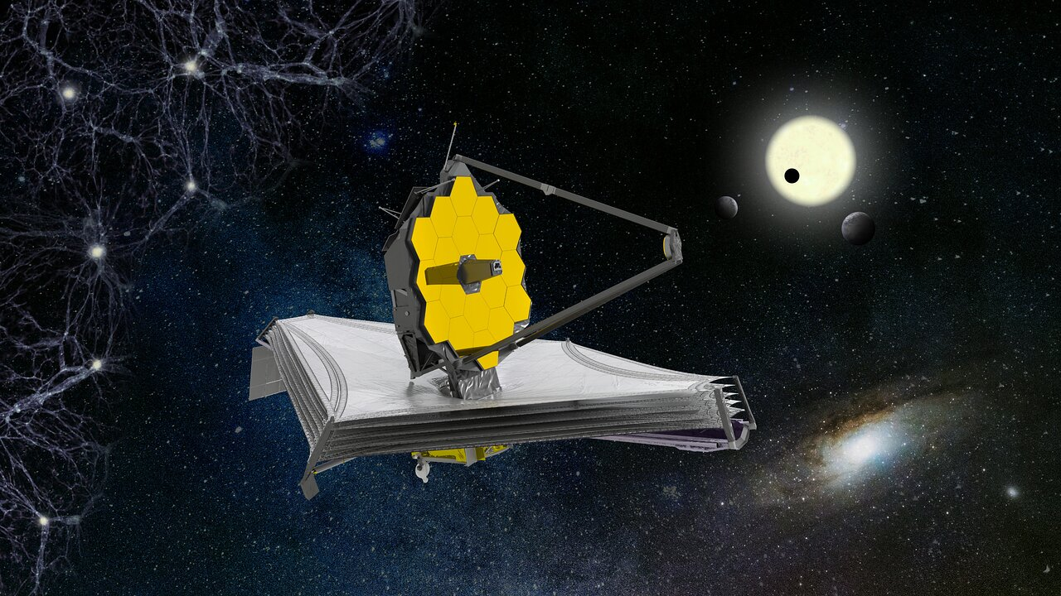
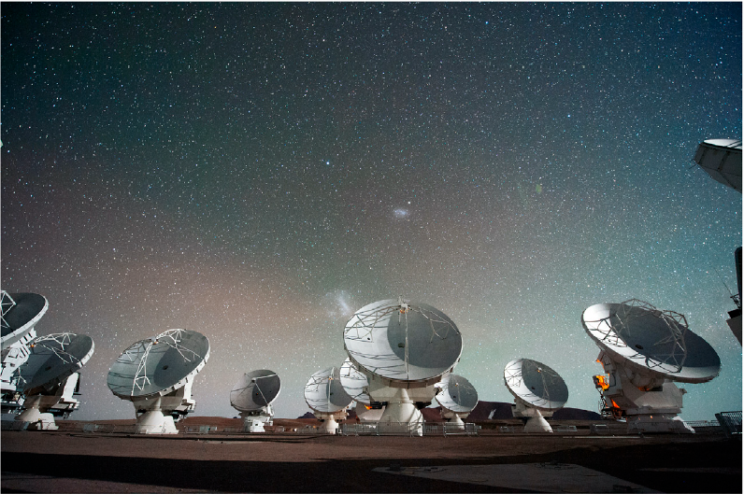

1
Instrumentation and new observation campaigns
Spatial
Arrays
Single
Telescopes
JWST - https://esawebb.org/
ALMA–credit: ESO.org.
https://iram-institute.org
Notes:
The development of astrophysical instrumentation has brought us into a new phase of observation of our universe. By the James Webb Space Telescop launched in December 2021. From 2011, the large ALMA antenna array in Chile and giant radio telescopes such as IRAM 30.

Slide 5

1
Instrumentation and new observation campaigns
Spatial
Arrays
Single
Telescopes
JWST - https://esawebb.org/
ALMA–credit: ESO.org.
Observation in various type of environments
https://iram-institute.org
Notes:
Many molecules are being observed in different regions of our cosmos. I've included 3 images here. The first on the left is a protostar. The second is an image of comete 67P, where complex molecules were detected during the Rosetta mission. The third photo is a photodissociation zone where traces of methanol have been found by the JWSP (2023).

Slide 6
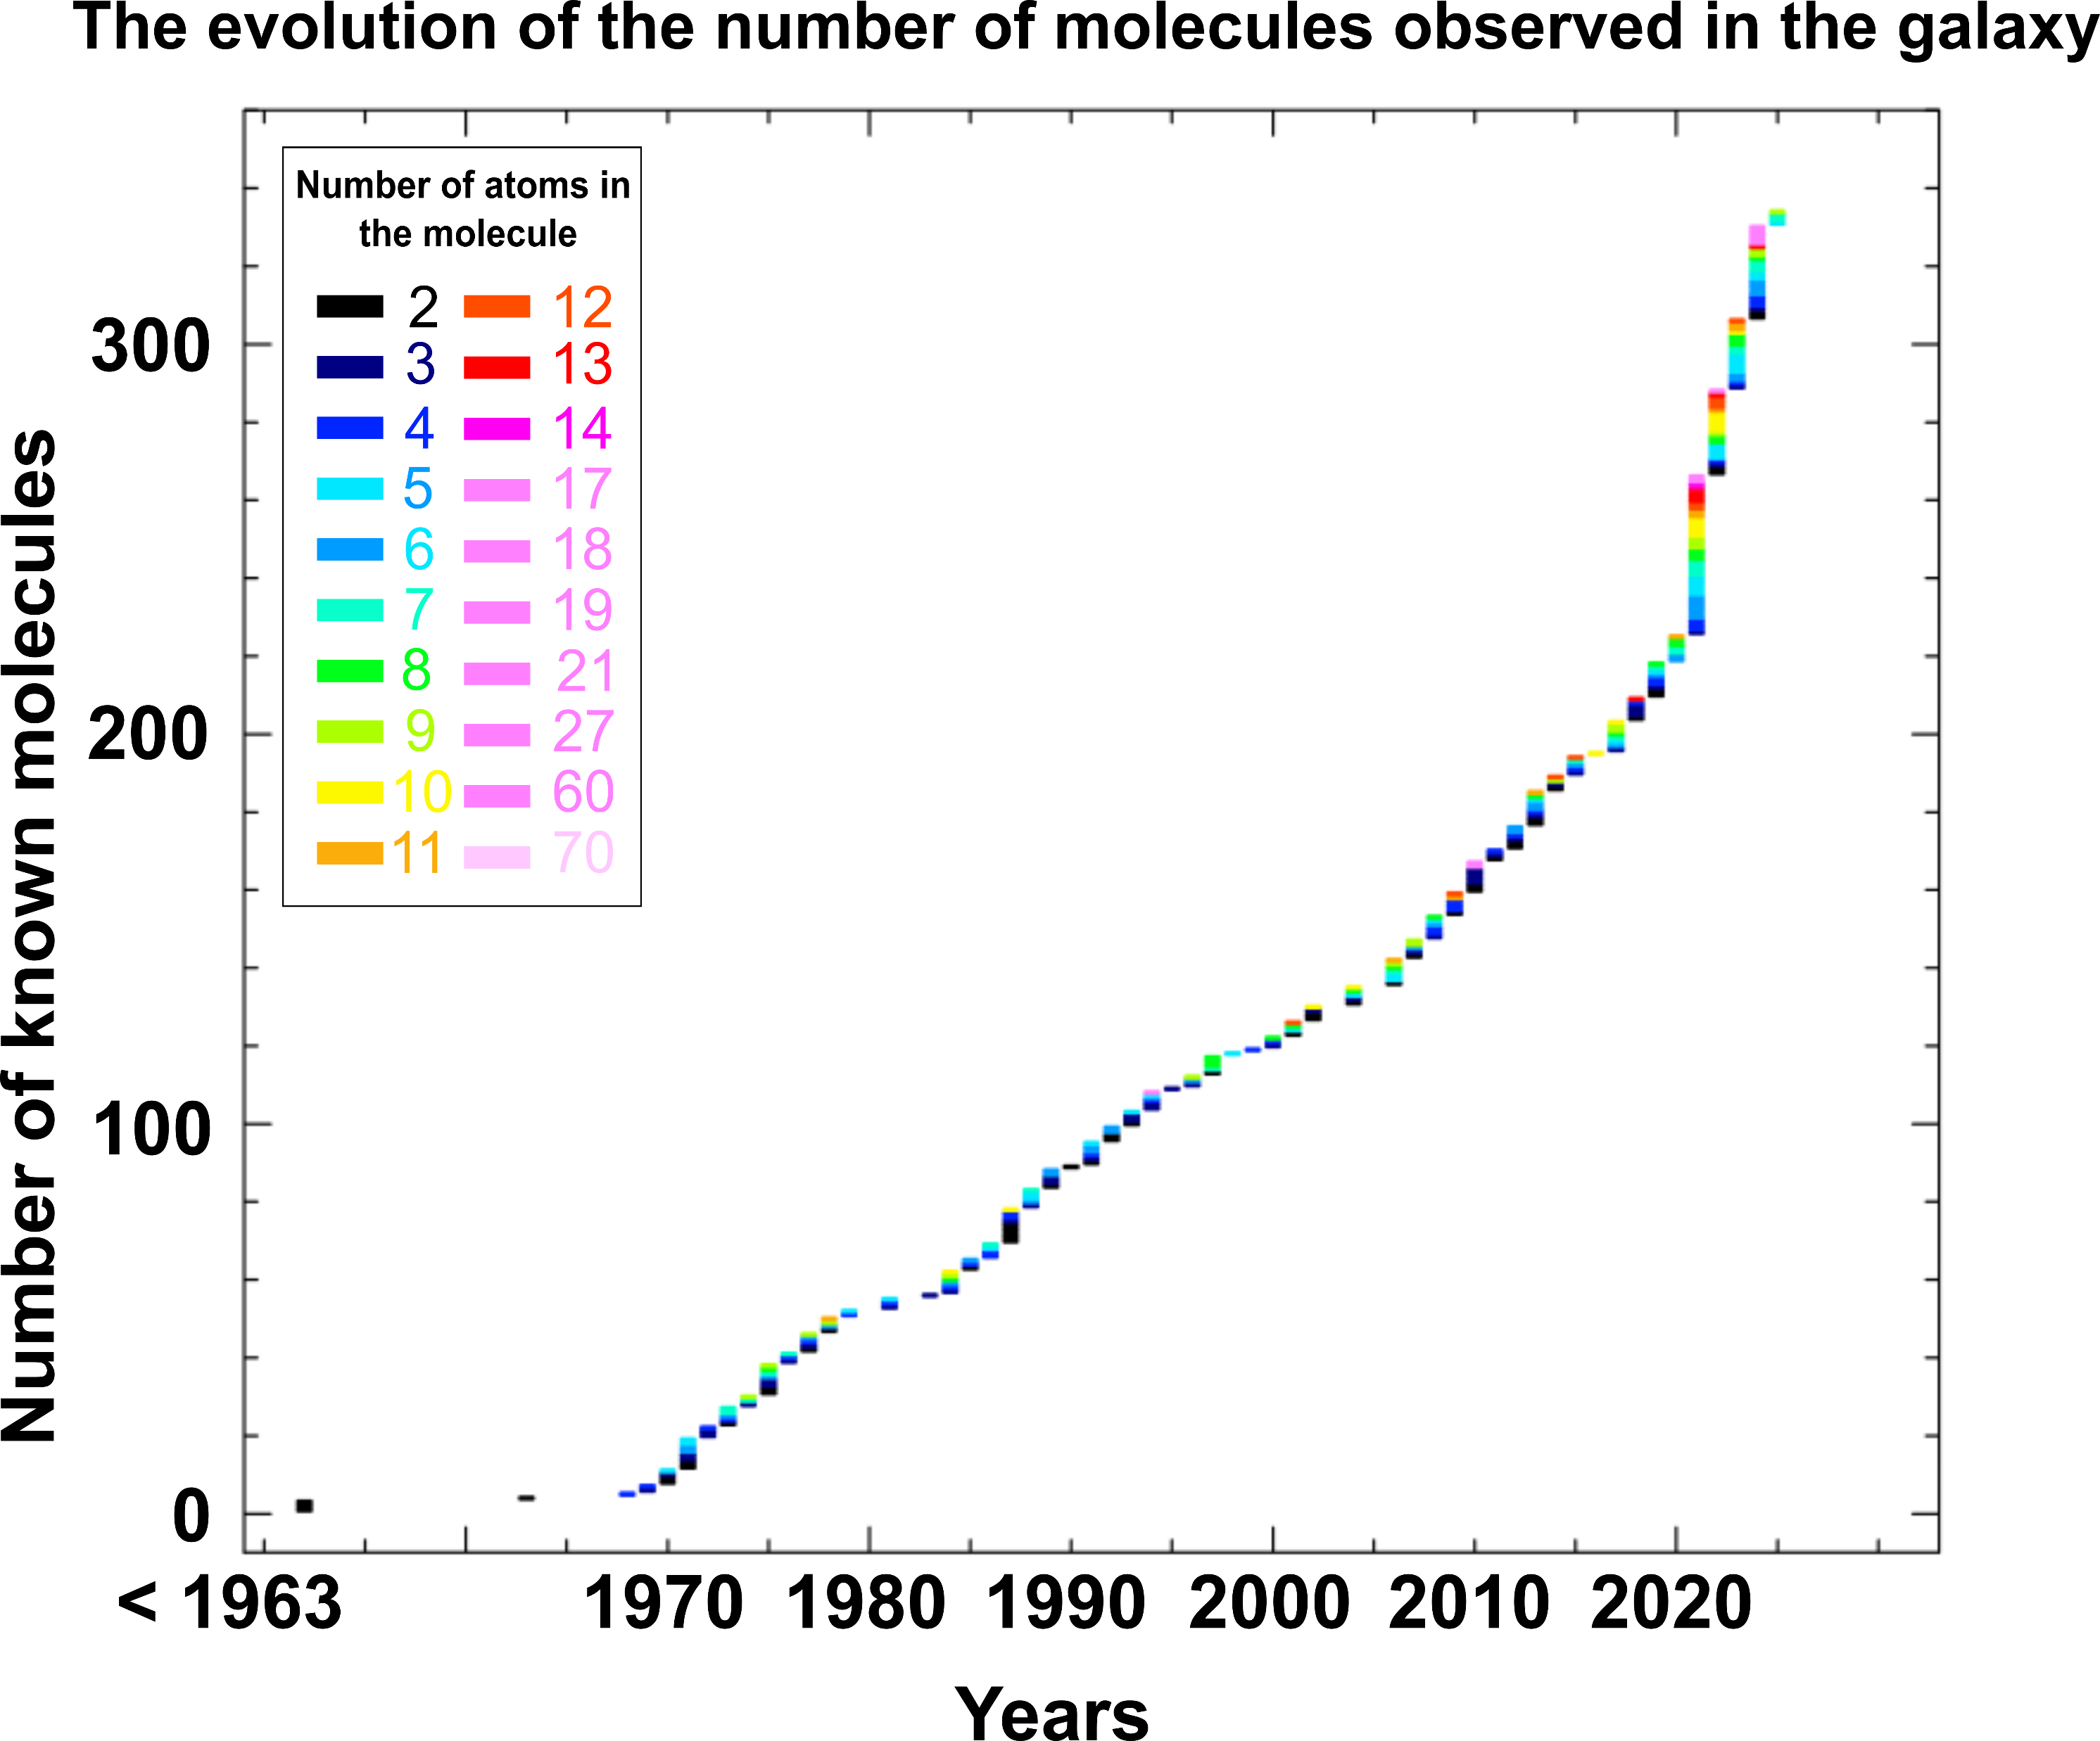
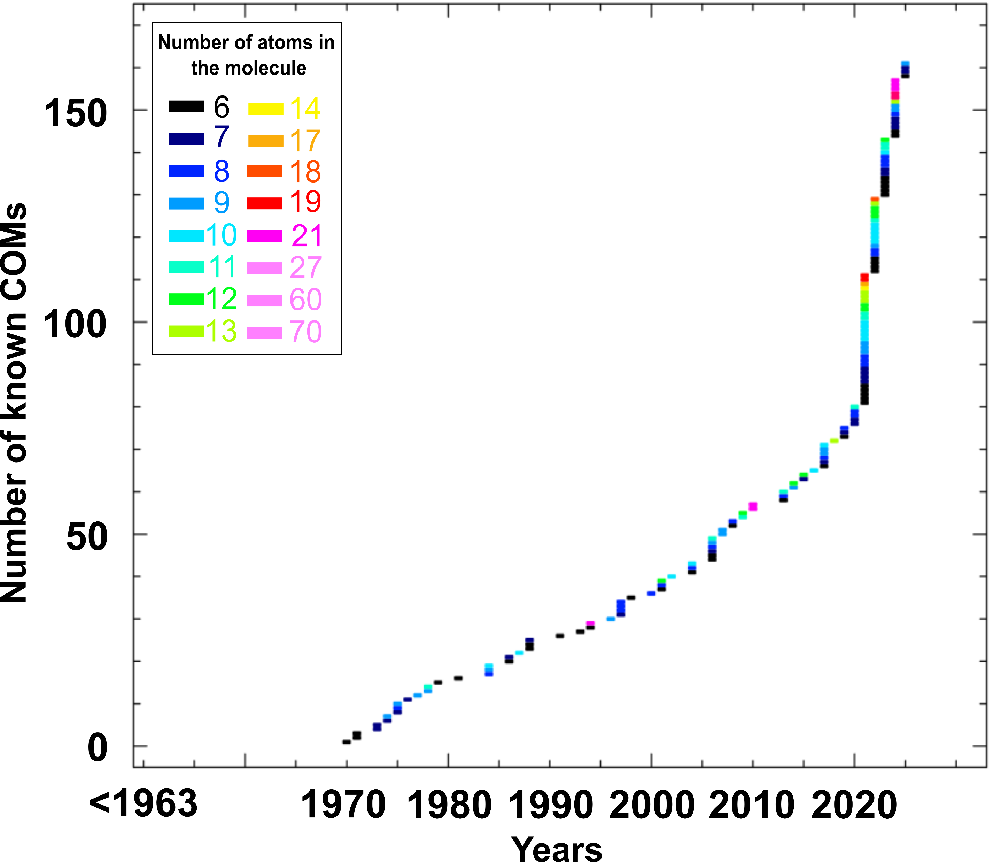
1
Molecules in Space ?
334 molecules observed in February 2025
Only Complex Organic Molecules (COMs)
109 since 2021 with 81 being COMs
48 % of them are Complex Organic Molecules
Jimenez-Serra, I., Codella, C., & Belloche, A. (2025).
Notes:
In February 2025, the University of Koln in Germany counted the number of molecules observed in the galaxy at 334. This graph shows the evolution in the number of complex molecules since the 1970s. On the right, this graph shows only the COMs observed in the galaxy. This second graph shows that 48% of all observed molecules are COMs. There has been a real explosion since 2021. The number of molecules detected since then is 109, 81 of which are COMs. Notice one third of all observations recorded since 1970 have been made in the last 4 years alone.

Slide 7
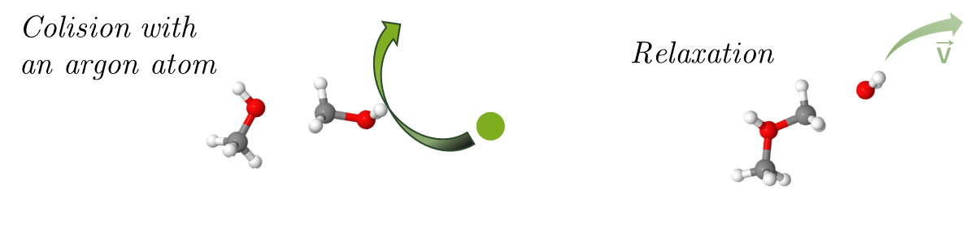
2
Experience
Energy
deposited
Short Time
Scale (fs)
Electronic
excitation
Vibrational
energy
Single collision with an argon atom
The relaxation processes are analysed after a fixed time window typically 200ns.
Event by event recording
Notes:
Our laboratory astrophysics experience here at IP2I is designed to study non-thermal equilibrium processes. Energy is deposited by electronic excitation over a short time scale, and is then transformed into vibrational energy. Relaxation processes are then analyzed for a fixed time window of a hundred nanoseconds.

Slide 8
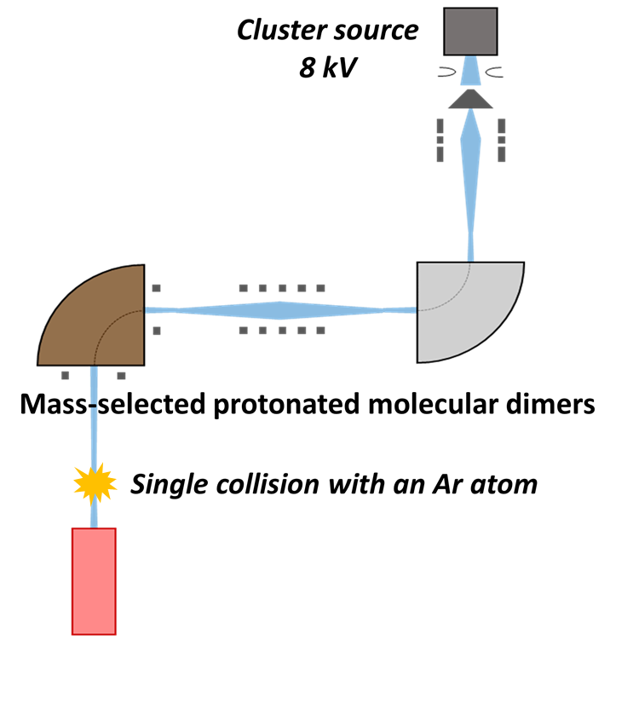
2
Experimental Setup - DIAM
Dispositif
Irradiation
Agrégats
Moléculaires
Notes:
The DIAM device studies the relaxation of mass-selected protonated molecular clusters (e.g., water, pyridine, methanol, glycine) after a high-velocity single collision with argon. Clusters are formed by electron impact in a supersonic jet, accelerated to 8 keV, and analyzed through correlated detection of neutral and charged fragments, providing insights into gas-phase isolated cluster.

Slide 9
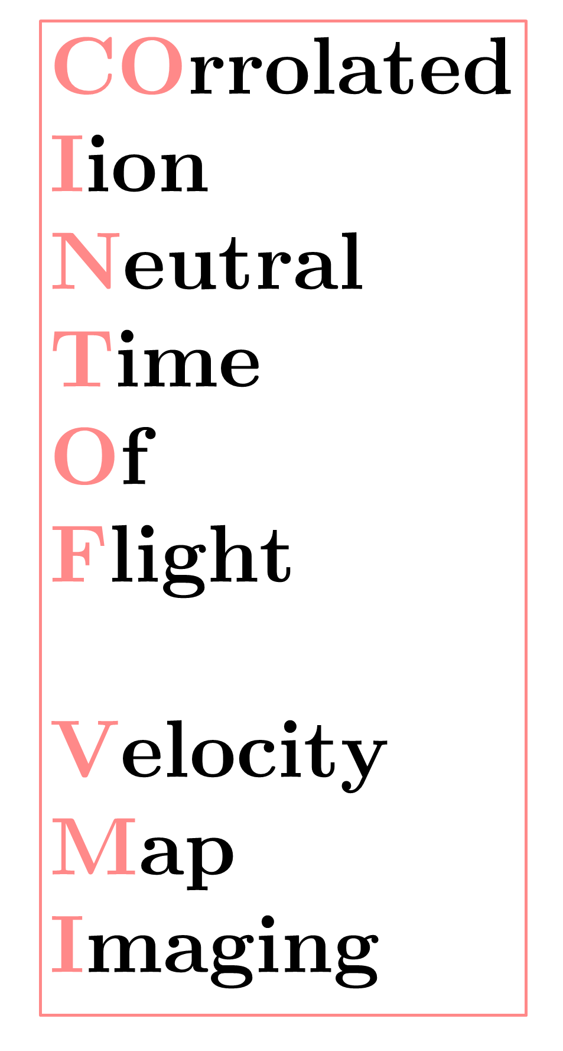
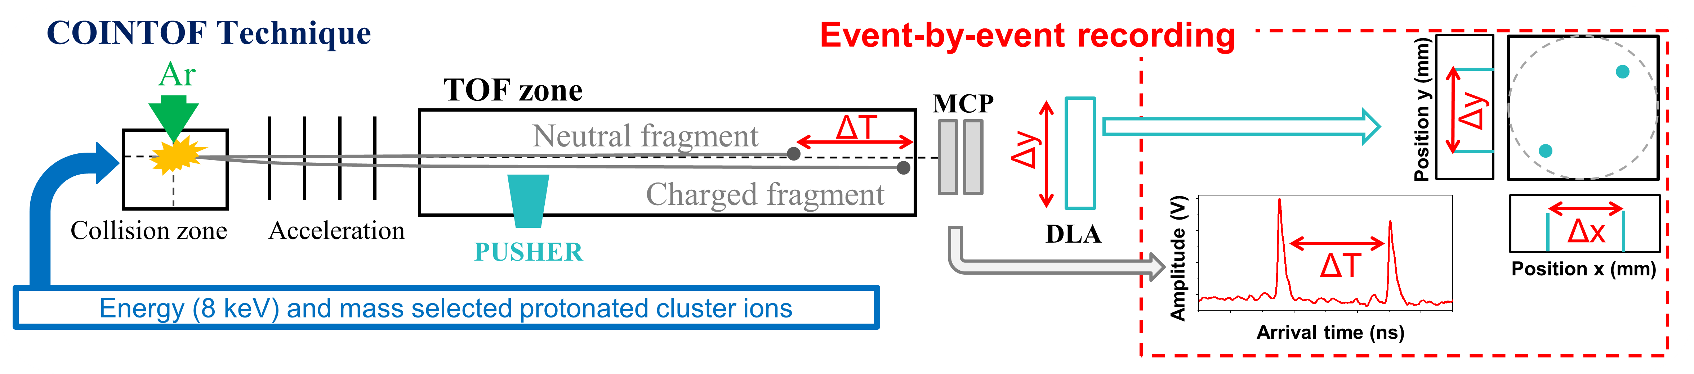
2
Experimental Setup – COINTOF VMI
Notes:
After the single collision with Ar atom. We enter into out of equilibrium process, the system need to relax.
The relaxation induces the production of fragments detected after a given time window.
We record the arrival time and the impact position of the fragments with the COINTOF-VMI method

Slide 10
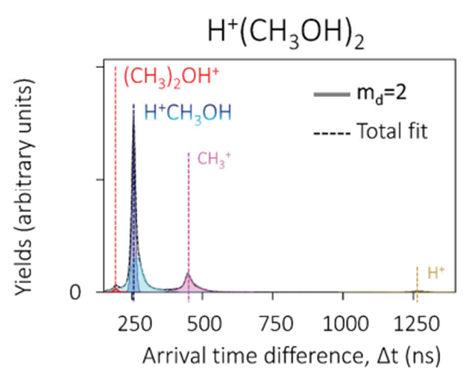
2
Experimental Setup – COINTOF VMI
Notes:
Record the arrival time of both fragment.
Charged fragment is accelerated where the neutral is not.
The differences in arrival times allow us, based on mass spectra, to obtain the branching ratios of each relaxation channel considered.
This step enables us to characterize the chemical species involved in these processes.

Slide 11
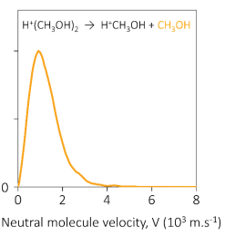
2
Experimental Setup – COINTOF VMI
Notes:
The record of fragment positions resulting from post-collisional relaxation of a protonated cluster provides information unique to our experience : the velocity distribution of the neutral fragment of the reaction.
This experiment provides us with quantitative information on the different relaxation channel involved in a reaction.

Slide 12
3
Theoretical Methods
Energy
deposited
Short Time
Scale (fs)
Electronic
excitation
Vibrational
energy
Single collision with an argon atom
Broad deposited
energy range 0 to 10eV
Localised Excitation
in a molecule before dissociation
Analyze after a fixed Time Window
Mutliple
Relaxation
Channels
How
Energy
Redistribute
Channel’s
Competition
Observation
Notes:
By exploring a wide range of energy deposition, from 0 to 10 electronvolts, we observe various relaxation channels, including evaporation, fragmentation, and the formation of more complex molecules.
When excitation is localized within a molecule of the cluster, we can study how energy redistributes within small clusters.
This energy deposition, occurring on a short timescale relative to the characteristic motion of nuclei, is typical of radiation damage in molecular systems.
These measurements are used to constrain theoretical models of statistical physics.

Slide 13
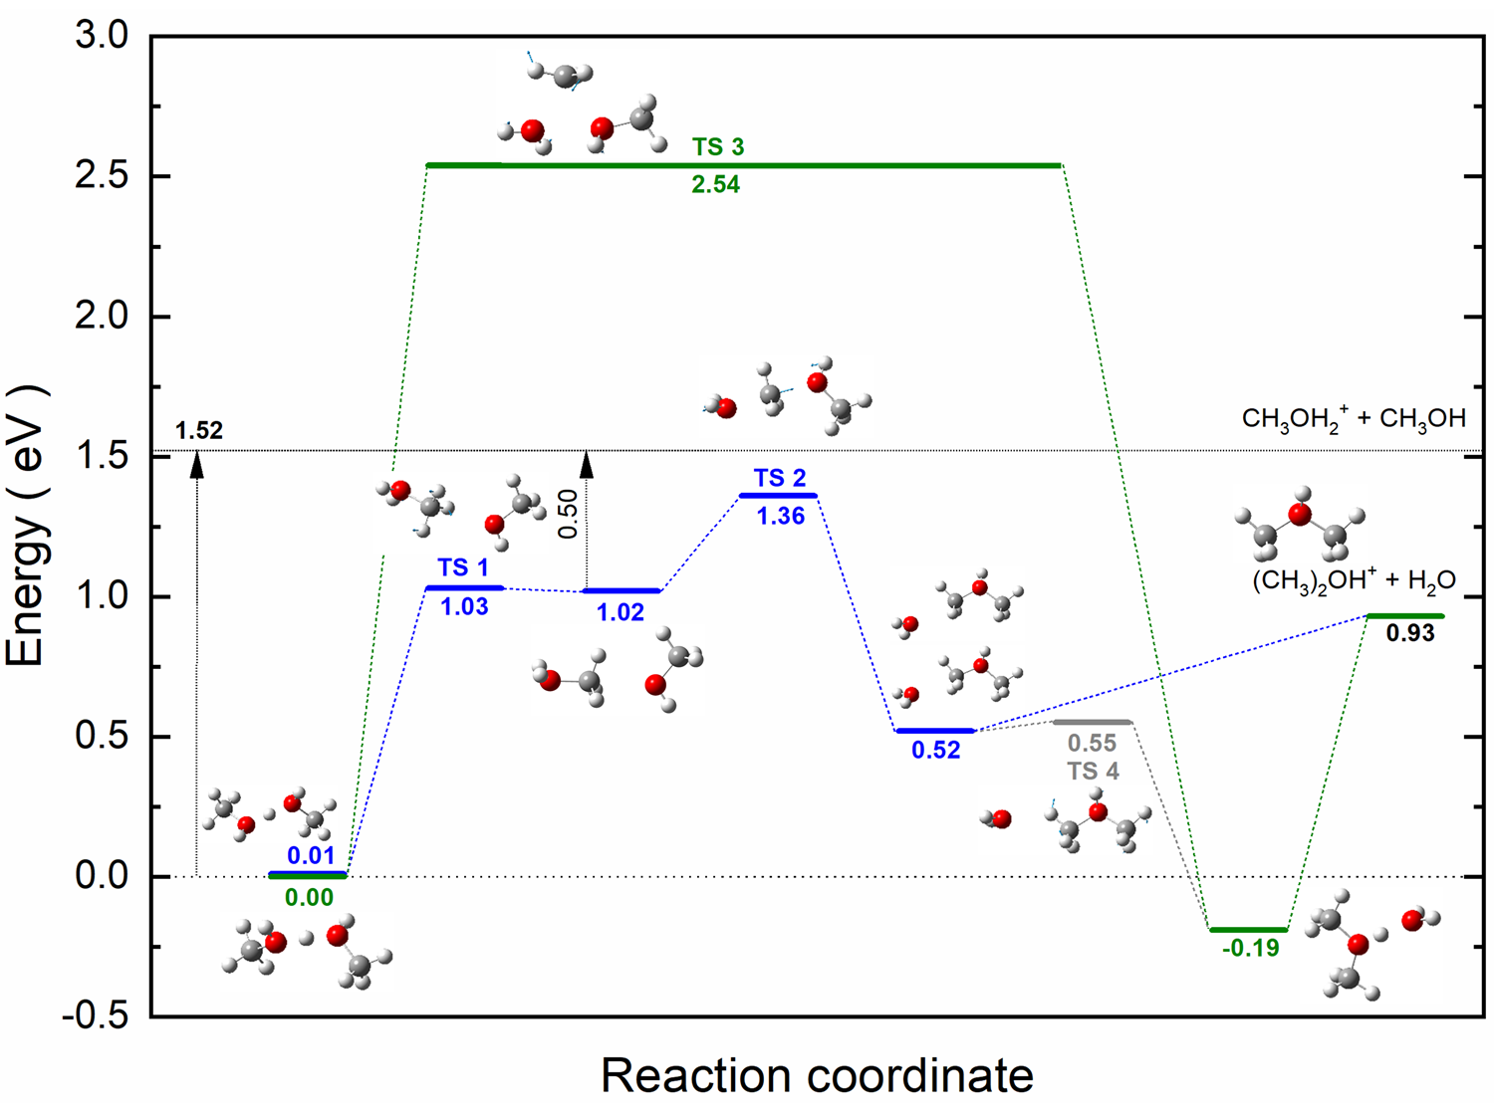
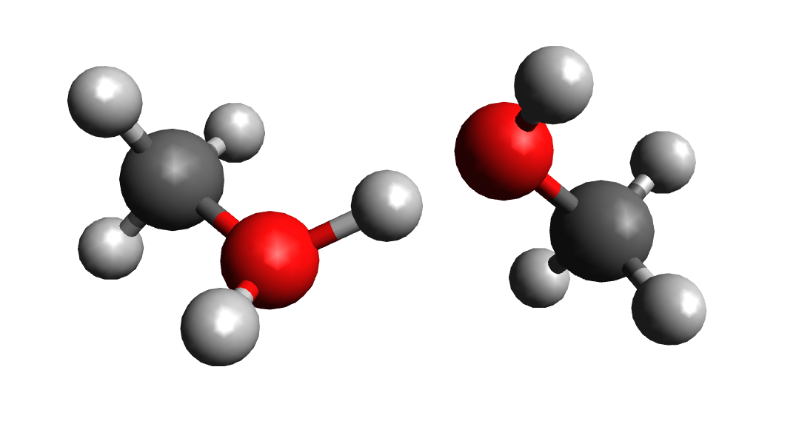
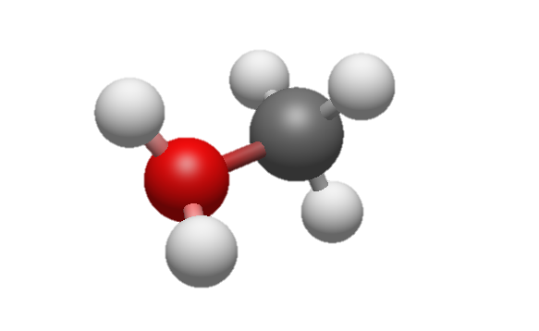
3
Density Functional Theory Calculations
Quantitative information on energies and vibrational frequencies (modes)
Densities of state (DoS) are calculated from the modes.
DoS allow us to use the statistical model of Phase Space Theory
Study the competition between multiples dissociations channels
Notes:
PST : Reactant and Product infos
DFT for energies and modes
Evaporation orange
Blue and green reactivity channel with a transition state : expand carbon chain

Slide 14
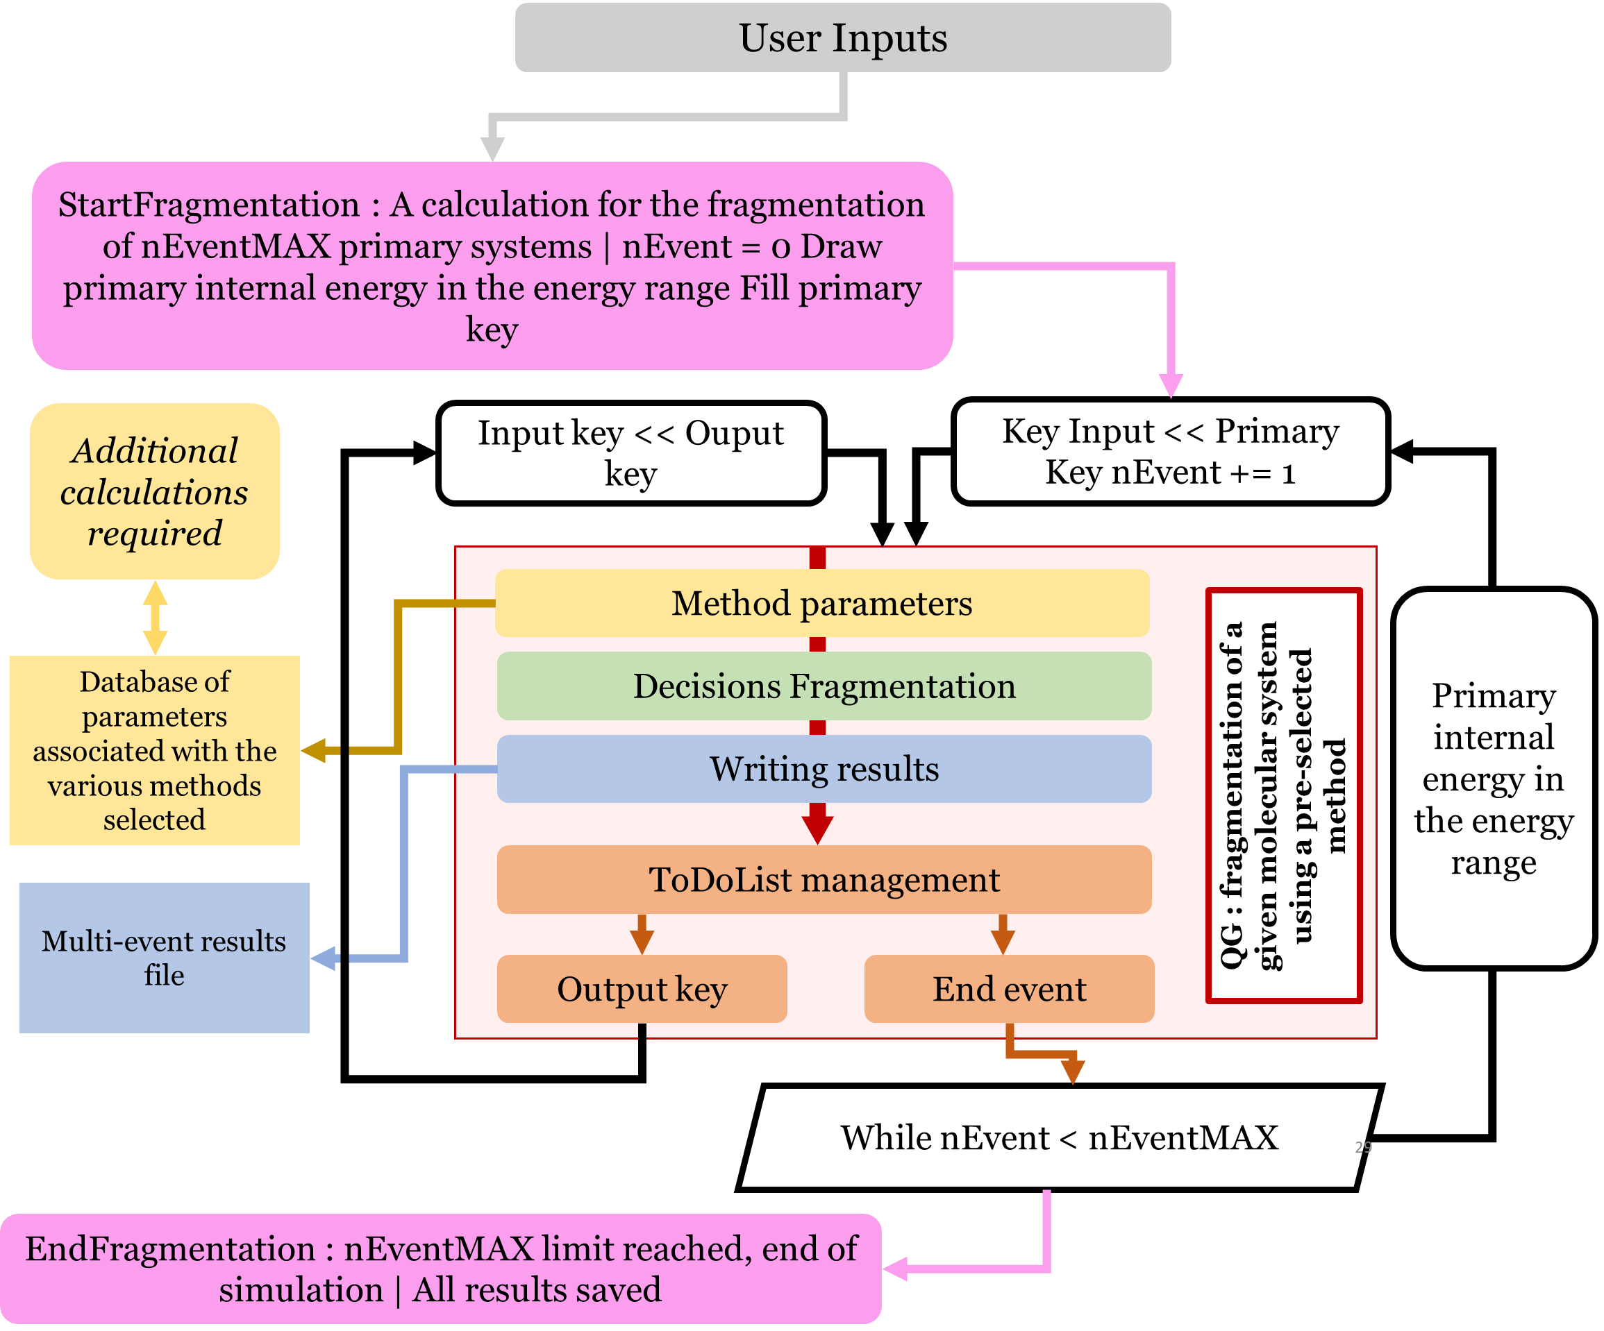
3
Statistical modeling of relaxation channel competition

Slide 15
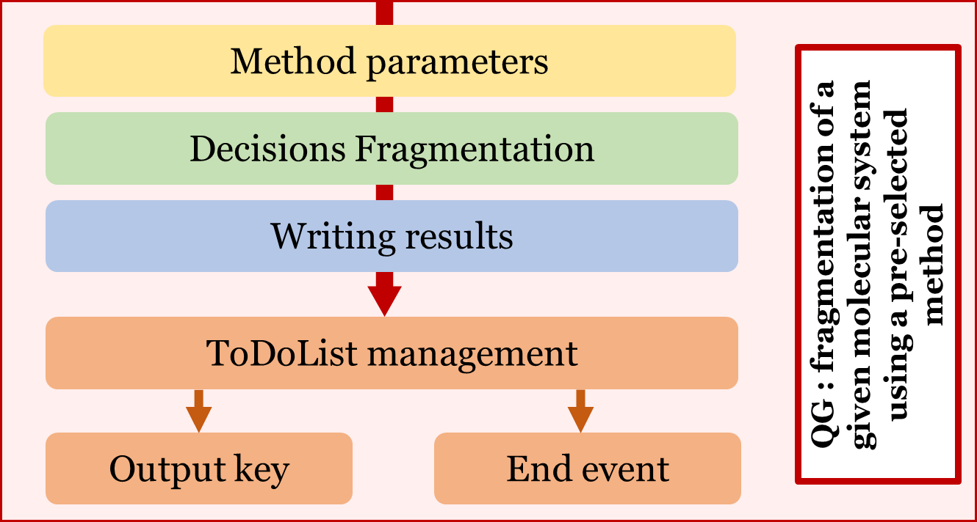
3
Focusing on the QG part
Time rate calculations – depend on the model
Time decision
Energy decision
Storing results for multiparametric analysis
Enables a self-management loop for the computer program

Slide 16
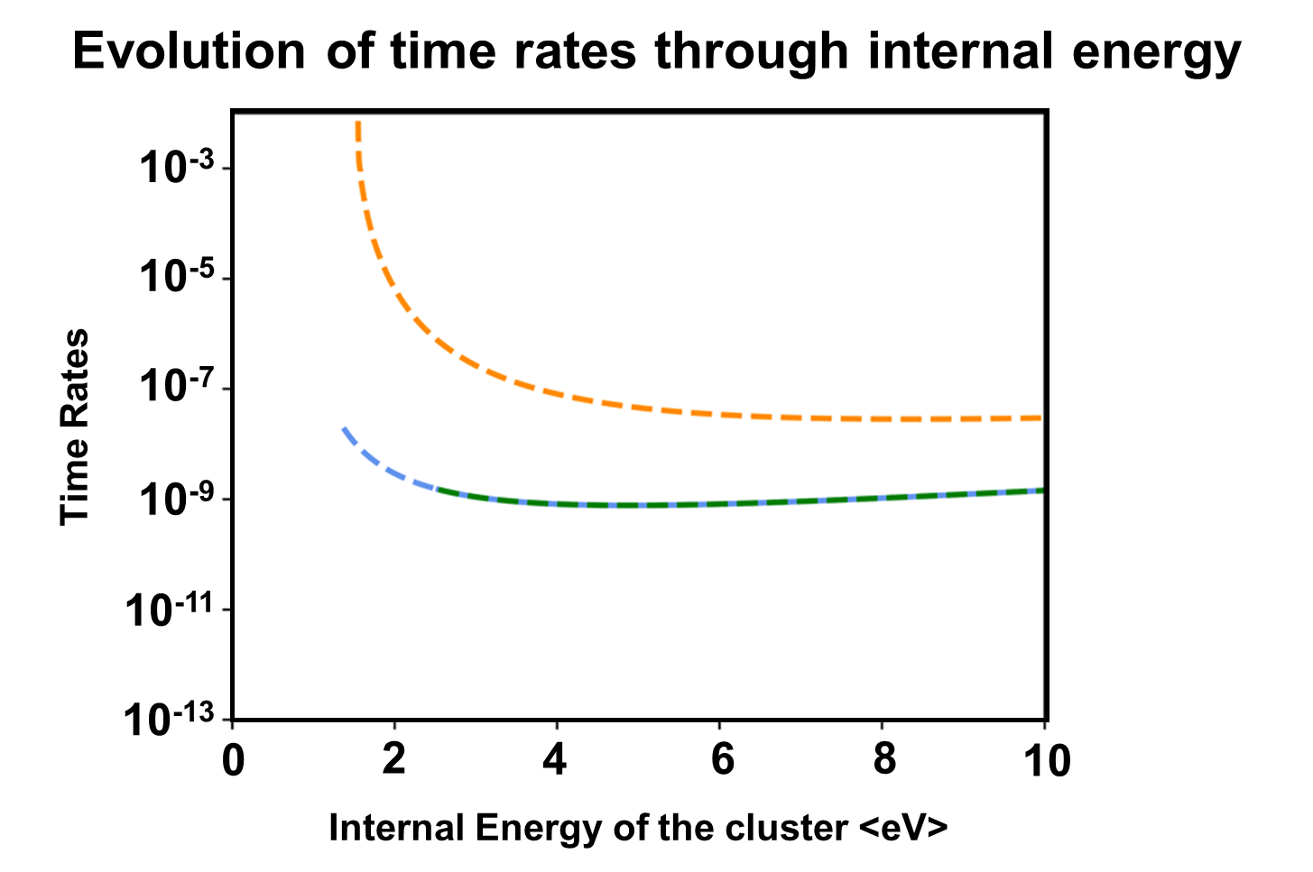
3
Time Rate as a function of the internal energy
Method parameters
Formation of dimethyl ether
Evaporation of a methanol molecule
The Phase Space Theory (PST) model can be used to calculate the time constants of the different relaxation paths.
Notes:
In our example, around a protone methanol dimer, we observe 3 channels: in orange, the channel for the evaporation of a methanol dimer. In blue and green, the 2 channels with 2 distinct transition states. We can see directly the impact of the ZPEs of the products and reagents of our reaction.As explained earlier, from the DFT calculations I obtained the absolute values of the state densities, which are then used in the PST statistical model to calculate the KER probability densities and which subsequently give us the time constants for the different paths involved.These constants are represented here as a function of the internal energy of the parent cluster.

Slide 17
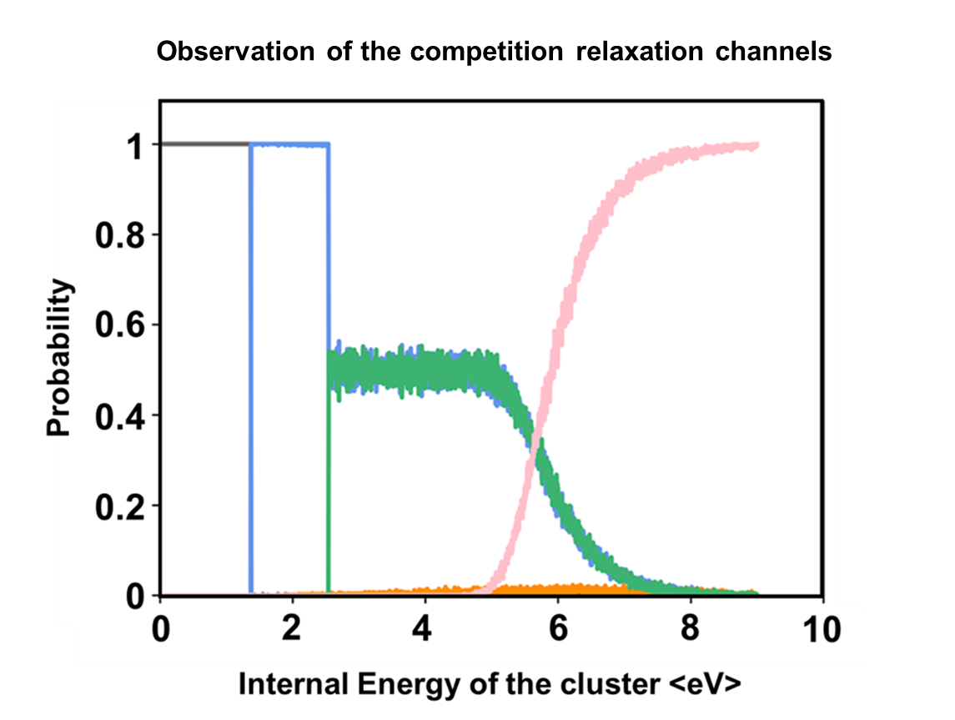
3
Evolution of probability
Decisions Fragmentation
Time Decision
No dissociation
Formation of dimethyl ether
Evaporation of a methanol molecule
Fragmentation post-evaporation.
Notes:
In gray, I've introduced the possibility of doing nothing into my simulation, and in pink, the possibility of fragmenting after a first reaction.
These 2 pieces of information are crucial to probe quantitatively the competition between evaporation and reactivation in the same cluster.

Slide 18
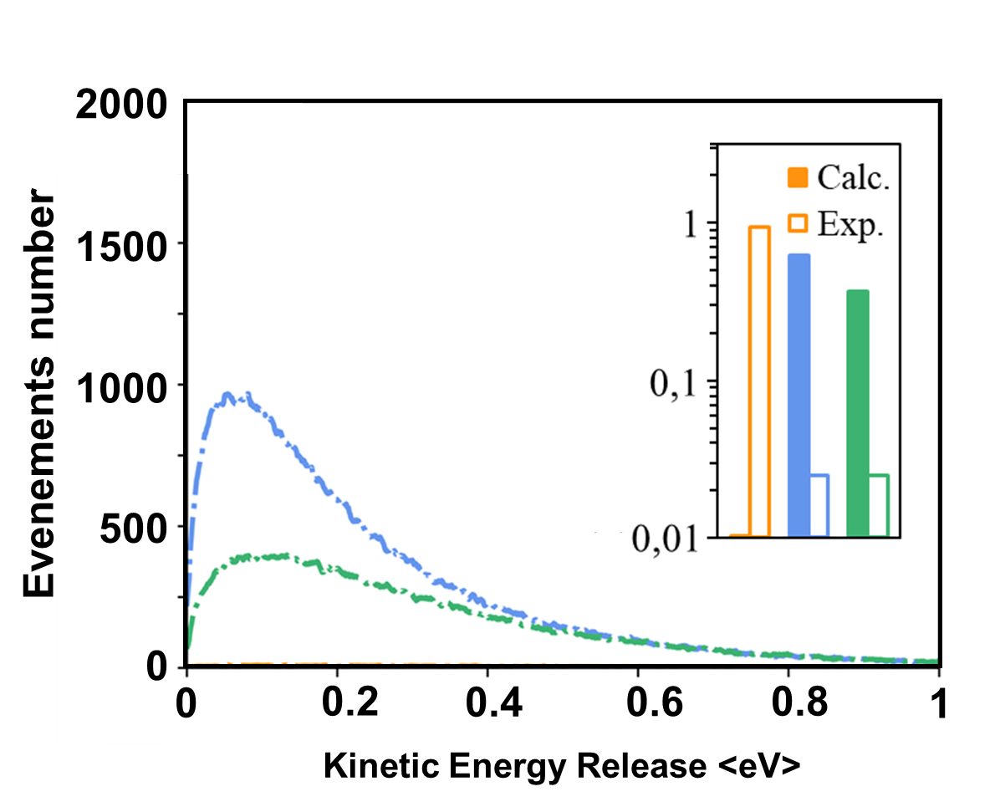
3
Decisions Fragmentation
Kinetic Energy Release
KERs Probability Density Function
Energy Decision
Formation of dimethyl ether
Evaporation of a methanol molecule
Kinetic energy distribution released during relaxation calculated for a uniform internal energy distribution
between 0 and 10 eV and comparison between experimental and model branching ratios in insert.
Notes:
The Monte Carlo simulation uses random draws to generate Kinetic Energy Release (KER) distributions, assuming each relaxation channel occurs independently. The distributions provide quantitative insights into kinetic energy redistribution within the cluster. The graph compares these simulated distributions (solid histograms) with experimental data (blank histograms), including branching ratios as inserts.

Slide 19
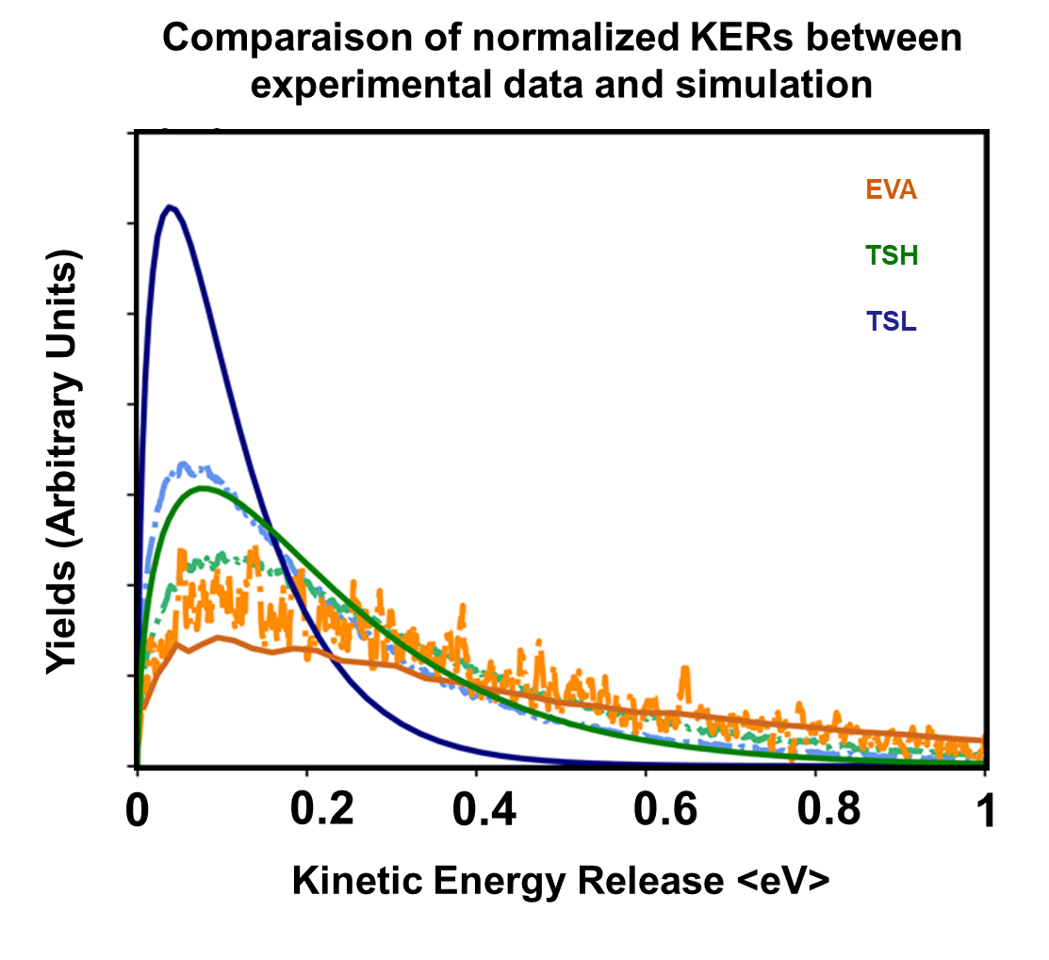
3
Decisions Fragmentation
Energie Decision
KERs Probability Density Function
Formation of dimethyl ether
Evaporation of a methanol molecule
Kinetic energy distribution released during relaxation calculated for a uniform internal energy distribution
between 0 and 10 eV and comparison between experimental and model branching ratios in insert.
Calculated distribution normalised to the same number of events (dashed line) and compared to the
experimentally measured distribution (solid line).
Notes:
The normalized KER distributions from the simulation (dotted lines) are compared against absolute experimental data (solid lines) from DIAM analysis. This initial comparison validates the model's ability to quantitatively measure energies involved.
To improve accuracy, corrective factors need to be applied to better align with experimental connection ratios.

Slide 20
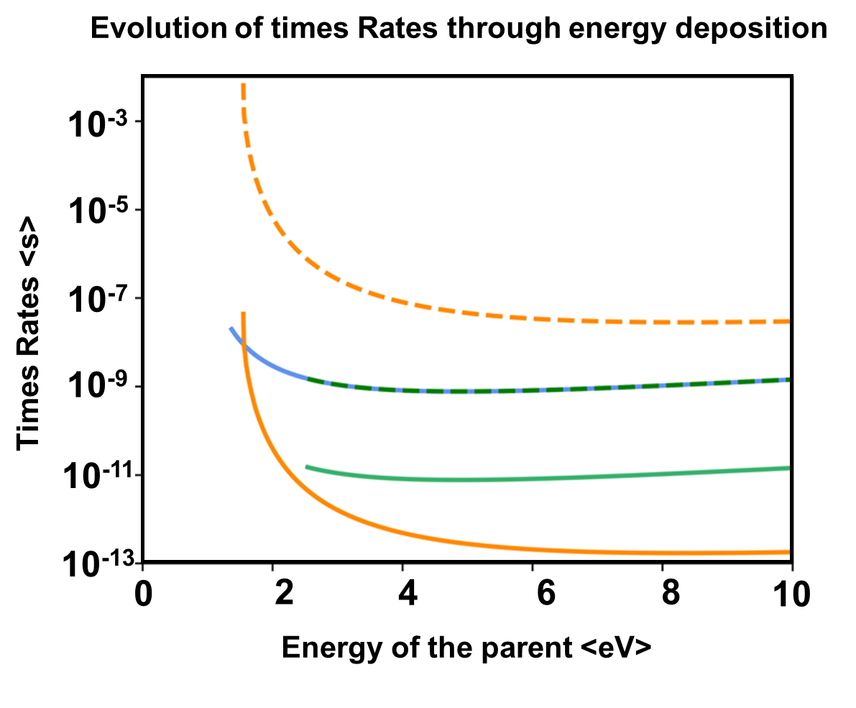
3
Exploring limits of the model
Method parameters
The probability curve for the evaporation channel is significantly steeper compared to before
Notes:
The evaporation time constant now ranges from 1 nanosecond at low energy to 0.1 picoseconds at high energy, which is notably shorter than the time constants for the TS2 and TS3 reaction paths. This observation aligns well with the measured branching ratios.

Slide 21
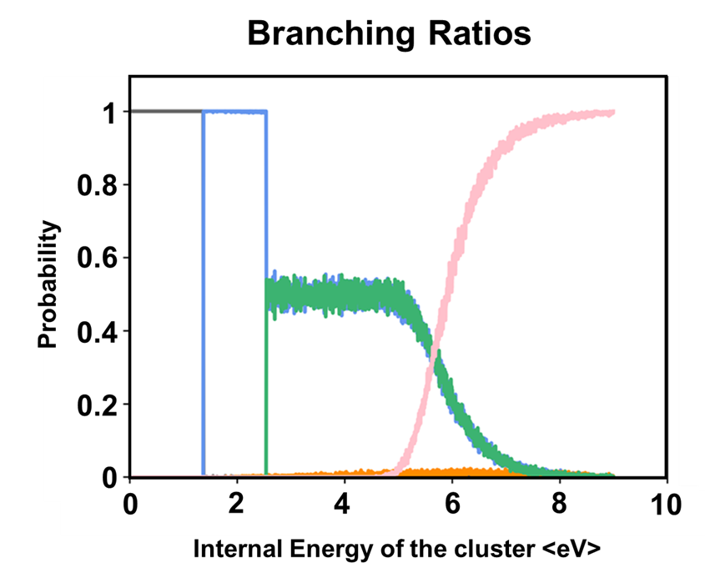
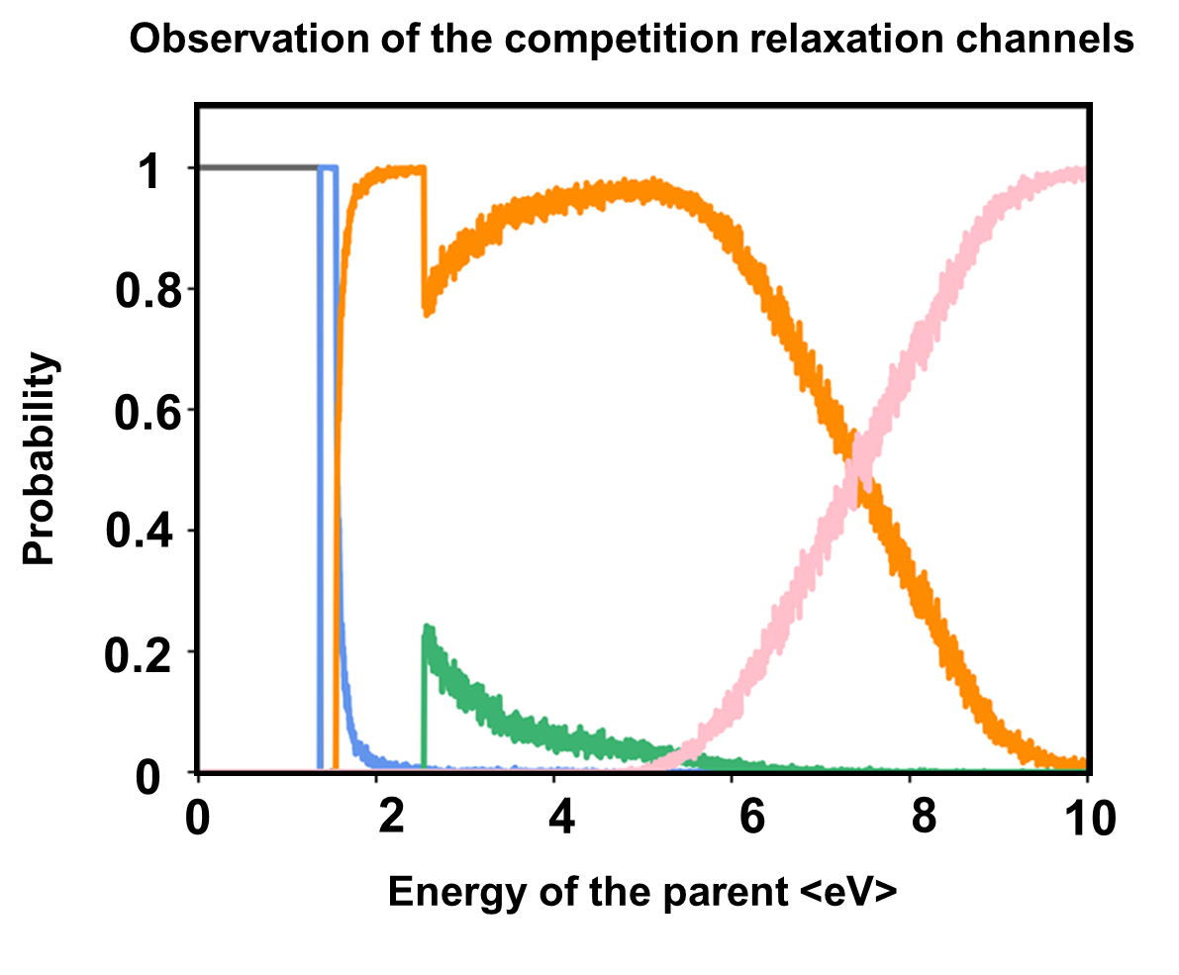
3
Evolution of probability with the correction
Decisions Fragmentation
Time Decision
Observation of the competition relaxation channels
The shift in time rates reveals a significantly different observation of the competition, with the evaporation path now occurring much more frequently.

Slide 22
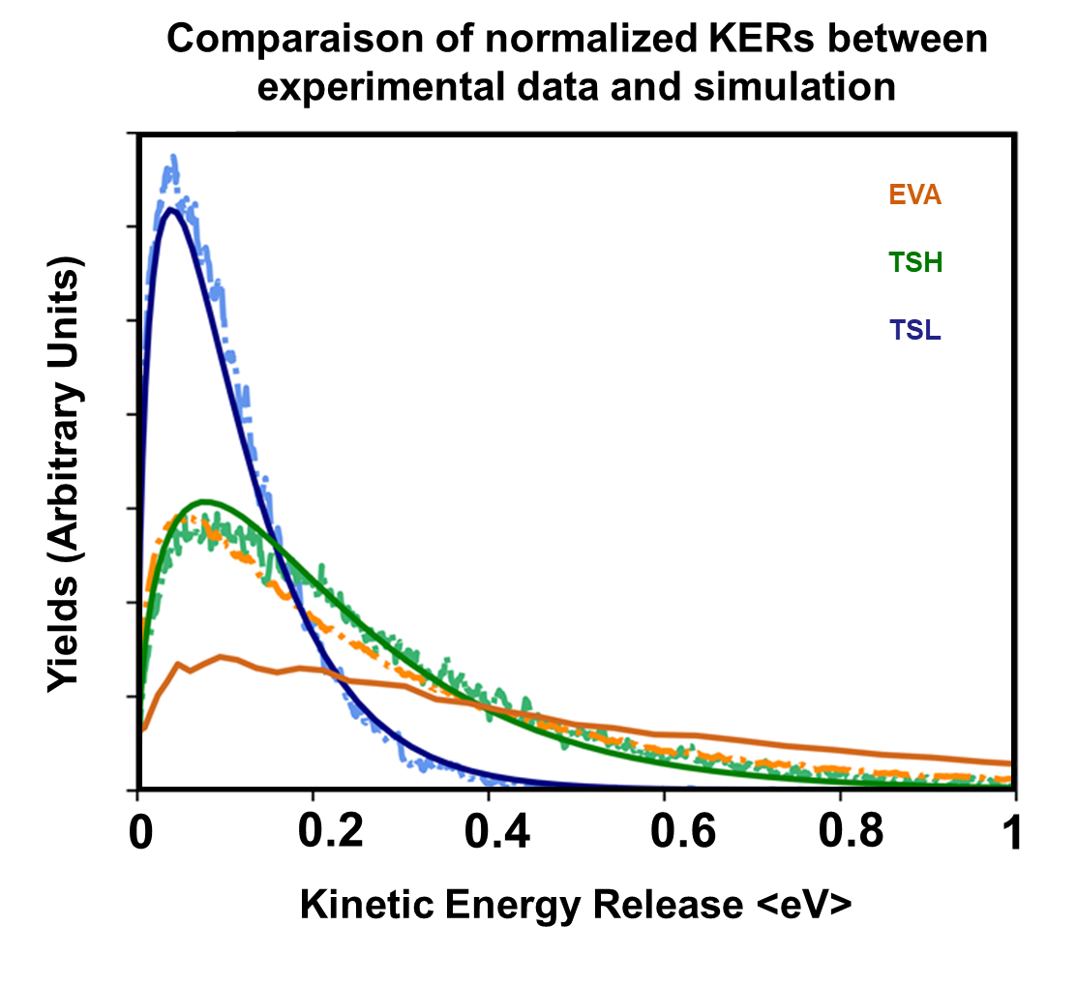
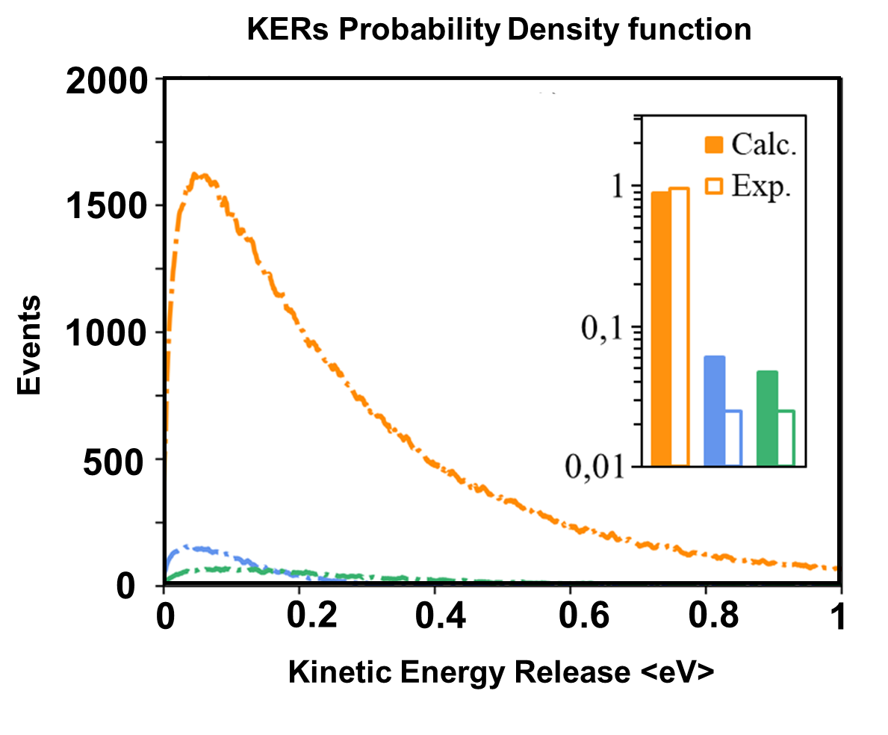
3
New branching ratios
Decisions Fragmentation
Energy Decision
Calculated distribution normalized to the same number of events (dashed line) and compared to the
experimentally measured distribution (solid line).
Notes:
This highlights the crucial importance of quantitative experimental measurements in constraining theoretical models in statistical physic.
Here the branching ratios are much better to fit the experimental datas and the KERs curve fit nicely also.

Slide 23
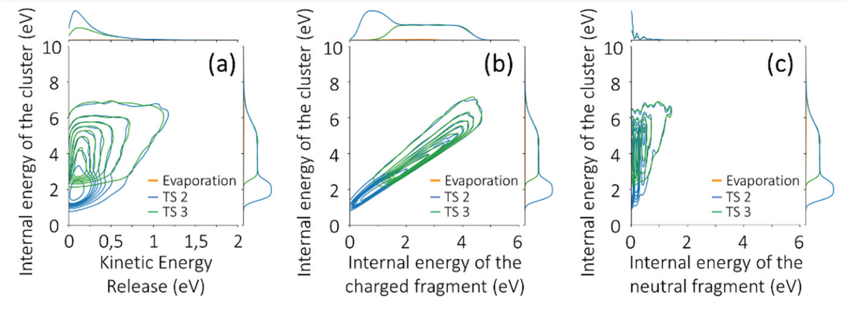

3
Exploration of the internal energy of the fragment
Decisions Fragmentation
We can compare raw data from the experience with the simulated data
Quantitative measurement of the kinetic energy release
$$E_{r}+E_{a}=KER+E_{1}^{+}+E_{2}$$
Notes:
The KER distributions provide absolute mean values and shifts close to experimental results. The theoretical model is constrained by measuring branching ratios and kinetic energy distributions released during cluster relaxation after a single high-speed collision. This model offers insights into energy redistribution that experiments can't directly access.
Figure illustrates correlations for each relaxation channel:
Internal energy of the cluster vs. released kinetic energy (a)
Internal energy of the cluster vs. internal energy of the charged fragment (b)
Internal energy of the cluster vs. internal energy of the neutral fragment (c)
Key observations:
KER distribution widens with increasing cluster internal energy.
Internal energies of charged and neutral fragments correlate with cluster internal energy.
The neutral fragment's internal energy is quantized due to water molecule eigenmodes.

Slide 24
3
Exploration of the internal energy of the fragment
Decisions Fragmentation
Deeper informations on the redistribution of the energy
Quantitative measurement of internal energies in the charged fragment
$$E_{r}+E_{a}=KER+E_{1}^{+}+E_{2}$$
Notes:
The KER distributions provide absolute mean values and shifts close to experimental results. The theoretical model is constrained by measuring branching ratios and kinetic energy distributions released during cluster relaxation after a single high-speed collision. This model offers insights into energy redistribution that experiments can't directly access.
Figure illustrates correlations for each relaxation channel:
Internal energy of the cluster vs. released kinetic energy (a)
Internal energy of the cluster vs. internal energy of the charged fragment (b)
Internal energy of the cluster vs. internal energy of the neutral fragment (c)
Key observations:
KER distribution widens with increasing cluster internal energy.
Internal energies of charged and neutral fragments correlate with cluster internal energy.
The neutral fragment's internal energy is quantized due to water molecule eigenmodes.

Slide 25
3
Exploration of the internal energy of the fragment
Decisions Fragmentation
Deeper informations on the redistribution of the energy
Quantitative measurement of internal energies in the neutral fragment
$$E_{r}+E_{a}=KER+E_{1}^{+}+E_{2}$$
Notes:
The KER distributions provide absolute mean values and shifts close to experimental results. The theoretical model is constrained by measuring branching ratios and kinetic energy distributions released during cluster relaxation after a single high-speed collision. This model offers insights into energy redistribution that experiments can't directly access.
Figure illustrates correlations for each relaxation channel:
Internal energy of the cluster vs. released kinetic energy (a)
Internal energy of the cluster vs. internal energy of the charged fragment (b)
Internal energy of the cluster vs. internal energy of the neutral fragment (c)
Key observations:
KER distribution widens with increasing cluster internal energy.
Internal energies of charged and neutral fragments correlate with cluster internal energy.
The neutral fragment's internal energy is quantized due to water molecule eigenmodes.

Slide 26
3
Exploration of the internal energy of the fragment
Decisions Fragmentation
The model opens up the possibility of calculating the probability of electromagnetic radiation emission by fragments on longer time scales according to their internal energy.
Notes:
The KER distributions provide absolute mean values and shifts close to experimental results. The theoretical model is constrained by measuring branching ratios and kinetic energy distributions released during cluster relaxation after a single high-speed collision. This model offers insights into energy redistribution that experiments can't directly access.
Figure illustrates correlations for each relaxation channel:
Internal energy of the cluster vs. released kinetic energy (a)
Internal energy of the cluster vs. internal energy of the charged fragment (b)
Internal energy of the cluster vs. internal energy of the neutral fragment (c)
Key observations:
KER distribution widens with increasing cluster internal energy.
Internal energies of charged and neutral fragments correlate with cluster internal energy.
The neutral fragment's internal energy is quantized due to water molecule eigenmodes.

Slide 27
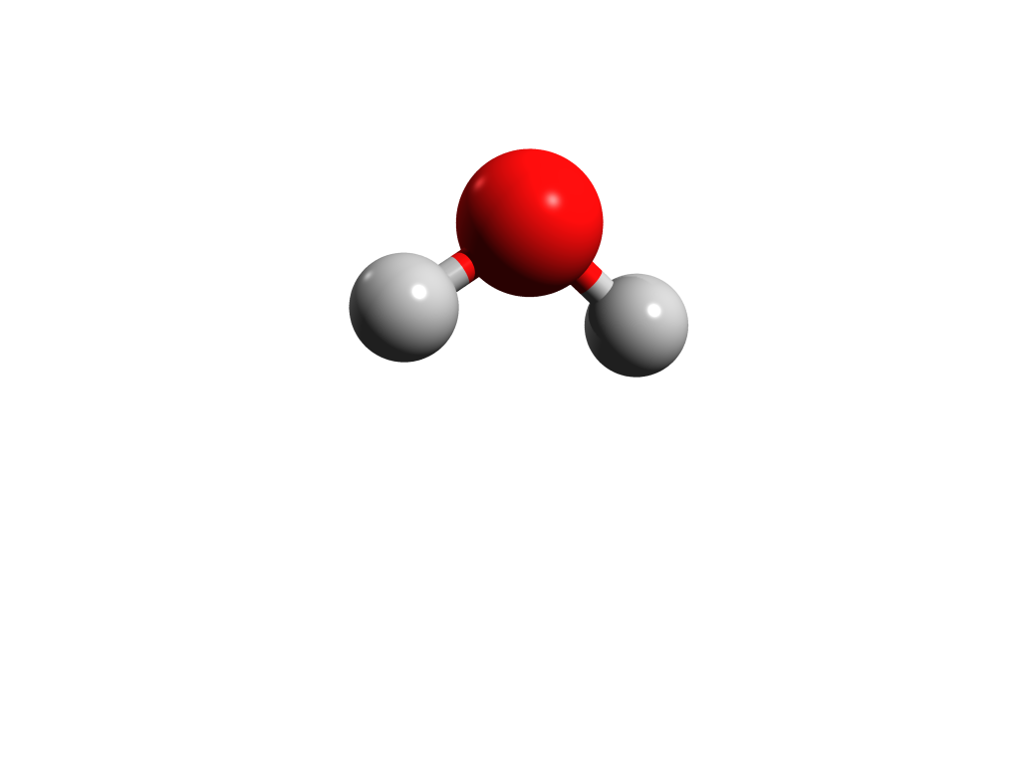
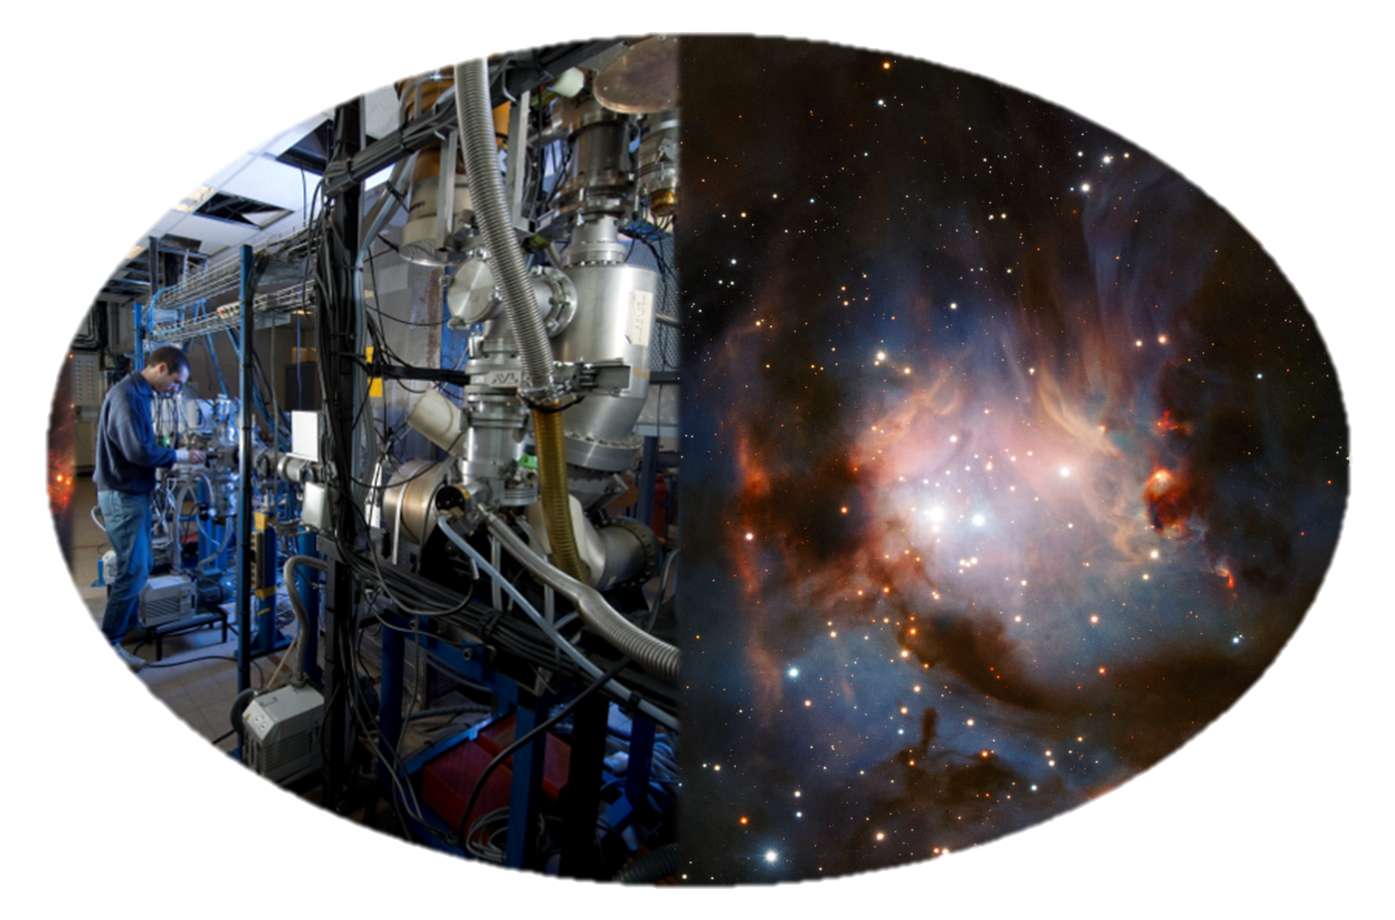
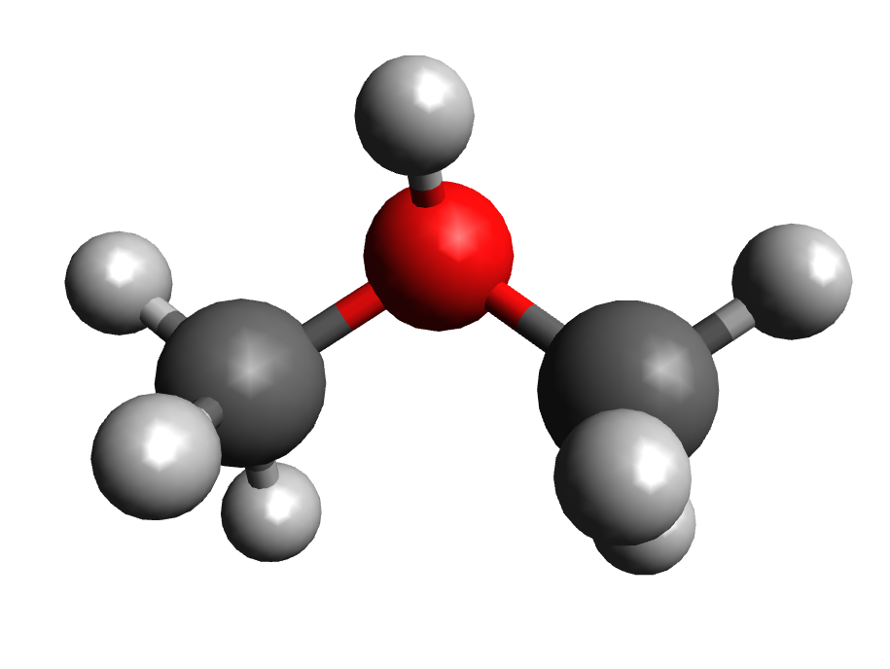
4
Combination of experiments and theory
Multiparametric dataset produced with DIAM, after single collision of protonated molecular clusters with an argon atom.
Development of a statistical model to study the competition between multiple relaxation’s channels for a protonated cluster.
Measurement of the energy distribution of the charged and neutral fragments.
The experimental data constrain the theoretical model, which in return could quantitatively predict fragment energies with DIAM experiment
Notes:
A multiparametric dataset was produced using DIAM, following single collisions of protonated molecular clusters with an argon atom. In combination with the development of statistical model – The Phase Space Theory. The next phase of my project will involve exploring other complex molecules in the coming months, such as pyridine, which has implications for our Earth's atmosphere, and glycine as well. I will observe the sequential evaporation of multiple identical molecules.

Slide 28
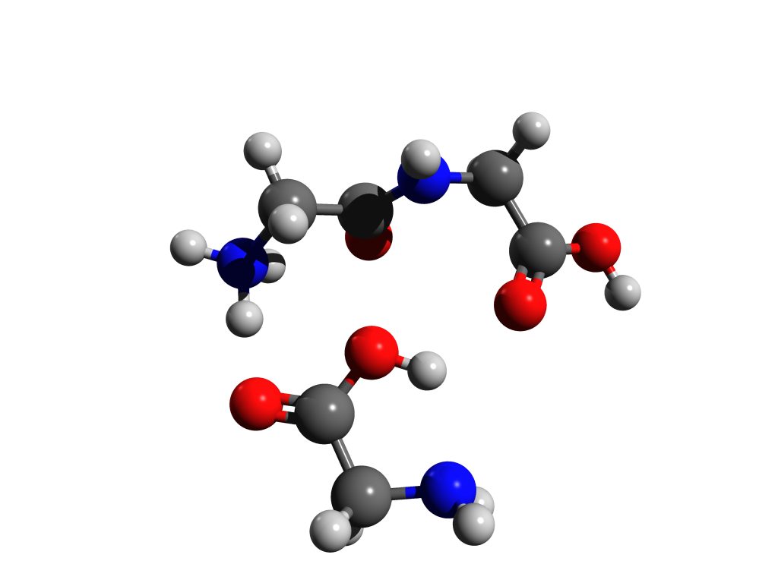
That’s all folks !

